Slide 1

Applied Hydrogeology Field Training:
Examples from the Aquifer Testing Module
Donald M. “Matt” Reeves (matt.reeves@wmich.edu),
Duane R. Hampton, Thomas R. Howe, and Daniel G. Greene
GSA Annual Meeting
Seattle, WA
October 22, 2017

Slide 2
HFC Aquifer Testing, Summer II
Student and TA Acknowledgements
Teaching Assistants: Ryan Cascarano and Jay Kim
Nathan Allen
Adam Brown
Angela Butula
Katie Gurnicz
Mitch Behnke
Camille Buckley
Marissa Leitel
Kohl Schmidt
Luke Schmitz
Waverly Ferguson
Conner Frymier
Adam Meadows
Russell Wilson
Ivan Bell
Michael Burlow
Jennifer Howd
Corey Scher
Sabrina Good
Patrick Howe
Hannah Kloiber
Mike Moon
Thomas Kirejczyk
Stephen Loonie
Ryan Malia
Rachel Powell
Timothy Suess∗
Group 1
Group 4
Group 5
Group 2
Group 6
Group 3
*Drone photos
Emphasis on student generated figures and plots

Slide 3
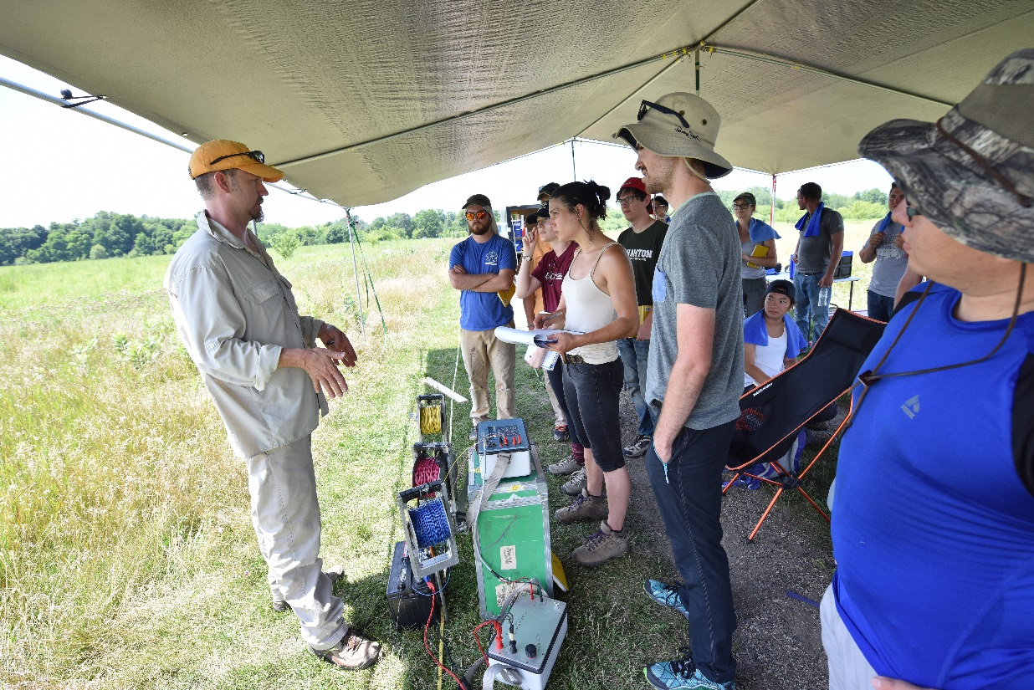
WMU Hydrogeology Field Course (HFC)
One of very few hydro-technical programs in the U.S., provides students with exceptional experiential learning opportunities. Started by Keck and Dr. Marek Zaluski in 1988, with Drs. Tom Straw, Dick Passero, Al Kehew & Duane Hampton.
Two summer sessions, 6 week-long 1 credit modules:
  40-hour HAZWOPER
  Environmental Geophysics
  Well Drilling and Installation
  Aquifer Testing
  Gas-Sediment-Water Sampling
  Remediation

Slide 4
Educational Objectives and Research Questions
Primary Course Objective: To effectively convey to a large group (25-30) of mostly undergraduate students the critical elements of aquifer testing in an field-oriented, experiential learning environment in 5 days.
This gives rise to the following educational questions and logistics:
How to teach students to conduct and analyze multi-well pumping tests, and single well slug, pneumatic, and step-drawdown tests.
How to provide a solid understanding of the assumptions and applicability of the well loss and efficiency estimates; Theis, Cooper-Jacob and Neuman delayed-yield pumping test analysis methods; and Hvorslev, Bouwer and Rice, and KGS slug analysis methods.
How to effectively utilize AQTESOLV to analyze course-generated data, work effectively as teams, become familiar with equipment, and develop writing skills.

Slide 5
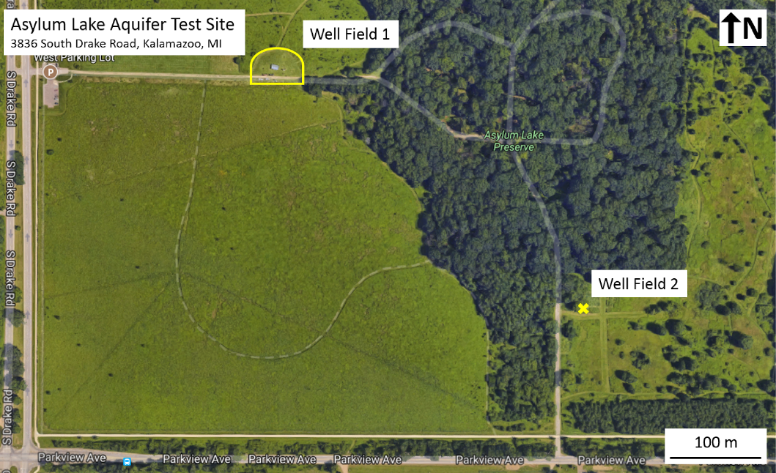
Group 6 – Kirejczyk, Loonie, Malia, Powell and Suess

Slide 6
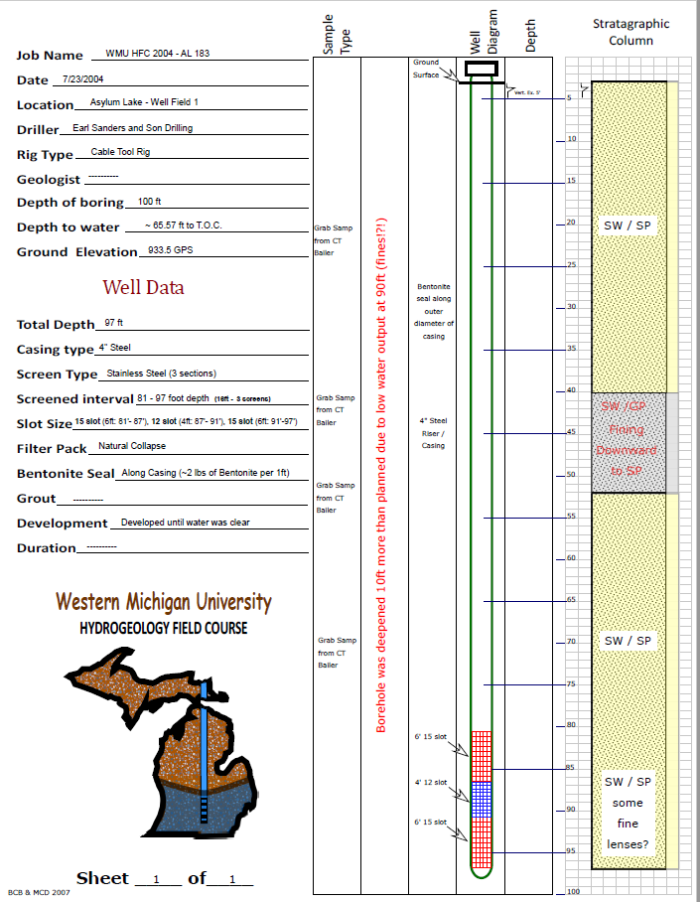
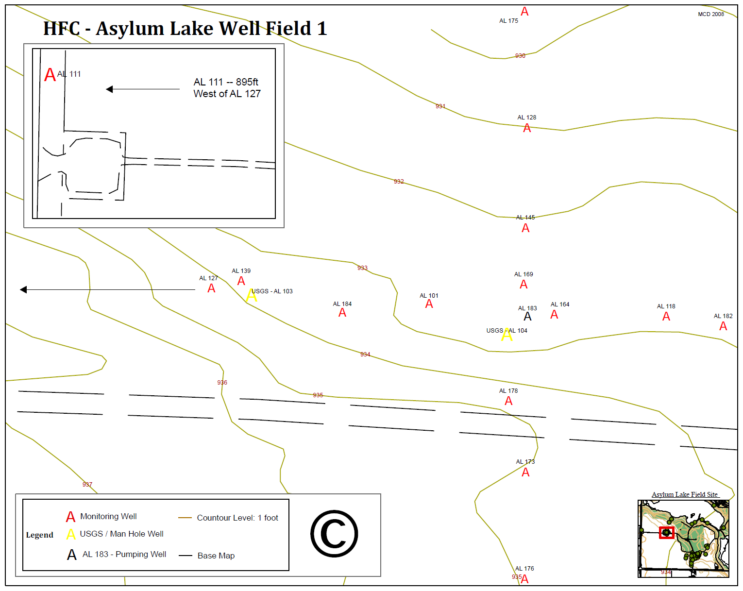
A total of 15 wells drilled in an unconfined glacial outwash aquifer: 4” pumping well with 14 PVC 2” monitoring wells.
Control well located ¼ mile upgradient to record background water level trends.
Monitoring wells are strategically placed along N-S and E-W transects and provide rare opportunity to experimentally test assumption of symmetric cone of depression.

Slide 7
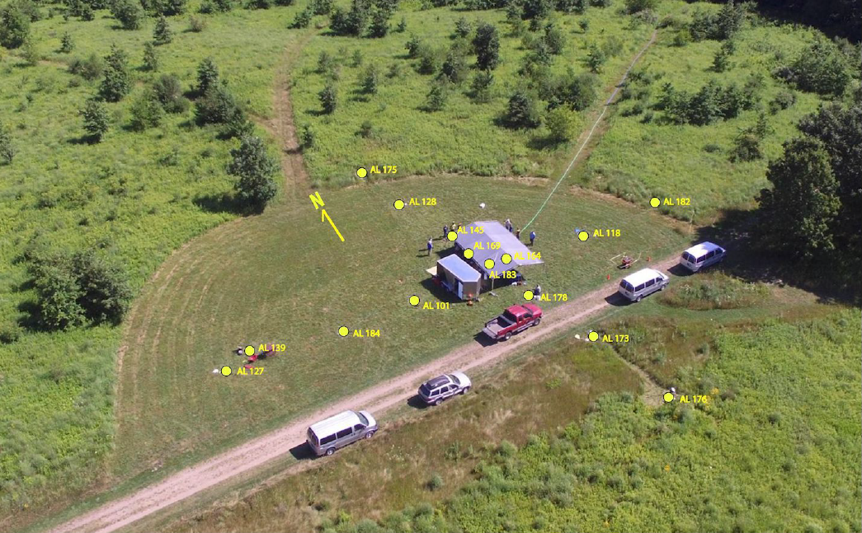
Asylum Lake Well Field 1
Pump discharge hose
Group 3 – Ferguson, Frymier, Meadows, Wilson

Slide 8
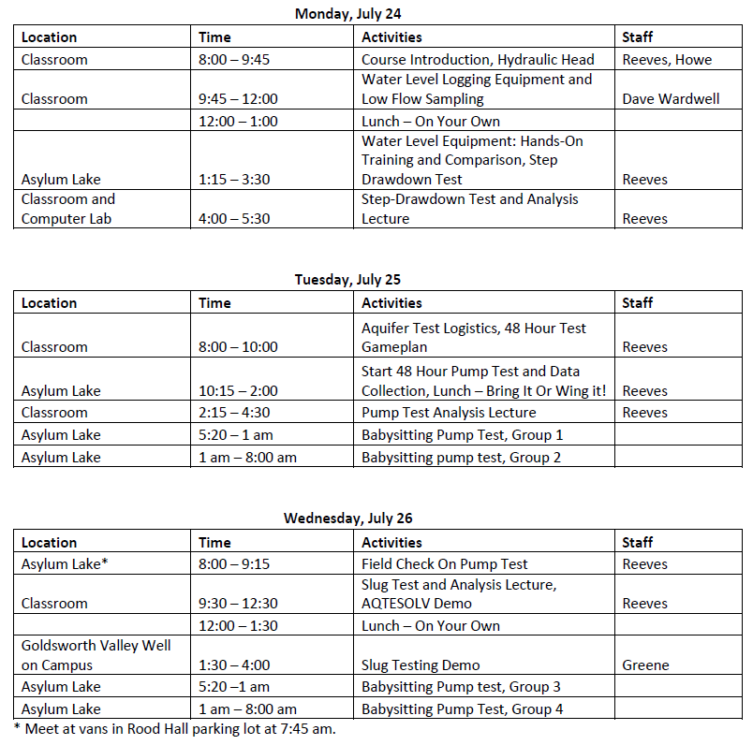
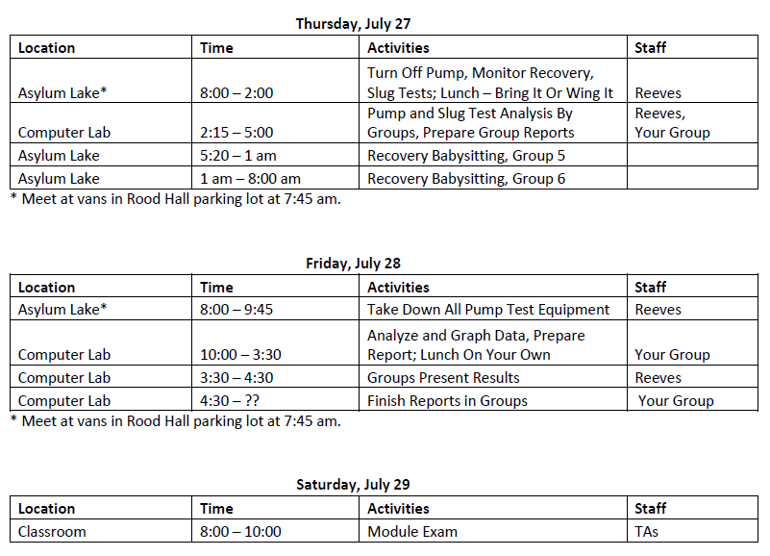

Slide 9
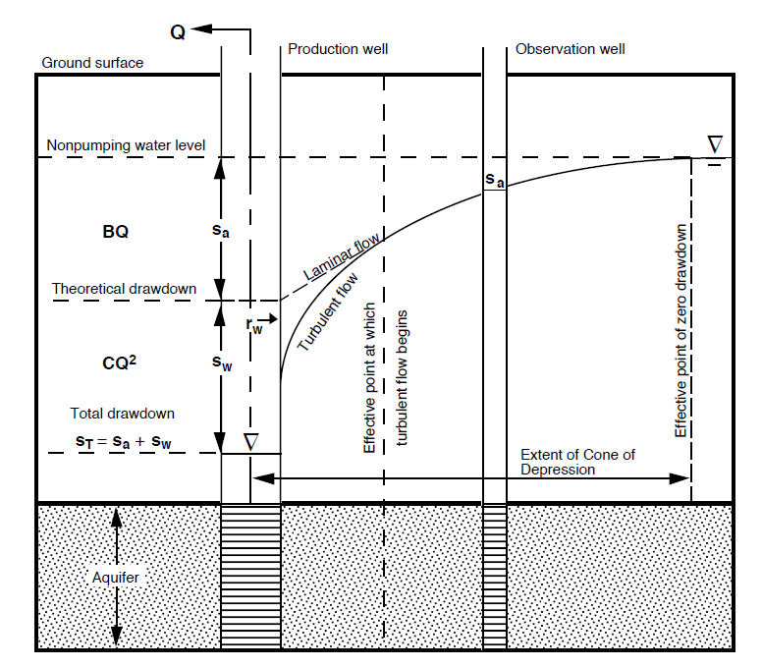
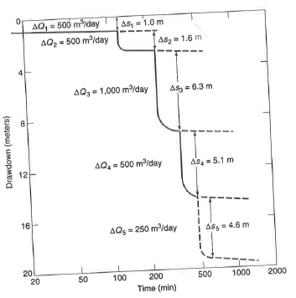
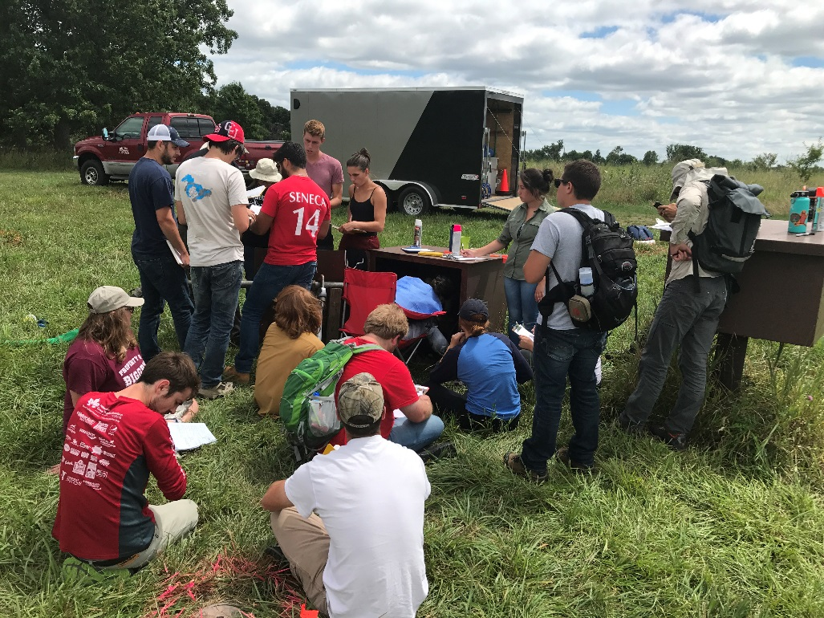
Step Drawdown Tests
Kasenow (2010)
Todd and Mays (2006)
Day 1: Lecture on well design, well efficiency, and step drawdown tests and analysis methods.
Perform step drawdown test and analyze data in computer lab.

Slide 10
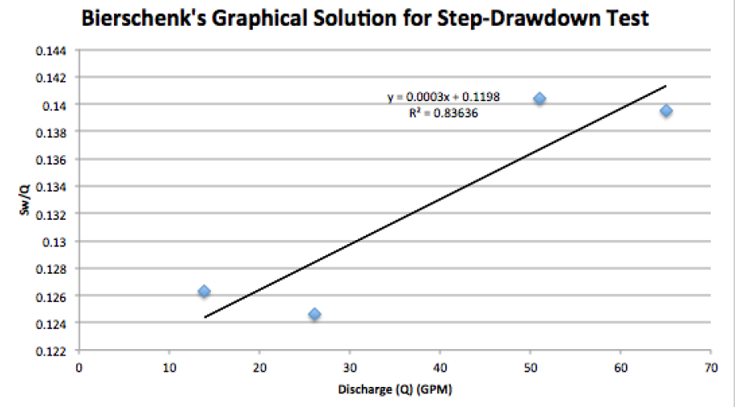
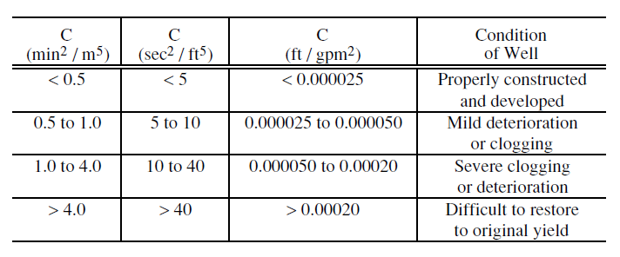
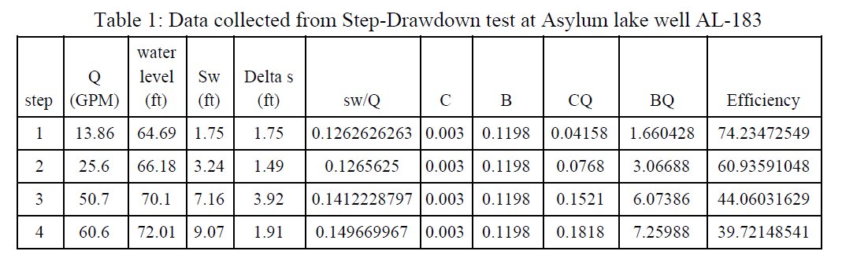
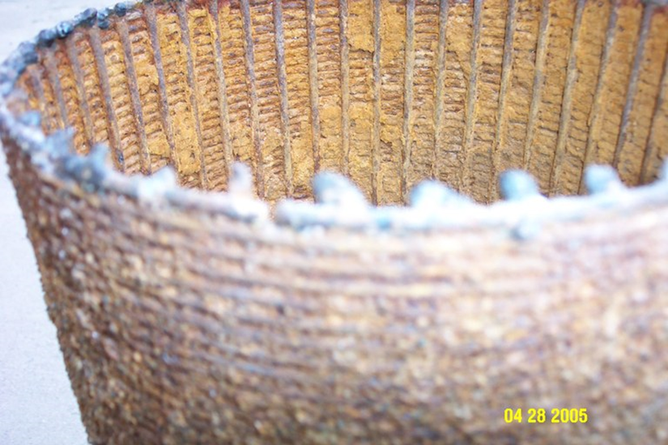
Kasenow (2010)
Group 1 – Allen, Brown, Butula, Gurnicz

Slide 11
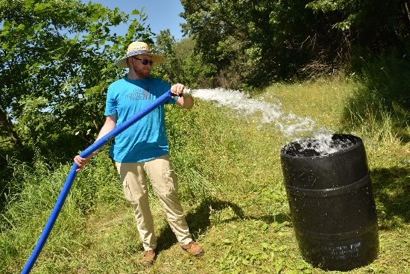
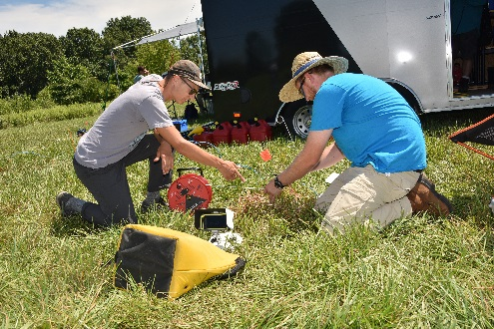
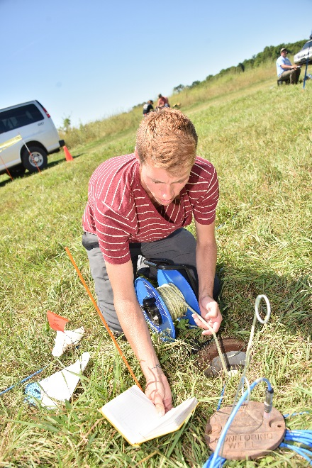
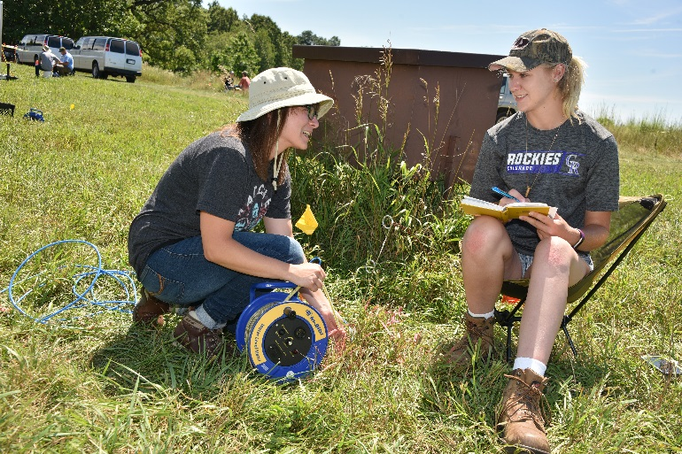
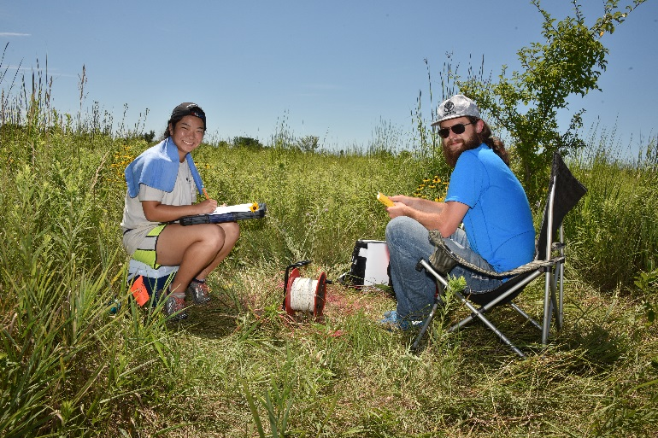
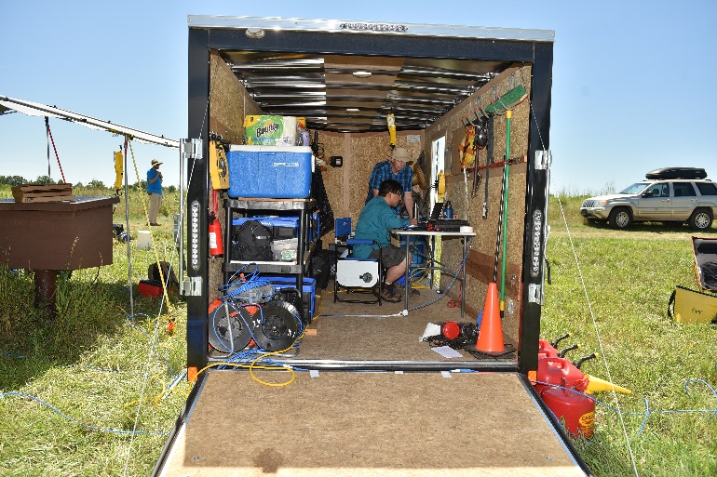
Multi-Well Pumping Tests
Lectures on pumping test test logistics, assumptions, equipment, and analysis.
Divide class into 6 groups, each group assigned 2-3 wells and responsible for setting up pressure transducers and taking manual (pre-test) static and dynamic (pumping and recovery) water levels.
Each group covers a night shift during 48-hour test: 2 shifts during pumping, 1 shift recovery.
High quality In-Situ vented pressure transducers used during course, joined using Virtual Hermit to observe real-time water levels.
Days 2-4 Pumping and Recovery, Day 5 Analysis; Pump failed after 28 hours

Slide 12
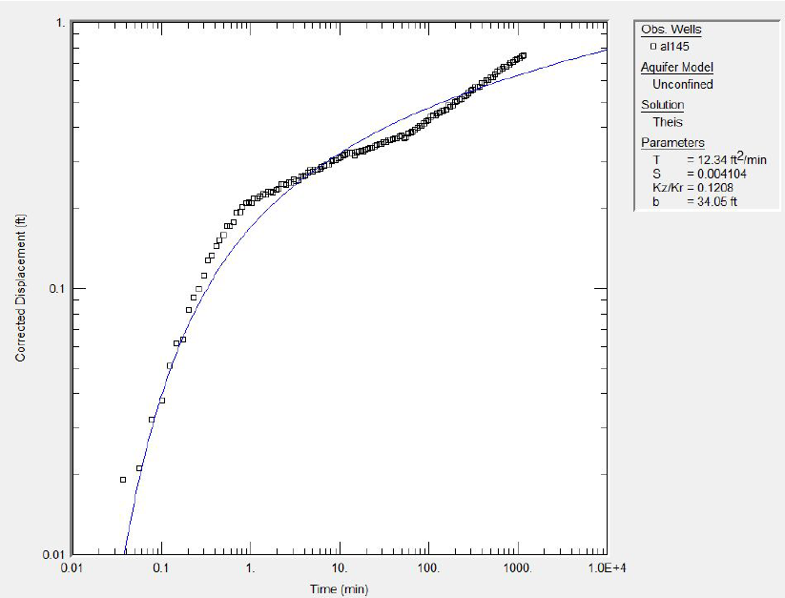
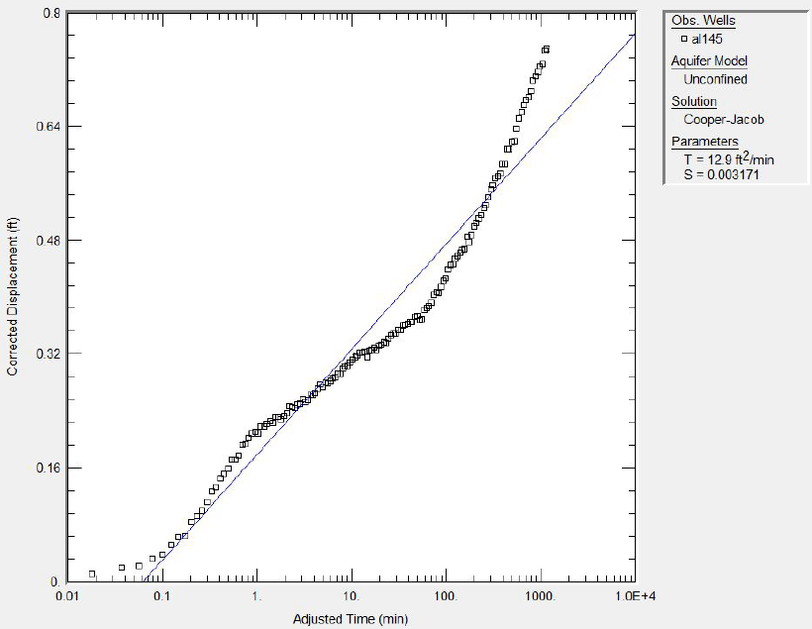
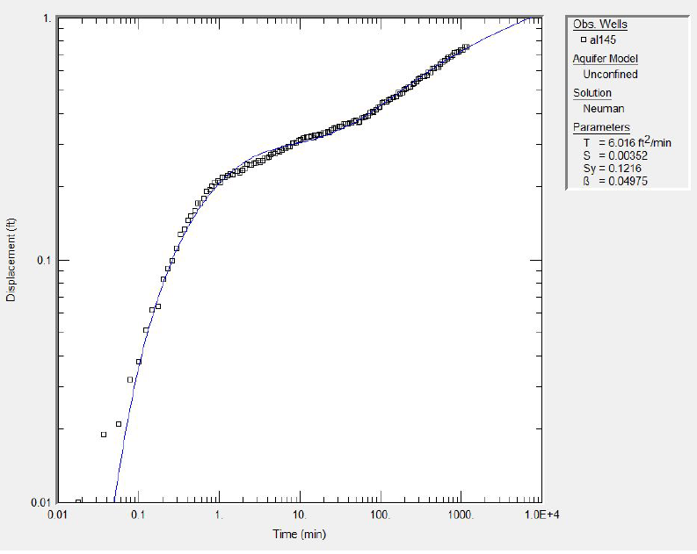
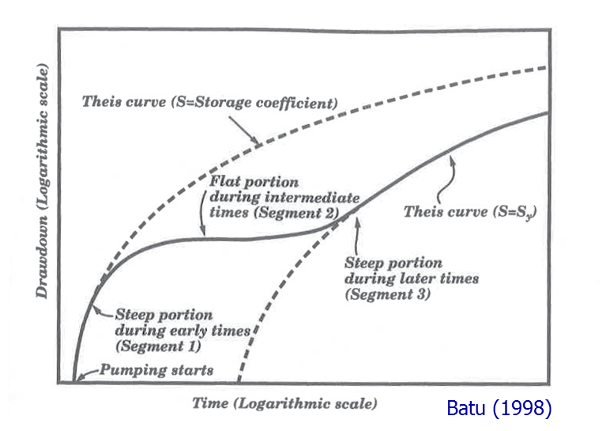
Multi-Well Pumping Test Analysis (28 hrs)
Which model best fits the data??
Group 6 – Kirejczyk, Loonie, Malia, Powell, and Suess

Slide 13
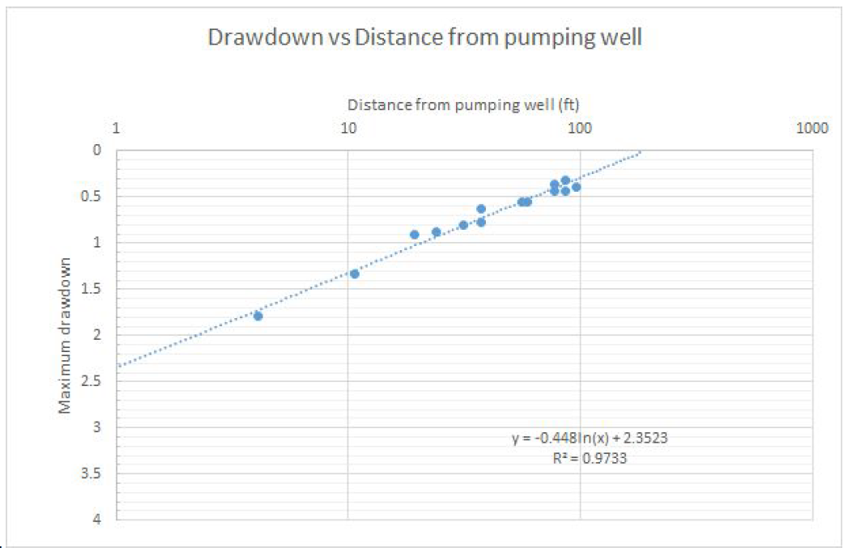
R_{e} ~ 190 ft
Good agreement between max drawdown with well distance for multiple wells indicates fairly symmetric cone of depression.
Group 2 – Buckley, Leitel, Schmidt, and Schmitz

Slide 14
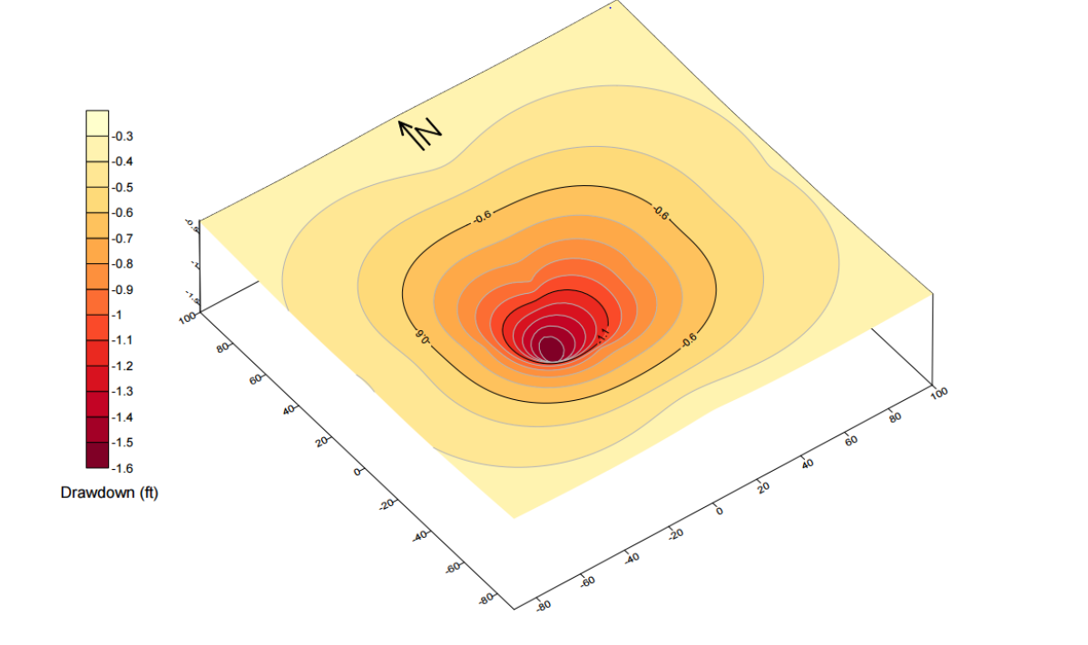
Group 4 – Bell, Burlow, Howd, and Scher

Slide 15
Slug Tests
Similar lecture-field format as pump testing, except we begin with field demo on Day 3 from Dan Greene on slug testing with emphasis on pneumatic (positive and negative pressure) slugs.
Students perform physical slug in, slug out tests in groups on Day 4
Analysis by groups on Day 5

Slide 16
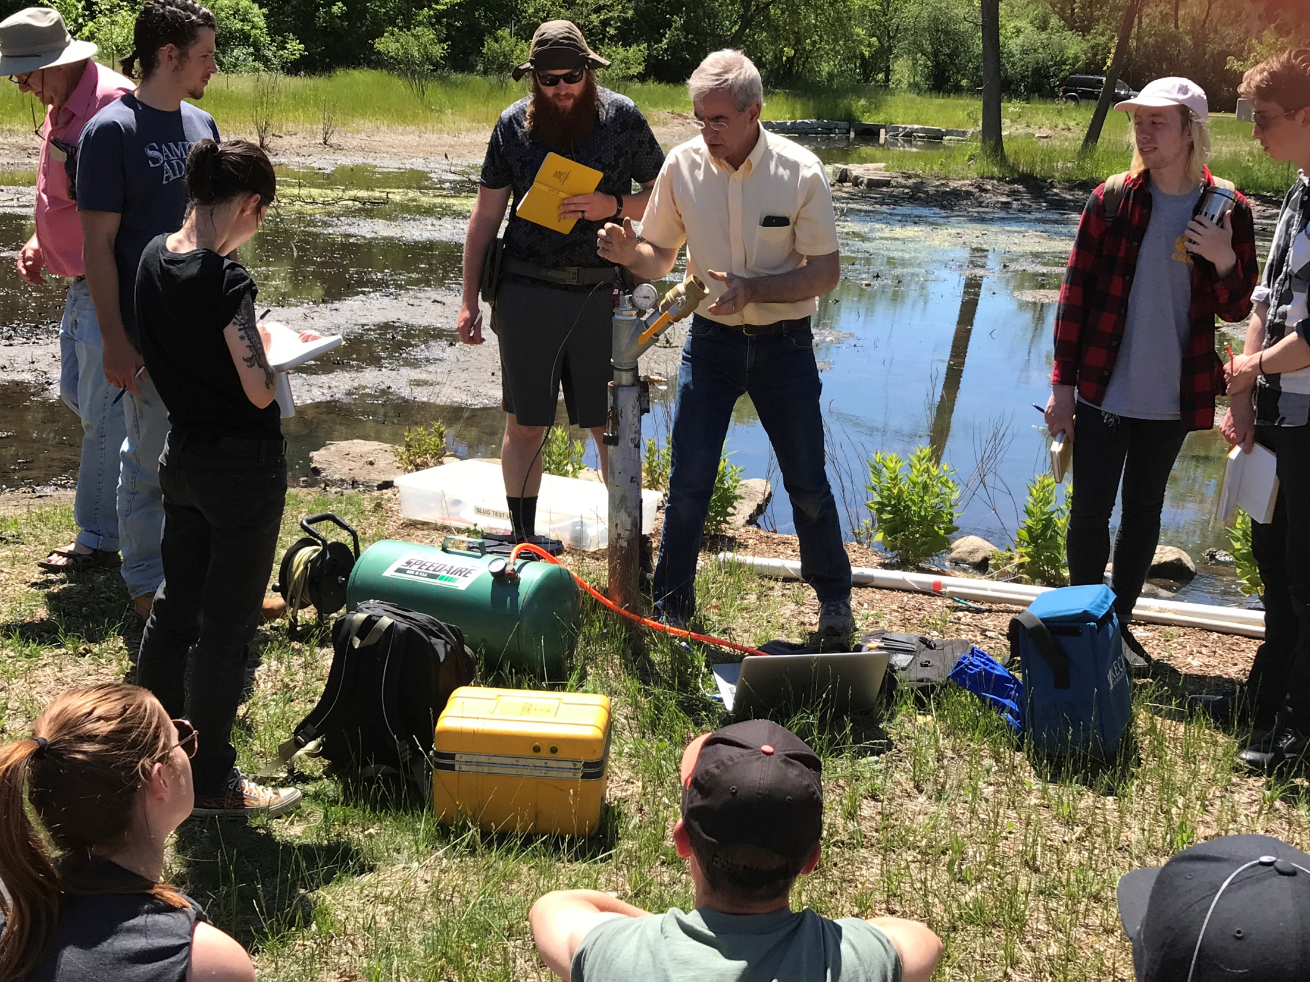
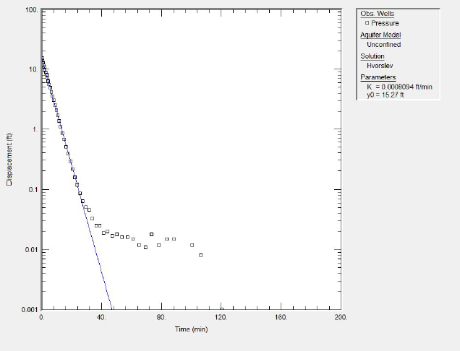
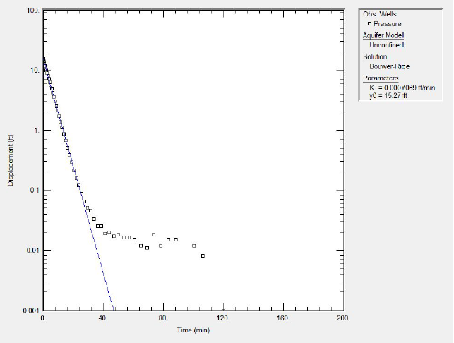
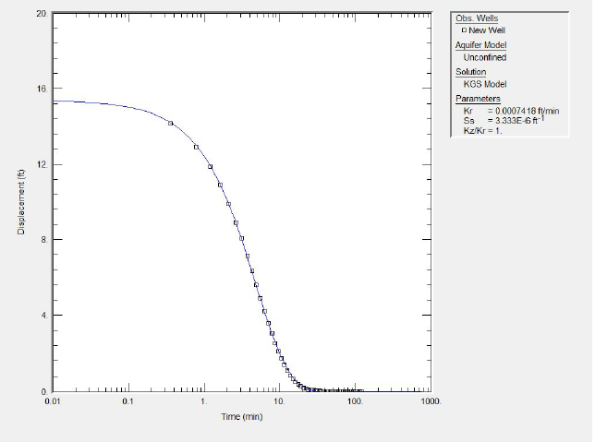
Hvorslev
Bouwer and Rice
KGS
Group 2 – Buckley, Leitel, Schmidt, and Schmitz

Slide 17
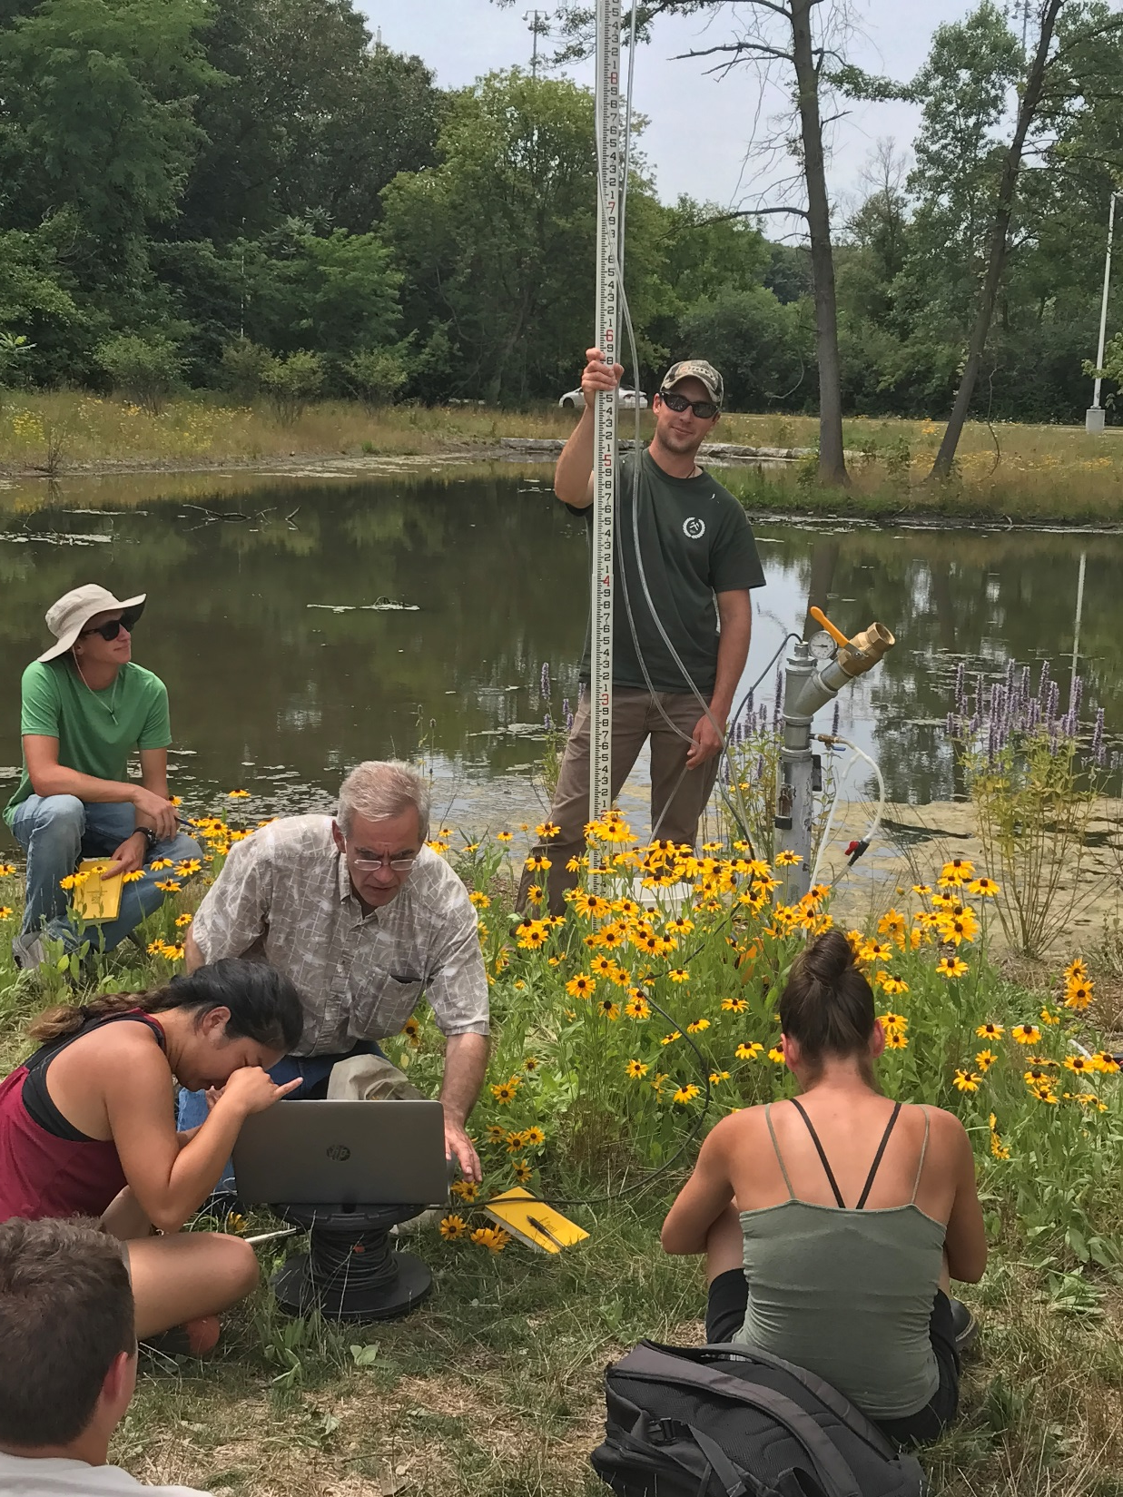
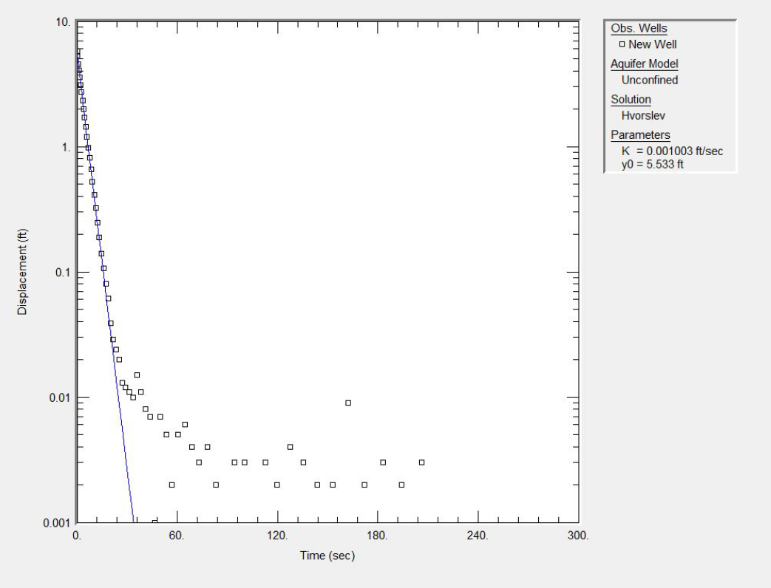
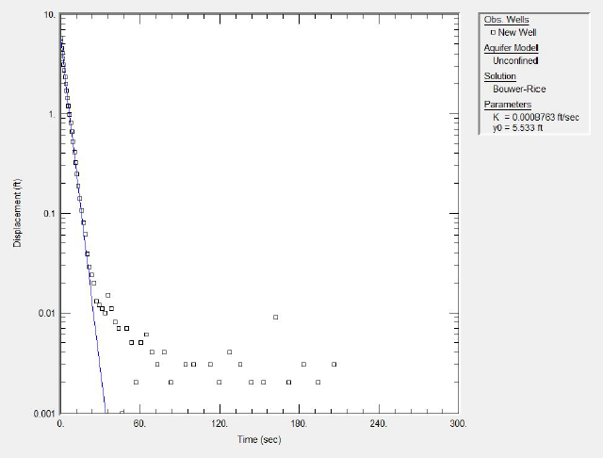
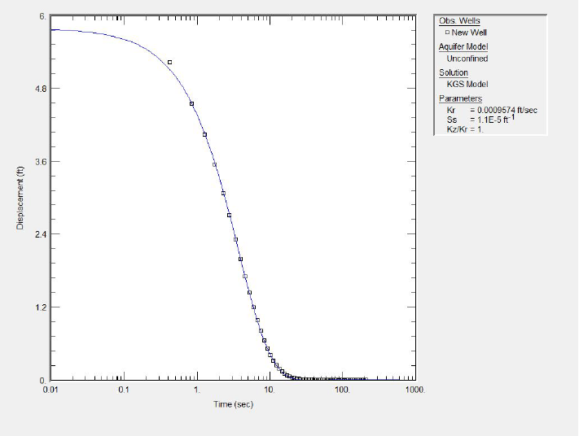
Hvorslev
Bouwer and Rice
KGS
Group 2 – Buckley, Leitel, Schmidt, and Schmitz

Slide 18
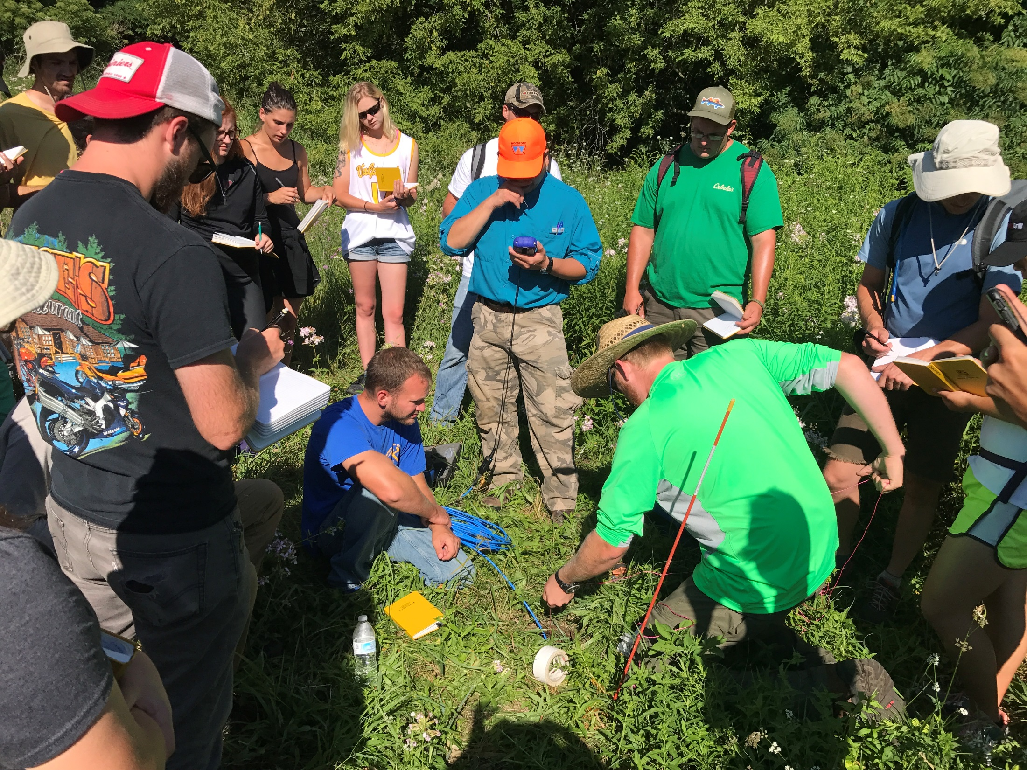
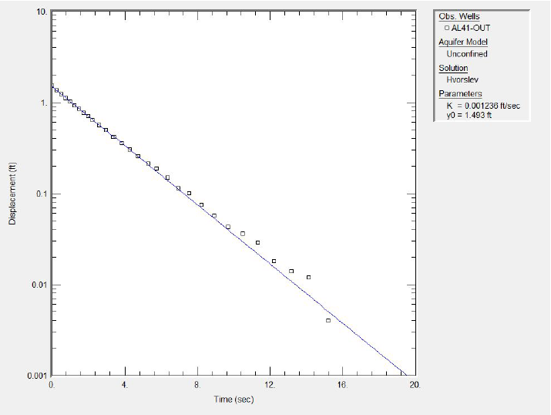
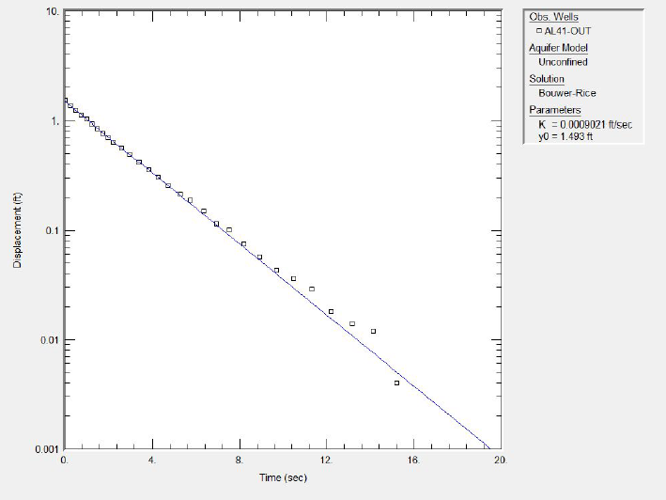
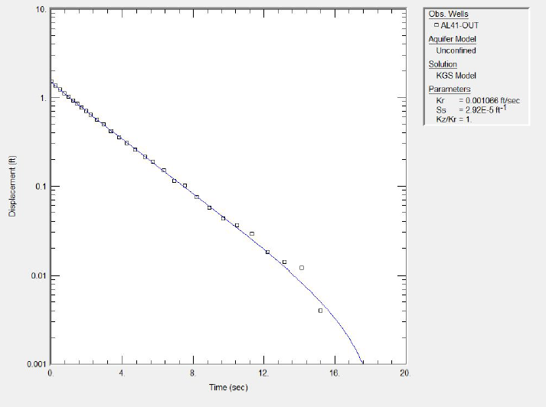
Hvorslev
Bouwer and Rice
KGS
Group 2 – Buckley, Leitel, Schmidt, and Schmitz

Slide 19
Summary
The aquifer testing module of the HFC effectively conveys the critical elements of aquifer testing in an field-oriented, experiential learning environment in 5 days.
Pump failure after 28 hours provided outstanding data with clear delayed yield signatures and additional opportunity for SII students to effectively learn how to analyze aquifer test data in AQTESOLVE – shorter pump test duration is being considered in future course offerings.
Shorter pumping test may allow for additional methods to be incorporated into course, such as spinner logs or downhole televiewers.
New 6” pumping well is currently being designed for Asylum Lake well field, followed by drilling and development.

Slide 20
WMU HFC Supporters
American Hydrogeology
Baroid Drilling Fluids
Big Foot Manufacturing Co.
BioBailer
Boart Longyear
City of Kalamazoo
Cook Well Screens
MI Department of Environmental Quality
Dune Technologies, LLC
Earl Sanders and Son
Envirologic Technologies, Inc.
FTCH, Inc.
Fondriest Environmental
Franklin Electric
GSSI
Geoprobe Systems
Geonics Limited
Geotech Enviornmental Equipment
Golden Software
Gundfos
HACH
HERON Instruments, Inc.
In-Situ, Inc.
Iris Instruments
Johnson Screens and Don Baron
Katz Well Drilling, Inc.
MATECO
MHE Products
Milan Supply Compay
Myron L. Company
QED Environmental Systems
Roctest
SME
Solinist
Sterns Drilling
Stock Drilling
Terra Contracting Services, LLC
West Michigan Drilling

Slide 21
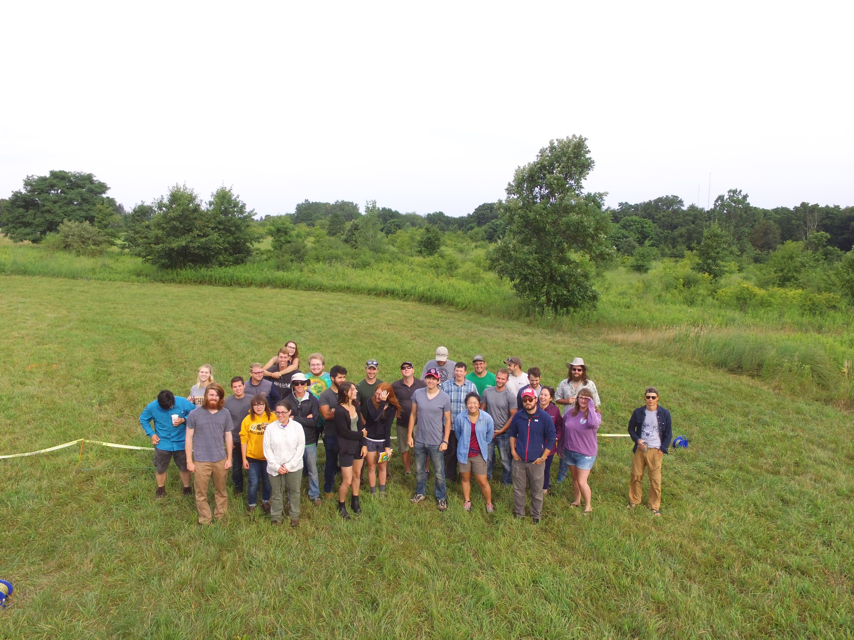
Questions?

