Slide 1
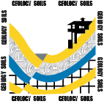

Flood Control, Stormwater Capture,
and Groundwater Recharge:
The Rory M. Shaw Wetlands Park Project
Robert A. Larson
Olga Cruz
Clay Masters
Karin Burger
Los Angeles County
Department of Public Works

Slide 2
Secondary Title
How to spend a half billion dollars
to conserve 590 acre-feet per year
of storm water
(oh, and alleviate street flooding)

Slide 3
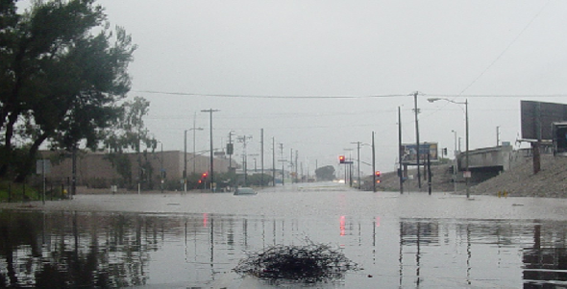
San Fernando Road at Tuxford Ave

Slide 4
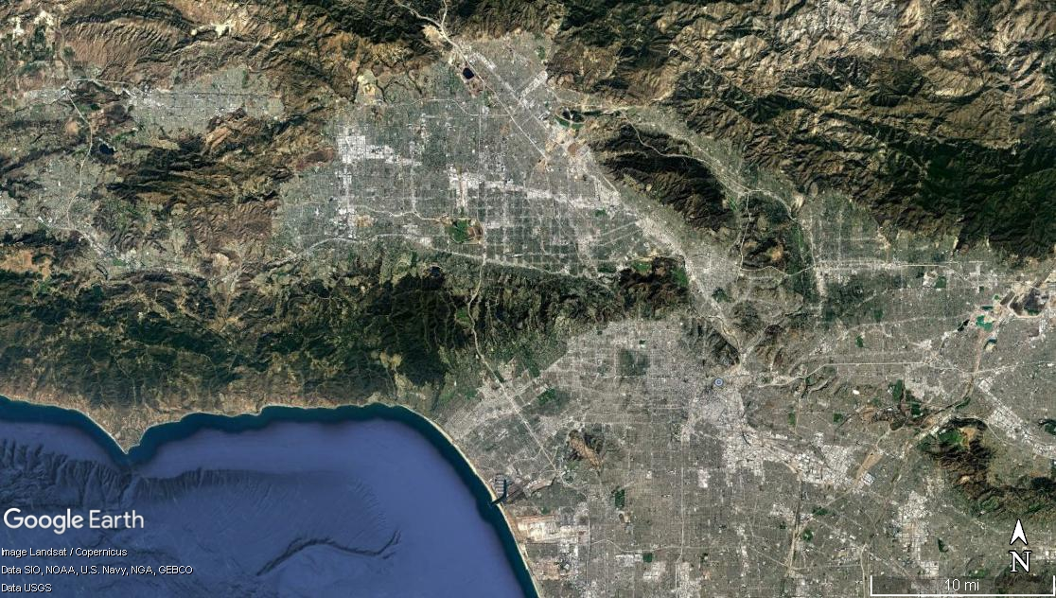
Verdugo Mtn
Santa Monica Mtn
Downtown
Los Angeles

Slide 5
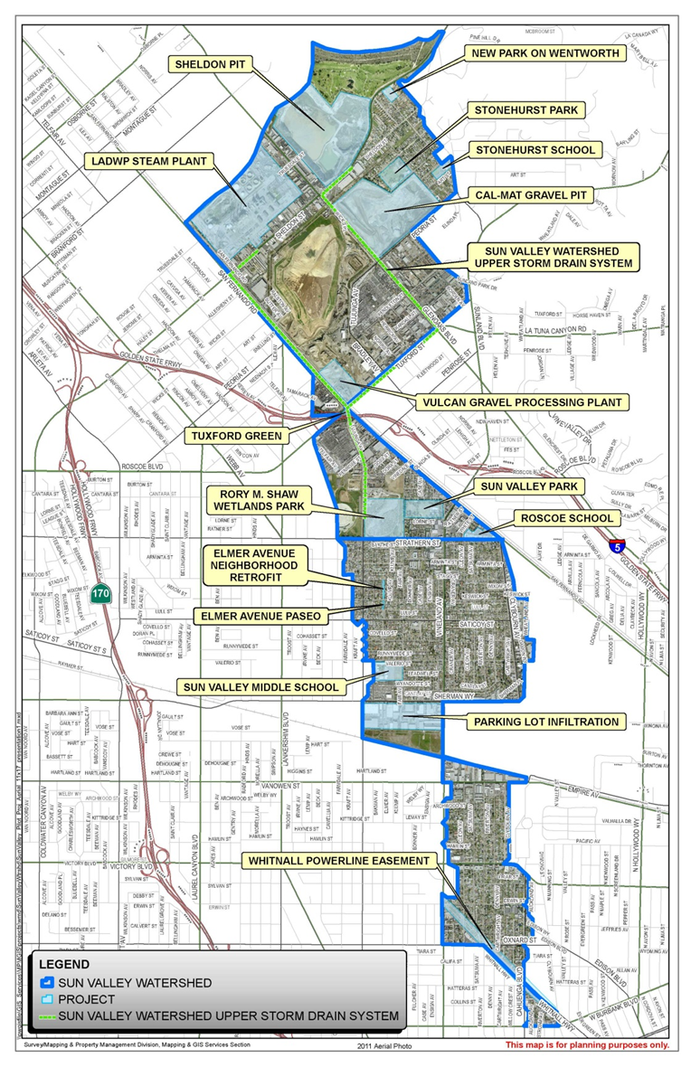

Slide 6
The Storm Drain
Drainage area of 929 acres
4.2 miles of storm drain trunk line - 48-96 inches in diameter
140 catch basins
Hanson Dam
Storm Drain Alignment
Strathern Pit
Sun Valley Park

Slide 7
Exploration
130 sonic bores
160 foot long Tunnel
under active MetroRail
Methane Zones

Slide 8
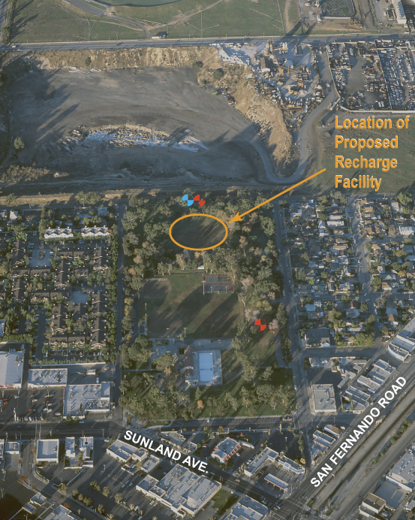
2001
Exploration
7 bores
1 infiltration test

Slide 9
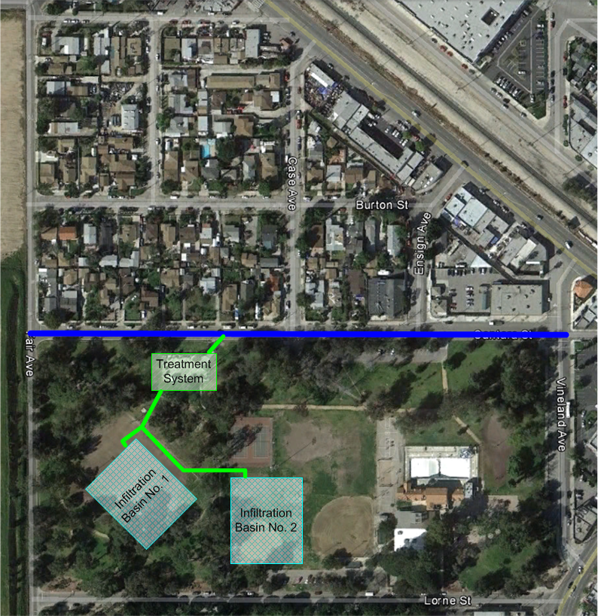
21 acres of street drainage
Sun Valley Park

Slide 10
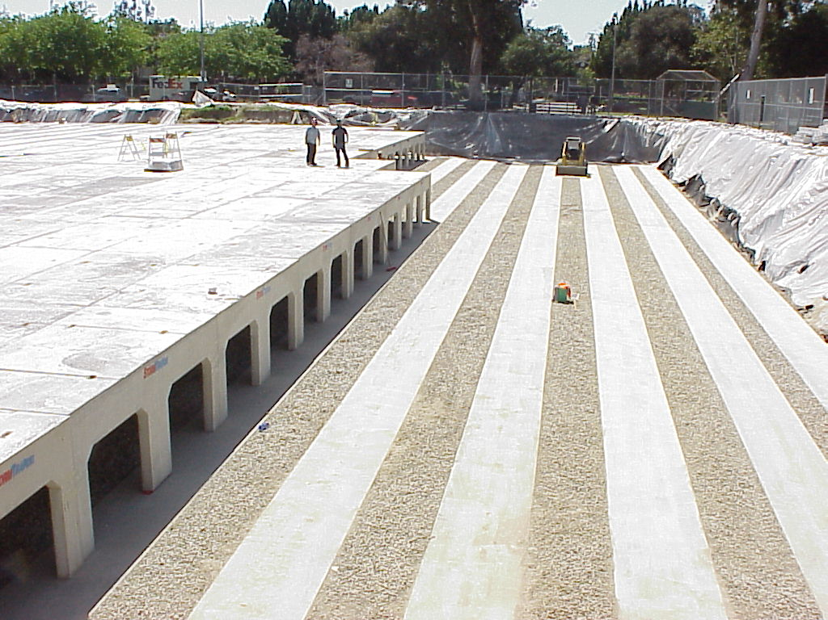
Infiltration modules completely changed during construction
Area of infiltration cut in half

Slide 11
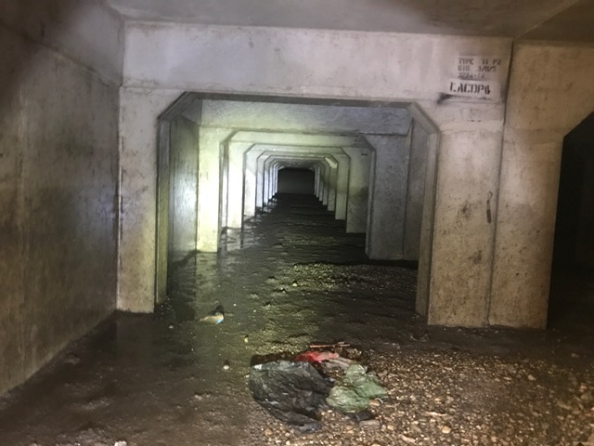
Pre-treatment failing – silt and trash in the gallery

Slide 12
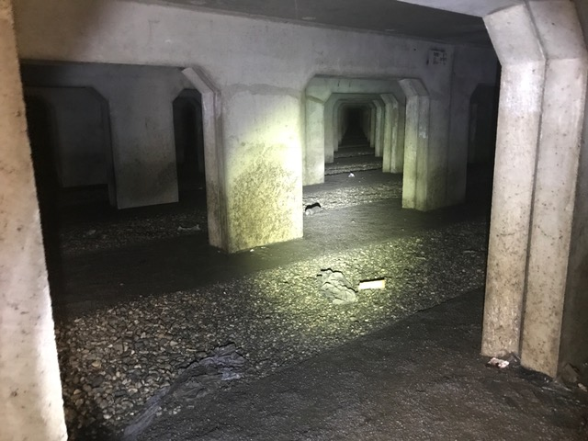

Slide 13
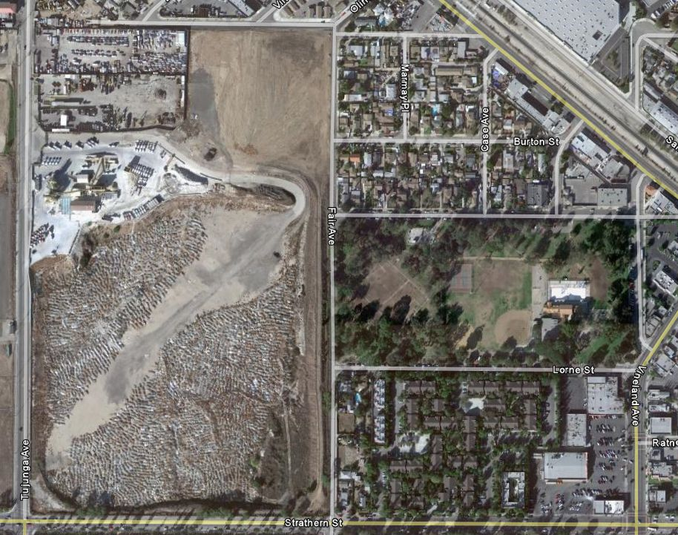
Project Site
Cave in site
Sun Valley Park
Strathern Pit mined 1926-1972
160 foot deep pit filled 1991-2008 as a 30 acre inert landfill
Acquired by LACDPW in 2010
Strathern Pit

Slide 14
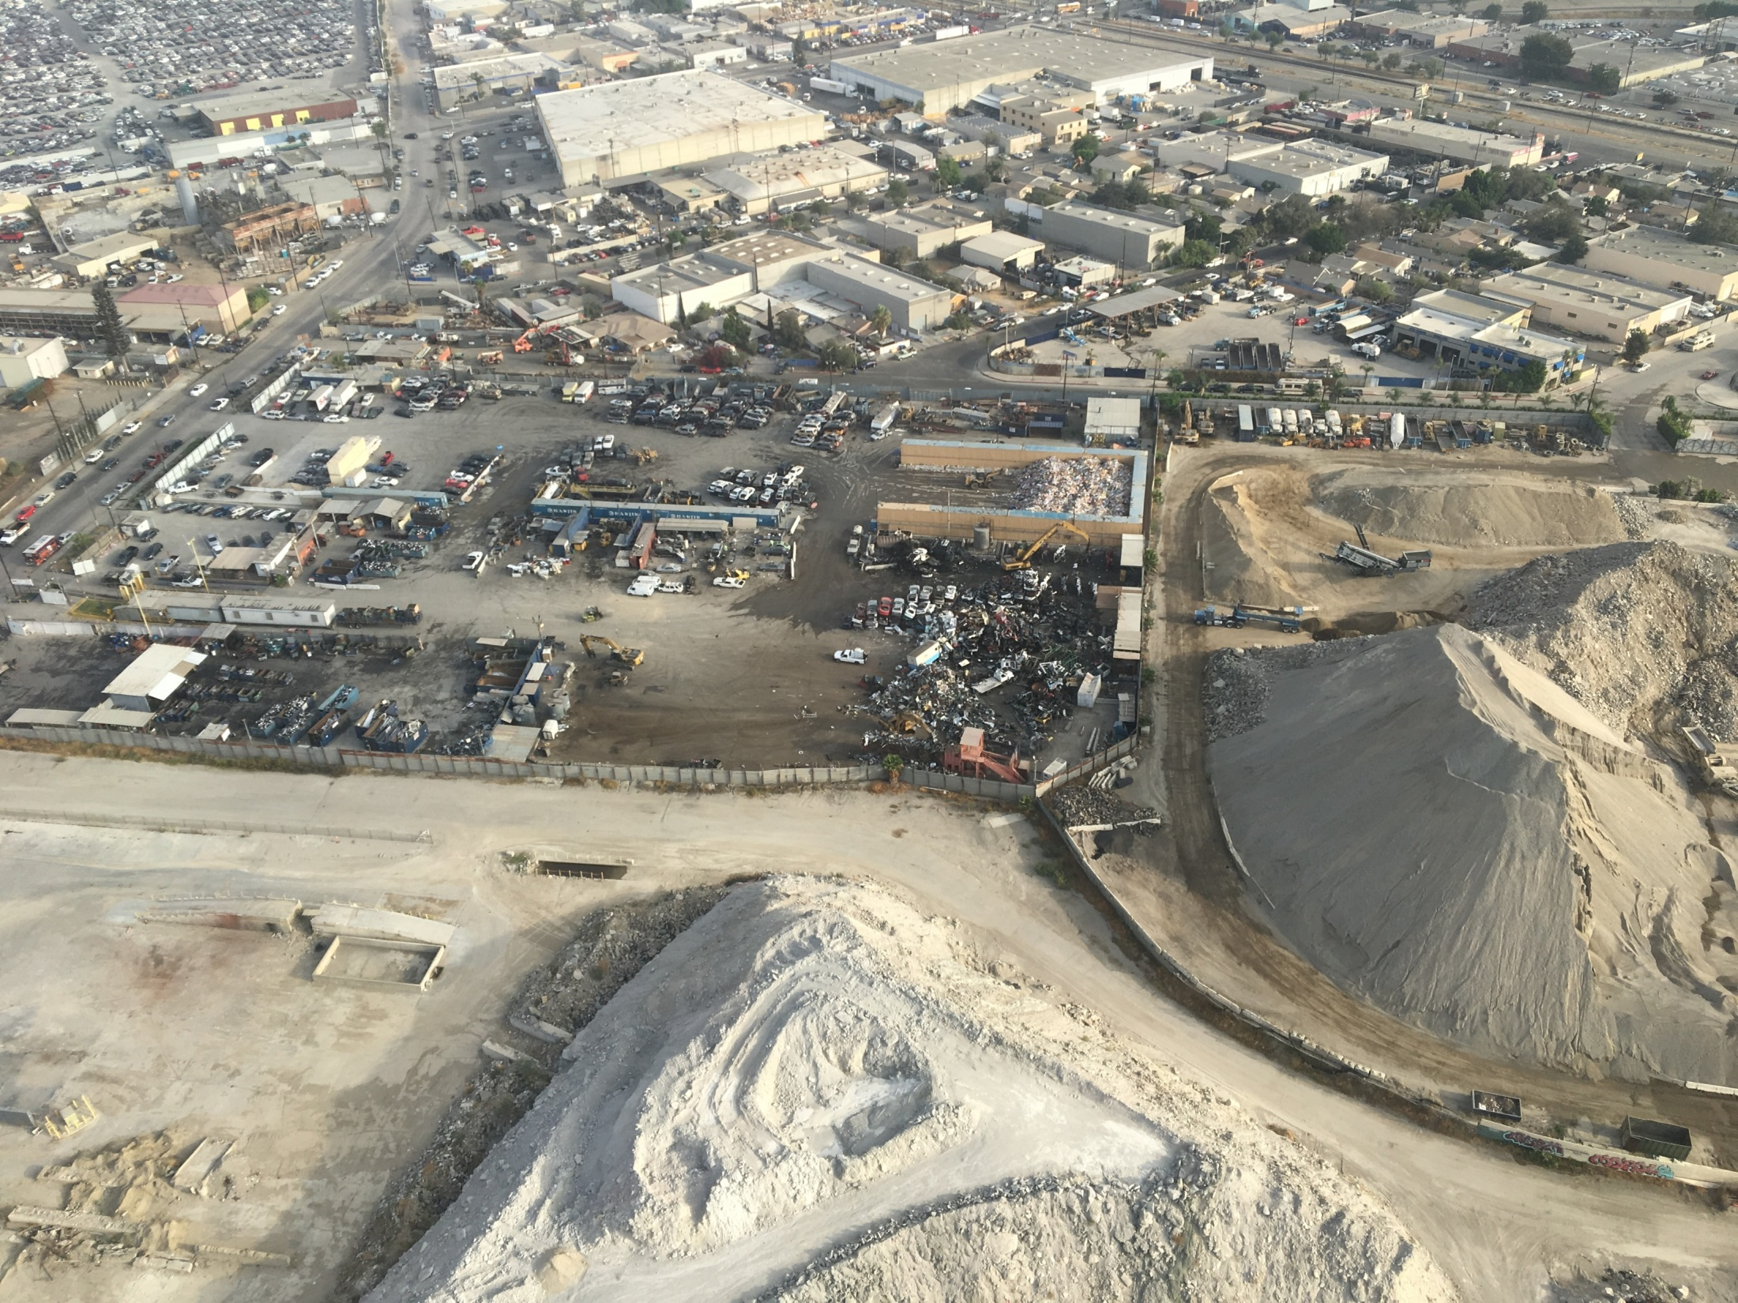
Another concrete plant
Newberry Landfill
Former Over and Over
Concrete Plant
Concrete slag pile

Slide 15
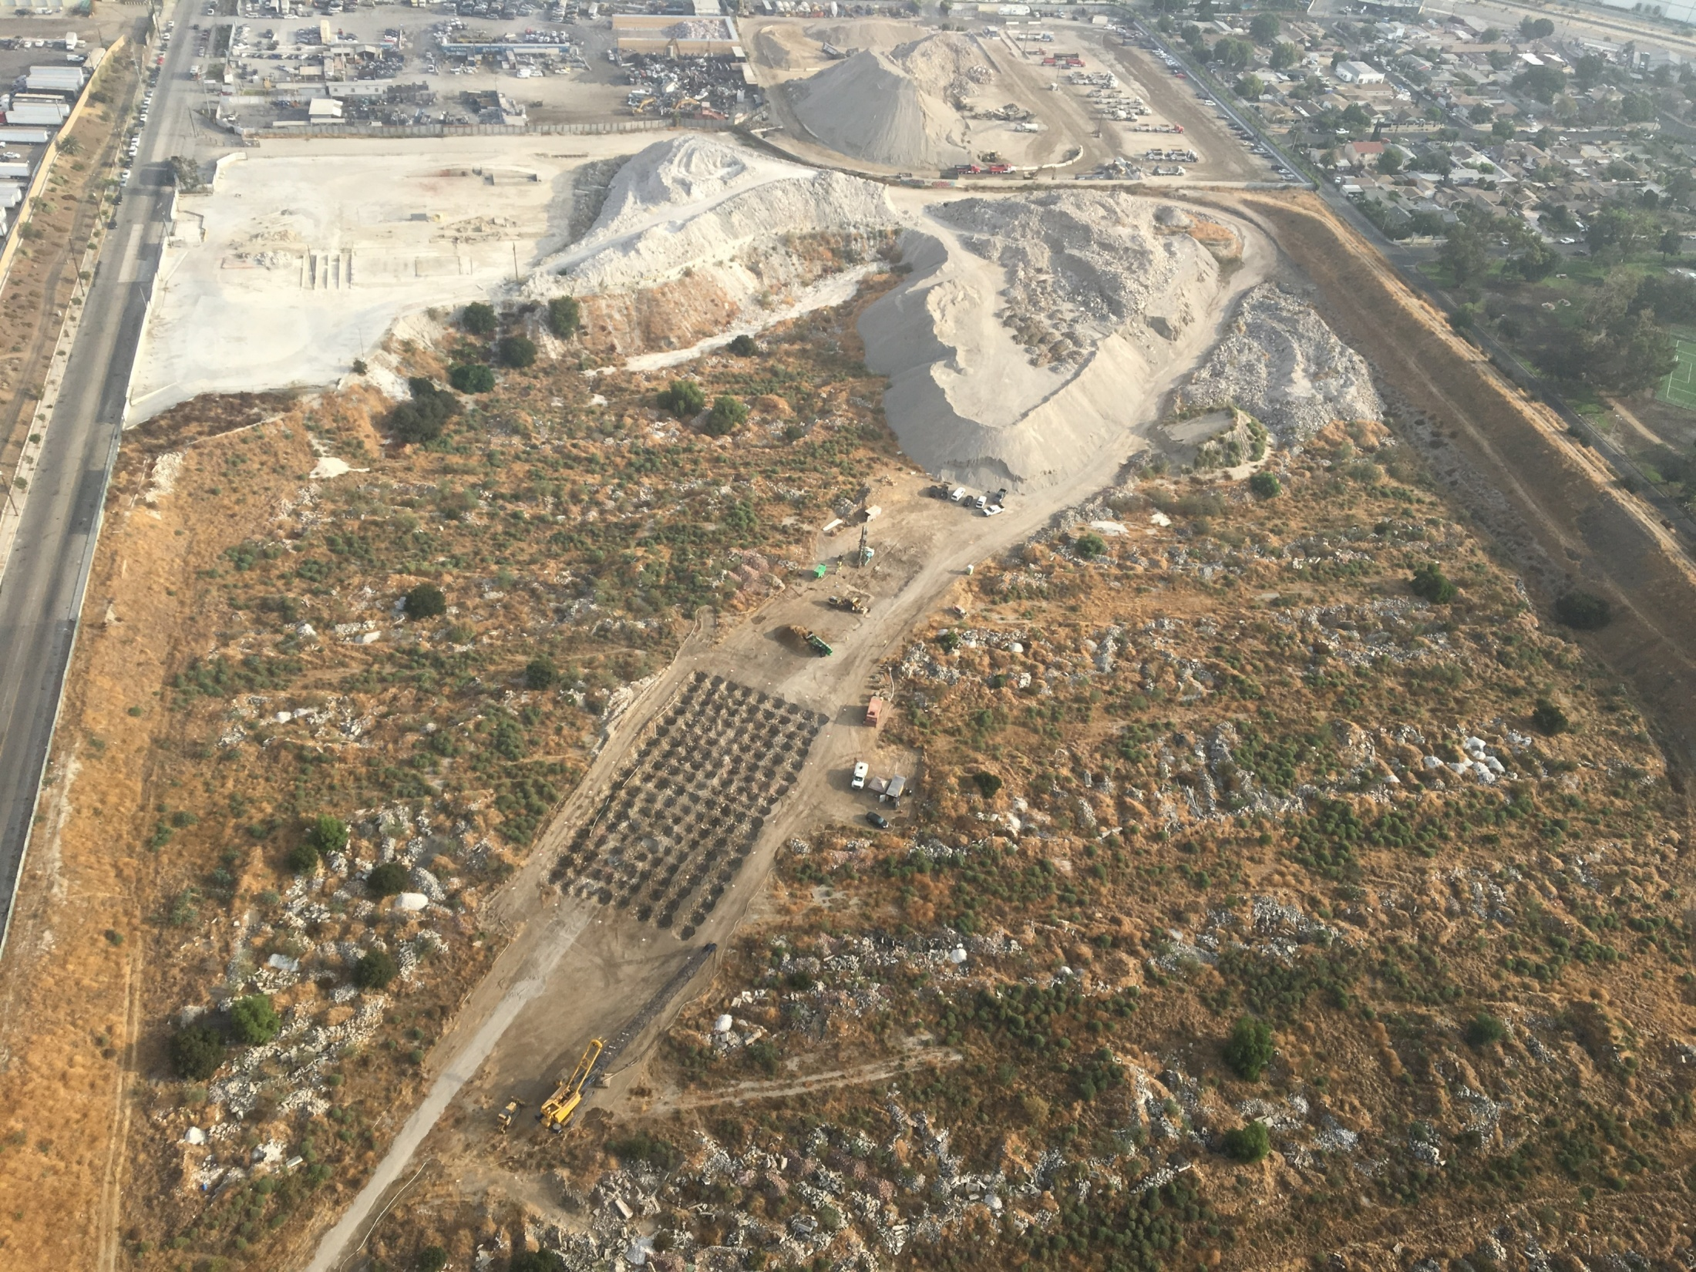
21 acre detention pond
10 acres of wetlands
15 acres of recreational facilities and open space
Exploration
50 bores from 30-150 feet deep
28 test pits

Slide 16
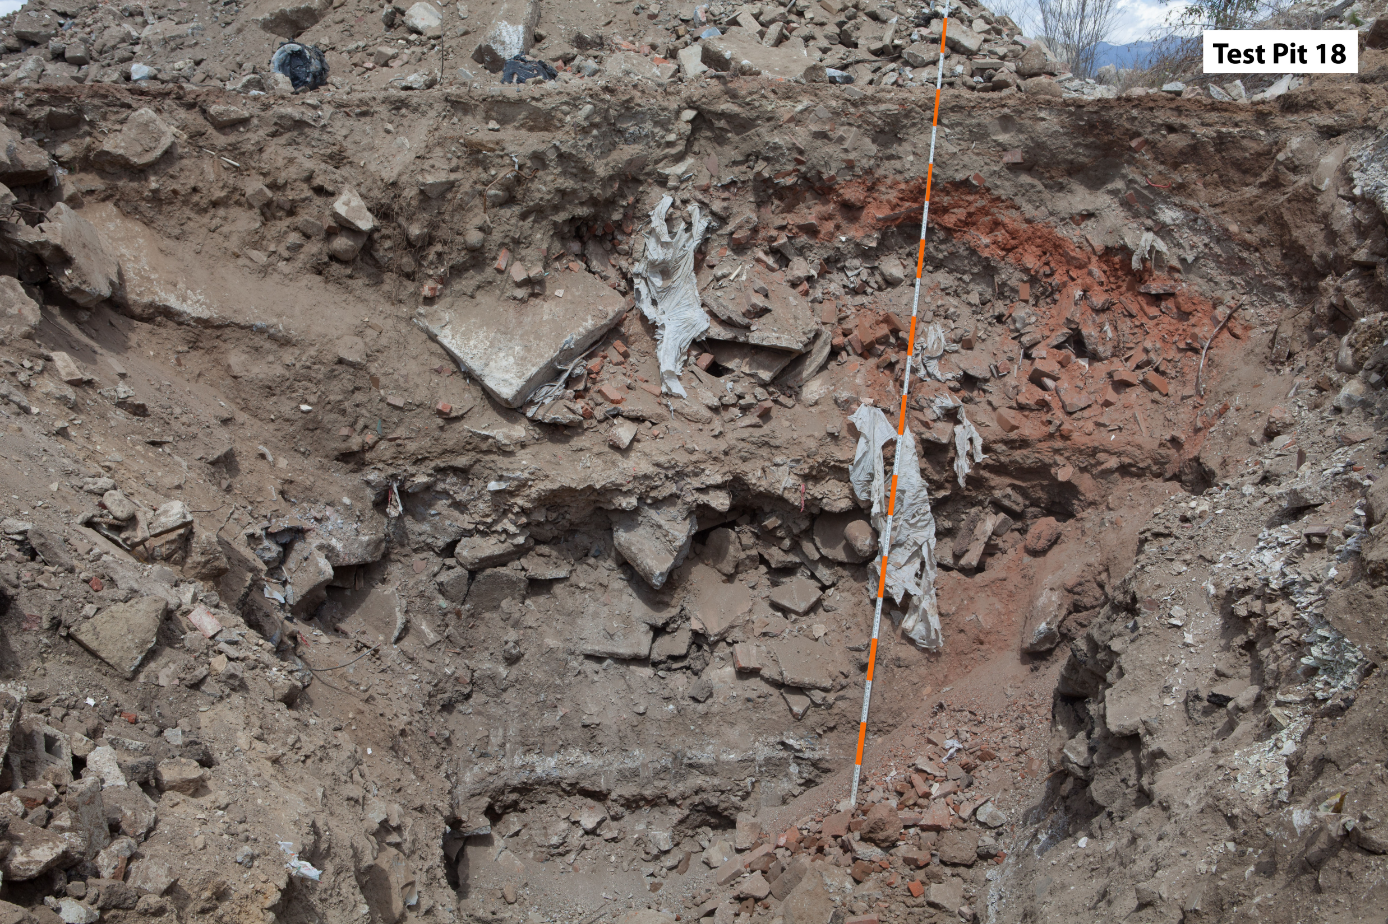
Settlement mitigation in upper 20-60 feet
Debris removal, crushing, and placement of engineered fill
Dynamic compaction
Compaction grouting

Slide 17
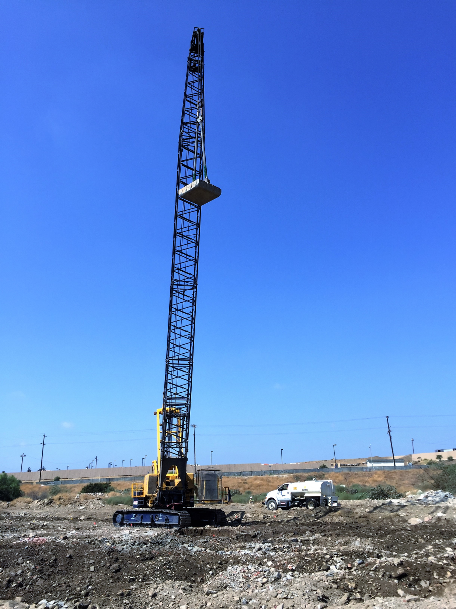
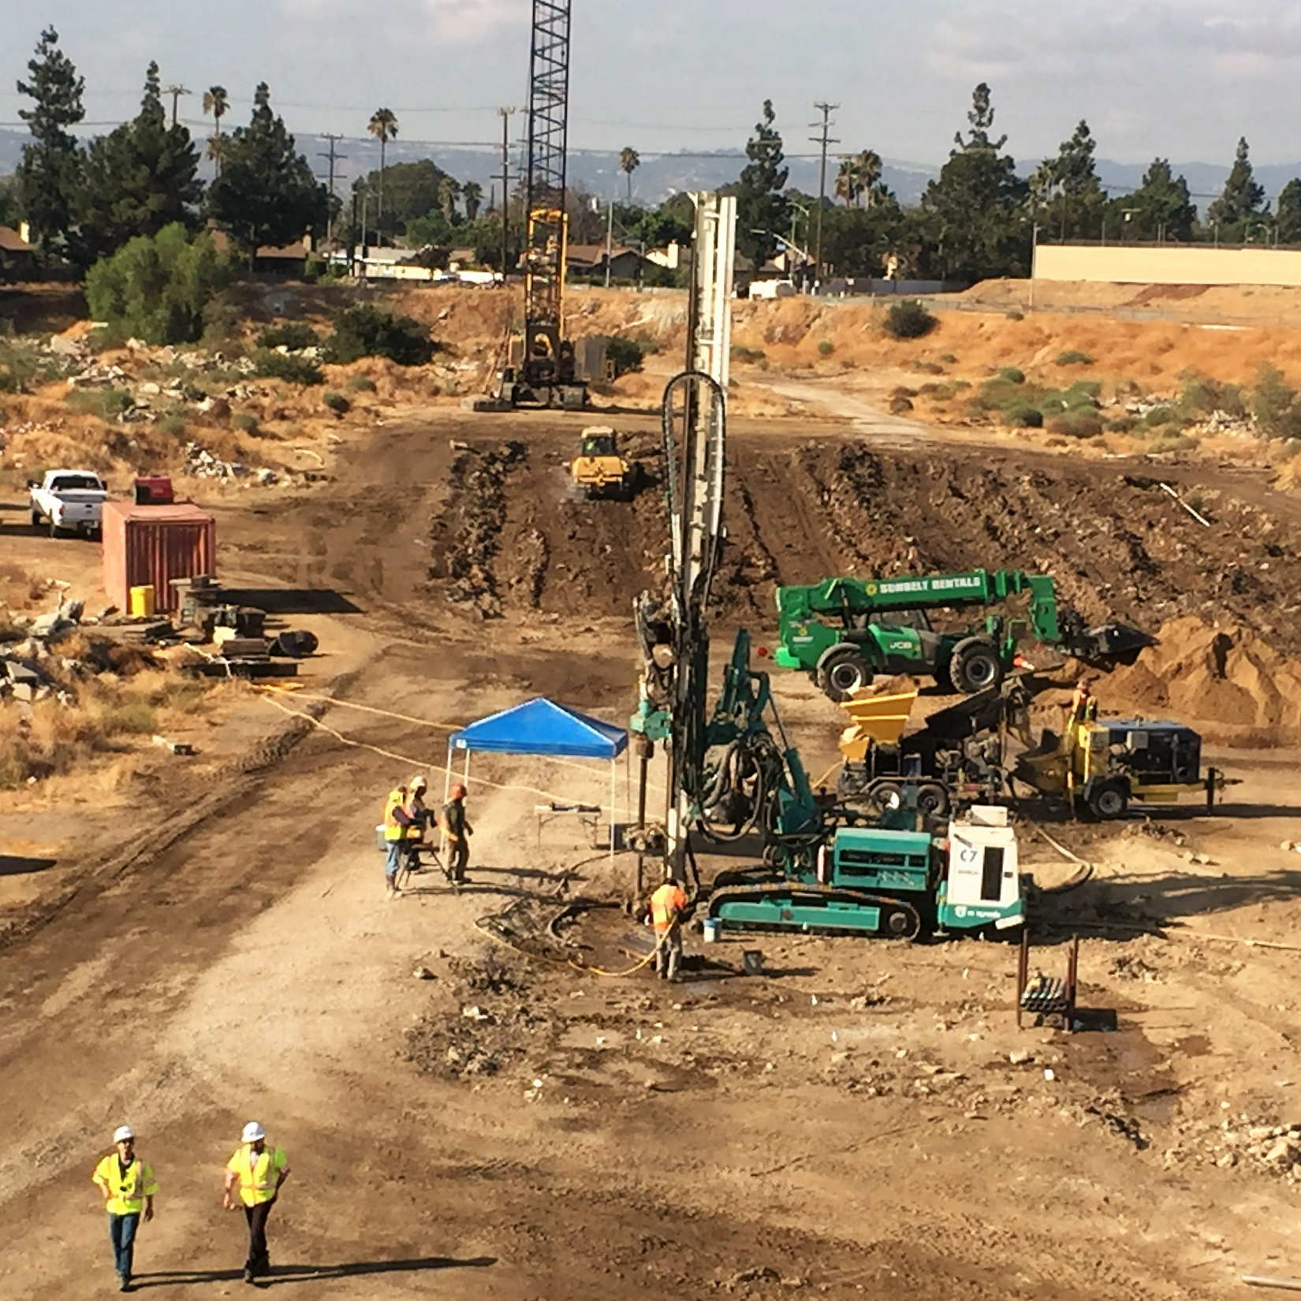
Dynamic
Compaction
Compaction Grouting

Slide 18
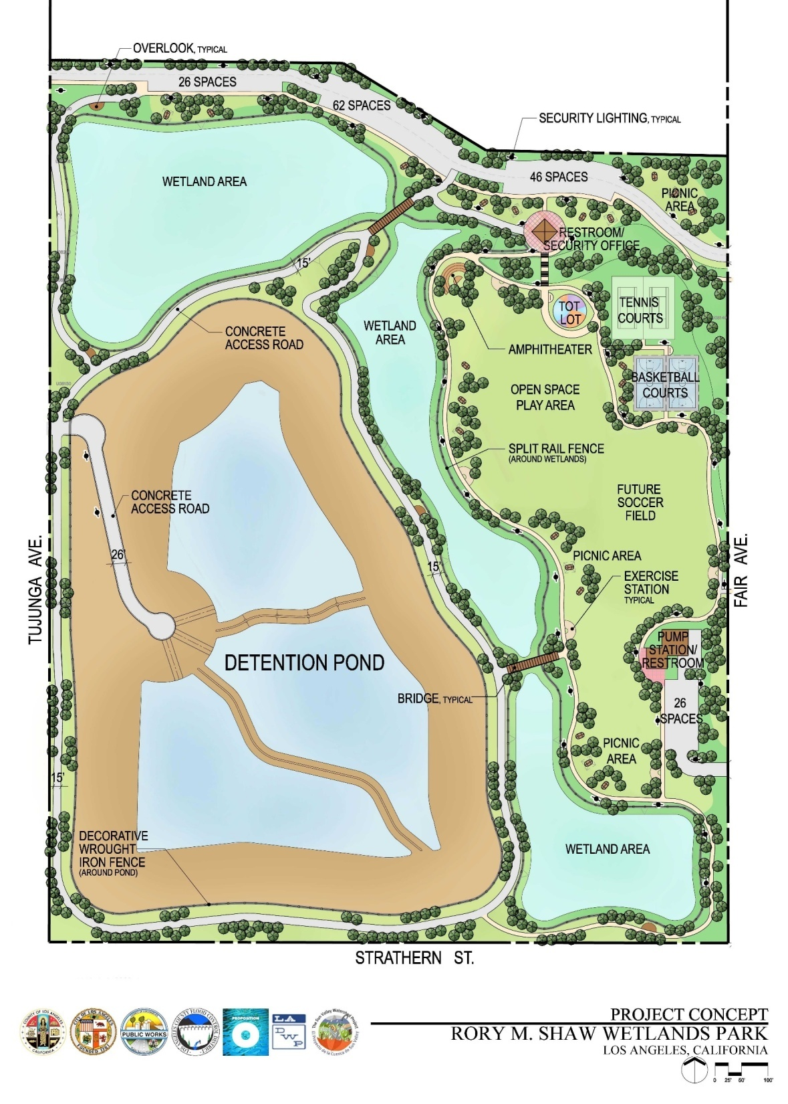
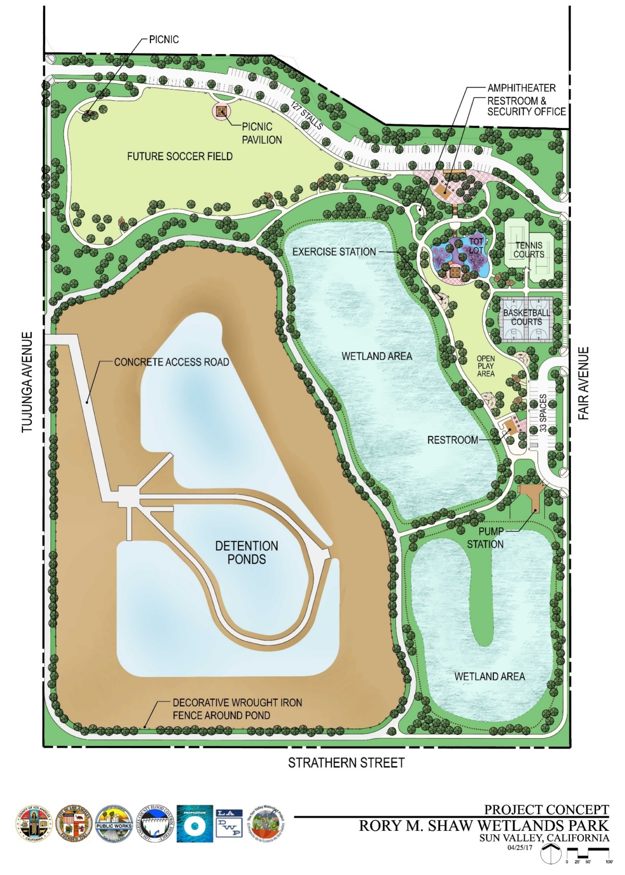
Previous design
Current design

