Slide 1


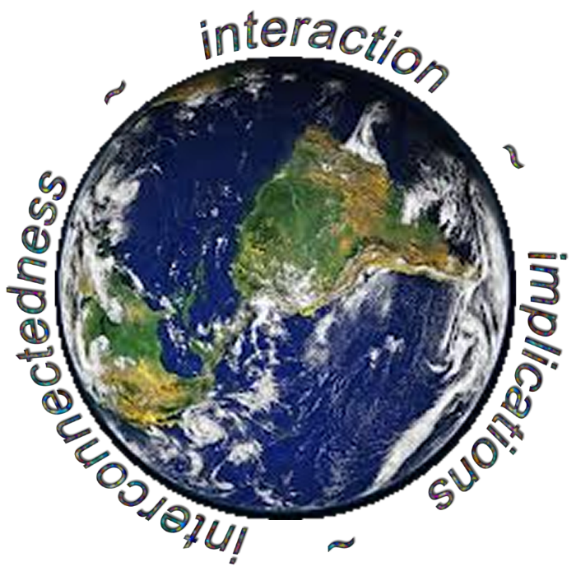
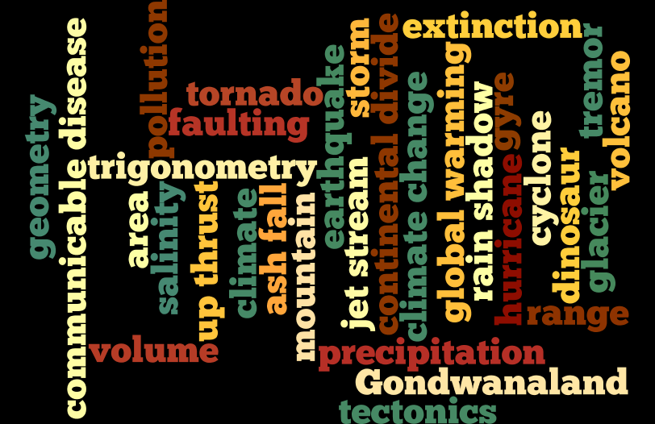
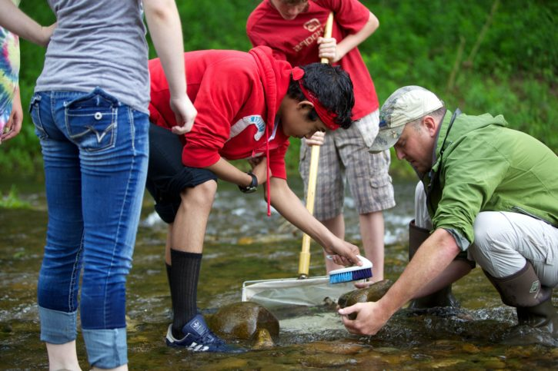
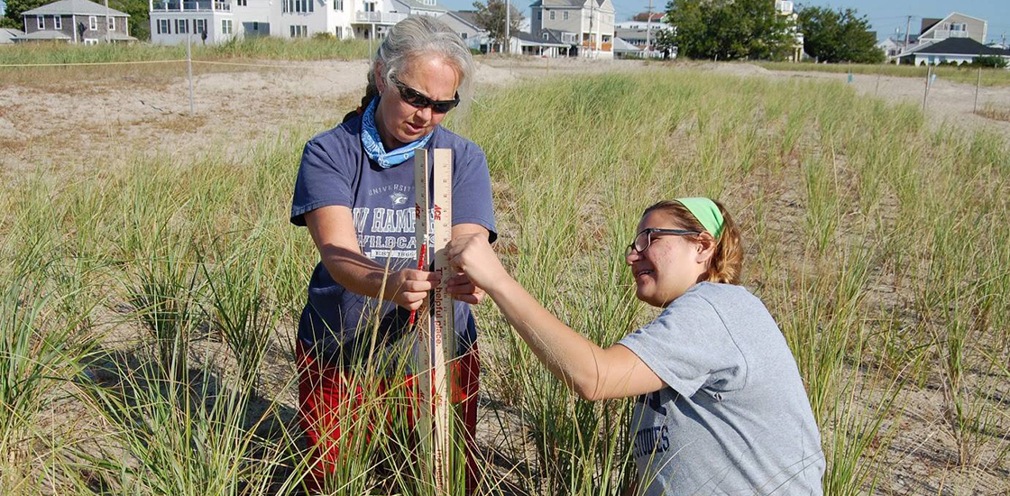
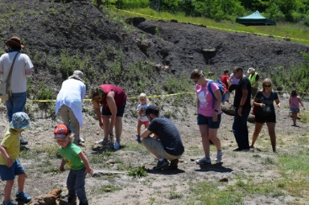
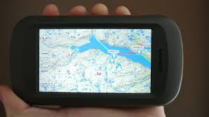
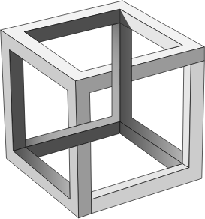
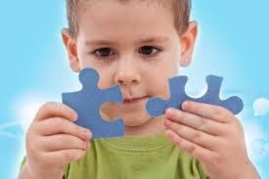
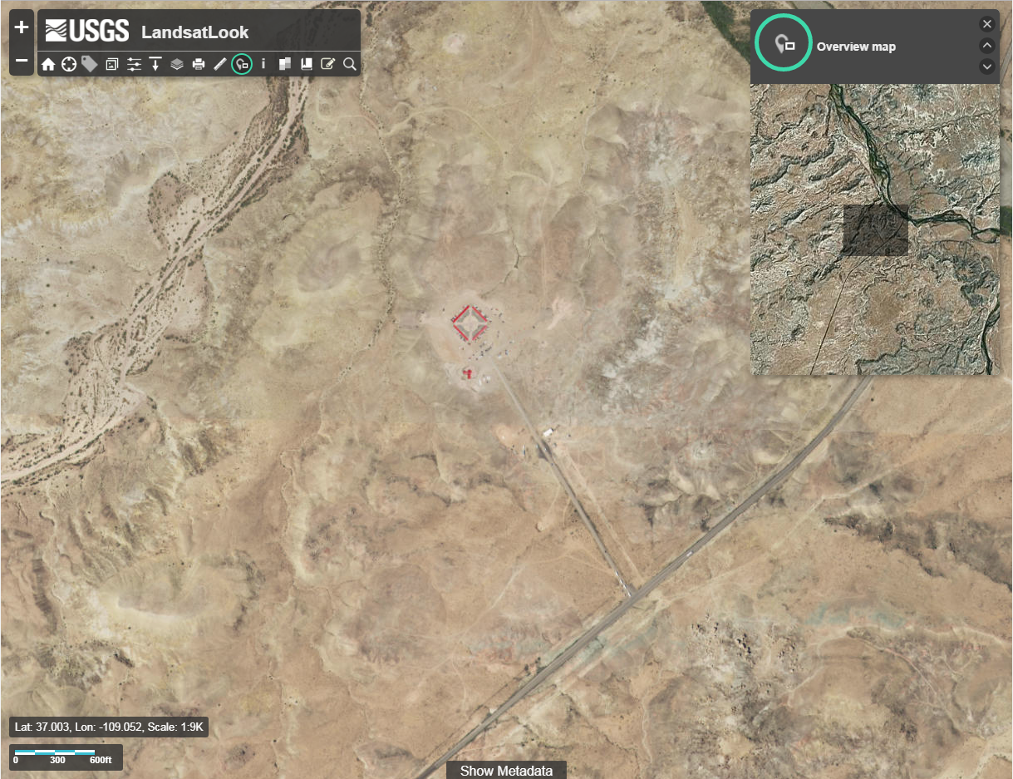
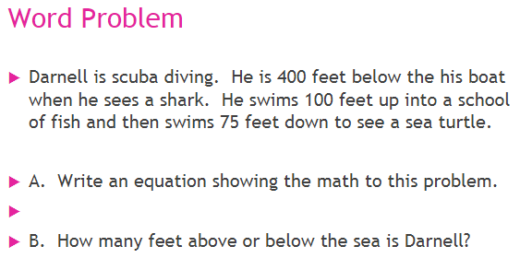
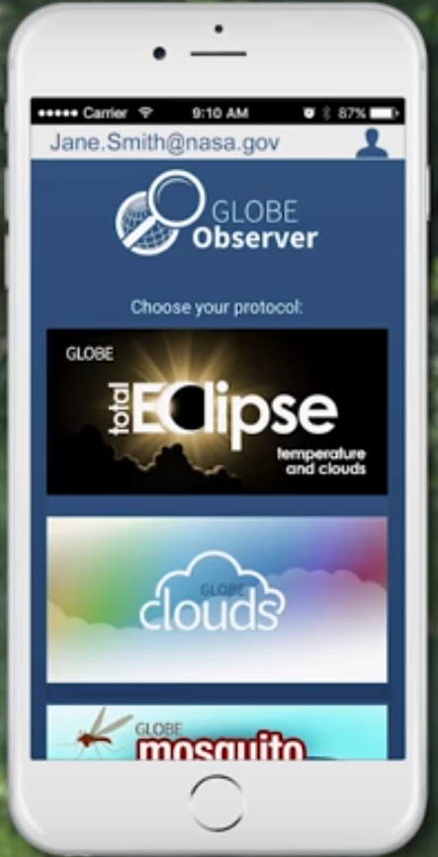
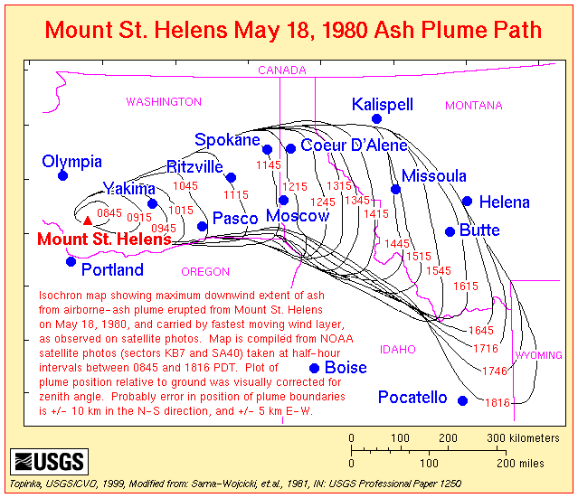
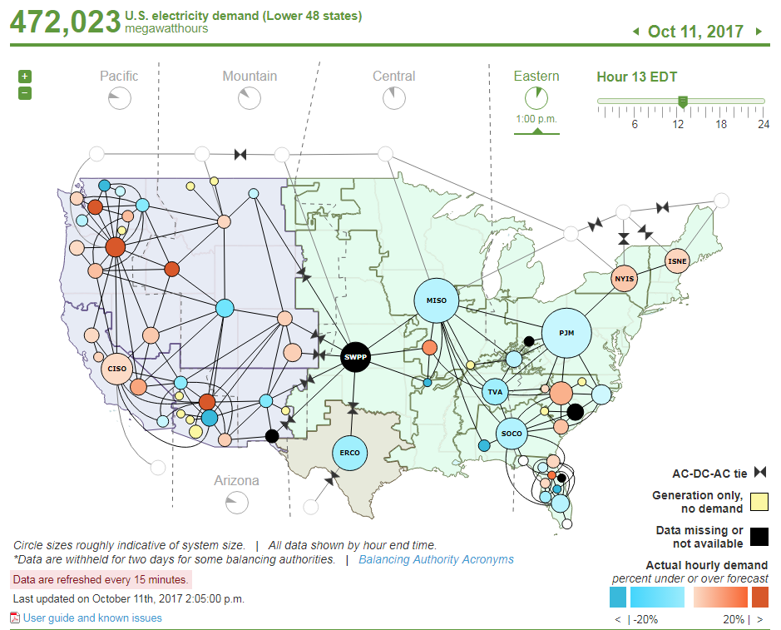
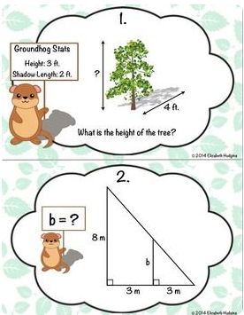
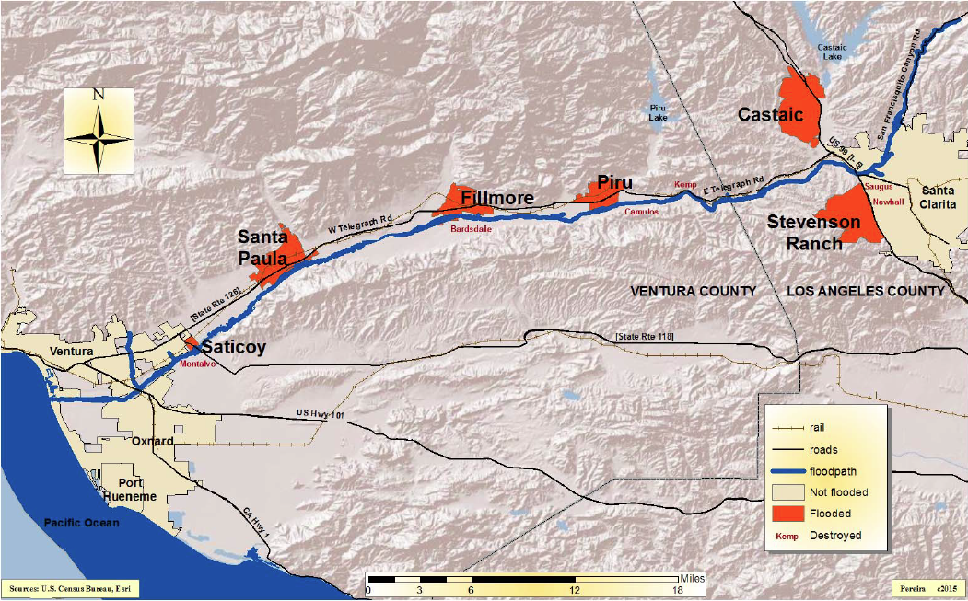
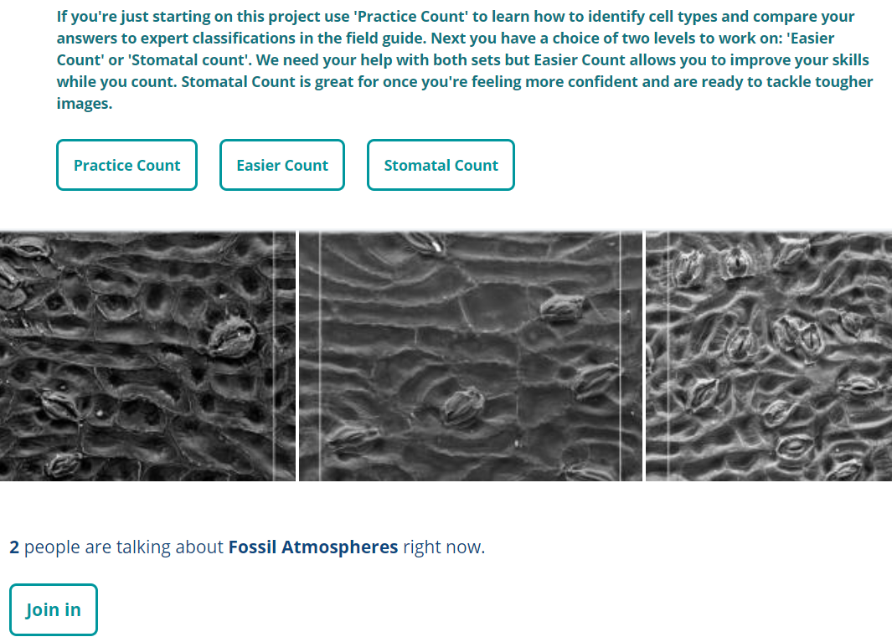
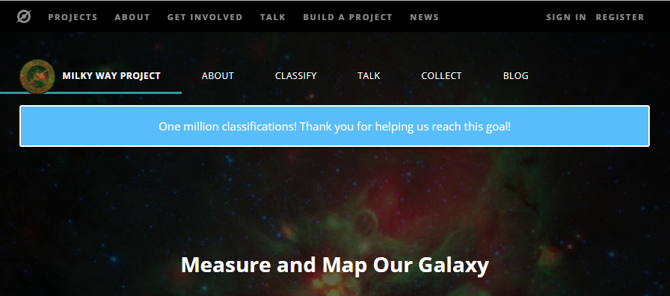
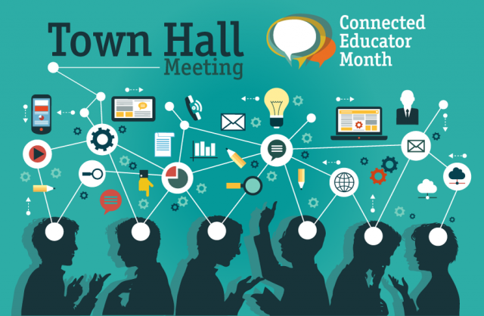
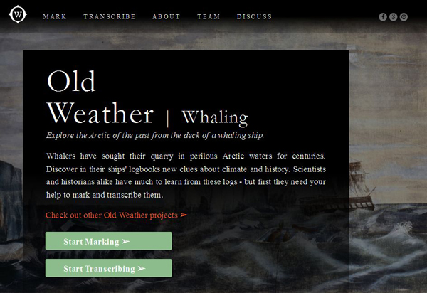
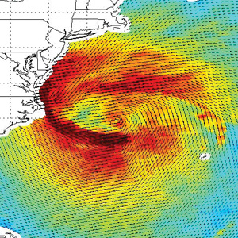
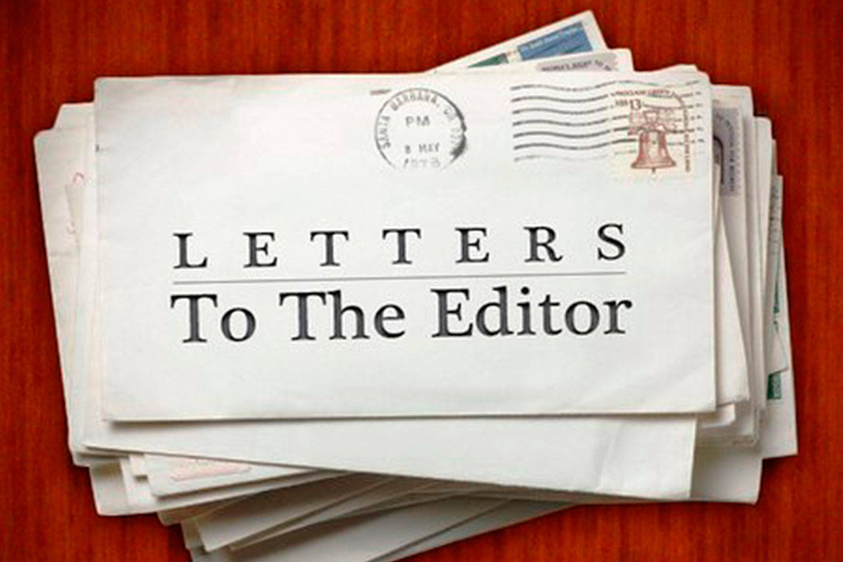
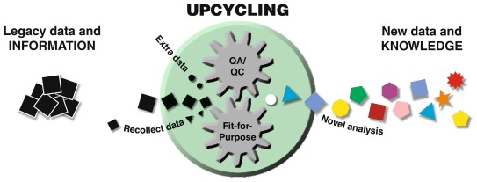
Cynthia Prosser
Physical Sciences Librarian
Science Library
Connecting the Dots with Data: Learning with Geoscience Data
Monica Pereira
Collections Coordinator
J.S. Broome Library
Edelson, Daniel. (2014). Geo-literacy: Preparation for far-reaching decisions. Retrieved from:
https://www.nationalgeographic.org/news/geo-literacy-preparation-far-reaching-decisions/
01: http://www.cbc.ca/beta/news/canada/newfoundland-labrador/new-high-resolution-gps-maps-
developed-for-newfoundland-snowmobilers-1.3373916
02: https://extinctmonsters.net/category/citizen-science/
03: https://pixnio.com/people/school-children-test-water-quality-chemistry-water-river
04: http://www.noaa.gov/work-with-us/volunteer-opportunities-citizen-scientists
05: http://study.com/academy/lesson/mc-escher-biography-art-facts.html
Spatial literacy is the kind of reasoning that sees:
All space as interconnected;
Interactions occur between and among spaces;
Implications of the connections and interactions.
(Edelson, Daniel C., 2014)
Articulating ideas about science requires specific vocabulary.
03
04
GPS units or mobile apps allow real world application of data.
Lifelong learning begins with
curiosity about nature.
First-hand experience in the scientific
process promotes engagement.
01
02
By participating in data collection, citizen scientists gain
familiarity with, and appreciation of, the scientific process.
05
05
Spatial literacy depends on the
connections, interactions, and implications
represented by data.
Connections between data and problem-solving are natural progressions.
06
07
12
Understanding what is and isn’t possible in the real world is part of spatial literacy.
11
NASA’s GLOBE
Observer app
allows
interested
individuals
of all ages
to participate
in scientific
observation.
13
06: https://intimateexcellent.wordpress.com/tag/problem-solving/
07: http://slideplayer.com/slide/10384758/ [Slide 12]
08: https://br.pinterest.com/pin/371476669242740262/
09: Pereira, M. (2015). Map of Santa Clara River Valley from St. Francis Dam to Pacific Ocean for
Disaster in Our Backyard: The Failure of the St. Francis Dam. J.S. Broome Library (Mar. 12 – May 15).
10: https://www.usgs.gov/products/data-and-tools/real-time-data/remote-land-sensing-and-landsat
11: https://feww.wordpress.com/tag/shinmoedake-volcano/
12: https://www.nasa.gov/feature/goddard/2017/nasa-invites-you-to-become-a-citizen-scientist-
during-us-total-solar-eclipse
13: https://www.eia.gov/beta/realtime_grid/#/status?end=20171011T13
08
Word problems reinforce connections between data and measurement.
09
10
Graphic representations illustrate
complex scientific ideas.
Data can be used to visualize impacts and outcomes of natural forces.
14
17
Professional use of geoscience data includes the analysis
of energy needs and supply and demand.
18
As laypeople learn of the results of scientific research they
are better informed to interact with their public officials.
Data collected by scientists impacts everyone.
14: https://www.zooniverse.org/projects/laurasoul/fossil-atmospheres
15: https://www.whalingmuseum.org/explore/collaborate/noaa-old-weather
16: https://www.cyclonecenter.org/?_ga=2.151750713.1083782641.1508090715-1922625753.
1508090715#/about
17. https://www.zooniverse.org/projects/povich/milky-way-project
18: http://www.connectededucators.org/join-us-connected-educator-month-town-hall-meeting-
monday-november-3/
19: http://www.sequimgazette.com/letters/
20: Vearncombe, J., Riganti, A. Isles, D. & Bright S. (2017). Data upcycling. Ore Geology Reviews.
89: 887-893.
16
19
20
15
Direct interactions with data through citizen science projects range from single-day activities to commitments to longer term projects.
Revisiting old data and reanalyzing it is another way
to gain new information. New methods of analysis
can shed new insights on old questions.
Geoscience Information Society, Annual Meeting of the Geological Society of America. Seattle, WA. October 24, 2017

