Slide 1

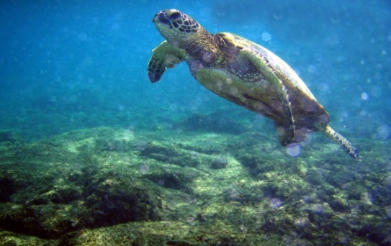


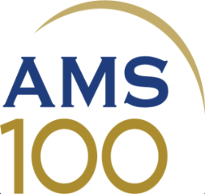

New Approaches to Raising Scientific Literacy through the AMS DataStreme Project
Wendy Abshire
Director, Education Program
American Meteorological Society

Slide 2


The AMS Education Program exists to
help foster scientific literacy in
Earth system science.

Slide 3
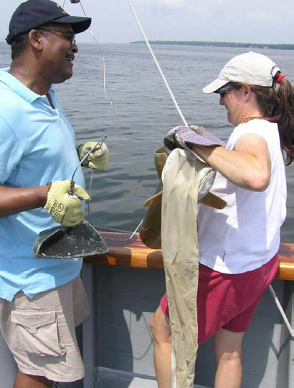
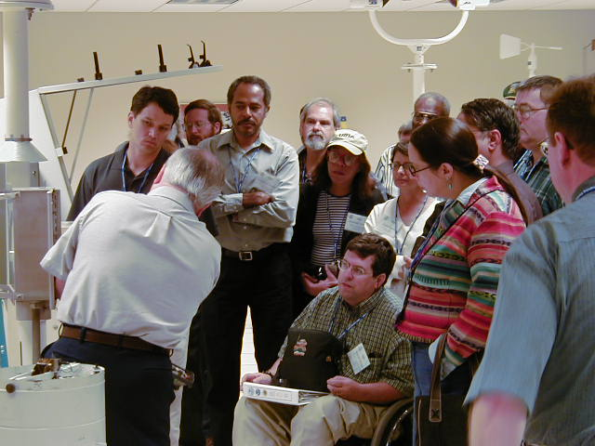
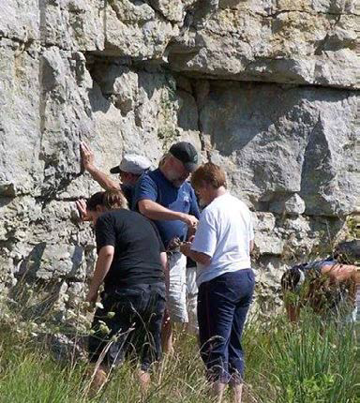
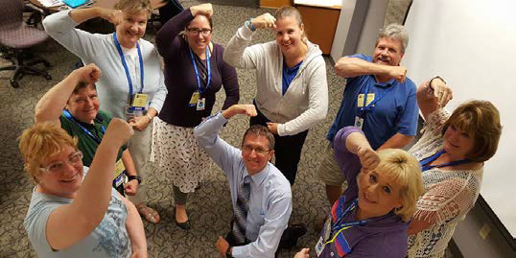
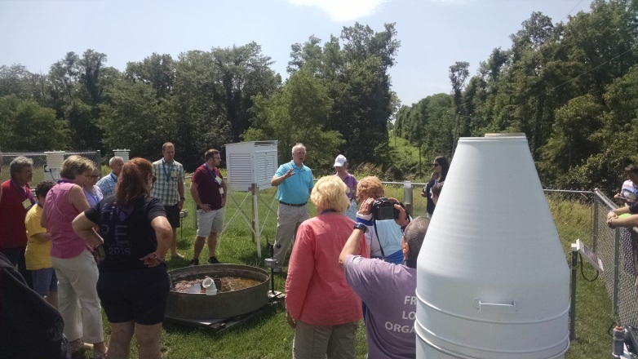
It starts with K-12 teachers!

Slide 4
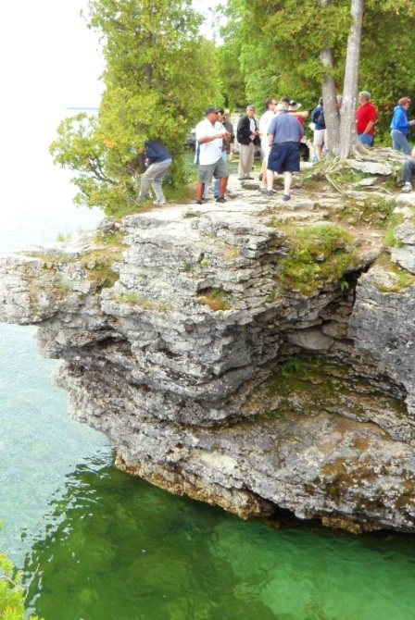
Teachers are the Key
Improve teachers’ competence and confidence
Provide materials that are standards-aligned and scientifically accurate
  Transformed by teachers into discipline- and age-appropriate lessons
Create a structure for peer-training
  Training impacts felt in schools and communities
Generate pathways for continued communication between trained teachers, scientists, and mentors
Leverage grant support to keep costs low

Slide 5
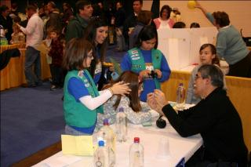
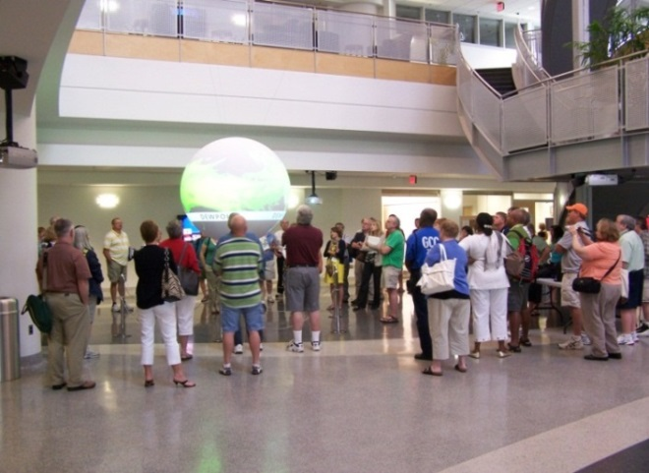
How Do We Carry Out Our Mission?
The DataStreme Project
  Datastreme Atmosphere
  DataStreme Ocean
  DataStreme Earth’s Climate System
Project Atmosphere
Maury Project
Any previous participants in the audience?

Slide 6

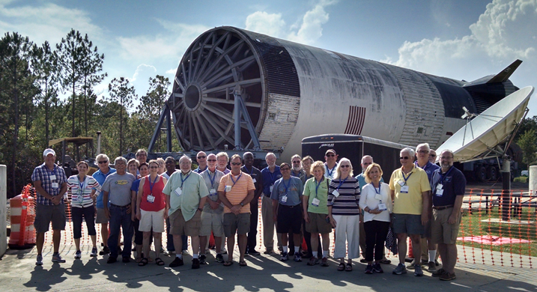
Ongoing modernization
in progress
Distance-learning courses in meteorology, oceanography, and climate science
Offered each fall and spring semester with support from Mentor Team Leaders
3 graduate credits in Earth science through California University of Pennsylvania upon completion of course and a Plan of Action for peer-training

Slide 7

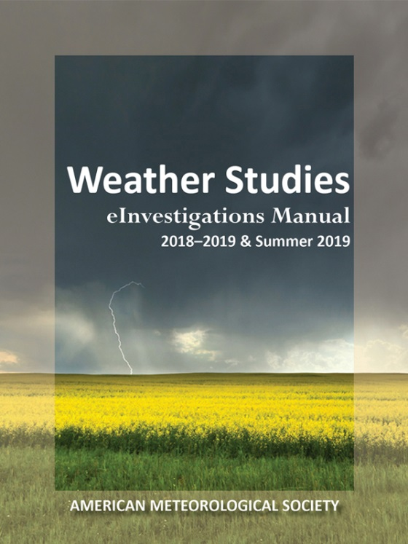
DataStreme Atmosphere
1996-Present
Focuses on the study of the atmospheric environment through the use of near real-time weather data
Update in progress!

Slide 8

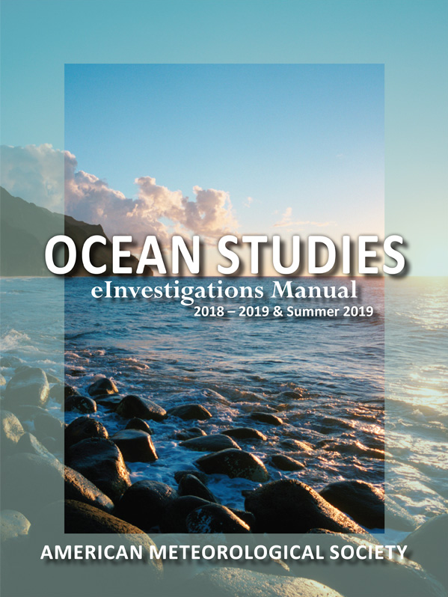
DataStreme Ocean
2003-Present
Explores the role of the ocean in the Earth system, also data-rich
Brand new edition!

Slide 9
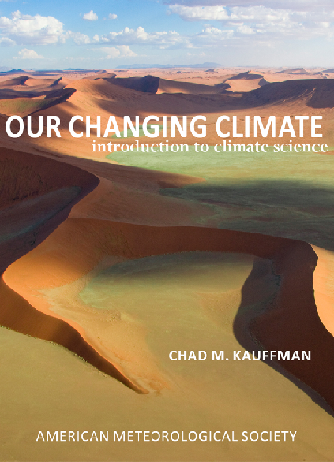
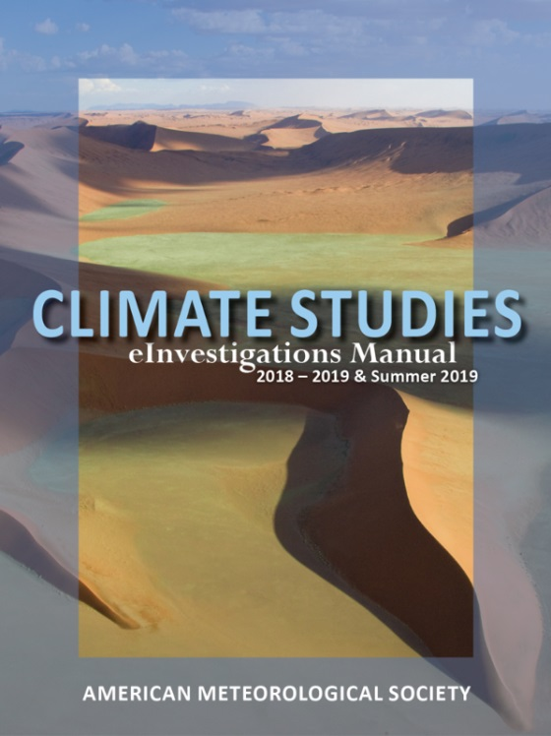
DataStreme Earth’s Climate System
2009-Present
Explores the fundamental science of Earth’s climate system and addresses relevant societal and health impacts

Slide 10
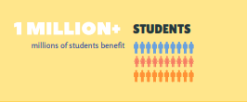
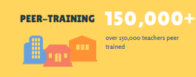
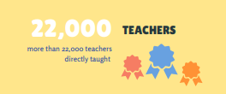

Since 1991…

Slide 11

DataStreme Modernization

Slide 12

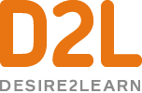

Recent Improvements
Using a Course Learning Management System (D2L)
Ongoing formalization of assessment process
  Weekly cognate activities done through “quiz” form submissions within D2L
Learning Objectives listed for each weekly module
New means of communication
  ZOOM video conferencing
  Discussion boards (now mandated)
  Increased use of “feedback” option within D2L
Lesson plan as a uniform culminating experience with mentor feedback and clearer guidelines and templates

Slide 13
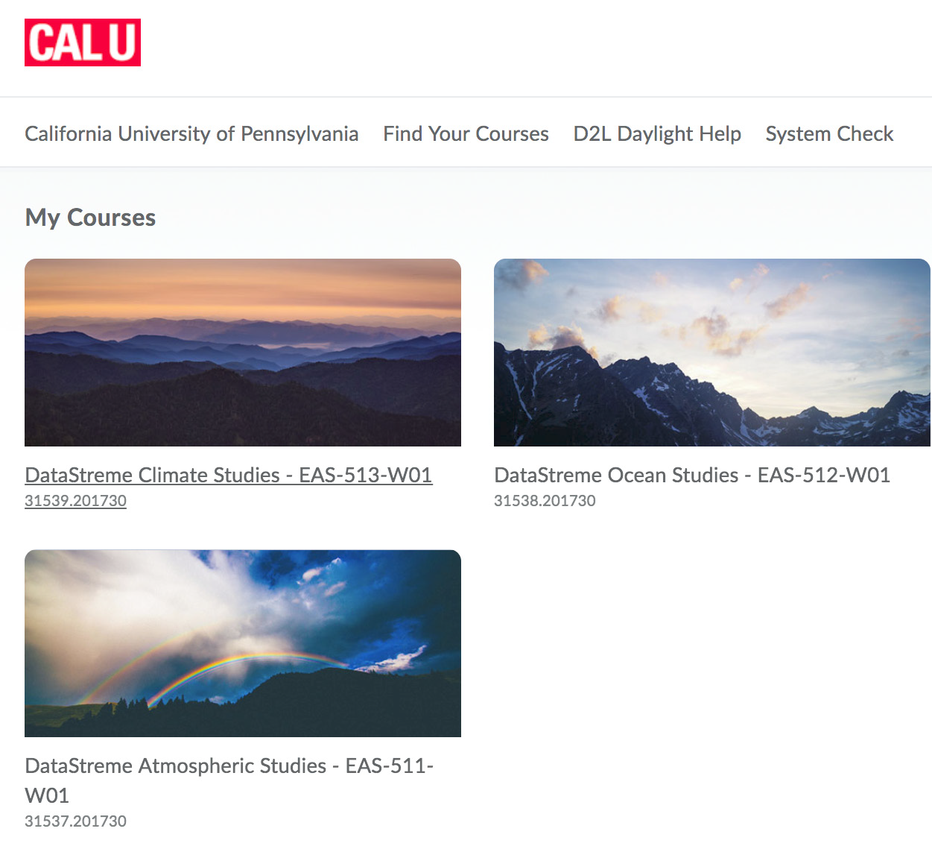
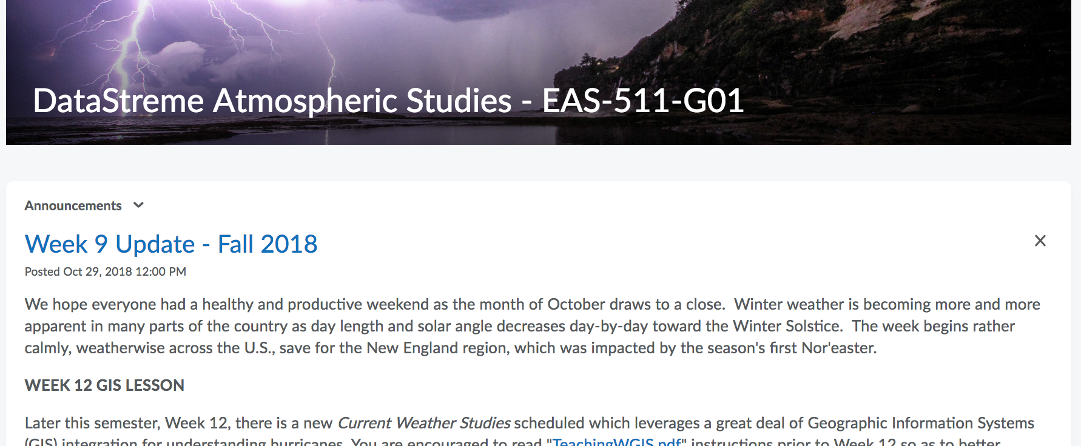
Cal U D2L
DataStreme Interface

Slide 14
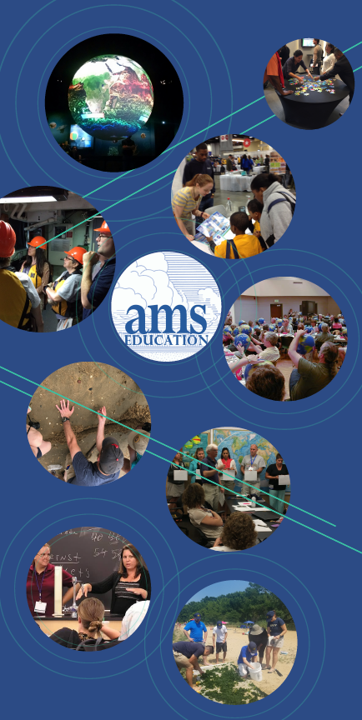
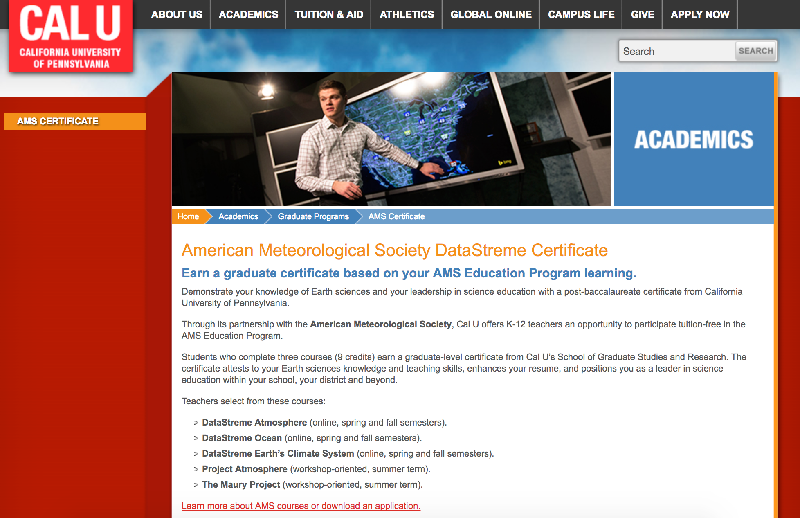
Opportunities
Participate in courses
Become a mentor leader or mentoring team member
Apply 9 DataStreme credits (3/course) toward an online Master of Education Leadership through Cal U
Apply 3 of 5 possible teacher professional development offerings (Datastreme, Project Atmosphere, & Maury Project) to a post-baccalaureate certificate

Slide 15
Modernization Continues…
…and the scientific integrity of the courses remains the same

Slide 16



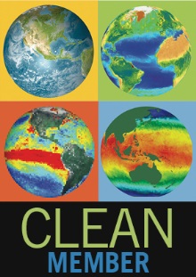

Conclusions
The AMS Education Program exists to foster Earth system science literacy for all.
Since 1996, over 22,000 teachers have completed a DataStreme course, Project Atmosphere, and/or Maury Project impacting thousands more teachers and millions of students.
DataStreme promotes collegial working relationships; participants become a representative in a major national science education program, and local leaders
DataStreme courses, Project Atmosphere, and the Maury Project are excellent teacher professional development opportunities (and getting better all the time!)
DataStreme is funded by award NA17SEC0080003 from the Environmental Literacy Program of the National Oceanic and Atmospheric Administration (NOAA), U.S. Department of Commerce. The statements, findings, conclusions, and recommendations are those of the author(s) and do not necessarily reflect the views of NOAA or the U.S. Department of Commerce.

Slide 17
Questions?
@AMSeducation
wabshire@ametsoc.org
www.ametsoc.org/amsedu
Visit booth #318 to learn more

