Slide 1
Multi-Scalar Studies of Soil Geomorphology and Soil Productivity in Petrified Forest National Park to Understand Prehistoric Agricultural Potential
Amy Schott
PhD Candidate, School of Anthropology
University of Arizona

Slide 2
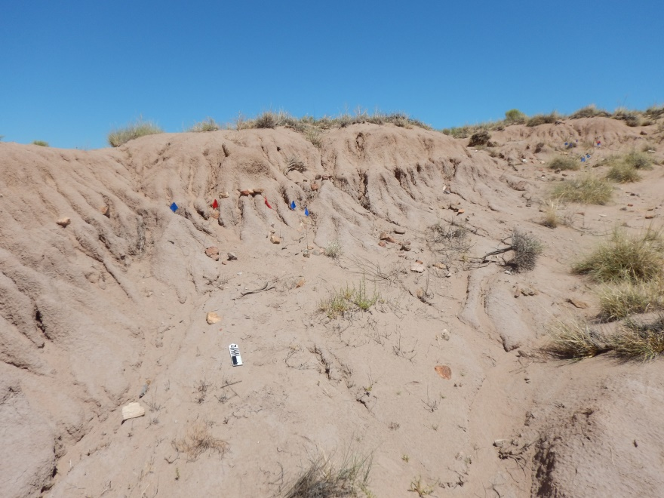
Notes:
I am currently working on a geoarchaeological research project in northeast Arizona in the Petrified Forest National Park, which is an eolian environment with a long archaeological history. My research looks at the relationship between the eolian landscape of sand dunes and sand sheets, and the prehistoric human use of the landscape, which seems to include pretty widespread agriculture in these sandy soils. I am especially interested in understanding how prehistoric peoples were able to cultivate crops in what is expected to be a poor environment. In this talk, I will present a summary of some of my dissertation research on this topic, focusing on understanding eolian soils at multiple scales of analysis.

Slide 3
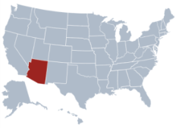
Study Area Environment
Petrified Forest National Park
Semi-arid, ~24cm annual precipitation
Seasonal rainfall and intermittent rivers and washes
High altitude grass and shrublands
Part of large sandsheet in Northeast Arizona
Map drawn after: Breed, Carol S., John F. McCauley, William J. Breed, Camilla K. McCauley, and Augustus S. Cotera, Jr. 1984 Eolian (Wind-formed) Landscapes. In Landscapes of Arizona--The Geological Story, edited by Terah L. Smiley, pp. 359–413. University Press of America, Inc.
Notes:
The Petrified Forest is located in northeastern Arizona, along the Puerco River Valley, which is a tributary of the Little Colorado River. Environmentally, this area is semi-arid. Today, many of the rivers in northern Arizona only flow seasonally, but in the last few thousand years, they may have flowed more of the year, and were ideal transportation corridors, facilitating long-distance trade. This area is also part of an area in Northeast Arizona with extensive sand sheets and dunes, which are sourced from sediment eroded into washes from the Little Colorado River and its tributaries.

Slide 4
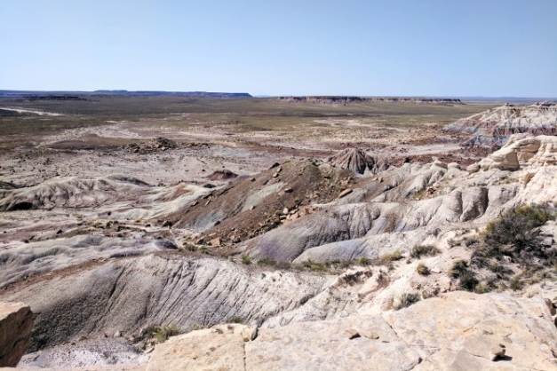
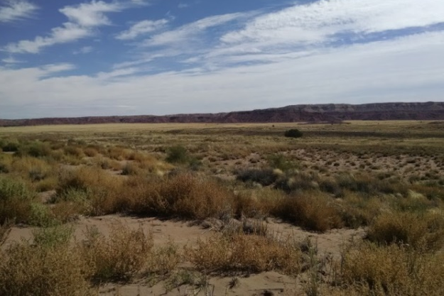
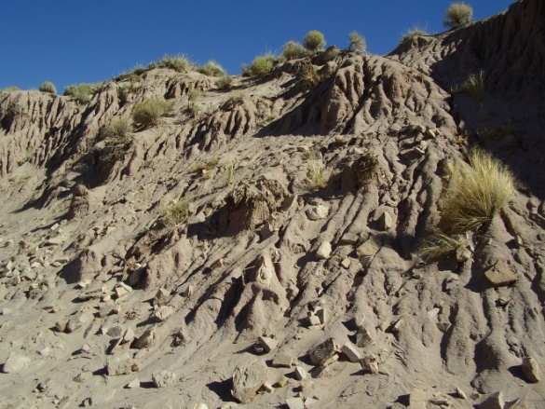
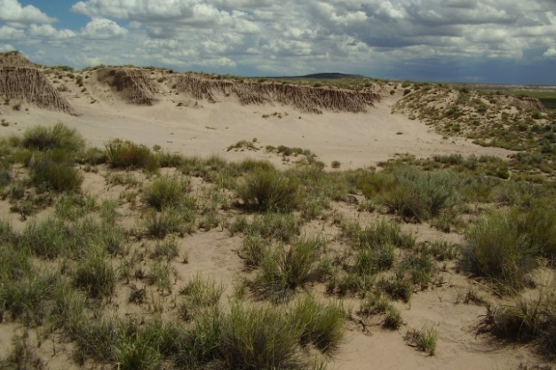
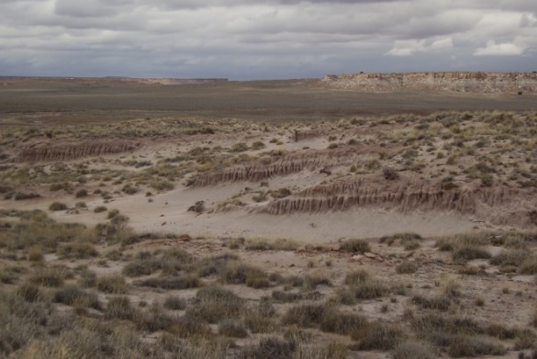
Study Area Environment
Triassic (200 million yrs) clay and sandstone eroded into badlands and mesas
Overlying Quaternary alluvial and eolian sediments
Dunes contain multiple buried deposits with soils
Many archaeological sites found on or within dunes
Notes:
[1]Geologically, the landscape consists of Triassic-age sedimentary rocks, mostly clay and sandstones, which are eroding into an extensive badlands that divide the landscape into high ridges or mesas, and low flat areas. This is covered by Quaternary fill [2], including alluvial floodplains, and extensive eolian sandsheets and dunes. Within the study area, most dunes are semi-stabilized by vegetation, with some erosion resulting in blowouts where sediment has been removed [3]. Some dunes contain obvious buried soils [4] from multiple depositional surfaces, and others do not. Many archaeology sites are located in dunes [5], and often the occupation horizon is visible where the dune has eroded or blown out, leaving archaeological sites in extremely eroded context.

Slide 5
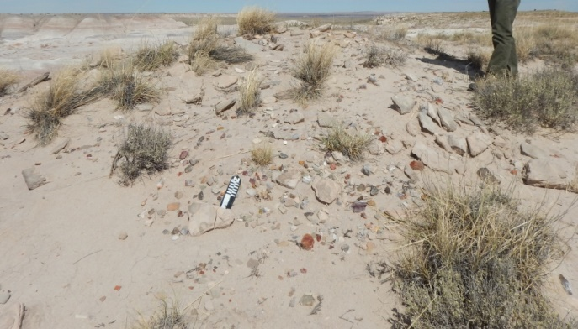
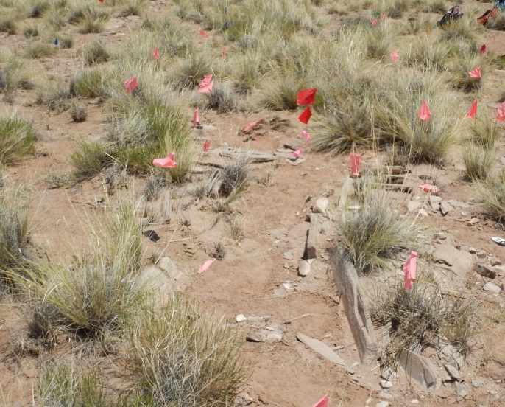
Archaeological History in Petrified Forest
Archaeological Period | Year
Historic | 1800+ A.D.
Protohistoric | 1450-1800 A.D.
Pueblo IV | 1350-1450 A.D.
Pueblo III | 1100-1350 A.D.
Pueblo II | 900-1100 A.D.
Pueblo I | 700-900 A.D.
Basketmaker III | 500-700 A.D.
Basketmaker II | 50-500 A.D.
Archaic | 8000 B.C. –A.D. 50
Paleoindian | >14000 –8000 B.C.
Notes:
Here is a short summary time-line of the archaeological history. This region has archaeological sites of all periods, from the Paleoindian period through the Historic. A majority of the archaeological sites, and those that we think relate to prehistoric agriculture, date to the Basketmaker II through Pueblo III periods, which is the focus of this study. Prior to this time, people where hunters and gatherers with limited use sites, and after this time, people moved into just a few, very large pueblos, and became more concentrated and thus are using a very different landscape strategy. During the Basketmaker period, inhabitants of this region began to cultivate domestic plants such as maize, and then throughout the later Pueblo Periods, these societies relied heavily on maize, along with beans and squash, for subsistence. Through this time, we see increasing sedentism on the landscape, beginning with use of pithouses and moving to above-ground pueblos, but a generally dispersed occupation of smaller villages on the landscape.

Slide 6
Research Objectives
Characterize geomorphic history of eolian landscape
Characterize eolian soils and sediments, including soil characteristics that would affect the ability to cultivate crops
Understand how prehistoric peoples used the landscape, at a landscape and site scale
Notes:
This project is a dissertation scale research project, so in order to focus on a few conclusions of that project, I’m going to give brief summaries, including a bit about (1) the geomorphic history of the eolian landscape, and I will focus more on (2) the eolian soils, including their quality for agricultural use, and (3) how prehistoric peoples may have used these soils for agriculture, on both the site and landscape scale.

Slide 7
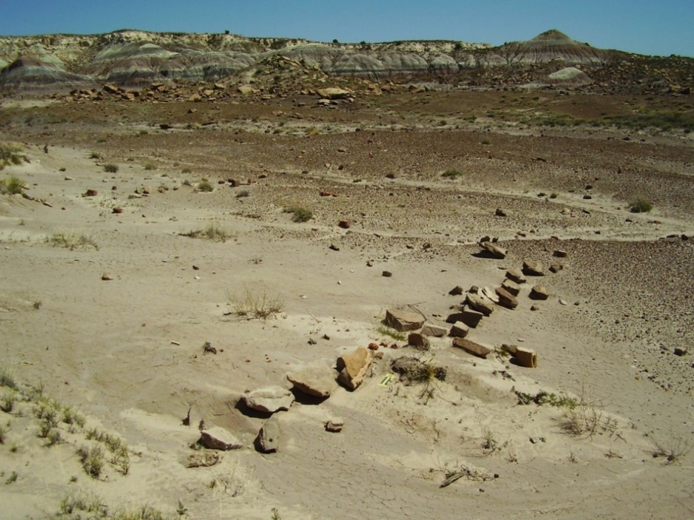
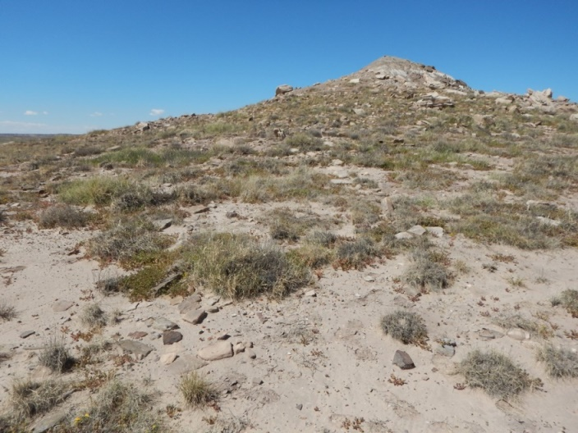
Prehistoric Agriculture in Dunes
An abundance of archaeological sites preferentially located in dunes
Lines of stones used as windbreaks are the clearest evidence for dune agriculture
only exist in a few sites, and most are in eroded contexts
Notes:
Generally, eolian sediments are sandy and considered poor for supporting crops, but archaeological evidence suggests prehistoric agriculturists preferentially targeted dunes for settlement, and likely farmed dunes and sand sheets. Archaeologists often find that in areas with extensive dunes and sand sheets, sites are most heavily concentrated within dunes and in dune blowouts, which supports our interpretations that dunes were targets for agriculture. In addition, the study area did not really see any significant depopulation in the entire period of Pueblo prehistory, between about AD400-1400, suggesting that it must produce enough crops to support at least a low population, which is what is inferred from settlement patterns of dispersed small sites. I seek to understand the geomorphic history of the eolian environment, and what geological factors contributed the long-term successful adaption to this marginal environment, and whether eolian sediments would have been good for farming. So, I focus heavily on understanding the eolian sediment characteristics and history.
The idea that the dunes in the park were used prehistorically for agriculture was first proposed in 1949, by archaeologist Fred Wendorf, who proposed that features which included lines of stone on slopes of dunes were agricultural features, suggested to be wind-blocks for small maize plants planted in dune sediments, similar to the ways that ethnographic pueblo groups did. Very few studies in the Southwest have directly investigated prehistoric Pueblo dune farming, likely because archaeologically this is very hard to determine; a stone-line like this is about the only evidence that a field was here, and most of time, we don’t even have that, we often just have isolated sandstone blocks. Ethnographic research on hydrology of Hopi dune fields suggests that the best sediments for dune farming have a layer of sand at the surface to prevent evaporation, above sediments with more loamy or clayey textures that hold more water.

Slide 8
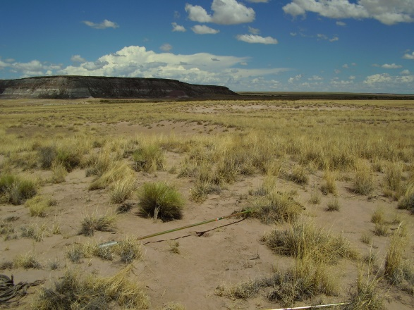
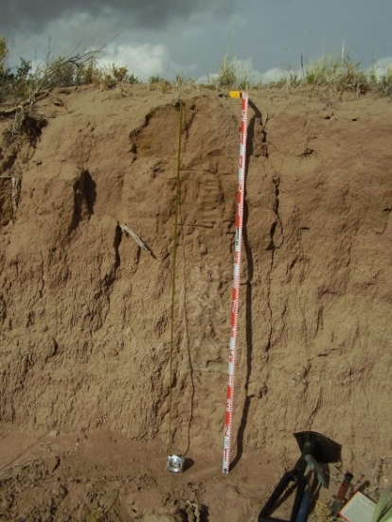
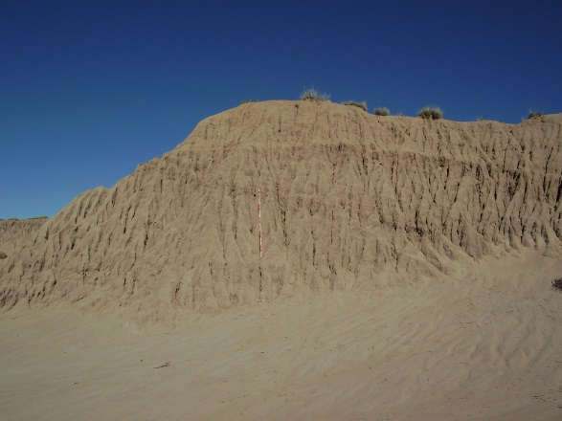

Soil Geomorphology and Chronology
Field and lab studies of soils and sediments
Areas of archaeological interest
Notes:
This project targeted areas across the park, focusing on those with better archaeological survey coverage, as well as areas where archaeological work has inferred widespread prehistoric agriculture. I used field and laboratory analysis to describe and understand soils, including degree of soil development and variability across the landscape. I used both exposed soil profiles in eroded dunes as well as buried soils in dunes and sandsheets that I sampled with the use of an auger.

Slide 9
Generally weakly developed soils, and lots of Late Holocene deposition
Some upland areas with better developed, older soils
High amounts of fine-grained sediments
Does not show texture changes of sand over loam that is expected to be ideal for dune farming
Some local variation
Notes:
In addition to looking at soil geomorphology, I also used OSL dating to determine chronology of eolian deposition. I won’t go into detail about all of these individual soil profiles, so I will jump to a summary of how I interpret all this soil data. [advance slide]
Results show that most soils here are generally weakly developed and young, while a few areas on upland mesas show much more developed soils, with well-developed argillic and carbonate horizons. Often, there are high amounts of fine grained particles of silt and especially clay, resulting in widespread loamy sand and especially sandy loam textures even in Late Holocene sand. It is especially interesting to have such a high clay content even in very young sand dunes. The ideal dune farming stratigraphy, of sand over loamy sediments with a lot of textural stratification, is not found extensively, as most soil profile show very little textural variation over deep depths, even with clearly stratified buried soils. A few places do have textural change, including some alluvial and slopewash areas, and there is some local variation.

Slide 10
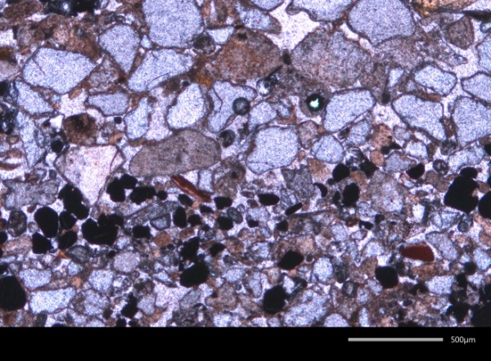
Soil Micromorphology
High percentage of clay particles in many soils
May be good for water holding
Clay is largely aggregates of particles, transported with parent material
Not likely due to soil forming processes, due to young ages of soils
Clay is dominantly kaolinite and smectite, similar to clay outcrops
May be incorporated from local geologic outcrops
Clay transported as aggregates
Notes:
The high clay content of 10-20%, was a really interesting result that was unexpected. It is not due to clay translocation and soil forming processes, due to the young ages of many of the dunes. Micromorphological analysis, which involves looking at intact blocks of sediment under a microscope in thin section, shows that much of the clay in the very young sand dunes is transported as aggregates, and therefore may be coming from local clay sources of Triassic badlands. Micromorphology was limited to just a few profiles in 3 areas, so I’m interpreting these results with that limitation in mind, but at least it shows that for some of the young sediments, clay is being incorporated as aggregates, which I think are from local sources. Clay mineralogy studies supports my hypothesis that this clay is from local sources; I found similar clay mineralogy of clays found in these young dunes to the local clay found in the claystone. Thus, the high clay content in the dunes and sand sheets may be the result of clay incorporated from erosion of the local clay badlands, though it does not rule out that the clay may be coming in from other regions with similar clay minerals, especially from other parts of Northern Arizona.

Slide 11
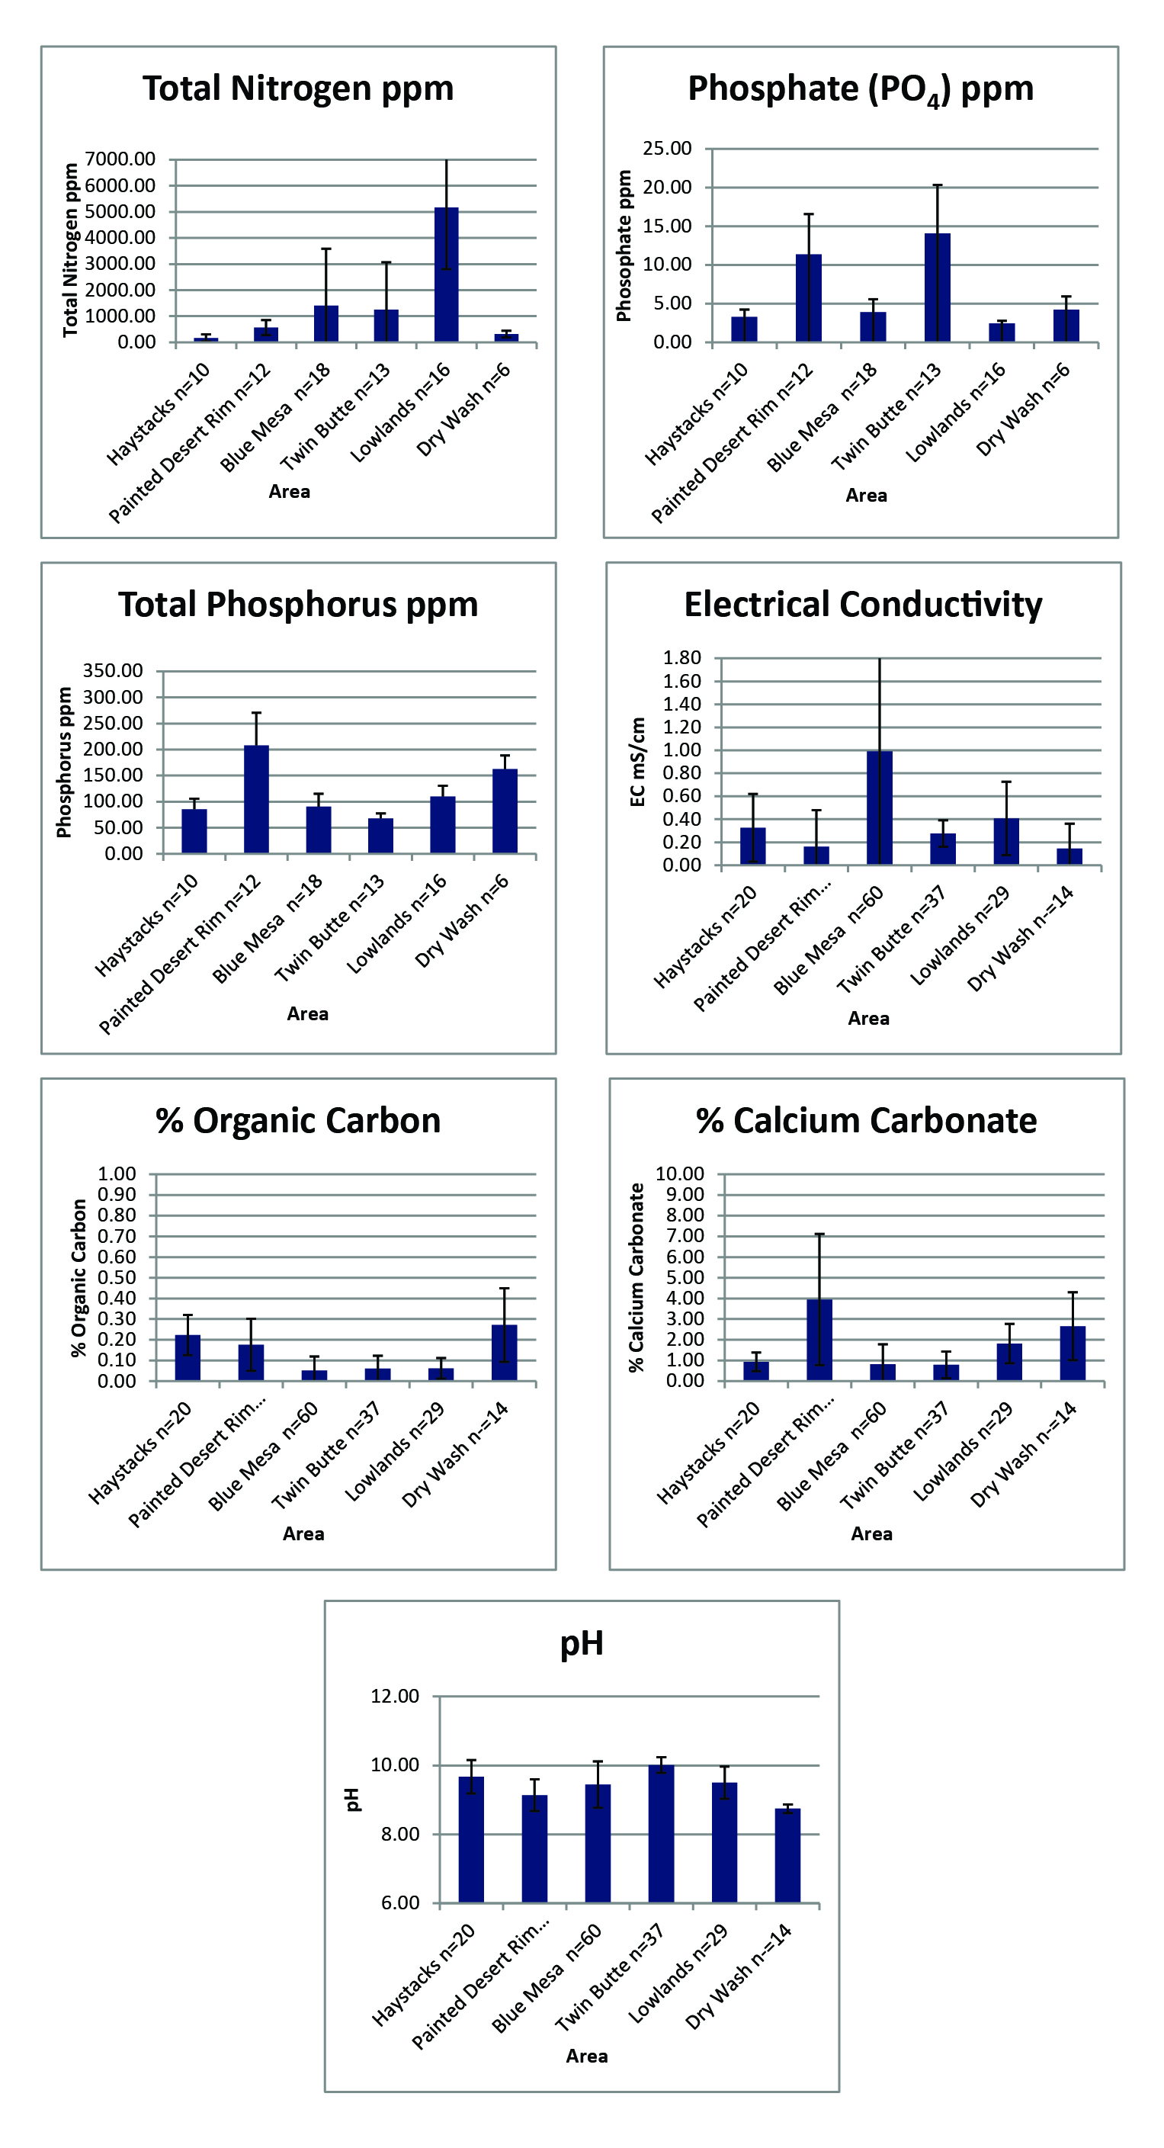
Soil Chemistry
Soil chemical analysis from 100 samples, both surface and buried
Nitrogen
Phosphorus
Available phosphate
Bulk Density
pH
Electrical Conductivity
Calcium Carbonate
Organic Matter
Results show generally low nutrient levels, but sufficient for agriculture
Little difference across study area or between surface and buried soils
Notes:
I have recently completed a study of soil chemistry across the study area, including nutrients that are commonly used to look at soil productivity and quality (Total Nitrogen, Total Phosphorus, Available Phosphate, Bulk Density, pH, Electrical Conductivity, Calcium carbonate and Organic matter content). I tested both surface and buried soils, because with dates from only a limited number of profiles, it was not always possible to know which soil was the surface during prehistoric occupation. I also compared soil chemistry of different areas across the study area. I should point out, that soil chemistry studies are targeting A horizons at the surface and buried soils, in areas that we consider to be prime agricultural areas based on archaeological remains, but do not come from documented cultivated fields, as there is very little evidence to show where the fields themselves were located, except in a few sites, and many of those are eroded.
Again, I’m not intending to go into the details in this talk, but to summarize, results show generally low nutrient levels, as well as similar patterns for surface and buried soils, showing that levels in the past may have been comparable to those of today. Though there is some variation, nutrients are generally low, but on average within the range of arable land, which supports the hypothesis that these soils were cultivated, but were likely of low quality, and thus regionally, the area can be considered a marginal one for agriculture. Older soils tend to have higher phosphate and phosphorus, but were still not of high nutrient quality.

Slide 12
Microenvironments
Notes:
Ultimately, this is a pretty brief overview of a lot of data. In looking for variation in soils and sediments at a landscape scale, as well as across a site-level scale, I was able to determine that there isn’t a widespread landscape scale pattern other than that older, better developed soils in older sand deposits are on the uplands, and more reactivated sand on the lowlands. No one area across the landscape seems to be particularly better or worse for agriculture. However, at the scale of the site, it seems that microenvironmental changes are more important. Though it may not make a difference on the landscape scale where people chose to cultivate crops, there is a bigger difference in soil texture changes across the scale of a site. Here, this is one example from the Twin Buttes site, showing soil profiles on the crest, slopes, and inter-dune areas, as well as further away from dune positions, there is greater variety of texture and soil changes with depth. This is on a scale of about several hundred meters across.

Slide 13
Conclusion
Results support that this area could have been farmed prehistorically, including use of sand dune farming
Local clay inputs may have improved water holding capacity of sandy soils
Soil chemistry suggests only marginally productive soils, which supports a hypothesis of low population levels who moved frequently
Soil geomorphology and soil chemistry suggest that micro-environments, such as slopes of dunes, may have played an important role
Notes:
These results support that this area could have been farmed prehistorically, including use of sand dune farming. The high clay content of the soils may have improved water holding capacity of sandy soils, but soil chemistry suggests only marginally productive soils, which supports a hypothesis from archaeological data of generally low population levels who moved frequently. Soil geomorphology suggests that microenvironments, such as slopes of dunes, may have played an important role in farming, as these may have better textural layering to both hold water and prevent evaporation, even though there is little difference in nutrients at the micro-scale. The micro-environment may have been a bigger factor in where prehistoric people farmed than the landscape level.

Slide 14



Acknowledgements
Funding for this project provided by
The Arizona Archaeological and Historical Society
The College of Social and Behavioral Sciences at the University of Arizona
The Charles Redd Center for Western Studies
The Geological Society of America
The Graduate and Professional Student Council at the University of Arizona
The School of Anthropology at the University of Arizona
Thank you to the Petrified Forest National Park, my committee members, Vance Holliday, Barbara Mills, and Jay Quade, and the many people who have helped with various stages of this project, Tammy Rittenour and the Utah State University Luminescence lab, Greg Luna Golya, Tanya Chiykowski, Jeff Homburg, Prakash Dakal, Craig Rasmussen and the Center for Environmental Physics at the University of Arizona.

