Slide 1




Fossil Eukaryotes in Terrestrial Paleoenvironments: Examples from Neoproterozoic to Cambrian Paleosols and Paleosaprolites
¹Steven G. Driese, ²Phillip Gopon, ³Kalle Kirsimäe, ²Brooke Johnson, ³Peeter Somelar, and ⁴Mark van Zuilen
¹Department of Geosciences, Terrestrial Paleoclimatology Research Group, Baylor University, Waco, TX 76798-7354 USA; ²Department of Earth Sciences, University of Oxford, South Parks Road, Oxford, England, OX1 3AN UNITED KINGDOM; ³Department of Geology, Tartu University, 50411 Tartu, ESTONIA; Institut de Physique du Globe de Paris, Equipe Géomicrobiologie, 75238 Paris cedex 5, FRANCE

Slide 2
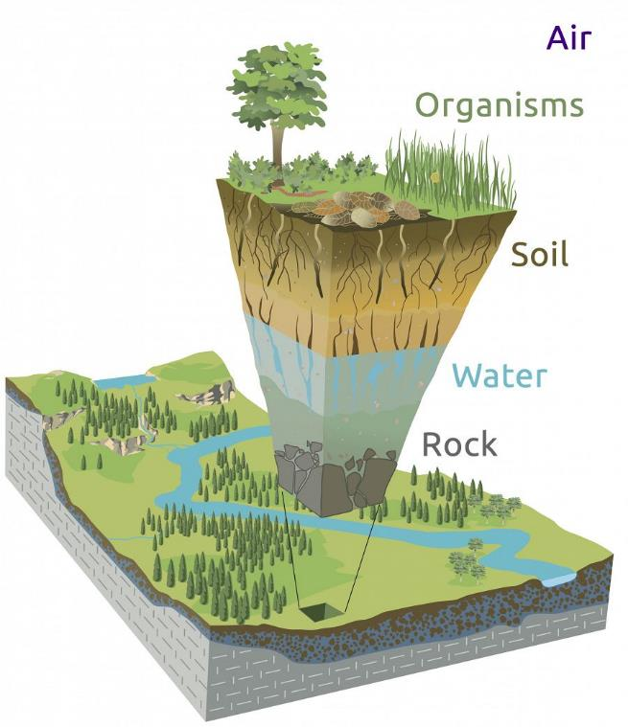
Theoretical Framework
Slide concept courtesy of:
Gary E. Stinchcomb and William E. Lukens
Soil Formation
State-Factor Model
S (or s) = f(Cl, O, R, P, T, …)
Cl = climate
O = organisms/biota
R = relief/geomorphology
P = parent material composition
T = time/duration of weathering
… = unknown influences (error)
Jenny (1941)
Understanding these factors requires an interdisciplinary team, and a variety of data collection techniques
WHAT ABOUT PRE-VASCULAR LAND PLANT ORGANISMS/BIOTA?

Slide 3

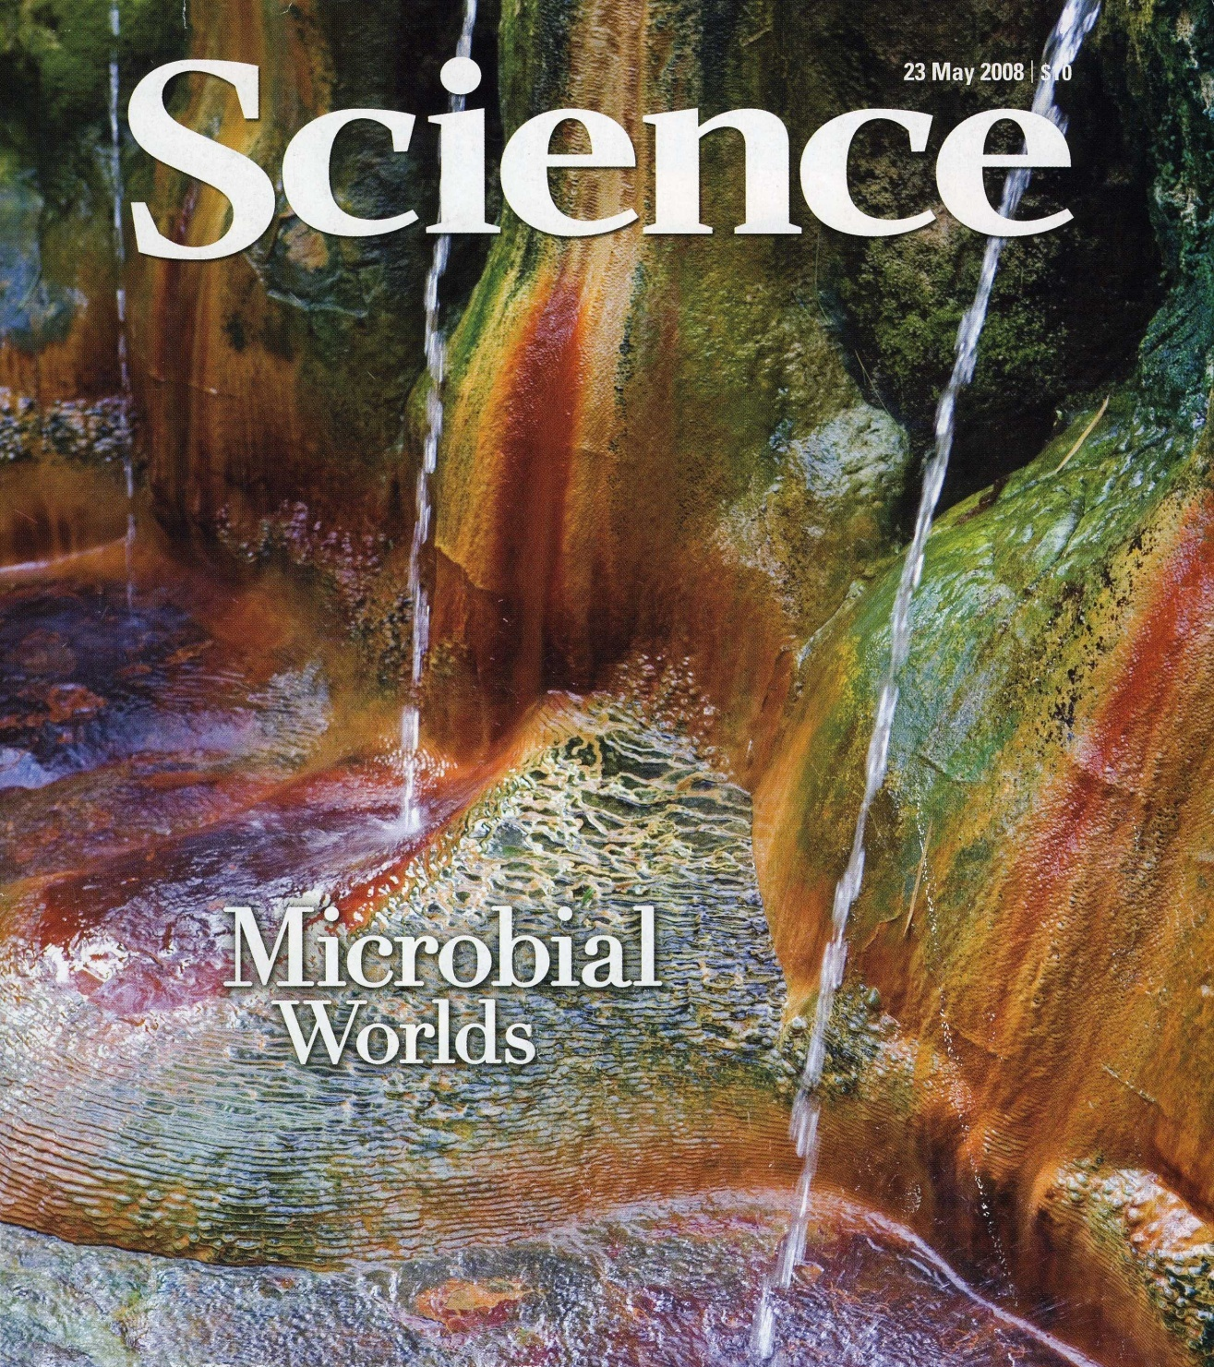
Traditional View of Precambrian Life on Land
Microbial “slime” world
Cyanobacteria- and fungi-dominated
Dominantly prokaryote organisms (lacking a cell nucleus): Archaea and bacteria
Biomass in soils and weathering surfaces assumed to be low

Slide 4
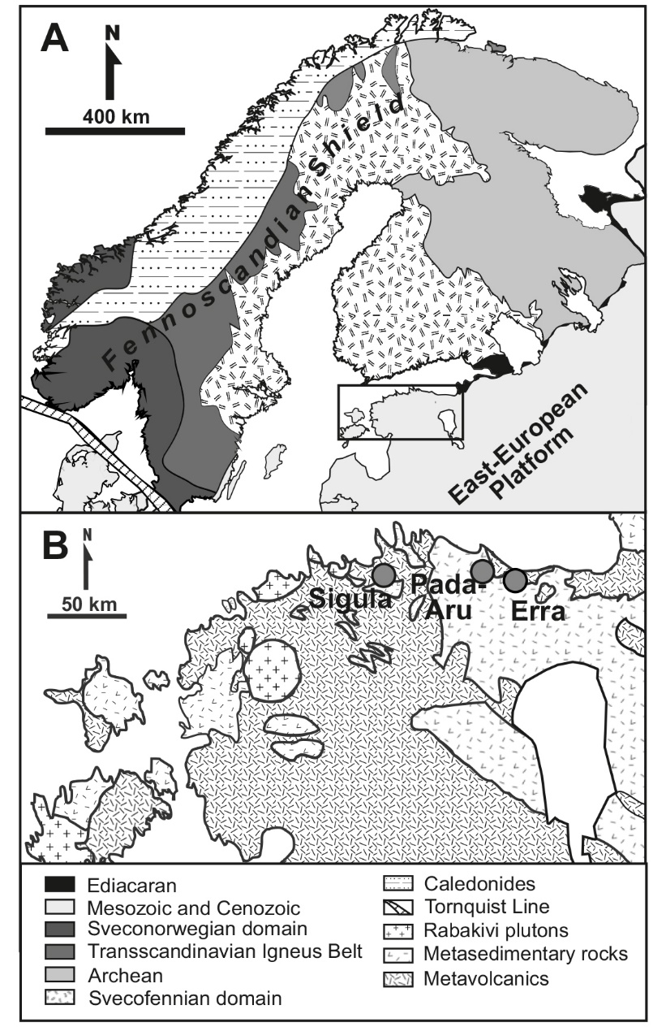
Neoproterozoic Baltic Paleosol, Estonia
1) Deep weathering to 30(+) meters.
2) Ferruginization and Hydrolysis: extensive feldspar weathering.
3) MAP (1500–1600 mm yr⁻¹: MAT (13–15(+) °C:
4) Minimum of 1.88×10⁵ and a maximum of 1.02×10⁶ yr weathering duration
Erra Profile Thin-Sections
Driese et al., 2018, Precambrian Research, Oxisolic processes….

Slide 5
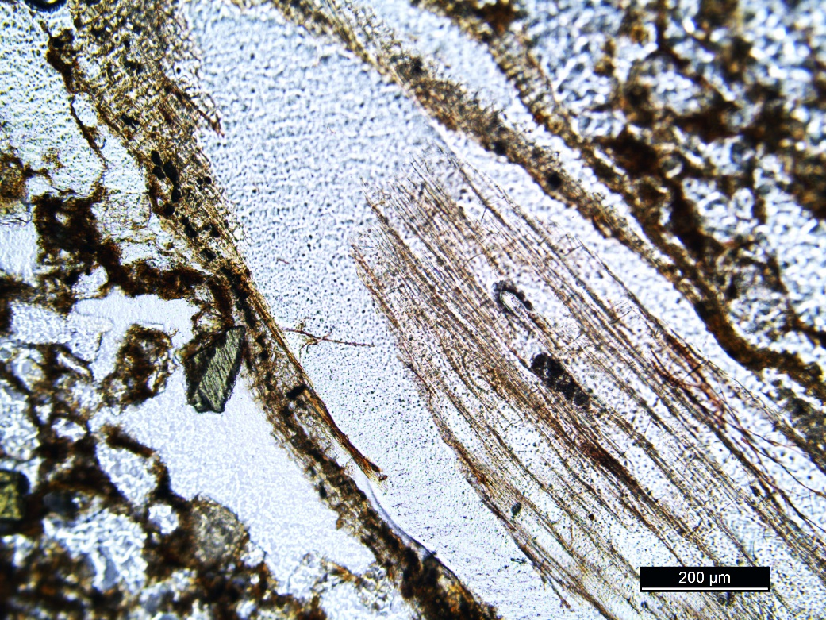
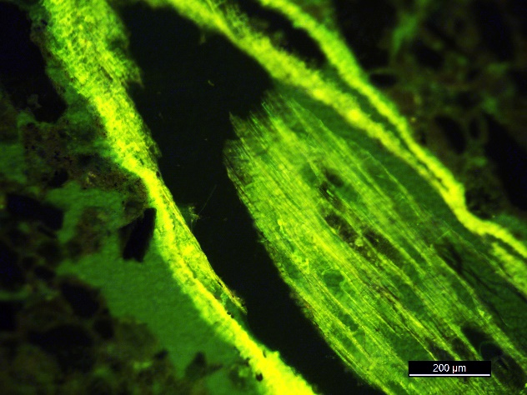
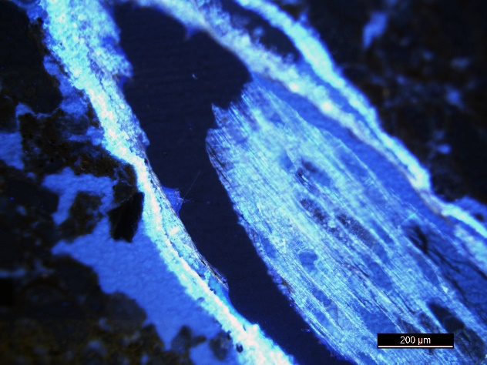
Technique of UV Fluorescence (UVf)
Modern “live” root US soil
Principles and applications of UVf to studies of soil and regolith micromorphology: Altemüller and Van Vliet-Lanoë (1990) and Stoops (2003, 2017).
Blue autofluorescence (425-495 nm) and green autofluorescence (525-560 nm) are principally employed for imaging.
Cellulose, lignins, waxy lipids, spores, pollen, cuticle all excite UVf; covered thin-sections can also be investigated.
Organic stains can enhance UV fluorescent behavior of some types of organic matter.
PPL
200 μm
50 μm
50 μm
UVf
UVf

Slide 6
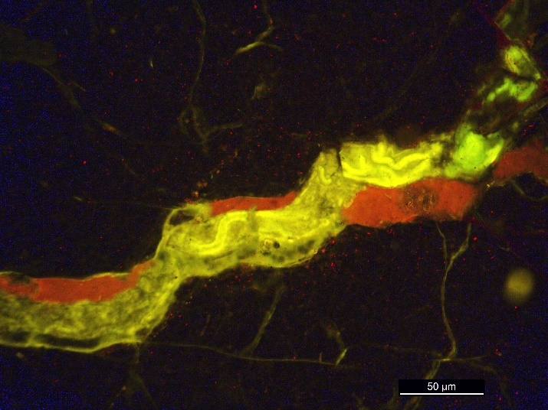
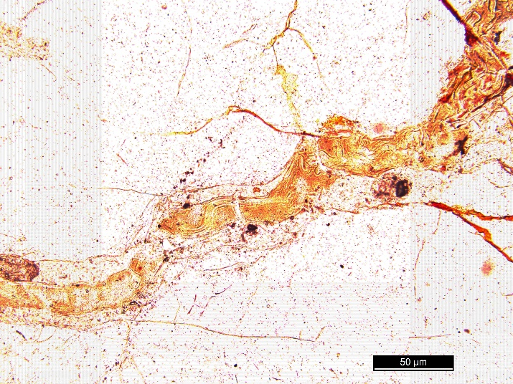
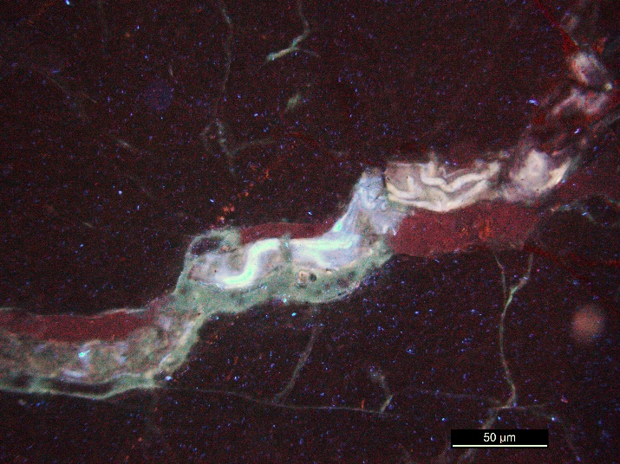
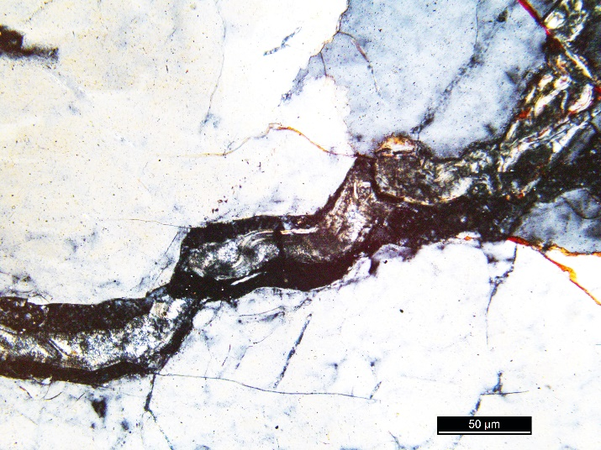
Evidence for Terrestrial Microbiota in Baltic Paleosol
UVf
PPL
Vermiform features
10-15 μm in diameter
up to 50-100 μm long
smooth-walled
straight to weakly sinuous, fluorescent
preserved in cracks and microfractures
within secondary silica deposits
50 μm
50 μm
UVf
XPL
50 μm
50 μm

Slide 7
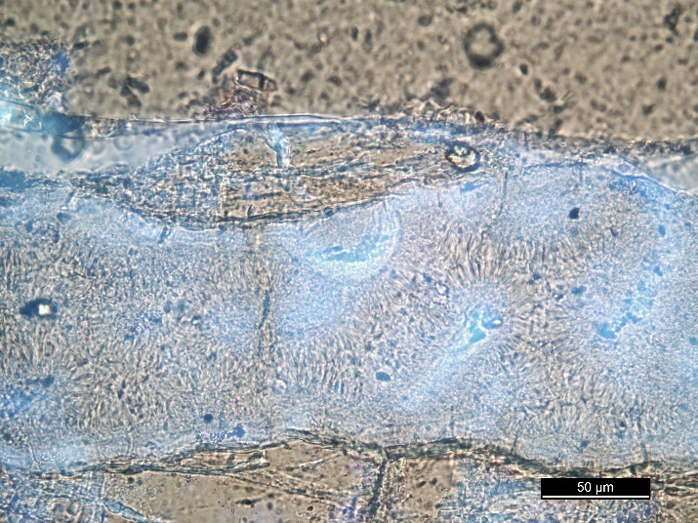
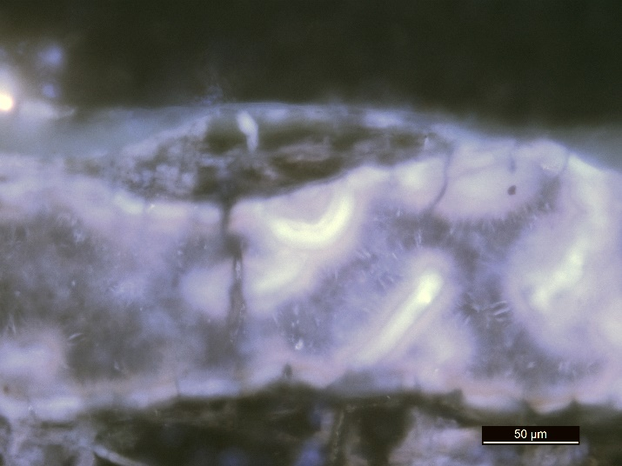
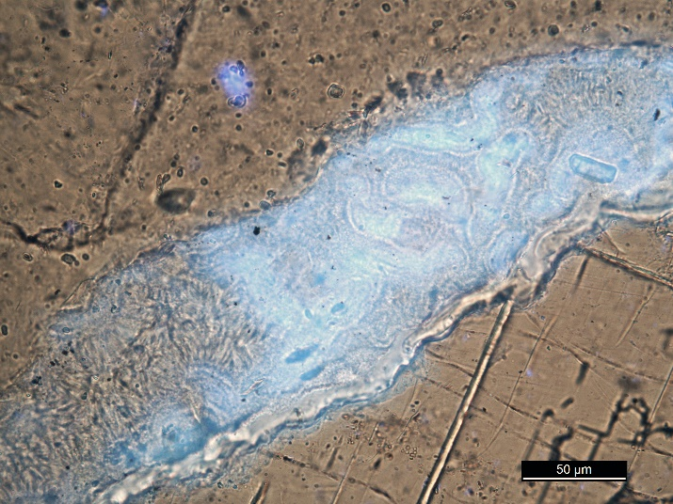
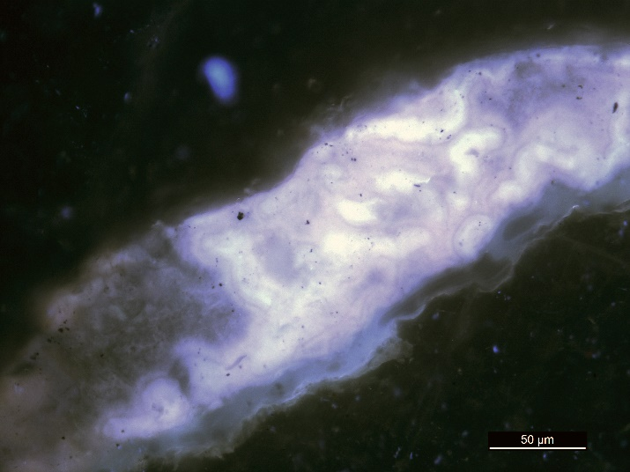
Evidence for Terrestrial Microbiota in Baltic Paleosol
Partial UVf and PPL
UVf
Vermiform features
10-15 μm in diameter
up to 50-100 μm long
smooth-walled, fluorescent walls and interiors
straight to weakly sinuous
preserved in cracks and microfractures
within secondary silica deposits
50 μm
50 μm
Partial UVf and PPL
UVf
50 μm
50 μm

Slide 8
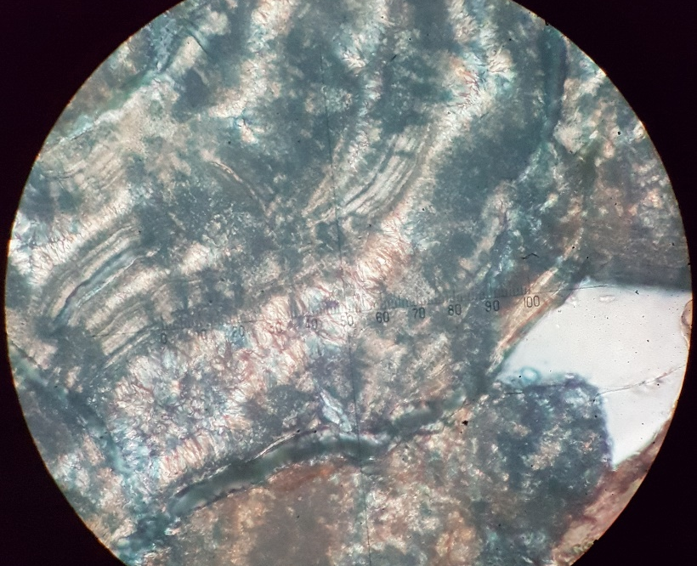
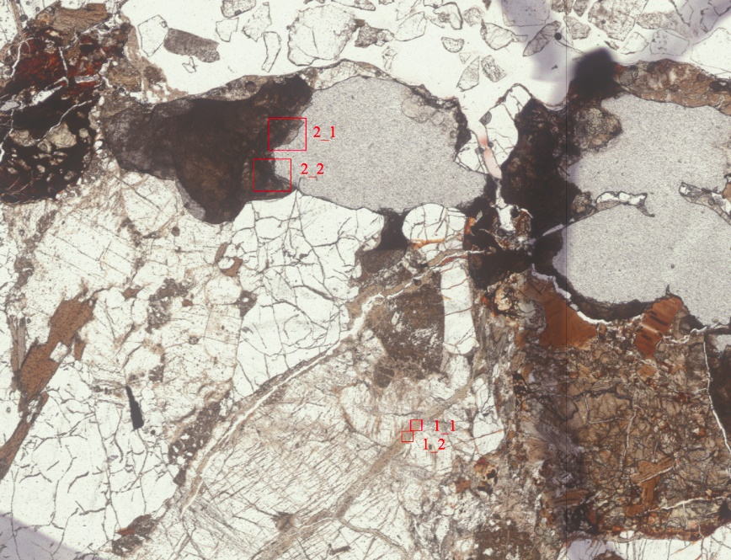
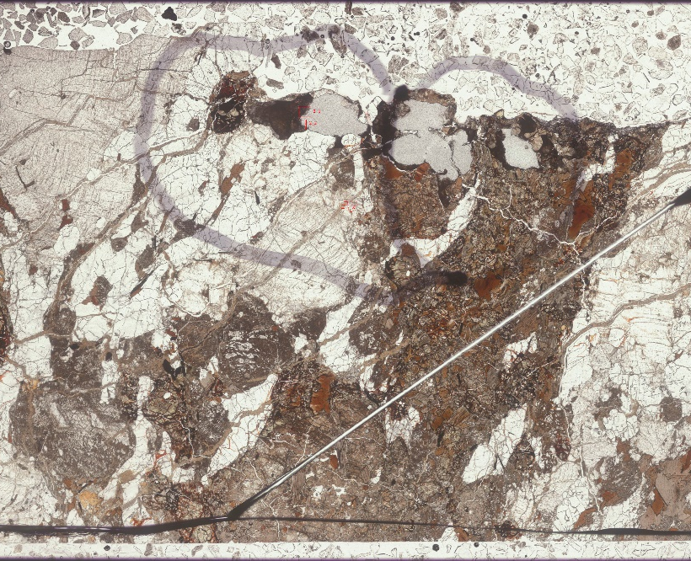
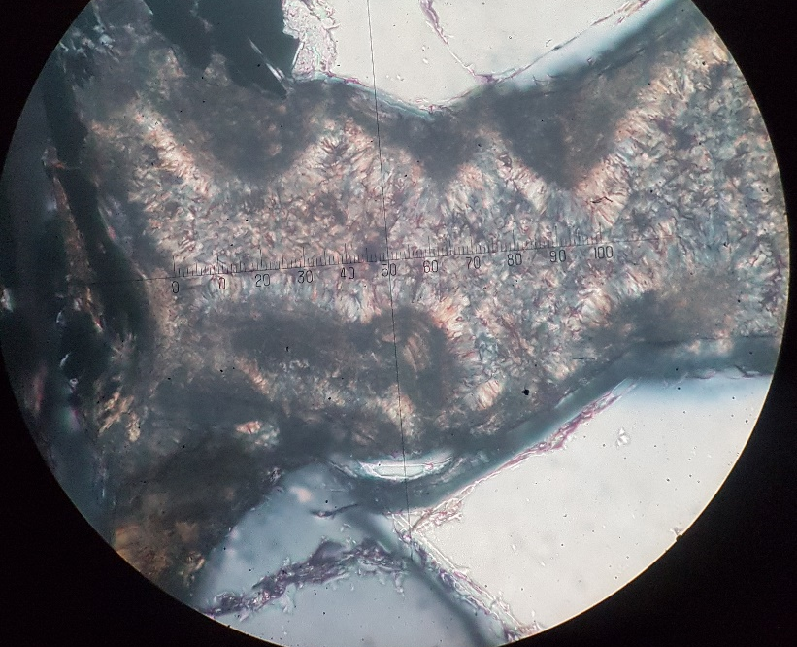
Additional Microanalytical Techniques
Vermiform features in duplicate thin-section billet
Analyzed at Oxford University, UK, using electron microprobe for element mapping
500 μm
2 mm

Slide 9
Evidence for Terrestrial Microbiota in Baltic Paleosol: Electron Microprobe Mapping
Vermiform features
smooth-walled, high Fe-Mg clay-lined walls and Si interiors
within secondary silica deposits
20 μm
Fe Kα
20 μm
Mg Kα
20 μm
Si Kα
20 μm
BSE

Slide 10
Evidence for Terrestrial Microbiota in Baltic Paleosol: Electron Microprobe Mapping
Vermiform features
smooth-walled, high Fe-Mg clay-lined walls and high Si interiors
within secondary silica deposits
20 μm
Fe Kα
20 μm
Mg Kα
20 μm
Si Kα
20 μm
BSE

Slide 11
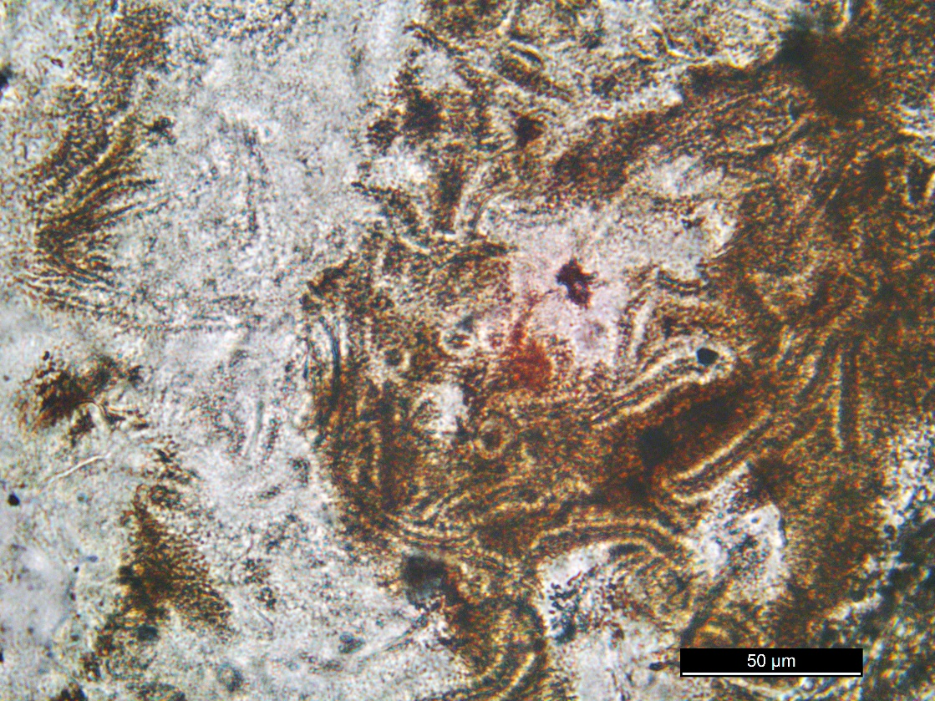
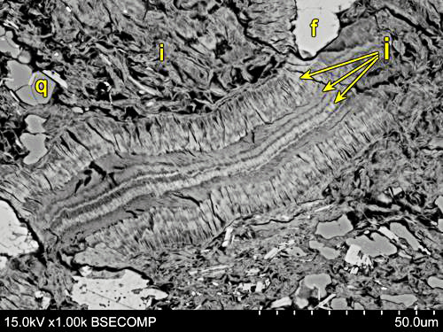
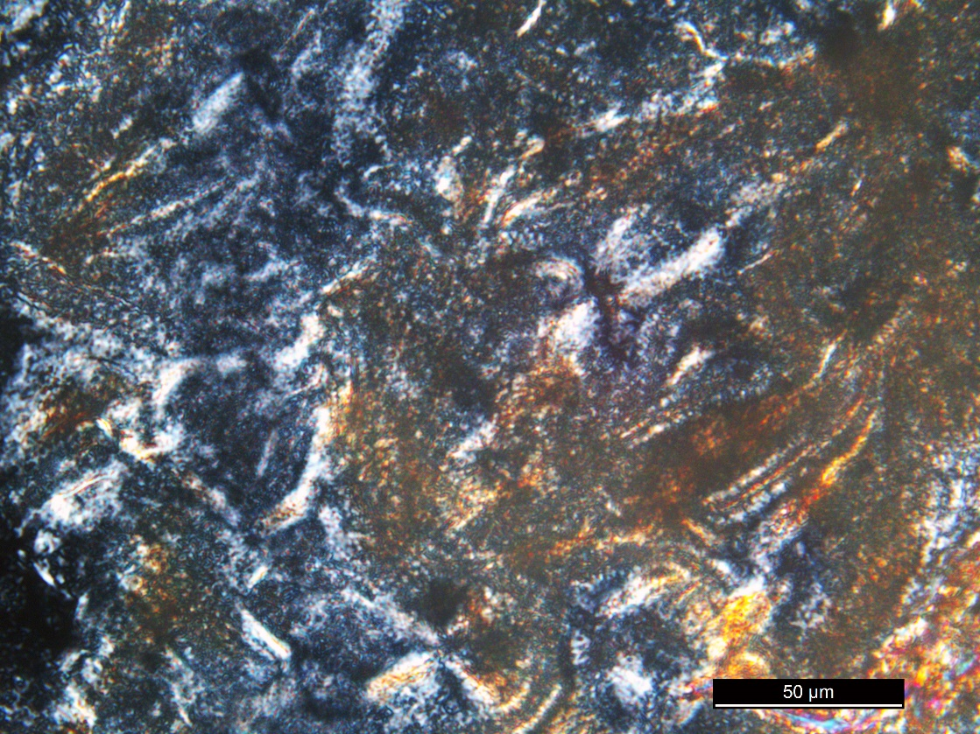
Additional Examples of Vermiforms -TR119 paleosol
BSE: Illite crystals (i) grown oriented to the vermiform wall
50 μm
50 μm
PPL
Cambrian (?) core TR119 paleosol from southwestern Wisconsin, USA
Medaris et al. (2018) Journal of Geology
50 μm
XPL

Slide 12
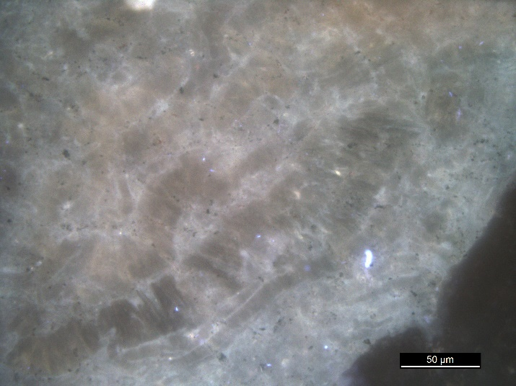
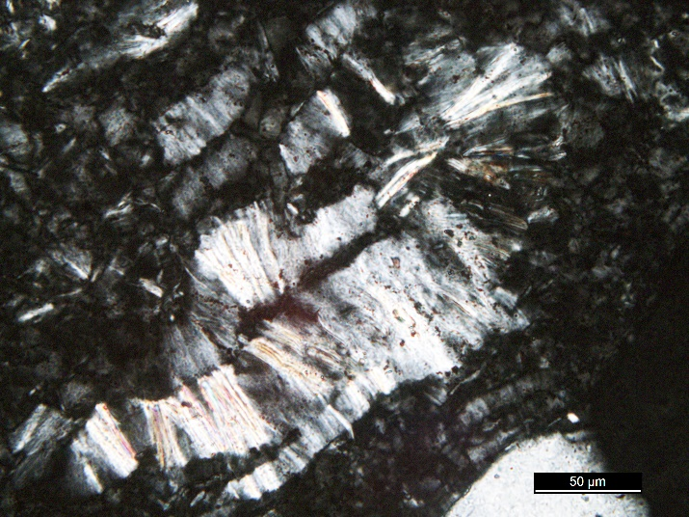
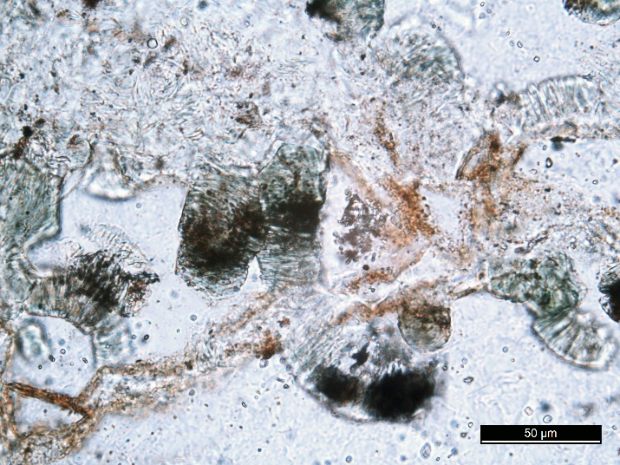
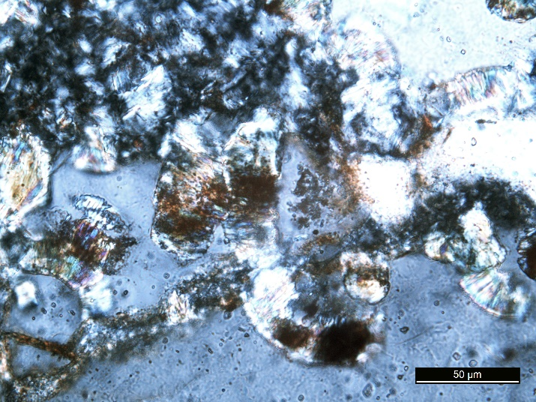
Features in Baltic Paleosol are NOT Abiotic Kaolinite-Vermiculite Vermiforms!
Squaw Creek Cambrian Paleosol, central Texas (Driese et al., 2007)
UVf
XPL
Vermiform, but internally consist of accordion-like stacks of crystals
Larger diameters
No organic walls
No organic interiors
Hydrothermal fluid origin?
50 μm
50 μm
PPL
XPL
50 μm
50 μm
Sub-Lamotte Cambrian Paleosol, southeastern Missouri (Sutton and Maynard, 1996)

Slide 13
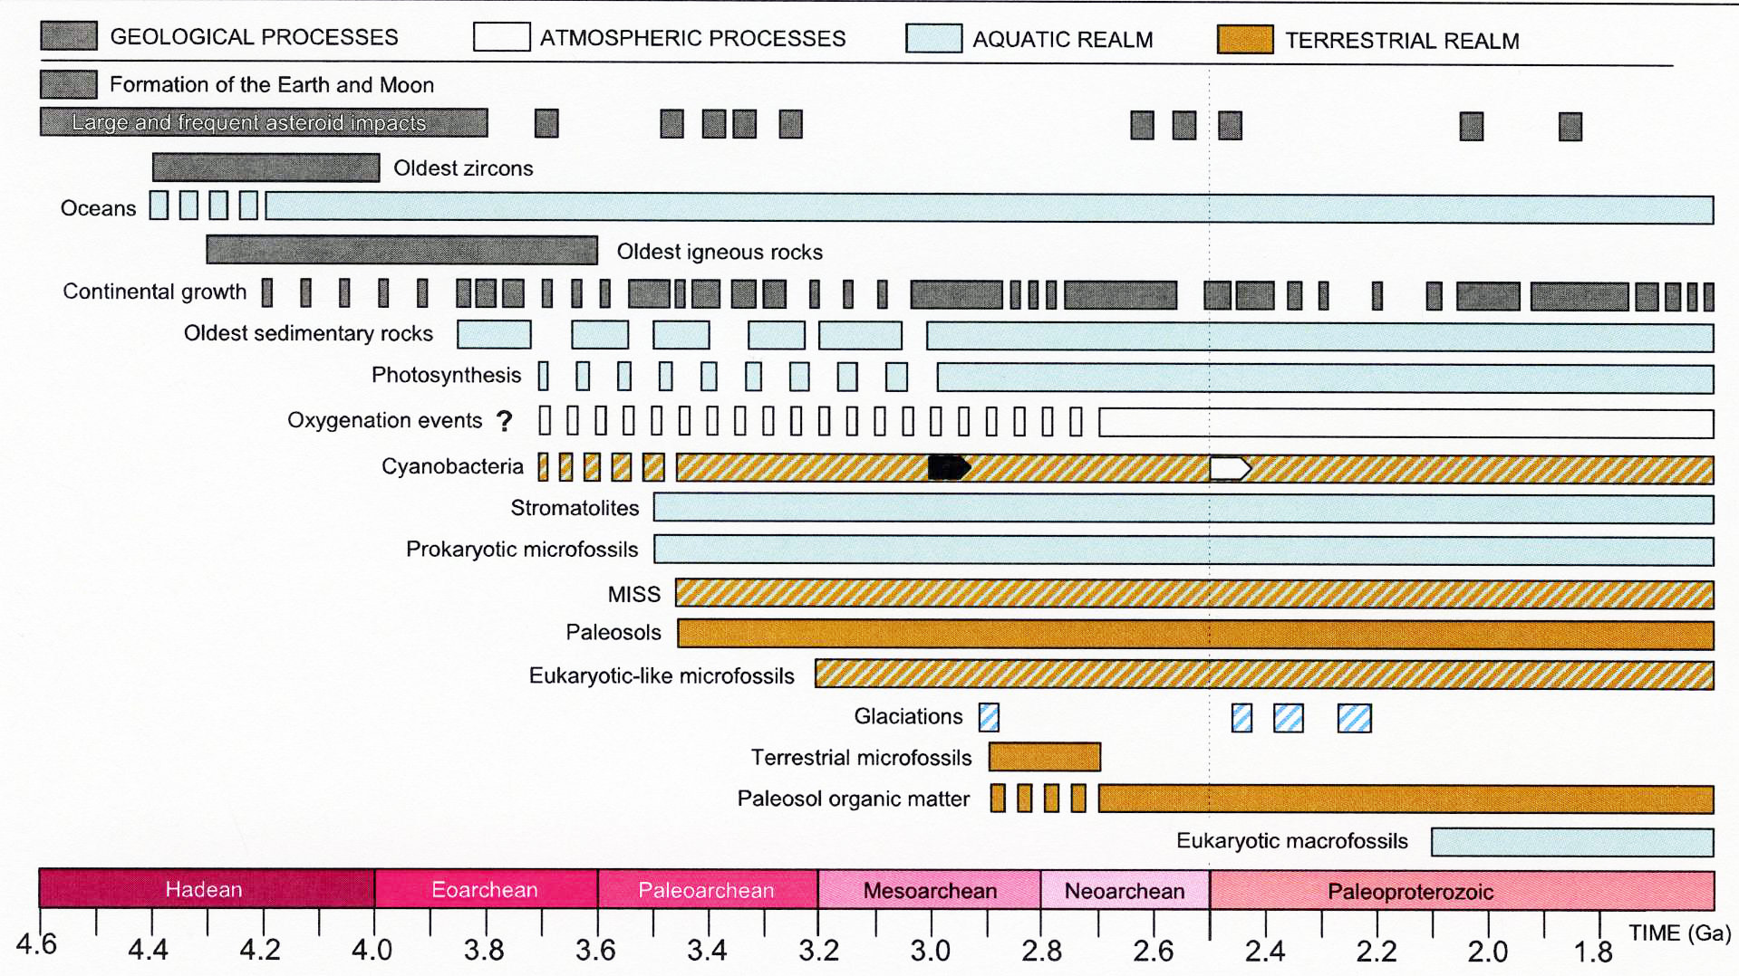
Suggested Chronology of Geological, Atmospheric and Biological Events During the Precambrian
Beraldi-Campesi (2013) Ecological Processes

Slide 14
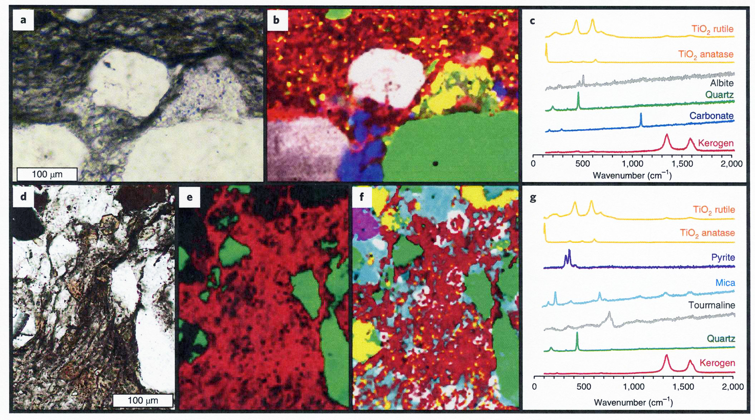
Microbial life and biogeochemical cycling on land 3,220 million years ago
PPL
Raman
Homann et al., 2018, Nature Geoscience
Terrestrial organic mats: Kerogenous, Filamentous structures in rocks of Moodies Group, Barberton Greenstone Belt, South Africa
PPL
Raman
Raman

Slide 15
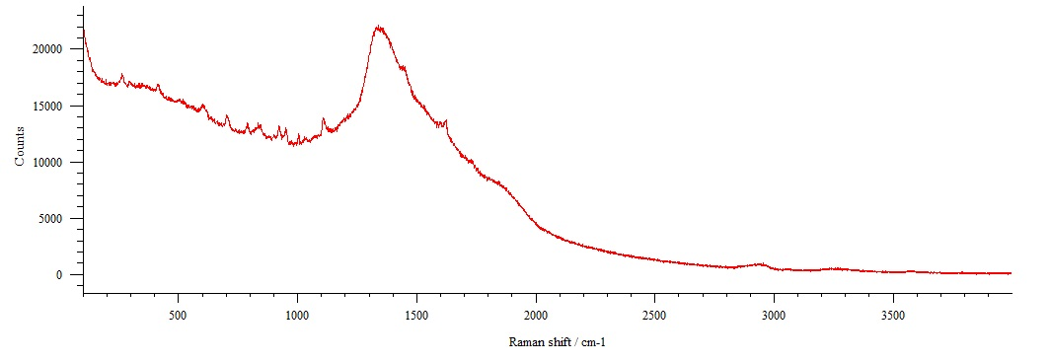
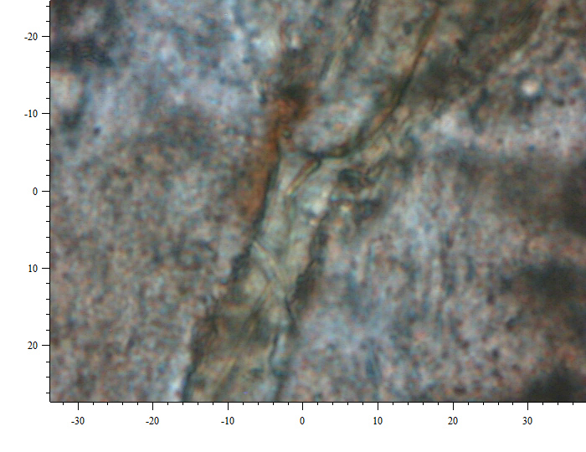
Raman Spectroscopy
Counts
Raman shift cm⁻¹
Excessive fluorescence with both red and green laser, centered at 1340 cm⁻¹ was always present, both inside and outside of vermiform features: results are inconclusive
10 μm

Slide 16
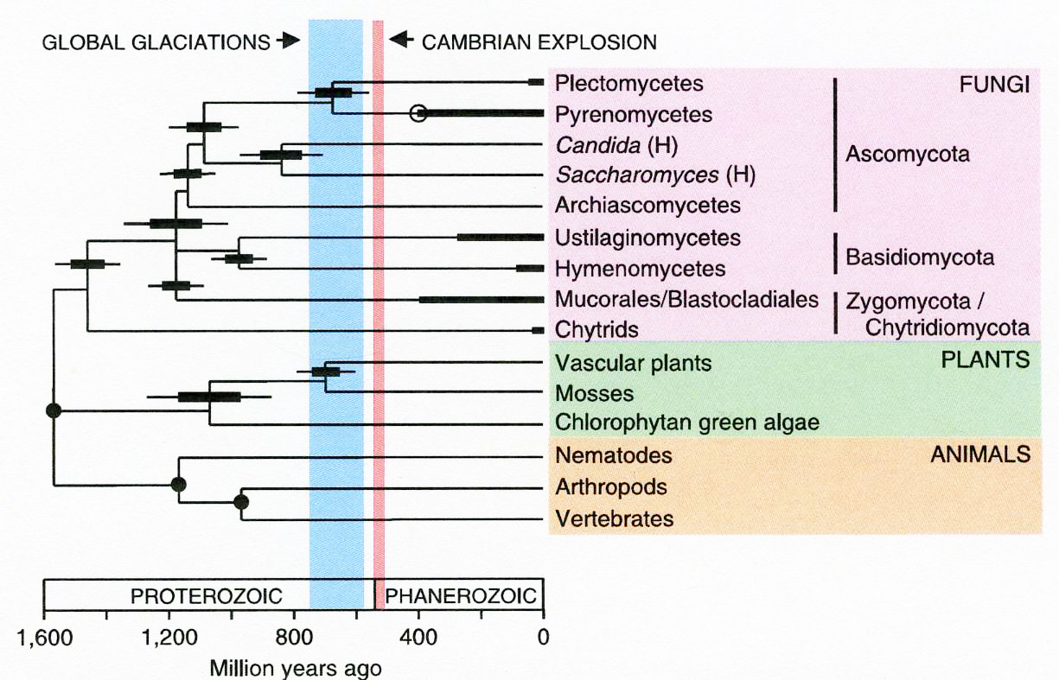
Molecular Clock Studies
Heckmann et al. (2001) Science

Slide 17
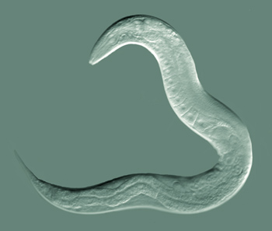
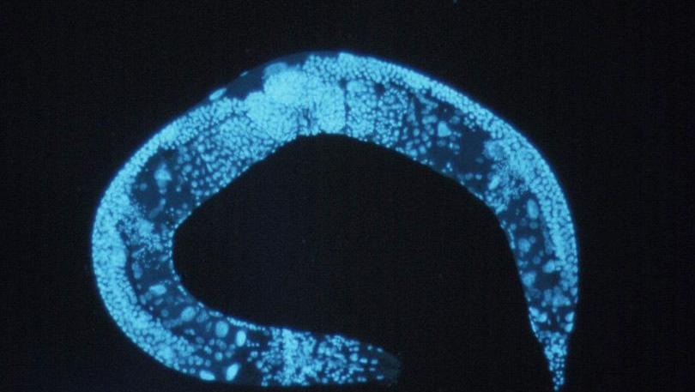
Modern Nematode
A
Caenorhabditis elegans
(A) [Bob Goldstein, UNC Chapel Hill: http://bio.unc.edu/people/faculty/goldstein/
(B) (https://www.genome.gov/10000570/)
(1998) Science 282: 2012-2021.
200 μm
B

Slide 18
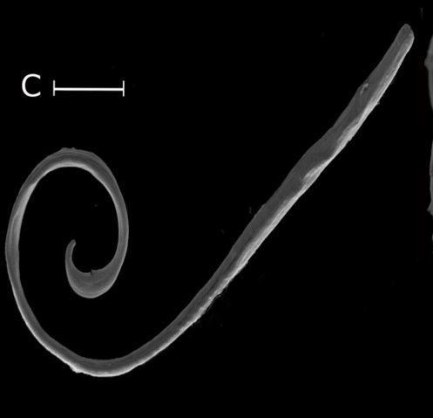
Mylonchulus brachyurus (Nematoda)
Possible Modern Analogs for Features in Neoproterozoic Baltic Paleosol (?)
Halicephalobus mephisto (Nematoda)
100 μm
“Roundworms”, not to be confused with earthworms
Nematodes generally < 1 mm long
Considered to be among the oldest multicellular organisms on Earth
Found at depths 1-2 km in South African gold mines (Borgonie and Lau (2018); Borgonie et al. (2011, 2015)
10 μm
https://aeon.co/essays/deep-beneath-the-earths-surface-life-is-weird-and-wonderful

Slide 19
Conclusions: For advancing research into reconstructing Precambrian Critical Zones and ecosystems from Paleosols:
1) Studies should include detailed paleosol and paleosaprolite micromorphology.
2) Access to UV fluorescence imaging revealed possible eukaryotes (Nematoda) in Baltic paleosol.
3) Seek to identify microbiological features that are hiding in the paleosol matrices!

