Slide 1
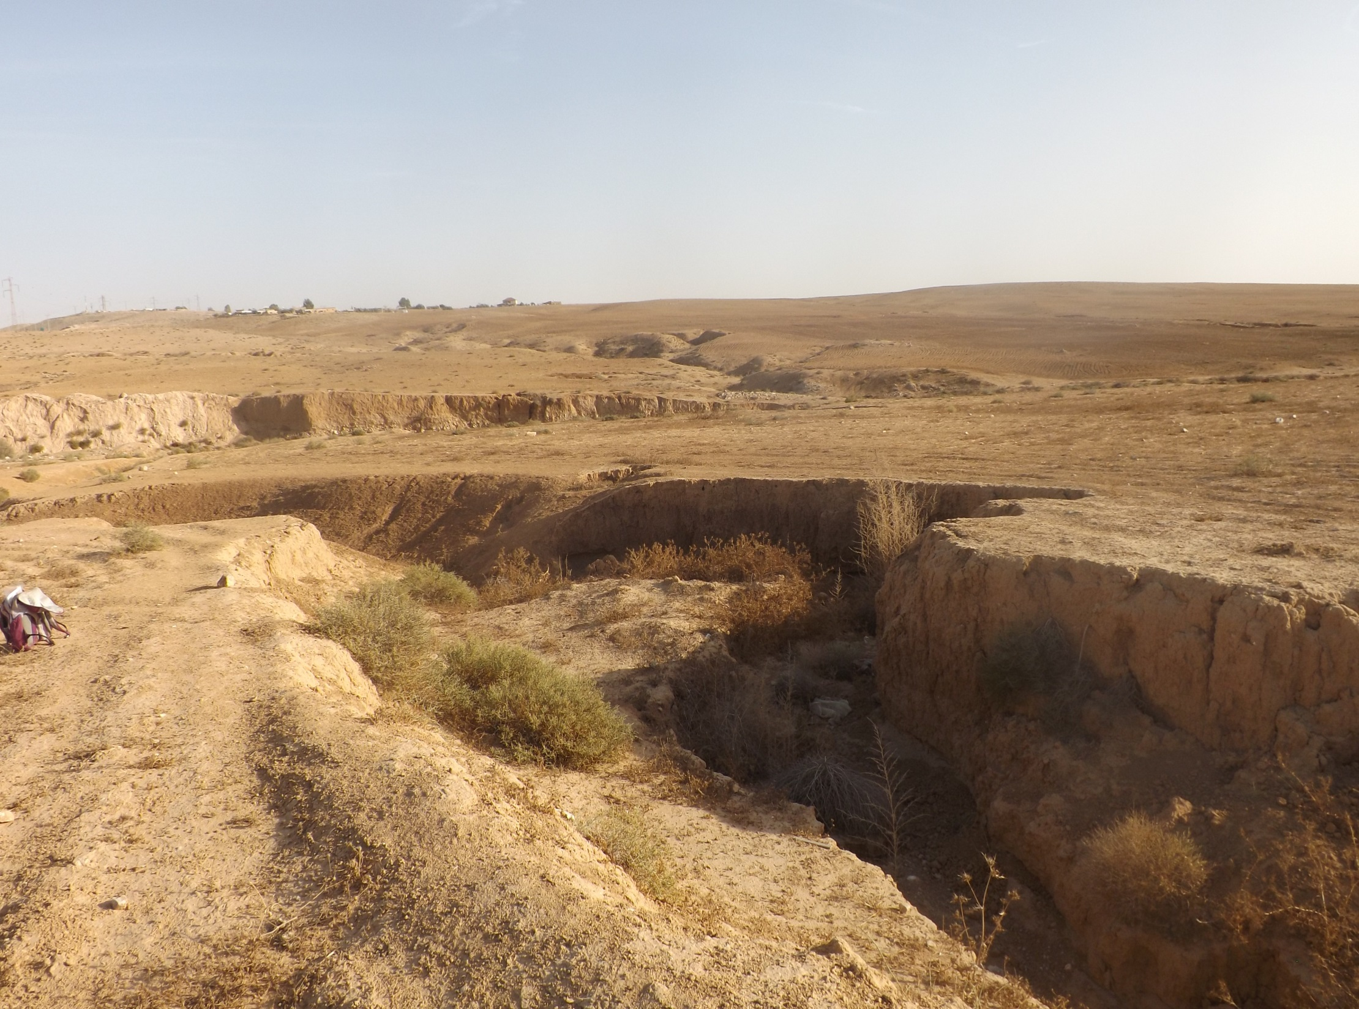


The effect of gully erosion on the ecology of arid loess agro-ecosystems
Amir Mor-Mussery & Jonathan B. Laronne
amir.mussery@gmail.com

Slide 2
patterns of gullied areas
The soil quality of gullies affects and is affected by the gullied landforms Blanco & Lal, 2010
Gullied area is puzzle of landforms affected both from by initial and stabilized gully units Sidorchuk, 1999

Slide 3
objectives
determine interrelations between geomorphological and ecological processes occurring in gullied areas
determine the evolution of the gullied area ecosystem

Slide 4
methodology
two representative gullied areas
cross sectional transects along gullies & neighboring landforms
properties of soil quality and biological activity
biodiversity of annual species
aerial photography

Slide 5
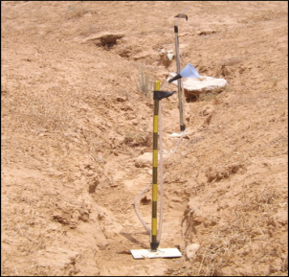
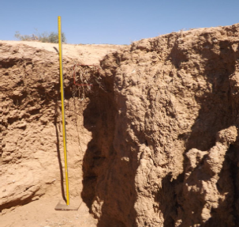
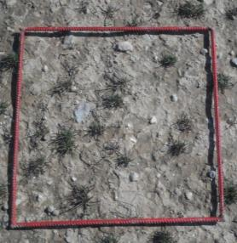
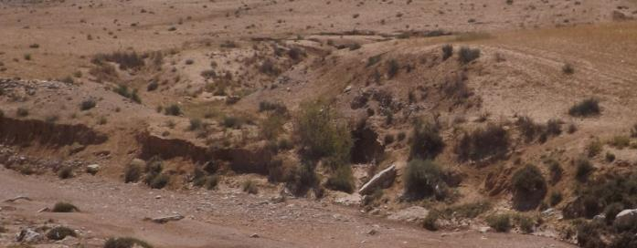
measurements
1
3.5m,25-30º
5.7º
1.0º
4m,0.2º
10m,5.0º
4
7m,1.5º
2
3a
6b
6c
6a
7m,1.5º
1.5m
1.4m
1.3m
25º
5
3b
12m,0.8º
3c
B

Slide 6
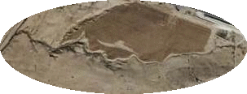

study site – wadi Attir
loess, semiarid, intensively rainfed cultivation
enhanced gully erosion
N
Wadi Attir channel
Eastern G.
Western G.
PWA
200m

Slide 7
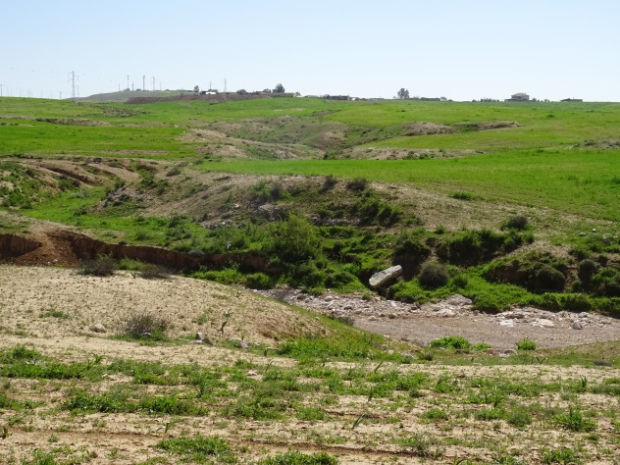
Gullies’ transect analyses
longitudinal analysis
cross sectional analysis
0
0.3
0.6
0.4
0.8
1

Slide 8
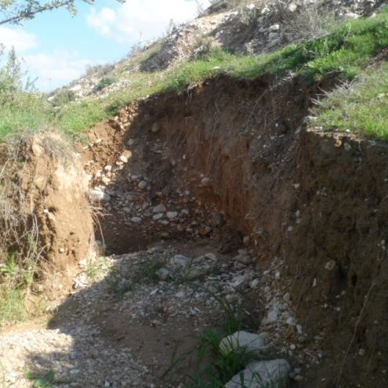
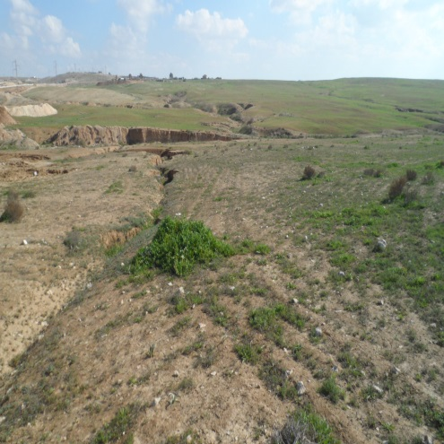
gully and affected landforms’ profiles
Upper Chanel
Initial units:
head-cut, bars, meandering, complex incision
Headcut
Lower Chanel
wadi.Atir
stabilized units:
eroded slope, rocky ground, flooded plains
6
5
4
Eroded slope
Gully
3
2
1

Slide 9
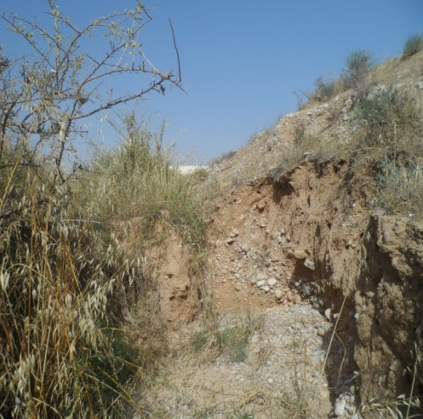
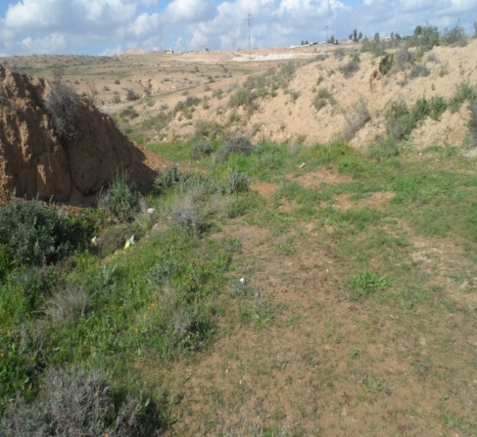
Stabilized gullied landforms by ecosystem engineers
shrubs:
head-cut, patches, shrubbery
Cereals
L.Shawi
(single)
L.Shawi
(group)
Bare
harvester ants:
Nested area
Bare
Chanel
Nested
Floodedplain

Slide 10
Gullies’ longitudinal profile
Western gully
Eastern gully
Z
0
G. head
G. bottom
0
Z
G. head
G. bottom
The SOM values of the winter sets are lower compared to the other seasons
The soil fertility of the Eastern gully is higher compared to the Western G.
The western gully has homogenous soil fertility compared the Eastern G.

Slide 11
Gullies’ cross section analysis, soil fertility
*
*
Z
0
Z
0
differences are smaller among the western gully units compared to the Eastern G.
SOM is higher in the channel, fine particles are low
fields are enriched with fine particles

Slide 12
Gullies’ cross section analysis, biological activity
**
**
*
**
*
*
*
gullies’ slopes encourage seedlings germination
The gullies’ slopes encourage nests’ creation

Slide 13
gullies and Flooded plain
*
*
Flooded plain and channel had similar soil fertility
Cereals are better grown in the flooded plains
Broad leaves are better grown in the channel

Slide 14
vegetation and head-cut stabilization
Lycopersicum shawi shrubbery stabilized deep depths and forms the widest ‘soil shelve’
Stippa capensis stabilized shallow depths

Slide 15
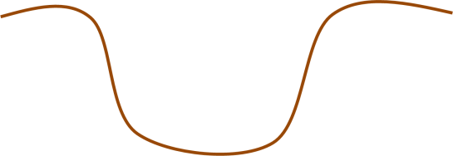
gullies cross section analysis of species biodiversity
# of species: Western 21; Eastern 10 → Eastern more accessible to grazers
Gully’ bottom/
Confluent with waddi
A. platyraphis
Field
Slope
Total: 9 sp.
4 sp.
A. platyraphis
Channel
A. platyraphis (+2sp.)
Total: 21 sp.

Slide 16
Discussion
The Eastern gully is more stabilized compared to the Western one.
Gullied landforms are ‘mini lab’ to long-term ecological processes.
Stabilized gullies enable accumulation of sediments and organic matter along their channel and slopes.
THE gullies’ slopes are been stabilized by shrubs and enhanced harvester ants’ activity.
Flooded plains characterized by high soil’ fertility and may use for cereals breeding.
Gullies may serve as hot plots for seeds’ dispersal of rare species in arid areas.

Slide 17
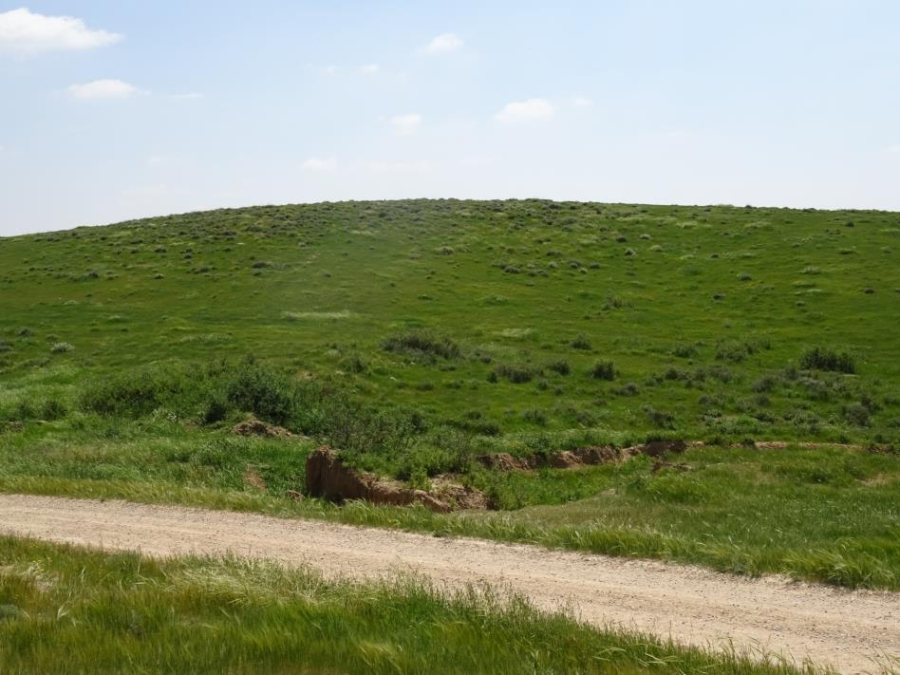
Conclusion
Adequate management of existing gullies leads to ecosystem restoration and increased agriculture utilization of the surrounding

Slide 18
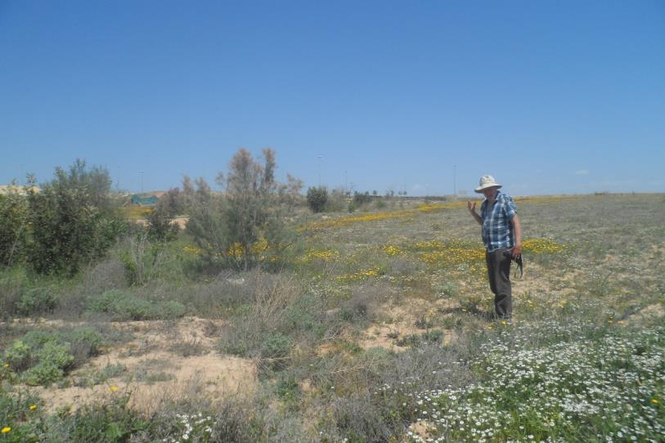
Acknowledgments
  Dr. Stefan Leu
  Dr. Michael Ben Eli

