Slide 1

Nitrate concentrations in streams as a function of Crop Cover in Midwestern Agricultural Watersheds: Assessing the role of corn and soybeans
Jacob Piske, Eric Peterson, Bill Perry

Slide 2
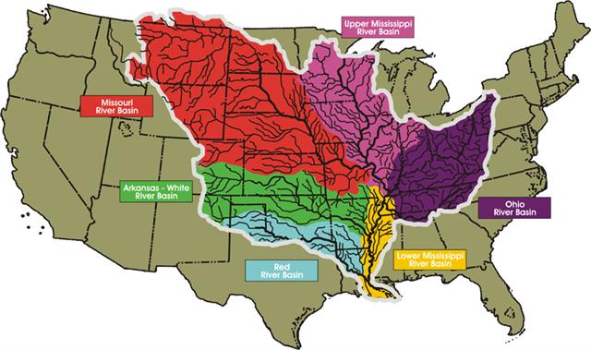
Nitrate Problems
Agricultural nonpoint source pollution
Impairing the water quality in 70% of rivers and streams
Approximately 25% of the NO₃⁻ in the stream system will remain mobile and continue to the Mississippi River
Contributes to Gulf of Mexico hypoxia
http://www.feedstuffs.com/news/court-dismisses-setting-pollution-diet-mississippi-river-basin

Slide 3
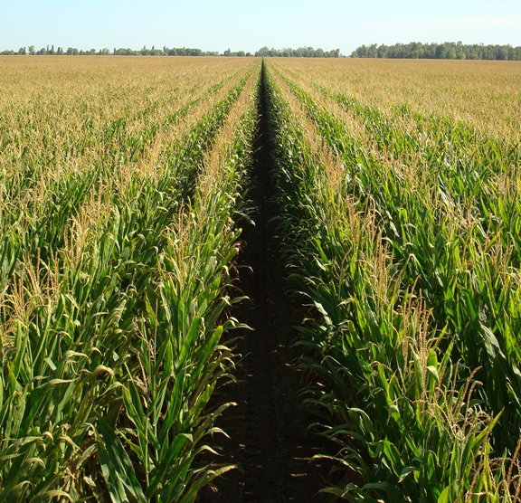
Agricultural Influence
Primary source of nutrients to surface water contamination
Fertilizer use, artificially drained areas, and decreased crop diversity
Average 163 kg ha⁻¹ N-fertilizers applied to corn (USDA, 2016)
Average 20 kg ha⁻¹ N-fertilizers applied to soybeans (USDA, 2015)
http://www.dairymoos.com/shocking-news-the-weather-is-unpredictable/

Slide 4
N-Fertilizer Rates

Slide 5
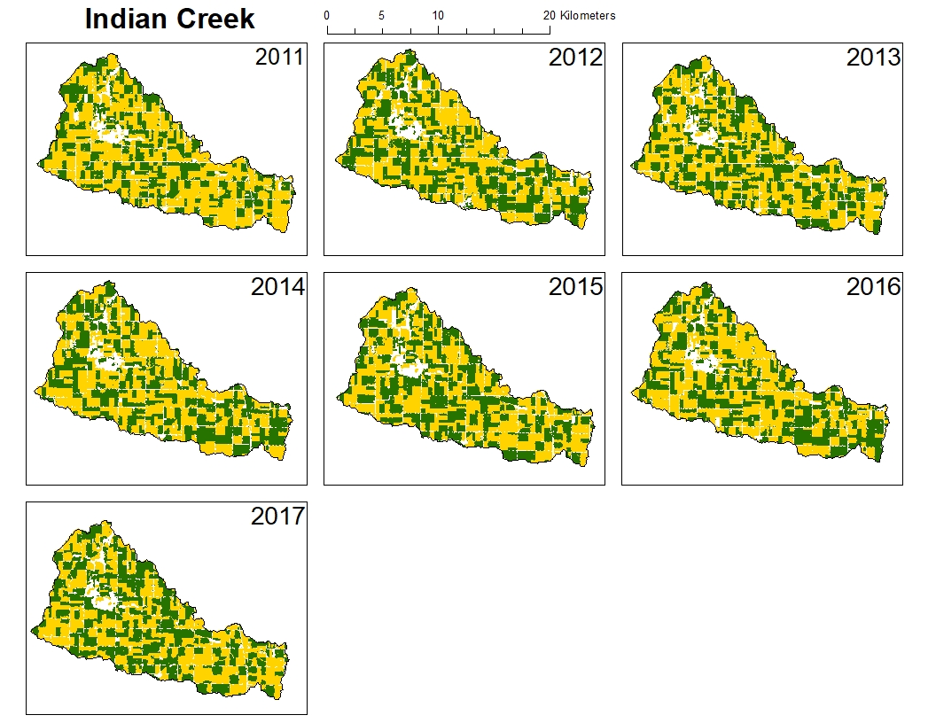
Agricultural Changes
Corn was grown in rotation with alfalfa and clovers
Increased availability of fertilizers and application rate
Intensive subsurface drainage (tile drains)
Current rotation is corn and soybean
Corn was grown in rotation with alfalfa and clovers
Increased availability of fertilizers and application rate
Intensive subsurface drainage (tile drains)
Current rotation is corn and soybean
Corn
Soybeans

Slide 6
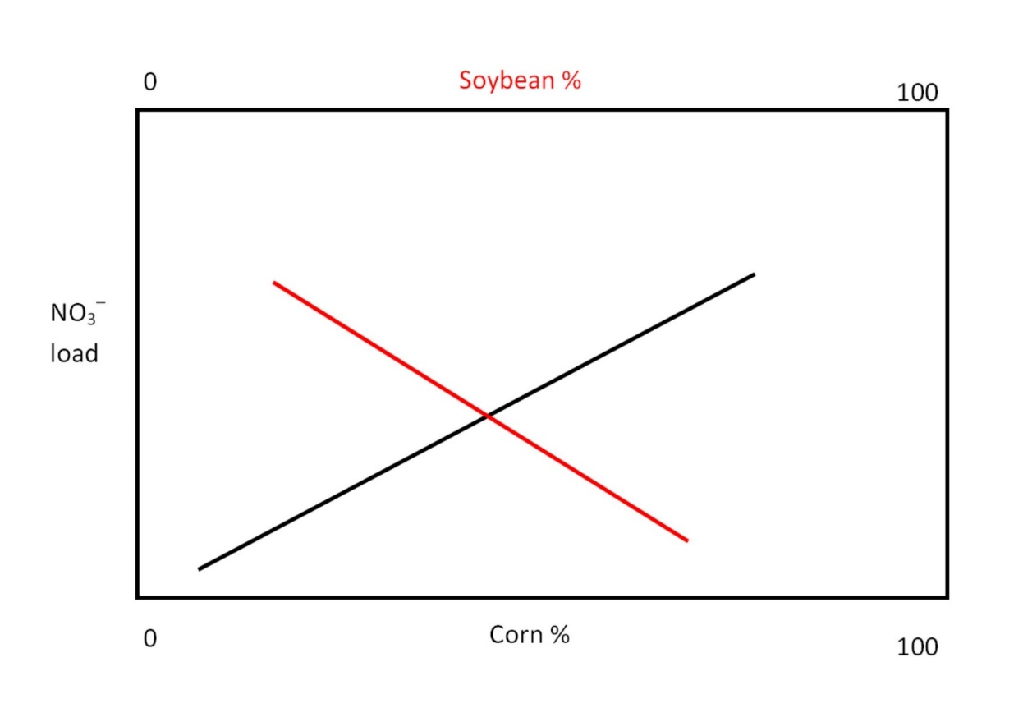
Research Question
Does a relationship exist between nitrate export and crop type (corn or soybean)?
Does nitrate export vary seasonally?

Slide 7
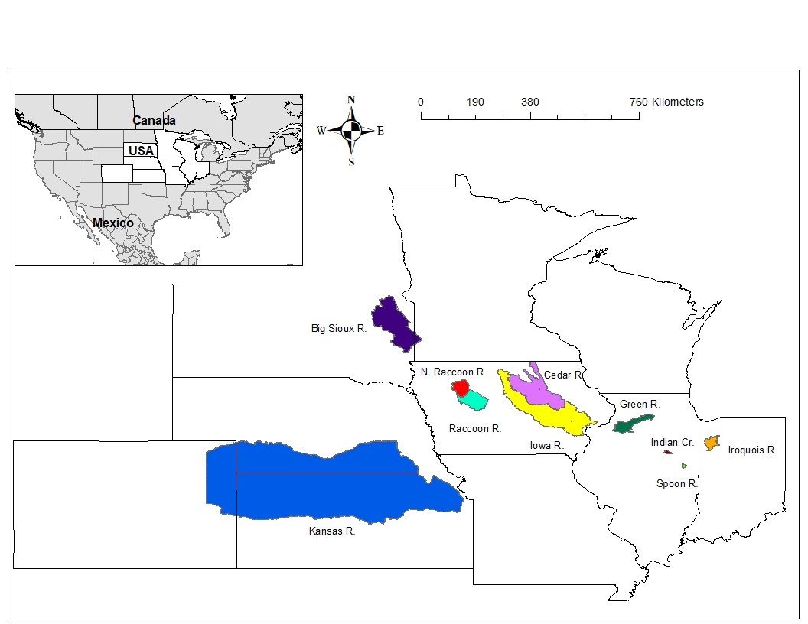
Watersheds

Slide 8
Stream Data
Continuous NO₃⁻ -N concentrations (mg/L) and discharge (Q, m³) were downloaded from the USGS Water Science Center
Data ranges from 2008 to 2017
USGS Station | River | Watershed Area (km²) | Percent Agriculture (2017) | NO³ Availability
3336850 | Spoon River | 106 | 92.18% | 2013 – 2017
5554300 | Indian Creek | 175 | 91.65% | 2011 – 2017
5482300 | North Raccoon River | 1813 | 84.26% | 2008 – 2017
5482500 | Raccoon River | 4195 | 84.02% | 2008 – 2017
5447500 | Green River | 2597 | 81.53% | 2015 – 2017
5524500 | Iroquois River | 1162 | 78.49% | 2015 – 2017
5464420 | Cedar River | 16425 | 75.85% | 2012 – 2017
5465500 | Iowa River | 32375 | 70.76% | 2009 – 2017
6481000 | Big Sioux River | 10170 | 59.17% | 2017
6892350 | Kansas River | 154767 | 44.15% | 2013 – 2017
Table sorted by percent agriculture
Table sorted by percent agriculture.

Slide 9
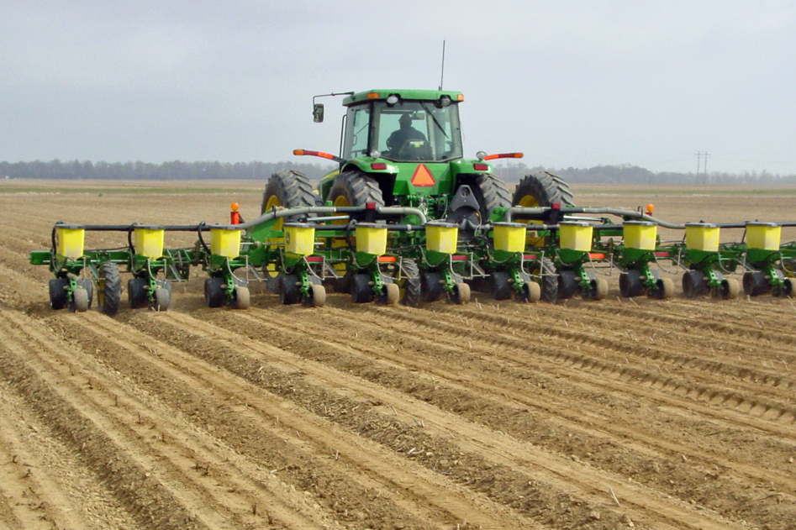
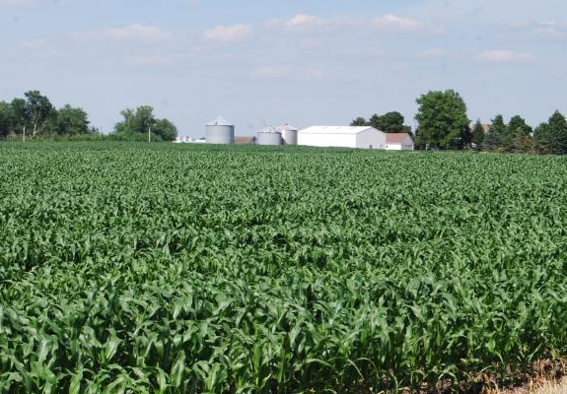
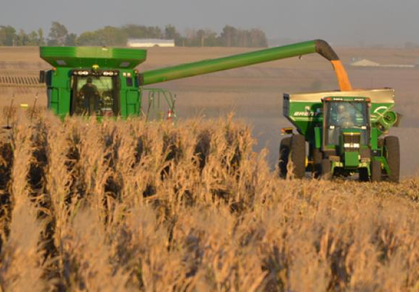
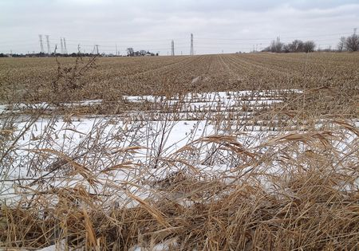
Data Categorization
Year
April 1 to March 31
Seasons (Hanrahan et al, 2018)
Spring – April 1 to June 30
Summer – July 1 to September 30
Fall – October 1 to December 31
Winter – January 1 to March 31

Slide 10
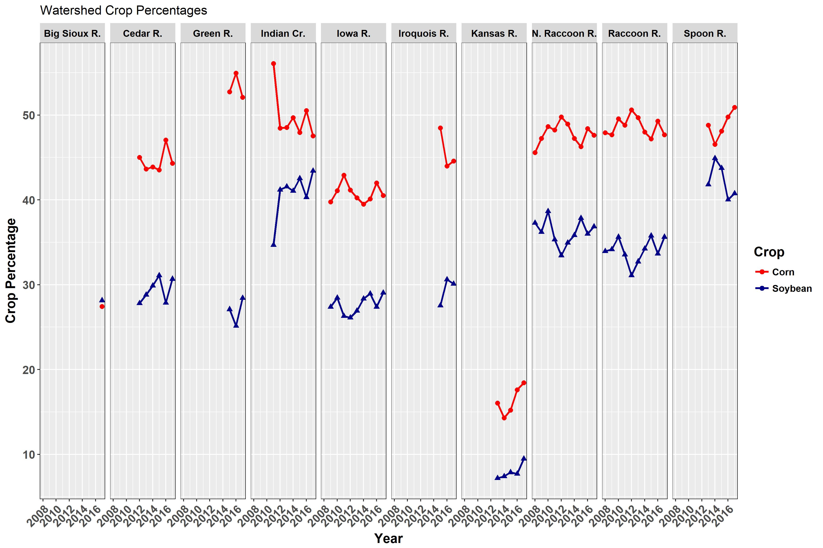
Crop Percentages

Slide 11
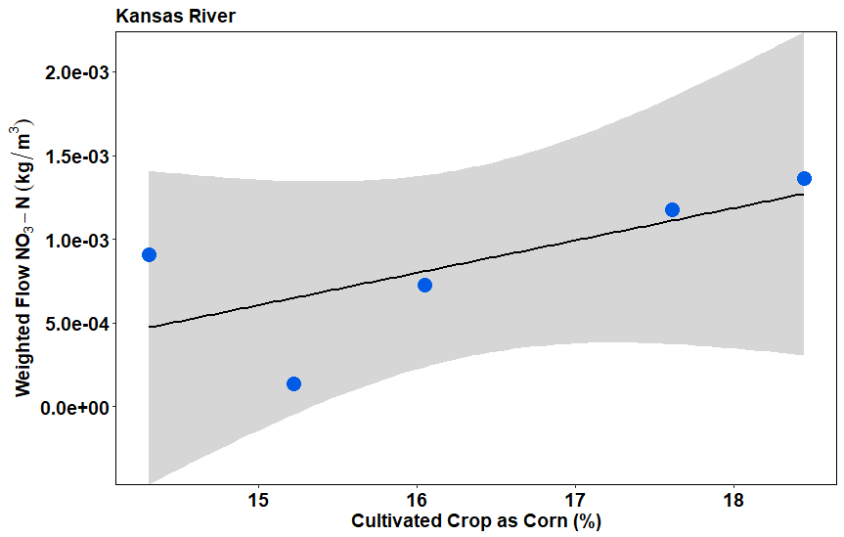
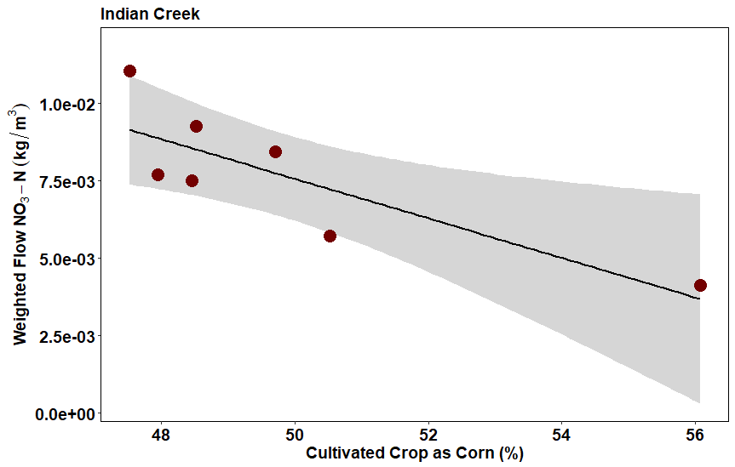
Yearly Corn vs. NO₃-Weighted Flow

Slide 12
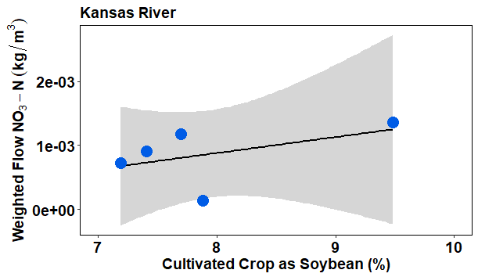
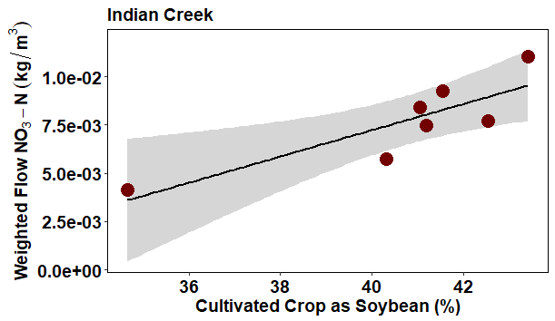
Yearly Soybean vs. NO₃- Weighted Flow

Slide 13
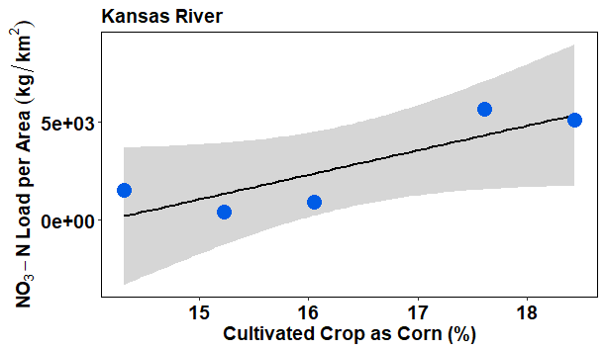
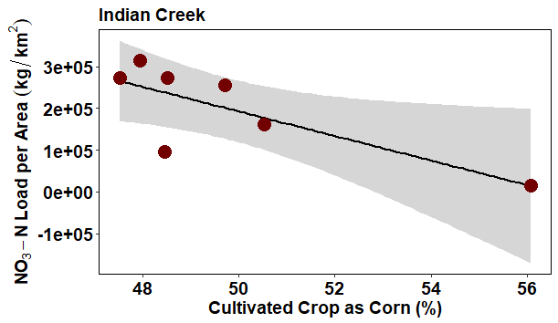
Yearly Corn vs. NO₃- Load

Slide 14
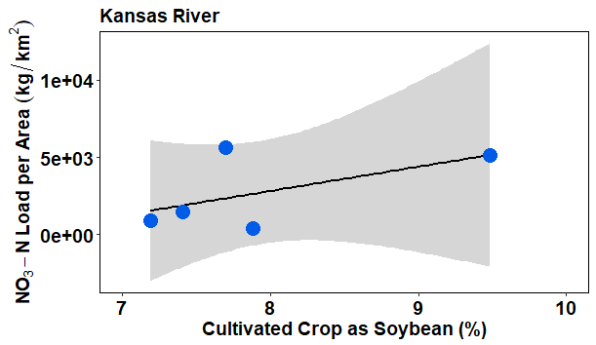
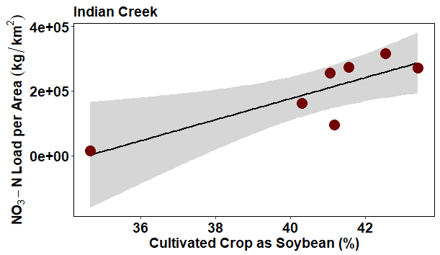
Yearly Soybean vs. NO₃- Load

Slide 15
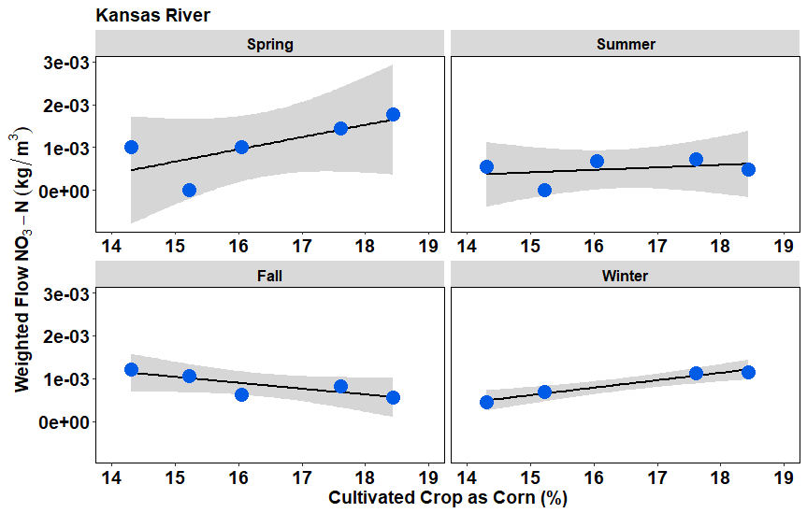
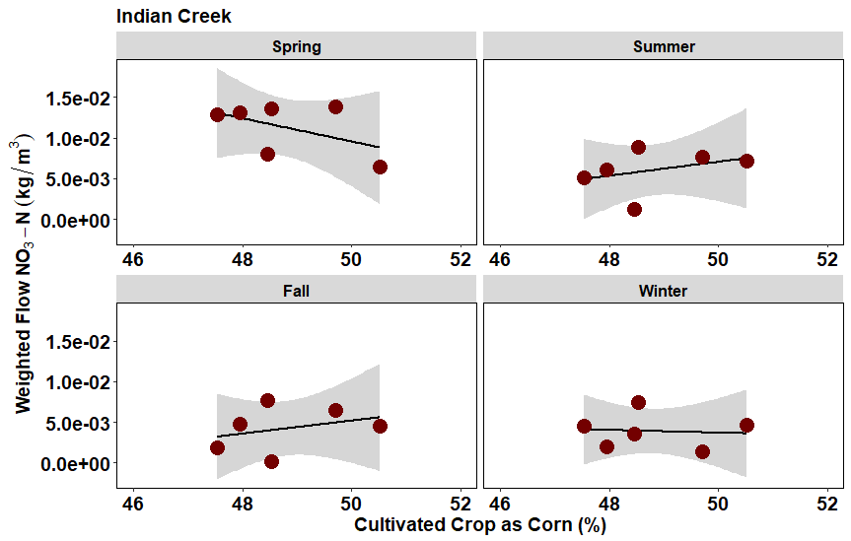
Seasonal Corn vs. NO₃- Weighted Flow

Slide 16
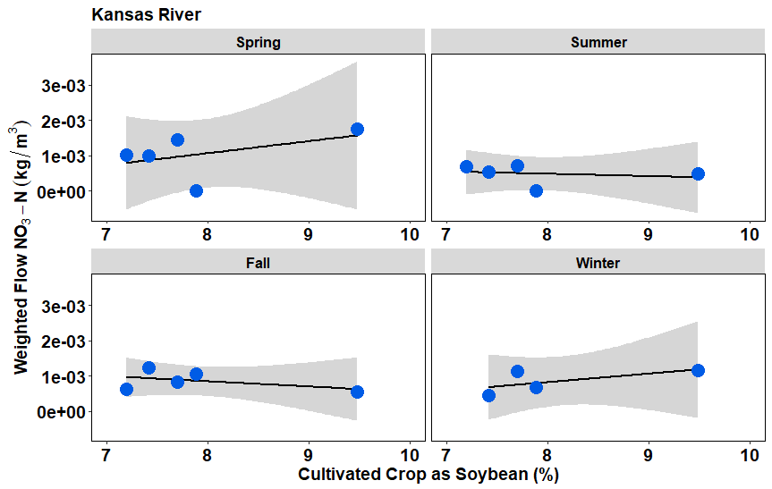
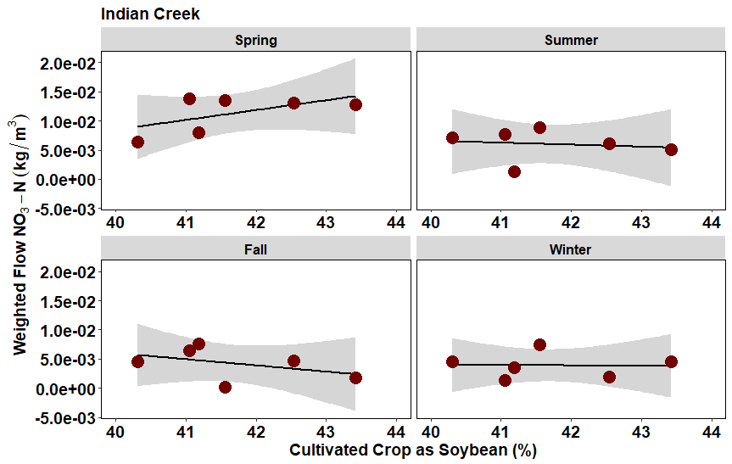
Seasonal Soybean vs. NO₃- Weighted Flow

Slide 17
Relationship – Export vs. Crop Type
Collective Data
Export increases as corn increases
Export increases as soybean increases

Slide 18

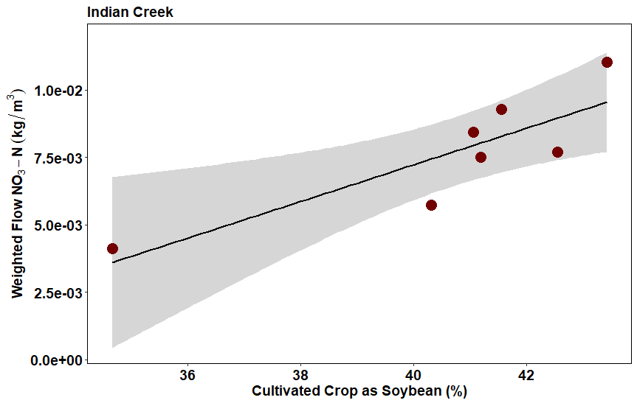
Relationship – Export vs. Crop Type
Individual Watersheds
Export decreases as corn increases
Export increases as soybean increases

Slide 19

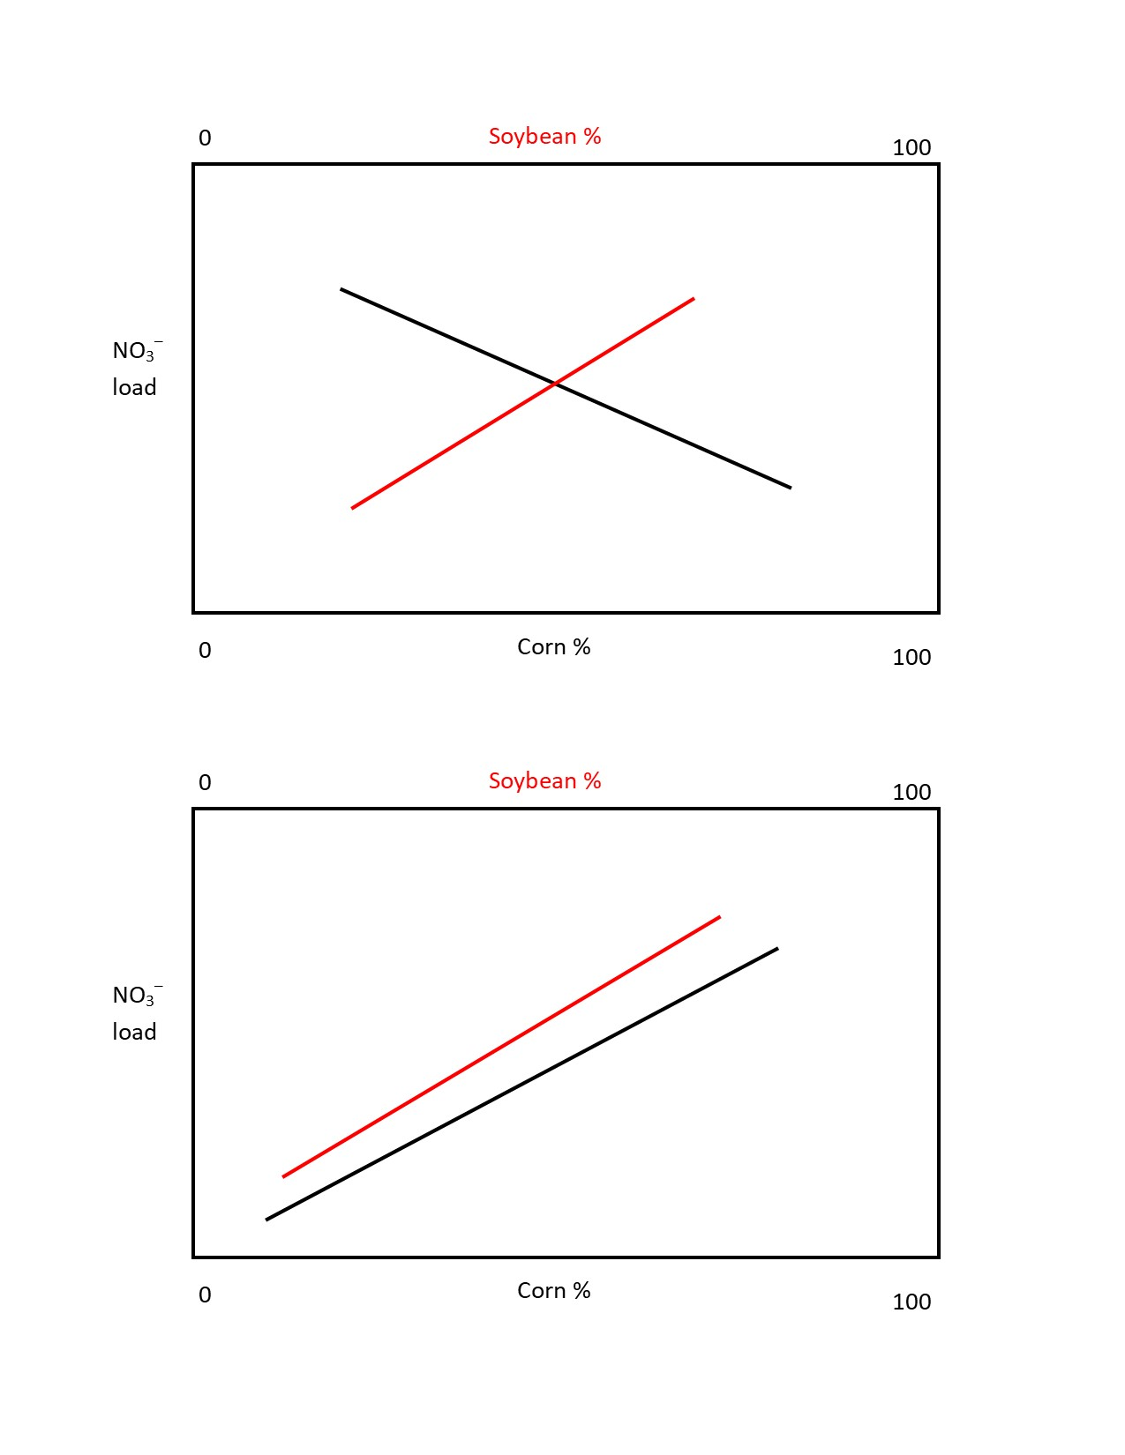
Conclusions & Future Work
Relationship exist but not as expected.
Season Recap
Highest export in spring
Similar export in summer and fall
Lowest export in winter
Collect crop and stream data for 2018
Hypothesis
Collectively
Individual
OR

Slide 20
Questions?

