Slide 1



Evaluating the Maquoketa Group (Ordovician) as a seal for the geologic sequestration of CO₂: A lithofacies and petrophysical case study in the Illinois Basin, Midwest USA
Cristian R. Medina^{1*}; John A. Rupp²; Maria Mastalerz^{1, 3}; Richard W. Lahann¹; and Patrick McLaughlin^{1, 3}
¹Indiana Geological Survey, Indiana University, Bloomington, Indiana
²Indiana University – Department of Earth and Atmospheric Sciences
³Indiana University –School of Public and Environmental Affairs
*crmedina@indiana.edu

Slide 2
Presentation Outline
Project Background
Methodology
Results
Conclusions

Slide 3

Project Background
“The Carbon Storage Assurance Facility Enterprise (CarbonSAFE) Initiative projects focus on development of geologic storage sites for the storage of 50+ million metric tons (MMT) of carbon dioxide (CO₂) from industrial sources...”
Source: https://www.netl.doe.gov
www.carbonsafe-illinois.org

Slide 4
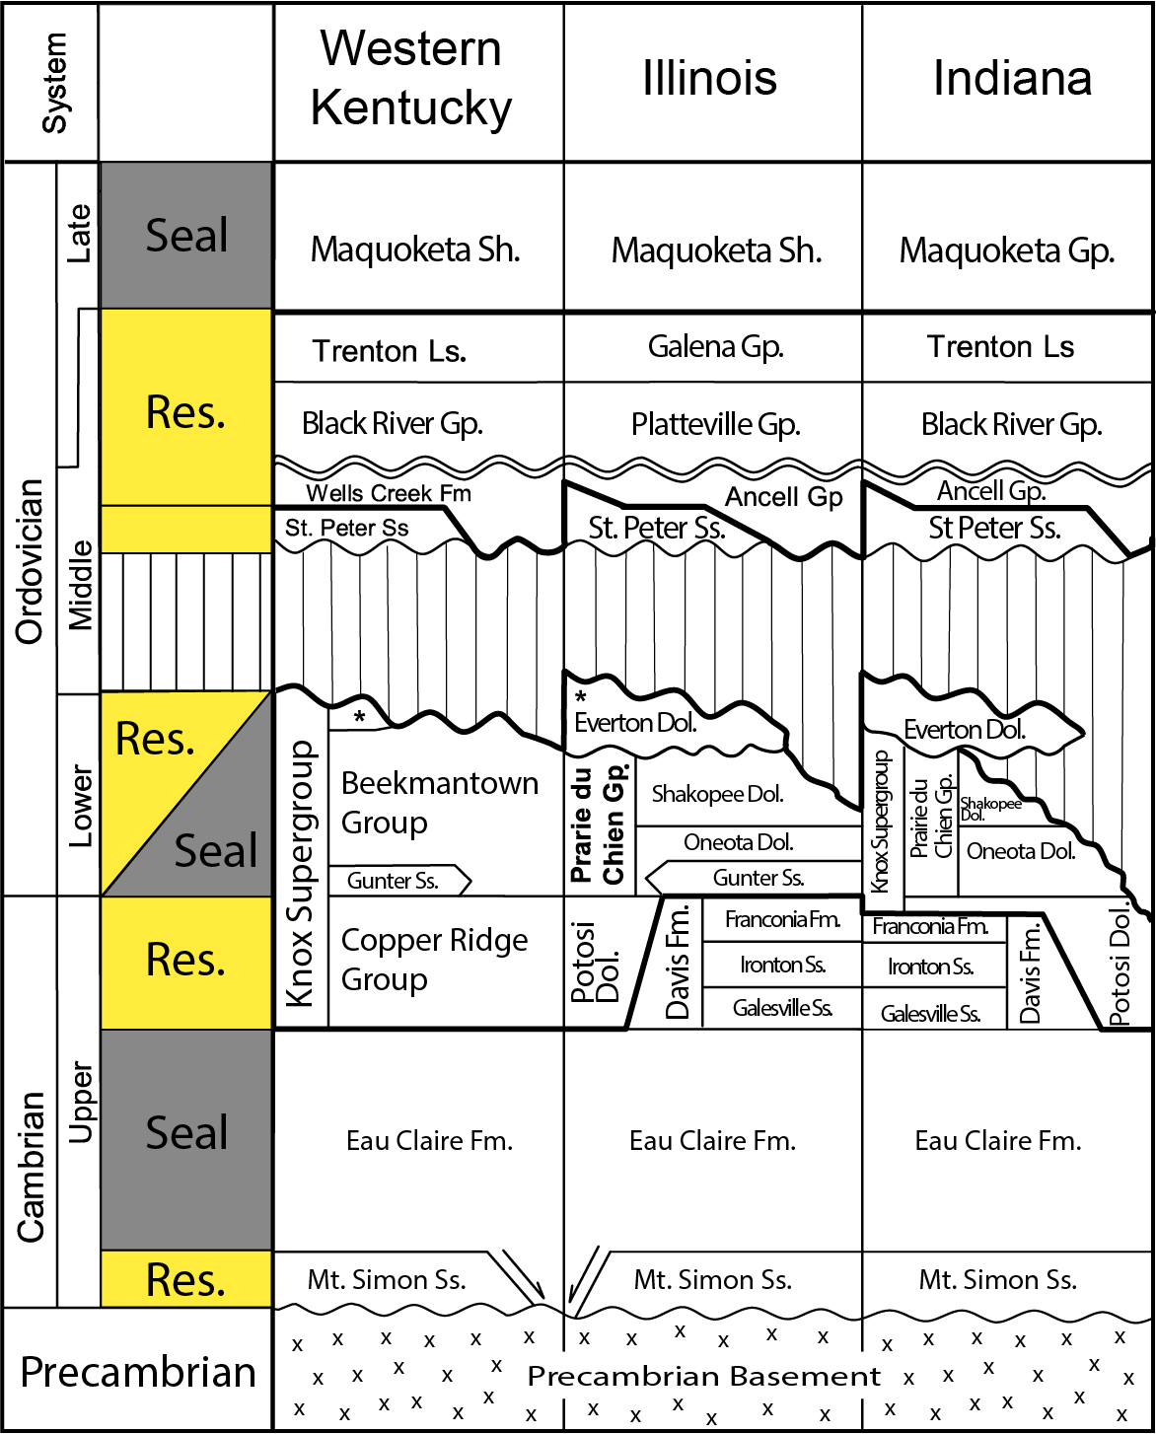
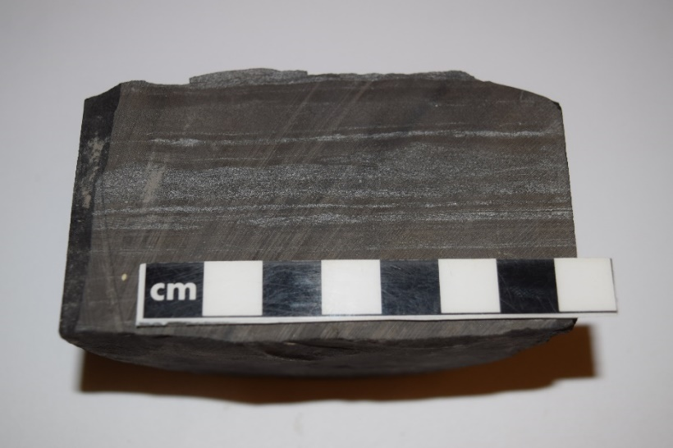
Upper Ordovician Maquoketa Group
A mixed carbonate-clastic succession product of large amounts of fine-grained siliciclastics sediments were shed from the eastern highlands during the Taconic Orogeny.
Project Background
Methodology
Results
Conclusions

Slide 5
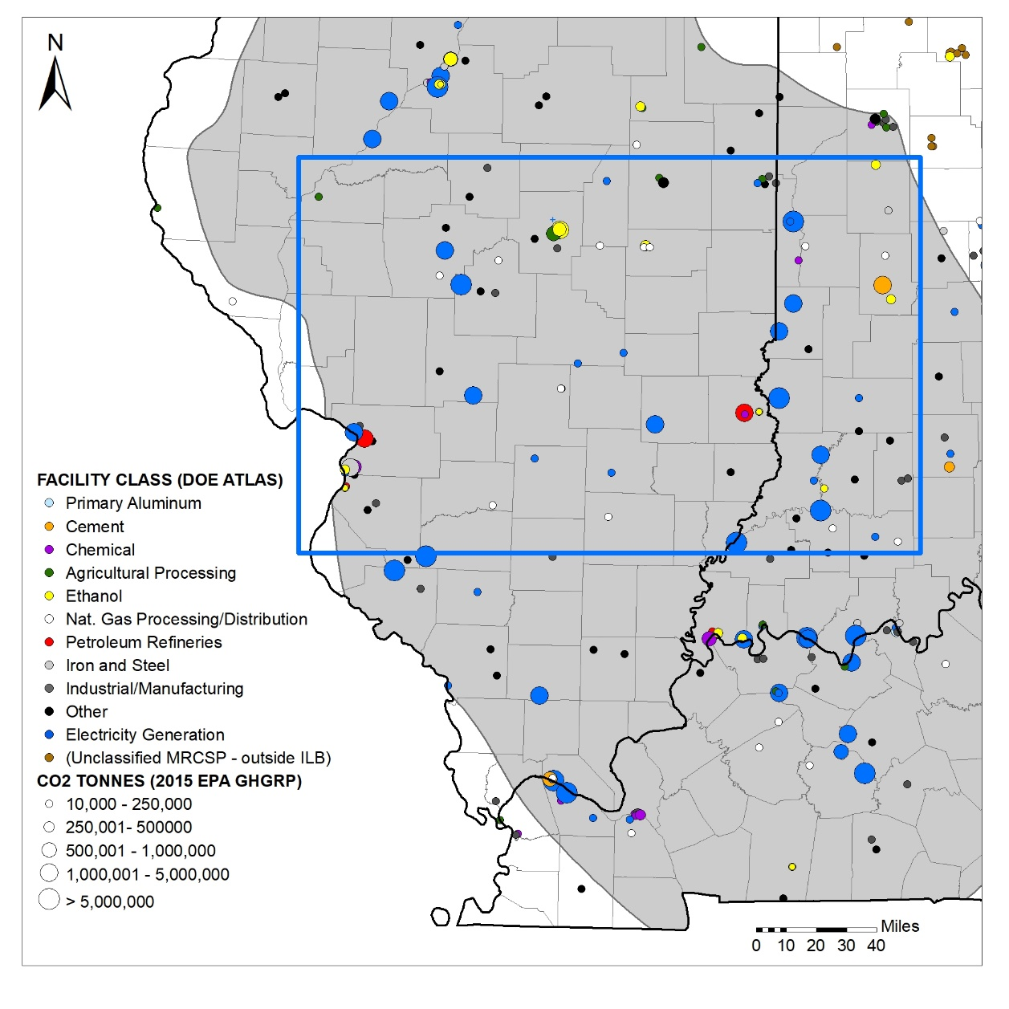
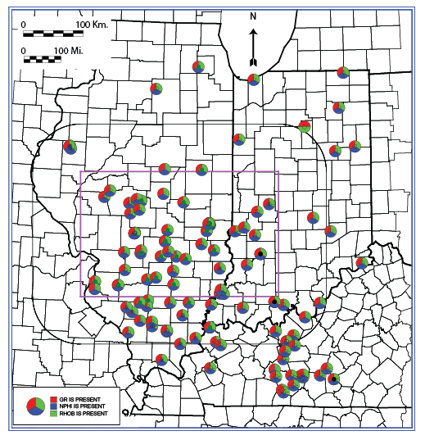
Study Area
Project Background
Methodology
Results
Conclusions

Slide 6
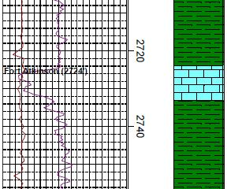
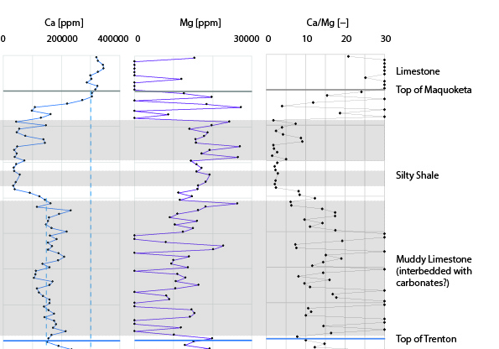
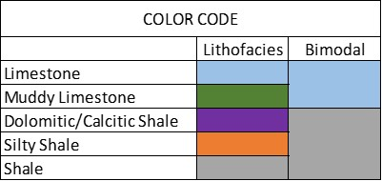
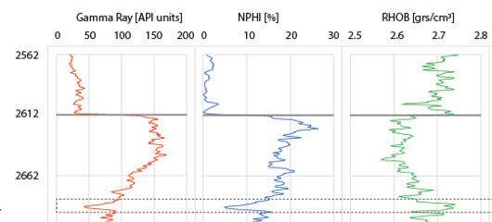
Methodology
Elemental Analysis (ELAN)
Portable X-Ray fluorescence (pXRF)
1
2
3
4
5
Geophysical logs (GR, NPHI, RHOB)
Project Background
Methodology
Results
Conclusions

Slide 7
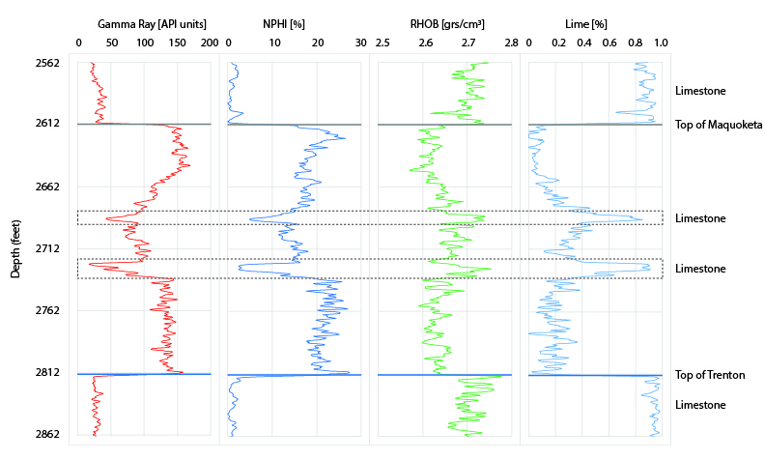
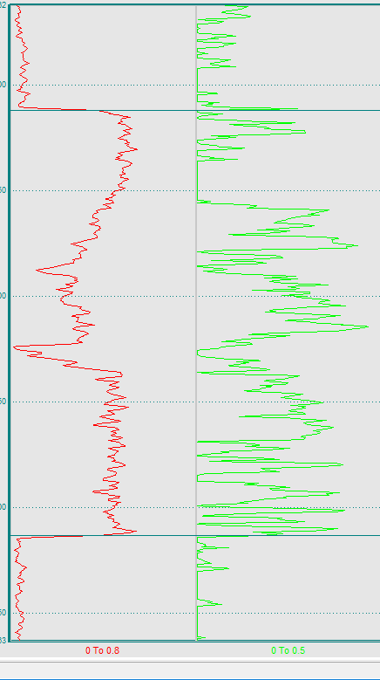
ELAN in ADM Well
1. Limestone: High Ca content (pXRF); low GR; low NPHI; high Ca/Mg ratio.
2. Muddy Limestone: High Si content (pXRF); low GR; medium Ca values.
3. Dolomitic/Calcitic Shale: Medium/high GR; medium-high NPHI; low Ca/Mg ratio.
4-5. Silty Shale or Shale: high GR; high Si content (pXRF).
Project Background
Methodology
Results
Conclusions
ELAN
Illite (Vol.)
Dol. (Vol.)
Silty Shale
Dol. Shale
Dol. Shale

Slide 8
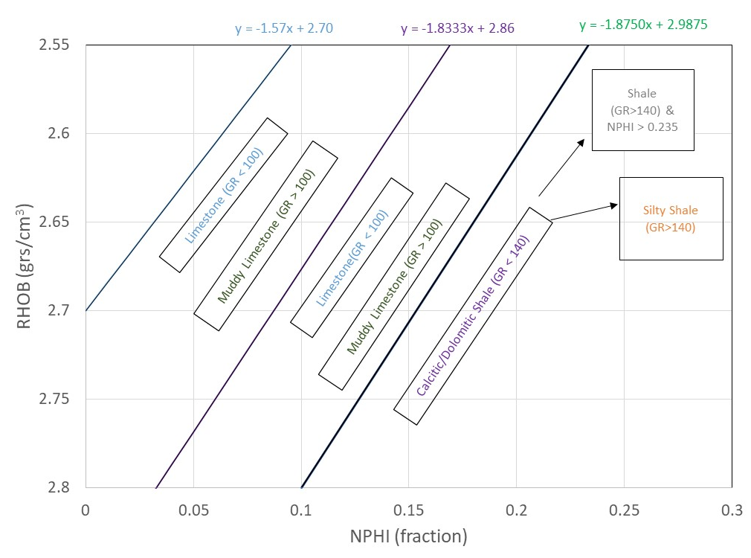
Model
Project Background
Methodology
Results
Conclusions
1
2
3
4
5

Slide 9
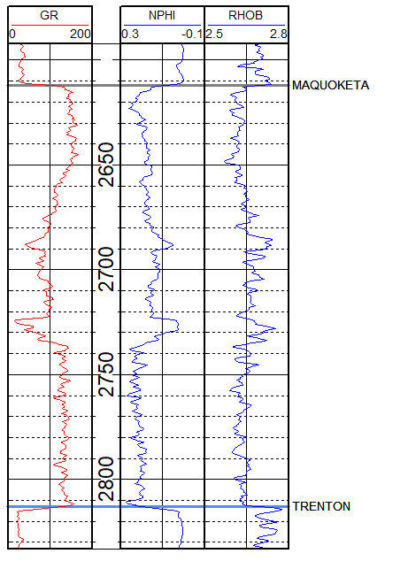
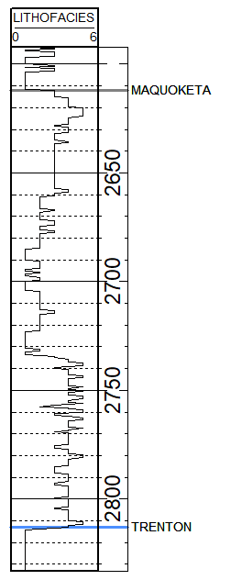
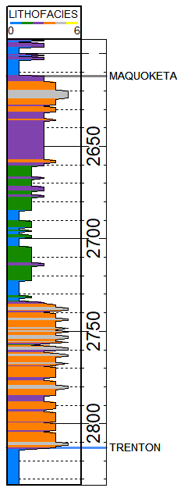
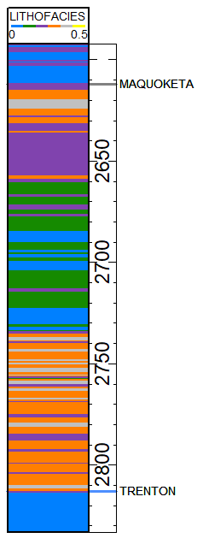
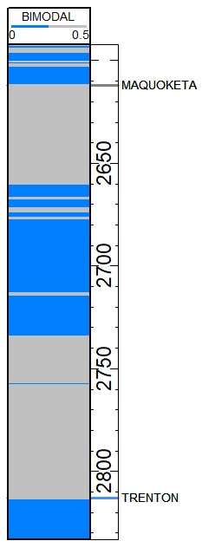
Output at Each Well: Lithofacies Log
1
2
3
4
5

Slide 10
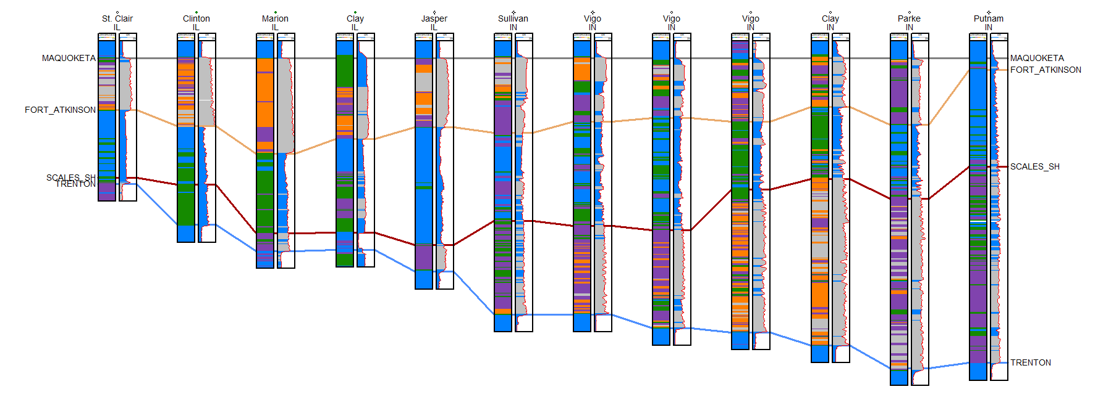
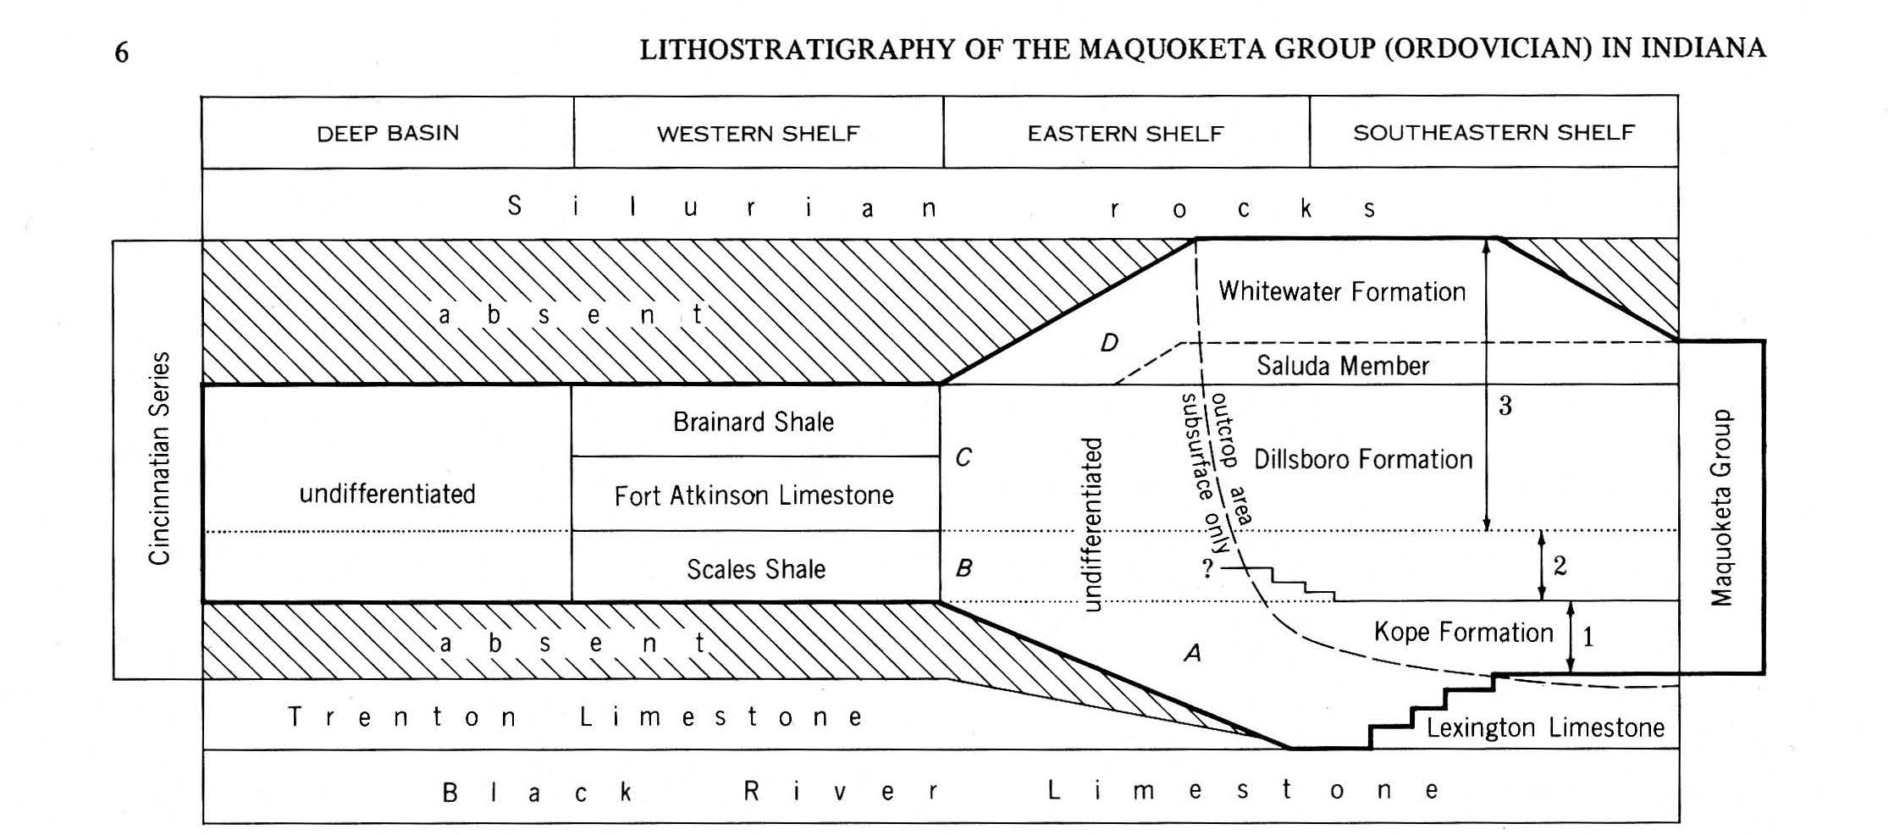
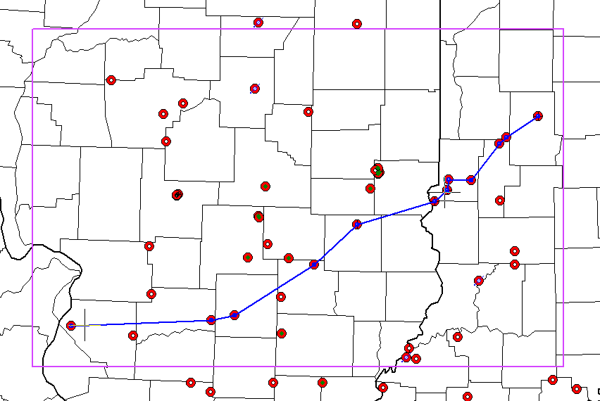
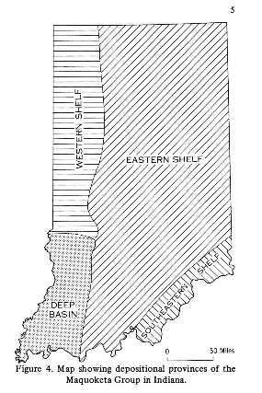
SWW
NEE
Project Background
Methodology
Results
Conclusions
NEE
SWW
Source: Gray, 1972

Slide 11
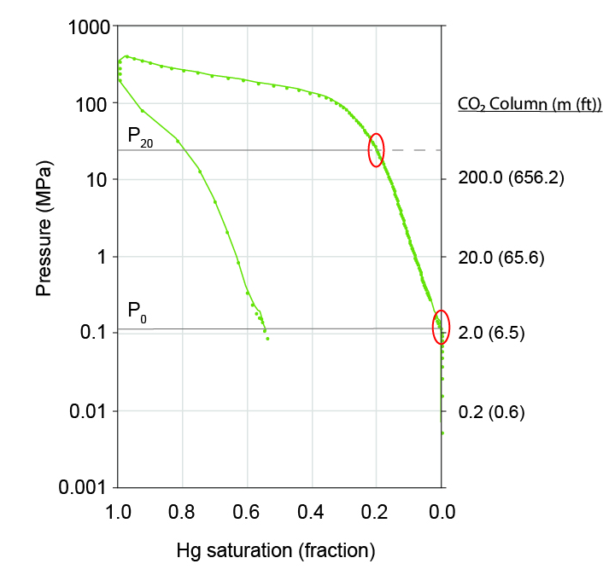


Implications for Sealing Efficiency
Assumptions:
Hg to CO₂ capillary pressure conversion: factor of 12.4:
Hydrostatic pressure gradient: 0.49 (psi/ft) (0.011 (MPa/m))
CO₂ density:
ρ_{co2}(kg/m³) = 712.88 + 0.4427 * P(MPa)
4. CO₂ column (h):
$∆P=\left(ρ_{brine}−ρ_{CO2}\right)gh$:
$h_{20}(m)=\frac{P_{20}}{9.8 ∗12.4∗\left(ρ_{brine}−ρ_{{CO}_{2}}\right)}$
Drainage
Imbibition
CO₂ column assuming 20% intrusion
Notes:
Analysis of 28 samples using a Micromeritics’ Autopore mercury porosimeter (MICP).
The main parameters used to evaluate sealing efficiency were capillary entry pressure (P₀) and pressure at 20% saturation (P₂₀) and related these values to a representative CO₂ column that the samples would be able to hold assuming density-gravity driven upward flow.

Slide 12
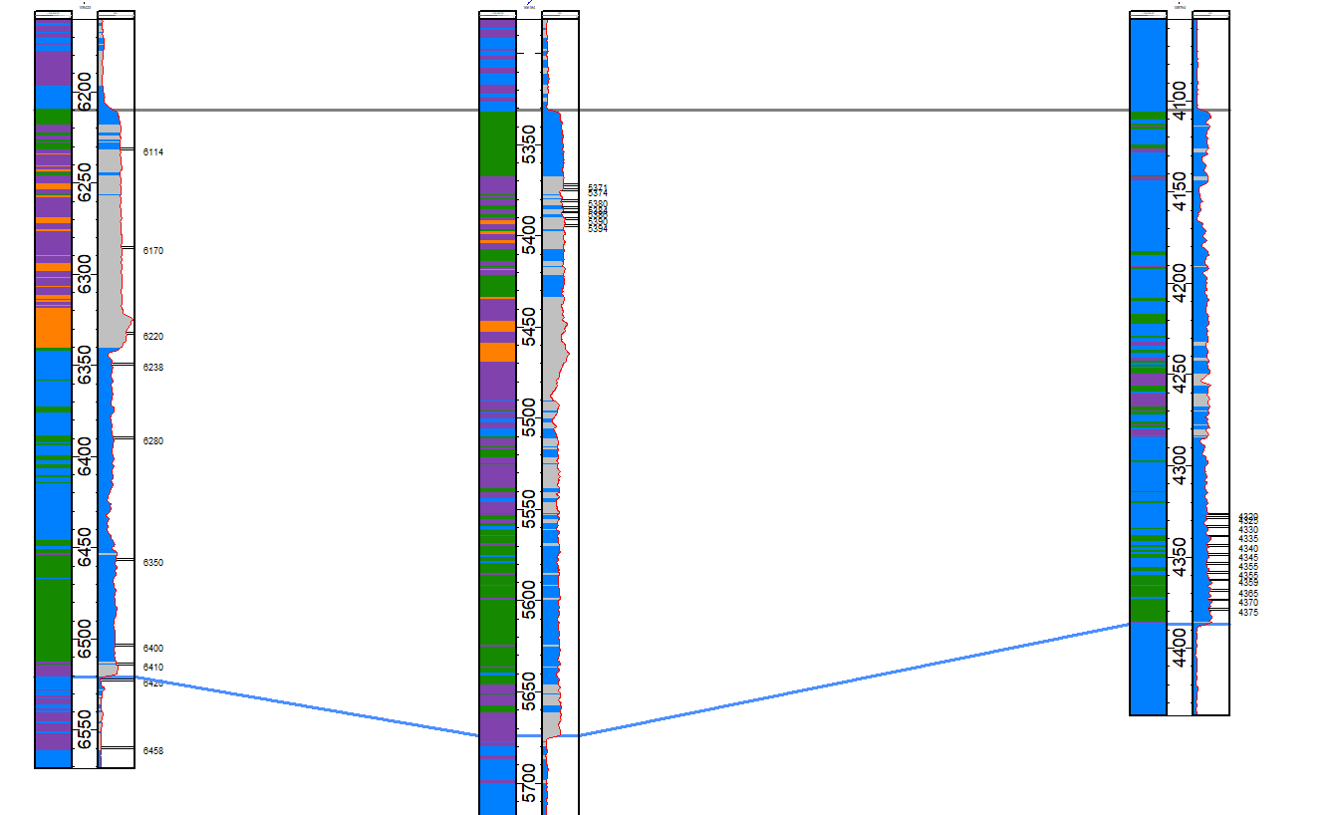
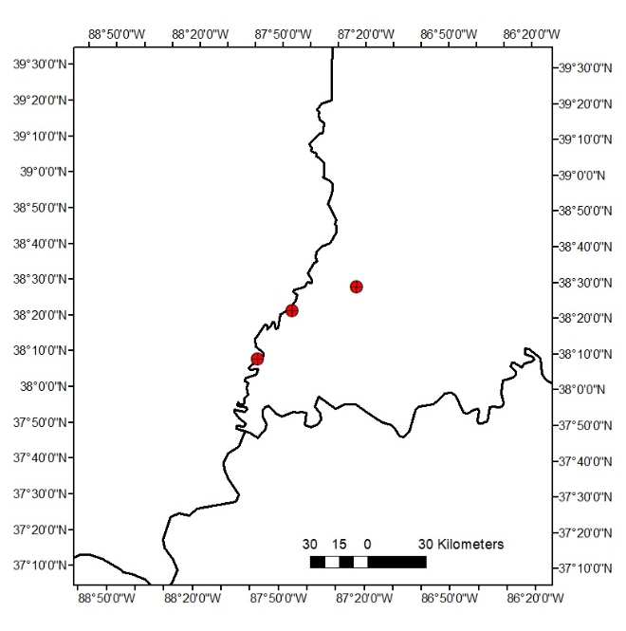
White Co., Illinois
Gibson Co., Indiana
Pike Co., Indiana
Project Background
Methodology
Results
Conclusions
?
?

Slide 13
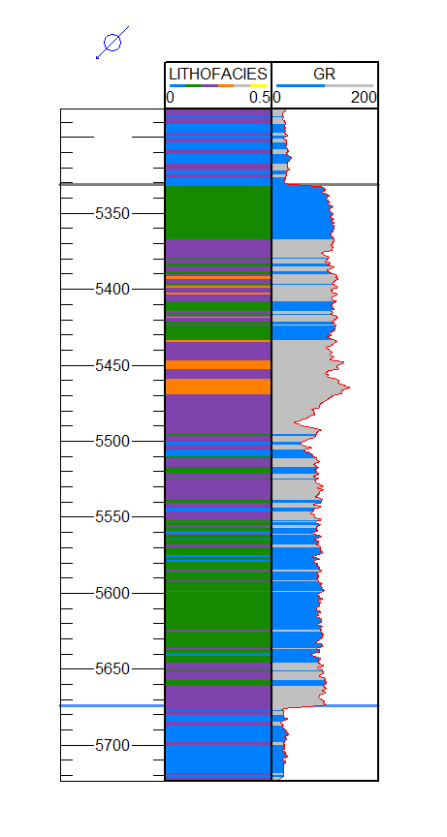
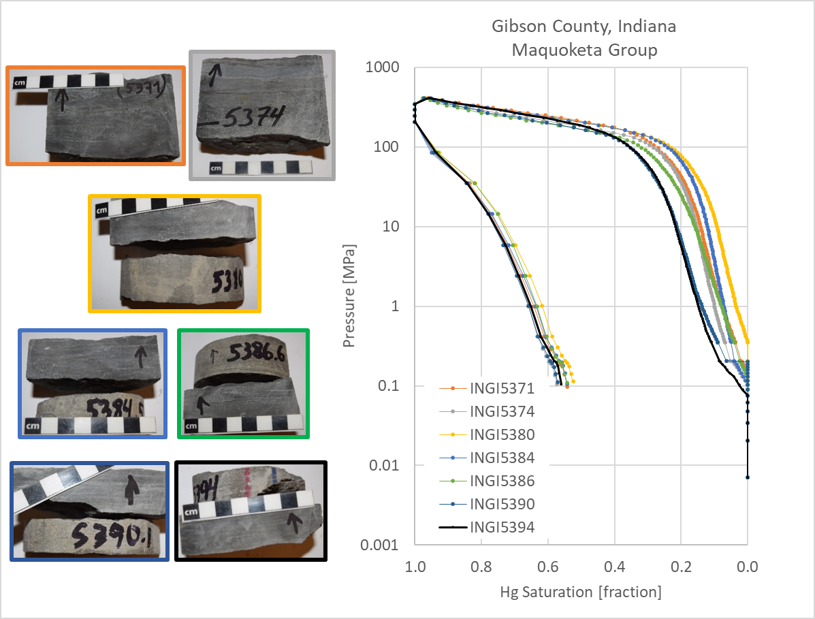
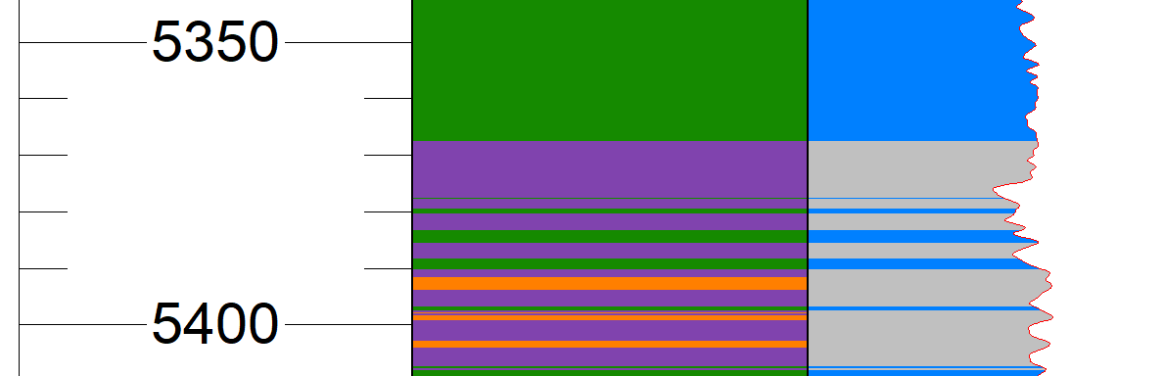
Well #1: Gibson County, Indiana
5370
5400
Project Background
Methodology
Results
Conclusion
Notes:
Hard to link petrofacies model (1 ft scale from logs) to micp profiles (samples of a few centimeters). But some consistencies are observed, such as…

Slide 14
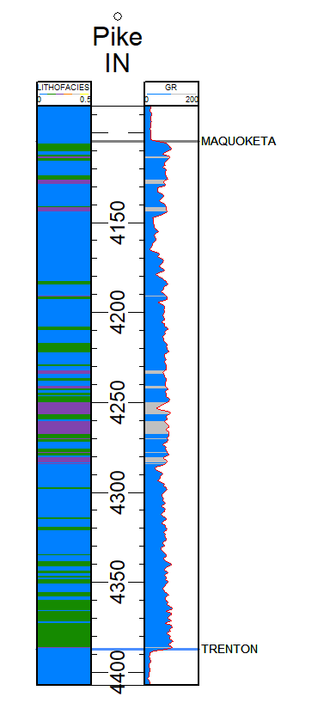

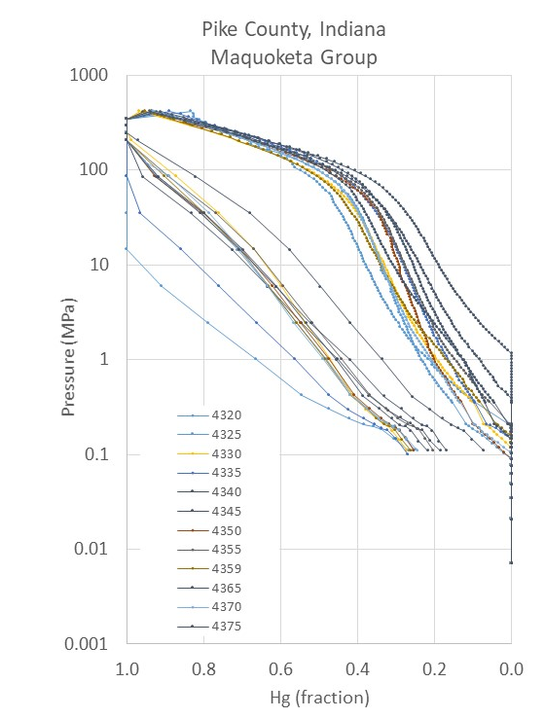
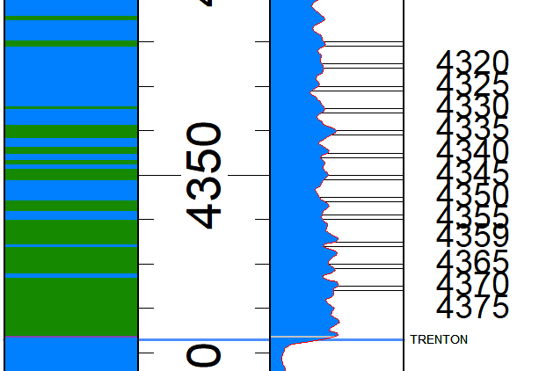
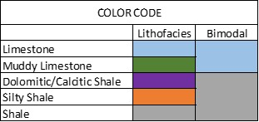
Well #2: Pike County, Indiana
White and Gibson Counties
4320’
Notes:
Pretty homogeneous distribution

Slide 15
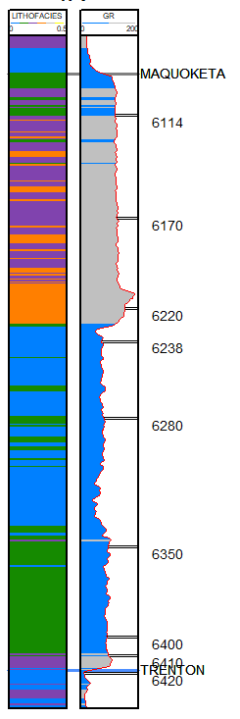
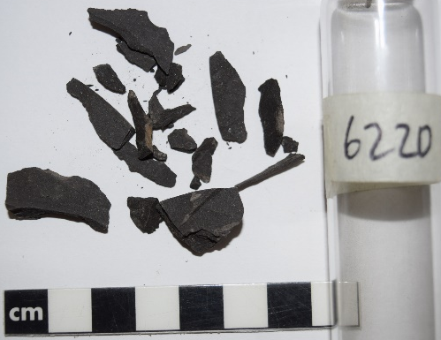
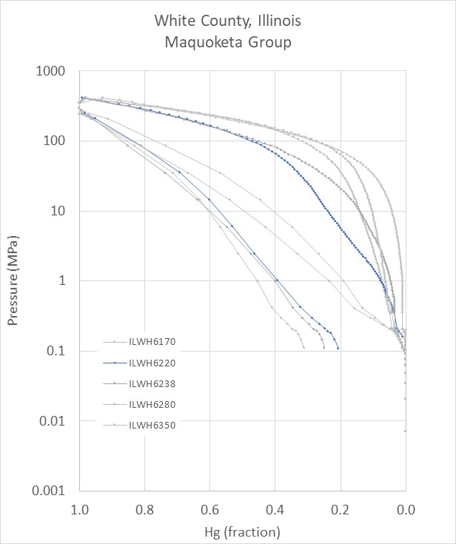
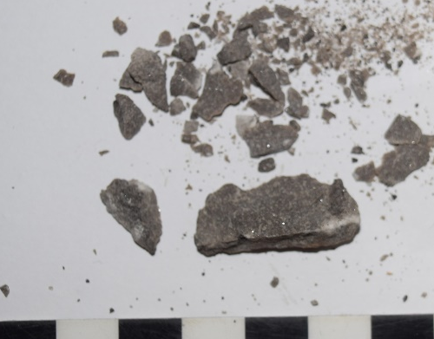
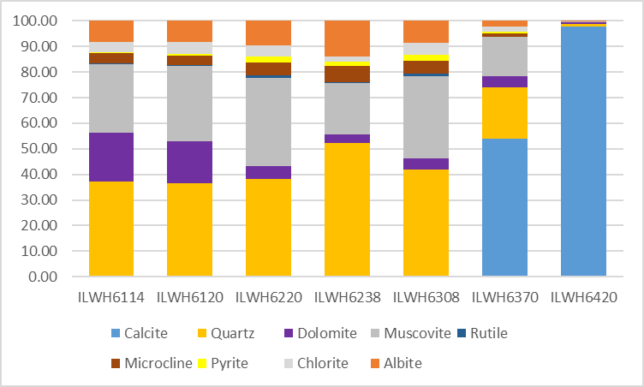
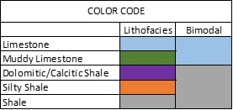
Well #3: White County, Illinois
Trenton Ls.
?
6440”
6220”
XRD
Illite
Notes:
High sulfur content (Py) miught provide additional porosity…

Slide 16
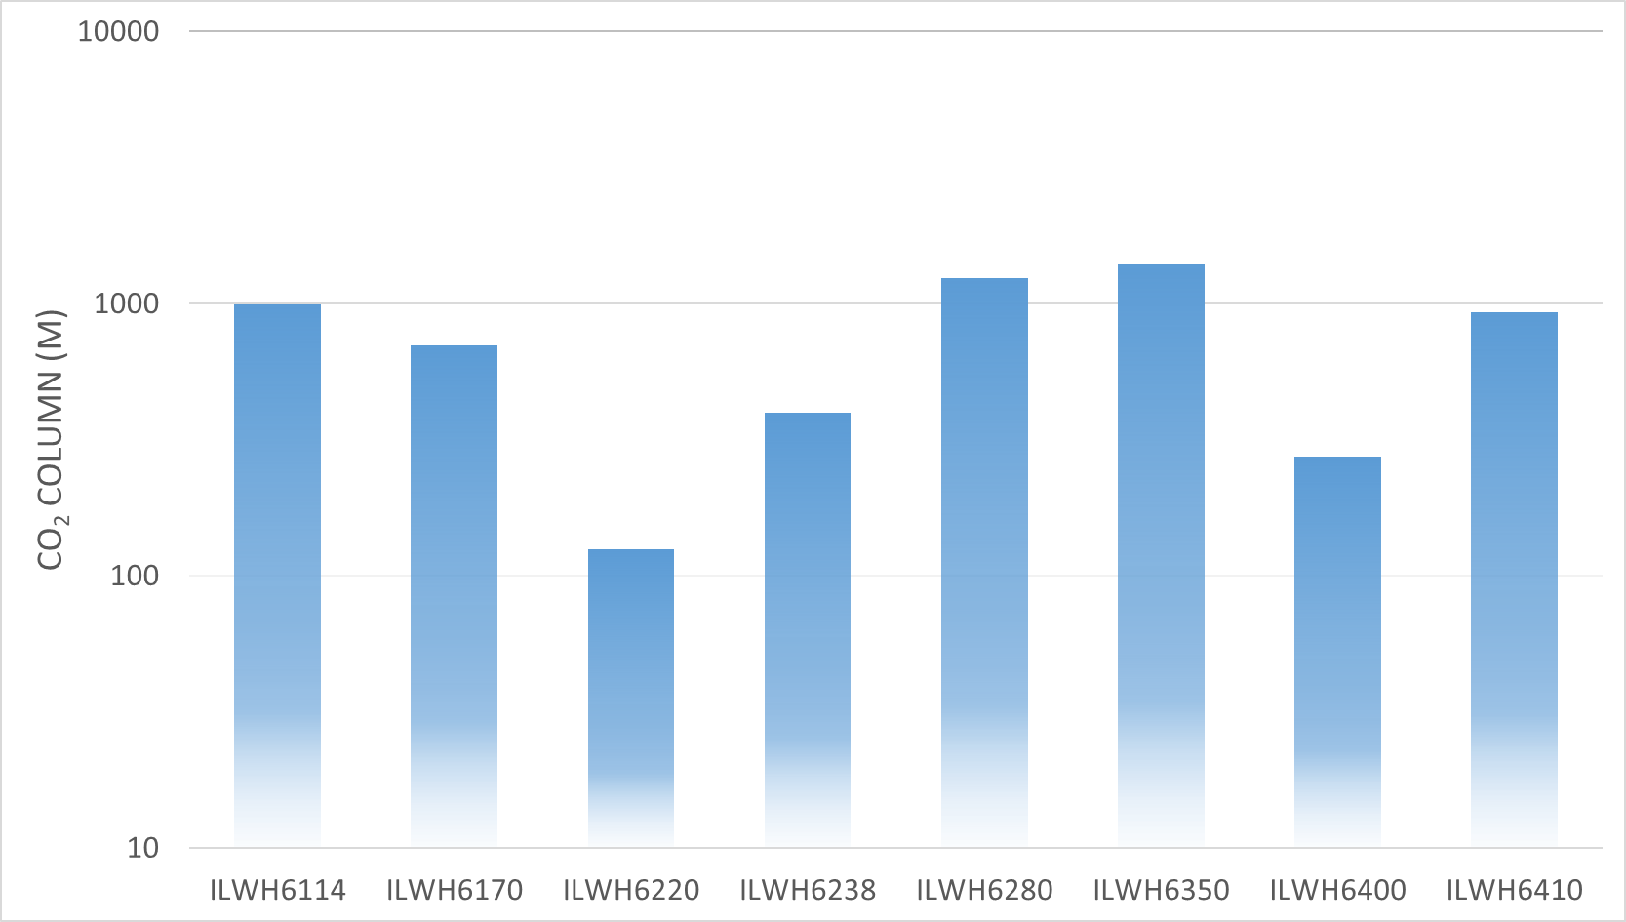
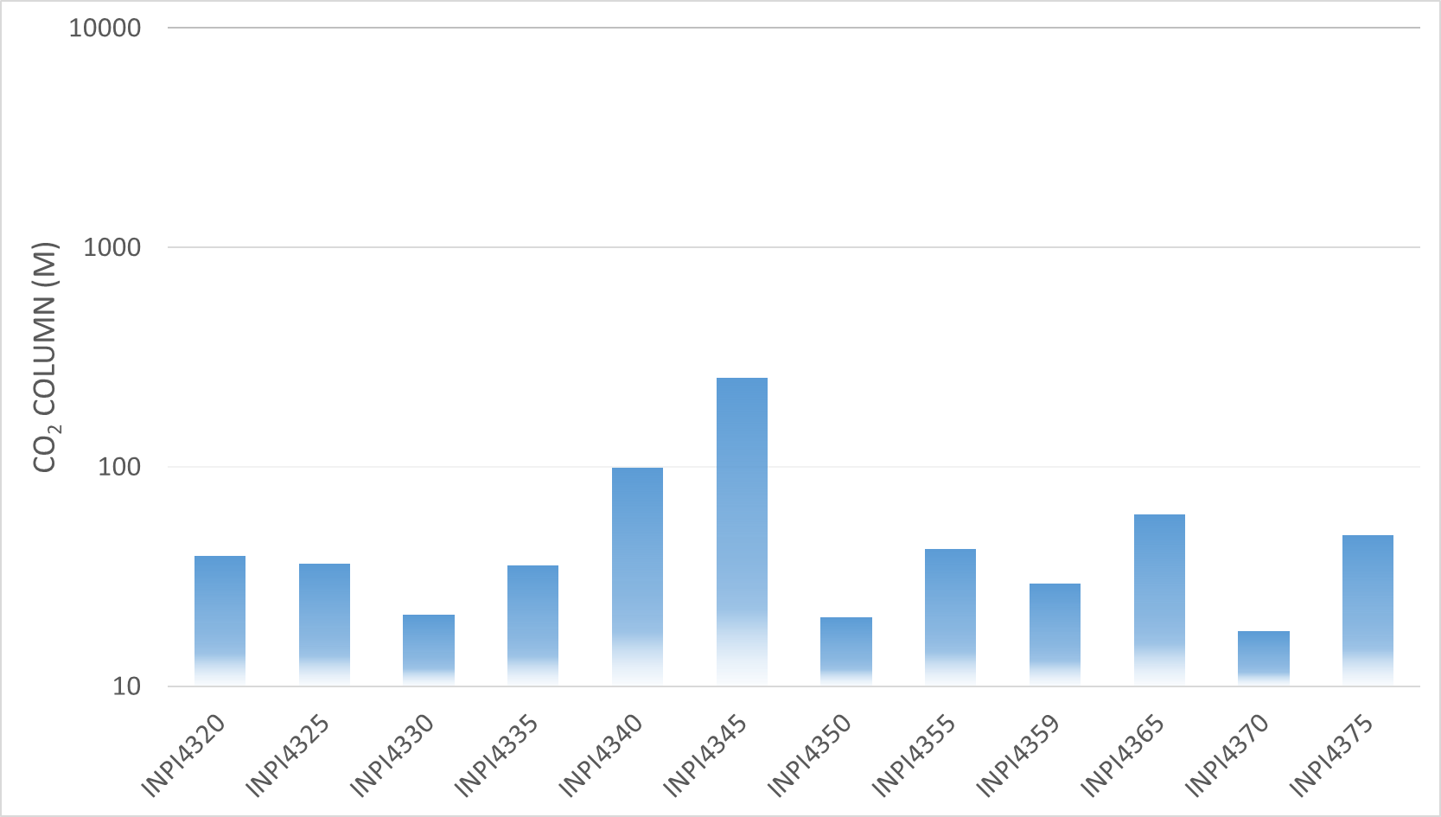
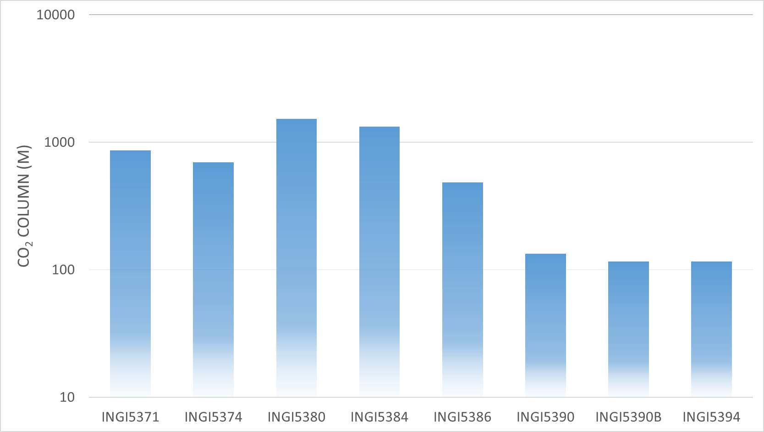
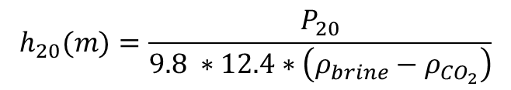
Sealing Efficiency – CO₂ Column
$$h_{20}(m)=\frac{P_{20}}{9.8 ∗12.4∗\left(ρ_{brine}−ρ_{{CO}_{2}}\right)}$$
White County, Illinois
Pike County, Indiana
Gibson County, Indiana

Slide 17
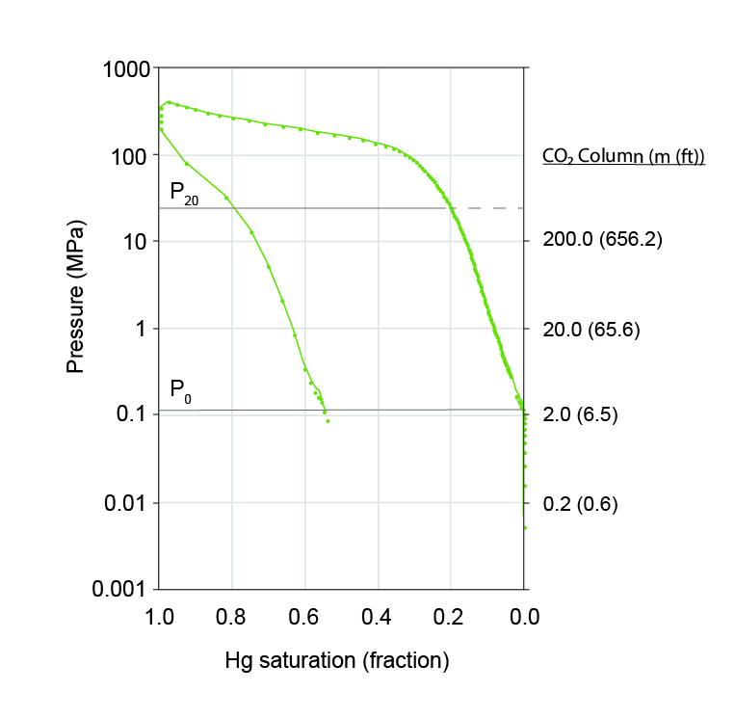
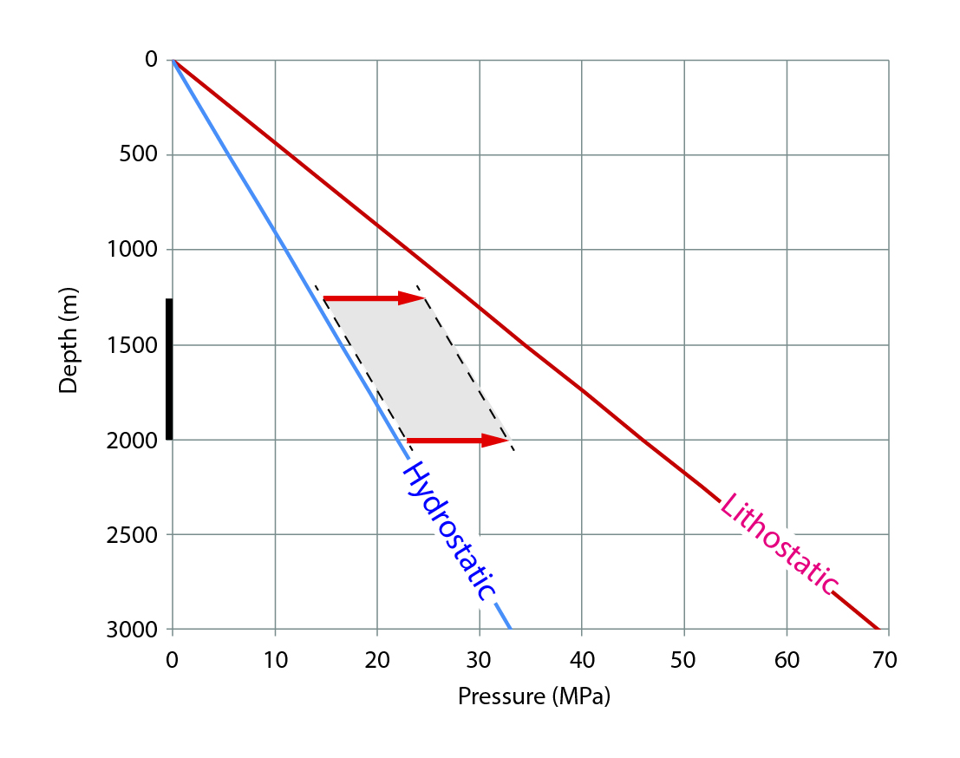
Sealing Efficiency – CO₂ Column
90% lithostatic
P₂₀ ranges between 10-100 MPa
1-10 MPa in CO₂-Brine System

Slide 18
Conclusions
The lithofacies model created from GR, NPHI and RHOB logs looks consistent when compared with
known stratigraphy
previous published work
However, some discrepancies between lithofacies model and petrofacies characteristics are evident and are due to the associated scales (~1 foot resolution for wireline logs versus centimeter-size samples for MICP, gas adsorption, pXRF, and XRD analyses).
Mercury Intrusion Capillary Pressure (MICP) results suggest that, if injecting supercritical CO₂ into the underlying units, the Maquoketa Group will serve as an efficient seal when considering buoyancy-driven upward flow.

Slide 19
Acknowledgements
This project was funded by the US Department of Energy through the CarbonSAFE-Illinois East Sub-Basin Project.

Slide 20
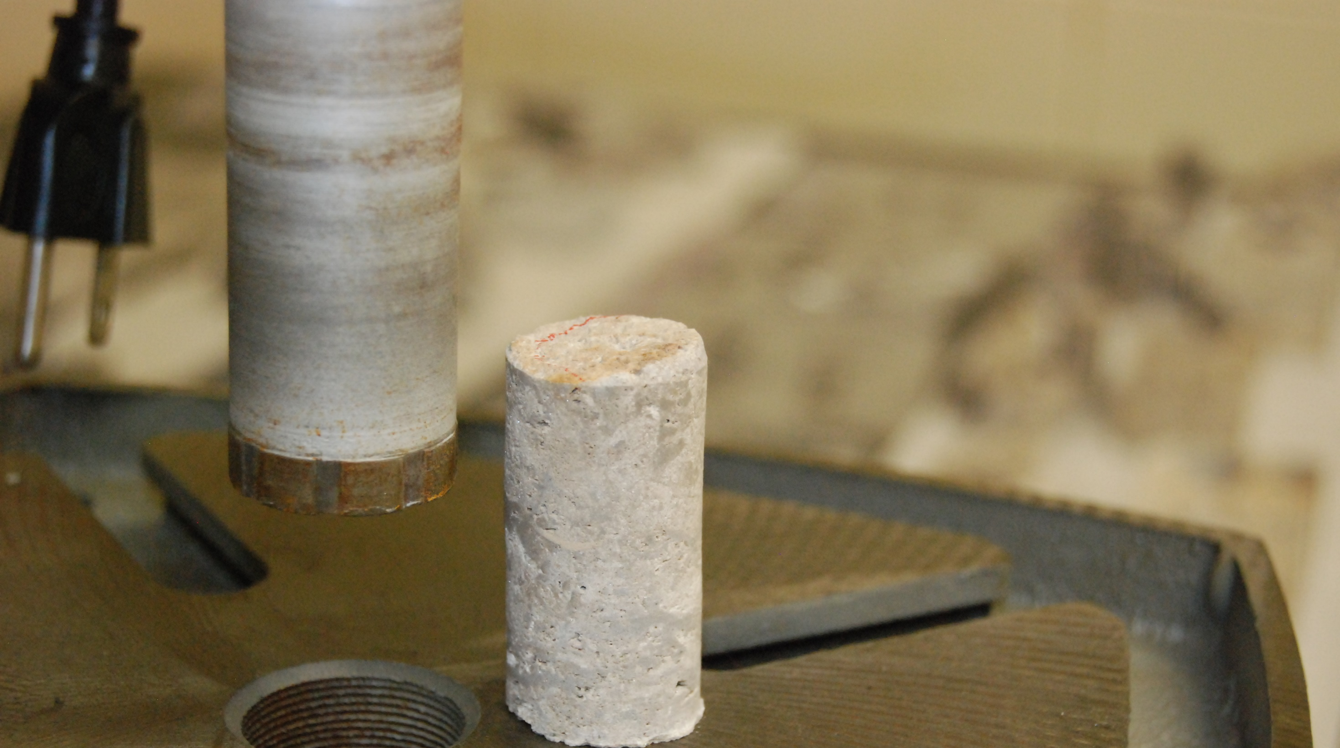
Thank you!
Questions?
Cristian R. Medina
crmedina@indiana.edu

