Slide 1
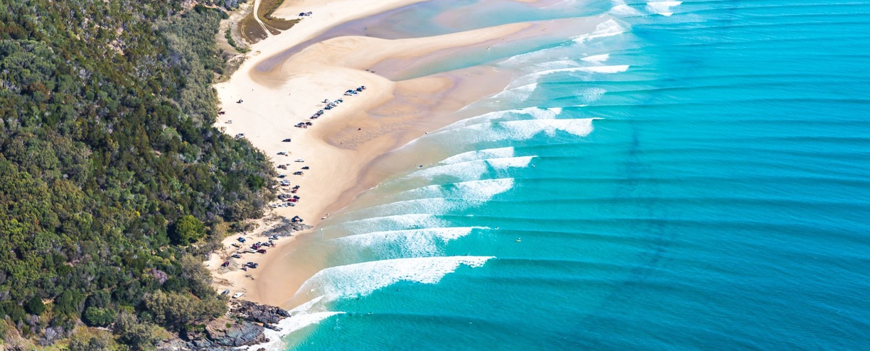
The Impact of Climate Change on Shoreline Dynamics Along Southeast Queensland, Australia
Joshua T. Kelly^{1,2}, Sarah McSweeney³, Jamie Shulmeister⁴, and Allen Gontz¹
¹San Diego State University, ²UCSD Scripps Institution of Oceanography, ³University of Melbourne, ⁴University of Queensland

Slide 2
Motivation
Variability in wave climate expected to be dominant process influencing shoreline change along exposed, sandy coastlines (i.e. Australia, Brazil, North Carolina)(Hemer et al., 2012)
For southeast Australia, wave climate has been well correlated to phases of El Niño-Southern Oscillation (ENSO; Ranasinghe et al., 2004; McSweeney and Shulmeister, 2018)
Where ENSO operates in tropical latitudes, wave climate of SE AU is likely influenced by other climate phenomena operating in the region such as:
Southern Annular Mode (SAM; Goodwin, 2005)
Subtropical Ridge (STR; Hemer et al., 2013)
There have been no attempts at understanding the relative influence of ENSO, SAM, and STR on shoreline change in SEQLD, or in SE AU in general.

Slide 3
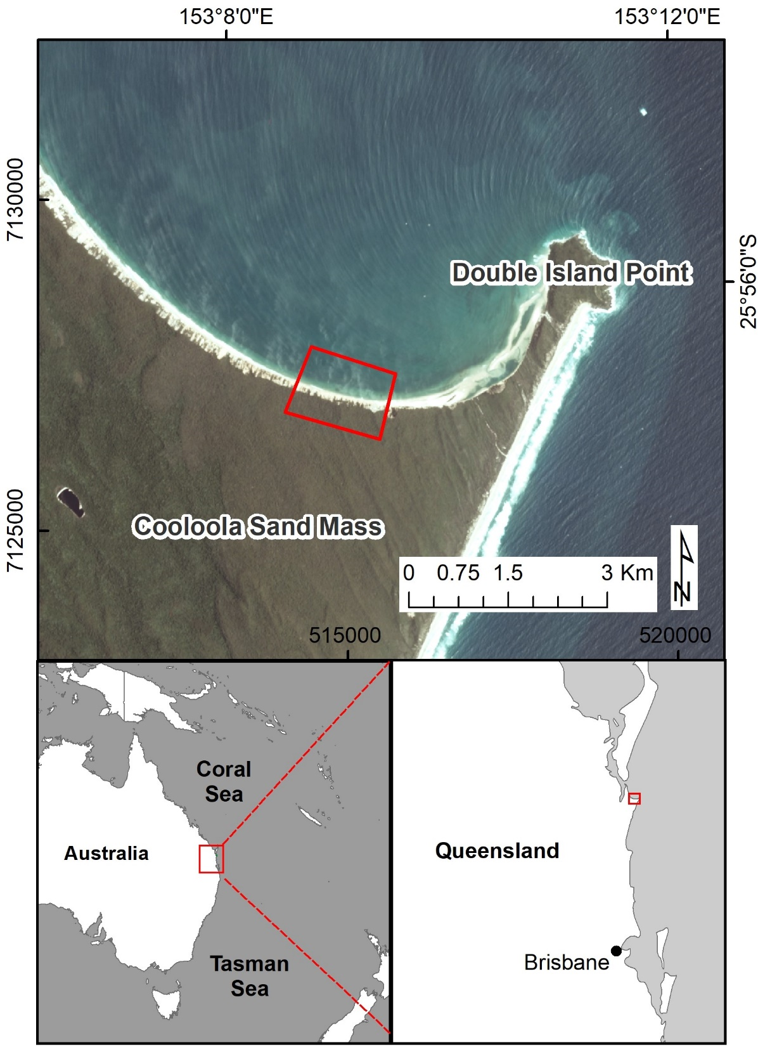
Study Area
Rainbow Beach, Cooloola Sand Mass, SEQLD
1 km stretch
Wave-dominated, micro-tidal
Shoreline supplied by an extensive, 1,100 km long longshore transport system that originates in New South Wales (transports 500,000 m³/yr of sand, Walker et al., 2018)
Sediment is sourced from the Hawkesbury Sandstone
Ultra mature - 98% Quartz/2% heavy minerals and feldspar (Thompson, 1983)

Slide 4
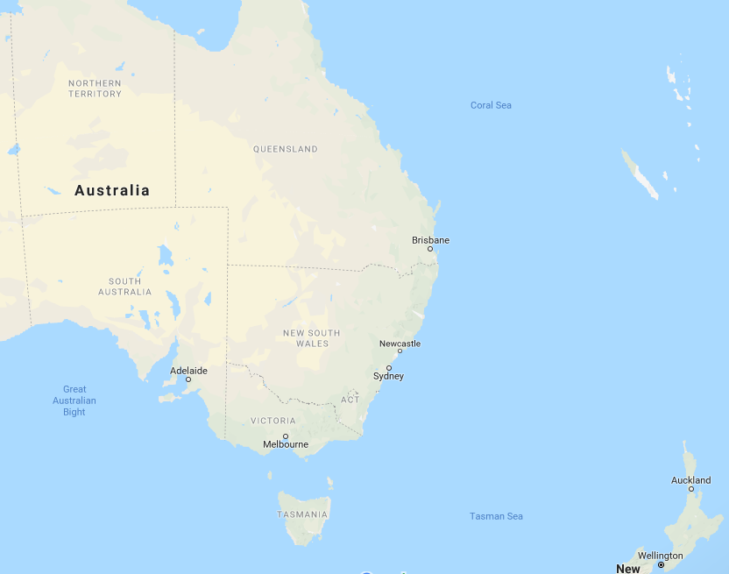
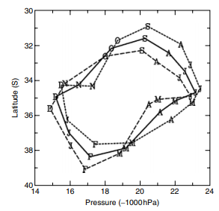
Ranasinghe et al., 2004
Goodwin, 2005
McSweeney and Shulmeister, 2018
La Niña (higher H_{s})
Positive SAM
Drosdowsky, 2005
Incident Wave Direction
Subtropical Ridge
Latitude Range
Incident Wave Direction
El Niño (lower H_{s})
Negative SAM

Slide 5
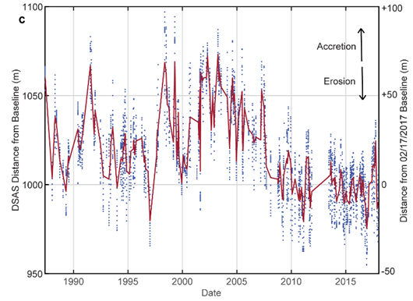
Shoreline Dataset
Shorelines mapped on 147 cloud-free Landsat 5, 7, and 8 scenes from 1996 to 2017
Shoreline interpreted as the boundary of water and non-water pixels determined by the Modified Normalized Difference Water Index (MNDWI, Xu 2006)
USGS Digital Shoreline Analysis System (Thieler et al., 2009) used to calculate rate-of-change statistics on the shoreline vector data
Shoreline distance measured at 20 transects and averaged to construct a change curve

Slide 6
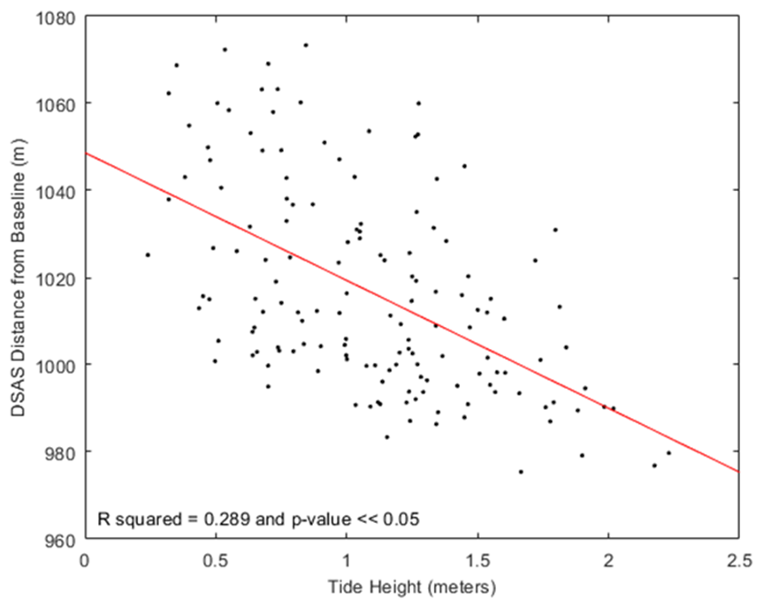
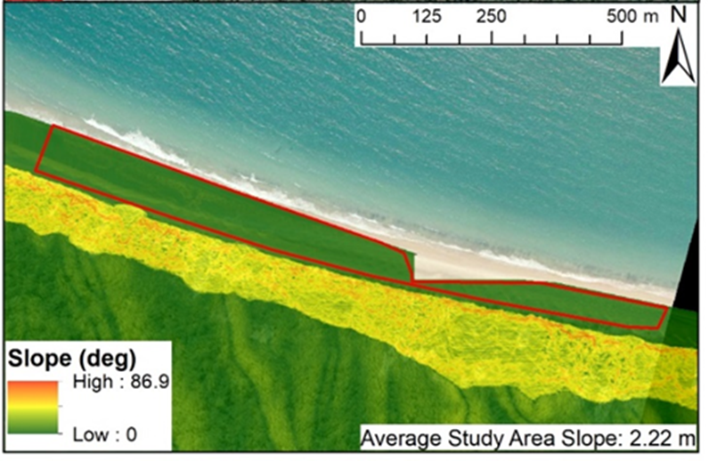
Tidal Correction
Significant horizontal offsets due to variable tide stages at the time of Landsat flyover
Width of intertidal zone estimated using 1 m LiDAR dataset:
Width = Vertical Tide Range/sin(Beach Slope) = 31.5 m
Difference between Landsat flyover tide height and high tide height provides % of total tide range shoreline has moved
Absolute distance the “shoreline” has moved due to tides is 31.5 m * % tide range (100% is low tide)

Slide 7
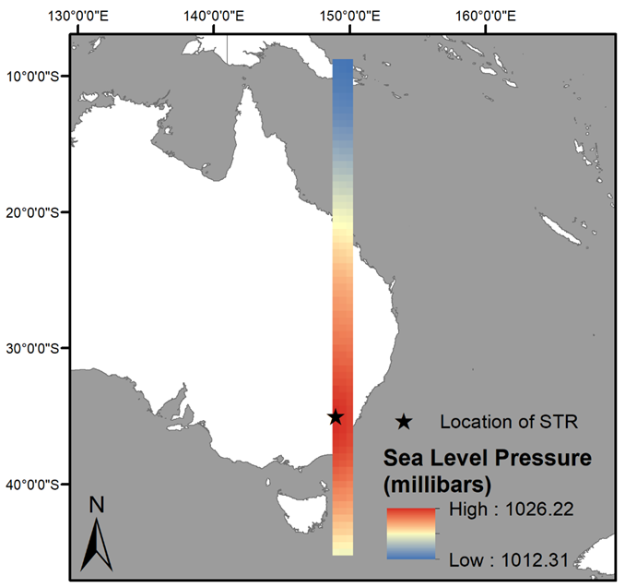
Climate Data
Monthly mean Southern Oscillation Index (SOI) from NOAA
Monthly mean Southern Annular Mode (SAM) from NWS
NCEP/NCAR Reanalysis Mean Sea Level Pressure from NOAA
The L Index of Drosdowsky, 2005 describes the latitudinal position of the STR – no public dataset
Reconstructed here using the MSLP data
Location (STR-L) and intensity of the peak (STR-P) MSLP over the 150° E band extracted for 264 time slices
Location of STR in May 2017

Slide 8
Correlation Procedure
3-month moving average filter applied to SOI, SAM, STR-L, and STR-P datasets
Climate time series datasets (n=264) interpolated to match sample size of shoreline position time series (n = 147)
Pearson correlation analyses performed on tidally-corrected shoreline distances and the four climate datasets
Correlation coefficient function in Matlab R2017b returns matrix of correlation coefficients, p-values, and lower and upper bounds for a 95% Confidence Interval

Slide 9
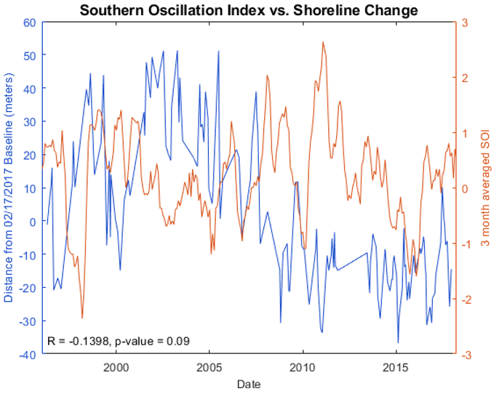
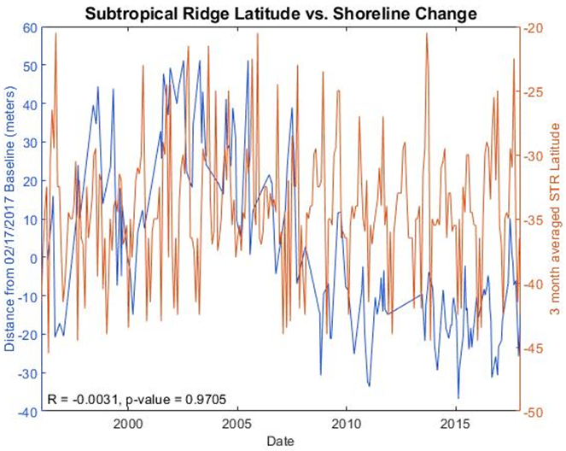
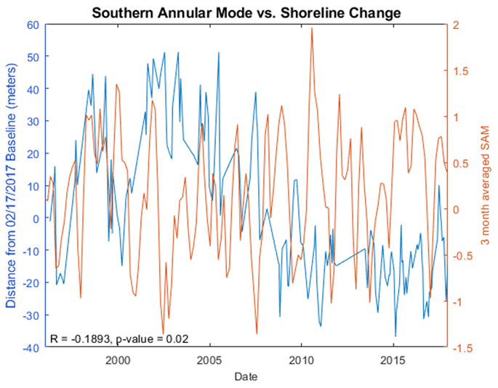
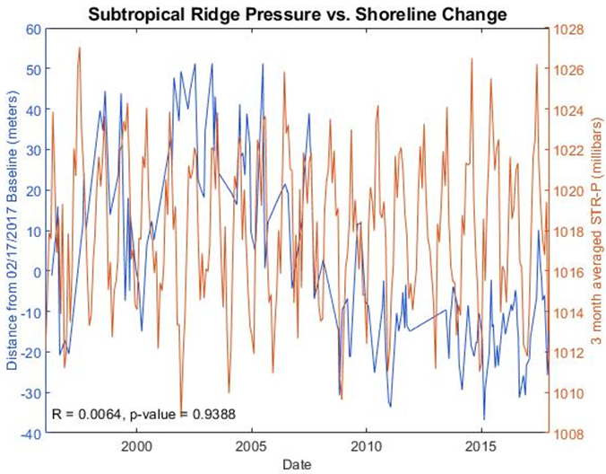
Results
SOI (R = -0.14) and SAM (R = -0.19) both show negative correlation with shoreline change
Shoreline retreats (progrades) during both positive (negative) SOI and SAM phases
Relatively low Pearson coefficient values attributed to noise of shoreline dataset
STR-L and STR-P show no observed correlation

Slide 10
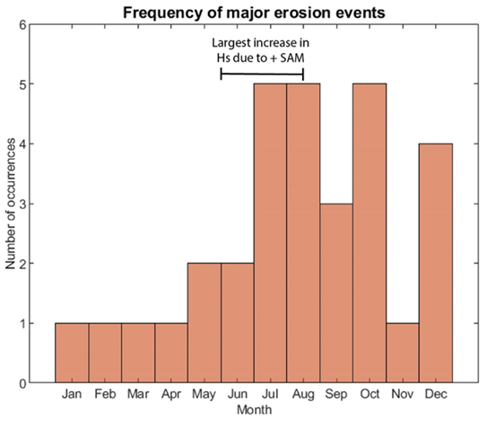
Shoreline Change and SAM
Very recent work has suggested SAM influences wave climate along the QLD coast (Marshall et al., 2018)
Marshall et al. (2018) show there is a 0.1-0.2 m increase in significant wave height during positive SAM phases, largest impact in austral winter (JJA)
Of 31 episodes of significant erosion (>10 m) detected, 20 occurred during or within 2 months of austral winter
We suggest for the first time that SAM has a likely influence on shoreline dynamics along the SEQLD coast

Slide 11
Future Climate Implications
Negative correlation between SOI/SAM and shoreline positions provides valuable insight into how the study area (and other similar AU shorelines) may respond to future predicted climate changes
Climate Index | Predicted Change | Wave climate impacts in SE AU | Shoreline impacts (based on this work)
Southern Annular Mode | Continue to become more positive (Arblaster et al., 2011; Hemer et al., 2010) | Increased wave energy flux due to enhanced northward propagating swell | Shoreline retreat
El Niño-Southern Oscillation | Continuous rise in global T will promote stronger La Niña anomalies (L’Heureux et al., 2013) Frequency of extreme La Niña events expected to increase 56% (Cai et al., 2015) | More La Niña-like wave climate: easterly wave incident wave direction and elevated sig. wave heights up to 0.1 m (McSweeney and Shulmeister, 2018) | Shoreline retreat

Slide 12




Acknowledgements
Support:
Allen Gontz, San Diego State University
Sarah McSweeney, The University of Melbourne
Jamie Shulmeister, The University of Queensland
Funding:
San Diego State University, Geological Society of America
Data:
USGS, NOAA, NWS, Queensland Government

Slide 13
Thank you for your attention
Barnard P.L., Short A.D., Harley M.D., Splinter K., Vitousek S., Turner I., Allan J., Banno M., Bryan K., Doria A., Hansen J., Kato S., Kuriyama Y., Randall-Goodwin E., Ruggiero P., Walker P., Heathfield D., 2015. Coastal vulnerability across the Pacific dominated by El Niño/Southern Oscillation. Nat. Geosci. 8, 801-807.
Drosdowsky, W., 2005b. The latitude of the subtropical ridge over Eastern Australia: TheL index revisited. Int. J. Climatol. 25, 1291–1299
Goodwin, I. D., 2005. A mid-shelf, mean wave direction climatology for Southeastern Australia, and its relationship to the El Niño-Southern Oscillation since 1878 A.D. Int. J. Climatol. 25, 1715-1729.
Hemer, M.A., McInnes, K.L., Ranasinghe, R., 2012. Climate and variability bias adjustment of climate model-derived winds for a southeast Australian dynamical wave model. Ocean Dyn. 62, 87–104.
Marshall, A.G., Hemer, M.A., Hendon, H.H., McInnes, K.L., 2018. Southern Annular Mode impacts on global ocean surface waves. Ocean Model. 129, 58-74.
McSweeney, S., Shulmeister, J., 2018. Variations in wave climate as a driver of decadal scale shoreline change at the Inskip Peninsula, southeast Queensland, Australia. Estuar. Coast. Shelf Sci. 209, 56-69.
Ranasinghe, R., McLoughlin, R., Short, A., Symonds, G., 2004. The Southern Oscillation Index, wave climate, and beach rotation. Mar. Geol. 204, 273-287.
Thieler, E.R., Himmelstoss, E. A., Zichichi, J. L., Ergul, A., 2017. Digital Shoreline Analysis System (DSAS) version 4.0 - An ArcGIS extension for calculating shoreline change (ver. 4.4, July 2017): U.S Geological Survey Open-File Report 2008-1278, https://pubs.er.usgs.gov/publication/ofr20081278
Thompson, C., 1983. Development and weathering of large parabolic dune systems along the subtropical coast of eastern Australia. Zeitschrift fur Geomorphologie, Supplementband. 45, 205–225.
Walker, J., Lees, B., Olley, J., Thompson, C., 2018. Dating the Cooloola coastal dunes of South-Eastern Queensland, Australia. Mar. Geol. 398, 73–85.
Xu, H., 2006. Modification of normalised difference water index (NDWI) to enhance open water features in remotely sensed imagery. Int. J. Remote Sens. 27, 3025-3033.

