Slide 1



Using Optically Stimulated Luminescence Dating of Beach Ridges to Measure Barrier Progradation
Julie Torres
Mark Kulp
Ioannis Georgiou
University of New Orleans
Duncan FitzGerald
Boston University
Kenneth Lepper
North Dakota State University
Notes:
Understanding the past morphodynamic evolution of barrier islands is necessary to determine their probable response to future relative sea level rise. The aim of this research was to reconstruct the growth of a barrier island by dating its beach ridges using OSL. This type of information has been lacking for all of LA’s barriers.
to refine and expand the current body of knowledge about the spatial extent and age of the Grand Isle barrier lithosome, 2) to provide an estimate of the sediment source and transport rates responsible for island growth, 3) to provide an evolutionary history

Slide 2
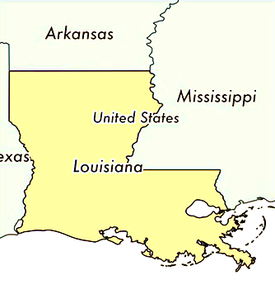
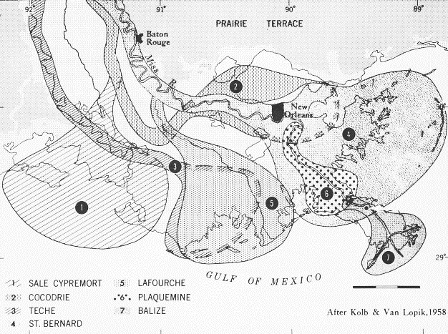
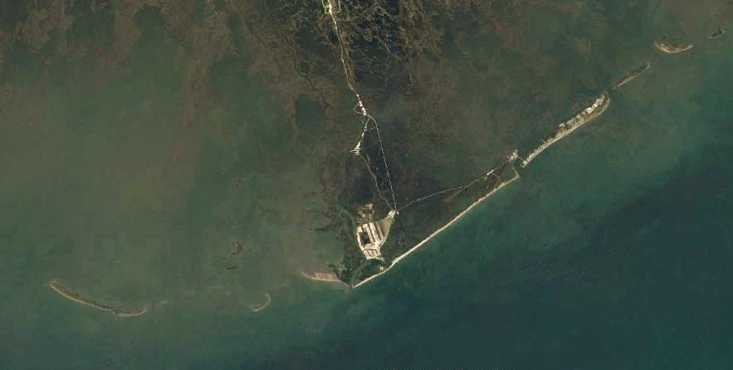

(a)
(modified 2015 Landsat satellite image from USGS Landsat Viewer)
90.25°
90°
Barataria
Bay
Barataria
Pass
Bayou Lafourche
Caminada
Pass
Grand Isle
29.2°
Timbalier
Bay
Caminada Headland
Gulf
of
Mexico
Timbalier Island
E. Timbalier Is.
10 km
90.5°
90.15°
2
Notes:
And that barrier is Grand Isle, Louisiana
Product of an old Mississippi River delta complex & part of the Bayou Lafourche transgressive depositional system, which consists of the central erosional Caminada headland & flanking barrier islands on either side.
Since abandonment of Lafourche delta, shoreface erosion has actively supplied sand for growth & development of Grand Isle in the form of beach ridges.

Slide 3
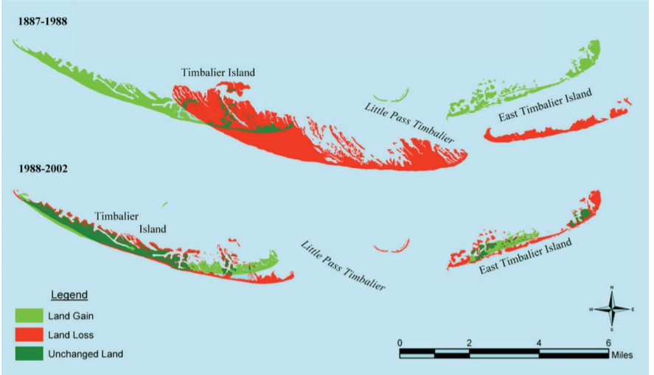
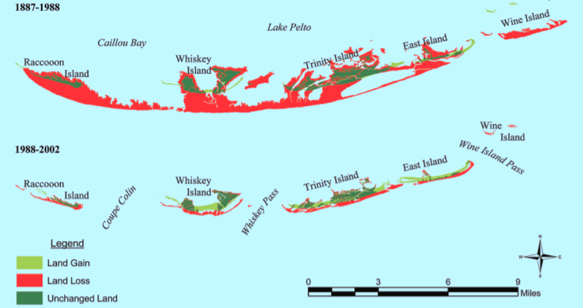
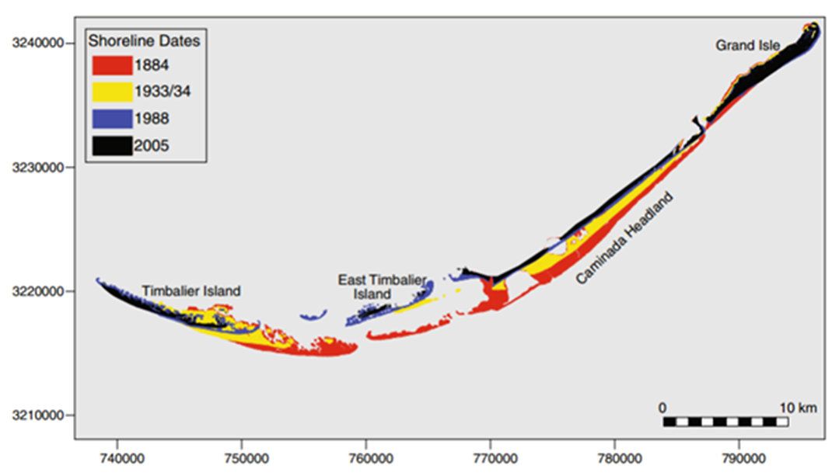
Timbalier Islands
Isles Dernieres
3
Miner et al., 2009
Notes:
This barrier is unique in that it is the only developed barrier island in Louisiana and has remained incredibly stable in relation to its counterparts. While other barriers have migrated landward or disintegrated in place, Grand Isle has maintained its volume and position. In fact some publications estimate Grand Isle has another 1000 years.

Slide 4
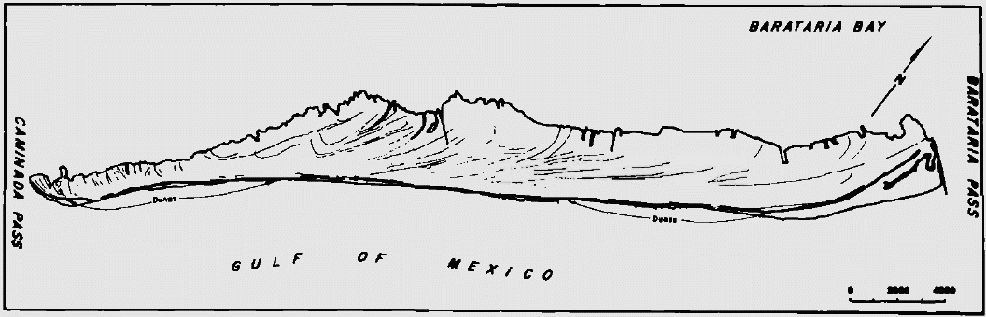
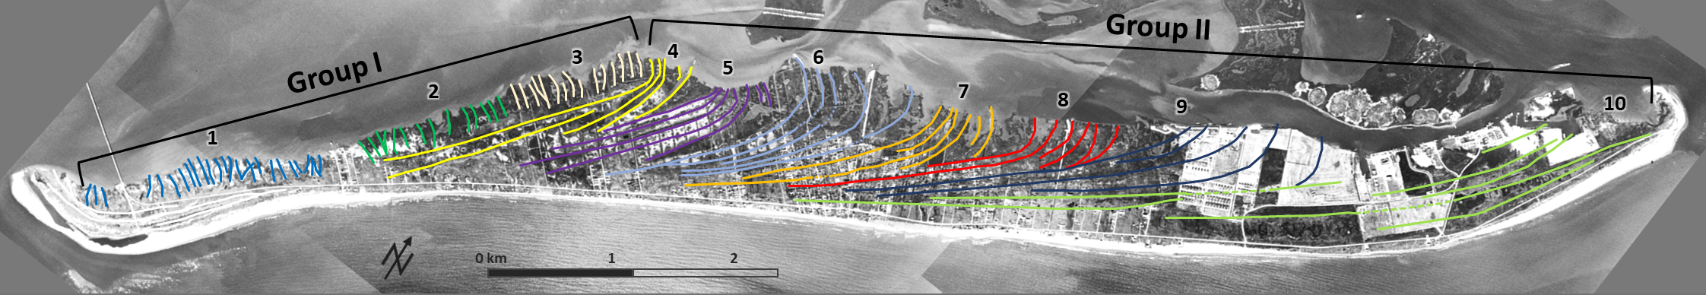

Beach ridges
Conatser, 1971
4
Notes:
Conatser used aerial photographs from 1945 map 25-35 beach ridges. With some better quality 1956 imagery, but still old enough that development had not yet obliterated the ridges, we were able to identify 10 distinctive sets of 5-20 ridges, grouped based on truncations. Then they were further split into 2 groups based on truncations at a higher scale, where Group II Ridges truncate Group I ridges.
– We wanted to find out how long it took for the ridges to form and at what rates.

Slide 5
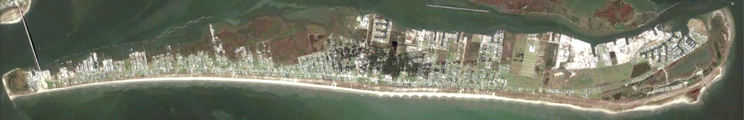
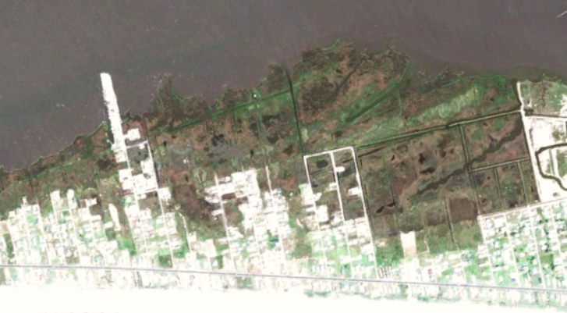
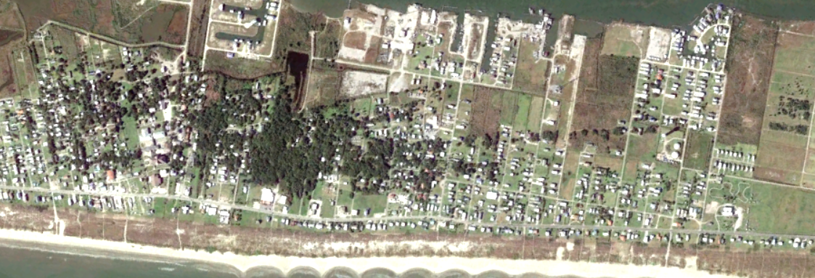
Beach ridges
5
Notes:
These beach ridges are so low in profile that they can’t be identified on the ground or with LiDAR. Other cues had to be used. Ridges are visible from above due to the vegetation patterns they create. Or these patterns in the marshes where the swales are filled with water.
This also helped us decide where to collect samples from. We were limited as we needed undeveloped, dry land to make sure the resulting ages actually represented time since burial. The entire west end of the island was off limis because it’s highly developed or marshland. The center of the island was out best bet as there are a park and nature preserve.

Slide 6
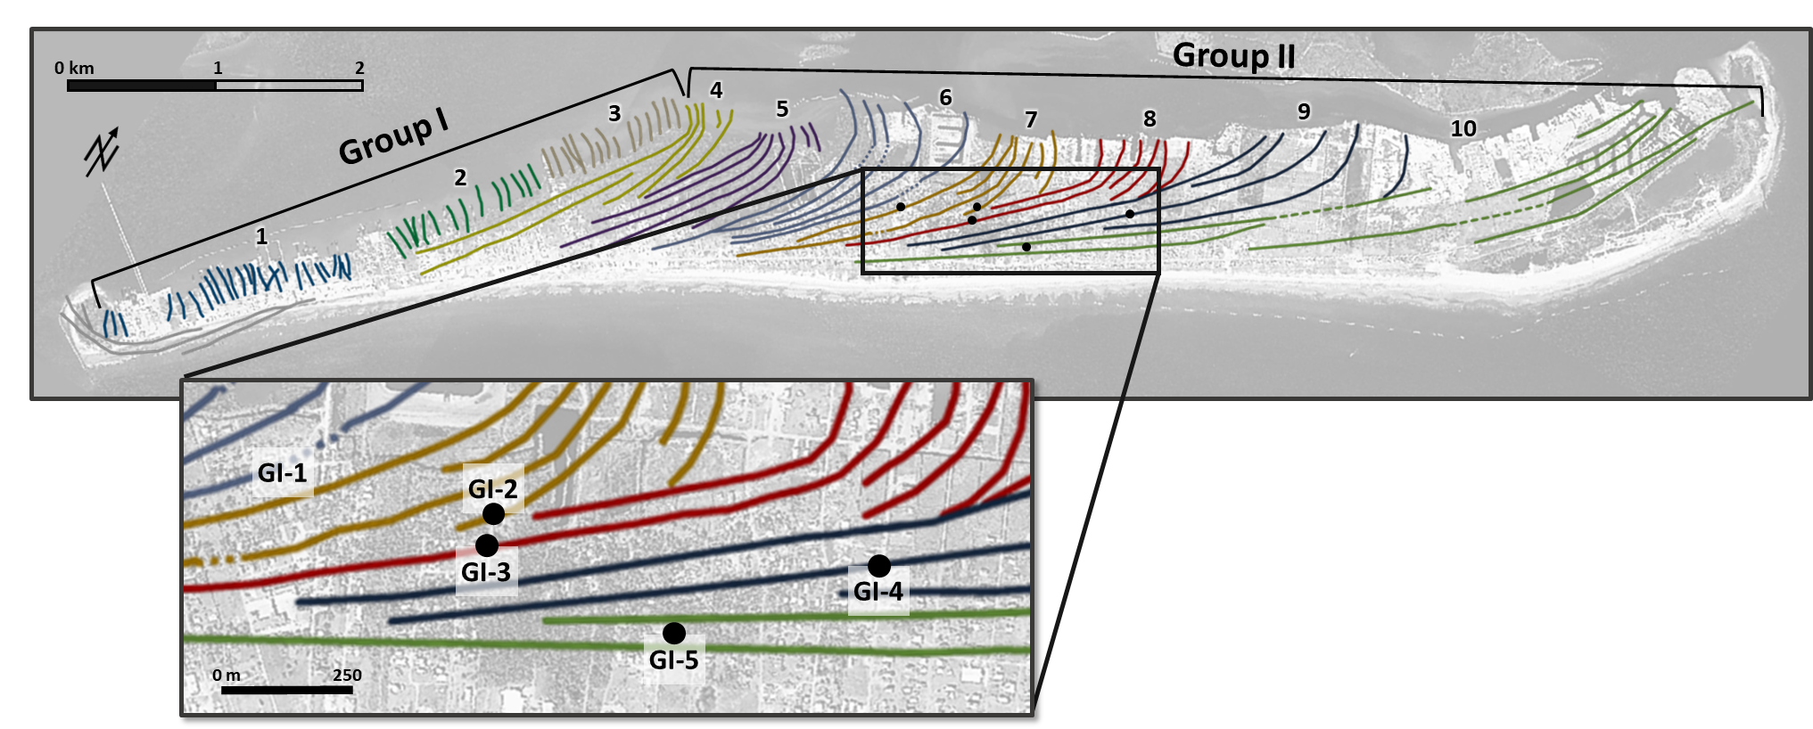
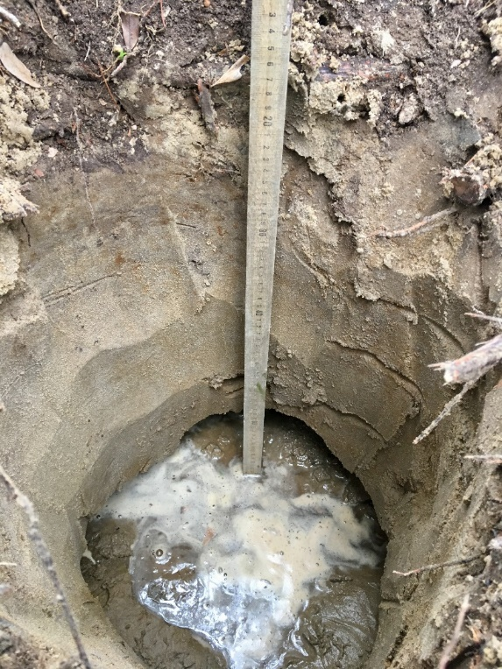
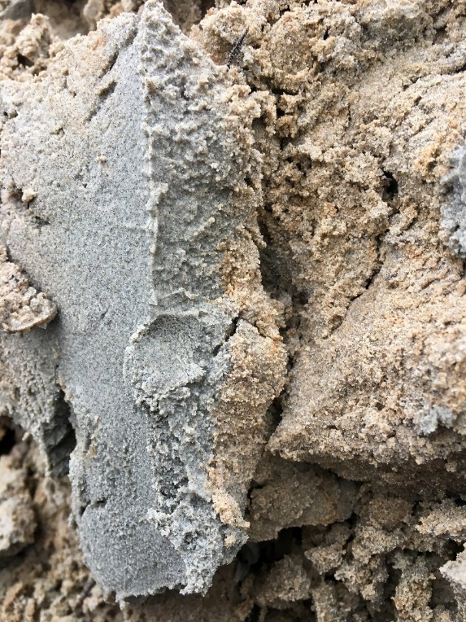
OSL Sampling locations
6
Notes:
- Here are the five sampling locations 1-5 based on the expected ages, from oldest to youngest.
- Super clean sand from about a meter deep, beyond which the water table was encountered.

Slide 7
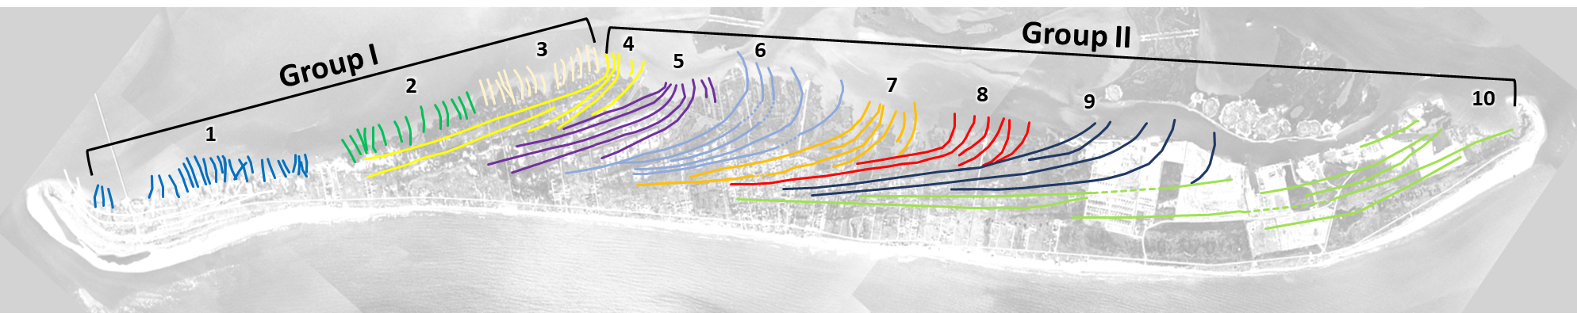
OSL Results
Sample ID | N | M/m | υ_{t} | δD_{c} | Equivalent Dose (Gy) | Dose Rate (Gy/Ka) | Age (yr) | Age Error (yr)
GI-1 | 95/96 | 1.01 | 0.147 | 1.1% | 0.581 ± 0.009 | 1.579 ± 0.139 | 370 ± 30 | 10
GI-2 | 95/96 | 1.00 | 0.126 | 1.3% | 0.547 ± 0.007 | 1.735 ± 0.148 | 320 ± 30 | 10
GI-3 | 94/96 | 0.99 | 0.247 | 0.6% | 0.221 ± 0.006 | 2.280 ± 0.186 | 100 ± 10 | 10
GI-3’ | 91/96 | 1.01 | 0.368 | 0.6% | 0.222 ± 0.009 | 2.280 ± 0.186 | 100 ± 10 | 10
GI-4 | 95/96 | 1.01 | 0.115 | 0.4% | 0.417 ± 0.005 | 1.572 ± 0.147 | 270 ± 30 | 10
GI-5 | 94/96 | 0.99 | 0.185 | 1.5% | 0.258 ± 0.005 | 1.544 ± 0.120 | 170 ± 10 | 10
370±30
320±30
270±30
170±10
7
Notes:
OSL analysis was carried out at the optical dating & dosimetry lab at North Dakota State University.
You can see the expected age progression, but GI-3 stood out and analysis was replicated with the same result. It is likely that we unknowingly sampled a pile of excavation waste materials with sediment that had been disturbed since its original deposition.

Slide 8
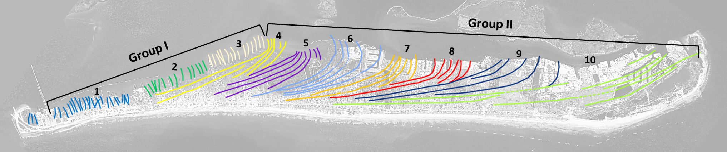
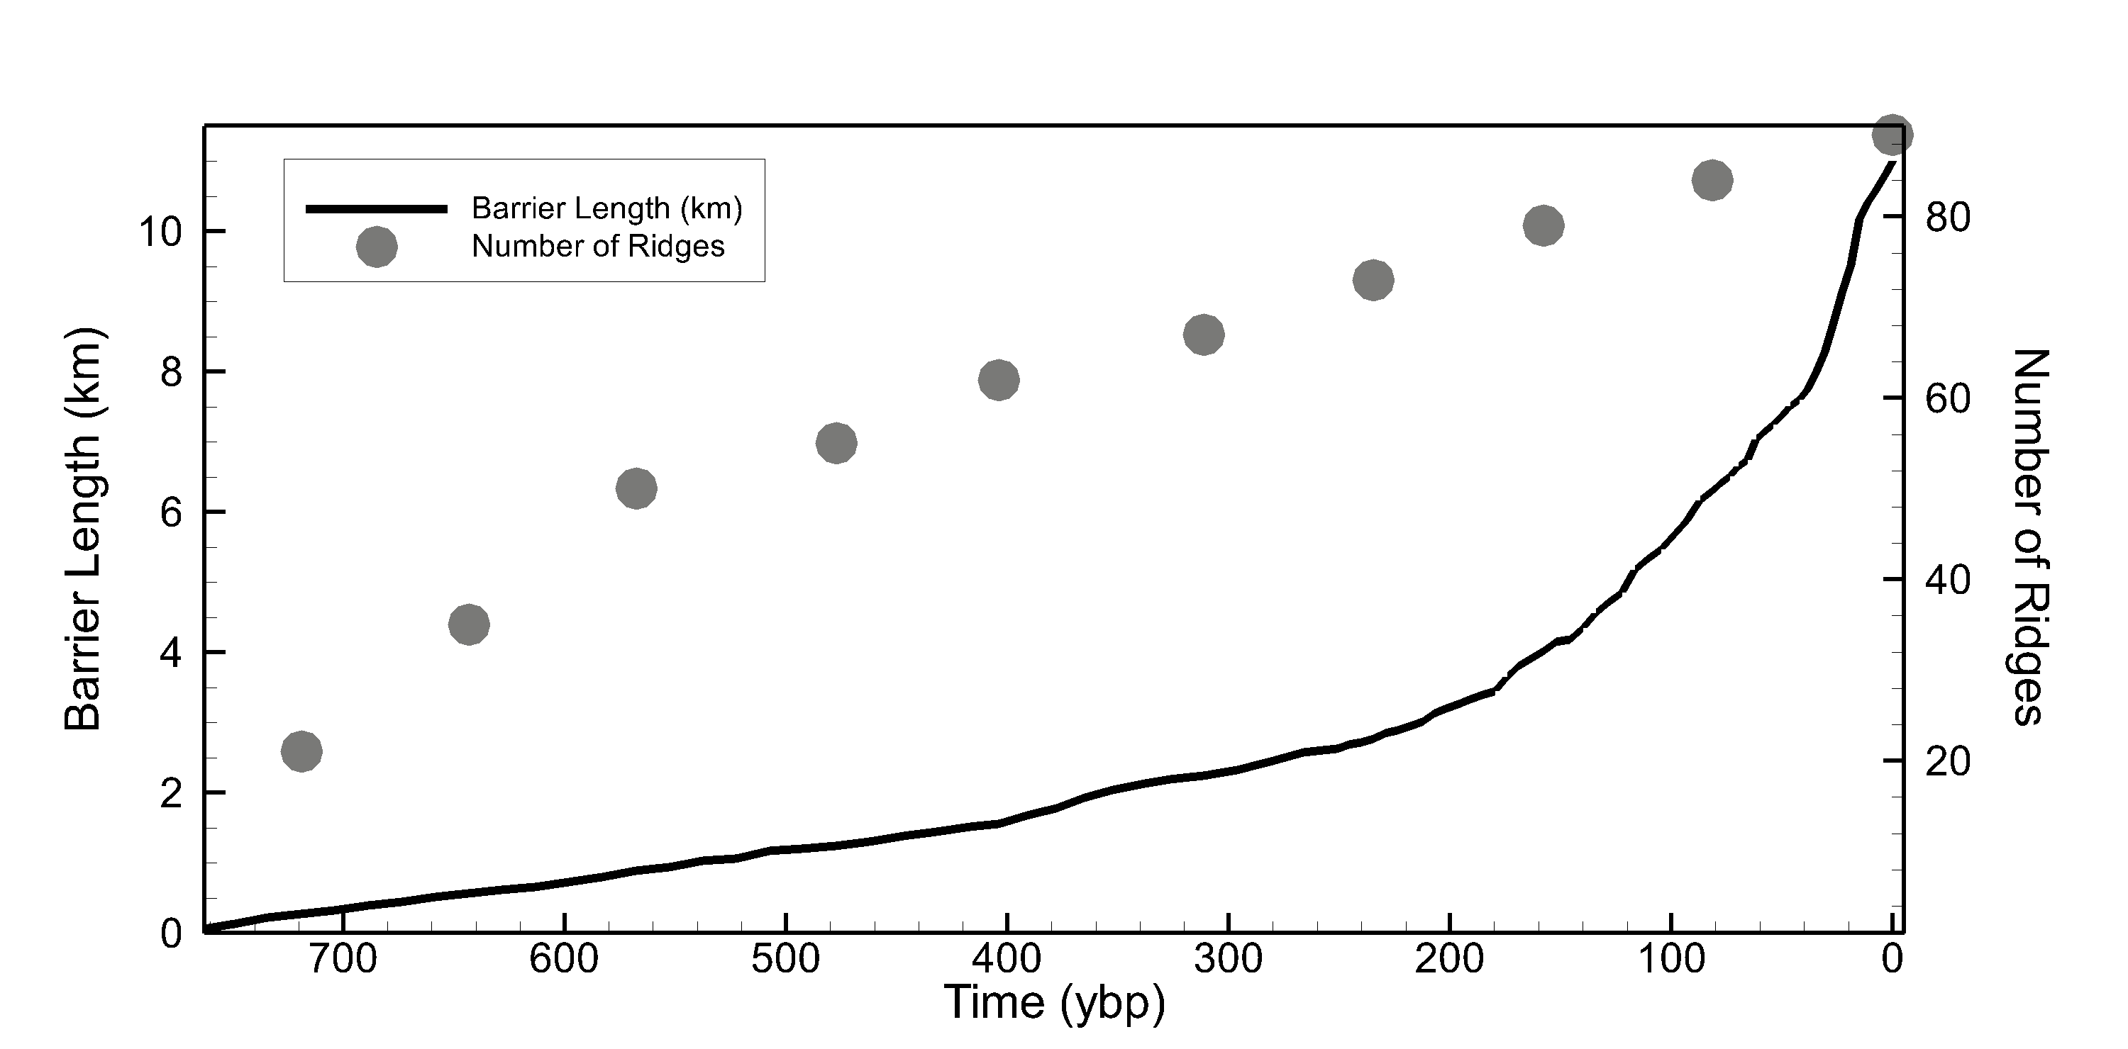
Set | Time of formation (ybp)
1 | 820
2 | 738
3 | 656
4 | 574
5 | 498
6 | 408
7 | 332
8 | 242
9 | 151
10 | 75
Erosional/non-depositional event
Max ridge accumulation rate (yr/ridge)
= (max age of older sample - min age of younger sample) / ridge count
Min ridge accumulation rate (yr/ridge)
= (min age of older sample - max age of younger sample) / ridge count
Reduced accommodation space
8
Notes:
- Using the number of years between the OSL ages and the number & spacing of ridges, we derived some estimations of how long each set took to form.
- It took roughly 820 years for the present ridges to form. We can see that it was about 600 years ago when deposition of Group I ridges ceased, erosion occurred, & deposition resumed, albeit in a slightly more easterly direction.
It’s difficult to know really at what pace everything after set 9 formed because numerous shoreline stabilization projects began in the 1960’s. However, we do believe that the spacing increases greatly in the east due to reduced accommodation space/shallower water. This trend is visible in this plot of barrier length & number of ridges vs time. The length of the island increases quickly while only a few ridges are formed.
So this provides us with a timeline and shows some trends in ridge development, & the next step was to determine rates of growth.

Slide 9
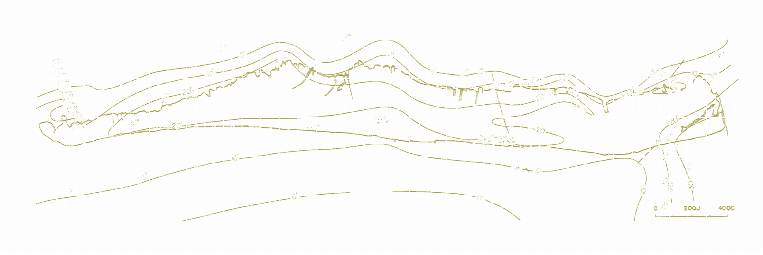
Lithosome Volume & Source erosion rate
Lithosome volume: 92,610,000 m³
Eastern Caminada Headland Erosion Rates
 | Data Source(s) | Rate (m³/yr)
1 | Georgiou et al. (2010) + McBride et al. (1992) | 334,740
2 | Harper (1977) | 217,610
3 | Miner et al. (2009) + Williams et al. (1992) | 309,176
4 | List et al. (1994) + Williams et al. (1992) | 291,023
5 | Morang et al. (2013) | 191,000*
6 | Georgiou et al. (2005) | 146,000*
Mean erosion rate: 248,260 m³/yr
* Excludes fine-grained sediment
9
Notes:
- Using isolith maps from Conatser showing thickness of the barrier sand unit, the volume of Grand Isle was estimated. Broken into boxes of about 90 sq m and each was assigned a thickness.
- To get a more complete picture of the system’s sediment budget, we extracted or calculated Caminada Headland erosion rates from several sources of shoreline and bathymetry change. The estimates ranged from 146,000 to 335,000 and a conservative average of 248,200.

Slide 10
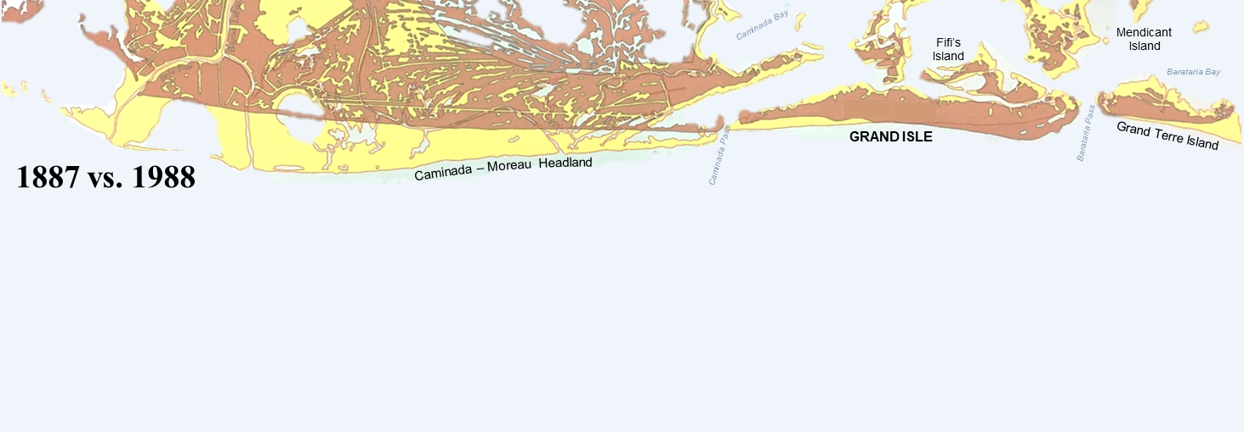


Sediment budget
Deposition Rate
Volume
Erosion
Rate
112,900 m³/yr
9.26x10⁷ m³
248,200 m³/yr
Duration:
820 yrs
Modified from McBride et al., 1992
10
Notes:
The erosion rate we calculated is only for the eastern two thirds due to a divergence in longshore transport…where 5-10% of eroded sediment is carried west and the majority is transported east. About 50% is captured by Grand Isle.
Also, we’ve got the volume and age of Grand Isle, so we can get an estimated rate of deposition of about 113,000 m3/yr.
We can see that the Caminada headland has been eroding at a rate more than sufficient to supply Grand Isle.

Slide 11
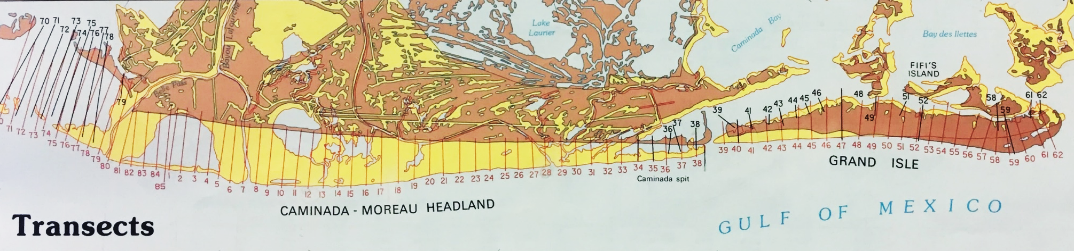
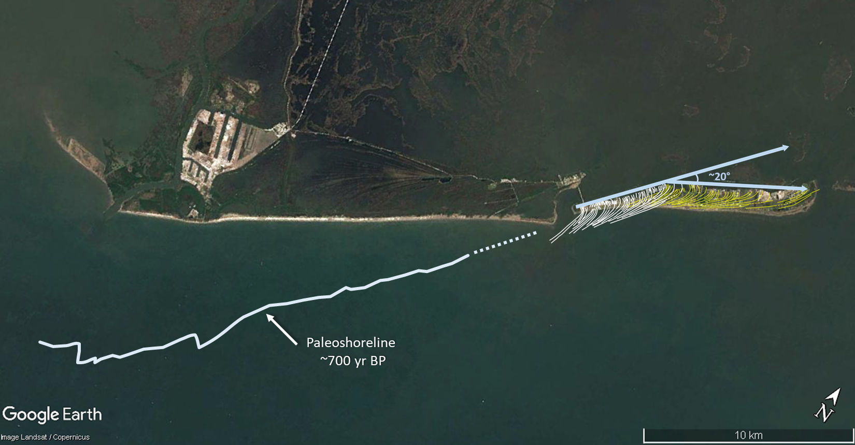
McBride et al., 1992
11
Notes:
- McBride and others calculated rates of shoreline change of Caminada headland for the past 100 years, so we extended those rates an additional 600 years into the past to get an idea of what the shoreline may have looked like then.
((Gradient in erosion from west to east. The rates of erosion and transport are assumed to be linear here, although this is likely not the case.
More likely erosion rates were much higher in the earlier stages than they have been in recent times because of a steeper shoreface and the incident wave angle to the headland was more erosive.

Slide 12
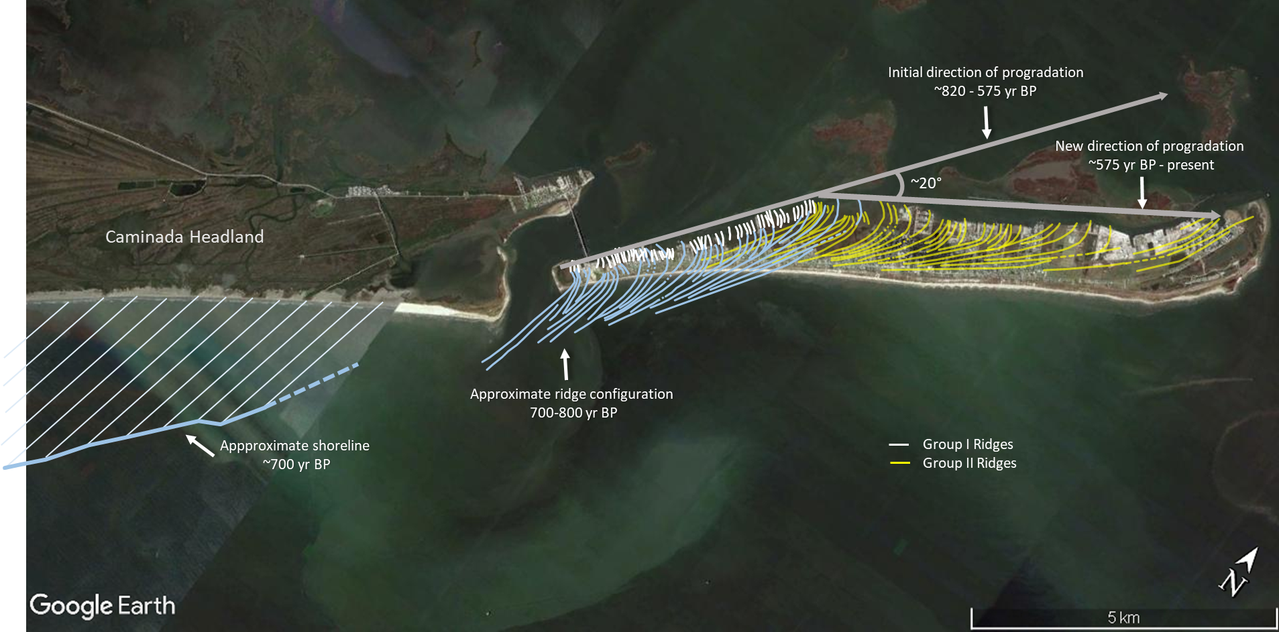
12
Notes:
If we zoon in, we can see the estimated configuration of Group I ridges in blue. In order to see what the Group I ridges may have looked ike in their entirety, a portion of the Group II ridges wee replicated and placed to match the angles of the existing segments. So we’ve got the estimated Caminada shoreline and Grand Isle ridges at 700 ybp, and we see a similar angle of progradation to the former Caminada coastline. What caused this abrupt change in progradation direction is not yet known, but we are looking into it.
- So we’ve got these growth parameters for Grand Isle, now how does it compare to other beach ridge pains around the world?

Slide 13
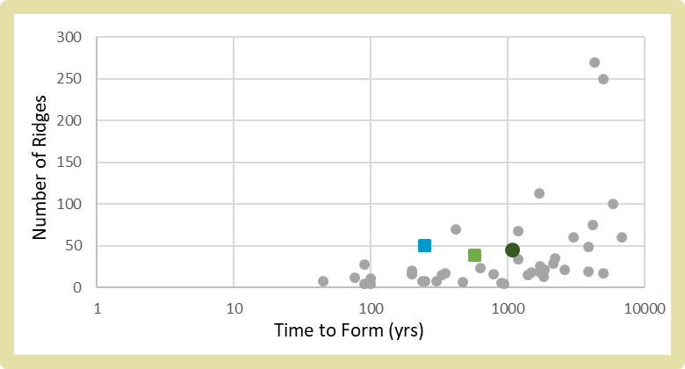
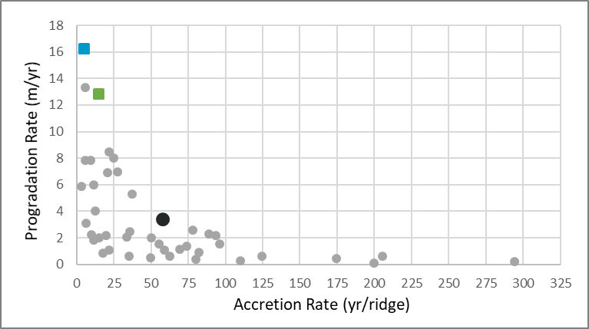
How does grand isle compare?
Location |  | Spacing (m) crest to crest | Time to form (yr) | BRP Width (m) | # Ridges | Accretion Rate (yr/ridge) | Progradation Rate (m/yr) | Publication
Grand Isle, LA | I ▪ | 41.5 | 246 | 4000 | 50 | 4.92 | 16.26 | Torres et al., 2018
 | II ▪ | 101.8 | 574 | 7379 | 39 | 14.72 | 12.86
Caminada Moreau, LA |  | 47.14 | 420 | 3300 | 70 | 6 | 7.86 | Penland et al., 1986
Richardson Hammock, FL |  | 22.5 | 200 | 450 | 20 | 10 | 2.25 | Rink & Lopez, 2010
Little St. George Island, FL | A | 203.3 | 1400 | 3050 | 15 | 93.3 | 2.18 | Rink & Lopez, 2010
 | B | 200.0 | 468 | 1200 | 6 | 78 | 2.56
 | C | 202.4 | 1868 | 4250 | 21 | 89.0 | 2.28
St. Joseph Peninsula, FL | A | 87.9 | 250 | 615 | 7 | 35.7 | 2.46 | Rink & Lopez, 2010
 | B | 142.3 | 350 | 2419 | 17 | 20.6 | 6.91
St. Vincent Island, FL |  | 72.2 | 1482 | 1300 | 18 | 82.3 | 0.88 | Rink & Lopez, 2010
Cape San Blas, FL | A | 197.5 | 300 | 1580 | 8 | 37.5 | 5.27 | Rink & Lopez, 2010
 | B | 186.7 | 330 | 2800 | 15 | 22 | 8.48
 | C | 190.4 | 630 | 4380 | 23 | 27.4 | 6.95
Sanibel Island, FL |  | 8.74 | 4300 | 2360 | 270 | 11.5 | 1.82 | Missimer, 1973
Canaveral, FL | A | 100 | 2140 | 2900 | 29 | 73.8 | 1.36 | Rink & Forrest, 2005
 | B | 148 | 1730 | 2700 | 18 | 96.1 | 1.56
 | C | 80 | 1730 | 2000 | 25 | 69.2 | 1.16
Savannah River, GA |  | - | 4500 | 10000 | - | - | 2.22 | DePratter & Howard, 1977
Nayarit, Mexico |  | 42.4 | 5000 | 10600 | 250 | 20 | 2.2 | Curray et al., 1969
Tabasco, Mexico |  | 47 | - | 2800 | 59.6 | - | - | Psuty, 1965
Costa Rica |  | 131.6 | 3900 | 2500 | 19 | 205.26 | 0.641 | Nieuwenhuyse et al., 1994
Quadros Lagoon, Brazil |  | 55 | - | 1138 | 21 | - | - | Hesp et al., 2005
Santa Catarina, Brazil | Navegantes | 20 | - | 5000 | - | - | 1 | FitzGerald et al., 2007
 | Pinheira | 25 | 3000 | 5000 | 60 | 50 | 2 | Hein et al., 2013
Golfo de Venezuela |  | 86.7 | 4165 | 6500 | 75 | 55.5 | 1.56 | Tanner, 1971
Boundary Bay, British Columbia |  | - | 500 | 800 | - | - | 1.6 | Engels & Roberts, 2005
 |  | - | 18 | 15.12 | - | - | 0.84
 |  | - | 9 | 4.32 | - | - | 0.48
Magdalen Islands, Canada | Les Sillons | - | 1820 | 700 | 13 | 200 | 0.1 | Remillard et al., 2015
Gulf of Almeria, Spain | H2 | 14.7 | 1200 | 1000 | 68 | 17.6 | 0.83 | Goy et al., 2003
 | H3 | 22.1 | 1200 | 750 | 34 | 35.3 | 0.625
Rhone, France | Deladel | - | 300 | 3000 | - | - | 10 | Rey et al., 2009
 | Peccais | 200 | 100 | 800 | 4 | 25 | 8
 | Saint-Roman | - | 120 | 983 | - | - | 8.2
Danube Delta, Romania | Sacalin | 80 | 45 | 600 | 7.5 | 6 | 13.33 | Vespremeanu et al., 2016
 | Buhaz | 70 | 200 | 1200 | 17.1 | 11.7 | 6
 | Palade | 70 | 240 | 500 | 7.1 | 33.8 | 2.08
 | West Saele | 40 | 2200 | 1400 | 35 | 62.9 | 0.64
 | New Periteasca | 50 | 200 | 800 | 16 | 12.5 | 4.00
Samsø, Denmark |  | 58.8 | 5000 | 1000 | 17 | 294.1 | 0.21 | Hede et al., 2015
Northern Jutland, Denmark |  | - | 1700 | - | 113 | 15 | 2 | Nielsen et al., 2006
Flakket, Denmark | I | 25 | 792 | 400 | 16 | 49.5 | 0.5 | Clemmensen et al., 2012
 | II | 20 | 77 | 240 | 12 | 6.4 | 3.1
 | III | 15 | 90 | 420 | 28 | 3.2 | 5.9
Beachmere, NE Australia |  | - | 560 | 89.6 | - | - | 0.16 | Brooke et al., 2008
 |  | 100 | 940 | 385 | 3.9 | - | 0.41
 |  | 23 | 90 | 95.4 | 4.15 | 21.7 | 1.06
Burdekin Region, NE Australia |  | 65 | 5910 | 6500 | 100 | 59.1 | 1.10 | Belperio, 1983
Keppel Bay, NE Australia | 6b | - | 100 | 165 | - | - | 1.70 | Brooke et al., 2008
 | 6a | - | 50 | 215 | - | - | 4.30
 | 3 | - | 370 | 625 | - | - | 1.70
Moruya, SE Australia |  | 33 | 6830 | 2000 | 60 | 110.0 | 0.27 | Oliver et al., 2015
Guichen Bay, SE Australia | 3 | 75 | 100 | 783 | 10.44 | 9.58 | 7.83 | Bristow & Pucillo, 2006
 | 4 | 75 | 900 | 387 | 5.16 | 174.4 | 0.43
 | 5 | 75 | 2600 | 1565 | 20.87 | 124.6 | 0.60
LeFevre Pen., S Australia |  | - | 5000 | 5000 | - | - | 1 | Bowman & Harvey, 1986
Guichen Bay, S Australia |  | 75 | 3900 | 3656 | 49 | 80 | 0.39 | Murray-Wallace et al., 2002
Phra Thong, Thailand | Phase 1 | - | 1500 | 3450 | - | - | 2.3 | Brill et al., 2015
 | Phase 3 | - | 500 | 1350 | - | - | 2.7
 | Phase 4 | - | 1800 | 1800 | - | - | 1
 | Phase 6 | - | 800 | - | - | - | -
Kujukuri, Japan |  | - | 6000 | 10 | - | - | 0.002 | Tamura et al., 2008
Group I
Group II
Mean
13
Notes:
I collected or calculated growth rates for 60 other sandy beach ridge plains from around the world from existing literature.
When we graph the number of ridges in a BRP vs time to form, both Group I and Group II ridges are near the average of about 50 ridges per thousand years.

Slide 14
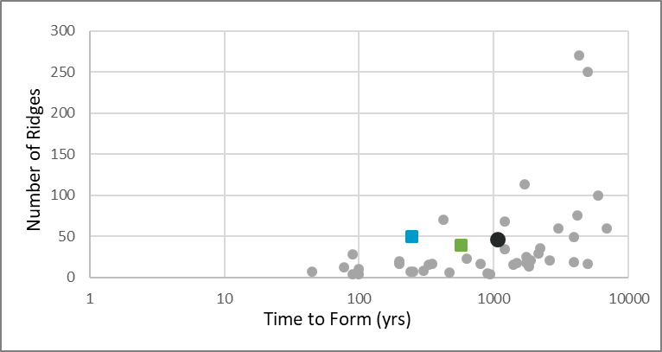
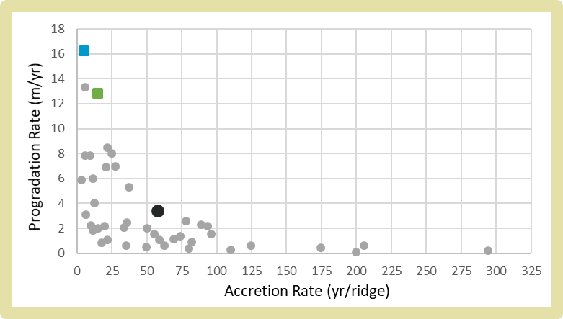
How does grand isle compare?
Location |  | Spacing (m) crest to crest | Time to form (yr) | BRP Width (m) | # Ridges | Accretion Rate (yr/ridge) | Progradation Rate (m/yr) | Publication
Grand Isle, LA | I ▪ | 41.5 | 246 | 4000 | 50 | 4.92 | 16.26 | Torres et al., 2018
 | II ▪ | 101.8 | 574 | 7379 | 39 | 14.72 | 12.86
Caminada Moreau, LA |  | 47.14 | 420 | 3300 | 70 | 6 | 7.86 | Penland et al., 1986
Richardson Hammock, FL |  | 22.5 | 200 | 450 | 20 | 10 | 2.25 | Rink & Lopez, 2010
Little St. George Island, FL | A | 203.3 | 1400 | 3050 | 15 | 93.3 | 2.18 | Rink & Lopez, 2010
 | B | 200.0 | 468 | 1200 | 6 | 78 | 2.56
 | C | 202.4 | 1868 | 4250 | 21 | 89.0 | 2.28
St. Joseph Peninsula, FL | A | 87.9 | 250 | 615 | 7 | 35.7 | 2.46 | Rink & Lopez, 2010
 | B | 142.3 | 350 | 2419 | 17 | 20.6 | 6.91
St. Vincent Island, FL |  | 72.2 | 1482 | 1300 | 18 | 82.3 | 0.88 | Rink & Lopez, 2010
Cape San Blas, FL | A | 197.5 | 300 | 1580 | 8 | 37.5 | 5.27 | Rink & Lopez, 2010
 | B | 186.7 | 330 | 2800 | 15 | 22 | 8.48
 | C | 190.4 | 630 | 4380 | 23 | 27.4 | 6.95
Sanibel Island, FL |  | 8.74 | 4300 | 2360 | 270 | 11.5 | 1.82 | Missimer, 1973
Canaveral, FL | A | 100 | 2140 | 2900 | 29 | 73.8 | 1.36 | Rink & Forrest, 2005
 | B | 148 | 1730 | 2700 | 18 | 96.1 | 1.56
 | C | 80 | 1730 | 2000 | 25 | 69.2 | 1.16
Savannah River, GA |  | - | 4500 | 10000 | - | - | 2.22 | DePratter & Howard, 1977
Nayarit, Mexico |  | 42.4 | 5000 | 10600 | 250 | 20 | 2.2 | Curray et al., 1969
Tabasco, Mexico |  | 47 | - | 2800 | 59.6 | - | - | Psuty, 1965
Costa Rica |  | 131.6 | 3900 | 2500 | 19 | 205.26 | 0.641 | Nieuwenhuyse et al., 1994
Quadros Lagoon, Brazil |  | 55 | - | 1138 | 21 | - | - | Hesp et al., 2005
Santa Catarina, Brazil | Navegantes | 20 | - | 5000 | - | - | 1 | FitzGerald et al., 2007
 | Pinheira | 25 | 3000 | 5000 | 60 | 50 | 2 | Hein et al., 2013
Golfo de Venezuela |  | 86.7 | 4165 | 6500 | 75 | 55.5 | 1.56 | Tanner, 1971
Boundary Bay, British Columbia |  | - | 500 | 800 | - | - | 1.6 | Engels & Roberts, 2005
 |  | - | 18 | 15.12 | - | - | 0.84
 |  | - | 9 | 4.32 | - | - | 0.48
Magdalen Islands, Canada | Les Sillons | - | 1820 | 700 | 13 | 200 | 0.1 | Remillard et al., 2015
Gulf of Almeria, Spain | H2 | 14.7 | 1200 | 1000 | 68 | 17.6 | 0.83 | Goy et al., 2003
 | H3 | 22.1 | 1200 | 750 | 34 | 35.3 | 0.625
Rhone, France | Deladel | - | 300 | 3000 | - | - | 10 | Rey et al., 2009
 | Peccais | 200 | 100 | 800 | 4 | 25 | 8
 | Saint-Roman | - | 120 | 983 | - | - | 8.2
Danube Delta, Romania | Sacalin | 80 | 45 | 600 | 7.5 | 6 | 13.33 | Vespremeanu et al., 2016
 | Buhaz | 70 | 200 | 1200 | 17.1 | 11.7 | 6
 | Palade | 70 | 240 | 500 | 7.1 | 33.8 | 2.08
 | West Saele | 40 | 2200 | 1400 | 35 | 62.9 | 0.64
 | New Periteasca | 50 | 200 | 800 | 16 | 12.5 | 4.00
Samsø, Denmark |  | 58.8 | 5000 | 1000 | 17 | 294.1 | 0.21 | Hede et al., 2015
Northern Jutland, Denmark |  | - | 1700 | - | 113 | 15 | 2 | Nielsen et al., 2006
Flakket, Denmark | I | 25 | 792 | 400 | 16 | 49.5 | 0.5 | Clemmensen et al., 2012
 | II | 20 | 77 | 240 | 12 | 6.4 | 3.1
 | III | 15 | 90 | 420 | 28 | 3.2 | 5.9
Beachmere, NE Australia |  | - | 560 | 89.6 | - | - | 0.16 | Brooke et al., 2008
 |  | 100 | 940 | 385 | 3.9 | - | 0.41
 |  | 23 | 90 | 95.4 | 4.15 | 21.7 | 1.06
Burdekin Region, NE Australia |  | 65 | 5910 | 6500 | 100 | 59.1 | 1.10 | Belperio, 1983
Keppel Bay, NE Australia | 6b | - | 100 | 165 | - | - | 1.70 | Brooke et al., 2008
 | 6a | - | 50 | 215 | - | - | 4.30
 | 3 | - | 370 | 625 | - | - | 1.70
Moruya, SE Australia |  | 33 | 6830 | 2000 | 60 | 110.0 | 0.27 | Oliver et al., 2015
Guichen Bay, SE Australia | 3 | 75 | 100 | 783 | 10.44 | 9.58 | 7.83 | Bristow & Pucillo, 2006
 | 4 | 75 | 900 | 387 | 5.16 | 174.4 | 0.43
 | 5 | 75 | 2600 | 1565 | 20.87 | 124.6 | 0.60
LeFevre Pen., S Australia |  | - | 5000 | 5000 | - | - | 1 | Bowman & Harvey, 1986
Guichen Bay, S Australia |  | 75 | 3900 | 3656 | 49 | 80 | 0.39 | Murray-Wallace et al., 2002
Phra Thong, Thailand | Phase 1 | - | 1500 | 3450 | - | - | 2.3 | Brill et al., 2015
 | Phase 3 | - | 500 | 1350 | - | - | 2.7
 | Phase 4 | - | 1800 | 1800 | - | - | 1
 | Phase 6 | - | 800 | - | - | - | -
Kujukuri, Japan |  | - | 6000 | 10 | - | - | 0.002 | Tamura et al., 2008
Group I
Group II
Mean
14
Notes:
Here progradation rate refers to the length of the beach ridge plain or island. Accretion rate is the length of time needed for one ridge to form. The average progradation rate calculated for both Group I and II ridges of Grand Isle are more than 4 times the average rate for all other studied BRPs (3.25 m/yr). Both groups experienced an accretion rate many times smaller than the average. So Grand Isle grew in both length and number of ridges very rapidly, which could be due to that ample, continuous sediment supply.
- So with just a few OSL dates,

Slide 15
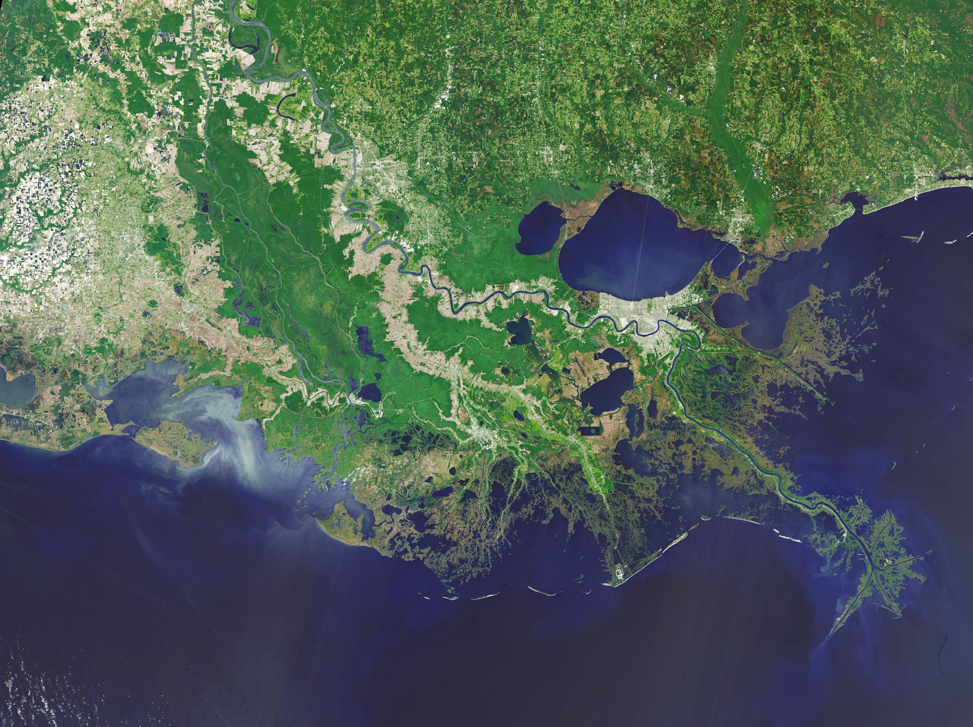
THANK YOU!
Julie Torres
Mark Kulp
Ioannis Georgiou
Duncan FitzGerald
Kenneth Lepper
NASA/USGS Landsat
15

