Slide 1
Why you should care about (geologic) energy research
Denise J. Hills and Bennet L. Bearden
Notes:
T18. Generating Sustainable Urban Systems: A Convergence of Geology and Society
Paper 2-11. Why you should care about energy research
Abstract:
The Energy Investigations Program (EIP) at the Geological Survey of Alabama is charged with researching all geological topics related to energy that would affect the state and region, and providing unbiased information about potential development, including projected costs, environmental impact, and broader economic impact. The state of Alabama has a rich history of coal, oil, and natural gas production; while these traditional hydrocarbon fuels are still necessary to meet current demands, other energy sources (geologic or otherwise) must be researched and understood to ensure that our long-term energy needs are met. EIP still conducts traditional hydrocarbon research, but much of our work is looking beyond pure fossil fuels. Current projects in EIP include work on carbon capture, utilization, and storage (CCUS), where we investigate how CO₂ produced from burning fossil fuels might be captured and then either used (e.g., enhanced recovery) or stored permanently (e.g., geologic sequestration). This knowledge and support of geologic CCUS increases our energy security by extending the life of traditional hydrocarbon fuels.
EIP is involved in other geologic energy research beyond fossil fuels, which is necessary for a more balanced energy portfolio. Compressed air energy storage and low-temperature geothermal energy are just two examples of alternative geologic energy resources that will be part of the upcoming energy revolution. We enable a stronger energy future through broad geologic energy research, but we must bridge the interface between geoscience research and public policy by informing the public, legislators, and industry about these varied geologic energy sources.
My name is Denise Hills, and I work for the Geological Survey of Alabama, a state government agency. I am the director of our Energy Research program, and I’m going to talk to you today about: Why do we conduct energy research in Alabama?

Slide 2
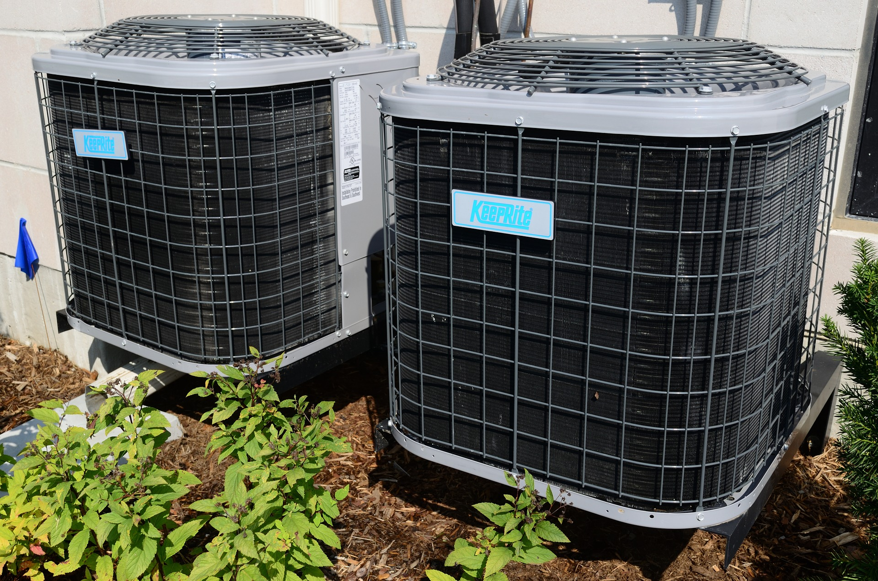

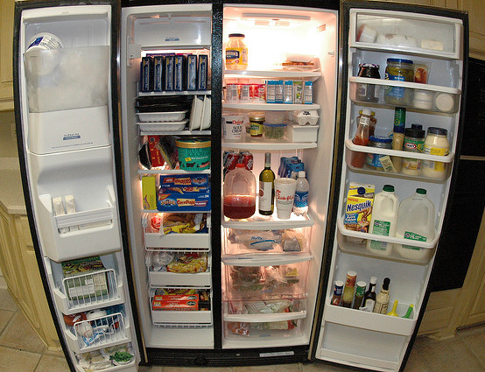

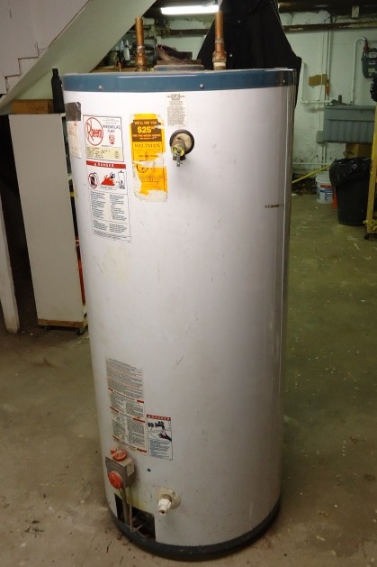
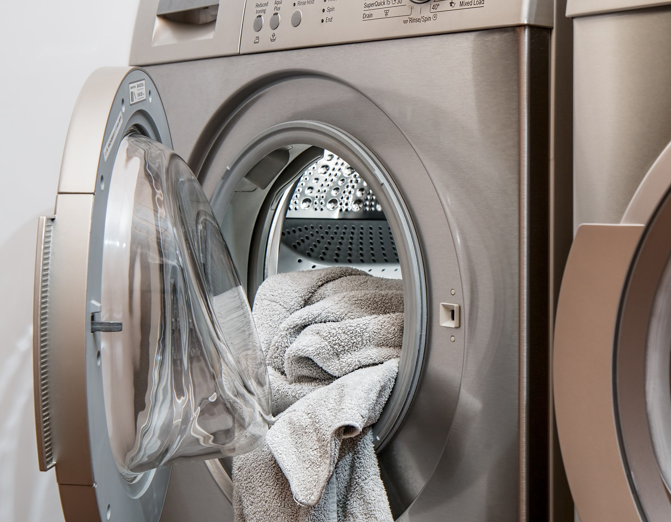
Notes:
Examples of energy usage. Home
Typically, when we think about energy, we think about what we use in our home.
We tend to focus on energy saving in our appliances like dishwashers, washing machines, lights. (click) But the two largest usages of home energy are HVAC (cooling and heating) and water heaters.

Slide 3




Notes:
Examples of energy usage. Transportation.
We know that we use energy in our personal cars. But energy use in transportation is more than just moving people around – it’s moving goods around via (advance) truck, (advance) train, airplane, (advance) cargo ship…

Slide 4



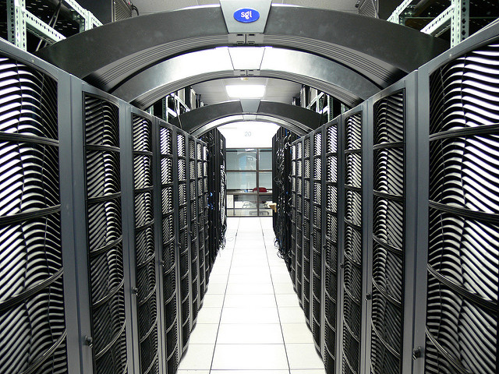
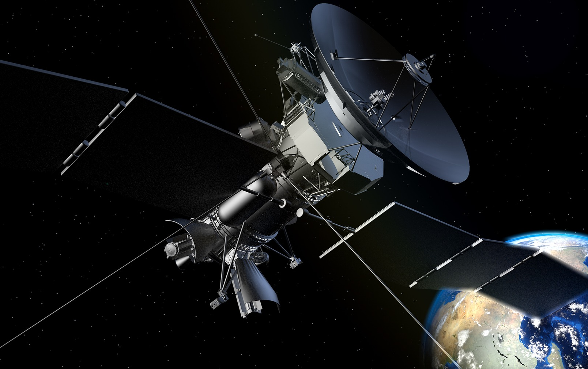
Notes:
Examples of energy usage. Communications
Personal communications (cell phones, computers); radio/tv; cloud computing/storage; transmission of communication (towers, satellites)

Slide 5
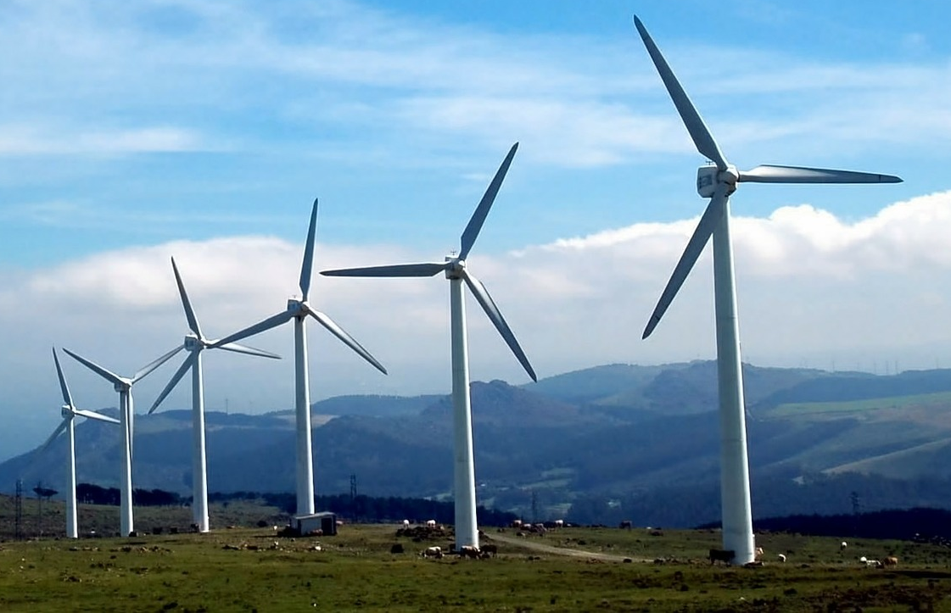
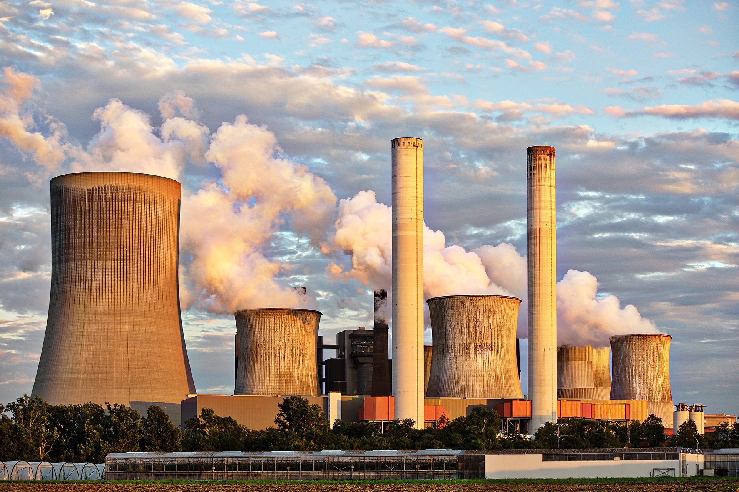
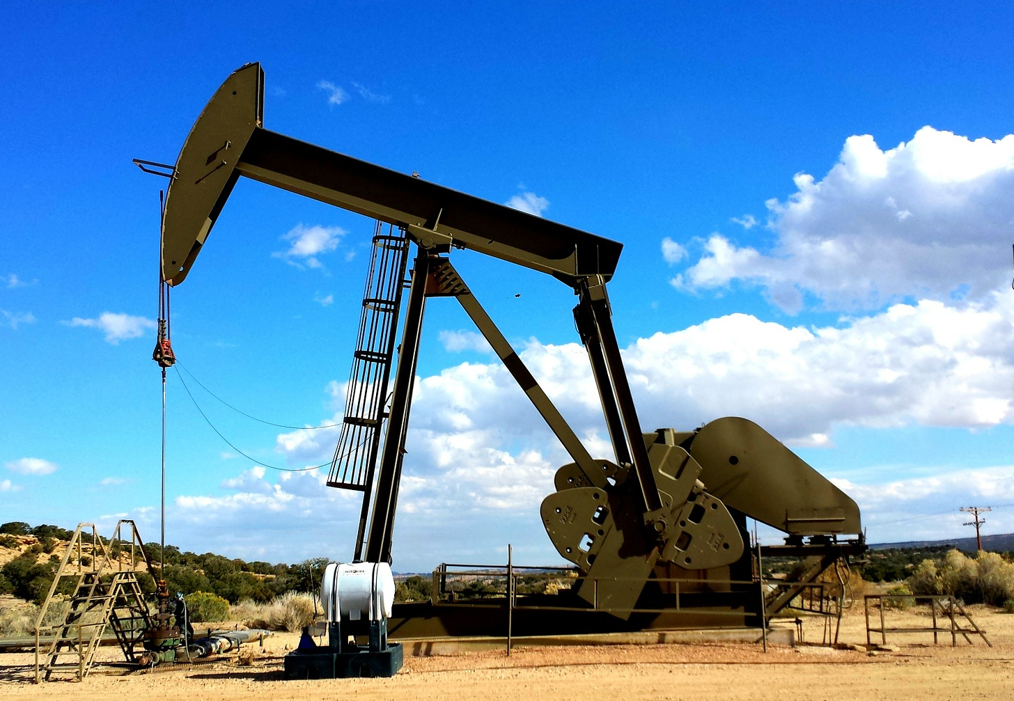
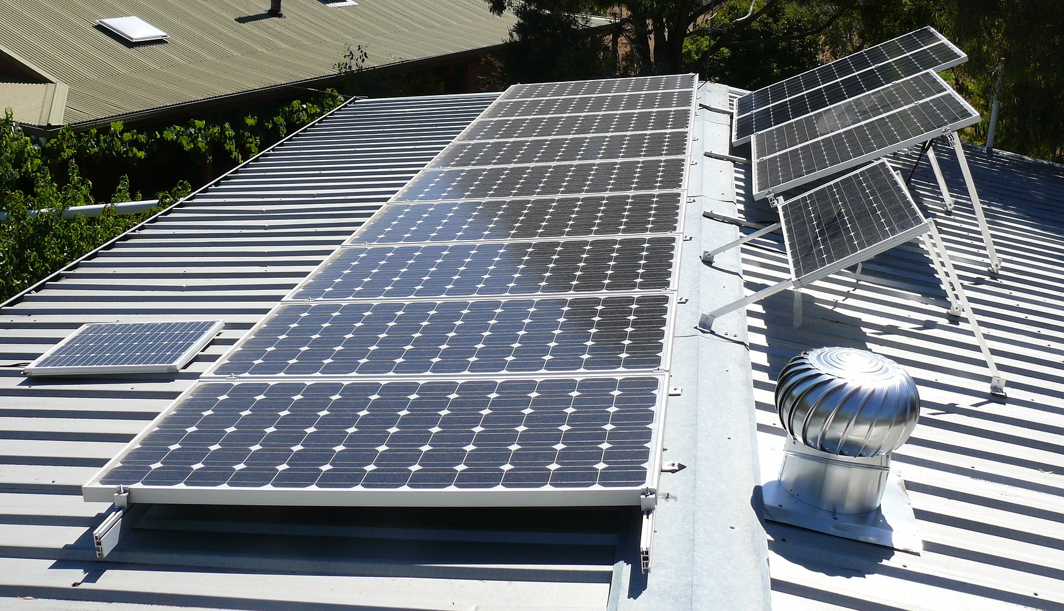
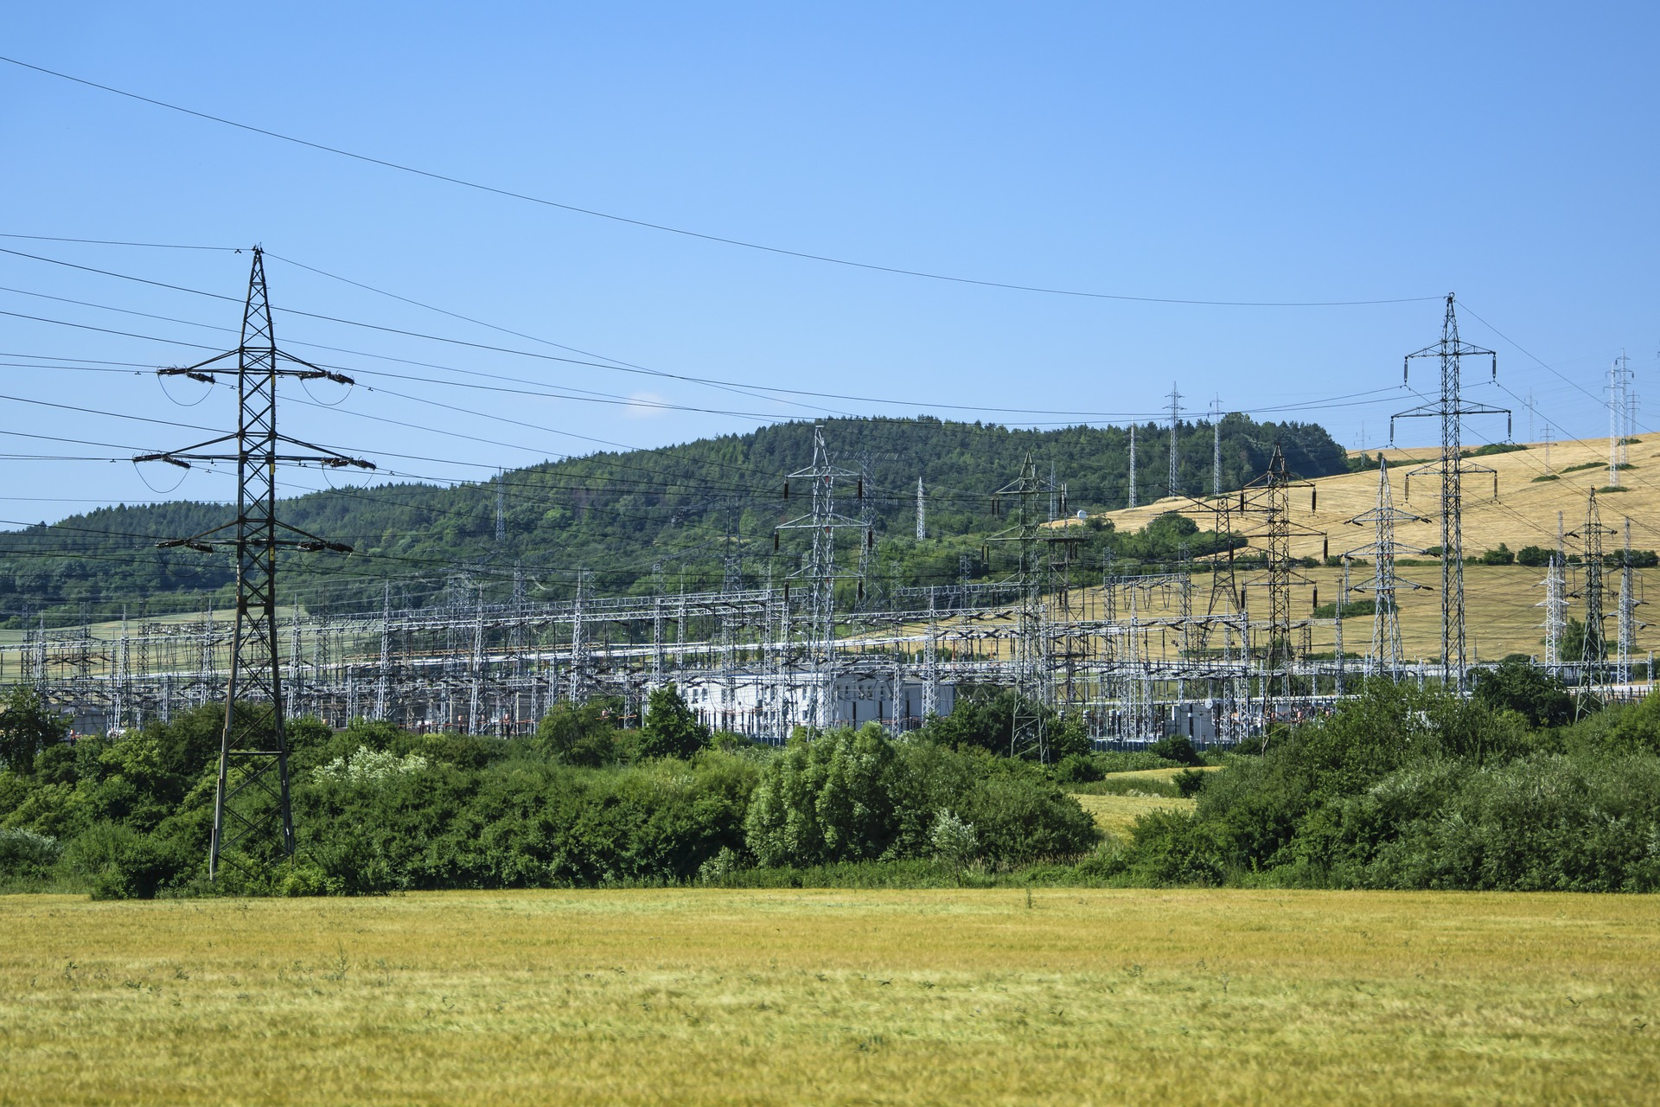
Notes:
Examples of energy usage. Energy production. You also need energy to MAKE energy. Without power production, nothing else will work. This includes power plants/transmission, as well extracting raw materials and refining of fuels for other use.
In Energy Policy, Change has evolved from a “Culture of Compliance” to “Energy that Powers Our Lives” conceptual framework: e,g., somewhat redefined “Energy Policy and law” as utilization of Natural Resources to create electricity and otherwise provide fuels for a modern economy.

Slide 6
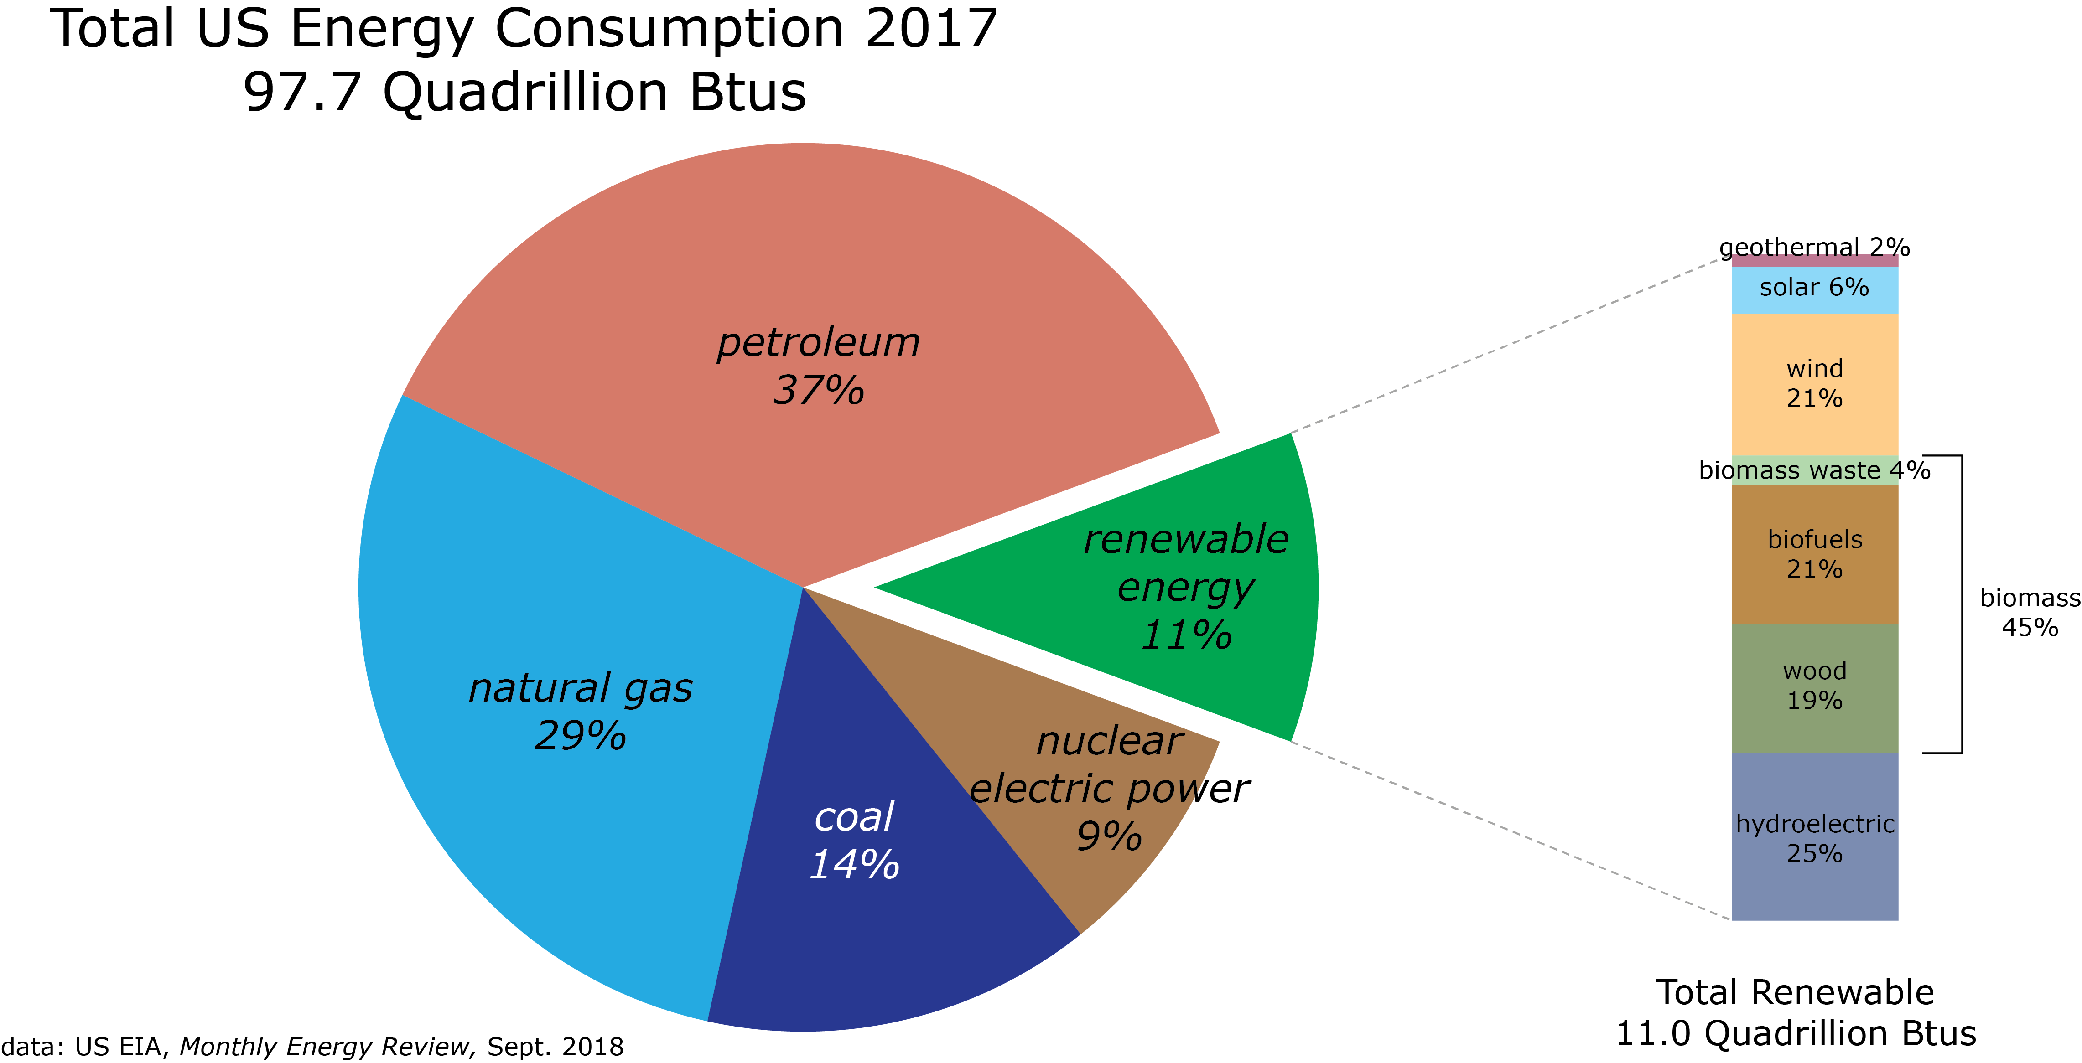
Notes:
Current US Energy Consumption (from 2017) by source
Btu – British Thermal Unit. Defined as the amount of heat required to raise the temperature of one pound of water by one degree Fahrenheit.
Downloaded on 25 October 2018; From US EIA Monthly Energy Review (MER): https://www.eia.gov/totalenergy/data/monthly/

Slide 7
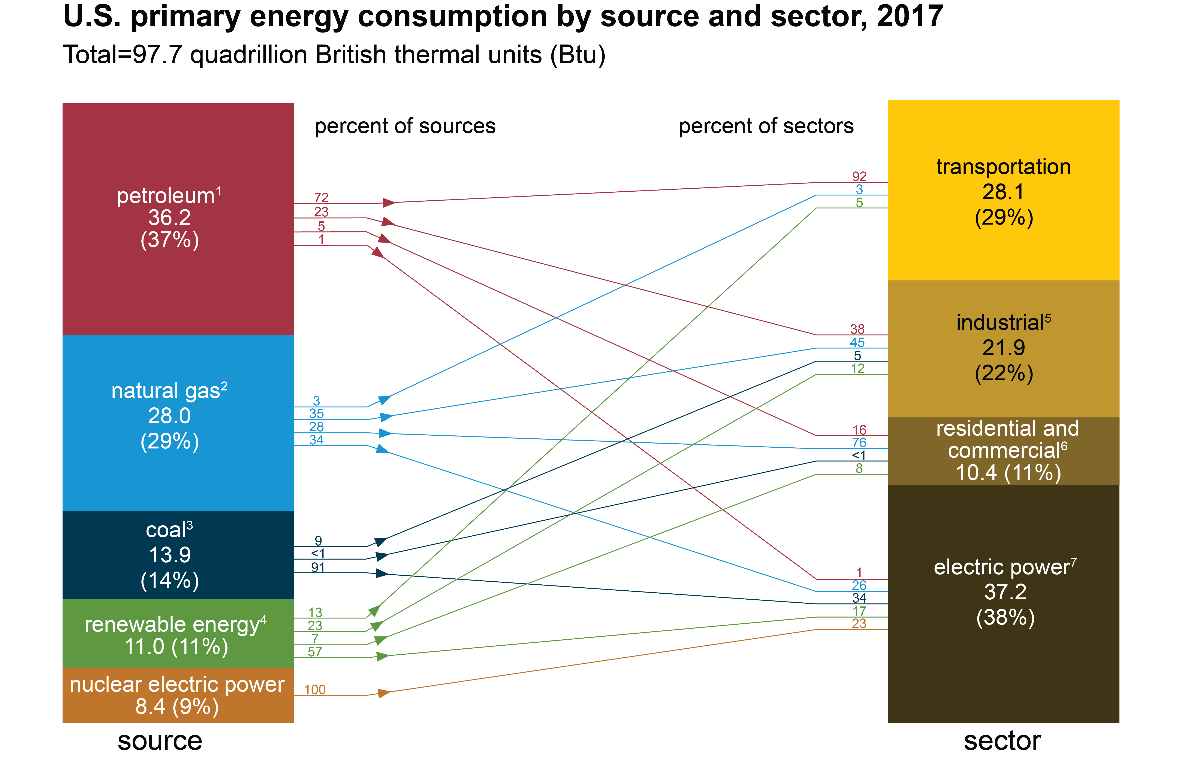
Notes:
Downloaded on 25 October 2018; From US EIA Monthly Energy Review (MER): https://www.eia.gov/totalenergy/data/monthly/
Equally important is how various energy sources are used. For example, most petroleum is used for transportation and most transportation relies on petroleum. There are not readily available alternatives for much of the transportation sector, meaning that hydrocarbons will still be necessary for a long time.

Slide 8
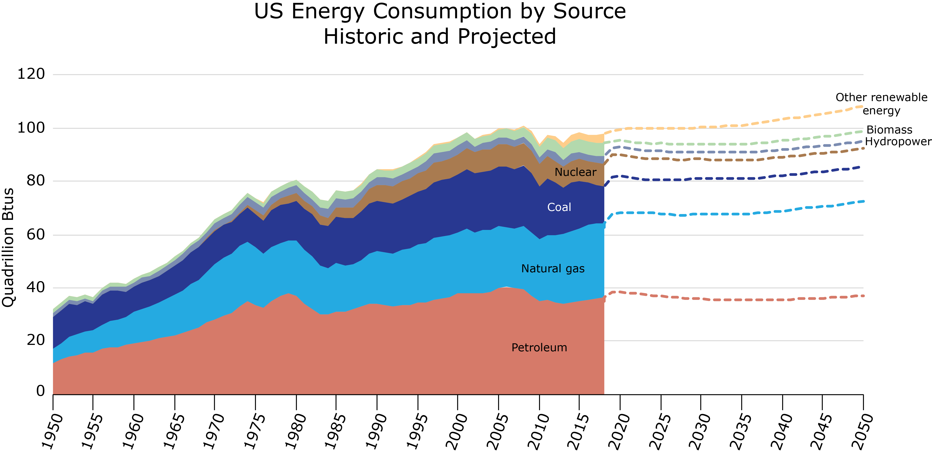
Notes:
Changing energy sources/use over time. US Historical Energy uses by source. Data from: U.S. Energy Information Administration, Monthly Energy Review
The U.S. Energy Information Administration's latest International Energy Outlook 2017 (IEO2017) projects that world energy consumption will grow by 28% between 2015 and 2040. Most of this growth is expected to come from countries that are not in the Organization for Economic Cooperation and Development (OECD), and especially in countries where demand is driven by strong economic growth, particularly in Asia. Non-OECD Asia (which includes China and India) accounts for more than 60% of the world's total increase in energy consumption from 2015 through 2040.
Through 2040, the IEO2017 projects increased world consumption of marketed energy from all fuel sources, except for coal demand, which is projected to remain essentially flat. Renewables are expected to be the fastest-growing energy source, with consumption increasing by an average 2.3% per year between 2015 and 2040. The world’s second fastest-growing source of energy is projected to be nuclear power, with consumption increasing by 1.5% per year over that period.
TAKEAWAY – Geologic energy is around to stay. Hydrocarbons are part of the ongoing energy solution.
Changes in Energy Policy caused a rebranding and adding of scope and dimension-updating of composition and topic names from all environmental sounding names and energy related names to a focus on overlap and intersection of energy/environmental policy-acid rain and SO2, CAA Amendments of 1990, deregulation and Enron, emissions, tax incentives, allowances, FERC, state policies, climate change, GHG, oil and gas, and renewables. Identifying different areas of intersection-regulation, project development. New boundaries rapidly converge-financing/transactions/ water-energy and air-energy nexus)

Slide 9





Notes:
“Energy Policy” evolved really since mid-2000s to appeal to the Energy (electricity) Law Bar. Enron event as a catalyst created issues from Enron case (outside looking in).
Geologic energy will continue to be part of our energy security future. Therefore, we need to continue to research geologic energy so that we can make informed decisions. Let me give you some practical examples of why and how we do that at the GSA.
GSA’s forward looking vision aids in dispelling the “myth of all renewables”-more diverse mix of energy and tradeoffs-liquids, solids, non-liquids and renewables. Shift from Energy Policy being just a “Federal” issue to state and local issues moving to decentralization with regional, micro-and smart grids. (Same shift shaping the future away from Washington DC to regional, state, and local issues).

Slide 10
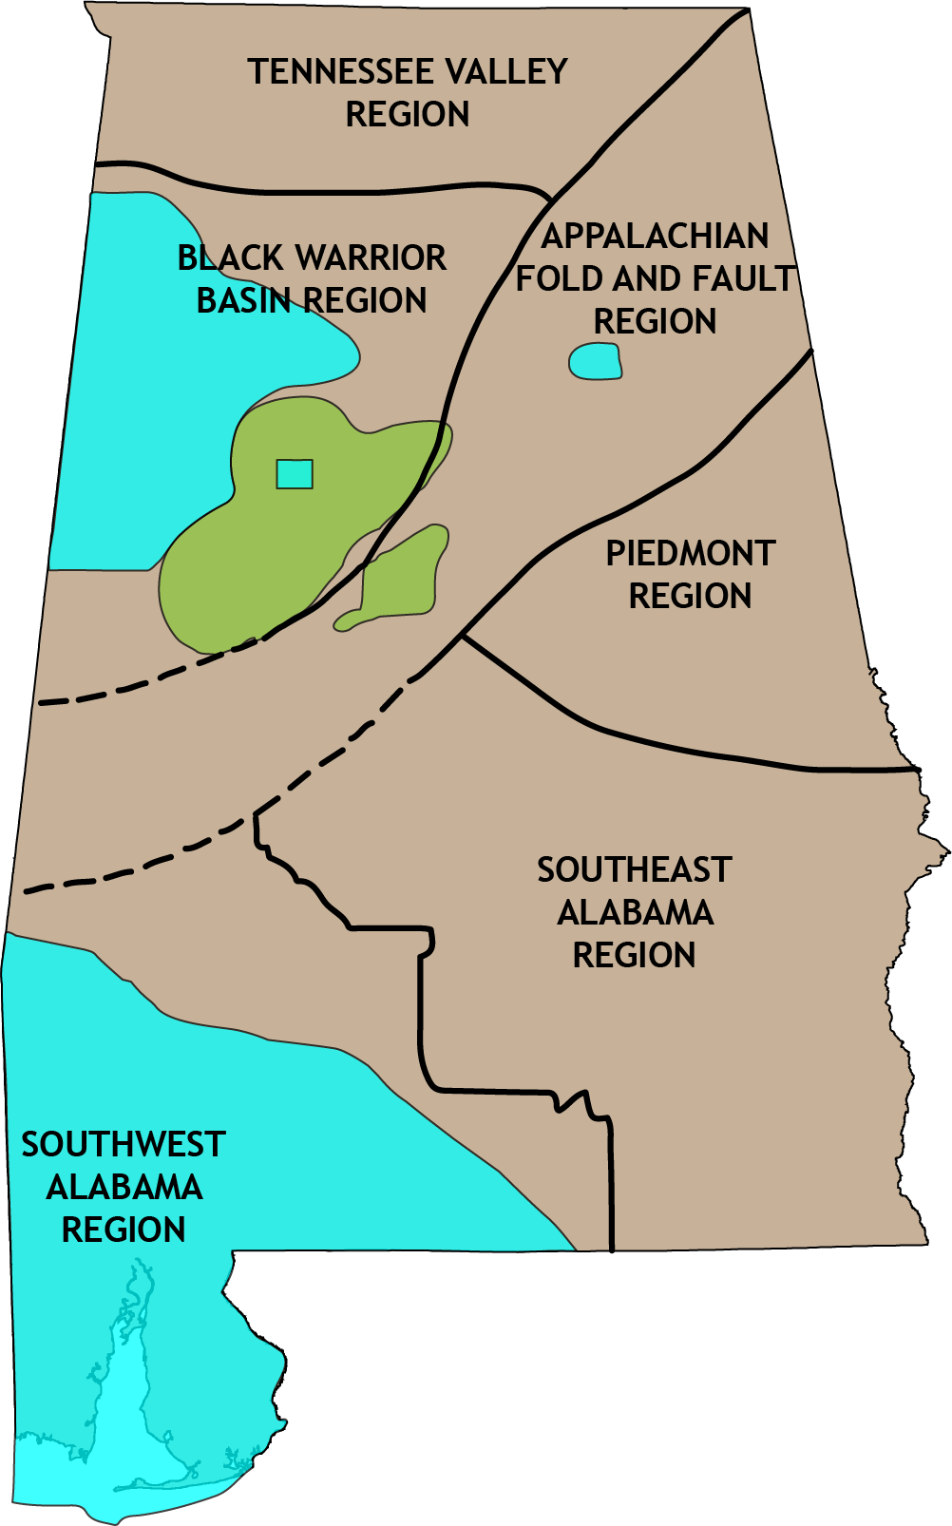
Notes:
The state of Alabama has a rich history of coal, oil, and natural gas production. These traditional fuels are still a necessary part of power production, even as other energy sources are being developed. Our program helps assess the remaining reserves of these hydrocarbons, both from areas that have had extensive production as well as new regions that have yet to have viable production.
ADVANCE. For example, we are currently doing an assessment for the oil sands resource found in NW Alabama. We are updating information on what we know about the resource including how much there might be. This is important so that people – particularly those who live and work in the area – can make informed decisions about how (or IF) development of the resource occurs.

Slide 11
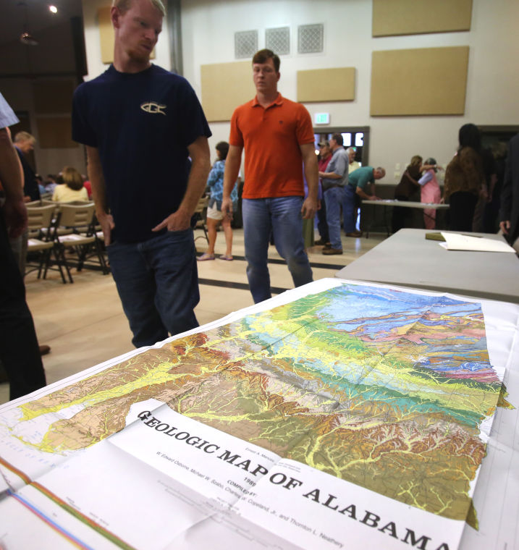
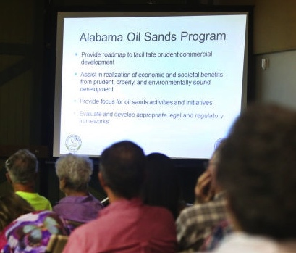
Notes:
Therefore, it’s important that we present our findings to the public to help them make decisions that work for their communities. Our Alabama Oil Sands Program is a great example where there was quite a lot of misinformation being shared. By presenting our findings to all, we become a trusted resources. We don’t tell people or companies if they should or should not develop – we just provide the information necessary for them to decide how or even if they want to develop the resource. Without our research, citizens and investors might not have access to unbiased information necessary to make appropriate decisions.
Photos From TimesDaily.com (online version of a Florence, AL, newspaper)

Slide 12
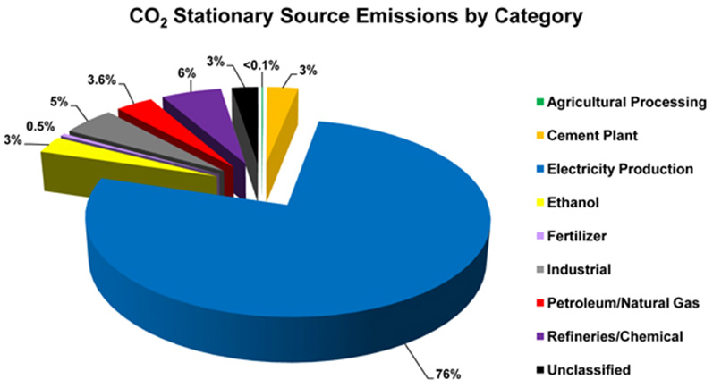
Notes:
12
Climate change became a catalyst and has affected the most changes in the last 20 years in terms of CAA and air regulations as well as a catalyst to complete changes in infrastructure (from coal in big plants and central stations to distributive generation in the grid, to micro-grids and smart grids) Evolving and policies to address it have been a primary impetus for convergence of what used to be independent environment. Climate change as a policy issue is fostering emergence of developing tools to optimize policy. Climate change now referred to by some as “diversification”-cleaner air and a diverse energy economy.
Breakdown of CO₂ stationary source emissions by category. As of November 2010, NETL's RCSPs have documented the location of 4,507 CO₂ stationary sources with total annual emissions of 3,470 million metric tons (3,825 million tons) of CO₂ in the United States. In Canada, the locations of CO₂ stationary sources with total annual emissions of 350 million metric tons (385 million tons) of CO₂ were also identified.

Slide 13
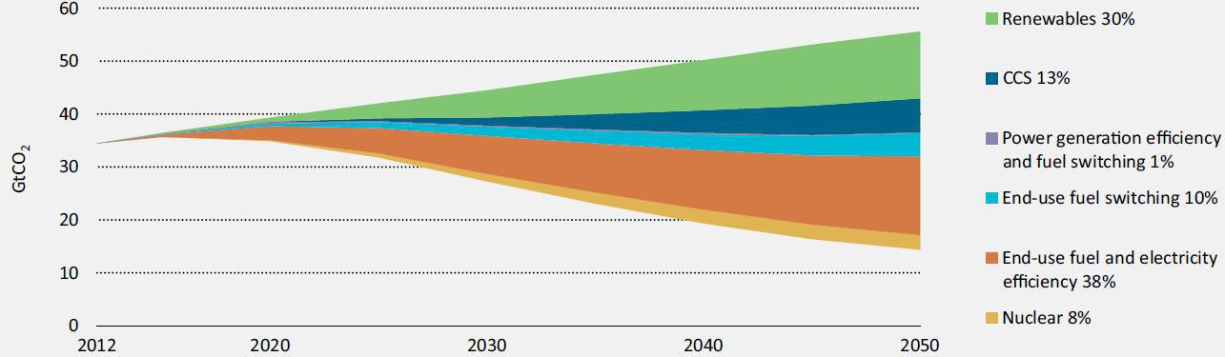
Key Technologies for Reducing Global CO₂ Emissions
IEA Energy Technology Perspectives 2015: https://www.iea.org/publications/freepublications/publication/ETP2015.pdf
Notes:
The IEA Technology Roadmap for CCS (IEA, 2009) suggests that the costs to half emissions by 2050 rise by 70% in the electricity sector if CCS is not implemented.
Therefore, much of the work we do at GSA is actually around what’s called CCUS – Carbon Capture, Utilization, and Storage. We research how carbon dioxide produced from burning traditional hydrocarbon fuels might be captured and then either used or stored permanently.
EPRI “Prism” report: http://mydocs.epri.com/docs/public/DiscussionPaper2007.pdf
IEA Technology Roadmap 2013: https://www.iea.org/publications/freepublications/publication/TechnologyRoadmapCarbonCaptureandStorage.pdf

Slide 14
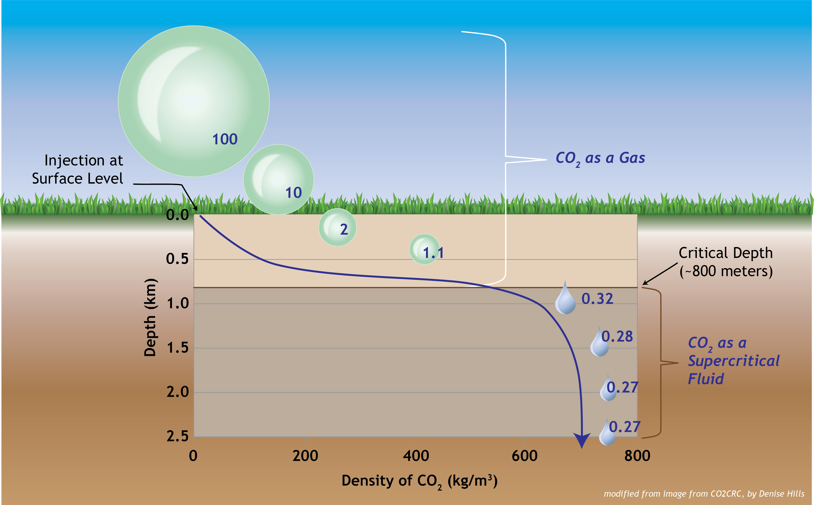
Notes:
CCUS enables industry to continue to operate while emitting fewer greenhouse gasses, making it a powerful tool for addressing mitigation of anthropogenic CO₂ in the atmosphere. However, storage must be safe, environmentally sustainable, and cost-effective.
Geologic storage is defined as the placement of CO₂ into a subsurface formation so that it will remain safely and permanently stored.
Why is Geologic storage of CO2 so attractive?
Pressure effects on CO₂ volume (image modified from Cooperative Research Centre for Greenhouse Gas Technologies (CO2CRC)).
Carbon dioxide (CO₂) can be stored underground as a supercritical fluid. Supercritical CO₂ means that the CO₂ is at a temperature in excess of 31.1°C (88ºF) and a pressure in excess of 72.9 atm (about 1,057 psi); this temperature and pressure defines the critical point for CO₂. At such high temperatures and pressures, the CO₂ has some properties like a gas and some properties like a liquid. In particular, it is dense like a liquid but has viscosity like a gas. The main advantage of storing CO₂ in the supercritical condition is that the required storage volume is substantially less than if the CO₂ were at “standard” (room)-pressure conditions.
Temperature naturally increases with depth in the Earth’s crust, as does the pressure of the fluids (brine, oil, or gas) in the formations. At depths below about 800 meters (about 2,600 feet), the natural temperature and fluid pressures are in excess of the critical point of CO₂ for most places on Earth. This means that CO₂ injected at this depth or deeper will remain in the supercritical condition given the temperatures and pressures present.

Slide 15
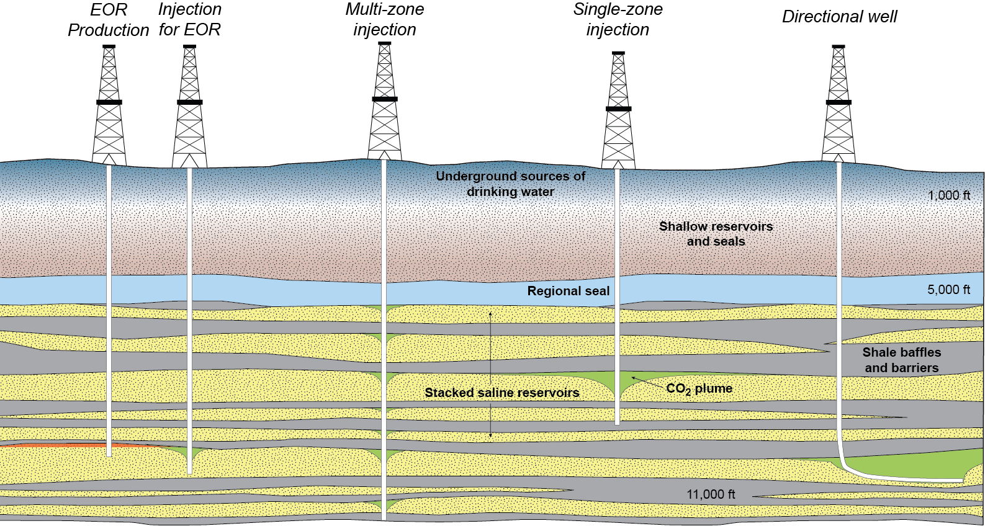
Notes:
Suitable storage formations can occur in both onshore and offshore settings, and each type of geologic formation presents different opportunities and challenges. The same types of geology that are good for producing oil and gas are also often good for geologic storage of carbon dioxide permanently. Carbon dioxide can also be used to produce more oil and gas from an older, less productive field, as it can be used to push more of the hydrocarbon out of the rock.
In partnership with the National Energy Technology Lab, Department of Energy, academic institutions, and industry, our work has put Alabama in the forefront of this work. This type of research can lead to job development and economic stability or growth within the state.

Slide 16
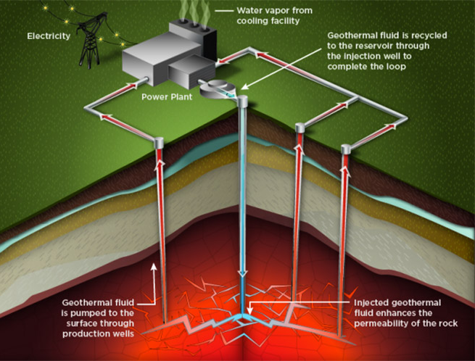
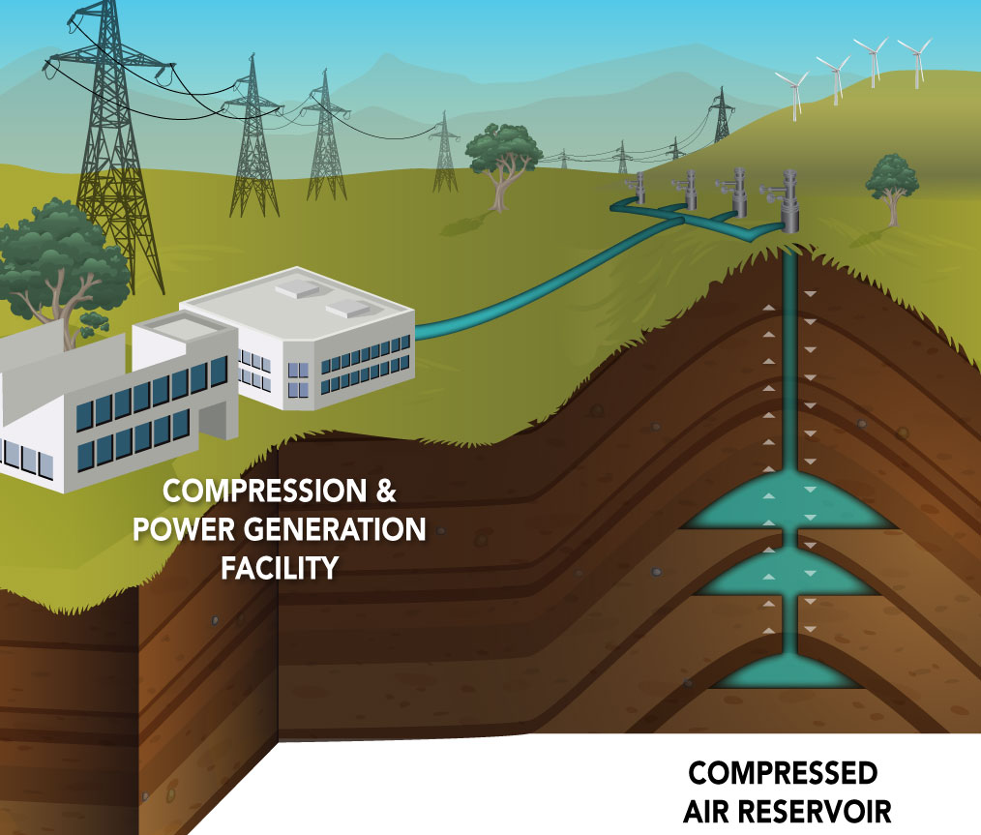
Notes:
Continued geological energy research by the GSA can be the catalyst for continued energy innovation, which is to the benefit of all Alabamians. This includes not only research related to hydrocarbon fuels, but all work on low-temperature enhance geothermal power production, and compressed air energy storage.

Slide 17
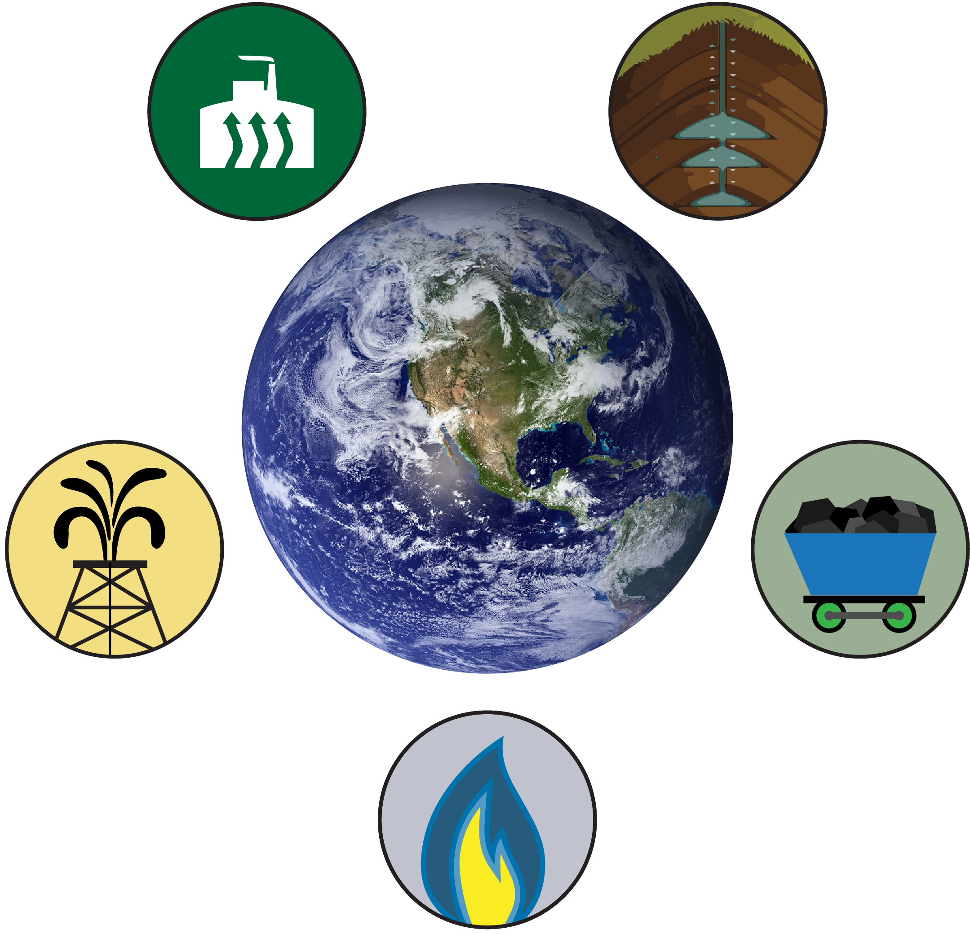
Notes:
Evolution of Energy/Environmental Policy intersection in programming has had “immediate application on the ground” to geoscientists in 1. serving clients; 2. growing practice; and 3. developing skill set.
GSA’s approach facilitates understanding of the converging interfaces among science, policy, and law. All of these areas have been more illuminated and more focused over time and GSA has recognized it as the agency evolved.
Changes in energy market have impacted Energy Policy-the manor by which the energy market channels investment is the huge condition precedent to environmental outcomes and impacts.
We all use energy every day. Prudent development of hydrocarbon fuels and other geologically sourced energy is key to economic growth and stability. Energy research is important because we need to provide accurate, up to date, and useful information to stakeholders about the energy resources
We do this in support of economic development, conservation, management, and public policy for the betterment of Alabama’s citizens, communities, and businesses – the people who live, work and play in the state.
In fact, geologic energy research in Alabama, and around the world, with continued collaboration between federal and state agencies, academic institutions, and industry, is vital to the goal of attaining US energy security and independence, while maintaining our quality of life.
Thank you!

Slide 18
Questions?
Notes:
T18. Generating Sustainable Urban Systems: A Convergence of Geology and Society
Paper 2-11. Why you should care about energy research
Abstract:
The Energy Investigations Program (EIP) at the Geological Survey of Alabama is charged with researching all geological topics related to energy that would affect the state and region, and providing unbiased information about potential development, including projected costs, environmental impact, and broader economic impact. The state of Alabama has a rich history of coal, oil, and natural gas production; while these traditional hydrocarbon fuels are still necessary to meet current demands, other energy sources (geologic or otherwise) must be researched and understood to ensure that our long-term energy needs are met. EIP still conducts traditional hydrocarbon research, but much of our work is looking beyond pure fossil fuels. Current projects in EIP include work on carbon capture, utilization, and storage (CCUS), where we investigate how CO₂ produced from burning fossil fuels might be captured and then either used (e.g., enhanced recovery) or stored permanently (e.g., geologic sequestration). This knowledge and support of geologic CCUS increases our energy security by extending the life of traditional hydrocarbon fuels.
EIP is involved in other geologic energy research beyond fossil fuels, which is necessary for a more balanced energy portfolio. Compressed air energy storage and low-temperature geothermal energy are just two examples of alternative geologic energy resources that will be part of the upcoming energy revolution. We enable a stronger energy future through broad geologic energy research, but we must bridge the interface between geoscience research and public policy by informing the public, legislators, and industry about these varied geologic energy sources.
My name is Denise Hills, and I work for the Geological Survey of Alabama, a state government agency. I am the director of our Energy Research program, and I’m going to talk to you today about: Why do we conduct energy research in Alabama?

Slide 20
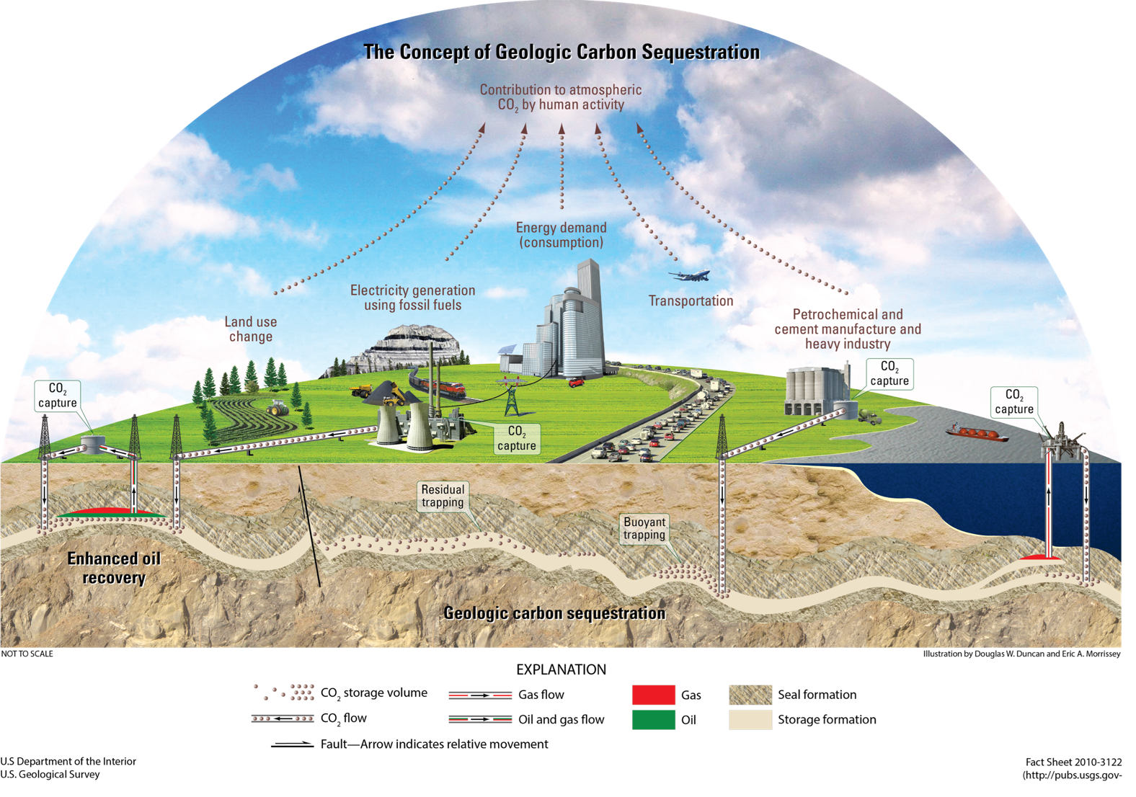
Notes:
Figure 1. Figure illustrating the concept of geologic carbon sequestration. Figure composed by Douglas W. Duncan and illustrated by Eric A. Morrissey.
USGS Fact Sheet 2010-3122
http://pubs.usgs.gov/fs/2010/3122
Carbon capture and storage (CCS) is the separation and capture of carbon dioxide (CO₂) from the emissions of industrial processes prior to release into the atmosphere and storage of the CO₂ in deep underground geologic formations. CCS enables industry to continue to operate while emitting fewer greenhouse gasses, making it a powerful tool for addressing mitigation of anthropogenic CO₂ in the atmosphere. However, storage must be safe, environmentally sustainable, and cost-effective. Suitable storage formations can occur in both onshore and offshore settings, and each type of geologic formation presents different opportunities and challenges. Geologic storage is defined as the placement of CO₂ into a subsurface formation so that it will remain safely and permanently stored.
DOE is investigating five types of underground formations for geologic carbon storage:
Saline formations
Oil and natural gas reservoirs
Unmineable coal areas
Organic-rich shales
Basalt formations

