Slide 1
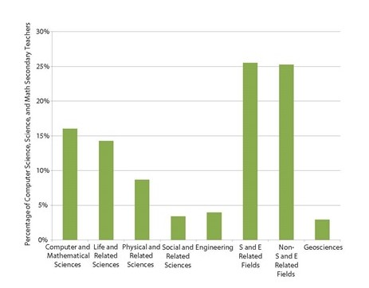
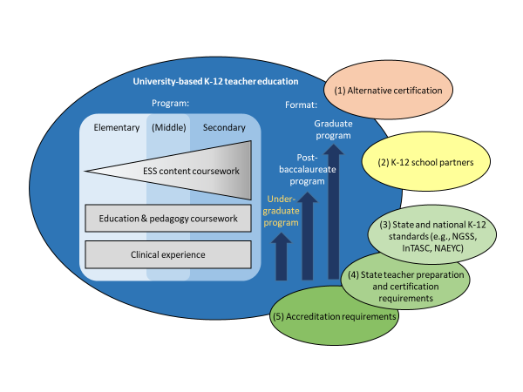







Geoscience Research and Information Needs for Supporting and Improving K-12 ESS Teacher Education
Kim Cheek, University of North Florida (k.cheek@unf.edu); Heather Petcovic, Western Michigan University; Jason Cervenec, Ohio State University; Robyn Dahl, Western Washington University; and Nancy Price, Portland State University
Grand Challenge I:
How do we attract and support a greater number of future K-12 ESS teachers who represent and can effectively engage diverse K-12 learners?
Grand Challenge 2:
What are effective models for incorporating ESS into undergraduate K-12 teacher preparation and in providing professional development for inservice teachers
Grand Challenge 3:
How do we best prepare future and practicing K-12 teachers to engage in ESS to promote three-dimensional learning that involves the integration of disciplinary core ideas, science and engineering practices and crosscutting concepts?
The GER Community Framework Project
The GER Community Framework Project is an NSF-funded project that engaged over 200 geoscience educators and researchers over a series of face-to-face and virtual events to develop priorities for future GER questions spanning 10 geoscience education research themes one of which is ESS teacher preparation. Figure 1 shows the relatively low percentage of secondary teachers who are adequately prepared to teach ESS. The situation is even more acute at the elementary level. Major external factors that impact ESS teacher preparation can be found in Figure 2. .Working Group 3 was charged with identifying Grand Challenges and recommendations for undergraduate ESS teacher preparation, but ncludes some recommendations for teacher professional development.
Recommended Research Strategies
Recommended Research Strategies
Recommended Research Strategies
Systematic literature reviews to establish why individuals become ESS teachers and to identify strategies for attracting underrepresented populations to ESS teaching
Survey of teacher preparation institutions focused on recruitment of diverse populations to ESS teaching
Review and synthesis of existing literature on factors that support the transition from preservice to inservice ESS teaching
Identification of barriers and attractors to K-12 ESS teaching for underrepresented populations
Investigation of whether institutions with that employ reformed teaching practices attract and support a more diverse pool of K-12 preservice ESS teachers than institutions with more traditional courses
Longitudinal phenomenological research to determine what factors contribute to thriving as an ESS teacher in the first few years of teaching
Identify and evaluate existing models of teacher preparation and professional development to determine the pedagogical content knowledge (PCK) needed by elementary, middle, and/or high school ESS teachers
Identify and evaluate alternate teacher preparation pathways
Define the specific PCK needed by teachers of ESS in elementary, middle, and high school, including for teaching special needs and underrepresented groups
Engage in collaborative research with other science education organizations
Identify successful P-16 partnerships for ESS teacher preparation
Develop a methodology or tool for evaluating ESS teacher preparation and professional development programs and models
Longitudinal phenomenological research to determine the long-term success of graduates of ESS teacher preparation programs
Identify teacher education models that promote 3-dimensional thinking in ESS teachers, particularly as it relates to teacher expertise with the science and engineering practices (SEPs)
Review the literature on available assessments for measuring the three-dimensionality of classroom instruction as it applies to ESS instructional models
Research that connects the effectiveness of conceptual change instructional approaches to 3-dimensional learning
University-based K-12 teacher education
Program:
Format:
Graduate program
Post-baccalaureate program
References
Petcovic, H., Cervenec, J., Cheek, K., Dahl, R., & Price, N. Research on Elementary, Middle, and Secondary Earth and Space Sciences Teacher Education. In St. John, K. (Ed.) (2018). A Community Framework for Geoscience Education Research. National Association of Geoscience Teachers. Retrieved from http://commons. lib.jmu.edu/ger_framework/15
Wilson, C. (2016). Status of the Geoscience Workforce 2016. American Geosciences Institute. Retrieved from https://www.americangeosciences.org/workforce/reports/status-report
Fig. 1. Percentage of secondary STEM teachers prepared in the geosciences. Reproduced from Wilson, 2016)
Fig. 2. A generalized conceptual model of university-based K-12 teacher education in ESS and key external factors that impact undergraduate teacher preparation and make it a complex and dynamic enterprise. Research Grand Challenges and recommended strategies were developed for undergraduate ESS teacher preparation but include some recommendations for teacher professional development.

