Slide 1

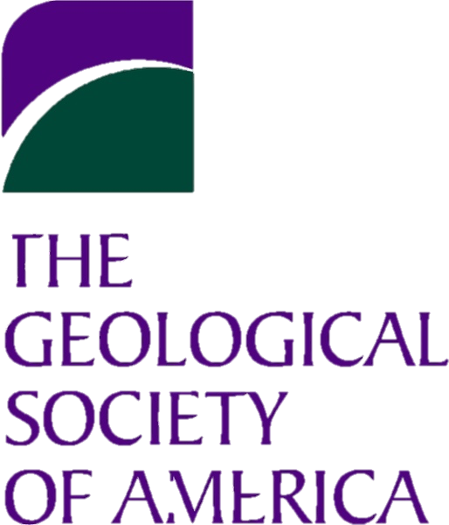


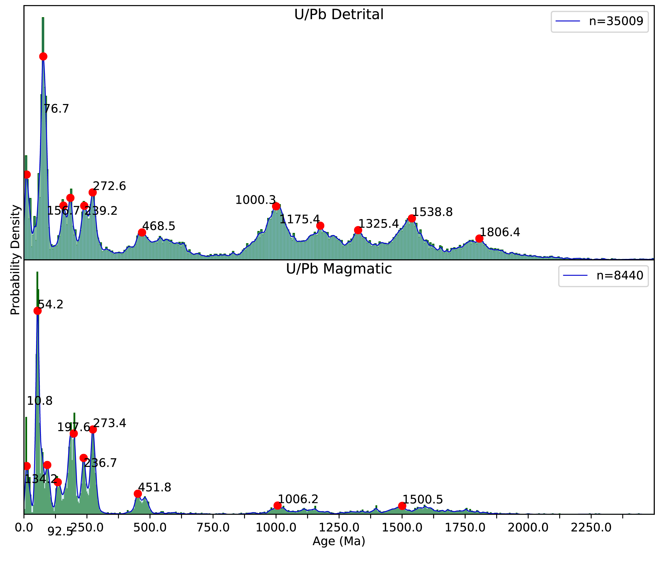
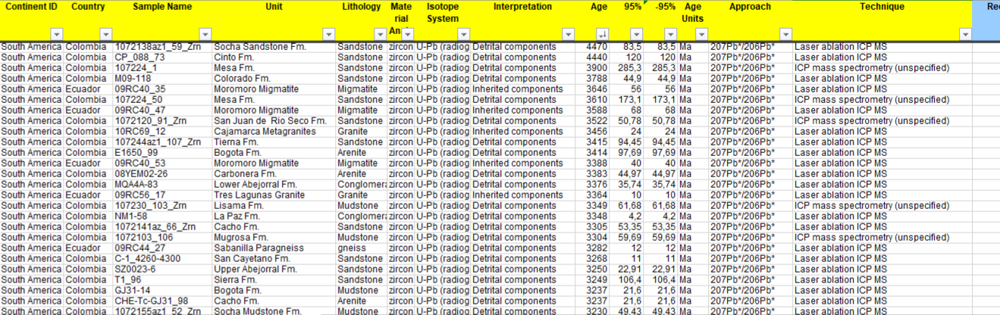
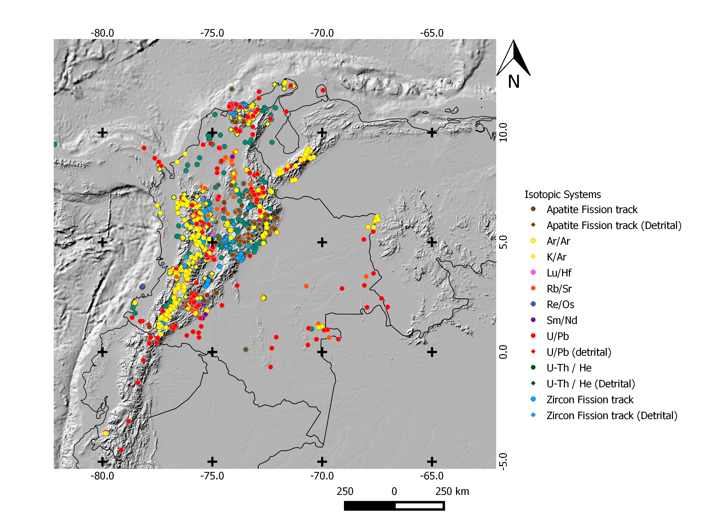
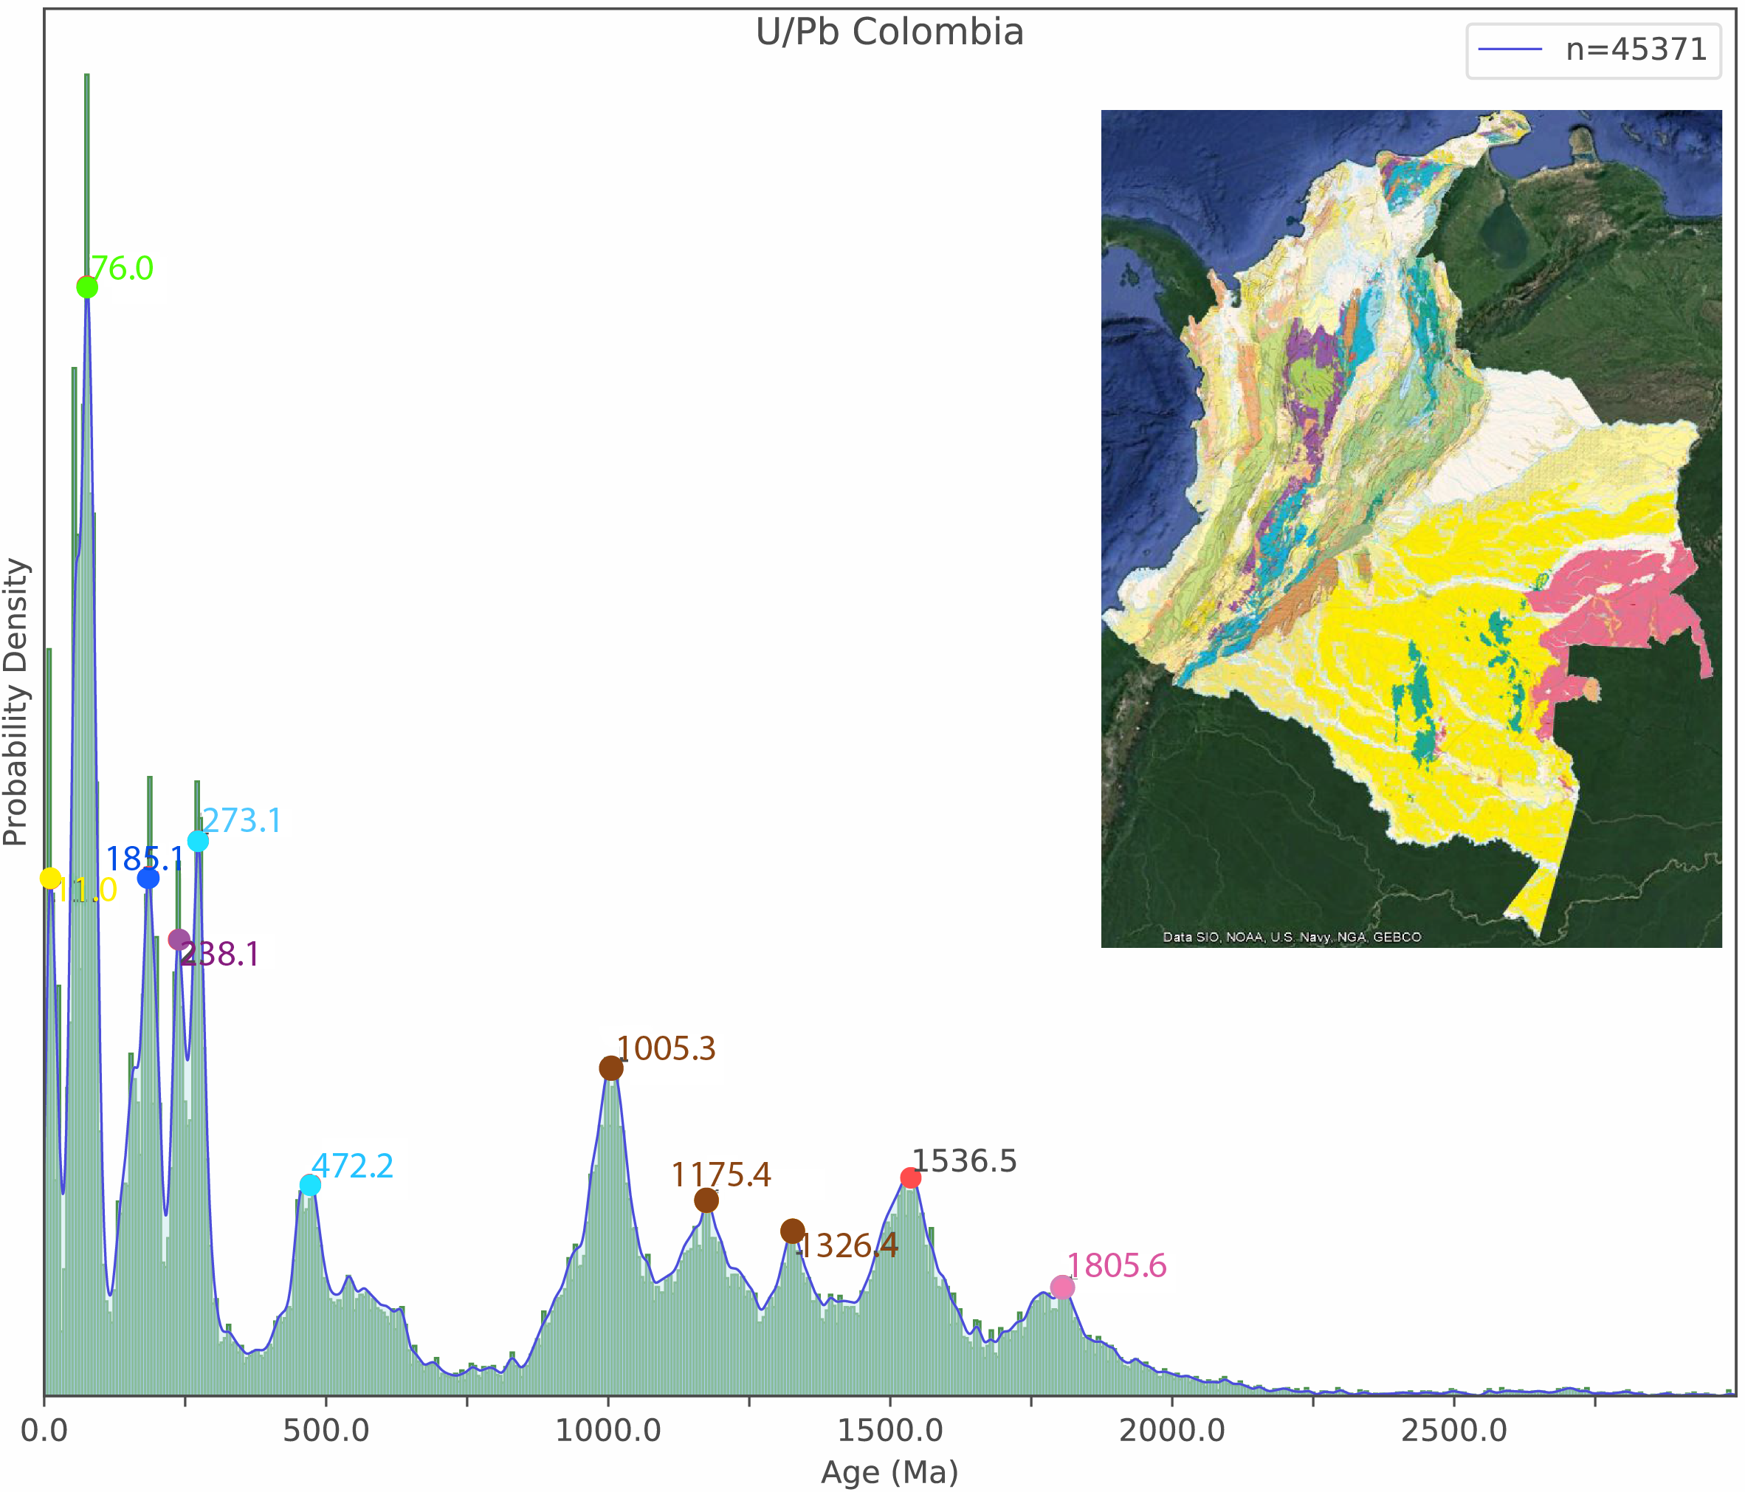
THE COLOMBIAN GEOCHRONOLOGICAL DATABASE (CGD)
4-7 November
Indianapolis, Indiana, USA
Rodríguez, A¹., Rojas-Agramonte, Y¹., Barrera, J ¹., Bonilla, S¹., Izquierdo, D¹ ., Marin, J¹., Marroquín, M¹., Daroca, M¹., Delgado, S¹., Corrales, A¹., Díaz, S¹.,Laverde, A ¹., Carvajal, A¹., Muñoz, M¹., Esquivel, L¹., Salazar, N¹., Caranton, W¹., Cartwright, D¹., Solano, J¹., Montes, C²., Cardona, A³ and Bayona, G⁴
¹ Universidad de Los Andes, Depto. de Geociencias, Facultad de Ciencias, Cra 1 Nº 18A – 12, Bogotá D.C., 111711, ² Universidad del Norte, Barranquilla,Colombia.³ Universidad Nacional de Colombia, Geología, Medellín, ⁴ Corporación Geológica ARES, Bogotá D.C.
ABSTRACT AND INTRODUCTION
Geochronological databases are powerful tools for characterizing the age spectra of a region and allows comparison with other areas. The use of such large datasets is becoming increasingly available but only a few countries or research groups are so far engaged in the painstaking work of constructing international database systems. Following the work of Gómez et al. (2015), a group of students of the Department of Geosciences at Universidad de los Andes (Colombia) is undertaking the task of creating an up-to-date and comprehensive geochronological database of the country. In this contribution, we present a large database of radiometric ages for the Colombian territory. The Colombian Geochronological Database (CGD) is a compilation of more than 50 000 published U/Pb, K/Ar, Ar/Ar, fission track (apatite and zircon), U-Th/He, Re/Os, Rb/Sr, and Sm/Nd ages. (Fig. 1)
Accompanying each age are geographic coordinates of the dated samples as well as information about lithological units and interpretative information extracted from the respective publications. The structure of the database provides a powerful interface for constructing queries and allow us to extract information on specific units, isotopic systems, age interpretations, provinces, terranes, references, etc. (Fig. 2)
This information establishes a very good framework for regional geological interpretations with geochronological, stratigraphic, structural and paleogeographic implications. Histograms and maps are produced with this database to summarize the geological history of Colombia since Precambrian times. (Fig. 3)
METHODOLOGY AND RESULTS
The information collected from both, StratDB and Dataview databases is synthesized in the excel spreadsheets available in the University of Saskatchewan Isotope Laboratory webpage administered by Bruce Eglington (StratDB: http://sil.usask.ca/SDB_compilations.htm, DataView: http://sil.usask.ca/DV_compilations.htm
An exhausting filtering criterion was applied to each, securing the quality of the database.
A Python 3.5 application to perform Kernel Density Estimations (KDE), Probability Density Plots (PDP), and Kernel Density Estimation with an adaptive bandwidth (KDEa) was developed. Also, a detection algorithm was included in the module to obtain the histograms peaks value.
Due to the magnitude of the data uncertainty error must be account using a KDE fixed bandwidth (Vermeesch et al., 2012)
a)
b)
Fig.4. Comparison between magmatic (a) and detrital (b) U-Pb ages.
Fig.2. DataView
DISCUSSION AND CONCLUSION
The present work constitute a first look into the wide age spectra from the rocks of Colombia, which spans from Precambrian to modern days (Fig. 3). The Compiled ages cover most of the Colombian territory and as we can see from the map in Figure 1, there is a correlation between past conflict areas and the absence of radiometric ages in some places. Therefore, with the present effort we want to present a clear insight from a regional perspective to the geology and tectonics of Colombia to the geoscience community. In addition, we want to make the radiometric ages from Colombia available to all scientists who are or will be interested in doing research in Colombia or to scientist interested in the geology of South America.
FUTURE WORK
The database will be available online and we plan to maintain and extend it by incorporating all new data in a routine way. A list of lithological units will also be added to the database.
REFERENCES
SGC (2016). Mapa geológico de Colombia 2015.
Eglington, B.M. (2004). Computers & Geosciences, v. 30, p. 847-858
Eglington et al., (2009). Spec. Publ. Geol. Soc. London, v. 323, p. 27-47.
Gómez et al., (2015). SGC, Publicaciones Geológicas Especiales 33, p. 9–33. Bogotá.
Vermeesch et al., (2012). Chemical Geology 312–313 (2012) 190–194.
ACKNOWLEDGEMENT
We acknowledge support from the Faculty of Science and the Geoscience Department from Universidad de los Andes, Colombia.
Grenvillian orogeny
Pangea break-up
Guyana-Amazon Craton
Jurassic Magmatism
Regional Metamorphism
Late Cretaceus Magmatism
Late Paleozoic Magmatism
Paleocene-Eocene Magmatism
Fig.1 -Location map of radiometric methods.
Pangea Amalgamation-Permian; S-type granites
Miocene Magmatism
Fig.3: General U/Pb histogram with peaks related to geological events in Colombia.

