Slide 1


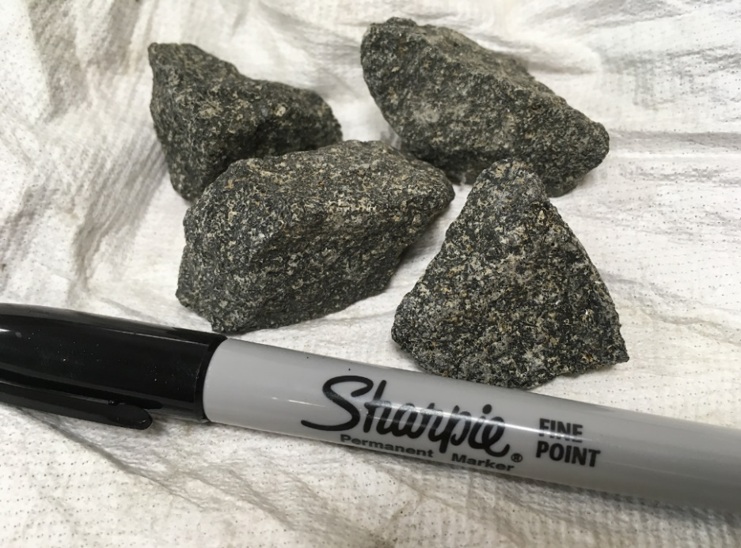
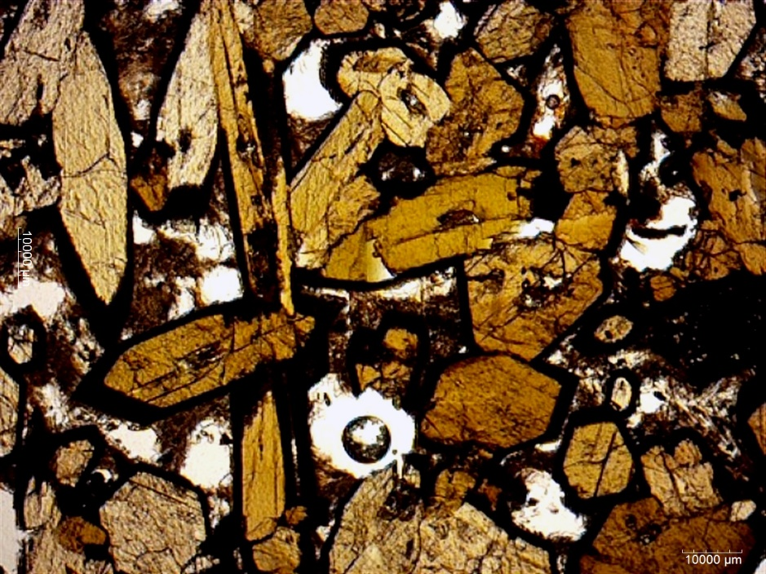
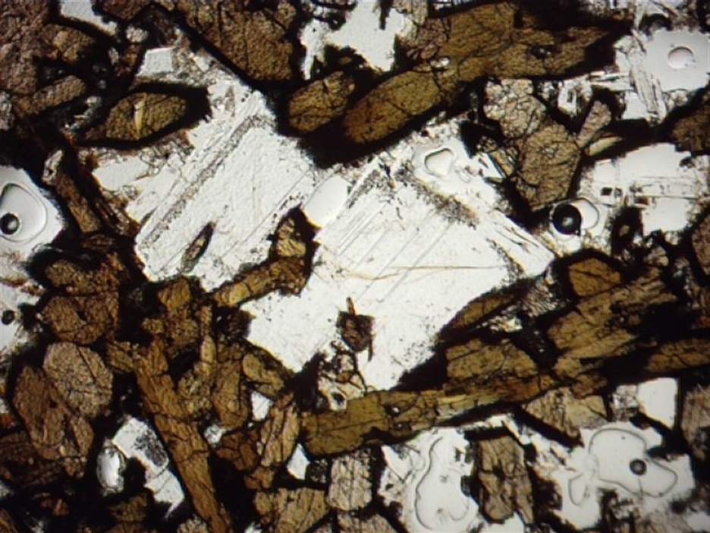
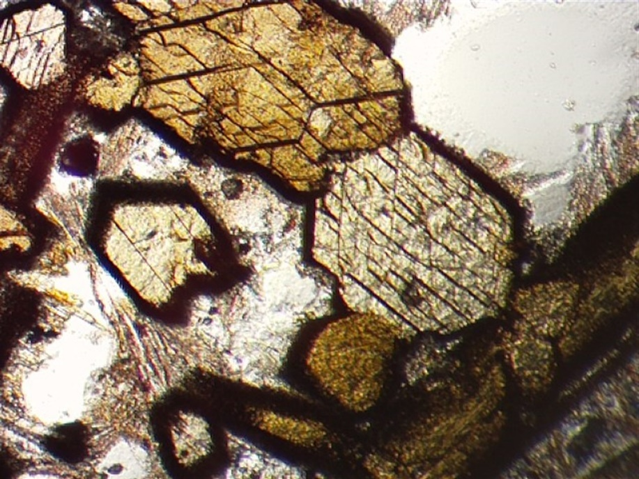
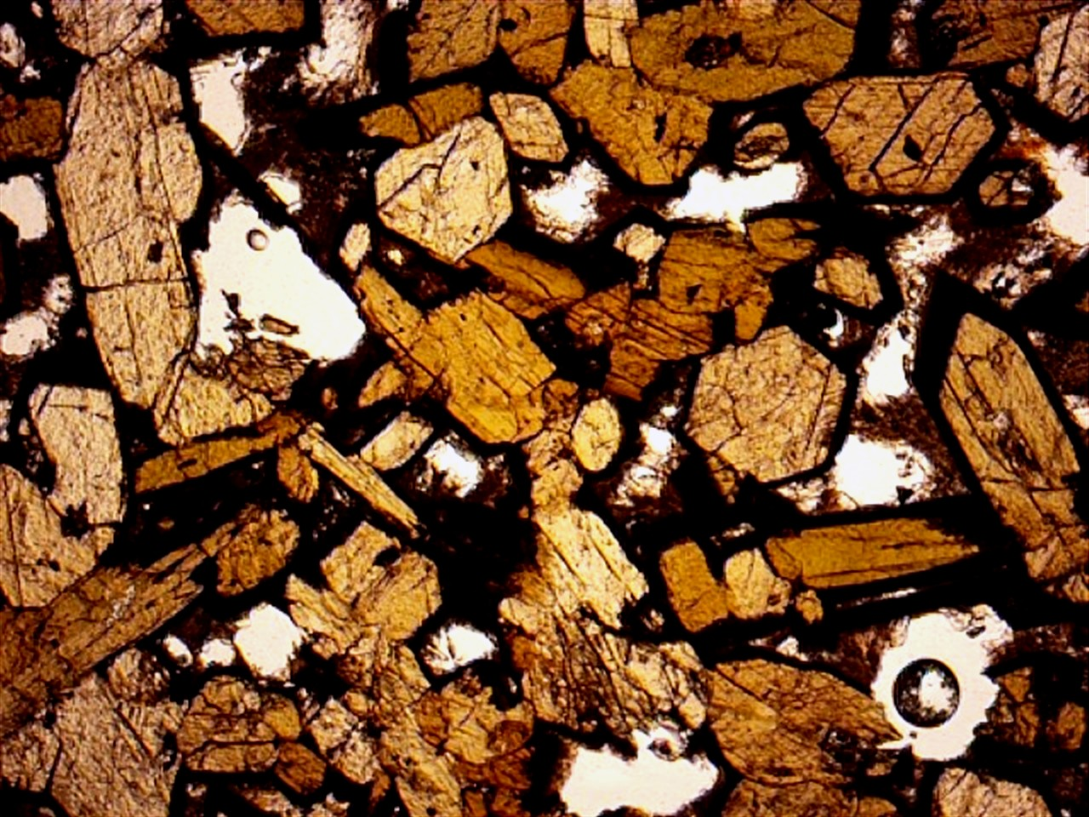

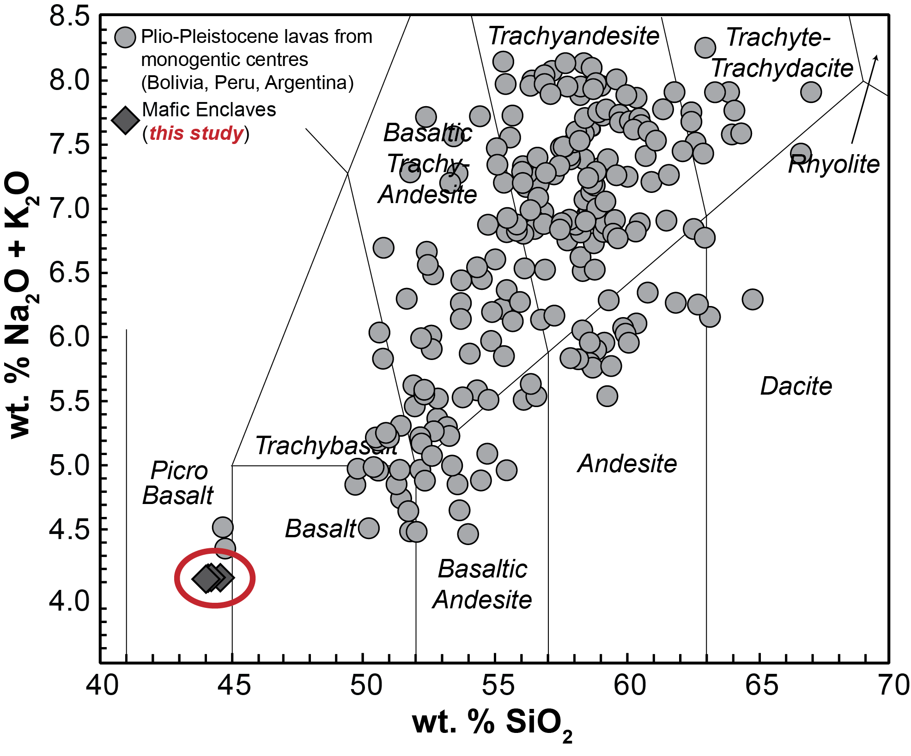
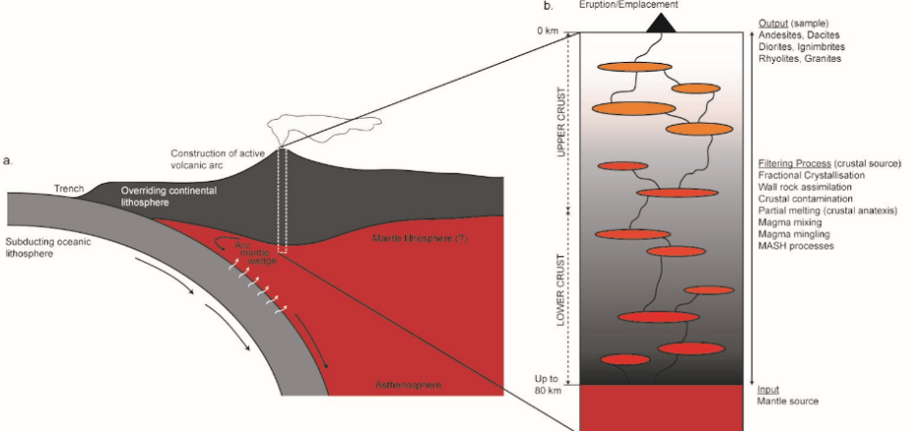
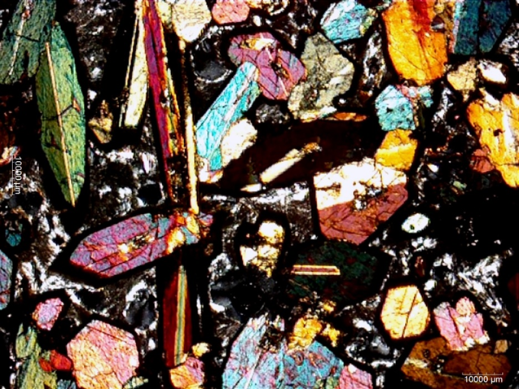
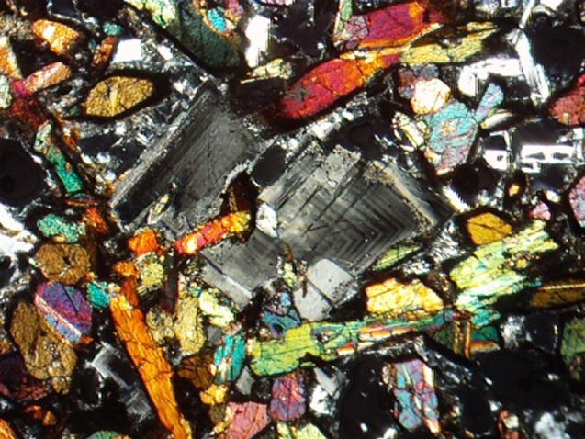
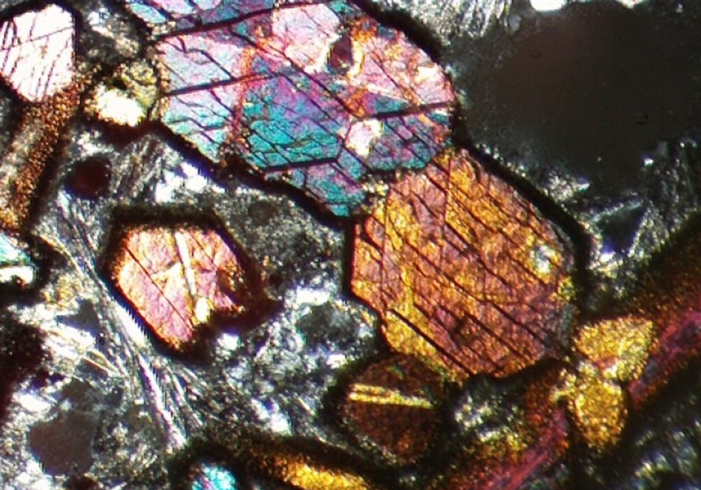
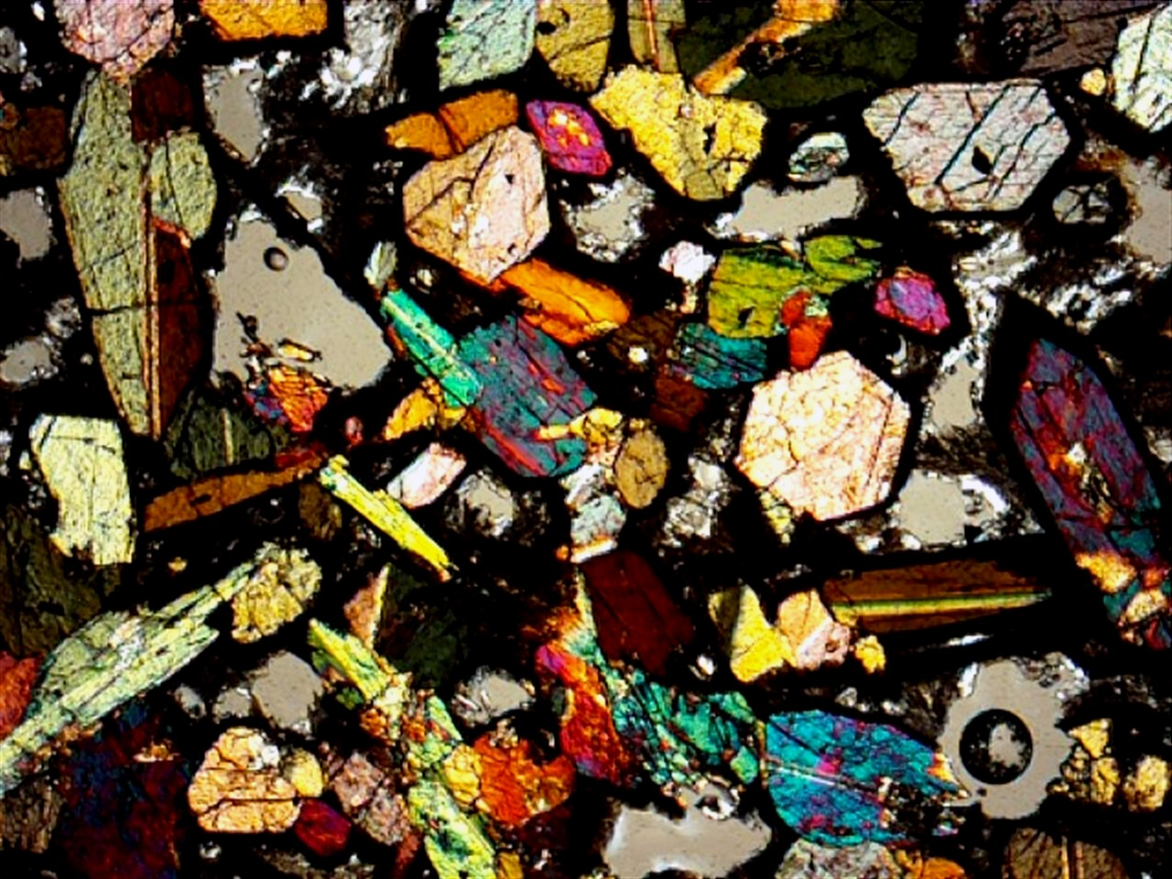
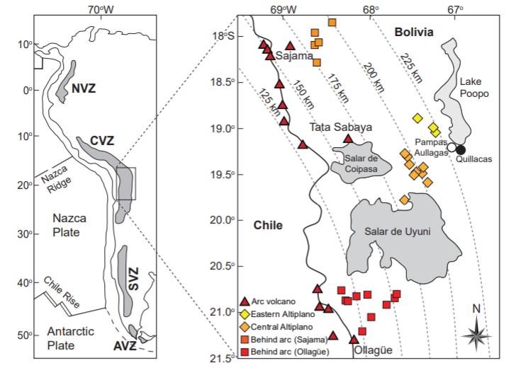
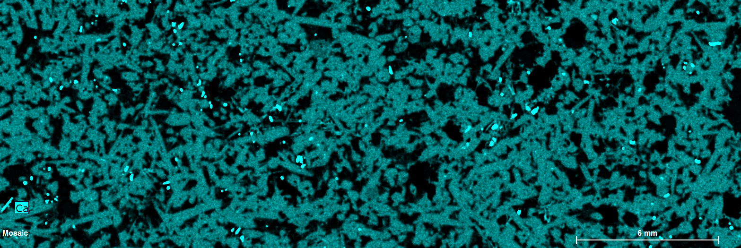
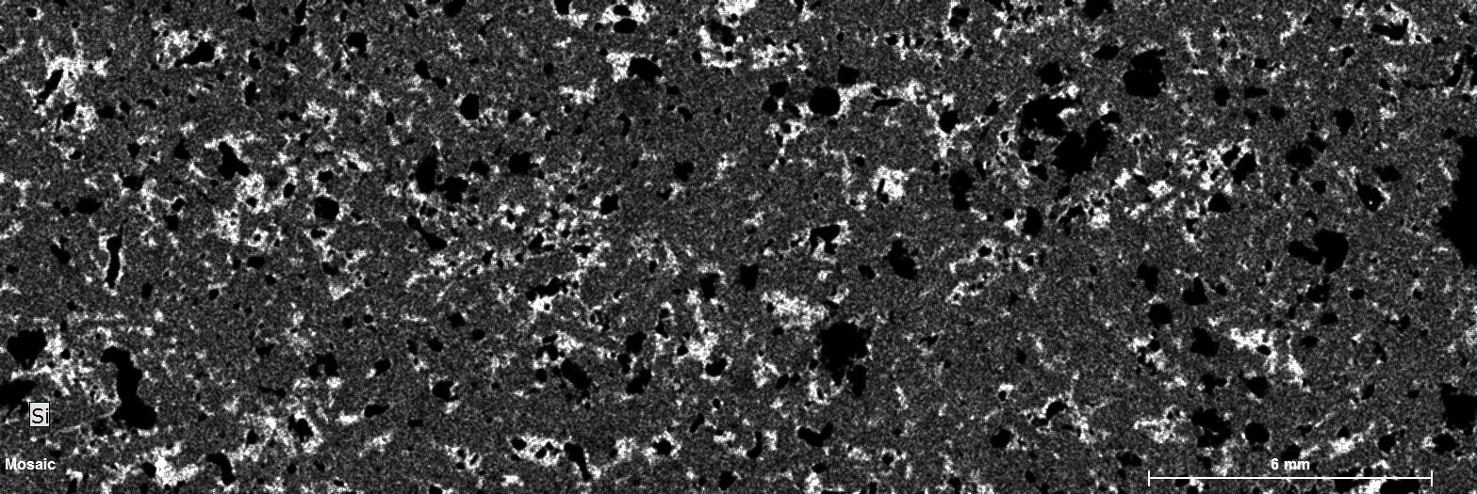
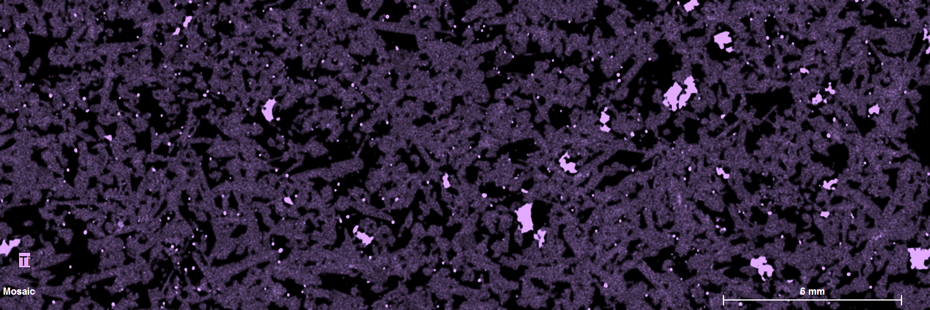
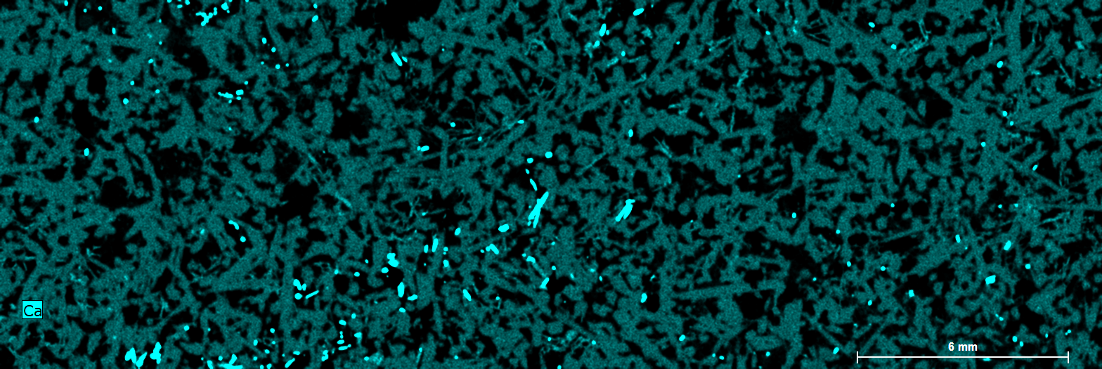
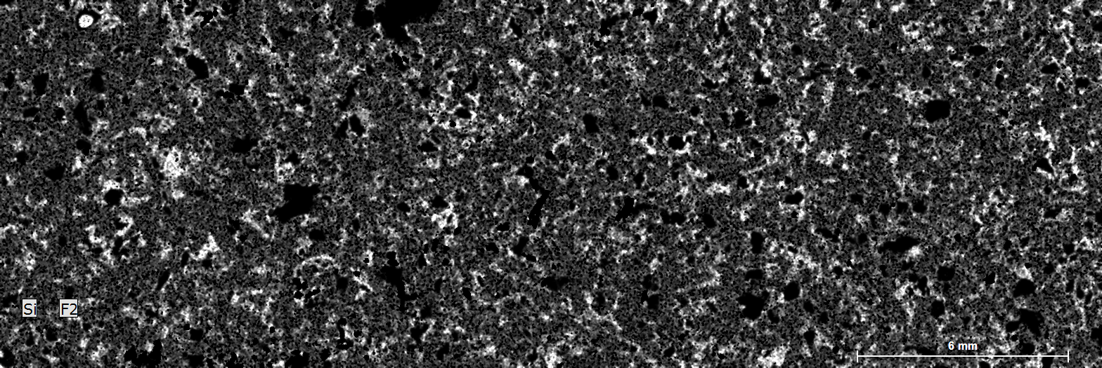
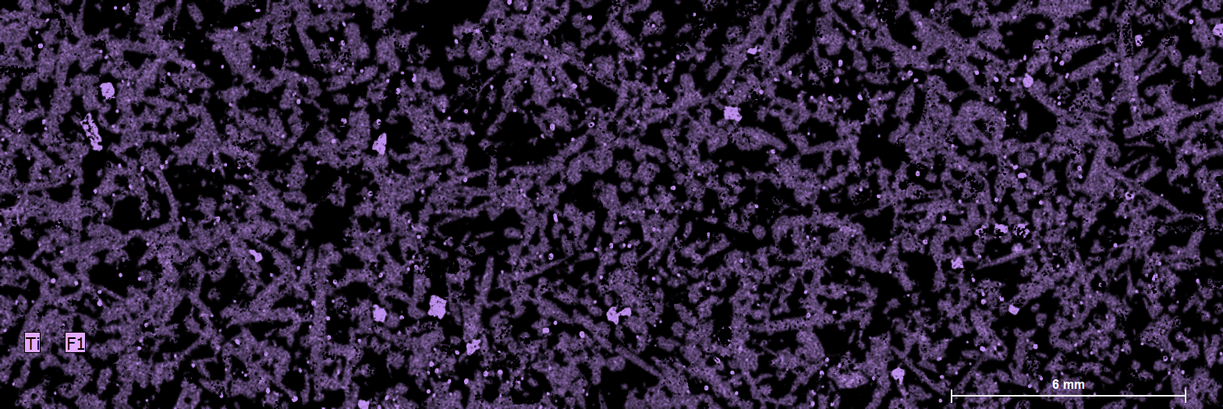
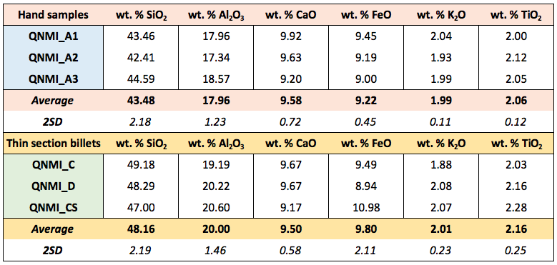
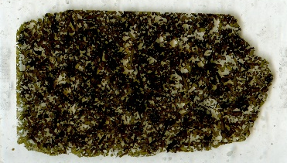
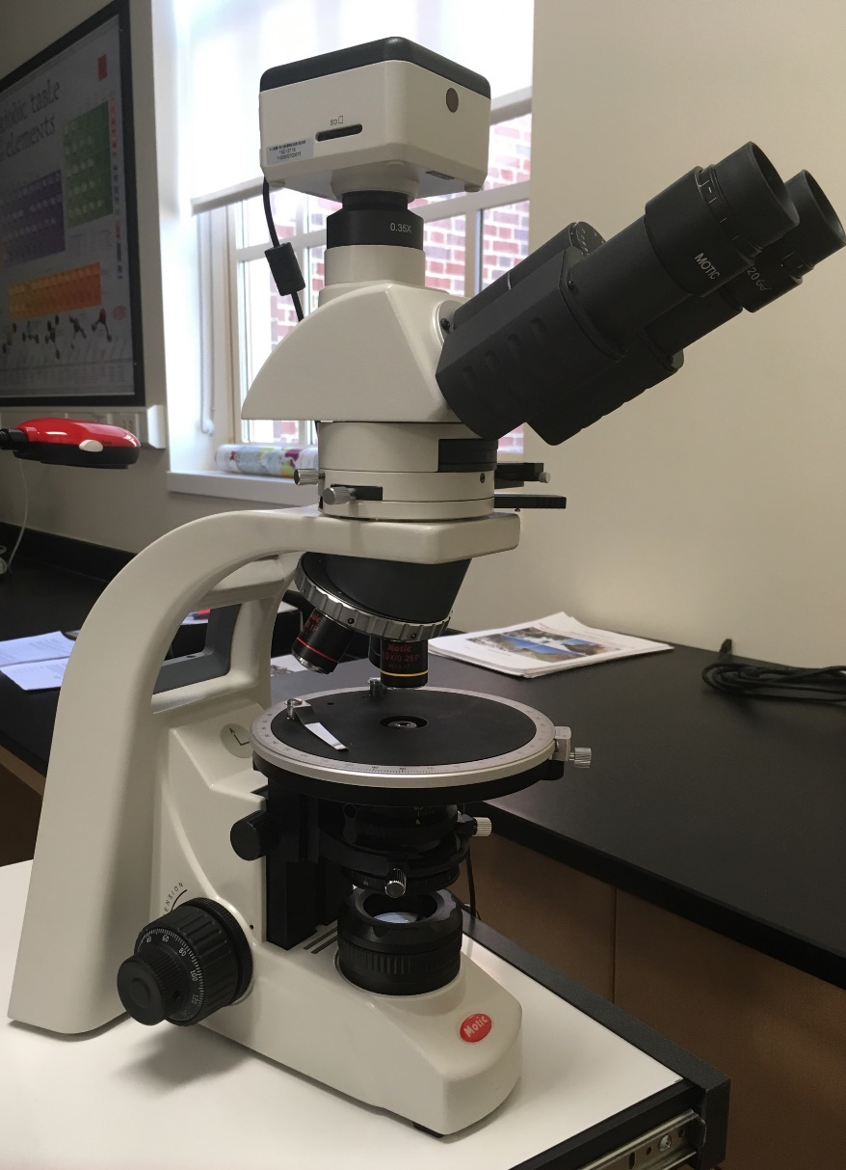

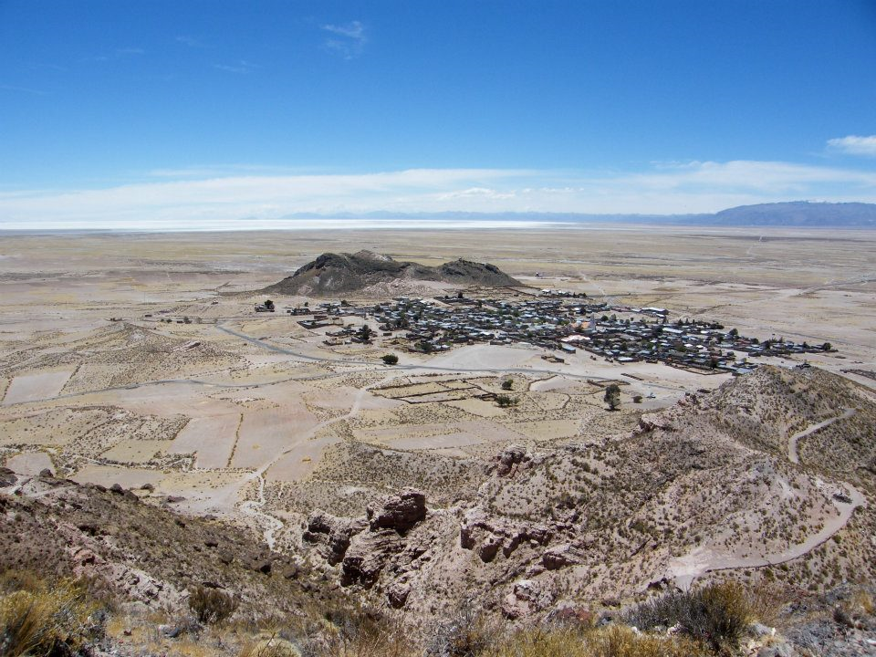
Mafic Enclaves from the Quillacas Volcanic Center in the Bolivian
Andes: Insights into Arc Magmatic Systems
David Beka Binyam¹, Ciara Childers¹, Sarah Emrick¹, Claire McLeod¹, Maureen Haley¹, Amy Wolfe¹, Tina Hill²
¹Dept. of Geology and Environmental Earth Science, Miami University, Oxford, OH, USA. ²Bruker AXS Inc, Madison, WI, USA.
1. Introduction and Research Objective:
Arc volcanoes form at subduction zones as the down going slab partially dehydrates (loses OH) and results in the generation and ascent of magma. Mafic cumulates from the plumbing system beneath the volcanoes represent a part of the magmatic system that is not otherwise recorded in the erupted lavas (Fig. 1). These cumulates therefore record a piece of the systems magmatic evolution with respect to the crystallization processes, of the ascending magma. Minerals such as amphibole (a “sponge^{[1]}”) play important roles in these systems. The objective of this research is to apply microscale information to the macroscale, in order to evaluate the history of these enclaves within the context of magmatic system evolution.
3. Results: Insights from Minerals:
1. Optical Microscopy
The analysis of thin sections in the laboratory, coupled with observations of hand samples allows for a comprehensive characterization of the textures and minerals within the samples.
In thin section (Figs. 3-6): In hand sample:
-Textures: Porphyritic, Phaneritic, Interstitial, -Textures: porphyritic, phaneritic
-Poikilitic, alignment of crystals, inequigranular -color: dark grey to black
-Euhedral to subhedral crystal shape -opaque
-Fine to medium grained (0.05-3.2mm)
Figure 3b: Amphibole crystals (XPL) Figure 4b: Zoned Plagioclase Feldspar (XPL) Figure 5b: 124º, 56º cleavage (XPL) Figure 6b: Mafic enclaves: poikilitic
===
Results (continued):
The mafic enclaves from the study can be classified as picro basalts to basalts due to the weight % SiO₂ in the sample, with respect to the weight % of Na₂O+K₂O (Fig. 10). The enclaves are chemically different from other volcanic rocks in the Central Andean region: other samples have higher silica (SiO₂) and alkali content (Na₂O+K₂O) as shown in Fig. 10.
5. Bulk Chemical Analyses (powder)
100µm
Amphibole
100µm
e
Amphibole with interstitial
Plagioclase Feldspar
Plagioclase Feldspar
Convergent Plate Boundary
100µm
100µm
Figure 3a: Amphibole crystals (PPL) Figure 4a: Plagioclase Feldspar (PPL) Figure 5a: Amphibole cleavage (124º, 56º) Figure 6a: Mafic enclaves: poikilitic
Amphibole
100µm
100µm
100µm
100µm
Figure 1: Cross section of a subduction zone, where the downgoing tectonic plate partially dehydrates to cause flux melting of the mantle. This leads to the generation of magma which ascends towards the Earth’s surface.
2. Elemental Mapping: (micro-XRF)
Figure 10: Total Alkali Silica plot (TAS) for Central Andean lavas.
Figure 7: Ca, Si, and Ti elemental maps collected from 2 thin sections of the Bolivian Mafic Enclaves. Relatively Ca-rich amphiboles are observed, as are likely Ti-rich oxide phases (potentially ilmenite).
4. Interpretations and Conclusions:
Mafic enclaves from the Quillacas volcano in the Central Andes of Bolivia represent an important stage of the textural, mineralogical, and chemical evolution of magmatic systems in arc settings. Texturally the samples are dominated by porphyritic, phaneritic, interstitial, and poikilitic features. Mineralogically the samples consist of 85-90% amphibole, 5-10% plagioclase, 0-5% quartz, and 0-5% oxides. Chemically, the samples are distinct from other Central Andean magmatic rocks, providing potentially new insights into the compositions of magma stored beneath Andean arc volcanoes. The presence of amphibole is also key to evaluating the evolution of arc-magmatic systems (Fig. 1). Further research will include in-situ analyses via EPMA (majors) and LA-ICP-MS (trace elements).
Ca
Si
Ti
Ca
Si
Ti
3. Scanning Electron Microscope (SEM):
4. XRF Major Element Data (Hand-held unit):
Amphibole
Amphibole
Figure 2: Map of the field site from which the studied samples were collected - the Bolivian Andes of South America. Samples collected from Quillacas volcano.
A
200µm
B
200µm
2. Methodology:
1. Optical Microscopy (thin sections)
2. Modal Mineralogy (proportions)
3. Scanning Electron Microscopy
4. Major element mapping (µ-XRF)
5. Bulk chemical analyses
Amphibole
Table 1: (above) results from hand held XRF analysis
C
5. References and Acknowledgements
Significant thanks are owed to the GSA Onto to the Future program who provided funding to David Beka Binyam. Faculty and Staff in the Department of Geology and Environmental Earth Science are thanked for their continuing support of our research.
200µm
200µm
Figure 9: (left) Image illustrating the location of the SEM-imaged amphibole crystals A-D (Figure 8).
All crystals are located on thin section QMNI_CS. Obtained through mineral mapping via optical microscopy.
^{[1]} Davidson et al. (2007). Amphibole “sponge” in arc crust. Geology, v. 35; 787-790.
C
D
Figure 8 A-D: SEM images of amphiboles from sample QMNI_CS (see figure 12) showing illustrating again the characteristic cleavage planes (124º, 56º), and likely dehydration rims (Fe-oxides + pyroxene). No evidence of chemical zonation is observed. Images were collected at the Center for Advanced microscopy and Imaging (CAMI) at Miami University
D
A
B

