Slide 1


Thermo-haline circulation in confined coastal aquifers and resulting deep submarine groundwater discharge
Anner Paldor, Einat Aharonov, Oded Katz
GSA annual meeting 2018, Indianapolis

Slide 2
In unconfined aquifers, Deep SGD of pure seawater arises from geothermal convection (Wilson, 2005)
Notes:
The Wilson model (unconfined aquifer) shows a full separation between the two processes – salt dispersion and resultant fresh/saline sgd is limited to the coast, and in the deep areas DSGD is due to the geothermal convection of pure seawater.

Slide 3
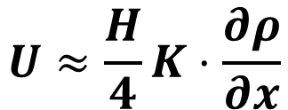

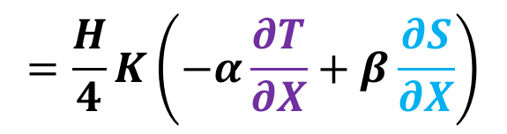
$$ρ_{1}>ρ_{2}$$
$$\vec{Ω}$$
$$ρ_{2}$$
Z
Y
$$ρ_{1}$$
X
Following Phillips (2009):
$$\vec{Ω}=∇×\vec{u}$$
$$U≈\frac{H}{4}K⋅\frac{∂ρ}{∂x}$$
$$=\frac{H}{4}K\left(−α\frac{∂T}{∂X}+β\frac{∂S}{∂X}\right)$$
Theory: tilted isopycnals in a confined aquifer provoke circulation. Flow velocity is linearly related to temperature and salinity horizontal gradients
Notes:
Theory based on Owen Philips – the intensity of circulation under tilted isopycnals is correlated to horizontal salinity and temperature gradients (and thus the resulting seepage velocity).

Slide 4
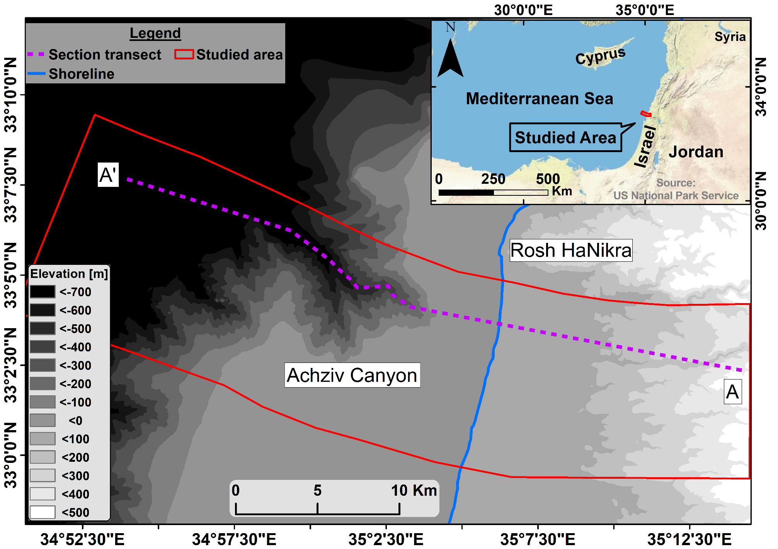
Case study for DSGD: Achziv Canyon
Notes:
In the next slide – the onshore-offshore geological CS which its transect is marked here by dashed magenta.

Slide 5
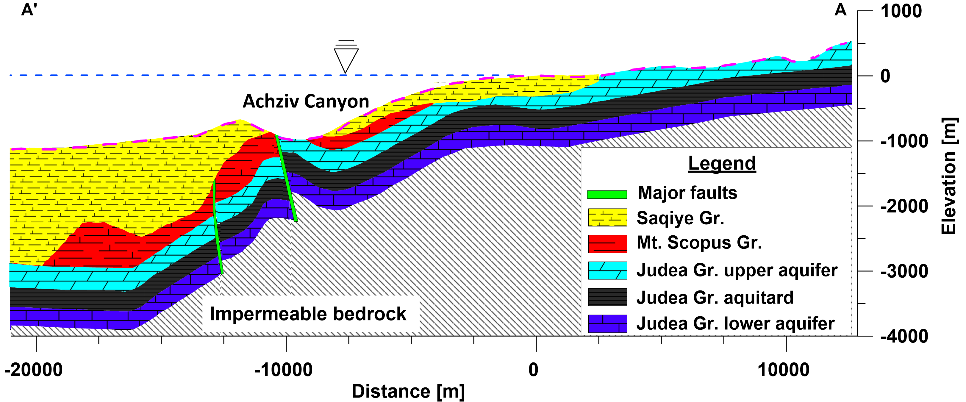
Two key features of the geological section:
(1) Flexural structure;
(2) Outcropping of JG aquifer in the Aczhiv Canyon

Slide 6
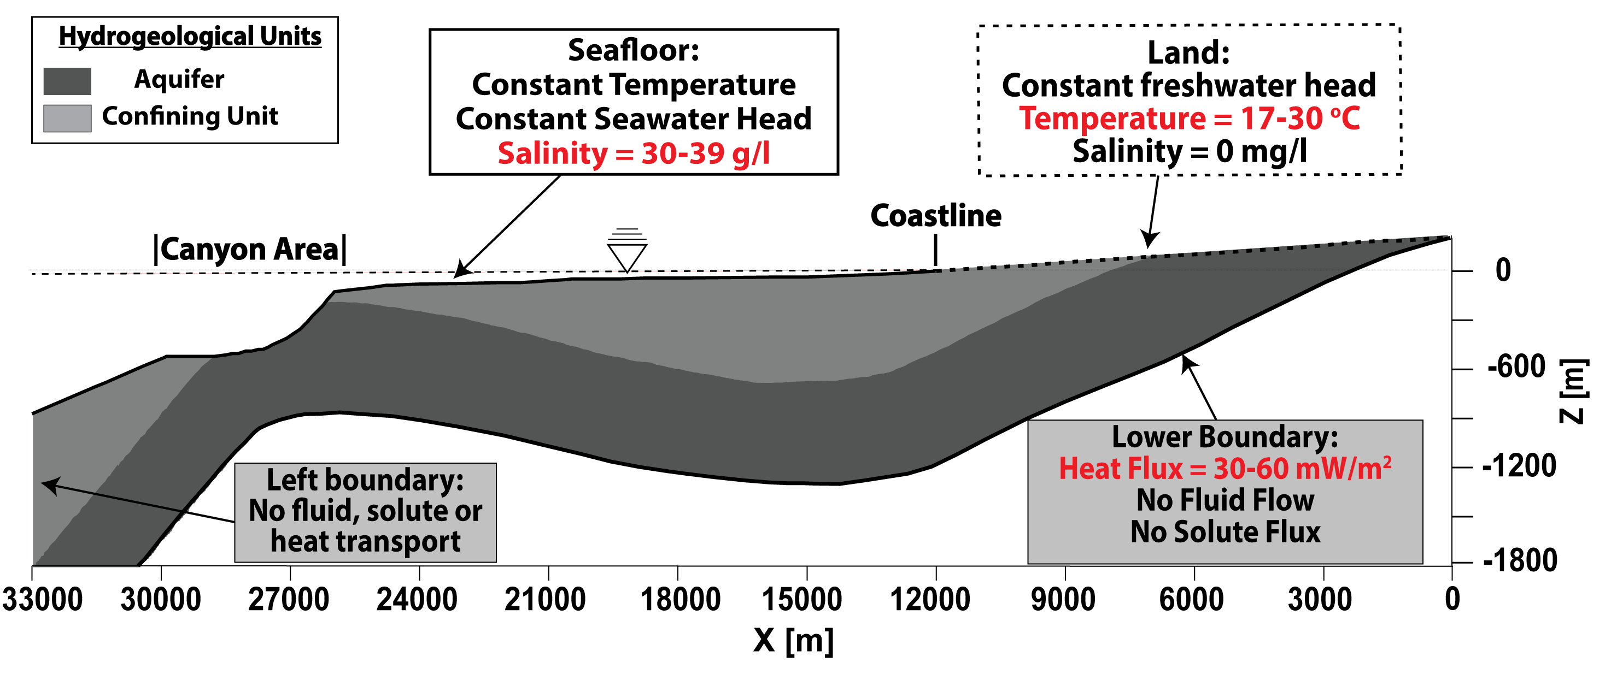
FEFLOW model based on the geological section
Notes:
To test the theory presented earlier, we tested the sensitivity of VSGD to 3 parameters – basal heat flux (30-60 mW/m²), land temperature (17-30 Celsius), and seawater salinity (30-39 psu).

Slide 7
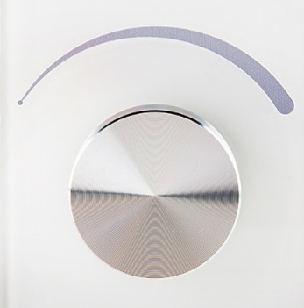
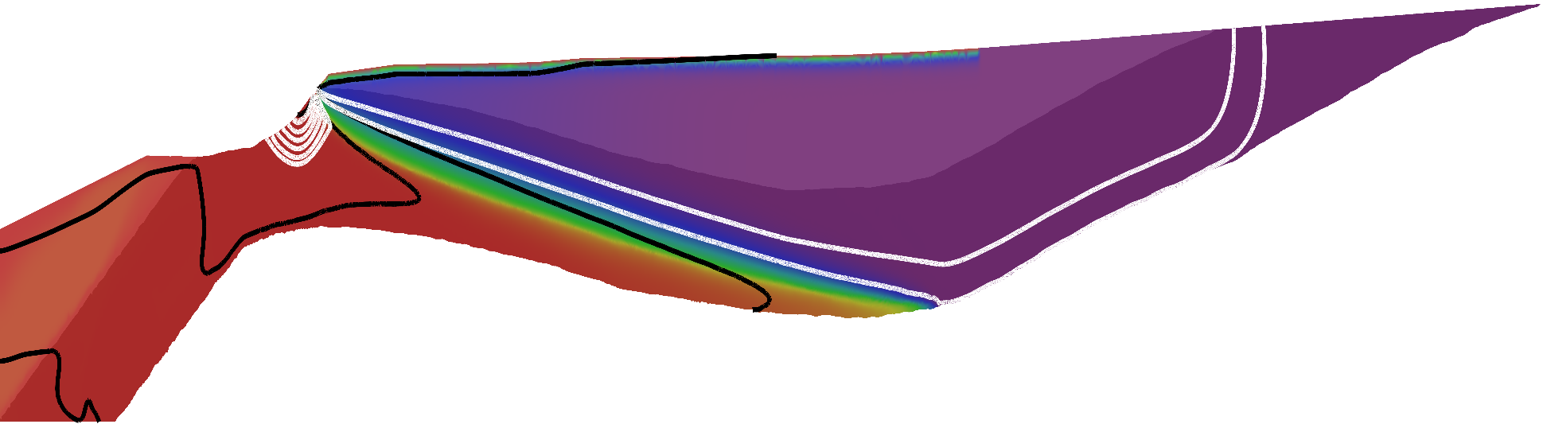
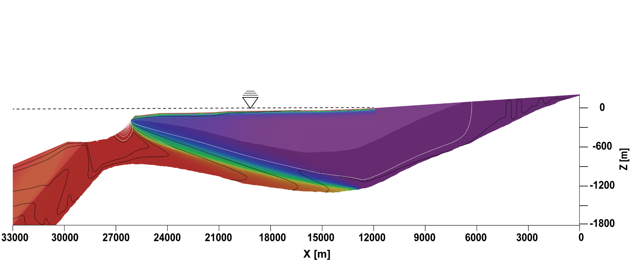
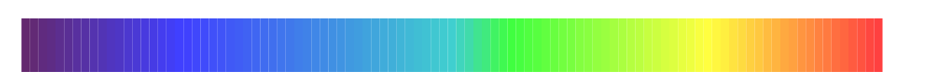
End-member 1: Freshwater DSGD
Confinement
Z [m]
0
-600
Isotherms
-1200
Streamlines
-1800
33000
27000
21000
15000
9000
3000
X [m]
0
50
100
Salinity [%]
Notes:
This case is sometime considered unrealistic given present day heads

Slide 8
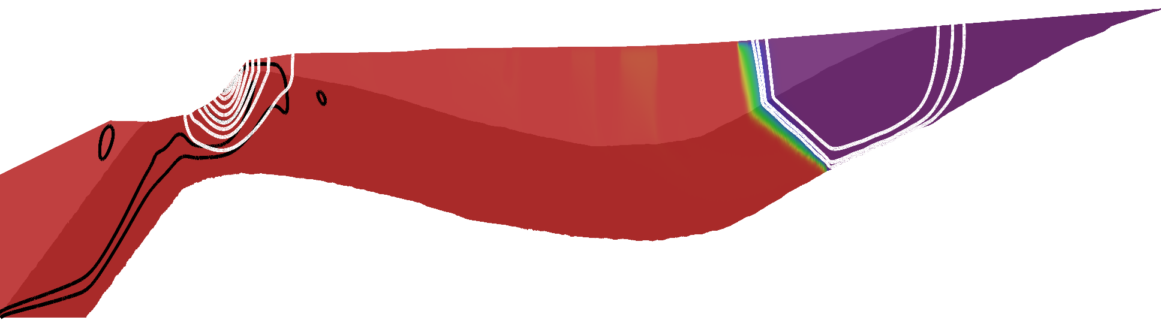
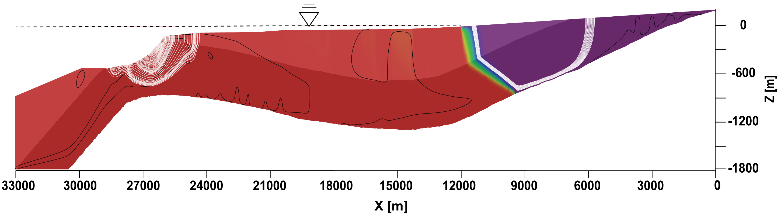
End-member 2: Saltwater DSGD
Confinement
Z [m]
0
-600
Isotherms
-1200
Streamlines
-1800
33000
27000
21000
15000
9000
3000
X [m]
0
50
100
Salinity [%]
Notes:
This is in fact the Wilson case.

Slide 9
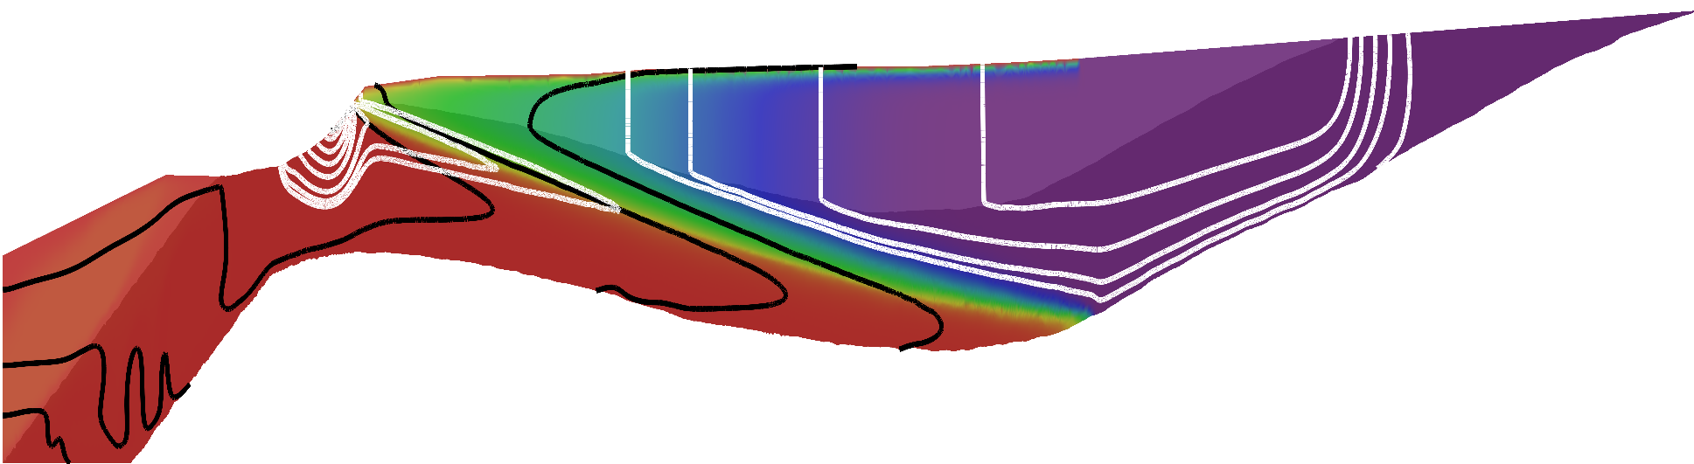
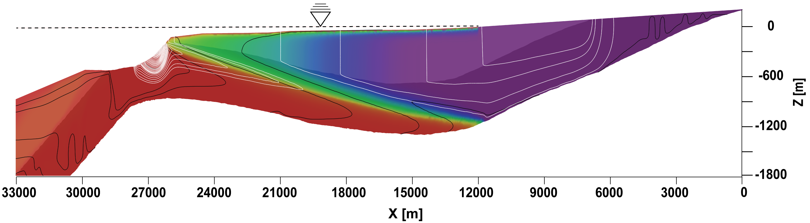
Intermediate case: Saline DSGD
Confinement
Z [m]
0
-600
Isotherms
-1200
Streamlines
-1800
33000
27000
21000
15000
9000
3000
X [m]
0
50
100
Salinity [%]
Notes:
This intermediate case is an interesting “sweet spot” between the two end members – DSGD is saline, but terrestrial (fresh) groundwater does not flow all the way to the seepage site – it percolates upwards through the confining unit some ~6 km before (note the white vertical streamline at x~21000)!

Slide 10
Seepage velocity is expected to increase w. increasing temperature & salinity horizontal differences
$$U≈\frac{H}{4}K\left(−α\frac{∂T}{∂X}+β\frac{∂S}{∂X}\right)$$

Slide 11
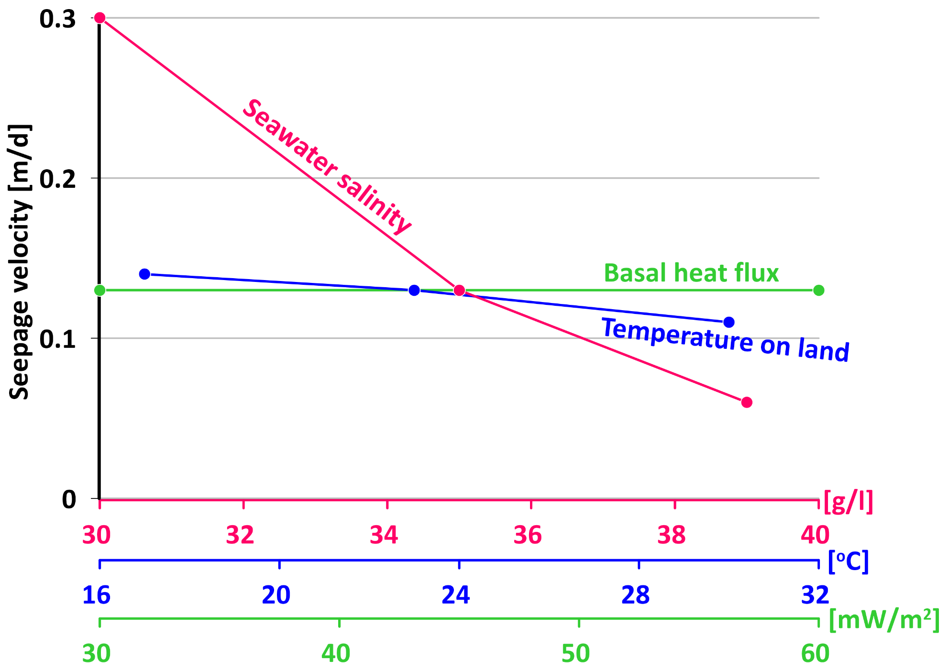
Instead - Increasing global gradients in T&S decreases seepage.
Notes:
Basal heat flux (green) has almost no effect. Land temperature and seawater salinity reduce the seepage velocity, allegedly contradicting the theory.

Slide 12
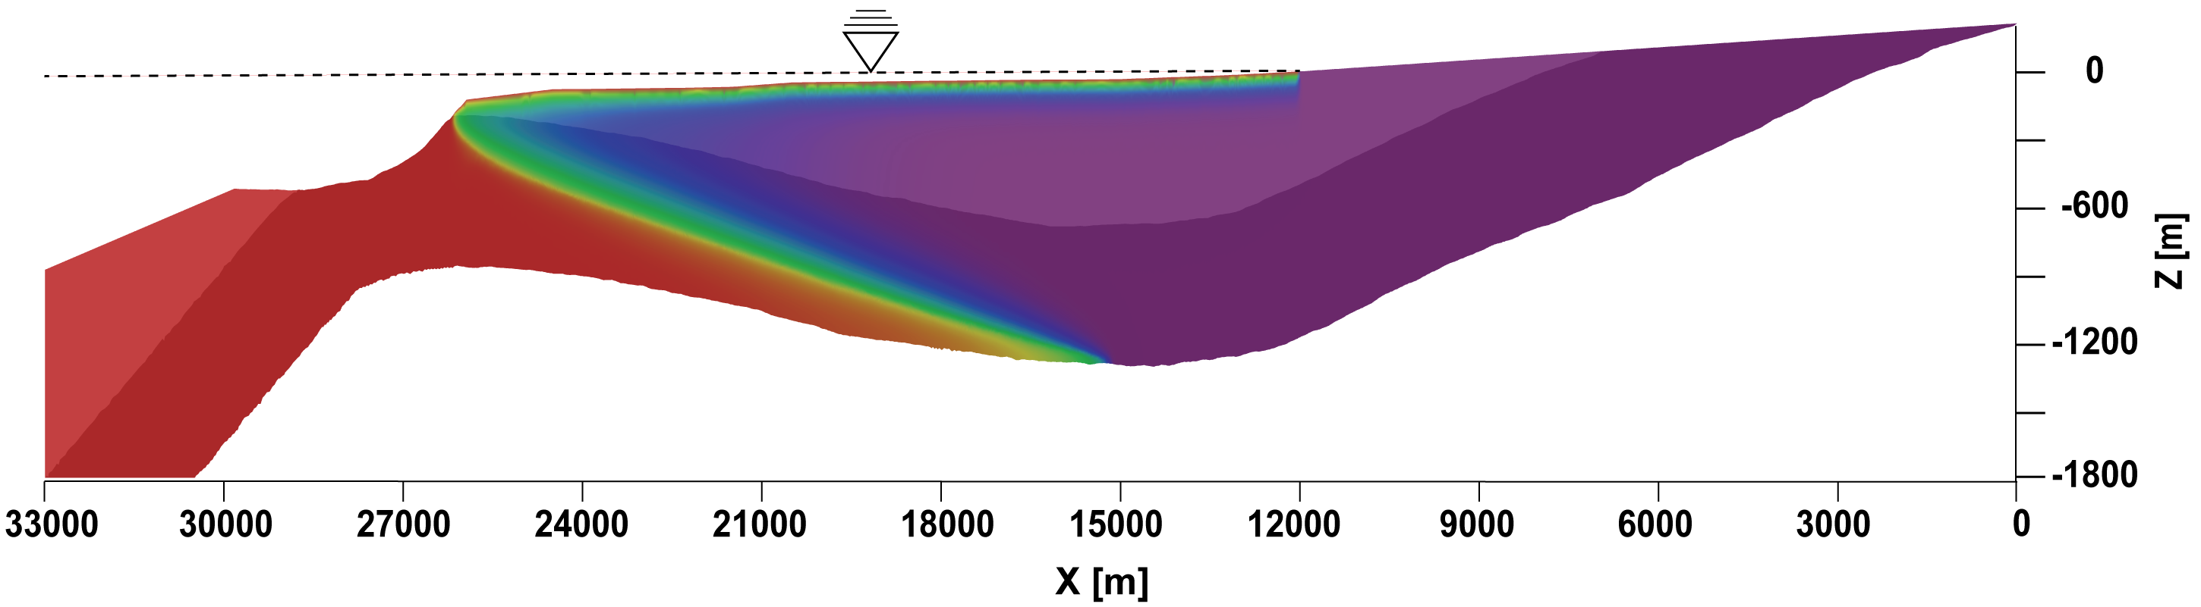
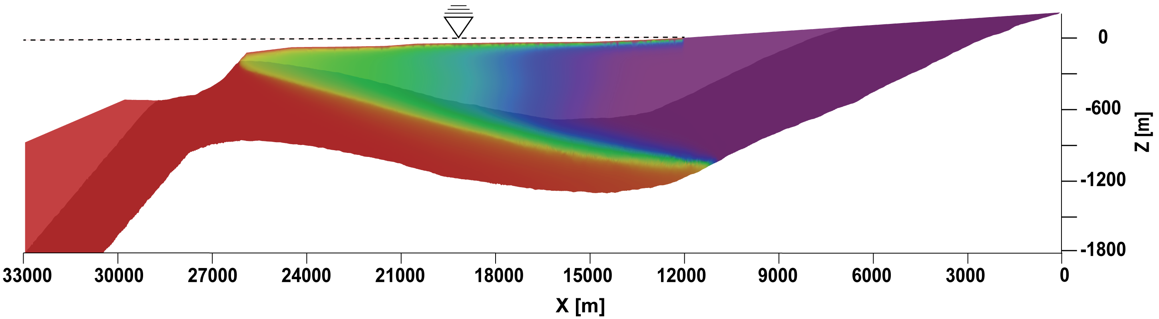
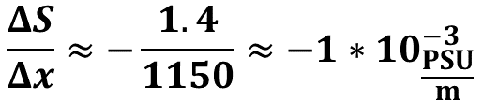
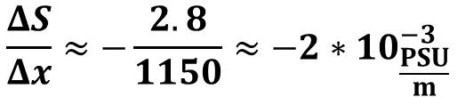
Increased global salinity difference between ocean and land causes decreased local salinity gradients.
0
Z [m]
$$\frac{ΔS}{Δx}≈−\frac{2.8}{1150}≈−2∗{10}_{\frac{PSU}{m}}^{−3}$$
-600
-1200
Seawater salinity = 30 g/l
-1800
33000
27000
21000
15000
9000
3000
X [m]
0
Z [m]
$$\frac{ΔS}{Δx}≈−\frac{1.4}{1150}≈−1∗{10}_{\frac{PSU}{m}}^{−3}$$
-600
-1200
Seawater salinity = 39 g/l
-1800
33000
27000
21000
15000
9000
3000
X [m]
0
50
100
Salinity [%]
Notes:
This is what happens – when the density contrast between seawater and terrestrial groundwater is higher (i.e. higher seawater salinity or lower land temperature), the interfaces (either the salt interface or the thermal interface) are pushed inland (again, because the seawater is heavier than the terrestrial groundwater). This decreases the local salinity/temperature gradients (here only the salinity gradient is shown) and weakens the circulation and the resultant seepage. This is counterintuitive because the general salinity/temperature differences in the system increase.

Slide 13
TAKE HOME MESSAGES
at the nearshore scale SGD in unconfined aquifers results from elevated heads and dispersive mixing of fresh groundwater and seawater along the interface.
deep SGD in unconfined aquifers, occurs purely from geothermal convection, in which case seeping water is 100% SW.
In confined aquifers that outcrop several km offshore, the two mechanisms combine to produce saline deep SGD from thermo-haline convection.
It is not the general salinity/temperature differences in the system that dictate seepage velocity, but rather the local gradients that drive circulation.

Slide 14
Thank you!
Taken from Moosdorf and Oehler [2017]

Slide 15
References
Moosdorf, N., & Oehler, T. (2017). Societal use of fresh submarine groundwater discharge: An overlooked water resource. Earth-Science Reviews, 171(April), 338–348. https://doi.org/10.1016/j.earscirev.2017.06.006
Phillips, O. M. (2009). Geological fluid dynamics: Sub-surface flow and reactions. Geological Fluid Dynamics: Sub-Surface Flow and Reactions. https://doi.org/10.1017/CBO9780511807473
Wilson, A. M. (2005). Fresh and saline groundwater discharge to the ocean: A regional perspective. Water Resources Research, 41(2), 1–11. https://doi.org/10.1029/2004WR003399

Slide 16
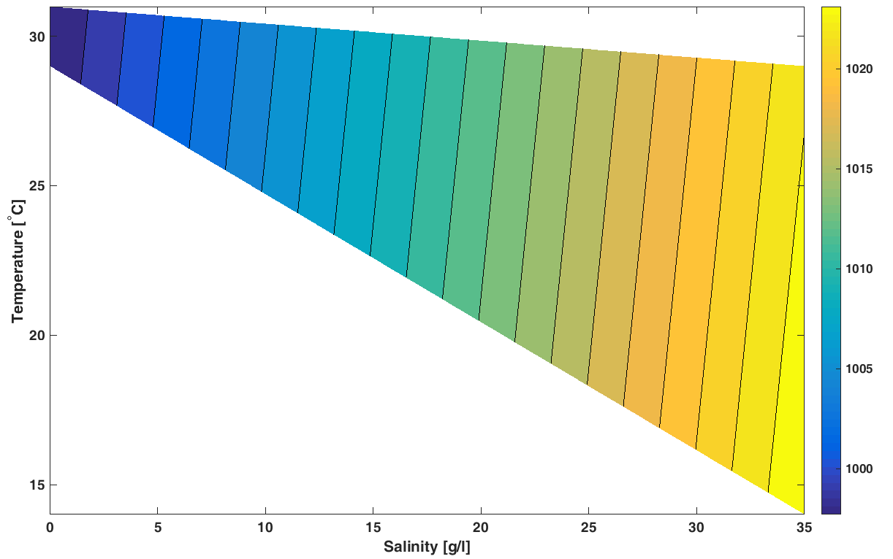
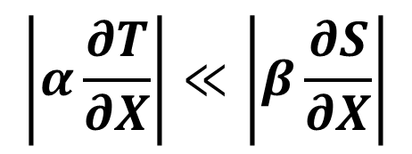
$$\left|α\frac{∂T}{∂X}\right|≪\left|β\frac{∂S}{∂X}\right|$$
Density [Kg m⁻³]
Notes:
It should be noted, though, that the thermal component of the circulation is ~OOM less than the salinity one.

Slide 17
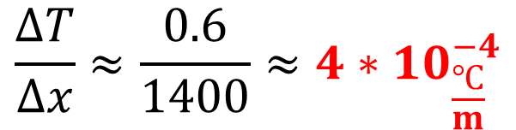
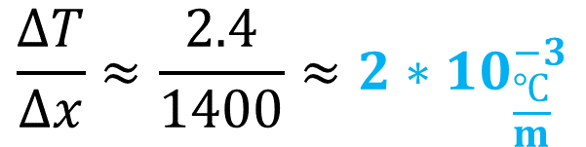
Increasing land temperature makes the land water lighter → the interface is pushed landwards → local gradients decrease
Land temperature = 17º
$$\frac{ΔT}{Δx}≈\frac{2.4}{1400}≈2∗{10}_{\frac{℃}{m}}^{−3}$$
Land temperature = 30º
$$\frac{ΔT}{Δx}≈\frac{0.6}{1400}≈4∗{10}_{\frac{℃}{m}}^{−4}$$
(Seawater Temperature = 14º)

Slide 18
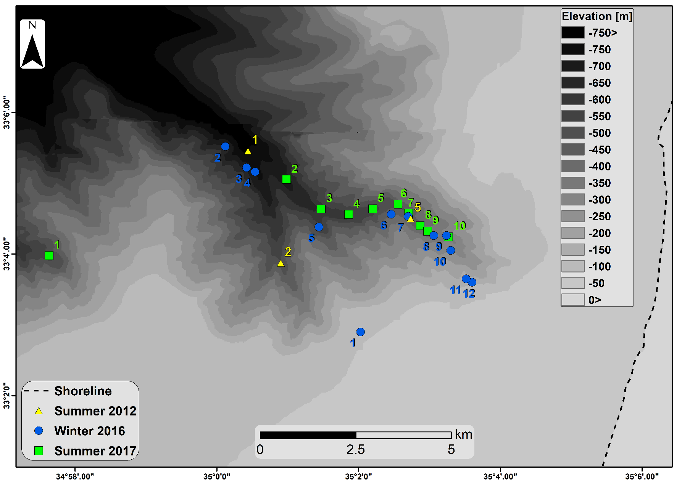
Hydrographic surveying of seawater where DSGD is predicted by the modeling
Area of predicted DSGD

Slide 19
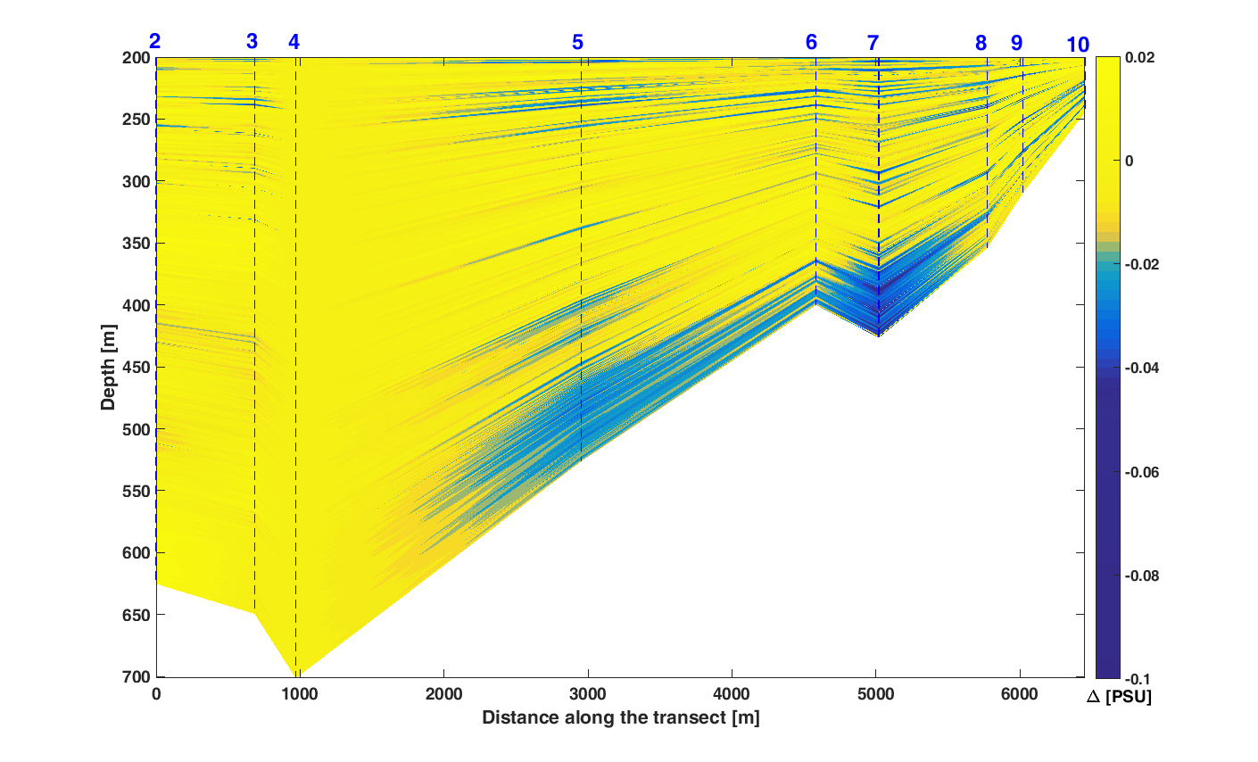
Salinity anomaly profile along the canyon shows low-salinity plume
Winter 16

