Slide 1



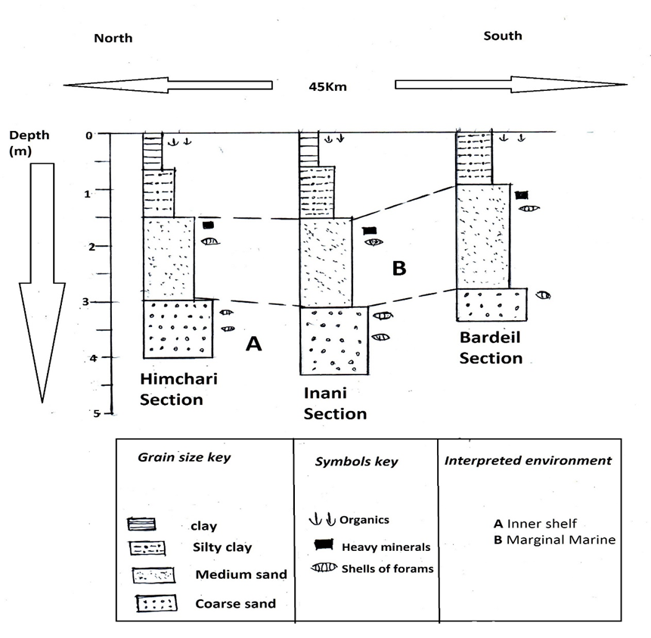
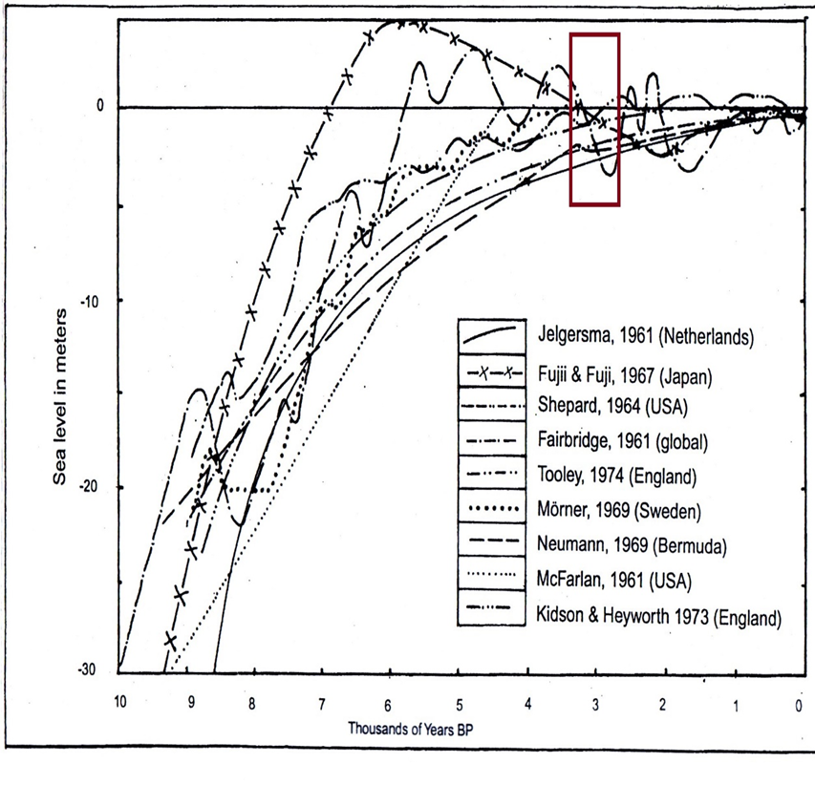
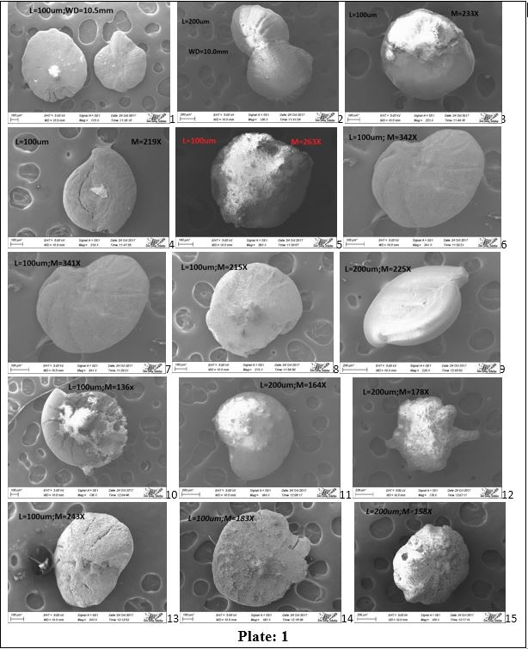
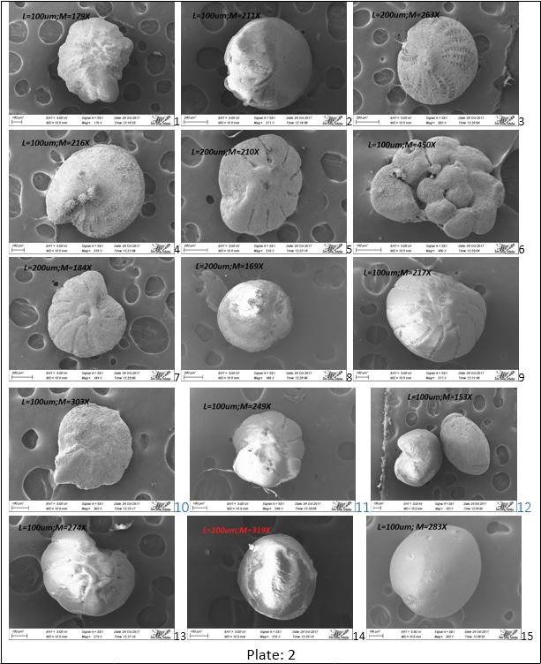
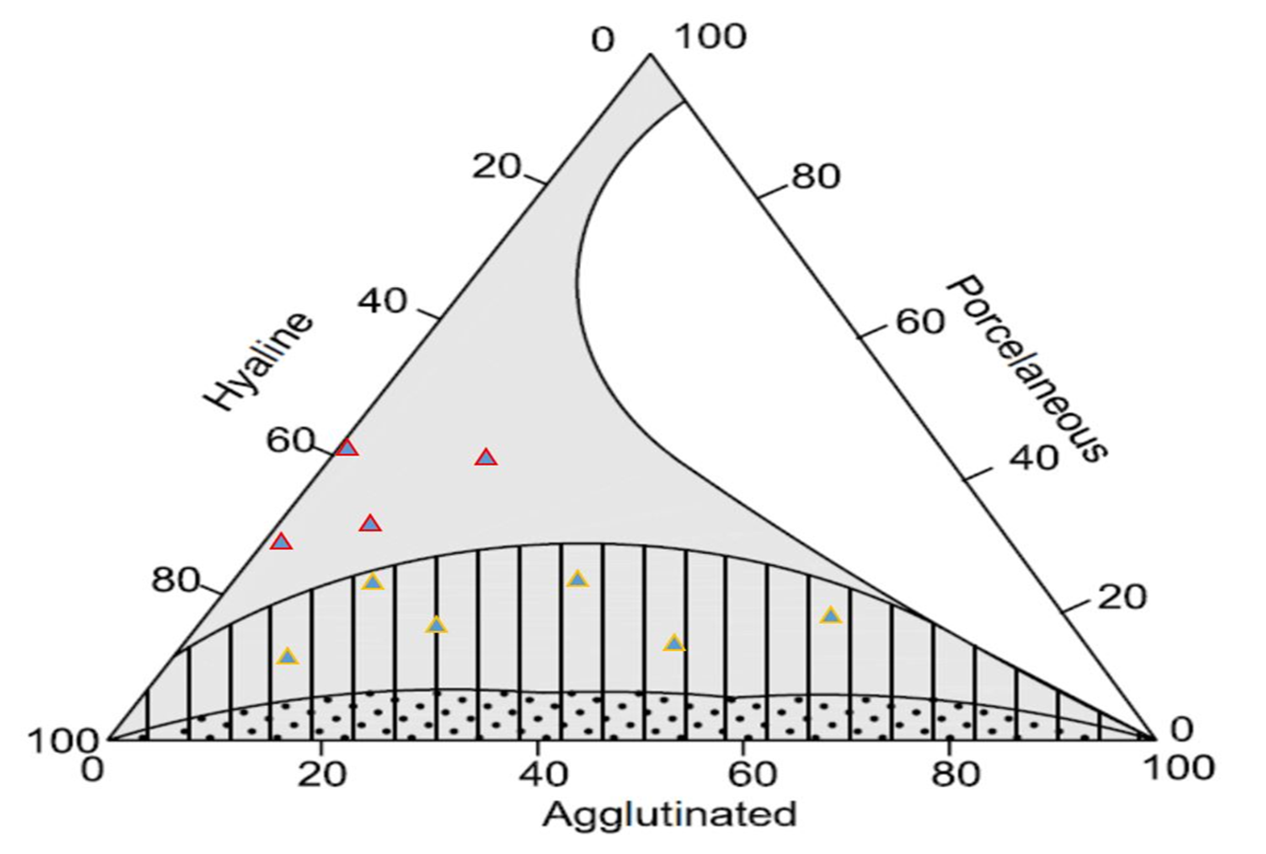
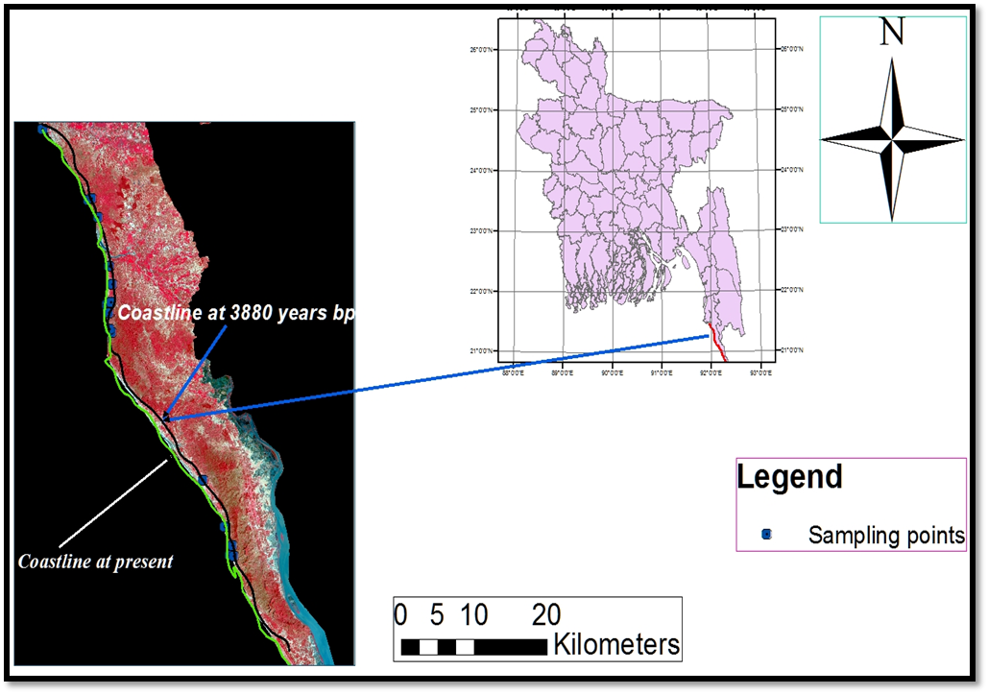
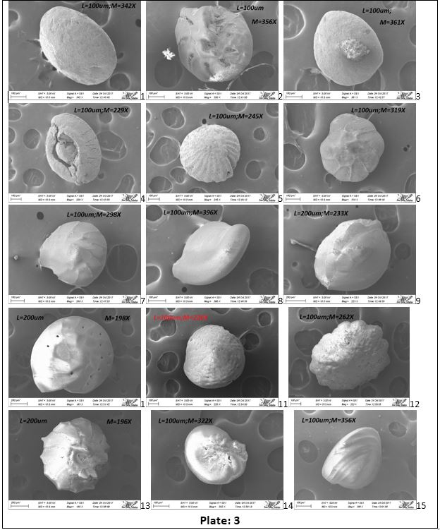
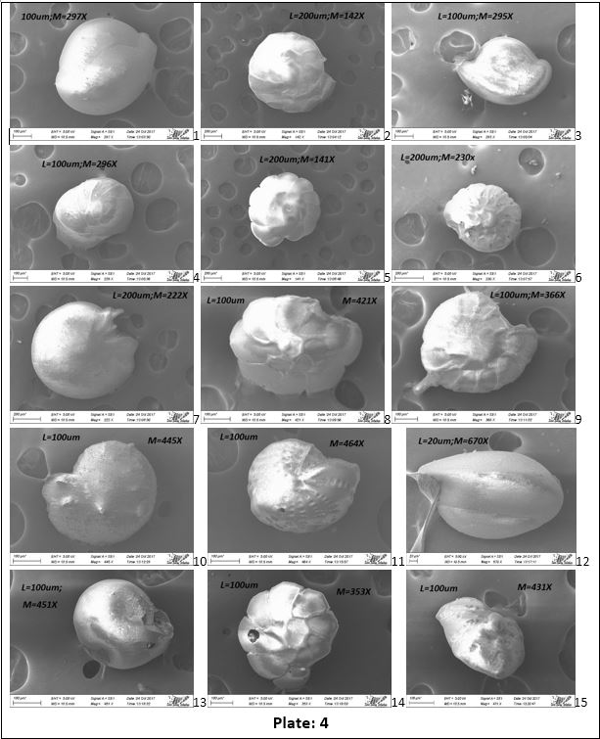
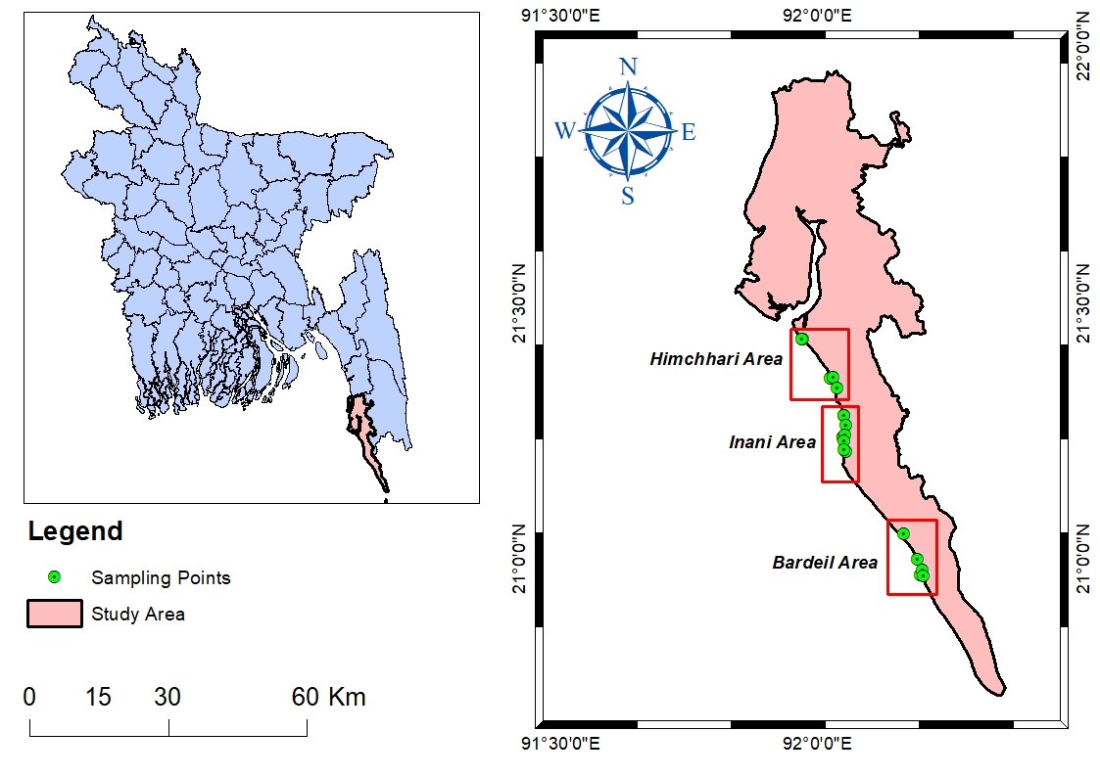


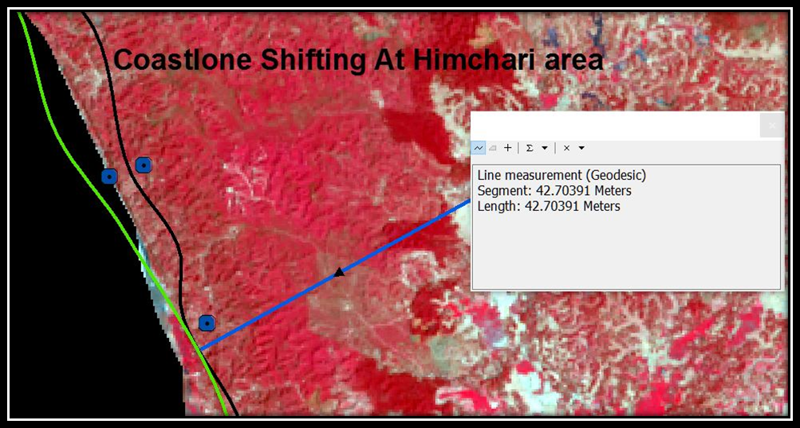
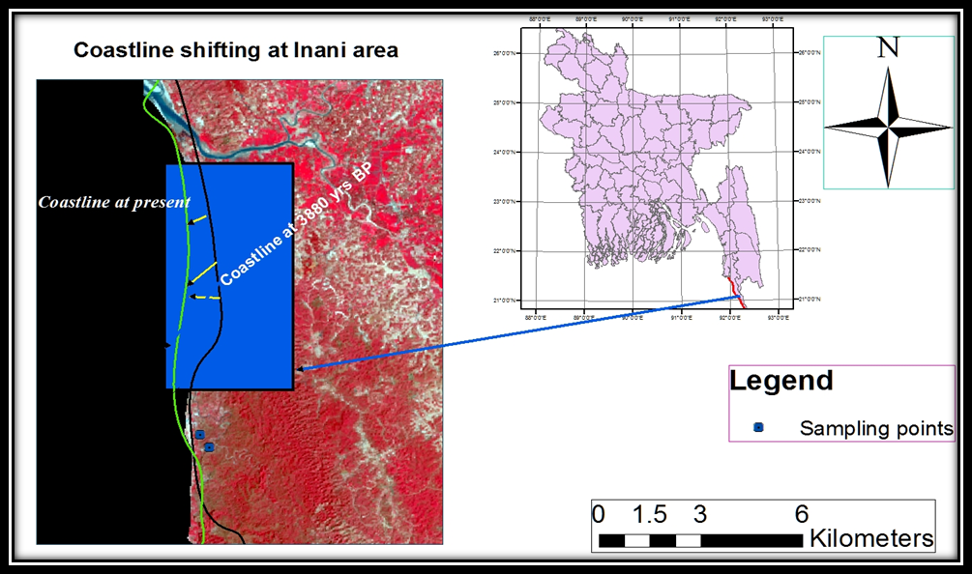
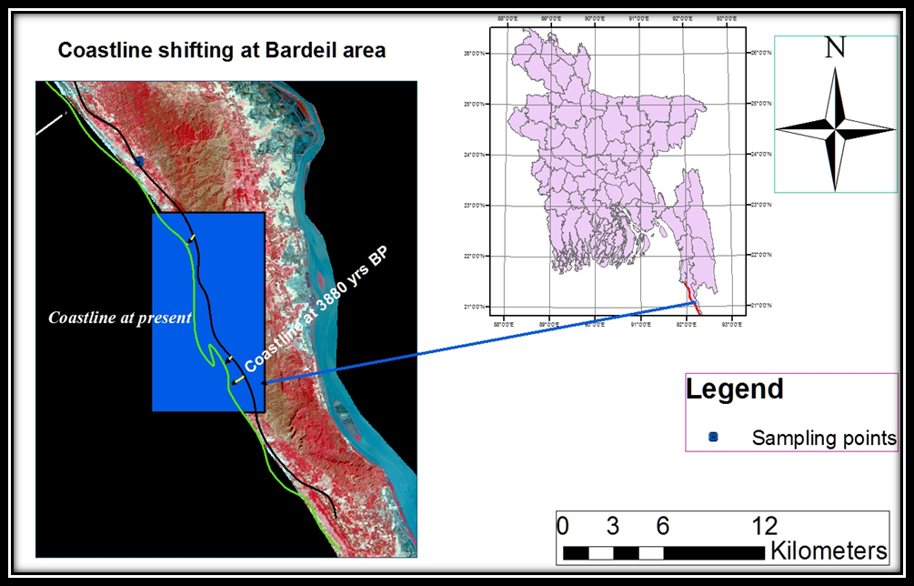
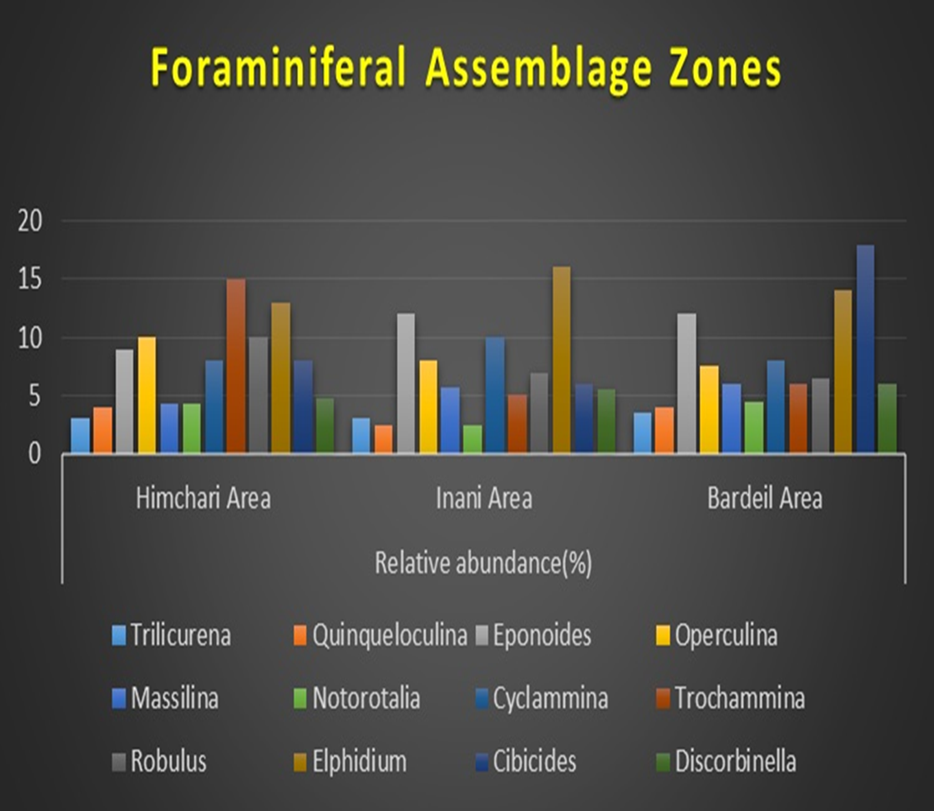
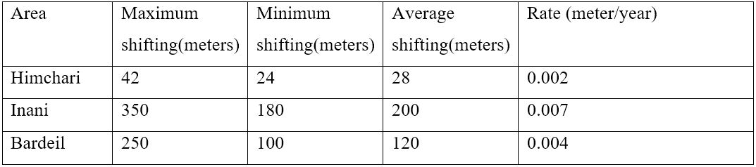
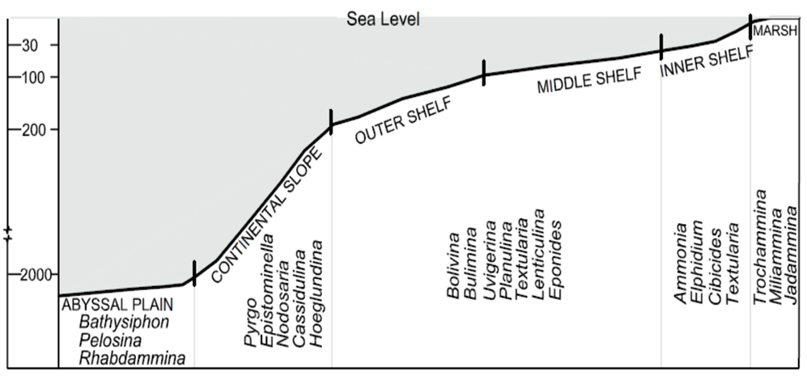
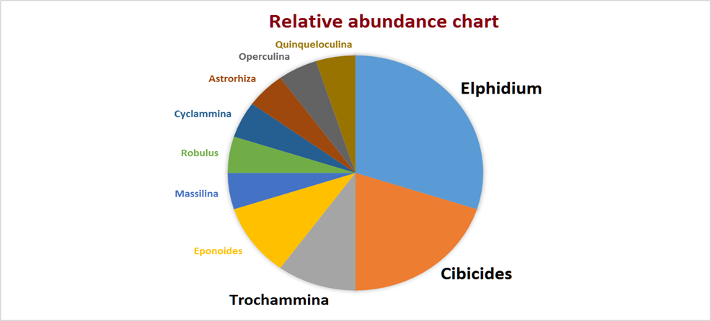
Reconstruction of Holocene Sea Level Change and Paleocoastline for the Eastern Coastal Margin of Bangladesh using Micropaleontological evidences
Subrota Kumar Saha*, Mahmud Al Noor Tushar and Md. Hussain Monsur
Department of Geology, University of Dhaka, Dhaka 1000, Bangladesh
Email*: sks@du.ac.bd
Abstract
Results: Taxonomy
Paleoenvironmental findings cont’d
Because of having a very good relationship with water column and water chemistry foraminifera are very popular in Paleoenvironmental studies. The present research has assessed the indicative values of salt-marsh foraminifera to reconstruct Paleo-coastline and Mid-Holocene sea level change based on some taxonomic, statistical and morphological parameters derived from the recorded species from Cox’s Bazar to Bardeil area. A total of 51 species representing 40 genera and 35 families were recorded. The plot of the aforementioned parameters of these species on various schematic diagrams reveals marginal-marine to inner-shelf as Paleoenvironment. The paleodepth was estimated as 36.19m from van der Zwaan equation (1990). The age of the recorded species was estimated as 3490 to 3880 years B.P. by carbon dating. A Paleo-coastline has been drawn and about 8mm/year of coastline shifting has been estimated in a GIS environment. Based on the Paleoenvironmental significance of recorded species, age dating and coastline shifting, this study justifies a regression of sea in the study area after the Mid-Holocene sea level rise.
Keywords: Foraminifera, Paleocoastline, Taxonomy, Coastline-shifting, salt-marsh.
A total of 51 species representing 40 genera and 35 families were recorded throughout the study. Most of them are benthic. The SEM plates of the recorded species are as follows:
The shell type ratios of the ten most representative samples (selected in terms of number of microforams recovered from each sample.
Table 1: Shell type ratios of representative samples.
Sample no | Agglutinated fraction (%) | Porcelaneous fraction (%) | Hyaline fraction (%)
1 | 0 | 30 | 70
2 | 25 | 10 | 65
3 | 0 | 25 | 75
4 | 30 | 30 | 40
5 | 15 | 15 | 70
6 | 50 | 20 | 30
7 | 20 | 30 | 50
8 | 10 | 10 | 80
9 | 15 | 25 | 60
10 | 0 | 30 | 70
Introduction
Figure 5: Stratigraphic succession of exposed quarries.
Figure 6: Some published sea level curves (After Islam, 2001) Red bordered rectangle marks the regressive trend within our dated interval, 3880 to 3490 years B.P.
Marine microfossils are the principle clues to investigate Paleoenvironment and sea level because they occur in sediments of all ages and under practically all environments. Because of environmental sensitivity, resistance to chemical weathering from ambient water and narrow ecological distribution of individual species, foraminifera remain at the center of microfossils based Paleoenvironmental and paleoecological investigations. The distribution of shells of foraminifera are controlled by a host of physical, chemical and biological parameters of the environment (Scott and Medioli 1980). That’s why a specific shell type of microforam bears the imprints of a specific environment and that was the main theme of the study. This study is a justification of indicative meaning of marsh foraminifera from Cox’s Bazar to Teknaf as sea level indicators based on taxonomic positions, morphological attributes and radiocarbon age of the recorded species.
1 Operculina granulosa; 2 Elphidium lessonii; 3 Trochammina arenosa; 4 Quinquloculina seminula; 5 Pseudomassilina australi 6 Eponoides repundus; 7, 8 Cibicides refulgens; 9 Trilocurena circularis; 10 Robulus macrodiscus; 11 Discorbis vesicularis; 12 Astrorhiza arenaris; 13 Cyclammina cancellata; 14 Cibicides refulgens; 15 Elphidiella arcctica
1 Astrorhiza arenaris; 2, 8 Operculina granulosa; 3 Elphidium lessonii; 4 Discorbis vesicularis; 5 Cyclammina cancellata; 7 Trochammina proteus; 9, 11, 13 Cibicides refulgens; 14, 15 Massilina sp.
A paleocoastline was drawn in a GIS environment by connecting the plain of intersections of the sample points that reveal marginal marine and those that reveal inner shelf as Paleoenvironment (Figure 7).
Study Area
For sampling and clear interpretation the entire study area was divided into 3 segments and samples were collected from 15 closely spaced locations with a spacing of 1.5km as shown in figure 1.
2 Discorbis vesicularis; 3 Operculina granulosa; 4 Trilocurena circularis; 5, 11 Elphidium lessonii; 6,7 Nonion labradoricum; 8,9 Trilocurena circularis; 10, 13, 14 Discorbis vesicularis; 11 Elphidium lessonii; 12 Astrorhiza arenaria; 15 Massilina secans.
1 Trilocurena circularis; 2 Nonion labradoricum; 3 Quinquloculina seminula; 4, 5, 6 Discorbis vesicularis; 7 Cibicides refulgens; 8, 9 Cyclammina cancellata; 11 Elphidium lessonii; 12 Trilocurena circularis; 14, 15 Trochammina inflatus.
Fig 4: Ternary plot of shell type ratios of most abundant species for discrimination of marsh(whole field),marginal marine(grey), shelf seas(hatched) and deep sea(dotted) environments; Modified from Murray, 1976. (Source: Saraswati, 2016).
= Samples from Inani and Himchari region.
= Samples from Bardeil region.
Figure 7: Paleocoastline at 3880 years B.P.
Table 2: Paleodepth from van der Zwaan equation that is ,D=e^(3.58718+(0.03534x%p) Where, D=depth in meters, %p= Planktonic to benthic ratio. The estimated depth for the study area falls within the depth range for inner-shelf (30-100m).
Sampling Area | Number of Planktic species (p) | Number of Benthic species (B) | Percent Planktic(%p) | Depth (m) from Van der Zwaan equation
Himchari | 1 | 25 | 4 | 36.18
Inani | 1 | 20 | 5 | 36.20
Bardeil | 1 | 28 | 3.6 | 36.17
Figure 8: Shifting of coastline at different segments of the study area.
The rate of shifting of coastline for the entire study area has been computed by taking 150 transects for each of the segments. The findings can be summarized by the following table:
Table 3: Summary of coastline shifting.
Interpretation and Reconstruction
Conclusion
Figure 1: Map of Study Area highlighting the sampling points.
Figure 2: Area wise assemblage zone.
Sampling points were located at a distance of more than 650m landward from the present coastline.
Obtained species symbolizes marginal marine to inner-shelf as Paleoenvironment.
Obtained radiocarbon dating interval matches with the regressive trend of sea level curves.
Reconstruction indicates a shifting of coastline towards the sea.
The integration of all of the above mentioned parameters signifies a sea level regression after Mid Holocene marine transgression.
Materials and Methods
Results: Paleoenvironmental findings
Paleoenvironmental investigations as a whole reveal marginal marine to inner shelf and the estimated Paleo depth was 36.19m that also falls within the depth range of inner shelf that is 30-100m.
Samples were collected along a line running more or less parallel to the present coastline and maintaining about 650m average landward horizontal distance to the present coastline from where we recovered microforams of inner shelf region.
Most of the foraminiferal species were collected from a continuous heavy minerals and organic shell rich layer of thickness about 0.2 to 0.5m (Figure 5) which means that the dead shells of microforams were deposited on the beach by the action of waves, tides and winds.
The integration of the above mentioned findings implies that there was a shifting of the living suite of microforams which in turns embraces the seaward shifting of coastline from the sampling locations to it’s present position that is the sea level regression.
Radiocarbon dating of representative samples give 3880 to 3490 years B.P. as the age of recorded species that supports our thought of regression (Figure 6).
This study is the compilation of both fieldwork and laboratory analysis. The entire methodology applied to the study can be outlined by the following way:
Collection and preservation of samples
Preparation of samples through drying and sieving
Picking of microforams and microphotography by SEM (Scanning Electronic Microscope) and Leica EZ4e microscope.
Identification of species based on international guidelines
Radiocarbon dating of some selected samples
Paleoenvironmental investigations and sea-level reconstruction.
The top right figure is the schematic diagram of diagnostic foraminiferal species from marsh to abyssal plain introduced by Saraswati 2016 and the bottom right figure is the relative abundance chart of the most indicative species derived from this study. The correlation of these two figures reveal the study area shows marsh to inner shelf Paleoenvironment.
References
Islam, M. S. 2001. Sea-Level Changes In Bangladesh: The Last Ten Thousand Years. Dhaka: Asiatic Society of Bangladesh.
• Joseph, A. & Cushman, 1969. Foraminifera Their classification and Economic use. Forth ed. London: Oxford University Press
• Loeblich, A. R. & Tappan, H., 1988. Foraminiferal Genera and Their Classification. Fifth ed. New York: Van Nostrand Reinhold Company
•Saraswati, P. K. & Srinivasan, M. S., 2016. Micropaleontology Principles and Applications. first ed. London: Springer International publisher.
•Scott, B. D. & Medioli, S. F., 1980. Vertical Zonation of marsh foraminifera as accurate indicators of former sea-levels.. Nature, Volume 272, pp. 528-531.
Van der Zwaan G. J. and Jorissen F. J., 1990. The depth dependency of planktonic/benthic foraminiferal ratios: constraints and applications. Mar. Geol volume 95, pp. 1-16.
Figure 3: Paleoenvironment from Relative abundance.

