Slide 1


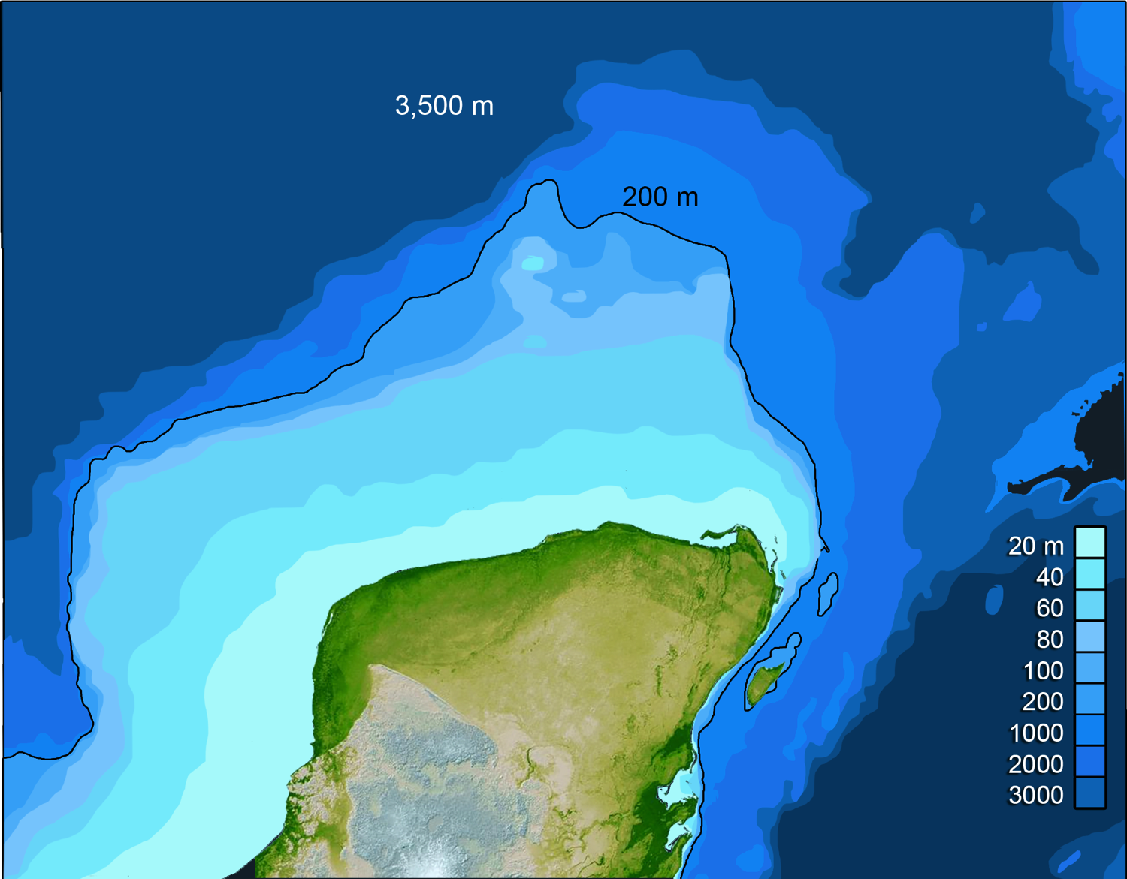
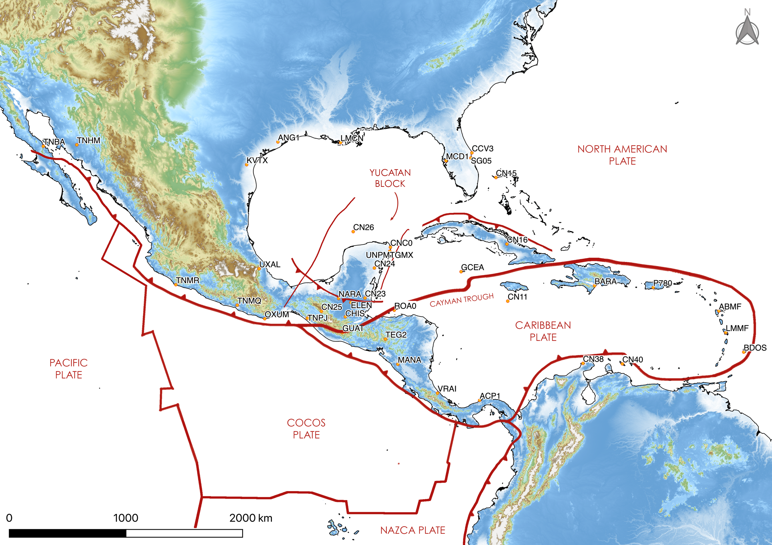
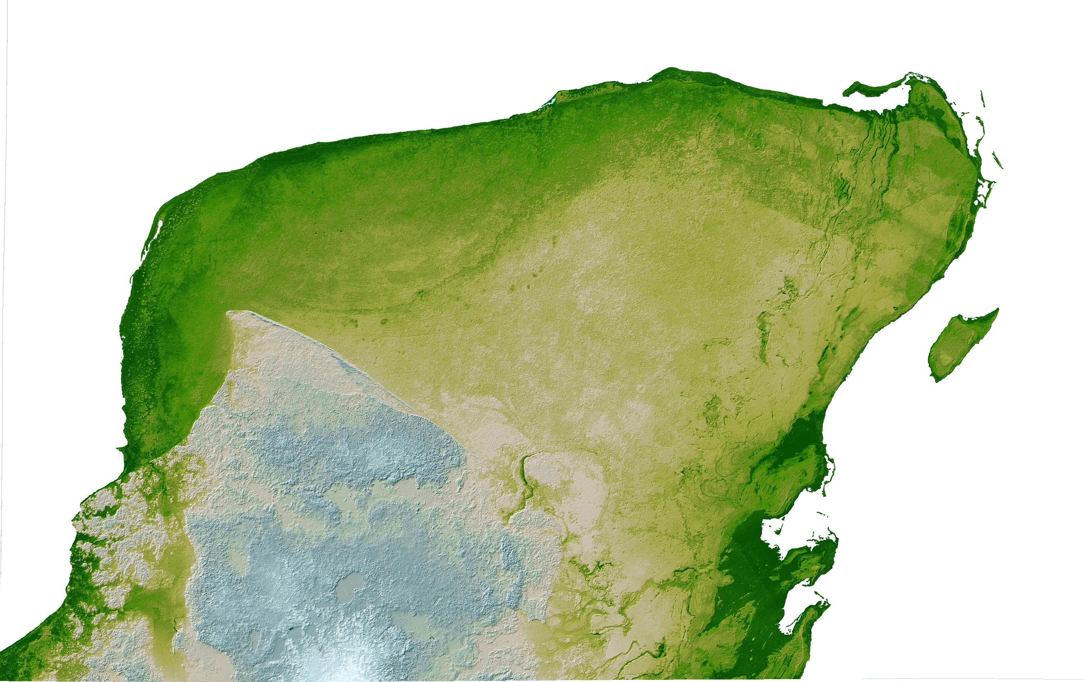
Exploring the Tectonic Stability of the Yucatán Block
Emiliano Monroy-Ríos, Patricia A Beddows – Northwestern University
Regional Setting
The Yucatán Block (YB) is a 450,000 km² continental microplate, covering southeast Mexico, northern Guatemala, and Belize.
A structural entity since at least 230 Ma, after initial seafloor spreading in the Gulf of Mexico.
It has been understood to be generally tectonically stable (and with no volcanic activity).
On a broader timescale it has been interpreted to be subsiding since Early/Middle Eocene.
Emiliano Monroy-Ríos - PhD candidate in Geochemistry
emiliano@earth.northwestern.edu
Geodetic data, coastal geomorphology, coastal ecology, and archaeological observations are used to assess YB vertical motion during Holocene.
Notes:
1) The Yucatán Peninsula is the subaerial portion of a carbonate platform deposited over the Yucatán Block unit, a continental microplate covering southeast Mexico, northern Guatemala, and Belize.
*2) It has been understood to be generally tectonically stable, while on a broader timescale it has been interpreted to be subsiding since Early/Middle Eocene.
*3) Geodetic data, coastal geomorphology, ecology, and archeological observations are further used to assess YB vertical motion at least back to mid-Holocene.

Slide 2
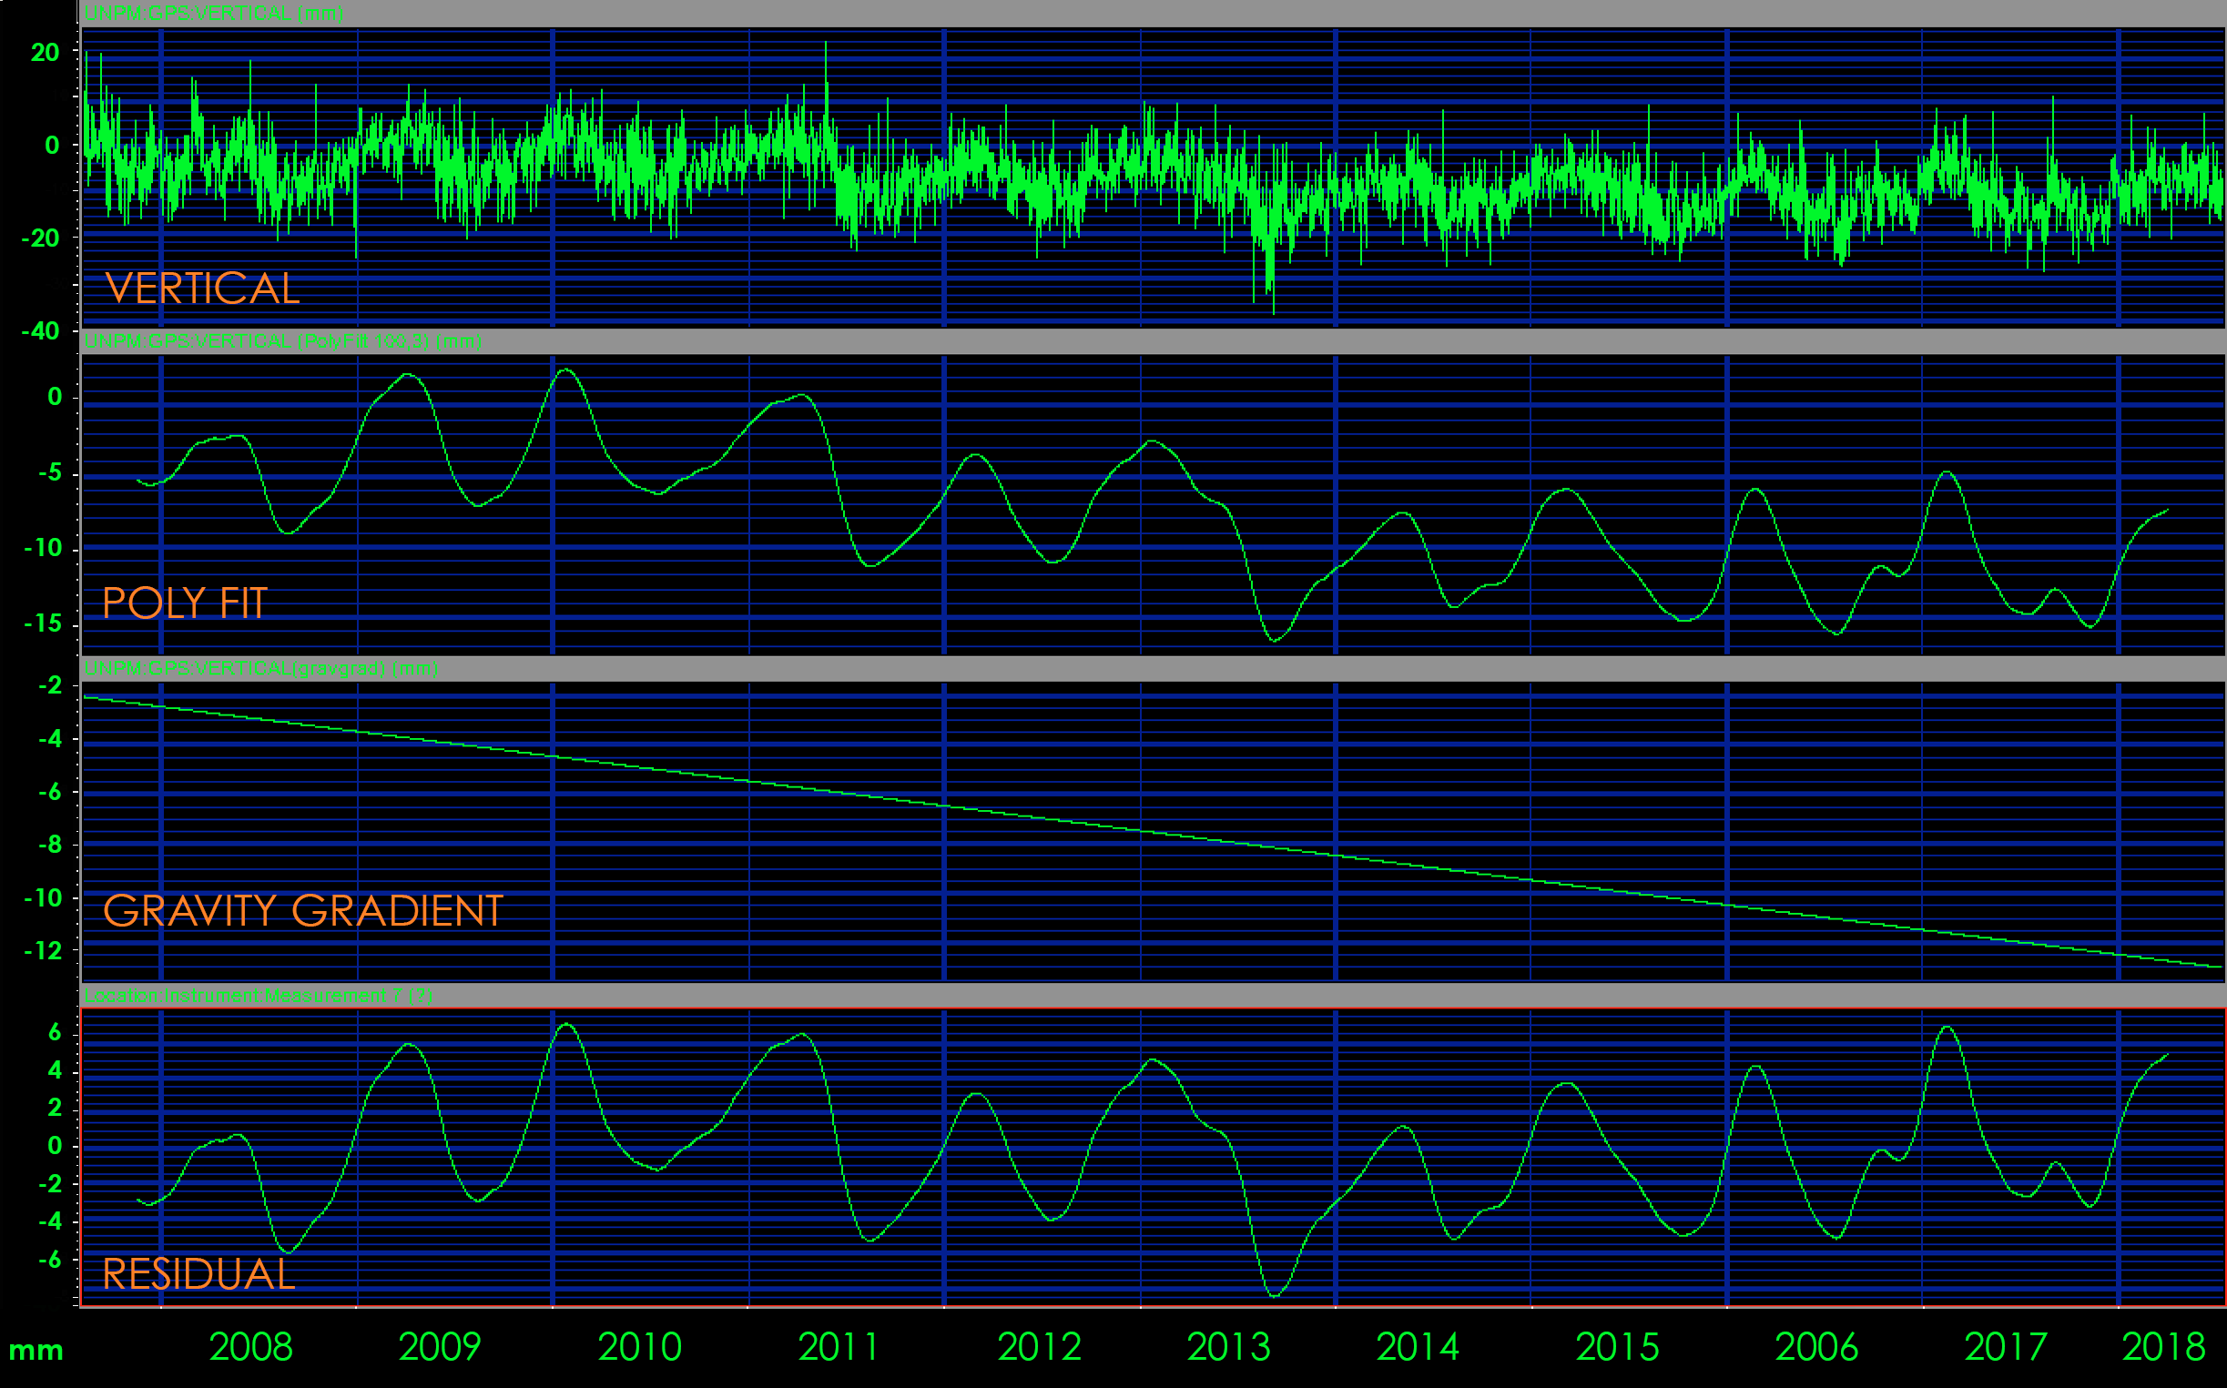
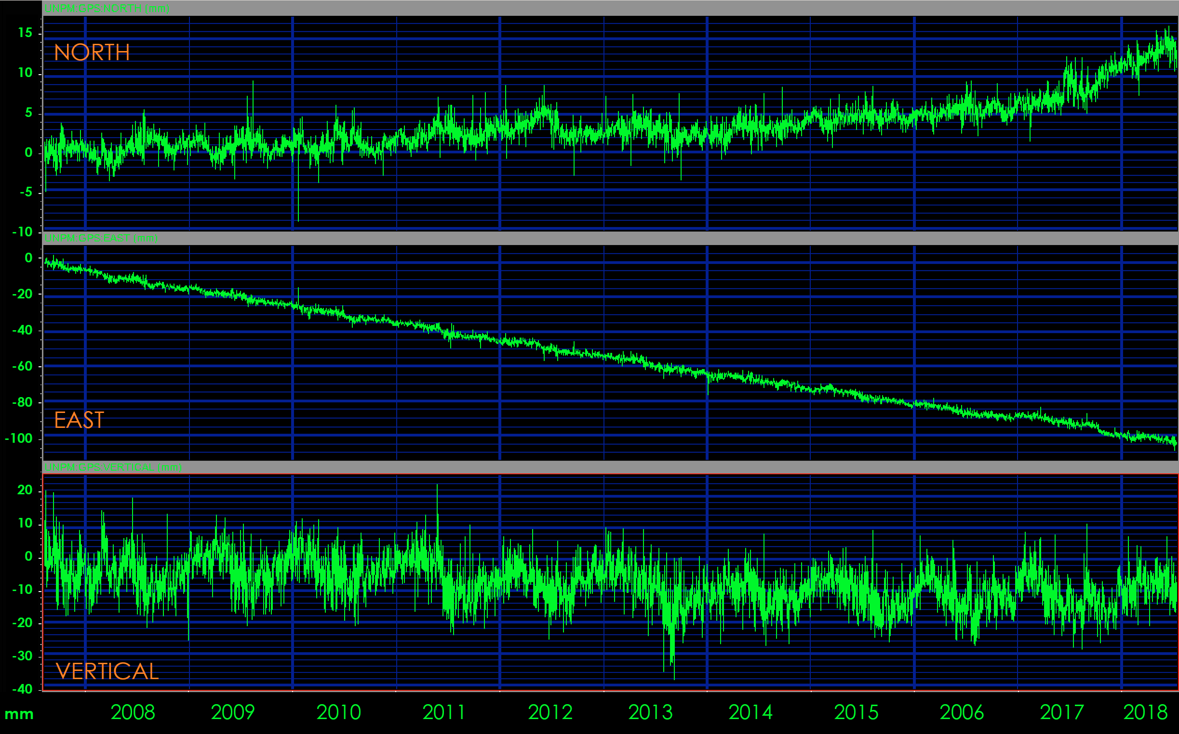
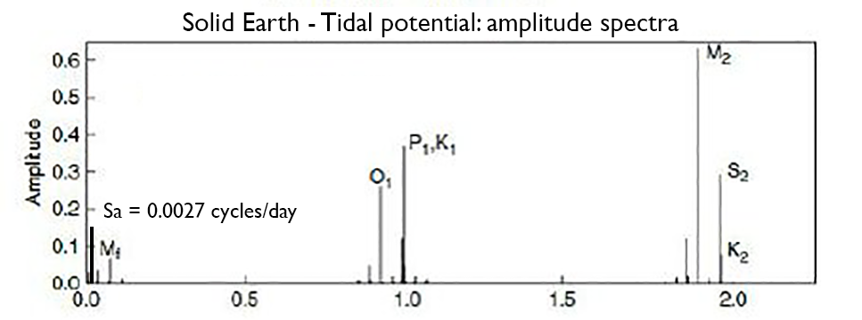
Exploring the Tectonic Stability of the Yucatán Block
Emiliano Monroy-Ríos, Patricia A Beddows – Northwestern University
Geodetic Data
Explore present day Yucatán Block motion.
UNAVCO Data Archive Interface v2.0 (DAI v2) - PBO, COCONet, and TLALOCNet GPS station networks.
IGS08 reference framework weighted average velocities with respect to the Earth's core.
Handling data - Earth Tides
10+ years of data for GNSS station UNPM located on the northeastern coast of the Yucatán Peninsula. Geodetic data shows periodical displacement of the solid earth's tides. Clearing out main tidal frequencies and correct for gravity gradients helps to handle data properly. Data from UNAVCO. Displacement in mm.
Notes:
1) We use geodetic derived data products from UNAVCO within the greater area –for GPS stations in the TLALOCNet, COCONet and PBO networks– to explore on the present day YB motion and tectonic behavior.
2) Geodetic data shows periodical displacement of the solid earth tides. The largest constituents are semi-diurnal, diurnal, semi-annual, and fortnightly contributions.
*3) Clearing out main tidal frequencies and correct for gravity gradients helps to handle data properly. Figure shows 10+ years of data for GNSS station UNPM located on the northeastern coast of the Yucatán Peninsula.
4) Figure shows Earth tides constituents. Solar annual (Sa) period of ~1 yr.

Slide 3
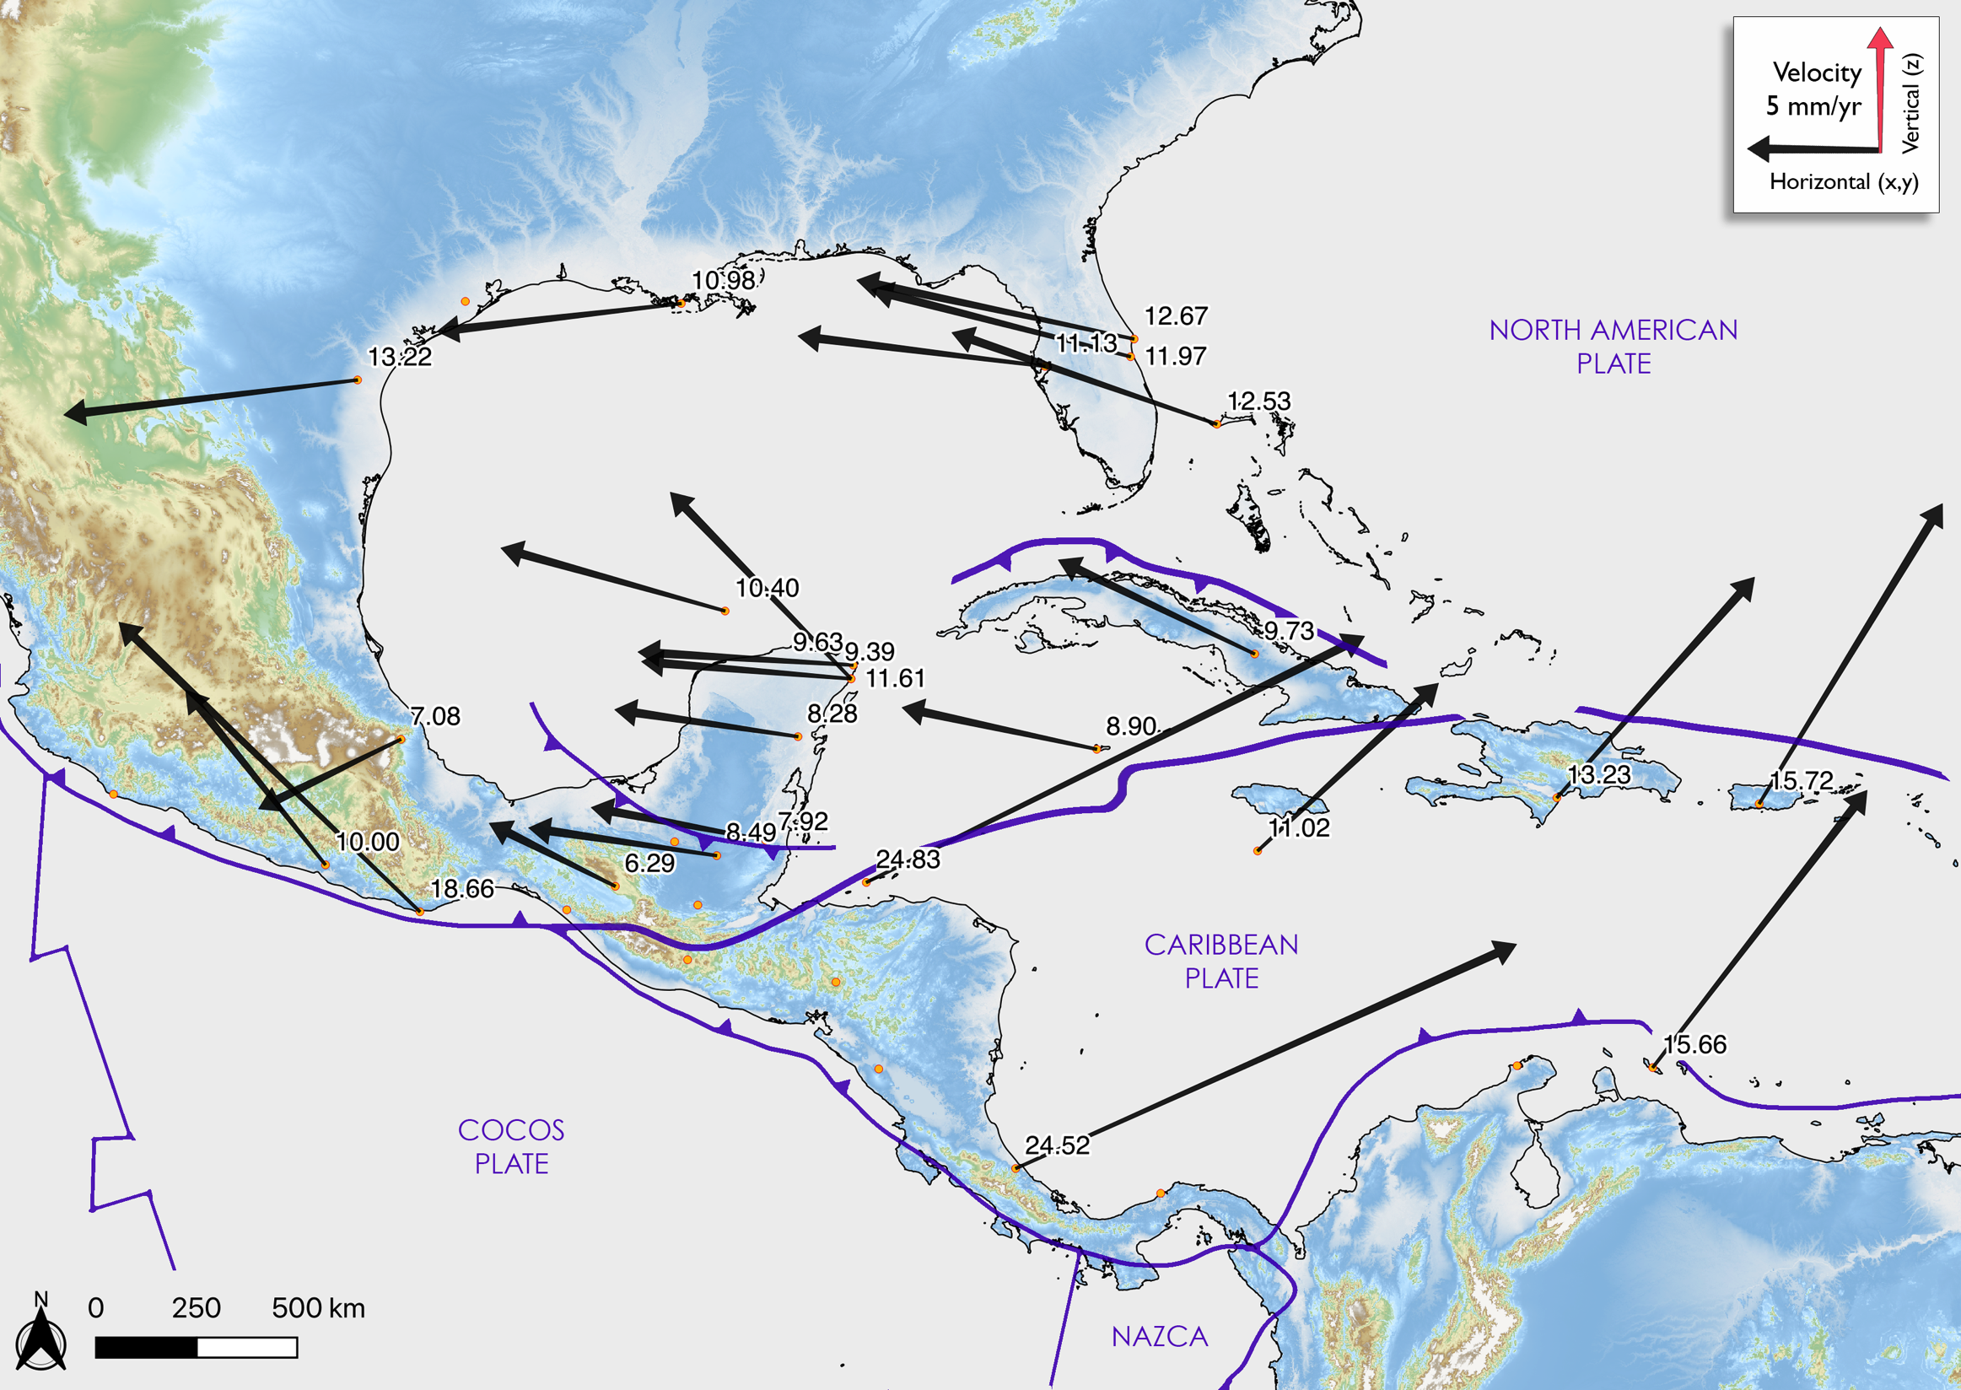
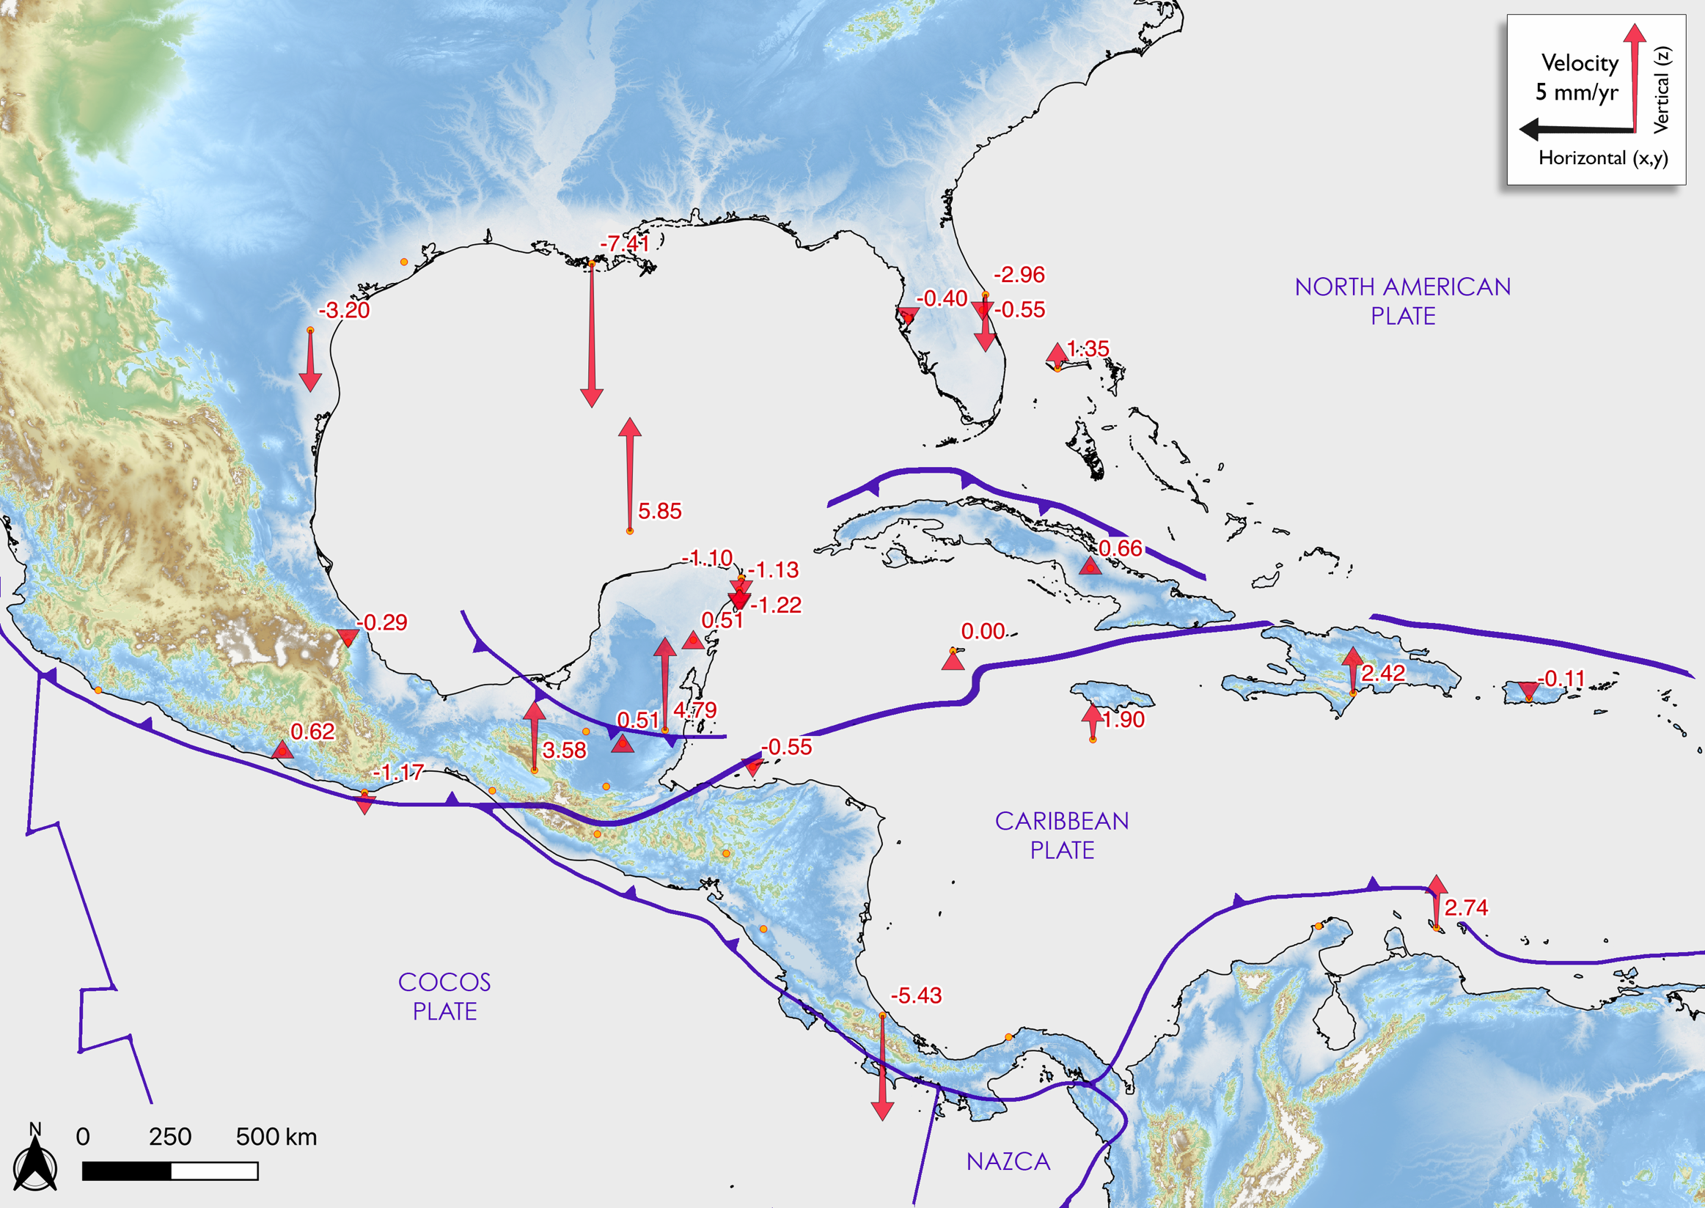
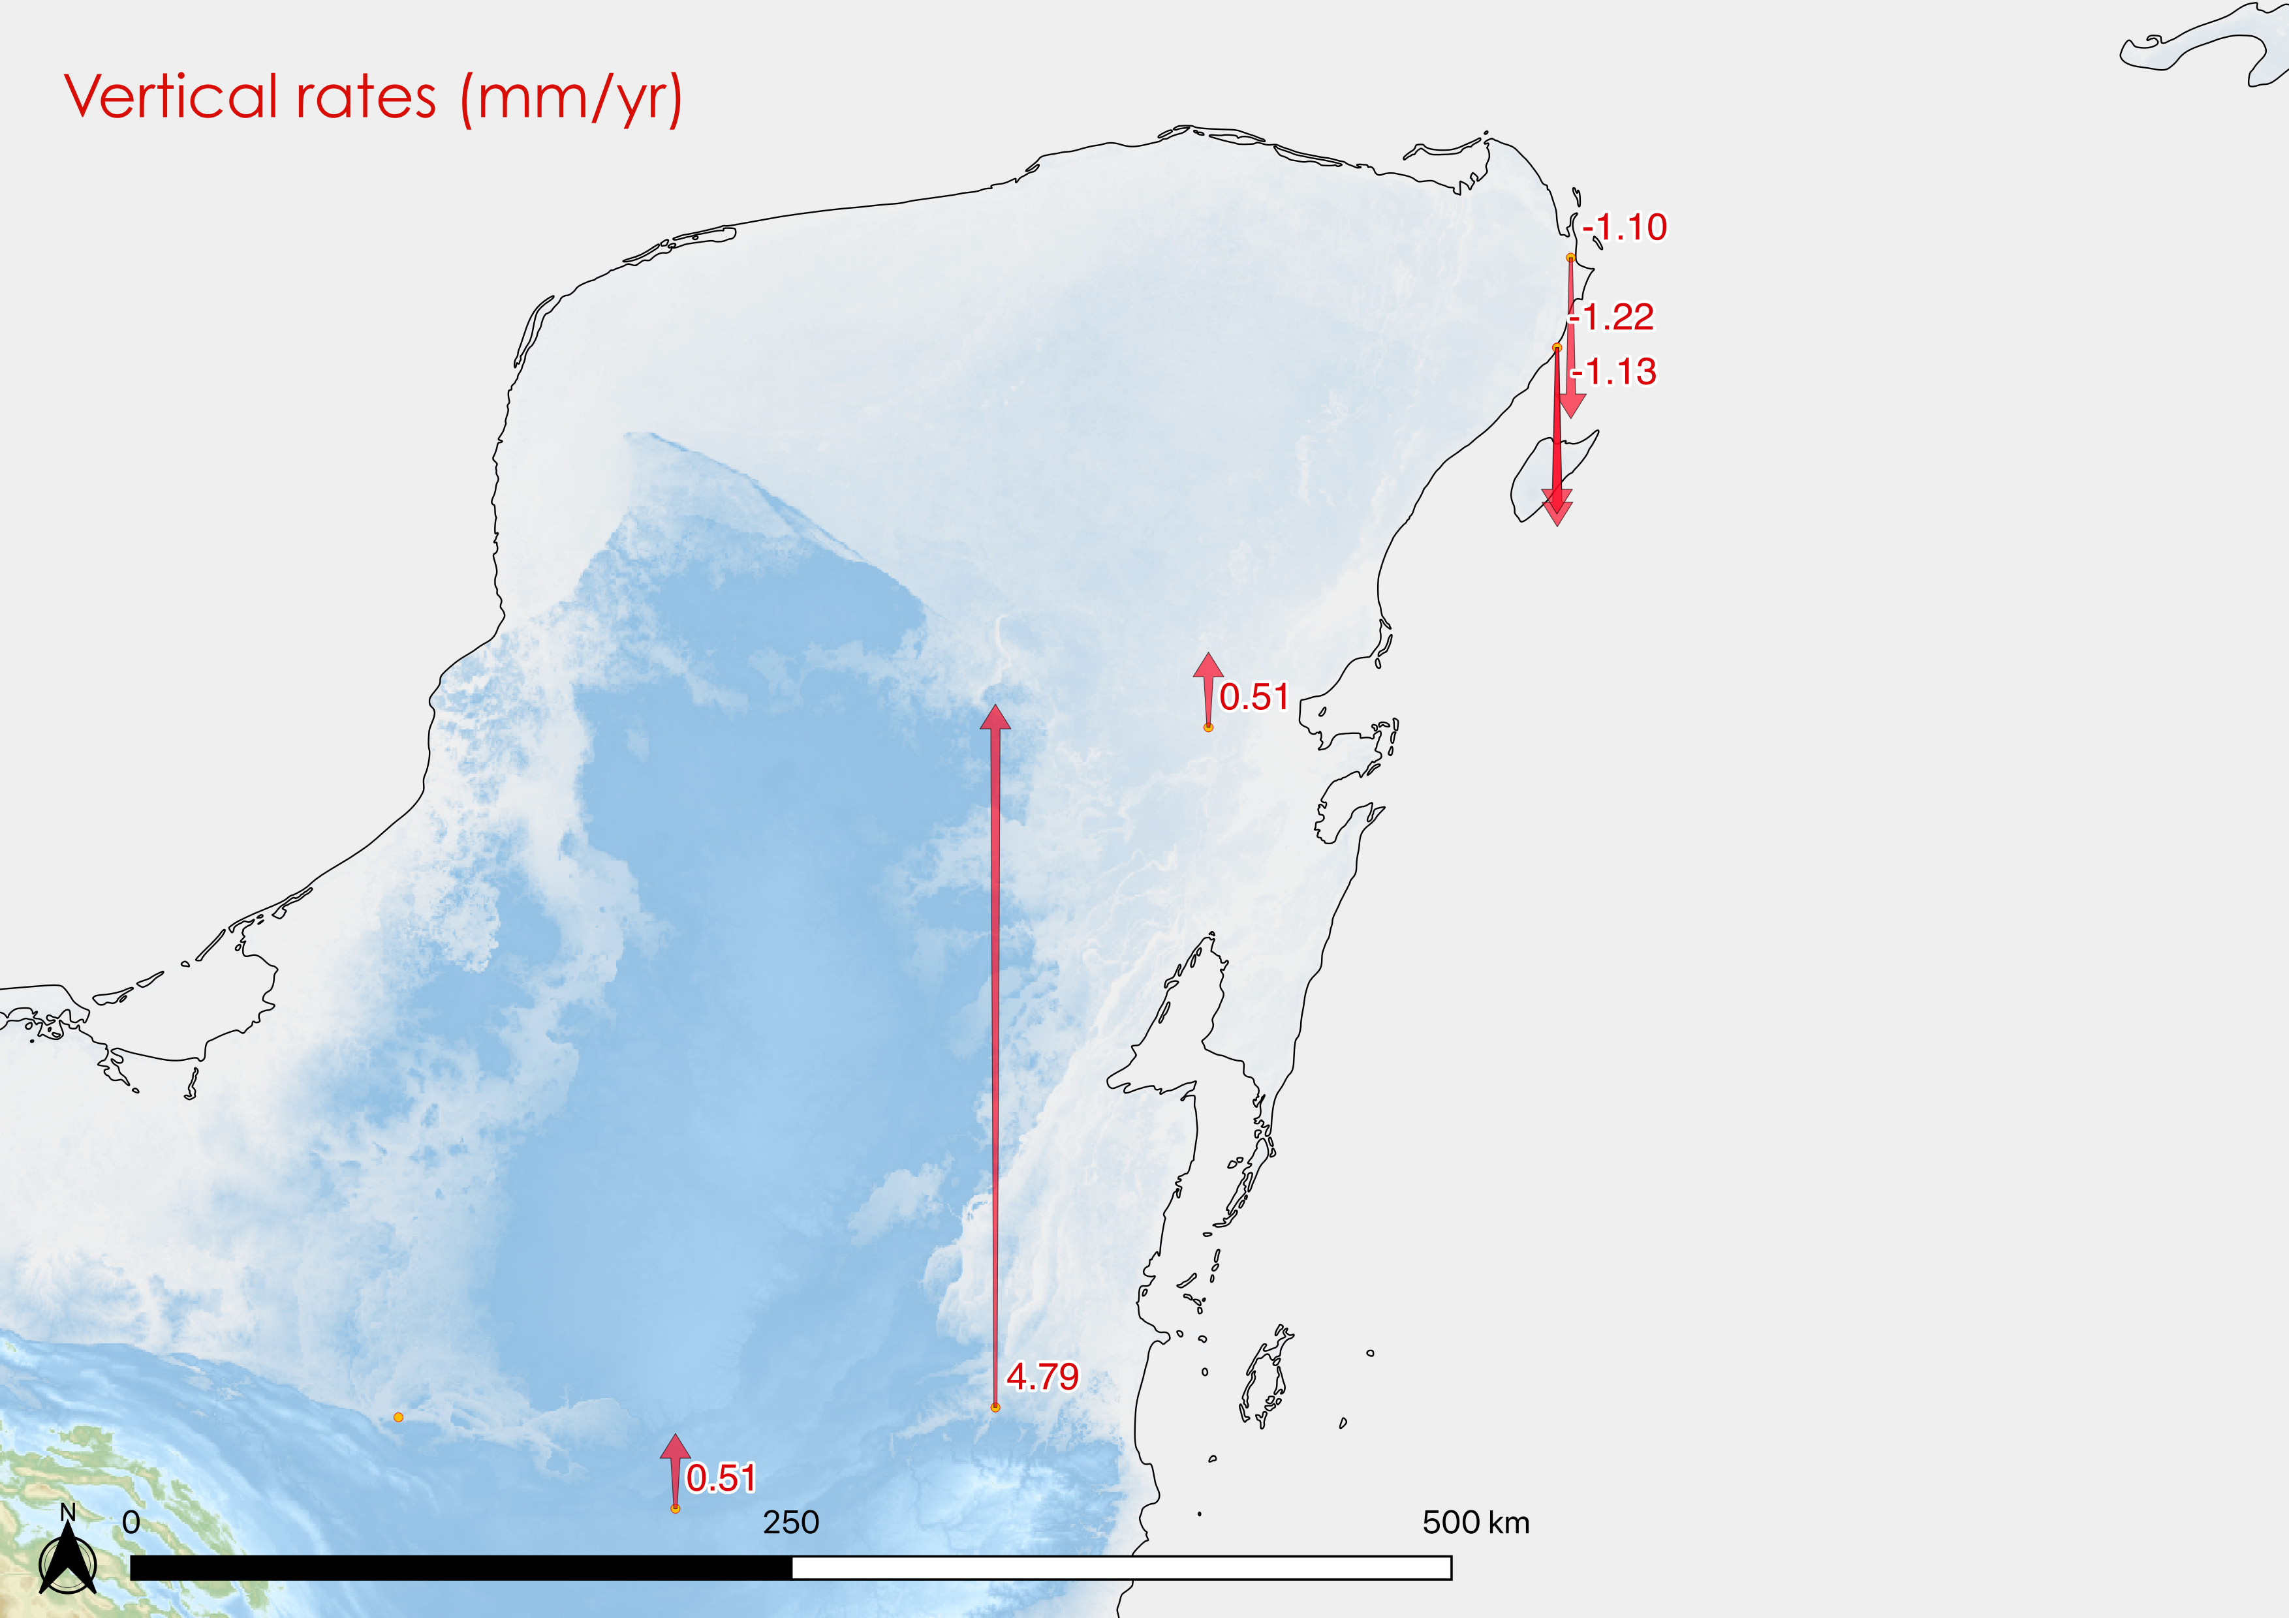
Exploring the Tectonic Stability of the Yucatán Block
Emiliano Monroy-Ríos, Patricia A Beddows – Northwestern University
Geodetic Data
The current motion is in the NW direction.
There are few stations on the Maya Block, and one is short duration record.
Looking at the longer 10+ year duration records (n=4), we see a NE corner submersion and vertical rates on the order of 1 mm/year.
The present vertical rates are 3-orders of magnitude higher than the previously indicated subsidence since Early/Middle Eocene.
Notes:
*1) The current motion is in the NW direction along with NE corner submersion.
*2) There are few stations on the Maya Block, and one is short duration record.
*3) The 10+ years of data indicate vertical rates on the order of 1 mm/year, which is of significance in interpretations of the hydrogeology, speleogenesis, paleoclimate records, and adaptation to climate change driven sea level rise.
*4) The present vertical rates are 3-orders of magnitude faster than the previously indicated subsidence since mid/late Eocene.

Slide 4
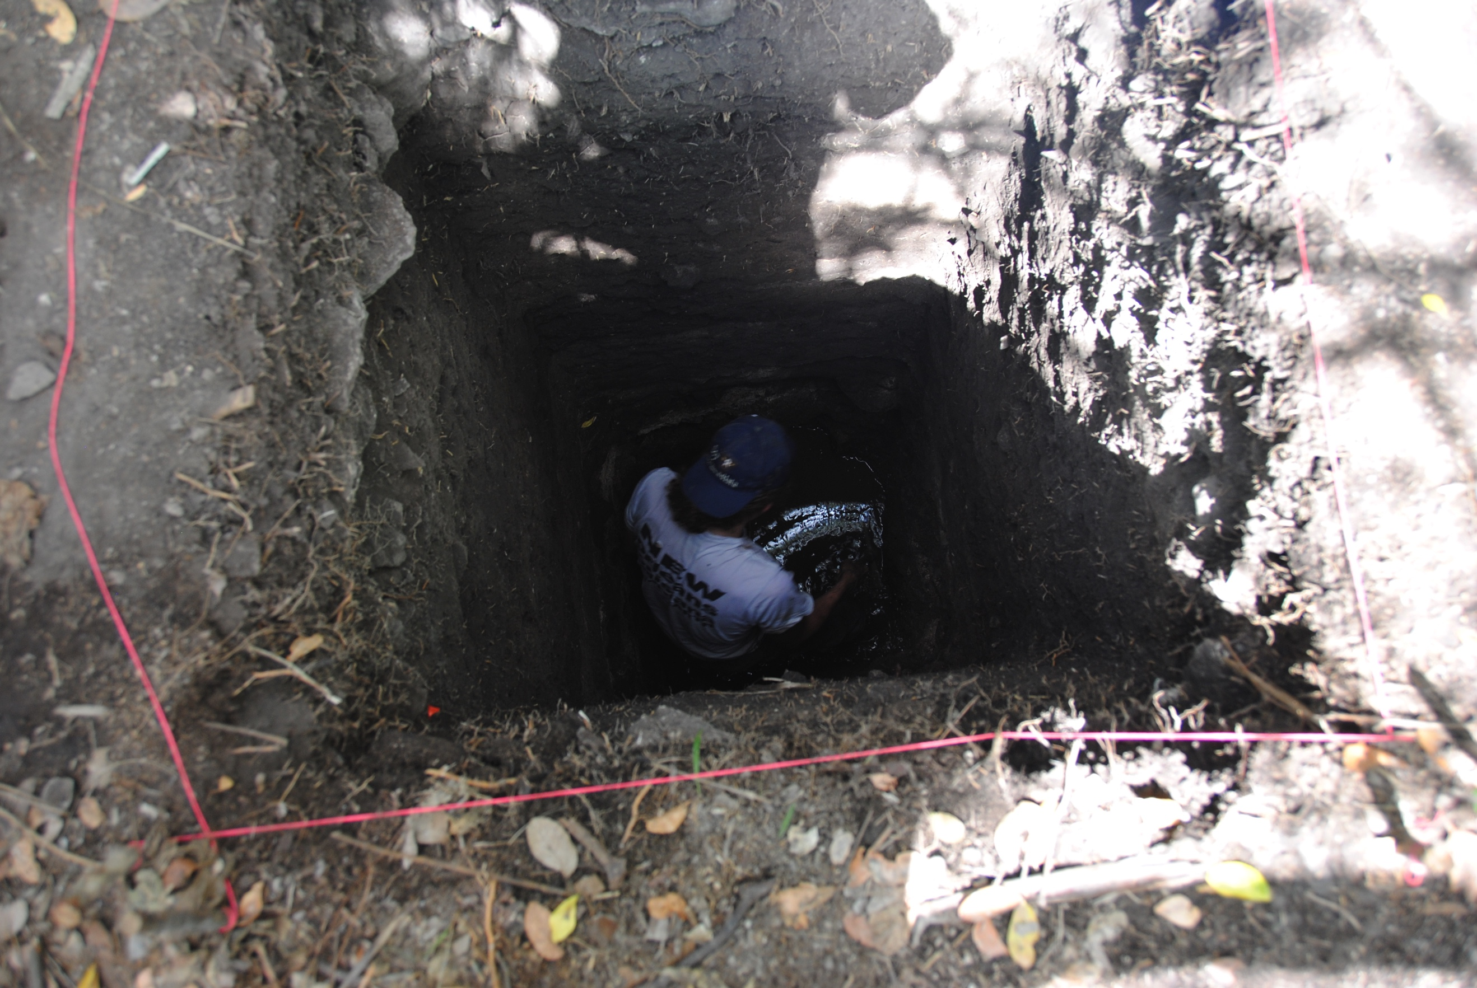
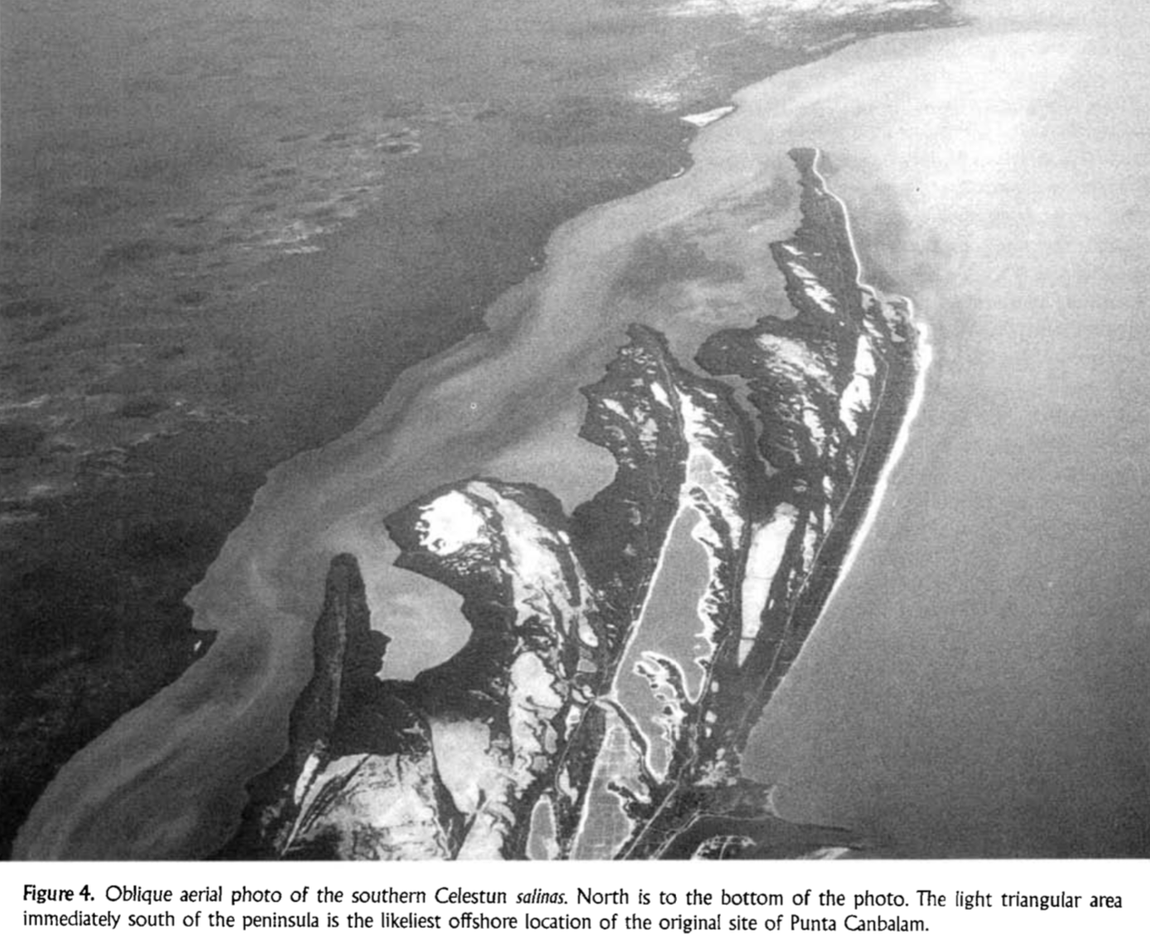
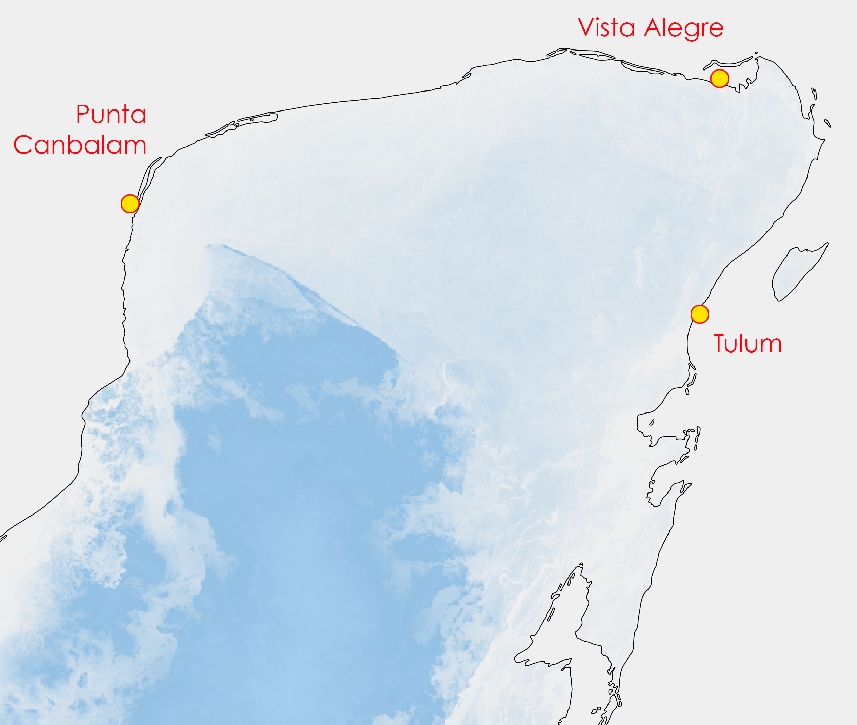
Exploring the Tectonic Stability of the Yucatán Block
Emiliano Monroy-Ríos, Patricia A Beddows – Northwestern University
Coastal Archaeology
NORTH COAST DOWN
Punta Canbalam
Site is now submerged close to the southern tip of the Celestún Peninsula, at a depth that cannot be explained solely by estimated regional SLR.
It was attributed to highly active erosional processes during Late Holocene (Dahlin et al., 1998).
Vista Alegre
Intact floor is 2.75 m below the ground surface but also at/below sea level. ¹⁴C dates it to the Terminal Preclassic / Early Classic.
Vista Alegre – Vista Alegre Site. Image courtesy Jeffrey B Glover, GSU.
Punta Canbalam – Image from Dahlin et al. (1998)
Notes:
1) Archaeological site Punta Canbalam (to the west) is now submerged close to the sand bar off the southern tip of the Celestún Peninsula, at a depth that cannot be explained solely by estimated regional sea level rise (Hanson & Maul, 1993) and was attributed to highly active erosional processes during Late Holocene (Dahlin et al., 1998).
*2) At the Vista Alegre site (north) the intact floor is 2.75 m below the ground surface but also below/at sea level. ¹⁴C dates it to the Terminal Preclassic / Early Classic, that is circa 250 CE.

Slide 5
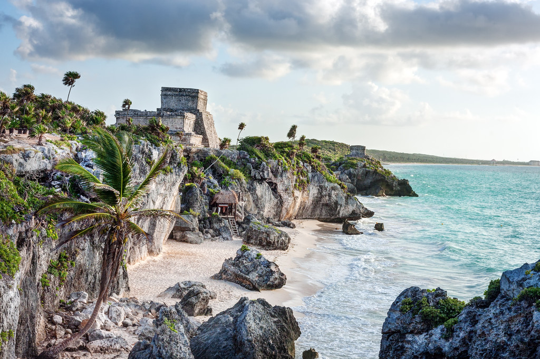
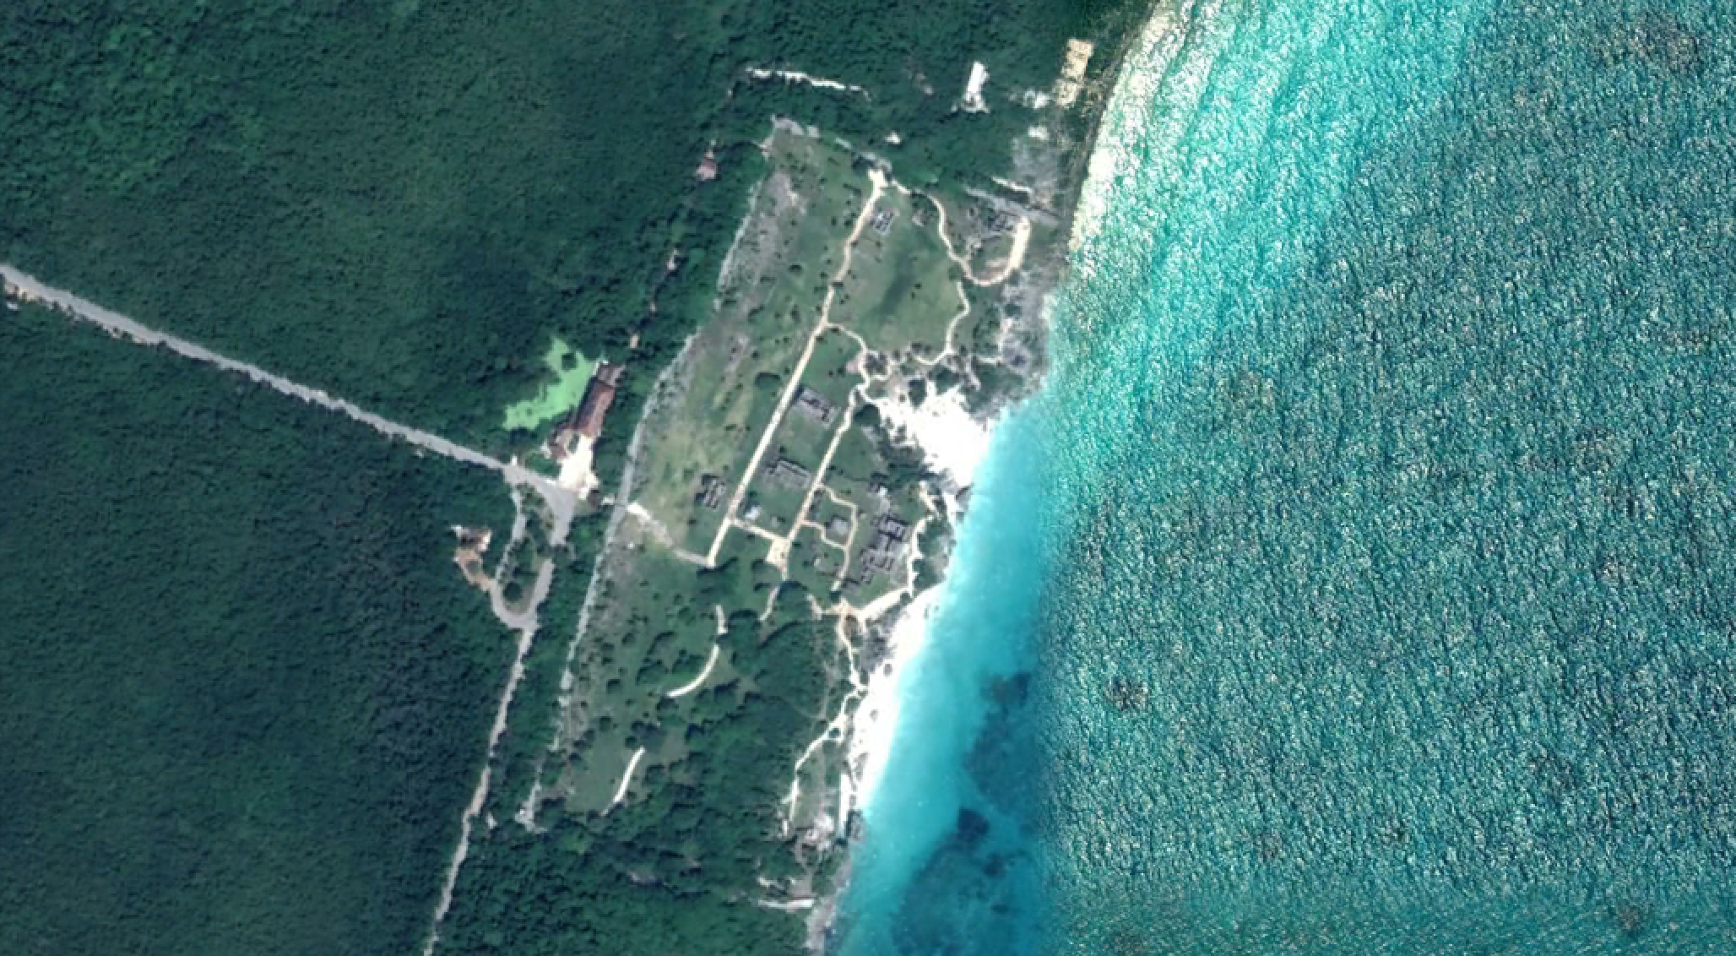
Exploring the Tectonic Stability of the Yucatán Block
Emiliano Monroy-Ríos, Patricia A Beddows – Northwestern University
Coastal Archaeology
SOUTHERN EAST COAST UPLIFTED?
Tulum
Quintana Roo. Eastern Caribbean coast. Site is on a cliff, a unique feature in the area.
Also, aerial view reveals a perched coastal spring? (drained caleta).
Tulum – Picture Matthew Karsten.
Google Earth Imagery (2018)
Notes:
1) Quintana Roo. Eastern Caribbean coast. Site is on a cliff, a unique feature in the area.
2) Also, aerial view reveals a perched coastal spring? (drained caleta).

Slide 6
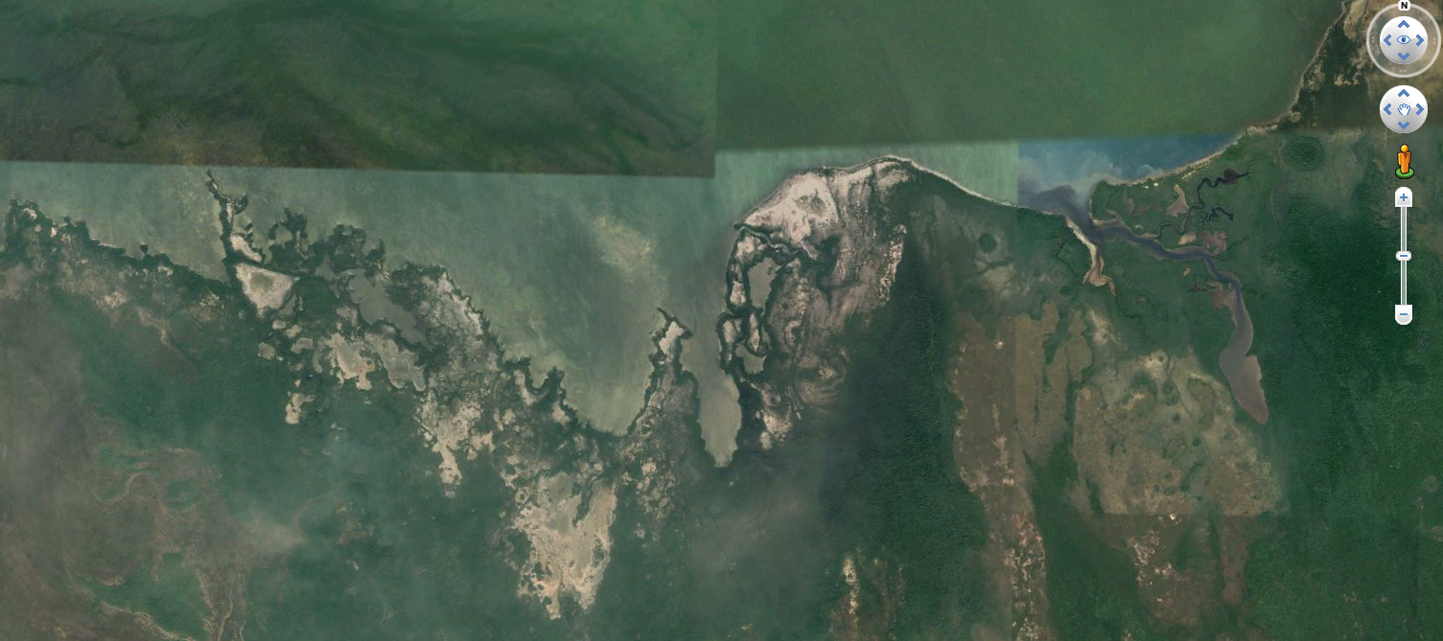
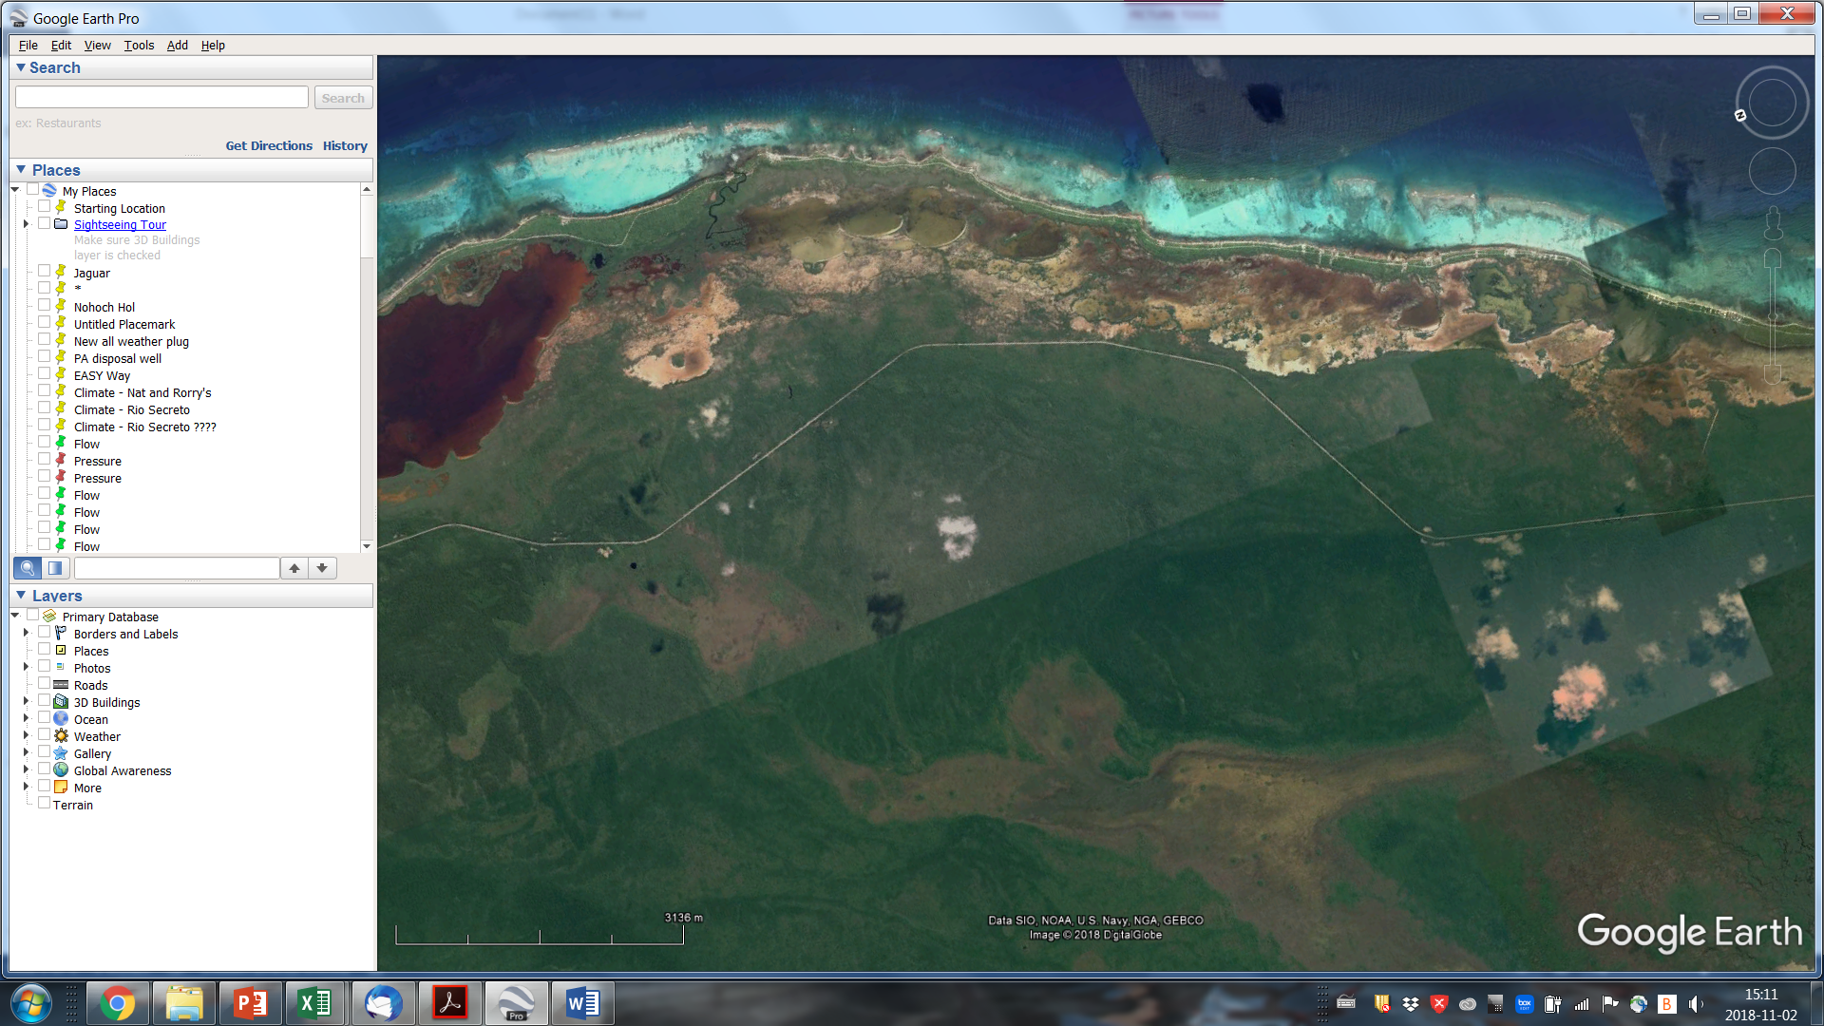
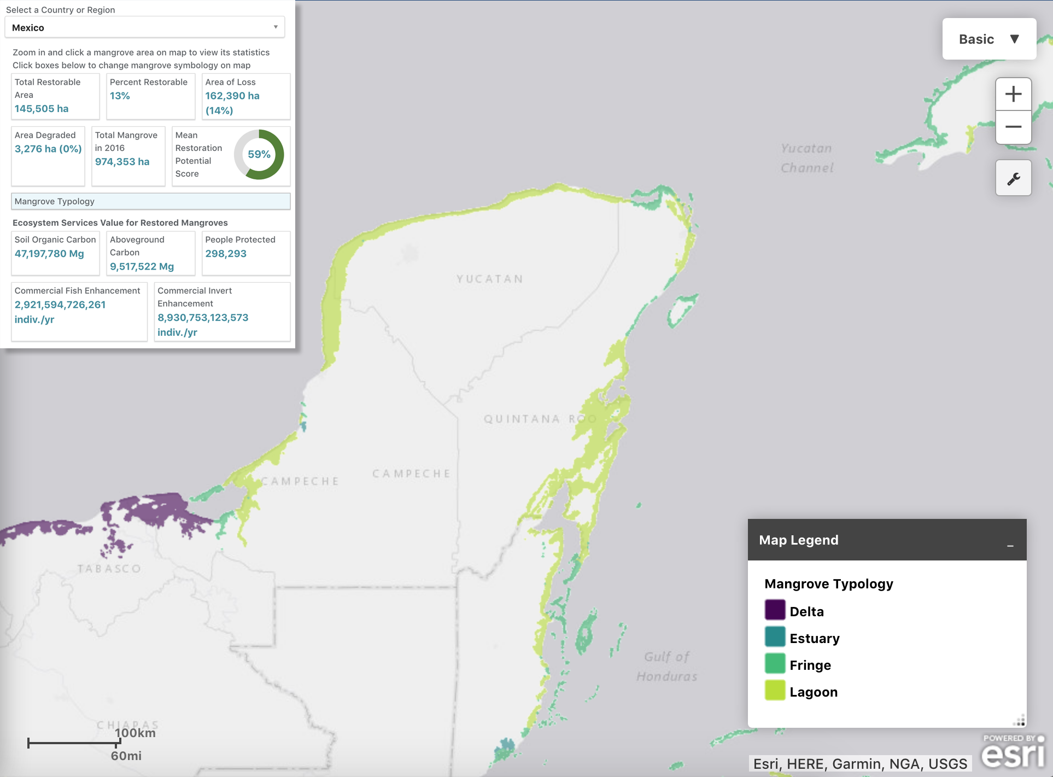
Exploring the Tectonic Stability of the Yucatán Block
Emiliano Monroy-Ríos, Patricia A Beddows – Northwestern University
Mangrove succession
North coast drown coastline?
Sea level rise has a prompt and direct effect on ecosystems in the intertidal zone.
During Holocene SLR had established the responses of coastal systems such as mangroves. Species with specific tolerances within the tidal spectrum had migrated landward.
NORTH COAST: Wetlands remain connected to ocean and actively flush by tides.
CARIBBEAN COAST: Wetlands seem to be perched and above sea level, including coastal mangroves decoupled form the ocean.
N
N
Caribbean coast perched mangroves decoupled form the ocean?
Global Mangrove Watch (2016) Mangrove Restoration.
http://maps.oceanwealth.org/mangrove-restoration/
Google Earth Imagery (2018)
Notes:
1) Sea level rise (SLR) has a prompt and direct effect on ecosystems in the intertidal zone, like mangroves, with increasingly influence of marine processes.
2) Species with specific tolerances had also migrated landward.
*3) NORTH COAST: Wetlands remain connected to ocean and actively flush by tides.
4) CARIBBEAN COAST: Wetlands seem to be perched and above sea level, including coastal mangroves decoupled form the ocean.

Slide 7
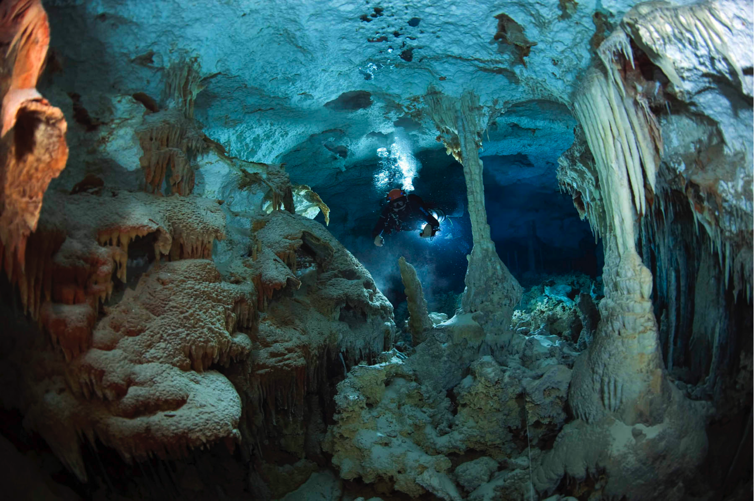
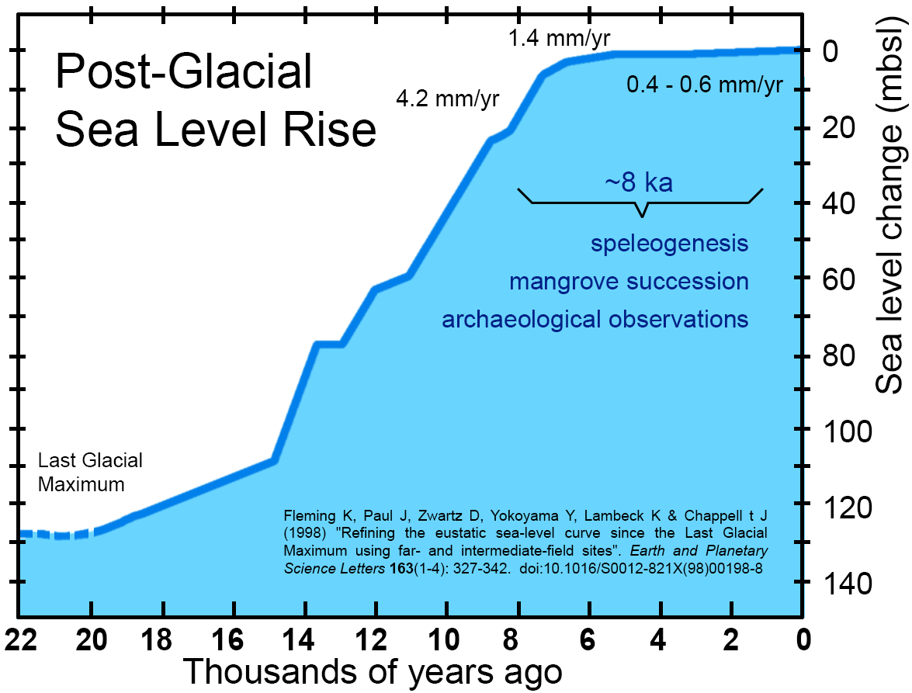
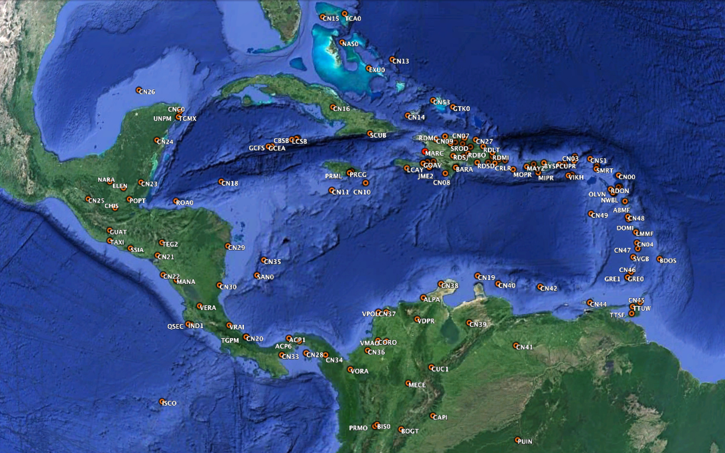
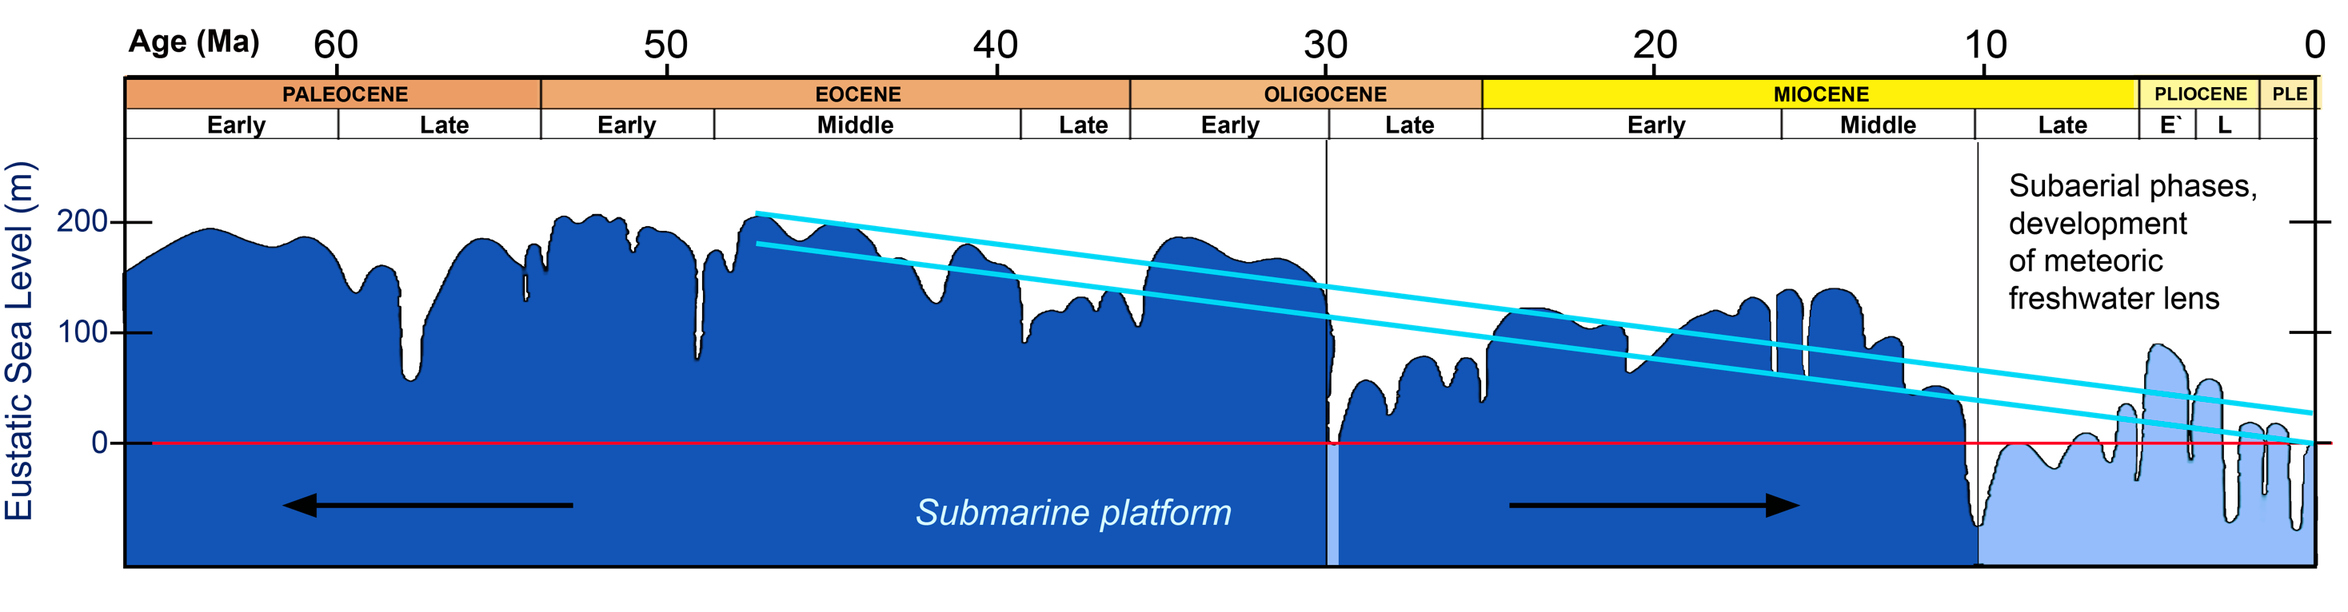
Exploring the Tectonic Stability of the Yucatán Block
Emiliano Monroy-Ríos, Patricia A Beddows – Northwestern University
Concluding Remarks
The YB is tectonically stable in the strict sense, without apparent deformation or rifting, yet the block is arguable in tilt/subsidence motions.
Persistence of motion is not in conflict with the long term proposed subsidence back to Middle/Late Eocene. Rate of plate motion seems to be 3-orders of magnitude higher at present day.
The observed 1 mm/year rate over the last 10 years is of significance in interpretations sea level records from the Yucatán Peninsula, and of the hydrogeology, speleogenesis, paleoclimate records, and adaptation to climate change driven sea level rise.
Additional geodetic stations are required to assess the whole block/platform motion, to further understand geomorphological processes, and to address climate change related sea level rise impacts.
Photography by Jill Heinerth
After Pope et al. (1996); Abreu & Anderson (1998) ; Kinsland et al. (2000).
Notes:
*1) The YB is tectonically stable in the strict sense, without apparent deformation or rifting, yet the block is arguable in tilt/subsidence motions that are of broad significance.
*2) Persistence of direction and rate of plate movement is not in conflict with the long term proposed subsidence back to Early to Middle Eocene. Rate of plate motion seems to be 3-orders of magnitude higher at present day.
*3) The observed 1 mm/year rate over the last 10 years is of significance in interpretations sea level records from the Yucatan Peninsula, and of the hydrogeology, speleogenesis, paleoclimate records, and adaptation to climate change driven sea level rise.
*4) Additional geodetic stations are required to assess the whole block/platform motion, and to further understand geomorphological processes, and to address climate change related sea level rise impacts.

