Slide 1


EVALUATION OF THE EFFECTIVENESS OF A 5-DAY UNIVERSITY BASED STEM ACADEMIC LEADERSHIP SUMMER CAMP FOR UNDERREPRESENTED HIGH SCHOOL JROTC STUDENTS USING THE TOSRA SURVEY INSTRUMENT
POWERS, Mark J.1, CLARY, Renee M.1, WALKER, Ryan2 and SMITH, Cade2, (1)Geosciences, Mississippi State University, Starkville, MS 39759, (2)Mississippi State University, B.S. Hood Rd, Mississippi State, Starkville, MS 39759

Slide 2
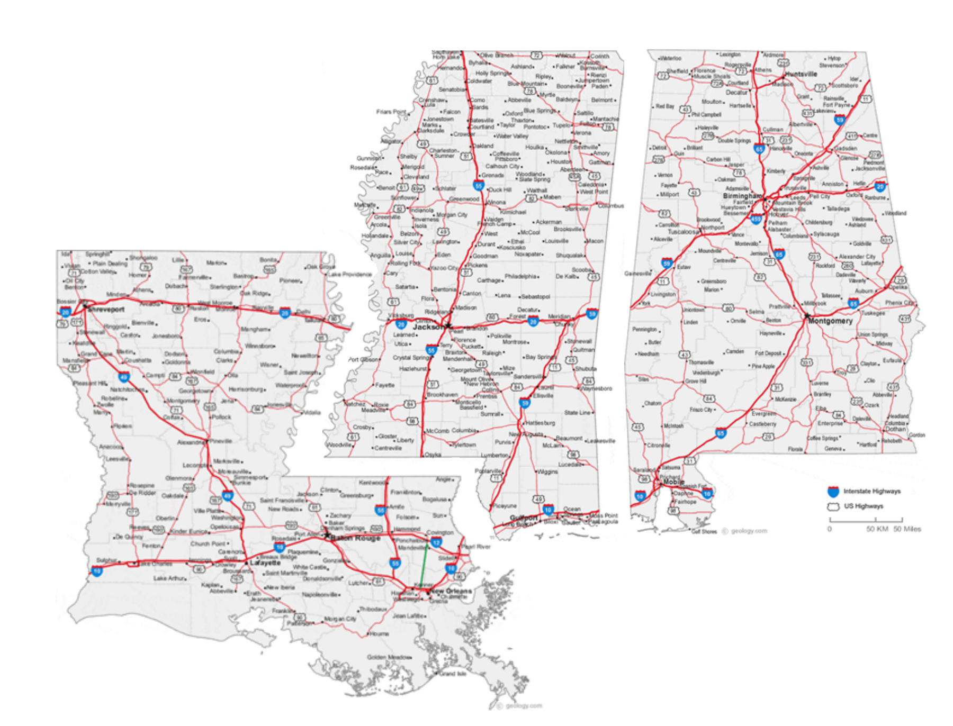
The Mississippi State University leaderSTATE STEM program provides a variety of experiences for Junior Reserve Officers Training Corps (JROTC) high school cadets across three states: Mississippi, Alabama and Louisiana, the majority of whom come from underrepresented demographic populations.
https://geology.com/state-map/

Slide 3
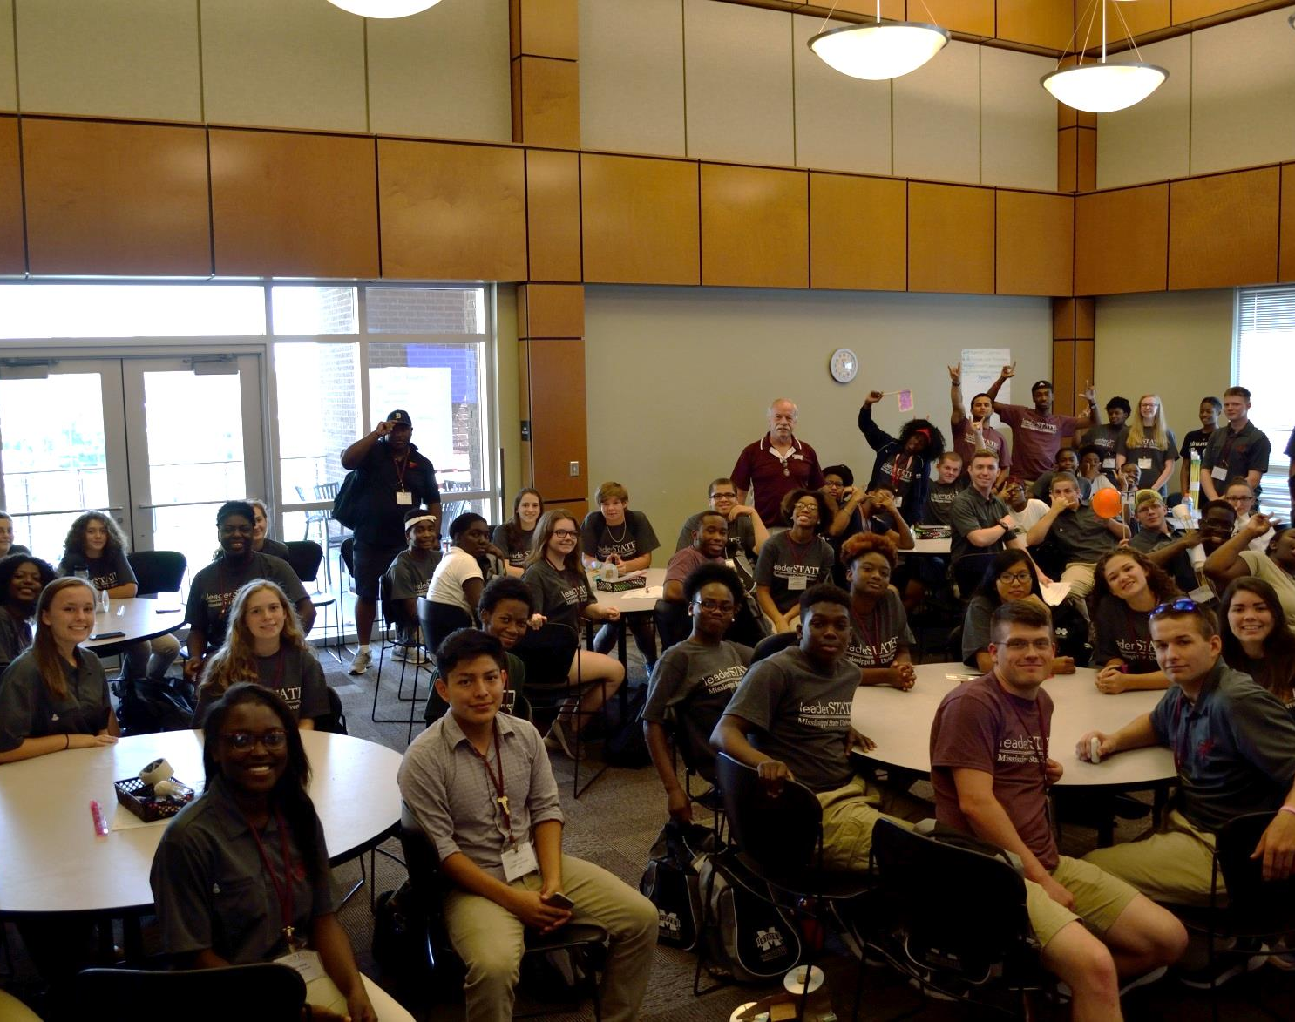
The demographics of each camp (N = 6 annually) vary. Camps populated by cadets from the Jackson, MS school system are about 96% African American and 65% female while some camps that host schools from Alabama and Louisiana are closer to a 50/50 split in gender and African American/Caucasian ethnicity.
Photo- Mark Powers

Slide 4
Each of the six, week long camps enroll up to 65 students with a potential 390 students impacted each summer. The core grade level for the students in the camps is rising juniors; inclusion of some sophomores and seniors form smaller percentages of the population.
Aggregate totals for the four camp years in the category of race shows that the two major groups, African American and white, comprise 70% and 30% respectively of the attendee population.
Males made up 40% and females made up 60 % of the total population.

Slide 5
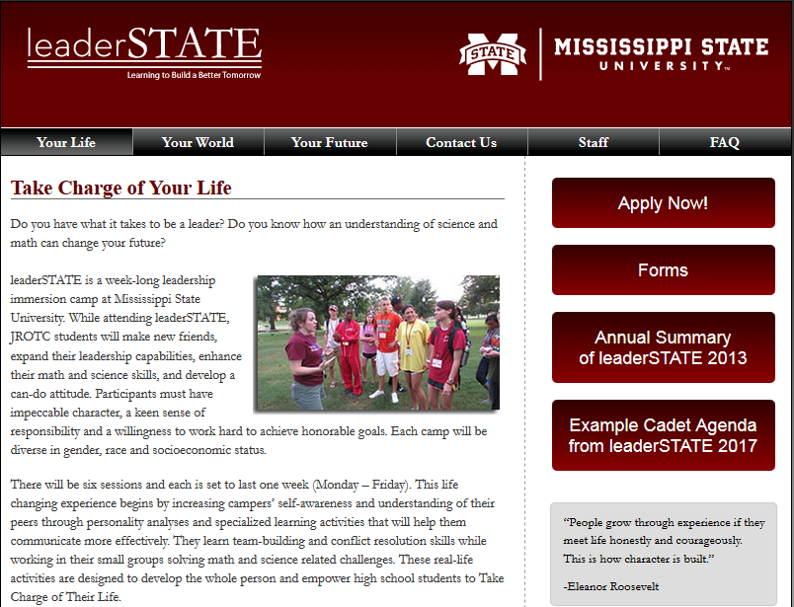
LeaderSTATE STEM offers 5-day summer camps (N=6) for over 300 students annually. The camps’ geosciences STEM component goal is to create an increased awareness of science and opportunities in geoscience careers through a variety of activities. The program is administered by MSU’s Office of Student Leadership and Community Engagement
http://leaderstate.msstate.edu/life/

Slide 6
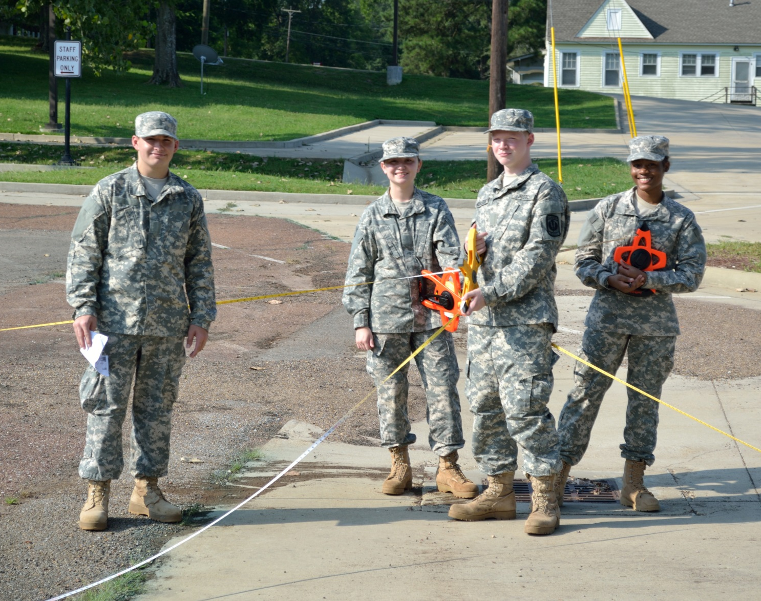
The camp offers a three prong approach to developing personal growth with activities related to personal fitness, leadership and STEM awareness and career opportunities. STEM learning is enhanced by learning activities that drill down into concepts that the Cadets may already have some familiarity with to build deeper understanding of the how and why of STEM learning.
Photo- Mark Powers

Slide 7

A partnership with the Geoscience department has been in place since 2016 which has evolved quickly in regards to the activities and methodologies that are presented to the cadets. The curriculum that has been developed by the Geoscience department is allied with the National Standards described in the Next Generation Science Standards.
https://images-na.ssl-images-amazon.com/images/
(Next Generation Science Standards, 2013).

Slide 8
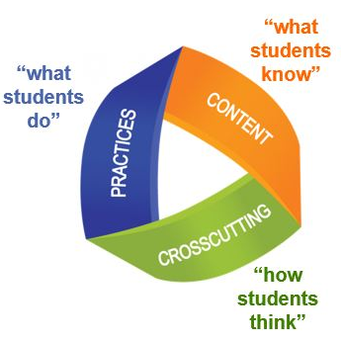
Activities and experiences during the camps explore geosciences fields of study and career opportunities. Industry tours are used to showcase potentially rewarding careers in industry, academia, research, and government that are related to STEM education.
https://www.georgiascienceteacher.org

Slide 9
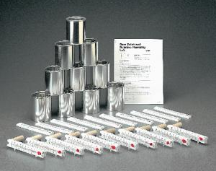
Students also construct deeper understanding of selected geoscience phenomena by using constructivist methods that are intended to build a desire for engagement in the general process of science learning.
https://www.boreal.com/store/product/8871672/dew-point-relative-humidity-lab-in-c-and-f

Slide 10
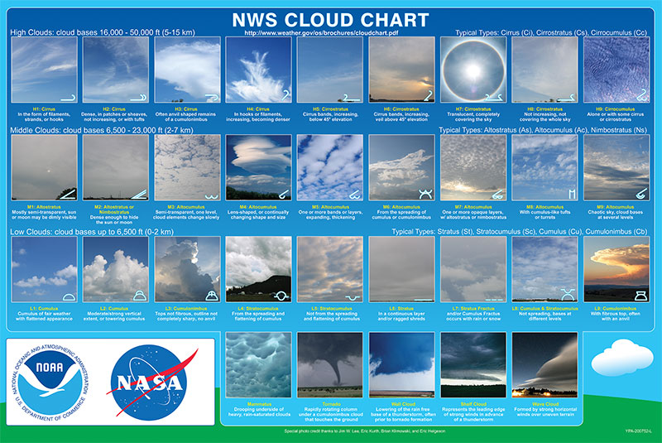
The broad variations in student experiences prior to camp attendance, coupled with short camp duration, resulted in a lesson plan structure that includes exploration of natural phenomena with which the students likely have some familiarity. The use of a constructivist and cooperative learning model helps shape students’ deeper understanding of those phenomena.
https://www.weather.gov/images/jetstream/clouds/cloudchart_nws.jpg

Slide 11
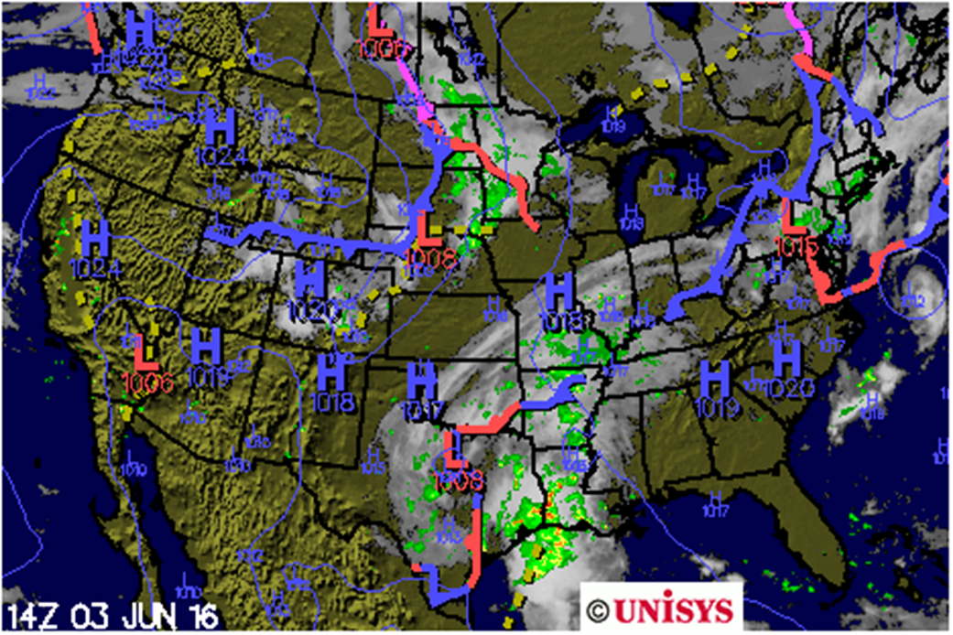
The general meteorology topics included understanding the mechanisms that contribute to weather phenomena and doing hands on investigations to explore dew point, humidity, frontal movement, air pressure, and cloud formation. Daily examination of various online weather maps and the collection, plotting and simple analysis of selected local weather data were used to highlight the importance of data literacy.
http://weather.unisys.com/index.php

Slide 12
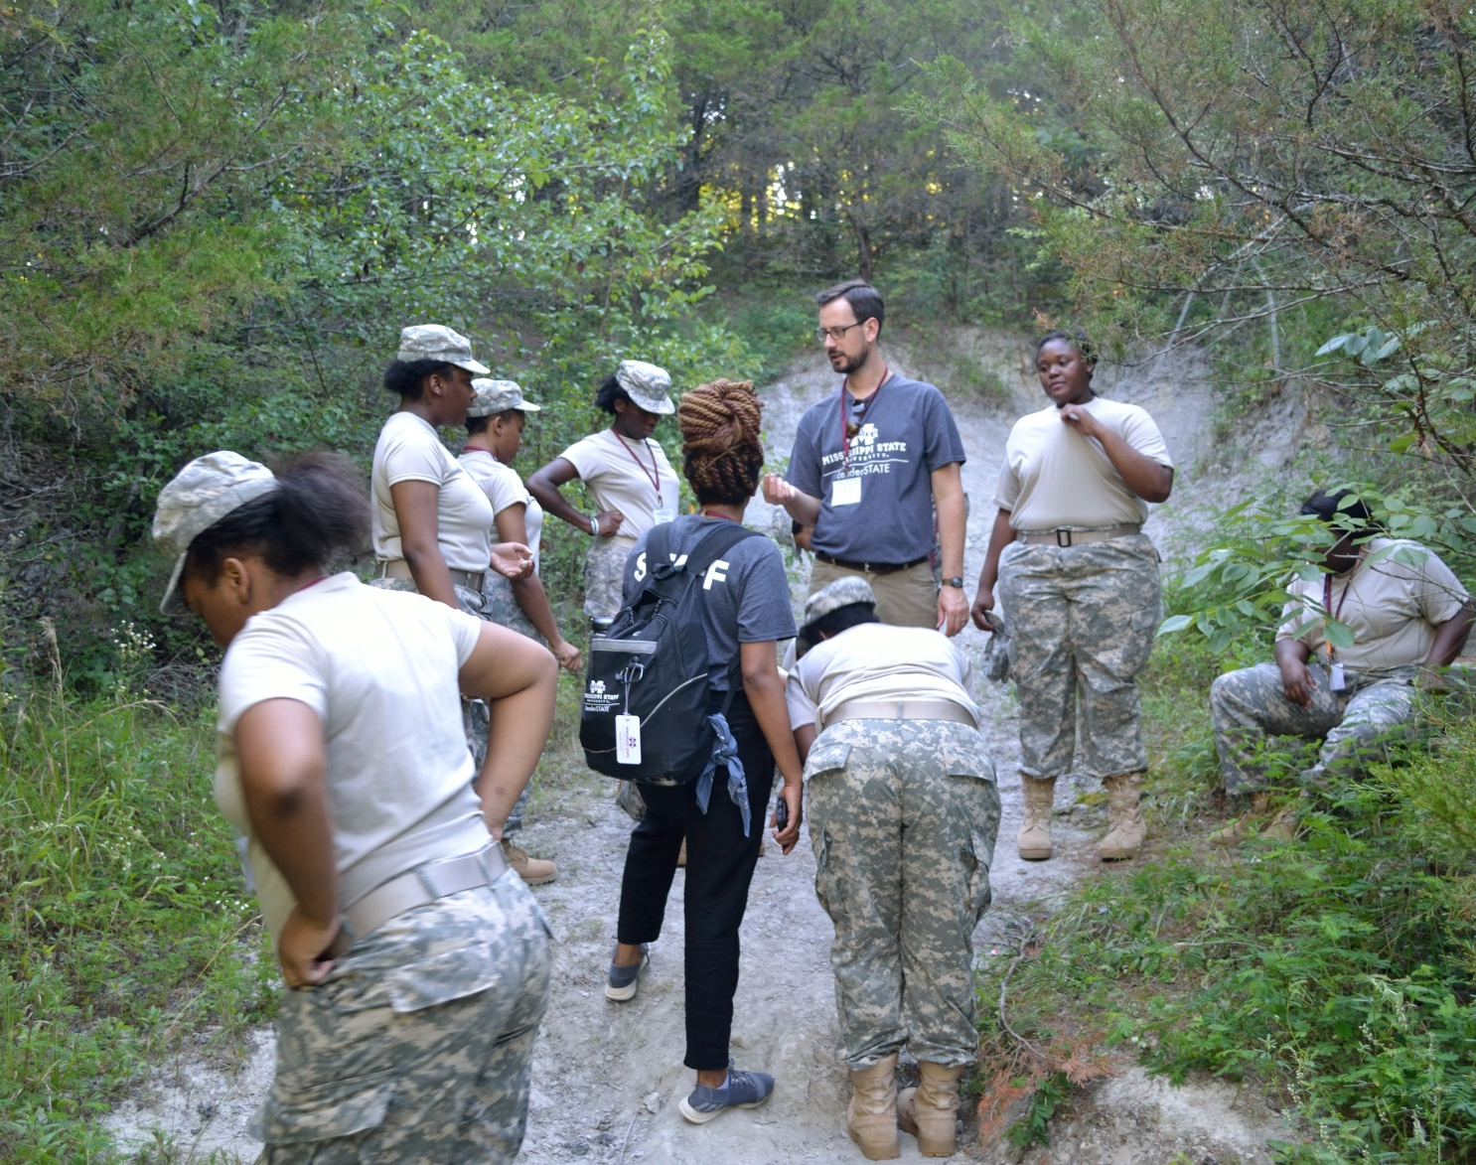
In addition to meteorology, students explored geologic time and large scale changes, including past climates and environments of the local landscape. An introduction to GIS and subsequent activities in and out of the classroom modeled the importance of data collection and analysis.
Photo- Mark Powers

Slide 13
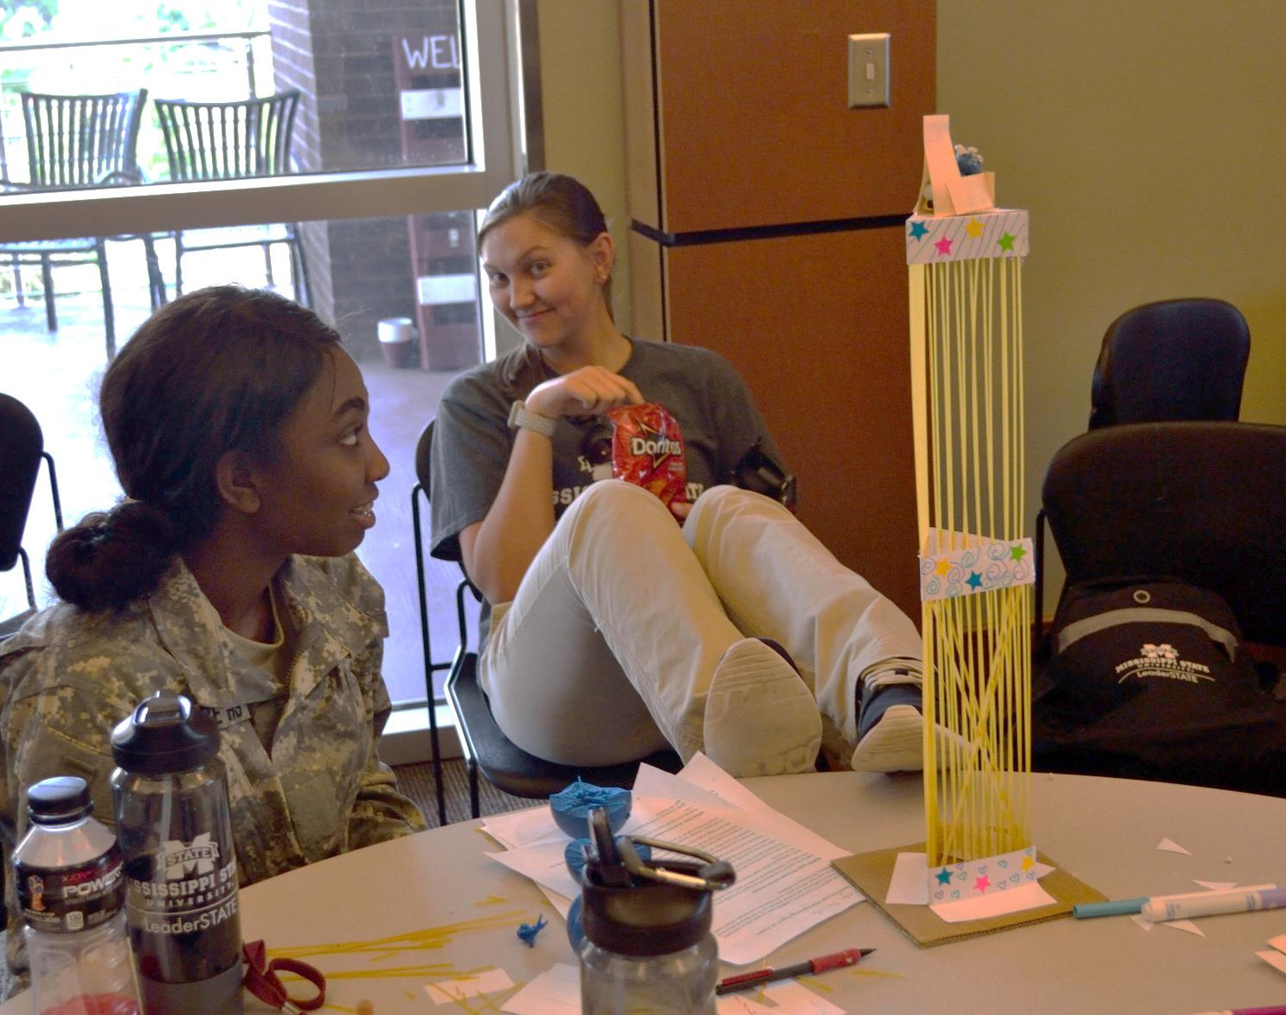
Earthquake triangulation modeling in and out of the classroom prefaced a culminating activity of the design and construction, within specified parameters, of a shake resistant tower
An air pressure powered car was another culminating activity that employed engineering design and collaborative group work.
Photo- Mark Powers

Slide 14
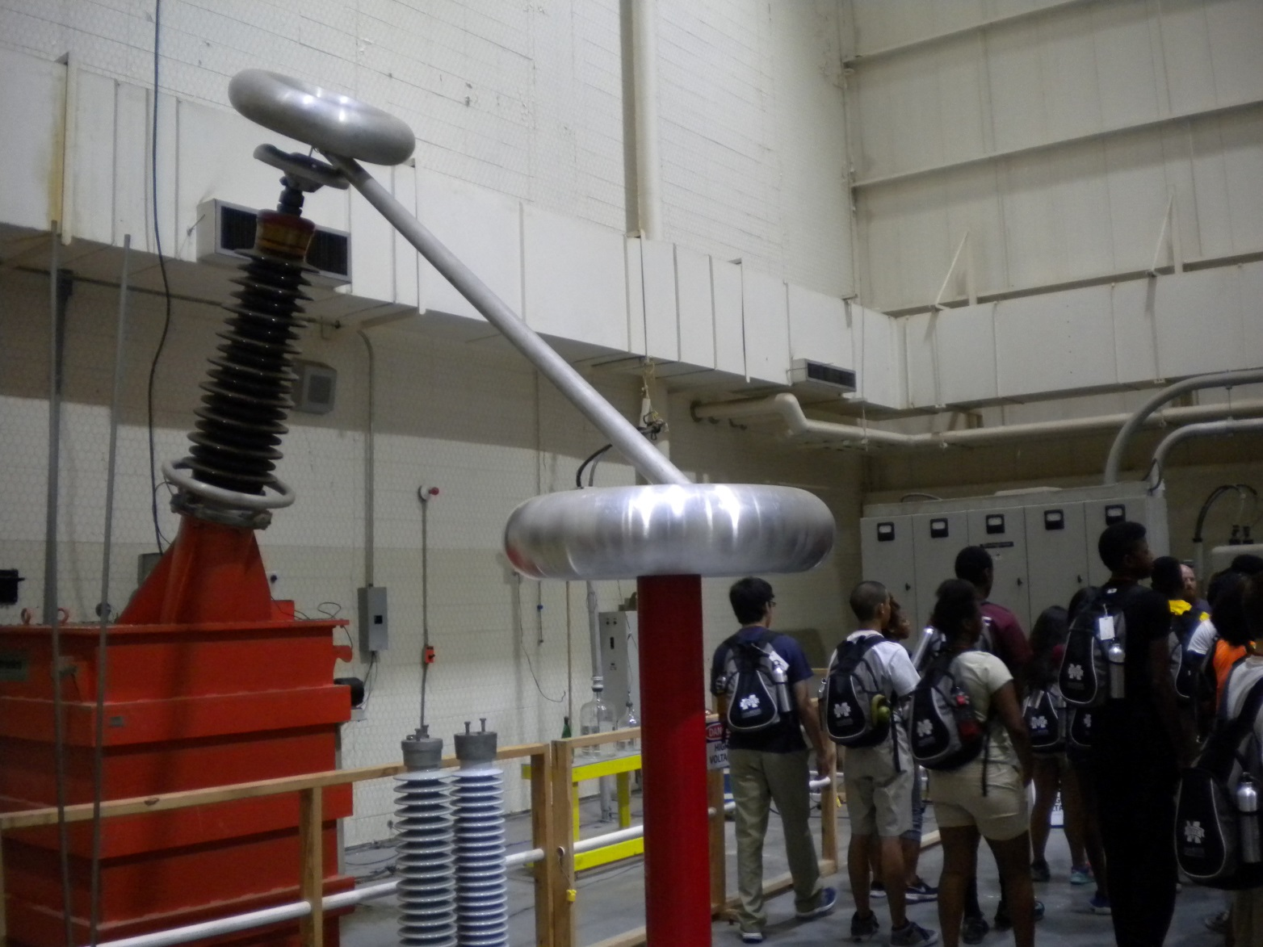
Another overarching desired outcome of the leaderSTATE STEM summer camps is to create an increased awareness in underrepresented populations of opportunities in geosciences STEM careers, which typically attract fewer students from those populations than do other areas of scientific study.
Photo- Mark Powers

Slide 15
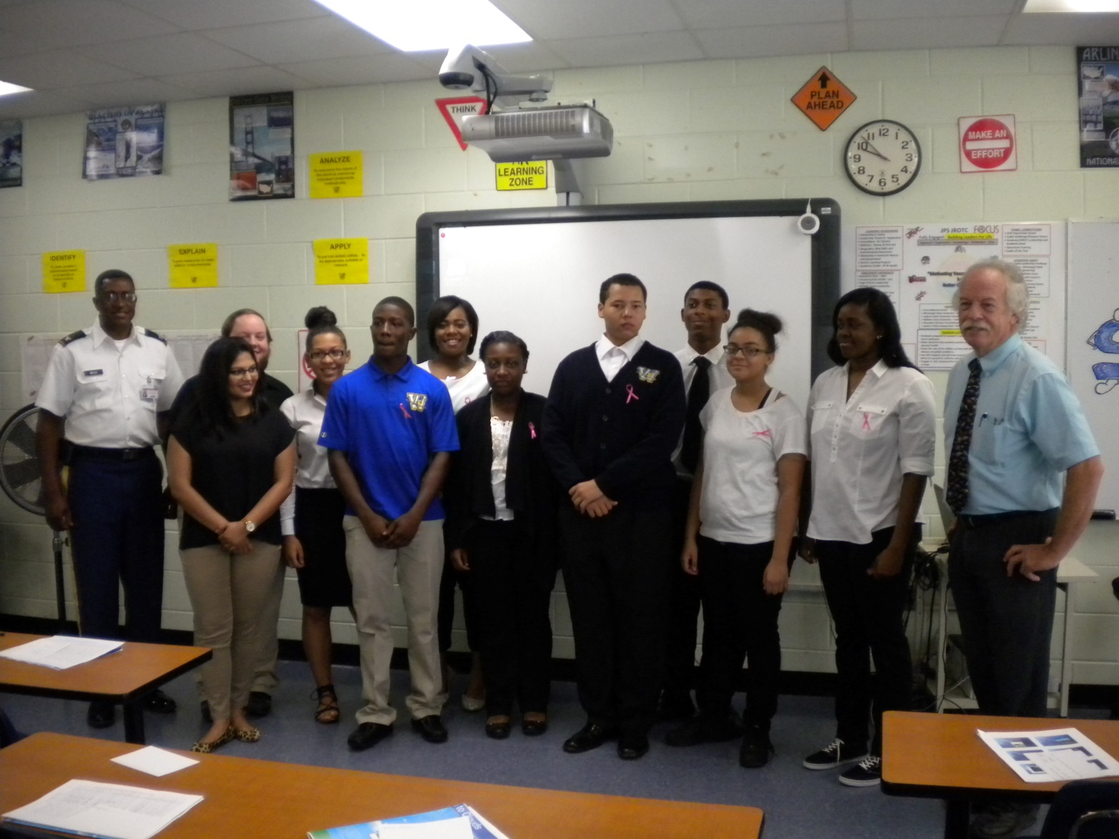
Given the large percentage of underrepresented cadets in the Jackson Mississippi School system, that school district was selected for follow on STEM activities in the subsequent academic year to further assess the impact of the camp.
Photo- Mark Powers

Slide 16
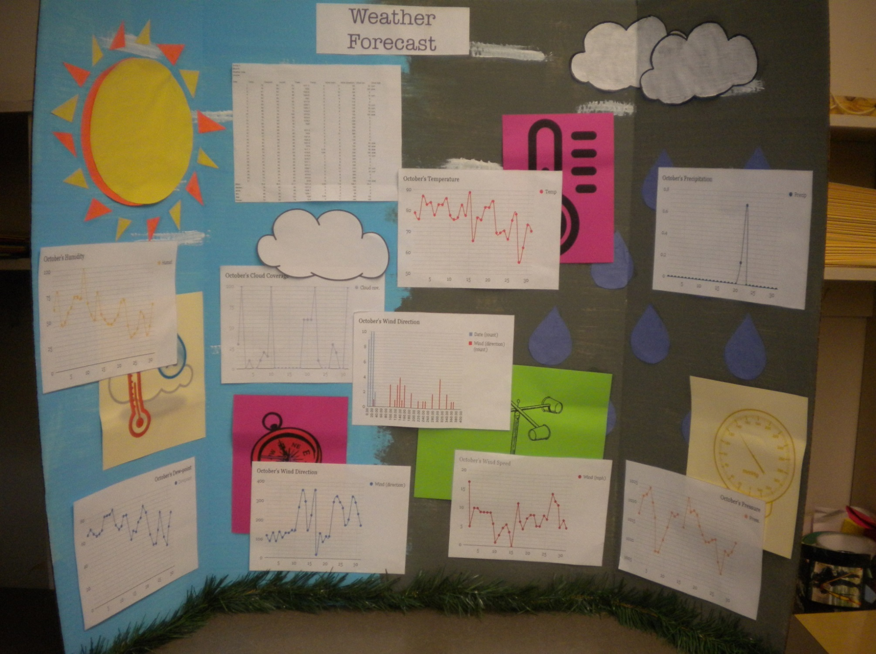
The follow on project, one month in duration, tasked students with the daily collection and analysis of weather data collection and analysis, applying data collection skills learned in the summer camp to a more complex and higher level outcome.
Photo- Mark Powers

Slide 17
To evaluate the effectiveness of student attitudes towards science, we administered the Test of Science Related Attitudes (TOSRA) instrument pre- and post-camp to ascertain changes across the seven scales that define attitudes about the world of science and society.

Slide 18

The TOSRA survey that was used at leaderSTATE was the 1981 iteration of that instrument developed by Barry Fraser for the Australian Council for Educational research. The handbook for that instrument describes details about its development and use
http://www.cms.k12.nc.us/cmsdepartments/ci/mathandscience/Documents/Test%20of%20Science-%20TOSRABJF.pdf

Slide 19
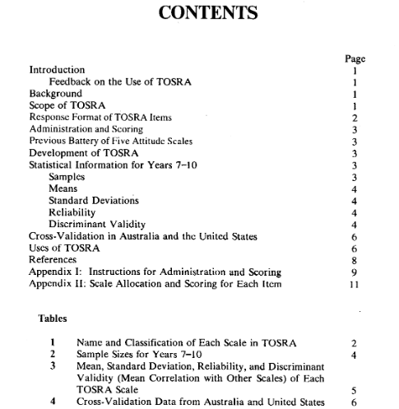
Contents and general scoring guide.
The 70 items in the TOSRA survey are allocated to the seven scales and are designated as positive or negative in the way that they are phrased. (ex; #1. Money on science is well worth spending. #50. This country is spending too much money on science.)
There are 5 response choices for each question that range from strongly agree (SA) to strongly disagree (SD).
Starting with SA, Positive items are scored 5-1, and negative items are scored 1-5.
Each scale category contains 10 items and therefore the minimum score is 10 and the maximum score is 50. for each scale.
Missing or invalid scores are given a 3.

Slide 20
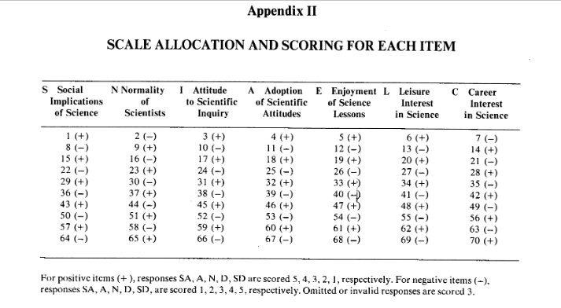
TOSRA Scale allocation and scoring scheme. The number represents the question and the (+) or (–) symbol designates the question as being positive or negative in its connotation.

Slide 21
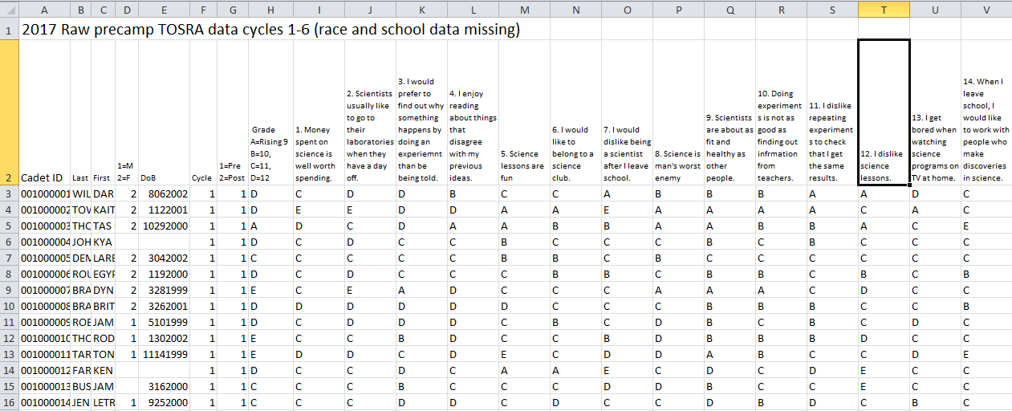
Raw data from the pre and post camp surveys for the last four years of the camp was organized in spreadsheets. Missing data was retrieved when possible, and various types of recoding and reordering of the data was performed. Incomplete or non-paired surveys were removed from the data.

Slide 22
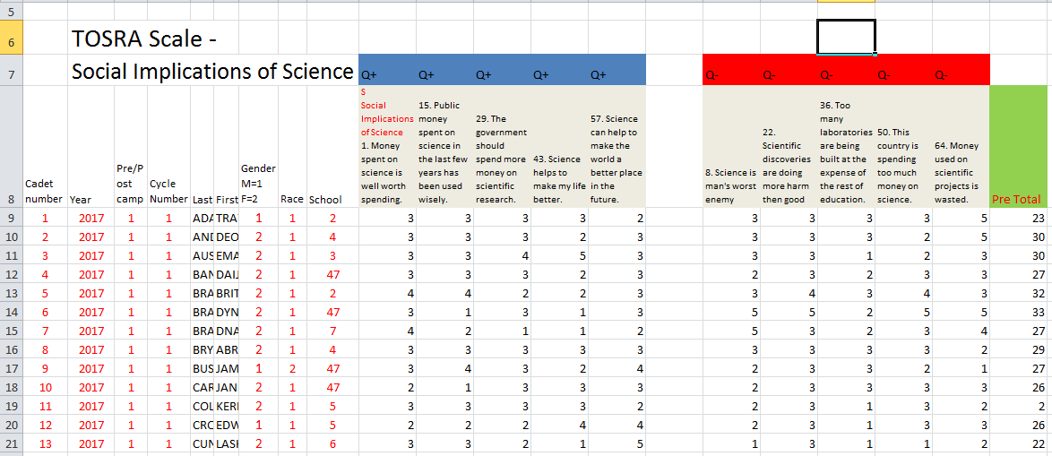
Refined data was organized into the TOSRA scale categories, students records were ordered and missing pre or post surveys were identified. Numeric codes replaced alphabetic codes and ending schools were coded from1-100.

Slide 23
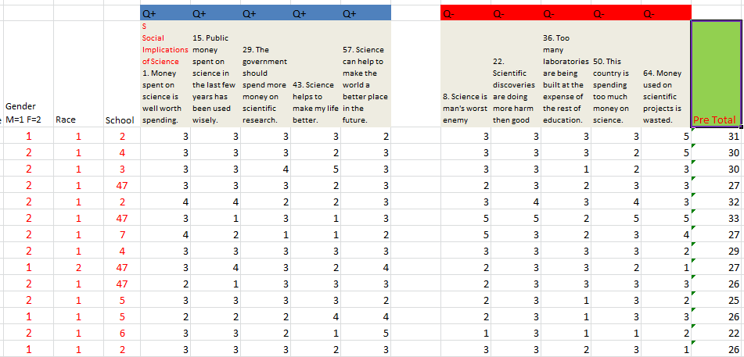

Sample TOSRA questions for Social Implications of Science Scale, precamp survey. Spreadsheet organized by grouping positive and negative question types. Data was recoded from alphabetic to numerical values. Totals for each Cadet responder is in the right column.

Slide 24
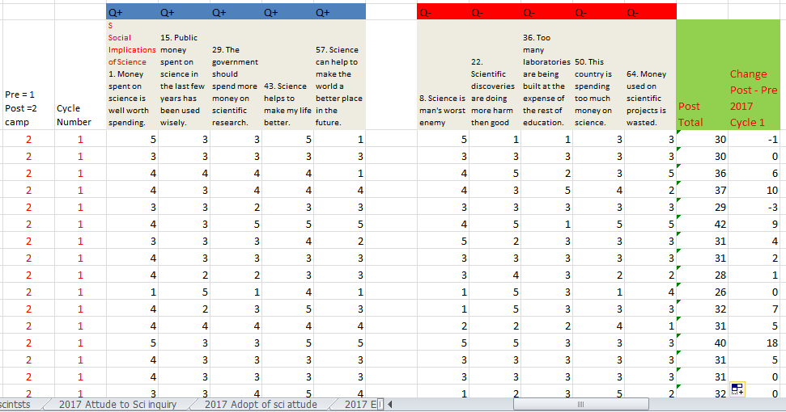
Sample TOSRA questions for Social Implications of Science Scale precamp-postcamp change in survey responses. Spreadsheet organized by grouping the positive and negative question types for each of the seven TOSRA Scale categories.

Slide 25
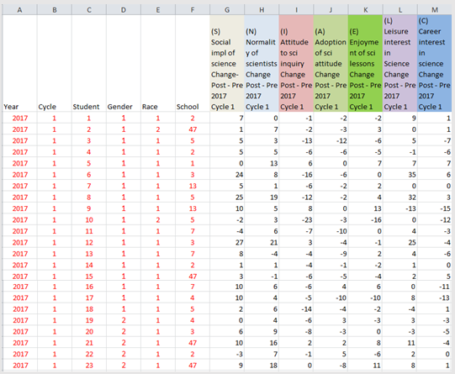
Sample of paired pre-post TOSRA survey results summary from 2014 - 2017 camp cycles. (N=1141 students) were analyzed for race, gender, and school correlations in each of the seven scale categories.

Slide 26

Chi square analysis of the change data was performed using the IBM SPS 25 program
https://developer.ibm.com

Slide 27
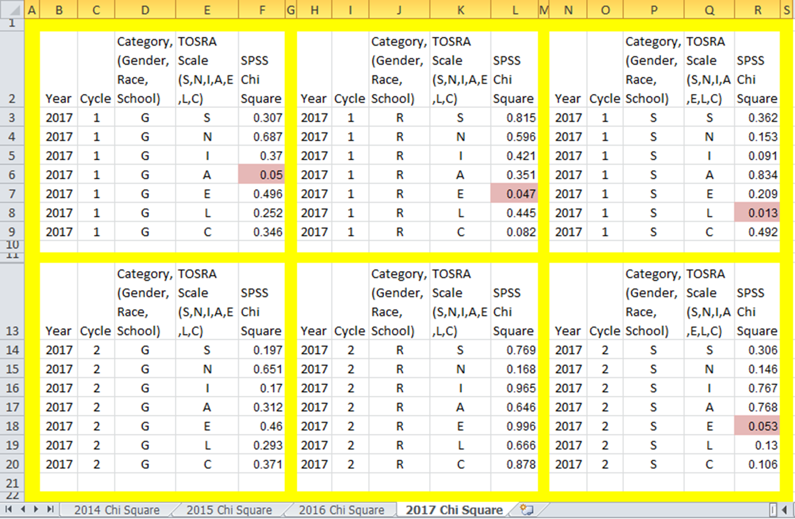
Chi square analysis of different demographic groups revealed only a scattered statistical improvement throughout the data (p = 0.05).

Slide 28
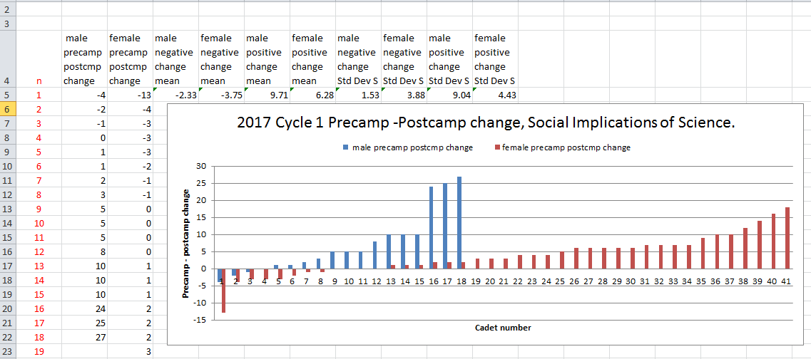
Histogram representations indicated improved TOSRA attitudes for different demographic groups.

Slide 29
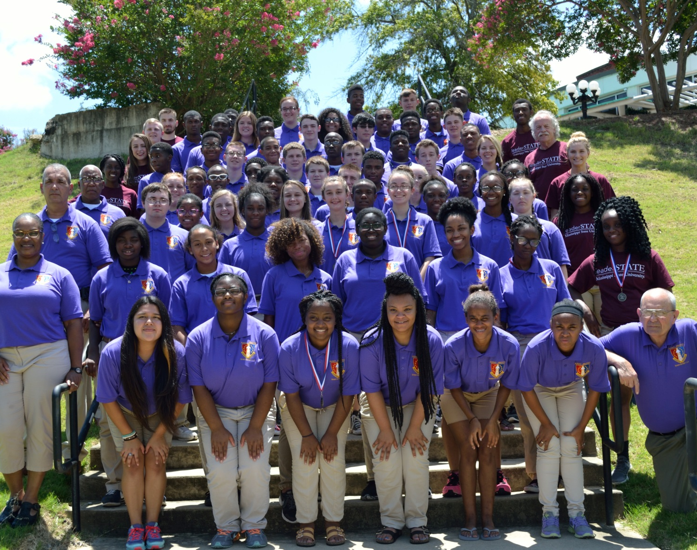
More research is needed to determine whether the TOSRA provides an appropriate assessment for the leaderSTATE STEM camps, and whether the 5-day experience is too limited to result in statistically significant attitudinal changes about science in the camp participants.
Photo- Mark Powers

Slide 30
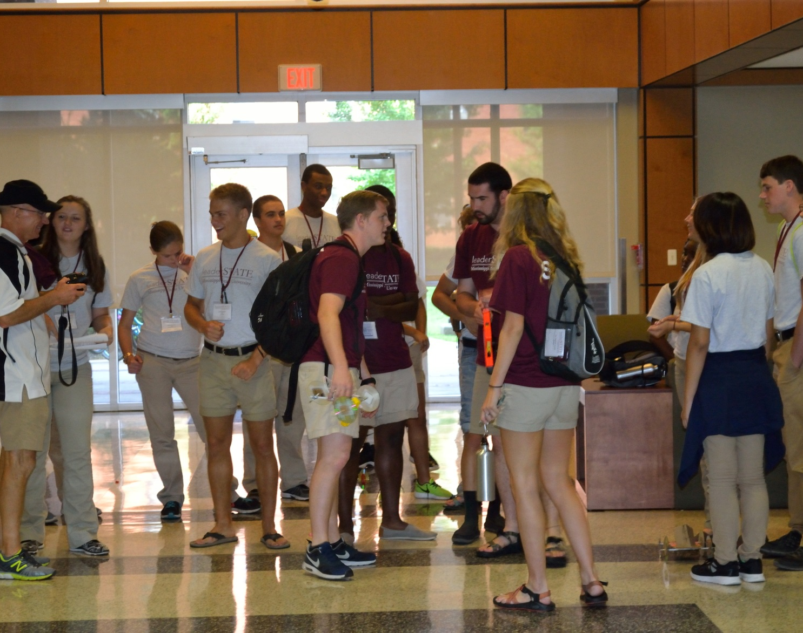
Implications for future research
The implications of this study may suggest not so much the need for a change in the structure, sequence and methodology of the learning experiences we conduct at leaderSTATE STEM, but rather the need for a more intentional focus in connecting the TOSRA scales to specific STEM activities that are part of the camp,
Photo- Mark Powers

Slide 31

Identifying a more appropriate instrument to probe students’ short term changes in attitudes toward science as a result of camp experience may also need to be investigated. A longer term survey when the students return to their home schools in the following year may also be of interest.
https://www.differencebtw.com/wp-content/uploads/2015/08/quantitative-research-vs-qualitative-research-810x405.j

Slide 32
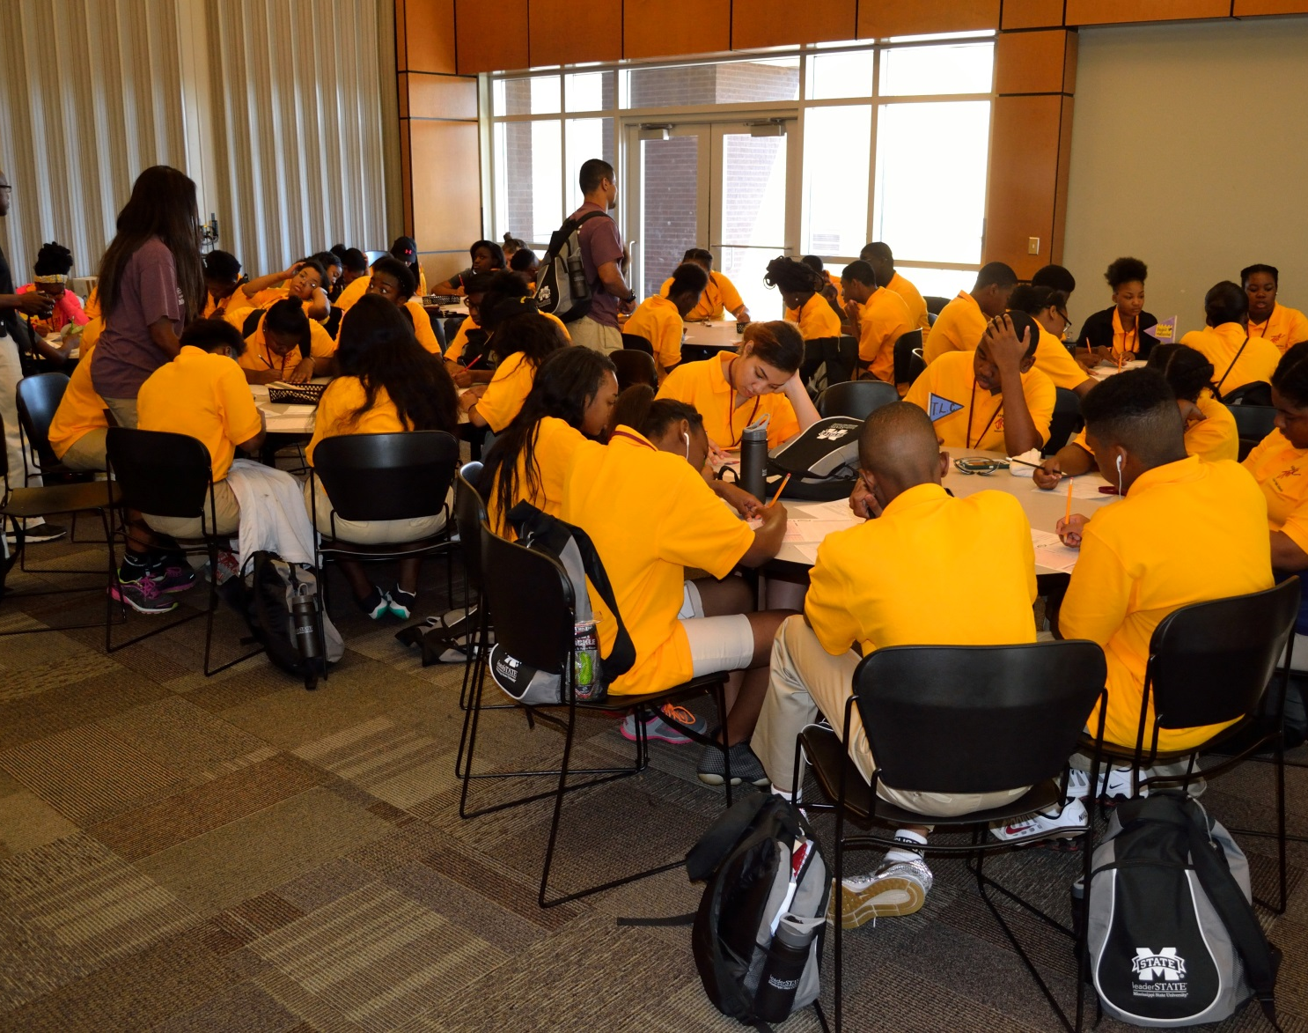
Regardless of the survey instrument used in future, leaderSTATE STEM camps, the surveys might benefit by being condensed to reduce “survey fatigue” that respondents may have experienced with a 70 question survey, administered twice in 5 days.
Photo- Mark Powers

Slide 33
Final Thoughts
Follow-up discussions with selected groups of students, as well as general comments expressed throughout the camps, indicate that the camp is a positive experience. In order to probe whether these comments are representative of leaderSTATE STEM experiences, in 2018 we included STEM-specific questions in the students’ daily evening reflections which may provide a data source to help us unpack the effects of the leaderSTATE STEM camps on participants’ science attitudes
The reflections from the Cadets about the camp and it’s impact on a variety of aspects of their lives is largely positive. The interpretation of the TOSRA data showing positive changes in their responses in many of the TOSRA scale categories is encouraging. The Geoscience department partnership with the camp as the developer and facilitator of the STEM curriculum continues to mature every year.

