Slide 1
Sand Deposition by Grainfall beyond the Lee Slope of a Large Parabolic Dune
Brian E. Bodenbender, Edward C. Hansen, Brian P. Yurk, Suzanne J. DeVries-Zimmerman, and Jacob T. Stid
Department of Geological and Environmental Sciences and Mathematics Department
Hope College, Holland, Michigan

Slide 2
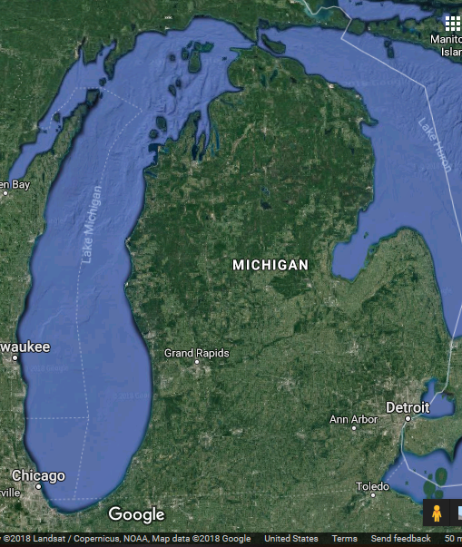
Green Mountain is a 40 m high parabolic dune on the lakeshore between Holland and Saugatuck, Michigan

Slide 3
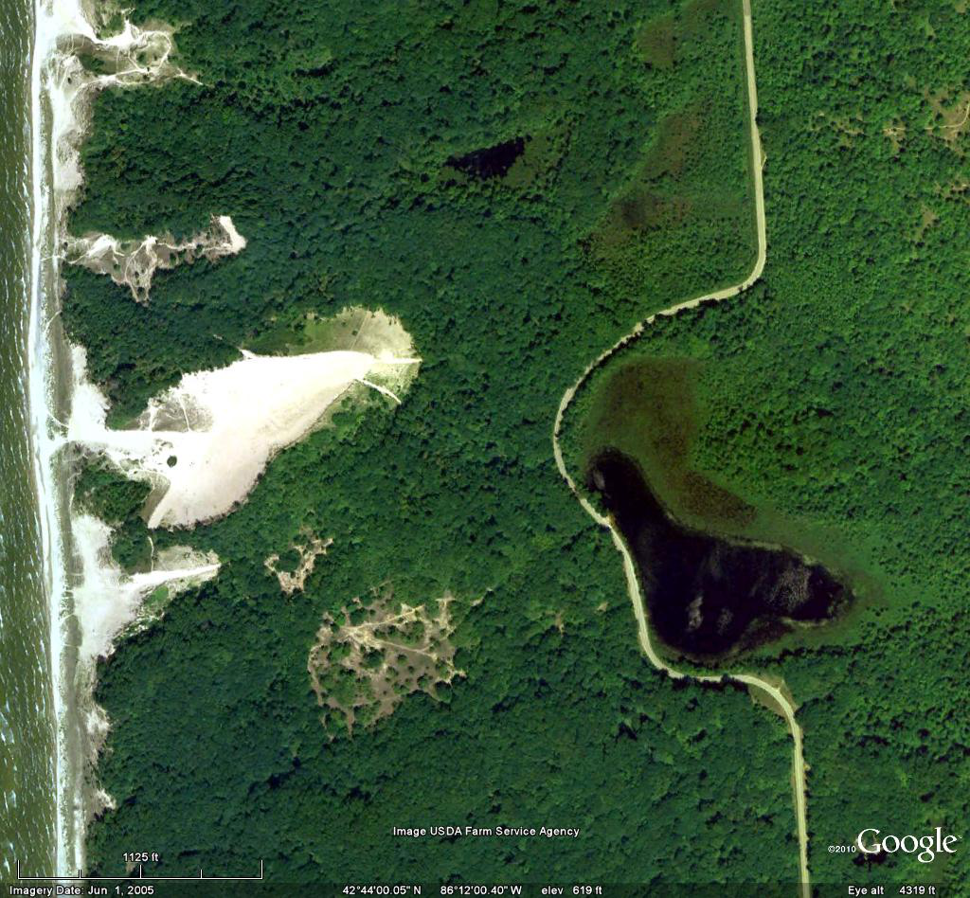
GM
Green Mountain and smaller dunes to north and south

Slide 4
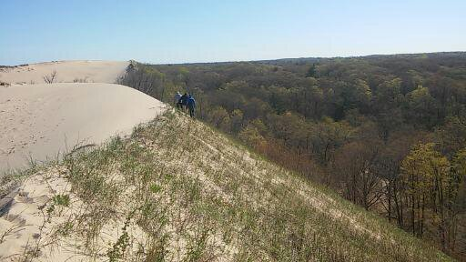
View of Green Mountain from dune 400 m southwest.
Arrow shows dune axis. Crest is well above leeward forest.

Slide 5
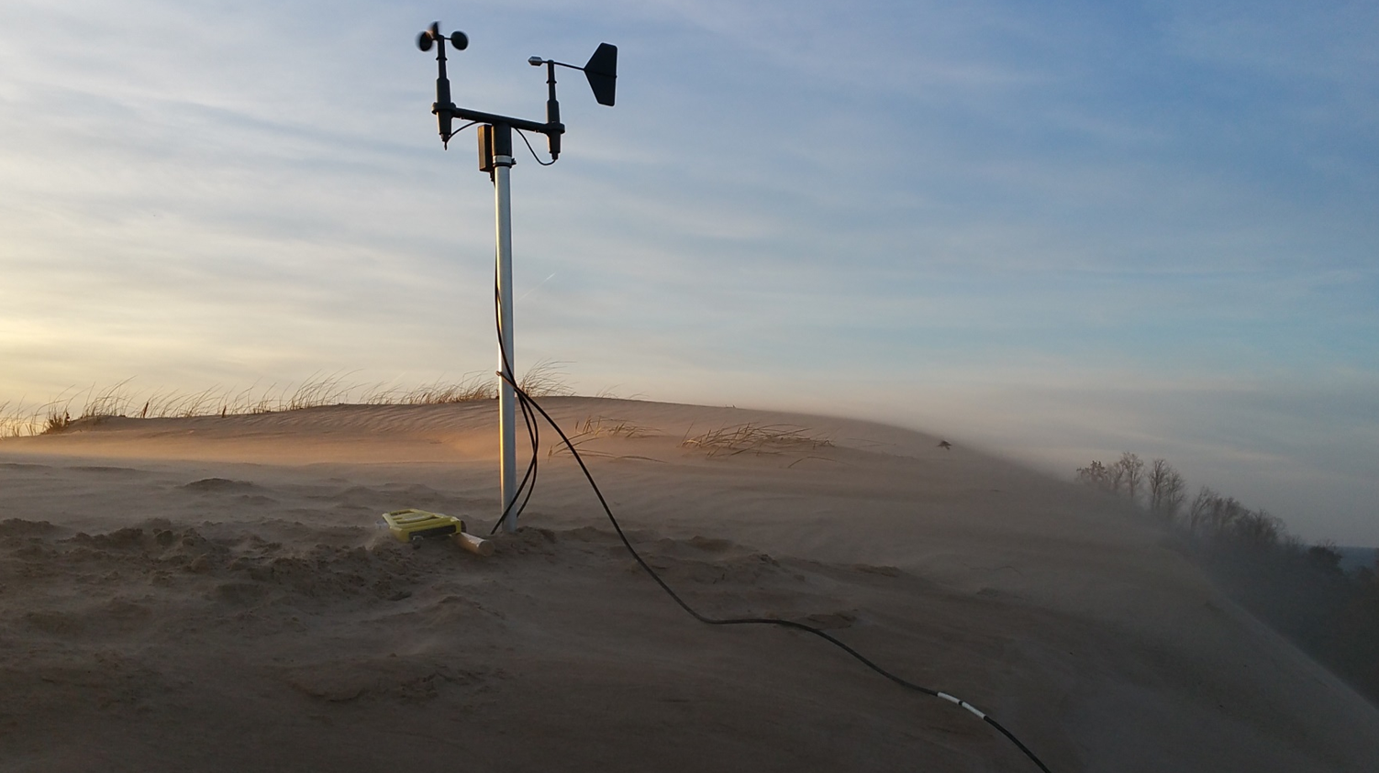
Flow separation can affect saltation and suspension of sand in lee.

Slide 6
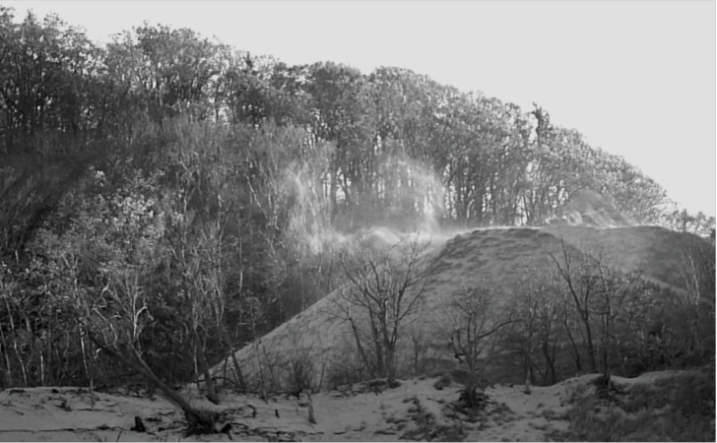

Slide 7
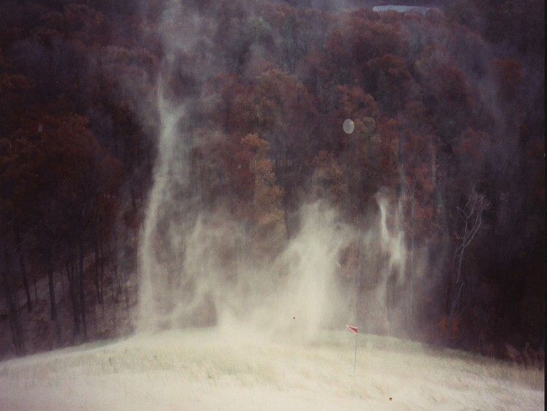
Turbulent eddies may lift sand vertically
Most prior studies concentrate on the lee slope itself

Slide 8
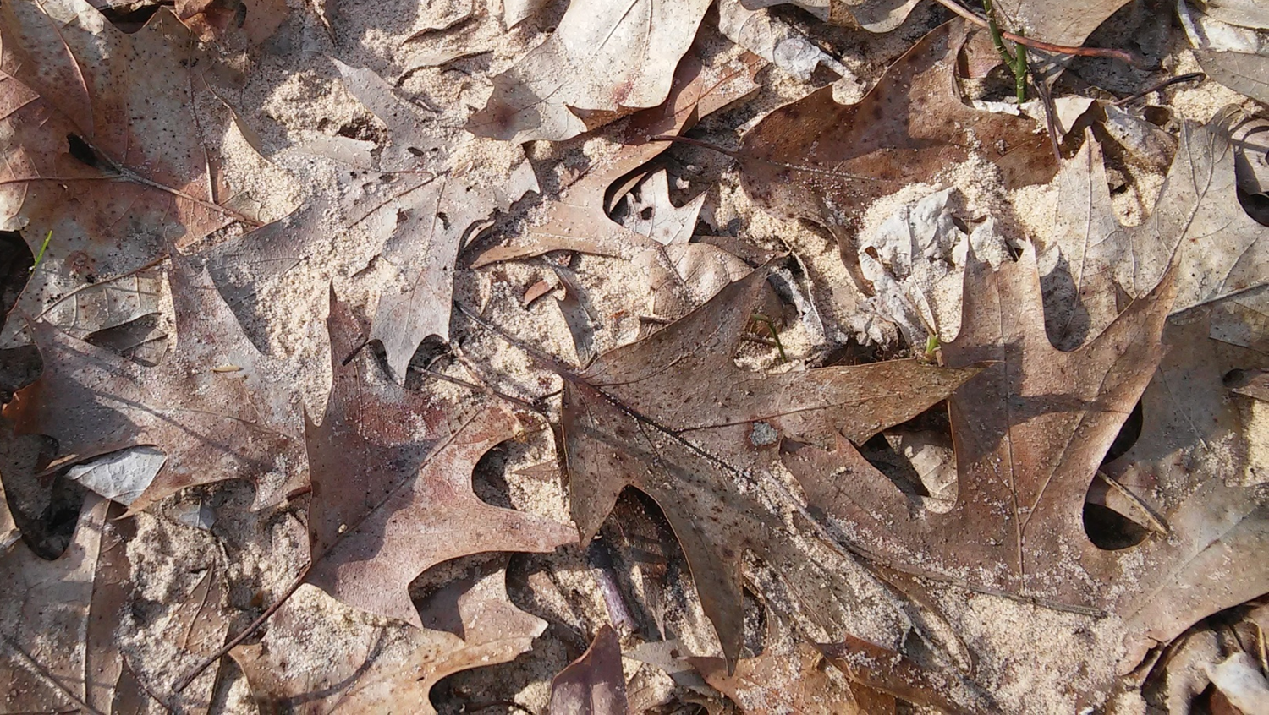
Sand is commonly observed in the forest beyond the dune lee slope

Slide 9
Niveo-aeolian transport?
Grainfall?

Slide 10
Goal of this study is to document grainfall as a transport mechanism downwind of a large parabolic dune

Slide 11
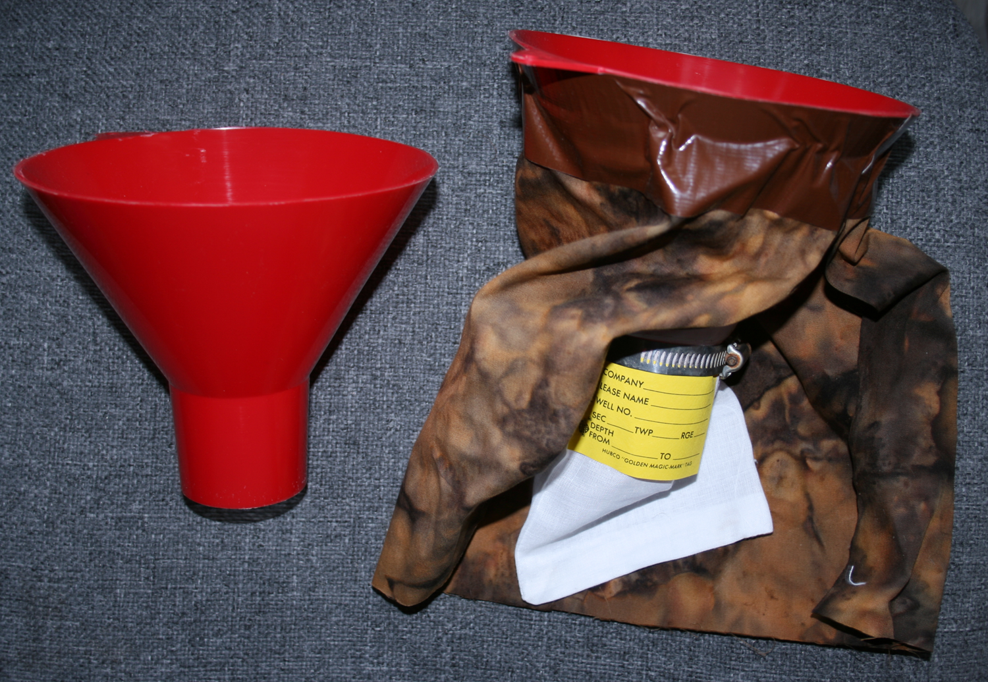

Slide 12
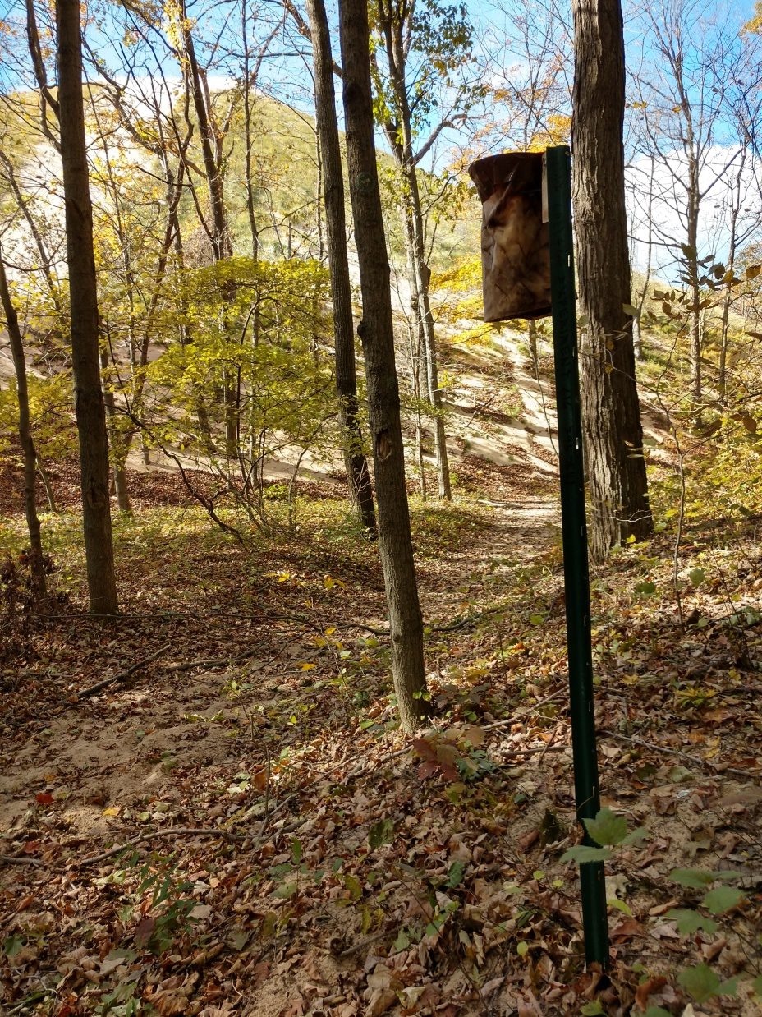
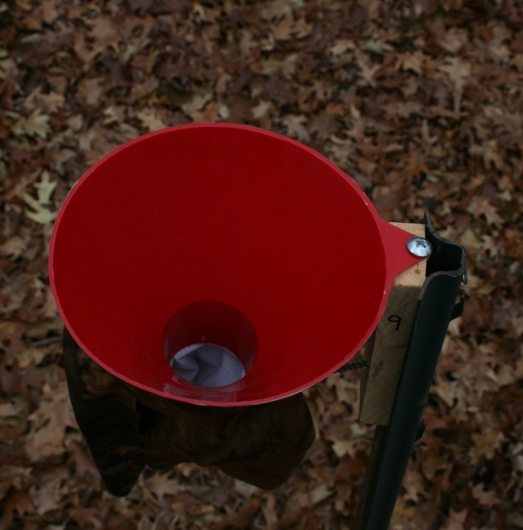

Slide 13
Long-term grainfall traps at Green Mountain

Slide 14
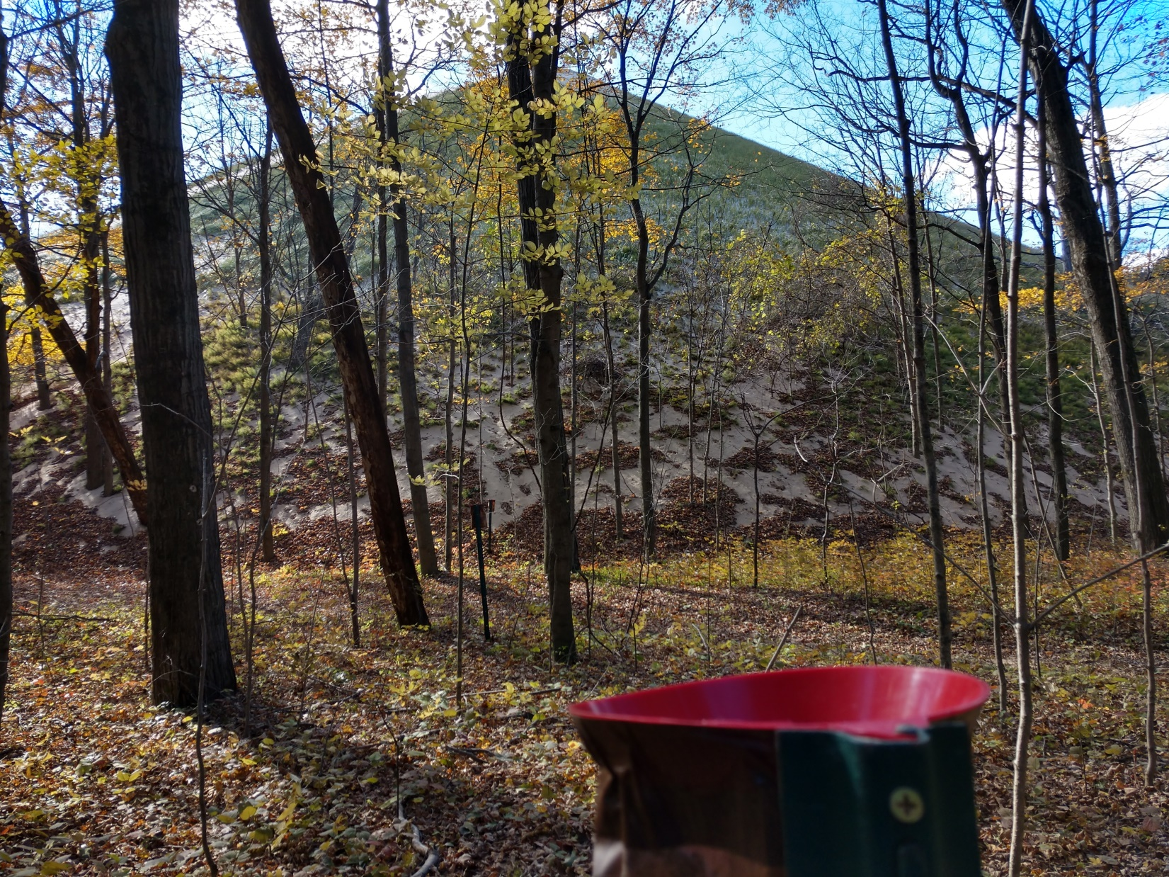
View of dune and traps 1–3 through backdune tree cover, Oct. 2018

Slide 15
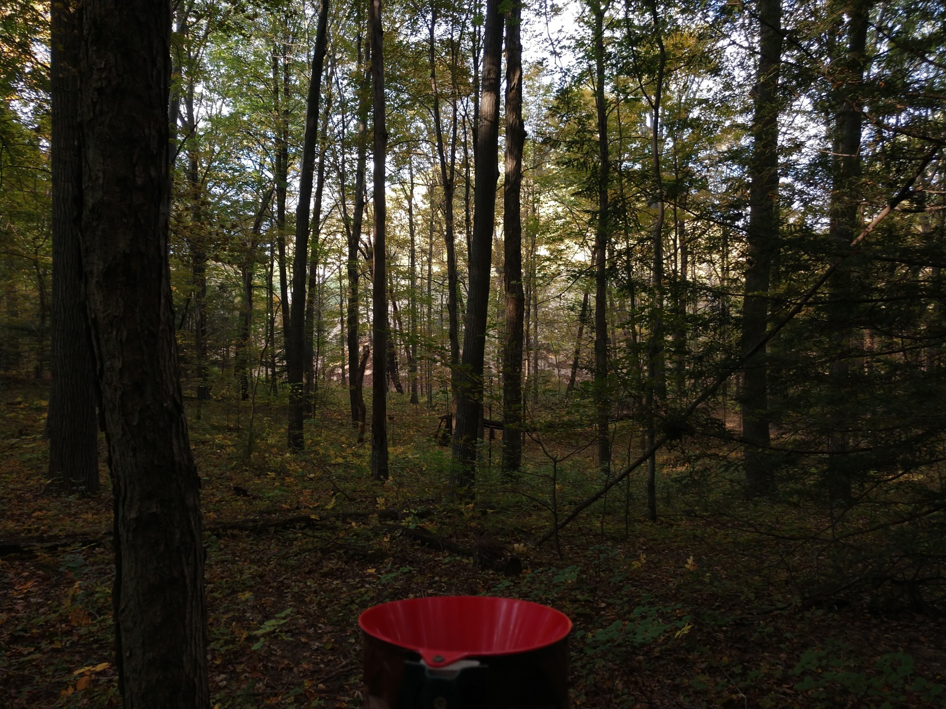
View of dune and traps 1–5 through backdune tree cover, Oct. 2018

Slide 16
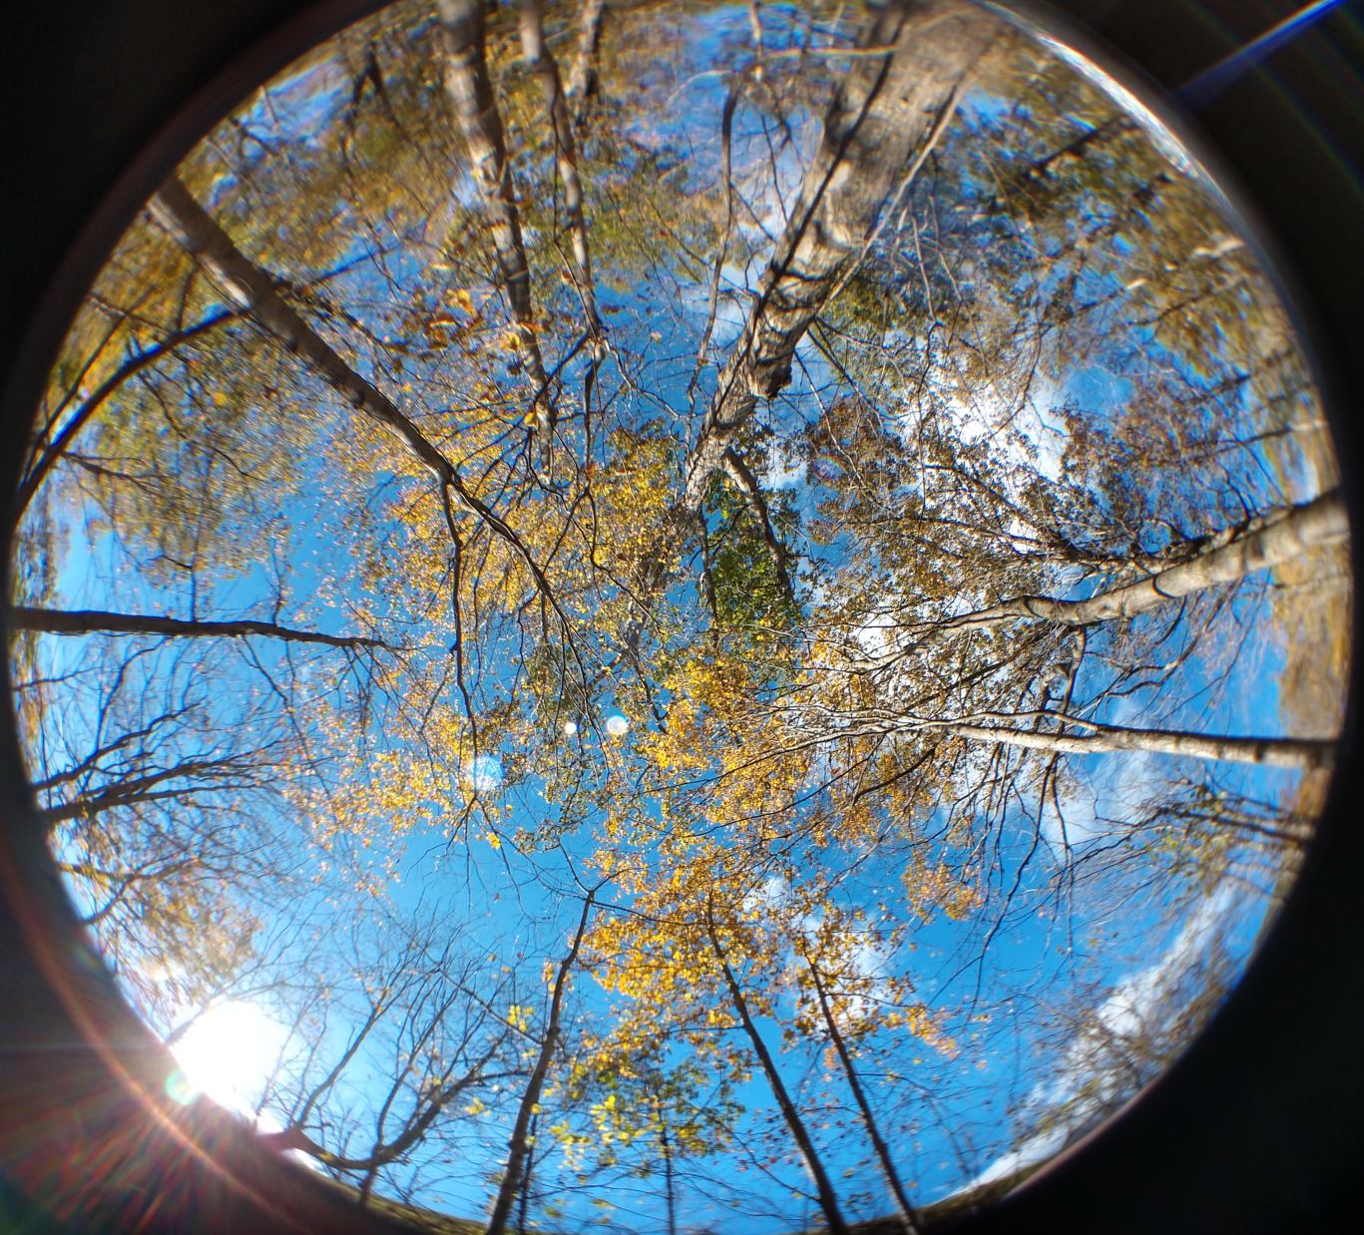
Leaf cover above trap 1
Oct. 23, 2018

Slide 17
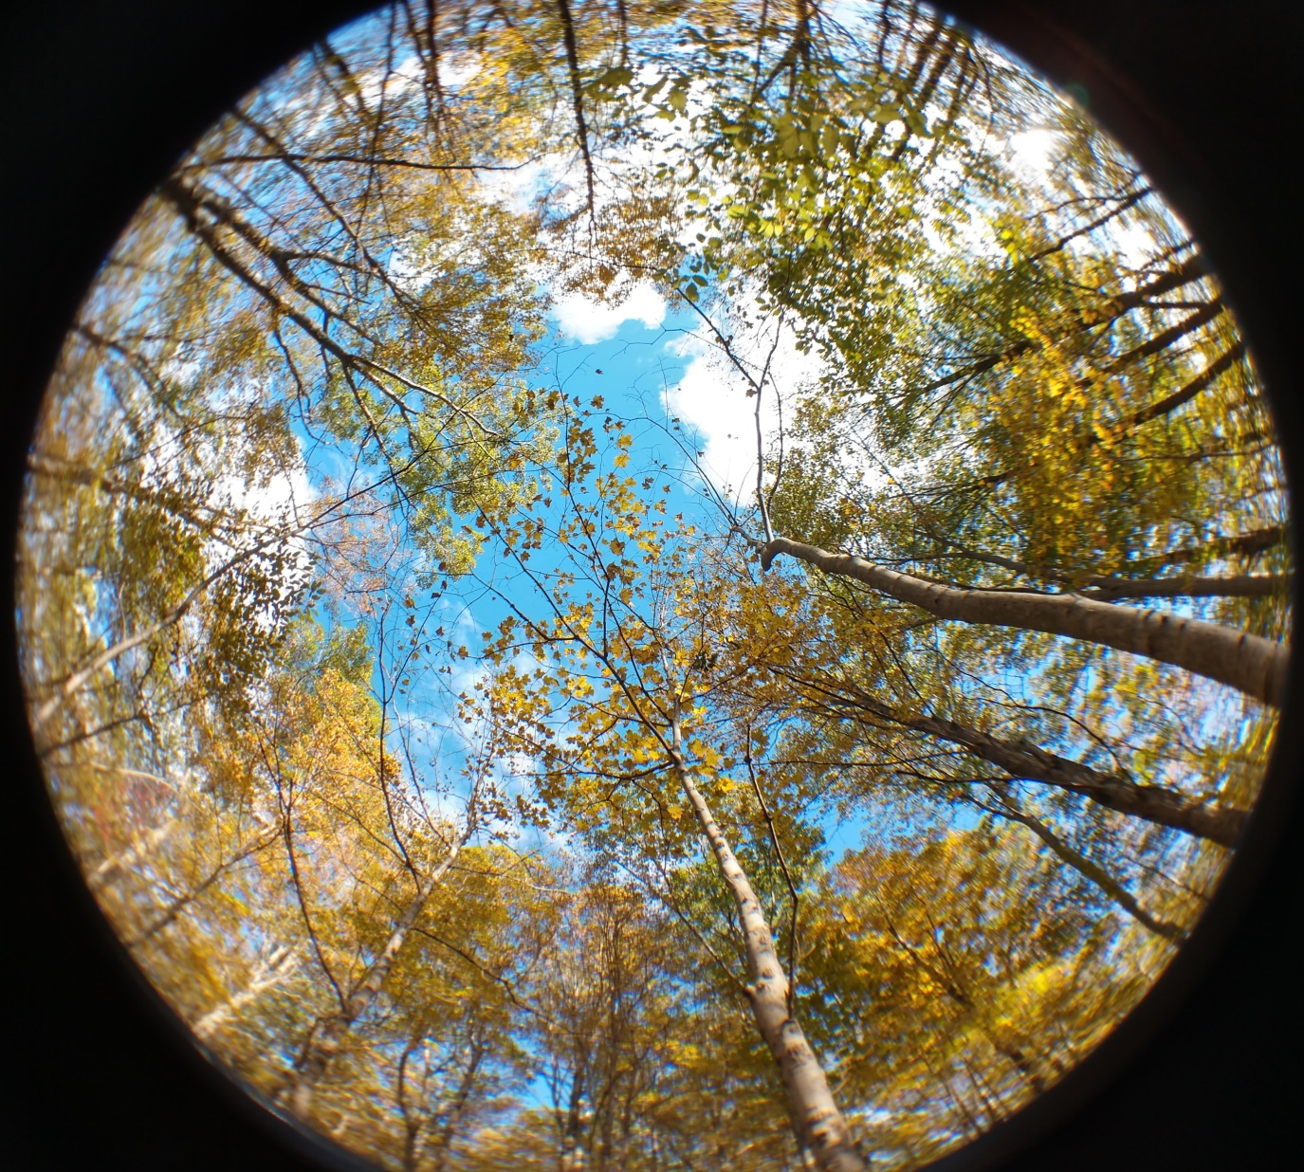
Leaf cover above trap 4
Oct. 23, 2018

Slide 18
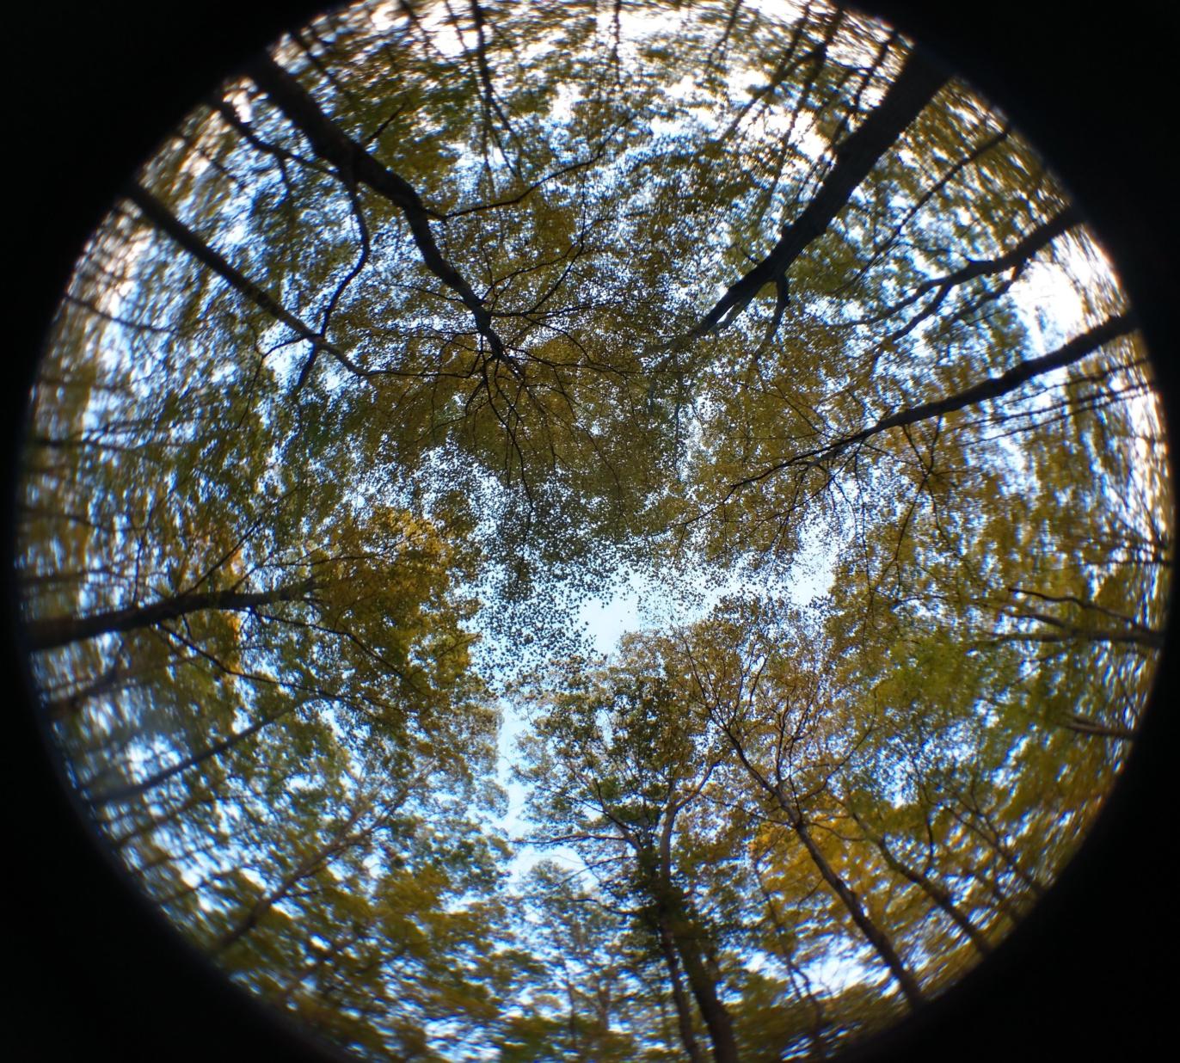
Leaf cover above trap 9
Oct. 23, 2018

Slide 19
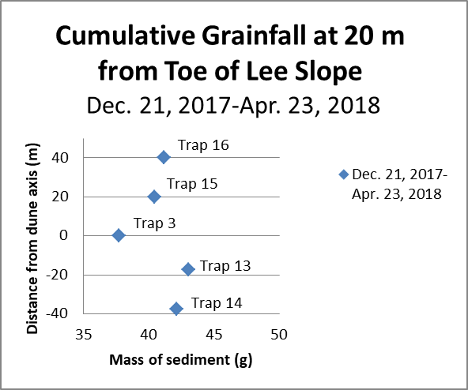
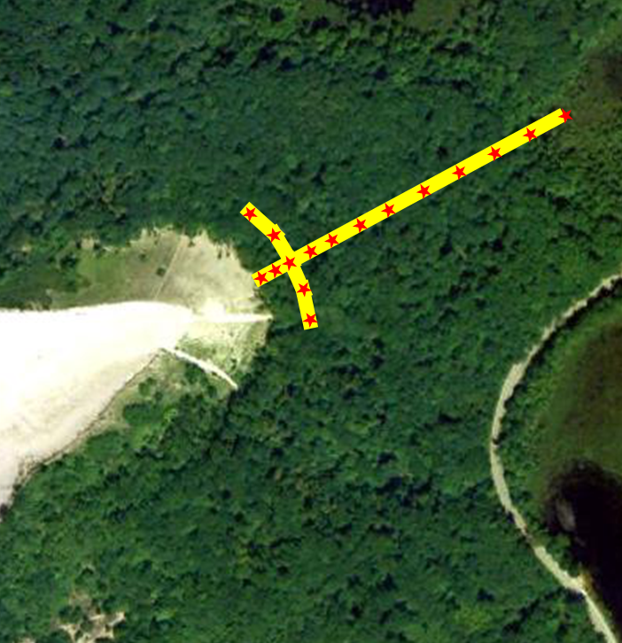

Slide 20
Dec. 4–6

Slide 21
Dec. 4–6

Slide 22
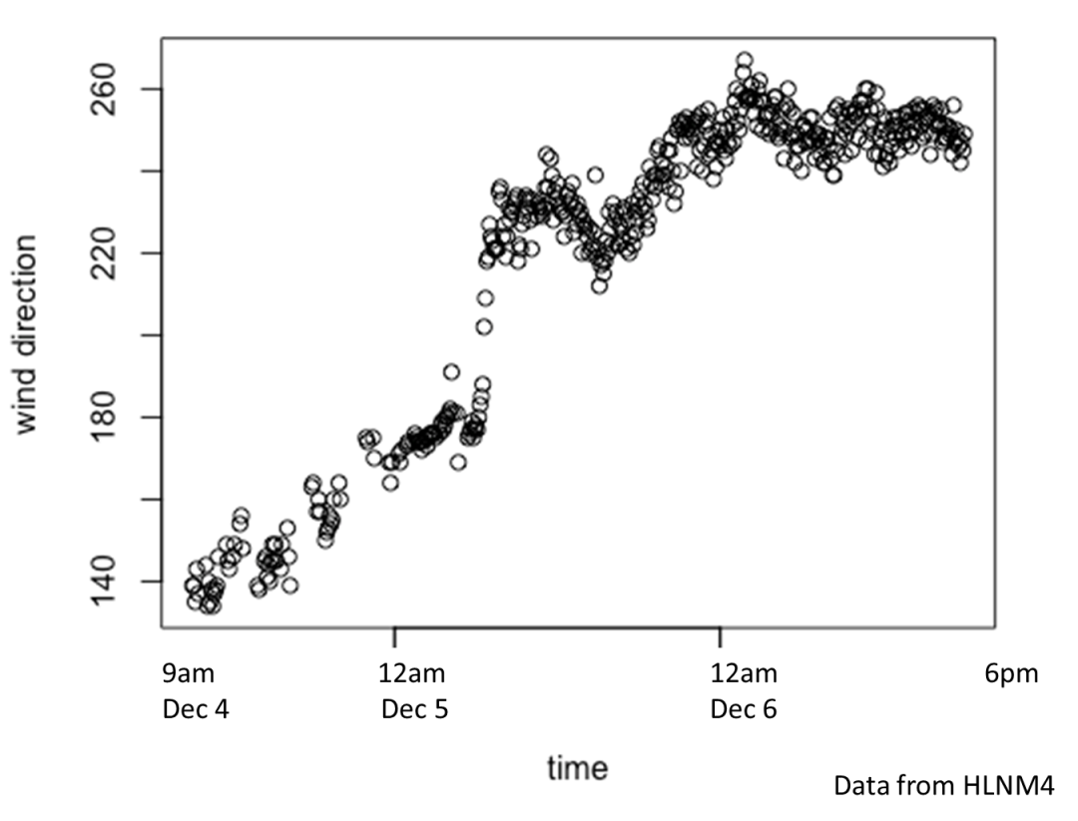
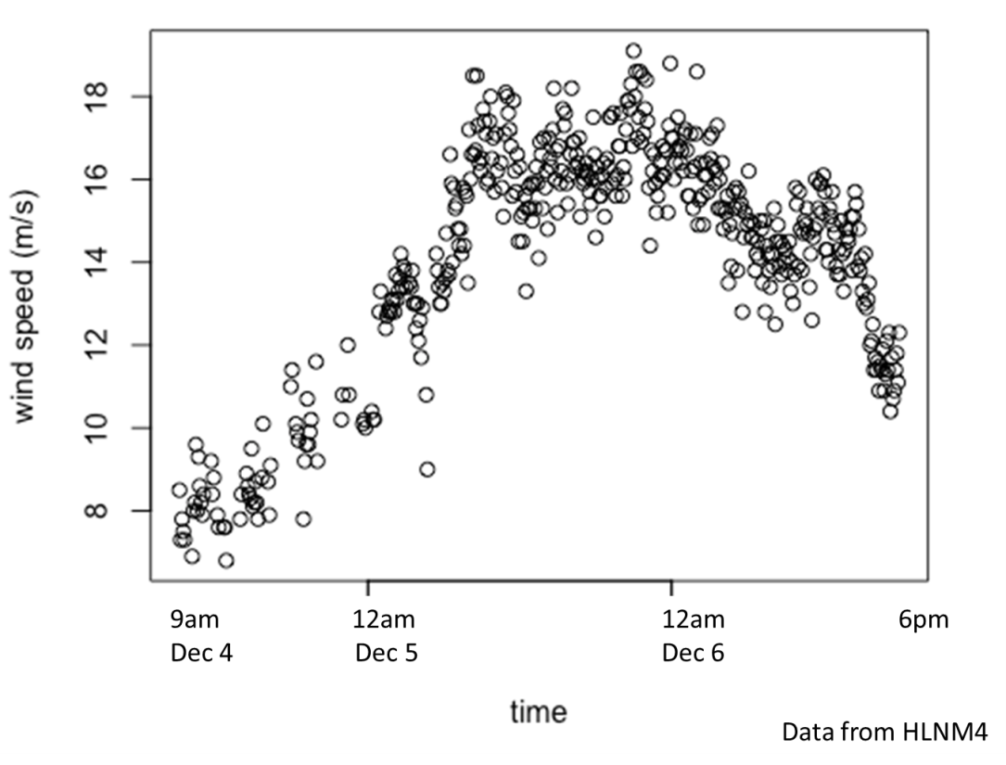
Storm data for Dec. 4–6, 2017
Wind direction
Wind speed
Fastest winds paralleled dune axis (≈250–70°)

Slide 24
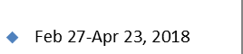
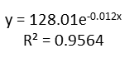
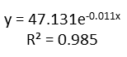

Slide 25
Conclusions
Grainfall can occur at least 215 m leeward of the base of large parabolic dunes
Deposition likely occurs along a front at least 30° to either side of the dune axis
Over a season, grainfall can deposit 9.3 kg/m² at 10 m from the lee slope and 1.4 kg/m² at 165 m

Slide 26
Conclusions
A single storm accounted for the majority of grainfall from late fall 2017 to fall 2018
A single storm can deposit at least 6.1 kg/m² of sand at 10 m beyond the lee slope and 0.95 kg/m² at 165 m
Grainfall was very low from March through August, 2018
An exponential model best fits the mass of grains transported relative to distance from the dune

Slide 27
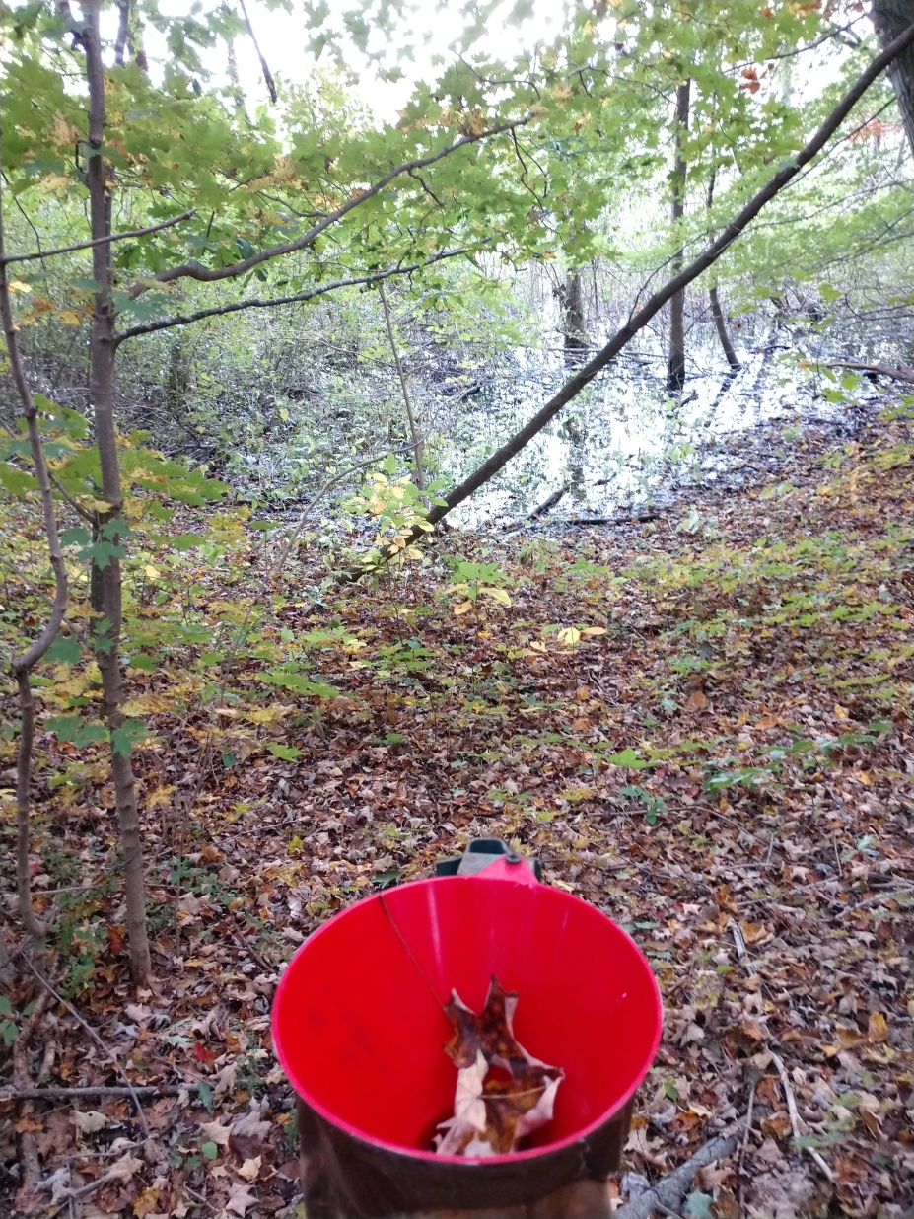
Conclusions
Grainfall can transport sand to wetlands behind current dunes, supporting the use of sand in lake and wetland cores as proxies for dune activity
Acknowledgements
Thank you for listening!

