Slide 1

Utilizing creative exercise assessment of a course-based undergraduate research experience to identify and correct students’ misconceptions and misunderstandings in an introductory mineralogy & petrology course
Jamie MacDonald¹, Jeff Ryan², Rosemary Hickey-Vargas³, Mary Beck⁴, Sven Holbik⁴, and, Scott Lewis²
1: Florida Gulf Coast University
2: University of South Florida
3: Florida International University
4: Valencia College

Slide 2
INTRODUCTION
Engaging students in undergraduate research is an effective strategy for increasing interest and retention in STEM, and inspires students to persist in STEM (Lopatto, 2010; Linn et al., 2015; Thiry et al., 2012; and others).
Incorporating advanced instrumentation into undergraduate research is an effective method towards providing students with an authentic research experience (Weaver et al., 2008).
In an effort to reach a larger and more diverse student audience there has been a recent trend towards the development of course-based undergraduate research experiences (CUREs) (Wei and Woodin, 2011; Corwin et al., 2015).
Need for more CURE assessment (Auchincloss et al., 2014).

Slide 3
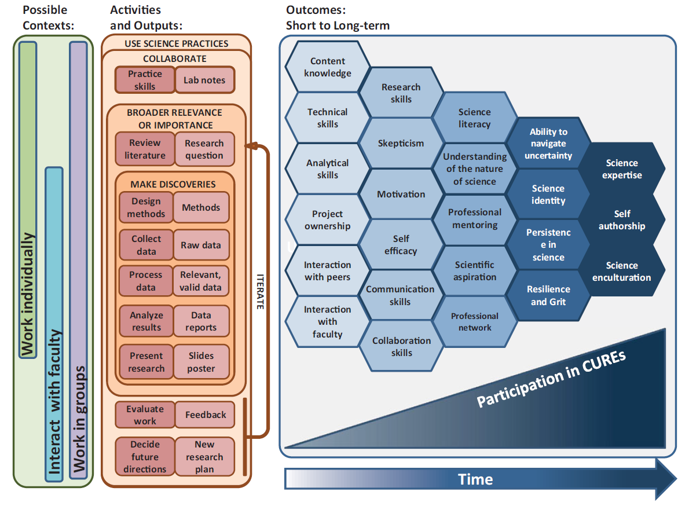
CURE logic model. From Auchincloss et al. (2014)

Slide 4
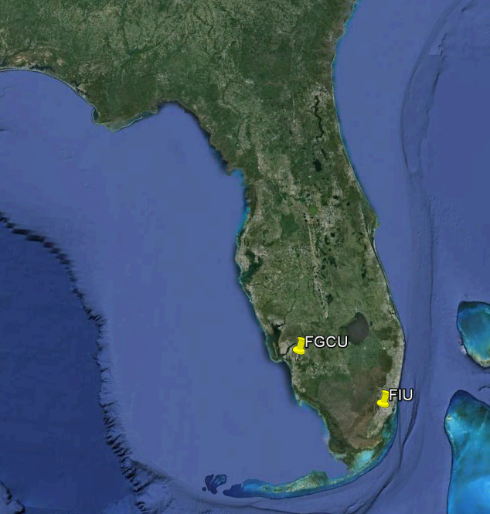
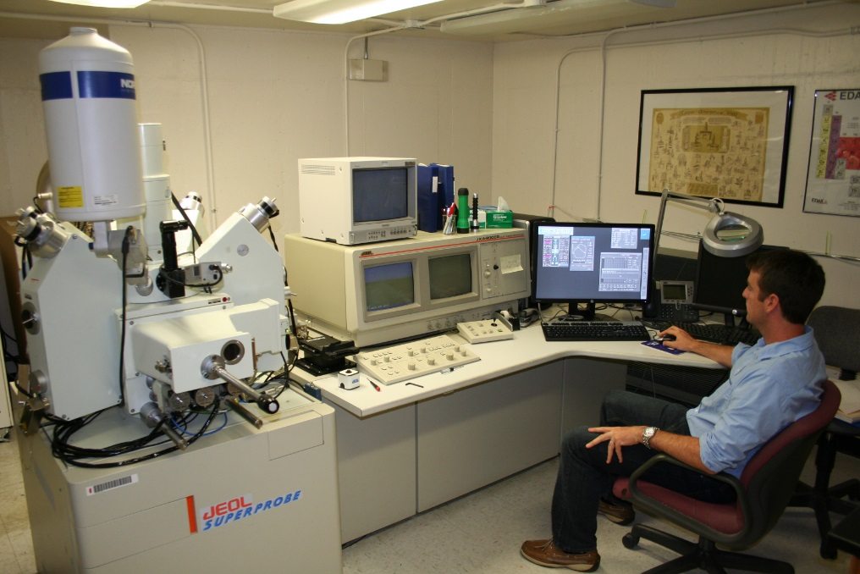
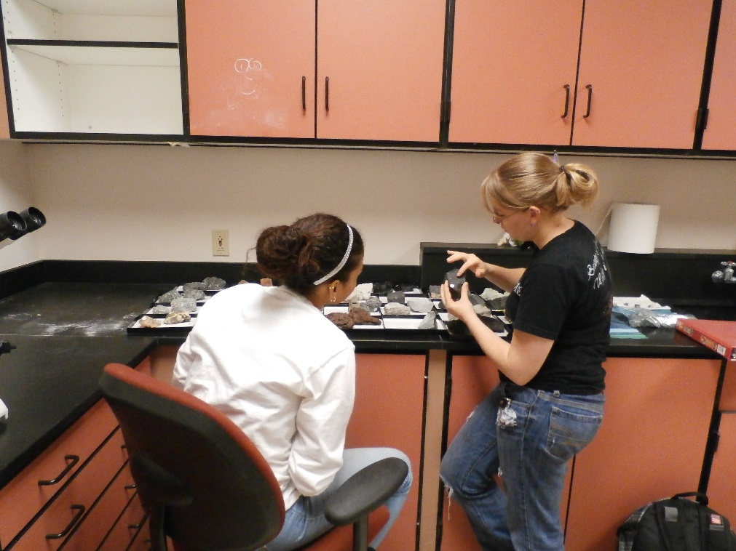
Electron Probe Micro-Analyzer (EPMA) at FIU
FGCU
FIU
Min-Pet class at FGCU
NSF TUES CURE in GLY 3202C, Mineralogy & Petrology.
FGCU students remotely used the EPMA at FIU to image and chemically analyze plagioclase feldspars.

Slide 5
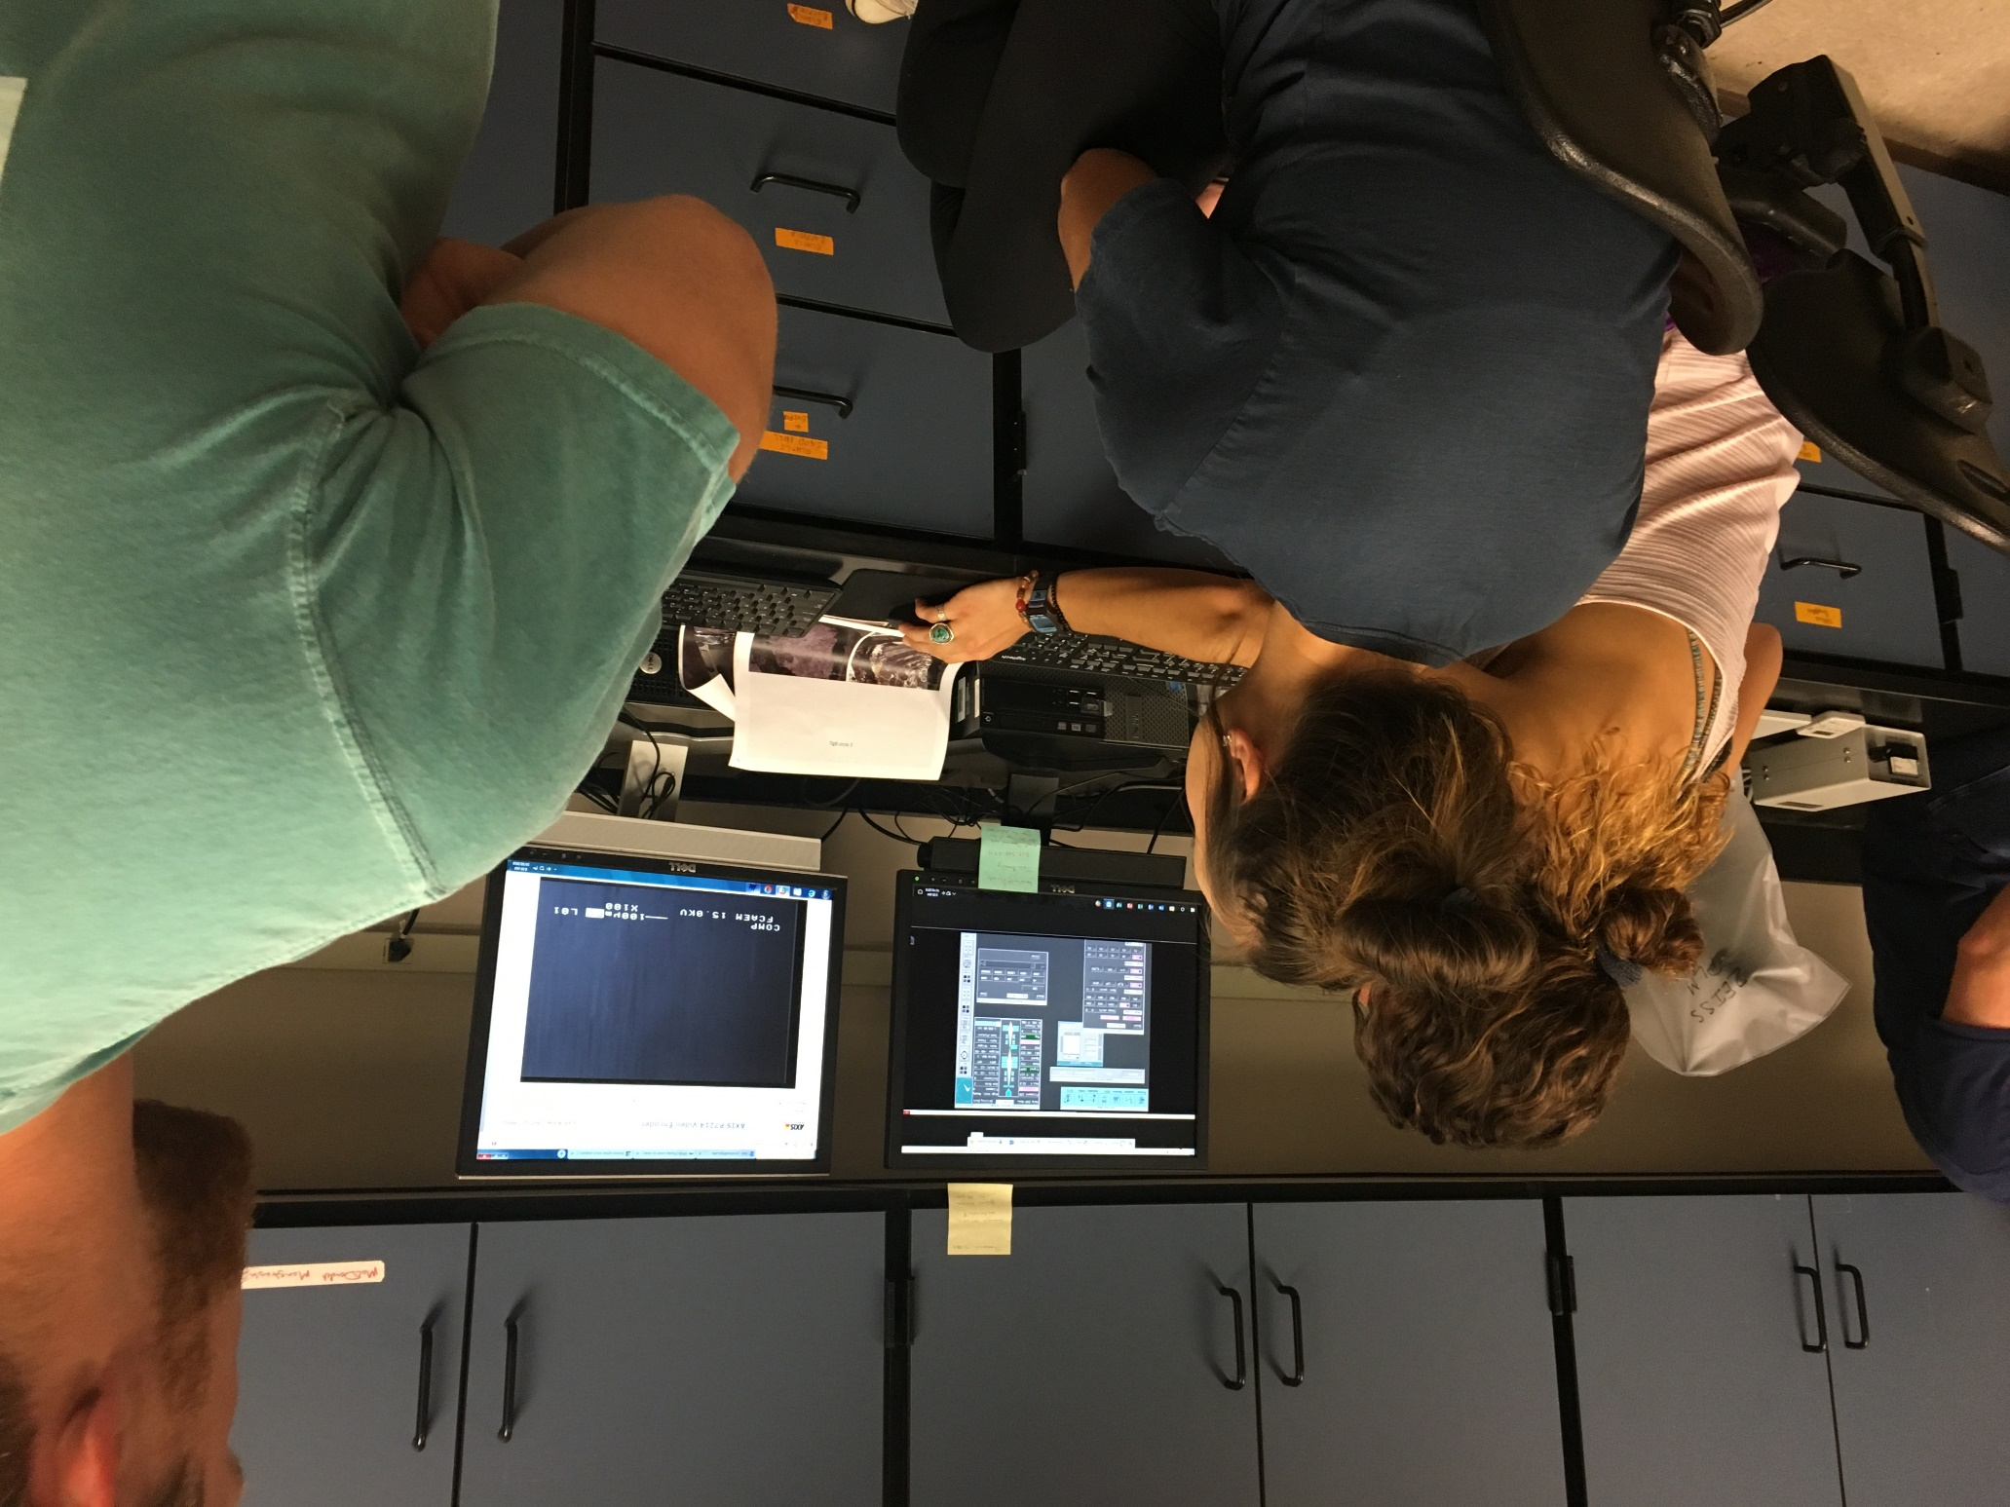
FGCU students operating the EPMA remotely as part of the CURE

Slide 6
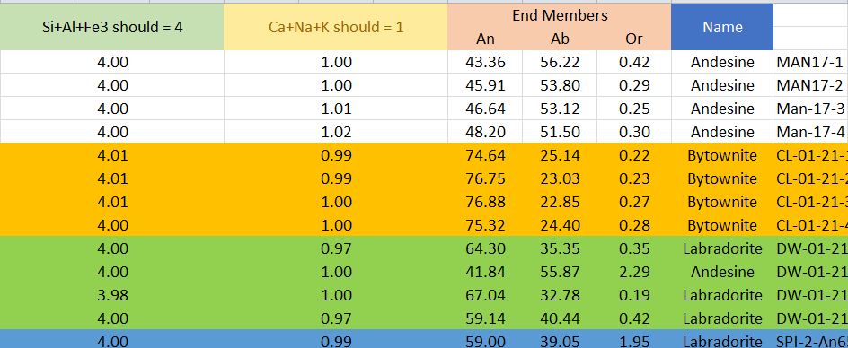
Finally, students could check to see if their formula units were correct and calculate their end members.
Andesine e.g. from sample MAN17-1:
Si⁴⁺ + Al³⁺ + Fe³⁺ = 4.00
Ca²⁺ + Na⁺ + K⁺ = 1.00
An_{43.36}; Ab_{56.22}; Or_{0.42}

Slide 7
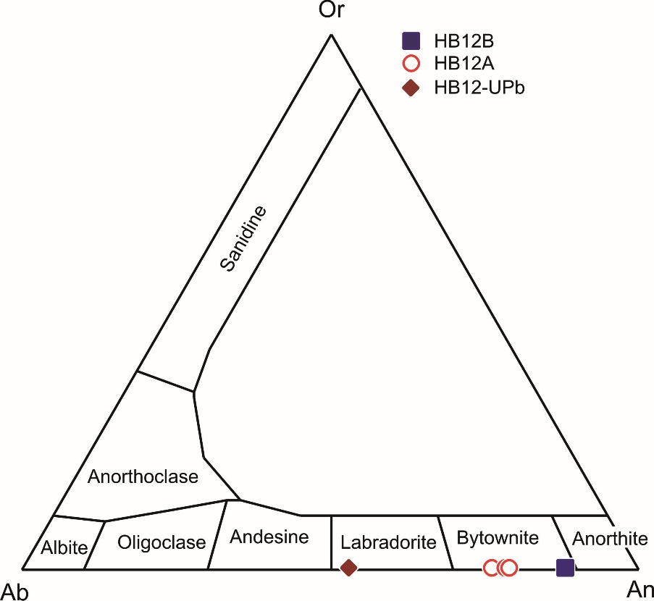
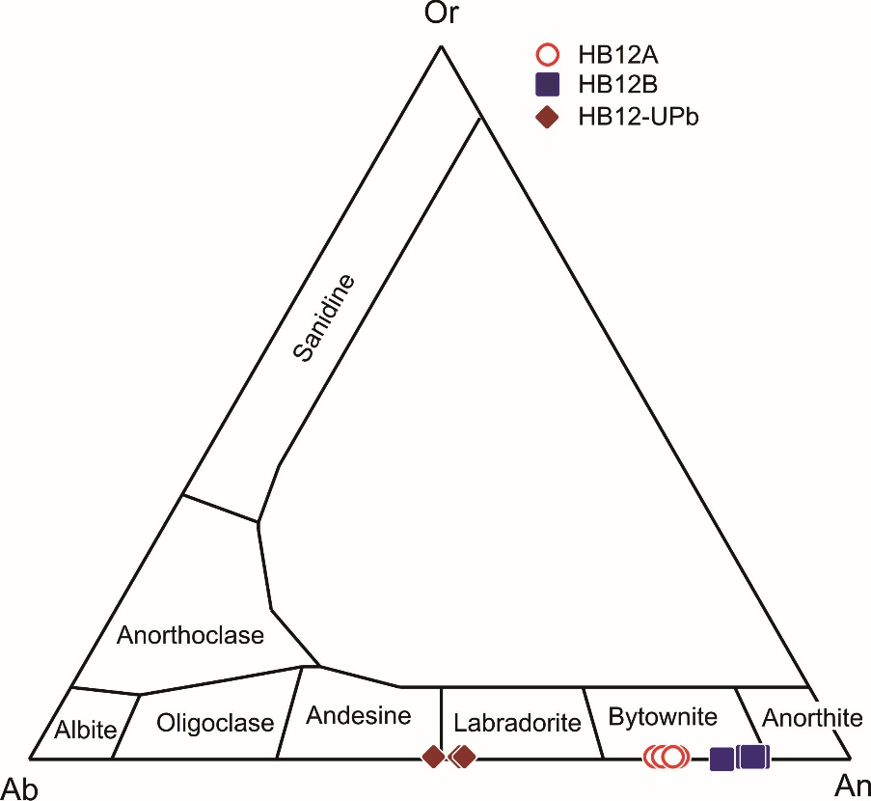
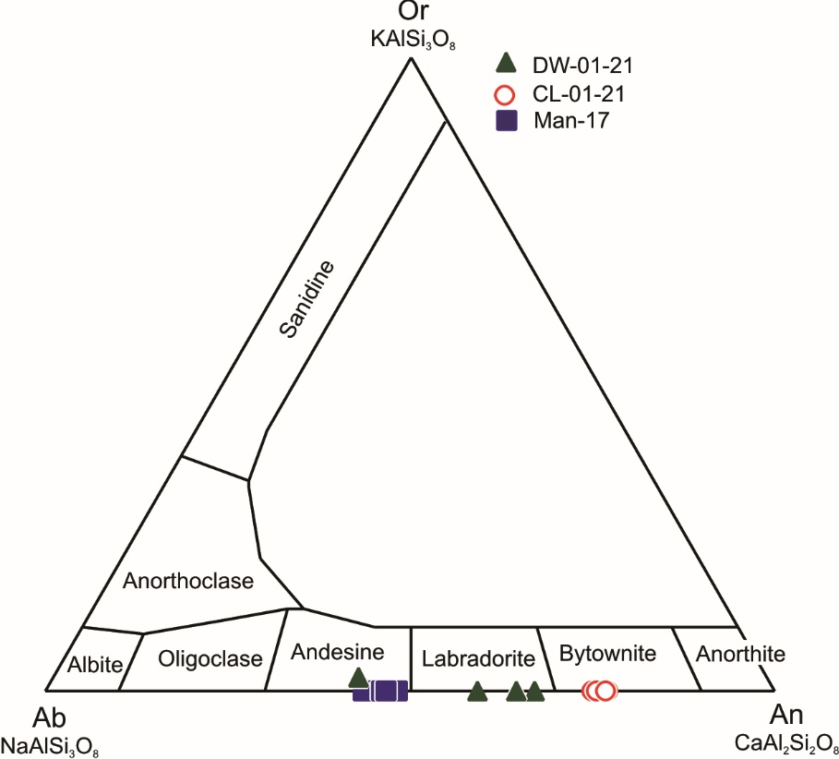
2014 Class Section
2015 Class Section
2016 Class Section
n = 12
n = 12
n = 13
37 plagioclase feldspars analyzed remotely via EPMA by FGCU students plotted on the feldspar composition triangle diagram.

Slide 8
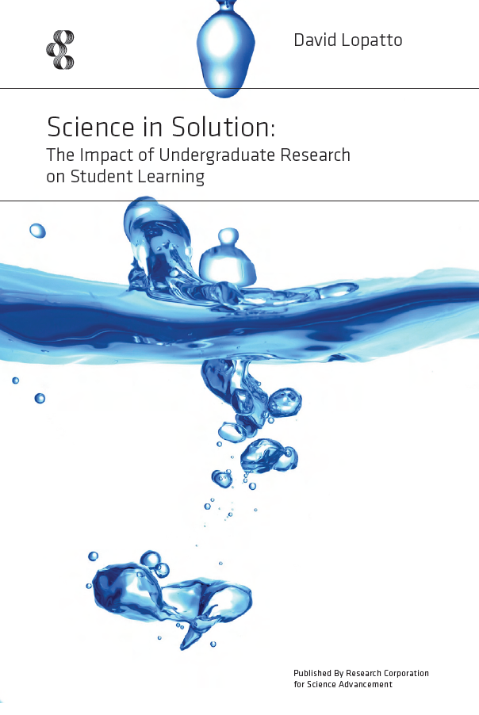
Benefits assessment
Modeled after the CURE survey of Lopatto (2010).
Benefits assessment survey given as part of the creative exercise post-test.
Usually given on the last day of class.

Slide 9
Benefits assessment of CUREs in Min-Pet course
Conducted over two years.
n = 36

Slide 10
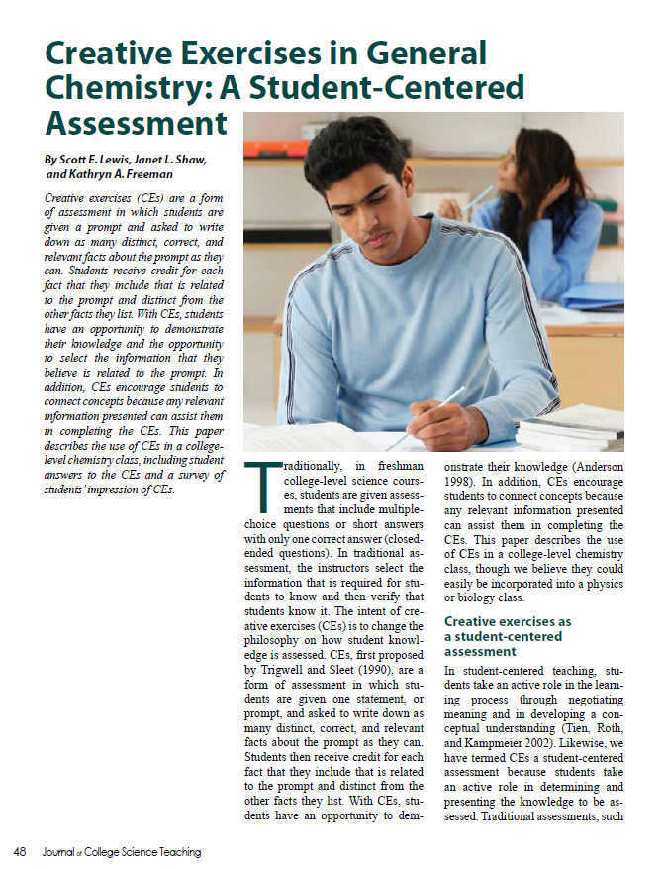
CURE Assessment
Utilized the creative exercises question methods of Lewis et al. (2010).
Creative exercise questions pre-test given early in the semester, usually first day of class.
Creative exercise questions post-test given late in the semester, usually last day of class

Slide 11
n = 50
Pre-test Average: 28/91 points (SD 7 points)
Post Test Average: 42/91 points (SD 11 points)
Average Pre- to Post-Test Gain: 14 points

Slide 12
Write down as many correct, distinct, and relevant facts you can about mafic magma. You will receive 2 points for each correct statement. Five statements will get you full credit. Only two of your answers can be related to where mafic magma is found at the Earth’s surface.

Slide 13
Write down as many correct, distinct, and relevant facts you can about mafic magma. You will receive 2 points for each correct statement. Five statements will get you full credit. Only two of your answers can be related to where mafic magma is found at the Earth’s surface.

Slide 14
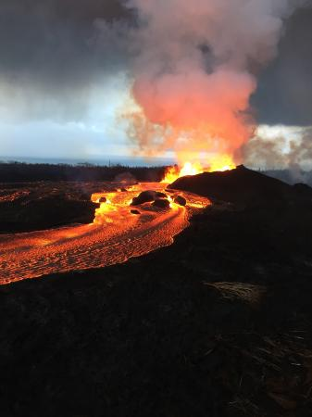
Students are commonly assigning mafic magma a dark color. Suggests students’ have confusion between the rocks and minerals created by the magma, and the magma itself.

Slide 15
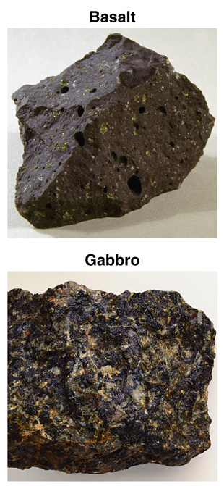
Students are never mentioning gabbro when answering question about mafic magma! Suggests poor connections between magma chamber, magmatic processes, and volcanic rocks/features.

Slide 16
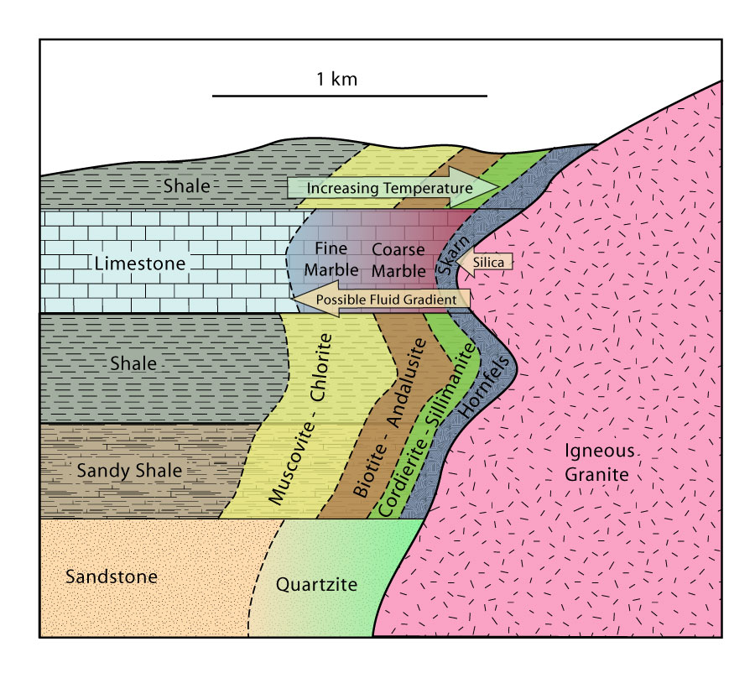
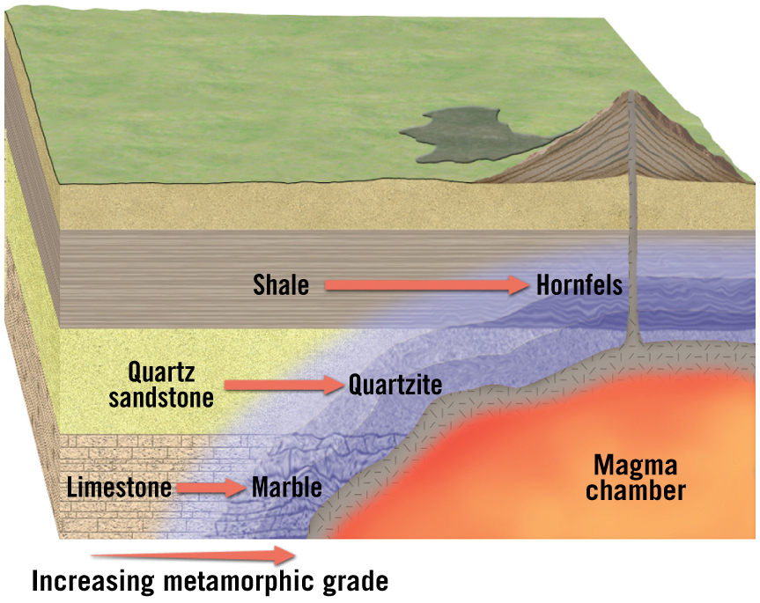
Assessment: Poor connection between mafic magma and metamorphism.
Students trying to make connections to contact metamorphism.
Winter, Igneous and Metamorphic petrology
Lutgens and Tarbuck (and Tasa)

Slide 17
Write down as many correct, distinct, and relevant facts you can about why volcanoes erupt. You will receive 2 points for each correct statement. Three statements will get you full credit.
“ “

Slide 18
Write down as many correct, distinct, and relevant facts you can about why volcanoes erupt. You will receive 2 points for each correct statement. Three statements will get you full credit.

Slide 19
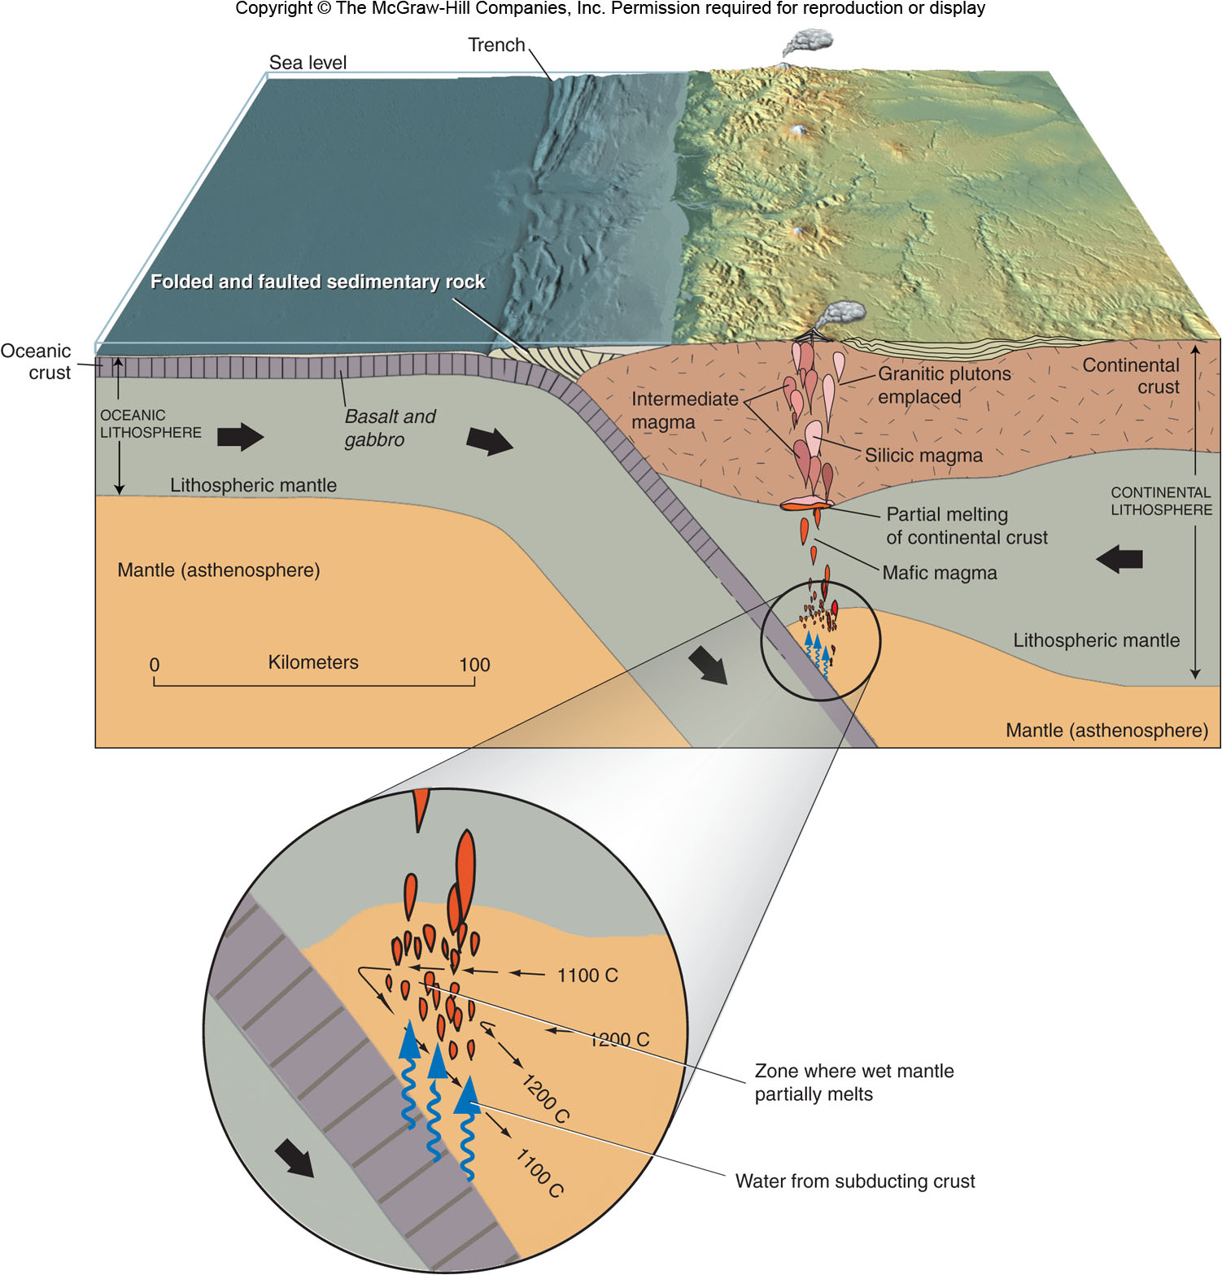
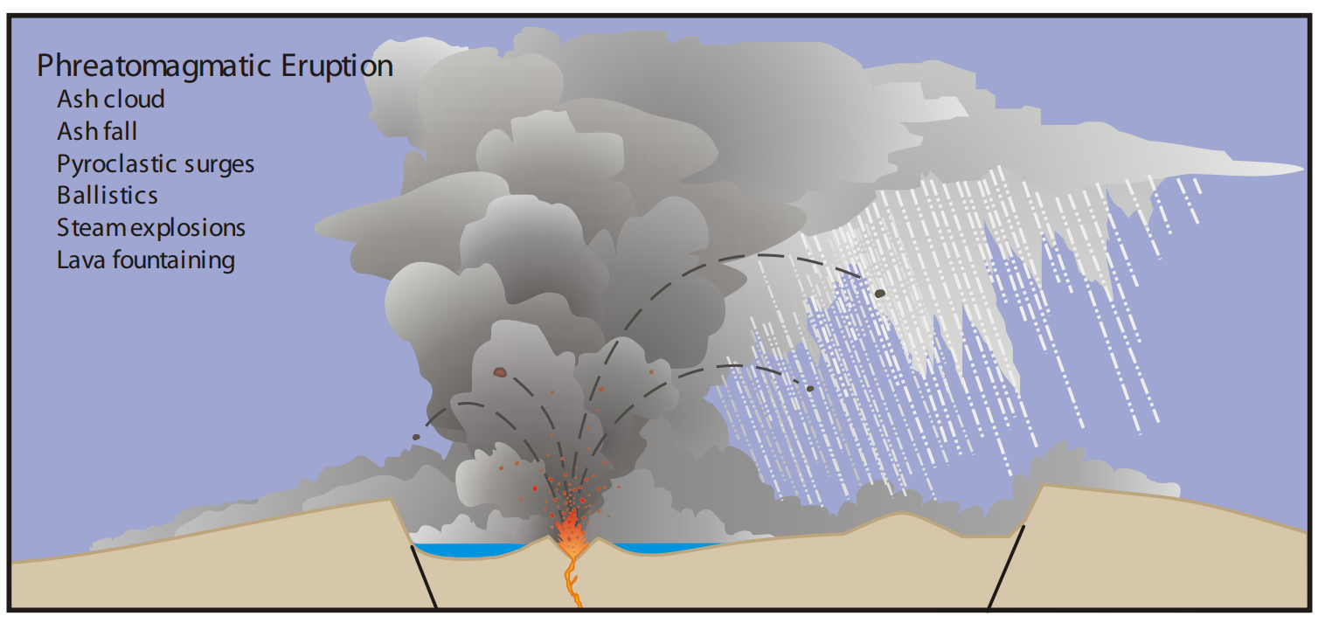
(Begét et al., 2005)
Students are mixing concepts.
Common misunderstanding between magma generation by the addition of volatiles to the mantle through subduction 150 km below surface and phreatomagmatic volcanic eruptions at the surface.

Slide 20
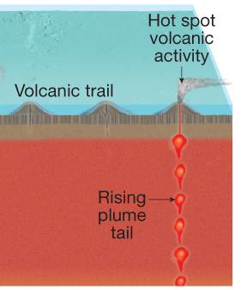
Students are not making the connection between the density and temperature differences of mafic magma vs. the mantle that forces the mafic magma to rise through the mantle.
Instead they are just saying “hotspot” or “plume”.
Also, commonly stating that movement of plates will cause a volcanic eruption.

Slide 21
CONCLUSIONS
Engaging students in undergraduate research is an effective strategy; however, assessment is critical to understanding all of the benefits of the CURE.
Students are commonly assigning mafic magma the attributes of the rocks and minerals it produces.
Students are not making meaningful connections between magmatic processes and their volcanic products – focusing on the volcanic products.
The physical scale of magmatic/volcanic processes may not be adequately conveyed to the students. Confusing/mixing large-scale features with local, smaller-scale features.

