Slide 1
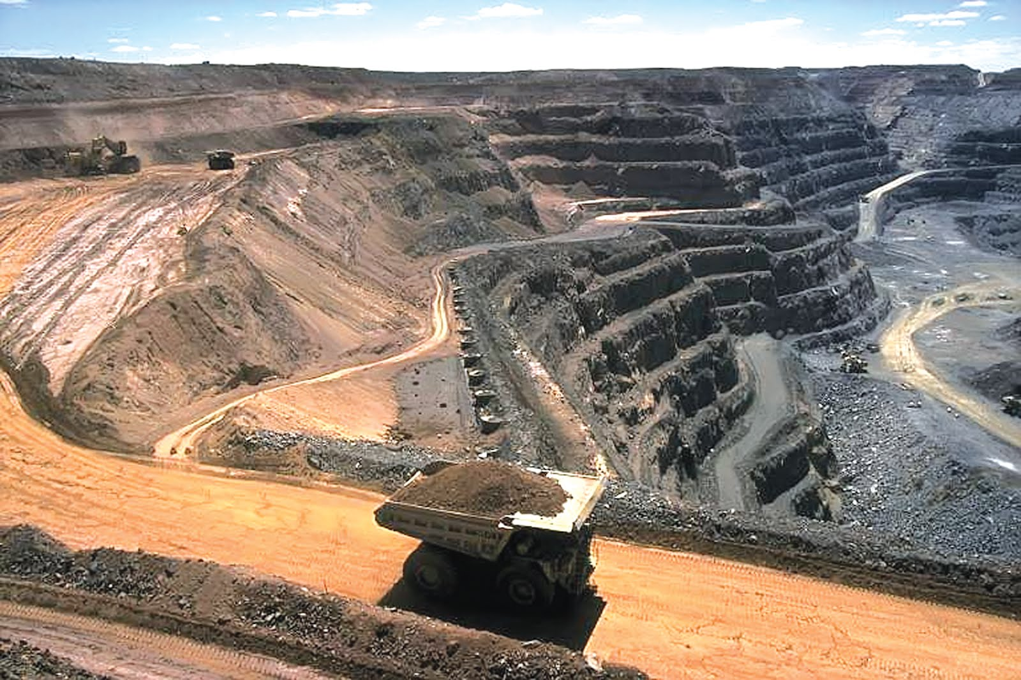
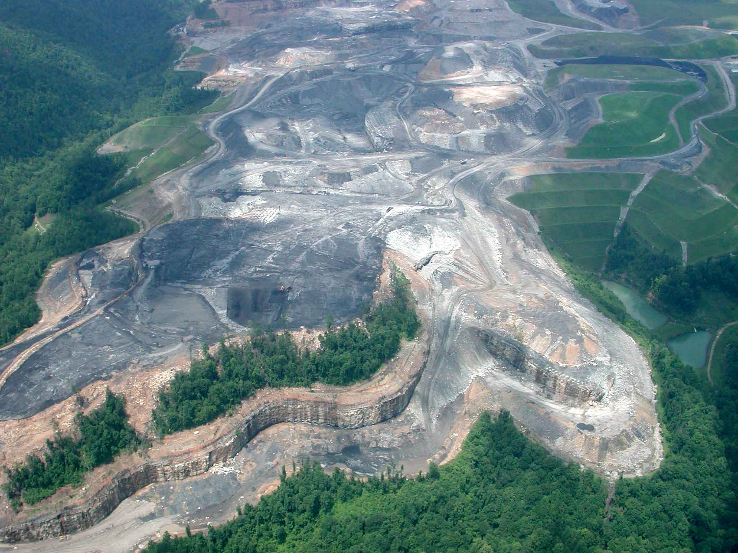
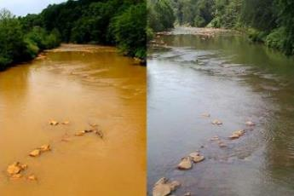
Water Quality Predicting Model in Coal-Mine Impacted Watersheds in Eastern Kentucky
Oguz Sariyildiz, Buddhi Gyawali, George Antonious, Ken Semmens, Demetrio Zourarakis
GSA 2018
Kentucky State University

Slide 2


Outline
Introduction
Research Problem, Objectives
Methodology
Results & Discussion
Conclusion & Limitations
Acknowledgements & References

Slide 3
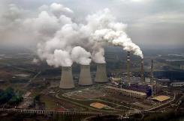

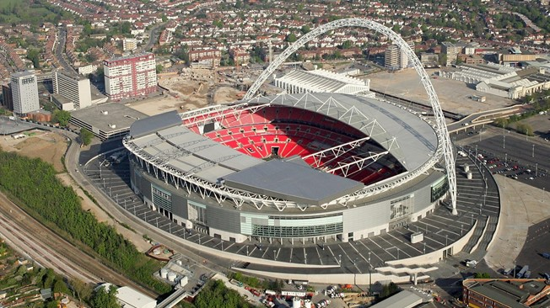
Introduction
Coal is the most important energy resource in Kentucky
Kentucky, the fourth-largest coal mining state, produced more than 39 million tons of bituminous coal in 2016 (EIA, 2017)
87% of Kentucky's net electricity generation was produced by coal (EIA, 2016).
About 162 million tons of coal produced in 1990 (EIA, 2016) at its peak level which is equivalent of 100,000 times volume of Wembley Soccer Stadium.
Tennesee Valley Authority
Caranddriver.com
FIFA.com

Slide 4
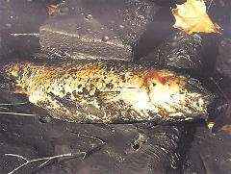
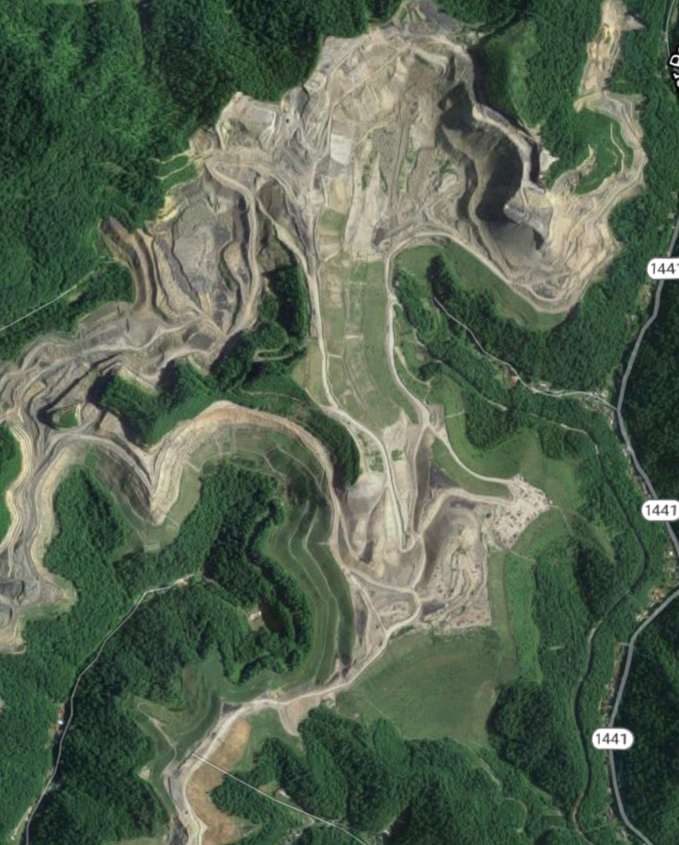
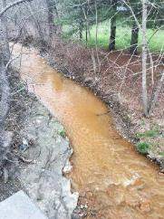
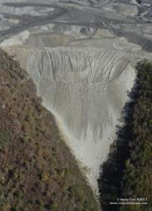
How Coal Mining Affects Environment
Negative influence on local ecologies, stream habitat
Negative impact on hydrology of a watershed
Changes in pH, higher conductivity, and elevated dissolved ions
Valley fills
Forest loss

Slide 5
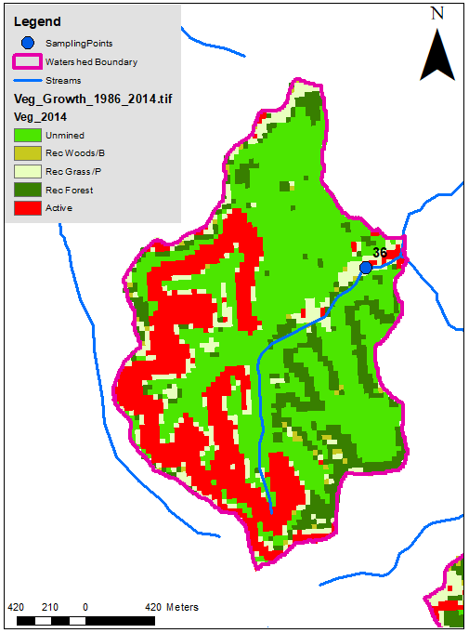
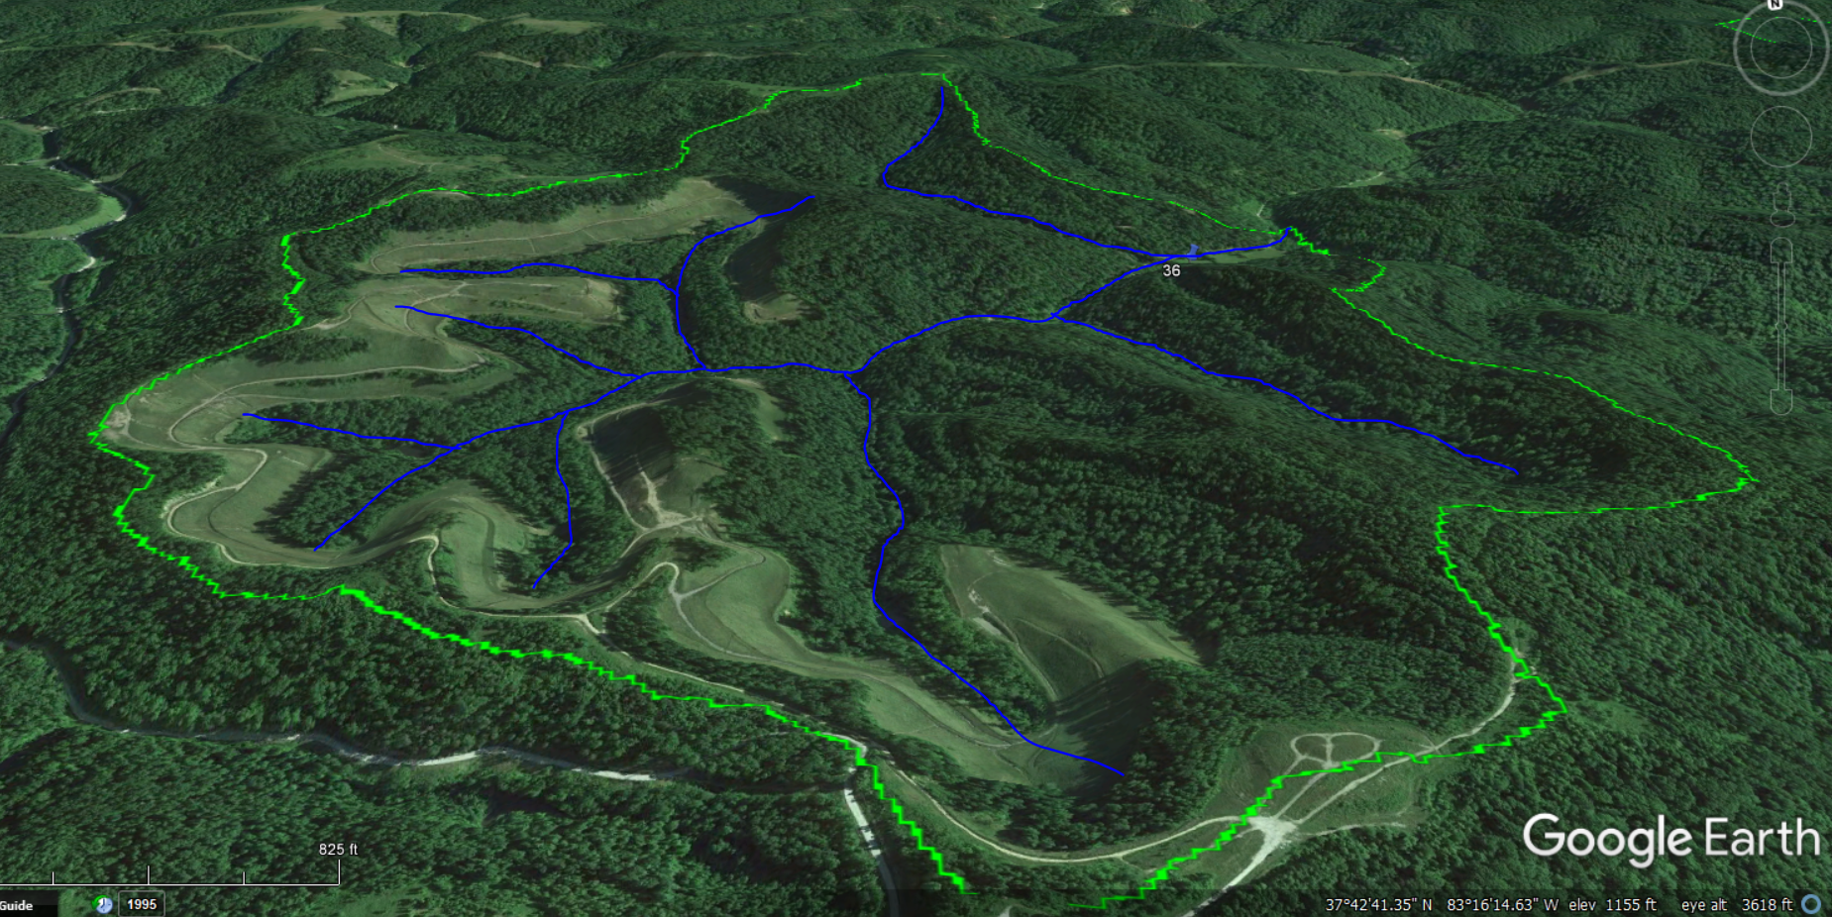
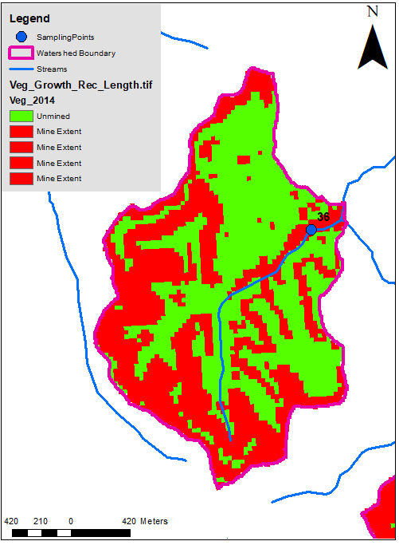
Research Problem
Adjusted Mining Percentage
Mining percentage is inversely related to local ecology health and water quality,
  However, some of the reclaimed lands turn to reclaimed forest after several years of reclamation.
Influence of reclaimed forests to water quality has not been studied.
Cumulative Mining Percentage
Exit Point
Mined (%) | Mined-RF (%) | Rec. Age
40 | 28 | 16 year

Slide 6
Objectives
Identify the correlation between mined areas, reclamation age, and water quality parameters in watersheds mined between 1986-2017;
Investigate the effects of reclaimed forest and reclaimed woods to CMRWQ in watersheds;

Slide 7
Methodology
Defining Research Area
NDVI Maps and Vegetation Classification (Barren, Grass, Rec. Woods, Rec. Forest, Unmined)
Water Sampling
Mining Percentage (%)
Vegetation Cover Change (%)
Reclamation Age (years)
Conductivity, Alkalinity, pH, SO₄, Mg, Ca, Al, Fe, Mn
Correlation Analyses
Mining Percentage (%) – Water Quality Parameters
Vegetation Cover Change (%) – Water Quality Parameters
Reclamation Age (years) – Reclaimed Forest Percentage
Regression Model

Slide 8
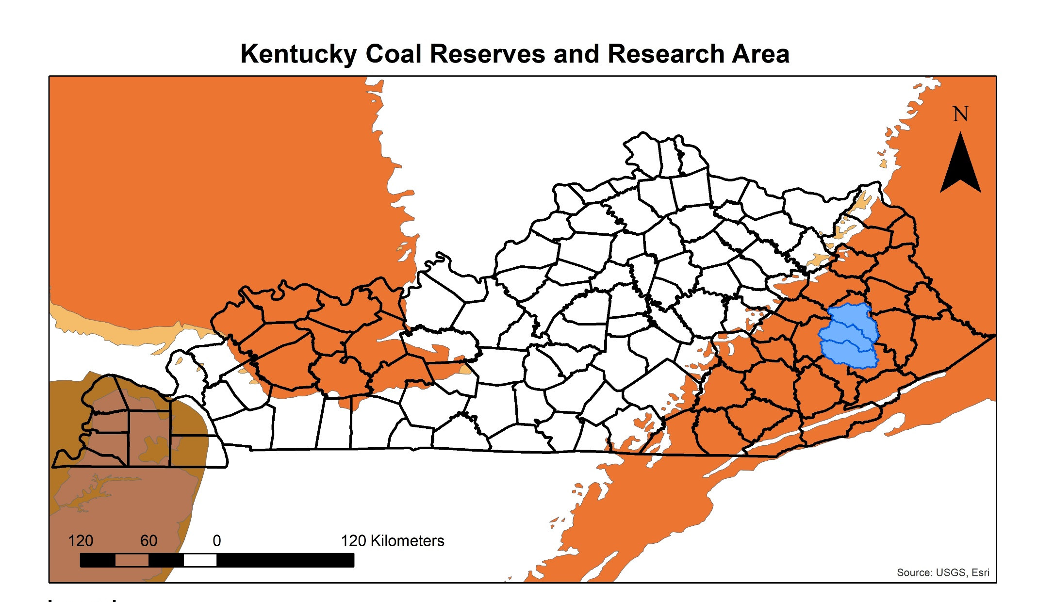
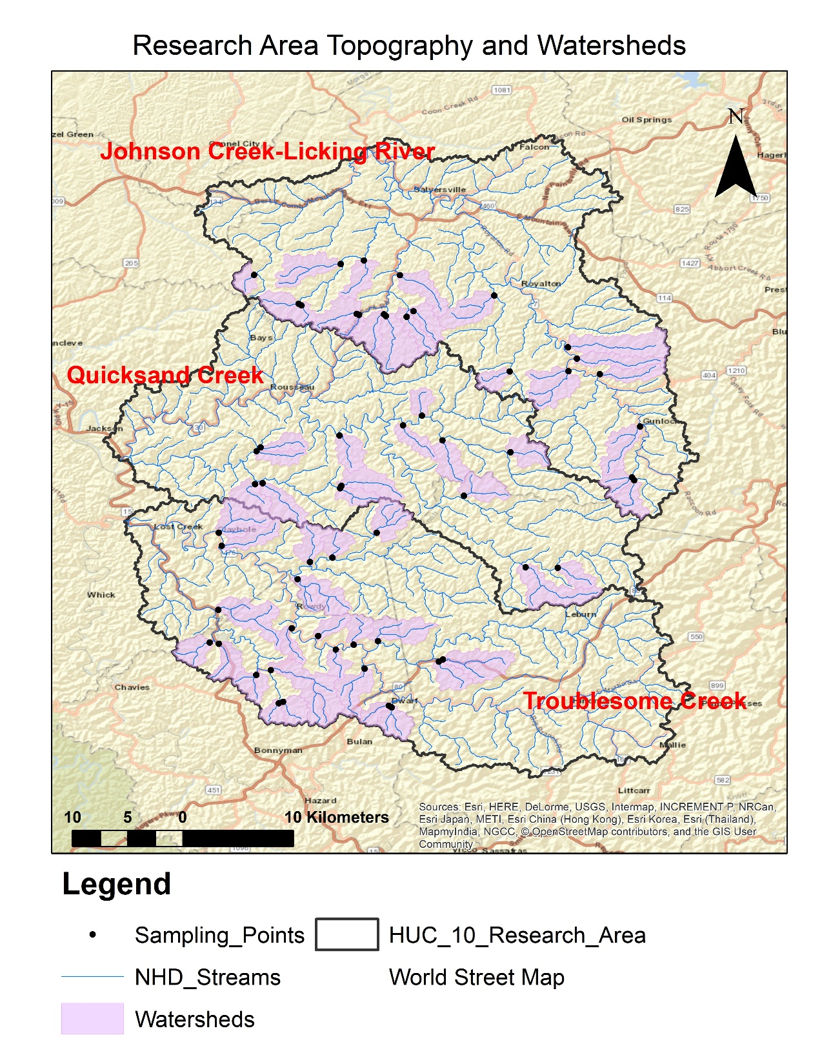
Research Area and Kentucky Coal Reserve Map
Research Area Characteristics
Developed= 5%, Agriculture= 1.5%, Grass/Pasture=15.5%, Forest/Woods=76%, Barren=3.5% (2011 NLCD)
1768 km² (683 sq-mi)
Minimal underground mining (KDMP)
Variety in mining extent and reclamation age (Landsat 5,7,8)

Slide 9
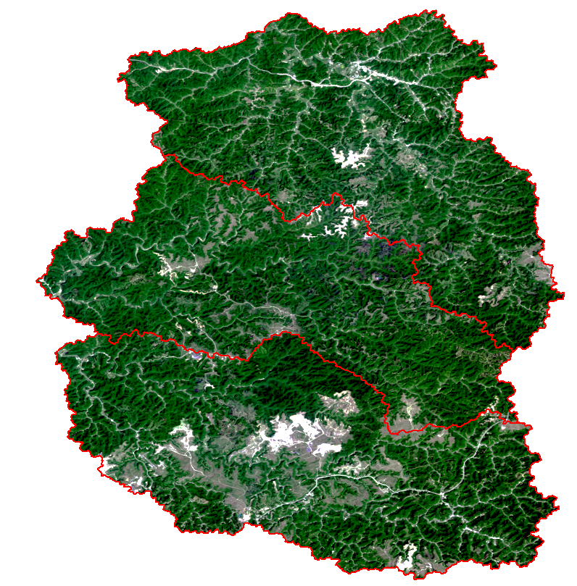
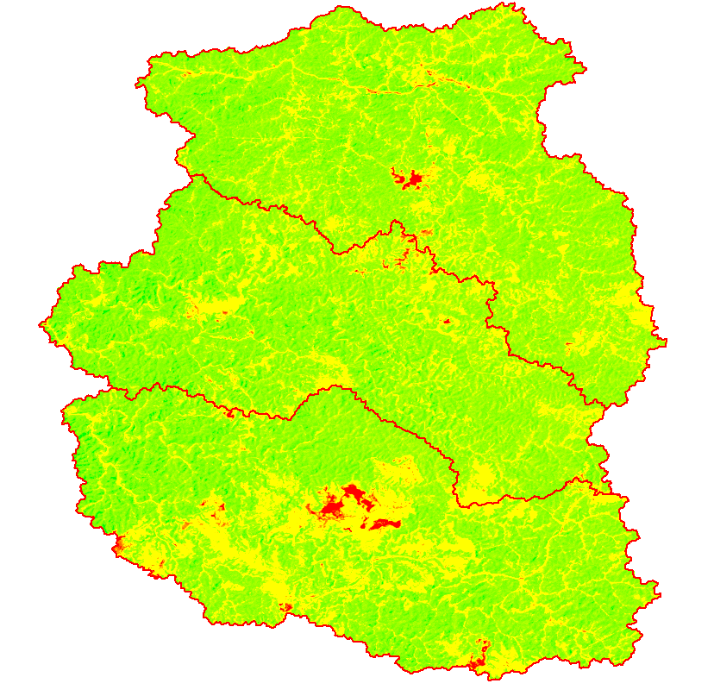
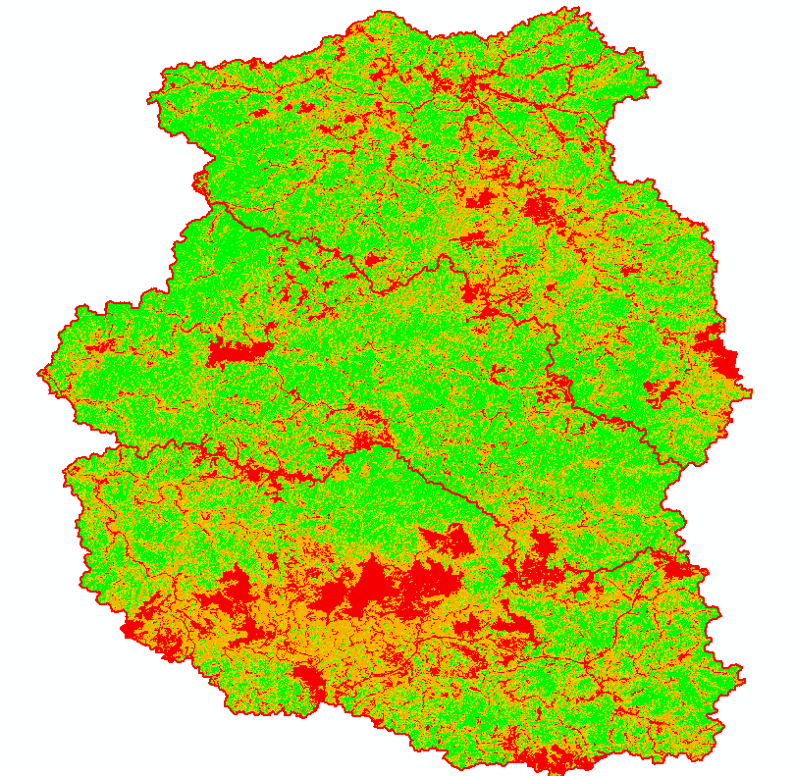

Vegetation Cover Change Analysis
Landsat
1986, 1990, 1994, 1999, 2002, 2006, 2010, 2014 and 2017
RGB, NIR
NDVI
1986, 1990, 1994, 1999, 2002, 2006, 2010, 2014 and 2017
Reclassification
1986, 1990, 1994, 1999, 2002, 2006, 2010, 2014 and 2017
Barren, Grass, Woods, Forest
Earth Explorer | Image Analysis | Reclassify tool | Raster Calculator | Cell Statistics | Con Tool | Zonal Histogram | Table to Excel | SPSS

Slide 10
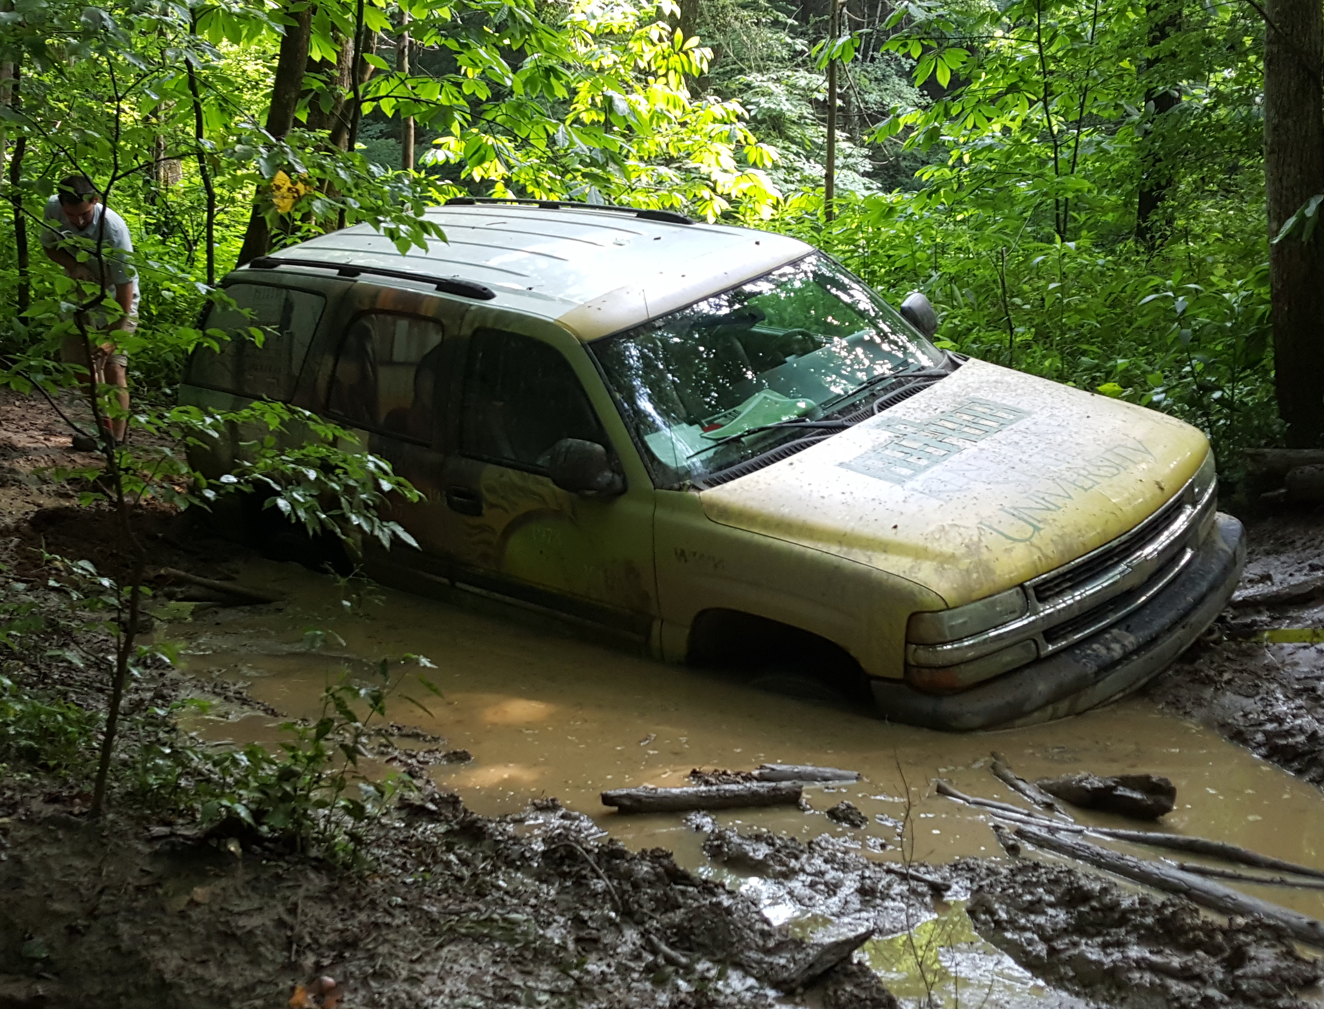
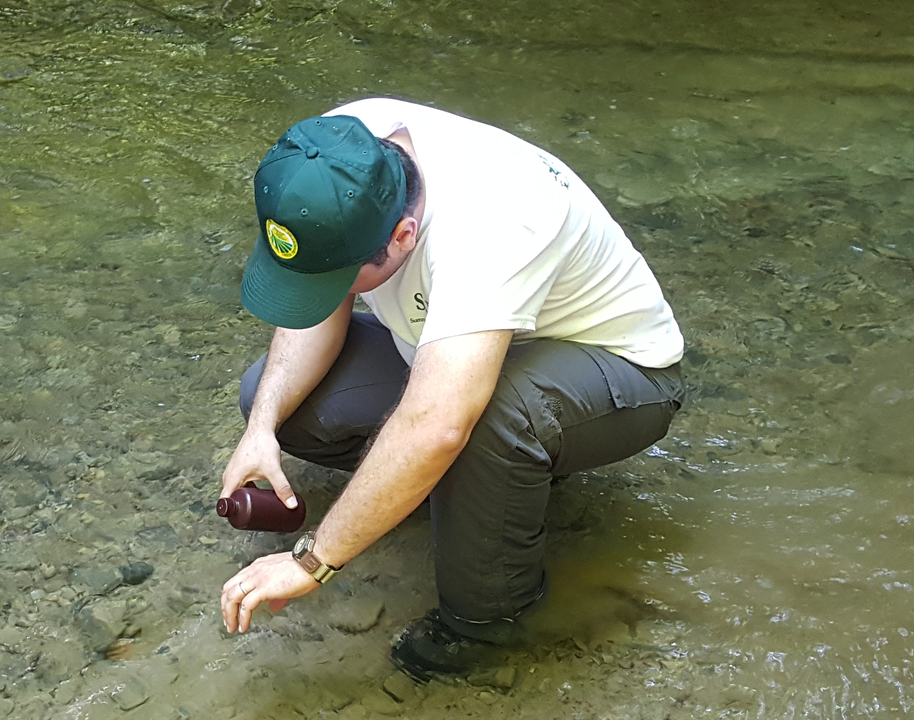
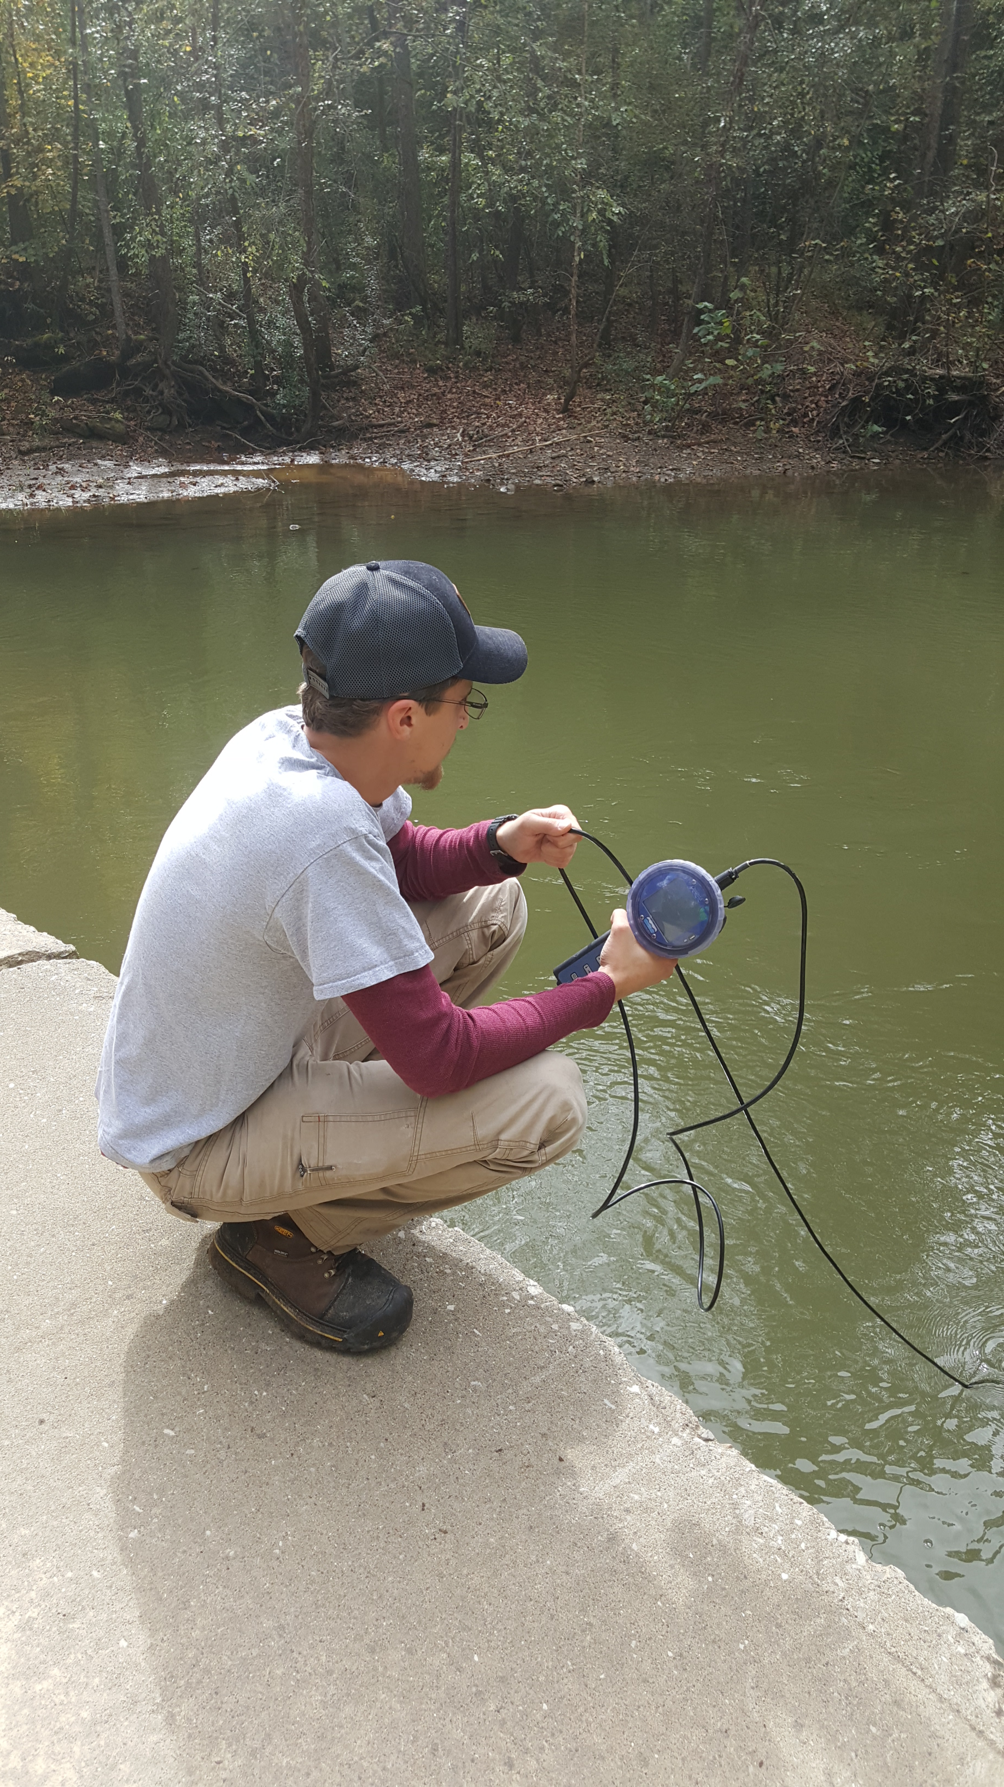
Water Quality Analysis
NHD 100k stream shapefile
HUC10 basin polygons
Stream reach watershed polygons
Sampling and measurement
May 15 Field study (n=9)
Jul 21 Field study (n=15)
Oct 21 Field study (n=58)
Laboratory analysis
Laboratory analysis
In situ measurements
Dependent variables
Dependent variables
Dependent variable
SO₄²⁻, alkalinity, conductivity, Ca²⁺, Mg²⁺, Mn, Al, and Fe
SO₄²⁻, alkalinity, conductivity, Ca²⁺, Mg²⁺, Mn, Al, and Fe
Conductivity

Slide 11
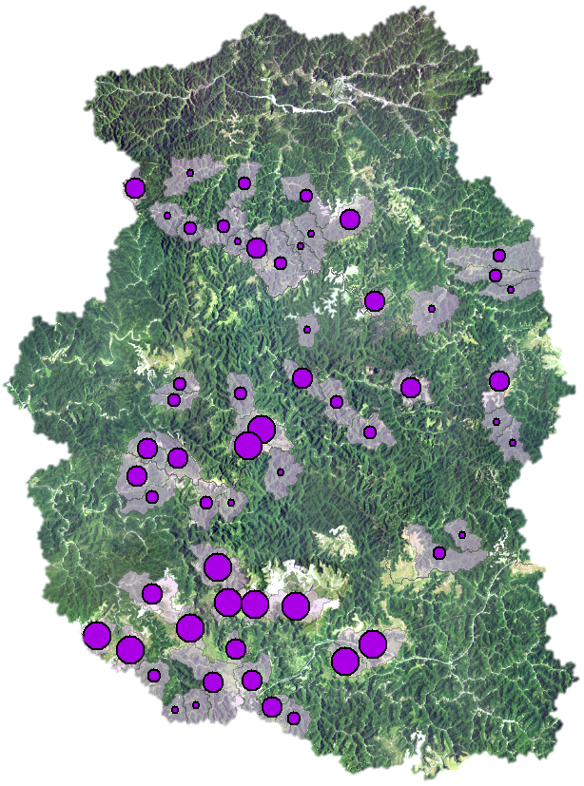
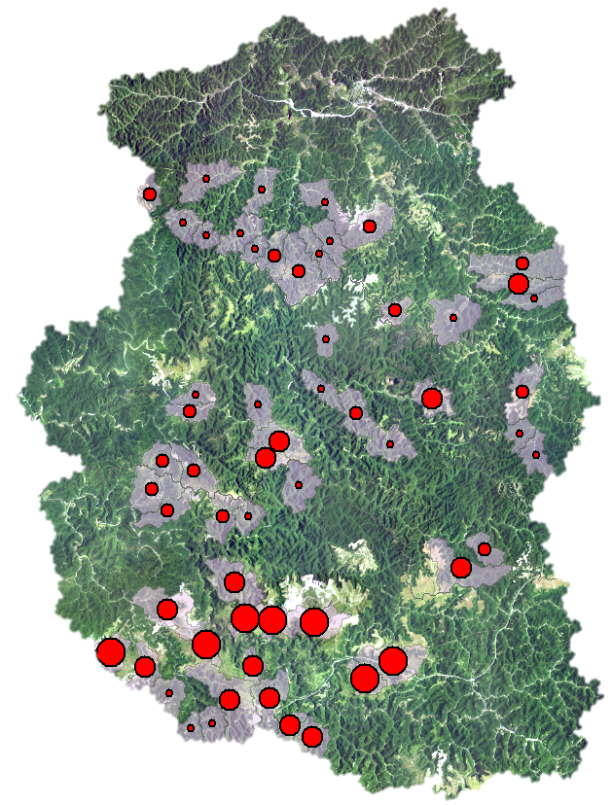
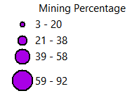
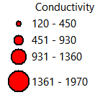
Mining (%) vs Conductivity (uS/cm)
R= 0.86; P<0.01
N=58, October 21

Slide 12
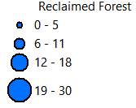
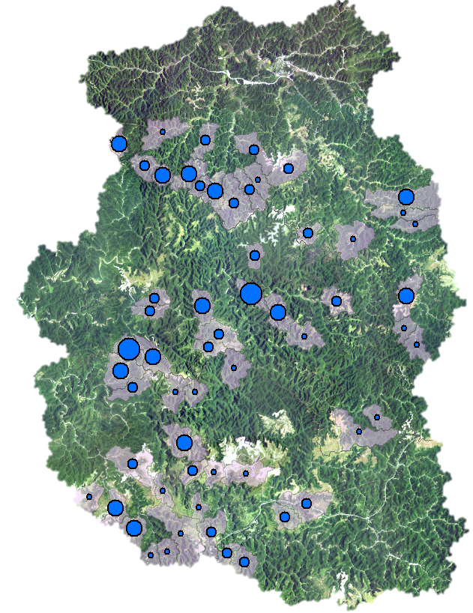
Reclaimed Forest (%) vs Conductivity (uS/cm)
R= -0.07; P> 0.05
N=58, October 21

Slide 13
Mining-RF (%) vs Conductivity (uS/cm)
R= 0.90; P<0.01
N=58, October 21

Slide 14
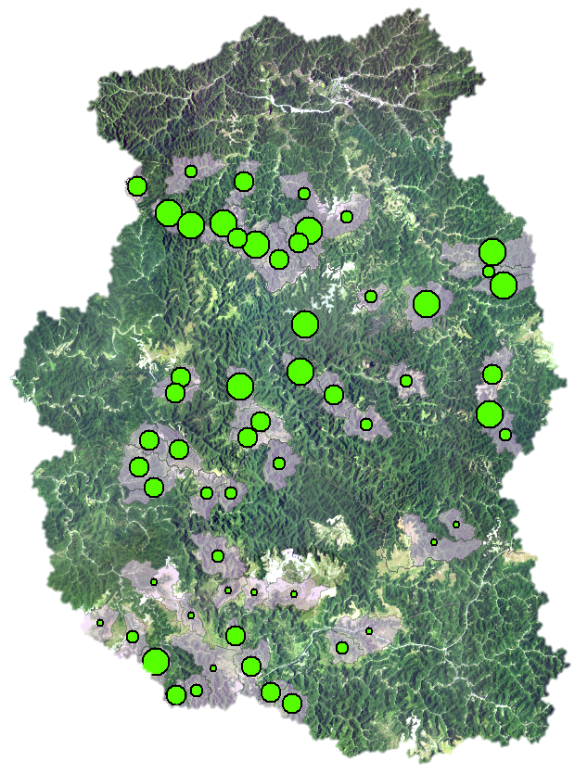
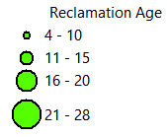
Reclamation Age vs Conductivity (uS/cm)
R= -0.67; P<0.01
N=58, October 21

Slide 15
Pearson Correlation Matrix (May 15, 2017 n=9)
 | Mined (%) | Mined w/o RF (%) | Reclaimed Forest (%) | Reclaimed Woods (%) | Reclamation Age (Years) | Alkalinity (mg/L) | Conductivity (uS/cm) | SO₄²⁻ (mg/L) | Ca²⁺ (mg/L) | Mg²⁺ (mg/L)
Mined (%) | 1 | .980** | .886** | .920** | .255 | .751* | .761* | .749* | .776* | .791*
Mined w/o RF (%) | .980** | 1 | .775* | .940** | .155 | .785* | .794* | .775* | .797* | .837**
Reclaimed Forest (%) | .886** | .775* | 1 | .726* | .443 | .553 | .563 | .568 | .601 | .558
Reclaimed Woods (%) | .920** | .940** | .726* | 1 | .338 | .907** | .884** | .843** | .903** | .914**
Reclamation Age (Years) | .255 | .155 | .443 | .338 | 1 | .241 | .158 | .182 | .218 | .159
Alkalinity (mg/L) | .751* | .785* | .553 | .907** | .241 | 1 | .985** | .897** | .993** | .962**
Conductivity (uS/cm) | .761* | .794* | .563 | .884** | .158 | .985** | 1 | .933** | .987** | .969**
SO₄²⁻ (mg/L) | .749* | .775* | .568 | .843** | .182 | .897** | .933** | 1 | .921** | .964**
Ca²⁺ (mg/L) | .776* | .797* | .601 | .903** | .218 | .993** | .987** | .921** | 1 | .974**
Mg²⁺ (mg/L) | .791* | .837** | .558 | .914** | .159 | .962** | .969** | .964** | .974** | 1
**. Correlation is significant at the 0.01 level (2-tailed).
*. Correlation is significant at the 0.05 level (2-tailed).

Slide 16
Pearson Correlation Matrix (July 21, 2017 n=15)
 | Mined (%) | Mined w/o RF (%) | Reclaimed Forest (%) | Reclaimed Woods (%) | Reclamation Age (Years) | Alkalinity (mg/L) | Conductivity (uS/cm) | SO₄²⁻ (mg/L) | Ca²⁺ (mg/L) | Mg²⁺ (mg/L)
Mined (%) | 1 | .956** | .280 | .780** | -.407 | .457* | .790** | .777** | .795** | .754**
Mined w/o RF (%) | .956** | 1 | -.013 | .705** | -.626** | .581** | .899** | .891** | .904** | .879**
Reclaimed Forest (%) | .280 | -.013 | 1 | .352 | .665** | -.344 | -.251 | -.269 | -.249 | -.308
Reclaimed Woods (%) | .780** | .705** | .352 | 1 | -.240 | .287 | .550** | .467* | .486* | .474*
Reclamation Age (Years) | -.407 | -.626** | .665** | -.240 | 1 | -.478* | -.702** | -.712** | -.702** | -.715**
Alkalinity (mg/L) | .457* | .581** | -.344 | .287 | -.478* | 1 | .693** | .640** | .679** | .723**
Conductivity (uS/cm) | .790** | .899** | -.251 | .550** | -.702** | .693** | 1 | .983** | .990** | .988**
SO₄²⁻ (mg/L) | .777** | .891** | -.269 | .467* | -.712** | .640** | .983** | 1 | .994** | .991**
Ca²⁺ (mg/L) | .795** | .904** | -.249 | .486* | -.702** | .679** | .990** | .994** | 1 | .988**
Mg²⁺ (mg/L) | .754** | .879** | -.308 | .474* | -.715** | .723** | .988** | .991** | .988** | 1
**. Correlation is significant at the 0.01 level (2-tailed).
*. Correlation is significant at the 0.05 level (2-tailed).

Slide 17
 | Pearson Correlation Matrix (Oct 11, 2017 n=58)
 | Mined (%) | Reclaimed Forest (%) | Reclaimed Woods (%) | Reclamation Age (year) | Conductivity (uS/cm) | Log Mined | Mined w/o RF (%)
Mined (%) | 1 | 0.223 | .831** | -.496** | .863** | .908** | .965**
Reclaimed Forest (%) | .223 | 1 | .246 | .500** | -0.072 | .451** | -.032
Reclaimed Woods (%) | .831** | .246 | 1 | -.329* | .720** | .796** | .799**
Reclamation Age (year) | -.496** | .500** | -.329* | 1 | -.672** | .294* | .636**
Conductivity (uS/cm) | .863** | -.072 | .720** | -.672** | 1 | .726* | .904**
Log Mined | .908** | .451** | .796** | .294* | .726** | 1 | .823**
Mined w/o RF (%) | .965** | -.032 | .799** | .636** | .904** | .823** | 1
**. Correlation is significant at the 0.01 level (2-tailed).
*. Correlation is significant at the 0.05 level (2-tailed).

Slide 18
Descriptive Statistics
 | Minimum | Mean | Maximum
Mined (%) | 2.52 | 38.09 | 92.23
Reclaimed Forest (%) | 0.42 | 8.21 | 30.41
Reclaimed Woods (%) | 1.27 | 17.42 | 44.01
Reclamation Age (year) | 4.12 | 15.99 | 27.95
Mined w/o RF (%) | 2.10 | 29.88 | 90.92
Conductivity (uS/cm) | 120.00 | 763.10 | 1970.00
Only 21% of mined area on average was converted to reclaimed forest between 1986 to 2017.
Conductivity >300 uS/cm affects aquatic environment negatively (Bernhardt et al. 2011; Griffith et al. 2012). 72% of the watersheds had conductivity >300 uS/cm
Conductivity >500 uS/cm indicates ecological impairment and decreases biological diversity (Agouridis et al. 2012; Pond et al. 2008). 55% of watersheds had conductivity >500 uS/cm.

Slide 19
Effects of mined and reclamation age parameters on conductivity
Hypothesis: No significant correlation between mining percentage, reclamation age, and water quality parameters in watersheds mined between 1986 to 2017
Regression Model A Summary –Conductivity Prediction
Step | R | R² | R² _{adj} | Δ R₂
Mining Percentage | .863ª | .745 | .741 | .745
Reclamation Age | .908^{b} | .825 | .818 | 0.08
Coefficients for Final Model
 | B | β | p
(Constant) | 610.732 |  | <.001
Mining Percentage | 16.956 | .703 | <.001
Reclamation Age (year) | -30.860 | -.324 | <.001
Other studies reported conductivity was best predicted with mining percentage (Hopkins et 2013; Merriam et al 2015; Bernhardt et al. 2012)
  None of these studies reported a correlation between reclamation age and conductivity.
In this study, reclamation age was a significant contributor in conductivity prediction

Slide 20
Effects of vegetation cover change on conductivity
Hypothesis: Reclaimed forest or reclaimed woods do not affect CMRWQ in watersheds
Regression Model B Summary – Conductivity Prediction
Step | R | R² | R² _{adj} | Δ R₂
Mined w/o RF (%) | .904 | .816 | .813 | .816
Reclamation Age (years) | .912 | .832 | .826 | .016
Coefficients for Final Model
Model | B | β | p
(Constant) | 429.20 |  | <.006
Mined w/o RF (%) | 19.54 | .799 | <.001
Reclamation Age (years) | -15.64 | -.164 | <.026
Removing the reclaimed forested areas suggests that reclaimed forest has a positive effect on conductivity mitigation (Wei et al. 2011).
This model indicated that the model improved slightly on the prediction of conductivity.

Slide 21
Conclusion
Conductivity was highly associated with other coal mine water quality parameters (alkalinity, SO₄²⁻, Ca²⁺, Mg⁺²) except Al, Fe.
Mining percentage (1986-2017) inversely related with water quality.
There was a moderate but significant correlation between reclamation age and water quality.
Accounting vegetation cover change (reclaimed forest areas) improved the conductivity prediction.

Slide 22
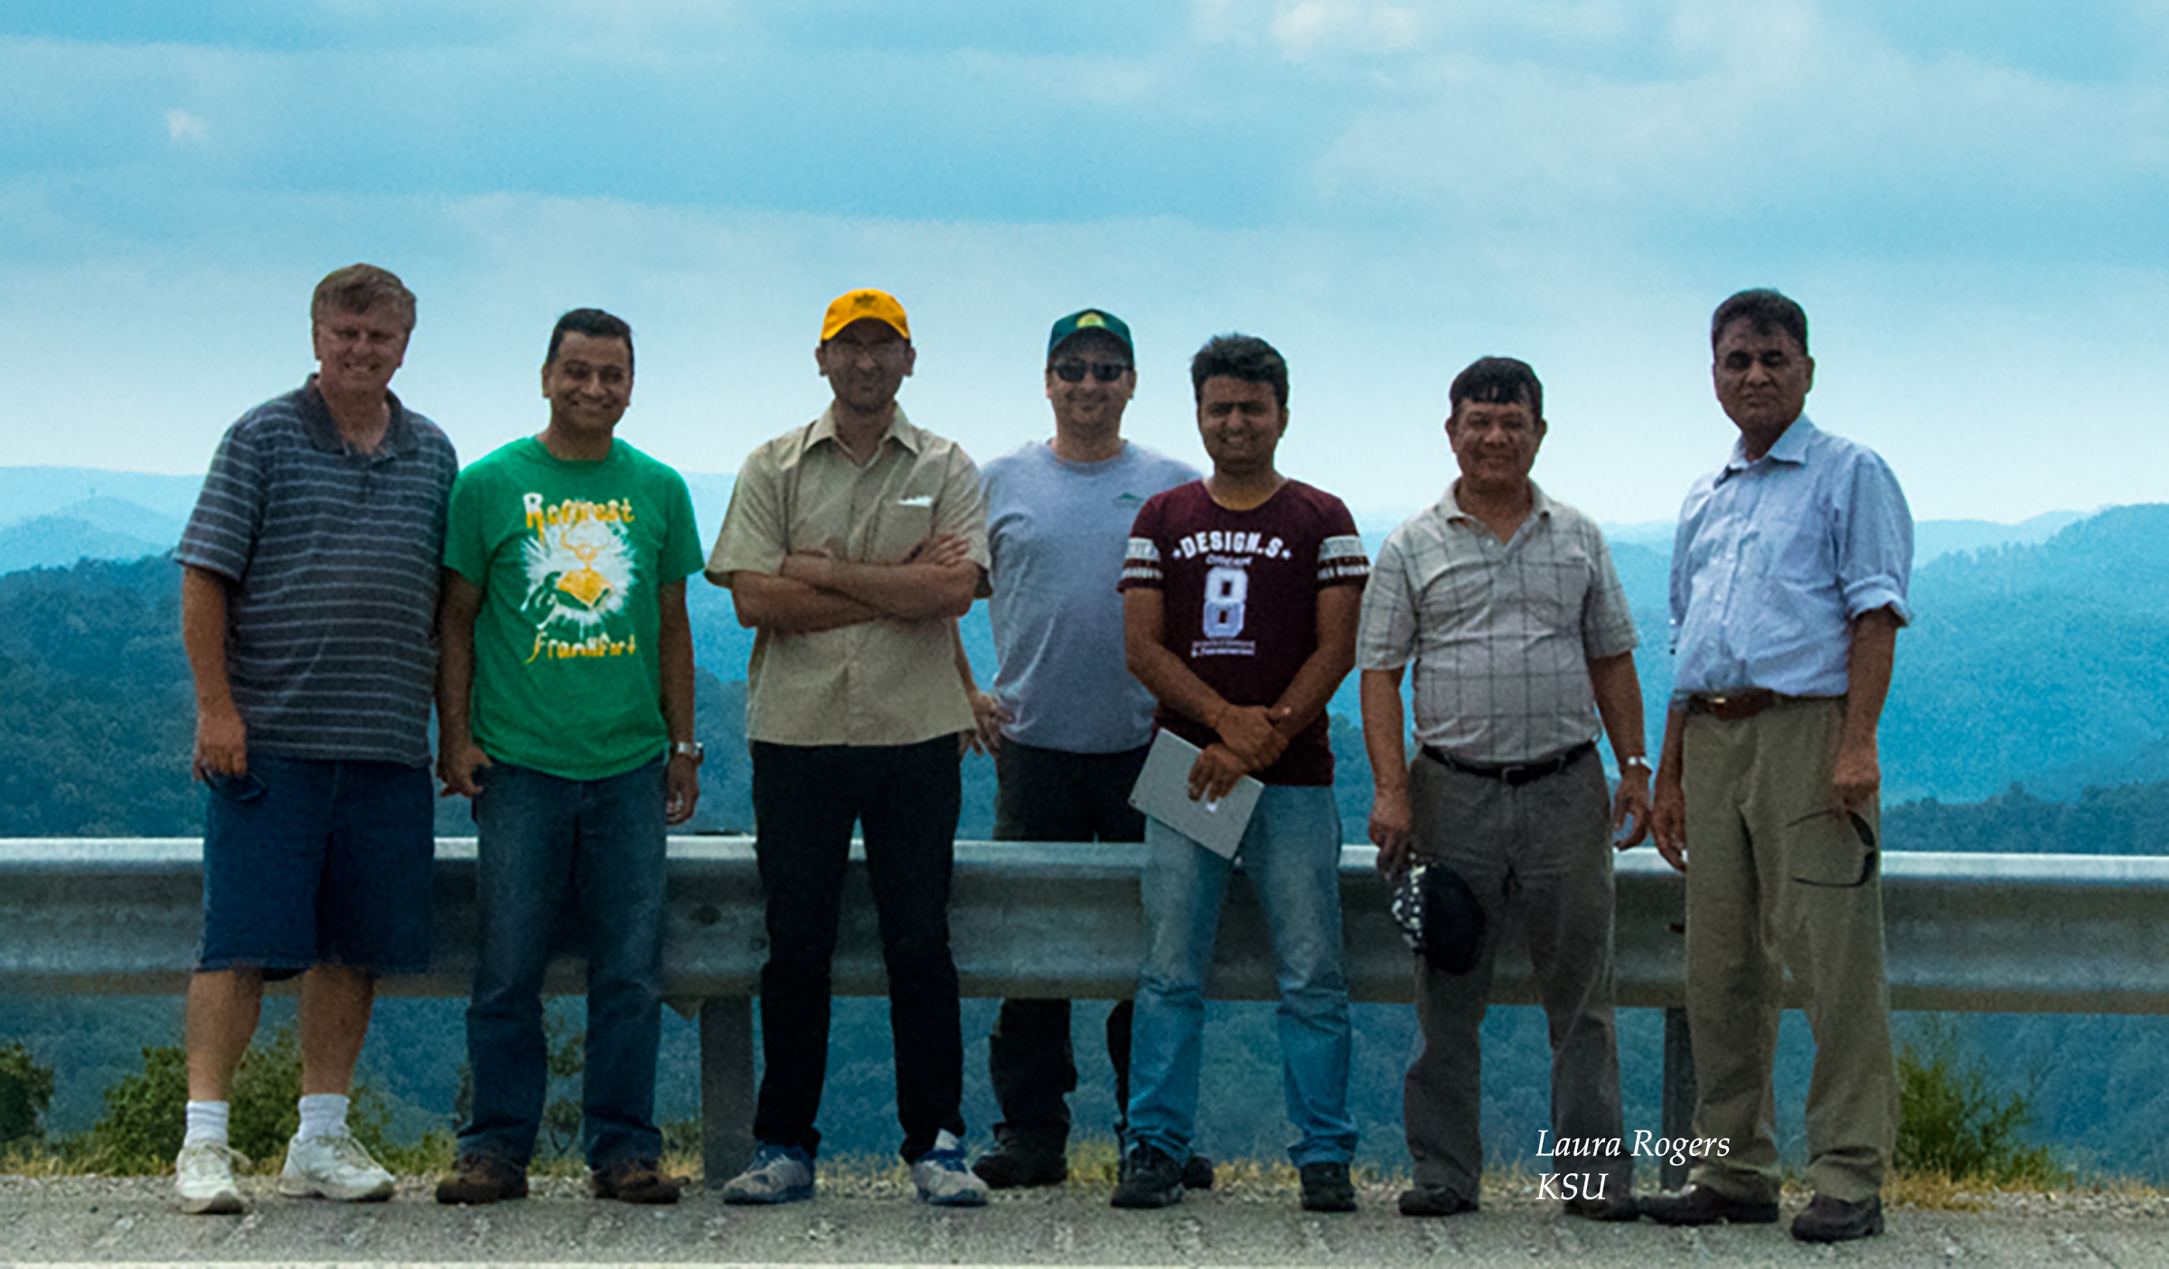


Acknowledgments & Thanks
This research is funded by USDA / NIFA “Enhancing Research-and-Extension Capability by Studying Land Cover Change, Quality of Life, and Microclimate Variation in Kentucky.” Award Number: 2014-38821-22398, Kentucky State University (PI Dr. Buddhi Gyawali).
This research was funded by USDA Forest Service McIntire Stennis grant- Geospatial Characterization of Kentucky Forests for Agroforestry and Bioenergy Production” 2013-2017, Grant Number 210165 (PI Dr. Kirk Pomper).
Dr. Buddhi Gyawali, Dr. George Antonious, Dr. Ken Semmens, Dr. Demetrio Zourarakis
Jeremy Sandifer, Ken Bates and Dr. Tilak Shresta, Laura Rogers, Ralph Rogers
Marty Matisoff and Dr. Christina McManus
Jarod Jones, Gabriel Stone and Sujan Bhattarai
Dr. Carmen Agouridis, Chris Osborne and University of Kentucky Robinson Forest
Kentucky State University College of Agriculture, Food Science and Sustainable Systems.

Slide 23
Key References
Agouridis, C. T.; P. N. Angel; T. J. Taylor; C. D. Barton; R. C. Warner; X. Yu & C. D. Wood (2012). Water quality characteristics of discharge from reforested loose-dumped mine spoil in eastern Kentucky. Journal of Environmental Quality 41: 454–468.
Bernhardt, E. S.; B. D. Lutz; R. S. King; J. P. Fay; C. E. Carter; A. M. Helton ... & J. Amos (2012). How many mountains can we mine? Assessing the regional degradation of central Appalachian rivers by surface coal mining. Environmental science & technology, 46(15), 8115-8122.
Energy and Environment Cabinet (EEC) (2016). History of Coal in Kentucky, http://energy.ky.gov/Coal%20Facts%20Library/Kentucky%20Coal%20Facts%20-%2016th%20Edition%20(2016).pdf, Accessed on Aug 19, 2017
Evans, D. M.; C. E. Zipper; E. T. Hester & S. H. Schoenholtz (2015). Hydrologic effects of surface coal mining in Appalachia (US). JAWRA Journal of the American Water Resources Association, 51(5), 1436-1452.
Griffith, J. A. (2002). Geographic techniques and recent applications of remote sensing to landscape-water quality studies. Water, Air, & Soil Pollution, 138, 181−197.
Hopkins, R. L.; B. M. Altier; D. Haselman; A. D. Merry & J. J. White (2013). Exploring the legacy effects of surface coal mining on stream chemistry. Hydrobiologia, 713(1), 87-95.
Hooke, R. (1999). Spatial distribution of human geomorphic activity in the United States: comparison with rivers. Earth Surface Processes and Landforms, 24(8), 687-692.
Lindberg, T. T.; E. S. Bernhardt; R. Bier; A. M. Helton; R. B. Merola; A. Vengosh & R. T. Di Giulio (2011). Cumulative impacts of mountaintop mining on an Appalachian watershed. Proceedings of the National Academy of Sciences, 108(52), 20929-20934.
Merriam, E. R.; J. T. Petty; M. P. Strager; A. E. Maxwell & P. F. Ziemkiewicz (2015). Landscape-based cumulative effects models for predicting stream response to mountaintop mining in multistressor Appalachian watersheds. Freshwater Science, 34(3), 1006-1019.
Merricks, T. C.; D. S. Cherry; C. E. Zipper; R. J. Currie & T. W. Valenti (2007). Coal-mine hollow fill and settling pond influences on headwater streams in southern West Virginia, USA. Environmental Monitoring and Assessment, 129(1-3), 359-378.

Slide 24
Key References
Negley, T. L. & K. N. Eshleman (2006). Comparison of stormflow responses of surface mined and forested watersheds in the Appalachian Mountains, USA. Hydrological Processes, 20, 3467−3483.
Palmer, M. A.; E. S. Bernhardt; W. H. Schlesinger; K. N. Eshleman; E. Foufoula-Georgiou; M. S. Hendryx ... & P. S. White, (2010). Mountaintop mining consequences. Science, 327(5962), 148-149.
Petty, J. T.; J. B. Fulton; M. P. Strager; G. T. Merovich Jr; J. M. Stiles & P. F. Ziemkiewicz (2010). Landscape indicators and thresholds of stream ecological impairment in an intensively mined Appalachian watershed. Journal of the North American Benthological Society, 29(4), 1292-1309.
Phillips, J. D. (2004). Impacts of surface mine valley fills on headwater floods in eastern Kentucky. Environmental Geology, 45(3), 367-380.
US EPA (2011). In The Effects of Mountaintop Mines and Valley Fills on Aquatic Ecosystems of the Central Appalachian Coalfields; EPA/600/ R-09/138F; U.S. Environmental Protection Agency: Washington, DC, 2011.
US EPA (2013). Enviro-atlas, Hydrologic Unit Codes https://enviroatlas.epa.gov/enviroatlas/DataFactSheets/pdf/Supplemental/HUC.pdf Accessed on Feb 12, 2018
Wei, X.; H. Wei & R. C. Viadero Jr (2011). Post-reclamation water quality trend in a Mid-Appalachian watershed of abandoned mine lands. Science of the Total Environment, 409(5), 941-948.
Zipper, C. E.; J. A. Burger; J. G. Skousen; P. N. Angel; C. D. Barton; V. Davis & J. A. Franklin (2011). Restoring forests and associated ecosystem services on Appalachian coal surface mines. Environmental Management, 47(5), 751-765.

Slide 25
Thank you!
QUESTIONS & COMMENTS

Slide 26
Limitations & Future Studies
Regression Model A and B are specific to impacted areas with a low proportion of developed and agricultural lands, although this situation is common in central Appalachia.
Temporal and spatial bias on reclamation age and delineated mined areas. Most of the active areas, however, overlapped between time intervals.
Vegetation cover change conductivity examination can be repeated using more reliable data to improve the prediction models.
Future studies may possibly include underground mining, developed areas and agricultural area effects with increased sample size.

Slide 27
Statistical Analyses
Independent variables
Dependent variables
Normal distribution
Linearity check
Normal distribution
Not normal
Normal
Normal
Not normal
Linear
Not linear
Transformation
Transformation
Transformation
Normal
Not normal
Not normal
Normal
Bivariate Pearson Correlation
Variable removed
Variable removed
P > 0.05
P ≤ 0.05
Not linear
No significant relation between variables
Variable adjusted
Multivariate Regression Model
Removing insignificant coefficients, collinear variables and checking heteroscedasticity
Multivariate Regression Model Equation
Y = β₀+ β₁ X_{I} +……..+ β_{n}X_{n} + e

Slide 28
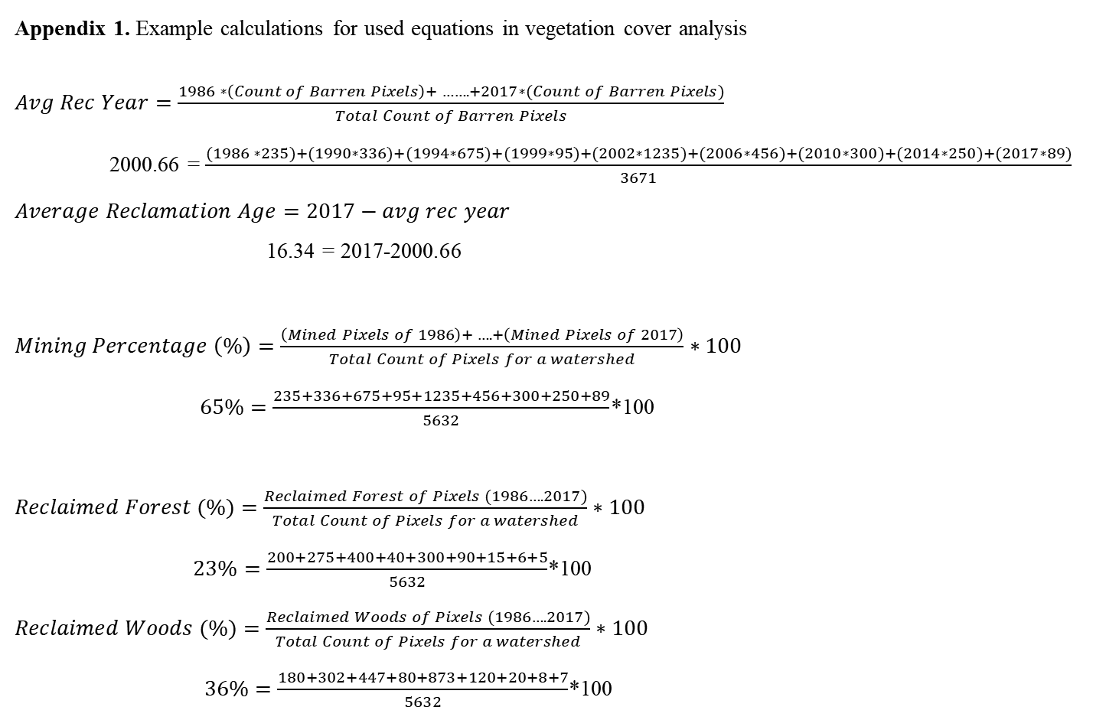
Appendix 1. Example calculations for used equations in vegetation cover analysis
$Avg Rec Year=\frac{1986 ∗\left(Count of Barren Pixels\right)+ …….+2017∗(Count of Barren Pixels)}{Total Count of Barren Pixels}$
2000.66 = $\frac{(1986 ∗235)+(1990∗336)+(1994∗675)+(1999∗95)+(2002∗1235)+(2006∗456)+(2010∗300)+(2014∗250)+(2017∗89)}{3671}$
$Average Reclamation Age=2017−avg rec year$
16.34 = 2017-2000.66
$Mining Percentage \left(\%\right)=\frac{\left(Mined Pixels of 1986\right)+ ….+\left(Mined Pixels of 2017\right)}{Total Count of Pixels for a watershed}∗100$
$65\%=\frac{235+336+675+95+1235+456+300+250+89}{5632}$*100
$Reclaimed Forest (\%)=\frac{Reclaimed Forest of Pixels (1986….2017)}{Total Count of Pixels for a watershed}∗100$
$23\%=\frac{200+275+400+40+300+90+15+6+5}{5632}$*100
$Reclaimed Woods (\%)=\frac{Reclaimed Woods of Pixels (1986….2017)}{Total Count of Pixels for a watershed}∗100$
$36\%=\frac{180+302+447+80+873+120+20+8+7}{5632}$*100

Slide 29

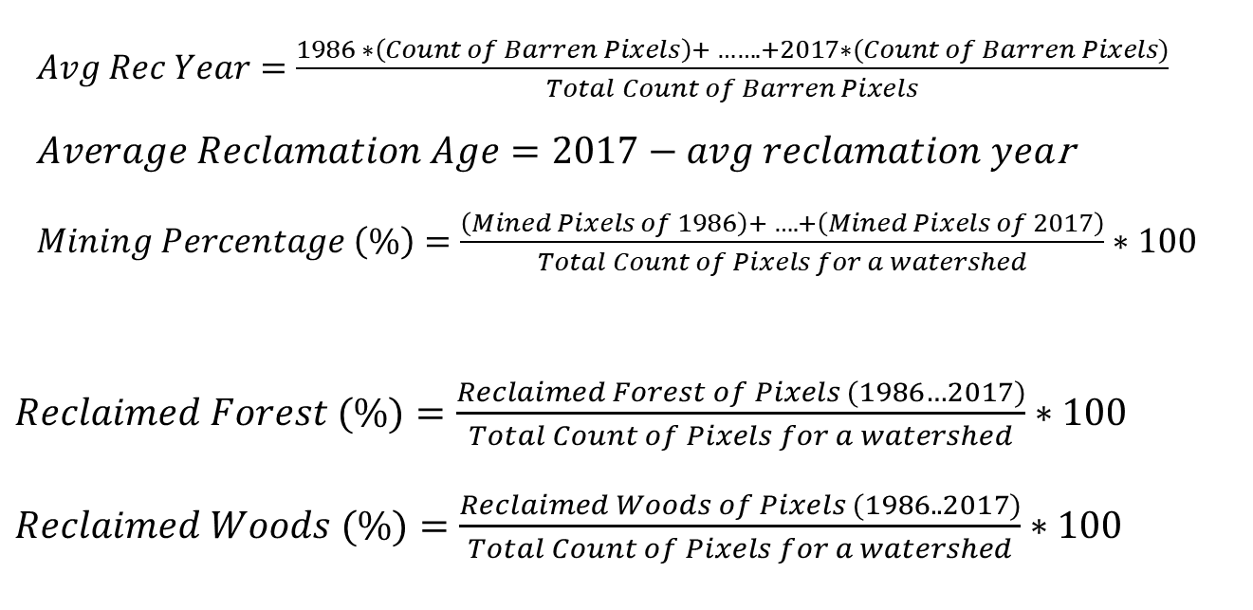
Calculation of Remote Sensing Variables
$Avg Rec Year=\frac{1986 ∗\left(Count of Barren Pixels\right)+ …….+2017∗(Count of Barren Pixels)}{Total Count of Barren Pixels}$ $Average Reclamation Age=2017−avg reclamation yea$r
$Mining Percentage \left(\%\right)=\frac{\left(Mined Pixels of 1986\right)+ ….+\left(Mined Pixels of 2017\right)}{Total Count of Pixels for a watershed}∗100$
$Reclaimed Forest (\%)=\frac{Reclaimed Forest of Pixels (1986…2017)}{Total Count of Pixels for a watershed}∗100$
$Reclaimed Woods (\%)=\frac{Reclaimed Woods of Pixels (1986..2017)}{Total Count of Pixels for a watershed}∗100$
Undisturbed
Active
Mined in 1986, now reclaimed Forest

Slide 30
Appendix 5. Seasonal conductivity change
 |  |  | Conductivity
Watershed | Mined-RF | Rec. Age | 15-May | 21-Jul | 21-Oct
9 | 9.05 | 20.3 | 88 | 203 | 190
10 | 11.53 | 18.47 | 165 | 279 | 270
11 | 21.97 | 22.1 | 176 | 348 | 310
29 | 32.99 | 21 | 280 | 627 | 560
32 | 7.71 | 14.24 | 130 | 174 | 160
33 | 18.28 | 16.45 | 153 | 245 | 210
34 | 12.62 | 21.62 | 120 | 266 | 190
ANOVA
source | df | SS | MS | F
Total N | 20 | 0.000103
Group | 2 | 4.23E-05 | 2.11E-05 | 6.292259
Error | 18 | 6.05E-05 | 3.36E-06
F > F(2,18) Then p < 0.05

Slide 31
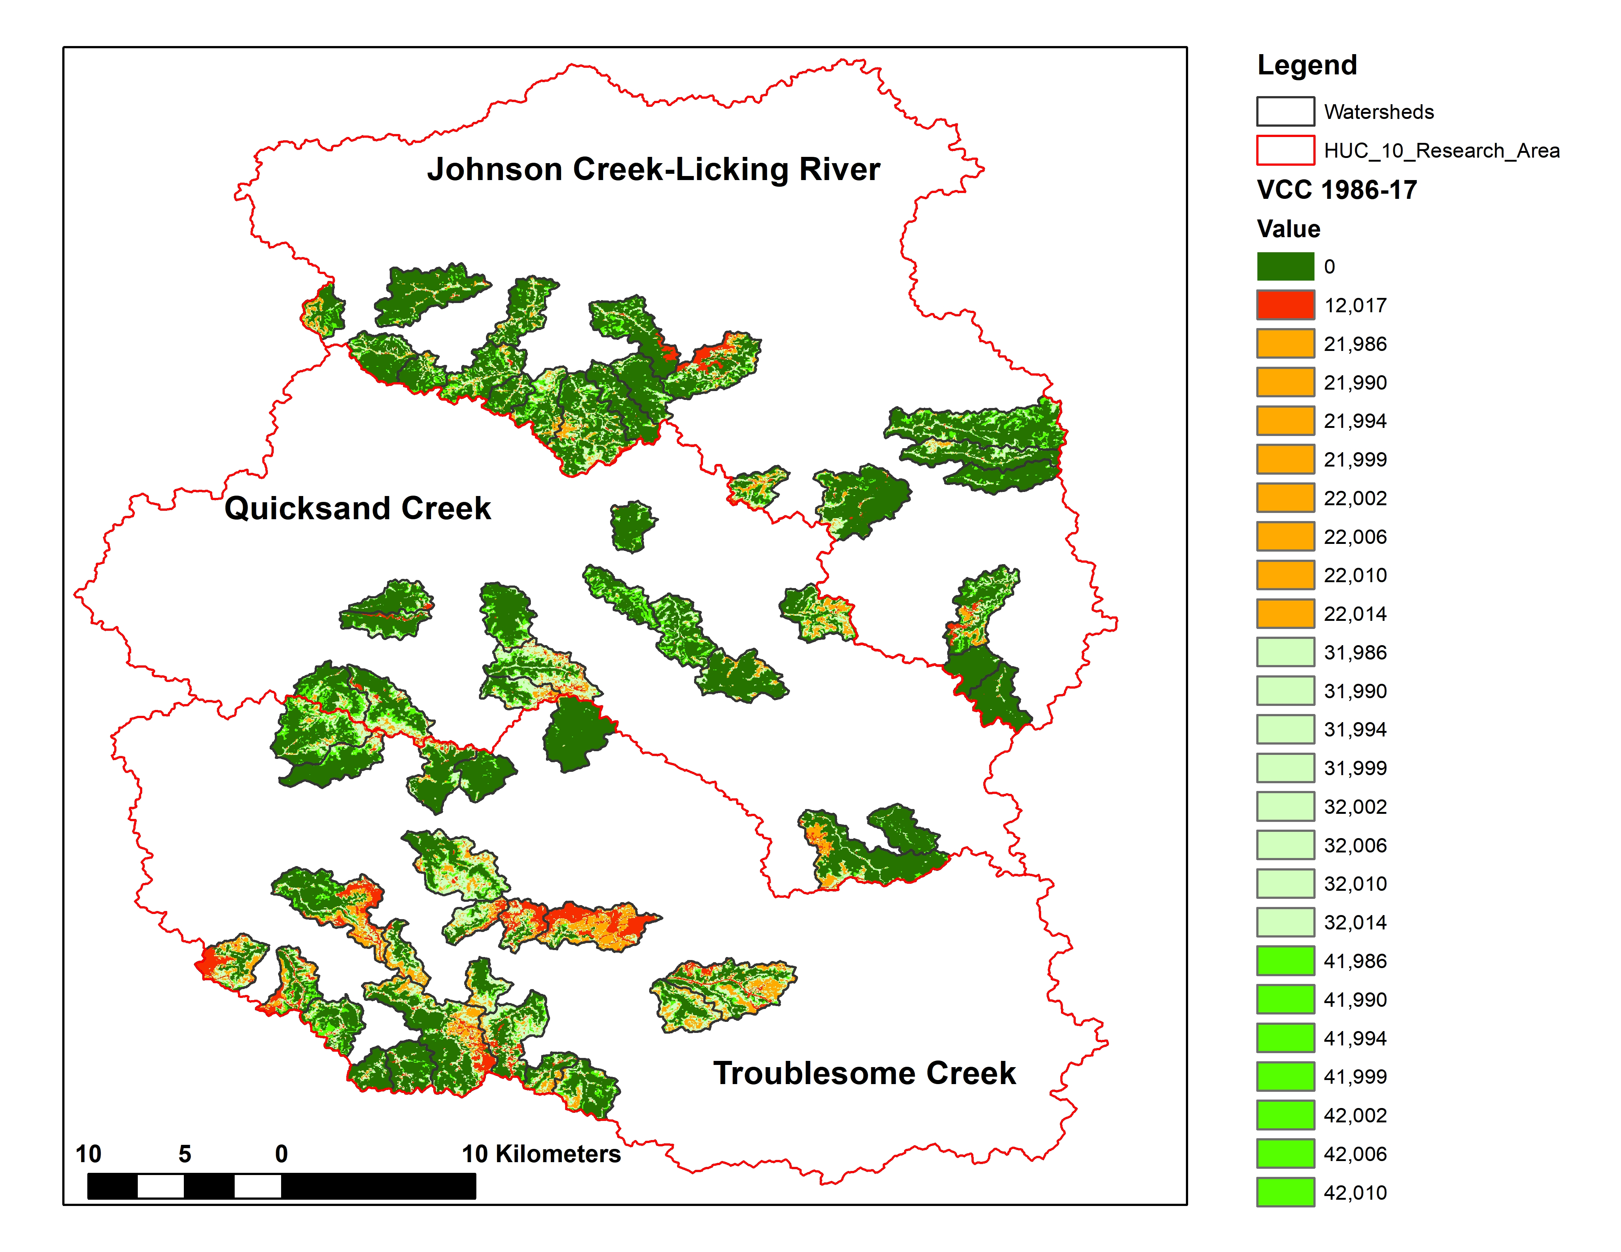
Appendix 6. Vegetation Cover Change Analysis
Unmined
Active
Mining
ReclaimedGrass
Reclaimed
Woods
Reclaimed
Forest

Slide 32
Appendix 7. Major elements and minerals found in coal
Major inorganic minerals in coal are: quartz (SiO₂), clay minerals (contain Al and (OH)), pyrite (Fe₂S), calcite (CaCO₃), siderite (FeCO₃).
FeS₂ + 3.75O₂ + 3.5H₂O → Fe(OH) ₃ + 2SO₄²⁻ + 4H⁺
2CaCO₃ + 2H⁺ → Ca²⁺ + 2HCO₃⁻ CaMgCO₃ + 2H⁺ → Ca²⁺ +Mg²⁺ + 2HCO₃⁻
FeCO₃ + 2H⁺ → Fe²⁺ + 2HCO₃⁻

Slide 33
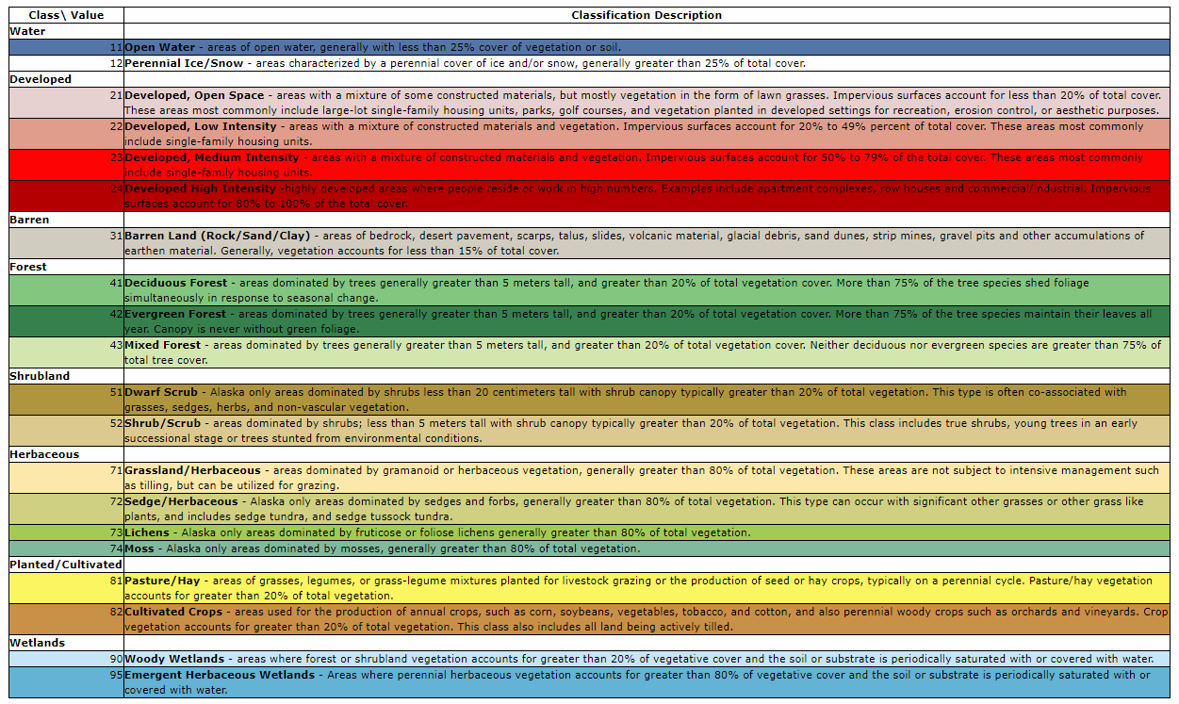
Appendix 8. 2011 NLCD Land cover classes

Slide 34

References

Slide 35
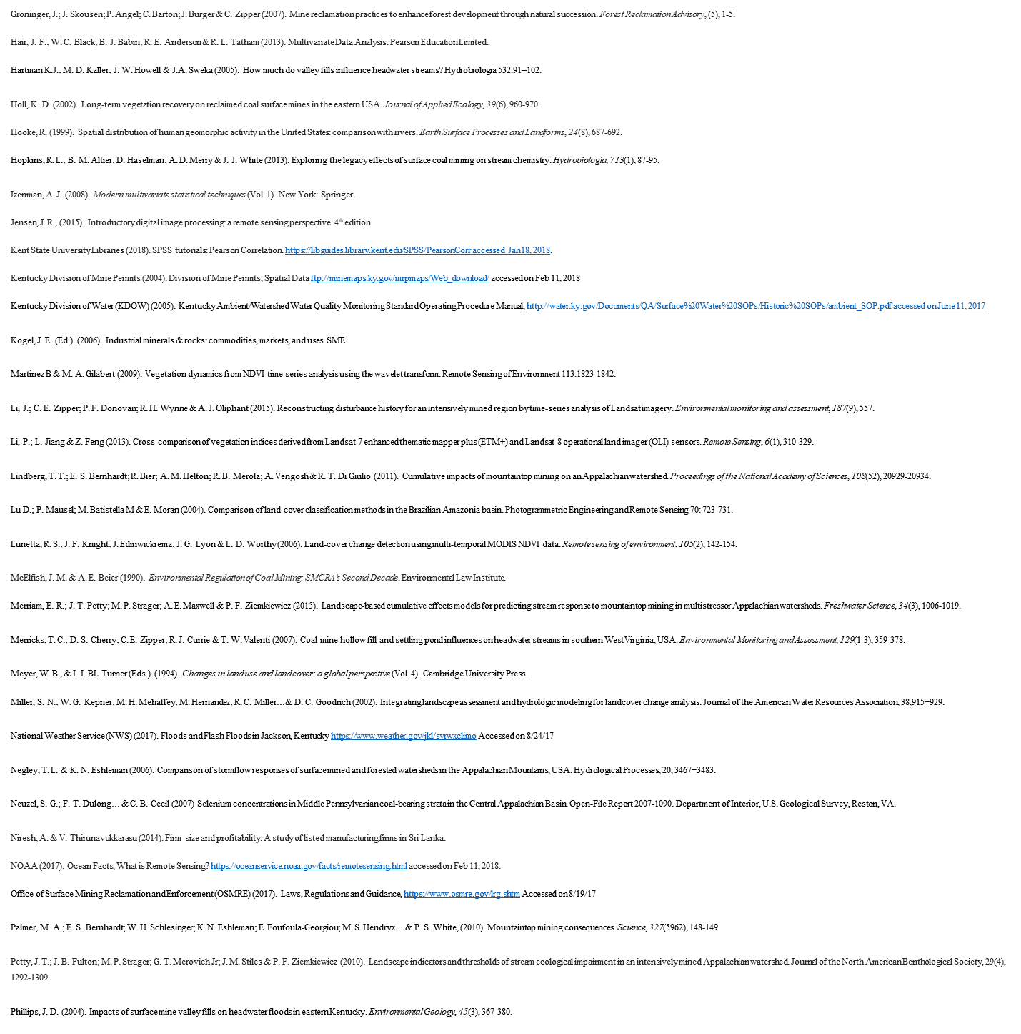
References

Slide 36
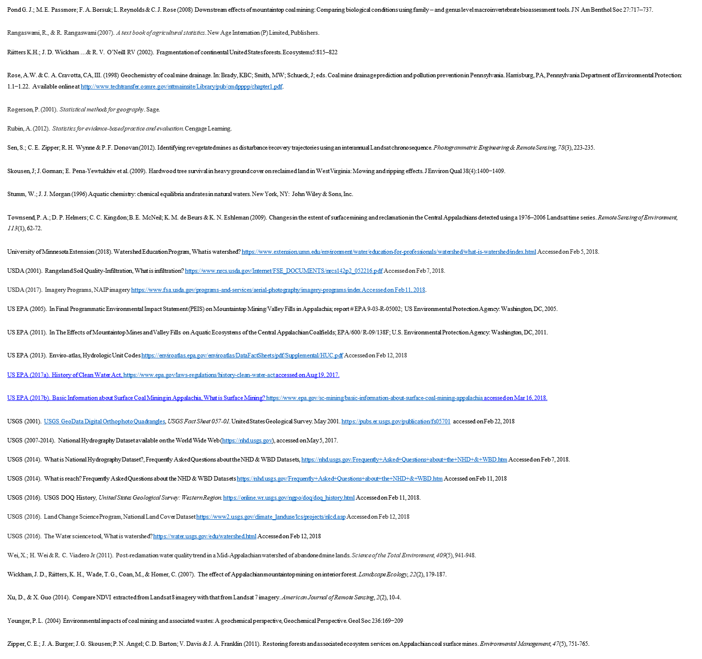
References

