Slide 1

Geochemistry, Provenance, and Cultural Significance of Chert Stone Tools, Coshocton County, Ohio
Diana Simone
Department of Geology

Slide 2
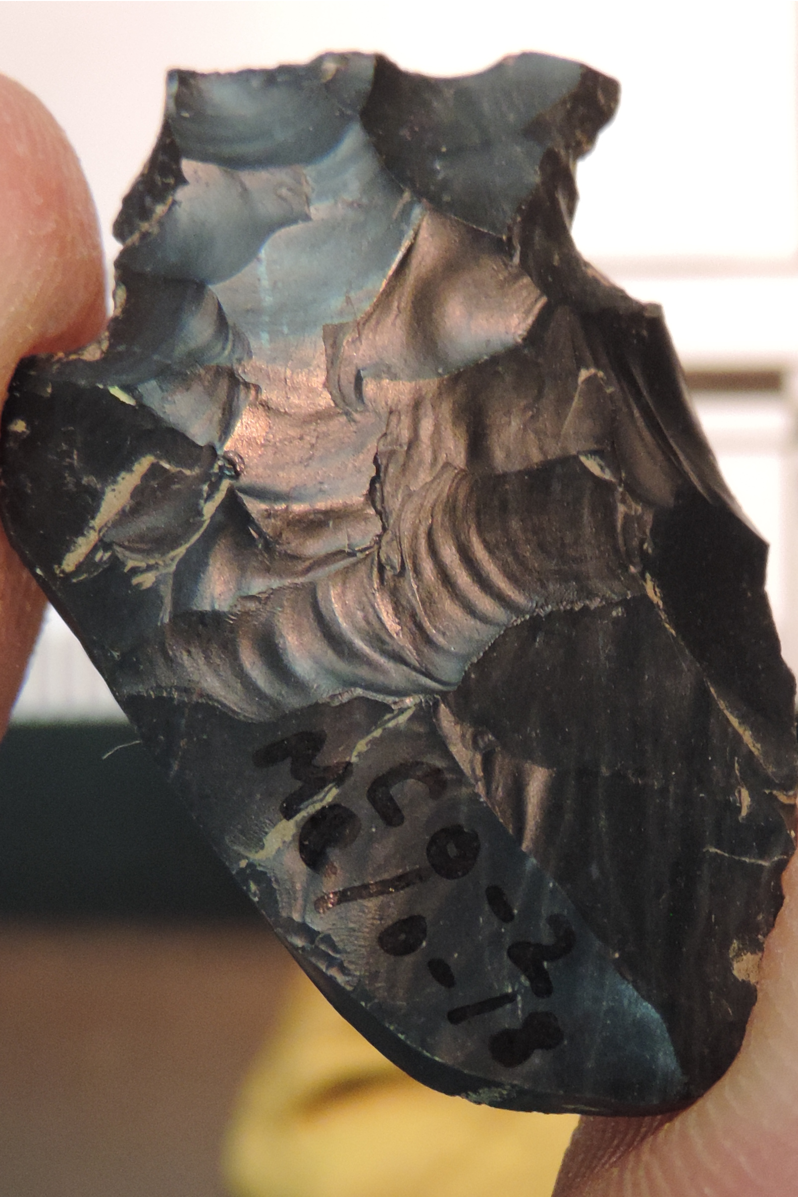
Purpose of Research
Provide insight for prehistoric American cultures
Cultures are studied through their technology and stone tools made from chert, flint, and chalcedony
Visible color comparison is the most common way for provenance of artifacts to be determined
Welling site artifact. Courtesy of Dr. Metin Eren, Kent State University Anthropology Department.

Slide 3
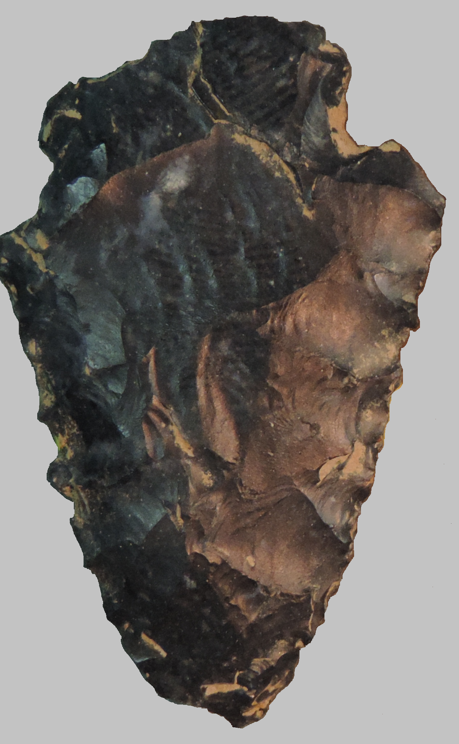
Samples for Chemical Analysis
Artifacts
59 samples found at the Welling archaeological site in Nellie, Ohio
Outcrops
89 samples from Ohio, Illinois, Michigan, Maine, Indiana, North Carolina, Kentucky, West Virginia, Delaware, Idaho, Tennessee, and Ontario
Welling site sample. Courtesy of Dr. Metin Eren, Kent State University Anthropology Department.

Slide 4
Prehistoric Ohio
People
Artifacts
Hunter/gathers eventually becoming less nomadic
Used chert to create tools
Traded fabricated tools and chert for other commodities
Samples are from the Holocene, specifically
Early Archaic to Late Woodland Cultures
9000 to 400 BP

Slide 5
Hypotheses: The artifacts found at the Welling archaeological site were produced from Upper Mercer Chert. Holocene cultures were specific when choosing the natural materials used to create their tools and chose chert with a high silica content.

Slide 6
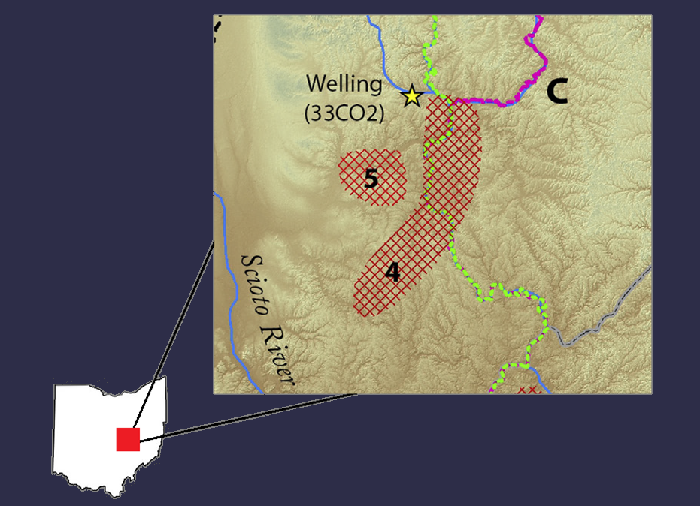
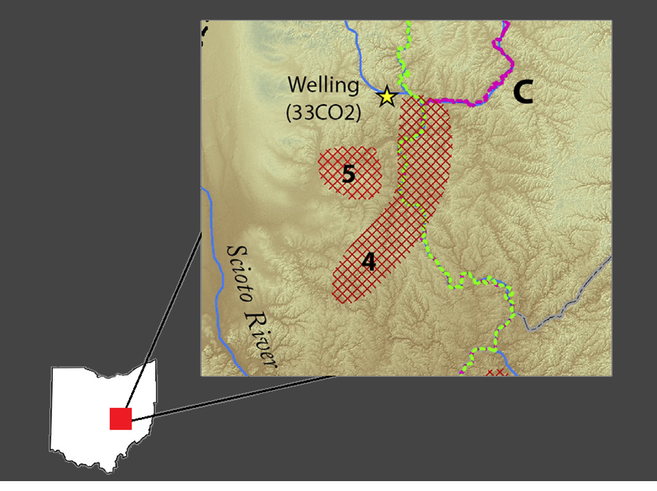
Study Area

Slide 7
Methods
Major and Minor Element Analysis
Energy Dispersive X-ray Fluorescence (ED-XRF)
Loss on ignition (L.O.I.)
LeNeo Fluxer

Slide 8
Results
Element analysis
The silica content for the Upper Mercer chert is between 87.8% to 97.8% and the majority of the artifacts plot above 94%, and the lowest is 90%.
I prepared graphs of all elements analyzed plotted against the SiO2 content, comparing Welling artifacts with various outcrops including the Upper Mercer.

Slide 9
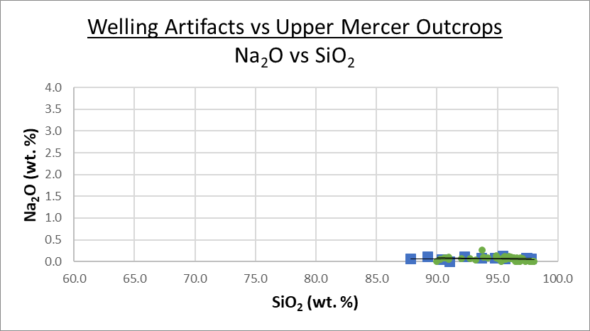
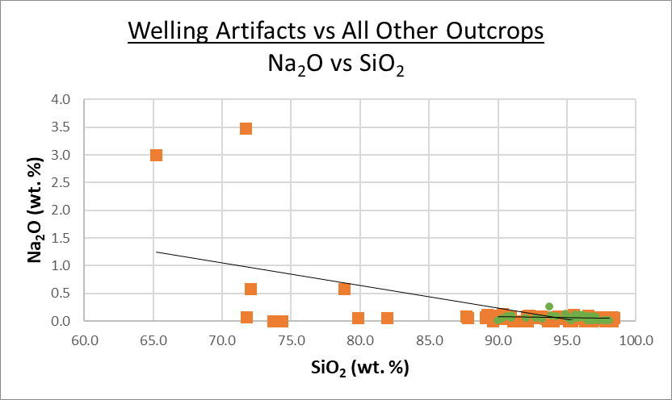
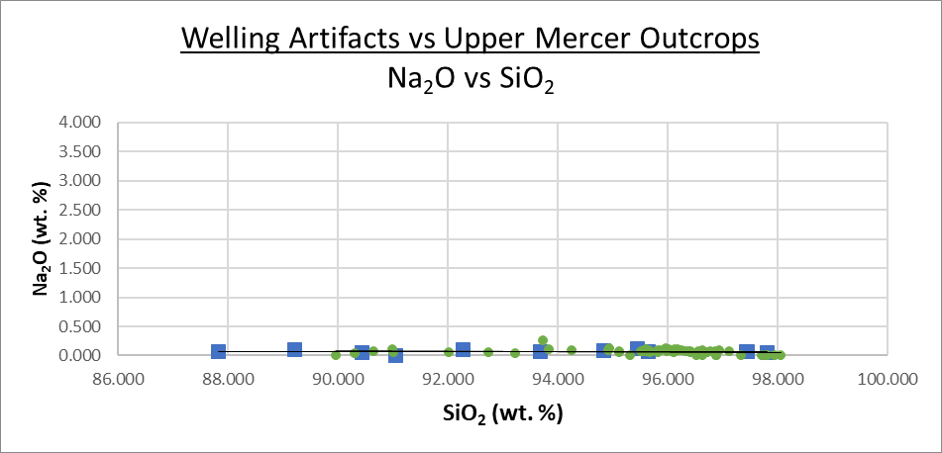
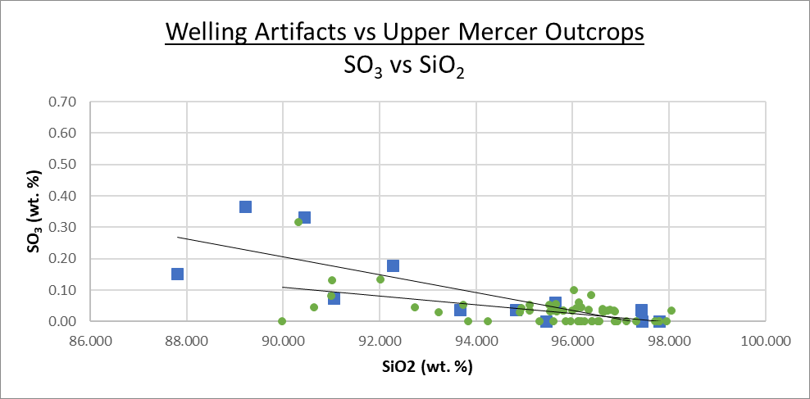
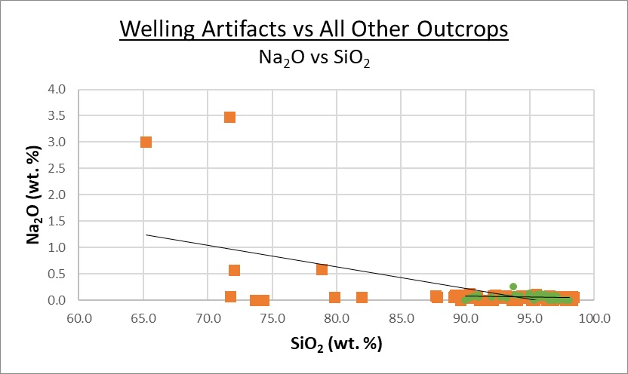
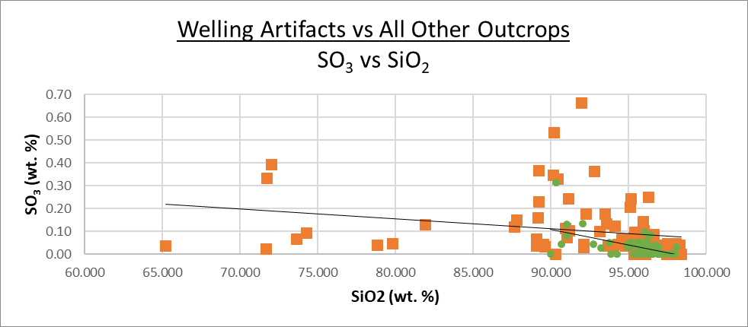
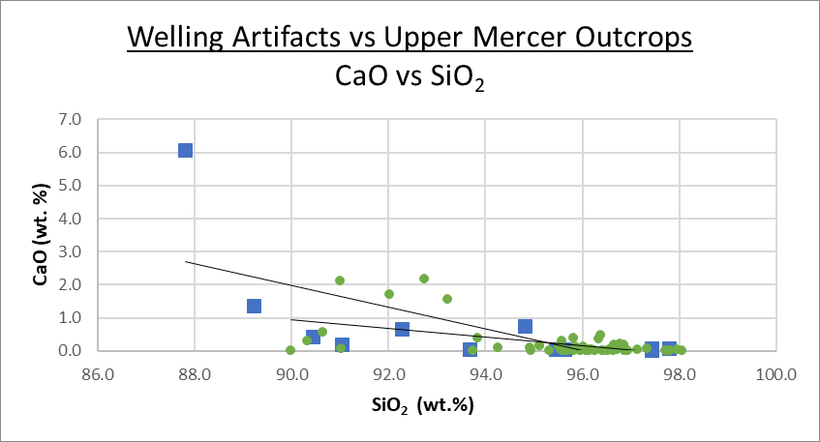
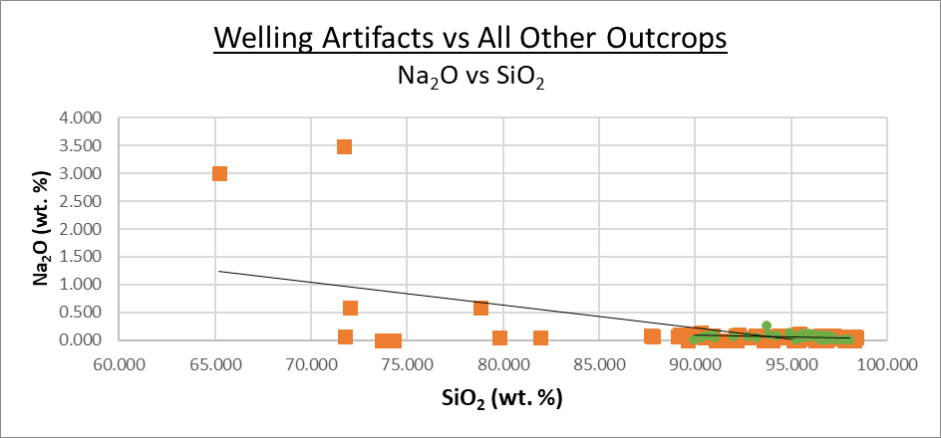
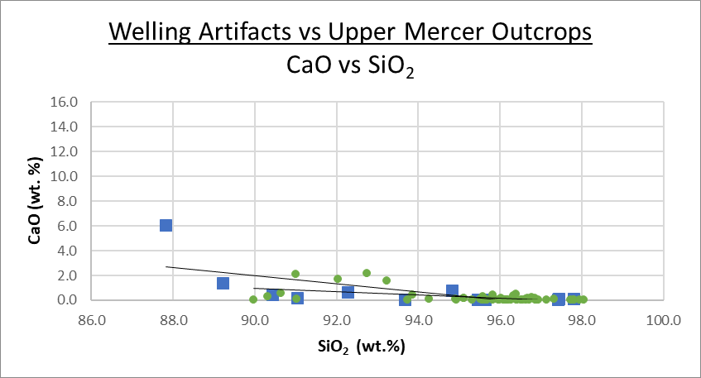
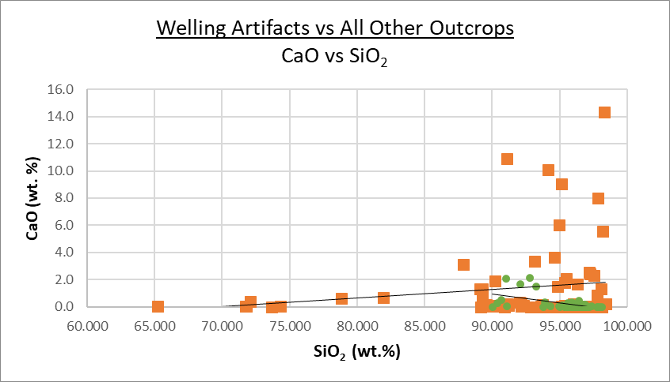
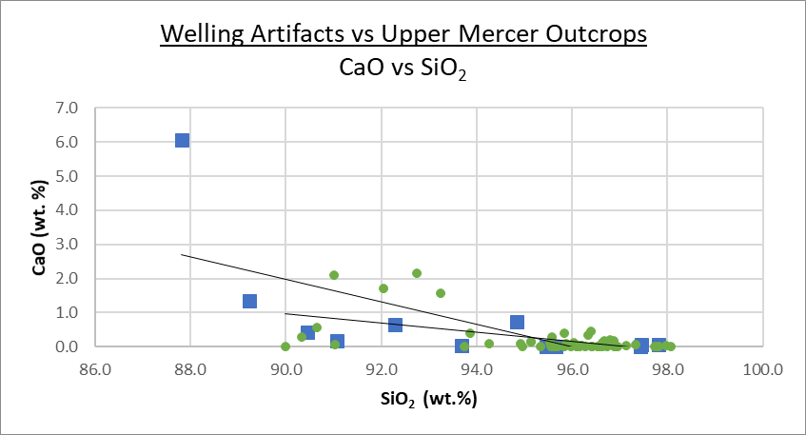
Results: Na₂O

Slide 10
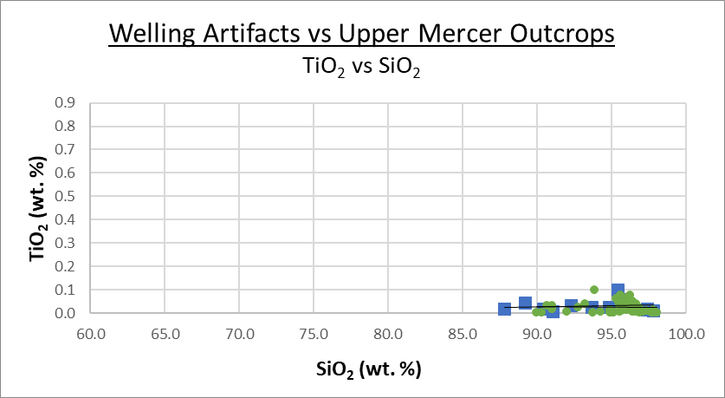
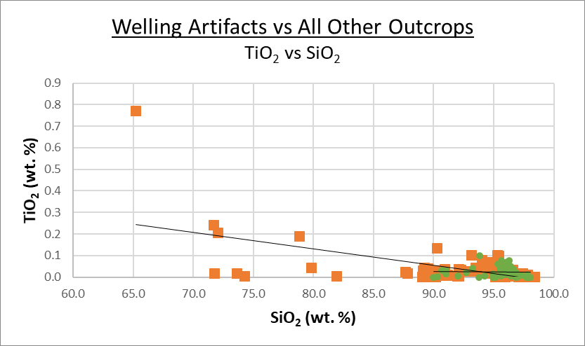
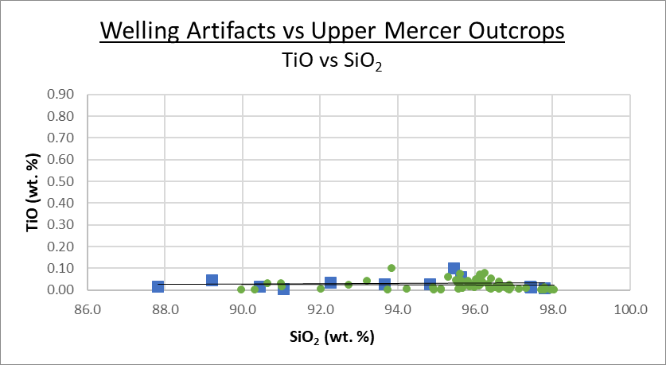
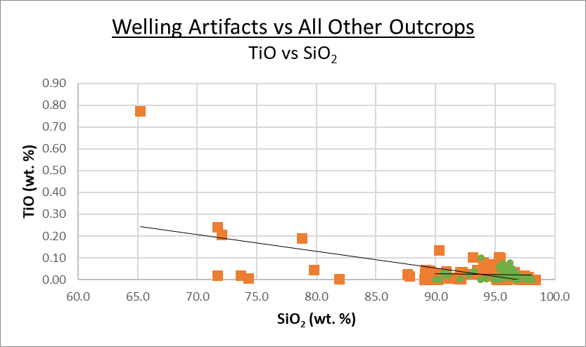
Results: TiO₂

Slide 11
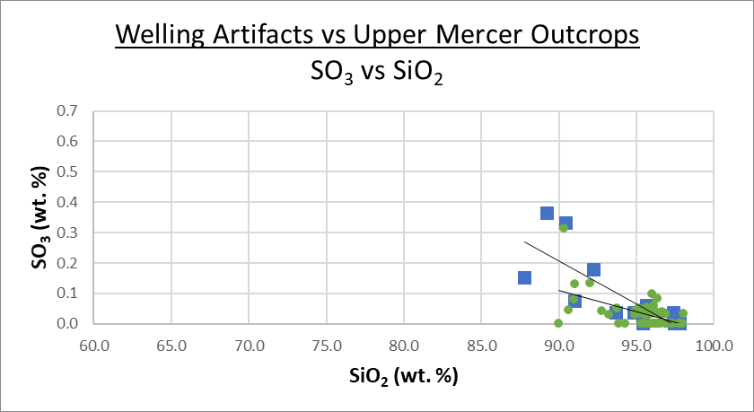
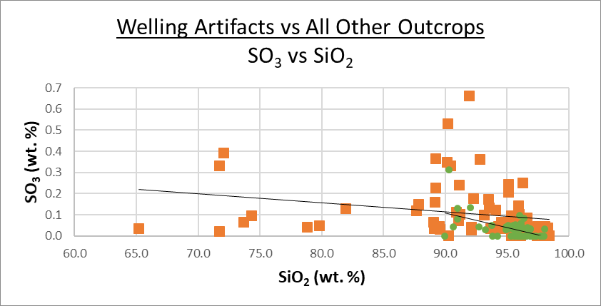
Results: SO₃

Slide 12
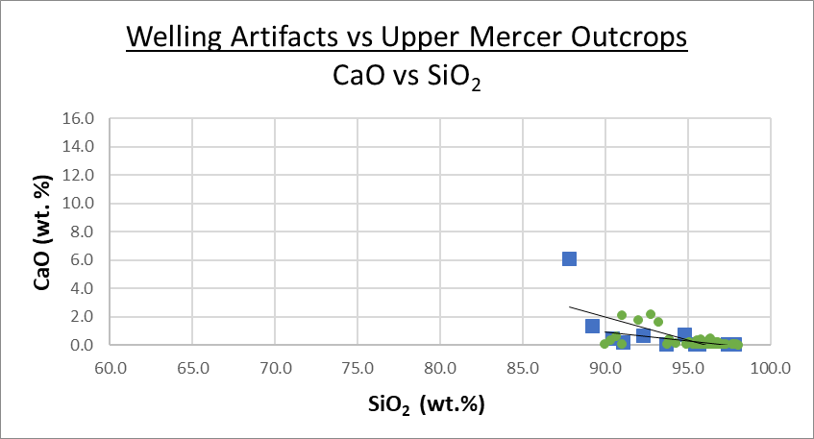
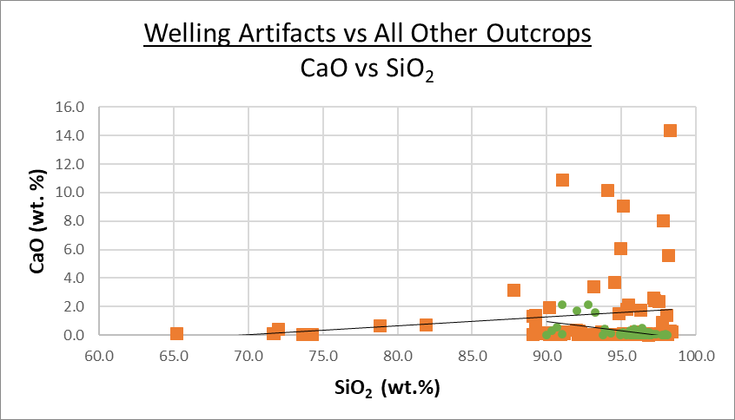
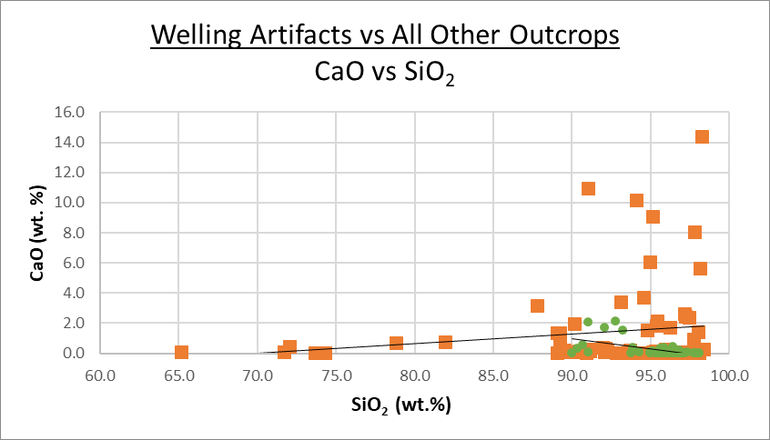
Results: CaO

Slide 13
Conclusions
Geochemically, the 59 artifact samples fall within the Upper Mercer range. Therefore, I conclude that they were all produced from Upper Mercer chert.
Holocene cultures appear to have selected higher quality chert to construct their tools.

Slide 14
Thank you

