Slide 1


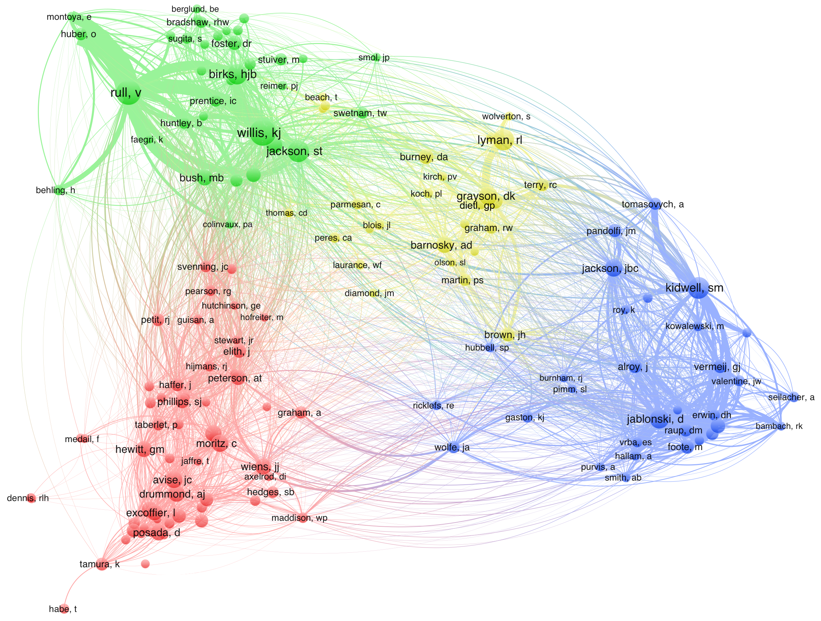
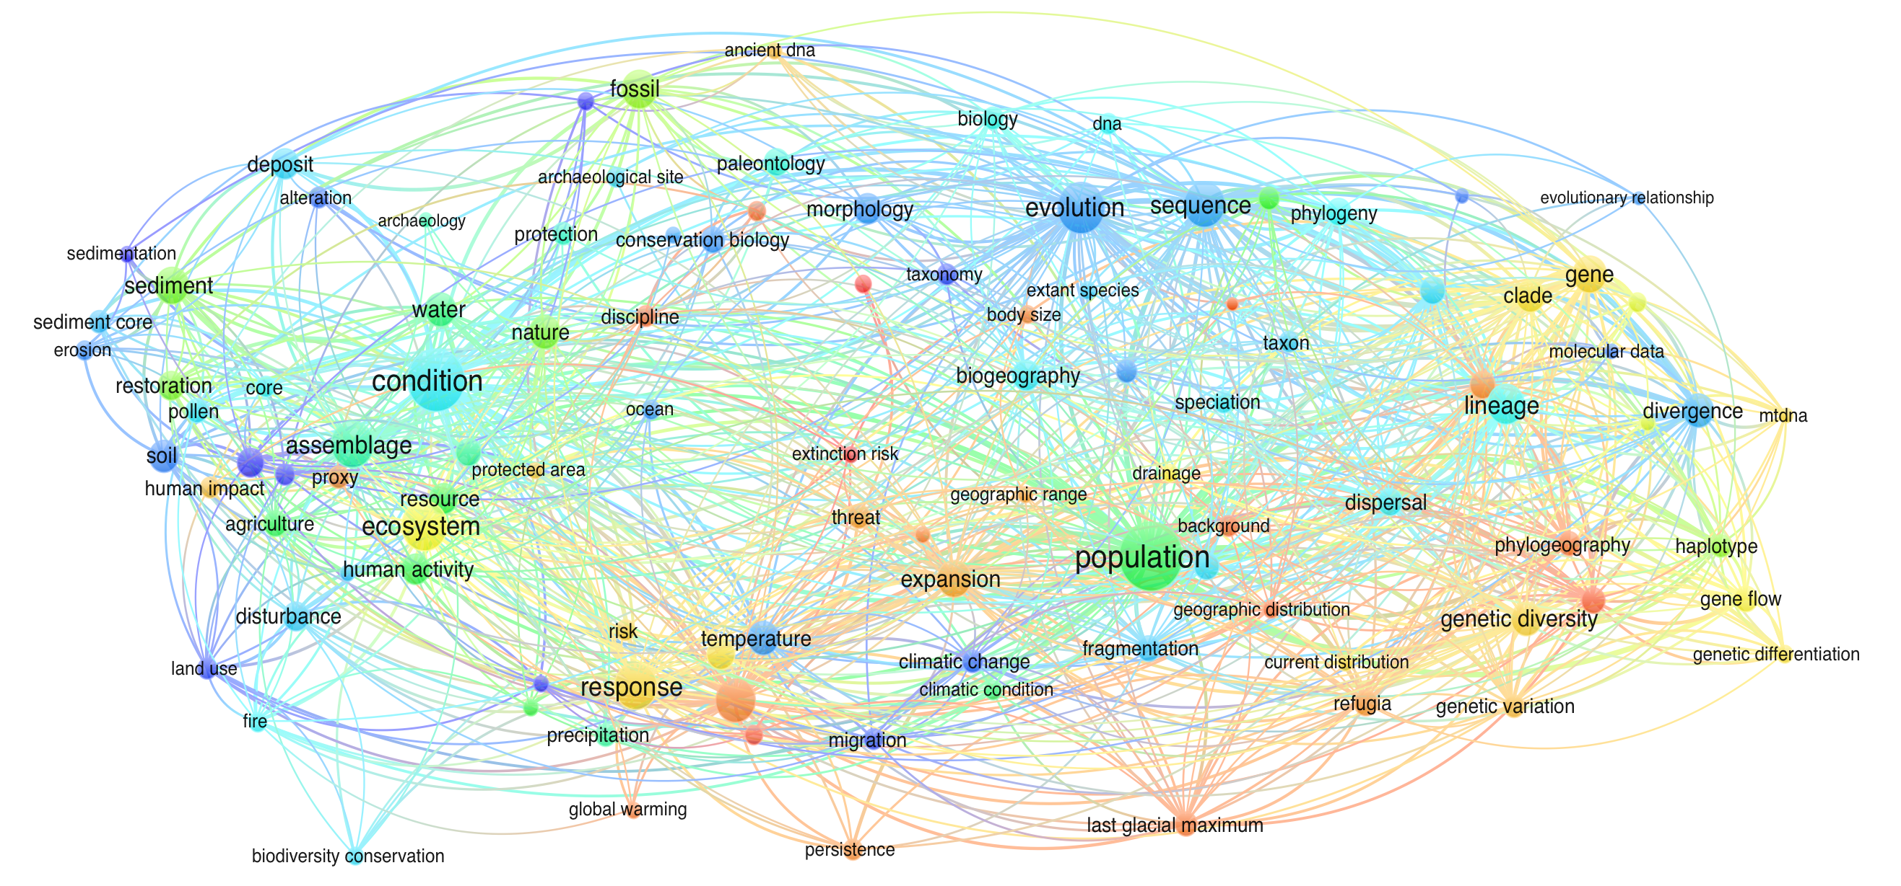

A Conceptual Map of Conservation Paleobiology: Visualizing a Discipline
Carrie L. Tyler
Geology & Environmental Earth Science, Miami University, Oxford, Ohio
tylercl@miamiOH.edu
Here bibliographic maps were created using Web of Science publication records relating to research on conservation paleobiology to conceptualize intellectual structure and dynamics, and visualize scientific advancement and emerging research. Bibliographic records were downloaded using a topic search of “conservation paleo*” in Web of Science which yielded 833 records. Networks were created using an algorithm analogous to multidimensional scaling to position data in a multidimensional vector space and minimize stress to construct relationships between citations, keywords, documents, and authors.
The more frequently words co-occur, the stronger the relationships between them. Emerging topics can therefore be identified by examining the frequency of the use of specific terms and the body of literature that scientists are actively citing. Colors differentiate three communities, based on the strength of inter- group relationships. The size of nodes indicates occurrence frequency, and words
Co-citation records indirect interactions between scientists through the scientific literature, by identifying and counting the number of times author pairs are cited among a set of articles. The more cited authors two documents have in common, the greater the co-citation strength. Authors’ last names and first initials are shown over nodes. Node size corresponds to relative number of citations, larger nodes identify greater numbers of citations. Links indicate relationships between authors. Colors differentiate four communities representing authors disciplinary affiliations.
Abstract
Text Co-Occurrence Networks
Bibliographic Co-Citation Network
associated with larger nodes occurred more frequently. Greater line width corresponds to stronger relationships. Communities could be broadly identified as three fields of research,
with paleontological terms primarily
occurring with conservation biology.
conservation ecology
& paleobiology
paleontology, archeobiology & environmental
history
ecology
paleontology
genetics & evolutionary
biology
climate science & ecology
A temporal overlay was then applied to identify fast-growing, emerging areas of research. Warmer colors denote
more recent publications,
and node size corresponds
to occurrence frequency. The popularization of conservation paleobiology in 2006 and
its subsequent rise is
evident in the average year for terms such as “ paleobiology”
“ (2011), “fossil” (2010), and “paleoecology” (2009). Terms within genetics
and ecology were overwhelmingly more recent,
many of which were associated with ecological responses to climate change.
Temporal Overlay
genetics & evolutionary biology
Marine Conservation Paleobiology
C.L. Tyler and C.L. Schneider (Eds.)
The invisible college of conservation paleobiology crosses research domains. Research included scholars from a wide range of disciplines, with significant intellectual exchange between sub-disciplines. Publications by paleontologists did not form a distinct sub-discipline (i.e., conservation research within paleontology), but was substantively coherent and interrelated with environmental history and conservation archeobiology, and conservation science.
These findings indicate a strong unity and inter-relatedness of content despite intellectual sub-communities, suggesting that conservation science is one research field with at least three major research themes: Environmental history and conservation archeobiology, genetics and evolutionary biology, and ecology. This suggests that there is likely a greater potential for conservation paleobiology to hook into pre-existing infrastructure and professional societies than is currently recognized.
Conclusions
average publication year

