Slide 1


Ascertaining the Effects of Gaseous Pore Pressure and Net Confining Stress on Permeability of Tight Cores Using a New Steady-State Approach
Michael J. Hannon, Jr.* - Indiana Geological and Water Survey
Yael T. Tucker – National Energy Technology Laboratory, ORISE
Daniel J. Soeder – South Dakota School of Mines & Technology

Slide 2
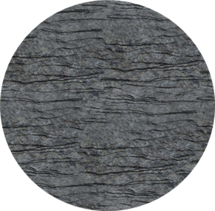
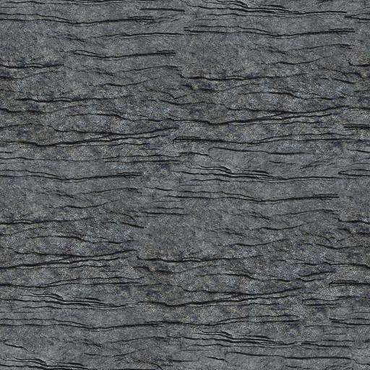
Shale Oil & Gas Recovery
Recovery Mechanisms:
1
Darcy/turbulent fracture flow
Recovery Rate
Gas desorption
2
3
Darcy matrix flow
Time
Horizontal Well
** Large pressure gradients near fractures due to low permeability
Hannon, M.J. & S. Finsterle. The Effect of Anisotropy on Multi-dimensional Pressure-Pulse-Decay Experiments. Transport in Porous Media (2018). 123:545–562. https://doi.org/10.1007/s11242-017-0941-x

Slide 3
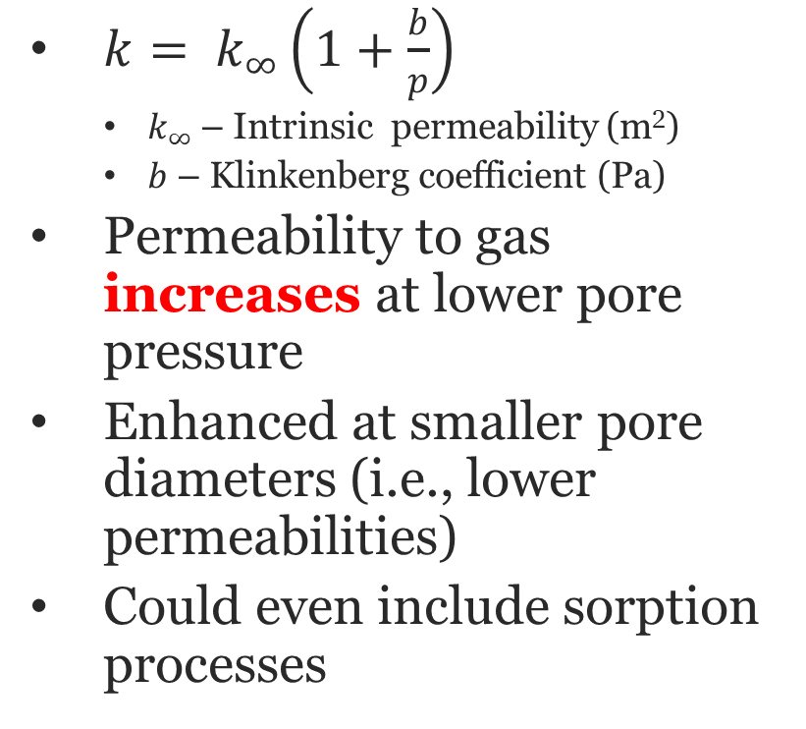
Permeability Enhancement at Lower Pore Pressure (Gas Slip or “Klinkenberg” Effects)
${k= k}_{∞}\left(1+\frac{b}{p}\right)$
$k_{∞}$ – Intrinsic permeability (m²)
$b$ – Klinkenberg coefficient (Pa)
Permeability to gas increases at lower pore pressure
Enhanced at smaller pore diameters (i.e., lower permeabilities)
Could even include sorption processes
Klinkenberg, L.J. The Permeability of Porous Media to Liquids and Gases. In Drilling and Production Practice (1941), pp. 200-213.

Slide 4
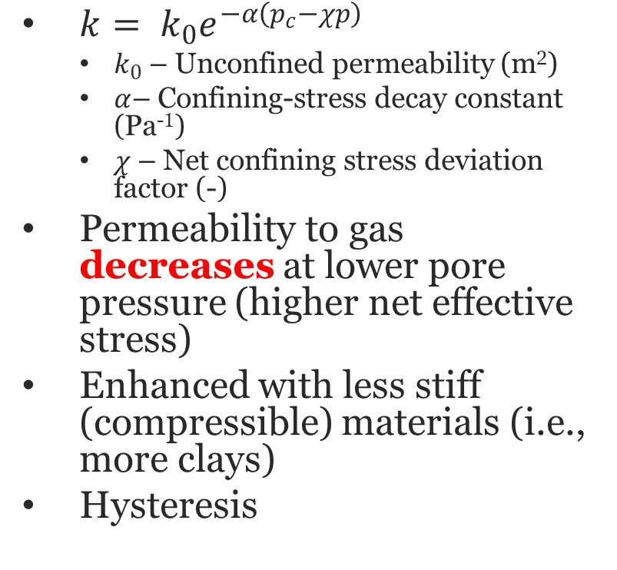
Permeability Reduction at Lower Pore Pressure (Net Effective Stress)
${k= k}_{0}e^{−α\left(p_{c}−χp\right)}$
$k_{0}$ – Unconfined permeability (m²)
$α$– Confining-stress decay constant (Pa⁻¹)
$χ$ – Net confining stress deviation factor (-)
Permeability to gas decreases at lower pore pressure (higher net effective stress)
Enhanced with less stiff (compressible) materials (i.e., more clays)
Hysteresis
Yang, Y. and A.C. Aplin. Permeability and Petrophysical Properties of 30 Natural Mudstones. Journal of Geophysical Research (2007), 112:B03206.

Slide 5
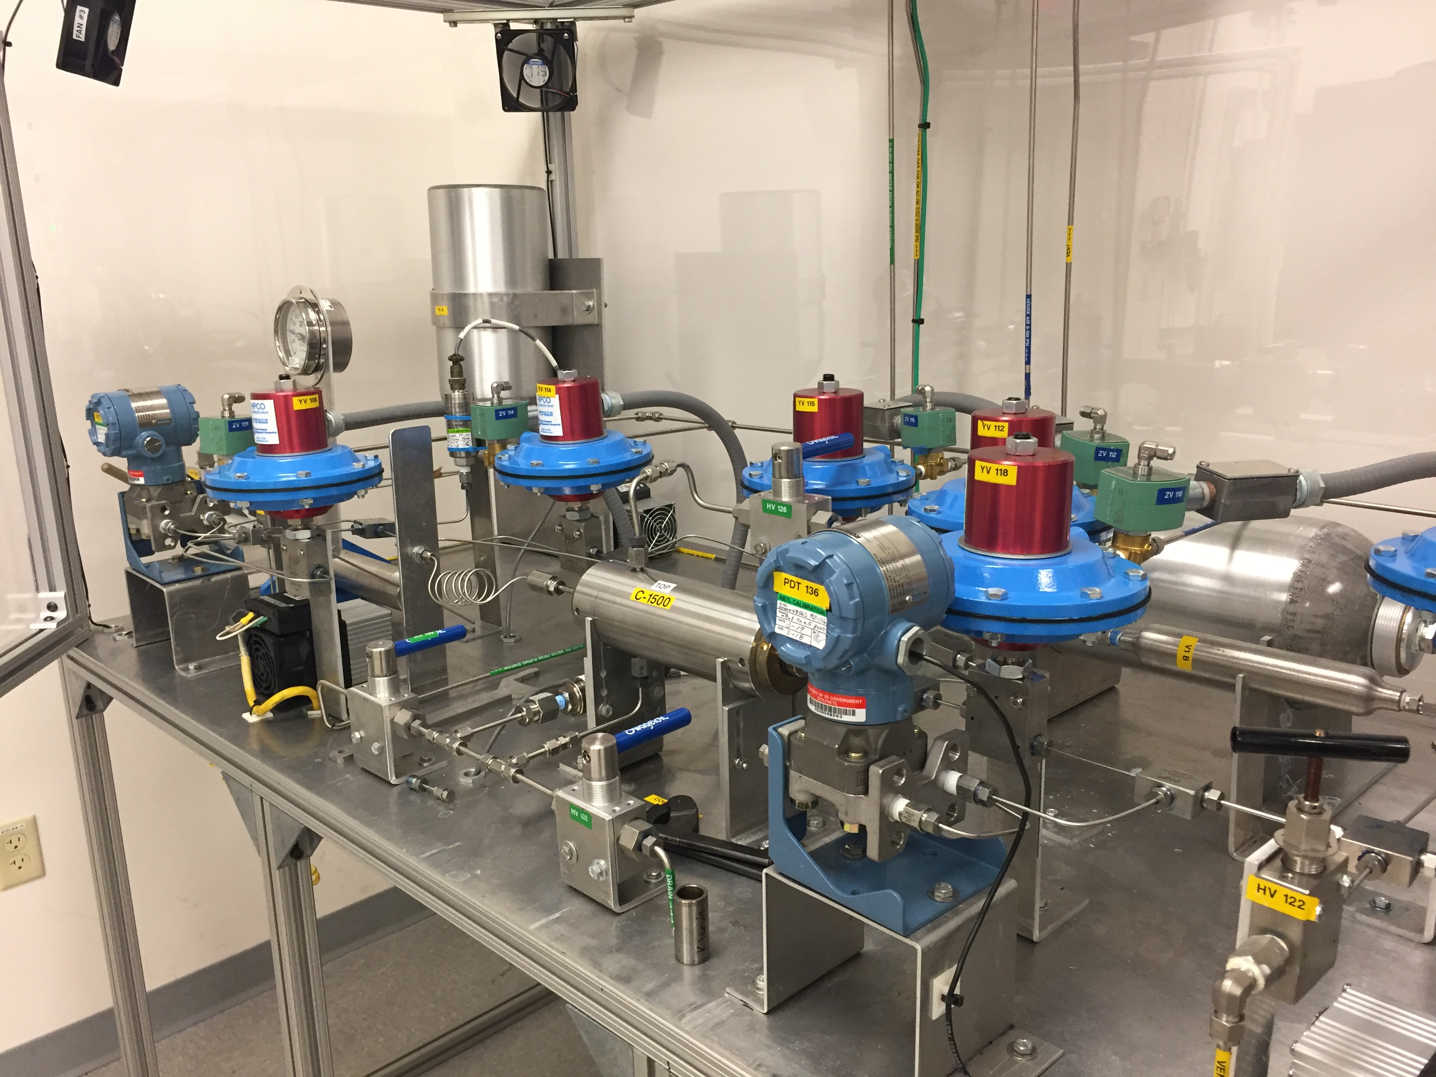

The Randolph Steady-State Core Analysis Laboratory (RaSSCAL)
Quasi steady-state permeability assessment
Modified for high pressure gradients
Faster flow through the sample
More similar to in-situ conditions
Math becomes trickier
Upstream (u)
p_{u}
$$\frac{dp_{d}}{dt}$$
p
Core Sample
p_{d}
t
Downstream (d)
Core Sample
Similar to WVU PPAL system. See Zamirian et al. New Steady-State Technique for Measuring Shale Core Plug Permeability. From SPE/CSUR Unconventional Resources Conference (2014), SPE-171613-MS. https://doi.org/10.2118/171613-MS
u
d

Slide 6
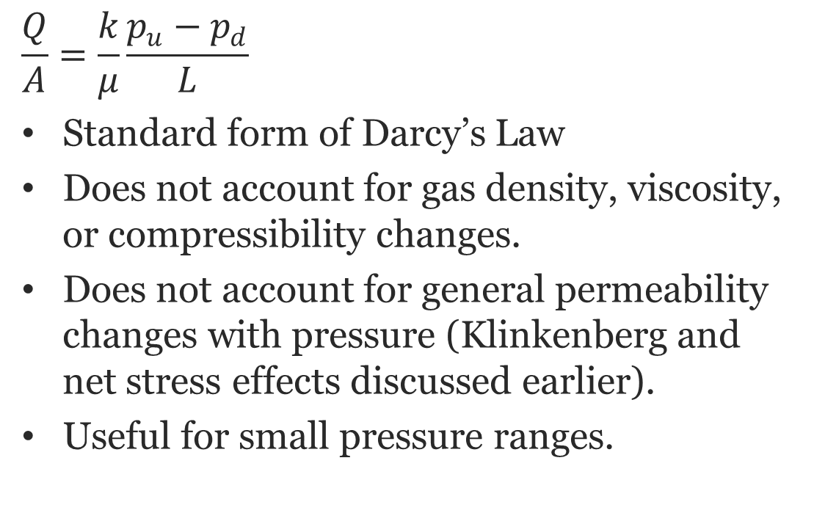


Standard Darcy’s Law
$$=\frac{1}{A}\frac{V_{d}}{p_{d}}\frac{dp_{d}}{dt}$$
$$\frac{Q}{A}=\frac{k}{μ}\frac{p_{u}−p_{d}}{L}$$
Standard form of Darcy’s Law
Does not account for gas density, viscosity, or compressibility changes.
Does not account for general permeability changes with pressure (Klinkenberg and net stress effects discussed earlier).
Useful for small pressure ranges.
p_{u}
$$\frac{dp_{d}}{dt}$$
p
p_{d}
t
Core Sample
u
d

Slide 7
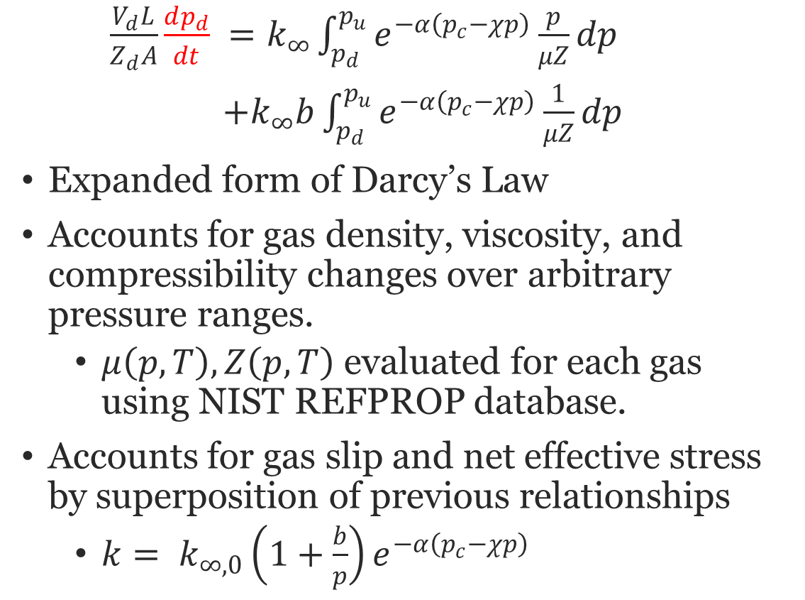
Fancy Darcy’s Law
$\frac{V_{d}L}{Z_{d}A}\frac{dp_{d}}{dt} =k_{∞}\int_{p_{d}}^{p_{u}}{e^{−α\left(p_{c}−χp\right)}\frac{p}{μZ}dp}$
$+k_{∞}b\int_{p_{d}}^{p_{u}}{e^{−α\left(p_{c}−χp\right)}\frac{1}{μZ}dp}$
Expanded form of Darcy’s Law
Accounts for gas density, viscosity, and compressibility changes over arbitrary pressure ranges.
$μ\left(p,T\right), Z\left(p,T\right)$ evaluated for each gas using NIST REFPROP database.
Accounts for gas slip and net effective stress by superposition of previous relationships
${k= k}_{∞,0}\left(1+\frac{b}{p}\right)e^{−α\left(p_{c}−χp\right)}$
p_{u}
$$\frac{dp_{d}}{dt}$$
p
p_{d}
t
Core Sample
u
d

Slide 8
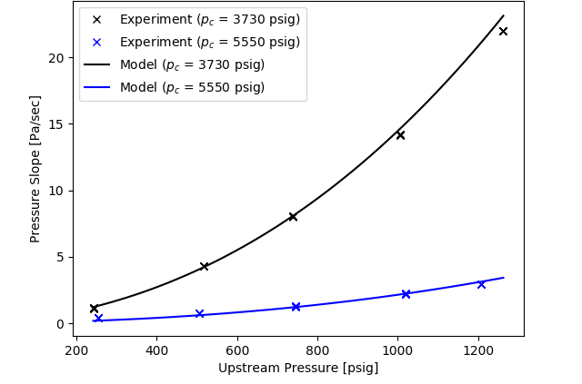
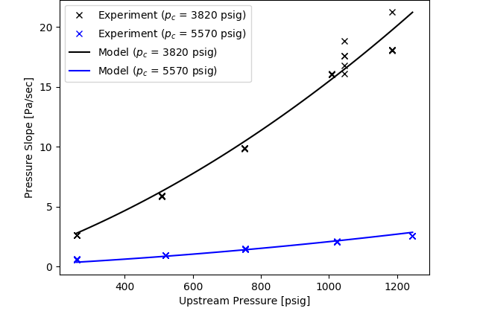
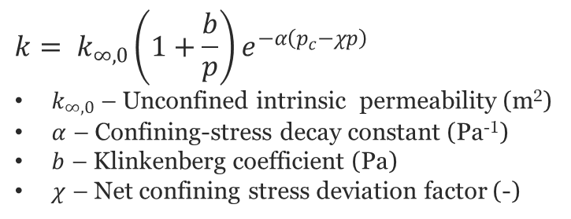
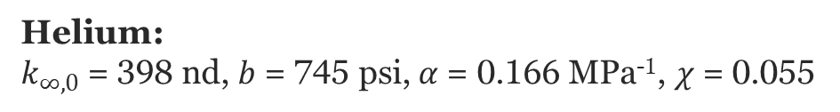
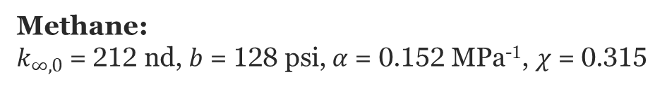
Results – Marcellus Shale
$${k= k}_{∞,0}\left(1+\frac{b}{p}\right)e^{−α\left(p_{c}−χp\right)}$$
$k_{∞,0}$ – Unconfined intrinsic permeability (m²)
$α$ – Confining-stress decay constant (Pa⁻¹)
$b$ – Klinkenberg coefficient (Pa)
$χ$ – Net confining stress deviation factor (-)
Methane:
$k_{∞,0}$ = 212 nd, $b$ = 128 psi, $α$= 0.152 MPa⁻¹, $χ$ = 0.315
Helium:
$k_{∞,0}$ = 398 nd, $b$ = 745 psi, $α$= 0.166 MPa⁻¹, $χ$ = 0.055

Slide 9
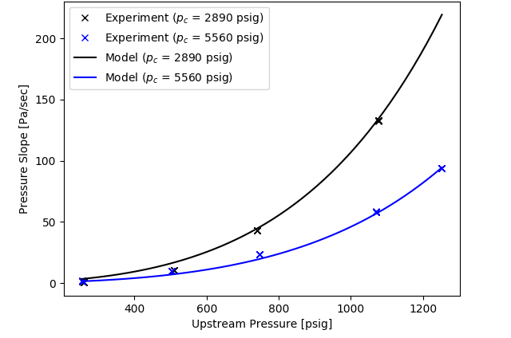
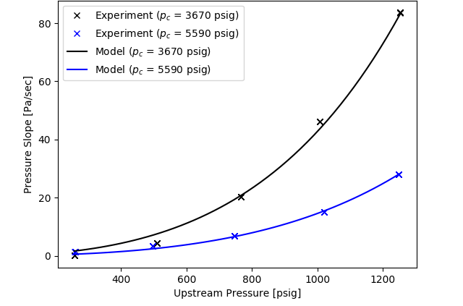
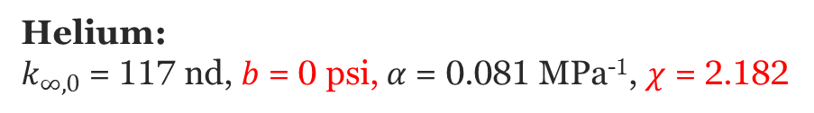
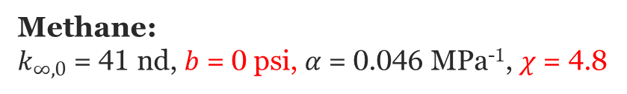
Results – Oriskany Sandstone
$${k= k}_{∞,0}\left(1+\frac{b}{p}\right)e^{−α\left(p_{c}−χp\right)}$$
$k_{∞,0}$ – Unconfined intrinsic permeability (m²)
$α$ – Confining-stress decay constant (Pa⁻¹)
$b$ – Klinkenberg coefficient (Pa)
$χ$ – Net confining stress deviation factor (-)
Methane:
$k_{∞,0}$ = 41 nd, $b$ = 0 psi, $α$= 0.046 MPa⁻¹, $χ$ = 4.8
Helium:
$k_{∞,0}$ = 117 nd, $b$ = 0 psi, $α$= 0.081 MPa⁻¹, $χ$ = 2.182

Slide 10
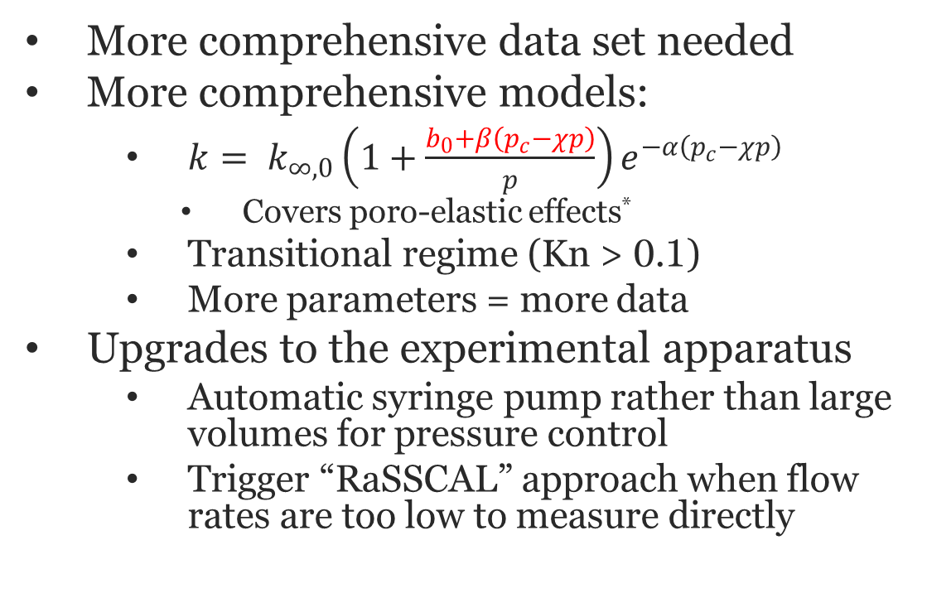
Future Work
More comprehensive data set needed
More comprehensive models:
${k= k}_{∞,0}\left(1+\frac{b_{0}+β\left(p_{c}−χp\right)}{p}\right)e^{−α\left(p_{c}−χp\right)}$
Covers poro-elastic effects*
Transitional regime (Kn > 0.1)
More parameters = more data
Upgrades to the experimental apparatus
Automatic syringe pump rather than large volumes for pressure control
Trigger “RaSSCAL” approach when flow rates are too low to measure directly
From Pump
Core Holder
Const.
Pressure
H
L
DP Transmitter
Thanks for your time!
Any questions?
*Fink et al. Apparent permeability of gas shales – Superposition of fluid-dynamic and poro-elastic effects. *Fuel (2017). 199:532–550. https://doi.org/10.1016/j.fuel.2017.02.086

