Slide 1
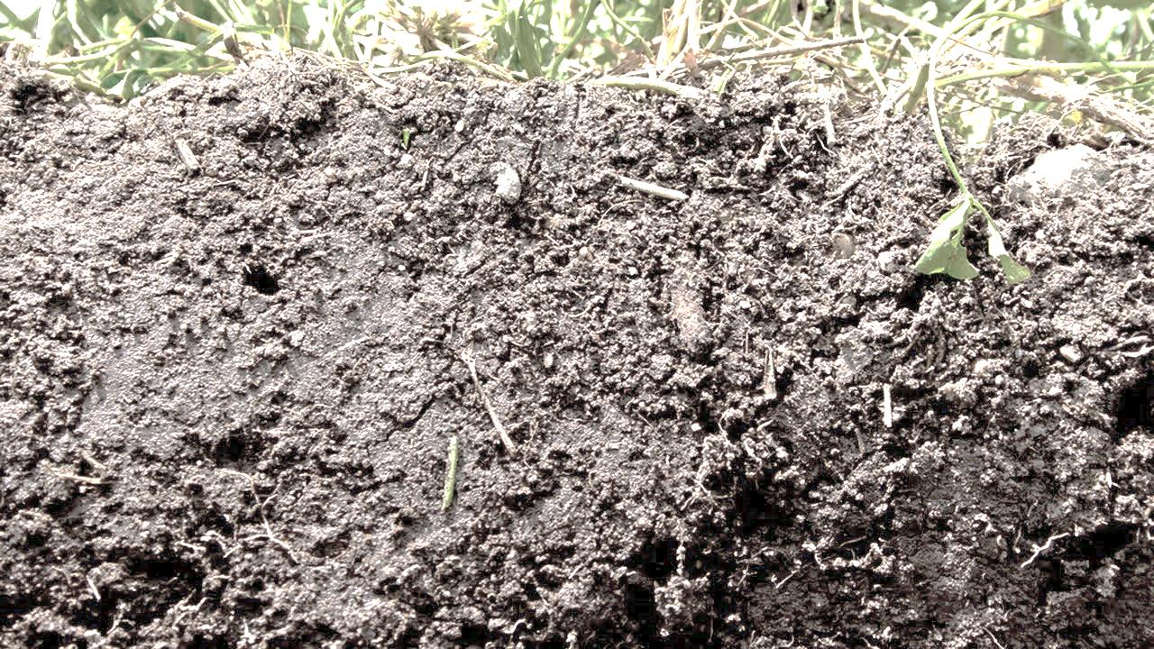


The Effect of Unregulated Discharges Into Urban Lakes and Ponds of Freshwater Ecosystem
VIMAL N. SOOMAI, ANDREW L. LEUNG and RATAN DHAR
Vimal N. Soomai Undergraduate(Environmental Health Science Major)
Earth and Physical Sciences School of Arts and Sciences

Slide 2
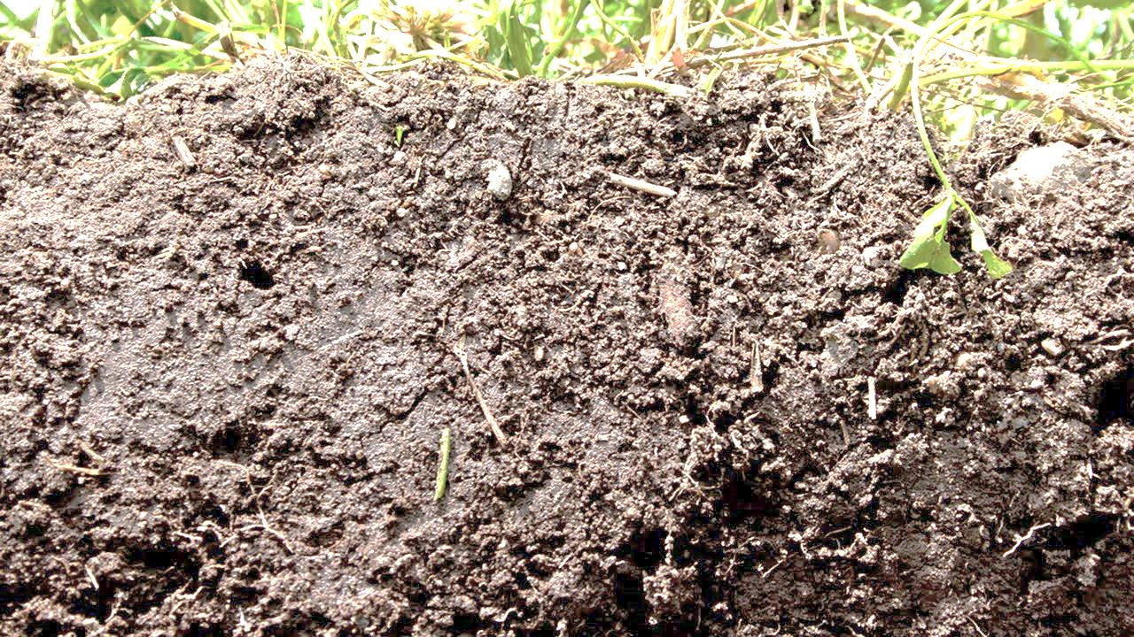
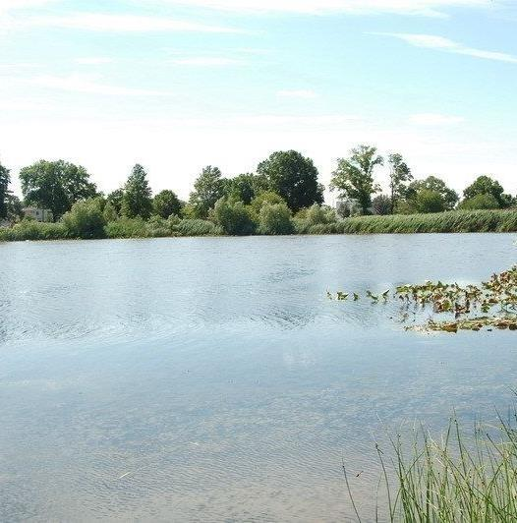
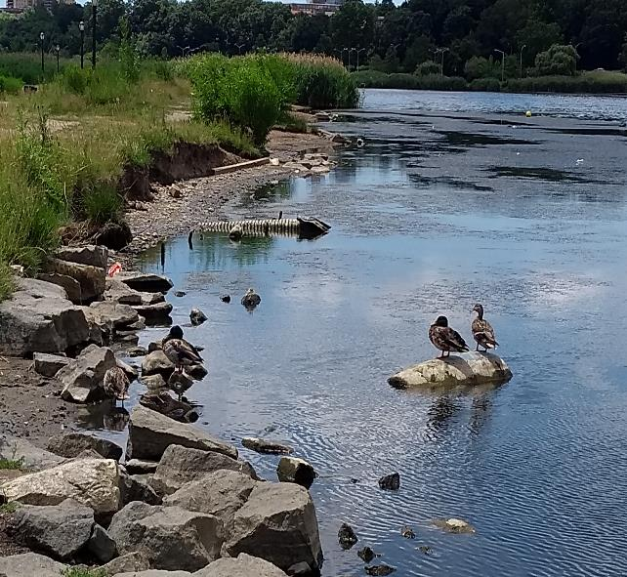
In urban areas experiencing growth in population, anthropogenic activity is also partially responsible for the organic materials and nutrients which directly affect soil and water bodies.
Motivation
Experiencing rapid growth of population in urban areas like NYC, anthropogenic impacts on the environment via increased recreational activities in public parks and lake causes excessive organic and nutrients loads in the water bodies.
Due to rapid urbanization NYC particularly in Queens areas often experience street flooding from CSO overflowing. Consequently raw sewage gets into the public water body and its adjacent soils. This study reported the impact of unregulated water in NYC’s recreational properties.
https://www1.nyc.gov/assets/planning/download/pdf/data-maps/nyc-population/projections_report_2010_2040.pd

Slide 3
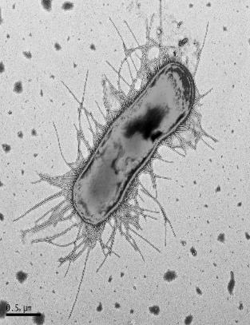
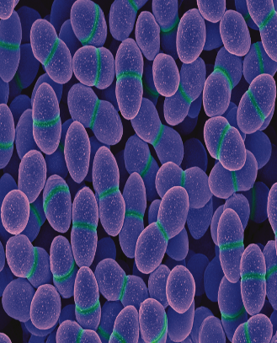
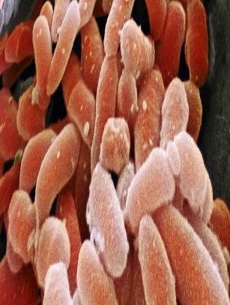
Fecal Indicator Bacteria (FIB)
Coliforms (total coliforms, E. coli) and fecal streptococci (enterococci), are used as indicators of possible sewage contamination because they are commonly found in human and animal feces. Pathogenic micro-organisms are associated with fecal waste and can cause a variety of diseases (typhoid, cholera, hepatitis) either through the ingestion of contaminated water or the consumption of contaminated shellfish.

Slide 4
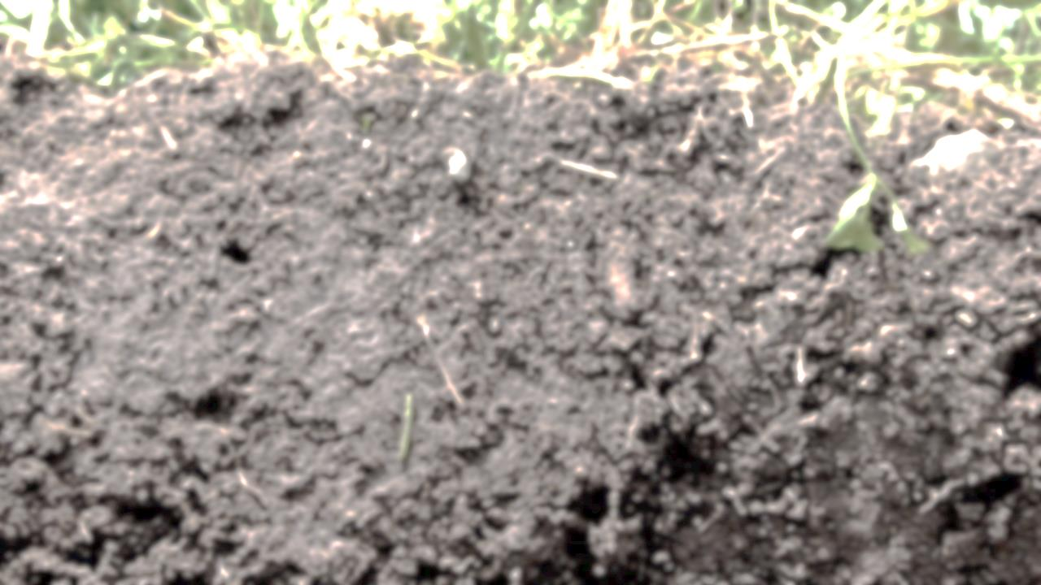
Hypothesis: Unregulated discharge, occurring via frequent flooding in Queens county of New York City often causes intense surface runoff and sub-surface flow. Consequently this organic and nutrient rich sewage-mixed water containing high level of Fecal Indicator Bacteria (FIB) could cause the enrichment of total coliform, E. Coli and Enterococci in the freshwater ecosystem.
Objective: The main objective of this study is to examine the occurrence and progression FIBs in lake soils and water environment.

Slide 5
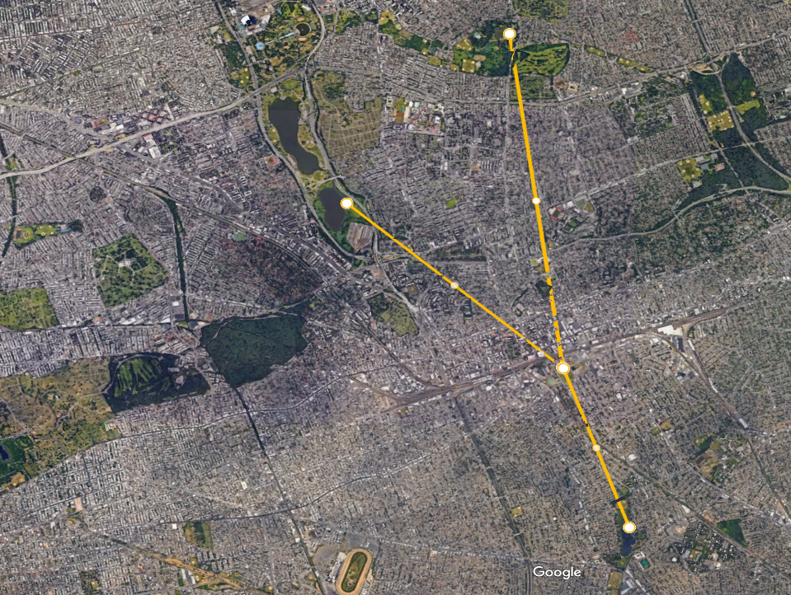
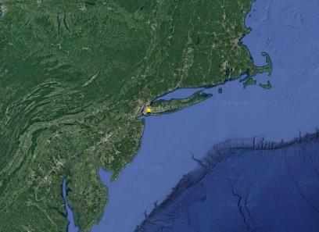
Kissena Park
Flushing Meadow Lake
North-Eastern U.S
York College
Baisley Park

Slide 6
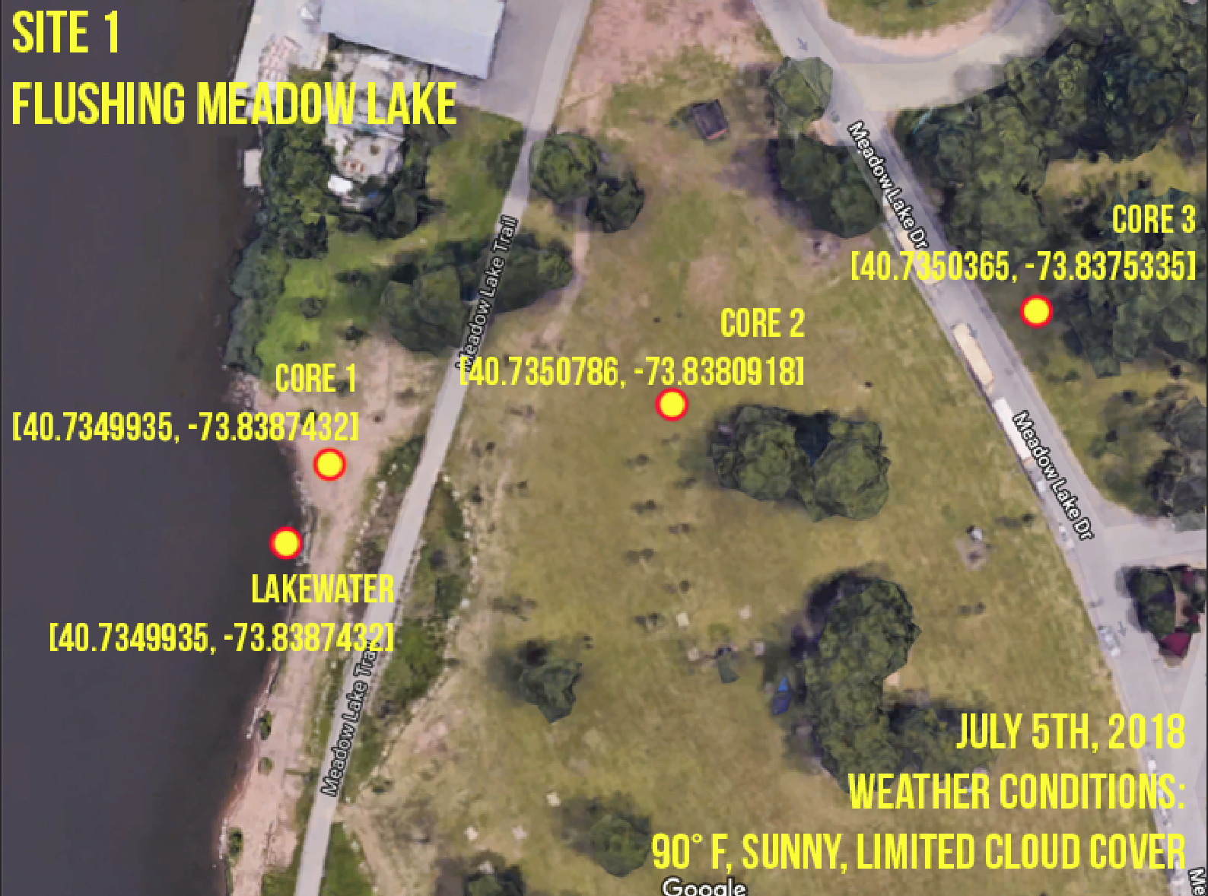

Slide 7
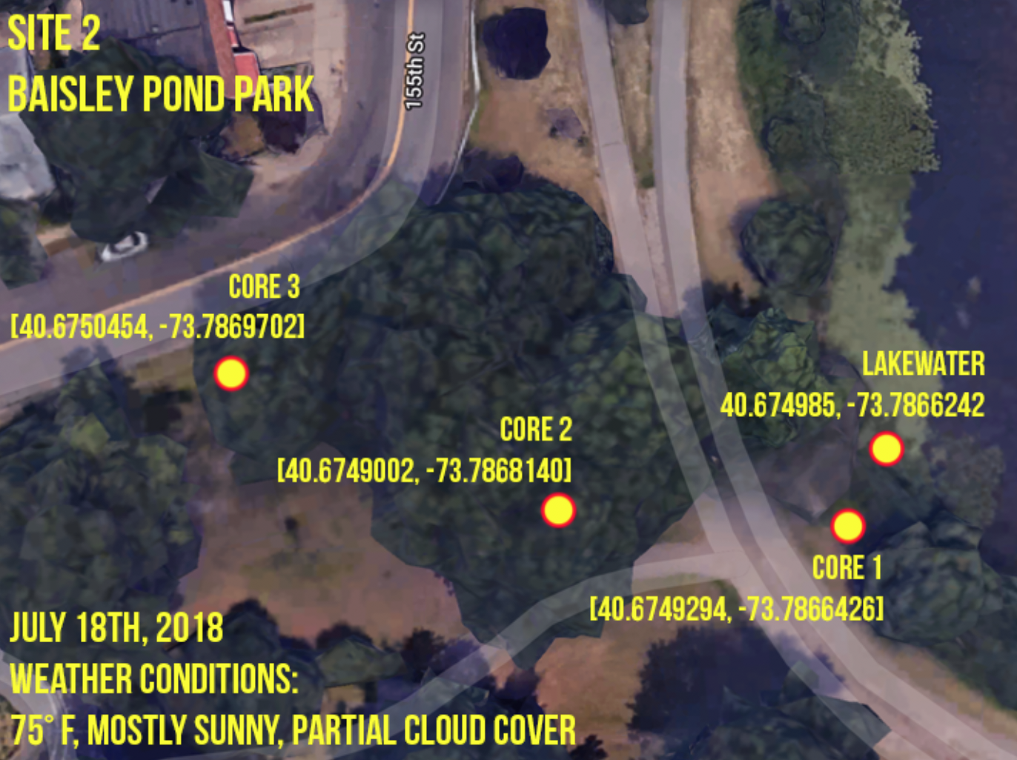

Slide 8
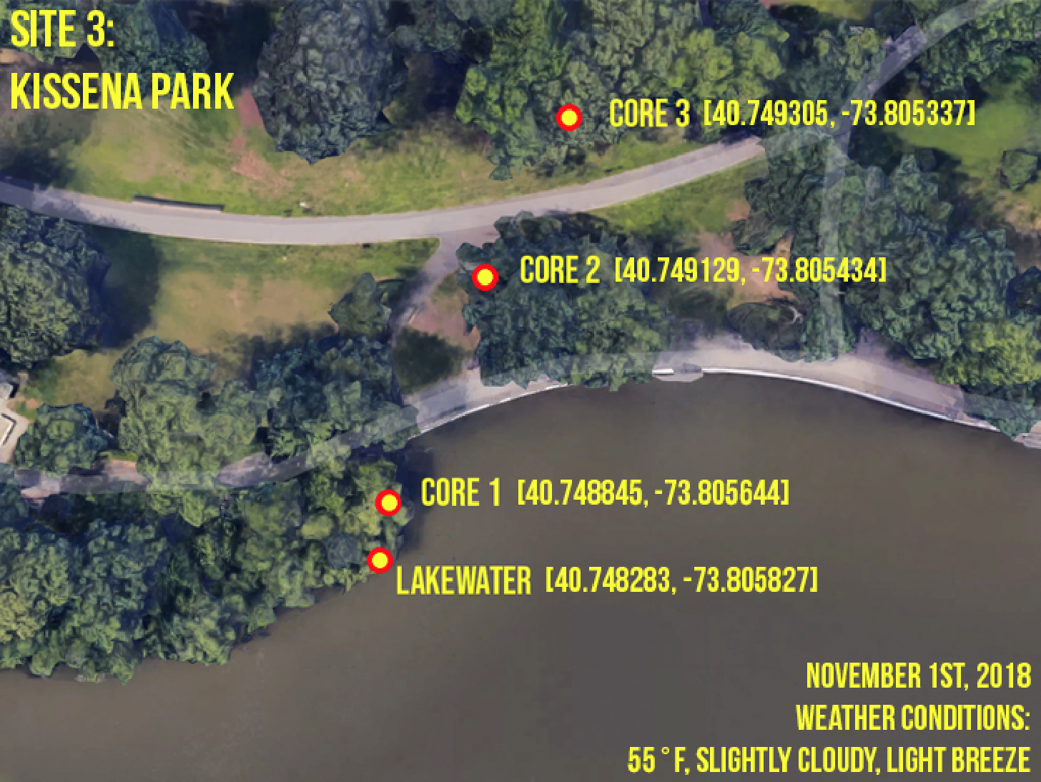

Slide 9
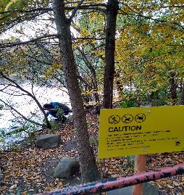
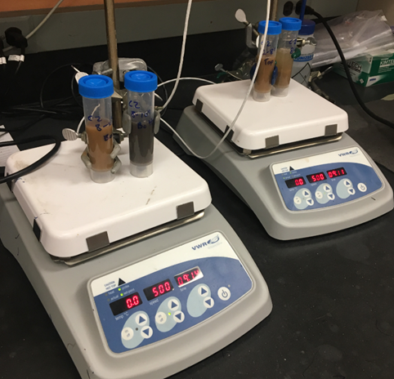
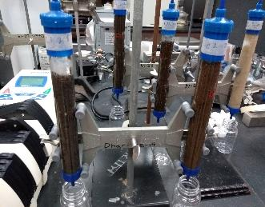
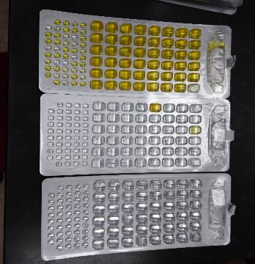
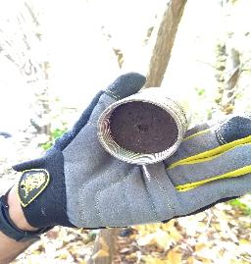
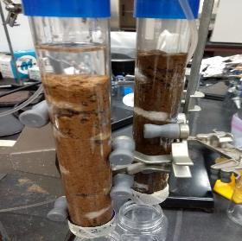
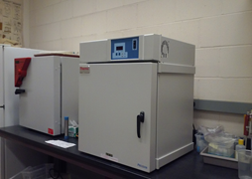
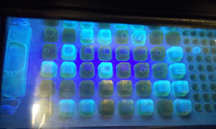
METHODOLOGY (EPA APPROVED IDEXX METHOD)
COLLECTION OF SAMPLES
BATCH EXPERIMENTS
COLUMN EXPERIMENTS
MICROBIAL COUNTS

Slide 10
RESULTS: FLUSHING MEADOW LAKE

Slide 11
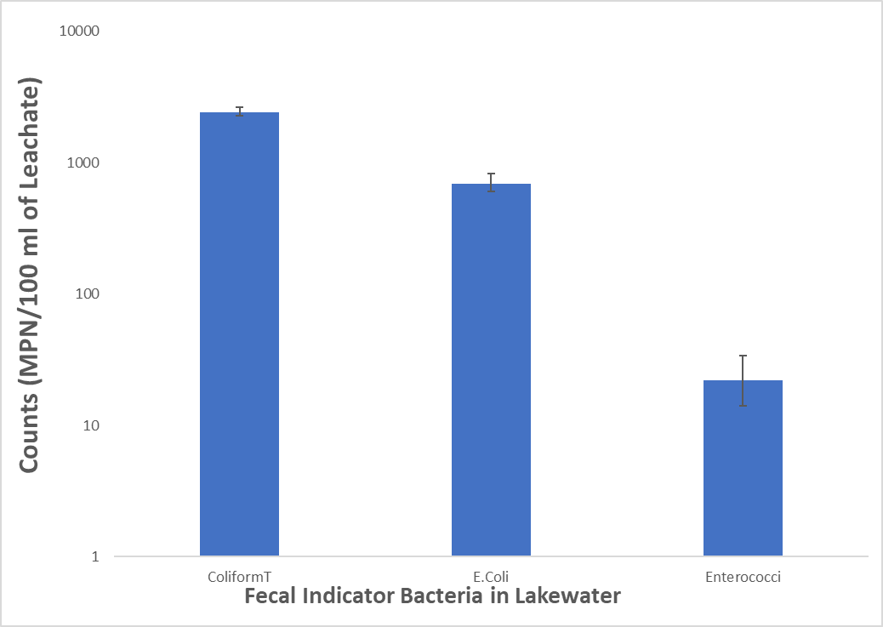
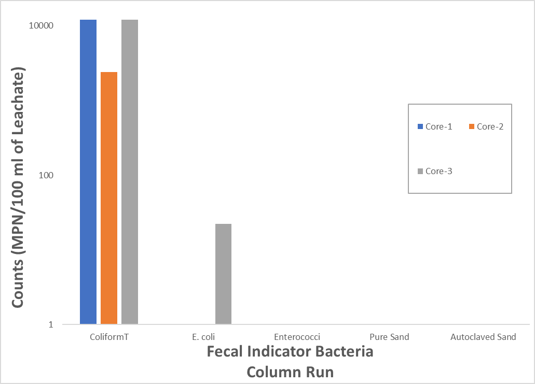
RESULTS:
FLUSHING MEADOW LAKE

Slide 12
RESULTS: BAISLEY POND PARK

Slide 13
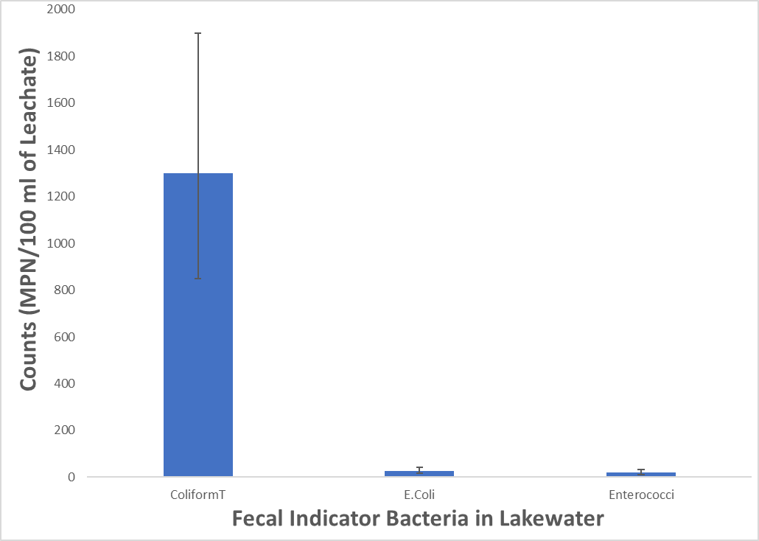
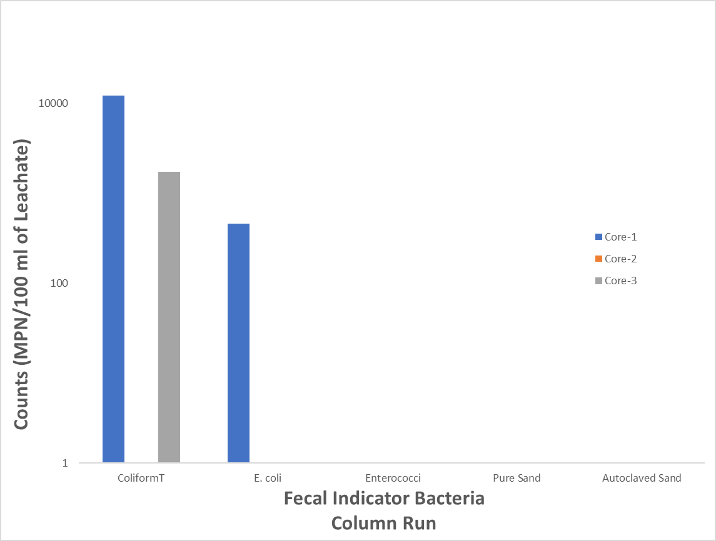
RESULTS: BAISLEY POND PARK

Slide 14
RESULTS: KISSENA PARK

Slide 15
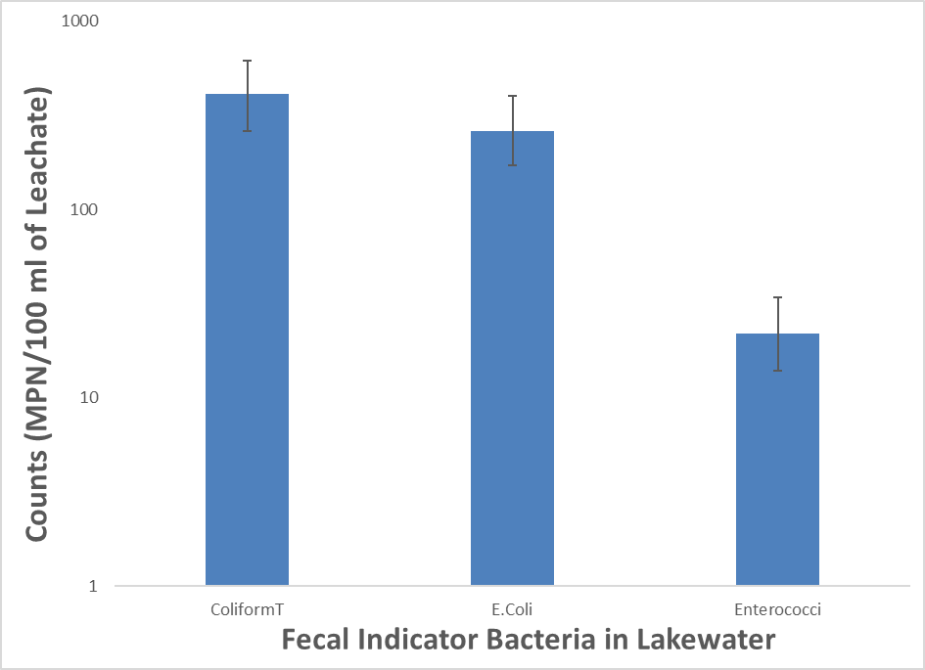
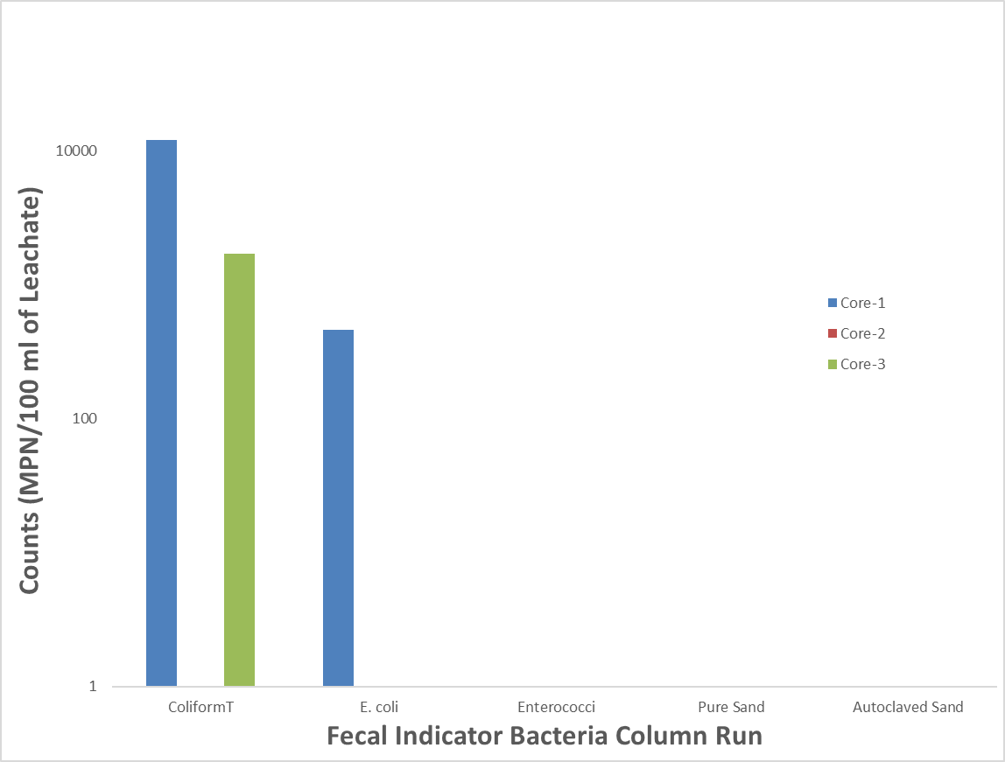
RESULTS: KISSENA PARK

Slide 16
Summary
FIB counts in water and adjacent soils are consistently higher in total coliform in all three parks.
Preliminary results from this short term study suggest that park soil could retain the significant number of FIBs that can result in elevated microbes in adjacent water body.
Both batch and column experiments released the microbes rather slow in column experiments.
There is no consistent spatial and vertical pattern observed in occurrence of FIBs suggesting the inconsistent variation in water FIB counts may be due to contribution from adjacent soils as secondary source of FIBs.

Slide 17



THANKS !!!
US Department of Education

Slide 18
References
[1] Steinberg, N., D.J. Suszkowski, L. Clark, and J. Way. 2004. Health of the Harbor: the first comprehensive look at the state of the NY/NJ Harbor Estuary. Report to the NY/NJ Harbor Estuary Program. Hudson River Foundation, New York, NY.
[2] DeFabio, D., Beauzile, W. and Dhar, R. K. 2011. Water Quality of Brackish Water in Jamaica Bay: Monitoring of Nutrients and Fecal Indicator Bacteria (FIB) " Long Island Sound biennial research conference proceedings, ISBN – 13 978-0-9802026-4-9, 9-14.
[3] Byappanahalli, M. N., and R. S. Fujioka. 1998. Evidence that tropical soil can support the growth of Escherichia coli. Water Sci. Technol. 38:171–174.
[4] Desmarais, T. R., H. M. Solo-Gabriele, and C. J. Palmer. 2002. Influence of soil on fecal indicator organisms in a tidally influenced subtropical environment. Appl. Environ. Microbiol. 68:1165–1172.
[5] Davies, C. M., J. A. Long, M. Donald, and N. J. Ashbolt. 1995. Survival of fecal microorganisms in marine and freshwater sediments. Appl. Environ.Microbiol. 61:1888–1896.
[6] Sherer, B. M., J. R. Miner, J. A. Moore, and J. D. Buckhouse. 1992. Indicator bacterial survival in stream sediments. J. Environ. Qual. 21:591–595.
[7] Dhar, R.K. and U. Ghosh, 2012. " Detection of fecal indicative bacteria (FIB) in an urban environment of Bowne Pond park at Flushing, New York City, USA." Geological Society of America Annual Meeting & Exposition. 44(7), 111. Nov. 4-7.

