Slide 1
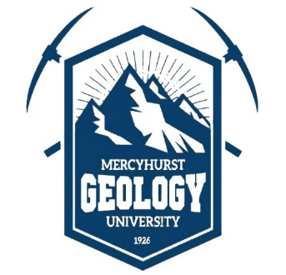

MORPHOLOGIC MEASUREMENTS OF EDIFICES IN THREE TERRESTRIAL BASALTIC VOLCANIC FIELDS: IMPLICATIONS FOR THEIR USE AS ANALOGS TO VENUSIAN SHIELD FIELDS
By Joseph McCarthy, Nicholas Lang, Cole Nypaver, and Bradley Thomson
Mercyhurst University Department of Geology, University of Tennessee Department of Earth and Planetary Sciences

Slide 2
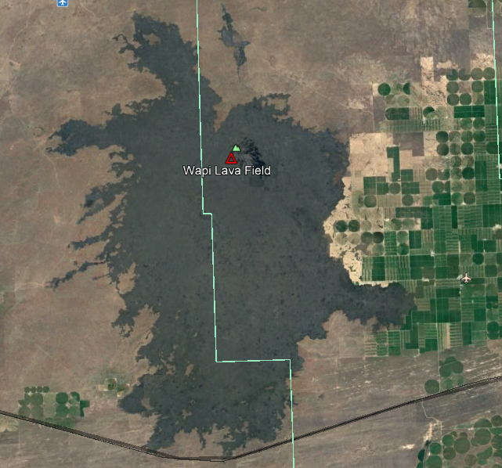
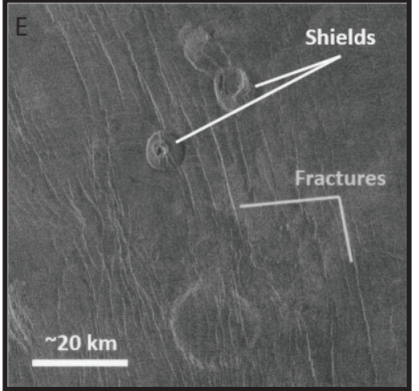
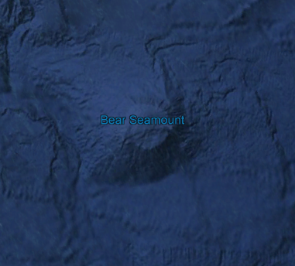
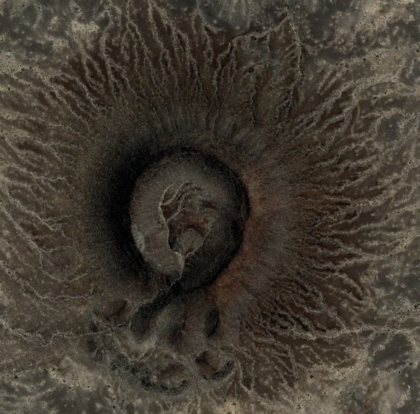
Background/Motivation
Proposed analogs:
Wapi Lava Field,
(Low Shield) Snake River Plain. Guest et al., 1992
Bear Seamount-New England Seamount Chain. Smith, 1996
Cinder Cone, Pinacate. Guest et al, 1992
Small volcanoes on Venus are abundant (x>10^6) Origin unclear. Terrestrial analogs provide possible way to further our understanding.

Slide 3
Background/Motivation
N
200 ft
Here, we are investigating morphologic similarities between Venus small edifices and terrestrial cinder cones.

Slide 4
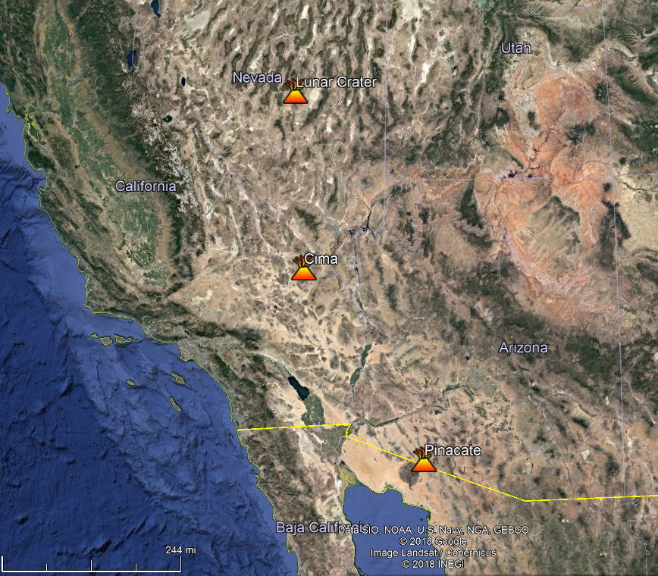
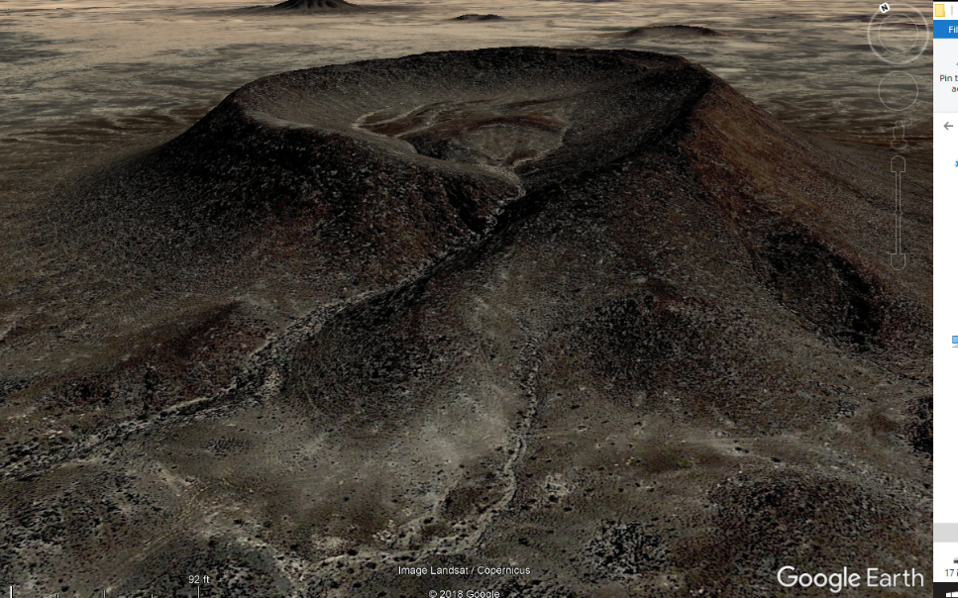
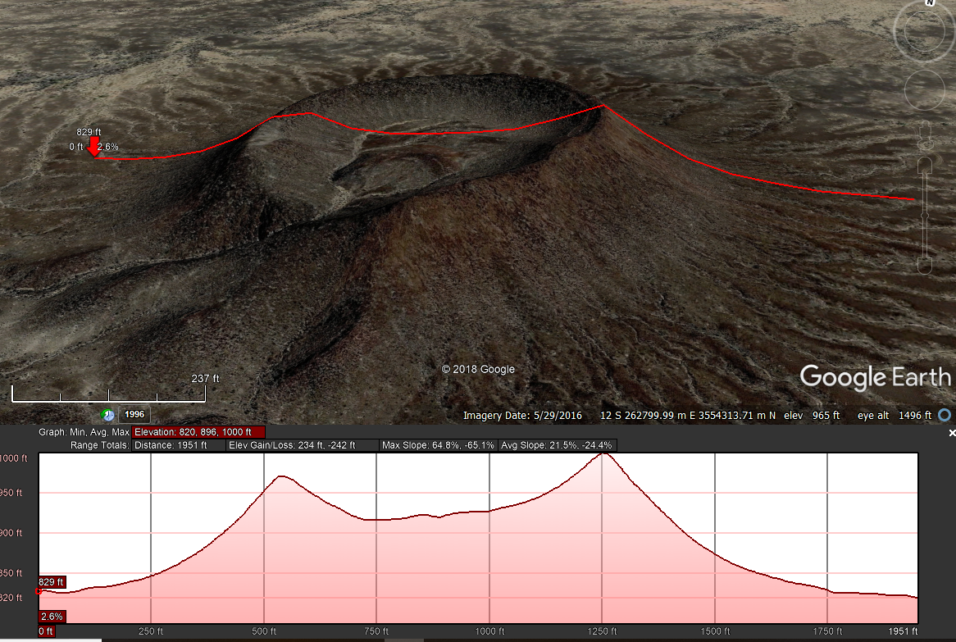
Methods
To get our data, we measured the heights, radius, volume, area, and slope of three terrestrial volcanic fields.
We measured 60 cones in each field to keep our data consistent

Slide 5
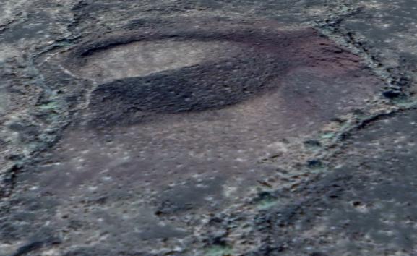
Basaltic Volcanic Field Locations
We choose 3 different fields on Earth, the Cima in California, Pinacate in Northern Mexico, and Lunar Crater in central Nevada.
We choose fields that had a lot of well-defined edifices that were mostly Pleistocene to Holocene in age.
We left out some of the older, eroded edifices, as they were hard to measure.
Limitations:
Measurements are approximated.
Google Earth, while a very useful tool, is also not always exact.
This cone, for example, clearly has vertical relief, but Google Earth renders it as 100% flat.

Slide 6
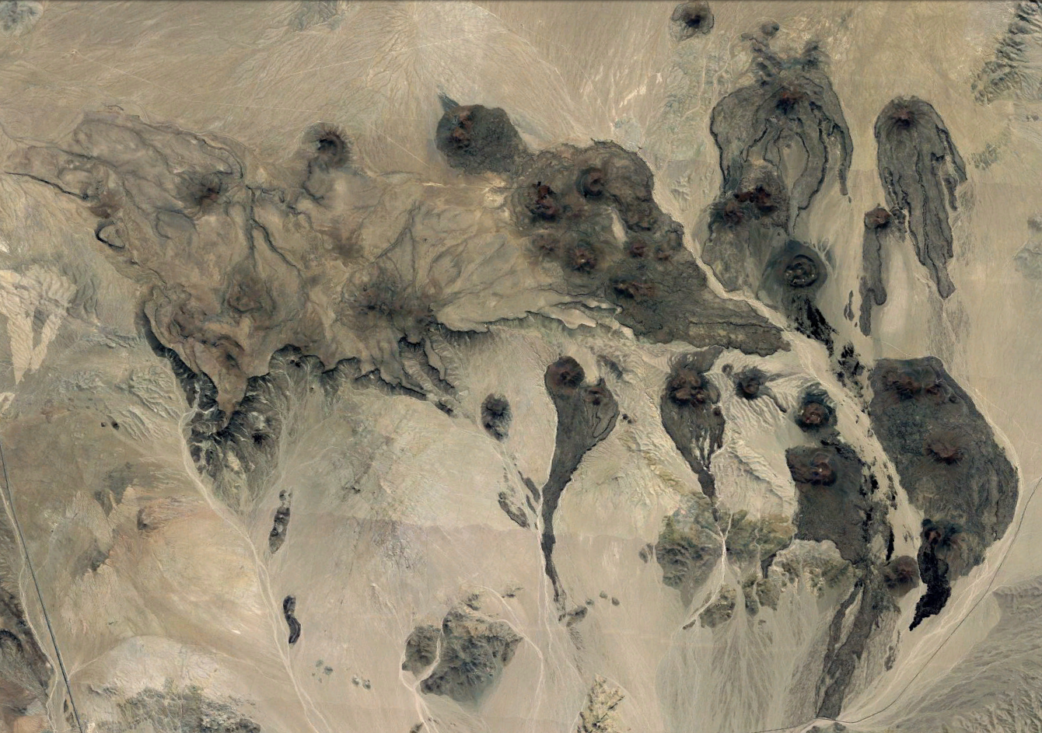
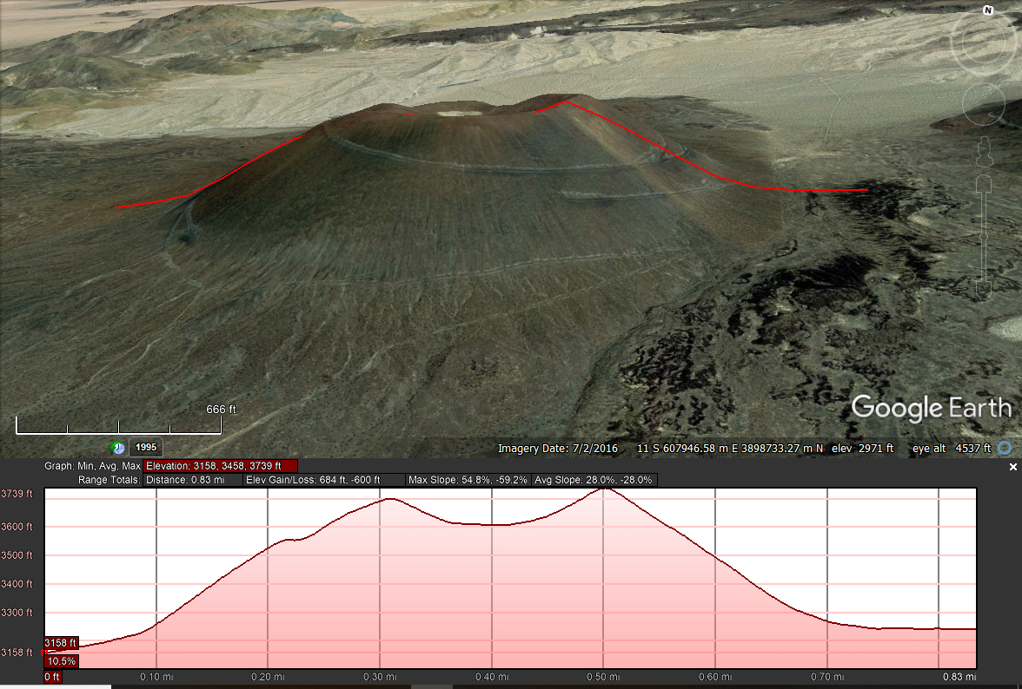
Cima
A Quaternary Volcanic field in California. Related to Basin and Range extension. Mostly small to large scoria cones. It is unknown if future eruptions will occur.
I measured 60 cones, although some of the older. Eroded edifices were left out of the final data, as they were hard to measure.
Most of the cones are early Pleistocene to early Holocene in age
The average radius of the tops of the cones was 118 meters, and the average height was 72 meters. The average slope was 13.68 degrees, and the average area was .3 km^2
N
3.7 mi

Slide 7
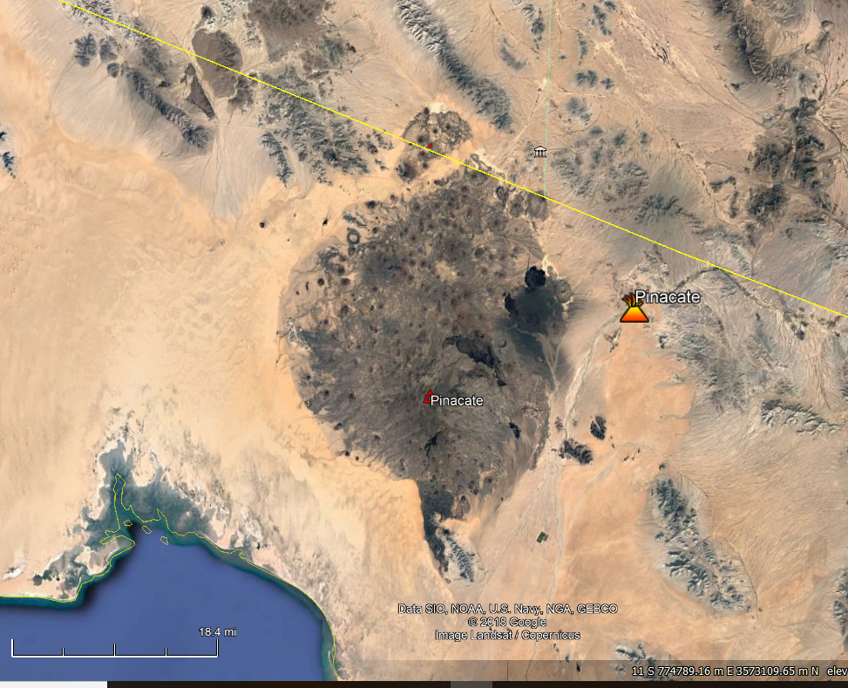
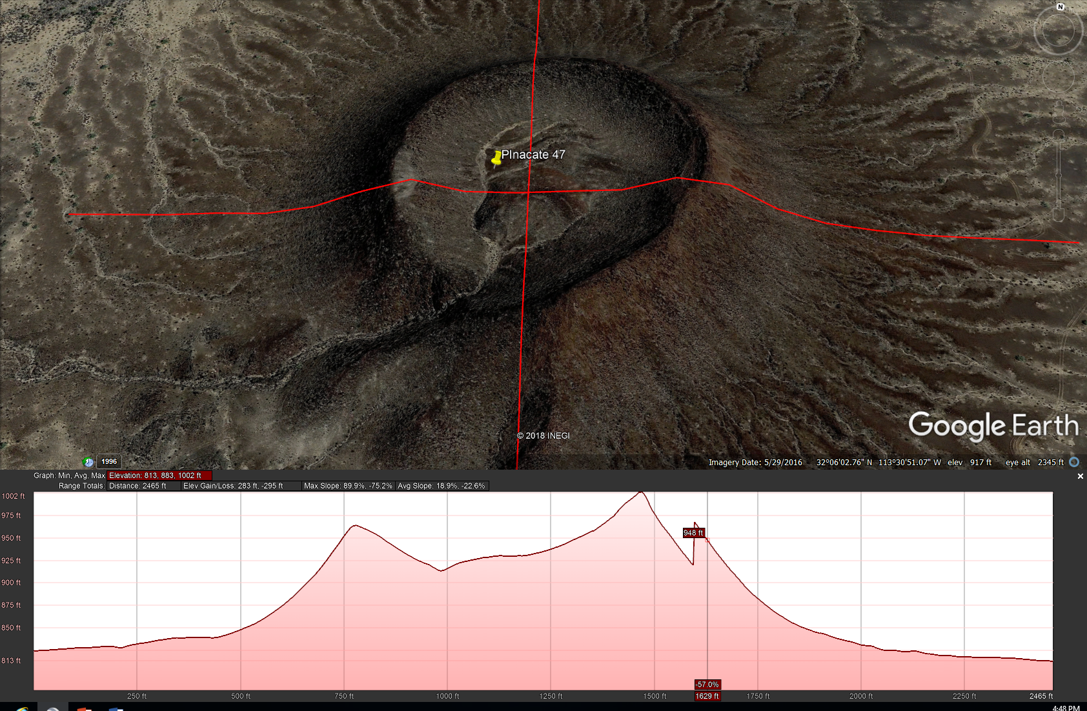
Pinacate
N
The Pinacate Volcanic Field is a Pliocene-Holocene field related to basin and range extension, located in an arid region of Northwestern Mexico close to the US border. The field itself is a large shield volcano flanked by hundreds of cinder cones, maars, and small splatter cones. It is currently dormant.
For Pinacate, I measured 60 edifices.
The average slope was 13.41 degrees, and the average area was .3 km^2
The average top radius was 138 meters, and the average height was 76 meters.
250 ft

Slide 8
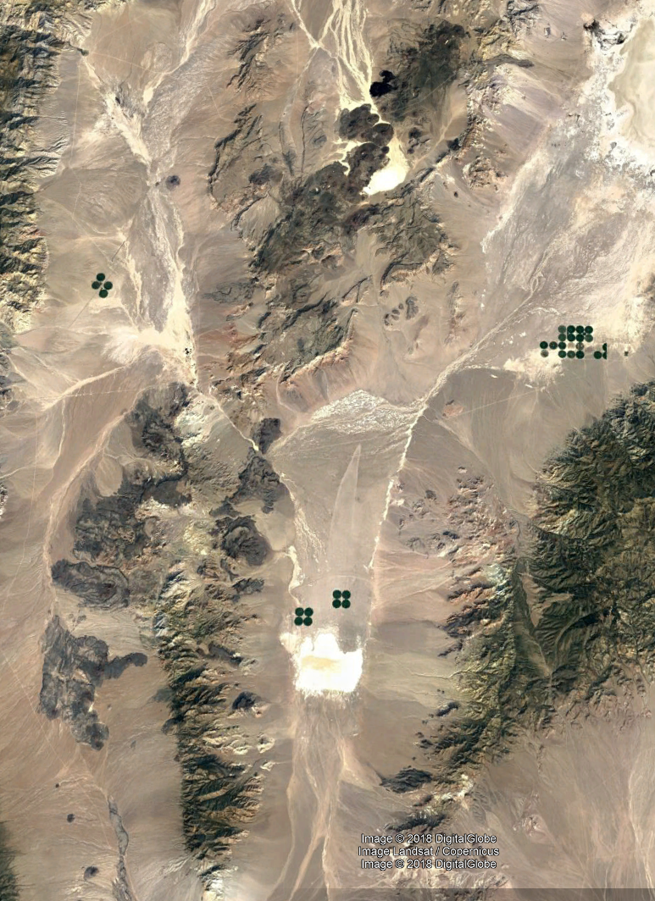
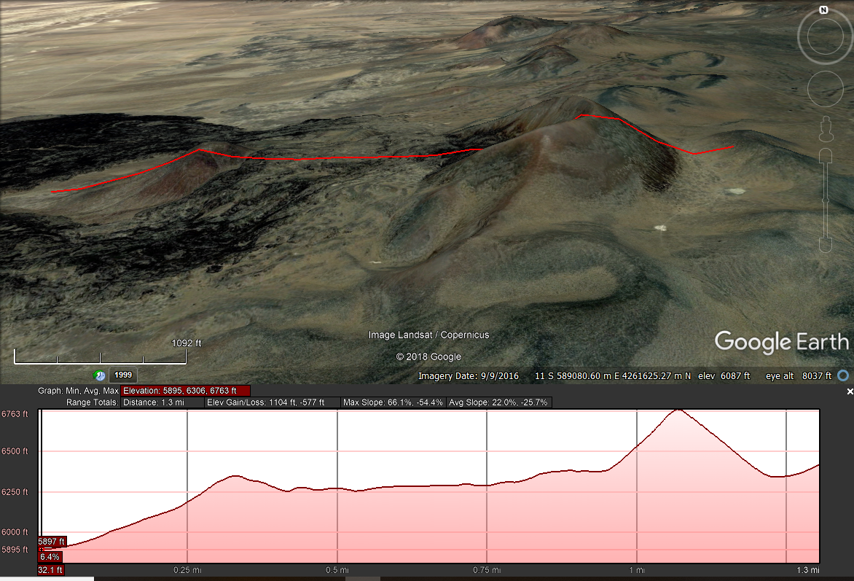
Lunar Crater
N
A late Miocene-Late Pleistocene volcanic field in central Nevada. Volcanism is related to extension of the Basin and Range province.
The volcanic field is made up of scoria cones, maars, splatter cones, and fissure vents.
Most of the vents to the SW were left out of the data, as they are heavily eroded, and some of them are buried by basin fill as a result of normal faulting
The average radius was 135 meters, and the average slope was 10 degrees.
The average area was .27 km^2, and the average height was 57 meters.
Geologists speculate that this field may only be dormant and might have future eruptions.
For this volcano, I measured 60 edifices.
(Valentine, 2017)
3.4 mi

Slide 9
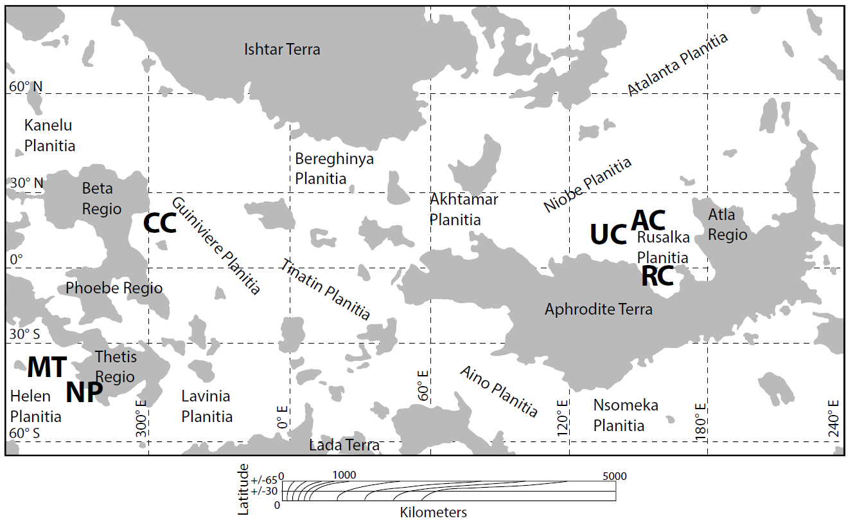
Venusian Fields (Nypaver et al., 2018)
From Nypaver et al., 2018
CC = Chernava Colles (n=5)
AC = Asherat Colles (n=2)
NP = Nordenflycht Patera (n=3)
UC = Urutonga Colles (n=2)
MT = Monoshi Tholus (n=4)
RC = Ran Colles (n=4)

Slide 10
Venusian Fields
We compared our data to 6 shield fields on Venus- Asherat, Chernava, Monoshi, Nordenflycht, Ran, and Urutonga.
The shields on Venus were much larger than the scoria cones on Earth. This is likely the result of the different kind of plate tectonics on Venus, and the different kinds of eruptions that formed the shields on Venus vs the cinder cones on Earth.
Venusian volcanoes also have much longer eruption cycles
From Nypaver et al., 2017

Slide 11
Conclusion and charts
We concluded that while fields on Earth can be used as analogs to fields on Venus, one must take into account the differences in geology between the two planets.
The volcanoes on Venus are overall much larger than volcanoes on Earth
The next graph shows that the three fields on Earth are all are similar in size. Research done on cinder cones in the Snake River Plain fill the gap between the other three fields and the Venusian fields.

Slide 14
References/questions?
Guest, J.E., Bulmer, M.H., Aubele, J., Beratan, K., Greeley, R., Head, J.W., Michaels, G., Weitz, C., and Wiles, C., 1992, Small volcanic edifices and volcanism in the plains of Venus: Journal of Geophysical Reasearch
Nypaver, Cole, et al. “Geologic mapping, morphometric characterization, and statistical analysis of six Venusian shield fields. Insights into the processes related to their formation” 2018
Pike, Richard J, et al. “Volcanoes on the inner planets: Some preliminary comparisons of gross topography” U.S Geological Survey, 1978
Smith, K Deborah, et al. “Comparison of the shapes and sizes of seafloor volcanoes on Earth and pancake domes on Venus”. Jornal of Volcanology and Geothermal Reasearch, Sep 1996
Valentine, Greg A., et al. “Lunar Crater Volcanic Field (Reveille and Pancake Ranges, Basin and Range Province, Nevada, USA).” Geosphere, vol. 13, no. 2, Apr. 2017, pp. 391–438. EBSCOhost, doi:10.1130/GES01428.1.

