Slide 1


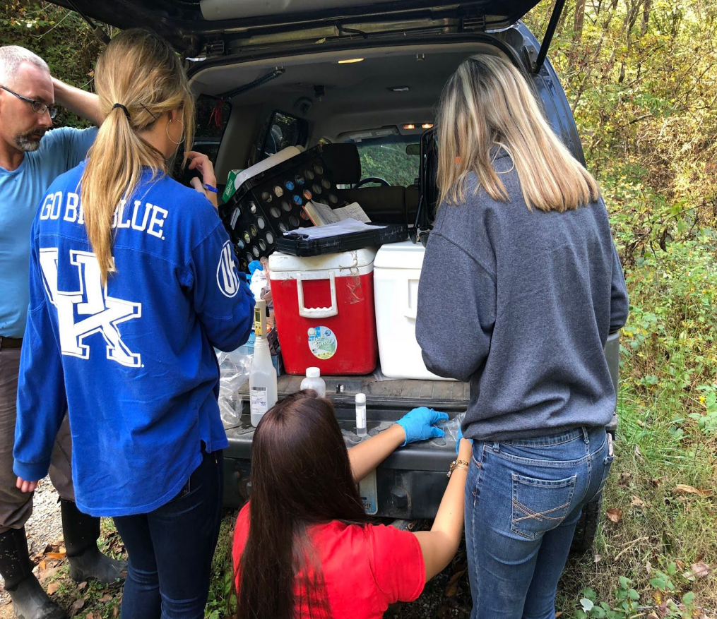
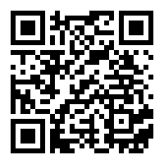
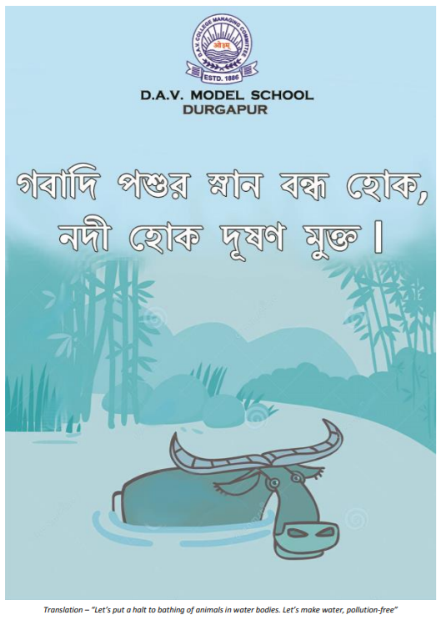
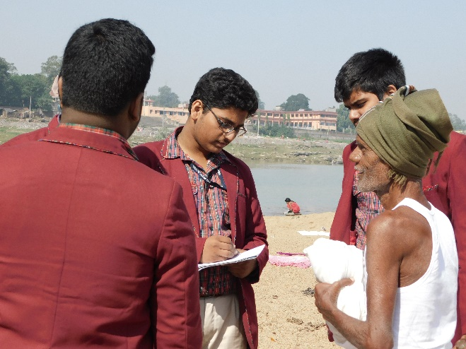
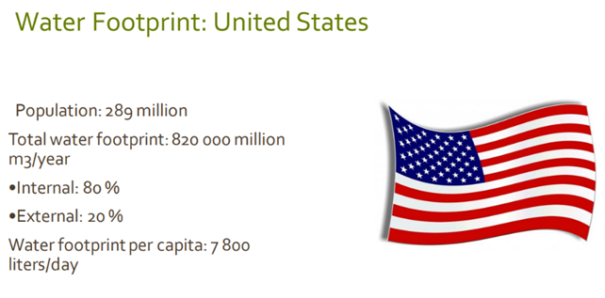
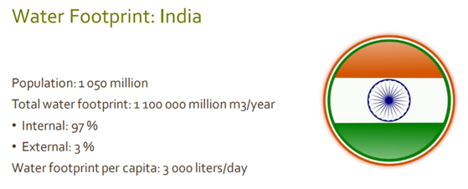
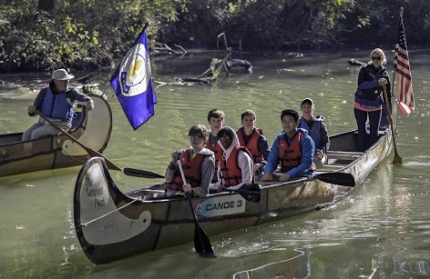
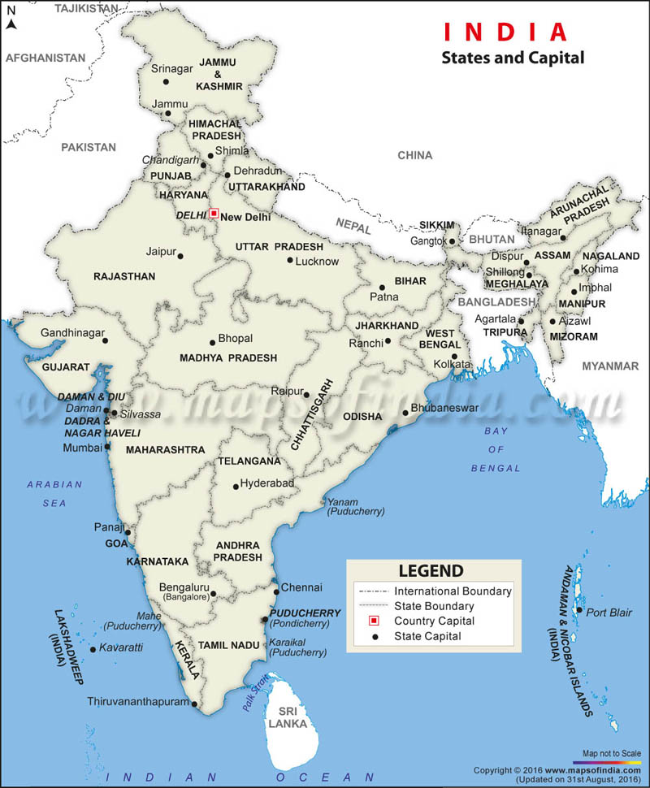
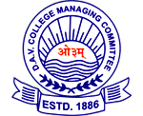

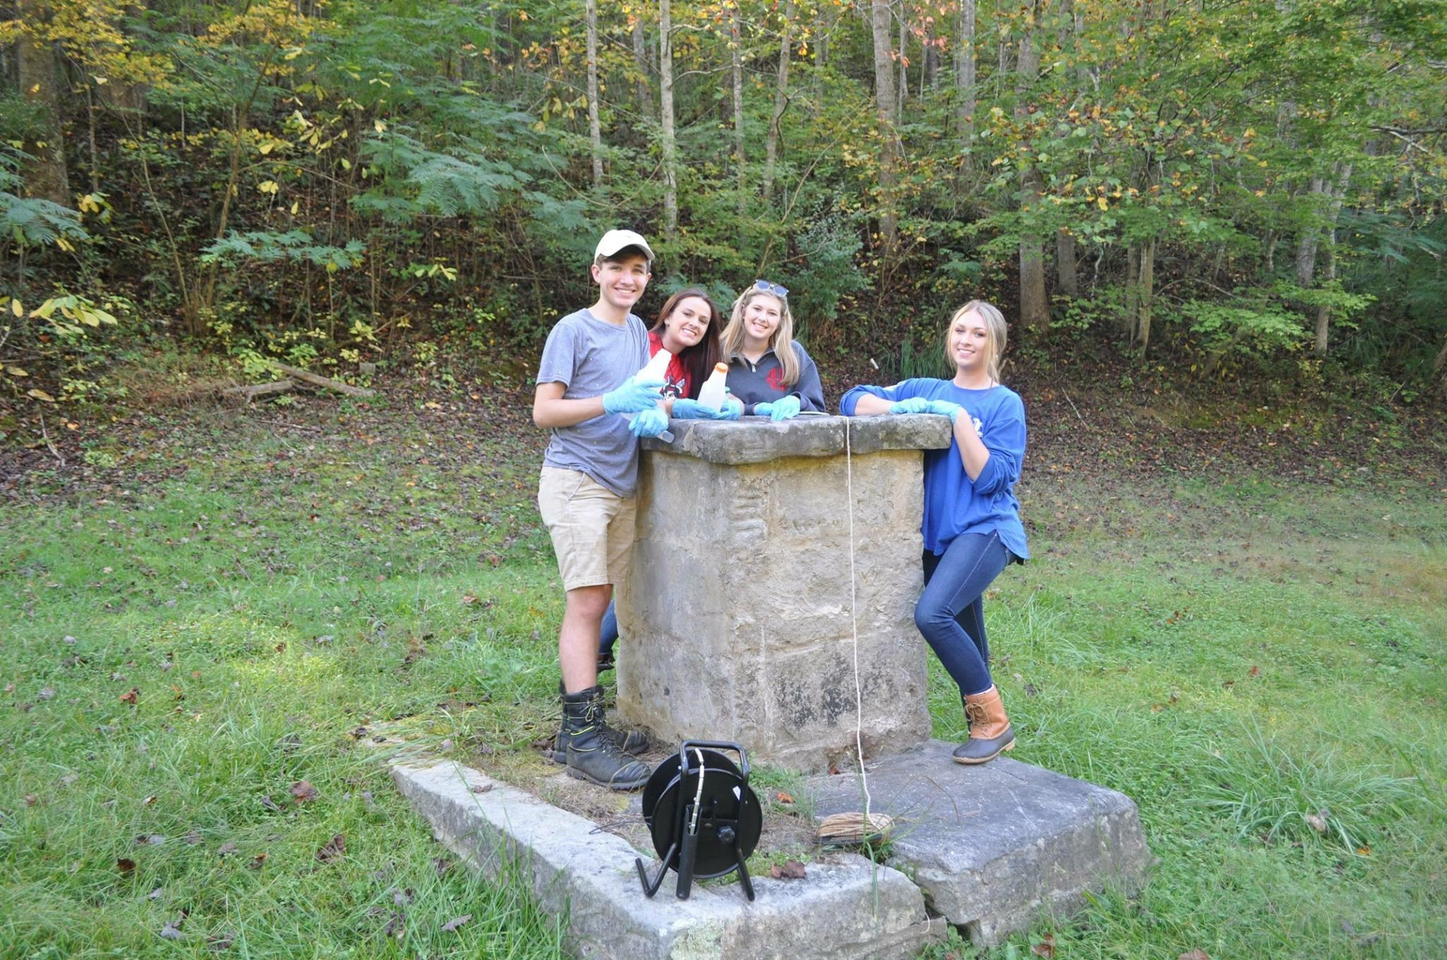
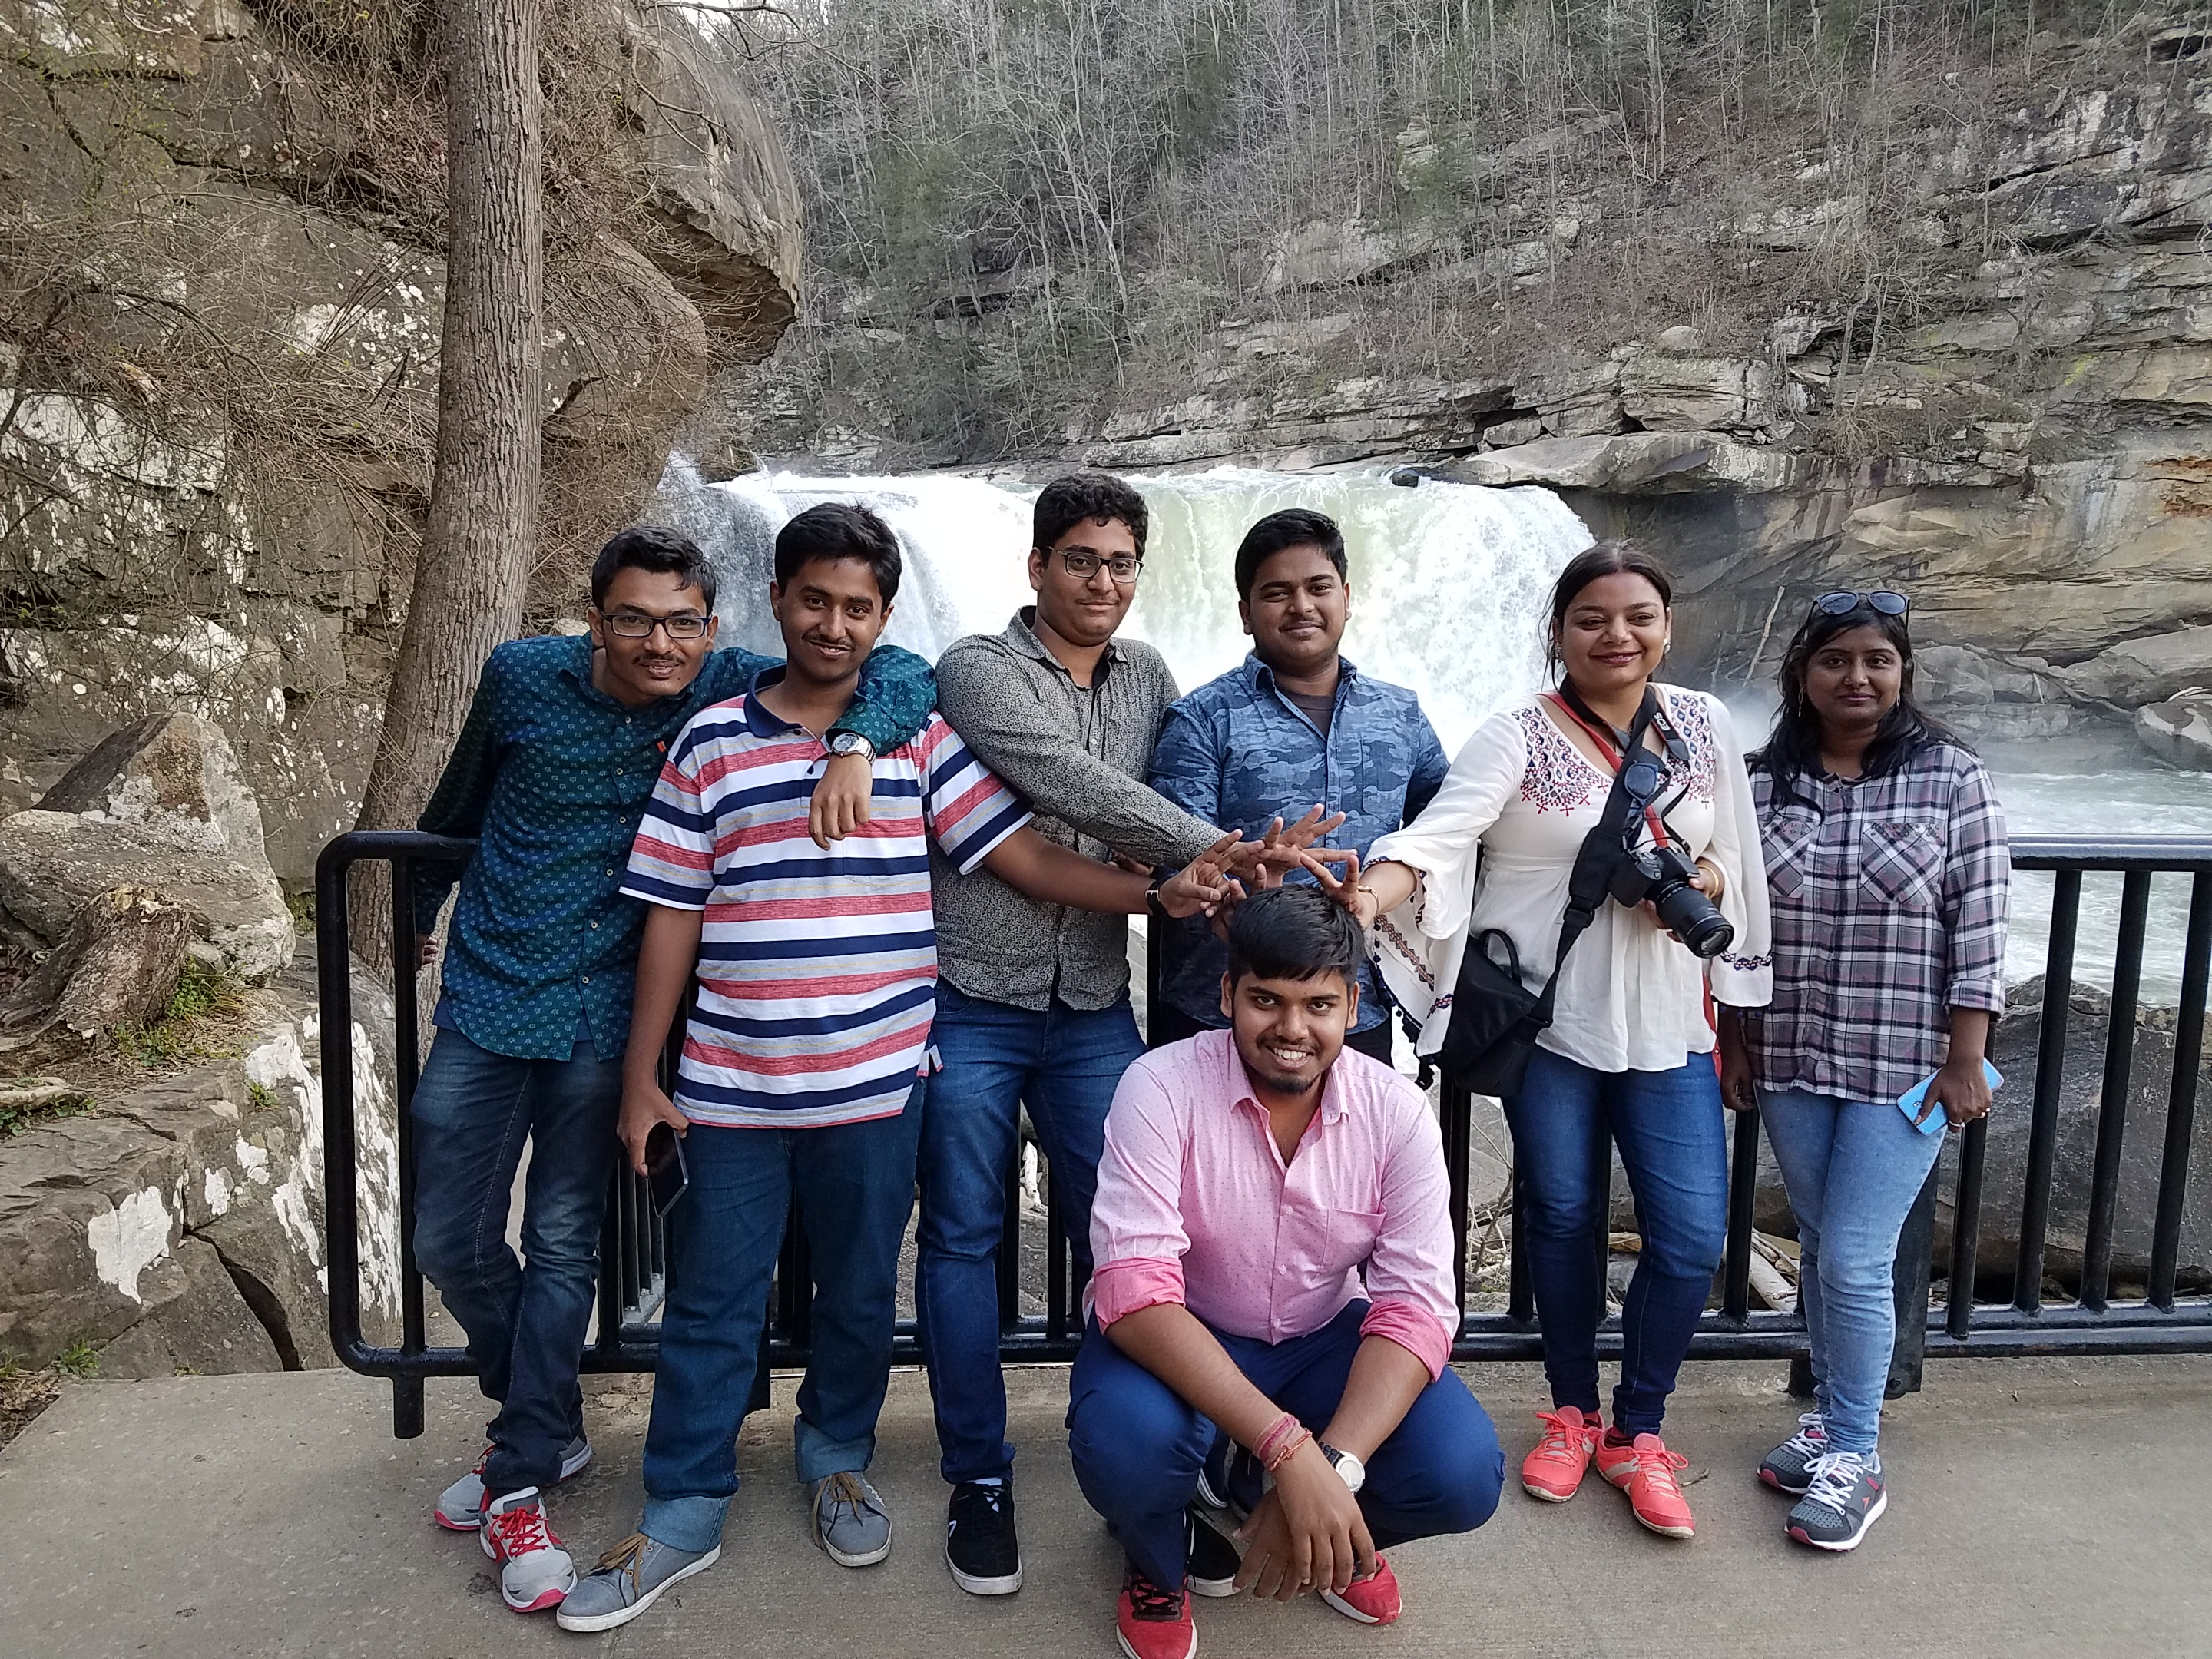
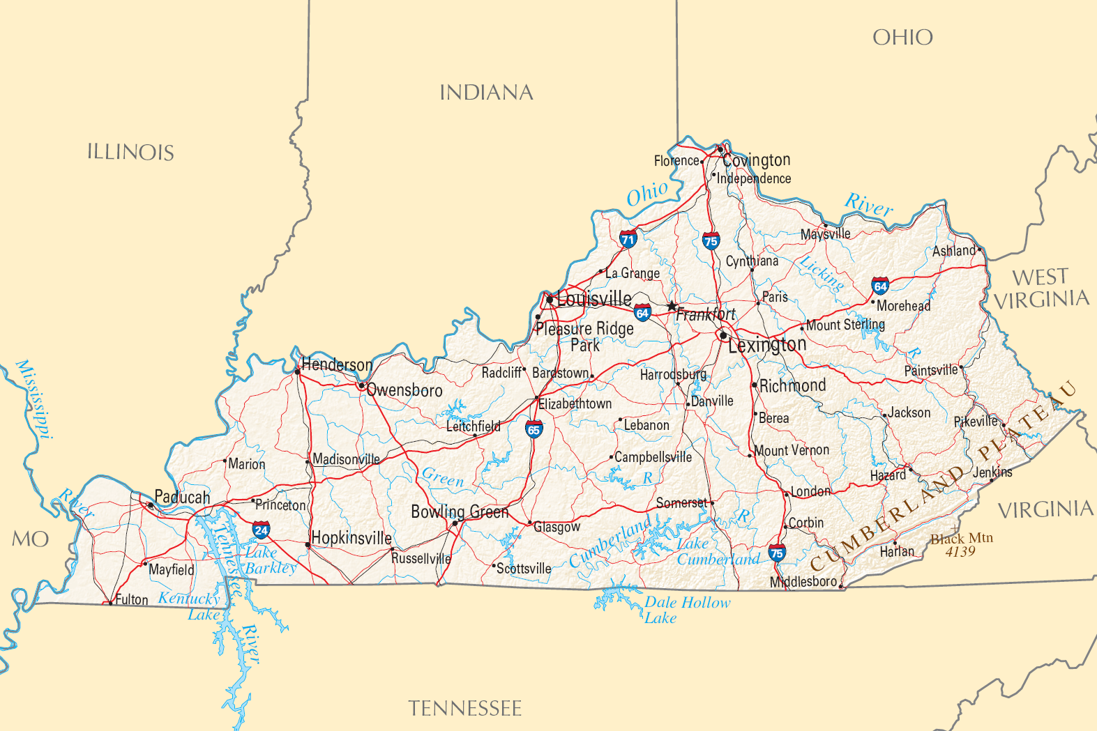
WIIKY (Water in India and Kentucky): Integrating Field Experiences with an Online Platform for High School Classes
Alan E. Fryar¹, Rebecca L. Freeman¹, Carol D. Hanley², and Amanda R. Sherman¹
¹Department of Earth and Environmental Sciences and ²College of Agriculture, Food and Environment, University of Kentucky
Rationale
Project Structure
Publicity Examples
Maintaining access to sufficient quantities of clean water for human and environmental needs, while minimizing water-related hazards, is challenging in both developing and developed countries.
To address these problems, education and community engagement are critical.
Statistically validated, multiple-choice pre- and post-tests on (1) aspects of the water cycle and pollution and (2) environmental awareness
Three modules, each with learning objectives; narrated slideshows explaining concepts with specific examples from India and Kentucky; activities to interpret online data sets from each region; and wiki and summary projects
Module 1: Water on our Planet
Module 2: Problems with Water
Module 3: Humans and Water
“Learning the basics of water analysis”: The Hindu (Chennai, India), December 22, 2017
“Winners of schools from West Bengal and Kentucky in water quality project announced”: India Bloom News Service, June 24, 2018
“Belfry High School team to travel to India to present water quality research”: Williamson (WV) Daily News, February 6, 2018
“Belfry High School students win 2018 East Kentucky Leadership Award for Youth Leadership”: Mountain News, April 23, 2018
To view these stories and more, please scan the QR code.
Goals
Link high schools in eastern India and Kentucky in learning about the water cycle, availability of water, water quality, human impacts on water, and actions to mitigate those impacts.
Promote environmental and cross-cultural awareness among the participants, their schools and communities, and visitors to the project website:
https://sites.google.com/view/wiiky-friends
Project-based learning including hands-on water testing of a selected local water body (Belfry High School).
Community Outreach and Engagement
Field Trip Examples
Orientation for Indian students at American Center (Kolkata)
DAV Model School (Kharagpur): cultural and scientific significance of River Kangsabati
DuPont Manual HS (Louisville): canoe trips on Beargrass Creek
Aboard The Sacajawea and The Sargeant Floyd, students canoed on Beargrass Creek for water quality testing and to learn about the historic impact of that site on Louisville, KY. They were hosted by Dr. David Wicks on October 20th and 27th, 2017 (DuPont Manual High School).
Results of water footprint study in Module 1, Wiki 2 (Belfry High School).
Participating Schools
For the final component of the project, students design and implement unique community outreach and education programs to engage local residents and improve the water quality of the water body the students studied (DAV Model School – Durgapur).
10 high schools in three states of eastern India:
all private (religious or secular), English-language instruction
5 in Kolkata; 2 in Guwahati (Assam); 1 each in Durgapur (West Bengal), Kharagpur (West Bengal), and Ranchi (Jharkhand)
9 public high schools in Kentucky:
3 in Lexington (1 traditional, 2 non-traditional); 2 in Louisville; rural/county high schools in Belfry (eastern KY), Greenville (western KY), Somerset (south-central KY), and Versailles (Lexington metro area)
Student Research Projects
Schools selected a local water body, tested its water quality, drew conclusions regarding the “health” of the water, and made community-based suggestions for improving it.
Project team members and collaborators reviewed and ranked research proposals
Top Indian proposal: DAV Model School (Durgapur)—River Barakar
“The Water Saviours” @ https://dav-water-lite.weebly.com
Top Kentucky proposal: Belfry High School—wells in Pike County (coal-mining region)
Challenges
Integrating activities into existing high school curricula and schedules
Maintaining participation
Meeting human-subjects research requirements (e.g., informed consent)
Obtaining statistically reliable assessment results
Acknowledgments
Maps depicting the locations of the participating high schools in eastern India (left) and Kentucky (below)
Funding agency: U.S. Department of State, Mission to India
Indian collaborators:
Diti Mookherjee and Aarti Iyer, Association for Social & Environmental Development (Kolkata)
Abhijit Mukherjee, Indian Institute of Technology Kharagpur
Chandan Mahanta, Indian Institute of Technology Guwahati
Ashok Ghosh, A.N. College (Patna, Bihar)
U.S. collaborators:
Esther Edwards, Carmen Agouridis, Mary Arthur and Brian Lee, UK College of Agriculture, Food and Environment
Digital Design Academy, Palmetto Ridge HS (Naples, FL)
Teams in action: Belfry High School (left) and DAV Model School - Durgapur (above).

