Slide 1



Isostatically Corrected Modeled Multilayer Sediment Cover for Global Paleobathymetry Reconstruction with Improved Parameterization using Varying Sediment Densities from Ocean Drilling Program(s)
Arghya Goswami
Department of Natural Sciences
Northwest Missouri State University

Slide 2

Keywords from the TITLE
For Global Paleobathymetry Reconstruction
Modeled
Multilayer Sediment Layer
Varying Sediment Densities
Isostatically Corrected
Data Source: Ocean Drilling Program(s)

Slide 3
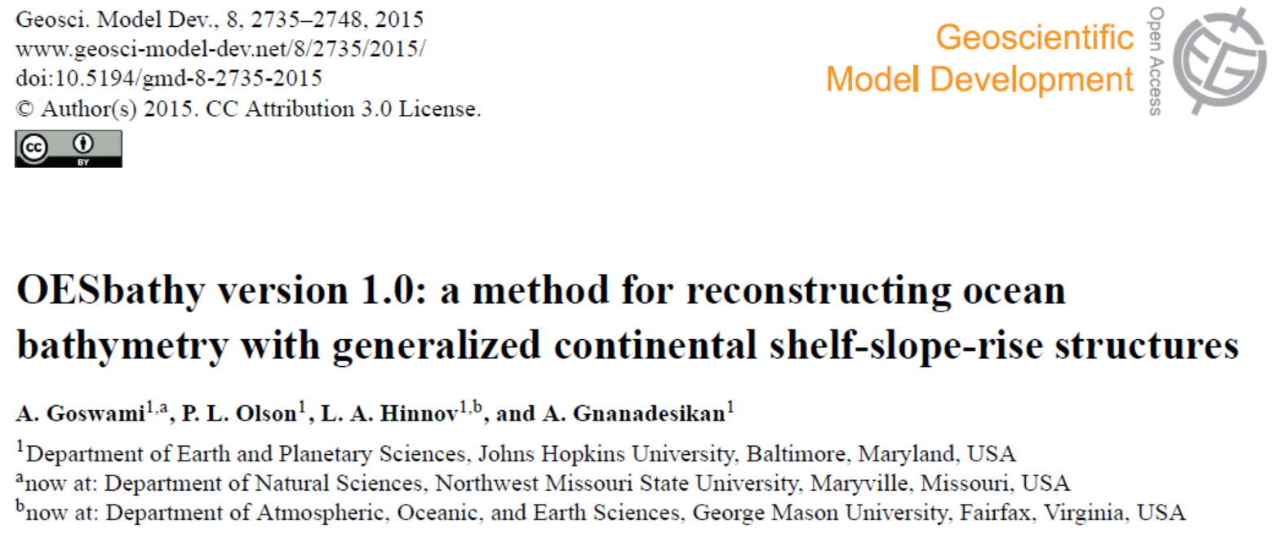
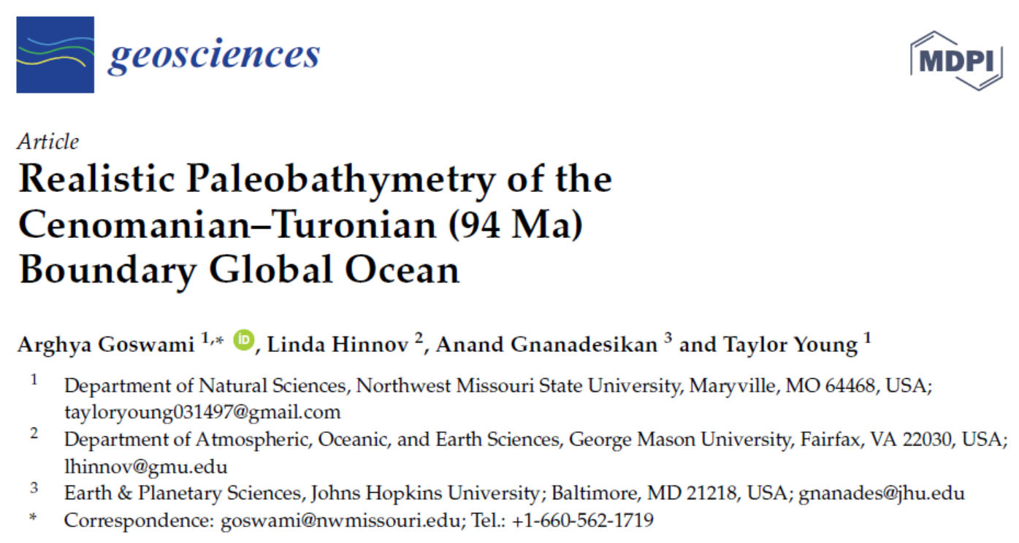
Motivation
Ocean bathymetry influences global climate in numerous ways
Detailed knowledge of paleobathymetry is required to quantify various climate processes in the geologic past
Paleoclimate simulation are commonly run with ‘bathtub’ like bathymetry.
Drive the motivation for paleobathymetry reconstruction.
Notes:
Ocean bathymetry influences global climate in numerous ways
Quantifying climate processes in the geologic past requires detailed knowledge of paleobathymetry
Paleoclimate simulation are generally run with ‘bathtub’ like bathymetry.

Slide 4
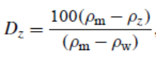
Isostatic Sediment Cover
Version 1 of OESBathy:
Parameterized sediment cover
Multilayer (16 total layers)
Isostatically loaded on top of the Depth-to-Basement
D_{z}: Density of the z^{th} layer
ρ _{m}: Density of mantle =3300 kgm⁻³
ρ _{w}: Density of ocean water = 1027.91 kgm⁻³
Crough (1983) and Sykes (1996)
Notes:
a third-degree polynomial fit between areacorrected
global sediment thickness data (Divins, 2003; Whittaker et al., 2013)
Sediment loading was calculated using a multicomponent
sediment layer with varying sediment densities given
in Table 2 in 100m increments of the sediment.
The variable sediment densities were calculated from a linear extrapolation of sediment densities in Crosby et al. (2006)
For the isostatic correction, in each 100m
sediment layer we calculate an adjusted thickness given by
xxxxxxxxxxxxxxxxxxxx
where Rhoz is the density of the zth layer, Rhom D3300 kgm􀀀3 and Rhow D 1000 kgm􀀀3. The sediment model has a total of 16 layers in which the basal layer includes all sediment deeper than 1500 m. For a given location we sum Dz to obtain the isostatically adjusted total sediment thickness, which is then added to the depth to basement to obtain the open ocean bathymetry. This loading correction is similar to procedures used by Crough (1983) and Sykes (1996).

Slide 5
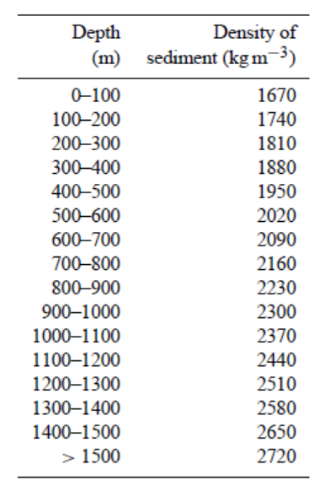
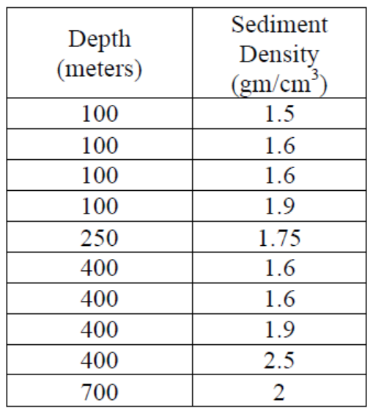
Isostatic Sediment Cover
Simple linear model derived from 10 published sediment densities (Crosby et al. 2006)
1 gm/cm³ = 1000 kg/m³
Notes:
a third-degree polynomial fit between area-corrected global sediment thickness data (Divins, 2003; Whittaker et al., 2013)
Sediment loading was calculated using a multicomponent sediment layer with varying sediment densities given in Table 2 in 100m increments of the sediment.
The variable sediment densities were calculated from a linear extrapolation of sediment densities in Crosby et al. (2006)
For the isostatic correction, in each 100m sediment layer we calculate an adjusted thickness given by
where Rhoz is the density of the zth layer, Rhom D3300 kgm􀀀3 and Rhow D 1000 kgm􀀀3. The sediment model has a total of 16 layers in which the basal layer includes all sediment deeper than 1500 m. For a given location we sum Dz to obtain the isostatically adjusted total sediment thickness, which is then added to the depth to basement to obtain the open ocean bathymetry.
This loading correction is similar to procedures used by Crough (1983) and Sykes (1996).

Slide 6
Approach then & NOW!
Simplistic approach
Good for initial attempt
Not very detailed
Not representative of extremely varied global ocean sediment density
Sediment Density Sub-model needs to be improved

Slide 7
Similar Studies for Sediment Densities
Tenzer & Gladkikh, 2014
20347 DSDP samples with ranging densities between 0.95 – 4.42 gm/cm³
Sediment – Rock interface @ 2.60 gm/cm³
Linear regression model
Documented lateral & depth density variation.

Slide 8
Similar Studies for Sediment Densities
Skyes, 1996 & Hamilton, 1976
Sediment density calculated using density-depth equations of Hamilton, 1976
Terrigenous, Calcareous, Clay and mix sediment densities
Density estimations calculated were compared with 9 ODP and 1 DSDP site data

Slide 9
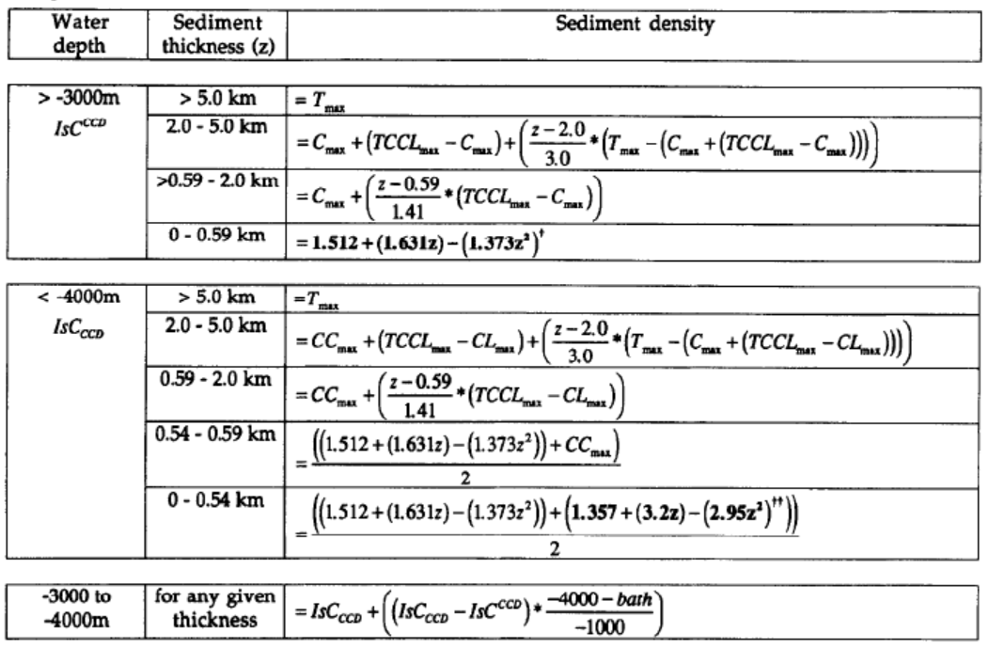
Similar Studies for Sediment Densities
Skyes, 1996
T_{max} (Terrigenous) = 2.5 gm/cm³
C_{max}(Calcareous) = 1.99 gm/cm³
CL_{max}(Clay)=2.22 gm/cm³
TCCL_{max}(Mixed terrigenous-calcareous-clay) = 2.11 gm/cm³

Slide 10
Similar Studies for Sediment Densities
 | This Study | Tenzer & Gladkikh, 2014 | Skyes, 1996
DSDP | Yes | Yes | 1 Site
ODP | Yes | No | 9 Sites
IODP | Intended | No | No*
Water Depth | Yes | Yes | Yes
Drilling Depth | Yes | Yes | No
Sediment Thickness | Yes | No | Yes
Seawater Density | Intended | Yes | No
Age of Ocean Crust | Yes | No | No
Continentality | Yes | No | No/Yes**
CCD Depth | Intended | No | Yes
Lateral Variability | Intended | Yes | No
Depth Variability | Yes | Yes | Yes
* Used densities derived from seismic interval velocities
**Used calcareous, pelagic clay and terrigenous

Slide 11
New Sediment Density Data
Deep Sea Drilling Project (DSDP)
Leg 1-94
Sites 1-624
Ocean Drilling Project (ODP)
Leg 100-210
Sites 625-1277
The Integrated Ocean Drilling Program (IODP)
Legs 301-349 (continuing)
Density Data Used

Slide 12
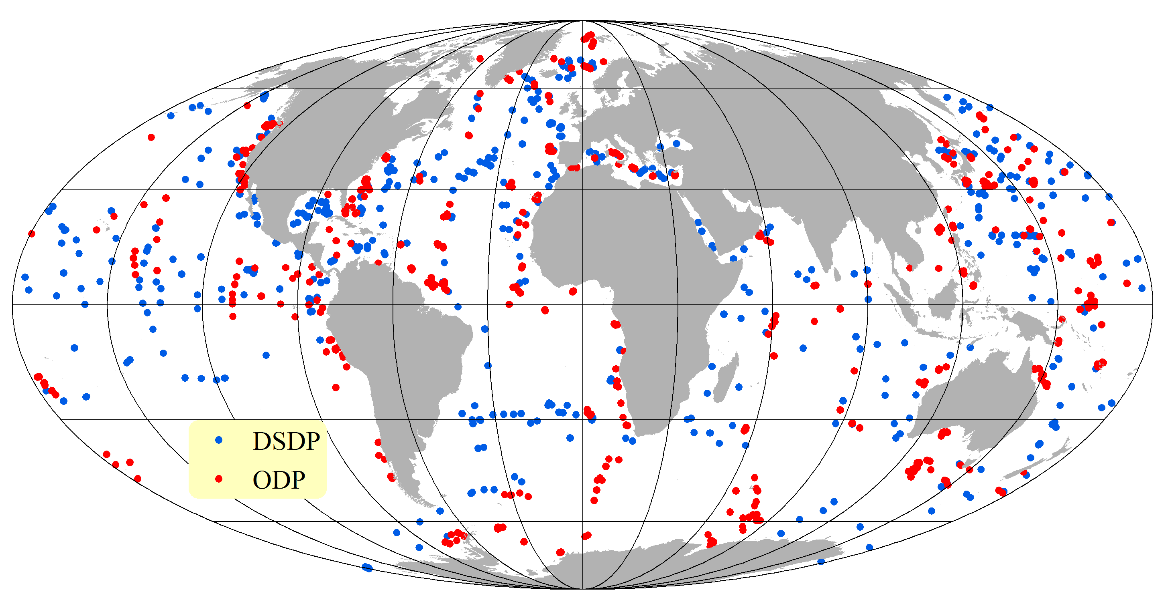
Global Distribution of DSDP & ODP Sites

Slide 13
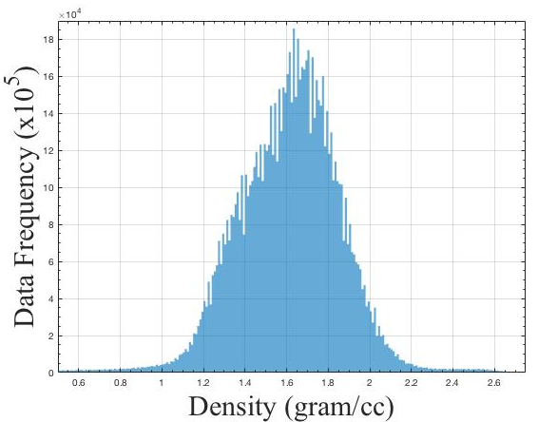
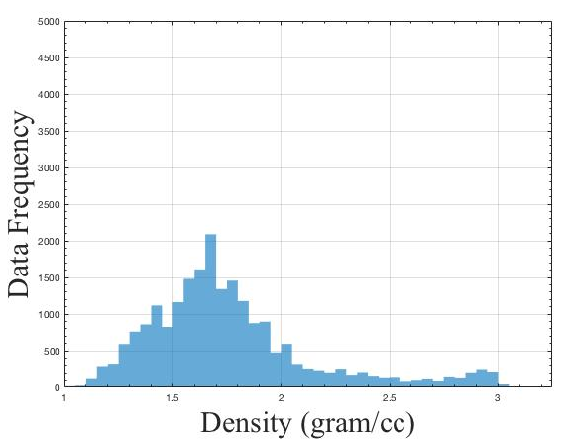
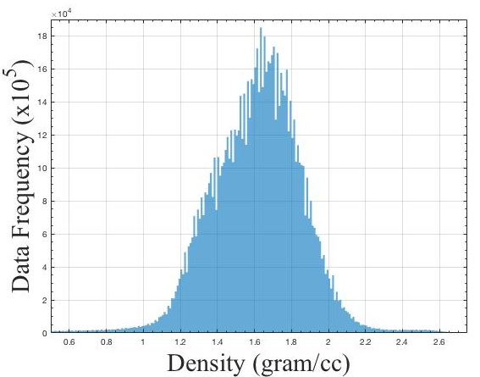
Histograms for All Density Data
DSDP
ODP
DSDP – ODP
Combined

Slide 14
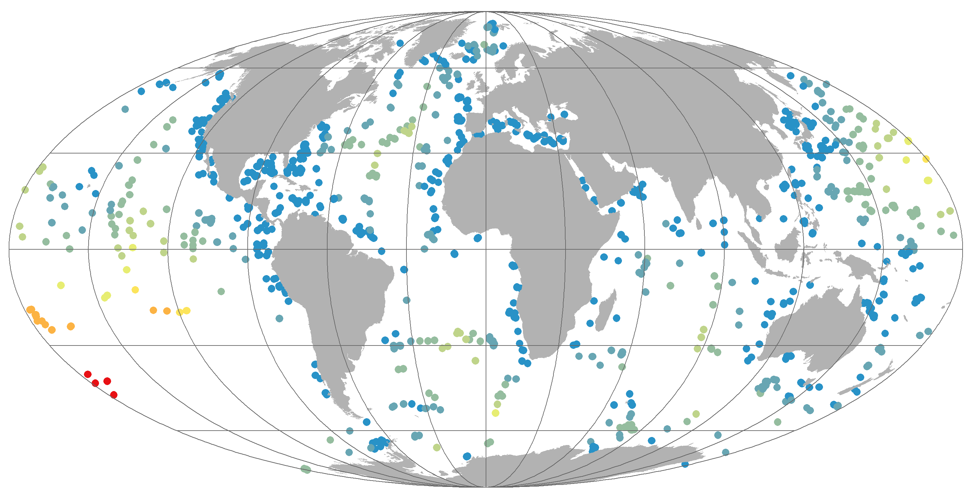
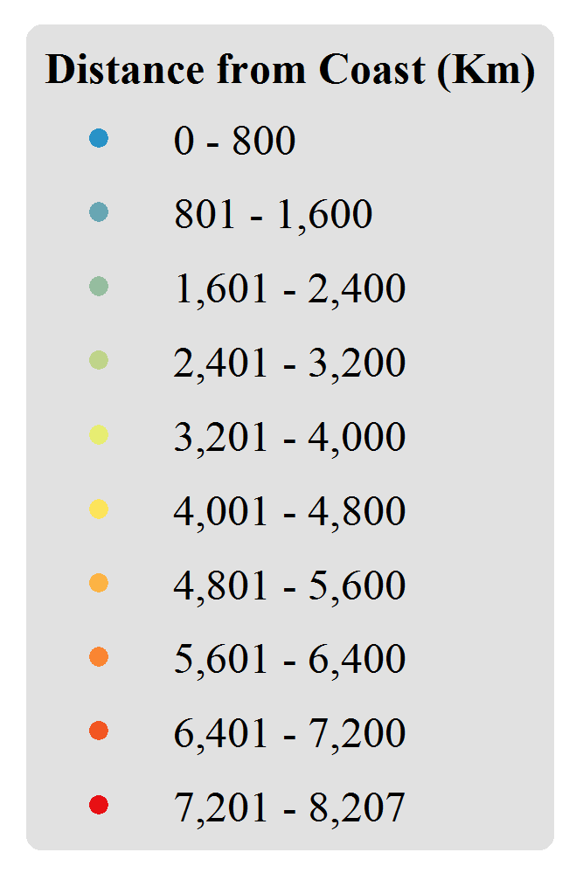
Variable: Continentality

Slide 15
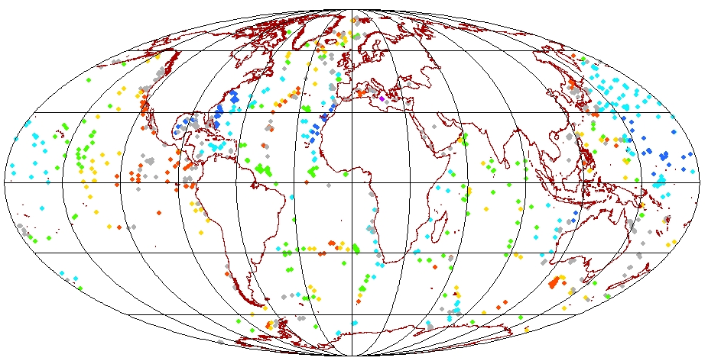
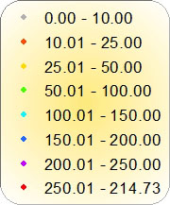
Age of the Ocean Crust (Ma)
Ocean crust age after Müller et al. 1997 & 2008

Slide 16
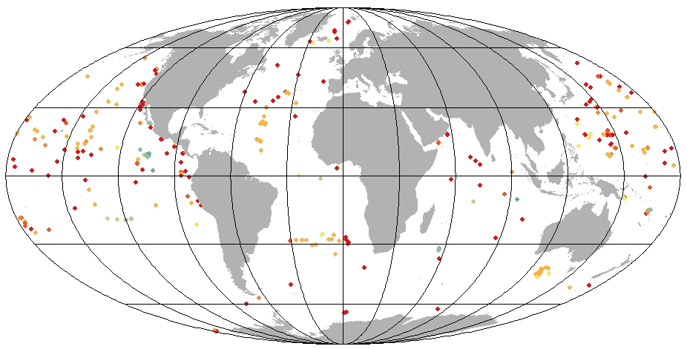
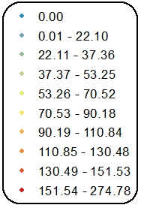
Sediment Thickness (meters)
Divins, 2003 & Whittracker, 2014

Slide 17
Basic Statistics of Sediment Data
Name | Count | Count without Missing Values | Maximum | Minimum | Mean | Median | Mode | Std. Deviation | Variance
DSDP Density Data | 25,942 | 21,614 | 4.42 | 0.95 | 1.77 | 1.69 | 1.66 | 0.39 | 0.16
ODP Density Data | 9,434,616 | 9,355,216 | 29.97 | -21.12 | 1.62 | 1.63 | 1.66 | 0.47 | 0.22
DSDP, ODP Combined Density Data | 9,460,558 | 9,376,830 | 29.97 | -21.12 | 1.62 | 1.63 | 1.66 | 0.47 | 0.22
Xx
Notes:
4,328 and 79,400 records have no density data

Slide 18
Density Data Processing…..
 | This Study | Tenzer & Gladkikh, 2014 | Skyes, 1996
DSDP | Yes | Yes | 1 Site
ODP | Yes | No | 9 Sites
IODP | Intended | No | No*
Water Depth | Yes | Yes | Yes
Drilling Depth | Yes | Yes | No
Sediment Thickness | Yes | No | Yes
Seawater Density | Intended | Yes | No
Age of Ocean Crust | Yes | No | No
Continentality | Yes | No | No/Yes**
CCD Depth | Intended | No | Yes
Lateral Variability | Intended | Yes | No
Depth Variability | Yes | Yes | Yes
* Used densities derived from seismic interval velocities
**Used calcareous, pelagic clay and terrigenous
Notes:
4,328 and 79,400 records have no density data

Slide 19
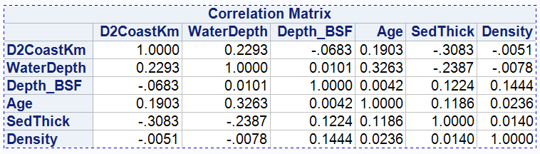
Density Data Processing…..
With six target variables in the database
Filtered the data for ‘Missing Values’
Created correlation matrix
Run Principal Component Regression to model Sediment Density with respect to others
Notes:
4,328 and 79,400 records have no density data

Slide 20
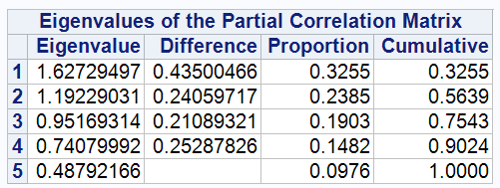
Density Data Processing…..
Accepted Eigenvalue greater than 0.95
So PC1, PC2, PC3 were accepted in the regression model
They account for ~75% variability in the sediment density data
Notes:
4,328 and 79,400 records have no density data

Slide 21

Sediment Density Model
SedDen = -5.06E-03*D2CoastKm – 7.75E-03*WaterDepth + 1.44E-1*Depth_BSF + 2.36E-02*Age + 1.40E-02*SedThick
SedDen = Sediment density
D2CoastKm = Distance to coast
WaterDepth = Water depth (from Mean Sea Level)
Depth_BSF = Sample depth below sea floor
SedThick = Thickness of the sediment layer
Age= Age of the ocean crust
Notes:
4,328 and 79,400 records have no density data

Slide 22
Future Work….
This is the very first run of the data analysis
Continue improving the analysis
Include the INTENDED variables in the study
Implement the module and see how the Modeled Sediment is varying than the simple approach used before.
Notes:
4,328 and 79,400 records have no density data

Slide 23
Acknowledgement
UGR student group: Ali Vinke, Alicia Boyer, Isabel Lopez, Robin Waltz
Northwest Missouri State University for support & funding
Notes:
4,328 and 79,400 records have no density data

Slide 24
References
Crosby, A., McKenzie, D., and Sclater, J.: The relationship between depth, age and gravity in the oceans, Geophys. J. Int., 166, 553–573, 2006.
Divins, D.: NGDC total sediment thickness of the world’s oceans and marginal seas, NOAA, Boulder, CO, 2003.
Goswami A., Hinnov L., Gnanadesikan A., Young T.: Realistic Paleobathymetry of the Cenomanian–Turonian (94 Ma) Boundary Global Ocean, Geosciences, 8(1), 21, 2018.
Goswami, A., Olson, P. L., Hinnov, L. A., and Gnanadesikan, A.: OESbathy version 1.0: a method for reconstructing ocean bathymetry with generalized continental shelf-slope-rise structures, Geosci. Model Dev., 8, 2735-2748, https://doi.org/10.5194/gmd-8-2735-2015, 2015.
Müller, R. D., Roest, W. R., Royer, J.-Y., Gahagan, L. M., and Sclater, J. G.: Digital isochrons of the world’s ocean floor, J. Geophys. Res., 102, 3211–3214, 1997.
Müller, R. D., Sdrolias, M., Gaina, C., and Roest, W. R.: Age, spreading rates, and spreading asymmetry of the world’s ocean crust: Geochem. Geophys. Geosys., 9, 1–19, 2008.
Sykes, T. J.: A correction for sediment load upon the ocean floor: Uniform versus varying sediment density estimations – Implications for isostatic correction, Mar. Geol., 133, 35–49, 1996.
Tenzer, R. and Gladkikh, V.: Assessment of density variations of marine sediments with ocean and sediment depths, The Scientific World Journal, 2014.
Whittaker, J. M., Goncharov, A., Williams, S. E., Müller, R. D., and Leitchenkov, G.: Global sediment thickness data set updated for the Australian-Antarctic Southern Ocean, Geochem. Geophy. Geosys., 14, 3297–3305, 2013.
Notes:
4,328 and 79,400 records have no density data

Slide 25

Thank
You!
Notes:
4,328 and 79,400 records have no density data

