Slide 1
Geochemistry and Organic Petrology of the Anna Shale (Pennsylvanian) and Pyrite “Suns” in Southwestern Illinois
Jacob Dyson¹, Susan Rimmer¹, Scott Erick²
Southern Illinois University Carbondale¹
Illinois Geological Survey²

Slide 2
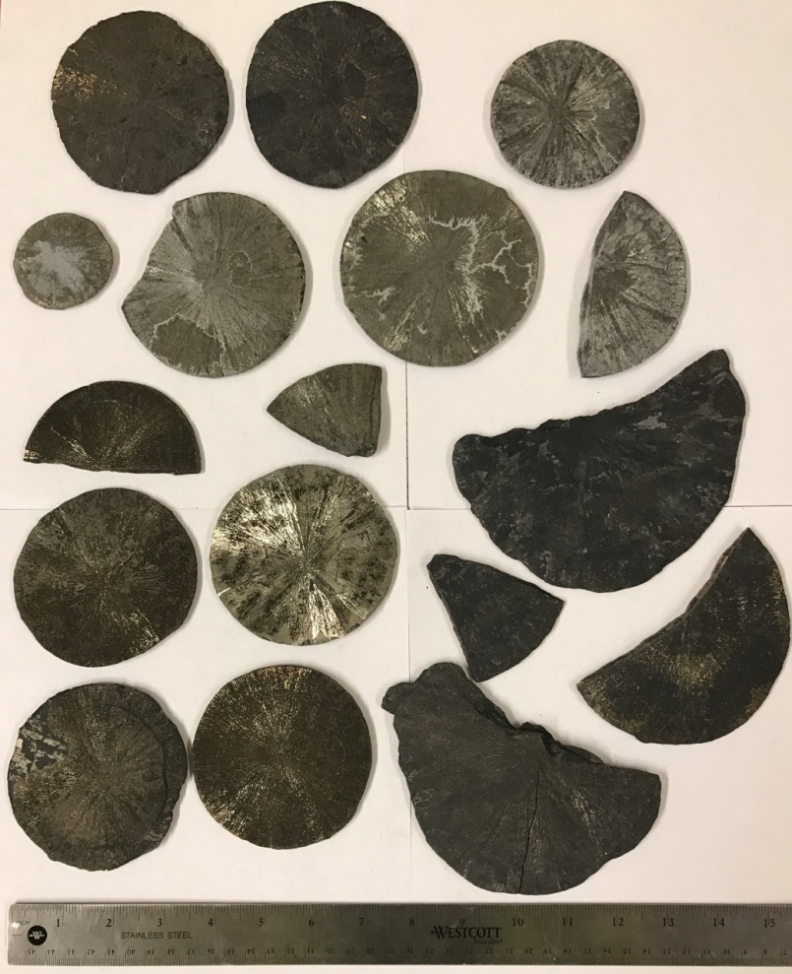
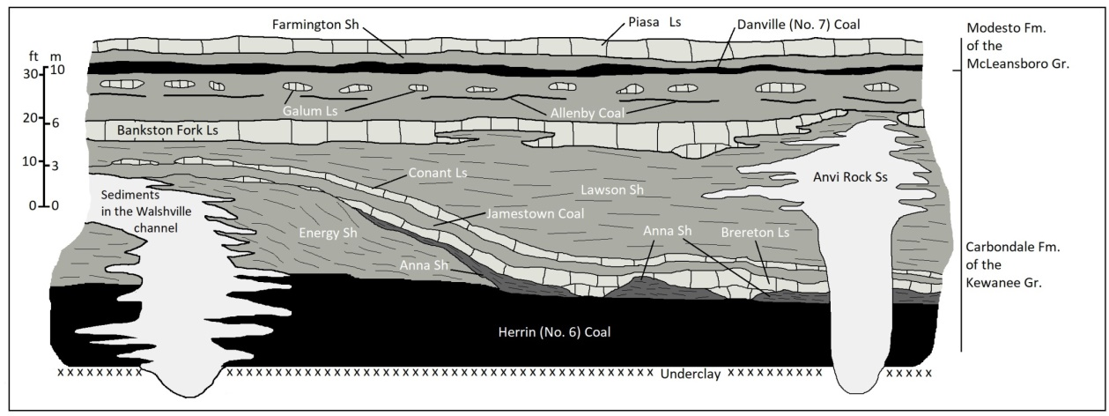
Pyrite suns
Disk-shaped pyrite concretions
Occur at the contact between the Herrin (No. 6) Coal and the Anna Shale
Range in size from 1cm to 15cm
(Redrafted from: Krause, 1979 after Allgaier, 1974)

Slide 3
Objectives
Assess the source-rock quality of the Anna Shale
Determine sources of OM using organic petrography
Evaluate the paleo-redox conditions during Anna Shale deposition
Investigate trace element enrichments of pyrite suns
Notes:
Presented in order we will discuss

Slide 4
Area of study
C7005
C7009
C6848
C7003
Lively Grove Mine
Washington County
N
Core Location
Herrin (No. 6) Coal Sample
Pyrite Sun and Roof Shale Samples
Prairie Eagle Mine
20 km
Perry County
10 mi
Notes:
4 cores from NE Washington Co; in southwestern Illinois
Herrin Coal sample for vitrinite reflectance
Several roof shale samples and pyrite suns from the Prairie Eagle mine

Slide 5
Source rock quality and maturity
TYPE I KEROGEN
 | Average | Range
TOC | 15.9 wt % | 2.2-37.0 wt %
HI | 225 mg HC/g TOC | 54-438 mg HC/g TOC
S1 | 1.32 mg HC/g | 0.05-4.76 mg HC/g
S2 | 45.9 mg HC/g | 1.2-159 mg HC/g
Tmax | 422°C | 411-432°C
*Ro | 0.43%
TYPE II KEROGEN
C6848
Lower Anna Shale and TOC intervals >20%
C7003
C7005
C7009
Upper Anna Shale and low TOC intervals
Roof Samples
TYPE III KEROGEN
*random vitrinite reflectance of Herrin (No. 6) Coal
TYPE IV KEROGEN
Notes:
Type II Kerogen w/ avg 15.9% TOC, range 2.2 - 37%
van-krevelen
Immature source rock
avg Tmax 422°C; Type II enter oil window at 425°C
Ro coal immature <0.5%
excellent potential avg S2 45.9; >5 is excellent

Slide 6
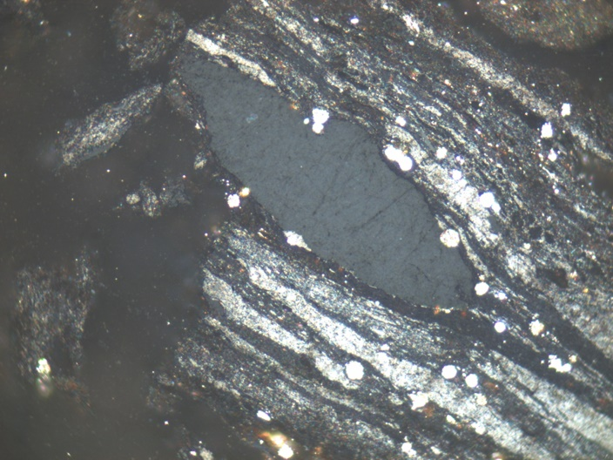
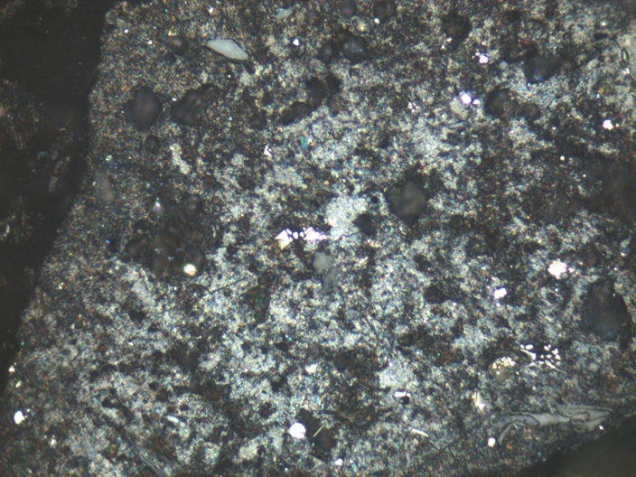
Organic petrography
6848 103-108
solid bitumen
Maceral | Average percent from visual estimates
Micrinite | 60.1%
Other Inertinites | 7.9%
Bituminite | 10.9%
Other Liptinites | 2.0%
Solid Bitumen | 17.8%
Vitrinite | 1.3%
layered micrinite
40 um
disseminated micrinite
7003 30-35
40 um
Notes:
Micrinite
1um size grains; high-reflectance
Hydrogen-rich inertinite maceral (Taylor and Liu, 1989)
Likely derived from formerly liptinitic material (ICCP, 2001)
Bituminite
Likely degradation product of algal/liptinitic/bacterial material
Solid Bitumen
Fills voids, cracks, forms along bedding
In immature/early-mature shales, product of thermal alteration (Mastalerz et al., 2018)

Slide 7
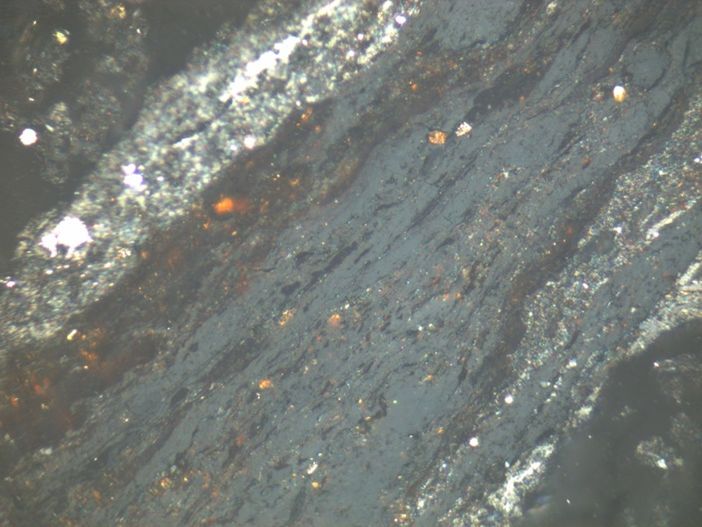
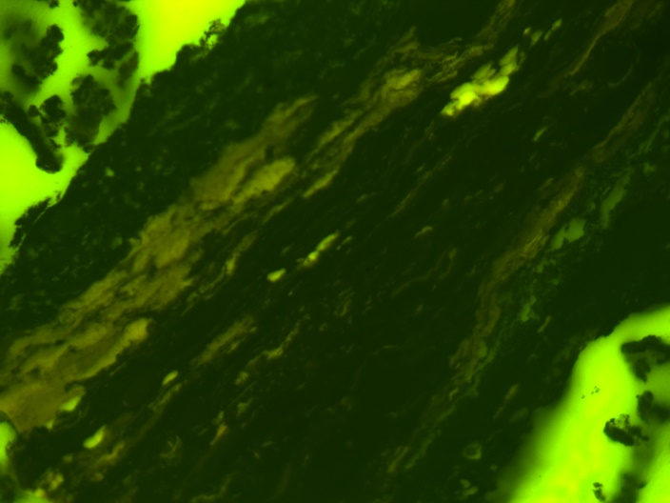
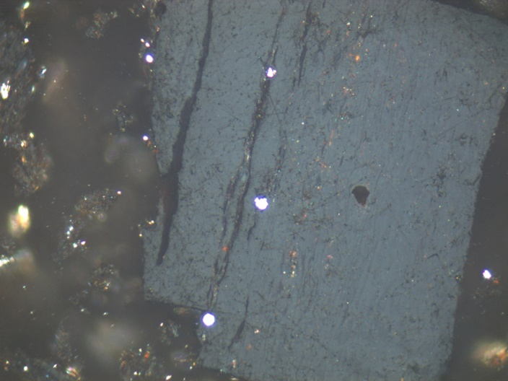
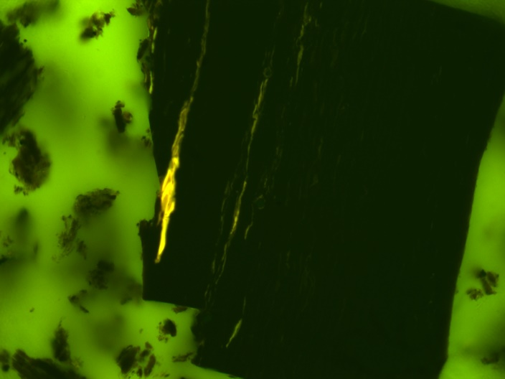
7005 30-35
7005 30-35
solid bitumen
bituminite
bituminite
40 um
40 um
7005 65-70
7005 65-70
cutinite
vitrinite
cutinite
40 um
40 um
Notes:
Bituminite
Dull fluorescence

Slide 8
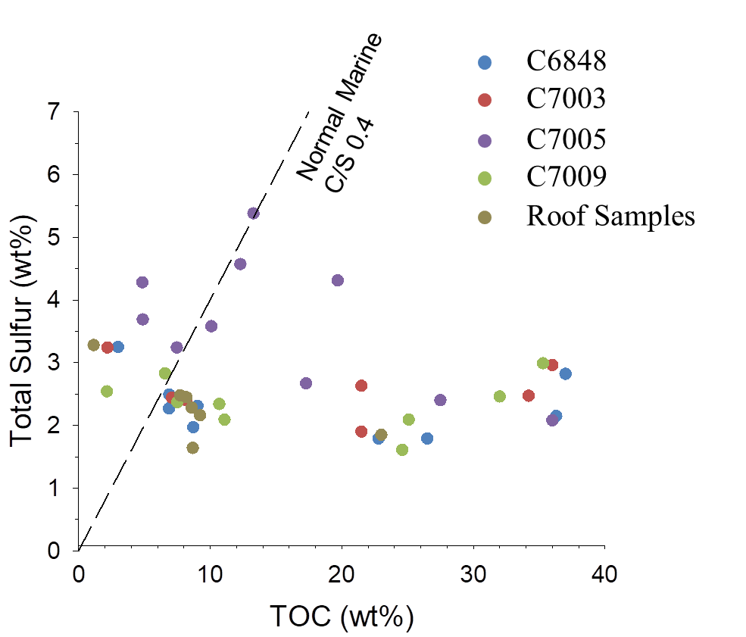
C-S relationships
Normal marine conditions line goes through the origin
Data show positive intercept on the S axis
Suggests an anoxic depositional environment
Notes:
C-S relationships used to distinguish norm. marine from anoxic/euxinic cond.
Norm. marine = intercept @ origin
Anoxic/euxinic = positive intercept
bullets

Slide 9
C-S-Fe relationships
C6848
C7003
C7005
DOP ≥ 0.42 = dysoxic
DOP ≥ 0.75 = anoxic/euxinic
Two trends of constant S/Fe ratio
Estimated DOP suggests dysoxic and anoxic conditions
C7009
Roof Samples
DOP 0.51
DOP 0.42
DOP 0.73
DOP 0.75
Notes:
Ternary plots of C-S-Fe can be used to estimate DOP based on relationships
S/Fe 1.15 = is the stoichiometric ratio of pyrite
S/C 0.4 = norm. marine trend

Slide 10
Paleo-redox conditions
Euxinic
TOC (wt%)
Dysoxic
Anoxic
Ni/Co
Dysoxic
Anoxic
Oxic
0
5
Oxic
0
20
40
Core C7009
10
109.2
Cyclic paleo-redox conditions
Large amounts of OM deposited in anoxic intervals
109.4
Depth (m)
109.6
109.8
0
5
10
0.4
0.9
Oxic
Anoxic
V/Cr
Dysoxic
V/(V+Ni)
Notes:
C6848 and C7003 show three anoxic periods and high TOC
Cyclic between dysoxic and anoxic conditions
V/Cr and Ni/Co may suggest marginally oxic cond. instead of dysoxic
Large amounts of OM deposited in anoxic intervals

Slide 11
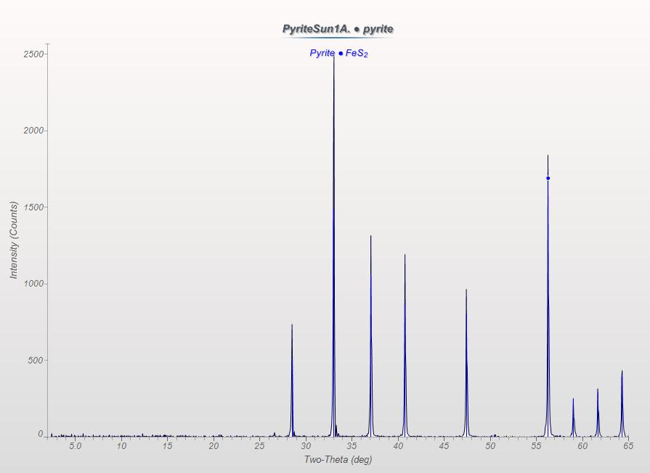
X-ray diffraction of pyrite suns
Notes:
- Multiple samples, multiple pyrite suns
- Pyrite suns are composed entirely of pyrite
- No marcasite present in analyzed samples

Slide 12
EPMA for pyrite sun trace elements
Vertical and horizontal point traverses
Analyzed for Mo, Cu, Zn, As, Pb, and Cd
Any concentration is below microprobe detection limits ~0.05 wt%
Next step LA-ICP-MS
Notes:
Laser ablation ICP MS in future

Slide 13
Paleo-redox conditions of roof samples
Oxic
Dysoxic
Oxic
Dysoxic
Roof 7
Roof 7
Roof 6
Roof 6
Roof 5
Roof 5
Roof 4
Roof 4
Roof 2
Roof 2
Roof 1
Roof 1
V/Cr
Ni/Co
Dysoxic
Anoxic
Euxinic
Oxic
Pyrite suns do not occur
Roof 7
Roof 6
Pyrite suns occur
Roof 5
Roof 4
Roof 2
Roof 1
V/(V+Ni)
Notes:
- More oxygenated/ less restricted cond. for roof samples w/o pyrite suns: V/Cr and V/(V+Ni)

Slide 14
Summary
Source-rock quality
Type II kerogen; Average 15.9% TOC
Immature - average Tmax 422°C
Sources of OM
Dominantly micrinite, solid bitumen, and bituminite
Paleo-redox conditions
Cyclic between dysoxic and anoxic conditions
Trace elements in pyrite suns
Not detectable to 0.05 wt% using a microprobe
Paleo-redox conditions of roof shale samples
Unclear relationships with pyrite sun occurrence

Slide 15
Thank you!
Special thanks to:
Dr. Dave Moecher – University of Kentucky
Prairie State Generating Company
Barry Sargeant – Knight Hawk Coal LLC
Zain Abdi – Southern Illinois University Carbondale
Joe Devera – Illinois State Geologic Survey

