Slide 1




Climate change effects over Belo Monte Dam’s hydroelectricity generation capacity: economic, environmental and social impacts
Marcelo G. P. Camargo (University of São Paulo - Brazil)
Prof. Dr. André O. Sawakuchi (USP - Brazil)
Prof. Dr. Gyrlene A. M. Silva (UNIFESP - Brazil)
Prof. Dr. Victor Sacek (USP - Brazil)
Photo: Betto Silva
Grant 2017/12470-2

Slide 2
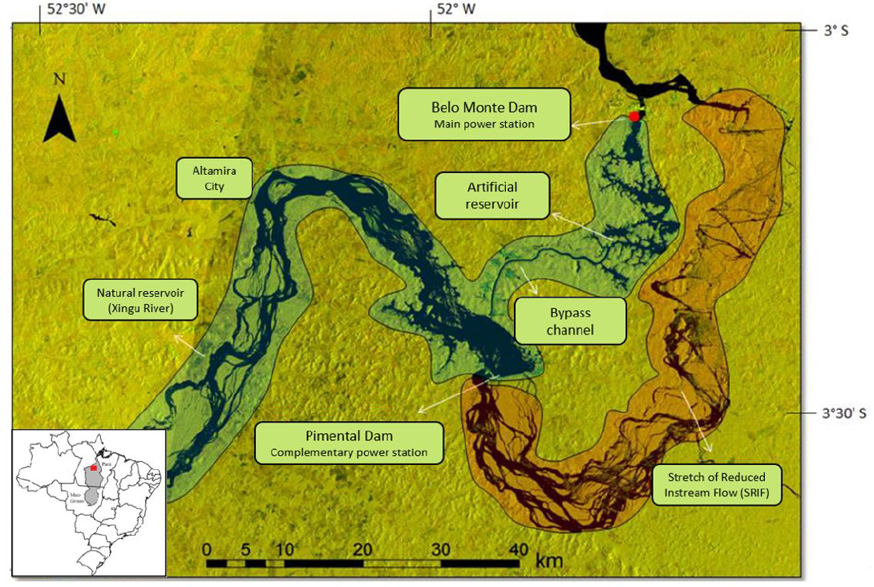
Context
Radar image - Jan/2016
Credits: Juan Doblas/ISA

Slide 3
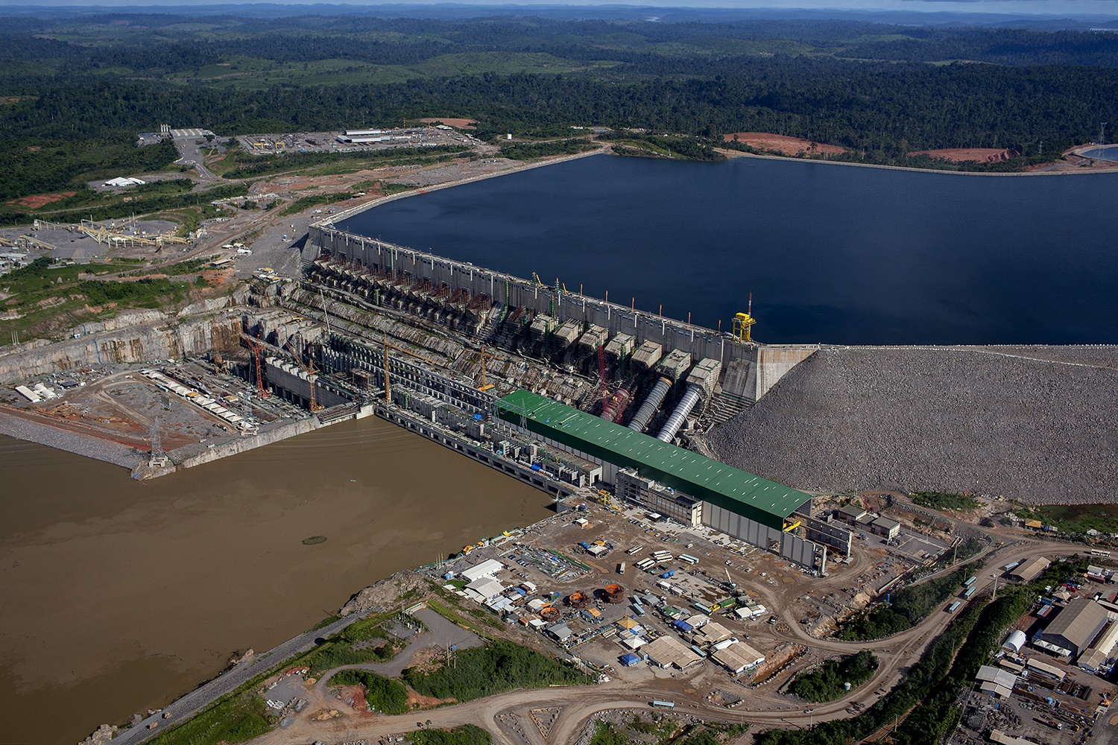

Slide 4
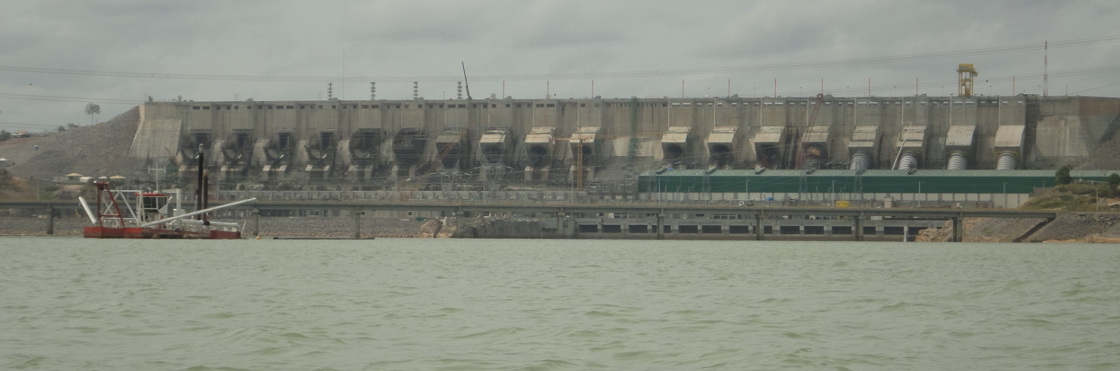
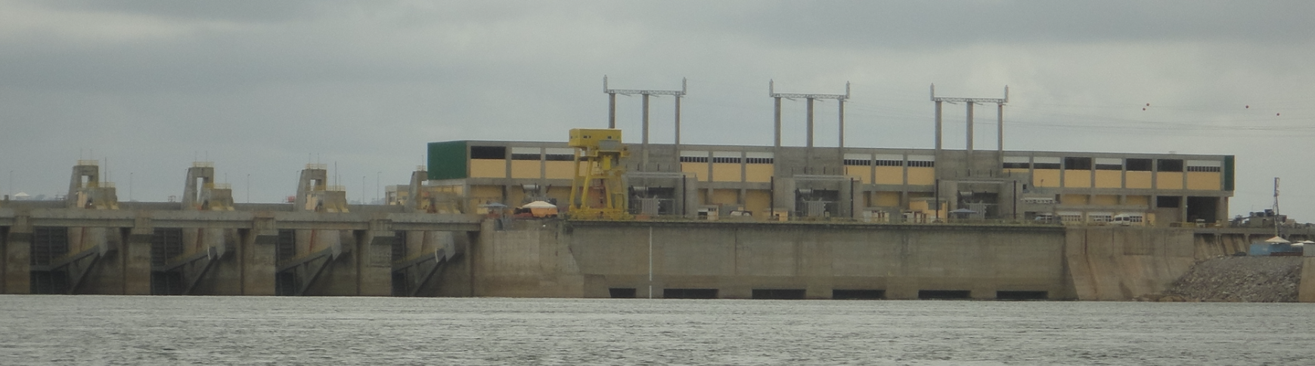
Belo Monte
Artificial reservoir level
Installed turbines (4 of 18 as of 2016)
~ 90 m
Main powerhouse
Xingu River
Pimental
Xingu River reservoir level
~ 20 m
Closed doors
Xingu River (Stretch of Reduced Inflow)
Photos: André Sawakuchi

Slide 5
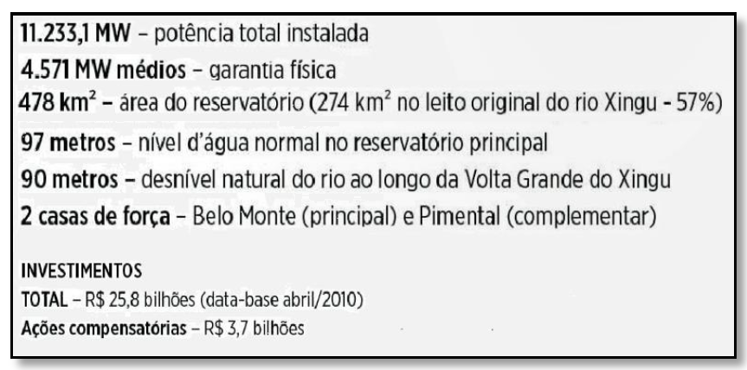
Belo Monte Dam – Main features
(Norte Energia, 2016)
Run of the river-type Dam
Reduced reservoir area
Generation capacity ≈ river’s discharge

Slide 6
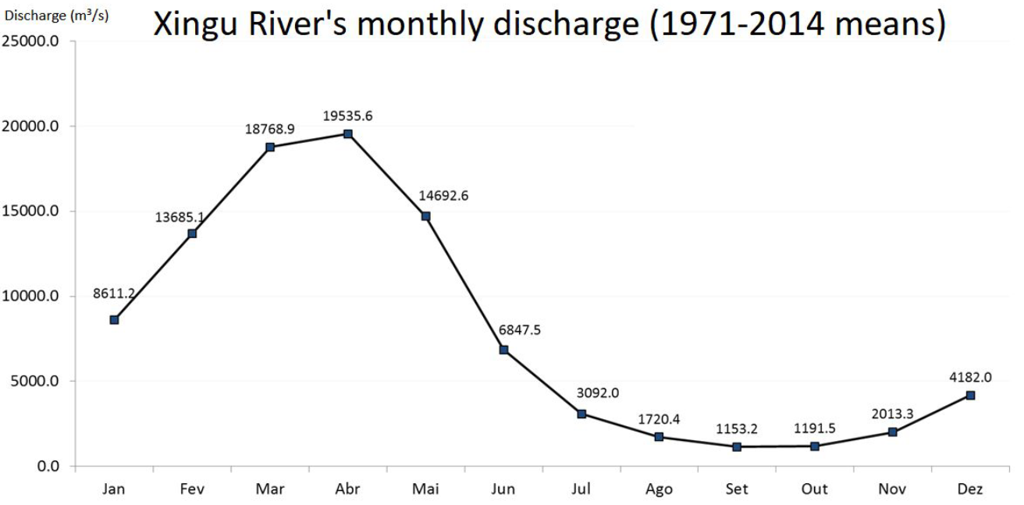
~ 100% installed capacity
Severely reduced to non-existant generation

Slide 7
Objective Evaluate Belo Monte’s energy generation potential over the next 30 years through simulations of Xingu River’s future discharge

Slide 8
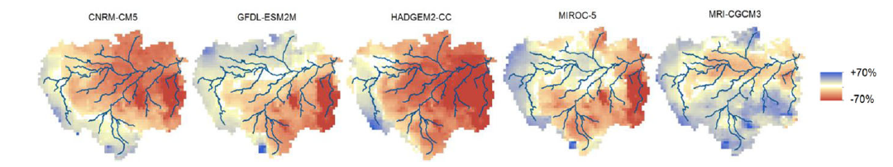
Motivation
Projections from five CMIP5/IPCC GCMs regarding surface water availability by the end of the century
(Sorribas et al., 2016)

Slide 9
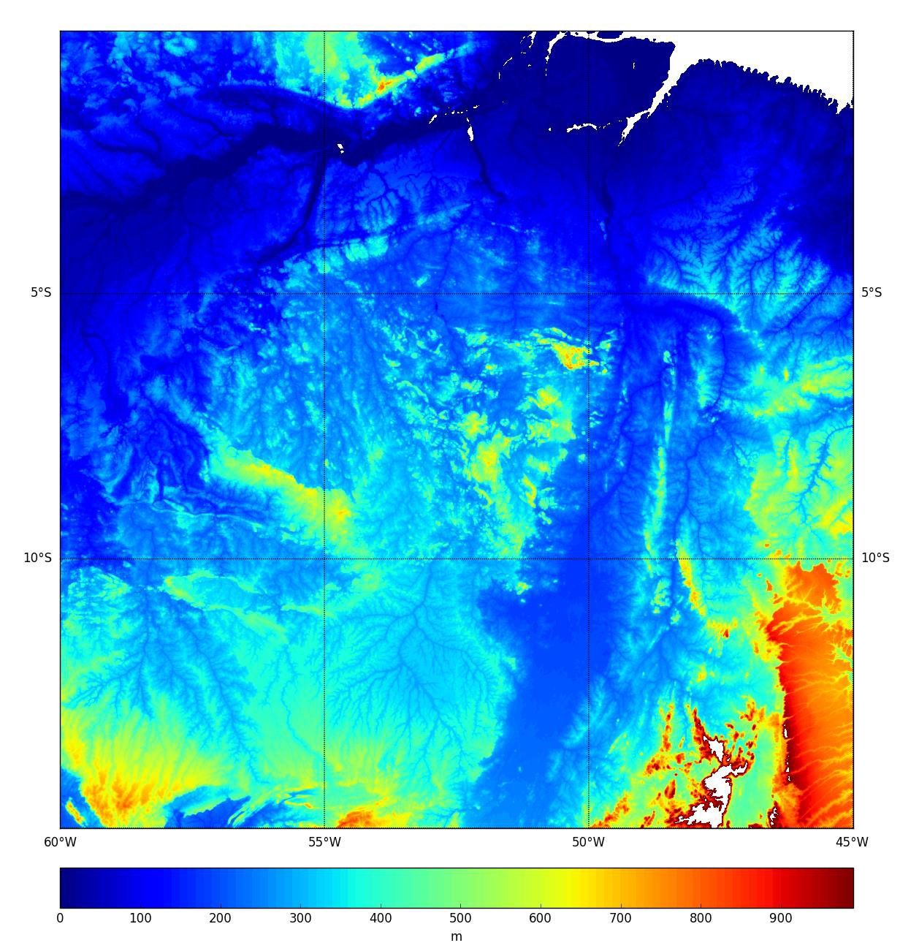
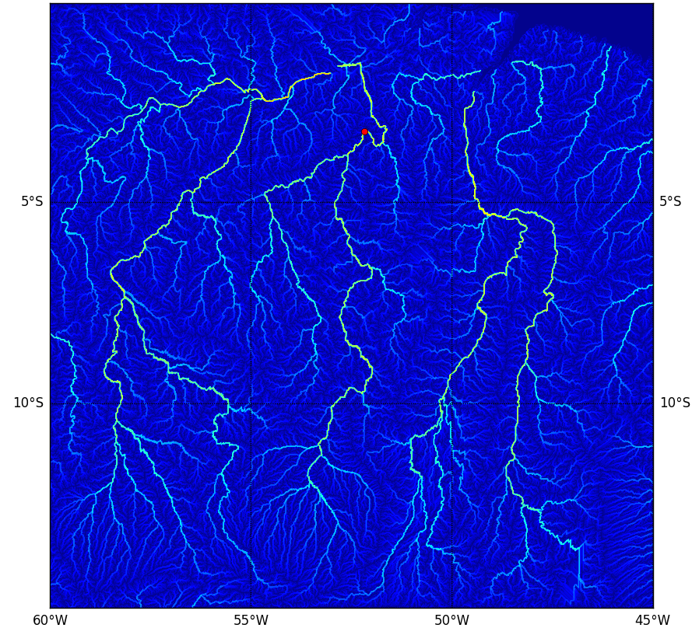
Method – Hydrologic simulation
Drainage system calculation based on topographic gradients
ETOPO1 Digital Elevation Model
(Amante and Eakins, 2009)

Slide 10
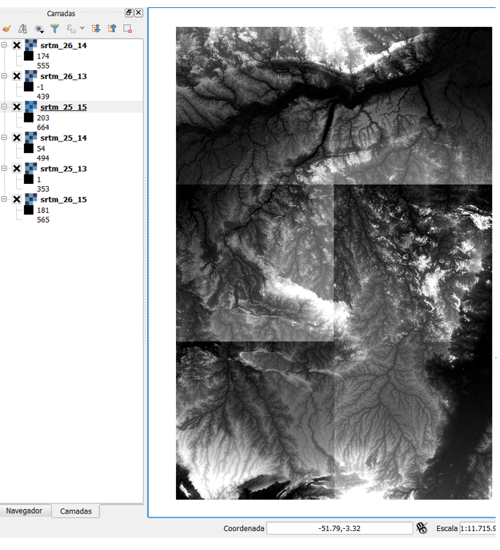
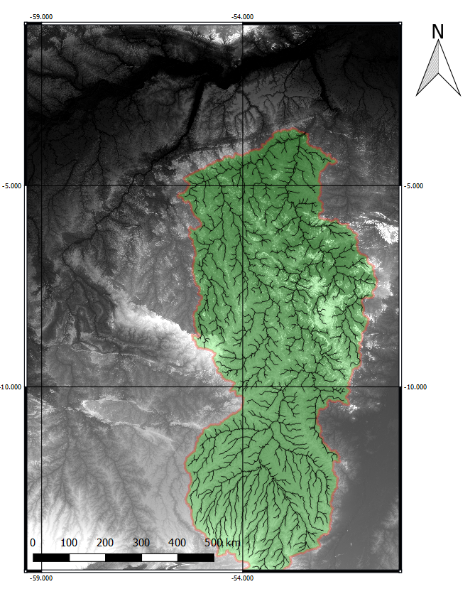
SRTMs:
25_13, 14 e 15
26_13, 14 e 15
(Datum: WGS84)
(Camargo et al., in prep.)

Slide 11
Results

Slide 12
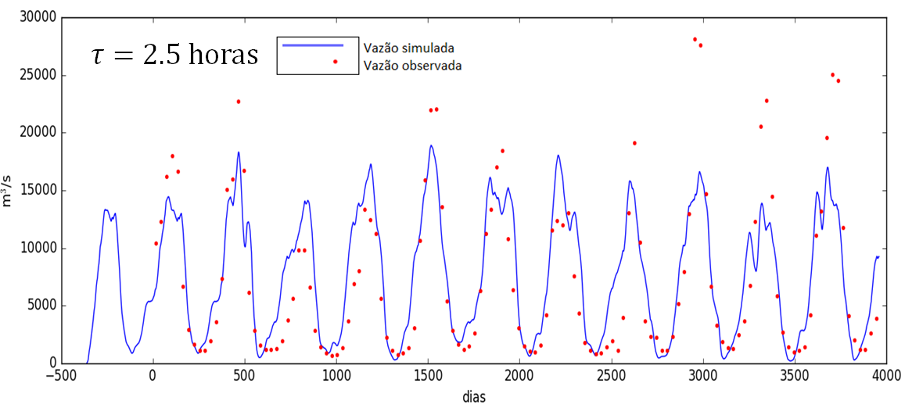
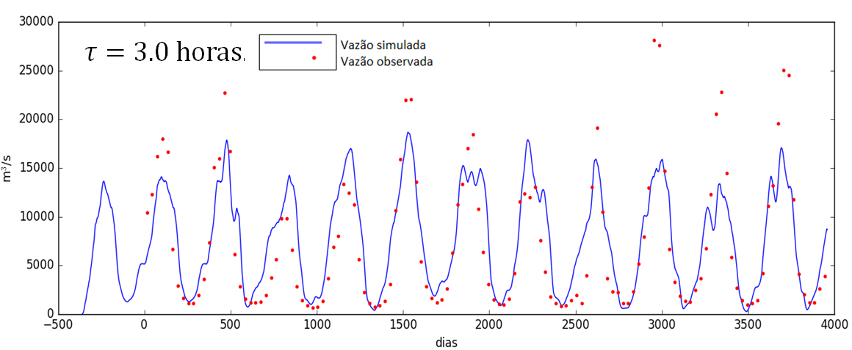
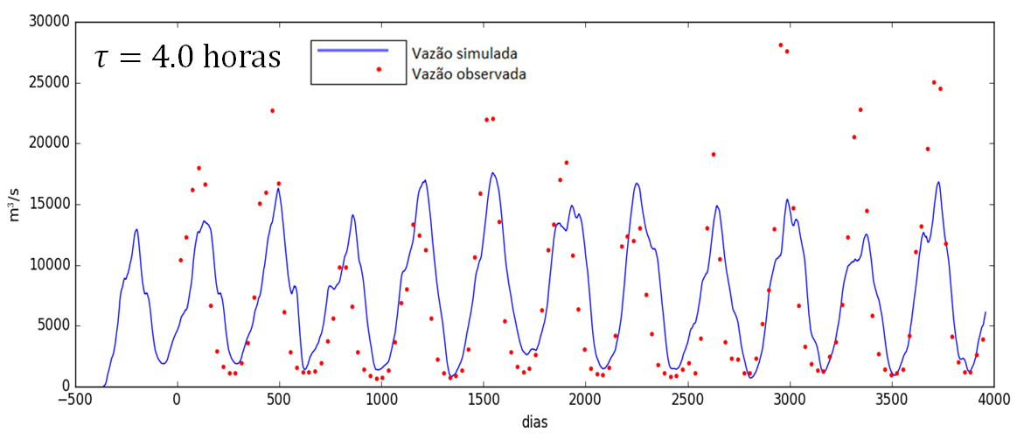
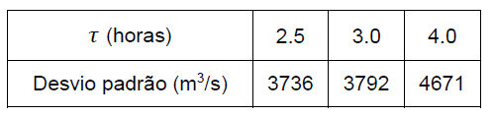
Numeric model calibration through historical rainfall data
*
*das diferenças entre cada valor simulado e observado
To better simulate rainfall loss due to water percolation / ET, only 30% of total rainfall contributed to the discharge

Slide 13
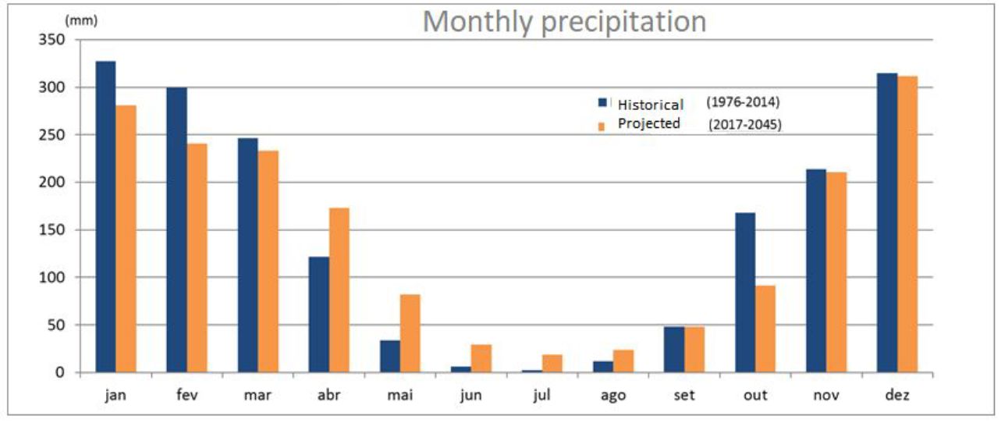
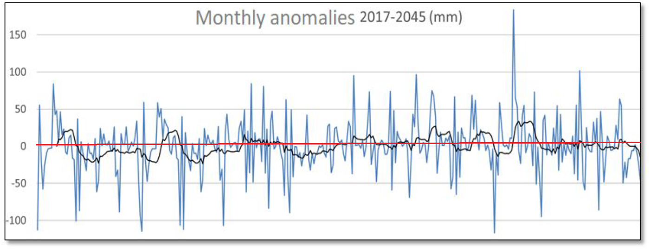
Future rainfall projections (multi-model average)
Persistent negative anomalies might be significantly worse to the river’s water availability than just one very negative anomaly

Slide 14
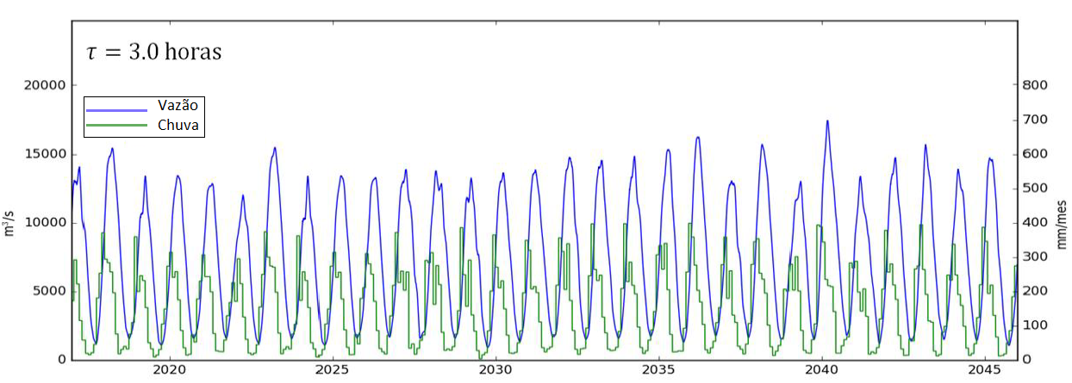
Discharges (2017 – 2045)
Average high water discharge (1971-2014)
Total discharge needed to fully operate while releasing water to the Stretch of Reduced Inflow.
-40%

Slide 15
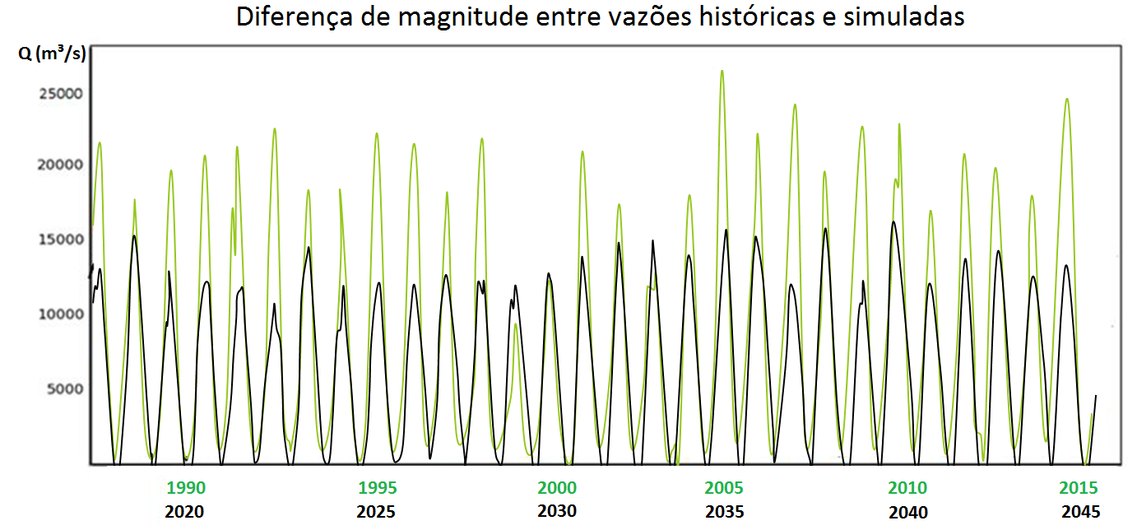
Future discharges are expected to be on average 28% lower than the historical ones

Slide 16
Discussion
Effects of deforesting on Xingu’s discharge
Present and future impacts of Belo Monte

Slide 17
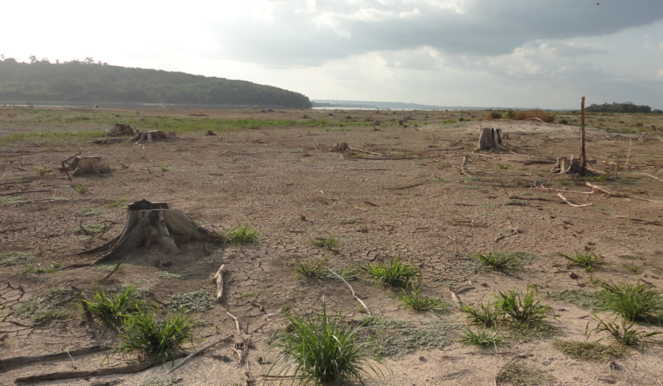
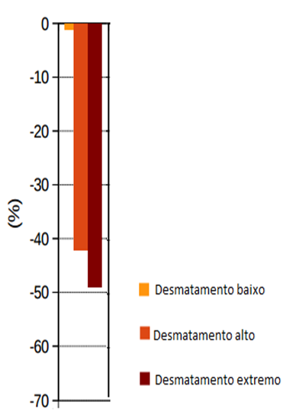
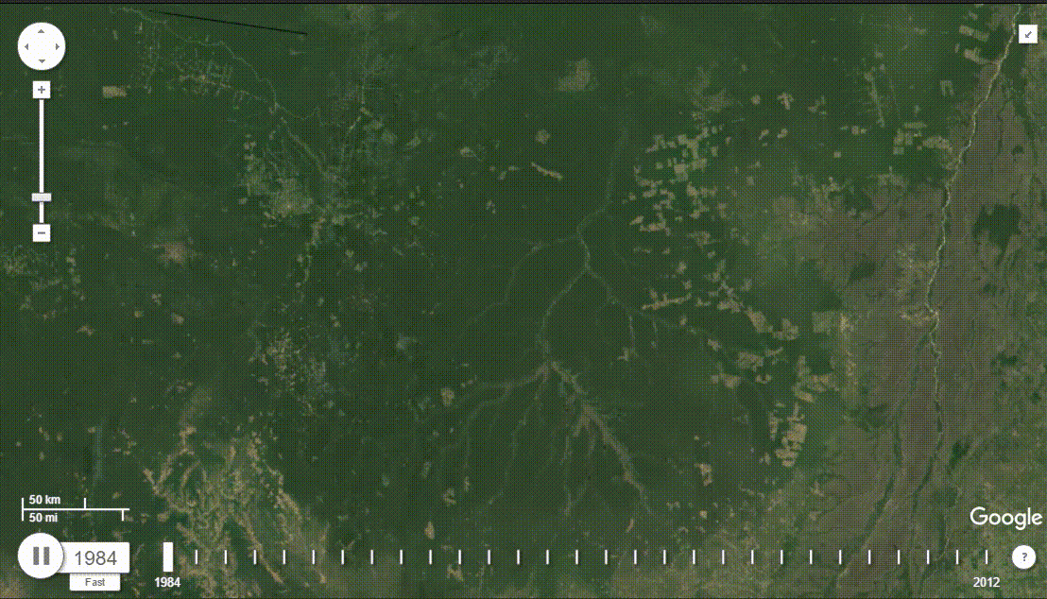
Projections of forest area loss at the Xingu River’s Basin by 2099, considering three scenarios of change on land use
(Adaptado de Guimberteau et al., 2016)
Foto: André Sawakuchi

Slide 18
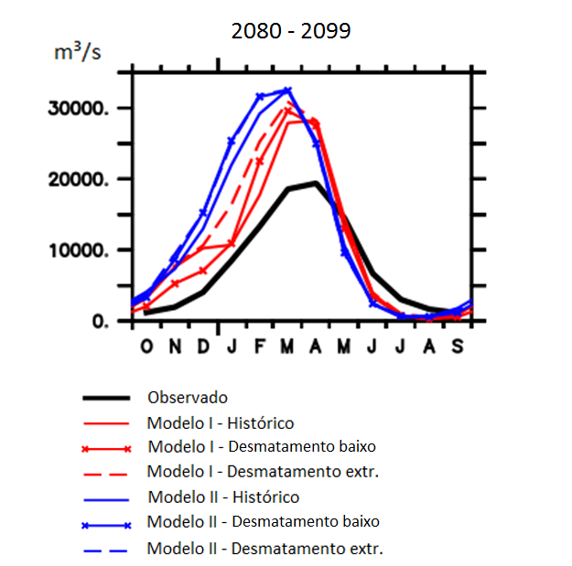
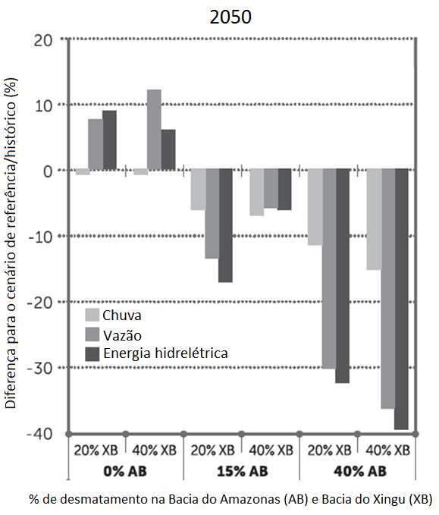
Effects of deforesting on Xingu River’s discharge
ET reduction only
Considering changes in rainfall
(Adaptado de Guimberteau et al., 2016)
(Stickler et al., 2013)

Slide 19
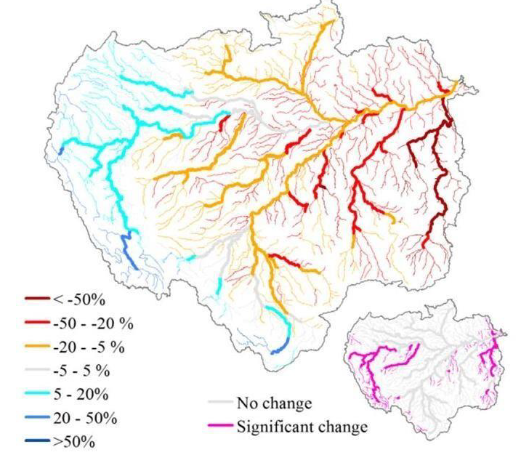
Changes on Amazonian rivers’ mean discharges (2070 – 2099)
(Sorribas et al., 2016)
Other papers point out similar (or even worse) scenarios, that will persist through Belo Monte’s entire estimated life

Slide 20
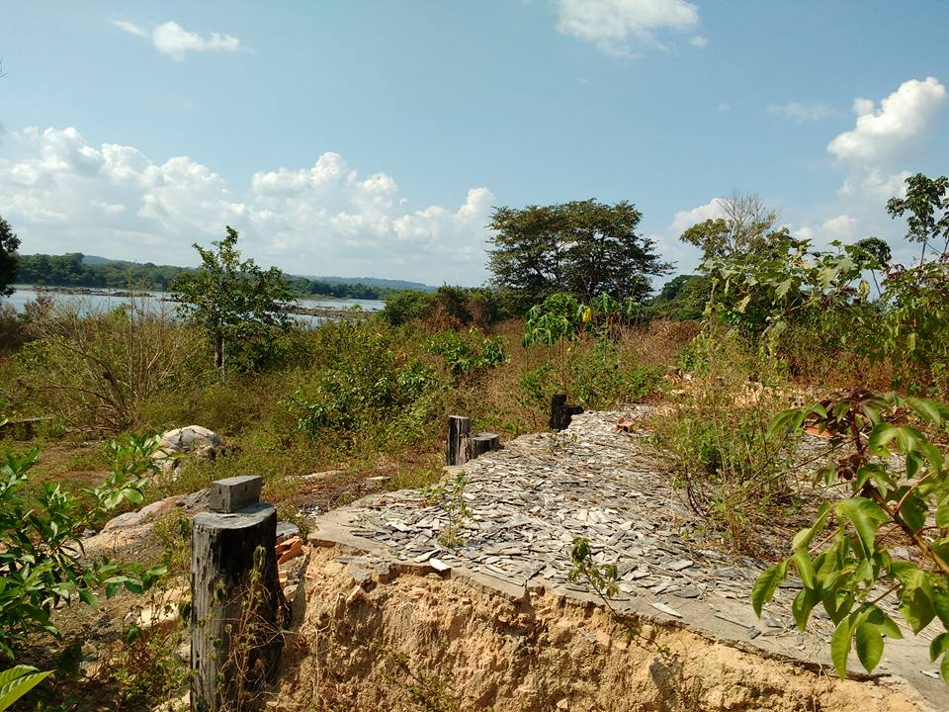

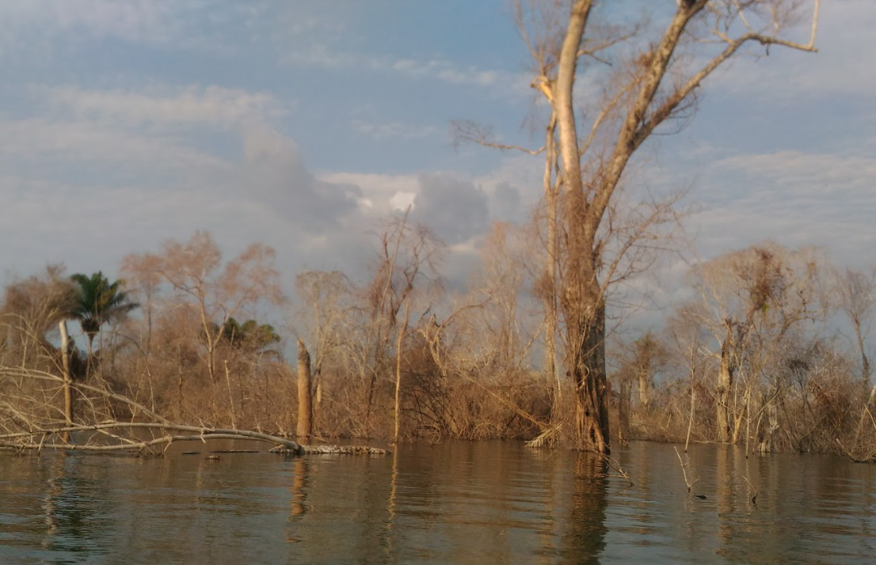
Solution: building more dams?
National Energy Policy Council Resolution – nº 6, 03/Jul/2008
Determines that the only comercially explored hydroelectric potential of the Xingu River is supposed to be Belo Monte
Very significant environmental impacts to:
Local population, biodiversity and ecosystems
Fotos: Rodolfo Salm e Marcelo Camargo

Slide 21
Final remarks

Slide 22
The hydrologic model precisely simulated historical discharges, showing to be a valid method;
Climatic projections point out less rainfall in the next few decades, compared to historical average;
Future simulated discharges are in average 28% lower than the historical means, which is in consonance with recent studies that predict a significantly drier in Eastern Amazon;
A future lower water availability will imply the decreasing of Belo Monte’s energy production;
Other energy resources present higher cost-benefits while also being notedly less impactul as hydropower in Amazon.

Slide 23


Slide 24

Obrigado!
Thank you!
Marcelo Camargo
Graduate Student (USP – Brazil)
marcelogpcamargo@gmail.com
Foto: Marcelo Camargo

Slide 25
References
Amante, C., B.W. Eakins (2009). ETOPO1 1 Arc-Minute Global Relief Model: Procedures, Data Sources and Analysis. NOAA Technical Memorandum NESDIS NGDC-24. National Geophysical Data Center, NOAA.
de Jong, P., Kiperstok A., Torres E.A. (2015). Economic and environmental analysis of electricity generation technologies in Brazil. Renewable and Sustainable Energy Reviews, 52, 725–739.
Dias, L. C. P., Macedo, M. N., Costa, M. H., Coe, M. T., Neill, C. (2015). Effects of land cover change on evapotranspiration and streamflow of small catchments in the Upper Xingu River Basin, Central Brazil. J. Hydrology: Regional Studies, 4 (B), 108-122.
Garcia-Castellanos, D. (2002). Interplay between lithospheric flexure and river transport in foreland basins. Basin Research, 14(2), 89-104.
Guimberteau et al. (2016) Impacts of future deforestation and climate change on the hydrology of the Amazon basin: a multi-model analysis with a new set of land-cover change scenarios. Hydrol. Earth Syst. Sci. Discuss. Em revisão.
IPCC (2014). Climate Change 2014: Synthesis Report. Contribution of Working Groups I, II and III to the Fifth Assessment Report of the Intergovernmental Panel on Climate Change. [Pachauri, R. K., Meyer, L. A. (eds.)]. IPCC, Geneva, Switzerland. http://www.ipcc.ch/report/ar5/index.shtml. Acesso em 22/02/2016.
Norte Energia S.A. (2016). UHE Belo Monte. <http://norteenergiasa.com.br/revista/>. Acessado em 20/07/2016.
Sacek, V. (2011). Modelagem numérica conjunta de processos sedimentares e tectônicos em bacias sedimentares. Tese de doutorado, IAG – USP.
Sacek, V. (2014). Drainage reversal of the Amazon River due to the coupling of surface and lithospheric processes. Earth and Planetary Science Letters, 401, 301-312.
Sorribas, M. V., Paiva, R. C. D. et al. (2016). Projections of climate change effects on discharge and inundation in the Amazon basin. Climatic Change, 136, 555-570.
Stickler, C. M., Coe, M. T., Costa, M. H., Nepstad, D. C., McGrath, D. G., Dias, L., Rodrigues, H. O., Soares-Filho, B. S. (2013). Dependence of hydropower energy generation on forests in the Amazon Basin at local and regional scales. Proceedings of The National Academy of Sciences, 110 (23), 9601-9606.
Vuuren, D. P., Edmonds, J., Kainuma, M. et al. (2011). The representative concentration pathways: an overview. Climatic Change, 109:5

