Slide 1
Geoportal
-- Share and Discover Research Data in Geoscience
Nicole kong
Associate professor of library science
GIS Specialist
Purdue university

Slide 2

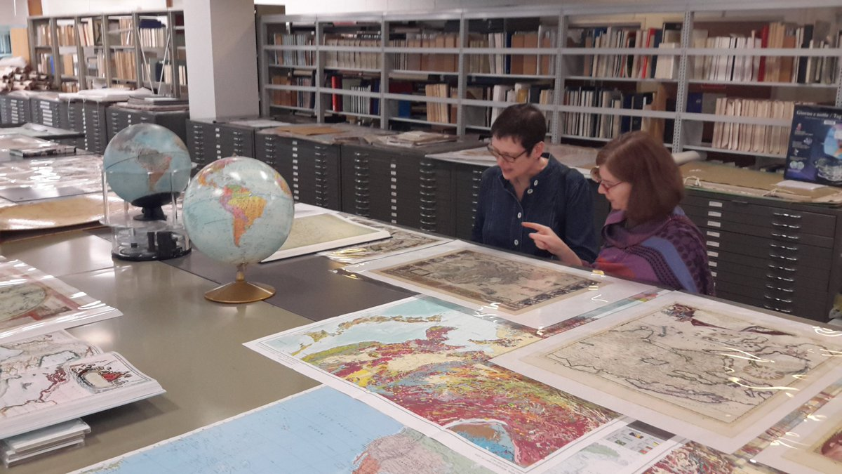

My Journey of Geospatial Information Librarianship
From a data user/maker to a librarian?
Conducted intensive GIS data curation interviews
Class visits
Over 50+ consultation sessions
Cyberinfrastructure development
http://teacher.scholastic.com/commclub/librarian/
https://twitter.com/MapCurator

Slide 3
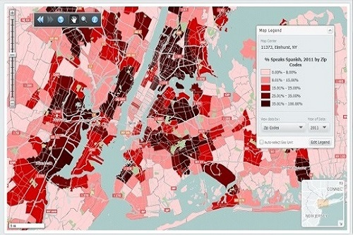
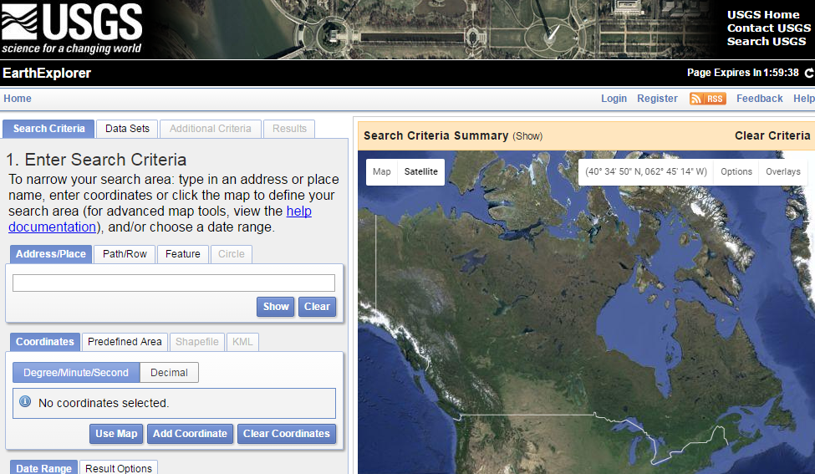

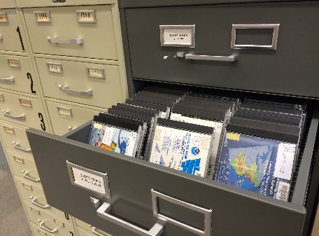
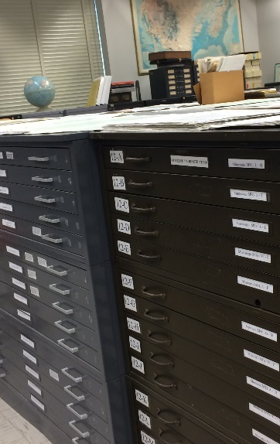

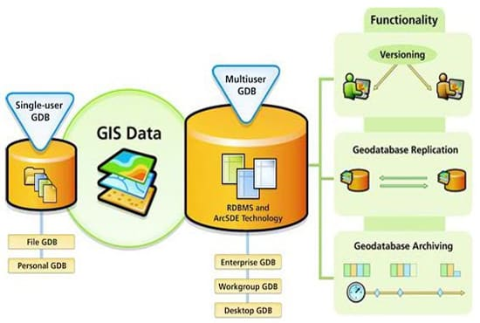

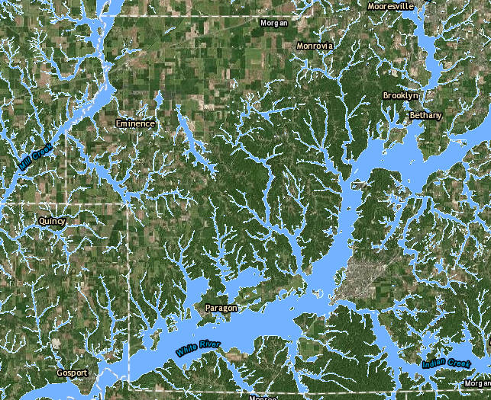
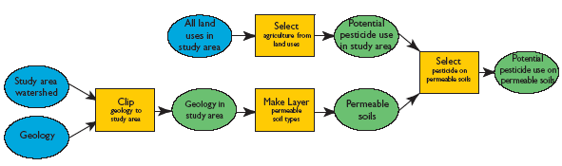
Serve for the Research Community
Digital Maps
Proprietary Data
Public Domain Data
External Datasets
Maps
Institutional Research Data
Geodatabase
Research Data
Model (code) as Data

Slide 4
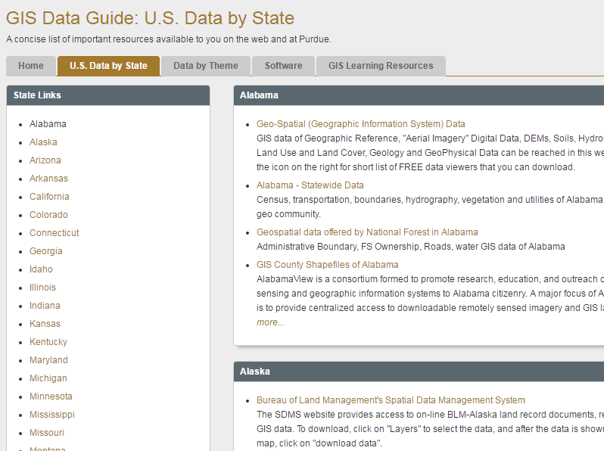
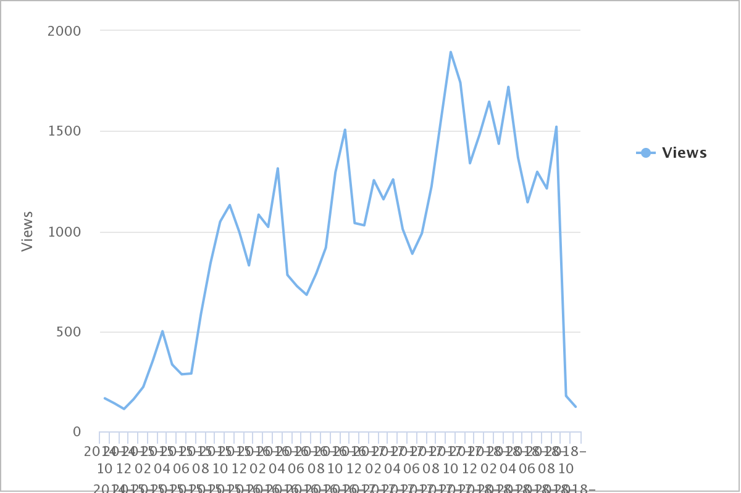
Dealing with External Dataset

Slide 5
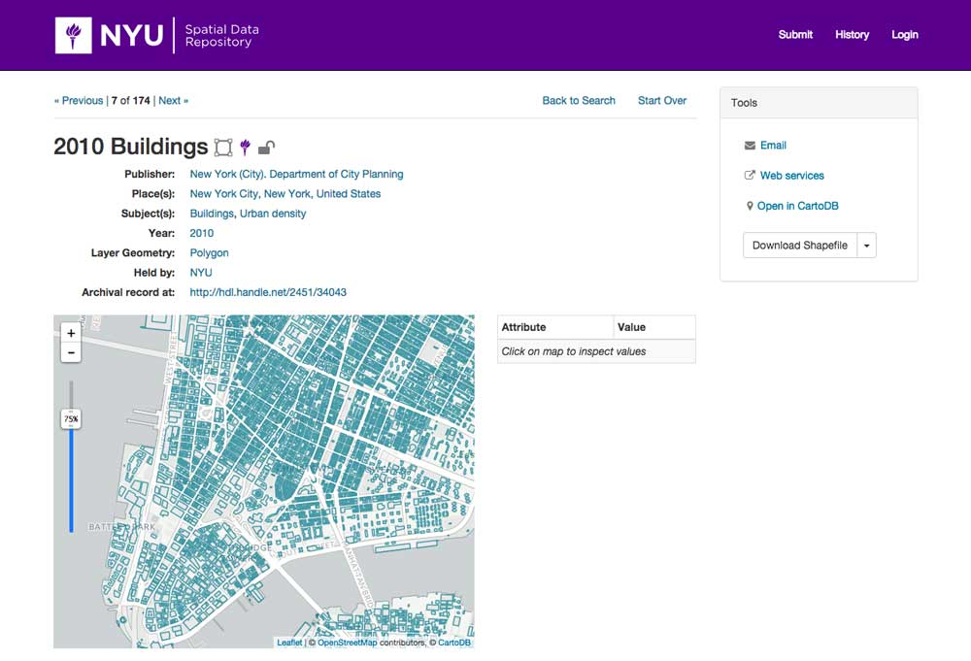

Geoportal
Geodata portal is a discovery layer which allows users to search various geospatial data, and access the information by:
a web map + data downloading
&

Slide 6
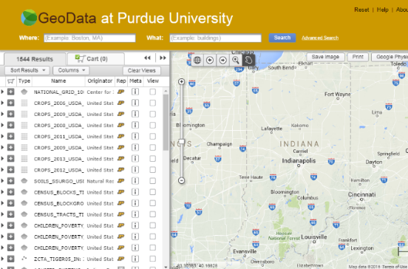
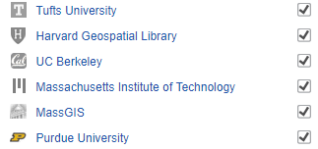
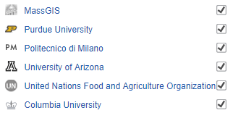
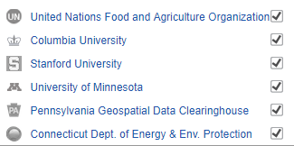
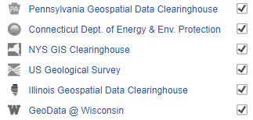
Purdue University Geodata Portal
Based upon Open Geoportal project
Harvest metadata from multiple institutions

Slide 7


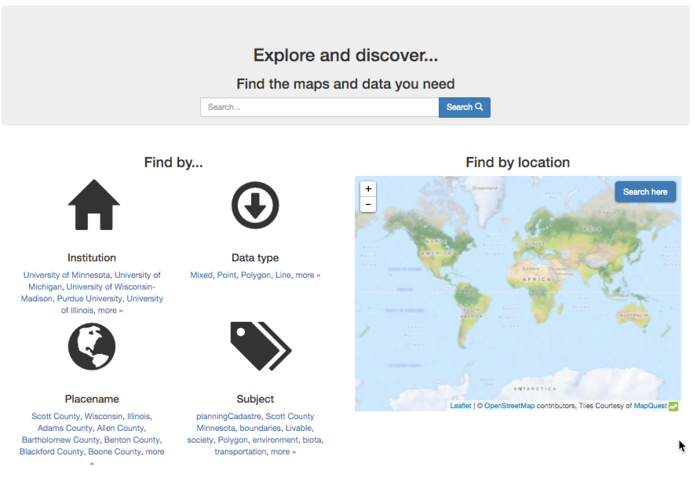

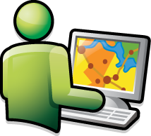
Technology Diagram
Web Map Service & Downloadable maps
organize
Geospatial Data
Publish
MetaData
UI
MetaData
Database
User

Slide 8





Setting up a Geoportal
Map Server /
Data Store
Metadata
Preparation
Portal Deployment
Community
Effort
Data access options:
Download
Web map services
Other
Choose a metadata standard
Content standard

Slide 9
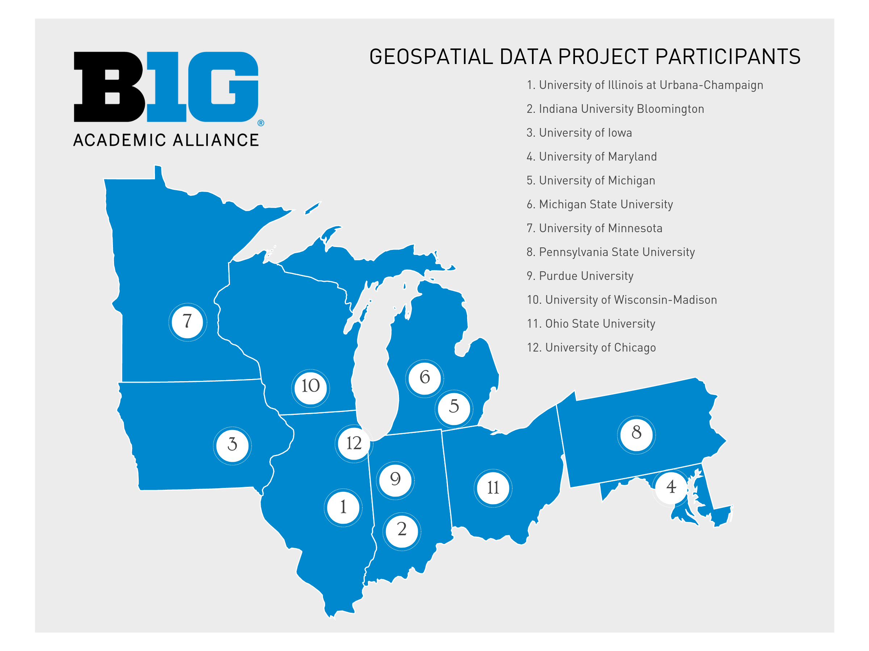
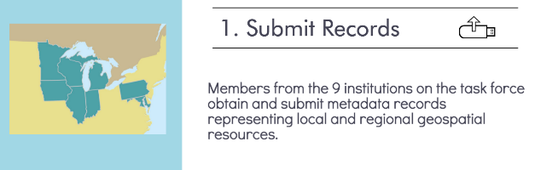

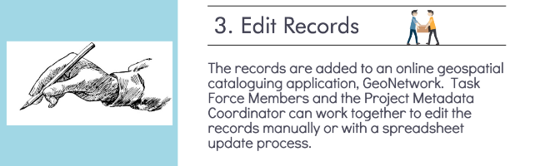
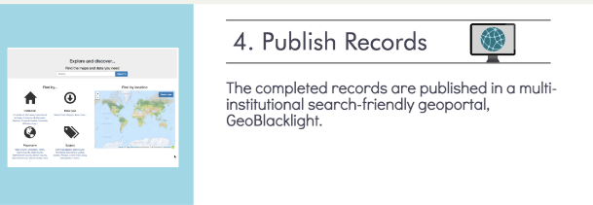
BTAA Geodata Portal
Project began in July 2015 with 9 universities
3 more universities joined in the second phase
Collaborative Metadata
Workflow

Slide 10
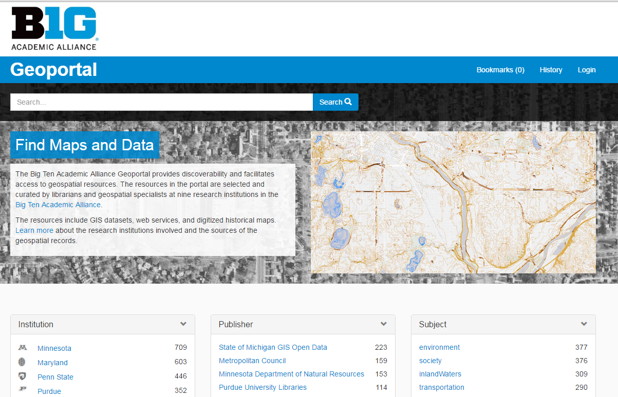
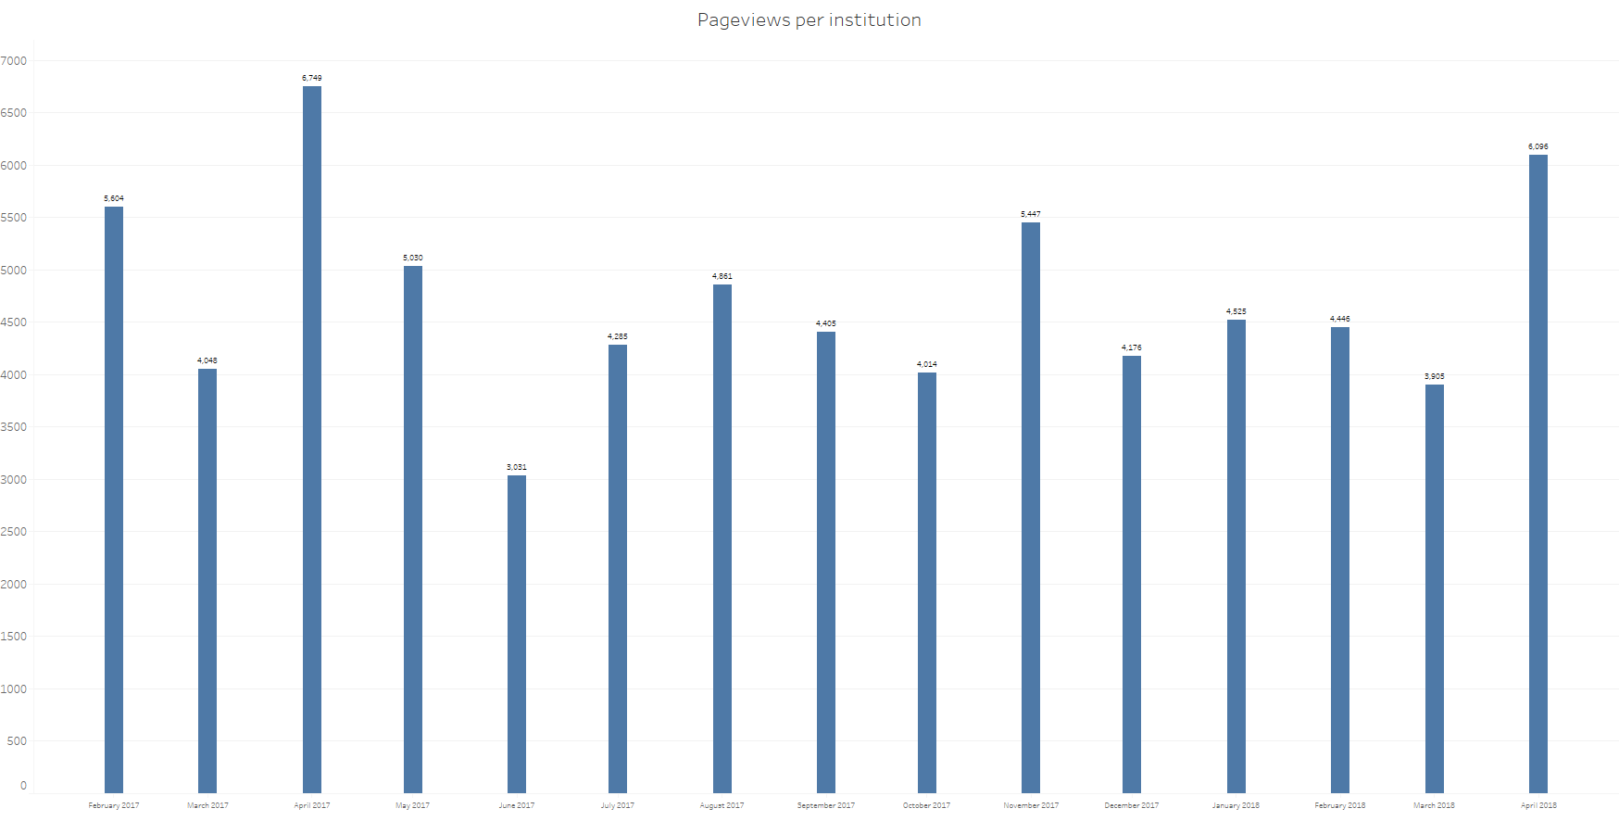
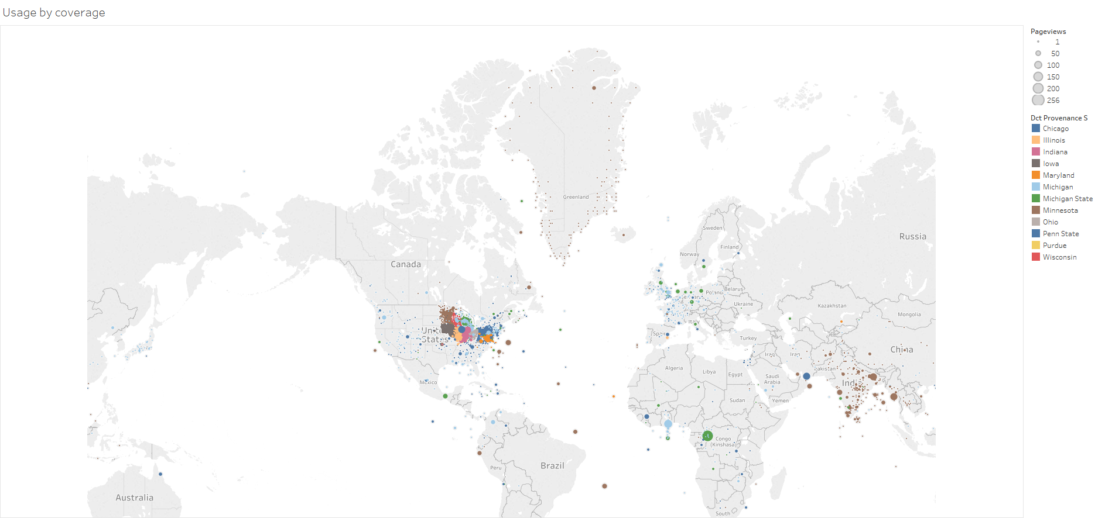
BTAA Geodata Portal
Page View by month
Usage by Coverage

Slide 11
Serve for the Research Community
Digital Maps
Proprietary Data
Public Domain Data
External Datasets
Maps
Institutional Research Data
Geodatabase
Research Data
Model (code) as Data

Slide 12
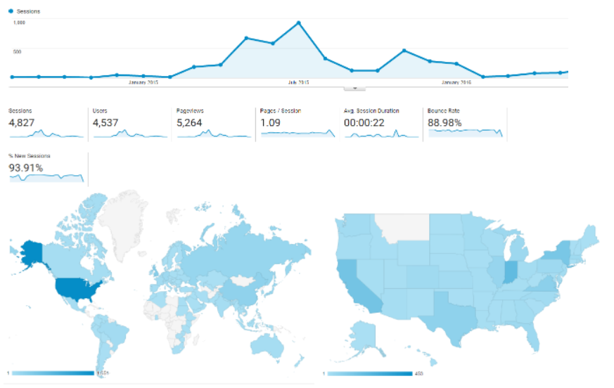
Expanding Institutional Data Repository

Slide 13
Advocate a Data Sharing Culture
FAIR data needs community efforts
Creating a graduate-level course for “Data Sharing and Publication”
  Identify valuable dataset
  Data documentation and metadata creation
  Data publication and sharing

Slide 14
Roadway
Challenges and the Future
Big data
Data preservation
International datasets

Slide 15
Thank You
Nicole Kong | kongn@purdue.edu

