Slide 1
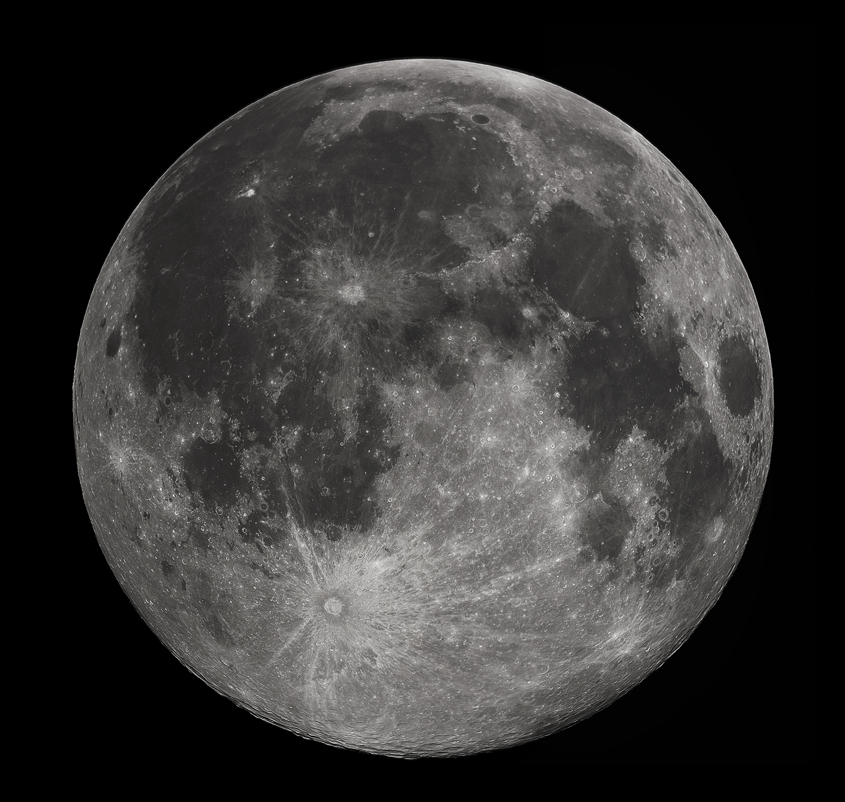




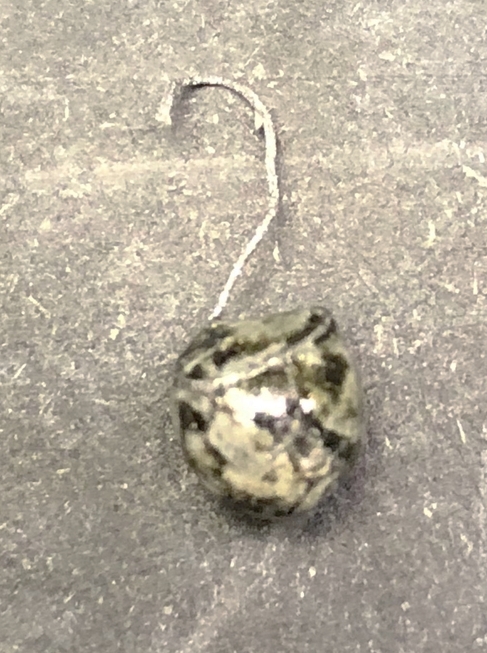
Rapid crystal growth in the solar system’s slowest cooled magma? Investigating the paradox of olivine P-enrichment in troctolite 76535 parent melt with laboratory crystallization experiments
Alexandra Kirsch¹, Julia Hammer², Benoit Welsch², and G. J. Taylor²
¹Marietta College, Marietta, Ohio, ²School of Ocean and Earth Science and Technology, University of Hawai’i at Mānoa, Honolulu, Hawai’i

Slide 2
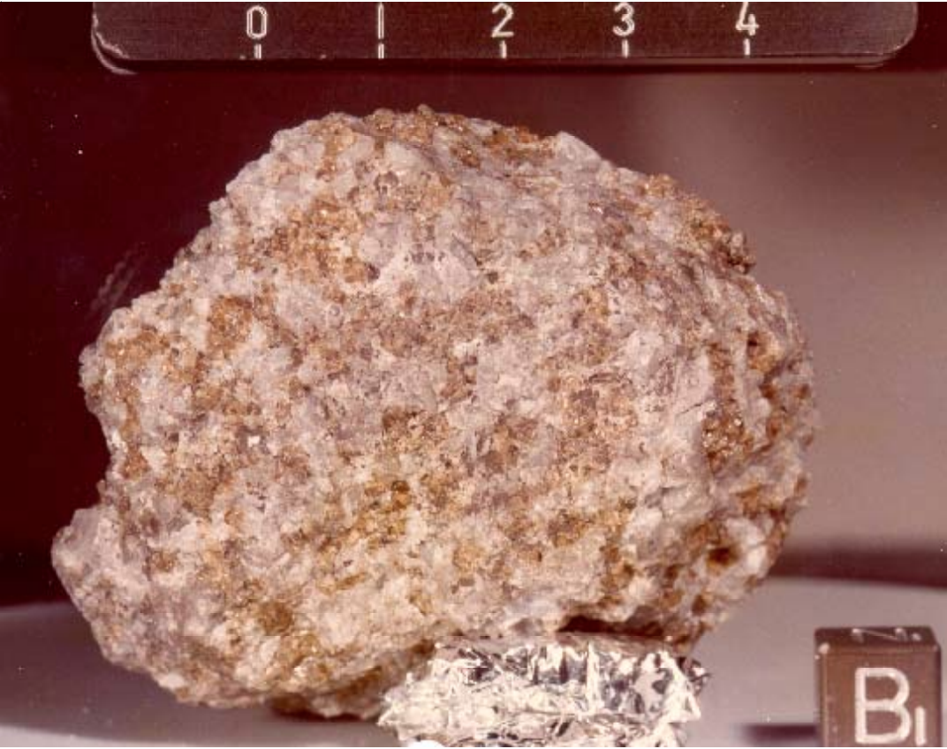
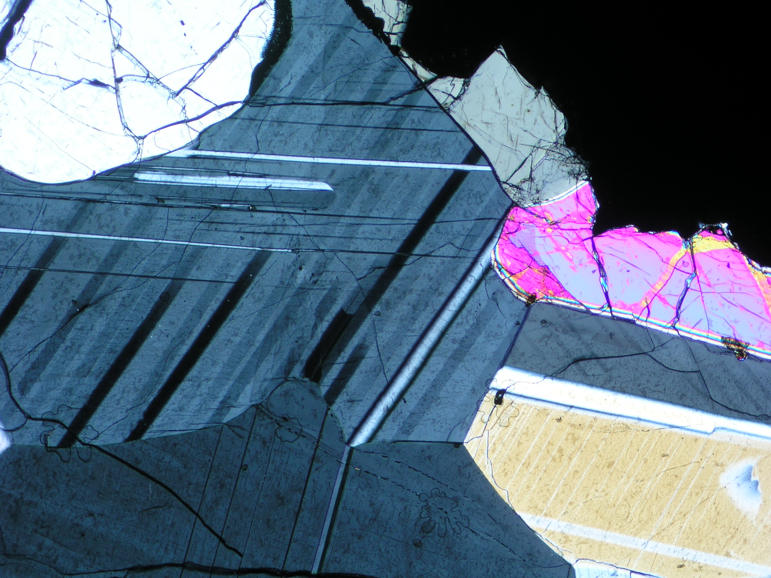
Background
Lunar Troctolite 76535_150 thin section at 4x magnification with orange displaying 120 degree grain boundaries
Lunar Troctolite 76535 hand sample (scale is in cm)
Meyer, C. (2012) 76535 Troctolite. Lunar Sample Compendium. web address: https://curator.jsc.nasa.gov/lunar/lsc/76535.pdf.

Slide 3
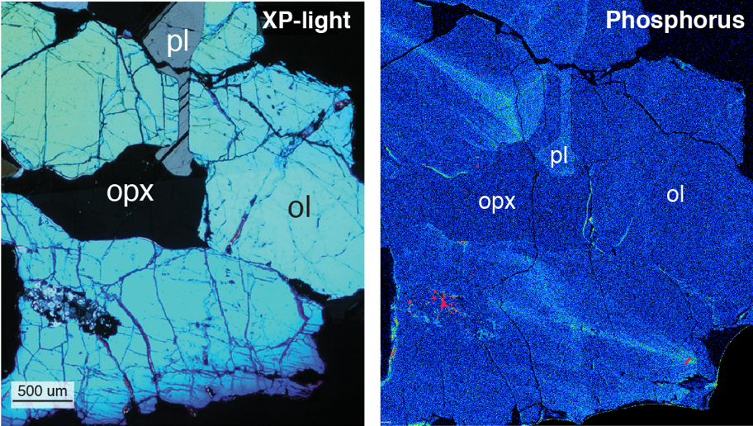
Background
Troctolite 76535 in XP light (right).
X-Ray intensity (P) mapped 76535 (left)
Hammer, et al. (2017) LPSC

Slide 4
Background
Troctolite 76535 in XP light (right).
X-Ray intensity (P) mapped 76535 (left)
Hammer, et al. (2017) LPSC

Slide 5
Primary Research Goals:
Synthesize a troctolite parent melt that compositionally matched, as accurately as possible, lunar troctolite 76535
Begin investigating olivine growth kinetics
Do superheating and undercooling influence crystal growth rate?

Slide 6
Synthesizing Troctolite Parent Melt (TPM)
Bulk composition calculated for 6g of sample powder using available reagents
Estimated parent liquid
Sonzogni et al., 2015 O'Sullivan and Neal, 2013.

Slide 7
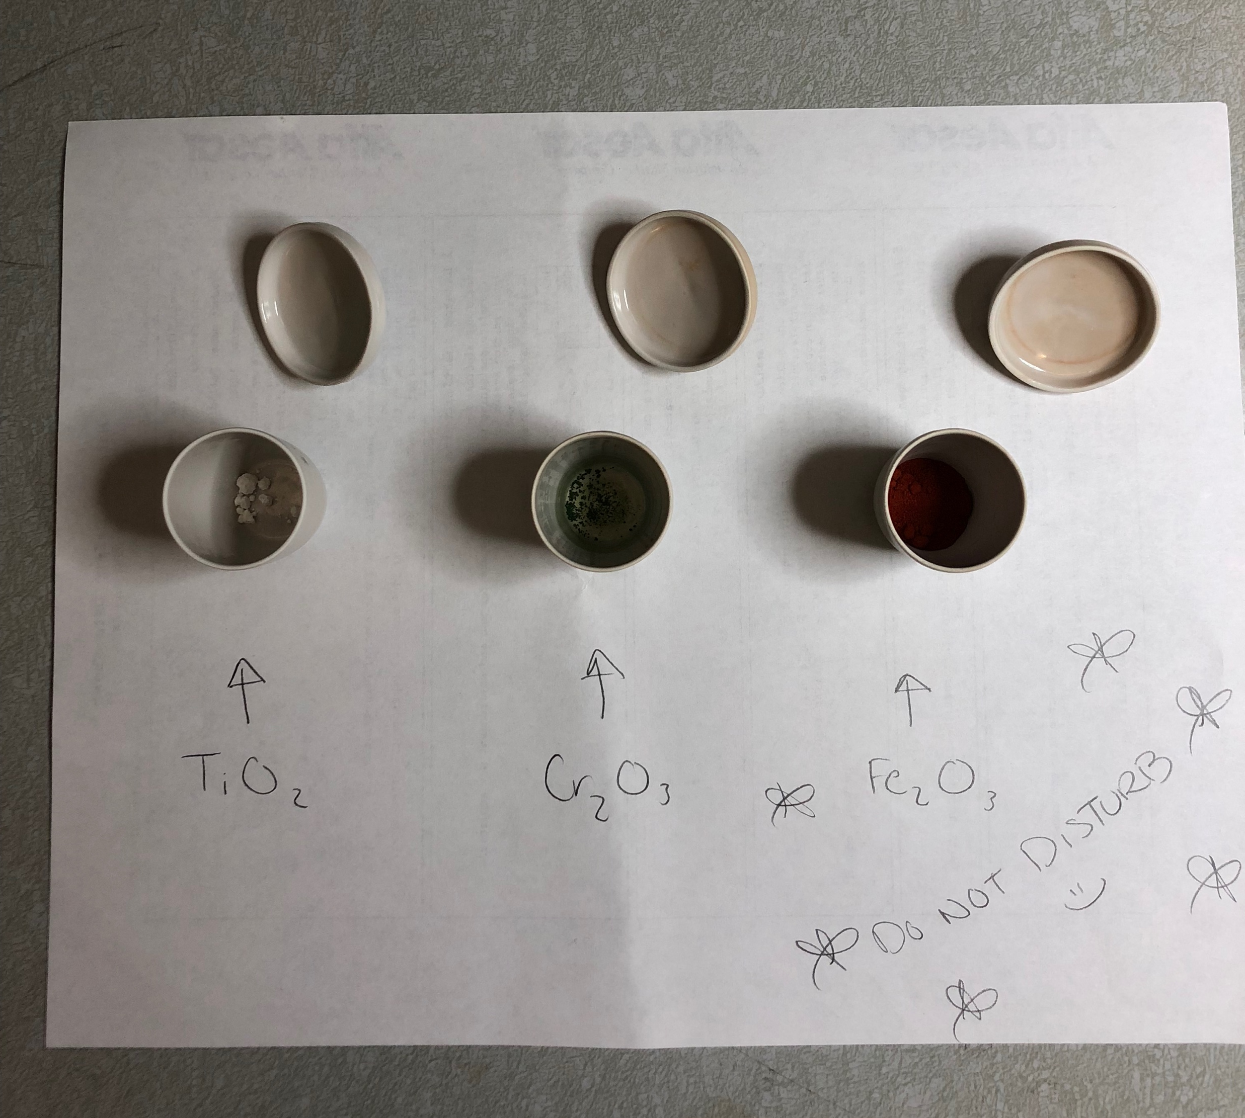
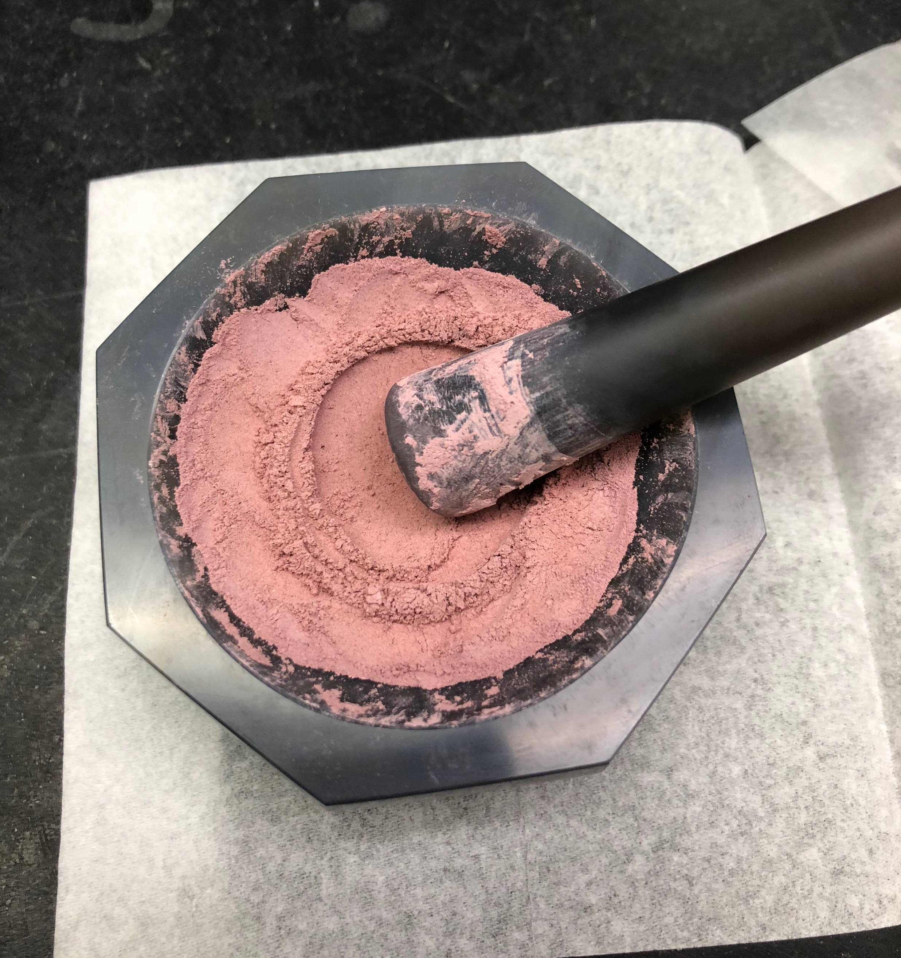
The process of using individual reagent powders (left) to synthesize a compositionally accurate troctolite sample

Slide 8
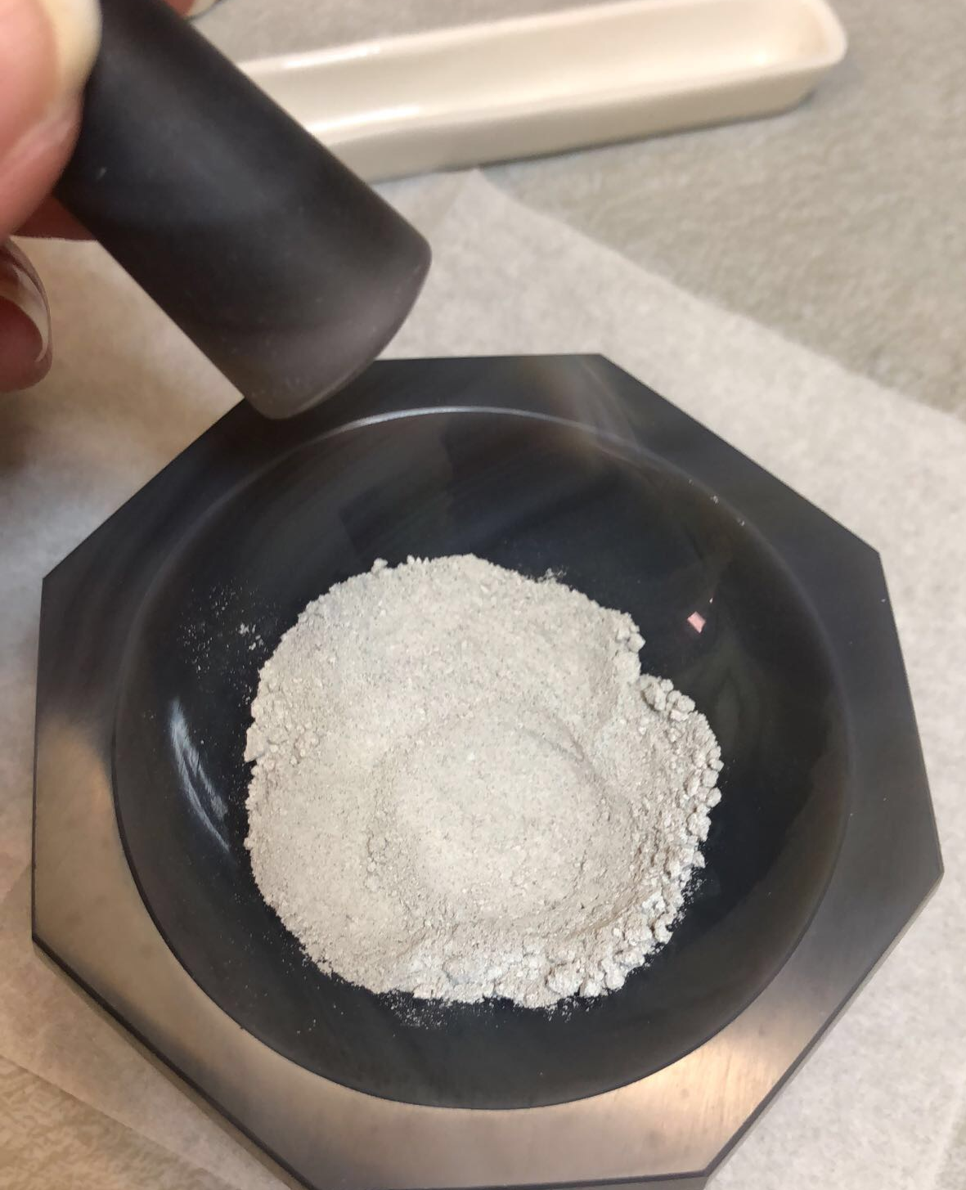
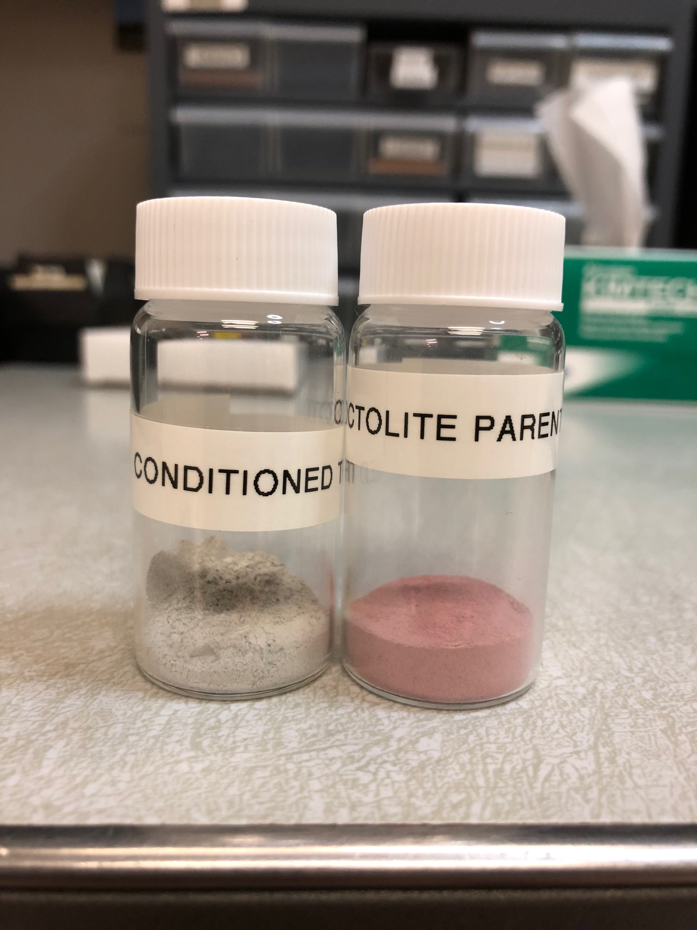
Final Product!
Troctolite Parent Melt (TPM) powder after conditioning (gray) at appropriate oxygen fugacity (FMQ -2)

Slide 9
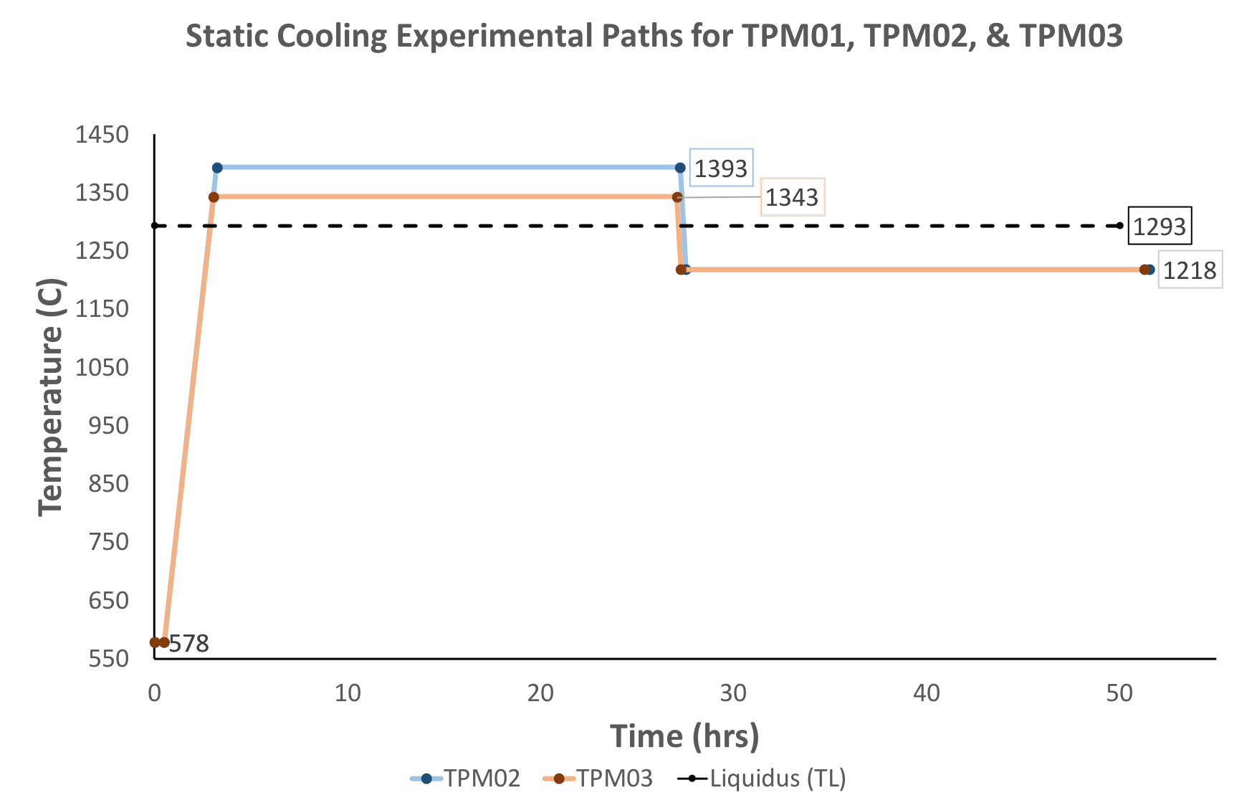
Investigating Superheating & Undercooling Effects on Rapid Crystal Growth
Superheating vs. Undercooling Experimental Grid
In-depth run plans (temp vs. time) for the blue and orange starred experiments on the left grid
01 & 02

Slide 10
Run Plan for TPM 01 & 02 (blue experiment)
In-depth run plans for starred experiments – focus on blue star & line. Superheat 100 ºC above liquidus and undercooled 75 ºC below liquidus
Superheating vs. Undercooling Experimental Grid
01 & 02

Slide 11
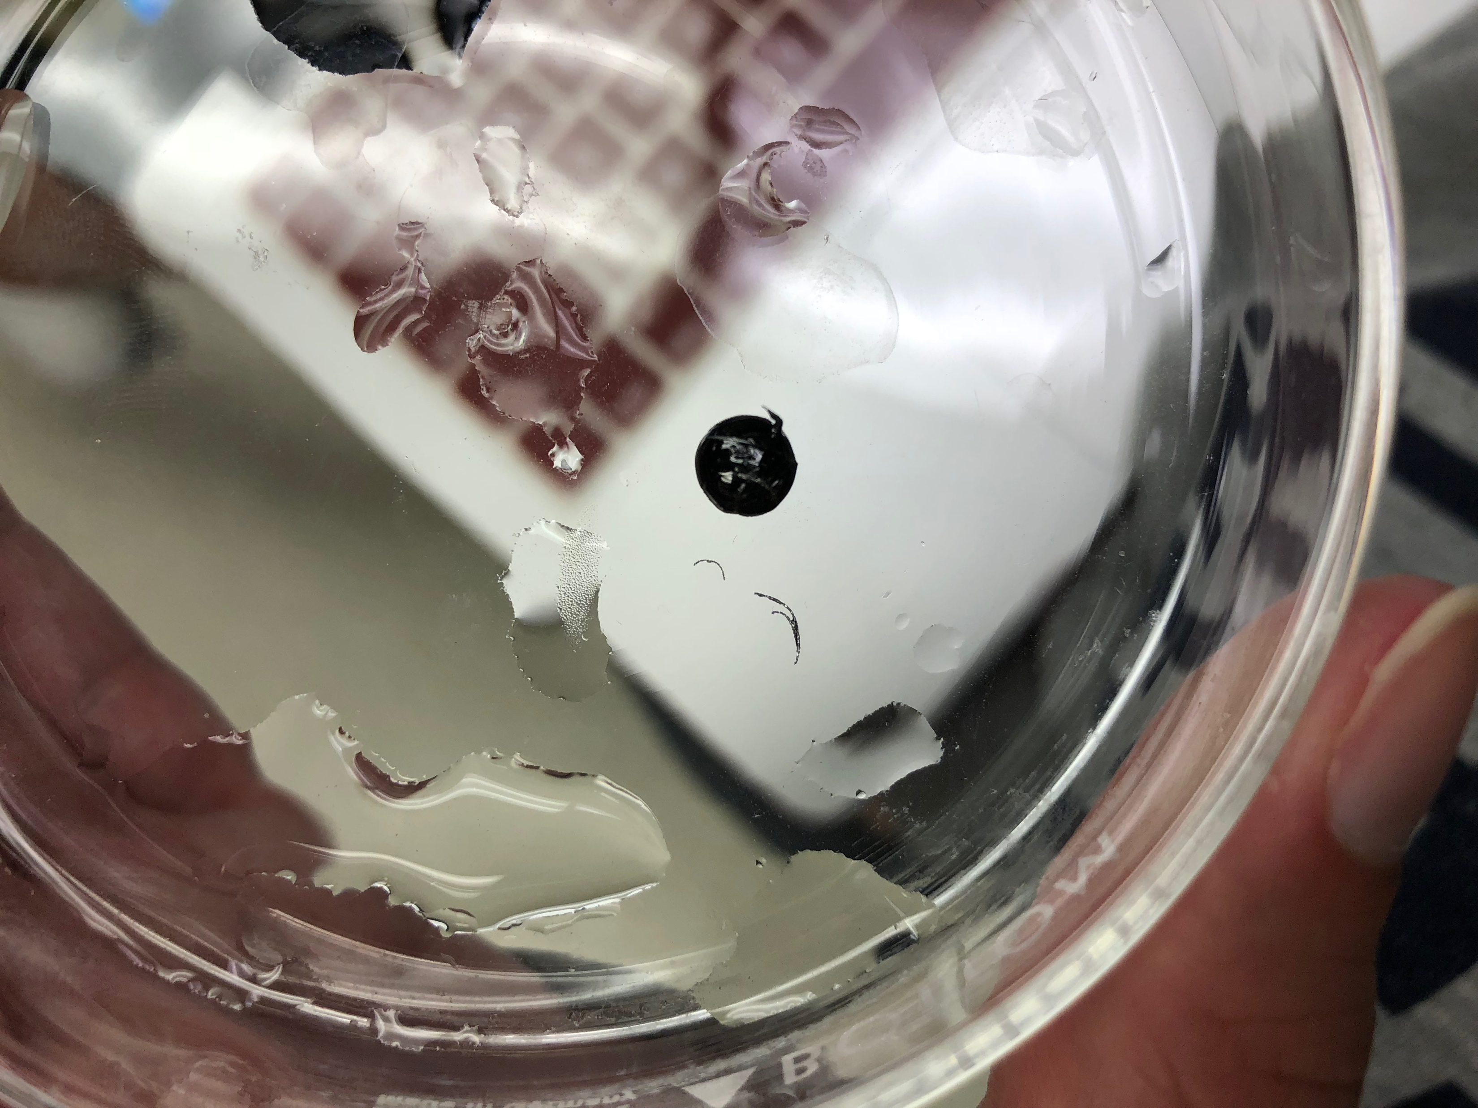
TPM 01

Slide 12
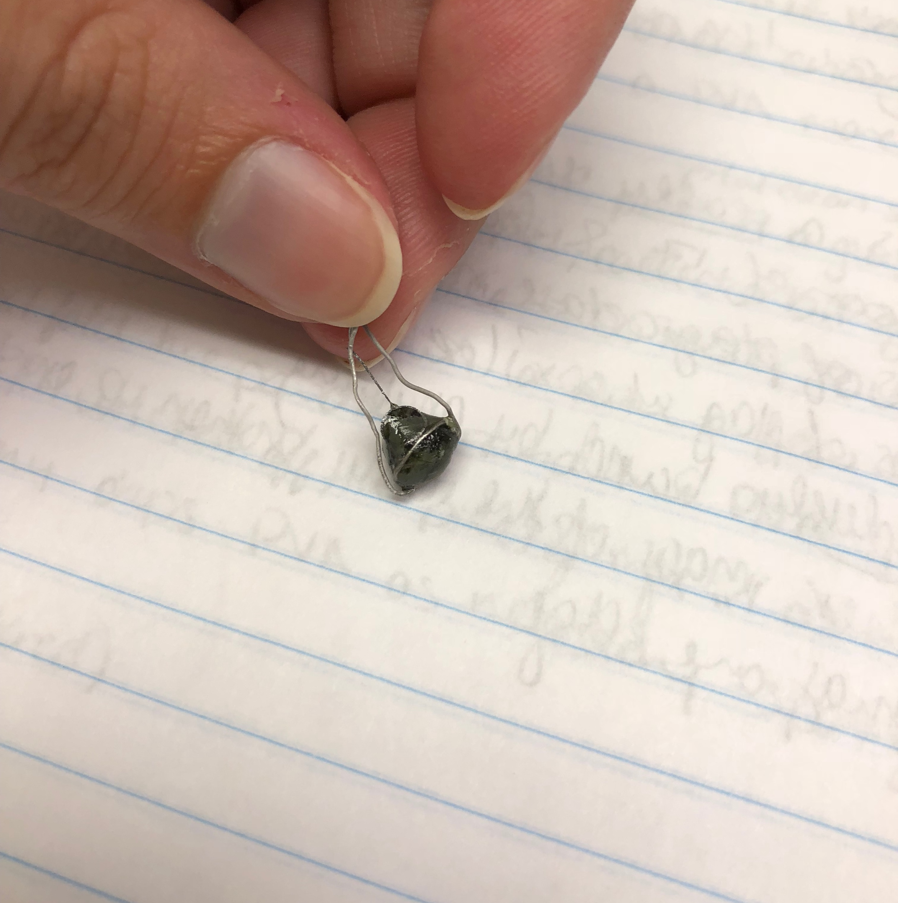
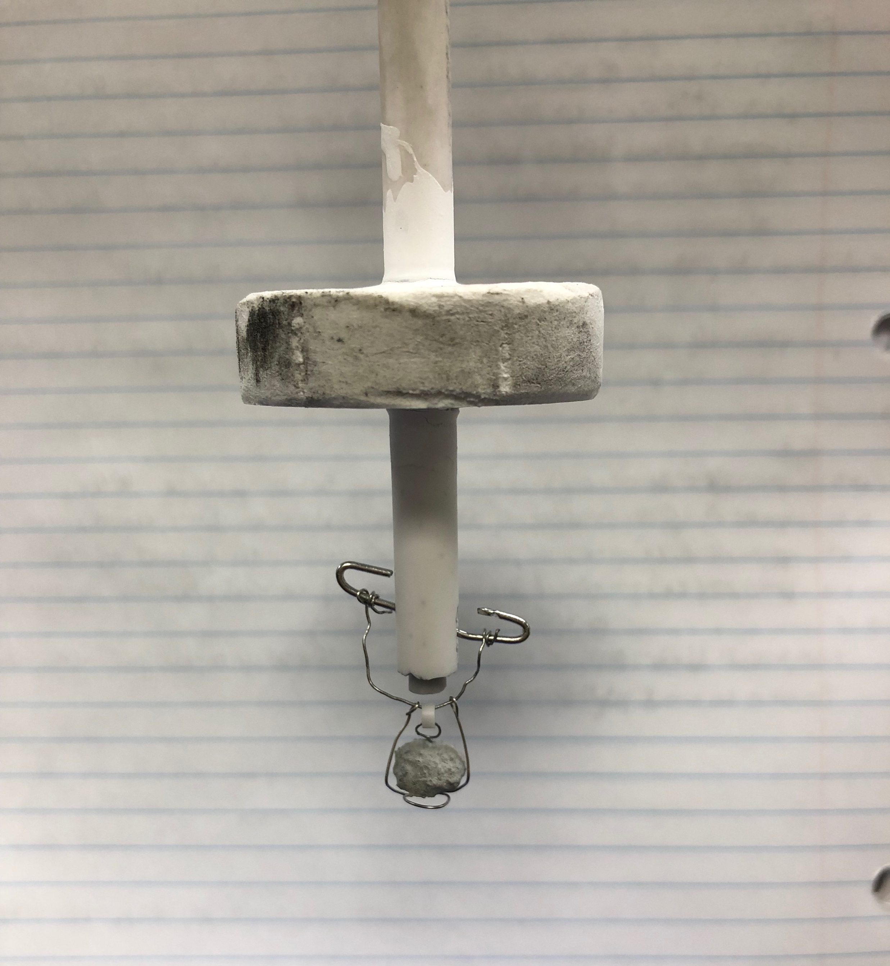
TPM 02

Slide 13
Run Plan for TPM 03 (orange experiment)
Superheating vs. Undercooling Experimental Grid
In-depth run plans for starred experiments – focus on orange star & line. Superheat 50 ºC above liquidus and undercooled 75 ºC below liquidus
01 & 02

Slide 14
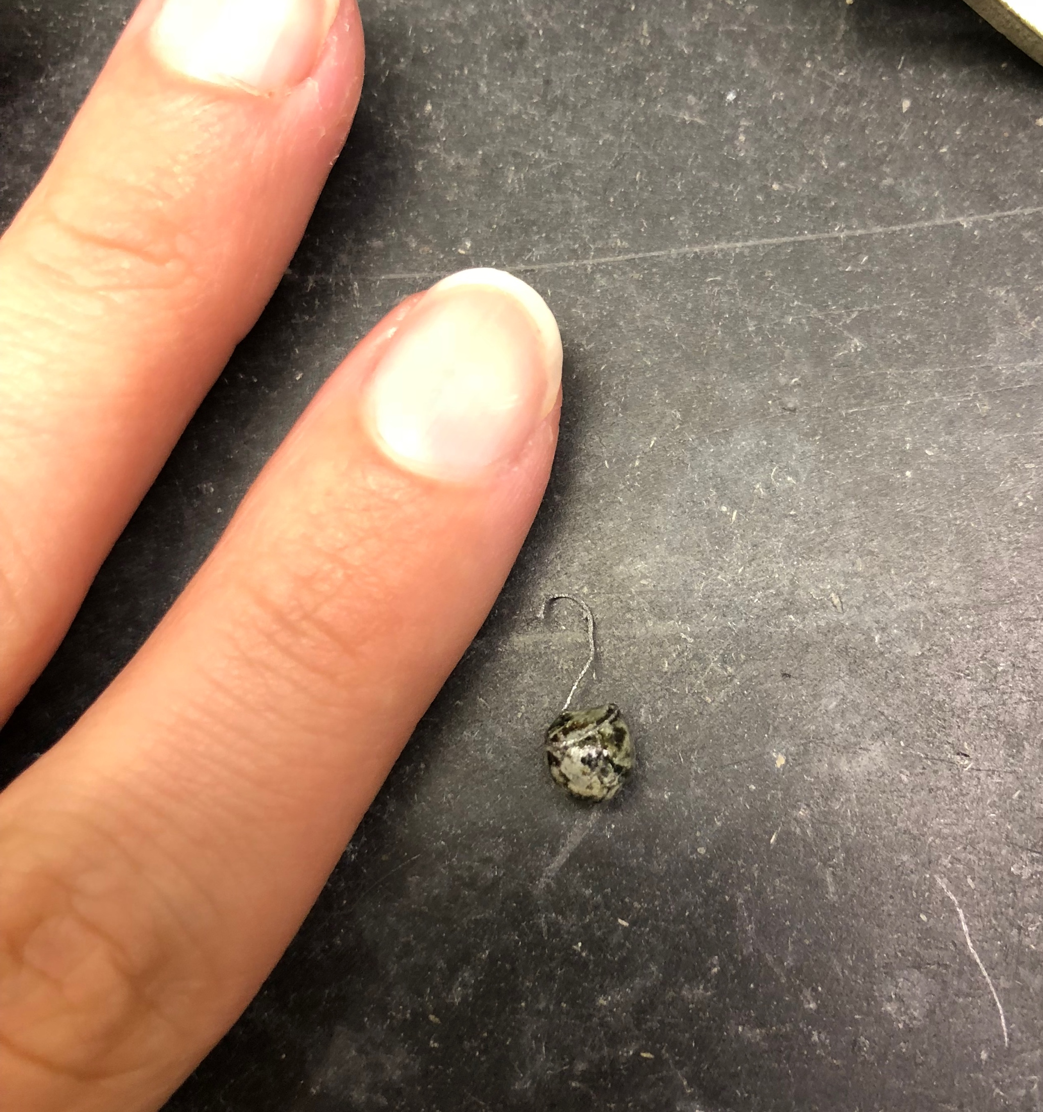
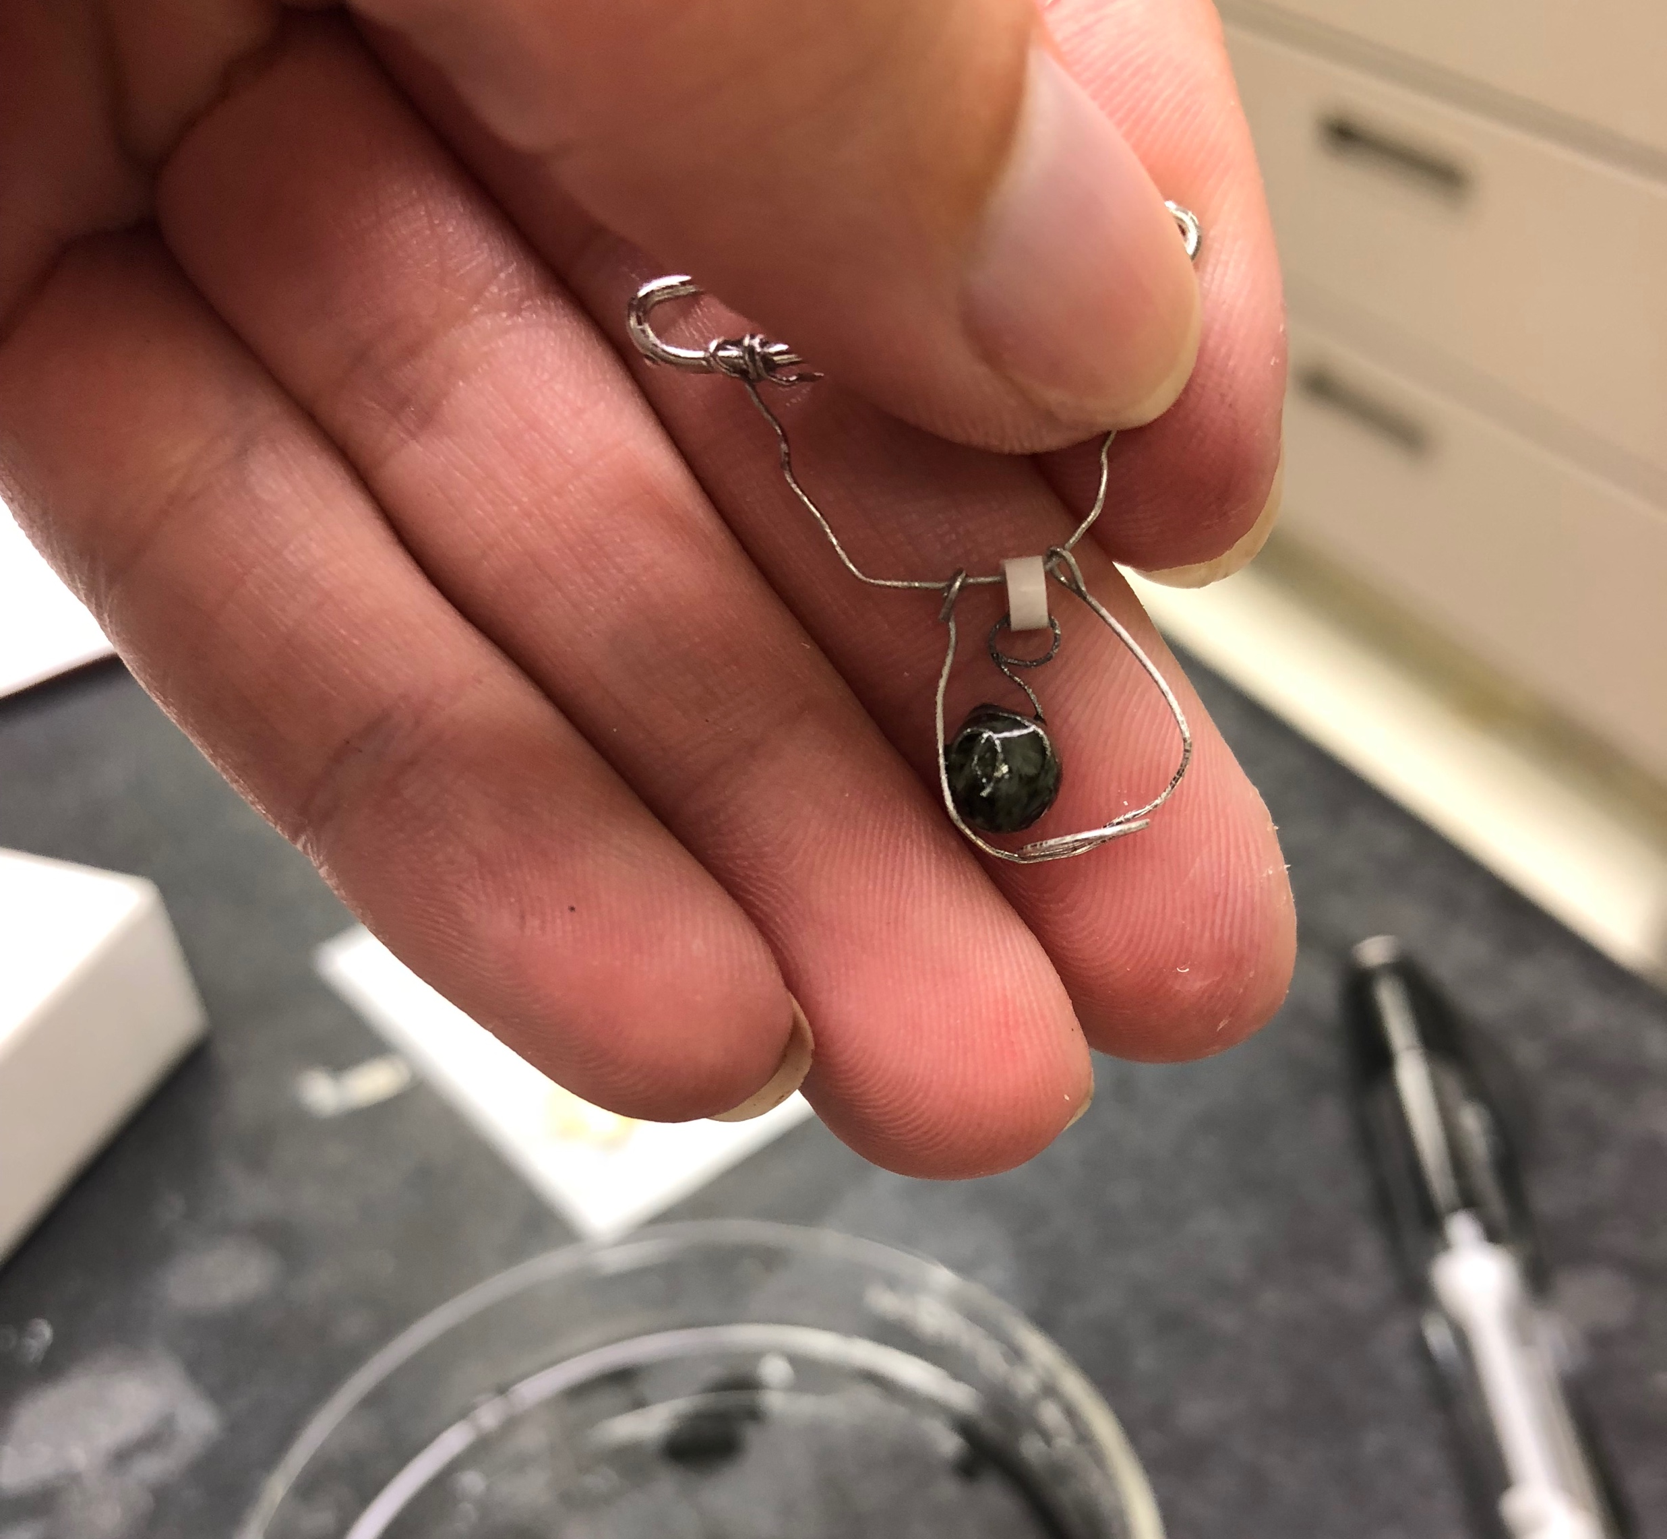
TPM 03

Slide 15
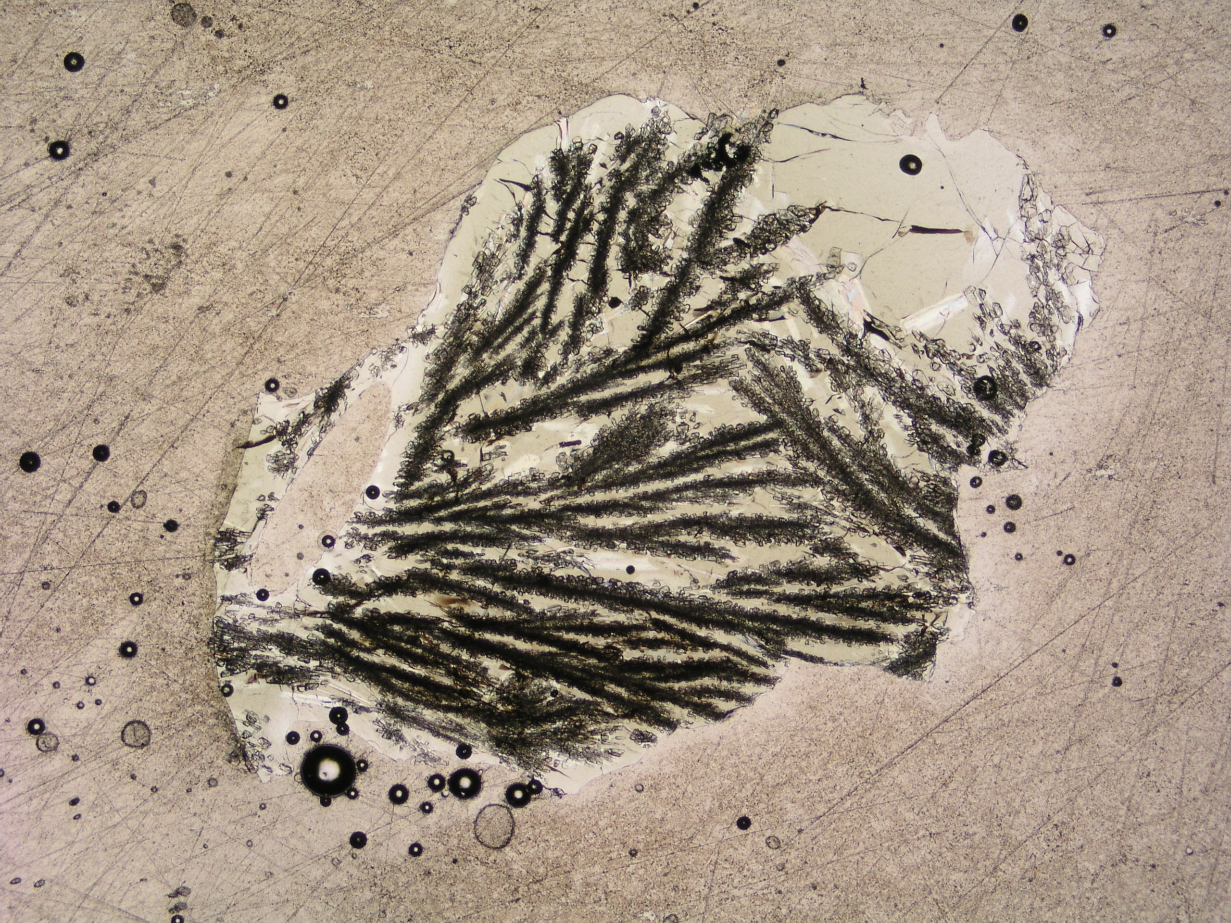
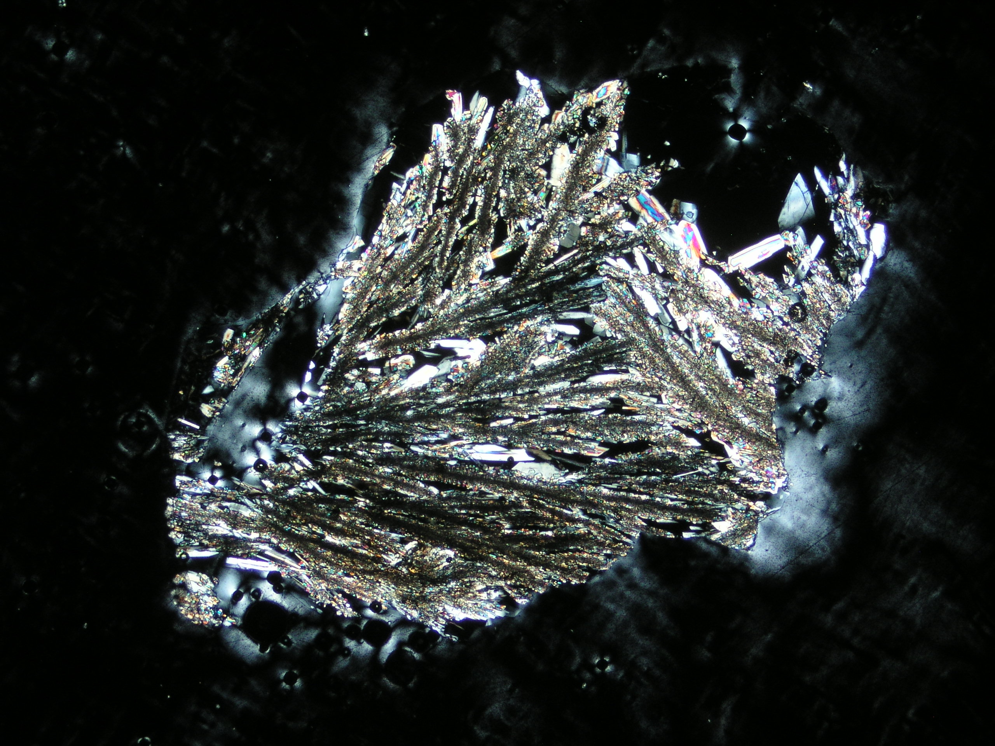
Analysis of TPM Experiments
TPM02 Sample at 2x magnification under polarized light and crossed-polars respectively

Slide 16
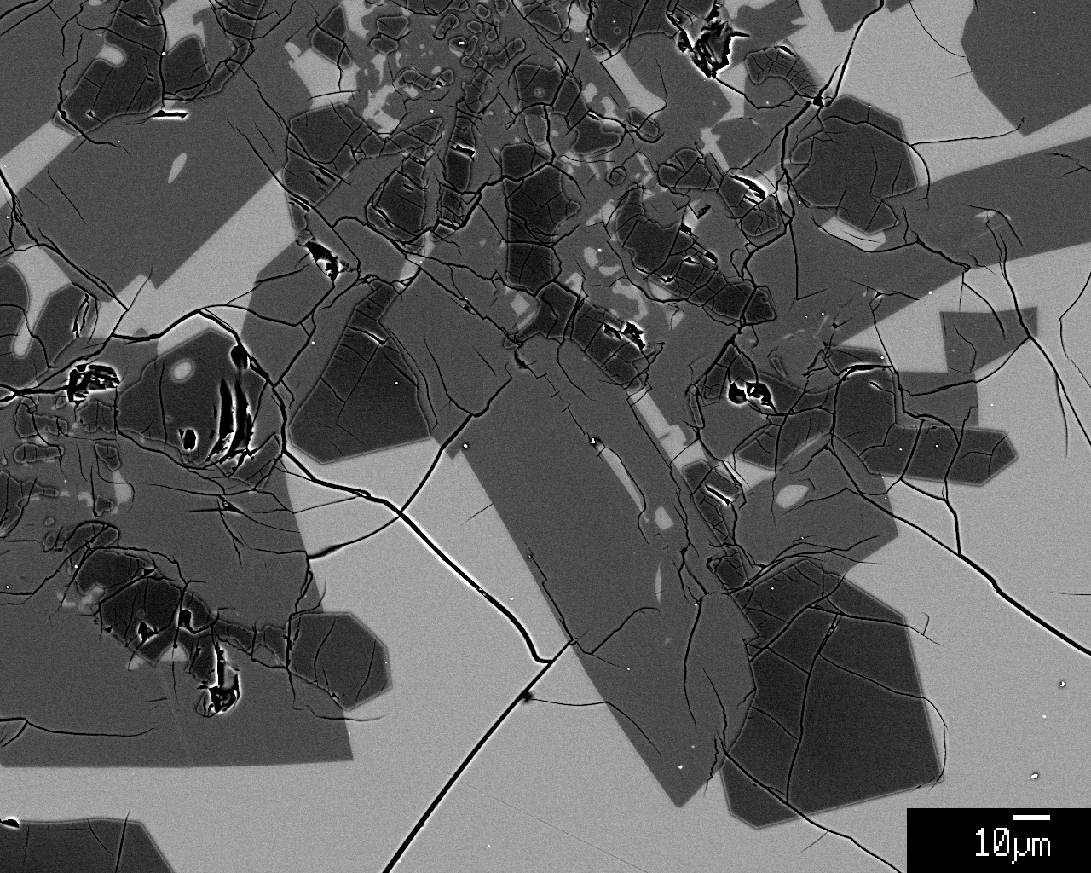
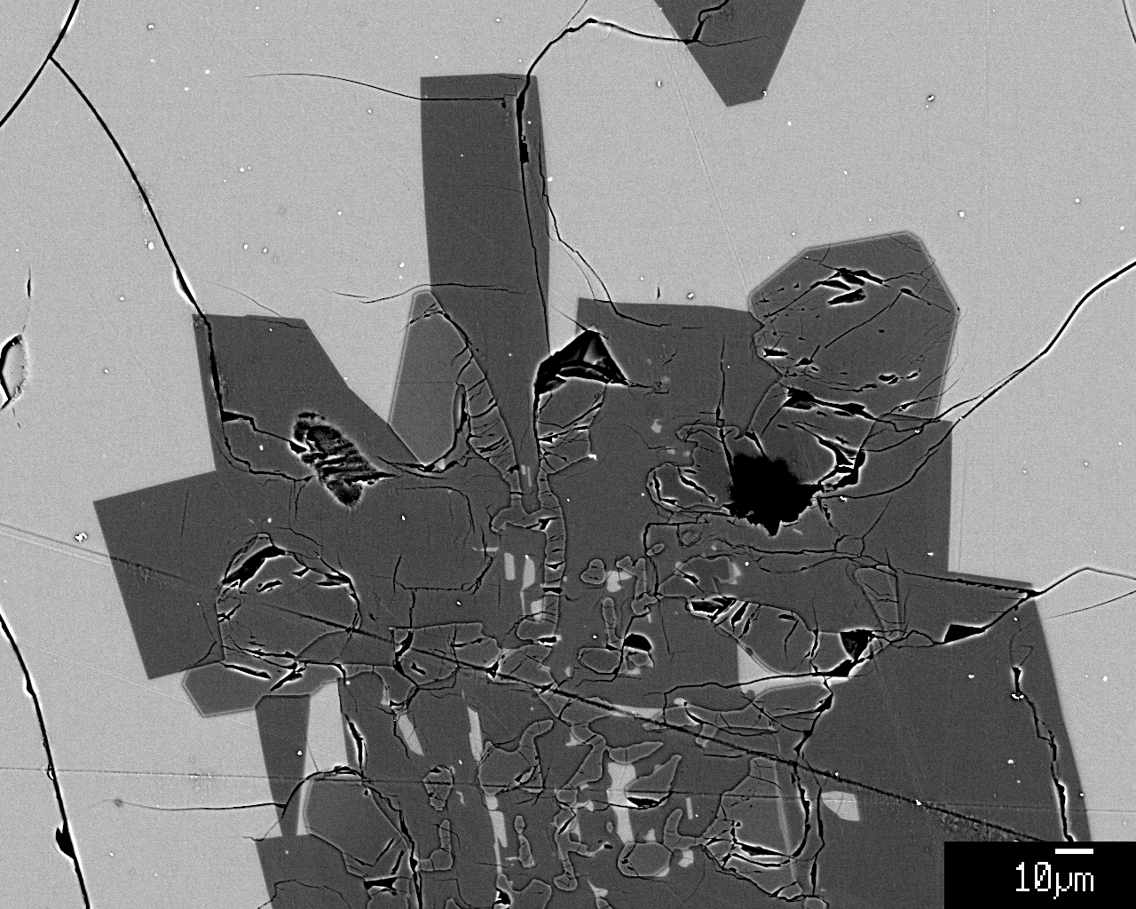
Microprobe Images of TPM 02 and 03
glass
ol
ol
plag
plag
ol
ol
glass
TPM 02* (left) and TPM 03 (right). Notice the euhedral olivine grains in contact with the melt, and the hopper olivine crystals within the plagioclase laths. Also note the gradient in sample TPM 02 within olivine grains showing the Mg content increasing within the interstitial grains.
*indicates Fe-loss

Slide 17
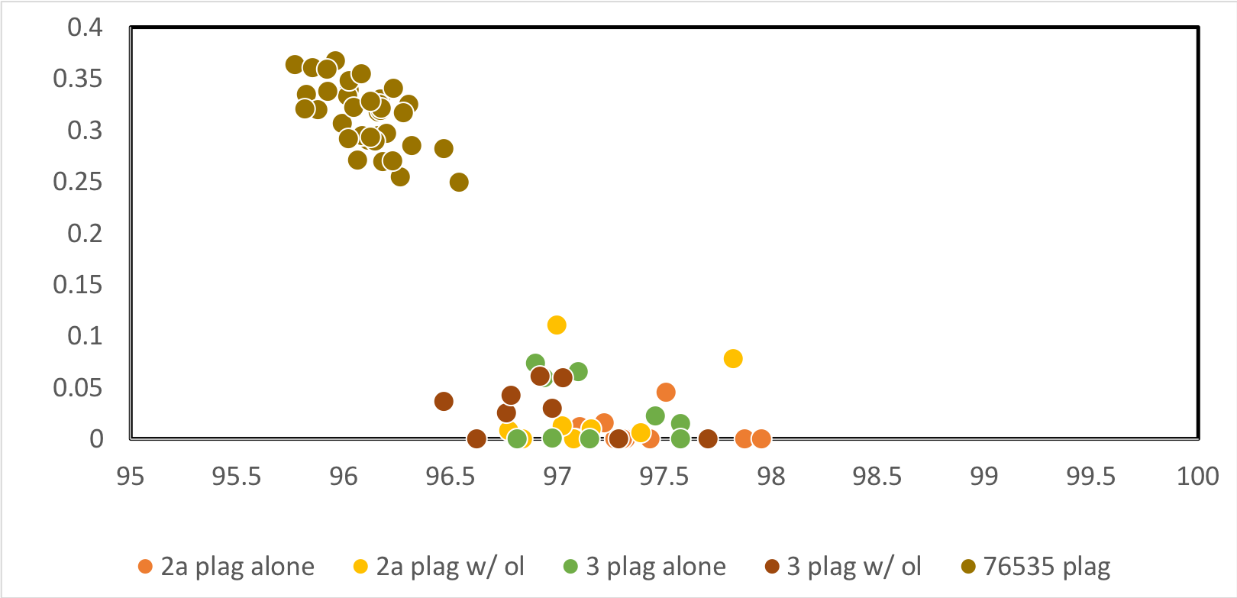
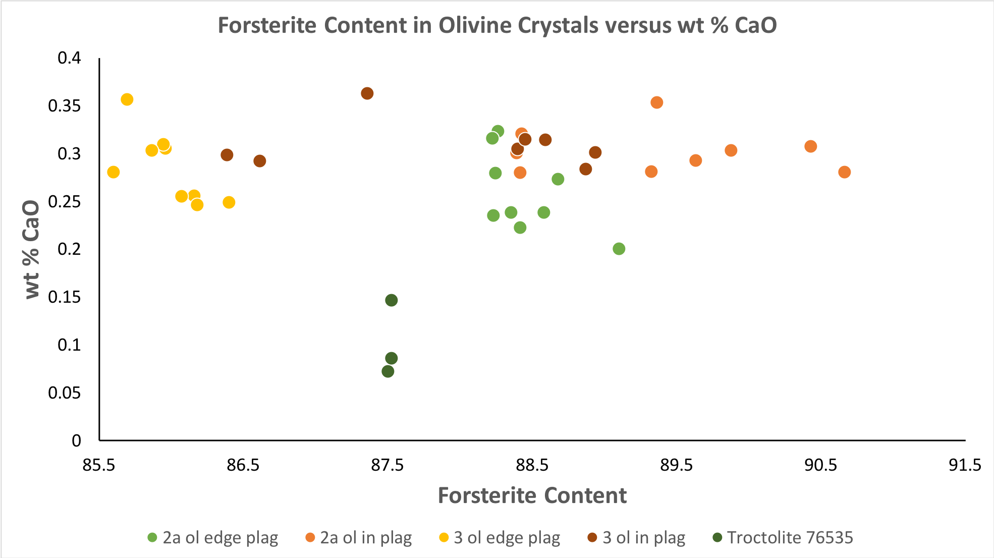
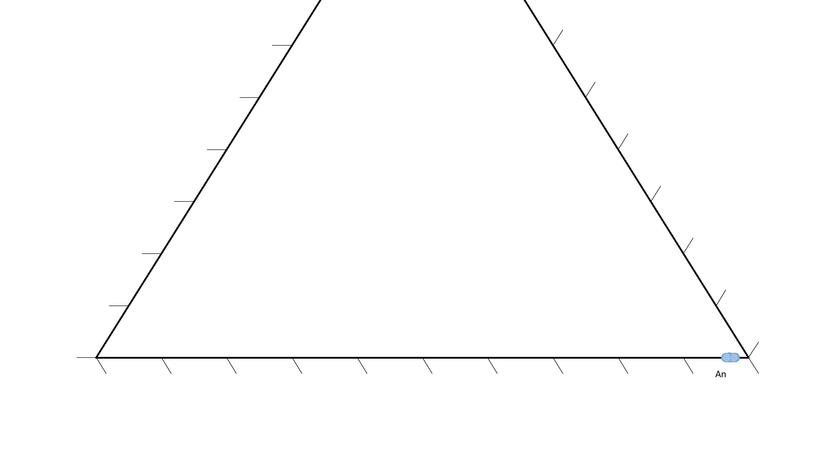
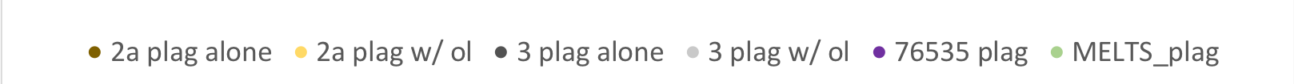
Compositional Analyses of Olivine and Plagioclase
Plagioclase Ternary Diagram
Forsterite Content in Olivine Crystals vs. wt % CaO
X^{pl}_{Or}
X^{pl}_{An}
Or
Or
An
Ab

Slide 18
Microprobe Images of TPM 02 and 03
glass
ol
ol
plag
plag
ol
ol
glass
TPM 02* (left) and TPM 03 (right). Notice the euhedral olivine grains in contact with the melt, and the hopper olivine crystals within the plagioclase laths. Also note the gradient in sample TPM 02 within olivine grains showing the Mg content increasing within the interstitial grains.
*indicates Fe-loss

Slide 19
Primary Conclusions:
Synthetic Troctolite Parent Melt (TPM) can be used for subsequent 76535 experiments.
Crystal morphologies indicate rapid crystal growth in both experiments, and no resolvable difference between them.
There is strong textural evidence that one phase or the other nucleated heterogeneously on the first-to-form phase.

Slide 20
Acknowledgements:
Thanks to the National Aeronautic Space Administration and specifically the Planetary Geology and Geophysics Undergraduate Research Program for both funding me and providing me with the opportunity to study lunar troctolite 76535 during the summer of 2018.
Thanks to my P.I. and mentor Dr. Julia Hammer for guiding and mentoring me through this process. And also to Manlio Calentti for working with me in the lab.
Thanks to Dr. Tracy Gregg and Robyn Wagner at the University of Buffalo for coordinating and aiding my PGGURP experience.
Thanks to G. Jeffrey Taylor for thrilling discussions on the LMO, and to Eric Hellebrand for EPMA guidance.
Thanks to Paul Wessel and the NSF GGREU students for welcoming me as an adopted student into their summer research cohort at UHM.
References:
Meyer, C. (2012) 76535 Troctolite. Lunar Sample Compendium. web address: https://curator.jsc.nasa.gov/lunar/lsc/76535.pdf.
Borg, L.E., Connely, J.N., Cassata, W., Gaffney, A., Bizzarro M. (2016) Chronologic implications for slow cooling of troctolite 76535 and temporal relationships between the Mg-suite and the ferroan anorthosite suite. Geochim. Cosmochim. Acta. doi: 10.1016/j.gca.2016.11.021.
Hammer, J. (2016) NSPIRES Scientific/ Technical/ Management proposal. NNH15ZDA001N-SSW.
Dymek, R.F., Albee, A.L., and Chodos, A.A. (1975) Comparative petrology of lunar cumulate rocks of possible primary origin: Dunite 72415, troctolite 76535, norite 78235, and anorthosite 62237. Proc. 6th Lunar Sci. Conf. 301-341.
Welsch B., Hammer J., Hellebrand E. (2014) Phosphorus zoning reveals dendritic architecture of olivine. Geology 42:867-870. doi: 10.1130/G35691.1.
Gualda, A.R., Ghiorso M. S., Lemons, R.V., Carley, T.L. (2012) Rhyolite-MELTS: a Modified Calibration of MELTS Optimized for Silica-rich, Fluid-bearing Magmatic Systems. Journal of Petrology 53:875-890. doi: 10.1093/petrology/egr080.

