Slide 1
Building Trust and Promoting Scientific Realism in the Classroom and Community: A Pathway to Climate Sanity
Mike Phillips
Geology Professor
Illinois Valley Community College
Oglesby, Illinois
Notes:
Good morning. I’m Mike Phillips and I teach geology at Illinois Valley Community College in north-central Illinois

Slide 2
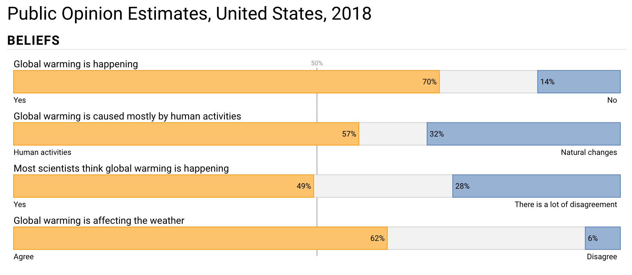
Notes:
The latest indicators of public opinion on global warming show progress in some areas while others are lagging.
It’s getting more difficult to deny warming, so the discussion has moved to who is responsible.
The need is pretty straight forward. We have to figure out how to move opinions in a direction that reflects reality and results in people taking action.

Slide 3
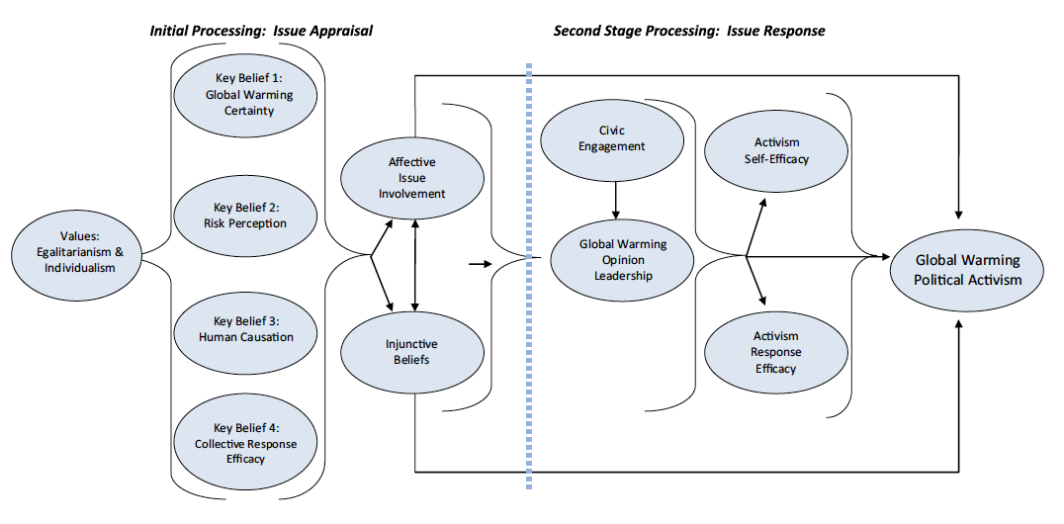
Theoretical Social-Cognitive Model of Political Activism for Climate Change Mitigation
Notes:
We are unlikely to see action if people are not convinced of the need.
This model shows us how to get to engagement and activism, and it starts with developing four key beliefs.

Slide 4
Issue Appraisal
Is it happening?
Is it a threat to me?
Am I responsible?
Can I do something about it?
Notes:
These beliefs are personal and they build sequentially.
<briefly describe each>

Slide 5
Barriers
Confirmation Bias
Disconfirmation Bias
Group Identity
Sunk Cost
Anti-Intellectualism
Threat to Livelihood
Lack of Attention (AKA Ignorance)
Notes:
But there are some well known barriers to overcome.

Slide 6
What Doesn’t Work Well
Appeal to Authority
Sage on the Stage (or Screen)
Arguing in Social Media
Doing Nothing
Notes:
Some of the approaches we love are not particularly effective.
Showing a video with Al Gore or Michael Mann
Lecturing
sharing memes & feeding the trolls
We still need to engage in these venues and techniques; they play a role. <click> We should not cede the field. And we do need to share good information with supporters and the curious. But this should not be where we expend the most time and effort.

Slide 7
What works?
Clear, Irrefutable Evidence Explained by an Expert in the Field
🤣
Notes:
It would be so much easier if this were all we had to do...

Slide 8

What is more likely to work...
...is that which is emergent from the landscape.
Take time to stop and pay attention.
Notes:
If you haven’t read this book, you should. Dr. Wildcat recommends that we avoid cookie-cutter solutions and instead look for solutions that are emergent from the natural landscape.
I suggest the same approach when considering the social and cultural landscape.

Slide 9
How people process new information
People want to maintain a positive self-concept
“You are a polluter who is destroying the earth” is not a positive self concept
Likely response: Reject concept of being a polluter
People make decisions, then work backwards to justify them. (We all do this.)
Notes:
Fortunately, we have social and cognitive science to help us understand this landscape.

Slide 10
The Successful Messenger
Has a personal connection
Shared identity
Insider status
Speaks One-on-One, F2F
Listens
Walks the talk
Is aware of “moral licensing” and try to avoid this pitfall that can lead to apparent hypocrisy
Acknowledges (and discusses) personal choices that do not appear to align with message
Notes:
So, what can you do to navigate this landscape?
First, consider how you approach your role as a messenger.

Slide 11
The Successful Message
Plainspoken
Speak in the language of the audience
Personal
Relate to commonalities
Relate to priorities of listener
Explore the data
Relevant
In context
In alignment with audience

Slide 12
The Successful Message
Avoid vague warnings of distant problems
Don’t ask for 180 degree change
Look for aligned goals
Solutions that do not require radical shift
Don’t get ahead of the audience
Meet people where they are
Don’t challenge foundational beliefs
Look for alignment
Careful framing

Slide 13
Open the door to discussion
Informal conversations
In the classroom
Support the “teachers”
Provide information and materials
Formal presentations
(preaching to the choir, mostly)
Give solid, shareable info to supporters

Slide 14
Tell the story
Make it personal
What you know
How you know it
Why it is important to you
Discuss the history of the science
How we got to today
Point out that contrarians typically rehash old, out-of-date research and arguments
Notes:
People respond to stories.

Slide 15
Now what?
Community involvement leads to opportunity
Get to know your audiences
Find common ground
Craft messages that will resonate
Share, share, share

Slide 16
Acknowledgements & Sources
Hidden Brain, National Public Radio
http://www.hiddenbrain.org/
On the Media, WNYC
https://www.wnycstudios.org/shows/otm
On Being Project
https://onbeing.org/
Yale Climate Change Communications
http://climatecommunication.yale.edu
Princeton U. Carbon Mitigation Initiative – Stabilization Wedges
http://cmi.princeton.edu/wedges
Teach The Earth
https://serc.carleton.edu/teachearth
Integrate Project
https://serc.carleton.edu/integrate

Slide 17
Acknowledgements & Sources
National Association of Geoscience Teachers
The Teacher Friendly Guide to Climate Change
Don Duggan-Haas, Paleontological Research Institute
Dr. Dan Wildcat, Haskell Indian Nations University
And many, many more...

Slide 18
Thank you!
Mike Phillips
Geology Professor
Illinois Valley Community College
www.ivcc.edu/phillips
Mike_Phillips@ivcc.edu

