Slide 1

Innocents Abroad:
Using Hawaiian Vacations And Google’s Tour Creator To Teach Geology
LeAnne Teruya
San Jose State University
leanne.teruya@sjsu.edu

Slide 2
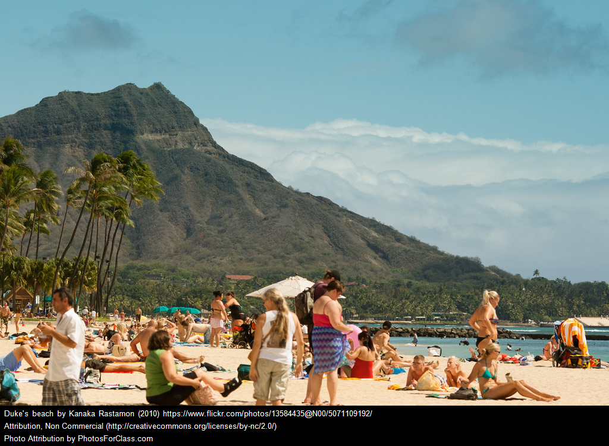
Innocents Abroad psst…there’s a volcano behind you
Notes:
Innocents Abroad…I am a big believer in place-based learning because it provides built in context for learning, and I like the idea of putting a new twist on something that the students already know. But sometimes, the radius of local places to use in teaching is pretty small because many students are not travelers—they don’t have the time, means, or even interest in exploring beyond the local area around them. This means that the range of geology that we can use for place-based geology can often be limited. So I wanted a way to reach farther away than the everyday travels of my students, and I started to think about other places that a good number of them might have been to that I could use as teaching examples.

Slide 3
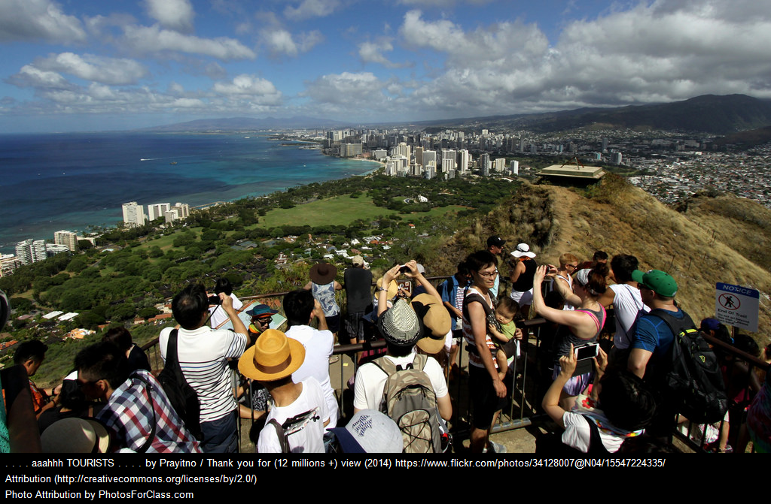
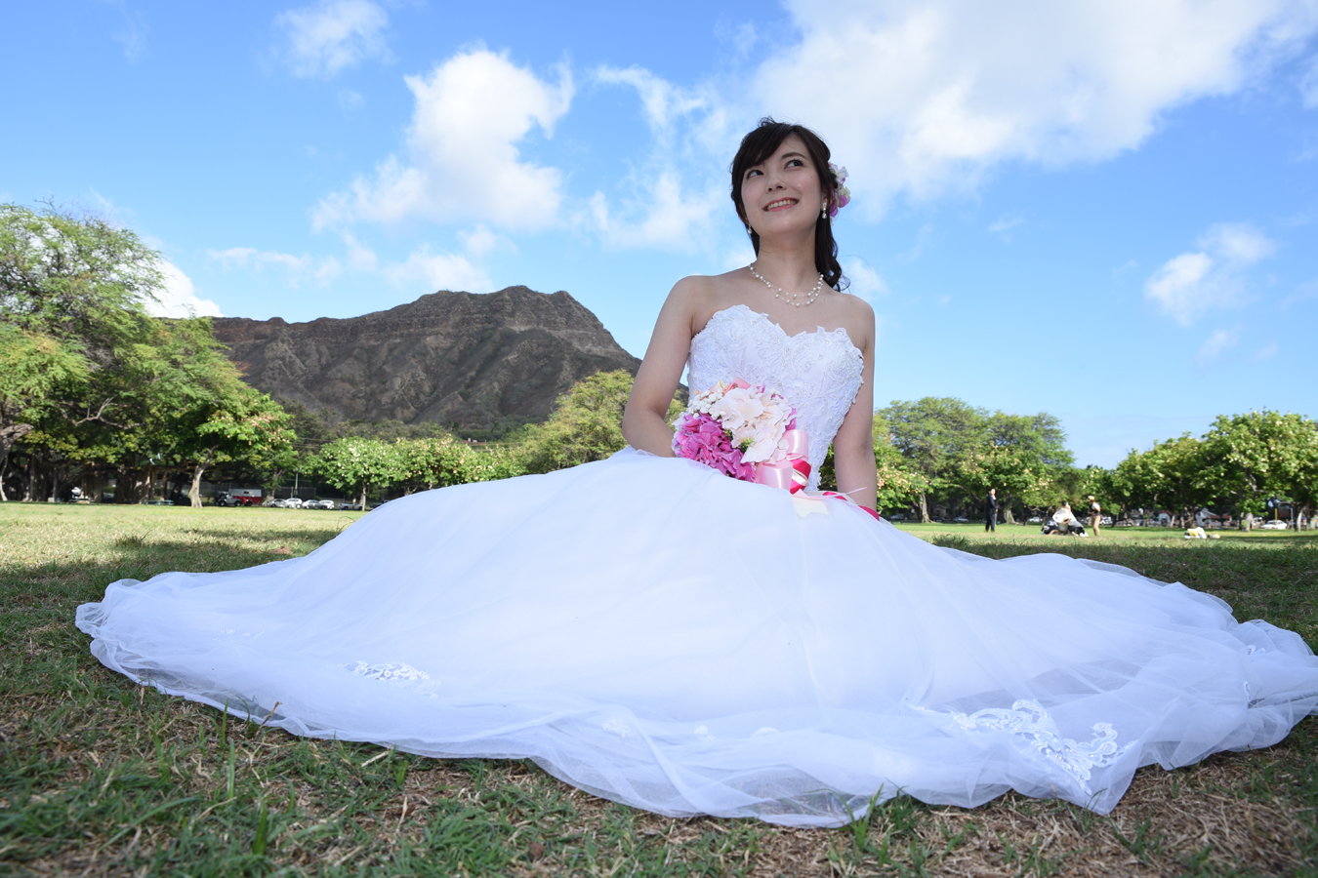

Familiar Topography, but Unnoticed Geology
Notes:
And that’s when I came up with the idea of using popular tourist destinations—some near, like the Monterey Aquarium, about 1 ½ hrs away,, or Disneyland—everyone has been there!—or Hawaii (because I have students who always have to miss a week of school to go to a wedding in Hawaii)! My goal was to find locations where people spend a lot of time not noticing the geology, places where they are familiar with the topography, but not the geology.

Slide 4

Expanding Place-Based Geology
Explore the geology of popular vacation spots on Oahu
  Diamond Head
  Hanauma Bay
Possible approaches:
  Field trip
  Webcams
  Virtual or Augmented reality Field Trip
Notes:
One of the places I’ve used in my extented place-based geology, is Hawaii (because many of my students have been there or plan to go there sometime in the future.) I decided on Diamond Head, because of it’s iconic nature as a symbol of O’ahu since visitors first started arriving in Hawaii, and I chose Hanauma Bay Nature Preserve because it is one of the most visited beaches (the best snorkeling) on O’ahu. So how would I use these places to teach geology? In my own fantasy, I could do a field trip—not realistic. I love using webcams! So I’ve done that—I like the ”real-time, you-are-there” aspect that makes the place feel real, even when you’ve never been there. (The place really does exist—live.) But that’s limited—there aren’t webcams that show details. So, then there are virtual and augmented reality field trips. Virtual reality field trips can be good if they aren’t just looking at photos on a website. I wanted a Virtual reality field trip that would make you feel like you’re there. I also like the idea of augmented reality field trips because they are more interactive (i.e. Pokemon Go). –I decided on a mixed reality platform—a virtual field trip that could take users to places, but also be somewhat interactive at each location on the trip.

Slide 5
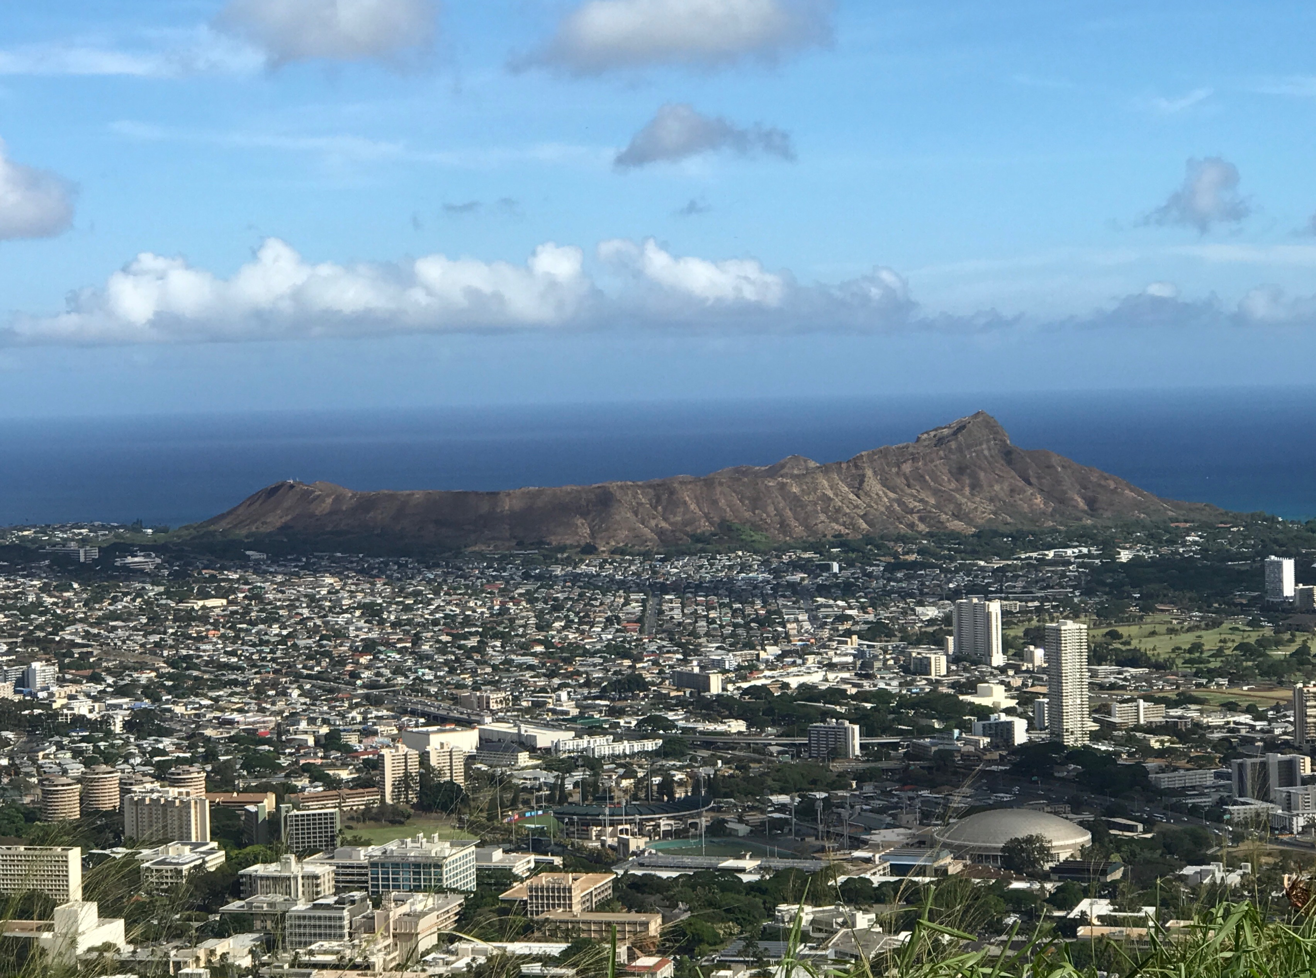

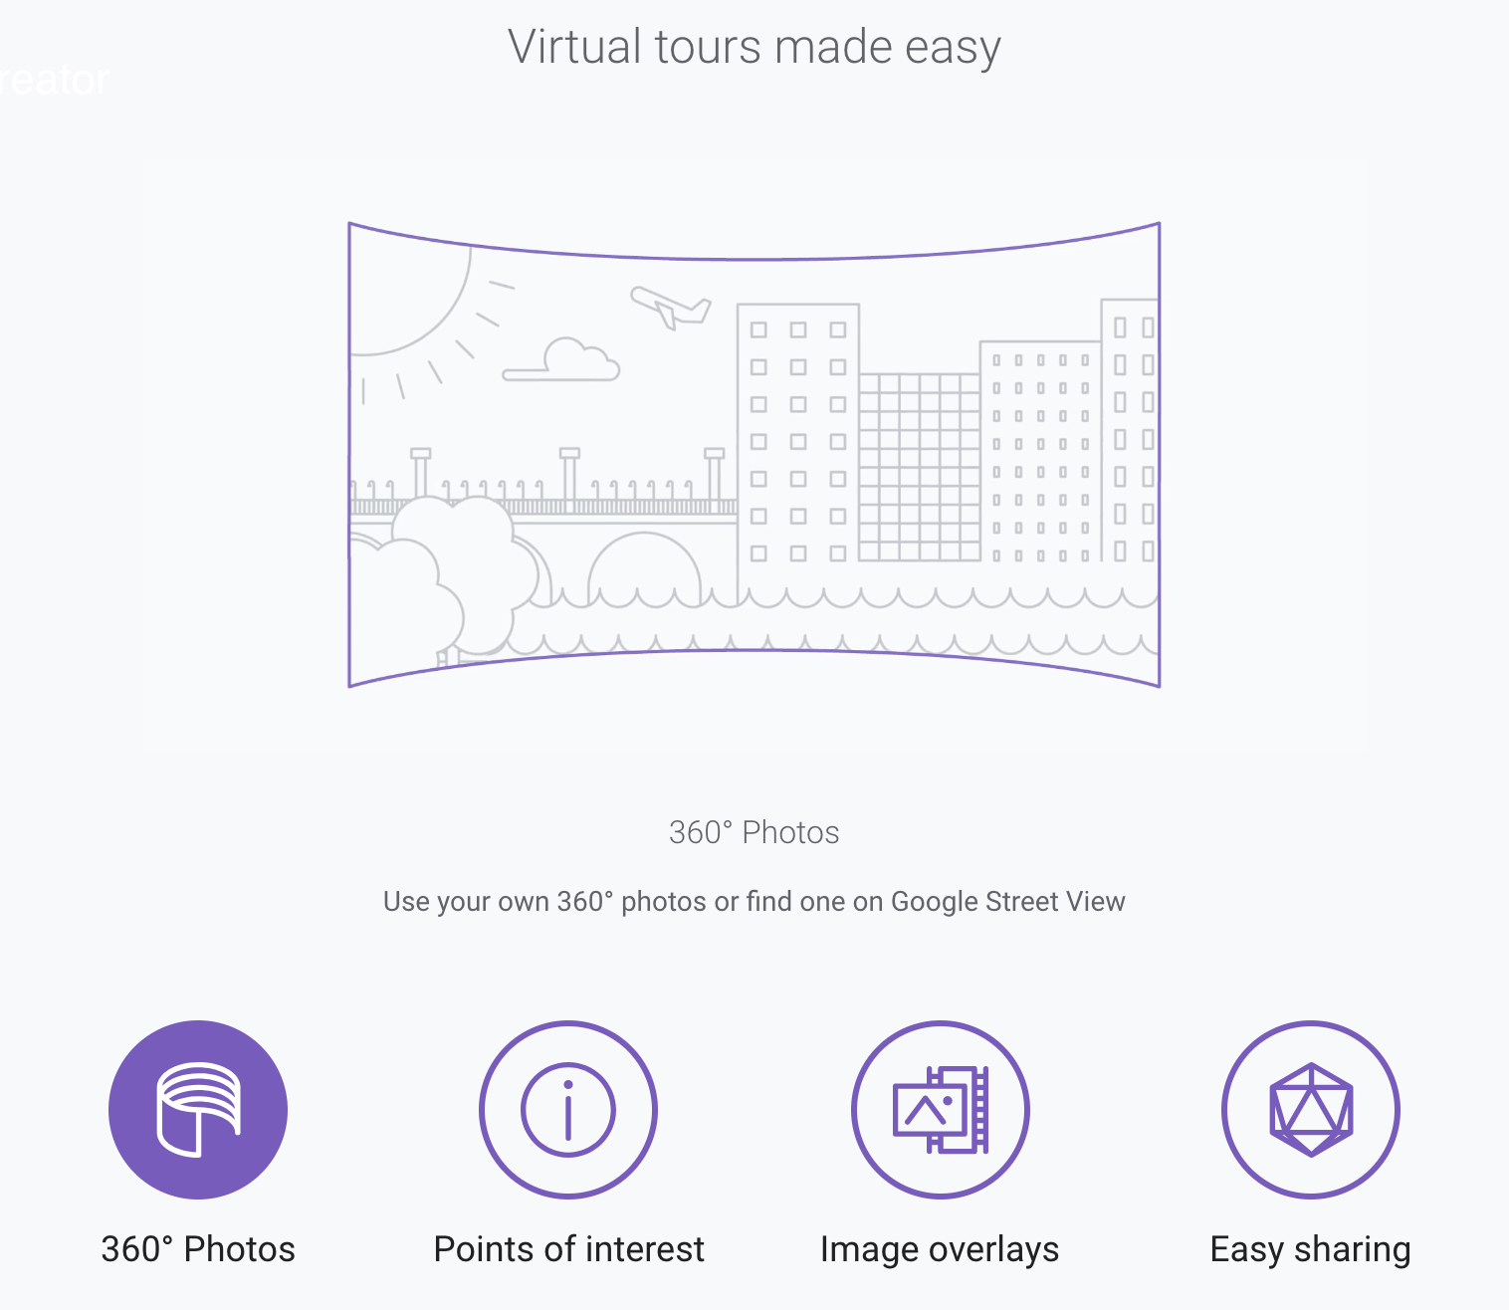
Google Tour Creator
Notes:
I chose Google Tour Creator, because it’s simple and intuitive to use, and uses 360 photos, and provides some interactivity with the user. The Tour Creator was just released earlier this year. What really drew me to this platform was the use of 360 photos. When I first started using Gigapan photos, I noticed that the ability to zoom in from afar to see geological details in rocks was effective because somehow the zooming provided a perspective/gave a context for the details in the rocks. Similarly, I’ve found that 360 degree photos also provide a different kind of perspective and context for what a person sees—something about not just looking at a flat picture in front of you that makes you feel more like you are actually at a place. Google Tours, made with the Tour Creator, utilizes 360 photos which can be viewed in 3D with Google Goggles or any other Virtual Reality headset. So the virtual tour make with the Tour Creator provides a fully immersive virtual field trip! Added to that is the interactivity of information and photo buttons that students can click on for information about specific locations in the photos.

Slide 6
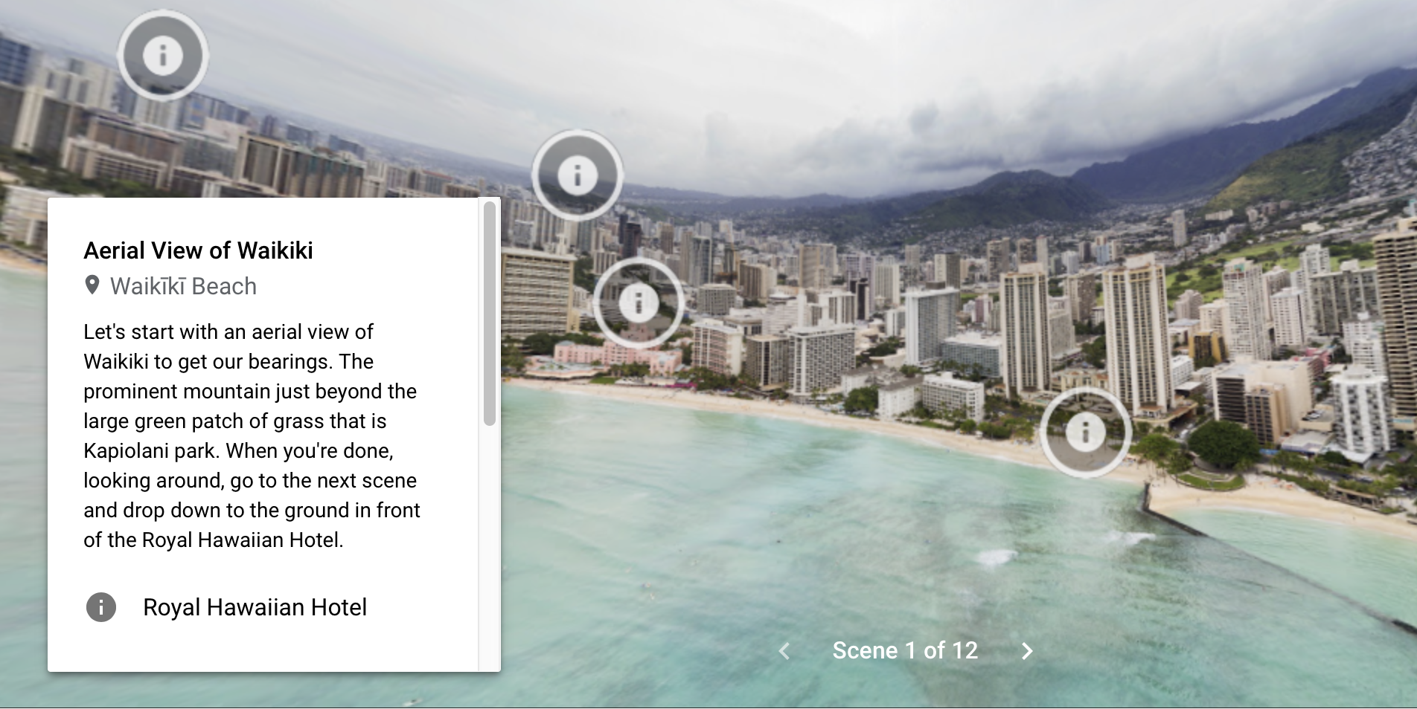
360º Photos from Google Streetview and User Uploads
Add landmarks, descriptions, & still photos
Notes:
I created a Google Tour called, “A Geologic Visit to Diamond Head and Hanauma Bay” and here is the first photo in the tour. It’s an aerial view of Waikiki as a general orienting overview before the trip actually starts. There is a window that pops up and will go away once you click on one of the information buttons, that tells you about this first scene in the trip. In this scene I’ve simply landmarked several areas that people may be familiar with—classic locations in Waikiki—and also Diamond Head. (This photo looks distorted, because it is—360 photos look this way when not views in 3D.) You can view this tour on a smartphone, tablet, or computer. On a phone you can use Google Cardboard, and on tablets and computers, just open the trip and drag around the photo to get the 360 degree perspective. Click on each information button, and an explanation of what you’re looking at will pop up. Alternatively, you can scroll through the information box and click on the titles next to the Information icon and you will be taken to the location in the photo automatically.

Slide 7
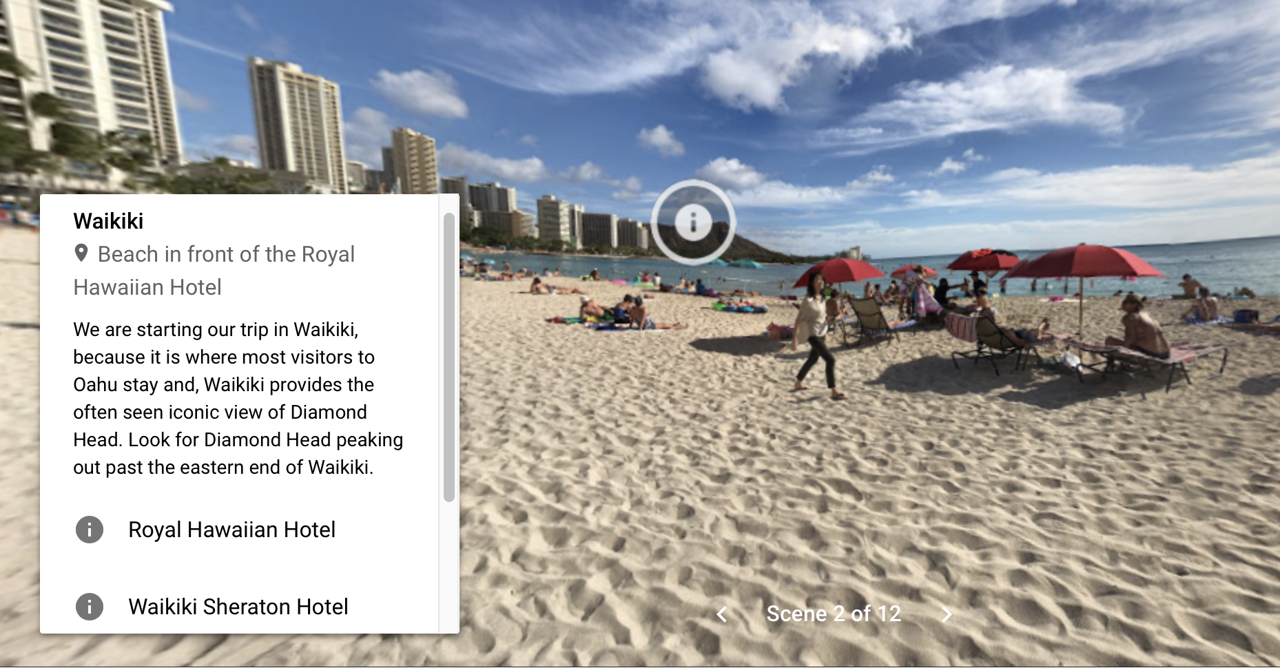
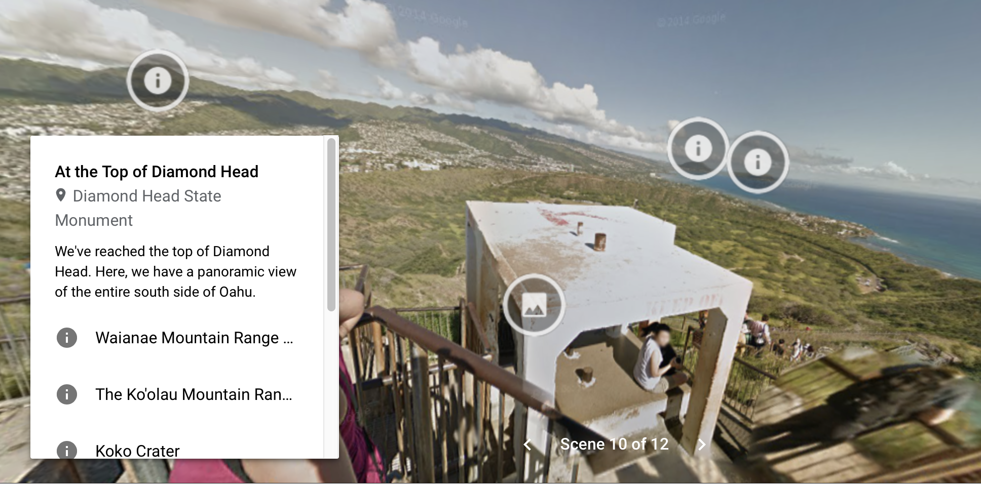
Familiar view of Diamond Head from Waikiki
Landmark other/next stops on the tour
Notes:
I chose views that would be familiar to people so that the context for the locations featured (i.e. Diamond Head and Hanauma Bay) would be easily recognized. Here is a view of Diamond Head from the Royal Hawaiian Hotel, which is the view featured in many postcards of Waikiki that have Diamond Head in the background. On this second photo here, I’ve landmarked the next stop—the location of Hanauma Bay—so that viewers get a feel for distance and connection between locations.

Slide 8
Uses and Advantages
Uses:
Virtual lesson
Field Trip Preview
Homework
Student project/Group Project
Community outreach
Advantages:
Mixed Reality = Virtual and Augemented Reality
Immersive & interactive
You don’t need your own photos
Notes:
So I like Google Tours so far, because use of the 360 degree photos and the bit of interactivity from clicking on informational buttons. This platform is what can be considered, “Mixed Reality,” because it is both virtual reality and augmented—with the addition of pop-ups. This platform provides an immersive experience for students, and Bonus! You don’t even need to provide your own photos! Every 360 degree photo in this tour is directly from Google Streetview—just type in the location you want, a google map shows up, and find a photo you can use.
Now how can these virtual tours be used in the classroom? Obviously, they are virtual field trips, but I have used a Google Tour as a field trip preview for the make-up field trip that students do on their own in downtown San Jose. The virtual preview trip ensures that they know exactly where each top on the trip is and exactly where to look to answer the questions on the field trip guide. Virtual trips can also be used as homework—similar to Google Earth assignments, but these are immersive. Next semester, my students will be creating tours as projects, and in the future, I want to have the projects be used by the public. One way to do this is to participate in a program that San Jose State has, called Science and Engineering in Action, where students go to schools in our community and teach them a little science or engineering. Wouldn’t this be great to introduce elementary students to geology?!

Slide 9
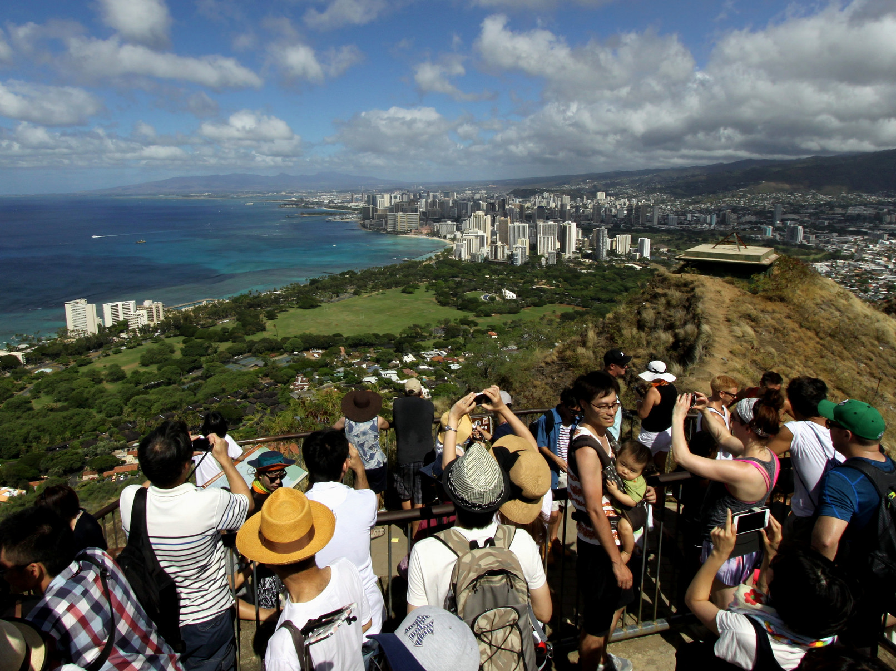
Tips for Creating Tours
Use familiar/easily recognizable views
Take your own photos when possible
Establish key landmarks and repeat in different scenes
Keep clutter to a minimum—a few highlights per scene
Remember that the size of inserted elements will be different on different devices
Notes:
Here are some tips for creating Google Tours: Use Familiar—easily recognizable—views so that people instantly recognize the area where the trip is centered. Establish key landmarks that are repeated in different scenes to provide context and the establish the relationship between field trip stops that are in different locations (like Diamond Head vs. Hanauma Bay)/ If possible, take your own photos, and I’ll come back to that in another slide. Keep clutter to a minimum—don’t landmark too many things! You don’t want to cover up the photo! And I’ll talk about this last point about sizing of element on the next slide.

Slide 10
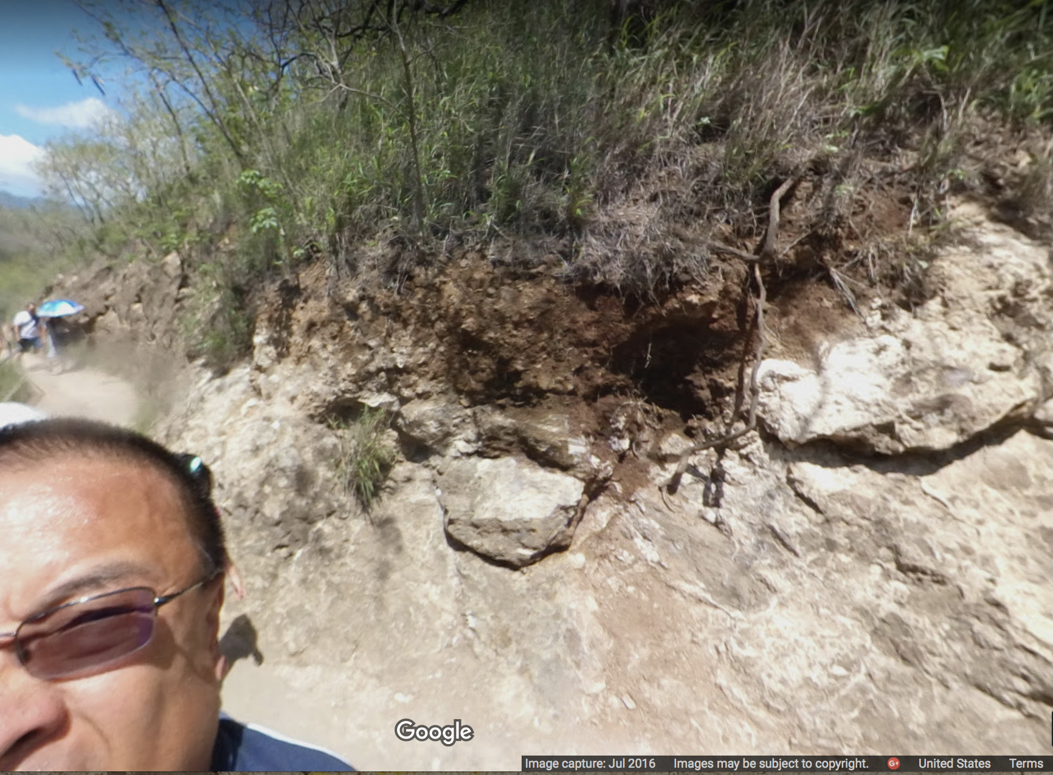
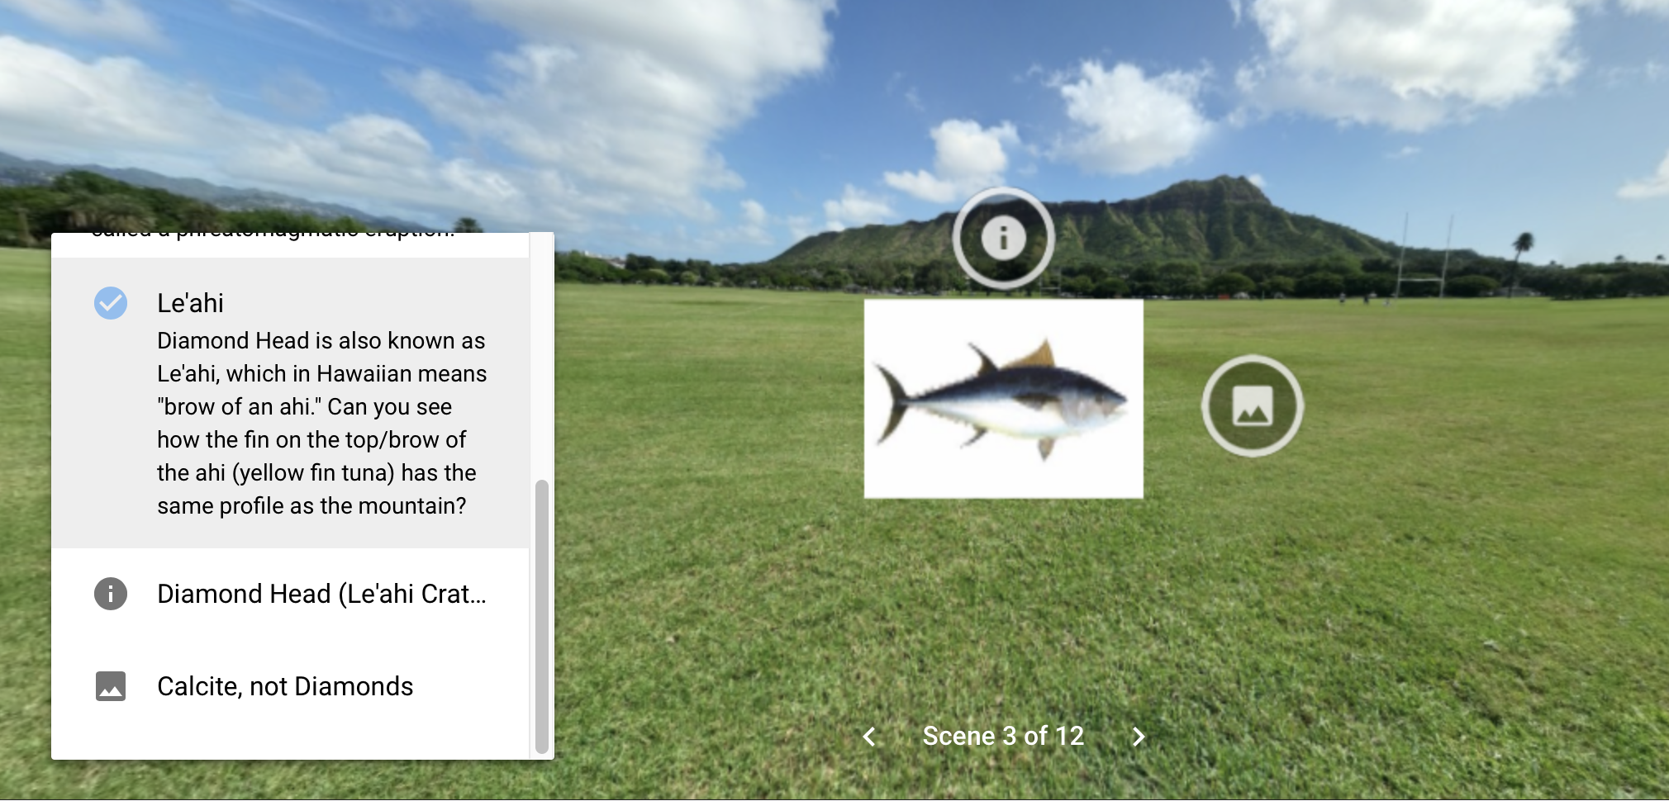
If possible, take your own photos
Take care when sizing elements
Notes:
If possible, take your own photos. Here’s why! You don’t this guy’s head in all your photos. Google Streetview for trails is mounted high on a backpack (to avoid the head problem), but there’s no good view of the ground and lower outcrops. And along the trail in Diamond Head, there are awesome chunks of coral fragments sticking out of the trail! If only there was a 360 photo that also captured the ground. Geologists want a different view than most other people, so you may not find the kind of photo you’re looking for. Use a tripod to avoid the ”head” problem and get closer to the ground.
Be mindful when sizing elements inserted in a Google Tour. The screenshot here shows a relatively small picture of an ahi (in Hawaiian, Diamond Head is Le’ahi—the brow of the ahi, tuna). When viewed on a phone, the ahi picture is HUGE and there is overlap with the narrative in the box. So you have to try to find a happy medium for all sizes of displays when inserting photos/pictures.

Slide 11
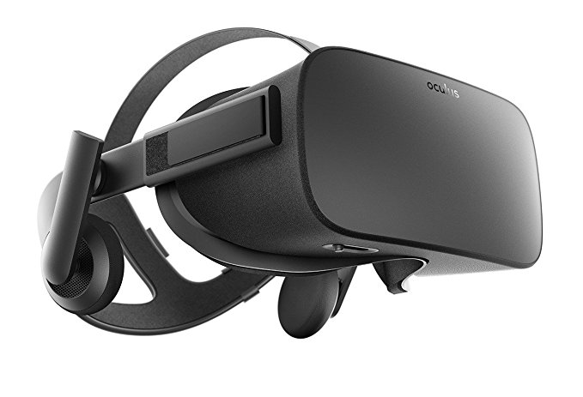
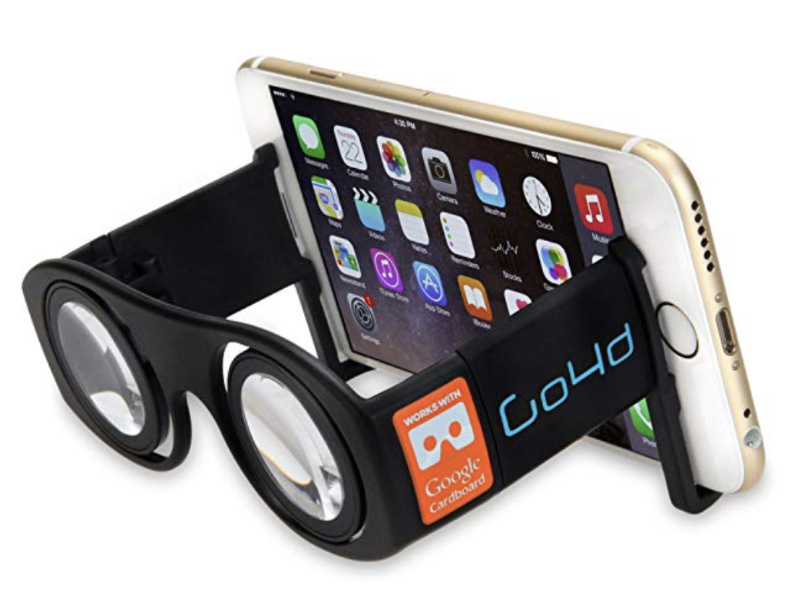
Disadvantages
Equipment expense
Access: Will all students have access?
  Equipment
  Internet required
No Google Tour app
Individual experience only
Possible Solutions:
Use a platform that is multi-device.
Lending—Department, School, or Library may lend equipment.
Do tour simultaneously in class.
Notes:
Okay, there is a Dark Side, of course. Expense is the first. For a truly immersive experience—the best experience possible—VR goggles are necessary. The cheapest option is google cardboard and inexpensive, totally uncomfortable, no-adjustments device that provides an ok experience. And secondly, HOW will all students have access to a VR viewer and internet. Another disadvantage is that there is no App—you have to go to the Google Tours website—you have to have internet access. Finally, how do you use what is by default an individual experience in a classroom setting?
Possible solutions: Use a multi-device platform so that people without smartphones have access. The best experience is with a smartphone and a viewer, but everyone can still experience the tour. Not perfect, but it works. For in-class use, get a classroom set of viewers. Outside of class, See if your school lends out equipment. Our library has very nice VR equipment and also laptops that students can check out. There is free wifi on campus and at libraries. As for the making the individual experience work during class time, wouldn’t it be great to have a way that everyone in the room could do the tour together at the same time without the professor running around to help or check to see that everyone is on task? Well…

Slide 12
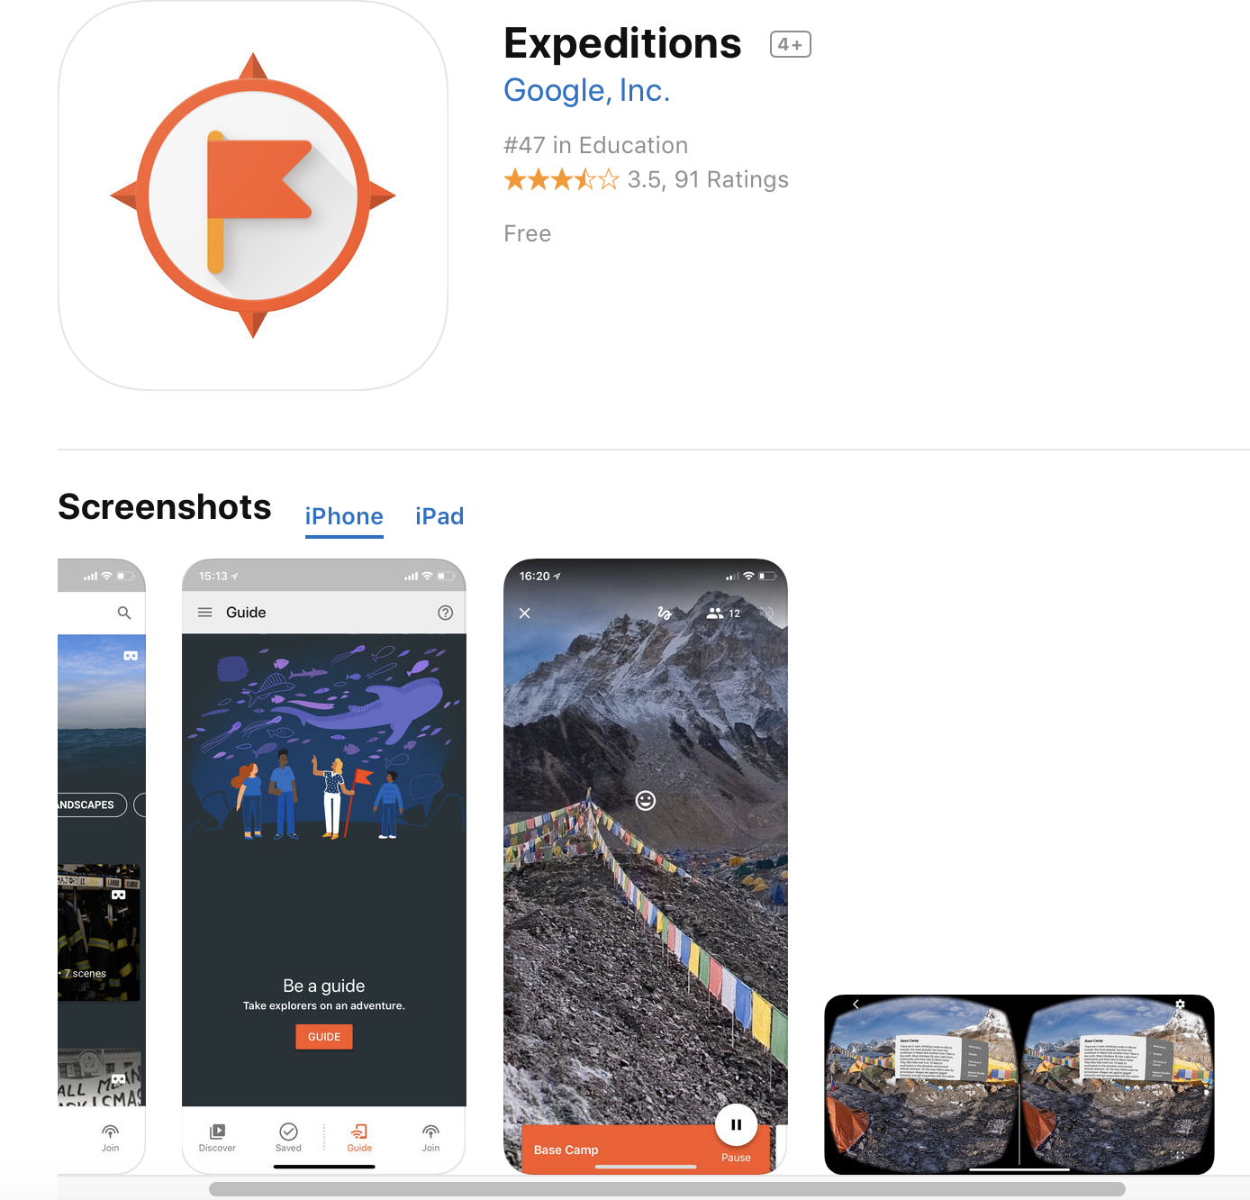
The Future is (sort of) Here! Google Expeditions:
Google Expeditions screenshot
Like Google Tours but used in class with teacher guiding the tour.
Soon: Ability to upload your created tours into Expeditions.
Notes:
Here’s the solution—Almost. Google Expeditions. It’s like a Google Tour, except that it is a guided tour with the instructor leading students through the tour stops. The teacher can ask questions and have students answer—fully interactive in class. Teachers can see exactly where every student is looking and guide the students to look at the right location! Soon, there will be a way to upload your tours into the Expeditions app (another advantage—it’s an app) and use your tour as an in-class activity.
So in Conclusion, there is a lot of potential for using Google tours in teaching geology. I hope to build a library of tours to extend place-based geology to more locations commonly visited by our blissfully Innocent Students Abroad.

Slide 13
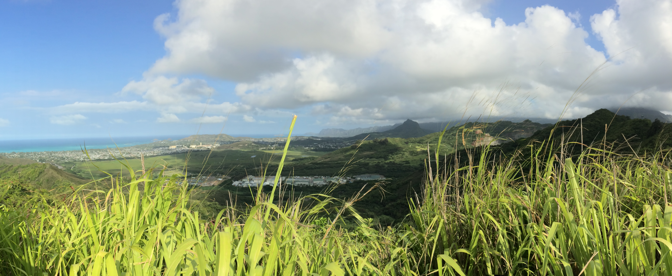
Thank You
And thank you to Lanny H. Fisk
whose love of discovery and teaching geology was infectious
Link to Google Tour:
A Geological Visit to Diamond Head and Hanauma Bay
https://poly.google.com/view/fr8EcZWqmaT

