Slide 1
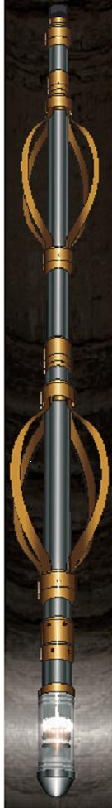
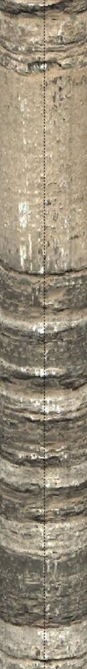

Seeing is Believing Brad Posner GSA Pittsburgh PA 03/22/11 OPTV

Slide 2
Dictionary Definitions
IMAGE
“a tangible or visual reproduction or imitation of the form of a thing”
“X” MI logging tools
PICTURE
“a description so vivid or graphic as to suggest a mental image or give an accurate idea of something”
OPTV logging service

Slide 3
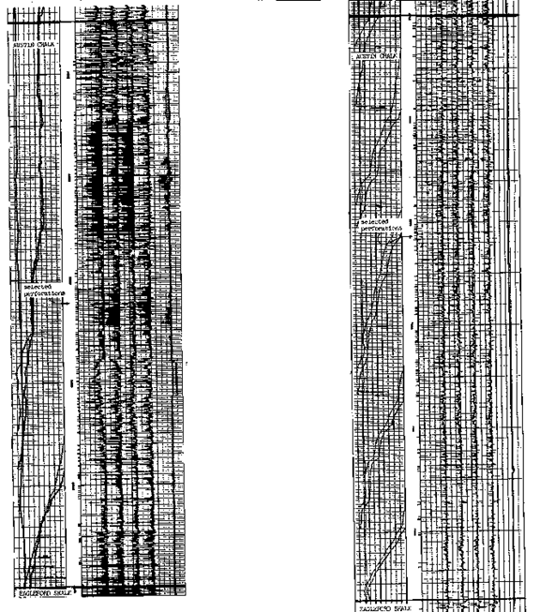
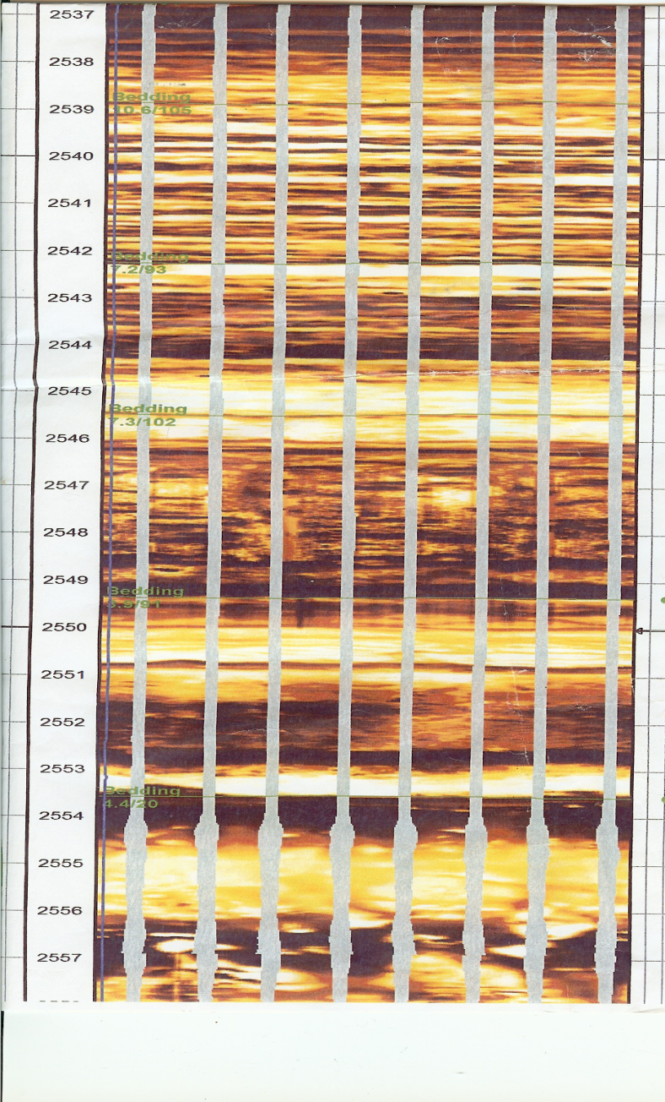
Electric Micro IMAGES
Raw Acquisition
Processed Image

Slide 4
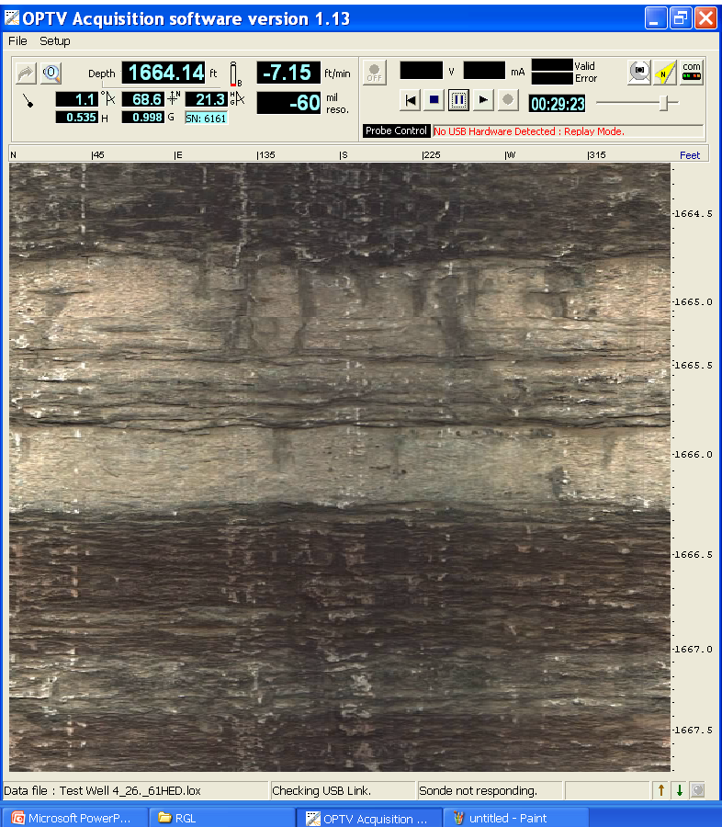
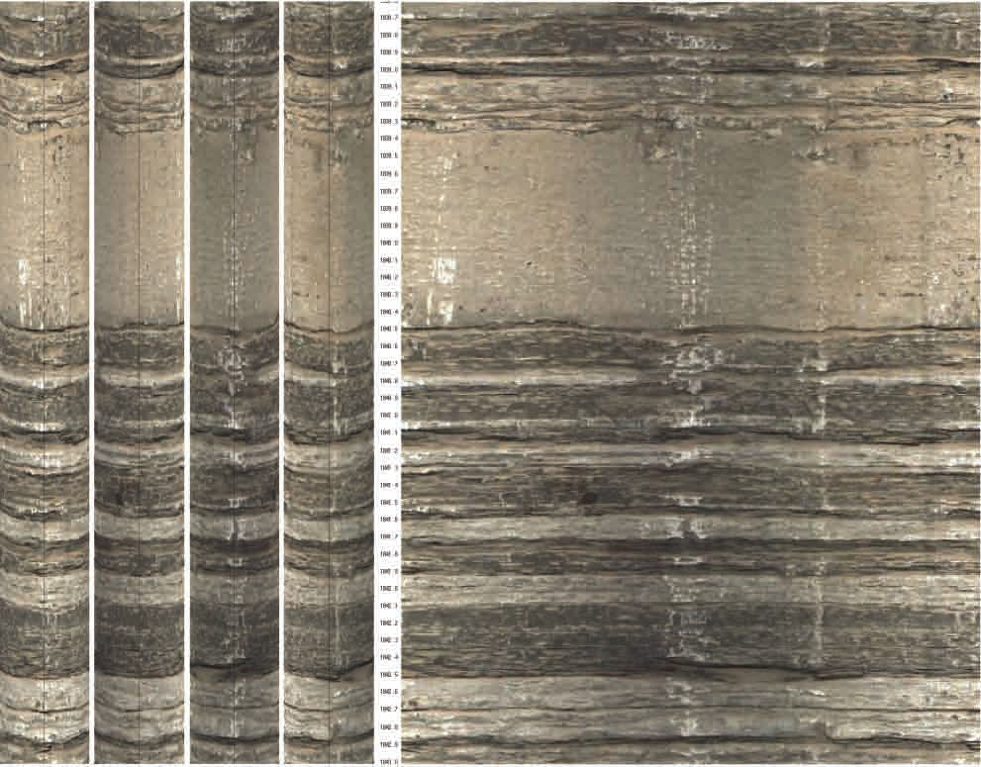
OPTV “PICTURE”
Processed Images
Raw Acquisition
N E S W
N E S W N

Slide 5
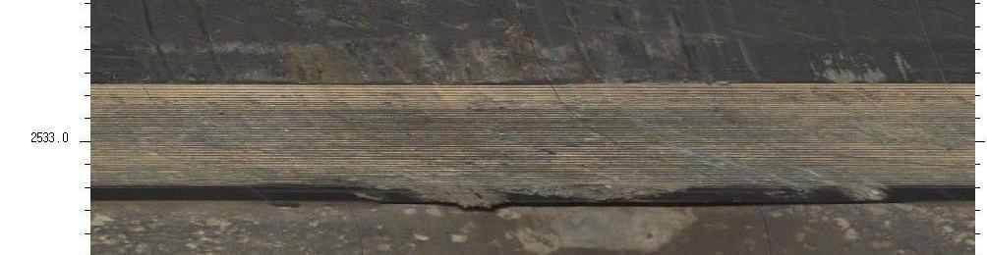
OPTV Resolution–Casing Shoe

Slide 6
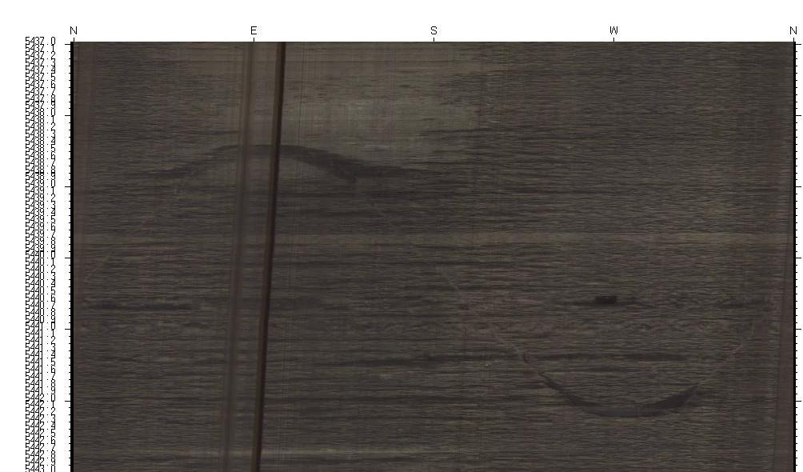
Lower Huron Horizontal Fracture

Slide 7
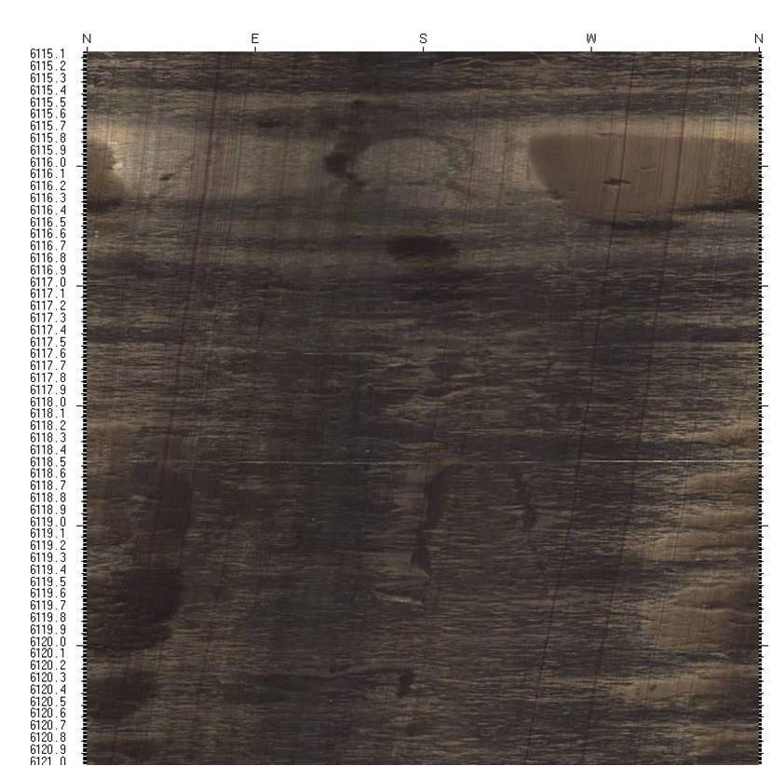
Marcellus – Cherry Valley Vertical Features

Slide 8
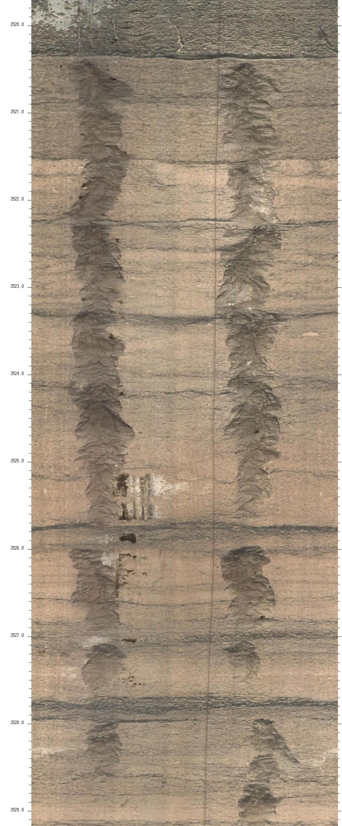
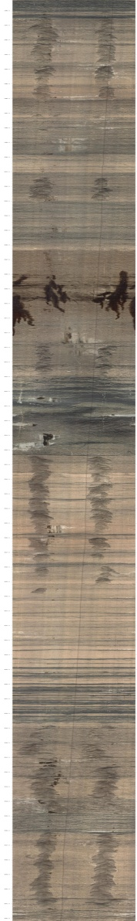
Borehole Breakout

Slide 9
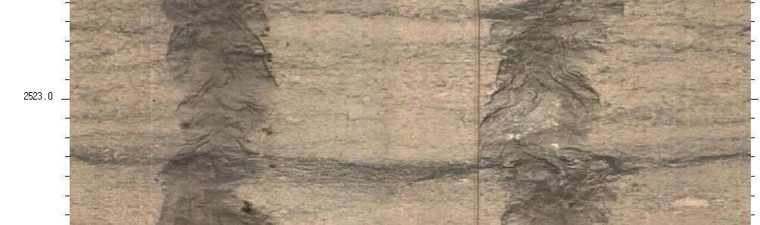
Close Up of Breakout

Slide 10
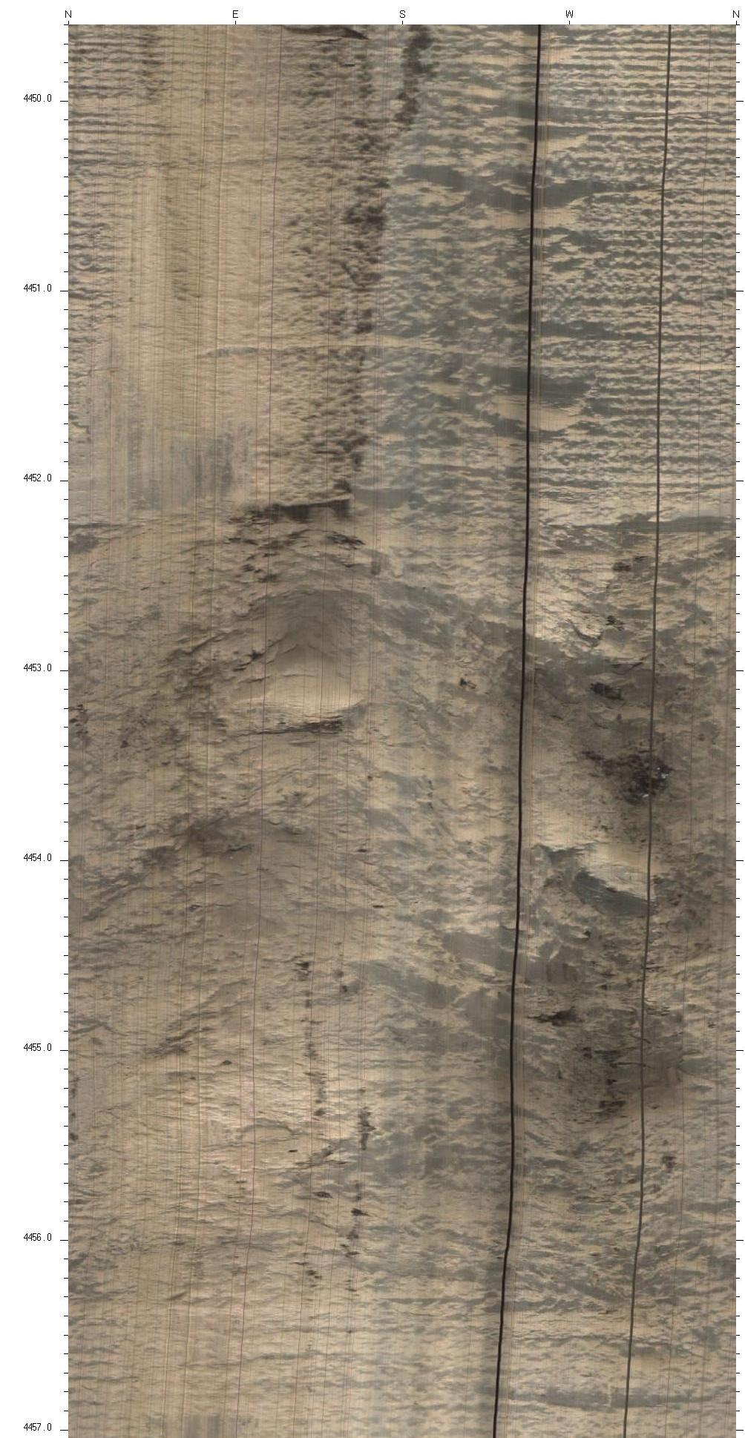
ELK Interval - Fault

Slide 11
Oil Entry

Slide 12
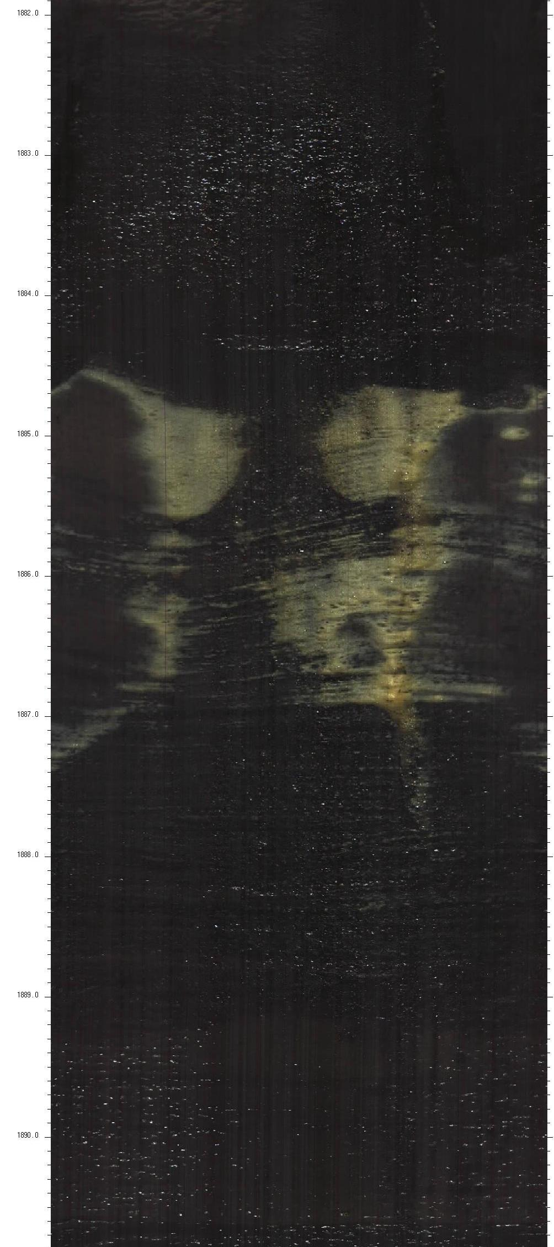
Gas Entry

Slide 13
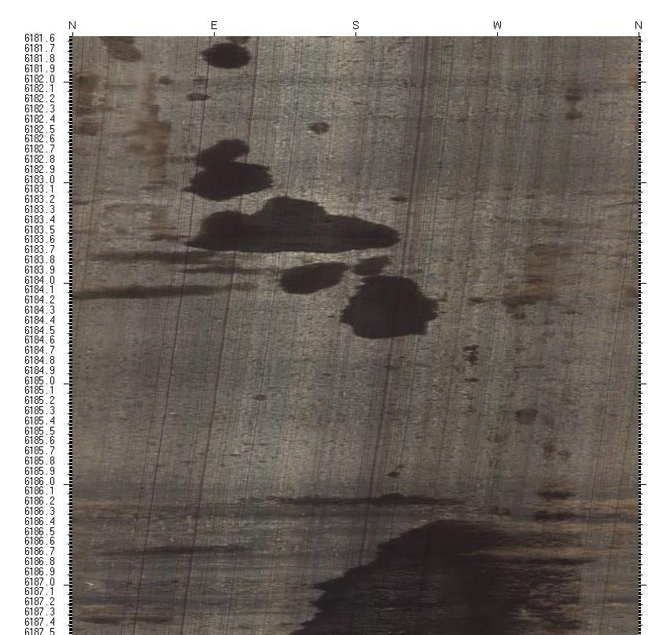
Onondaga Micro-pores & Fluid

Slide 14
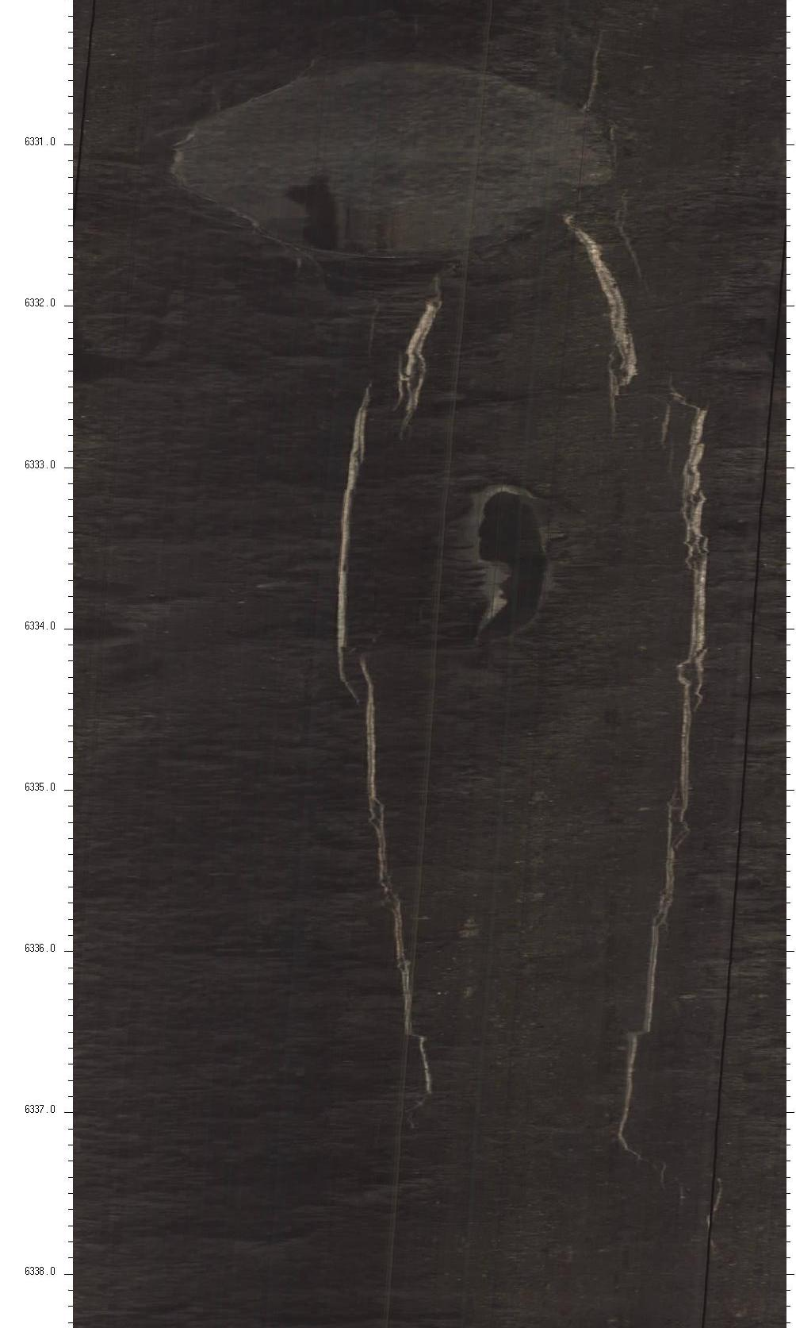
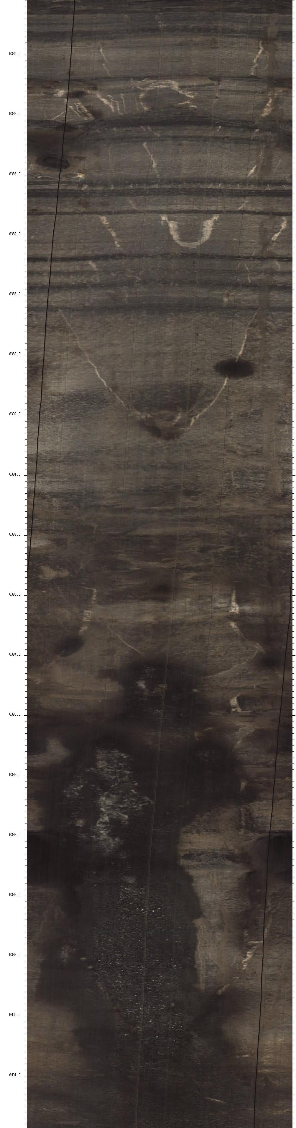
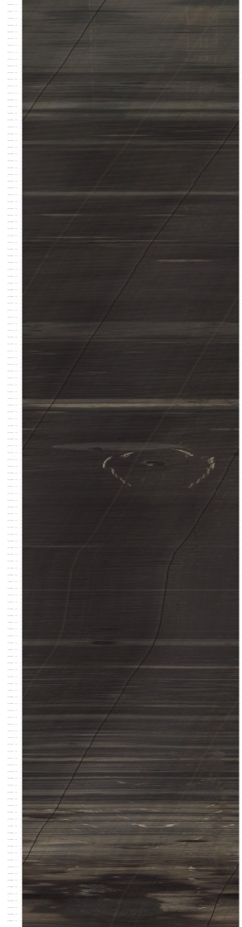
Marcellus

Slide 15
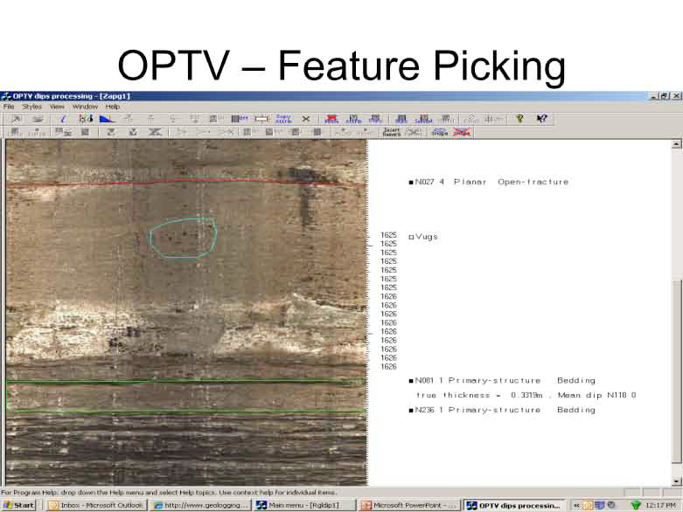
Pictures to Answers

Slide 16
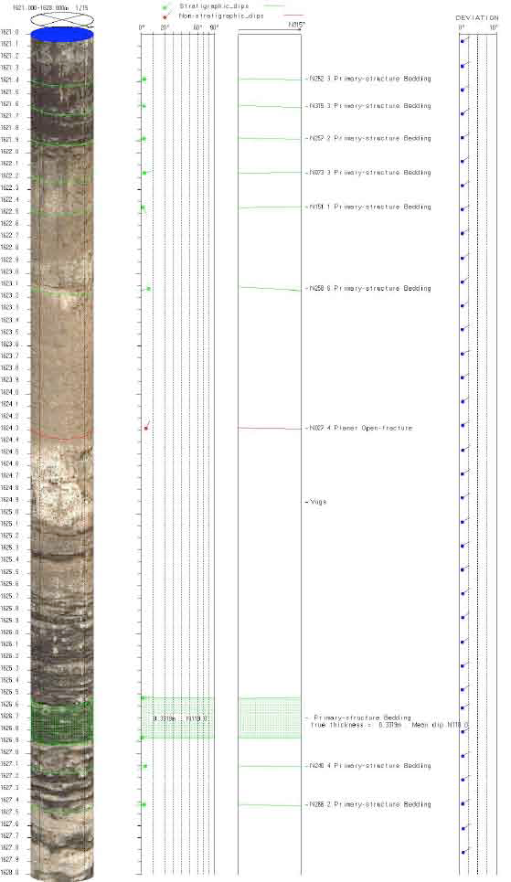
Pictures to Answers
OPTV - Dip Log

Slide 17
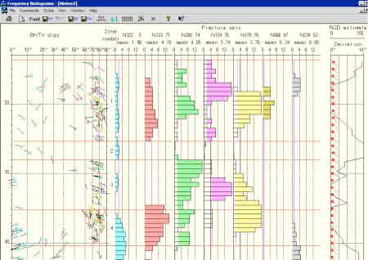
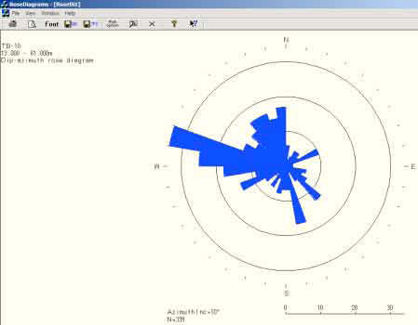
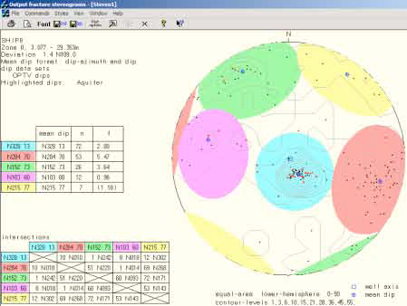
Pictures to Answers
Advanced Plots

Slide 18
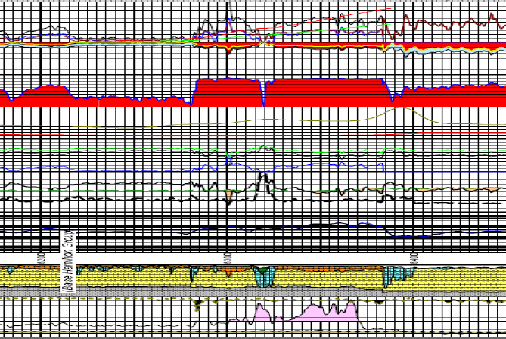
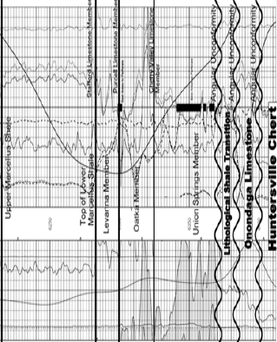
Marcellus Example

Slide 19
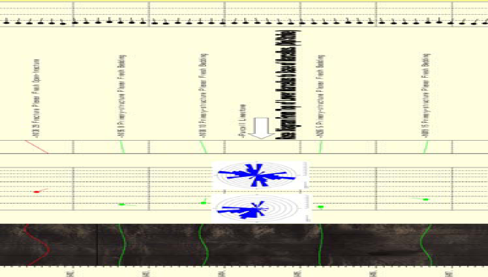
Fracture ID – Strike & Dip

Slide 20
Specifications
Length 5 Feet
Weight 11 Pounds (sinker bar provided)
Temperature 70 C
Pressure 2000PSI
OD 2.1” (centralization only limit)
Resolution
25/1000 of an inch @ 5ft/min
50/1000 of an inch @ 10ft/min
256 Million Colors
LED Lighting (Ultra Violet coming soon)
Gamma Ray Included

Slide 21
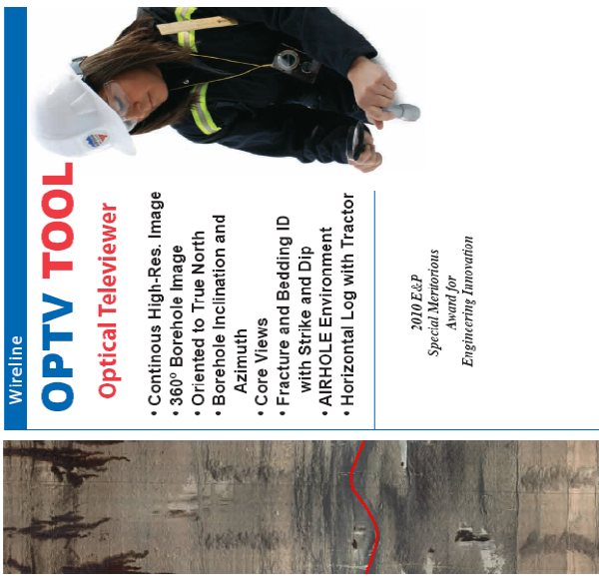
“Seeing is Believing” or “A Picture is worth a thousand words”

Slide 22
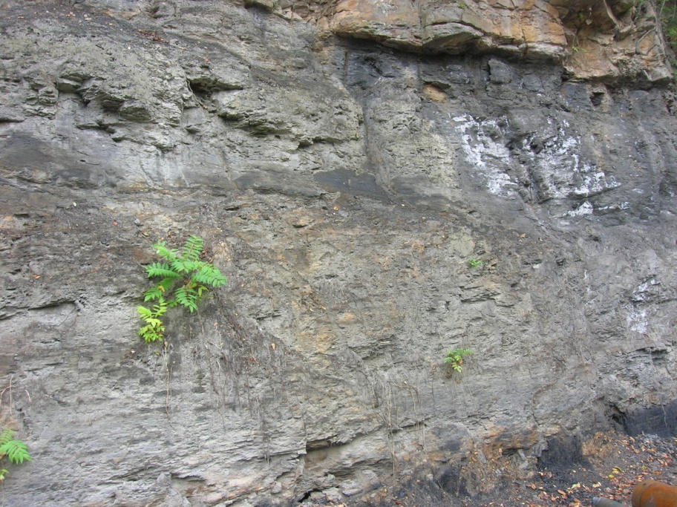
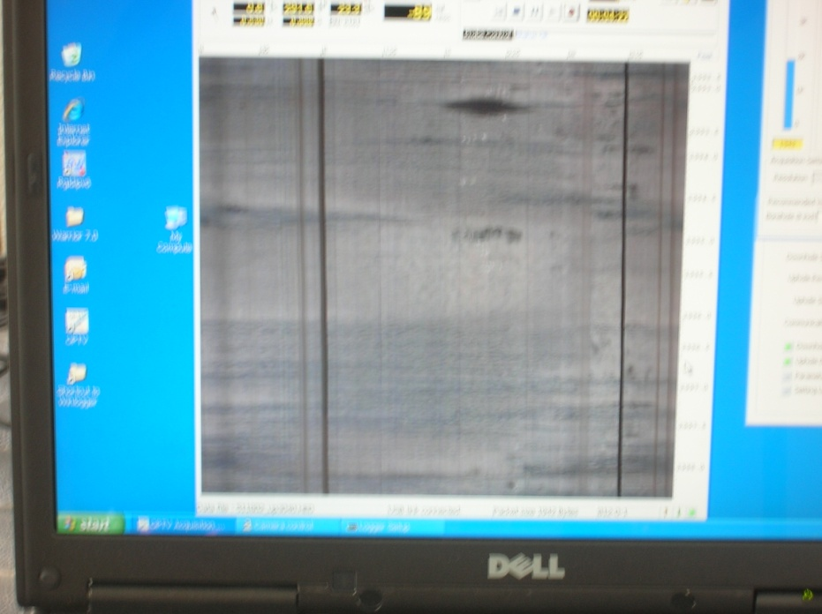
Questions?????
MM’s years from today……OPTV picture of weathered shale
Today…..picture outcrop of weathered shale

