Slide 1
Sewage Treatment Plant on a Major Fault Zone, Sewickley Township, Pennsylvania
Jim Hamel, Ph.D., P.E., P.G.
Hamel Geotechnical Consultants, Monroeville,
PA and GTech, Inc. Pittsburgh, PA

Slide 2
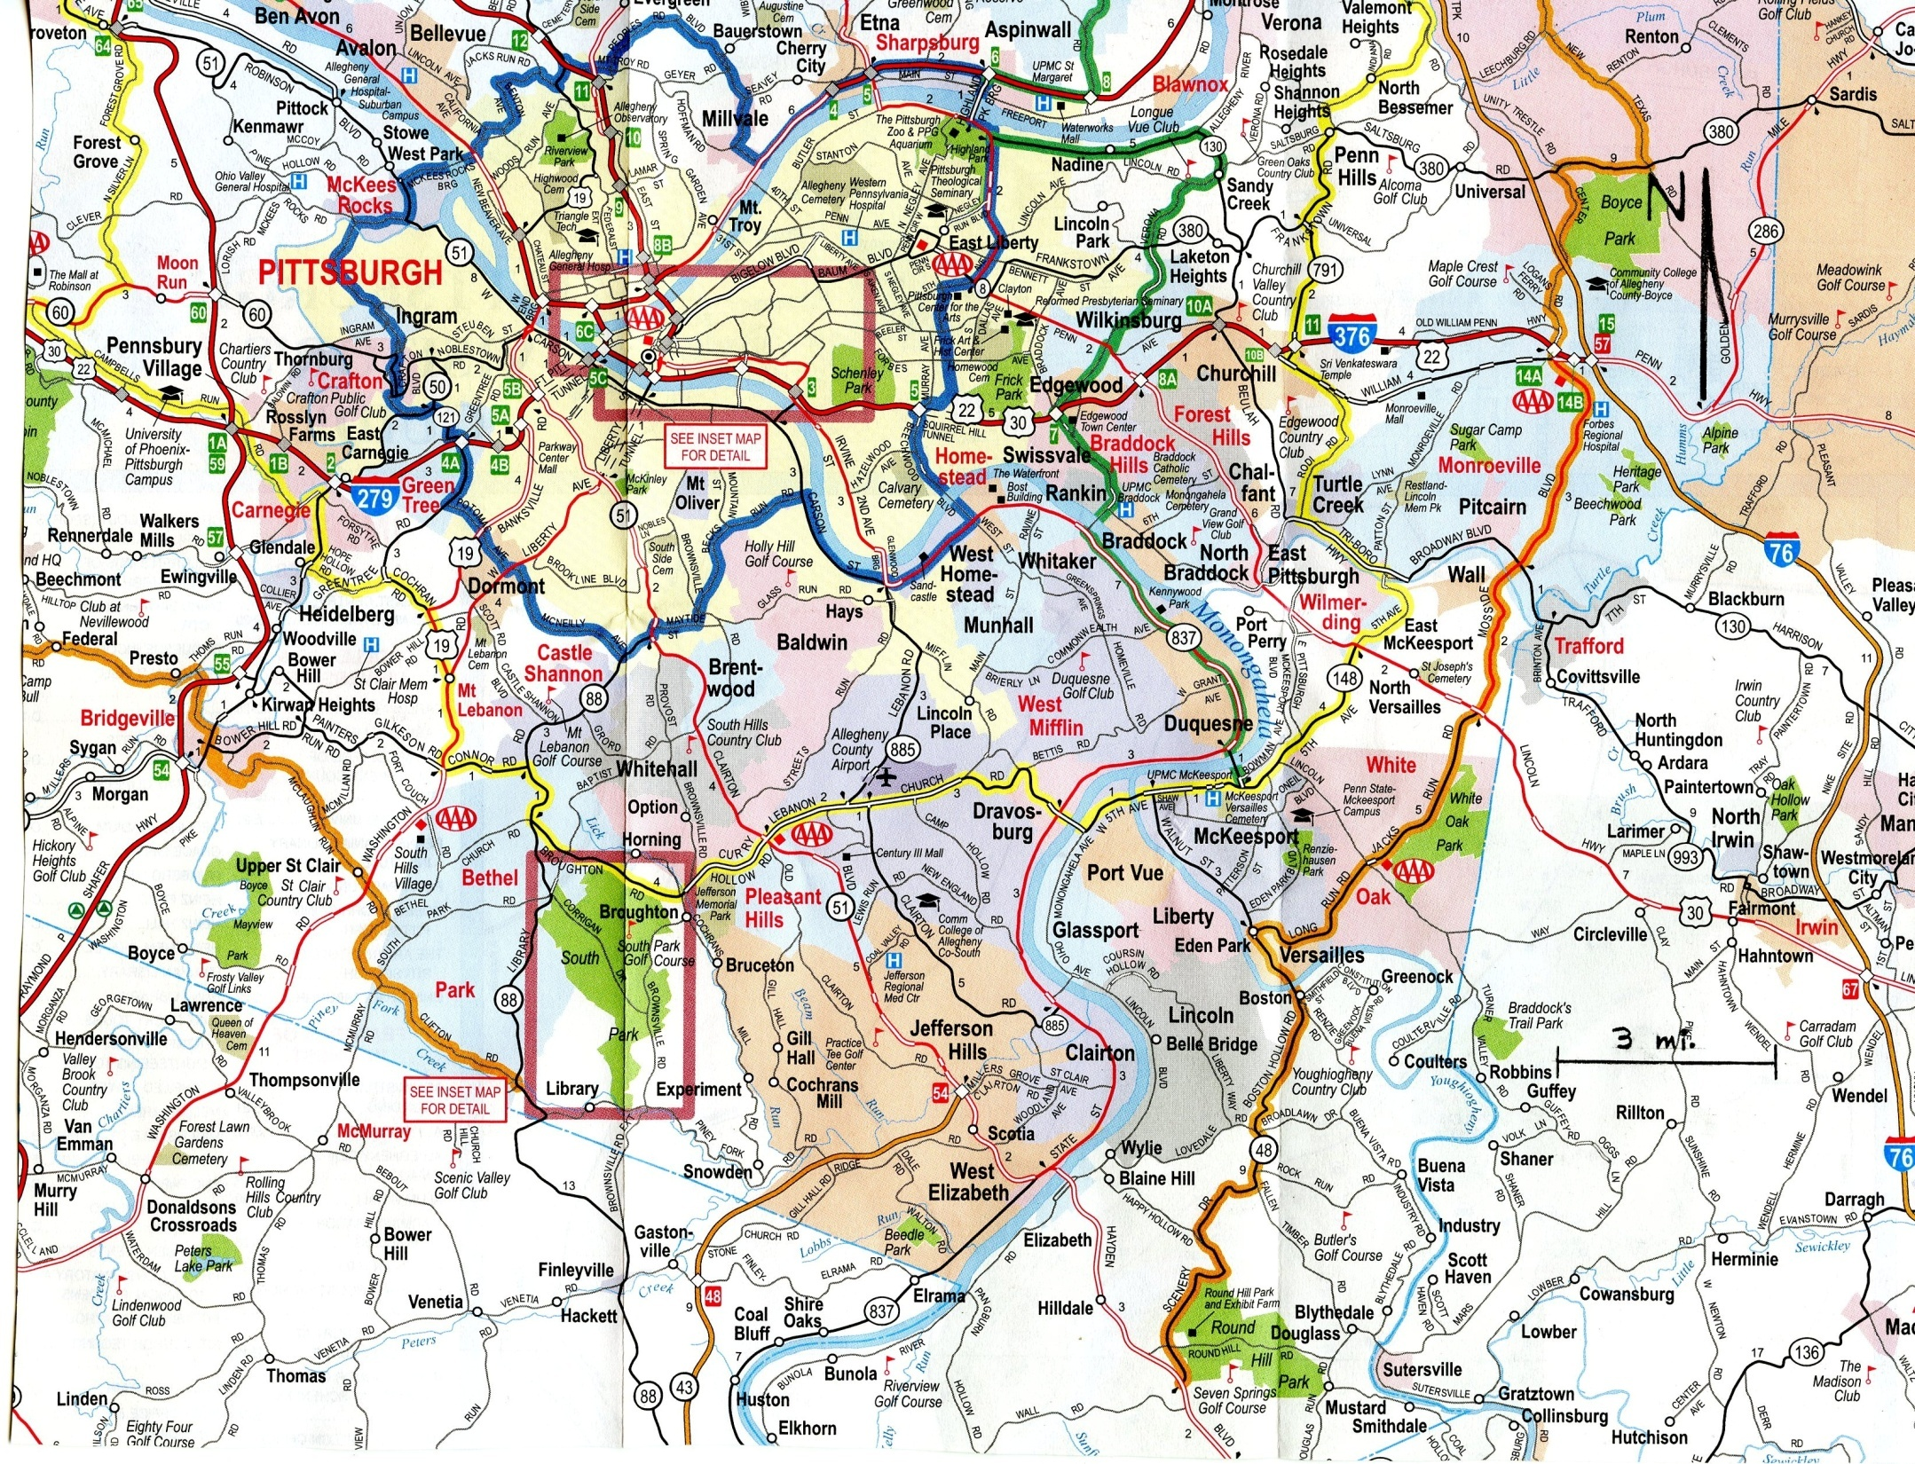

Slide 3
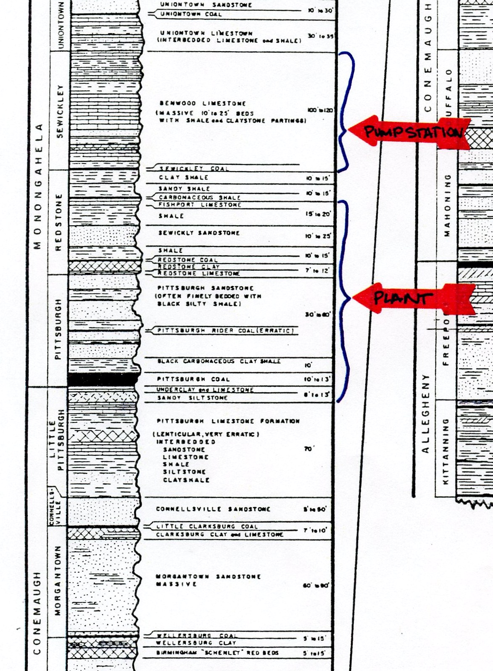
From PSI (2008)

Slide 4
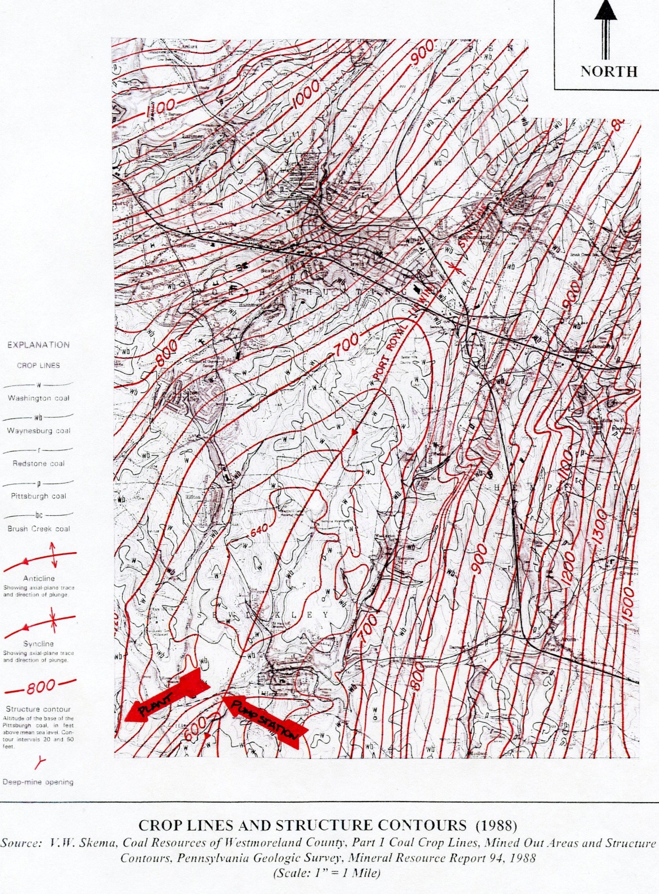
From PSI (2008)

Slide 5
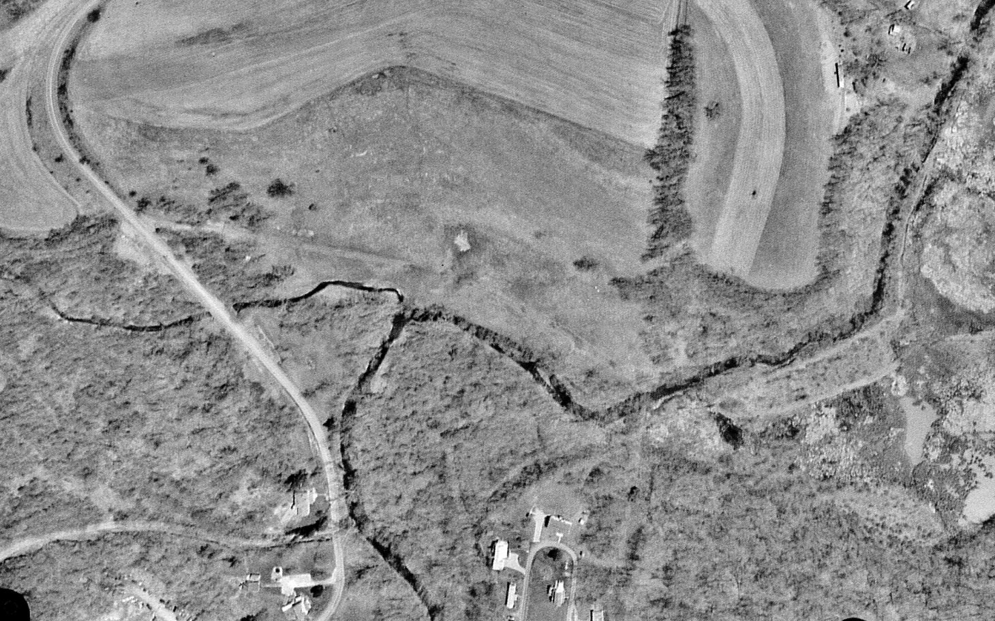
April 4, 2001

Slide 6
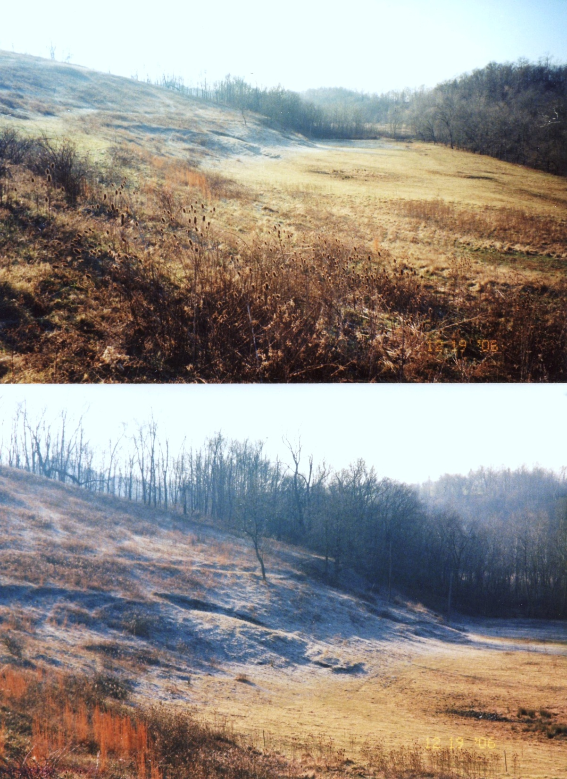
Dec. 19, 2006

Slide 7
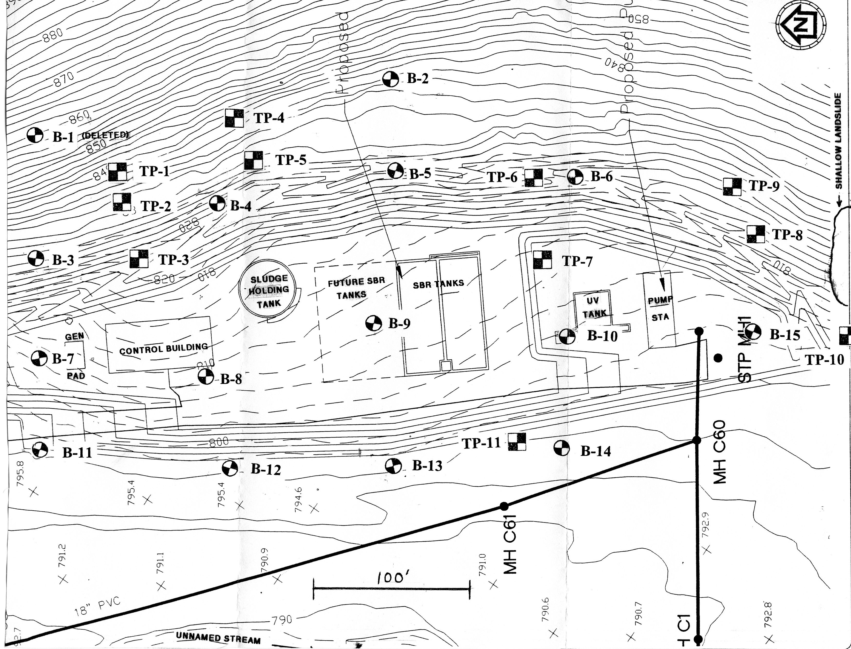
From PSI (2008)

Slide 8
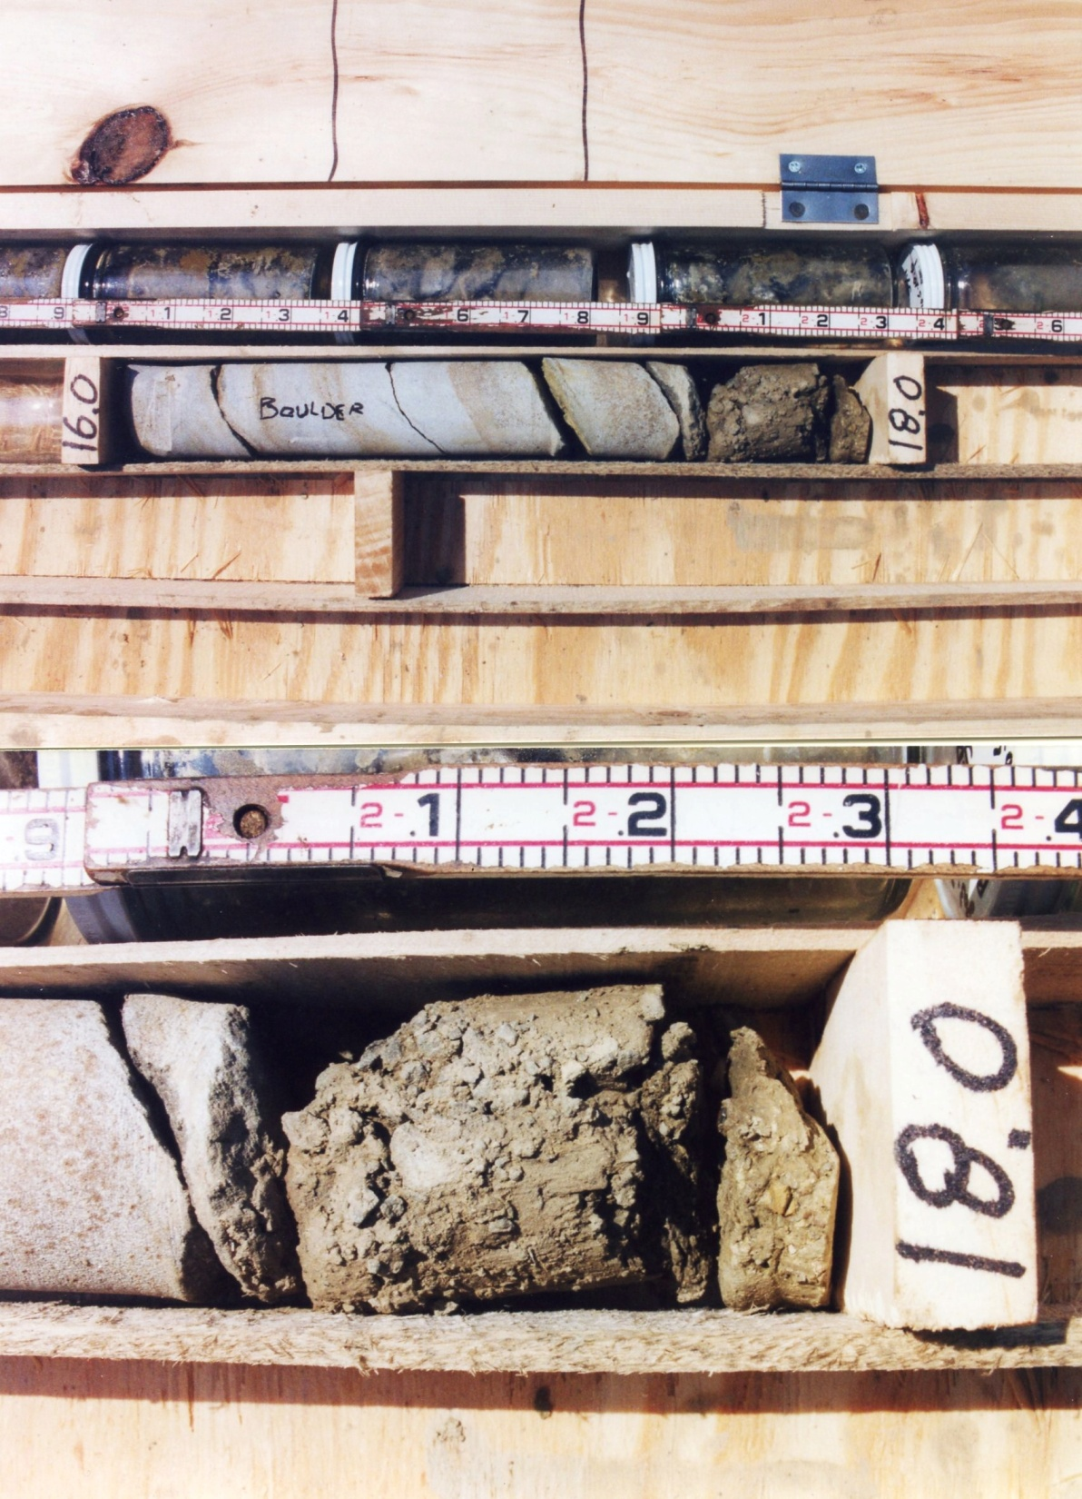
Aug. 29, 2007

Slide 9
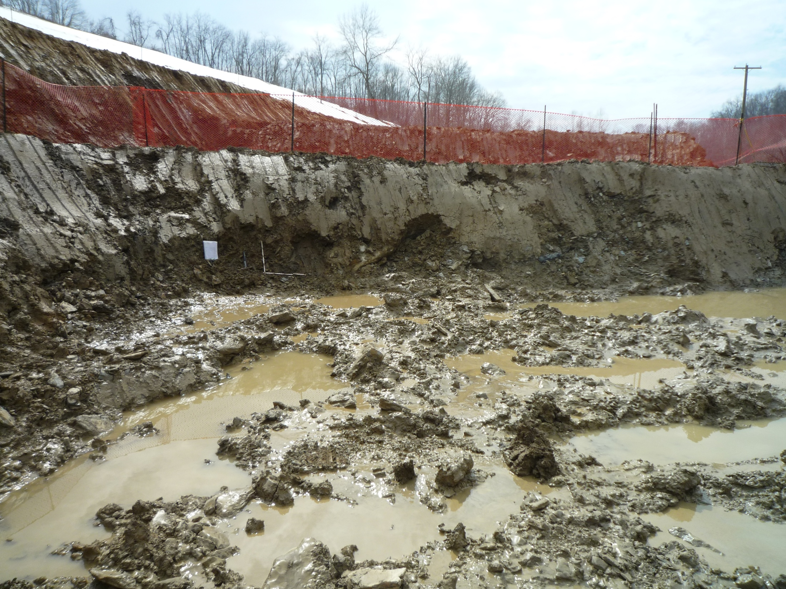
March 10, 2010

Slide 10
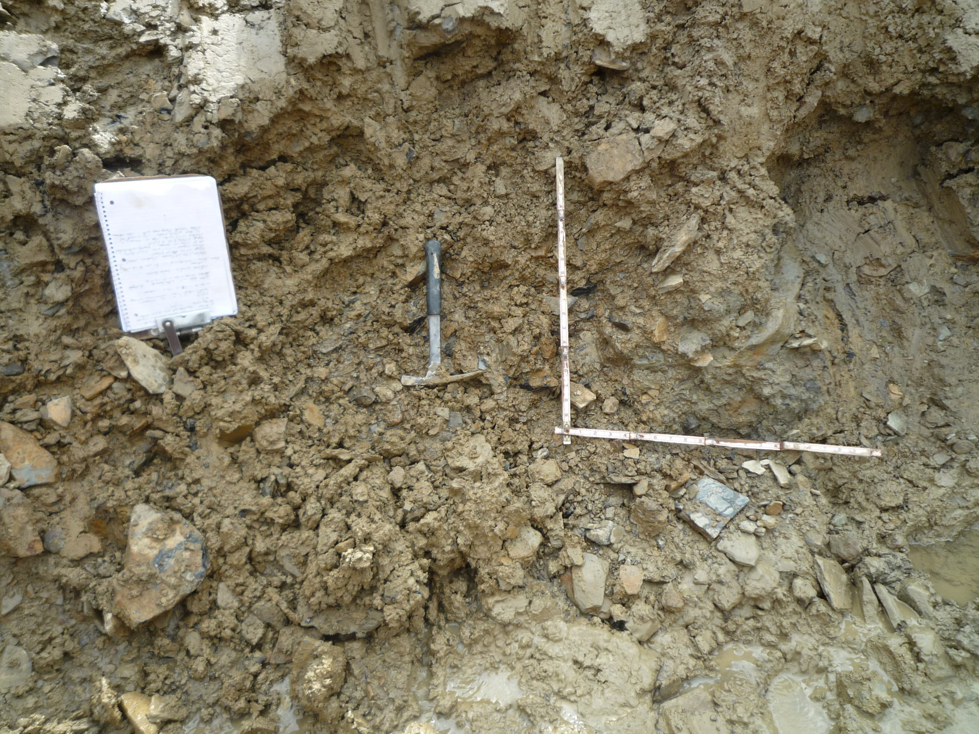
March 10, 2010

Slide 11
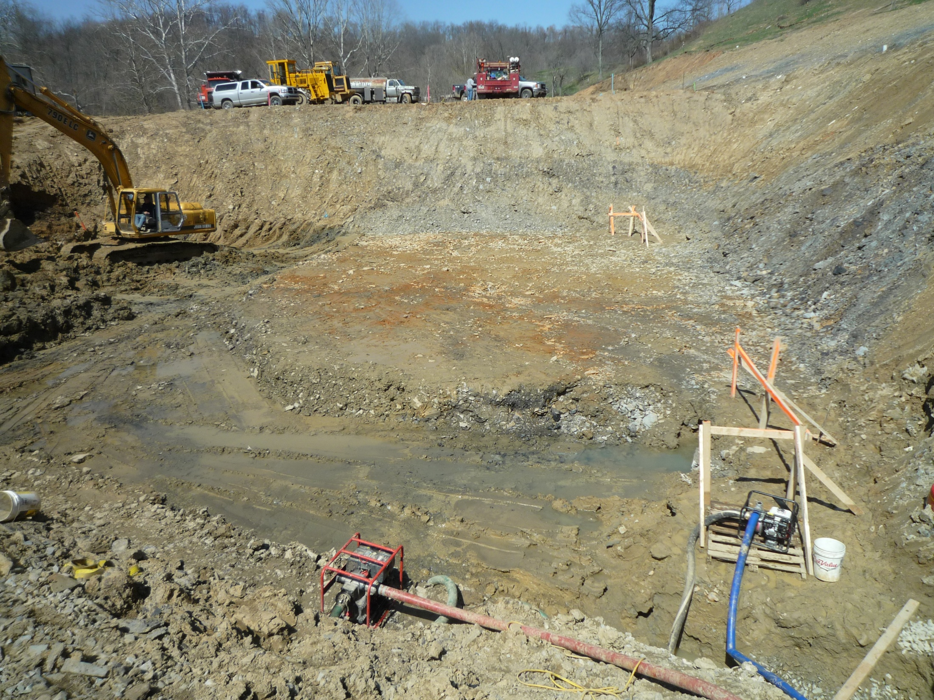
March 10, 2010
March 31, 2010

Slide 12
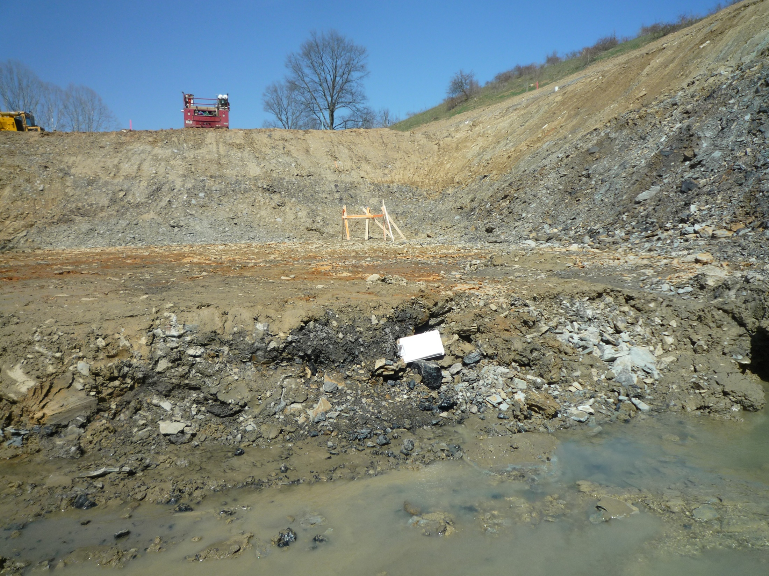
March 31, 2010

Slide 13
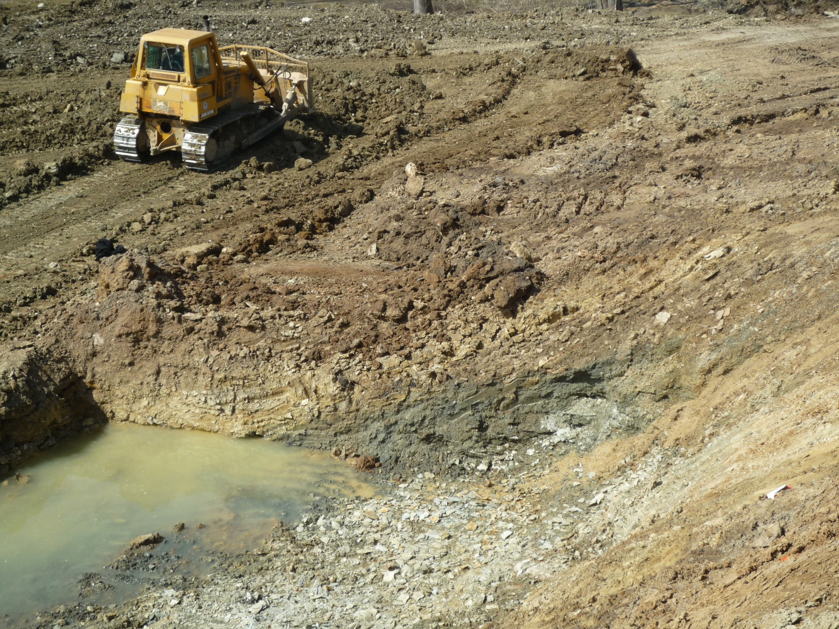
March 18, 2010

Slide 14
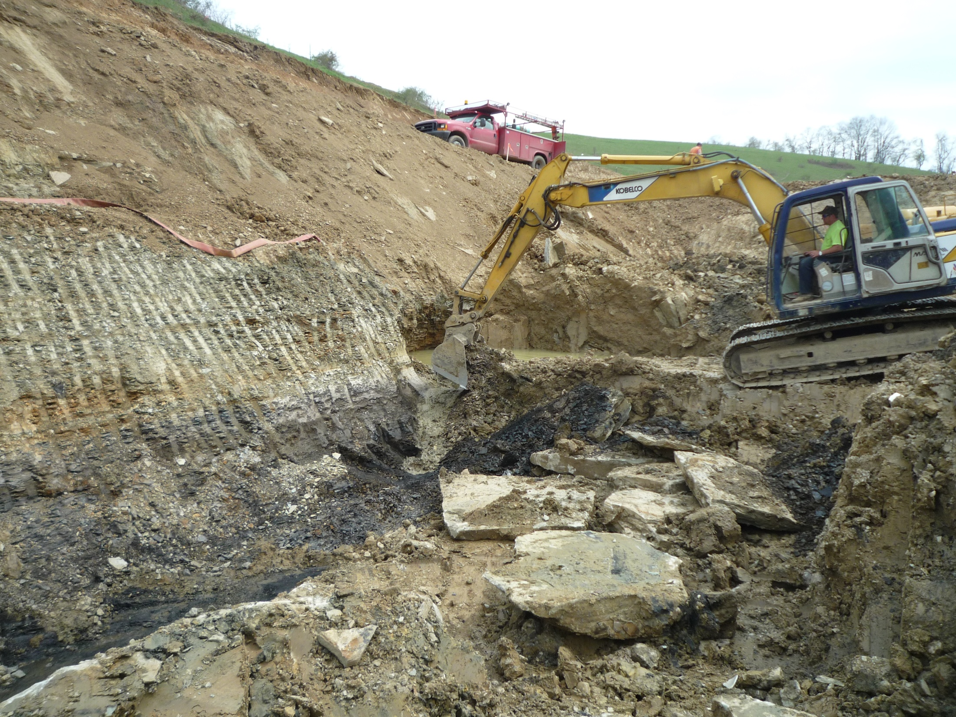
April 7, 2010
April 7, 2010

Slide 15
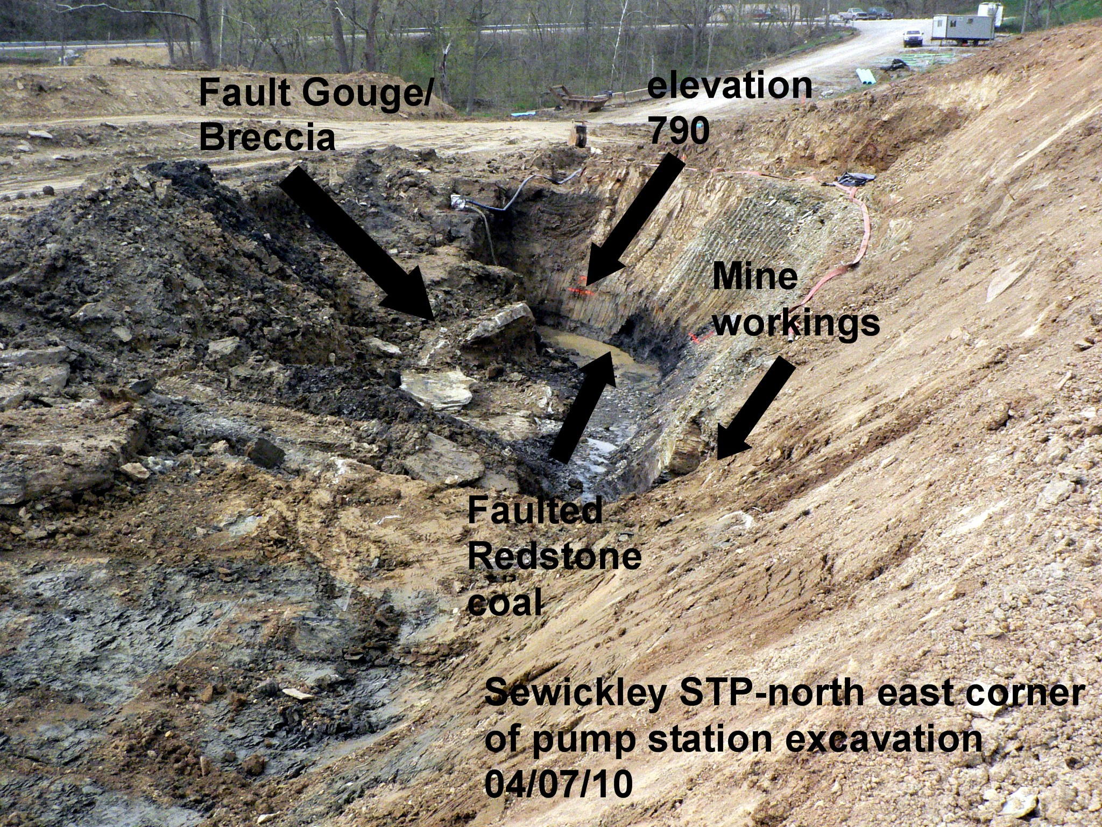
By Ron Koch

Slide 16
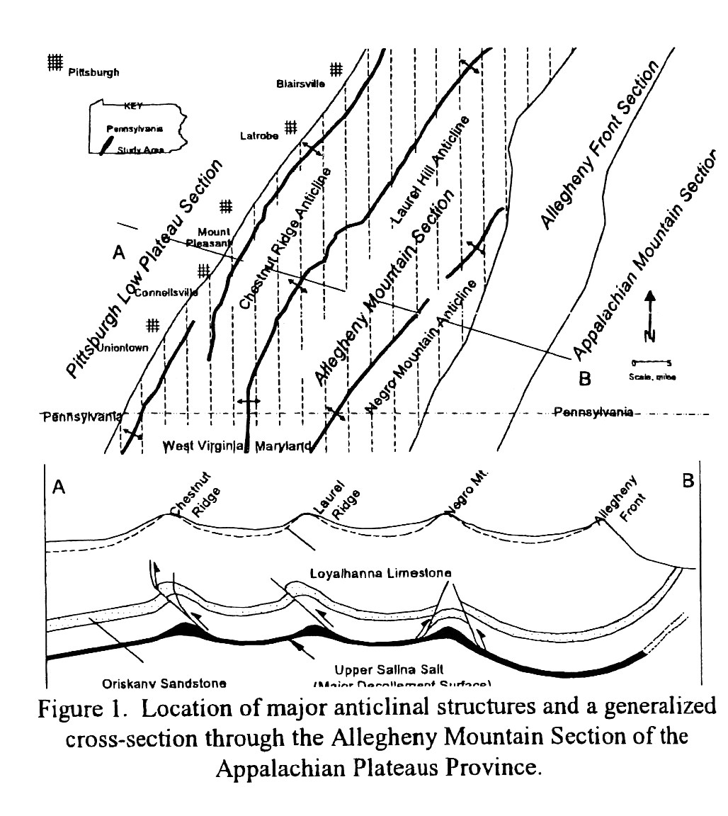
From Iannacchione and Coyle (2002)

Slide 17
Faults like this have both Geologic and Engineering Implications

Slide 18
Faults like this have both Geologic and Engineering Implications
Geologic Implications-
Tectonics of the region
Erosional patterns and landforms
Groundwater flow
Rock breakdown, weathering, and soil formation

Slide 19
Faults like this have both Geologic and Engineering Implications
Engineering Implications -
Layout and interpretation of subsurface exploration programs
Rock excavation methods and excavation support
Slope stability
Groundwater flow and dewatering
Foundation preparation, treatment, and support characteristics

Slide 20
Project Participants
Owner: Sewickley Township Municipal Authority, Herminie, PA
Funding: U.S. Department of Agriculture, Rural Utility Service, Greensburg, PA
General Contractor: Trinity Contracting, Inc., West Newton, PA
Owner’s Overall Consulting Engineer – Design and Construction Monitoring:
Gibson- Thomas Engineering Co., Inc., Latrobe, PA
Dan Schmitt
Bill Glasser
Ron Koch
Geotechnical Investigation: PSI, Inc., Pittsburgh, PA - Rochelle Dale
Overall Geotechnical Consultant: GTech, Inc., Pittsburgh, PA – Jim Hamel

