Slide 1
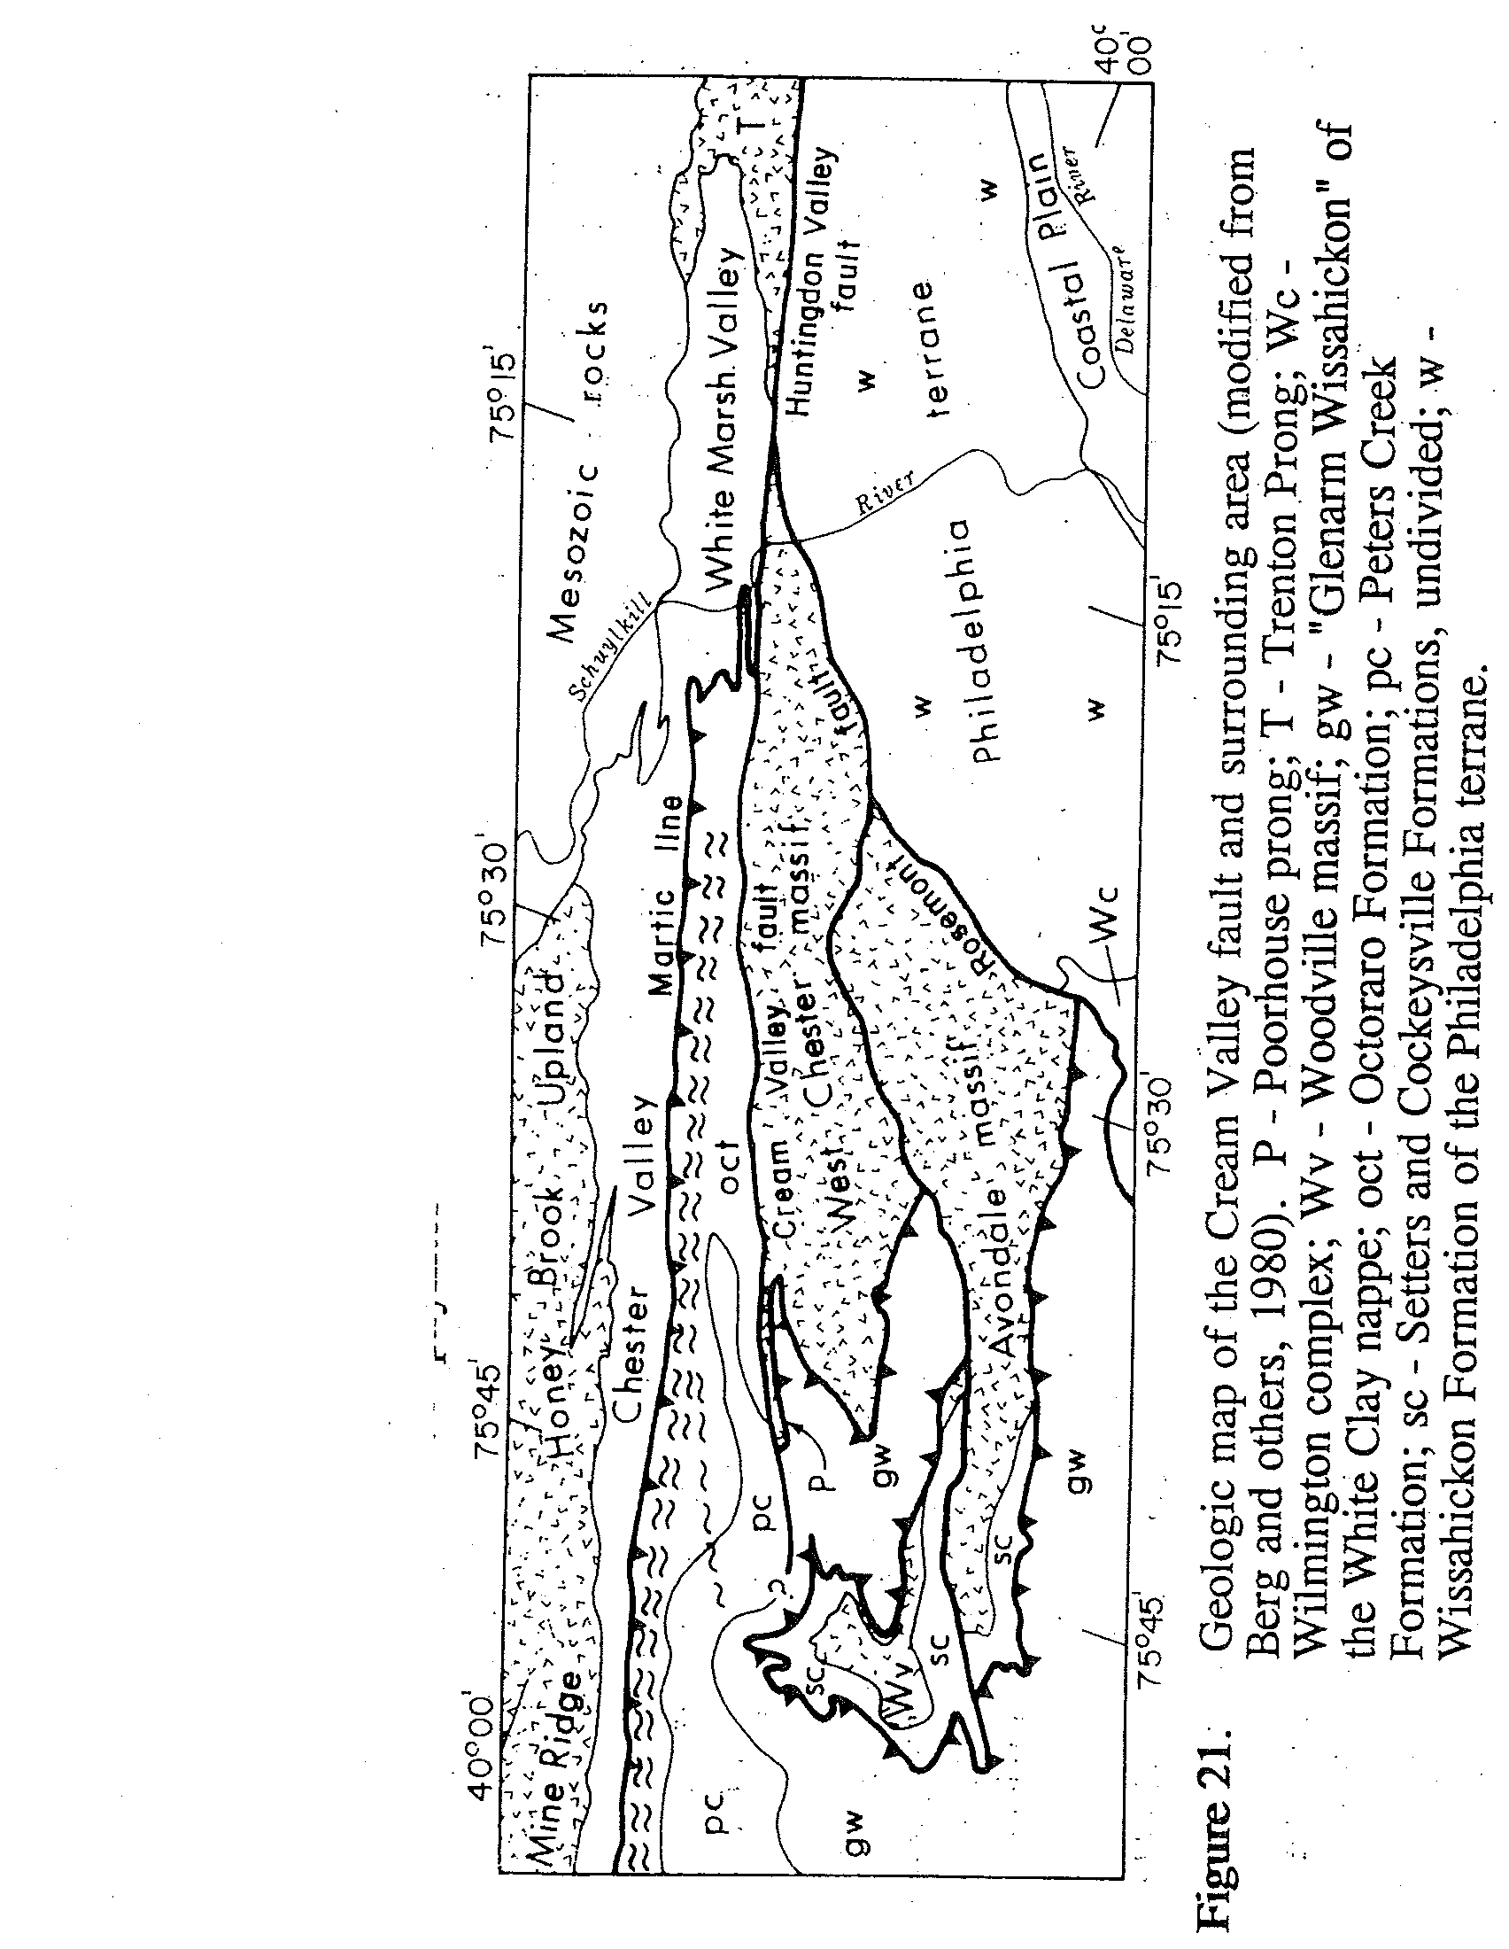
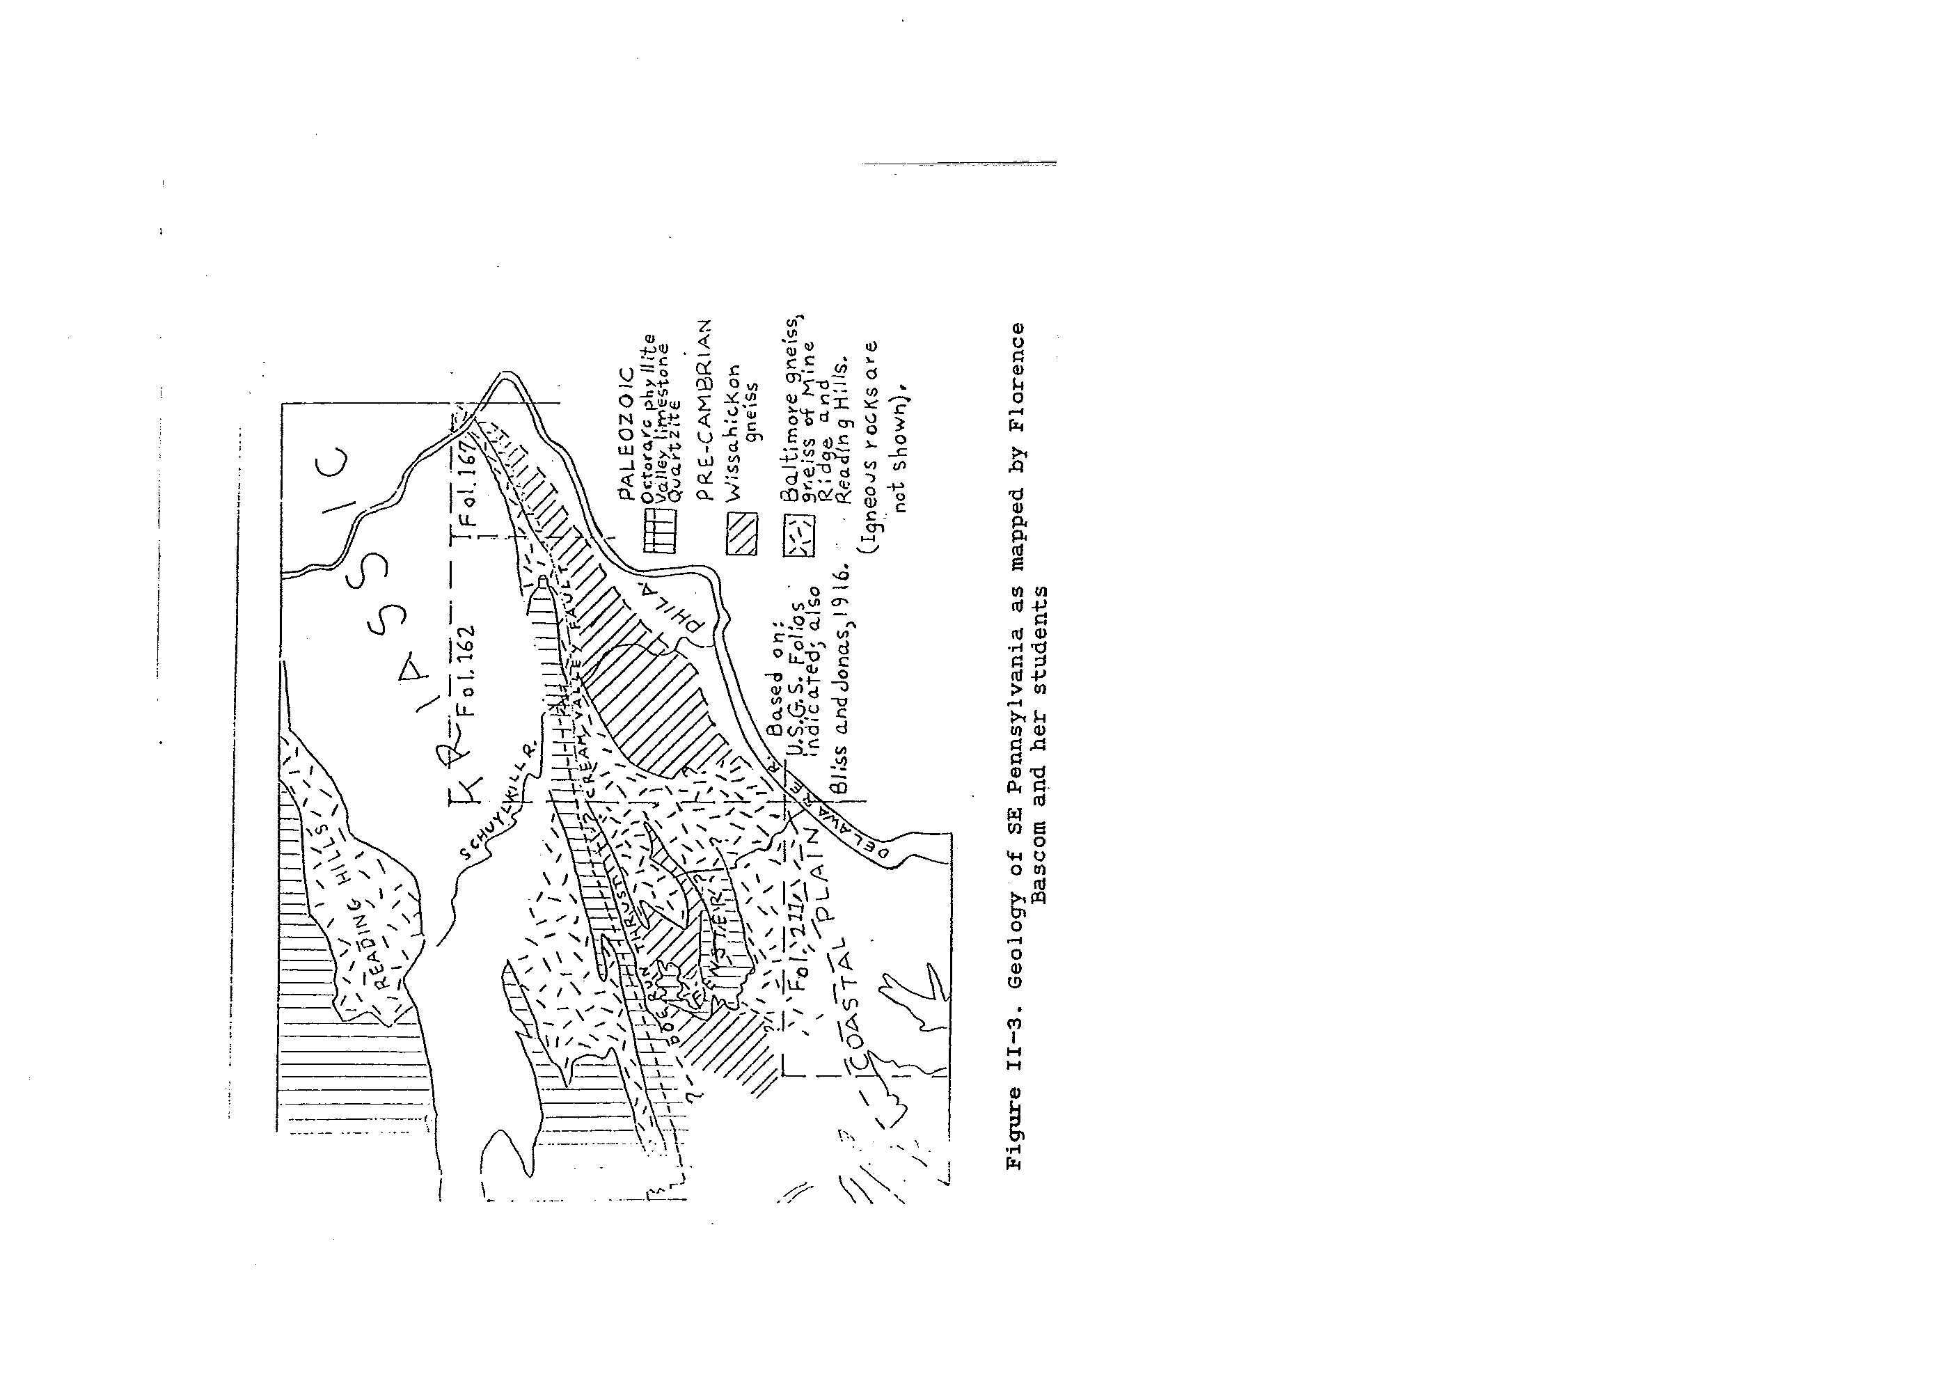
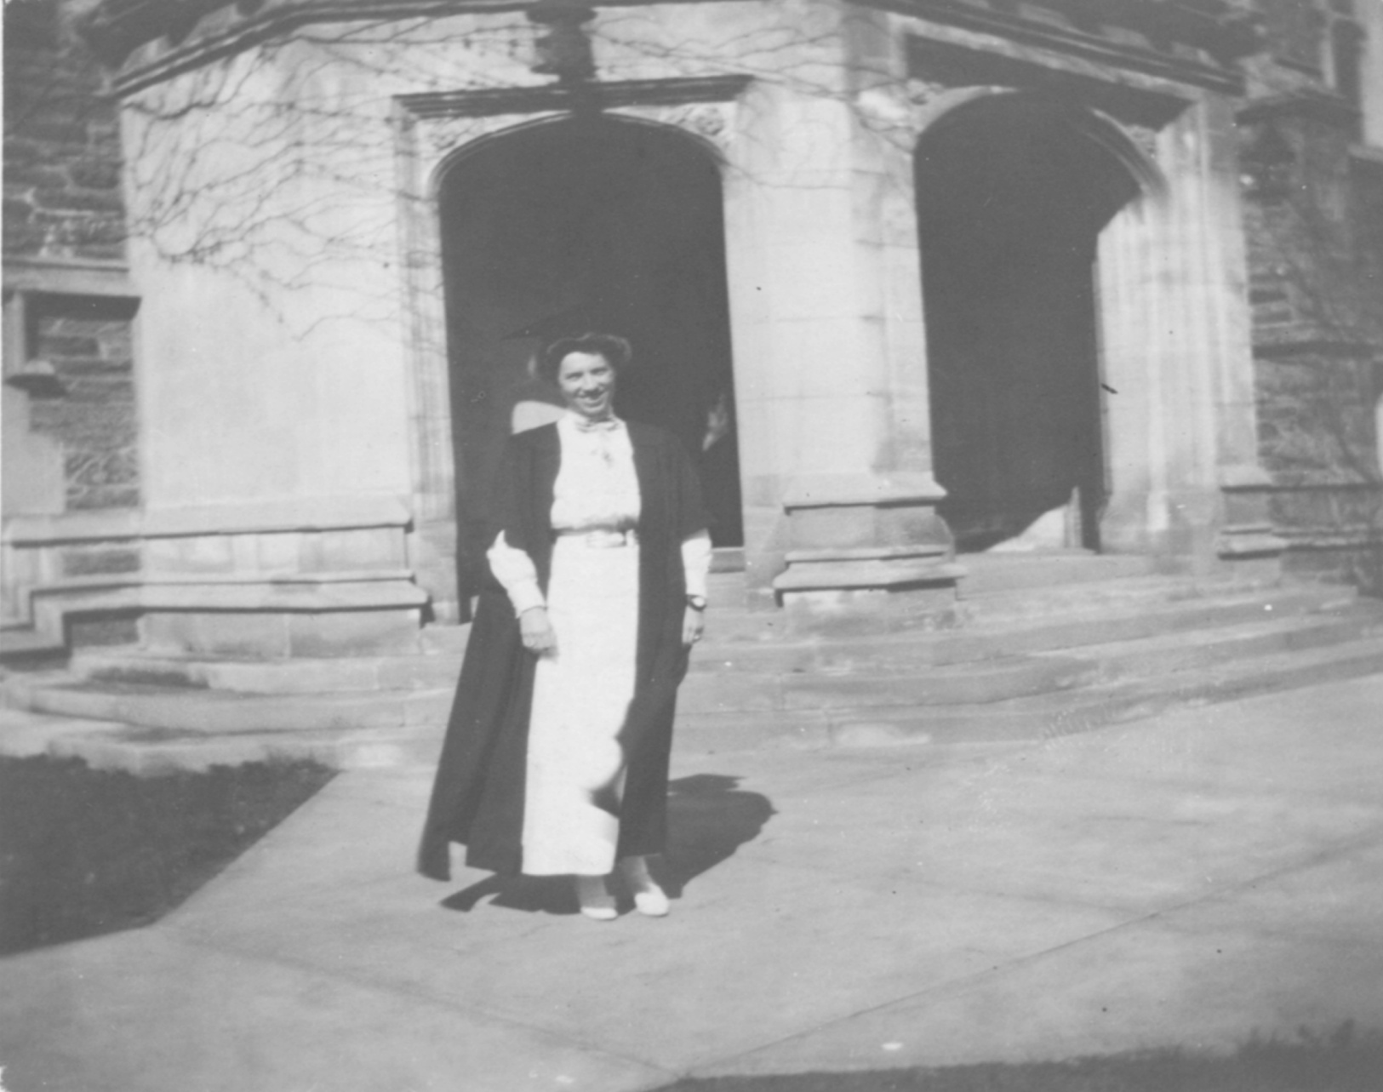
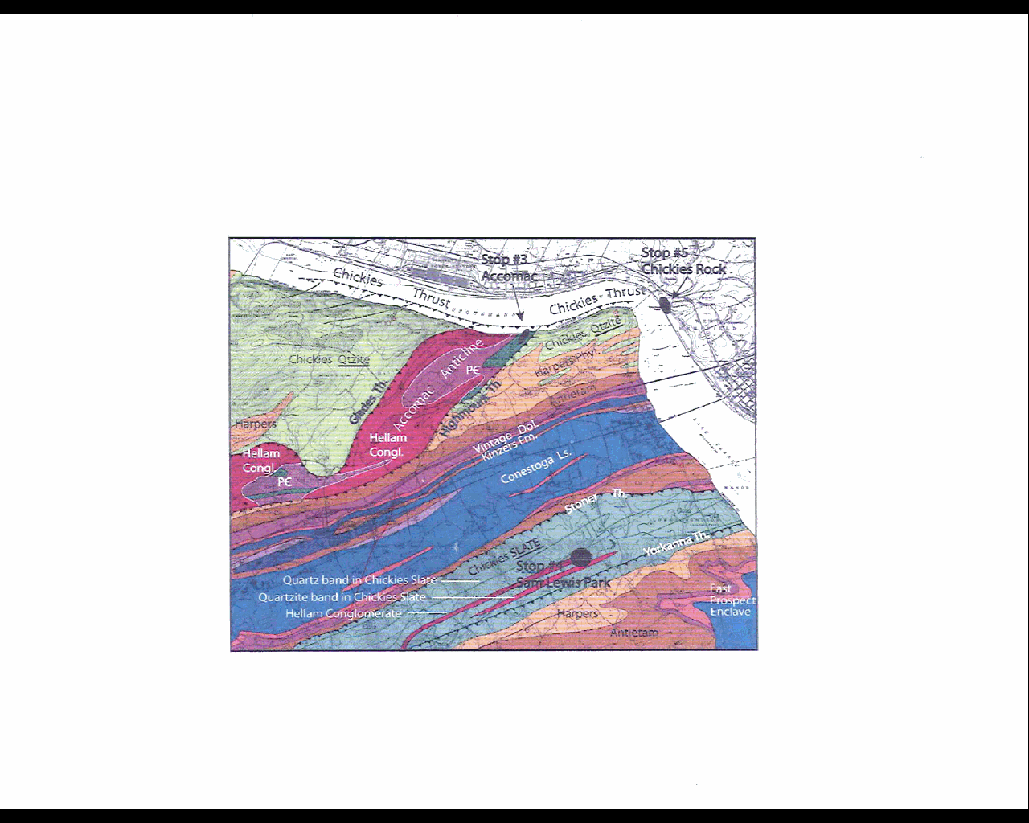
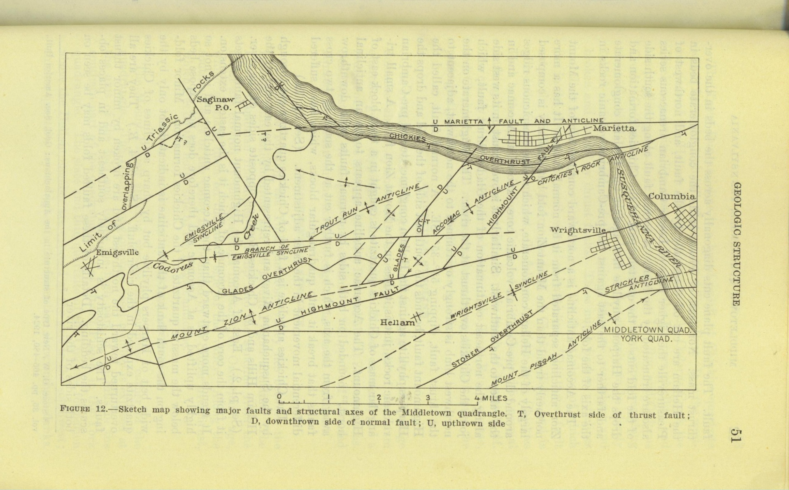
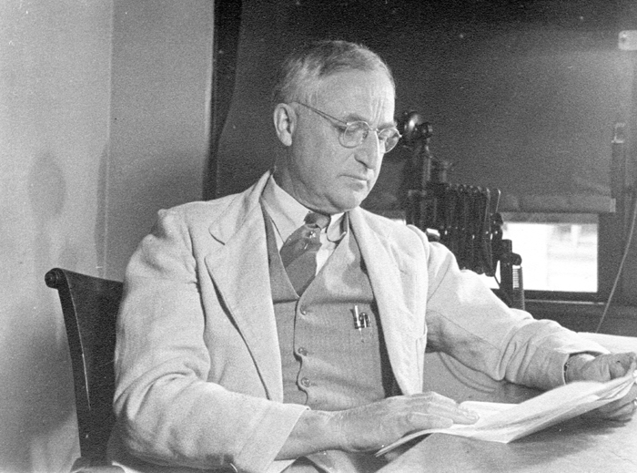
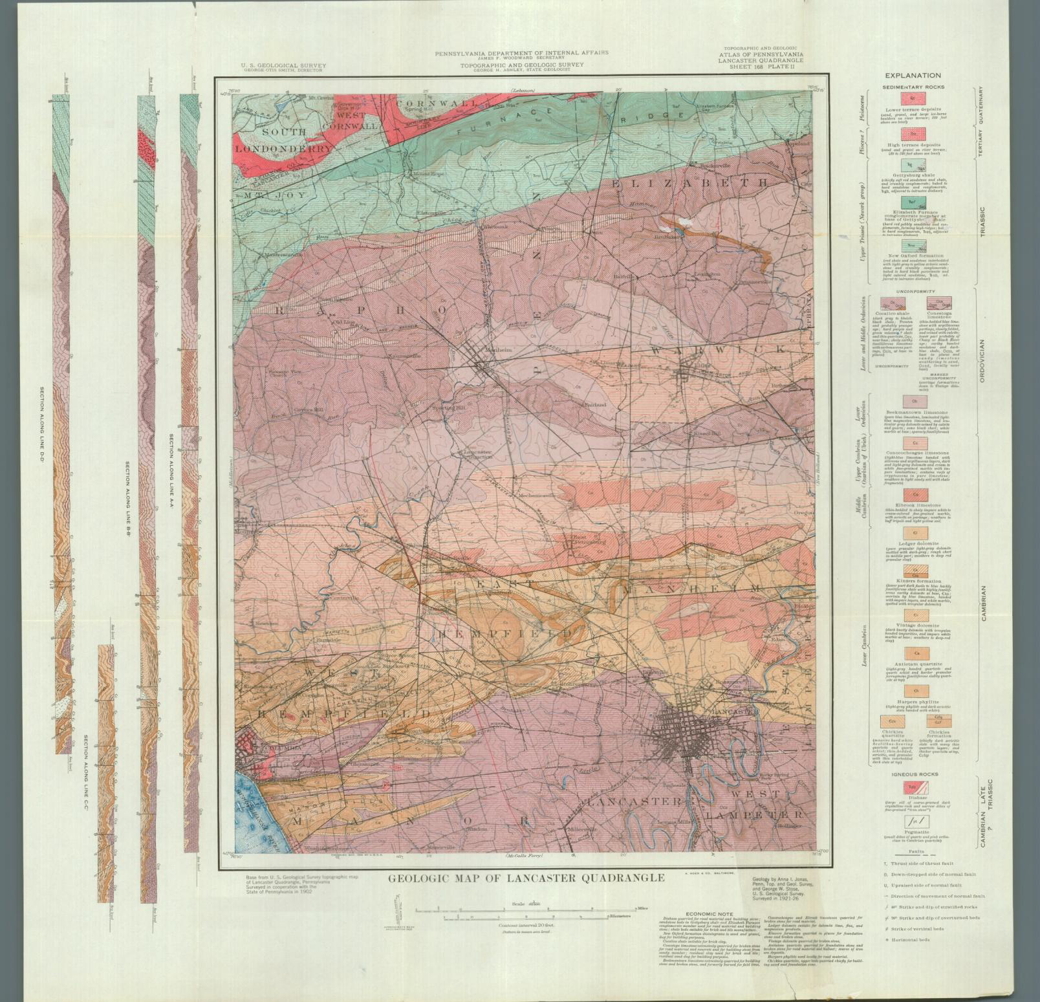
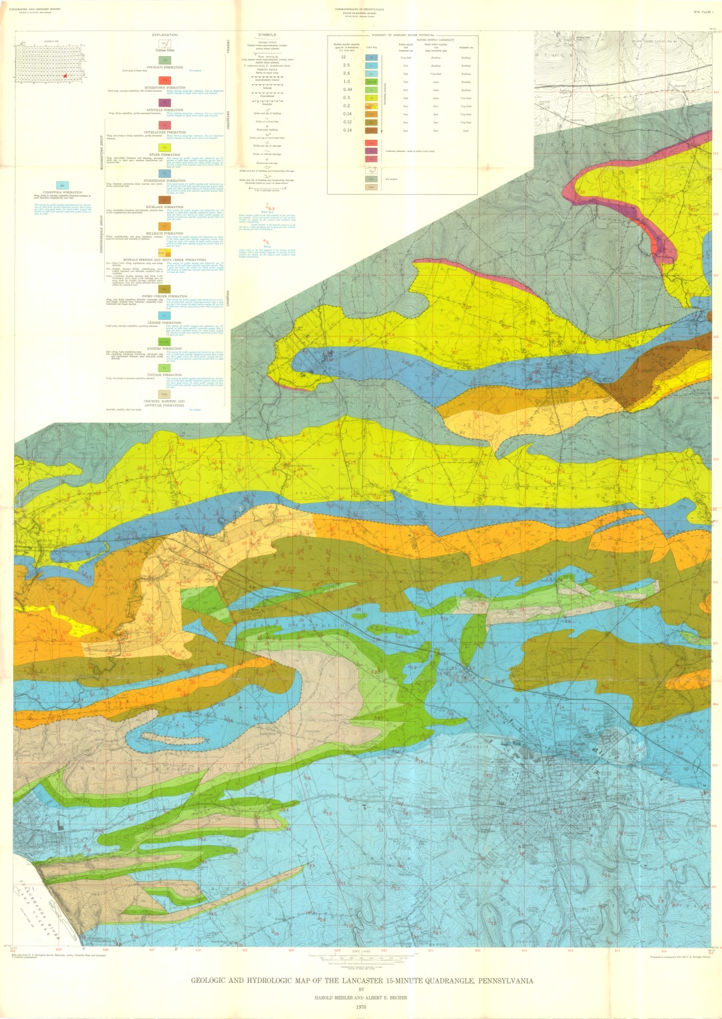
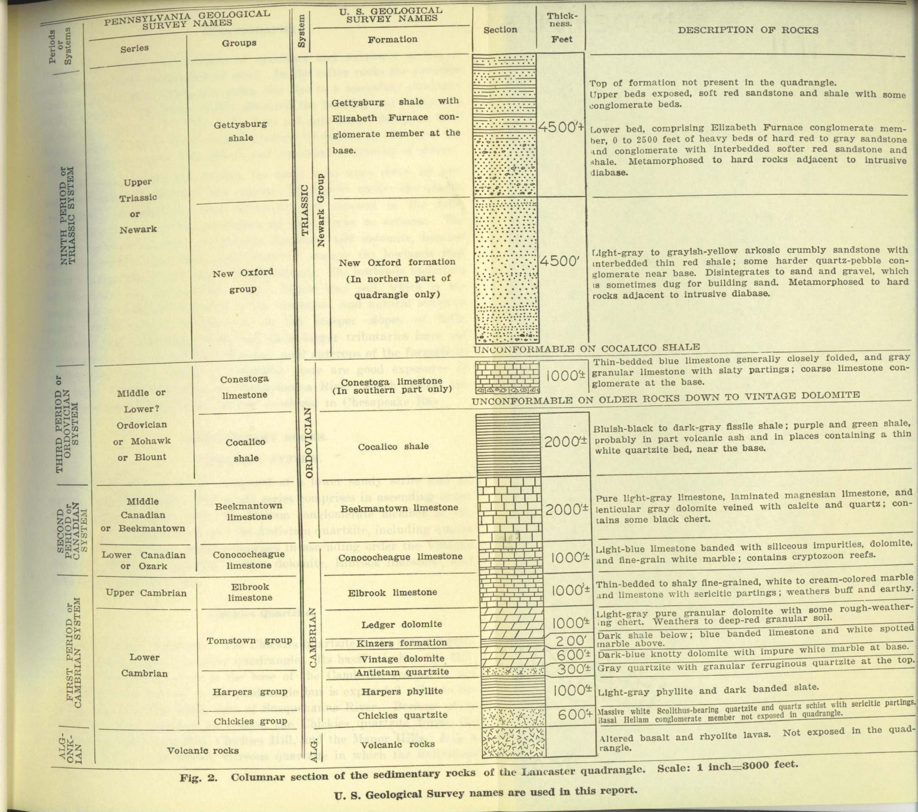
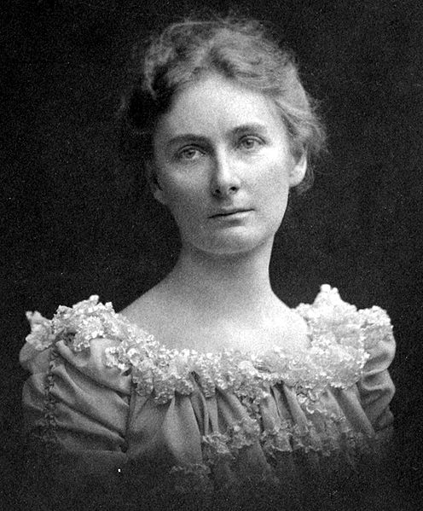
.
THEN AND NOW: GEOLOGIC INVESTIGATIONS OF FLORENCE BASCOM, GEORGE W. STOSE, AND ANNA JONAS STOSE IN SOUTHEASTERN PENNSYLVANIA
Jeri L Jones, Jones Geological Services & Charles K. Scharnberger, Millersville Univ.
ABSTRACT
Florence Bascom (1862-1945), George Willis Stose (1869-1960), and Anna Jonas Stose (1881-1974) became the most recognized geologic field mapping team in southeastern Pennsylvania. George began his investigations in the Appalachian Mountain region and Adams County, Pennsylvania, in the early 1900s, working with legendary geologist Florence Bascom. She taught at Bryn Mawr College near Philadelphia and conducted the initial research on the age and structure of the Piedmont metamorphic rocks, especially the Wissahickon Formation. In the 1920s, George teamed up with Anna Jonas, a student of Florence Bascom. George and Anna married in 1938. This team mapped individual quadrangles and regions in York and Lancaster Counties. Their reports became foundations for future investigations. Working with limited exposures and no knowledge of plate tectonics, they made very detailed interpretations of the stratigraphy and structure. With modern mapping techniques and more rock exposures, just how well have Bascom’s and the Stoses’ ideas stood the test of time?
REGIONAL GEOLOGY
At left are sketch maps made by Dorothy Wyckoff at Bryn Mawr College depicting the geology of southeastern Pennsylvania as mapped first by Bascom and her students (Jonas and Bliss), and later by the Stoses. (Ref. 6 ) For comparison, a more recent map is presented (far left, Ref. 7). Note that Bascom’s Doe Run thrust, which she placed between the Wissahickon Fm and the Octoraro Fm has been replaced on the Stoses’s map by the Martic thrust separating what Bascom called Octoraro, but the Stoses called Wissahickon, from the Conestoga Fm to the north. Rocks thought by Bascom, Jonas, and Stose to be Precambrian are now considered to be probably Lower Paleozoic (Ref. 8). Although Bascom had introduced the concept of large thrust faults with her Doe Run thrust, she never accepted the reality of the Martic overthrust, which led to a falling out with the Stoses. Note that on the recent map, the name Octoraro has been revived. The Stoses’s depiction of the crystalline massifs as exposures of basement nappes, although highly controversial at the time, has now come to be widely accepted. (Ref. 9)
Anna Jonas (Stose)
Born: 1881 Died: 1974
Education: Bryn Mawr College, Bryn Mawr, Pennsylvania (A.B., A.M. and Ph.D.)
Employment: Pennsylvania Geologic Survey and Maryland Geologic Survey
1919 – 1937
First published report with George W. Stose 1922
Married George W. Stose 1938
Classmate of Eleanora Bliss (Knopf) at Bryn Mawr College.
Her mentor was Florence Bascom
Anna was known as a very observant field geologist, and sometimes made bold and controversial interpretations
She always said what was on her mind and never changed her mind once it was made up. (Ref. 1)
TWO RECENT ASSESSMENTS
“Considering the quality of the available base maps, the absence of air photos, and the great speed with which this large area was mapped b relatively few people, it is much to the credit of Jonas, Stose, & Co. that, with appropriate stratigraphic reinterpretation, much of the area mapped by them remains sufficient for 1:250,000-scale presentation.” --David B. MacLachlan, (Ref. 4)
“One concludes that Stose and Stose had most of the structural elements mapped and well understood, far before their time. Even with 2/3 of a century’s advance in structural knowledge, these ‘improvements’ on their work are possible only with difficulty and still not altogether satisfactory results.” –Donald U. Wise, (Ref. 5)
MIDDLETOWN QUADRANGLE
Stose and Jonas published their report on the Middletown 15’ Quadrangle in 1933. (Ref. 10). At left is their structural map of the portion of that quadrangle around Accomac, in York County. By 1939, they had revised their interpretation, as shown on the right. (The figure reproduced here is from Ref. 5 , based on Ref. 11, based in turn on Ref. 12.)
George W. Stose
Born: 1869 Died: 1960
Education: Massachusetts Institute of Technology (B.S. and Ph.D)
Employment: U.S. Geological Survey
1894 – 1941 1942 – 1944
Volunteered preparing reports until 1953
George always prepared detailed and concise repports
He loved helping others, either within the geological field or in the community.
He was awarded the “Scroll of Honor “ from the USGS (Ref. 2)
Florence Bascom
Born: 1862 Died: 1945
Education: University of Wisconsin-Madison (B.S. and M.S.)
Johns Hopkins University (Ph.D)
Employment: Bryn Mawr College
1895-1928
United States Geological Survey
1896 - 1936
First woman to receive a Ph.D from Johns Hopkins University
Second woman to receive a Ph.D in geology from any university
First woman hired by the U.S.G.S.; known as grande dame of geology
First woman elected to the Council of the Geological Society of America
First woman officer of the Geological Society of America (Vice President in 1930)
Bascom crater on Venus and asteroid 6084 Bascom are named in honor of her. (Ref. 3)
LANCASTER QUADRANGLE
At left are two geologic maps of the Lancaster 15’ Quadrangle. On the far left is the Jonas and Stose 1930 map, (Ref. 13 ); to its right is the Meisler and Becher 1971 map (Ref. 14). Note especially the differences in the mapped faults. At that time, Jonas and Stose did not yet recognize the presence of Taconic structures in this region. Their stratigraphic column also is shown. Most of their formation names are still used today, although locally the names Zooks Corner, Buffalo Springs, and Snitz Creek have replaced Elbrook. The age of the Conestoga Formation is now recognized to be Middle Cambrian, not Ordovician. (Ref. 15) It is a deeper water facies correlative with, rather than unconformable over, several of the other Cambrian units.

