Slide 1

Geology of the War of 1812: Terrain influences on
the Battle of Cote Sans Dessein, Missouri Territory
Kevin R. Evans
John R. Bertalott
Department of Geography, Geology, and Planning
Missouri State University

Slide 2
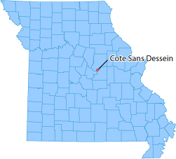
Overview
• Geology (terrain) influenced battles
in Missouri during the War of 1812
• Cote Sans Dessein lost hill in Missouri
River valley near mouth of Osage
River; also village, ca. 1808
• Cote Sans Dessein was gateway to
trade with Osage in southwestern
Missouri
• Important landmark and defensive position for settlers
• 1810, visited by Scottish botanist, John Bradbury
• 1815, site of Battle of Cote Sans Dessein
• 1819, visited by Edwin James, American naturalist, Long’s Expedition [led summit party “first” ascent Pike’s Peak]
Remaining Question
Why is there a lost hill at confluence of two major rivers?

Slide 3
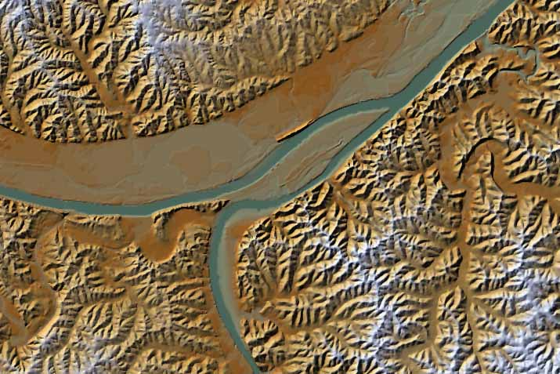
Cote Sans Dessein
Dodds Island
Bonnots Mill
Missouri River
Moreau River
Osage River
(USGS DEM)

Slide 4
Why combine geology and “recent” historic events?
• Geologists love history
• Geology played roles in many if not most historical events; e.g.,
strategy, economics of mineral, energy, and natural resources, as well as tactics and terrain
• For students, “place-based education” gives new perspectives
• For teachers gives “anecdotes for education”
• For researchers, increases skepticism of all written accounts
Anecdote from this talk
A lost hill is an erosional remnant left behind when a river cuts its floodplain or cuts off entrenched meander bends. During the War of 1812, a battle was fought on a steep lost hill in Missouri. High ground and a blockhouse fort allowed one rifleman to hold off more than 50 men in an attack that raged more than five hours.

Slide 5
Missouri Historical Perspective
1541 — Virreinato de Nueva España (Viceroyalty of New Spain) established Luisiana
1673 — Marquette and Joliet exploration of the Mississippi River
1703 — Settlement of St. Louis area
1718 — New Orleans founded
1755-1763 — Expulsion and migration of Acadians
1764 — St. Louis founded
1788 — New Madrid founded
1800 — French control of Spanish Luisiana
1803 — Louisiana Purchase ($15M)
1804-1806 — Lewis and Clark expedition
1808 — Cote Sans Dessein founded by French-Americans; gateway to the Osage River fur trade
1808 — Treaty of Ft. Clark (Osage ceded land)
1810 (March) — Bradbury expedition passes Cote Sans Dessein
1811-1812 (December to February) — New Madrid earthquakes

Slide 6
Missouri Historical Perspective (continued)
1812 (April) — Louisiana statehood; Missouri Territory established
1812 (June) — Declaration of war
1814 (December) — Treaty of Ghent
1815 (January) — Battle of New Orleans
1815 — 20 families lived in Cote Sans Dessein
1815 (April 4) — Battle of Cote Sans Dessein
1815 (May 24) — Battle of the Sink Hole

Slide 7
War of 1812
• Numerous reasons for war:
—> Naval independence from Britain
—> Invasion of Canada
—> Removal and control of Native American tribes
• War was in the Great Lakes area, Canada, New England, Alabama (Creek War), and the western theater
War in West
• Missouri, Illinois, Iowa, and Wisconsin
• U.S. Regulars, Missouri Rangers, French and American settlers vs. Sauk and Fox, Iowa, and Pottawotamie (British Allies)
• Territorial capital was St. Louis

Slide 8
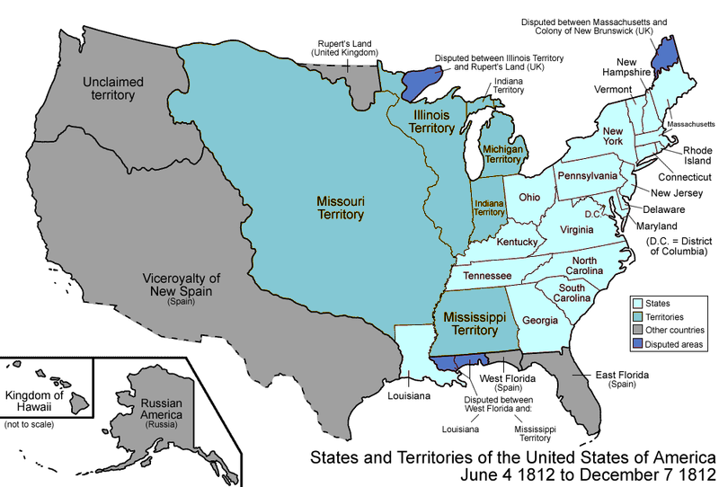
(Wikipedia, 2010)

Slide 9
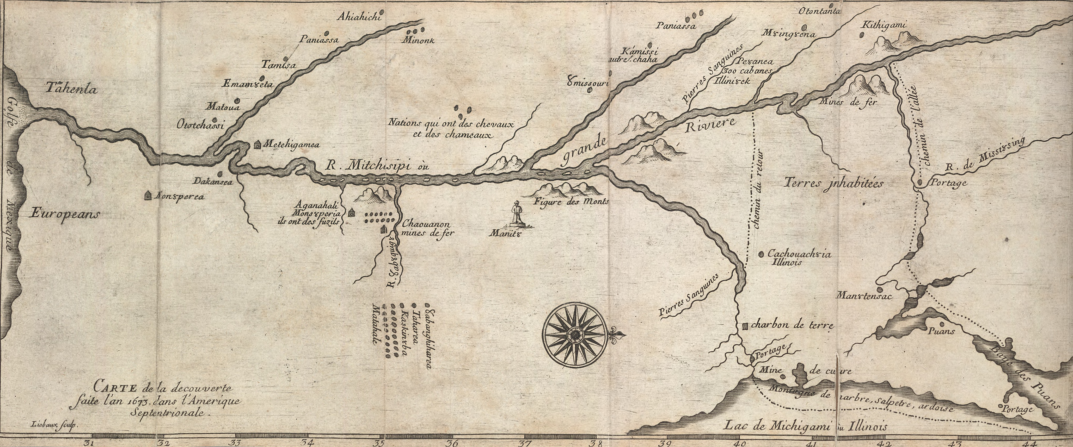
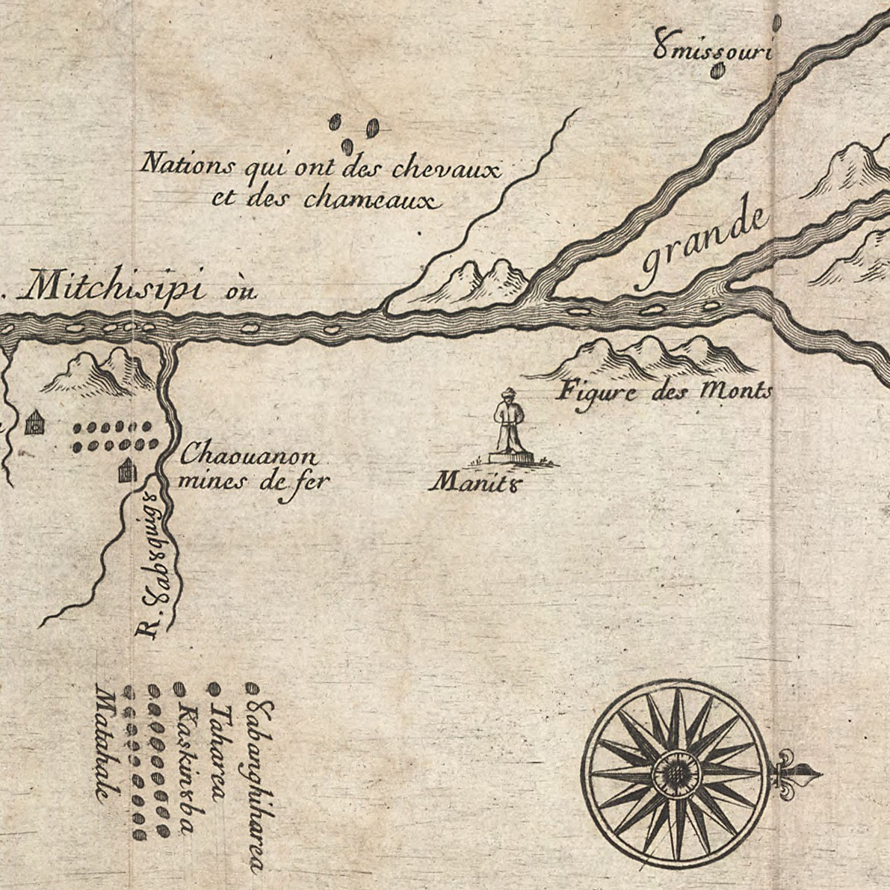
1673 — Marquette and Joliet explorations
(Marquette 1681)

Slide 10
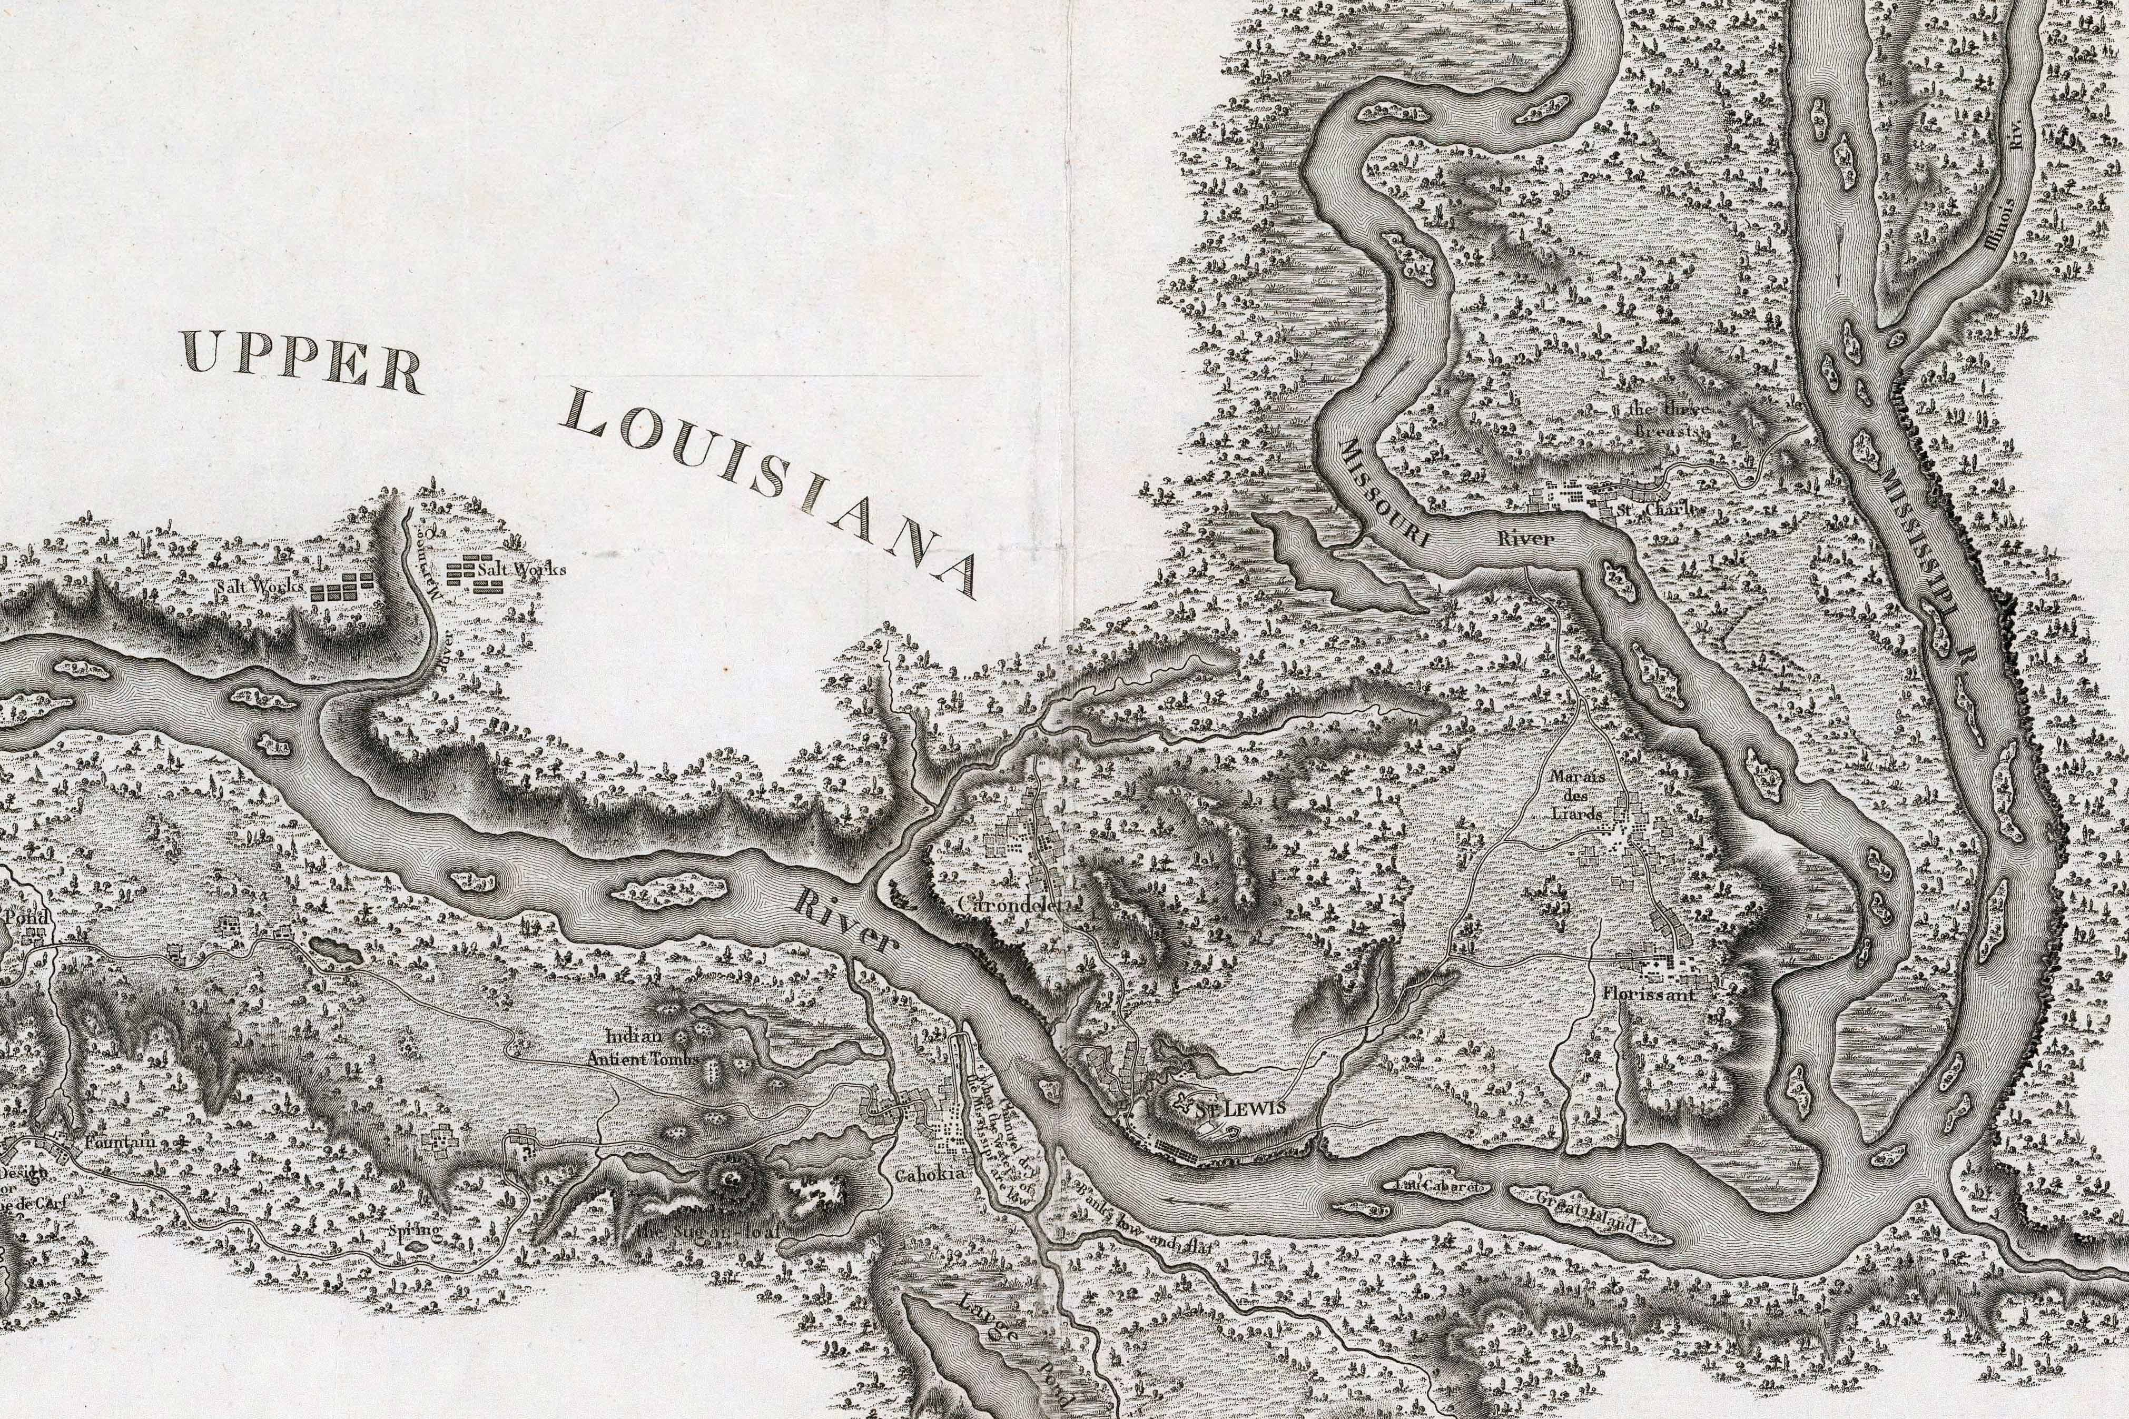
(Collot, 1796)

Slide 11
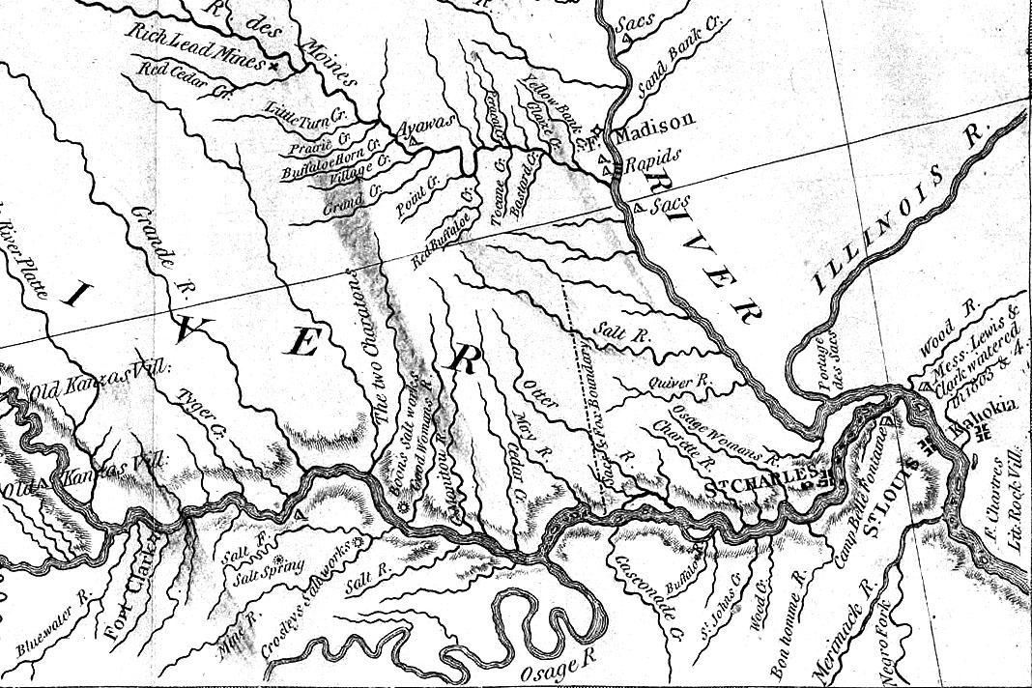
Cote Sans Dessein
(Lewis and Clark expedition, Bradford and Inskeep, publishers, 1814)

Slide 12
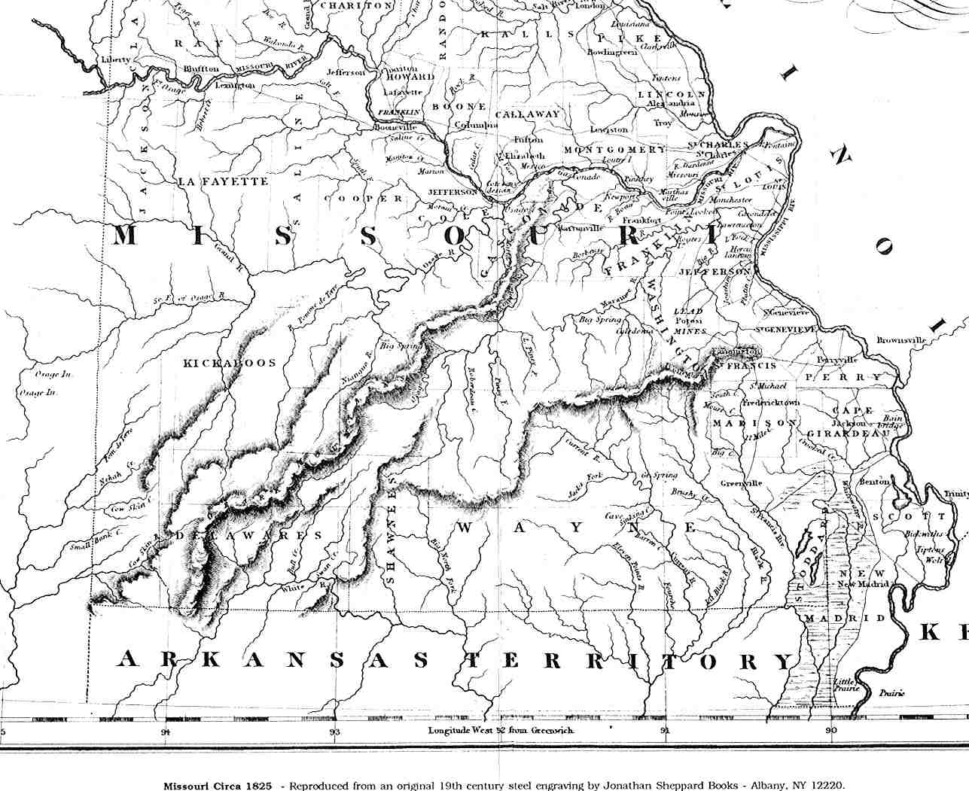
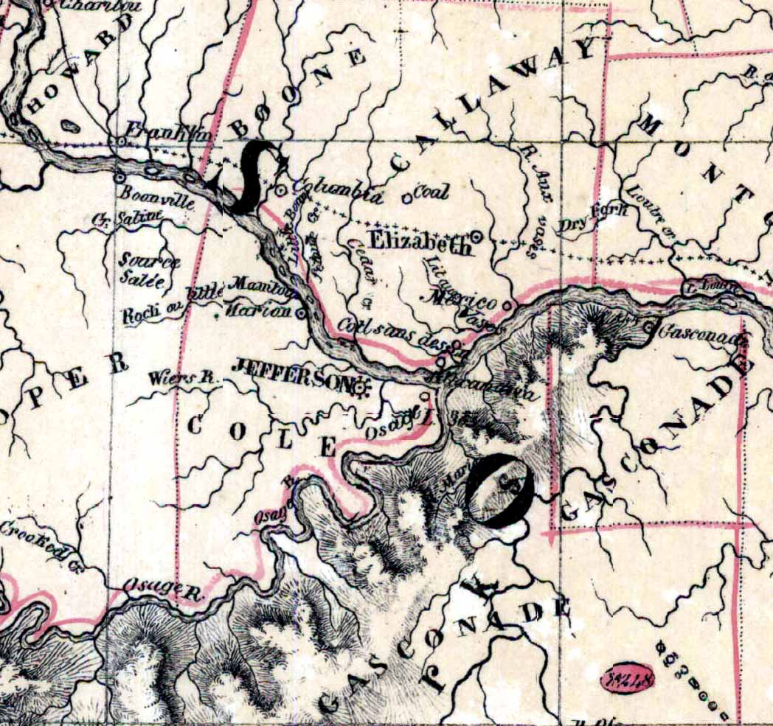
(American and French atlas reproductions, ca. 1825)

Slide 13
Cote Sans Dessein
Dodds Island
Bonnots Mill
Missouri River
Moreau River
Osage River
(USGS DEM)

Slide 14
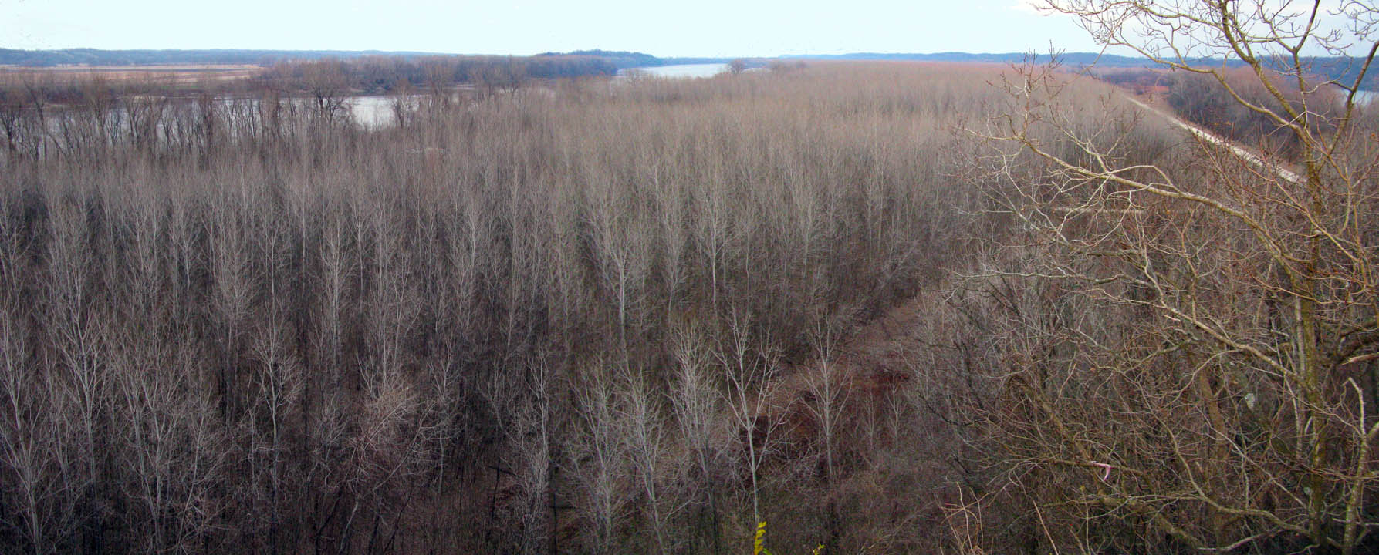
Cote Sans Dessein

Slide 15
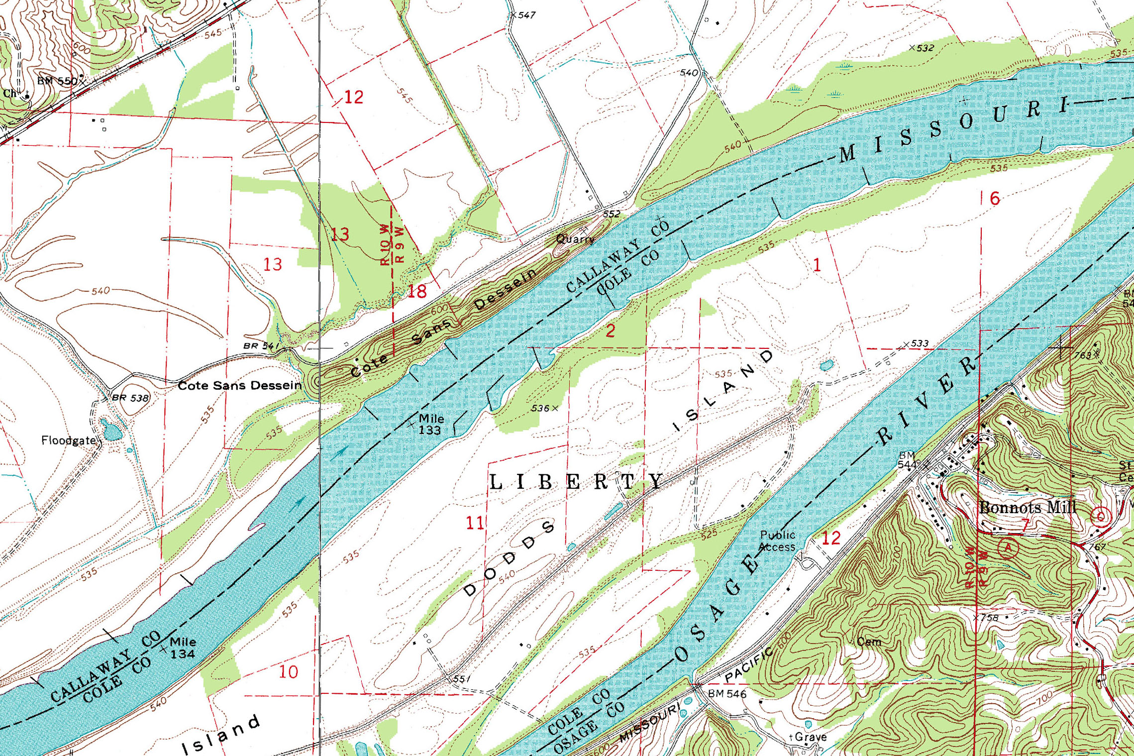
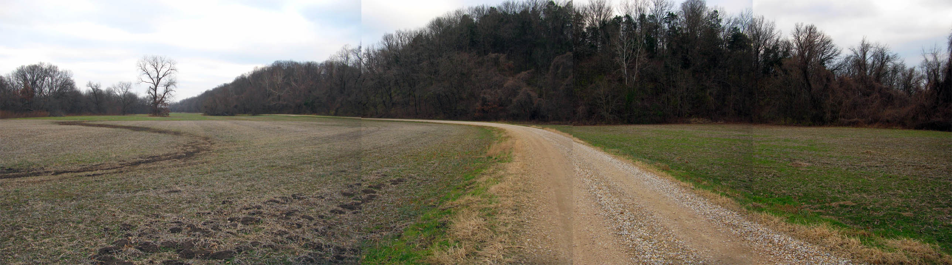

Slide 16
Morphology
• Linear ridge, 1.7 km long
• 200 m wide at base
• 45 m maximum relief
• ENE-WSW orientation
• Native American mounds (2 m) along entire ridge (Houk 1908)
Recent mapping efforts
• Bedrock geologic mapping (Vierrether and Starbuck, 2009)
Jefferson City Dolomite
• Surficial sediment mapping (Siemens, 2009)
Thick loess (6 m thick), sand and gravel successions at east end

Slide 17
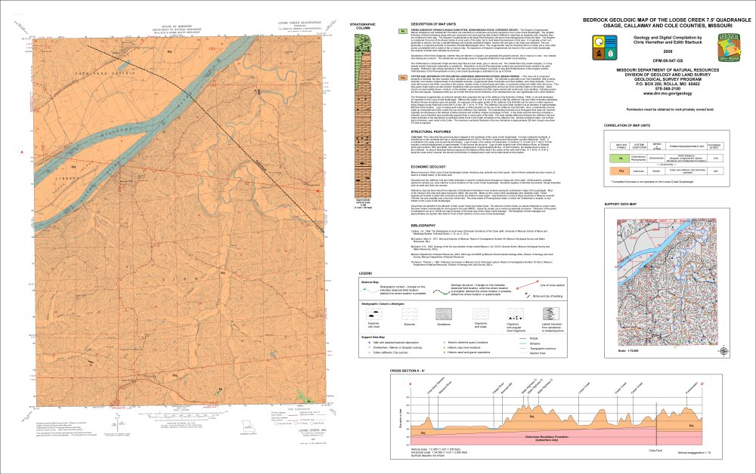

Slide 18
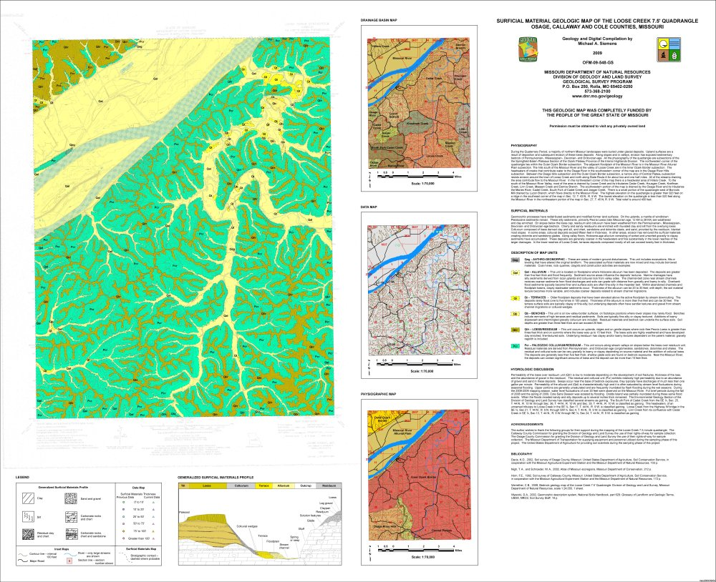

Slide 19
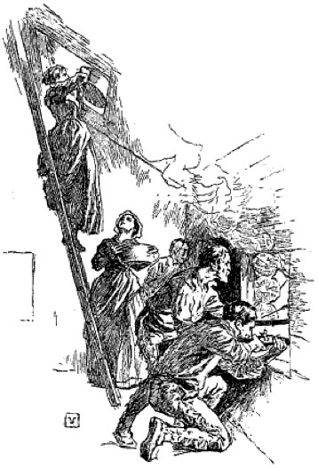
Battle of Cote Sans Dessein
• April 4, 1815
• Sauk and Fox war party spotted
• Pre-emptive(?) attack by settlers
• Running battle along northern
edge of river valley
• Women, children, and a few men
seek refuge in two blockhouses:
Thibault’s and Roy’s forts
• Roy’s fort nearly overrun
• Heroic actions of Mme. Roy
• Magazine explosion
Secondary sources:
(Edwin James, 1822)
(Ovid Bell, 1930)
(Musick, 1897)

Slide 20
Historical Epilogue
1819 — Cote Sans Dessein waypoint on Major Samuel H. Long Expedition with geologist Dr. Edwin James
1819 — Steamship Thomas Jefferson snagged and sunk
1821 — Missouri statehood
1822 — State capital selection committee met at Cote Sans Dessein; Cote Sans Dessein was preferred site; Spanish land grant and title issues; rejected
1844 — Missouri River flood destroys town of Cote Sans Dessein; Bonnot’s Mill established as river cut below Cote San Dessein (Conrad, 1901)
1950s? — Quarrying obliterated site of Thibault’s blockhouse and magazine

Slide 21
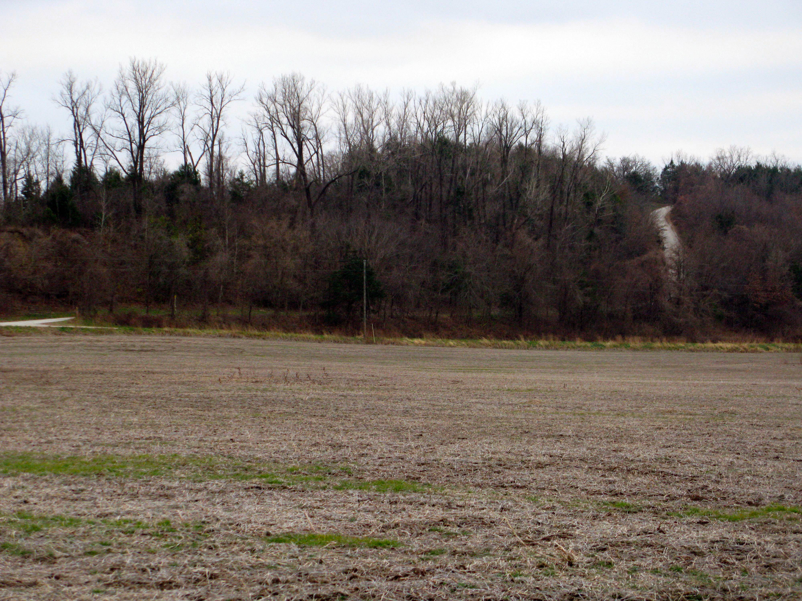
Quarry

Slide 22
Fluvial Considerations
• Historical interpretation for incision: Late Tertiary uplift
(Tarr, 1924)
• Spooner (2001) argued that no evidence of early Pleistocene lakes or river channels south of current river channel
• Marbut (1898) suggested confluence with Osage River preserved lost hill; note similarity to Tower Rock in Mississippi River
• Marbut (1898) noted Clark’s Hill and Osage City abandoned valley from Moreau River
• Beveridge and Vineyard (1991) followed these interpretations
• Physical and computer modeling may provide more insight into dynamics of confluences on erosional remnant preservation

Slide 23
Cote Sans Dessein
Dodds Island
Bonnots Mill
Missouri River
Moreau River
Osage River
Questions?
(USGS DEM)

