Slide 1
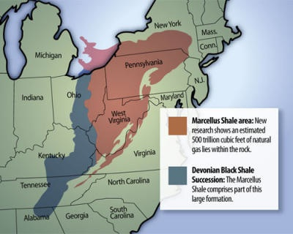
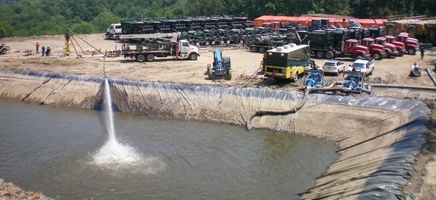
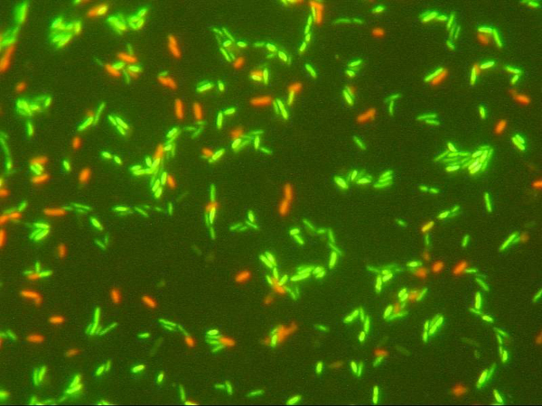
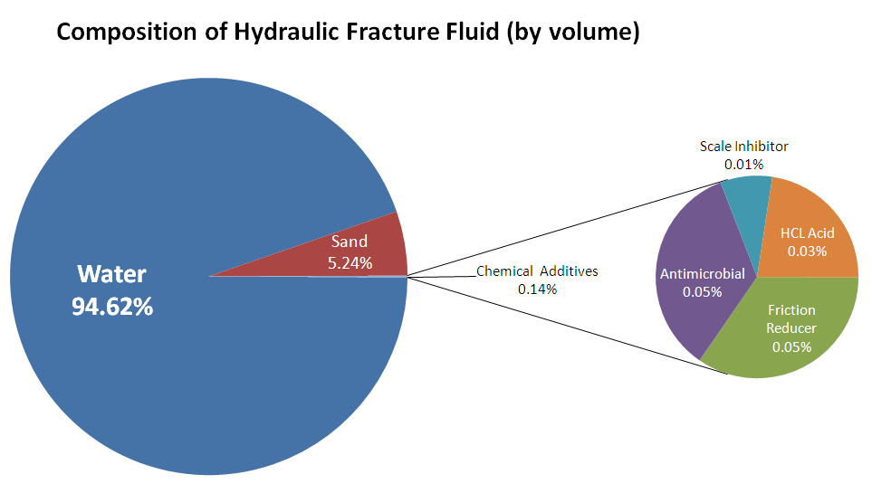
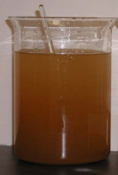
Preliminary Assessment of the Microbiology of Marcellus Shale Fracture and Flowback Waters
Angela Hartsock, H.M. Edenborn, P. Kaur, R.W. Hammack
National Energy Technology Laboratory, U.S. Department of Energy, P.O. Box 10940, Pittsburgh, PA 15236
Angela.Hartsock@or.netl.doe.gov
Website: www.netl.doe.gov
Customer Service: 1-800-553-7681
Background
Sampling and Field Sites
Impoundment Water
Samples were obtained from active Marcellus drilling sites in Western Pennsylvania. Frack water samples were obtained immediately prior to the frack job. Flowback samples were collected at the well head at designated time points. Impoundment samples were collected from impoundments of varying age and treatment history.
Impoundment water was collected from three separate impoundments from the surface, a mid-point depth, and the bottom of each.
Impoundment 1
The Marcellus Shale represents one of the largest under-developed natural gas reserves in the United States. Current drilling technologies have allowed economic recovery of natural gas from the Marcellus Shale, contributing to the current surge in well drilling.
DAPI cell counts ranged from ca. 10⁶-10⁸ cells/mL.
Image courtesy of Energy Corporation of America
FISH analysis of the microbial communities showed differences between depths and each impoundment.
Impoundment 1: the microbial community is dominated by the γ- and δ-proteobacteria. Culturing revealed active sulfate reducing bacteria, probably of the δ-proteobacteria.
Impoundment 2: the surface sample is dominated by the α-proteobacteria, which then decline with depth. Many of the α-proteobacteria are aerobic. A decrease in oxygen with depth could limit their growth.
Impoundment 3: the microbial community is dominated by the α- and γ-proteobacteria throughout the water column. The impoundment is being treated with aeration, oxygenating and mixing the water column, preventing stratification and perhaps contributing to the dominance of α-proteobacteria at depth.
Image courtesy of Geology.com
Questions & Methods
Production of natural gas from the Marcellus Shale requires hydraulic fracturing techniques. Millions of gallons of water are pumped into the well at high pressure to fracture the shale and release the natural gas.
How many microbes are associated with the different water types?
● Investigated using fluorescent counts of DAPI stained cells.
Are the microbes viable?
● Investigated using the Live/Dead fluorescent stain and culturing.
Impoundment 2
Water used for hydraulic fracturing (“frack water”) is supplemented with sand and chemical additives. The sand acts as a proppant, moving into fractures and “propping” them open to allow gas escape. The chemical additives have multiple purposes. Friction reducers are added to decrease friction between the fluid and the pipe. Acid is added to corrode cement and minerals blocking fractures. Scale inhibitors are added to prevent deposits in the pipe. And, finally, biocides are added to control microbial growth that can contribute to corrosion of pipes.
Are there big differences in the makeup of the microbial communities among the different water types?
● Investigated by FISH (Fluorescent in situ Hybridization) using probes specific to different bacterial groups.
After the fracturing process, the pressure is reduced and water flows back off the formation. This water is known as “flowback water”.
Fracture & Flowback Water
Frack water samples contained all the chemical additives, including biocide. In this case, the frack water consisted of a mix of fresh and impoundment waters. Cell counts were ca. 2.12x10⁷ cells/mL. A fluorescent LIVE/DEAD stain revealed that the majority of the cells were dead, but 20-40% were alive. FISH analysis of the microbial community showed a mixed community dominated by the γ- and δ-proteobacteria.
Impoundment 3
Image courtesy of Range Resources
Motivation
A large percentage, 25-100%, of the frack water returns to the surface. The flowback water still has the frack additives, but in addition, many of the Marcellus flowback waters contain high levels of salts (total dissolved solids, TDS) and other chemicals dissolved off the formation.
Frack Water cells/mL
Flowback water samples were collected starting at Day 1. Cell counts showed lower overall biomass than the frack water, shown by the dotted line (------). There was an unexplained peak at Day 3. On subsequent days, cell numbers returned to previous levels of ca. 10³-10⁴ cells/mL.
Summary
Many basic questions remain to be answered.
These preliminary studies have shown:
The fracture, flowback, and impoundment waters all contain microbial populations. The link between cell viability and biocide usage and concentration needs to be explored further.
The flowback water has fewer cells than the fracture and impoundment waters, suggesting microbial growth or acquisition may occur primarily in impoundments.
The microbial community in impoundments reflects treatment strategies and varies widely depending on history.
The flowback water is not suitable for direct disposal. Instead, it is typically stored in large surface impoundments where it is treated and eventually re-injected. The intensive water requirements and high levels of wastewater generation is of environmental concern. The microbiology of the Marcellus waters is currently unexplored. Here, we seek to provide fundamental knowledge of the microbiology of these waters. We hope that these studies can improve the management of microbial populations in flowback water, potentially aiding in remediation efforts.

