Slide 1
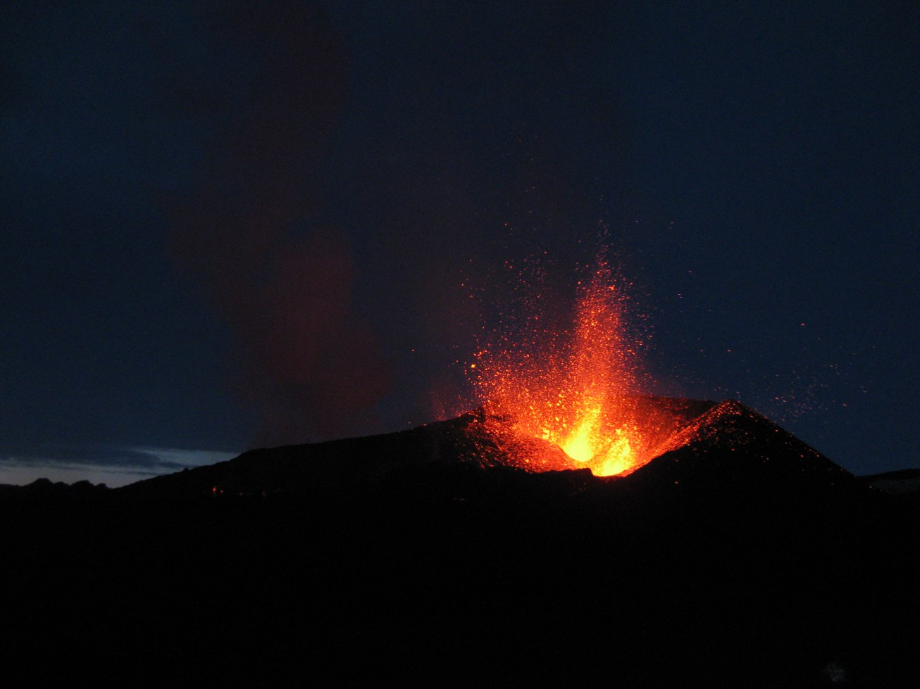

The Vogar Fissure Swarm, Reykjanes Peninsula, Iceland: Aseismic Kinematics of an Oblique Rift Zone
Keegan Runnals*, Pall Einarsson**, Dykstra Eusden*
*Bates College
**University of Iceland

Slide 2
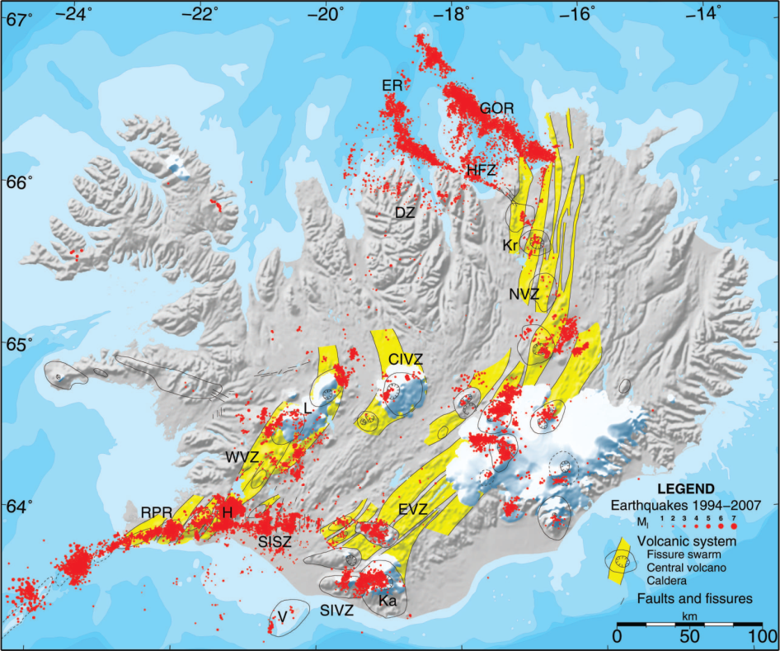
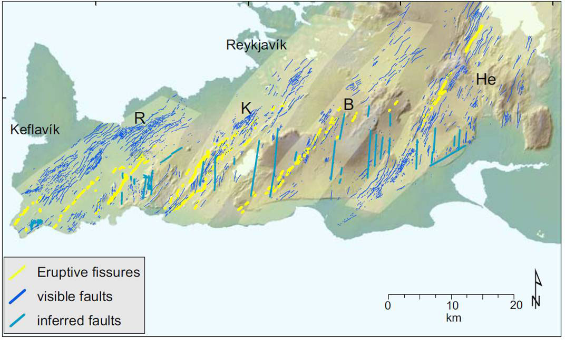
Location
Iceland tectonics consist of three zones:
Purely divergent (rift) zones, dominated by volcanic activity (Northern Volcanic Zone)
Transform zones, dominated by strike slip activity (South Icelandic Seismic Zone)
Oblique zones have both volcanic and strike slip activity (Reykjanes Peninsula)
Vogar Graben
Einarsson, 2008
The Reykjanes Peninsula is divided into a series of en echelon fissure swarms, each associated with its own volcanic system.
Jenness and Clifton, 2009

Slide 3
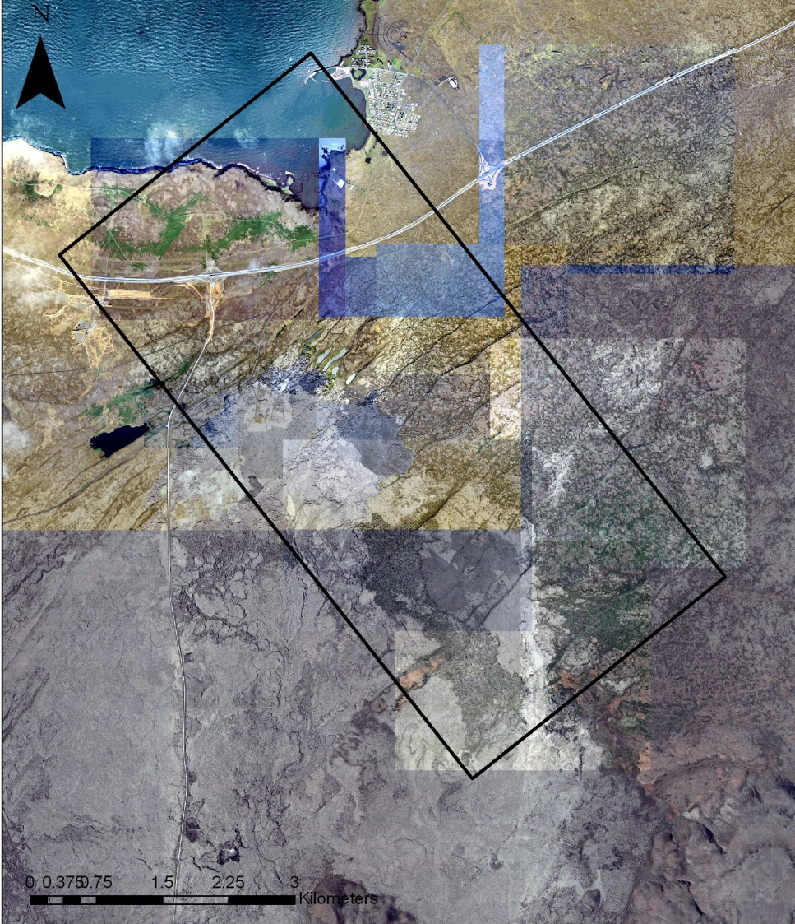
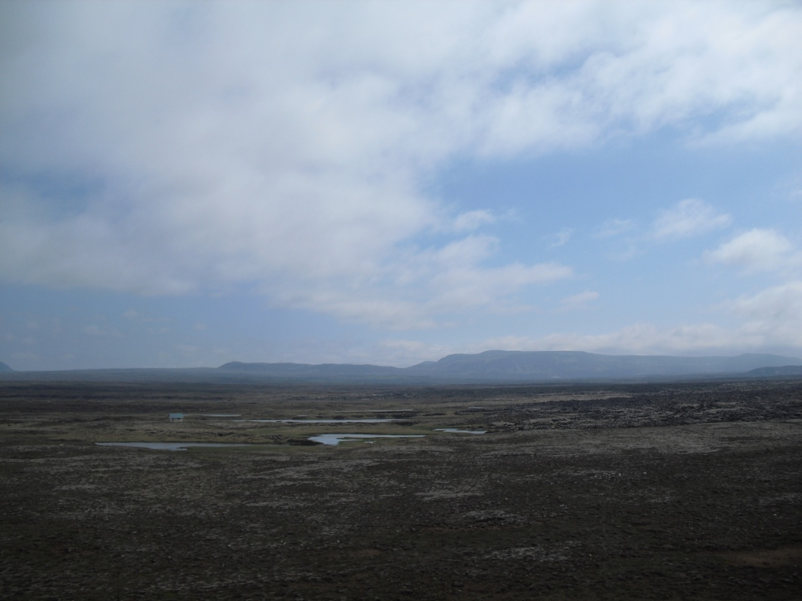
Study area in the Vogar graben
-The Vogar graben is an asymmetric graben made up of normal faults and fissures.
-Hyaloclastic ridges define the center of the plate boundary.
Thráinsskjaldarhraun

Slide 4
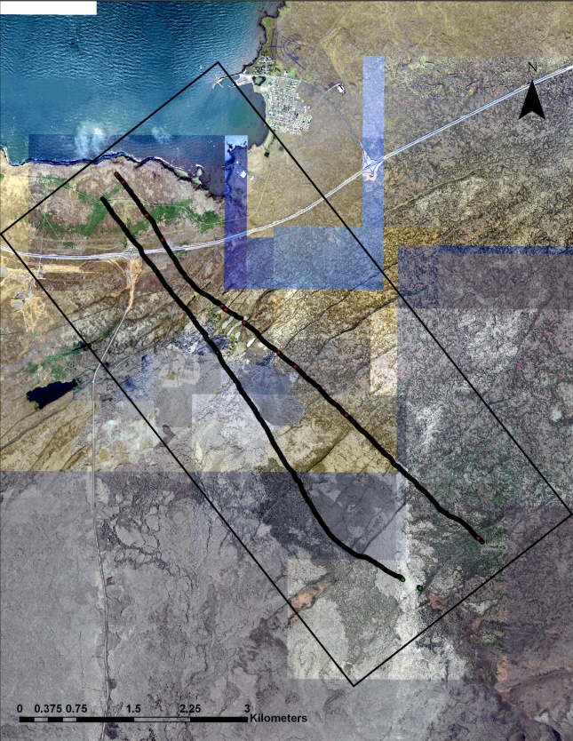
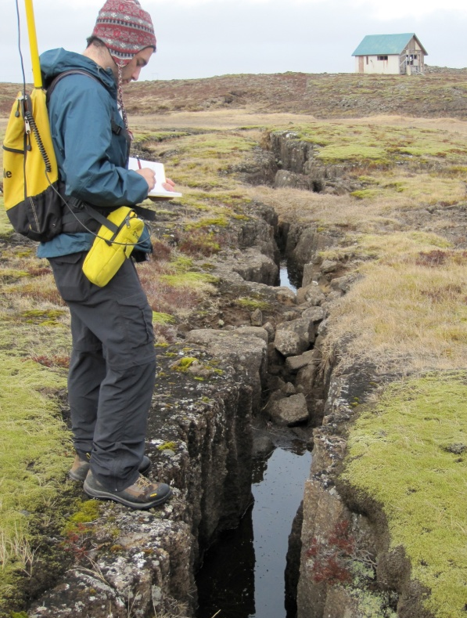
Methods
-Field observations and measurements
-Transects Across Graben taking continuous GPS points
-”Sausage Method”
-6 samples collected for thin section analysis
-ArcGIS, Microsoft Excel, Adobe Illustrator used to generate maps and profiles of fault scarps and cross section of graben

Slide 5
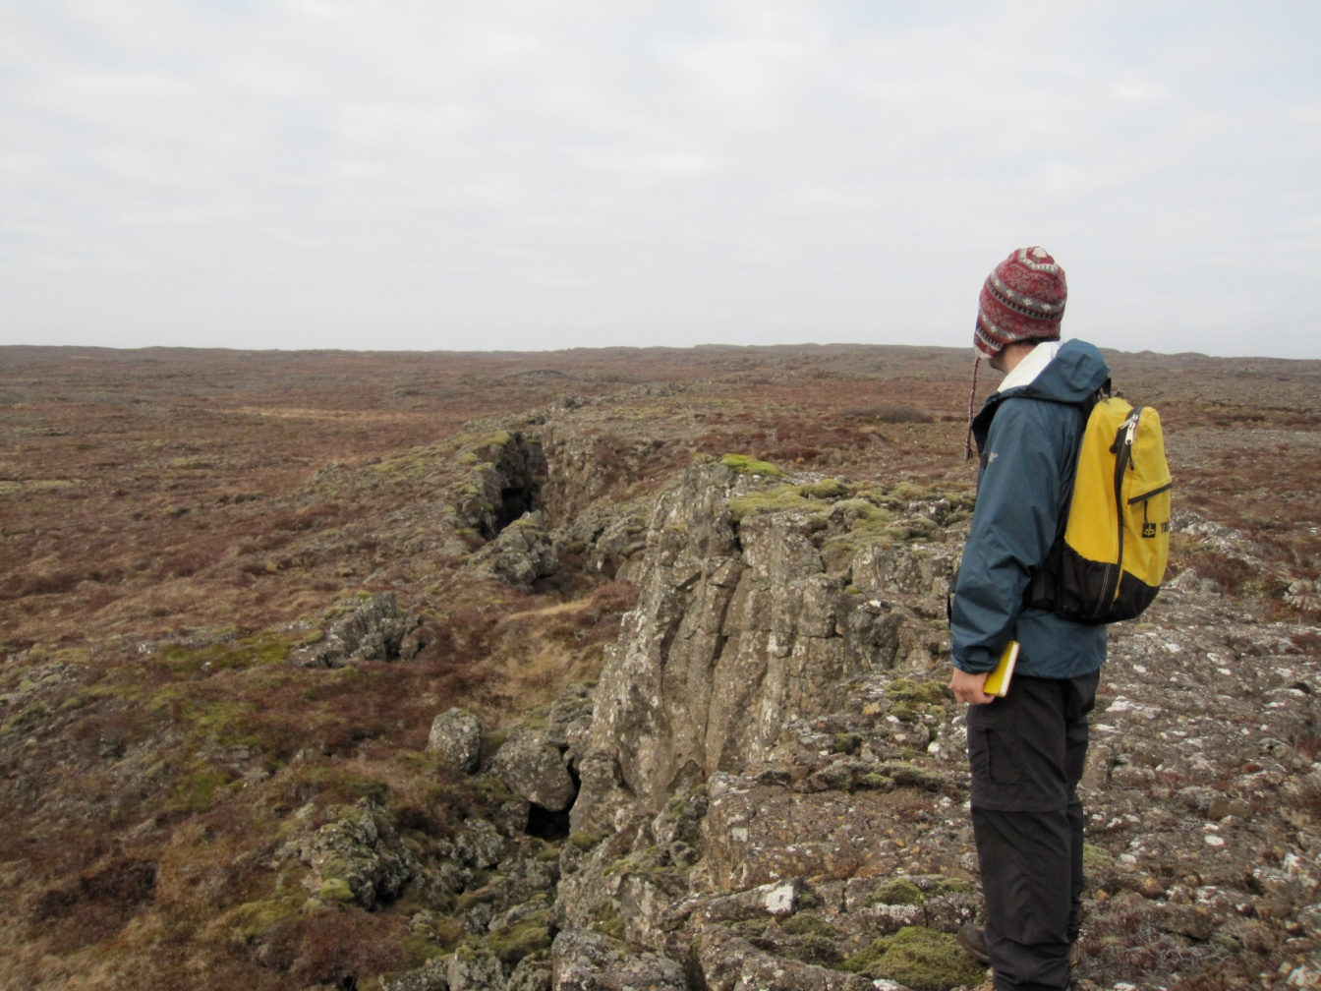
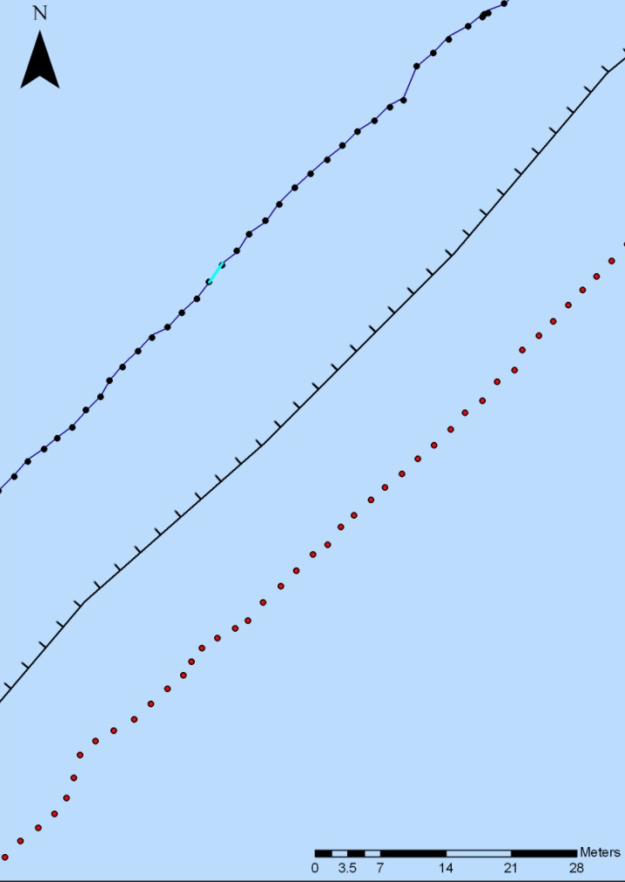
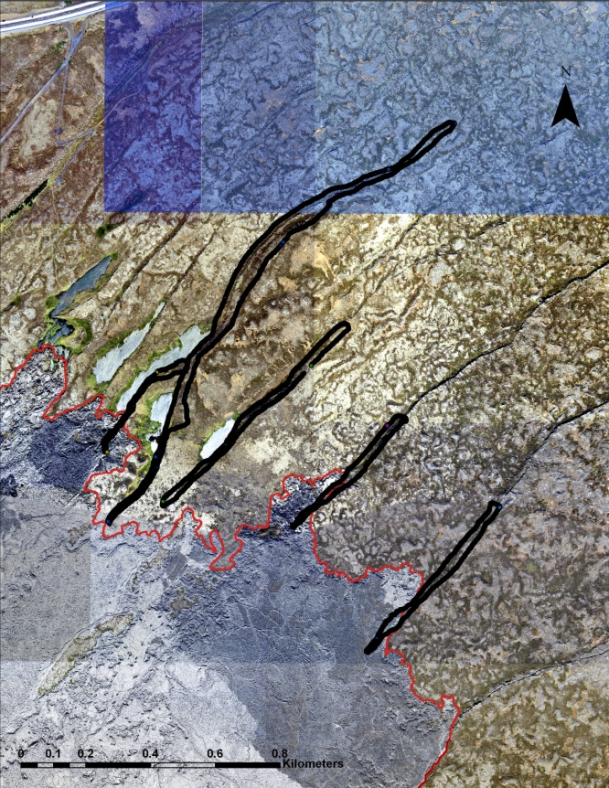
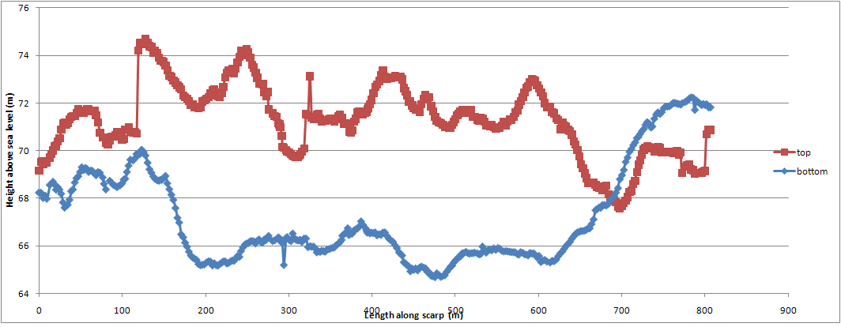
“Sausage Method”
Walked along top and bottom of scarp taking continuous waypoints which were imported into ArcGIS, cleaned up, and exported to Excel to determine throw along fault

Slide 6
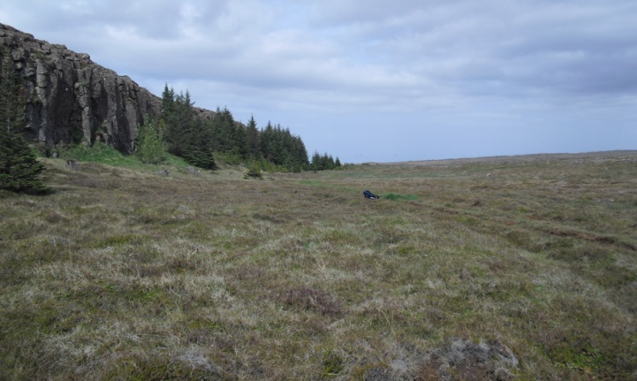
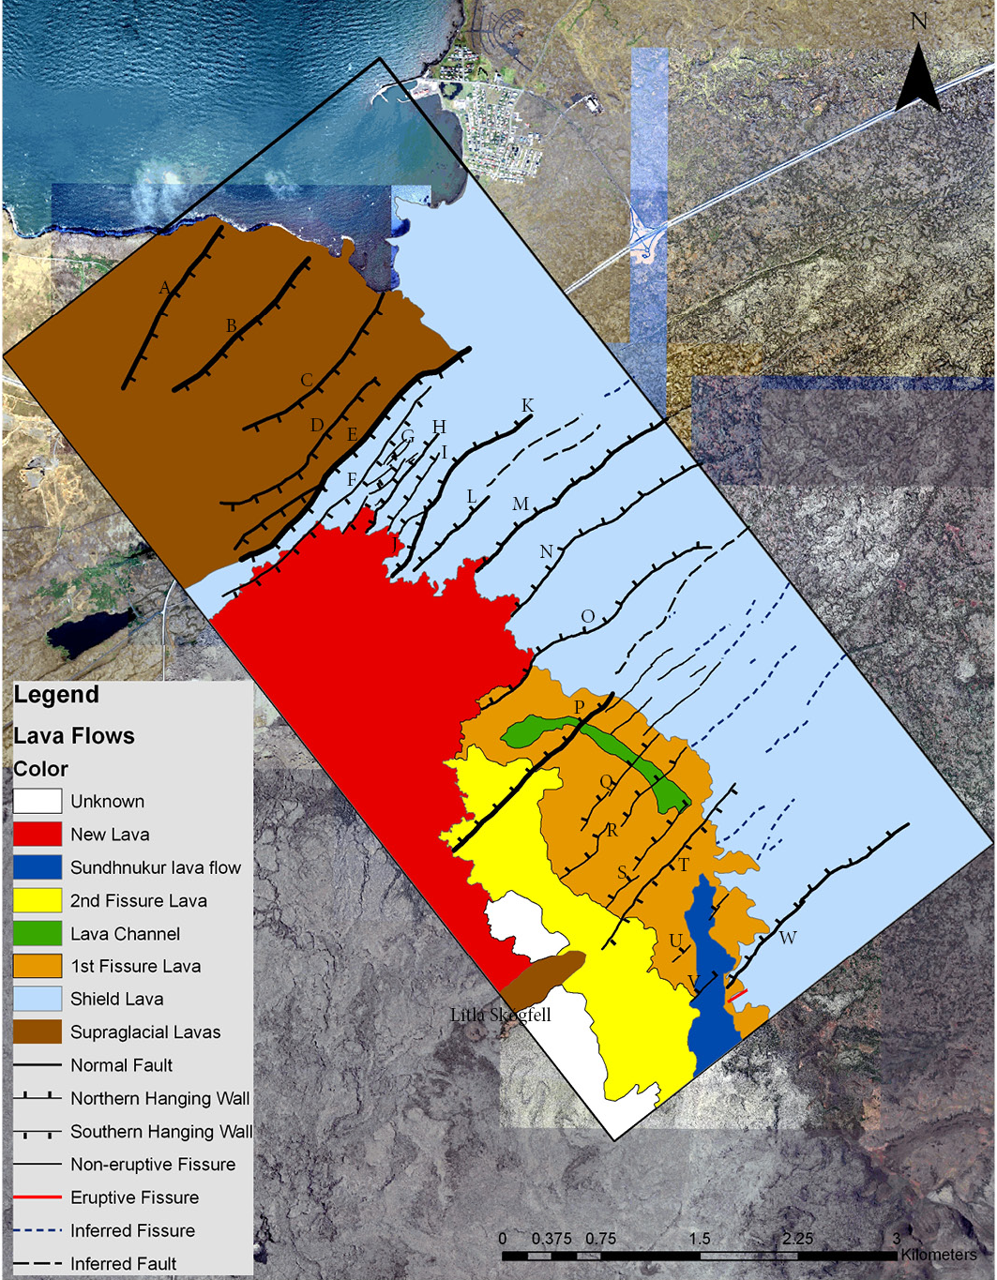
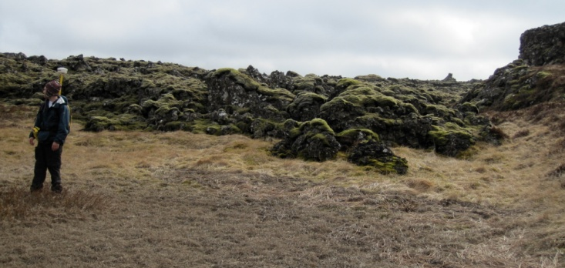
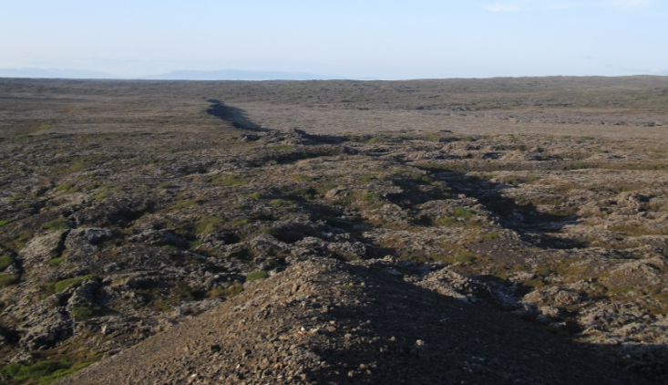
Structures in the field!
NE
Largest Scarp (20 m)
SW
Front of historical lava flow on shield lava
NE
Oppositely dipping scarp

Slide 7
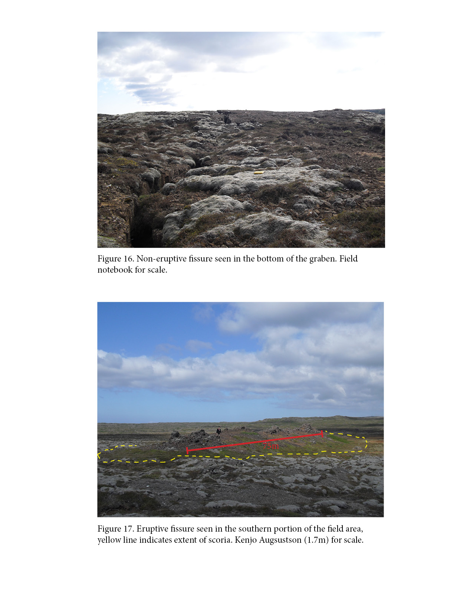
Fissure in the shield basalt
Small eruptive fissure found in the southwestern corner. Scoria extends about 5 m from its flanks

Slide 8
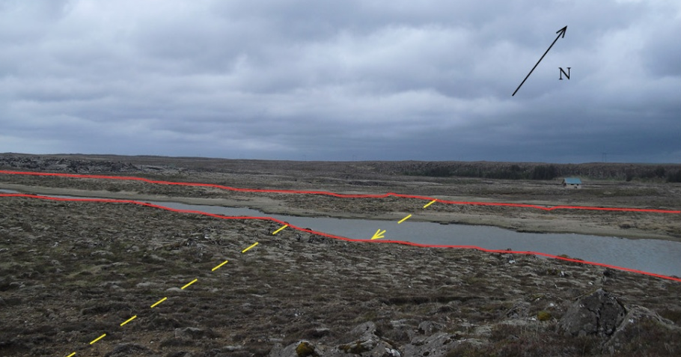
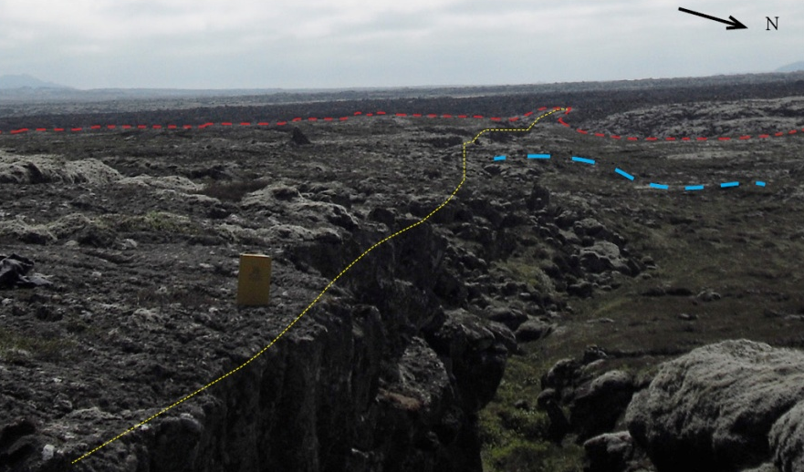
Dipping Blocks near the center of the graben
Scarp showing erosion, monocline, and control of historical lava flow

Slide 9
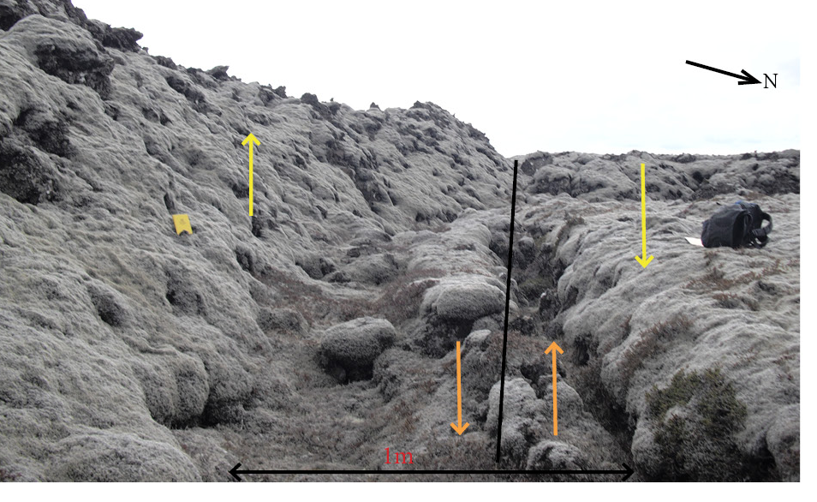

Structures in the historical lava
Apparent change in offset seen along strike of scarp F in the historical lava. Orange arrows show movement of fault in shield lava, while yellow arrows show apparent offset.
Higher topography in the historical lava along strike (red) of the hanging wall of fault J. Yellow indicates a small fissure.

Slide 10
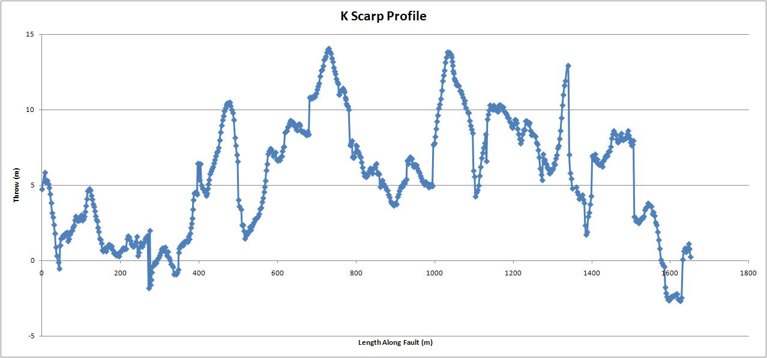
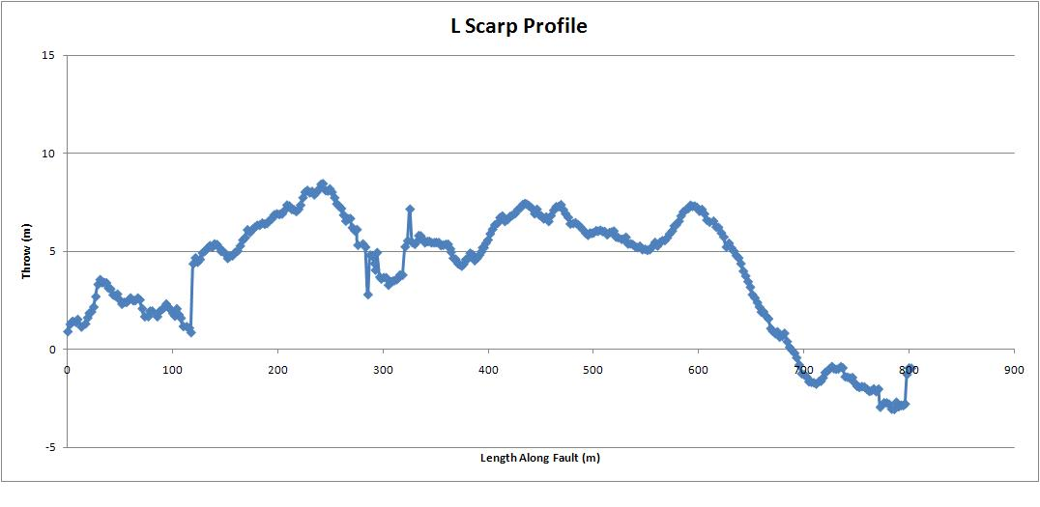
Throw profiles of faults not in contact with the historical lava
Scarps show variable amounts of throw.
Where the throw is negative the hanging wall has come above the foot wall.

Slide 11
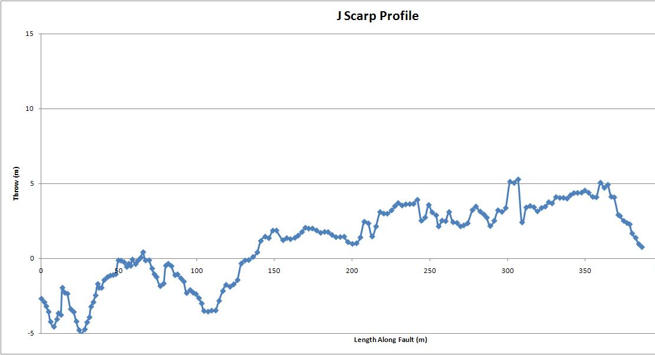
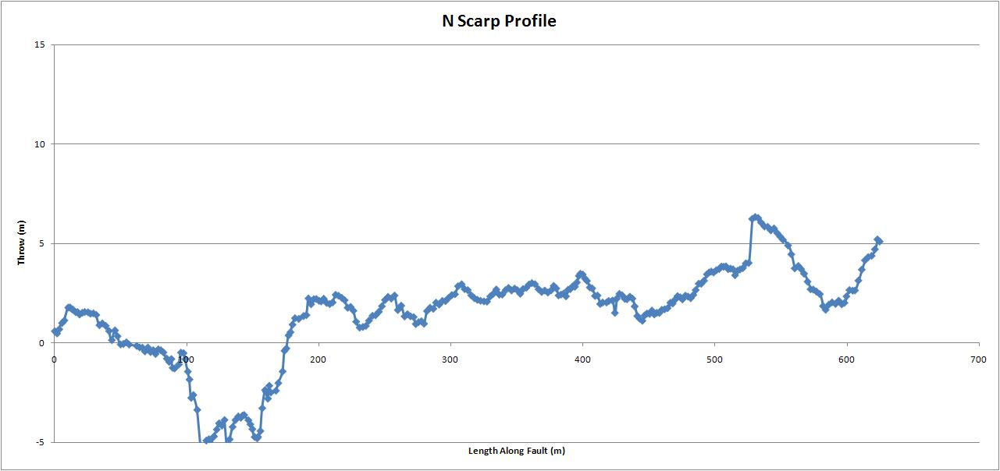
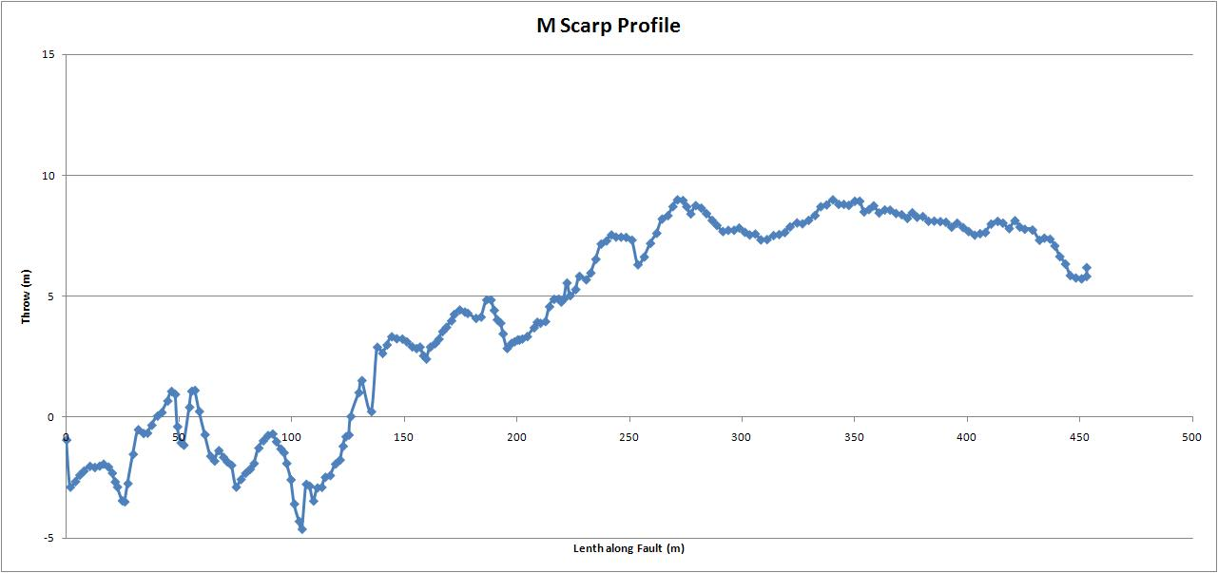
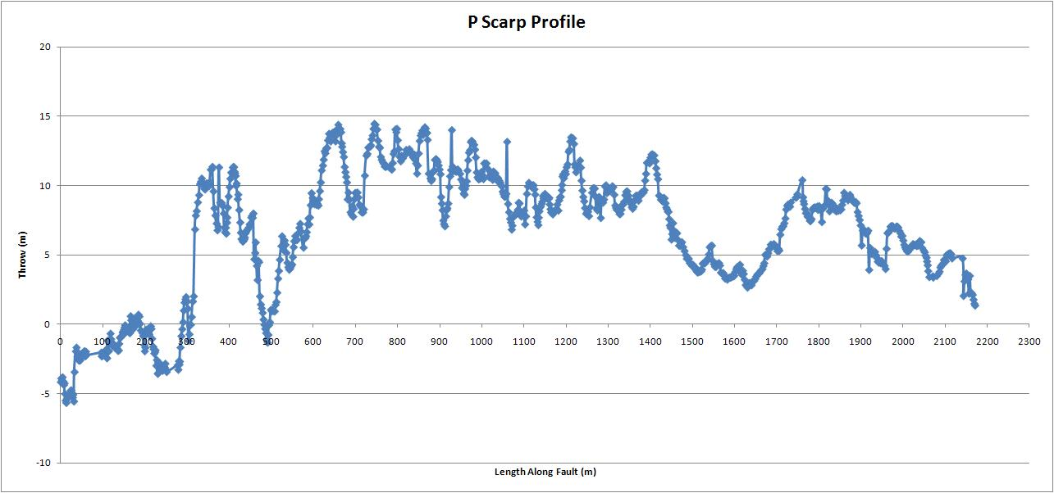
Throw profiles of faults in contact with the historical lava
All faults show negative throw in historical lava (where hanging wall is higher than foot wall) until the contact with the shield lava
Contact of historical lava and shield lava

Slide 12
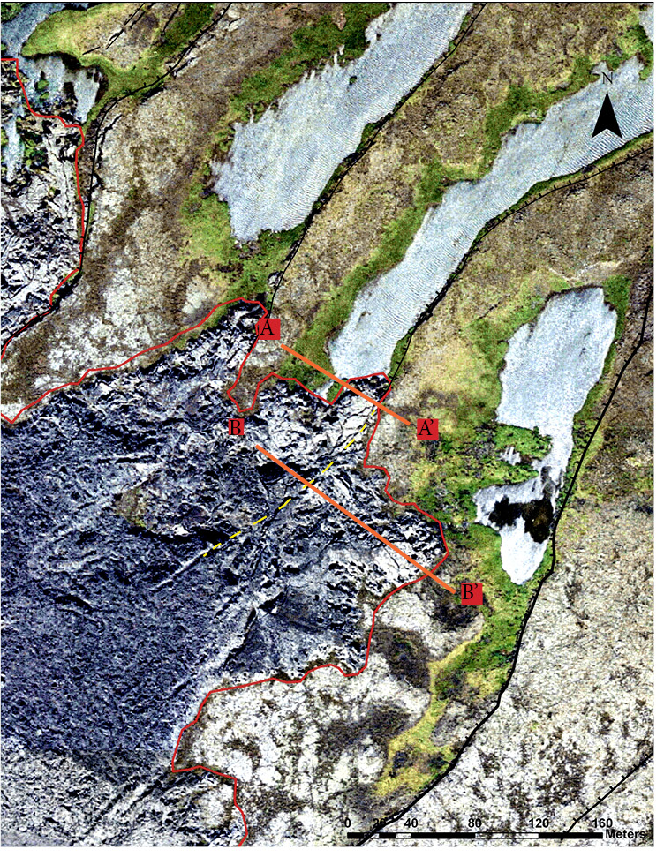
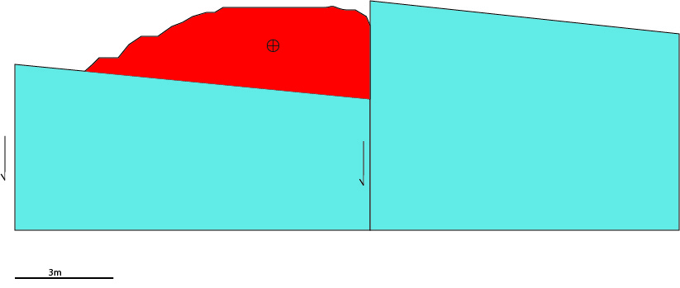
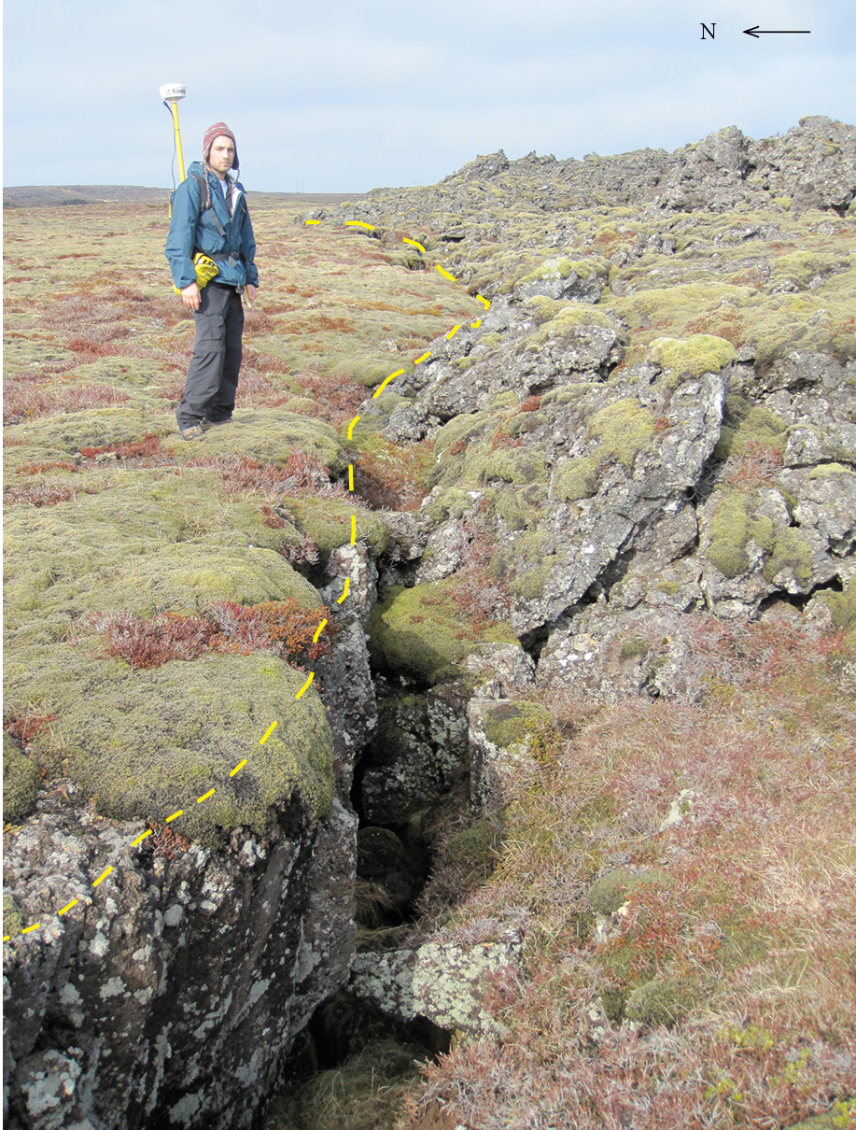
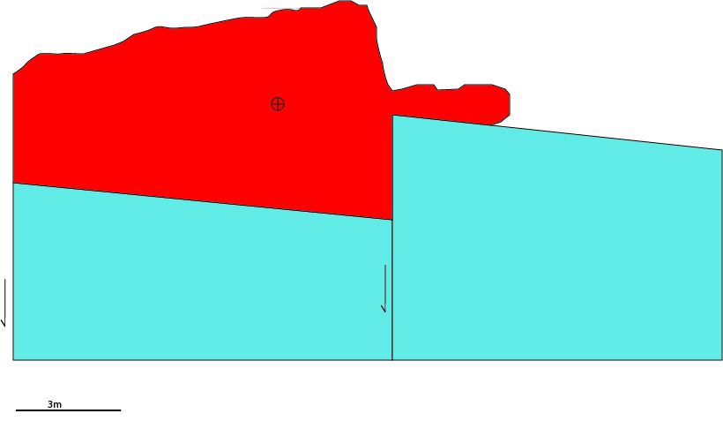
Analysis of observed structures
A
A’
B
B’
Aerial photograph of the historical lava flowing along scarp J.
Piling up of historical lava along scarp

Slide 13
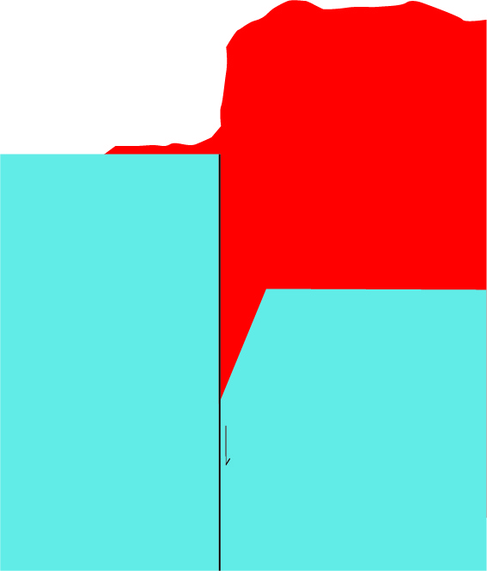
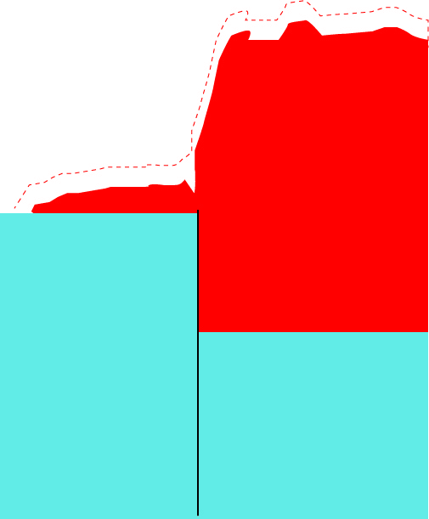
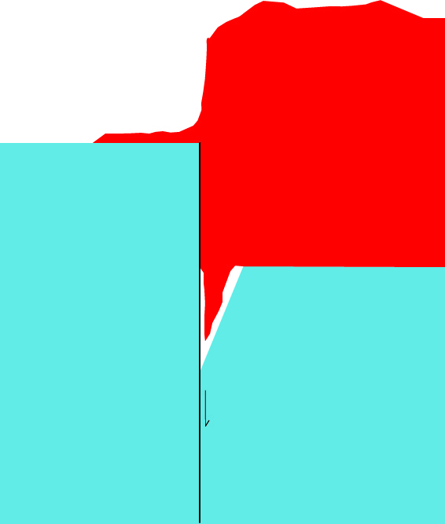
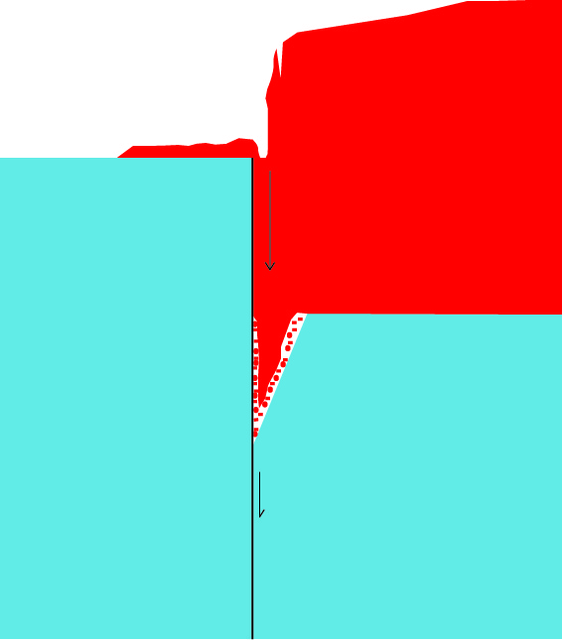
Cooling Structures
Slower cooling of larger body of lava
More rapid cooling, contraction
Lava flows into open fissure at base of fault
Lava in fissure contracts, creating space
Debris from the lava flow above fills in the empty space, creating a secondary rifting structure at the surface.
One model of how a fissure can form along a scarp that has been covered by the historical lava.

Slide 14
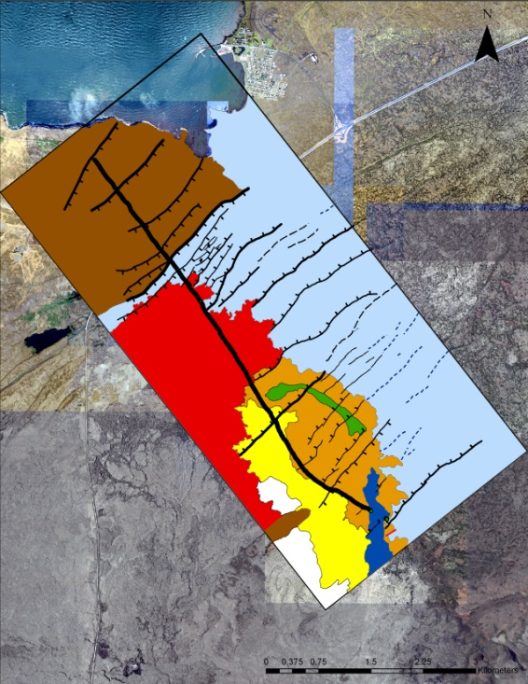
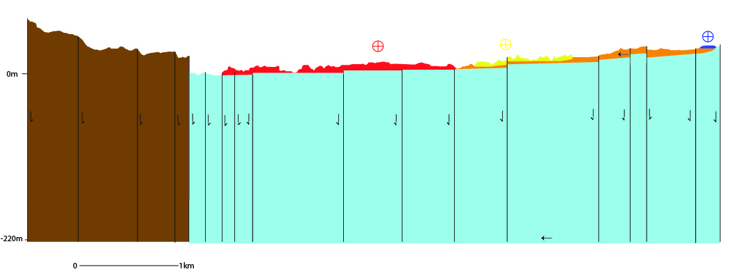
1:15 Scale Cross Section
A
Cross section showing the historical lava covering the faults and the other flows being cut by the faults. Cross hairs show direction of the lava flows.
A’
A
A’

Slide 15
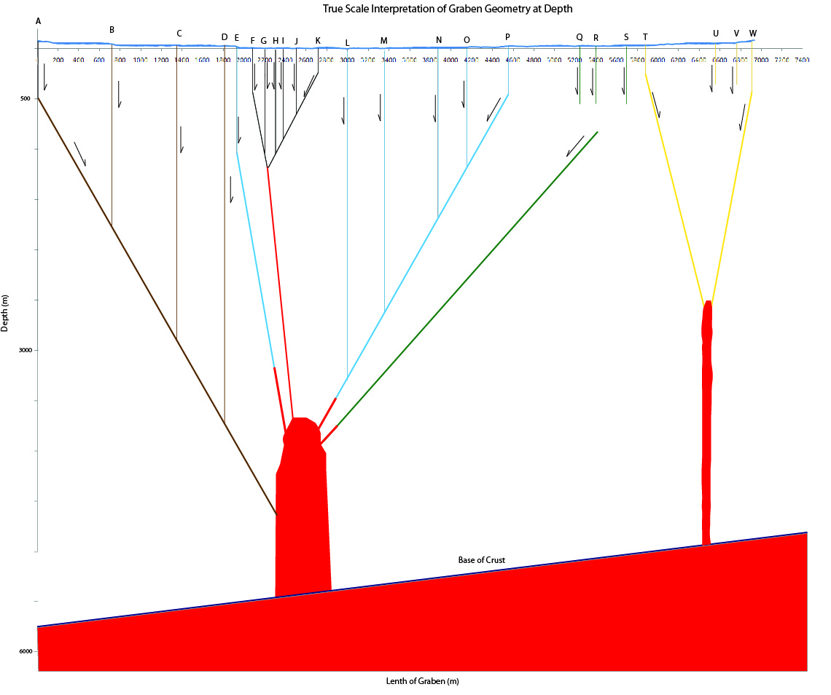
Hypothetical cross section of the Asymmetric Vogar graben

Slide 16
Reykjanes Peninsula
Jenness and Clifton, 2009

