Slide 1
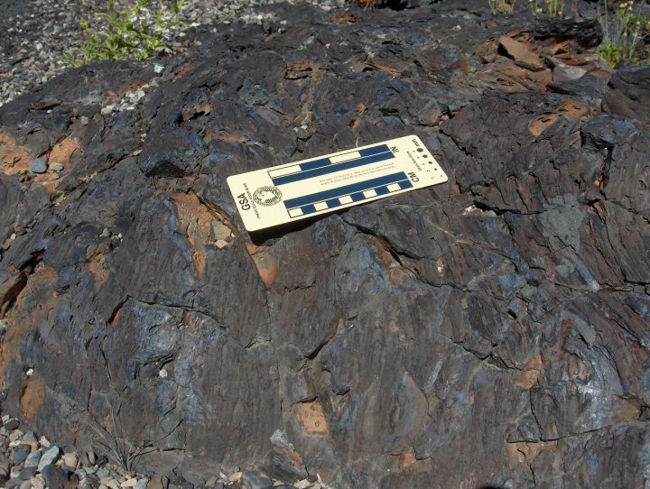
Classroom Rocks
A service-learning project to increase pedagogical tools for local earth science teachers and K-12 student interest in geology
By Kristen Schmeisser*, Ashley Altheide, and Carrie Wright

Slide 2
The problem
Local Earth science teachers do not have access to the quality rock samples they need
  Survey conducted by Chris Grathler and Allison Grabert, summer 2009
Pre-course surveys show basic Earth Science concepts in the state standards do not “stick” in students’ minds
  Possibly due to a lack of access to high-quality rock samples
Teachers want access to better samples, but lack funding to buy them and/or knowledge to collect samples themselves
Samples from science supply sources often beyond budget or not adequate

Slide 3
The problem
Few college freshmen at USI declare a geology major; most join the department after “discovering” geology in an intro course
Probable causes
  Lack of awareness (in high school) of geology as a viable and exciting major leading to a real career
  Lack of stimulating geoscience education in middle and high school

Slide 4
Literature review
The literature suggests that physical interaction with the samples will enhance student understanding.
  Clear and comprehensive visuals aid in student understanding (Dickey and Hicks, 1991)
  Lessons using manipulatives have a higher probability of producing greater achievement (Suydam and Higgins, 1997)
  Concrete materials presented by a knowledgeable instructor improves student attitudes about the subject (Sowell, 1989)

Slide 5
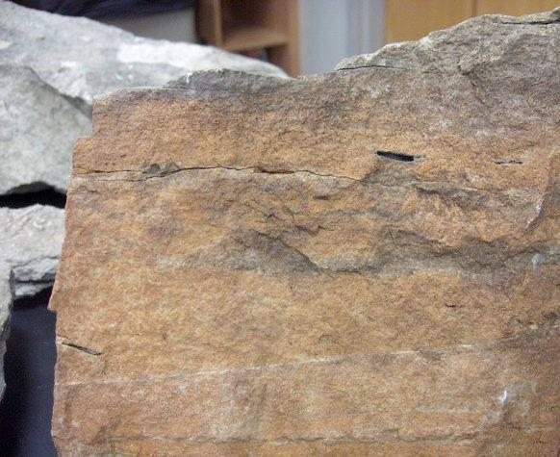
Since last summer, the research team has collected and processed samples, begun to organize them into teaching kits, and begun to develop and pilot related labs and activities which will later be loaned to teachers in local schools.

Slide 6
Overarching goals
  Increase geoscience interest in area K-12 students
    Increasing the likelihood that they might choose geology as a career path
  Increase geological content knowledge and pedagogical content knowledge for area K-12 teachers
  Continue to build upon the SwISTEM K-16 connection, making it an even better resource for educators, students, and schools

Slide 7
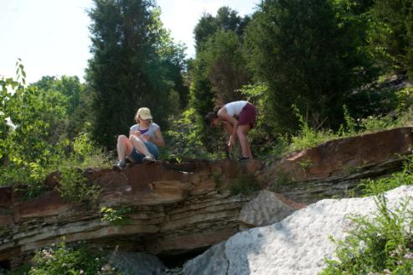
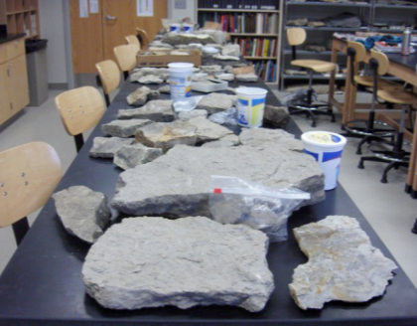
Rock samples
  Sedimentary rocks and fossils collected from local outcrops
      Improve students’ geological sense of place
      Increase knowledge of geology “in their own backyard”

Slide 8
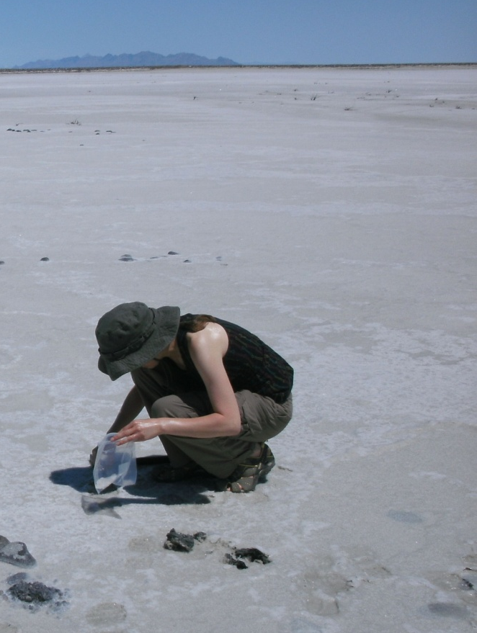
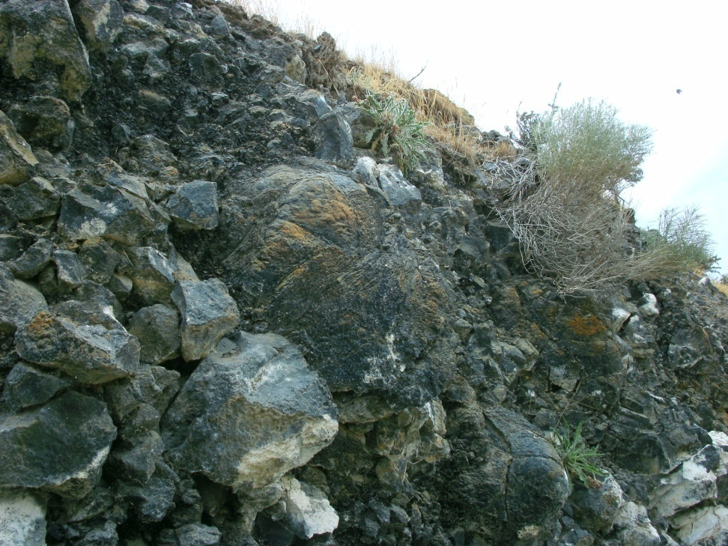
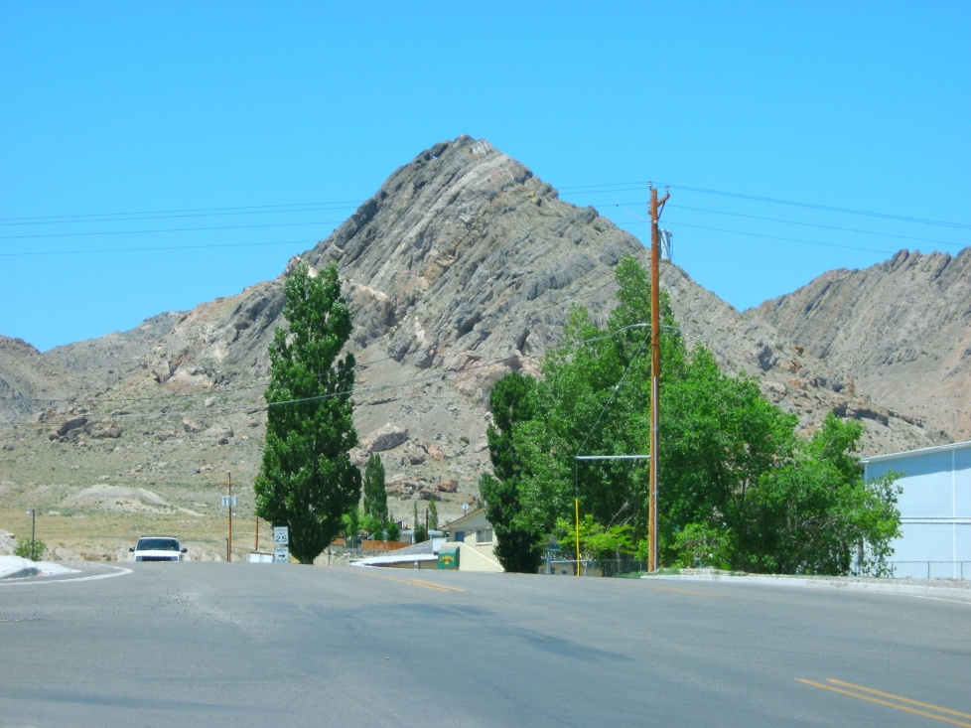
Rock samples
  Non-local samples were collected in the American West
      Basalts- Eastern Snake River Plain
      Evaporites- Bonneville Salt Flats
      Metamorphics- West Wendover, NV; Albion Range

Slide 9
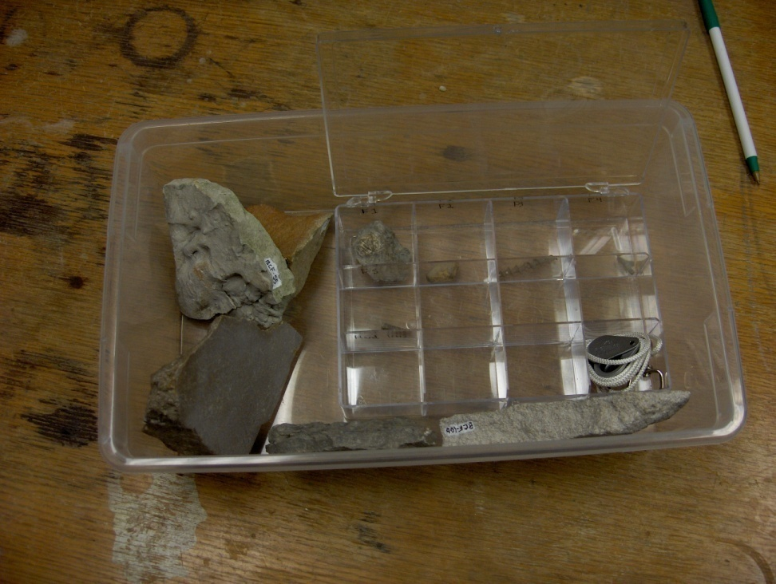
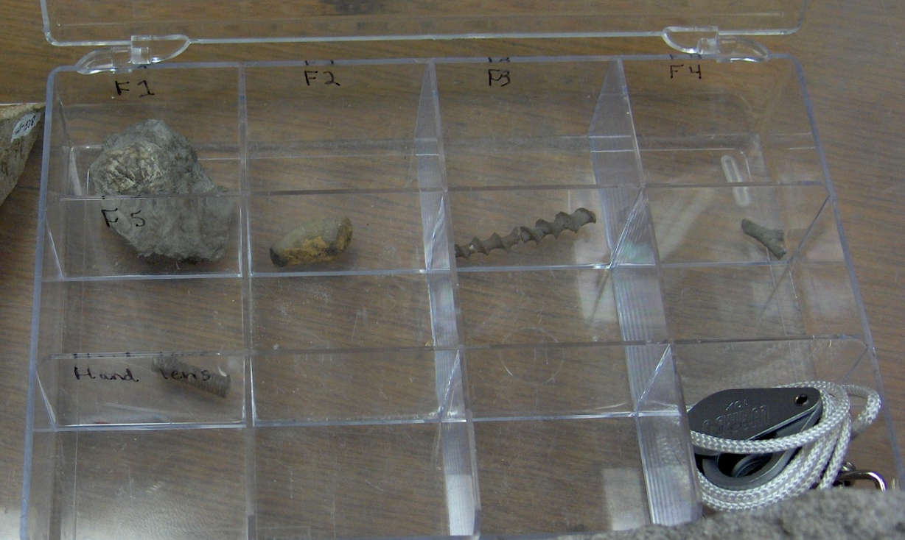
Teaching kits
Plastic containers with samples in a variety of sizes
  Loose fossils, minerals, and other loose, fragile samples- small, clear tackle boxes with dividers
  Small samples- white-out spot labeled in permanent marker to correspond with guide in a shoe box sized kit
  Large samples- like the smaller samples, but set in larger boxes and intended for whole class instructional use

Slide 10
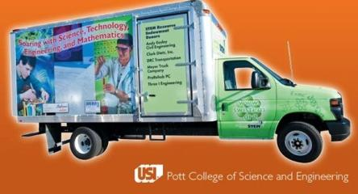
STEM resource center and trucks
  Delivers professional development, lab equipment, and manpower for K-12 teachers.
  2 mobile storage units, with $350,000 worth of STEM equipment
    Primarily for high school teachers
    A free service
    2 staff members drive the decorated U-Haul trucks
    Trucks funded by $600,000 of a WIRED grant, as well as money from the ISTEM network
    Currently have a Ward’s rock set in each truck

Slide 11
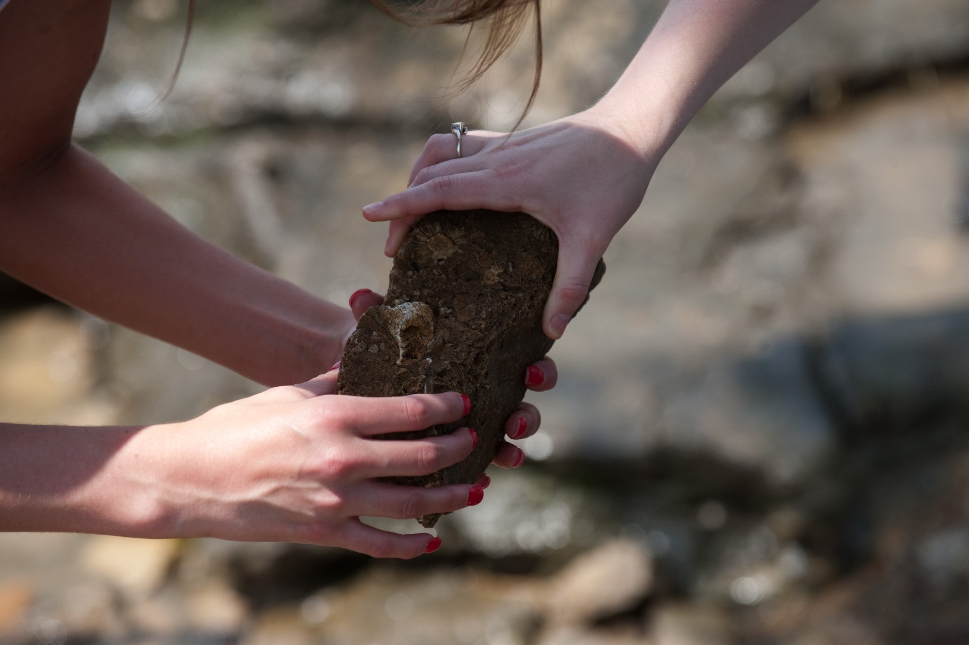
Literature review
Some similar rock set projects exist
  Pittsburgh Rocks! (Wolfe, 2006)
  Alabama Rocks! (Haywick, 2006)
  Pennsylvania rock and mineral kits (Delano, 2006)

Slide 12
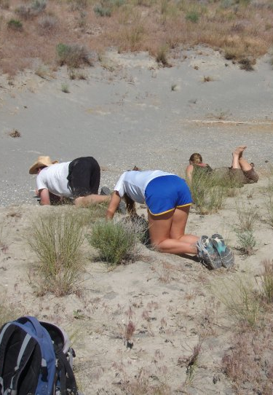
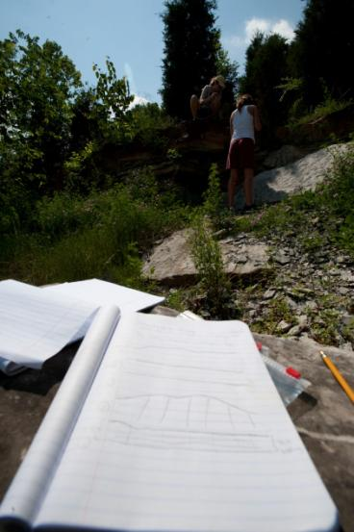
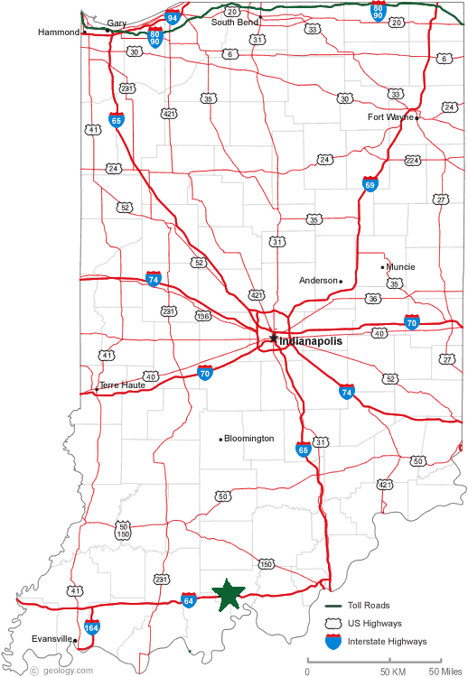
Methods
Sample collection
Geological field notes
Outcrop photography

Slide 13
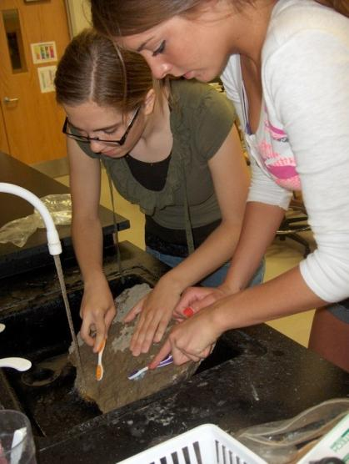
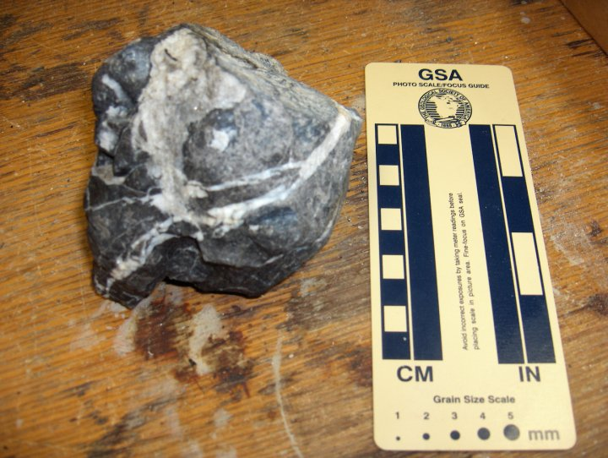
Methods
Sample cleaning
Sample identification
Sample photography

Slide 14
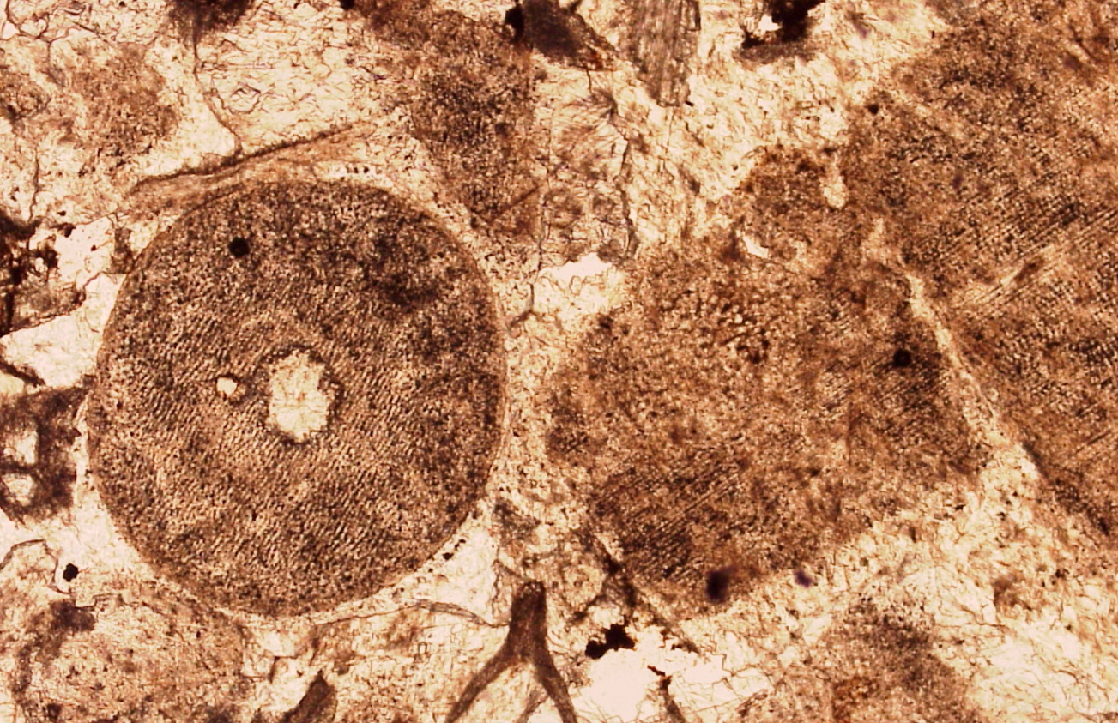
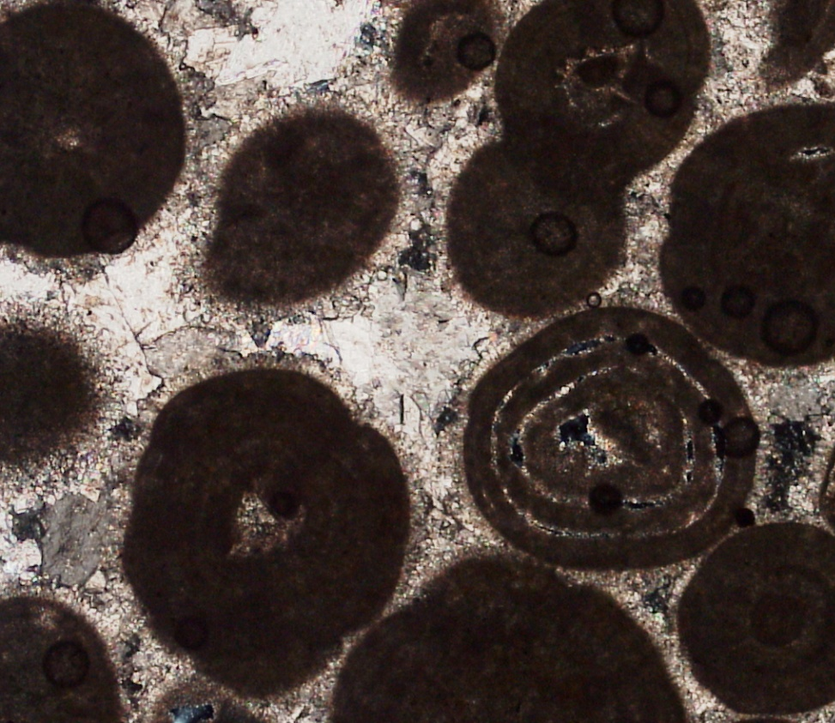
Methods
Thin sections of samples
Photography, printing, and lamination of thin section pictures

Slide 15
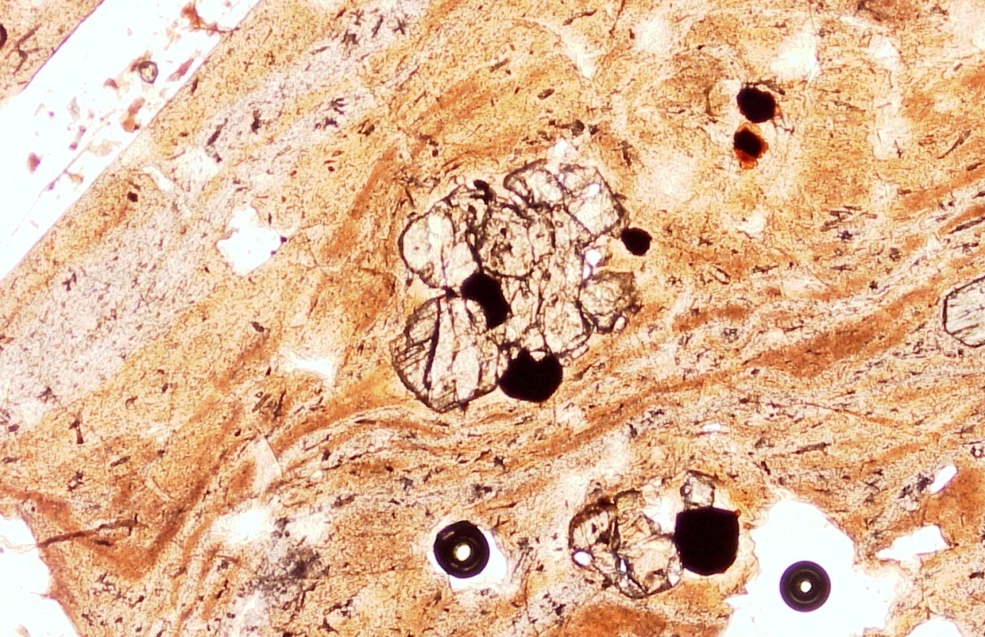
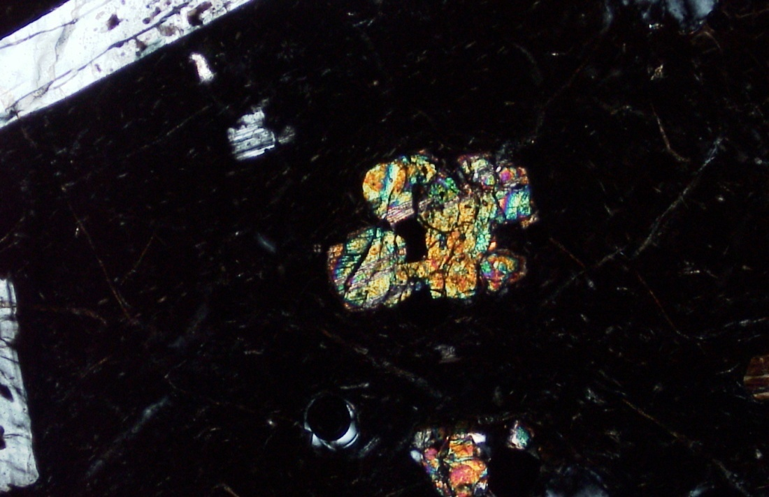
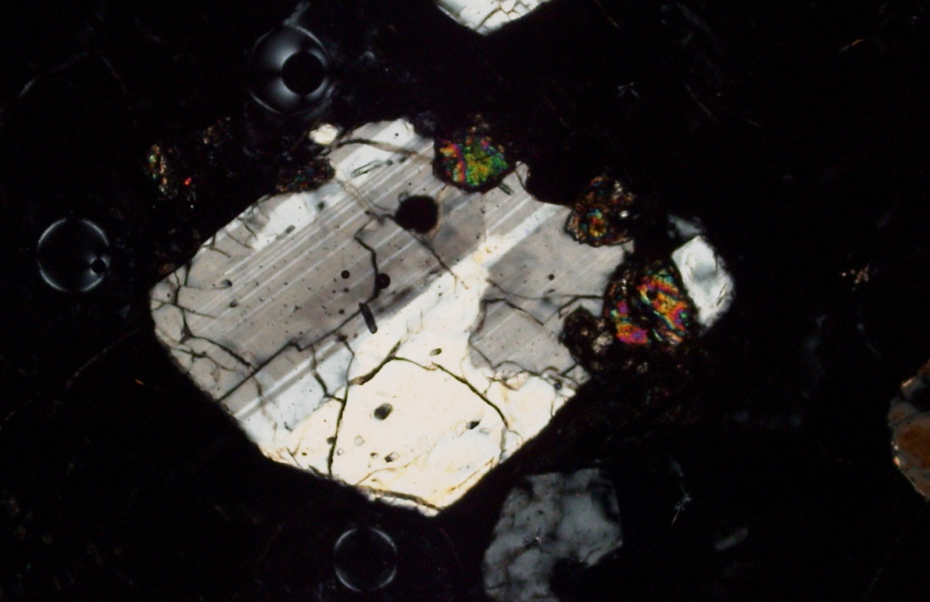
Albion Range Vitrophyre

Slide 16
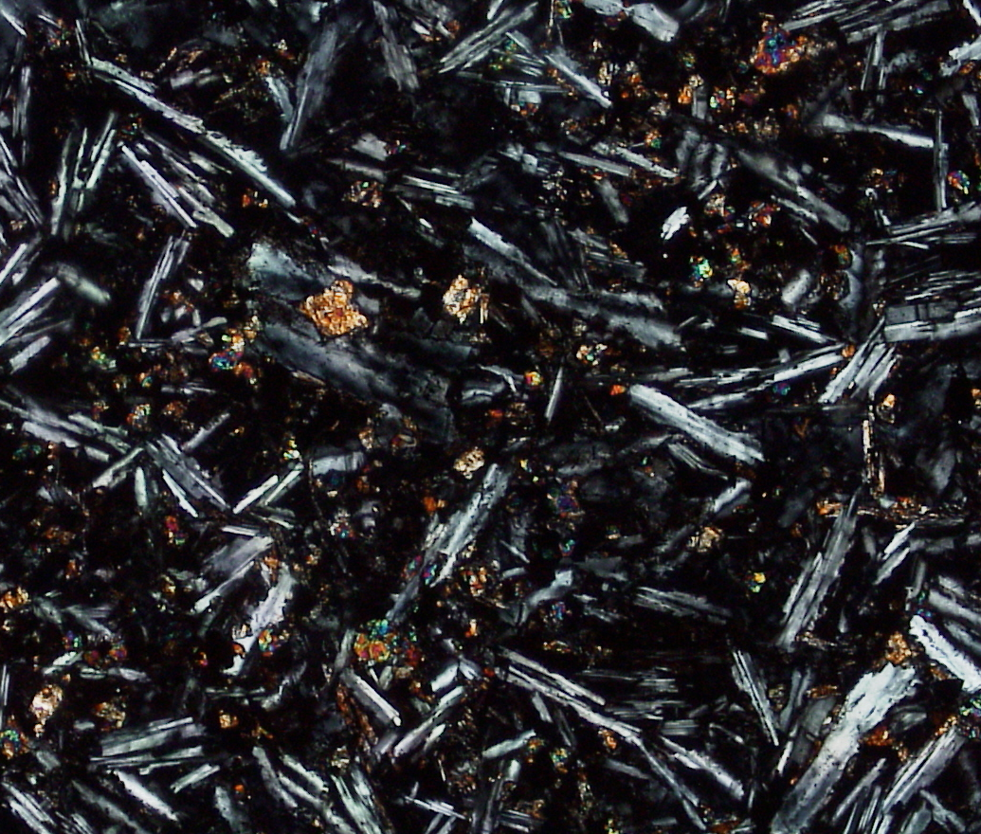
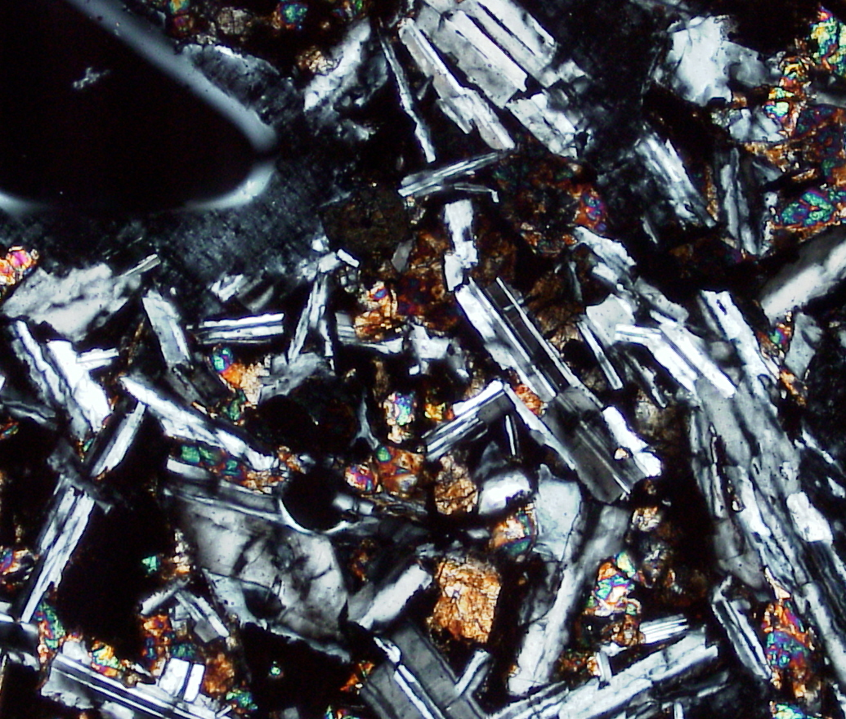
Clear Lakes Grade basalt
Craters of the Moon basalt

Slide 17
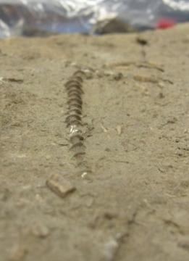
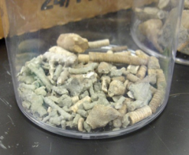
Methods
Catalog
  Photographs
  Detailed descriptions
Stratigraphic facies analysis (EOD’s)
Write up descriptive work in the form of a classroom guide
Develop labs and activities using the rock sets for various K-12 age groups

Slide 18
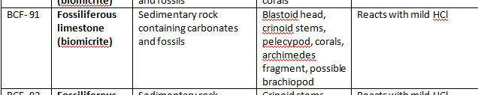
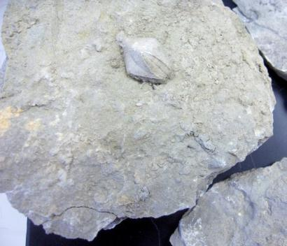
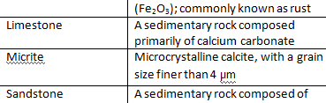
Example sample description

Slide 19
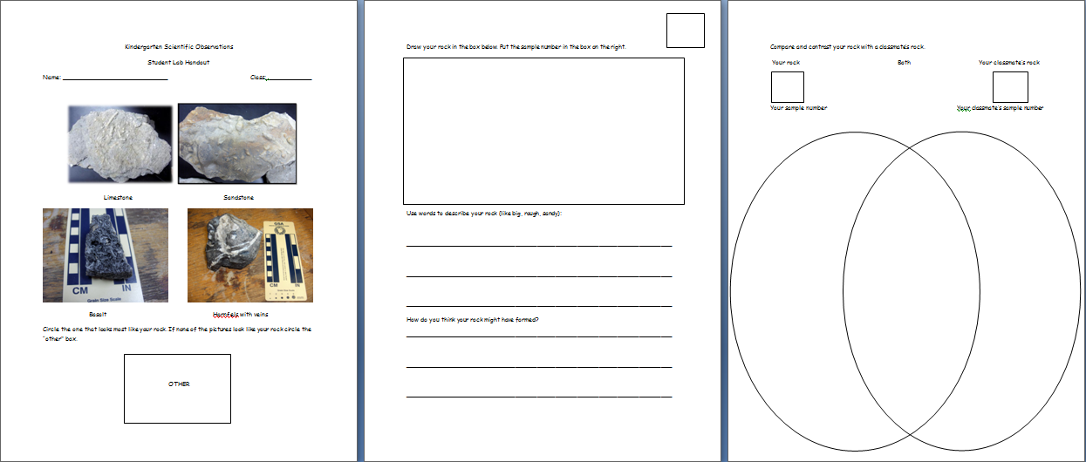
Lesson plan- Kindergarten WS

Slide 20
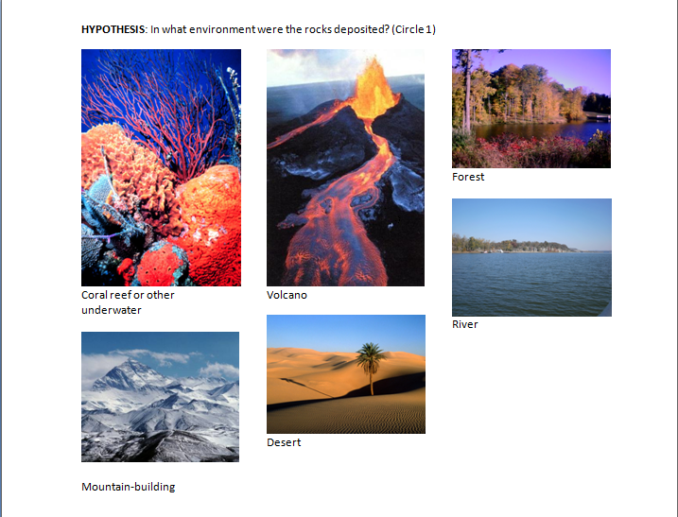
Lesson plan- Circle the hypothesis
Images courtesy of www.weirdwarp.com, www.global-warming-awareness2007.org, www.care2.com, and www.climatechange.thinkaboutit.eu

Slide 21
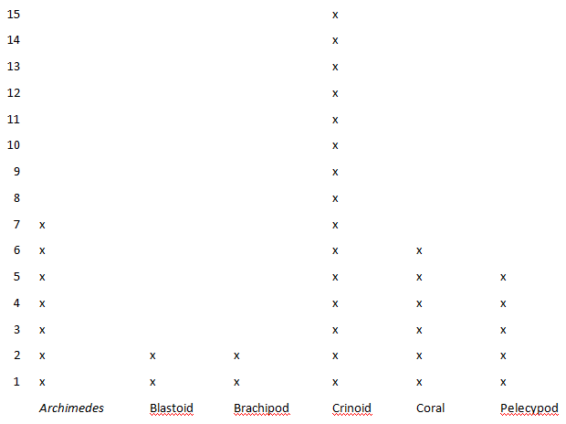
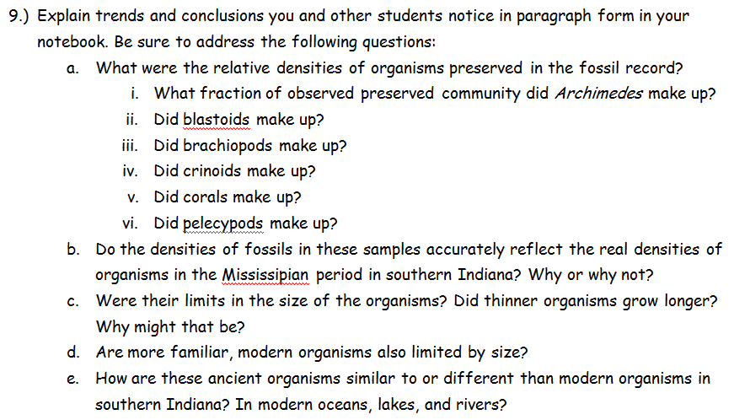
Lesson plan- Biology, math, and fossils

Slide 22
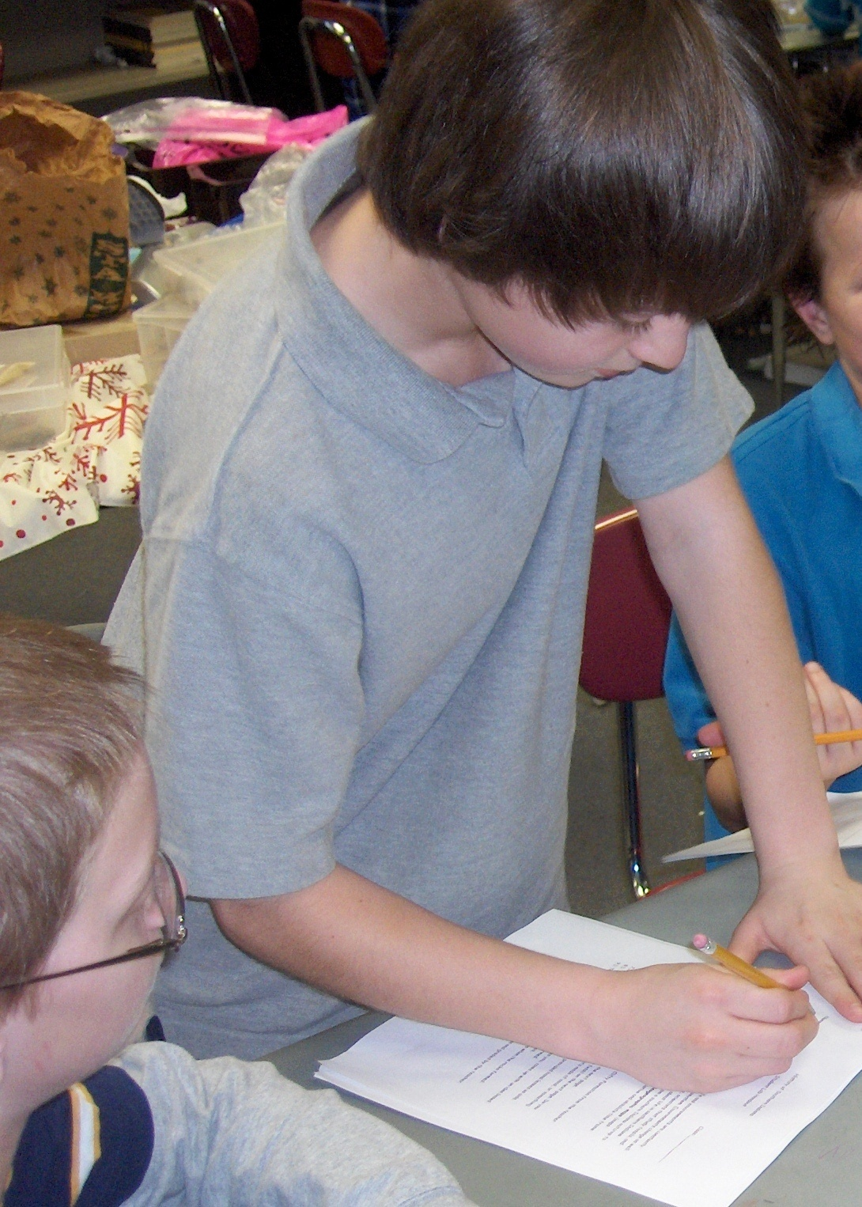
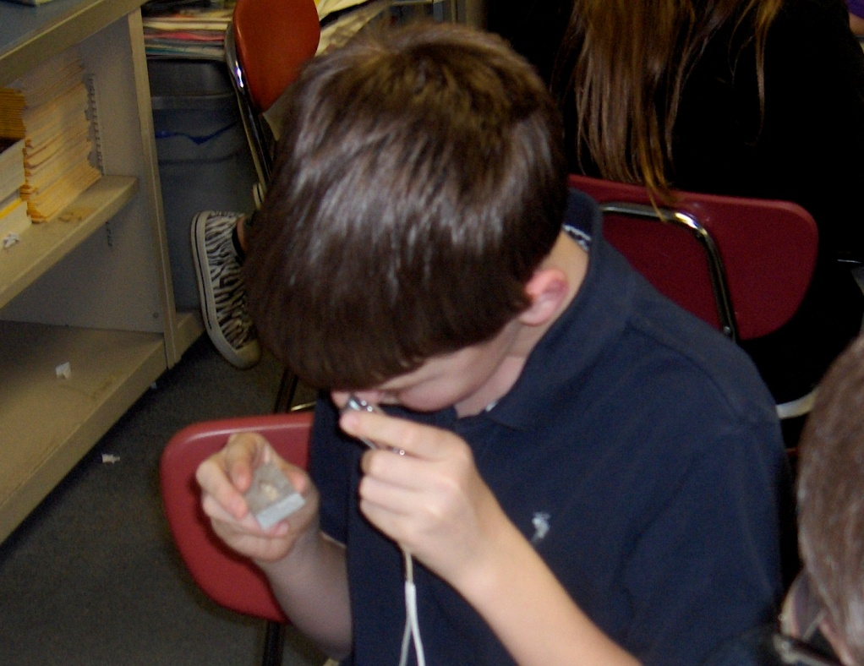
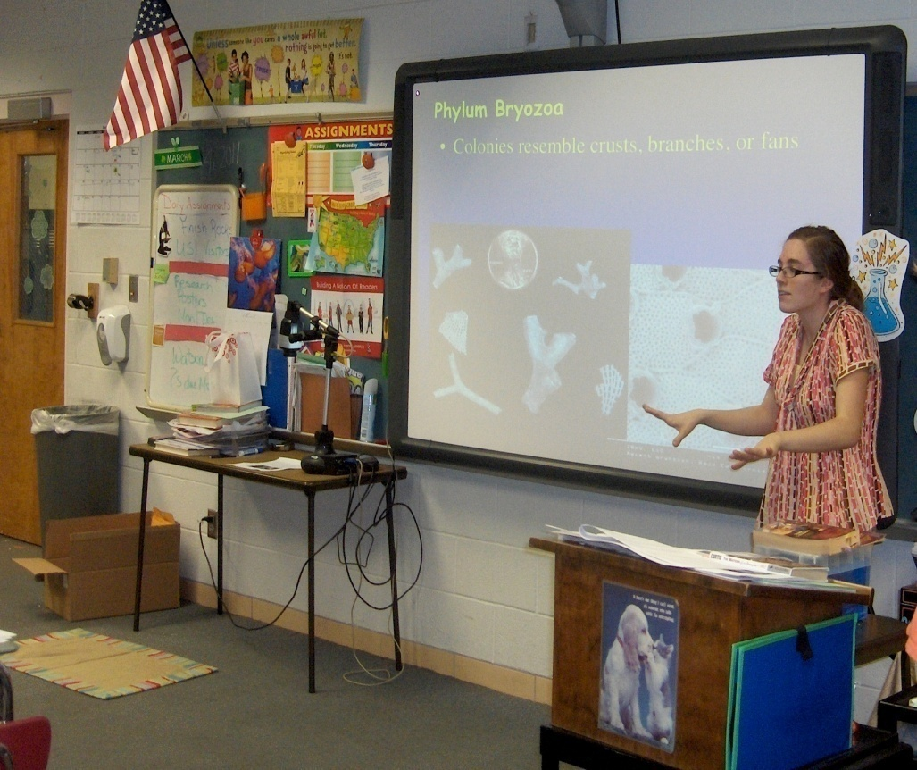

Slide 23
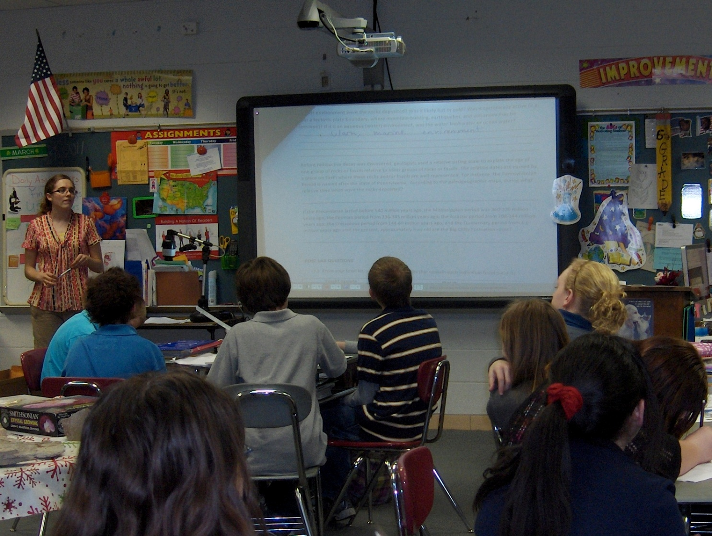
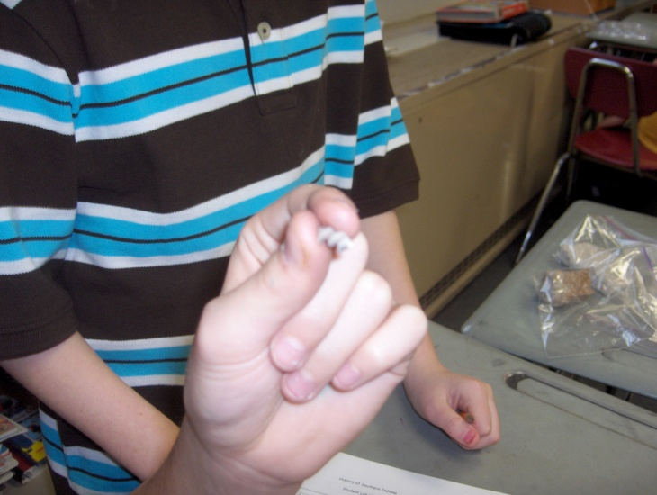
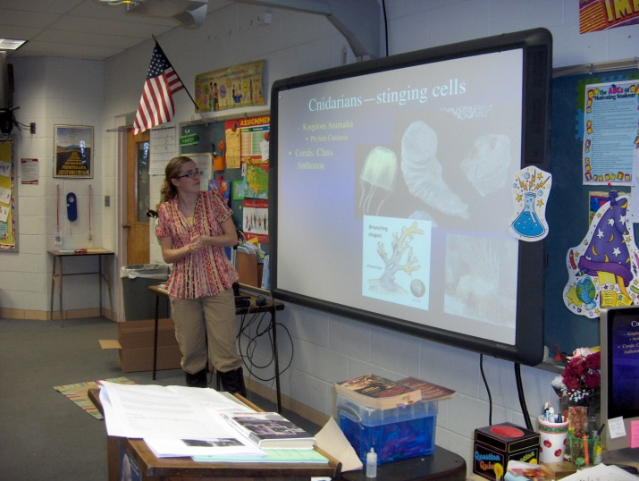
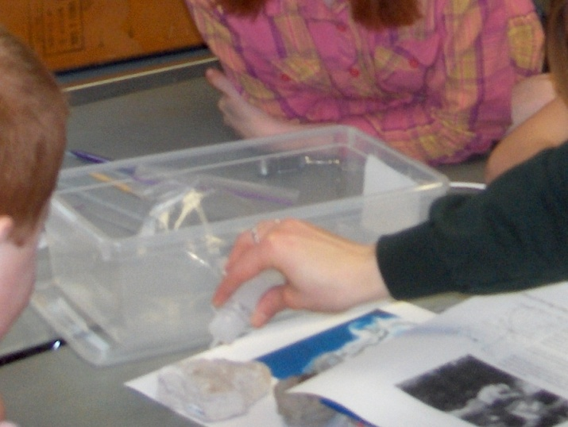

Slide 24
Future work
Test kits on a group of teachers in summer STEM workshops
Process any and all new samples
Finish thin section work
Continue activity/ lab development

Slide 25
Future work
Trips to other collecting destinations
  Cincinnati-area Ordovician brachiopods and rocks
  Southern Oregon
Publish our work in the Journal of Geoscience Education

Slide 26
References cited
Delano, H. L. (2006). The Pennsylvania rock and mineral kit re-invented. Abstracts with Programs - Geological Society of America, 38(2), 16.
Dickey, Joanna Paterno and Hendricks, Roberta Cox. Visual Perception Qualities of Instructional Materials. The Clearing House. 64 (1991), 168-170.
Haywick, Douglas W. Alabama Rocks!- A Student Community Project to Equip Public School Science Classes with Relevant Teaching Colections. 2006 Philadelphia Annual Meeting (22-25 Oct. 2006)
Raphael, Dennis and Wahlstrom, Merlin. The Influence of Instructional Aids on Mathematics Achievement. Journal for Research in Mathematics Education. 20 (1989), 173-190.
Sowell, Evelyn J. Effects of Manipulative Materials in Mathematics Instruction. Journal for Research in Mathematics Education. 20 (1991), 498-505.
Suydam, Marilyn N. and Higgins, Jon L. Activity-Based Learning in Elementary School Mathematics: Recommendations from Research. Abstract. Mathematics Education Information Report. 1985.
Wolfe, Amy L. Rock-On! A Hands-On Laboratory Experience Developed for Elementary School Science Specialists. 2006 Philadelphia Annual Meeting (22-25 Oct. 2006)

Slide 27
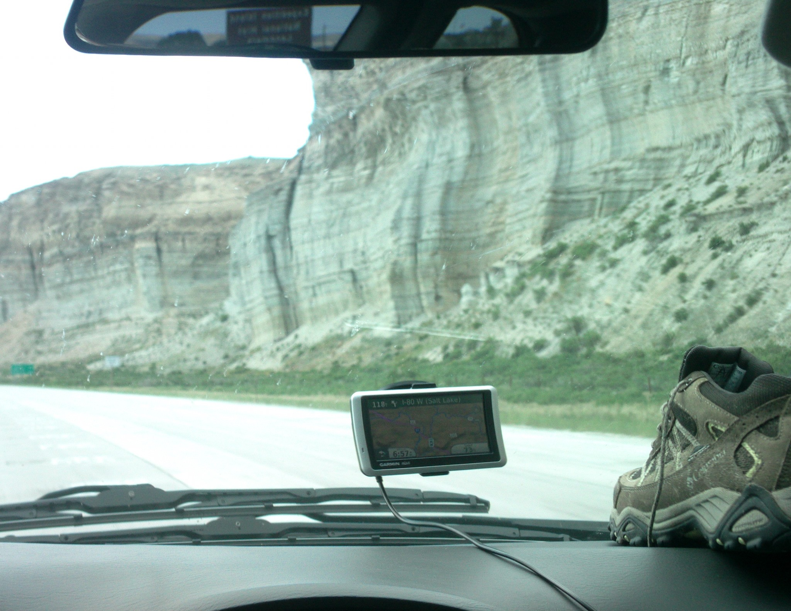
Thanks!
SwISTEM EURP
National Science Foundation
  NSF DUE -0756978
Endeavor Grant
University of Southern Indiana
USI Geology Department
Geology 161 classes
Allison Grabert and SwISTEM trucks
Drs. Bill Elliott, Jim Durbin,
and Tony Maria, and Holly Keimig
Carrie Wright, M.S.

Slide 28
Contact information
Allison Grabert
SwISTEM program coordinator
  812/228-5019
  afgrabert@usi.edu
  http://www.usi.edu/stem/Index.ASP
  http://www.istemnetwork.org/
The authors
  Kristen Schmeisser: keschmeiss@ mail.usi.edu
  Ashley Altheide: ataltheide@ mail.usi.edu
  Carrie Wright: clwright@usi.edu

