Slide 1
Transient Upper Crustal Kinematic Compatibility Structure Illuminated by the Chi-Chi Earthquake: Results from Strain Inversions in the Luliao Region, Taiwan
Ellen Lamont -
Jonathan Lewis -
Tim Byrne -
Jean Crespi -
Ruey-Juin Rau -
Indiana University of Pennsylvania, USA
Indiana University of Pennsylvania, USA
University of Connecticut, USA
University of Connecticut, USA
National Cheng Kung University, Taiwan

Slide 2
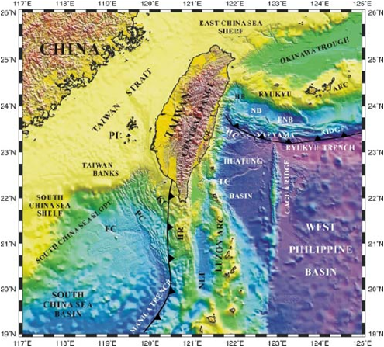
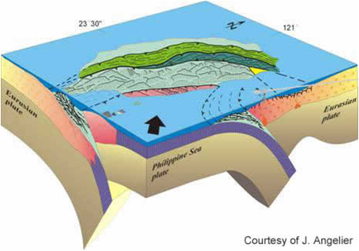
Taiwan is an active arc-continent collision zone.
Convergence = 82mm/yr toward the Northwest

Slide 3
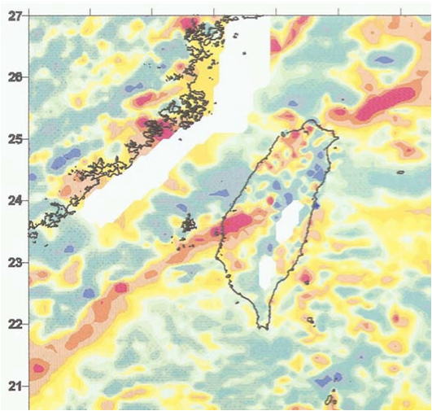
Offset magnetic high bands suggest the presence of a rift-related, continental margin fracture zone.
Full-Thickness Continental Crust
Fracture Zone
Transitional to Oceanic Crust

Slide 4
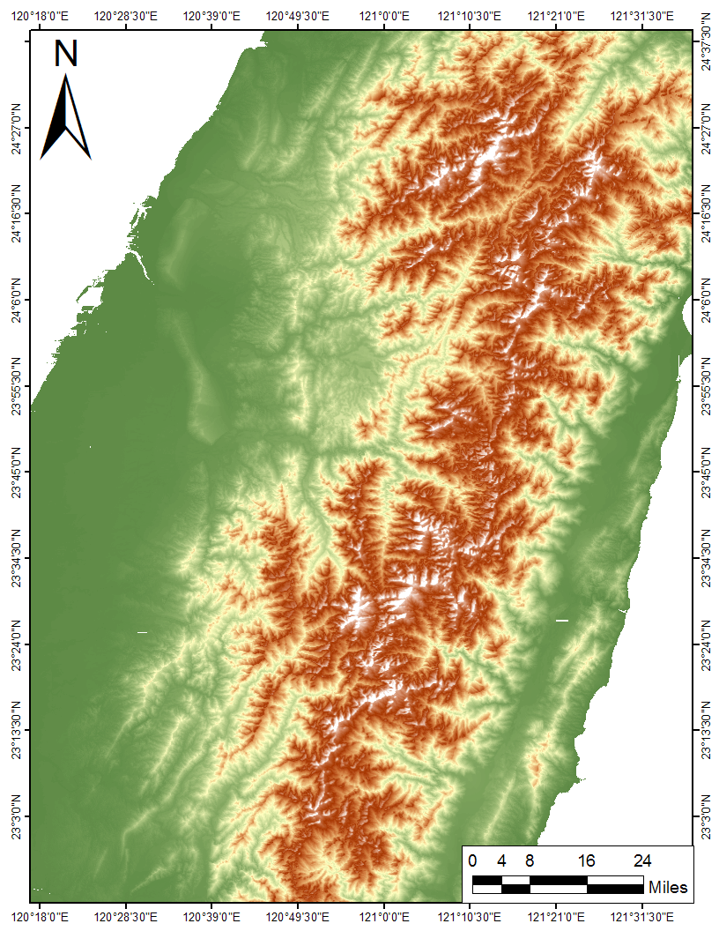
The Taiwan orogen is expanding differentially overtop of the footwall fracture zone.

Slide 5
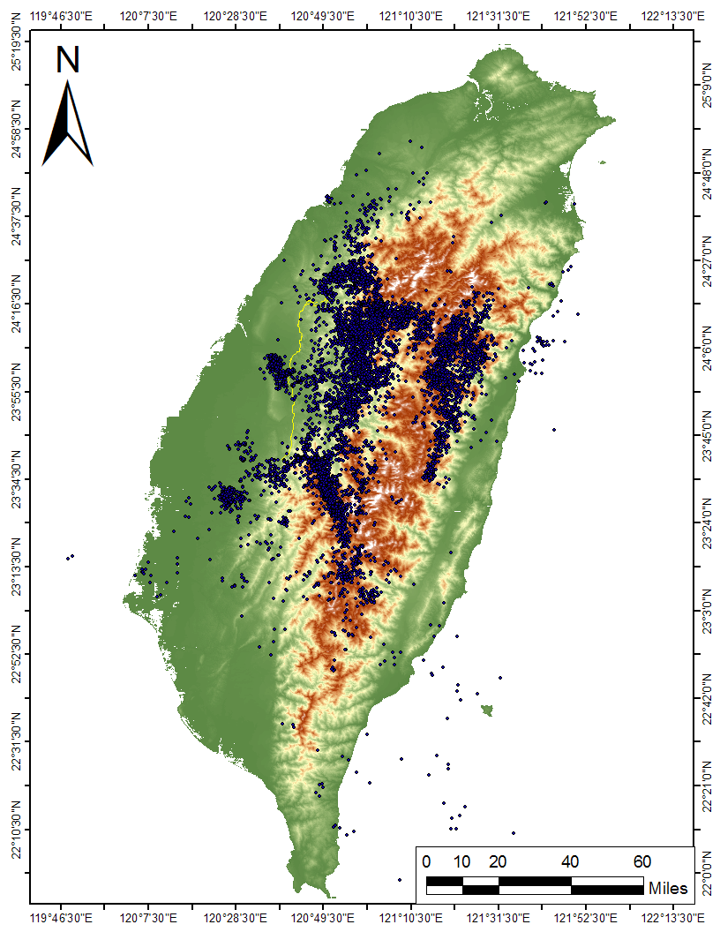
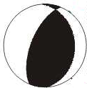
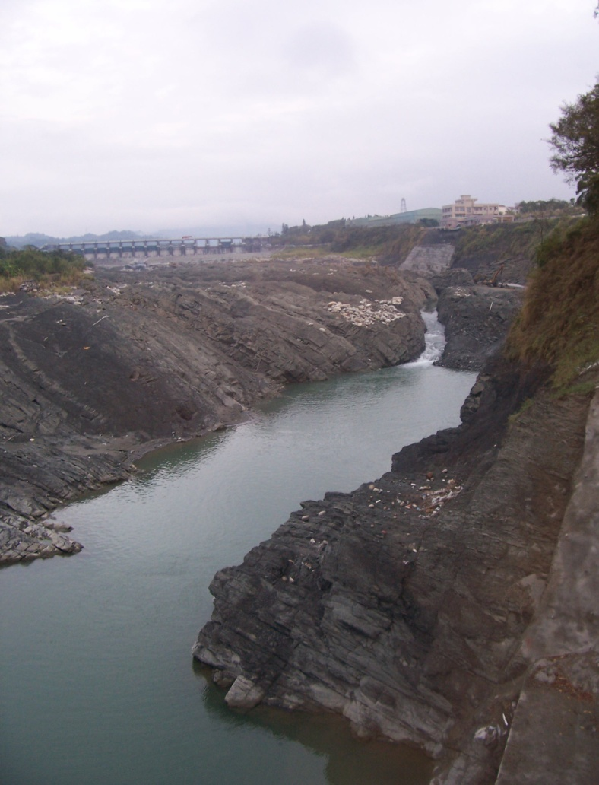
The 1999 Chi-Chi Earthquake…
Magnitude = 7.6 (Mw)
Shallow Epicenter (8km Depth)
Surface Rupture = 90km length
Produced over 20,000 Aftershocks

Slide 6
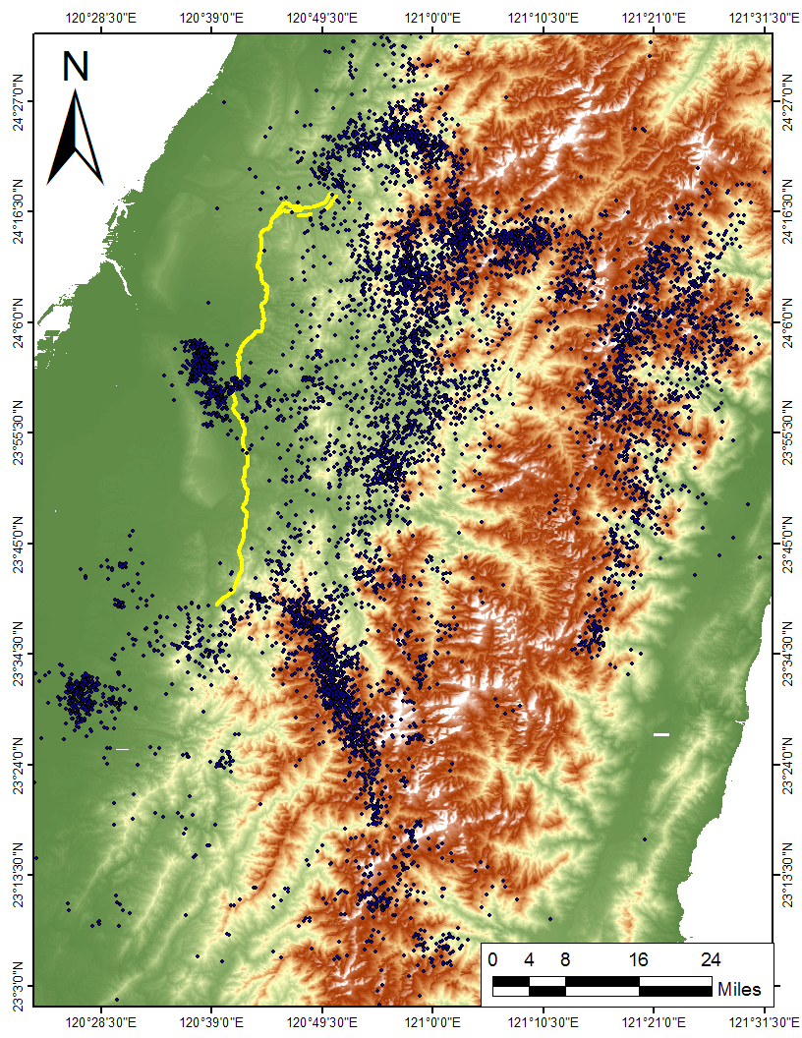
The 1999 Chi-Chi Earthquake…

Slide 7
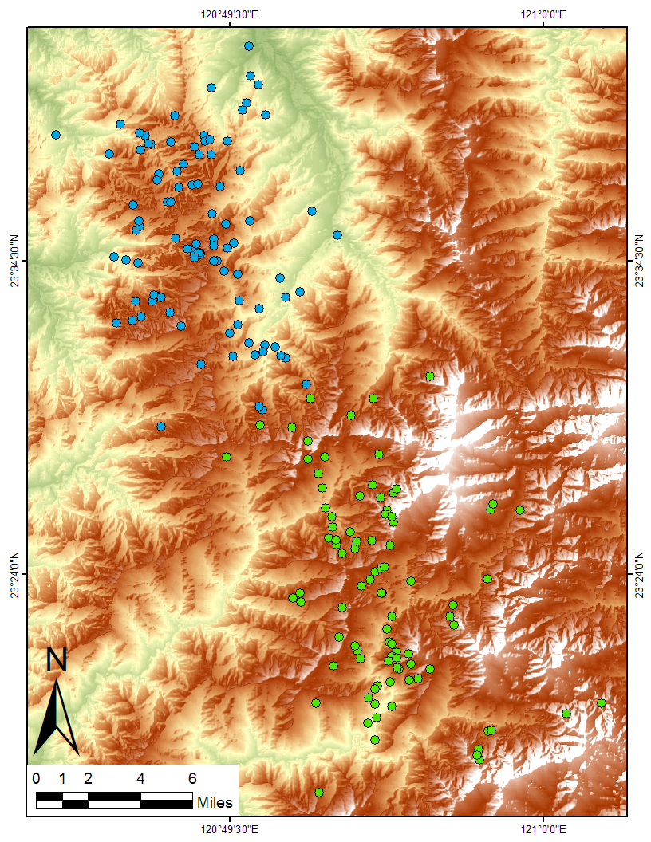
The Luliao Seismic Swarm is a heterogeneous set of 151 shallow (<11km) earthquakes.
NW Subset
SE Subset

Slide 8
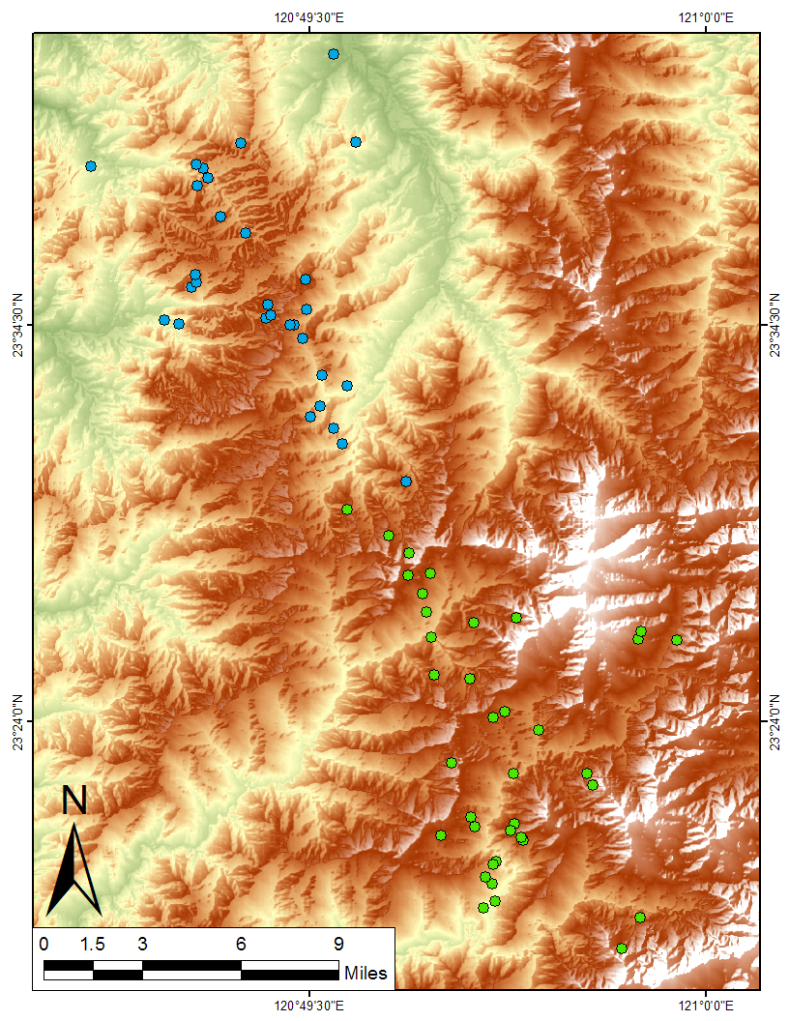
These filtered data reflect strike-slip type deformation.
NW
Strike-Slip
SE
Strike-Slip

Slide 9
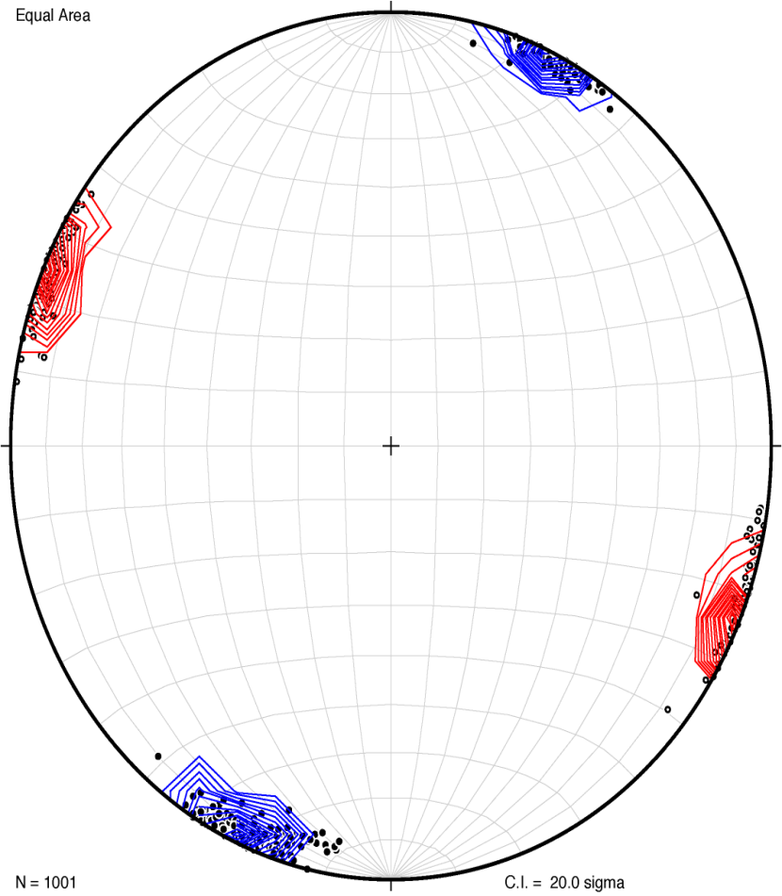
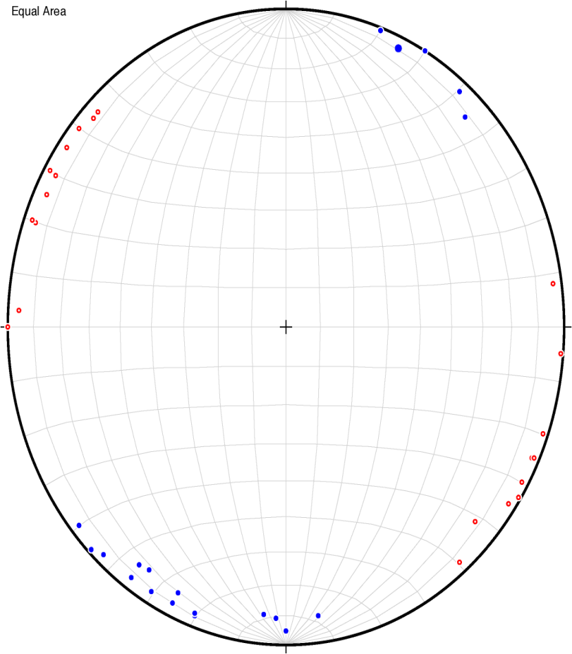
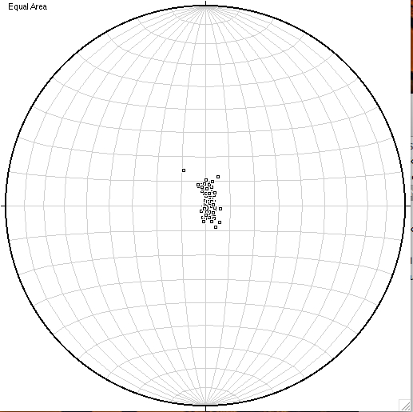
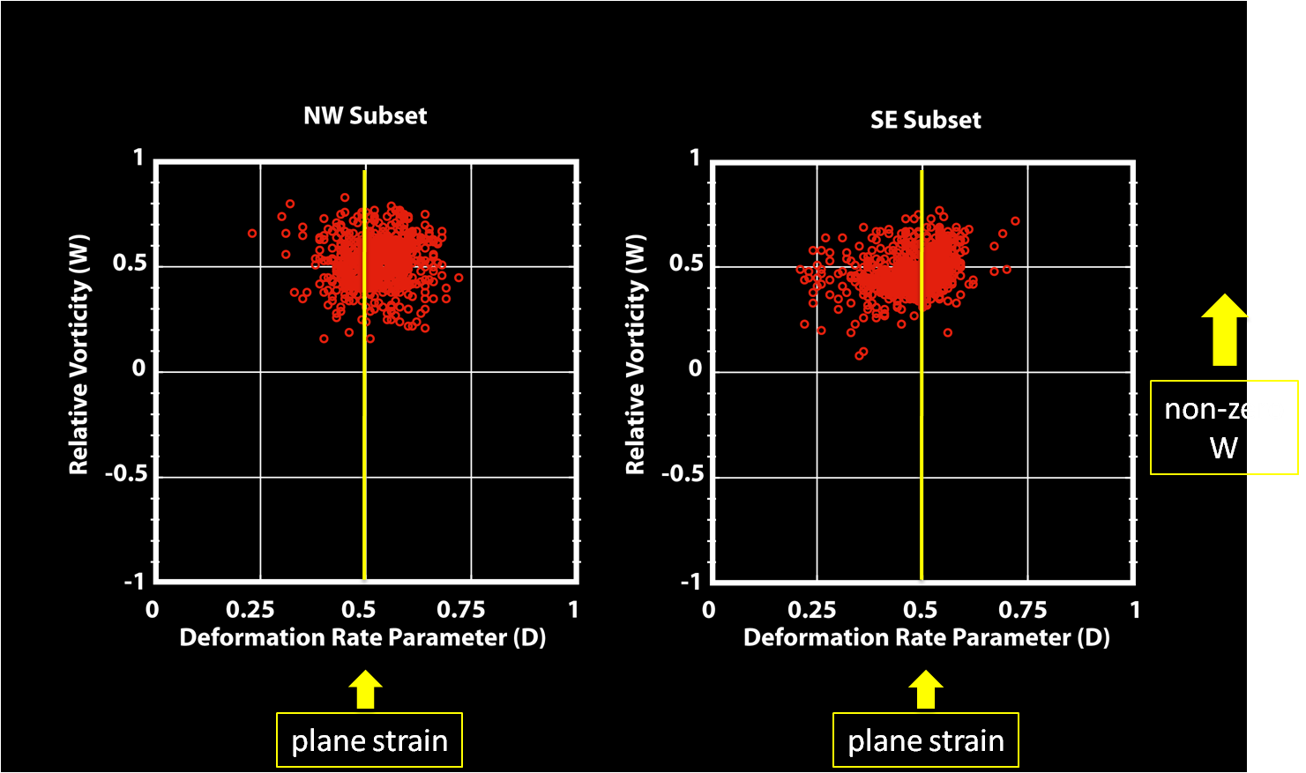
Bootstrap statistical inversions of the northwest focal mechanism strain tensors shows NE-SW Maximum Extension and NW-SE Maximum Compression
NW Input Strike-Slip-Type Focal Mechanisms
NW Inverted Best-fit Strain Tensors & Inversion Results
d3 = Compression
d1 = Extension
Rotation Axis
Non-Zero W values
= Block Rotation
D Values = 0.5 are plane strain

Slide 10
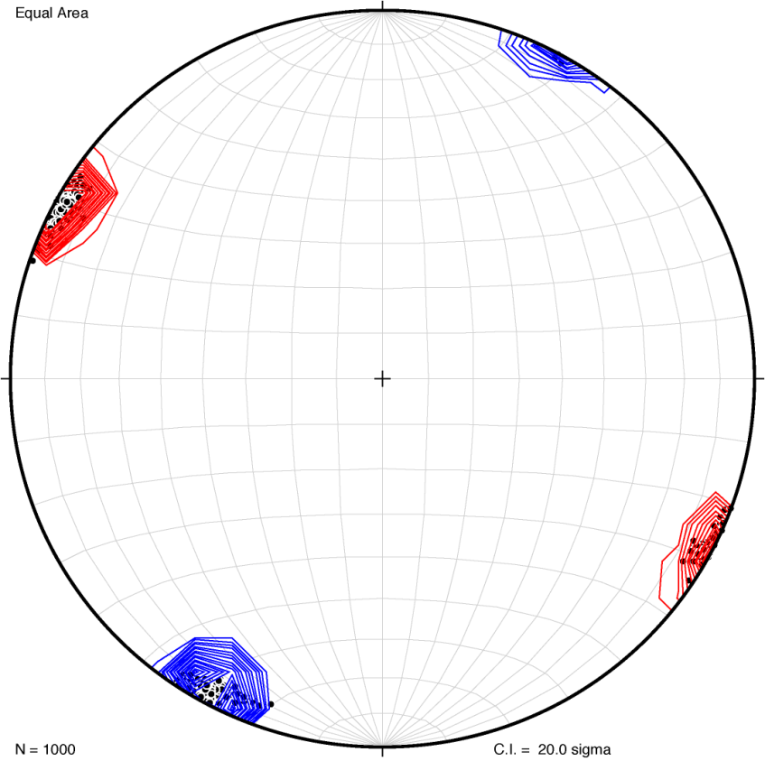
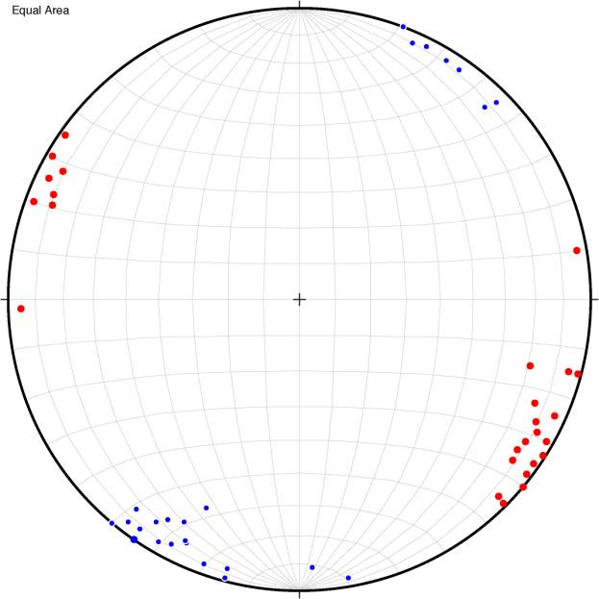
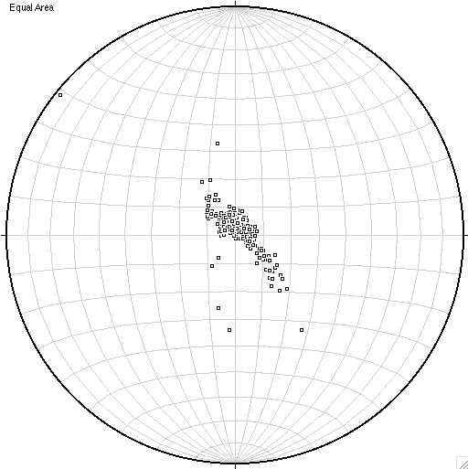
Bootstrap statistical inversions of the southeast focal mechanism strain tensors shows NE-SW Max. Extension and NW-SE Max. Compression, Plane Strain Deformation, and Counterclockwise Block Rotation
SE Input Strike-Slip-Type Focal Mechanisms
SE Inverted Best-fit Strain Tensors & Inversion Results
d3 = Compression
d1 = Extension
Rotation Axis
Non-Zero W values
= Block Rotation
D Values = 0.5 are plane strain

Slide 11
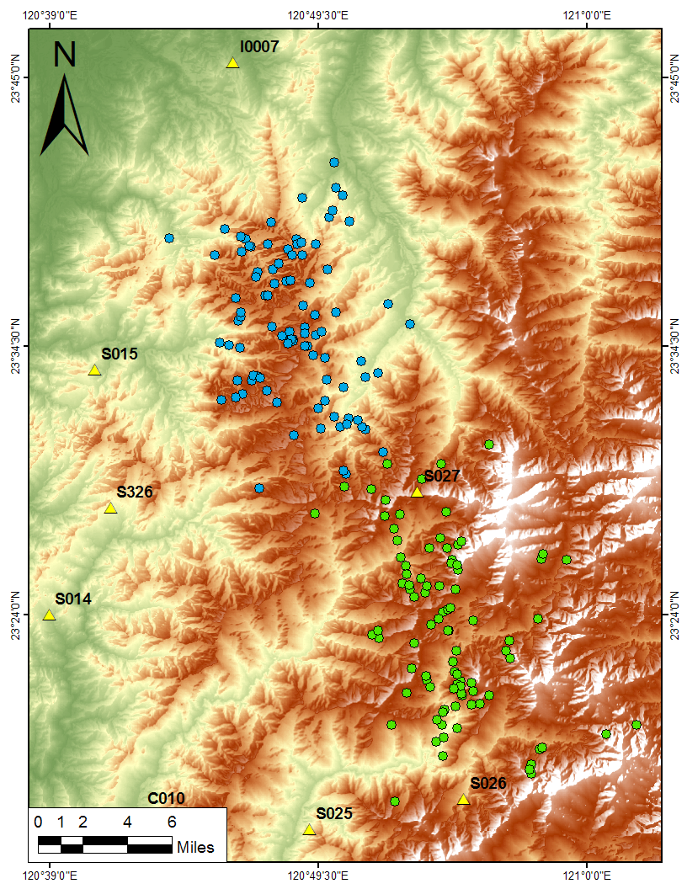
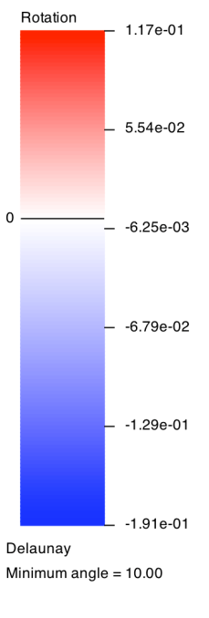
Inversions of published co-seismic GPS velocity vectors confirm the counterclockwise rotations found during our focal mechanism inversions.
Data from Hung, et al., 2002

Slide 12
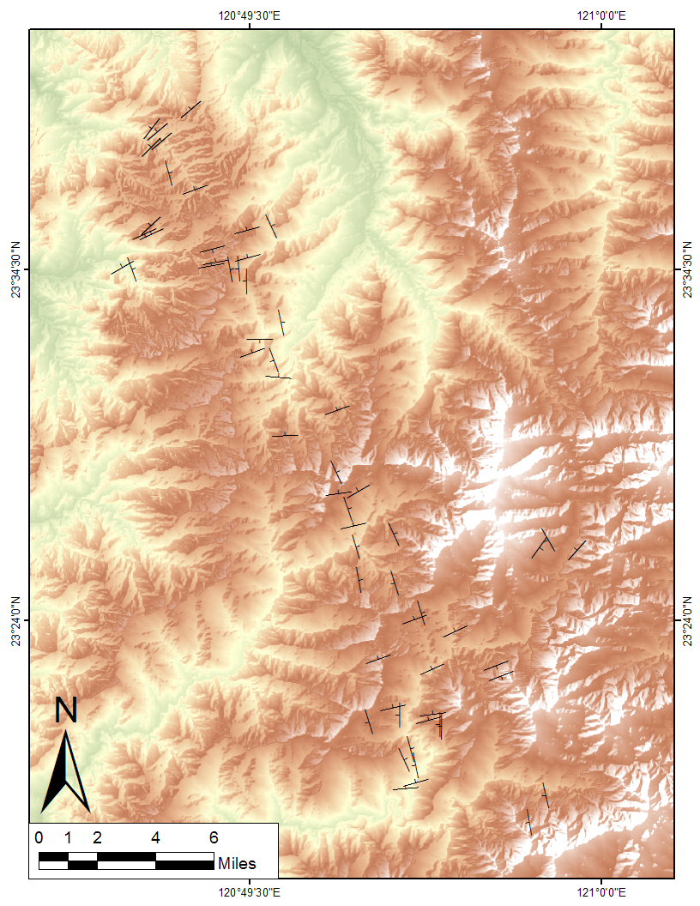
Preferred focal mechanism nodal plane orientations display a blocky pattern suggesting the probable location of block bounding faults.

Slide 13
Conclusions:
The Luliao Seismic Swarm is a zone of diffuse seismicity initiated at the onset of the Chi-Chi Earthquake
NE/SW extension consistent with extrusion
NW/SE compression consistent with the convergence vector of the Philippine Sea Plate
Plane strain deformation
Counterclockwise rotation of the small continuum in relation to the large continuum
Accommodating forward advancement of the northern portion of the orogen through wrench faulting

Slide 14
