Slide 1
Assessment of freshwaters mussels as paleoenvironmental indicators
Jessica Feenstra and Alan Wanamaker
Iowa State University
feens@iastate.edu

Slide 2
Introduction
Anthropogenic sources of waste impact water quality
  Ammonium, nitrate, and nitrite released into the groundwater, altering natural levels of dissolved inorganic nitrogen (DIN) of effected watershed
  Inhabitants of watershed also feel anthropogenic effect
Some species of mussels precipitate their shell in isotopic equilibrium with ambient water
  Record anthropogenic influences as variations in δ¹⁵N (Watanabe et al., 2009)
  Exhibit annual growth cessation lines induced by water temperature (Helama et al., 2009) that can act as a timeline
    Essentially archives of anthropogenic influence through time

Slide 3
Introduction
To date, research has focused almost entirely on saltwater mussels as records of anthropogenic influence
  Freshwater mussels should also be useful as indicators of changes in water chemistry
    Proper methodology for such a study is not yet documented

Slide 4
Objective
Find an adequate candidate for the study
Determine amount of shell carbonate necessary to effectively measure δ¹⁵N of freshwater mussels
Determine effects of acidification on shell carbonate
      Does acidification alter the δ¹⁵N signature of the shell material?
      If acidification is necessary, what is the acid application process?
Develop a time series of δ¹⁵N in Iowa

Slide 5
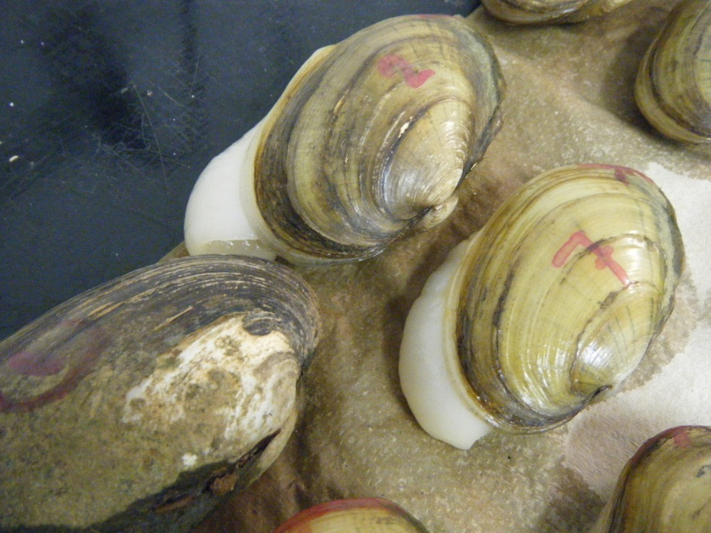
Choosing a species
Prime candidate: Lampsilis cardium
  Determined by Goewert et al. (2007) to:
    Precipitate shell in equilibrium with ambient water
    Display annual growth banding

Slide 6
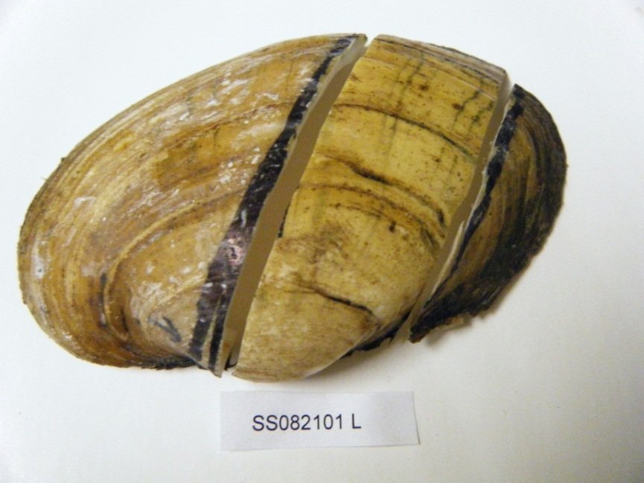
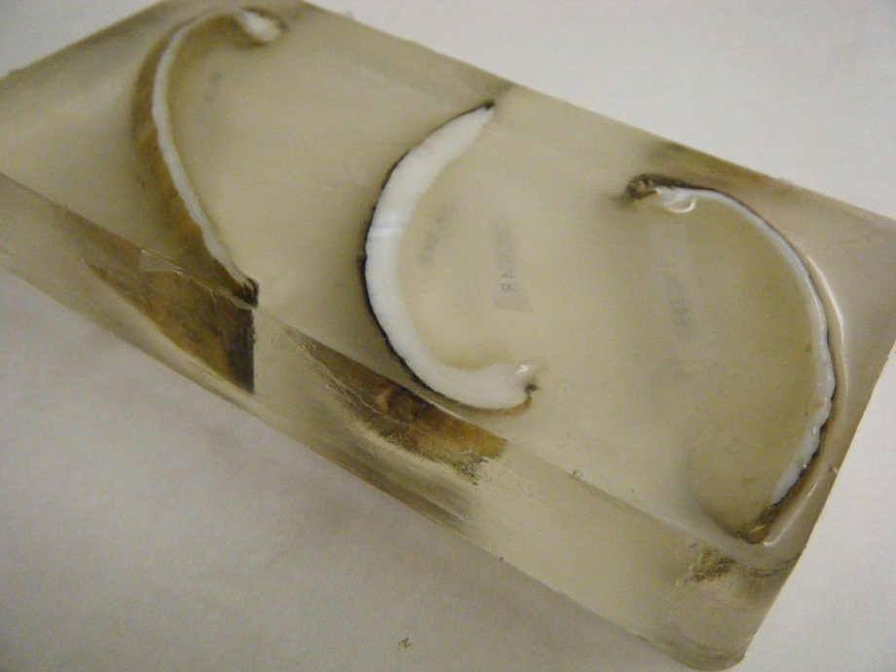
Methods
Acquiring the material
Collect shells of freshwater mussels
  Near agricultural zones
Cut, block, and polish shells
  Along axis of max growth
Determine age
Drill out shell carbonate with Dremel hand drill

Slide 7
Methods: Mass effect
Drill out 25mg of shell carbonate (homogenized)
  Weigh out .5mg, 1mg, 2mg, 3mg, 4mg, and 5mg of powder into tin capsules
  Evaluate sample on Elemental Analyzer (EA) for δ¹⁵N

Slide 8
Results

Slide 9
Methods: Acid effect
Drill out 100mg of shell carbonate (homogenized)
  Weigh out 5 samples at 10mg each into silver capsules
    Acidify drop-wise with 5% HCl until bubbling ceases (about 300 μg)
    [after Carmichael et al. (2008)]
  Weigh out 5 samples at 10mg each in tin capsules
Analyze acidified versus non-acidified samples on EA

Slide 10
Results – First trial
[For this trial, only analyzed acidified samples]

Slide 11
Results – Second trial

Slide 12
Results – Third Trial

Slide 13
A closer look at the acid effect
Made a mixture of .6mg acetanilide and 1mg pure CaCO₃
  Acidified drop-wise until bubbling ceased (about 125μg)
  Analyzed acidified samples against
    Non-acidified samples of same mixture
    Pure samples of acetanilide

Slide 14
Results

Slide 15
Analyzing δ¹⁵N of growth bands
Develop a time-series of δ¹⁵N for a mussel
Chose a mussel aged approximately 9 years
  Growth beginning in 2001
  Drilled 10mg from 2001 – 2008 bands
    Not enough material in 2009 band
Samples were analyzed pure, since acid effect still in question

Slide 16
Results
*Vertical error due to likely presence of epoxy resin, with determined δ¹⁵N of -.933‰
*Horizontal error due to inaccuracy of hand drilling

Slide 17
Conclusion
At least 3mg of powdered shell carbonate is necessary for stable δ¹⁵N values
  Higher intensity of peak with more mass, however
Analysis via acidification versus non-acidification is still unclear
  Do not know which data set is correct
There exists variability in δ¹⁵N of annual growth bands

Slide 18
Future work
Continue analysis of acidification versus non-acidification
Conduct additional analyses on change in δ¹⁵N of annual growth bands
  Produce a time series of change in δ¹⁵N in Iowa

Slide 19

Questions?

