Slide 1

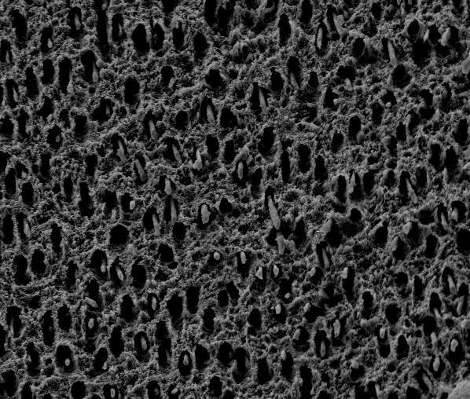
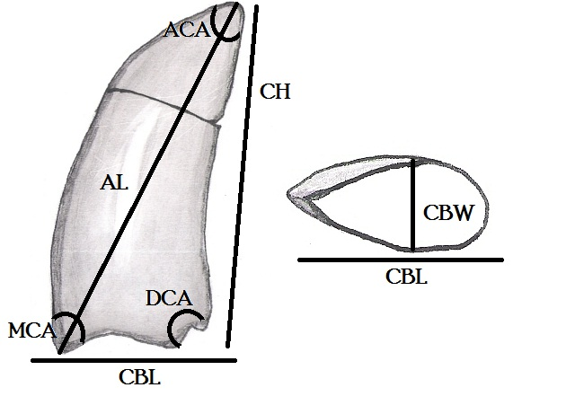
Microscopic Dental Structure in a Polycotylid Plesiosaur (Diapsida: Plesiosauroidea) from the Boyer Bay Member of the Sharon Springs Fm., Pierre Shale Group, South Dakota
Testin, Jason J., Department of Geology and Geologic Engineering, South Dakota School of Mines & Technology, Rapid City, SD
Abstract:
Work on the qualitative and quantitative description of dental morphologic variation in fossil reptiles has concentrated heavily on that of theropod dinosaurs, with the goal of identifying shed crowns. In contrast, little attention has been paid to Mesozoic marine reptile taxa, in particular polycotylid plesiosaurs. The teeth of polycotylid plesiosaurs are cone shaped, un-serrated and slightly recurved. The teeth are covered by a series of vertical enamel wrinkles that are more highly developed on the lingual surface of the crown, and decrease in width as they progress toward the apex. Polycotylid crowns are, in all respects other then size, homodont, with little change in shape noticeable between teeth in the anterior vs. posterior portion of the jaw. Some of the most promising research related to reptile tooth morphology, involves the analysis of surface and internal dental microstructure. To date no one has attempted to describe polycotylid dental microstructure beyond simple qualitative observations. This study gives the first overview of polycotylid plesiosaur enamel, dentin and pulp structures through the use of a scanning electron microscope.
1)Materials and Methods:
The sample examined was a crown from an unknown species of plesiosaur cf. Polycotylus, collected by Dr. James Martin (SDSM&T) from the Pierre Shale Group of South Dakota and given the Museum of Geology Collections number - SDSM 86604 .
The base of the crown was polished by hand using decreasing grades of sand paper and Aluminum Oxide powder.
The last step in the polishing process consisted of a 10 second acid etching using 2 N HCl.
The samples were coated in a thin layer of gold, which is used in the SEM to improve conduction of the electron beam, and prevent electrical charging of the samples.
2) Enamel Structure
3) Enamel Wrinkle Structures
Parallel enamel crystallites make up the majority of the crowns enamel structure. Parallel enamel is not as structurally sturdy as columnar enamel it presence as the major enamel type in polycotylid crowns may have a bearing on the types of prey items making up their diet.
The SEM used was the South Dakota School of Mines and Technologies’ Zeiss Supra40 Variable-Pressure Field-Emission Scanning Electron Microscope.
The SEM was set to High Pressure mode with an aperture of 30.00 μm, and a voltage of 10 kV.
All images were taken using the Secondary Electron Emission detector.
The enamel that makes up the wrinkles differs from the enamel between the wrinkles. The structure with-in an enamel wrinkle, is columnar enamel. The enamel between the wrinkles is made of parallel crystallites, with intermixed microunit modules.
Enamel Wrinkles on the lingual surface of the crown only, close to the base (left) and close to the apex (right)
Growth Rings in the Dentine or Artifacts of the Polishing?
6) Where to go from Here?
A study that will include destructive analysis of the crowns where longitudinal, tangential and cross section are taken.
Thin sections are produced, so as to thoroughly examine the enamel structure from all angles
4) Enamel/Dentine Junction
5) Dentinal Tubule Structure
Comparison of crown microstructure of various known polycotylid taxa.
Enamel structure should be coupled with gross morphological measurements of in-situ dentition.
References:
Everhart, M., 2010, Oceans of Kansas Paleontology. Retrieved November 5, 2010, from http://www.oceansofkansas.com/.
Everhart, M.J., 2005, Pliosaurs and Polycotylids, Oceans of Kansas: A Natural History of the Western Interior Sea: Bloomington, IN, Indiana University Press, p. 142-155.
Martin, J.E., Bertog, J.L., and Parris, D.C., 2007, Revised lithostratigraphy of the lower Pierre Shale Group (Campanian) of central South Dakota, Including newly designated members, in Martin, J.E., and Parris, D.C., eds., The Geology and Paleontology of the Late Cretaceous Marine Deposits of the Dakotas: Geological Society of America Special Paper 427, p. 9-21.
Sander, M.P., 1999, The microstructure of reptilian tooth enamel: Terminology, function, and phylogeny: Münchner Geowissenschaftliche Abhandlungen, Reihe A, v. 38, p. 1-102.
Sander, P.M., 2000, Prismless enamel in amniotes: terminology, function, and evolution, in Teaford, M.F., Smith, M.M., and Ferguseon, M.W.J., eds., Development, Function and Evolution of Teeth: Cambridge, NY, Cambridge University Press, p. 92-106.
Stokosa, K., 2005, Enamel Microstructure Variation within the Theropoda, in Carpenter, K., ed., The Carnivorous Dinosaurs: Bloomington, IN, Indiana University Press, p. 163-178.
Acknowledgments:
The author would like to thank my project advisor Darrin C. Pagnac, James E. Martin for assistance with choosing specimens for study from the South Dakota School of Mines and Technology collections, the South Dakota Army Corp. of Engineers, Sally Shelton Collections Manager and the staff of the SDSM&T Museum of Geology, J. Foster Sawyer for being a friend and unofficial faculty advisor, Edward Duke for assistance with the Scanning Electron Microscope, and interpretation of SEM results, Maribeth Price, my academic advisor, for early assistance with forming the project proposal, Arlette Hansen, curator of The Adams Museum in Deadwood, SD for specimen access, P. Martin Sander, University of Bonn for assistance with obtaining research material, Kelvin K. Krause, D.D.S. for discussions concerning comparison of SEM imagery to structures seen in human dentition microstructure, Finally I would like to thank my wife Krista Testin for continued love and support.
Enamel consists of as much as 99% inorganic material (hydroxyapatite), dentine is made of as much as 75% organic matrix, collagen. This highlights the differentiation between the crystalline enamel and the non-crystalline dentine.
These structures connected the main nerve of the crown, with the dentine layer of the tooth, stopping just short of the enamel -dentine junction.

