Slide 1

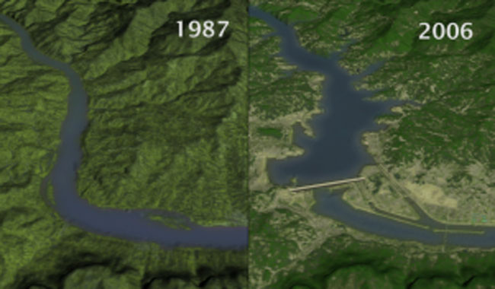
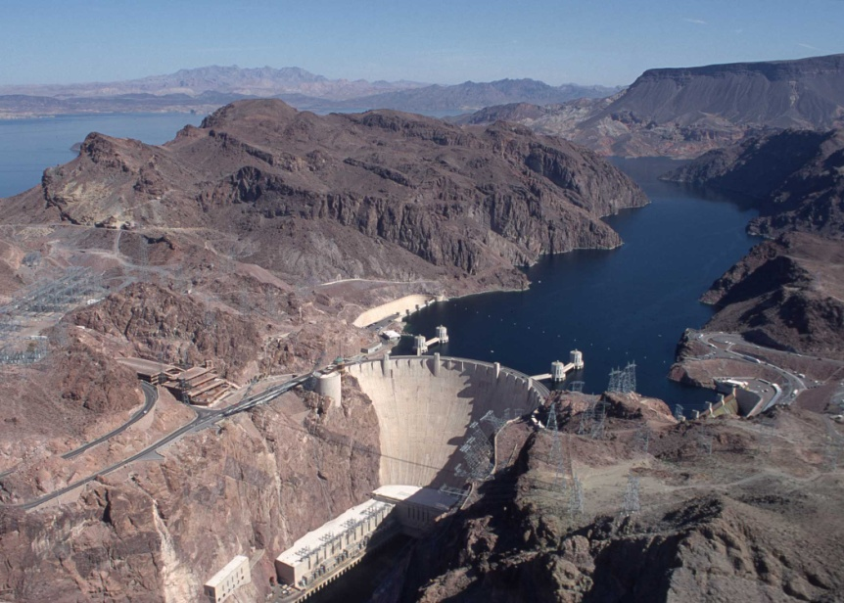
Dam release and monsoon controlled recharge and drawdown of riparian aquifers, Dolores River, Colorado
Melissa J. Boley,
Gary L. Gianniny, and Cythnia Dott
http://www.ourenergy.com/pictures/static_content/china_hydropower_as_the_right_solution/three_gorges_dam_zoom_full.jpg
http://serc.carleton.edu/images/eslabs/drought/hoover_dam.jpg

Slide 2
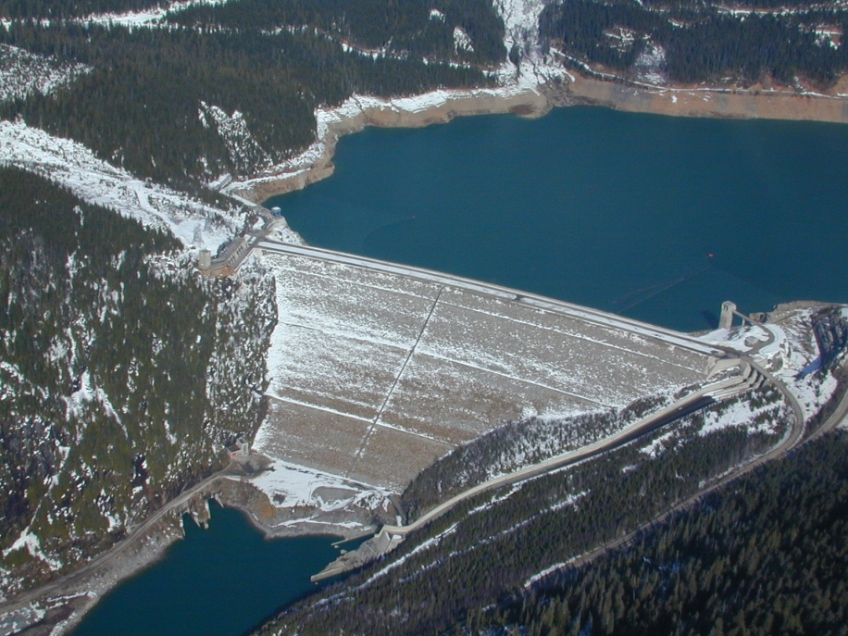
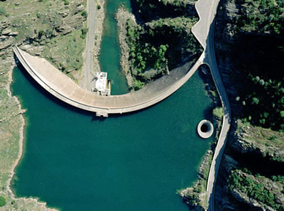
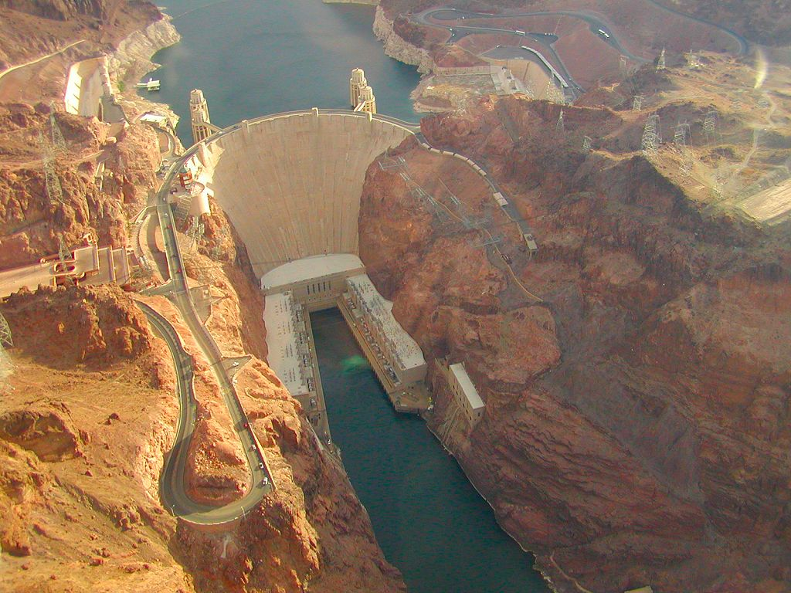
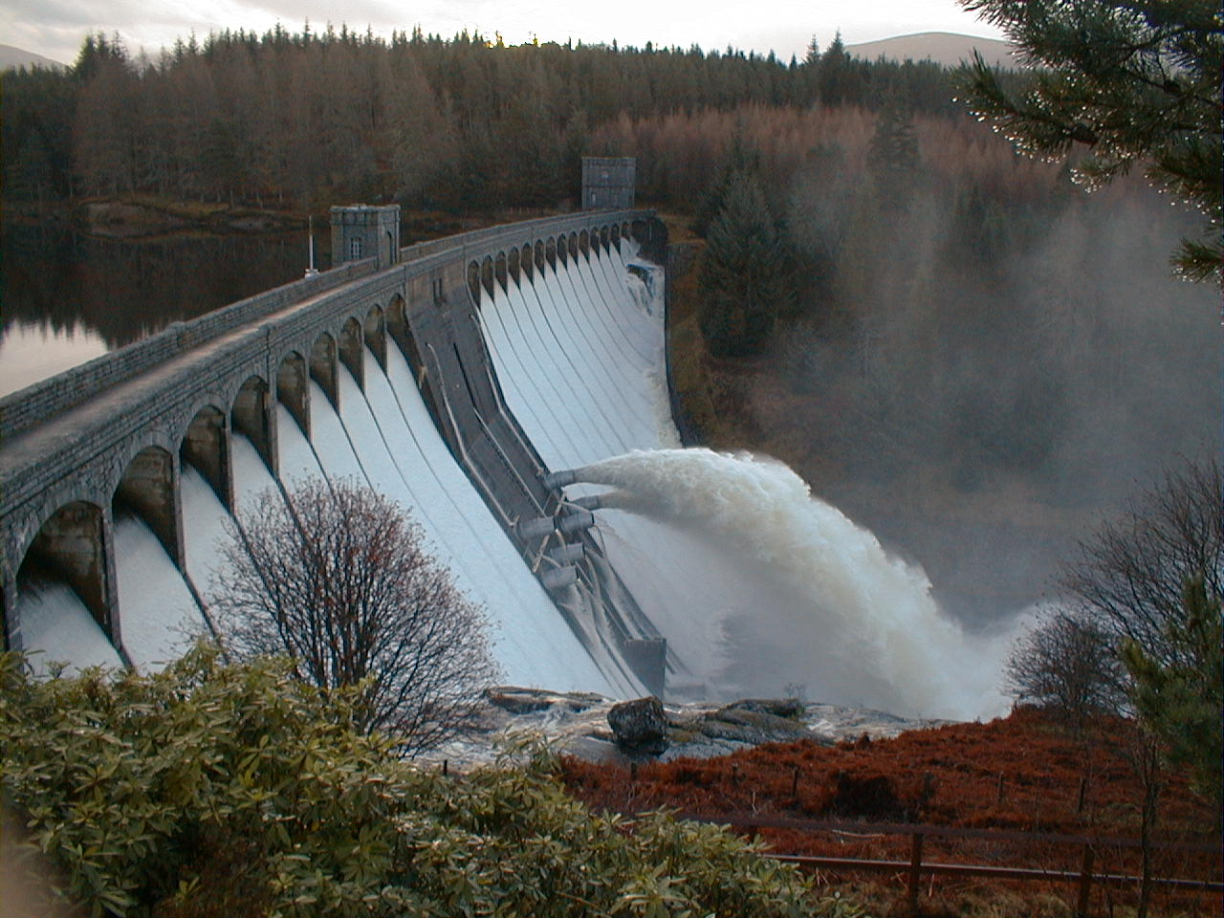
Impoundment impacts both upstream and downstream of dam construction.
The downstream impacts are largely connected to dam operations.
Few studies have focused on riparian aquifers.
The purpose of my study was to quantitatively research the effects of impoundment on riparian aquifers.
http://upload.wikimedia.org/wikipedia/commons/5/50/MicaDam.JPG
http://www.scwa2.com/images/Monticello%20Dam.jpg
Roughly 80,000 dams have been constructed in the United States over the past two centuries (Magilligan et al., 2003).
http://www.transportcafe.co.uk/image_25/hoover_dam.jpg
http://2.bp.blogspot.com/_Pxj7c3m549I/TJjOYVEC-CI/AAAAAAAAARE/YiOPoDLETKY/s1600/Dam.jpg

Slide 3
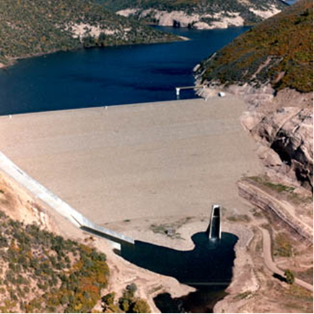
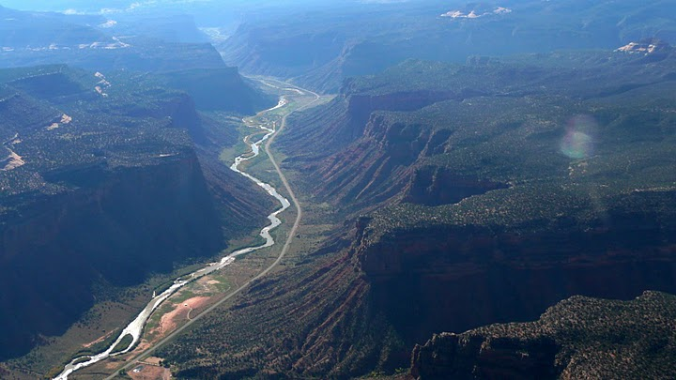
THE DOLORES RIVER
McPhee Dam
1986
http://coyotegulch.wordpress.com/2010/03/06/montezuma-valley-irrigation-company-faces-off-in-court-with-the-dolores-water-conservancy-district/

Slide 4
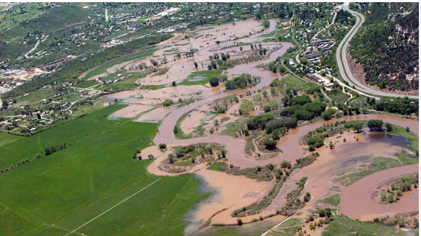
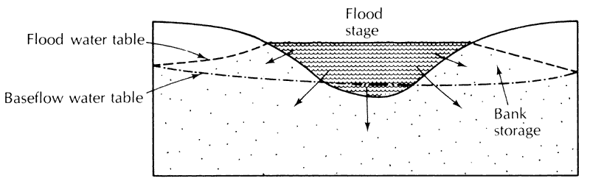
Recharge of Riparian Aquifers
It was found in Brazil, that the majority of the recharge for floodplain and bank aquifers was through peak river flows (Girard et al., 2003).
Therefore the reduction of peak flow, most likely causes a reduction in groundwater levels.
A stream contributing to groundwater recharge during a high flow event (Fetter, 2001)

Slide 5
River Flow Regime
The five critical components of the flow regime that regulate ecological processes in river systems:
                Frequency
                Duration
                Magnitude
                Timing
                Rate of change of hydrologic conditions
(Poff et al., 1997)

Slide 6
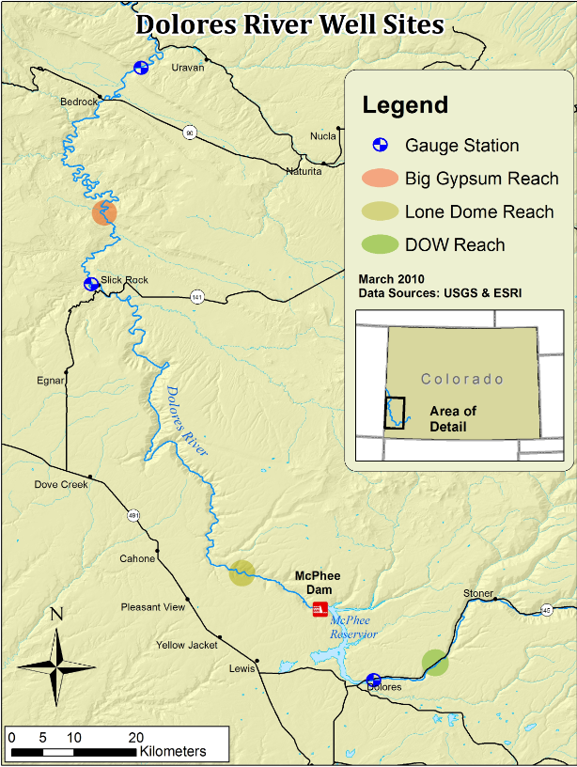
Three different riparian floodplain aquifers.
Two downstream of McPhee Reservoir and one area above.
The sites are in alluvial valley sections.

Slide 7
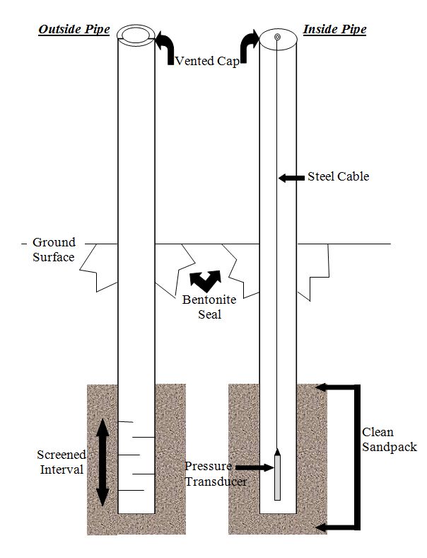
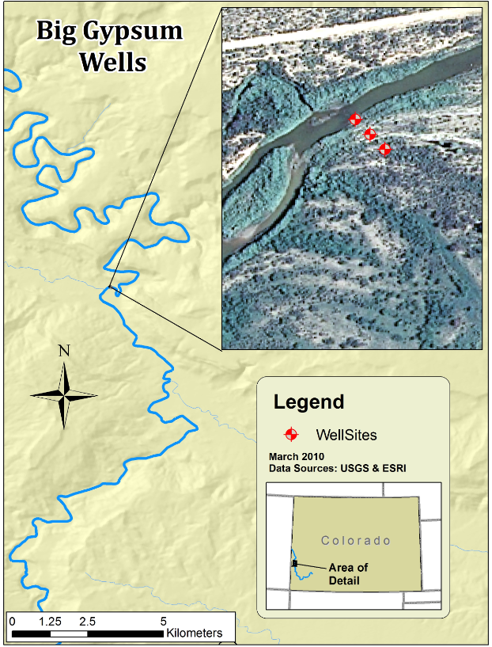
Well Installation
A transect of three piezometers
Drive point piezometers and slotted PVC piezometers
Each well was installed ~2-3 m below the land surface.
Submersible pressure transducers were used for data collection.
Data was collected every thirty minutes from May till October 2010.

Slide 8
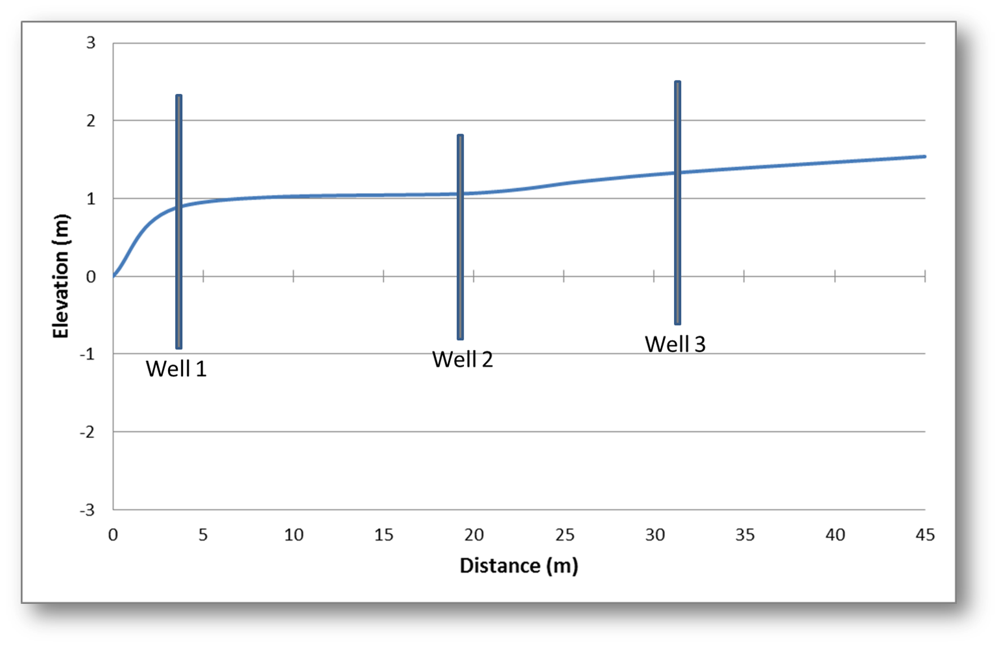
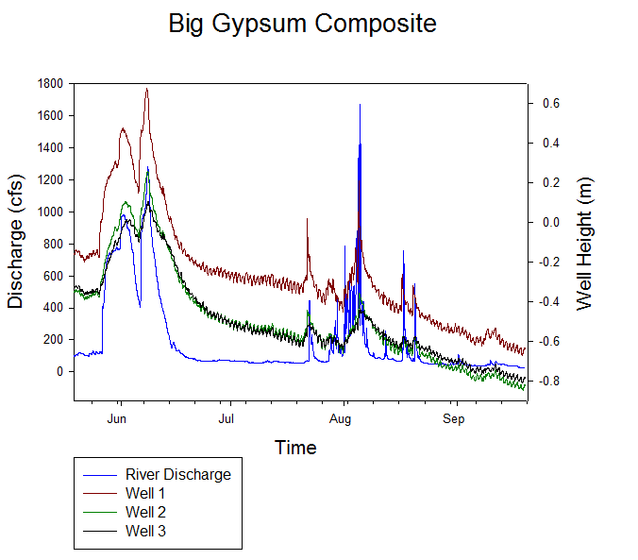
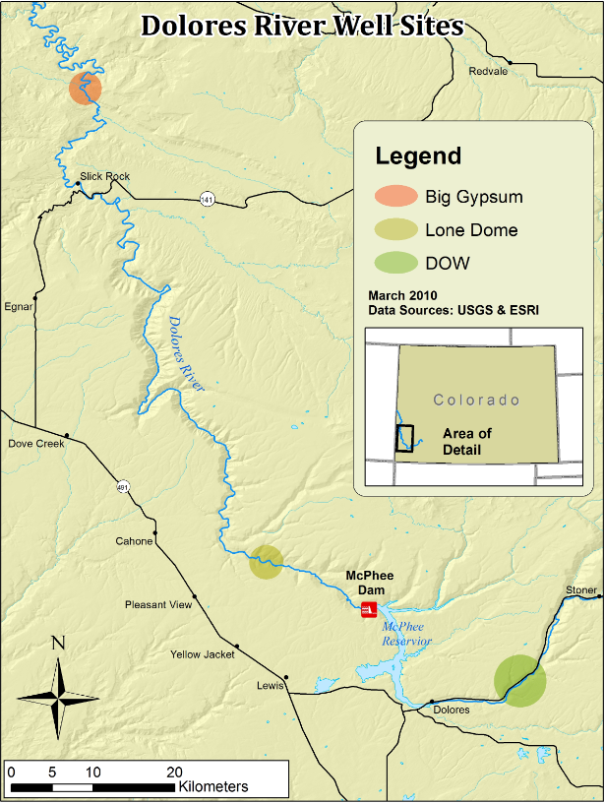
ground surface

Slide 9
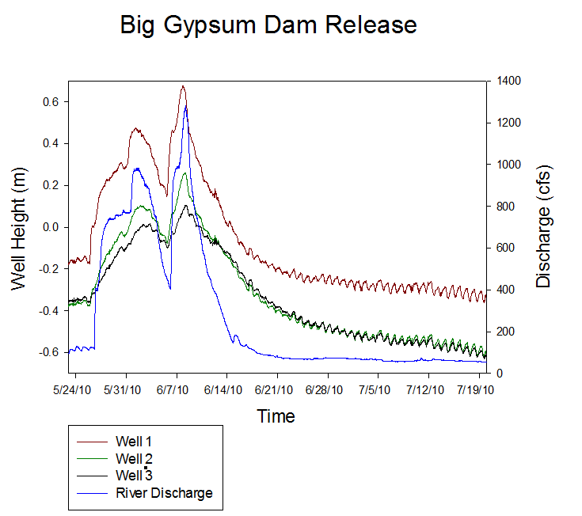
~1300 cfs
12 days
7 days
60 days
HIGH magnitude
LOW frequency
LONG duration
EFFECTIVE GROUNDWATER RECHARGE!

Slide 11
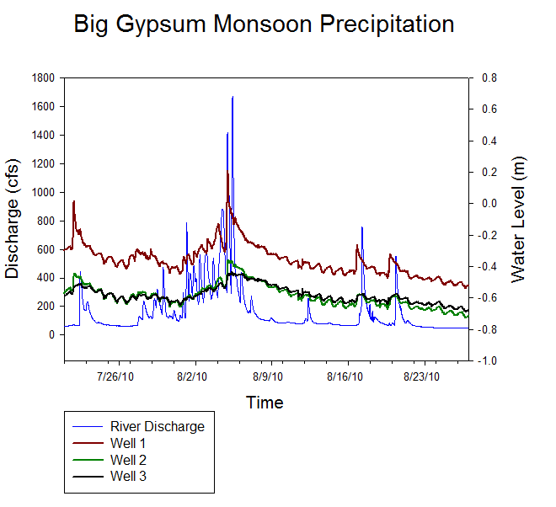
~1650 cfs > 1300
11 days of recharge
12 precip events
in 7 days
HIGH magnitude
HIGH frequency
SHORT duration
LESS EFFECTIVE GROUNDWATER RECHARGE!

Slide 12
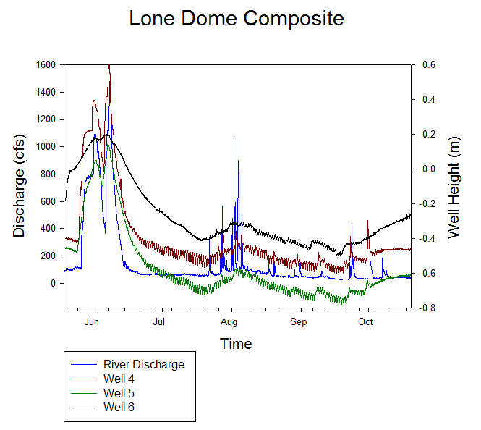
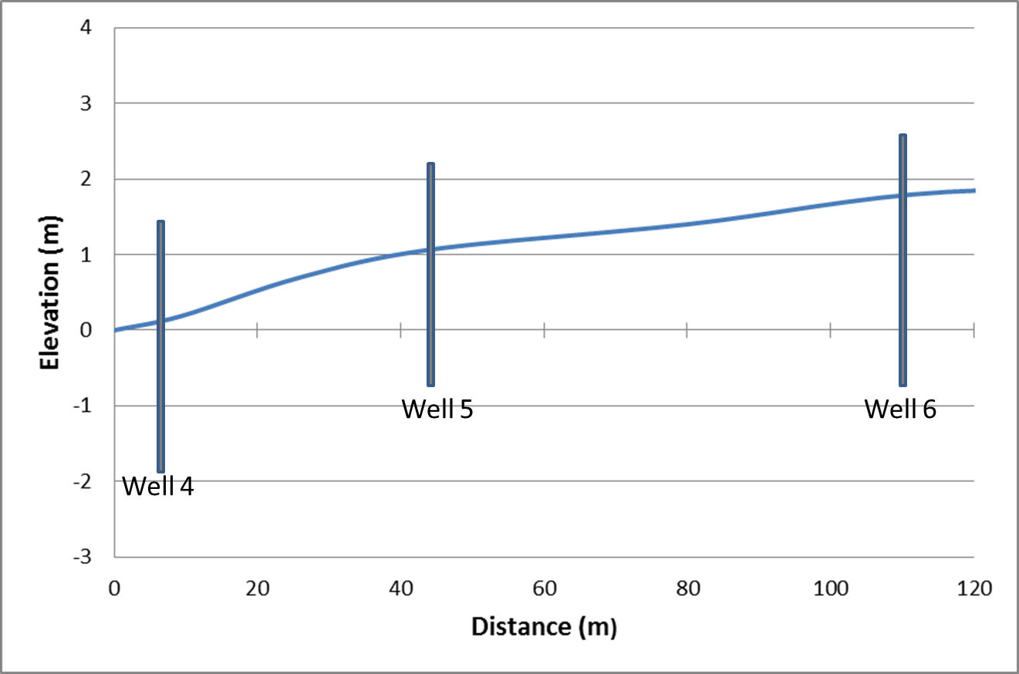
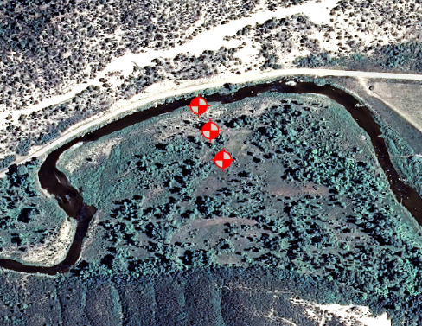
ground surface

Slide 13
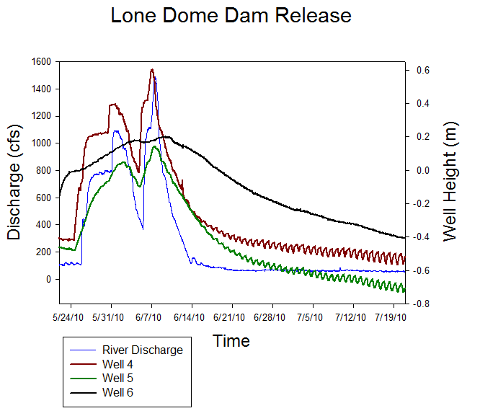
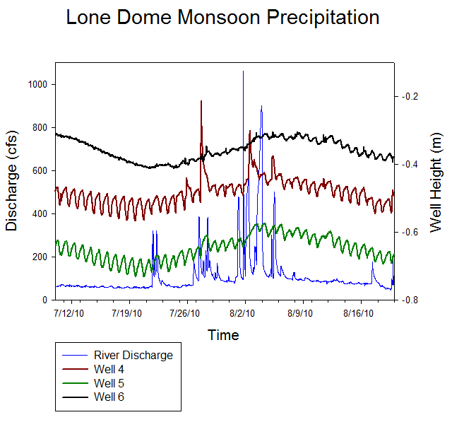
~1500 cfs
HIGH magnitude discharge
LOW frequency of events
LONG duration discharge
EFFECTIVE RECHARGE!
60+ days
20 days
1075 cfs
HIGH magnitude discharge
HIGH frequency of events
SHORT duration discharge
LESS EFFECTIVE RECHARGE
14 days
6 events

Slide 14
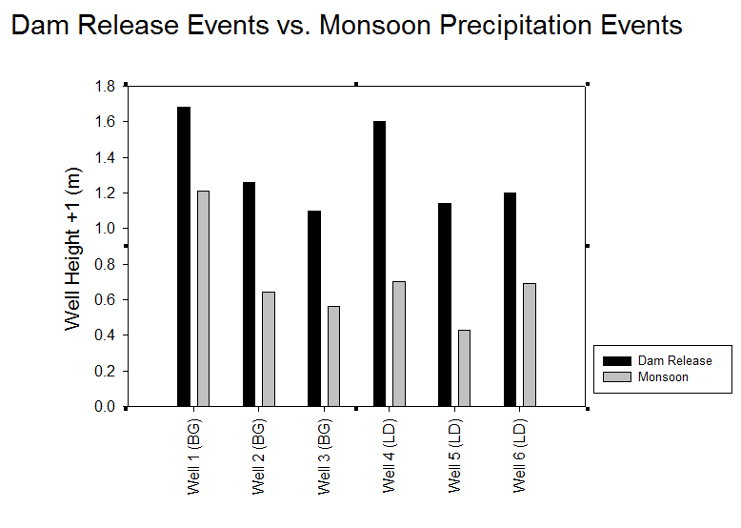

Slide 15
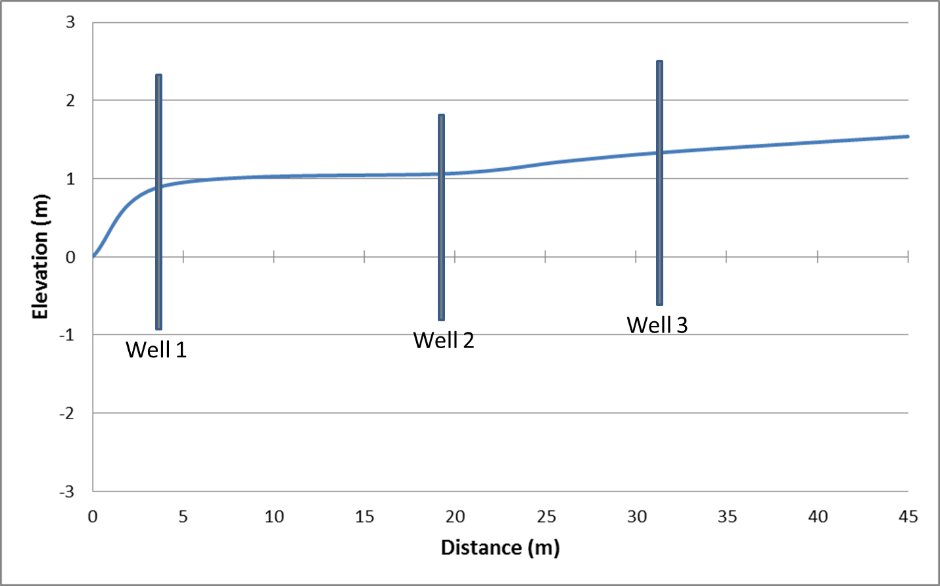
Big Gypsum Study Site
ground surface
Dam Release
Monsoon Precipitation
(Fetter, 2001)

Slide 16
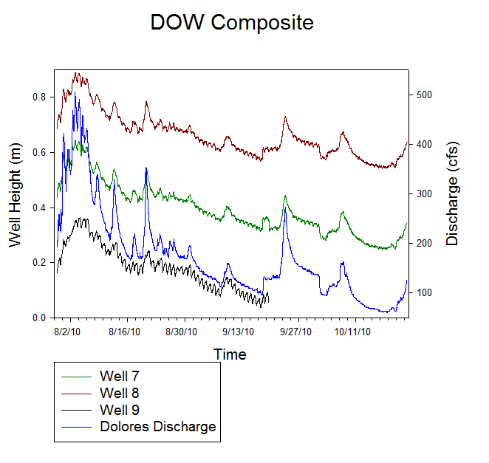
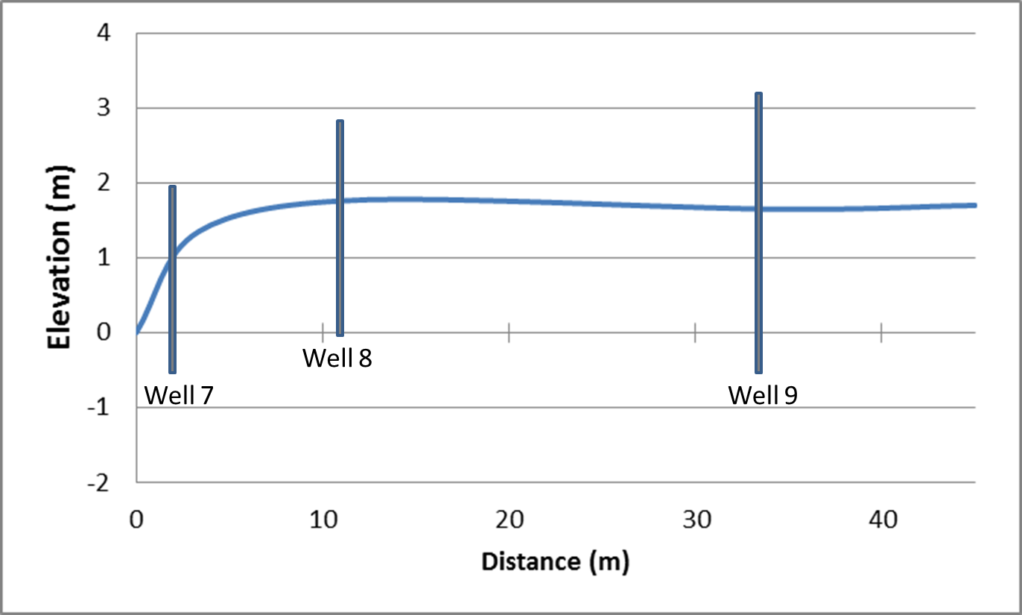
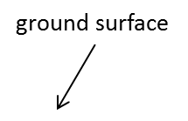
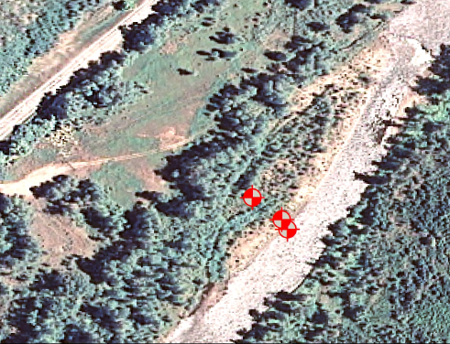

Slide 17
Diurnal Fluctuations

Slide 18
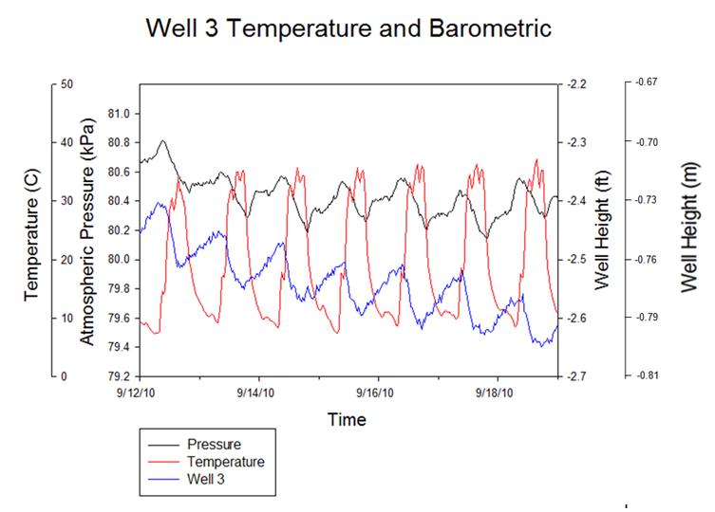
7 of 9 wells were directly proportional to barometric pressure
Low values: 16:30-17:30
This points to the use of water by phreatophyte plant species.
7 of 9 wells were also indirectly proportional to air temperature with <1 hr of offset
Notes:
Barometric is likely masked if it has an effect

Slide 19
In Summary

Slide 20
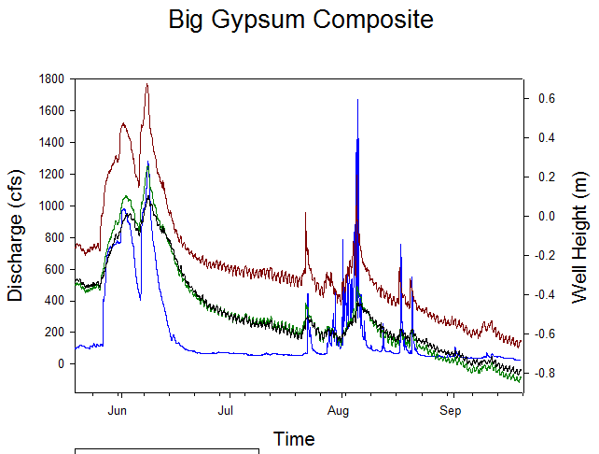

Slide 21
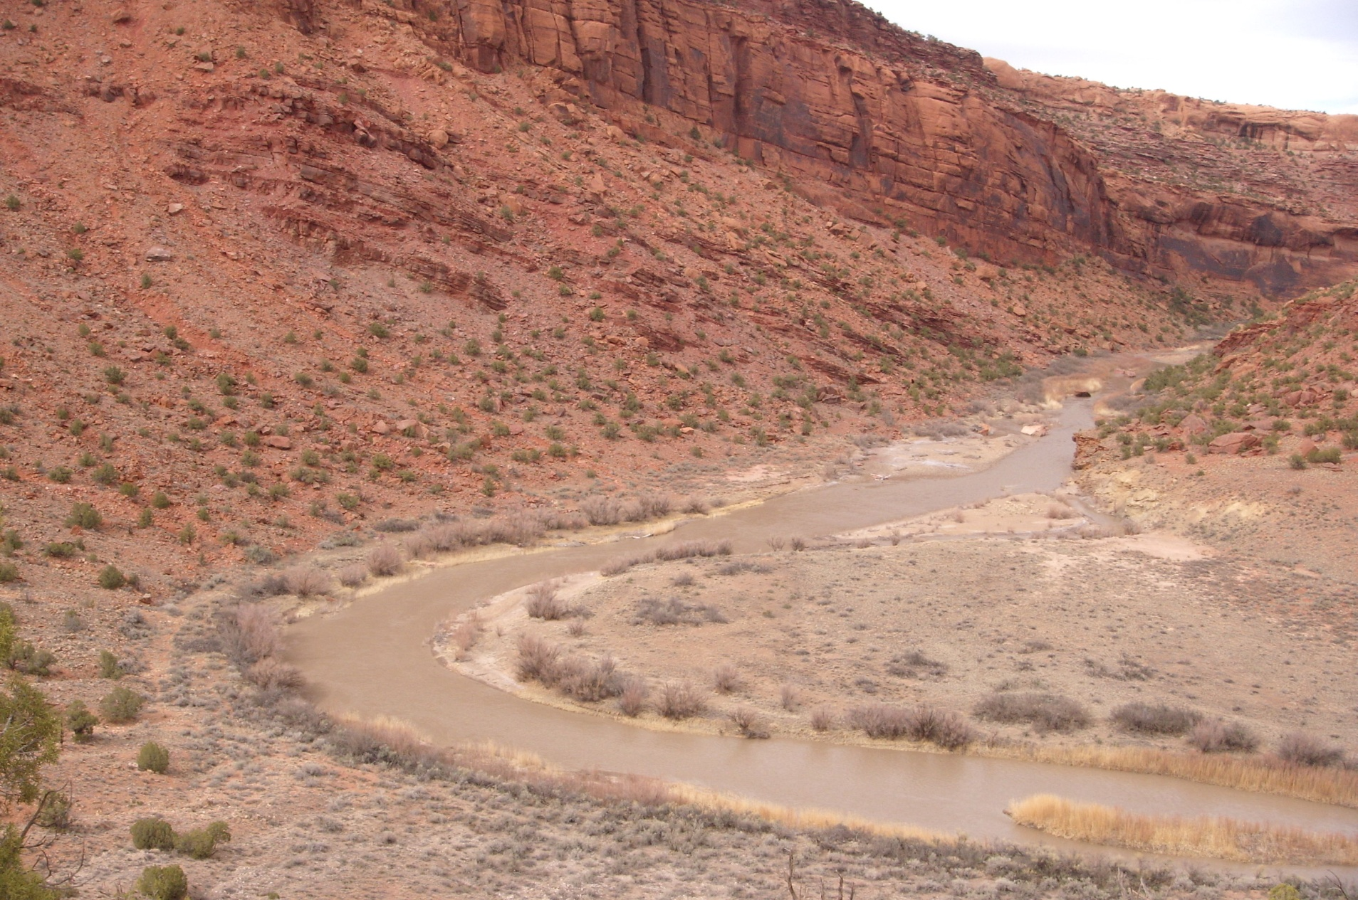
Conclusions
Significant downstream impacts on hydrology.
The duration, magnitude, and frequency of high flow events proved to be the important factors for groundwater recharge.
Long duration dam release events were found to be the principal contributor to recharge.
An increase in the duration of inundation is recommended for a more integrated ecological dam management system.

Slide 22
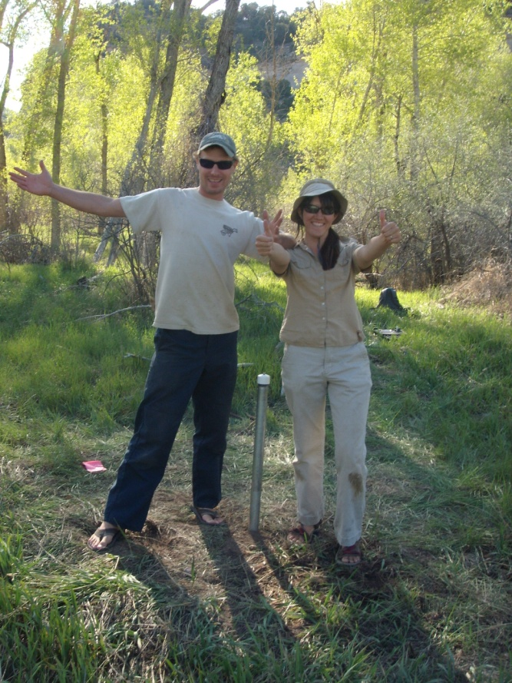
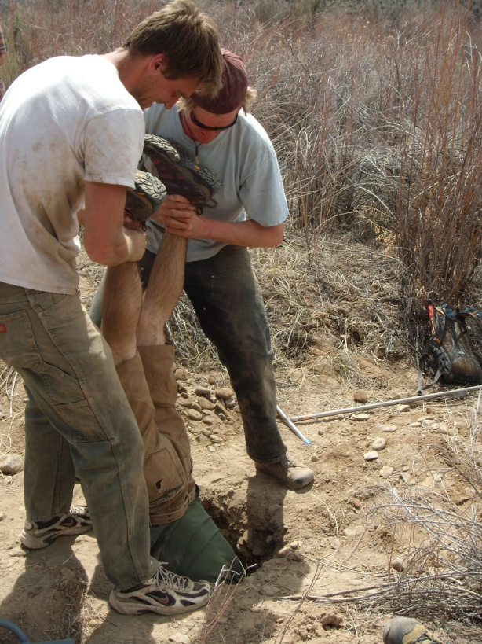
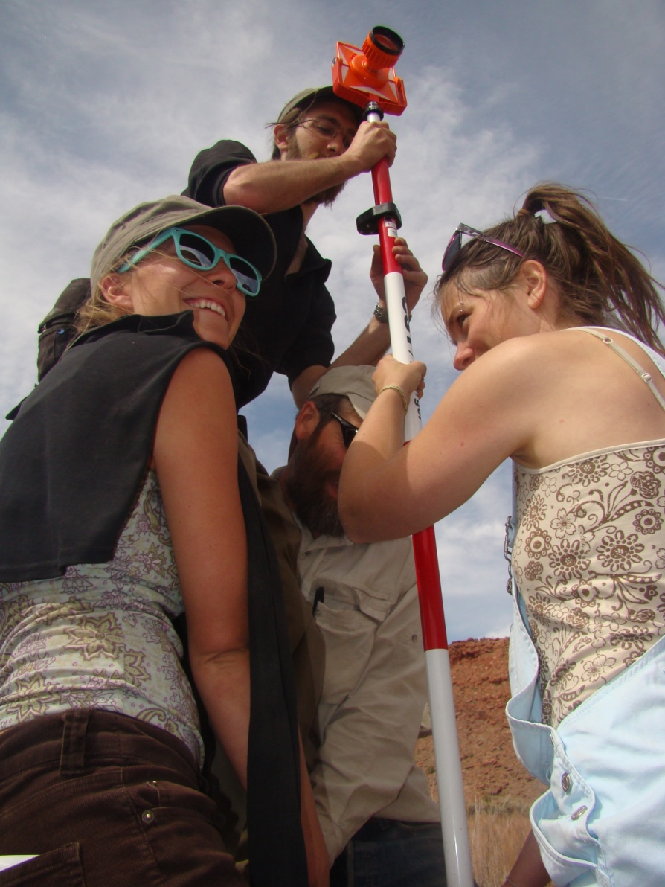
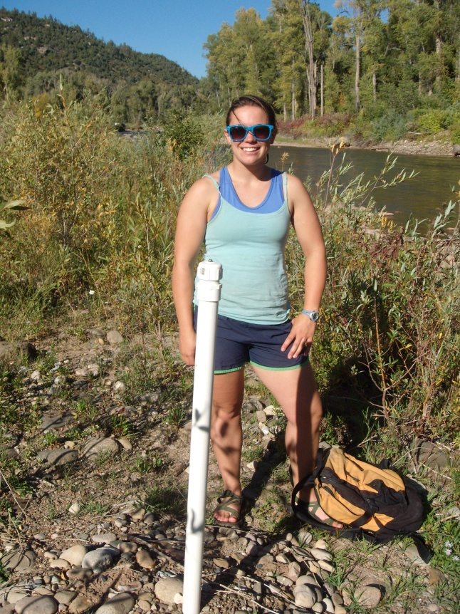
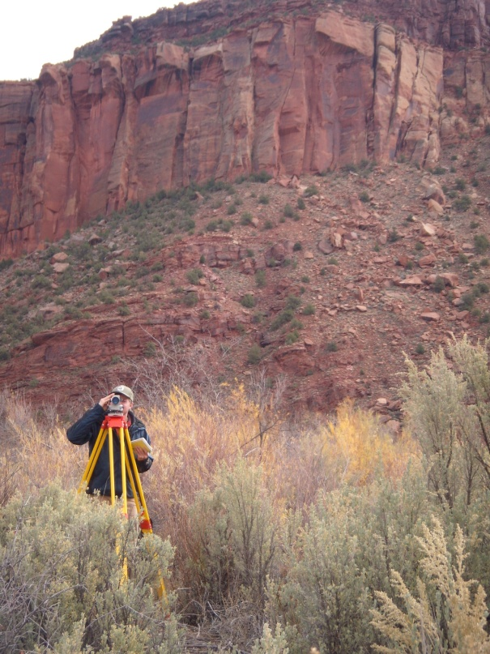
Acknowledgements
Special thanks to:
Fort Lewis College 2010 Groundwater Geology Class
Fort Lewis College Biology Summer Tamarisk Crew
Susannah Grannitto, Joshua Clutter, and Preston Carpenter
Dr. Maureen Brandon: Dean’s Grant
Dr. Ray Kenny
Dr. Julie Korb

Slide 23

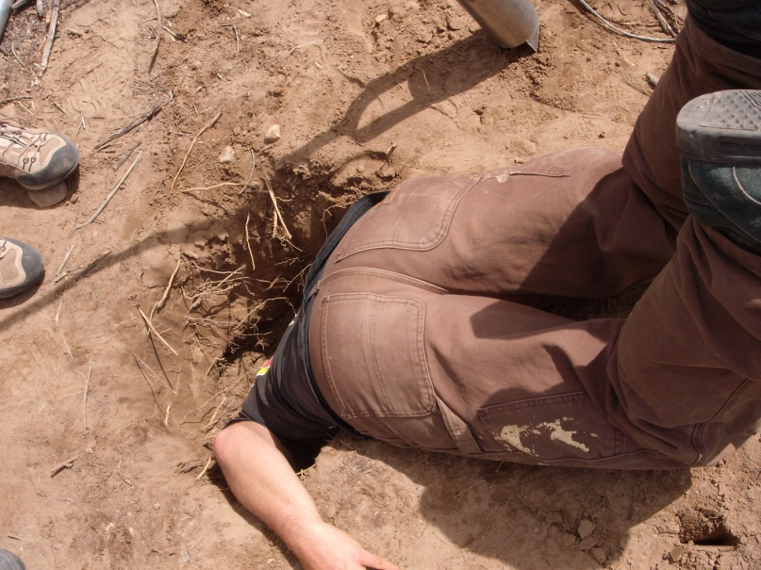
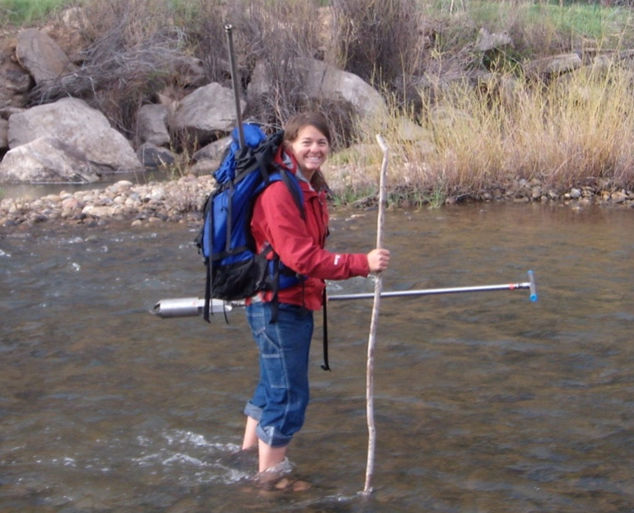
Any QUESTIONS????

