Slide 1
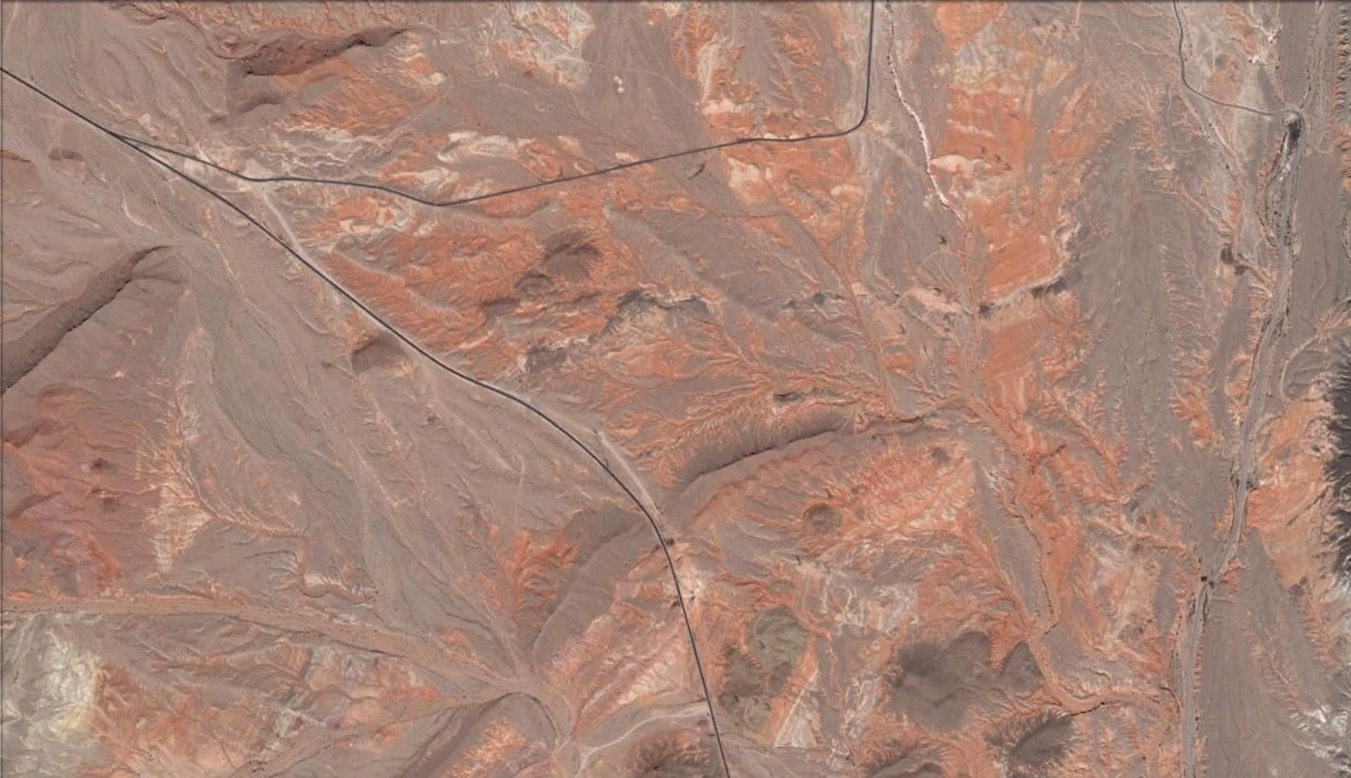
ANALYSIS OF BRECCIA LANDSLIDES WITHIN THE
LOWER HORSE SPRING FORMATION,
FRENCHMAN MOUNTAIN, LAKE MEAD, NEVADA
Rachelle Wagner, Mark Sitton,
Paul Umhoefer
Northern Arizona University
MIOCENE FAULT AND BASIN ANALYSIS, NORTHERN FRENCHMAN MOUNTAIN BLOCK, LAKE MEAD DOMAIN, NEVADA
Rachelle Wagner
Committee:
Dr. Paul Umhoefer
Dr. Ernie Duebendorfer
Sue Beard
Notes:
More information on these studies can be found at the following address:
http://www.cefns.nau.edu/Academic/Geology/programs/MS-geology/Theses/CompletedMSTheses.shtml
Search for Wagner (2010) or Sitton (2009).

Slide 2
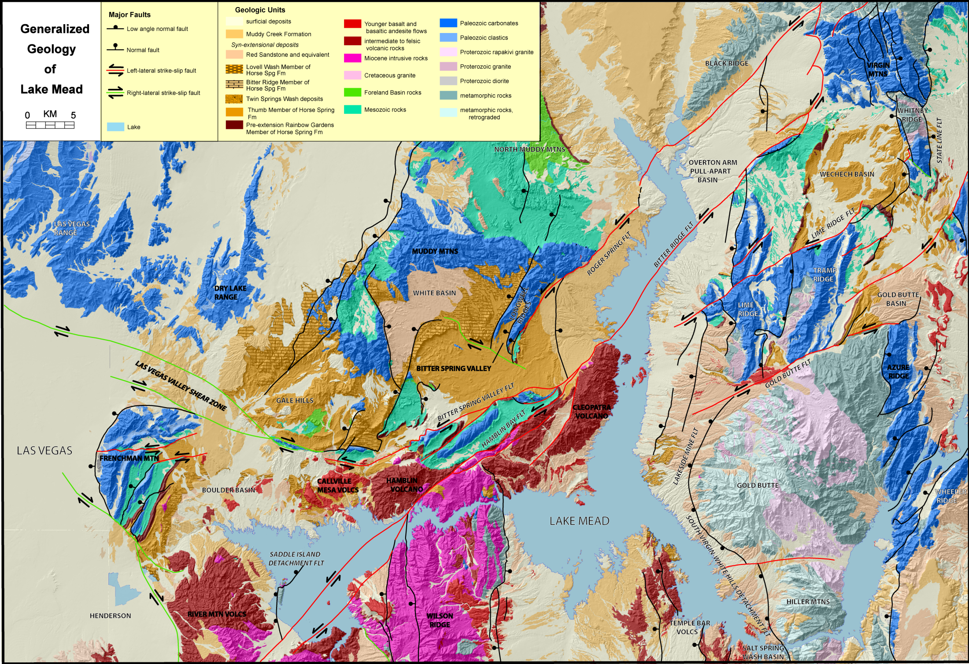
Active between
17 and 11 Ma
(Reiners et al., 2000; Fitzgerald et al., 2009)
Notes:
Generalized geology of the Lake Mead area. The legend at the top symbolizes all the Geologic Units. Key units related to this study are Proterozoic (lighter colors), Paleozoic (blue), Mesozoic (green), and Miocene (tan/beige). The Miocene intrusive volcanics and younger igneous units are symbolized by pink and dark red. The faults are marked in red for left-lateral, green for right-lateral, and black for normal. The Lake Mead fault system is made up of a series of left-lateral faults which progressed in time to the southwest. The Hamblin Bay fault (in the middle of the map) displaces the Hamblin-Cleopatra (13.1–10.1 Ma) stratovolcano by about 20 km. Figure from Beard et al. (2007).
The Gold Butte block was exposed by the South Virgin-White Hills detachment fault between 17 and 11 Ma based on apatite fission track and apatite and titanite (U-Th)/He thermochronology (Reiners et al., 2000; Fitzgerald et al., 2009). Exhumation of the Gold Butte block shed megabreccia deposits as landslides or rock avalanches onto the Frenchman Mountain block (Parolini, 1987; Rowland et al., 1990; Fryxell and Duebendorfer, 2005). Previous work investigating the source of these clasts suggests that the tectonically unroofed Gold Butte block was the source of the breccias (Parolini, 1987; Rowland et al., 1990; Fryxell and Duebendorfer, 2005).

Slide 3
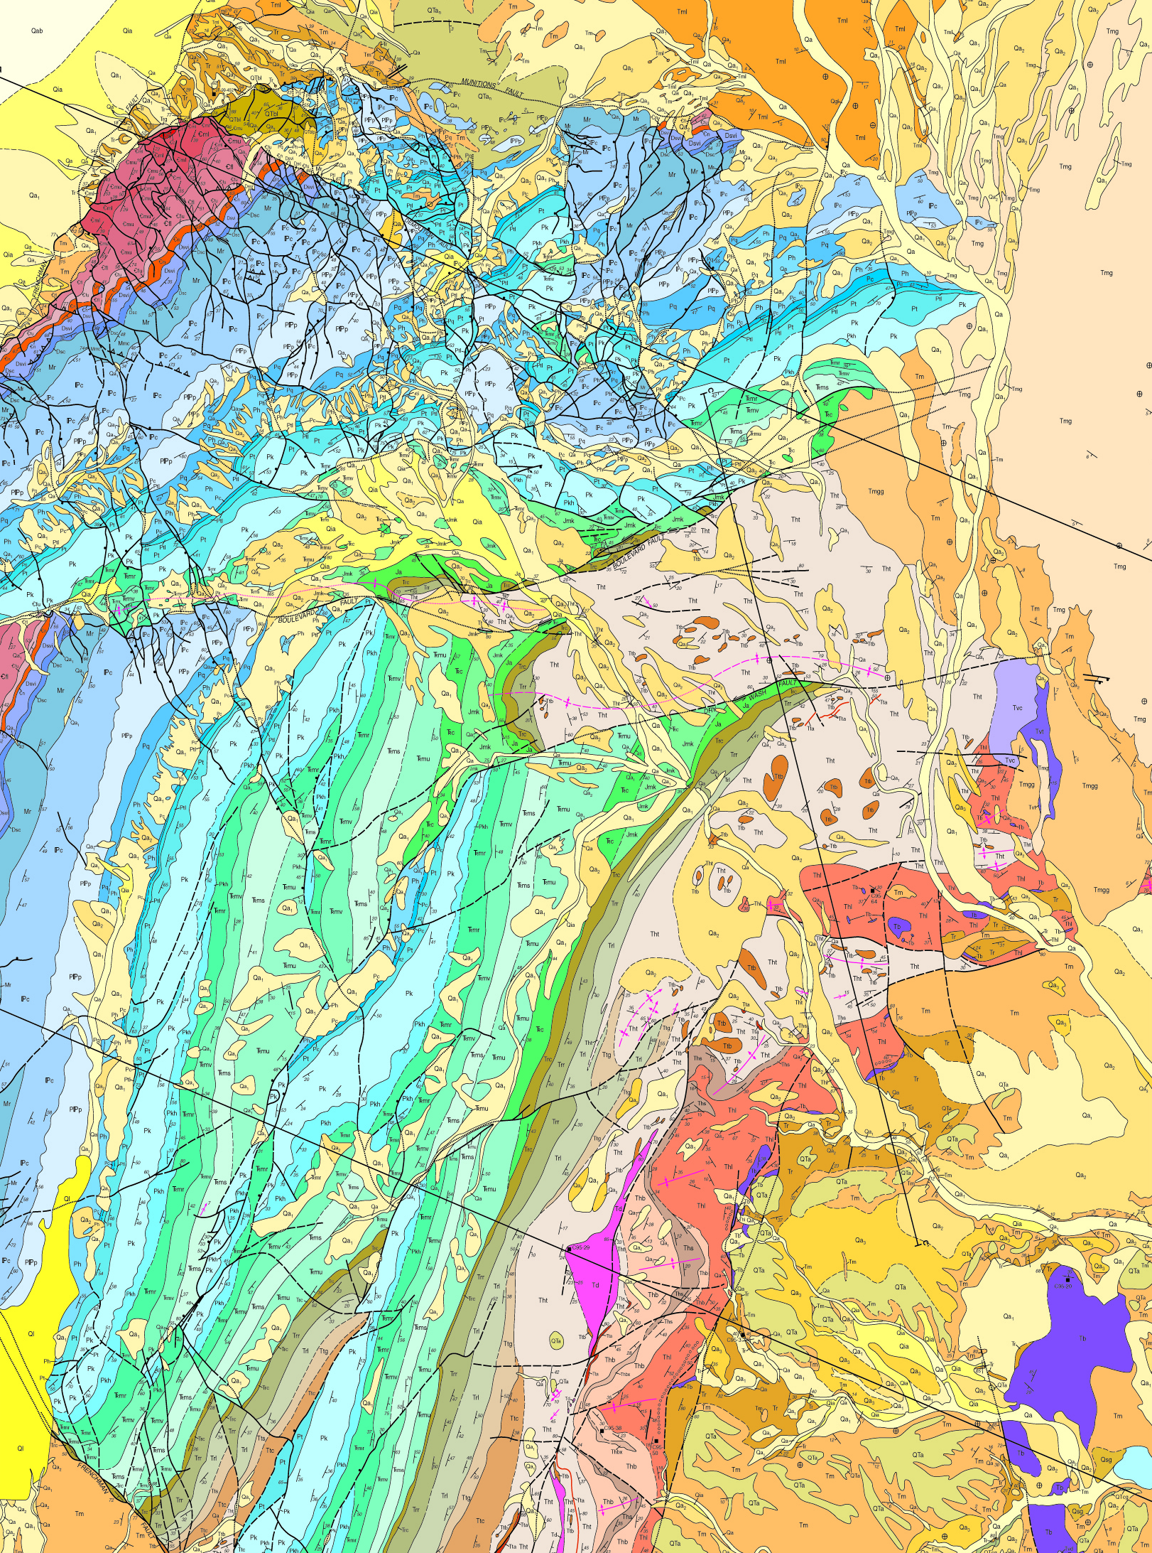
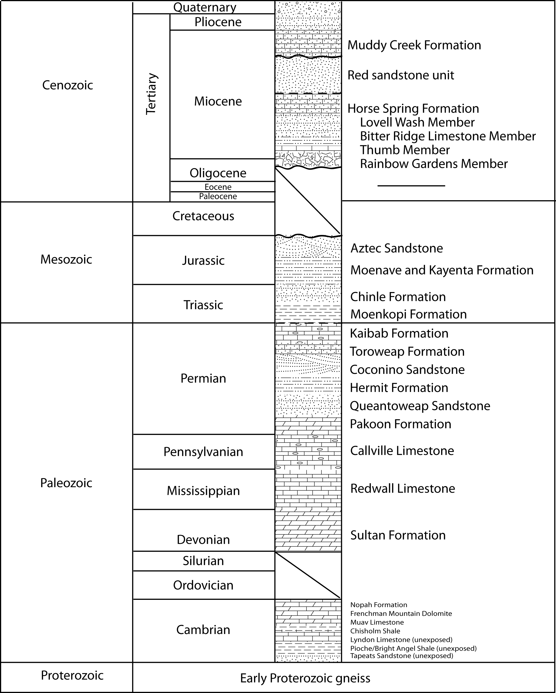
Frenchman Mountain quadrangle map
by Castor et al. (2000)
This study divides the Thumb Member at a 1:5000 scale.
Blue = Sitton study area
Yellow = Wagner study area
Notes:
The Frenchman Mountain Quadrangle by Castor et al. (2000) was used to define the study area. The tan colored Thumb Member inside the yellow square was subdivided at the 1:5000 scale for this study. South of the study area the Thumb is not well exposed and is covered with Quaternary alluvium. The study marked in blue was performed by Mark Sitton (MS Geology, NAU). His study performed measured sections and mapping of the Rainbow Gardens and Thumb Members. Together we defined the stratigraphy of the area. We also visited breccia outcrops to define and understand the different clasts and depositonal systems.

Slide 4
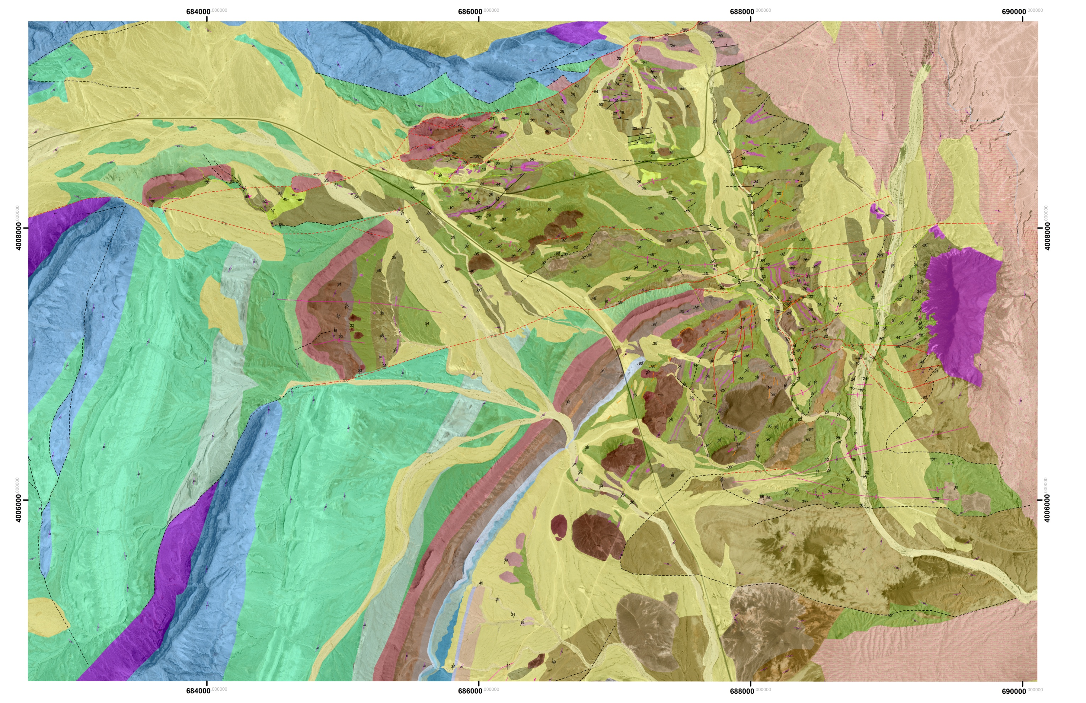
Geologic map of the study area 1:5,000
Boulevard fault zone
Dry Wash fault
1 km
N
Notes:
Map representing the yellow box from the previous slide at 1:5000 scale.
The orange box represents the next slide showing the location of the measured section. This was conducted in the most complete least faulted area with good exposure.
One thing to note about the breccia deposits: This study (Wagner, MS Geology, NAU) area contained 3 of the 4 breccia types found on Frenchman Mountain block. Breccia 1 is located in the Sitton (MS Geology, NAU) study area on the southernmost portion of Frenchman Mountain. It is not seen north of Lava Butte. The breccia deposits in this region are found as “corridors” and breccia outcrops. The corridors are observed in the washes in the same stratigraphic layer as the large breccia clasts deposits and are chaotically disrupted substrate. There are two deposits of Breccia 2 noted as 2a and 2b.

Slide 5
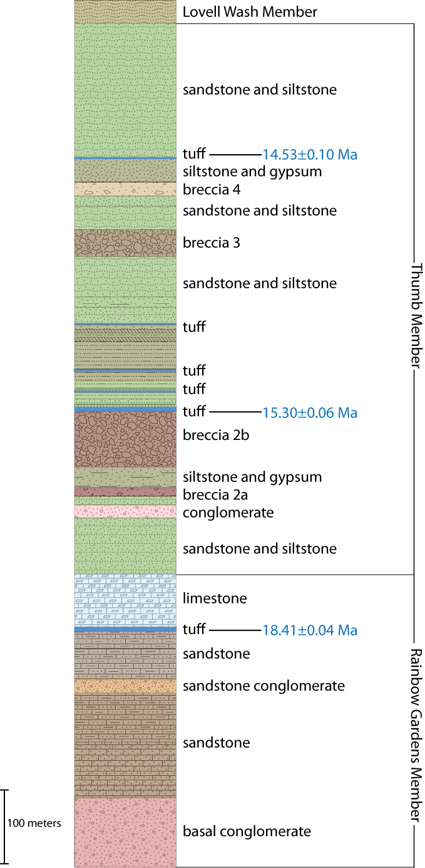
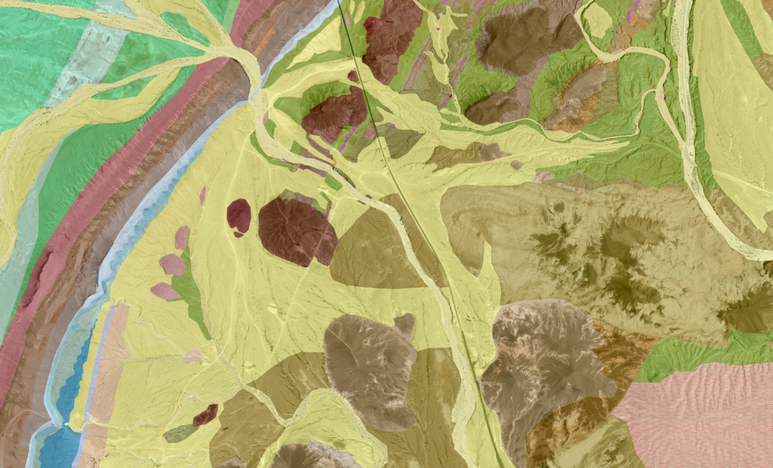
Stratigraphic column of the study area
14.53 ± 0.10 Ma
14.53 ± 0.10 Ma
15.30 ± 0.06 Ma
15.30 ± 0.06 Ma
18.41 ± 0.04 Ma
N
18.41 ± 0.04 Ma
140m
Measured section from Sitton (2009)
Notes:
The stratigraphic column on the right represents the measured section marked on the map from Sitton (MS Geology, NAU). The map shows the location of dated tuff samples and their representative dates.
Things to note on the stratigraphic column: Above the basal conglomerate, the Rainbow Gardens Member contains mostly flat bedded sandstones and limestone in this area, which represent fluvial or lake deposits. In the Thumb Member the sandstone deposits are mostly fluvial deposits with down lapping structures. There are also several tuffs in this portion of the Thumb Member. Low in the section is a conglomerate consisting mostly of Mesozoic clasts with four overlying breccia deposits. The Thumb Member conglomerate beds range from 5-30 cm thick and consist of sandstone, matrix-supported pebble conglomerate, and clast-supported cobble conglomerate. The conglomerate contains thin (3-5 cm) sandstone beds that contain tabular and trough cross beds with uncommon planar beds (5-10 cm thick). The Thumb Member conglomerate suggests the beginning of tectonic activity.
One outcrop of conglomerate and pebbly sandstone, south of the measured section, consists of beds that shallow from 82° to 34° dips to the east. Generally, the beds are steeper to the west and progressively become shallow to the east. The clasts range from pebbles to cobbles with rare boulders and contain a higher amount of quartzite clasts. Sets of beds (0.5 m to 1 m ) have kink-like folds and faults, which affect several beds. There are more kink folds in the steeply dipping beds and fewer kink folds in the shallower dipping beds. The beds display soft sediment deformation manifest as thickening in the hinges of the kink folds.
The soft sediment deformation observed is hypothesized to form from the faulting plastically deforming the beds. The overlying breccia units (2a and 2b) do not display evidence of local faulting within the Thumb Member beds. This suggests that the conglomerate in this location was faulted shortly after deposition at ~15.6 Ma and prior to the tuff sample dated at 15.30 Ma, located 150 m up section. This is the first indication of faulting during deposition in the study area.

Slide 6
Sedimentation rates and estimated deposit ages
~15.6 = Thumb Member conglomerate
Key marker beds estimated by 3 tuff dates
estimated deposit ages (Ma)
dated tuff | 18.41
conglomerate | 15.6
breccia 2a | 15.5
breccia 2b | 15.3
dated tuff | 15.30
undated tuff | 15.3
undated tuff | 15.2
undated tuff | 15.0
breccia 3 | 14.8
undated tuff | 14.7
breccia 4 | 14.6
undated tuff | 14.5
dated tuff | 14.53
Notes:
Sedimentation rates for three dated tuffs with interpolations from projected tuff dates. On the graph, the dated tuff samples are marked in blue on a graph of time vs. cumulative thickness. The blue solid lines represent the sedimentation rates between the tuff sample ages. The green dashed lines are estimates of sedimentation rates based on interpolations from the stratigraphic position of the conglomerate, which is evidence for beginning of faulting and the shift to increased sedimentation rates. Table provides dated sample ages (in bold) and estimated ages of units overlying the conglomerate based on the 462m/m.y. calculated sedimentation rate. Cumulative thickness derived from stratigraphic column.

Slide 7
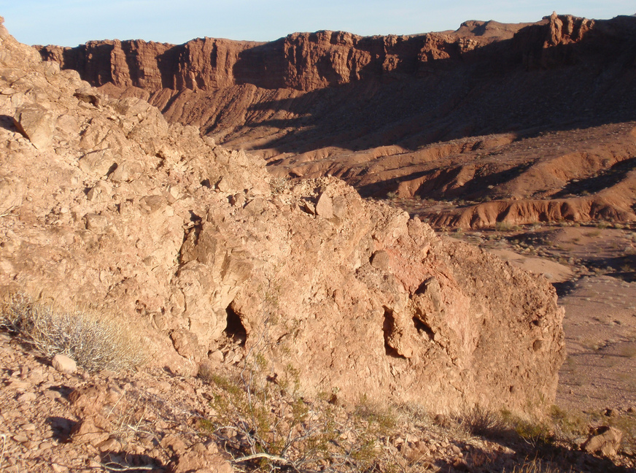
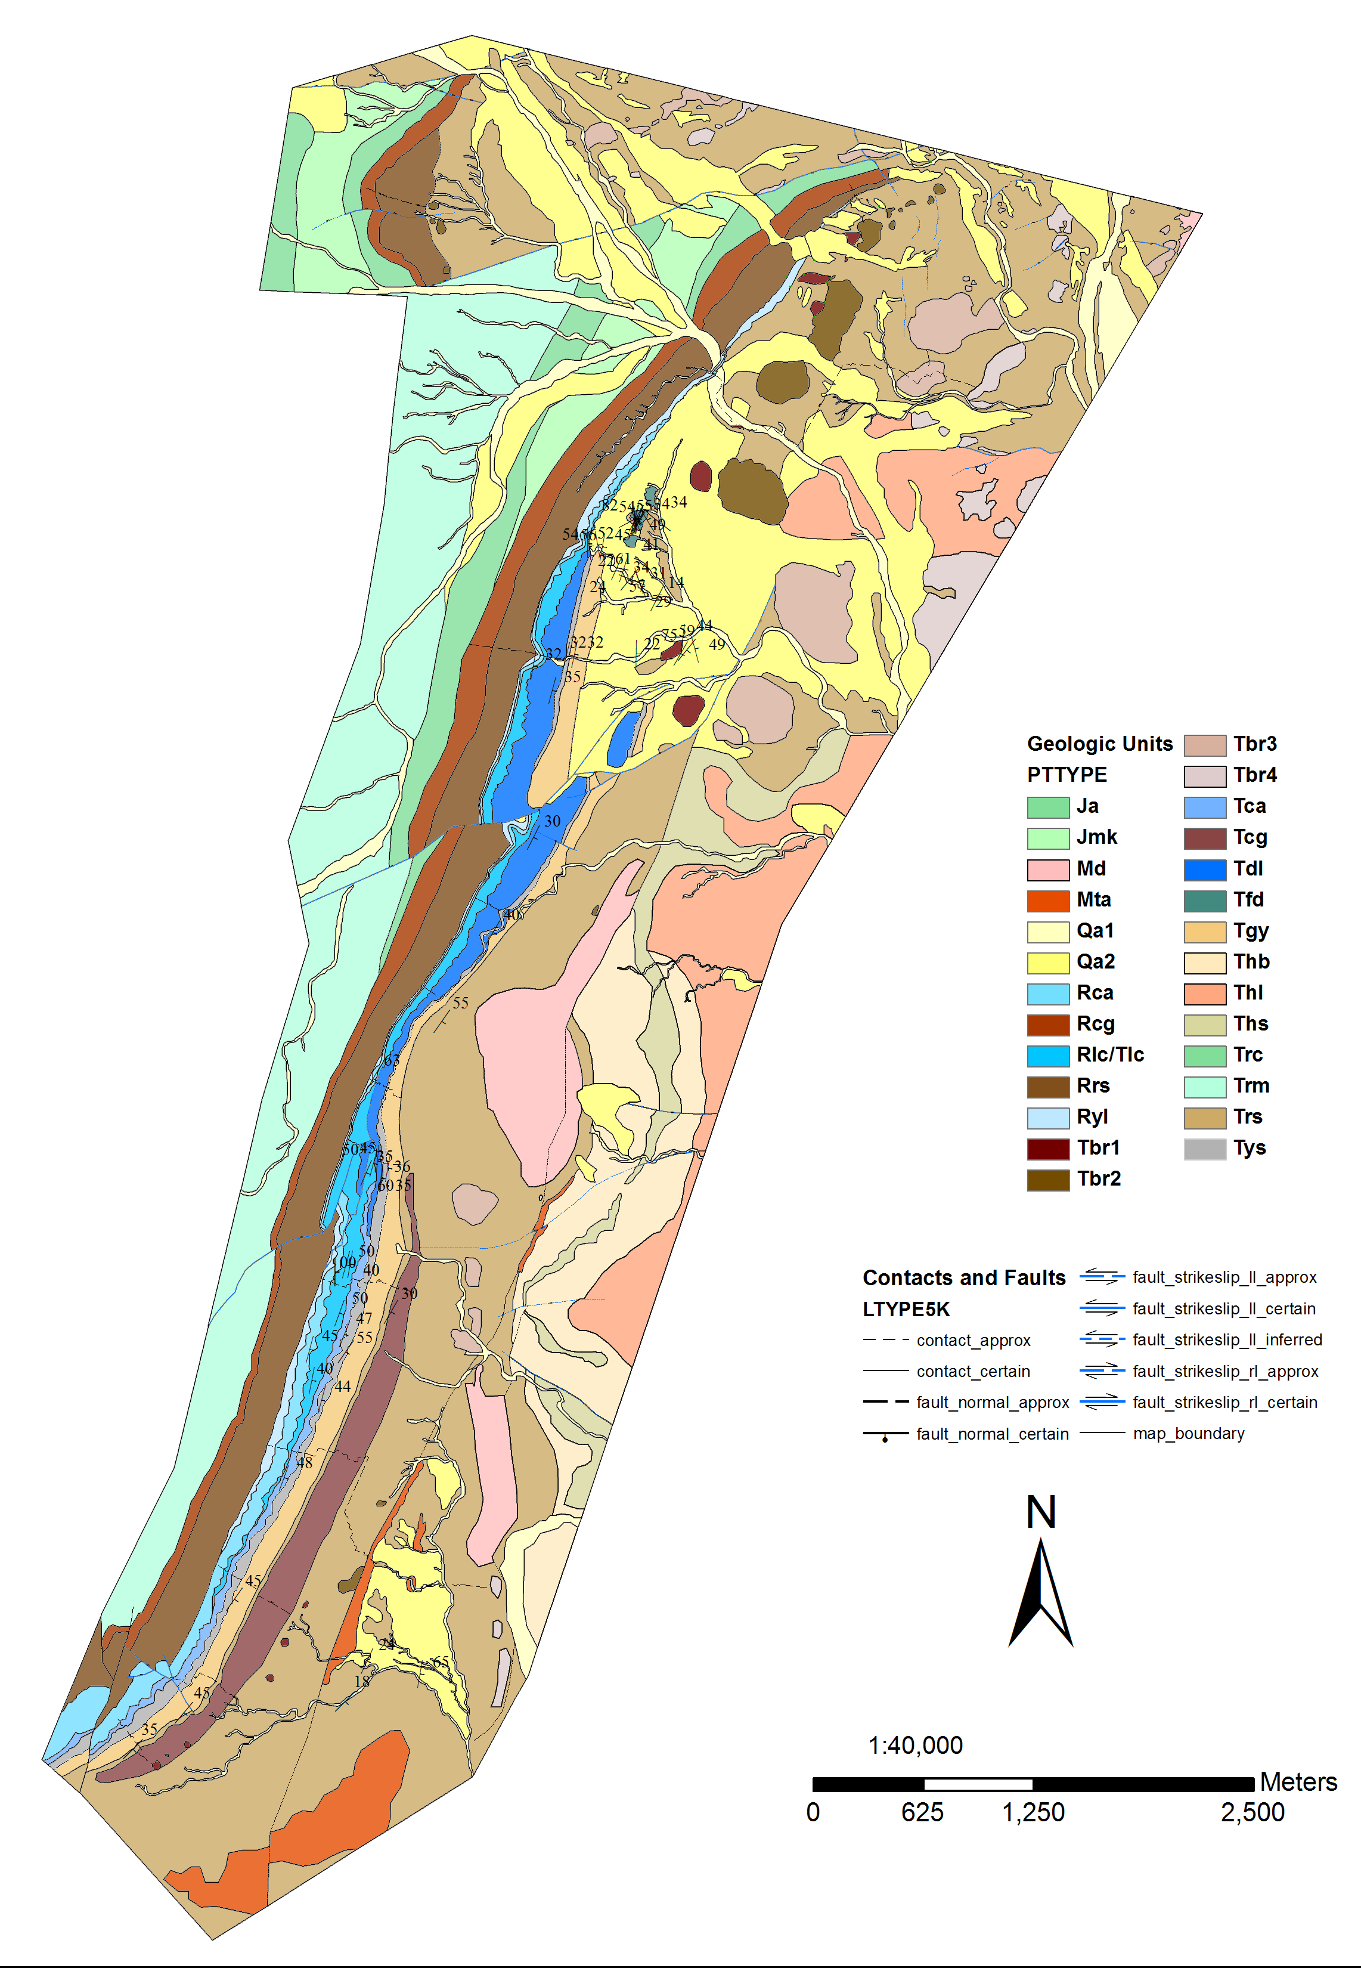
Megabreccias of the Thumb Member
locations of
breccia 1
Notes:
Geologic map from Sitton (MS Geology, NAU) and the location of Breccia 1. The picture shows an outcrop of Breccia 1. This breccia is monomictic consisting of a leucocratic granite not seen elsewhere on Frenchman Mountain block.

Slide 8
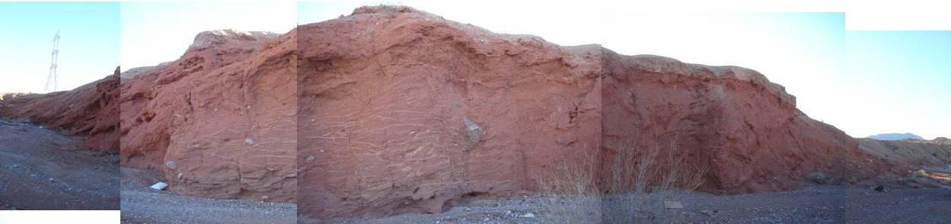
Megabreccias of the Thumb Member
1m
locations of breccia 2a
estimated deposit age of 15.54 Ma
Notes:
Location map and photograph of Breccia 2a outcrops and corridors of disrupted substrate. The composite photograph shows an outcrop of the breccia corridor. Note the secondary gypsum veins and widely distributed crystalline breccia clasts in a massive deposit. The breccia 2 (a&b) clasts are polymictic and consist of fine-grained granite, megacrystic (rapakivi) granite, biotite and pegmatite gneiss, garnet gneiss, and feldspathic gneiss.

Slide 9
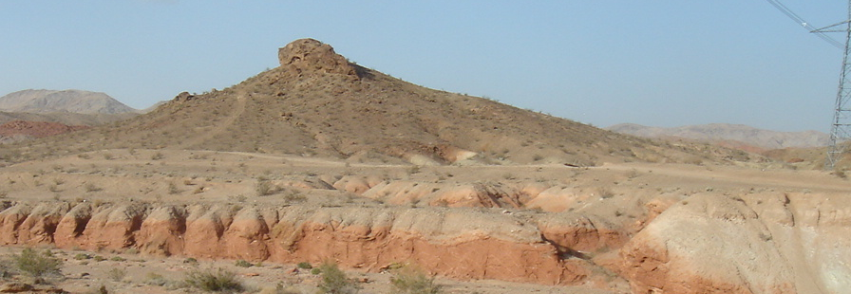
Megabreccias of the Thumb Member
B
5 cm
D
locations of breccia 2b
estimated deposit age of 15.3 Ma
0.5 m
Notes:
Location map and photograph of Breccia 2b outcrops and a corridors of disrupted substrate. The photograph shows an example of the breccia outcrop (dark knob in the distance) and the corridor (red strata exposed in the wash).

Slide 10
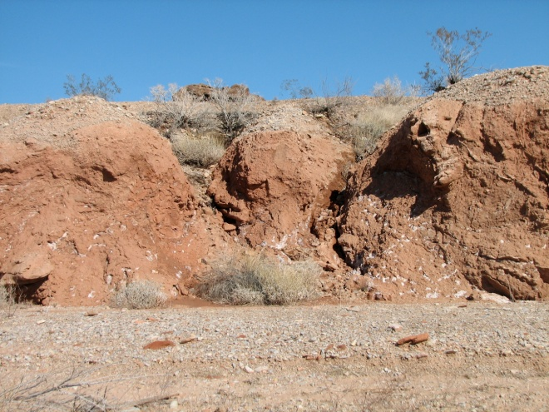
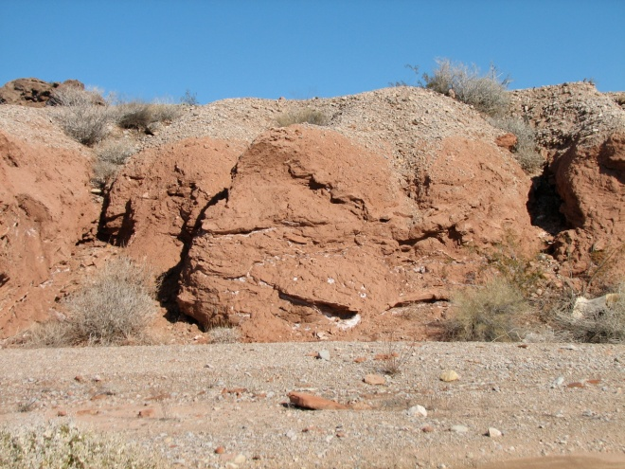
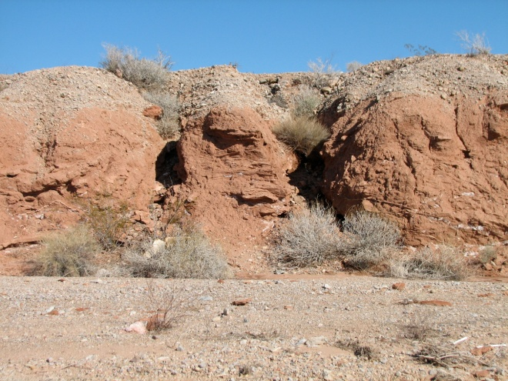
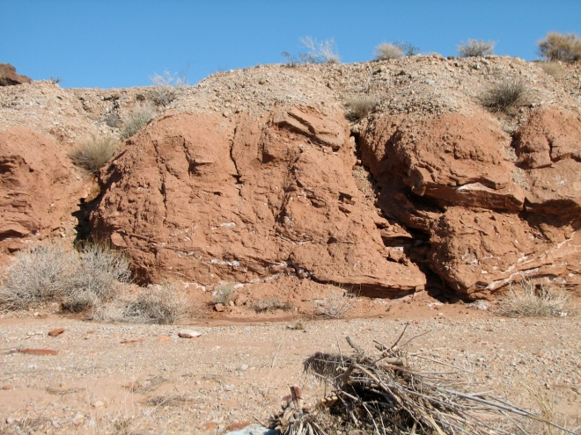
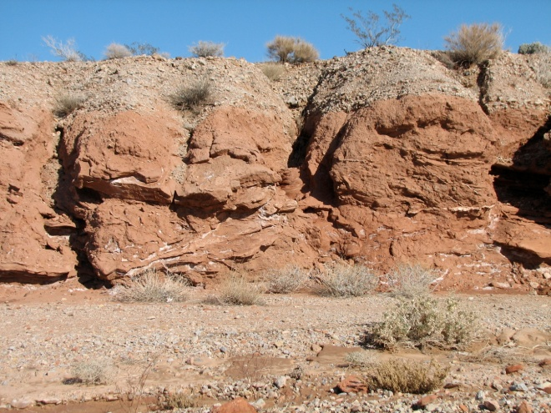
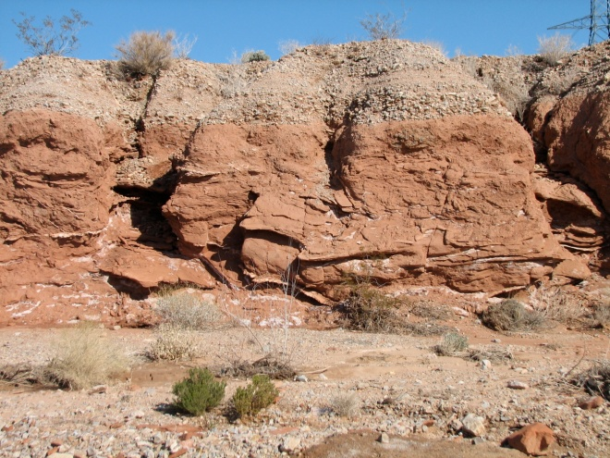
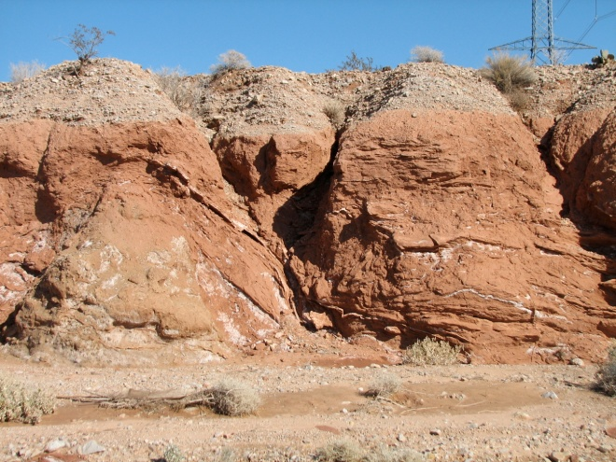
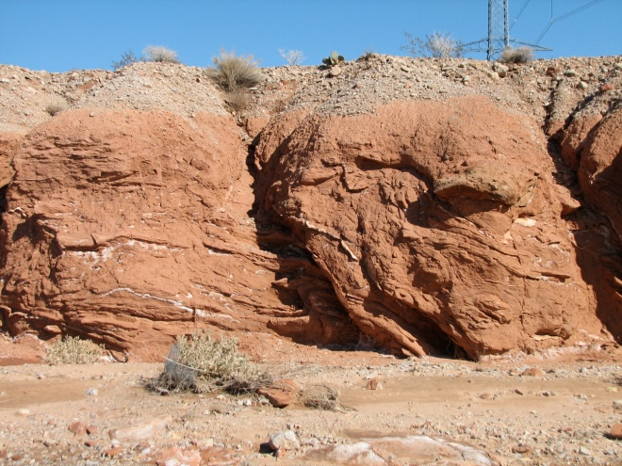
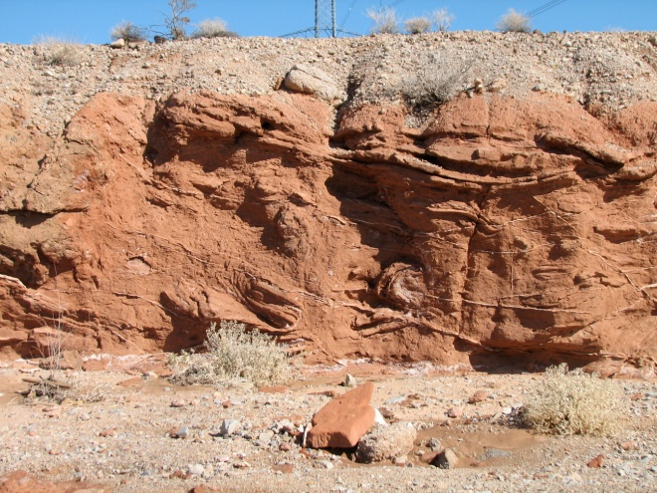
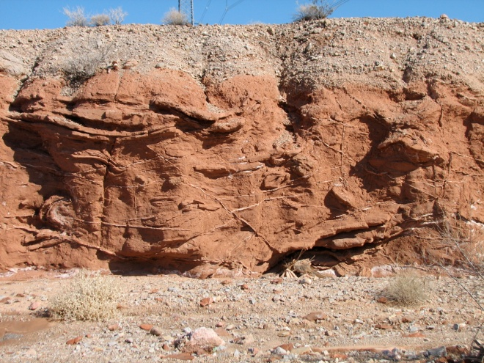
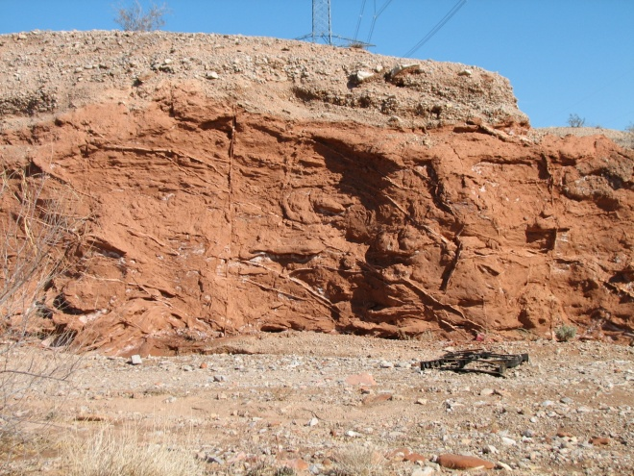
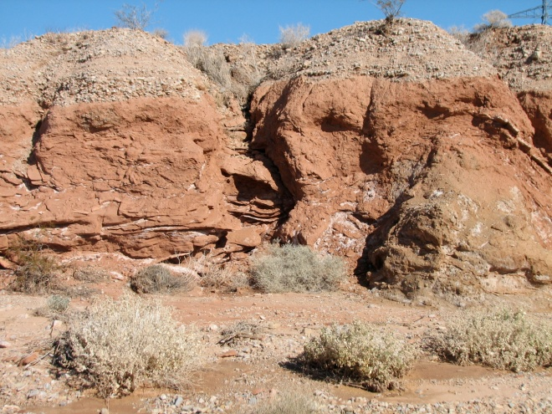
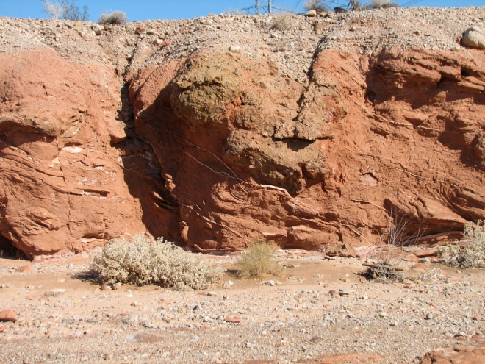
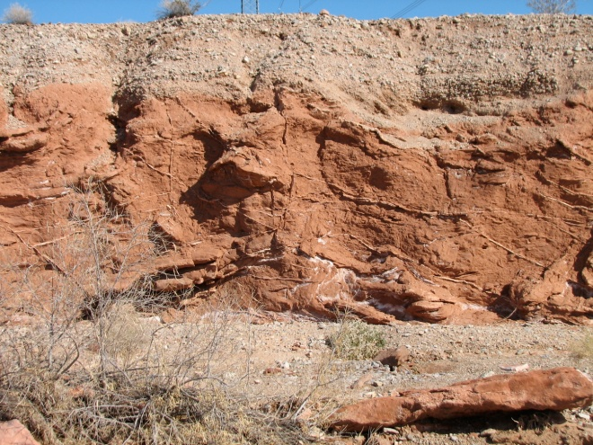
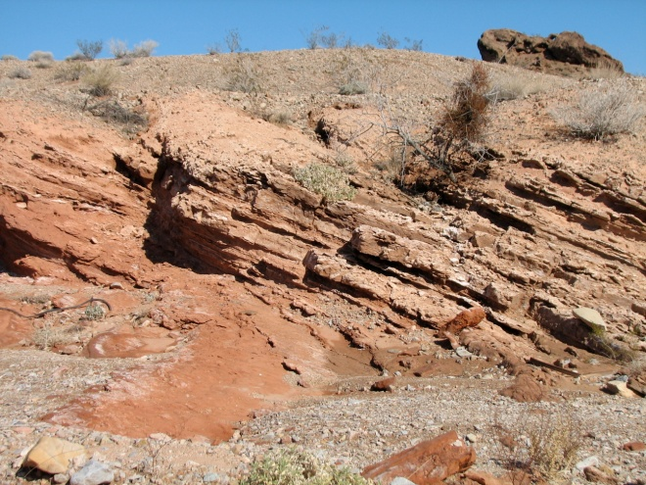
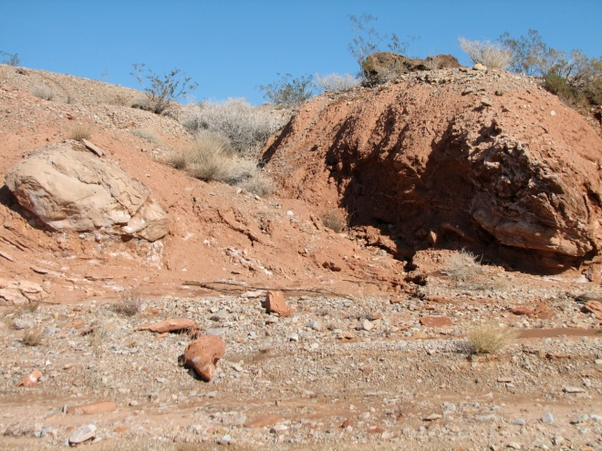
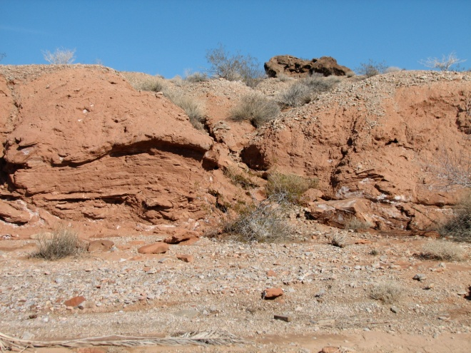
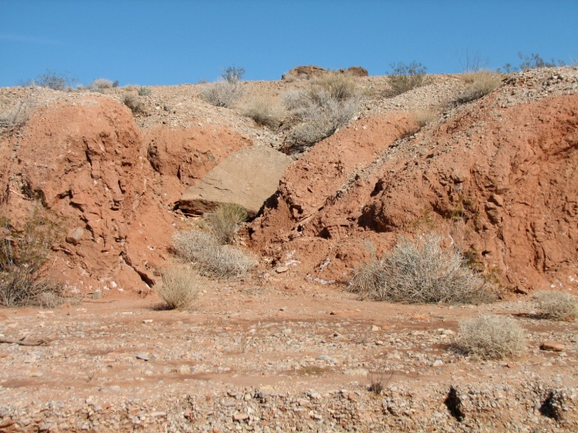
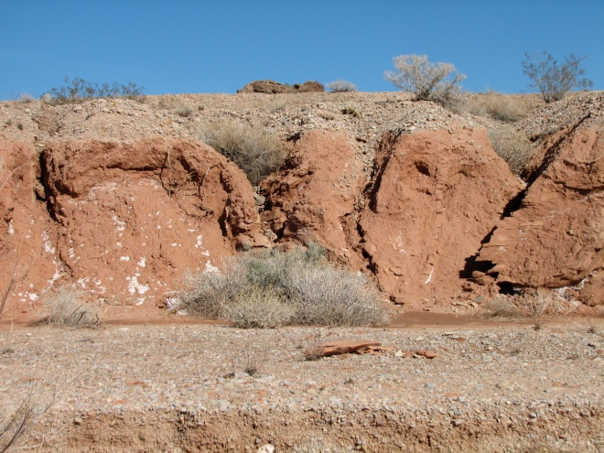
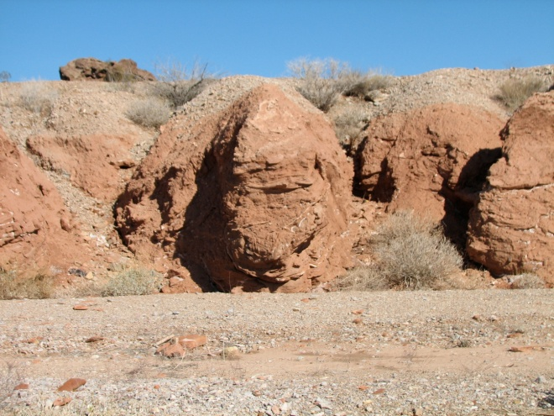
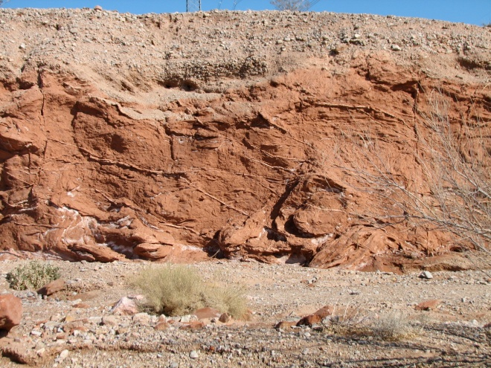
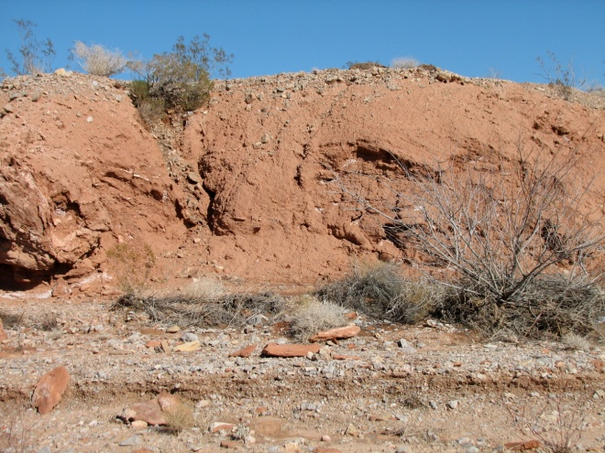
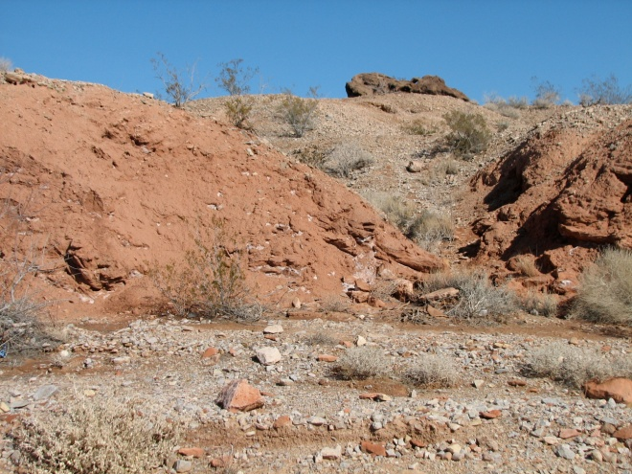
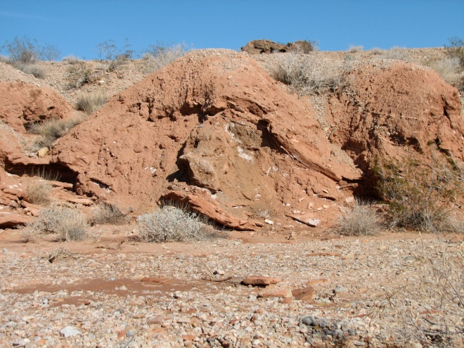
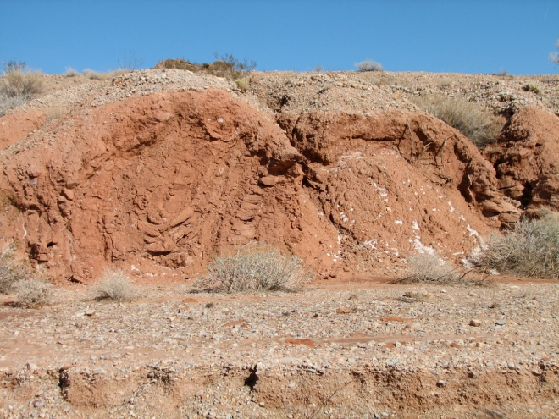
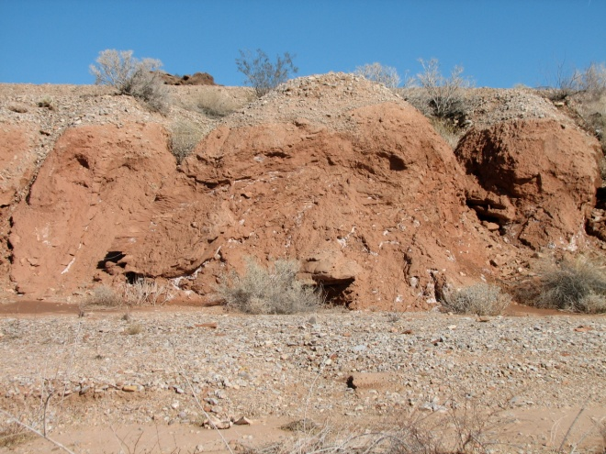
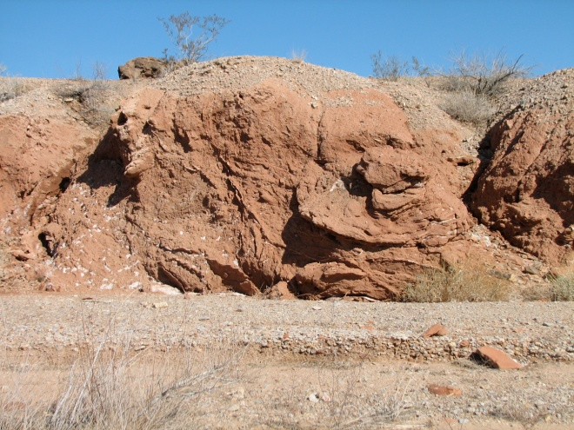
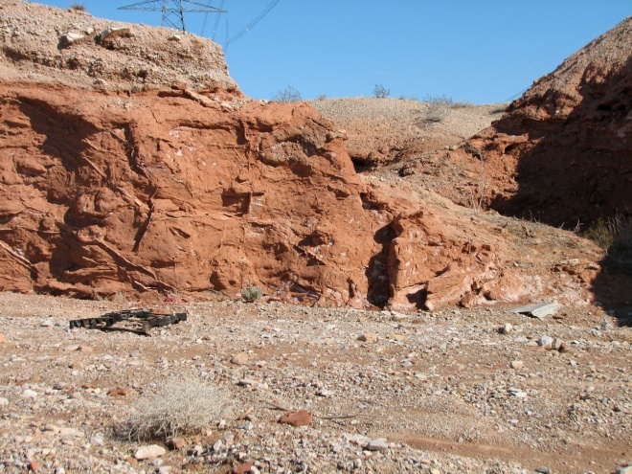
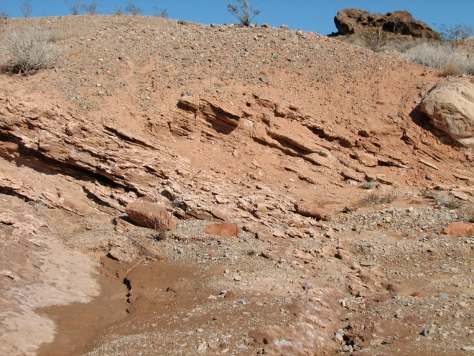
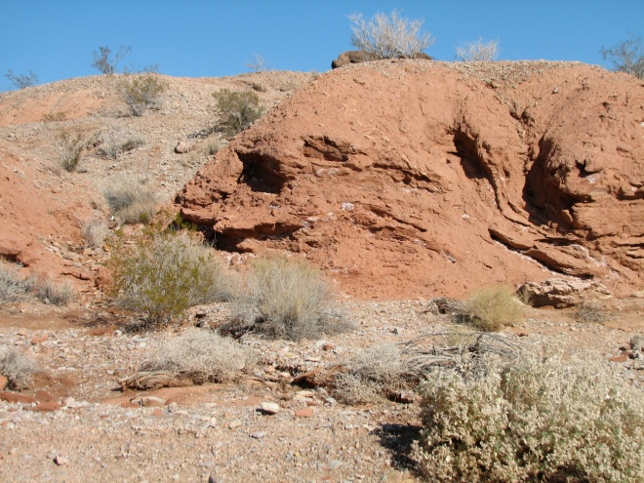
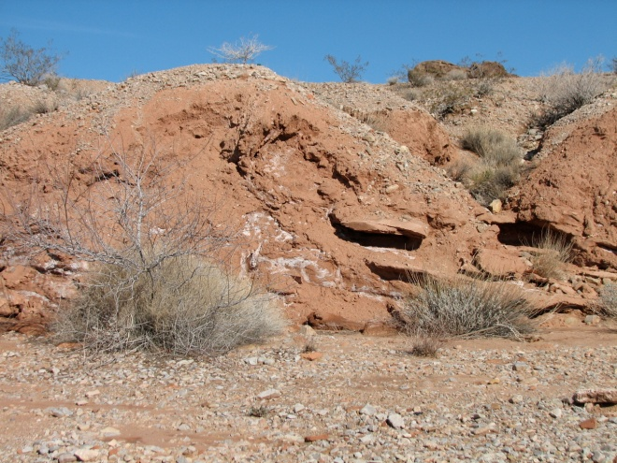

Breccia 2b corridor
N
140m
Notes:
Photographic montage of structural features within an exposure of breccia 2b facing north-northeast in Kodachrome Wash. The photographic montage is linked by the right side of the top row to the left side of the next row. Horizontal distance of montage is ~180 m. Map shows the location of the outcrop.
The bottom of the section shows well bedded flat lying strata. Up section the strata become a corridor of deformed substrate with a few large crystalline breccia clasts. The next slide shows the top of the section.
The axial planes and plunge of the folds of the bedding were measured and plotted on a stereonet.

Slide 11
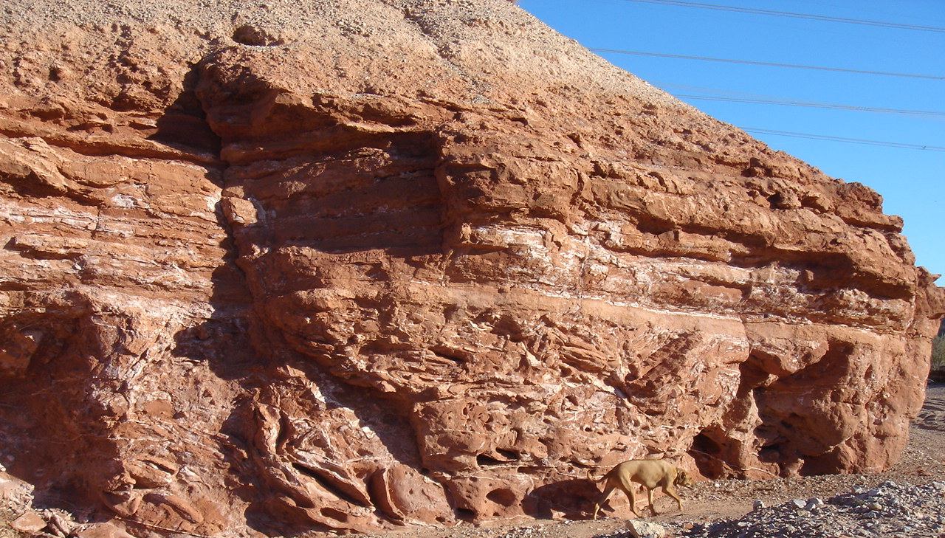
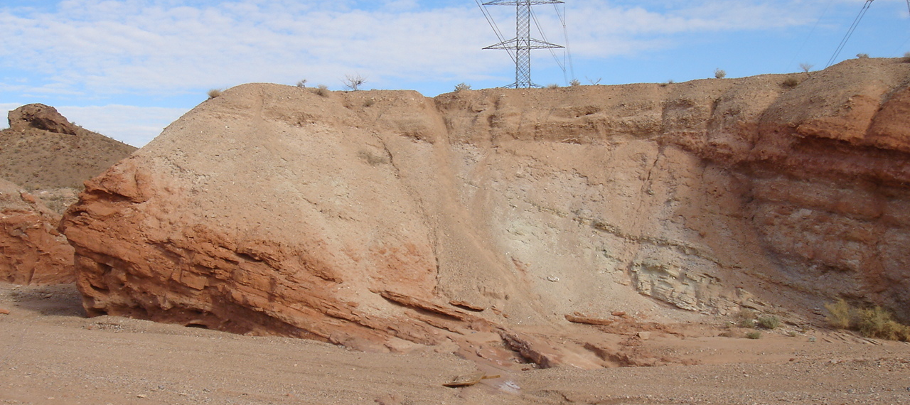
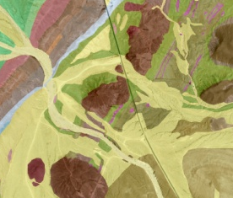
Tss
Tbr 2b (ss)
Breccia 2b
Contact between the well-bedded strata and the chaotically folded strata at the top of the breccia 2b section
Tss
15.30 Ma tuff
sandstone
breccia 2b
Tbr 2b (ss)
N
140m
Notes:
Location map and photograph of the chaotic sandstone beds (in solid lines) of breccia 2b overlain by undisturbed beds, in dashed lines, northeast side of Kodachrome Wash. View facing southeast. Location circled on geologic map with arrow showing direction for photograph.
Second picture shows the same wash facing north with the same sandstone overlying the breccia corridor strata. Just overlying the Breccia 2b deposit is the dated 15.30 tuff.

Slide 12
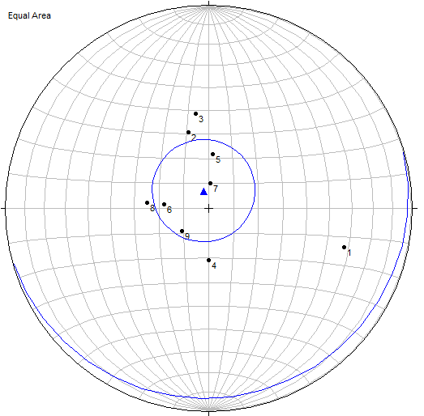
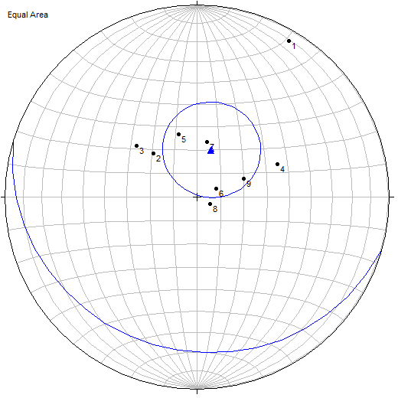
A
Axial planes recorded in Kodachrome Wash outcrop
Mean Pole
T&P= 344°, 83°
Great Circle
74°, 7° (RHR)
Stereonets of poles to fold axial planes in chaotically folded sandstone of breccia 2b
n=9
B
Data was tilted to horizontal (25°) and rotated counterclockwise (76°)
Mean Pole
T&P= 17°, 69°
Great Circle
107°, 21° (RHR)
n=9
Rotation data from Sonder et al., 1994
Notes:
This slide shows the poles to the fold axial planes as recorded from the outcrop and the adjusted values based on the paleomagnetic study by Sonder (et al., 1994).
The transportation direction after adjustment indicate a transport direction to the north.

Slide 13
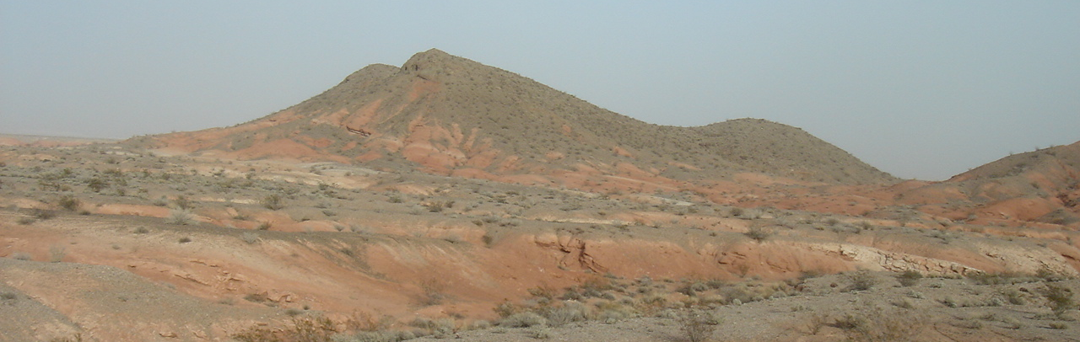
Megabreccias of the Thumb Member
30 cm
locations of breccia 3
estimated deposit age of 14.77 Ma
30 cm
Notes:
Location map and photograph of Breccia 3 outcrops and corridor. The photograph shows the well bedded strata at the base of the breccia outcrop. This breccia deposit was monomictic comprised of rapakivi granite, which is characterized by coarse-grained porphyritic to locally equigranular biotite and biotite-hornblende granite (Volborth, 1962).

Slide 14
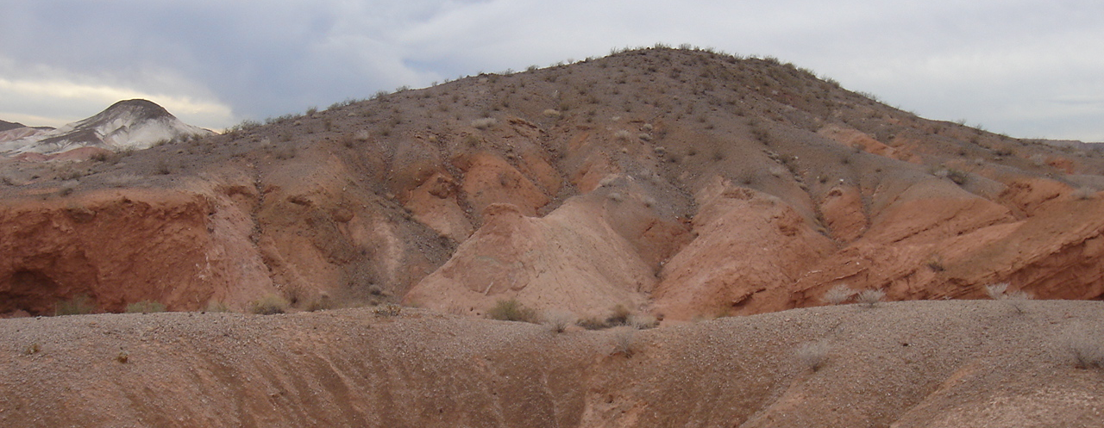
Megabreccias of the Thumb Member
locations of breccia 4
estimated deposit age of 14.62 Ma
Notes:
Location map and photograph of Breccia 4 outcrops and corridors. The photograph shows the well bedded strata at the base of the breccia outcrop (right side of photo). This breccia deposit is polymictic with a gypsiferous matrix. The Proterozoic clasts are biotite and garnet gneiss, and minor rapakivi granite and granodiorite gneiss clasts (Parolini, 1987).

Slide 15
Where were the breccias sourced?
Parolini, 1987; Rowland et al., 1990; Fryxell and Duebendorfer, 2005

Slide 16
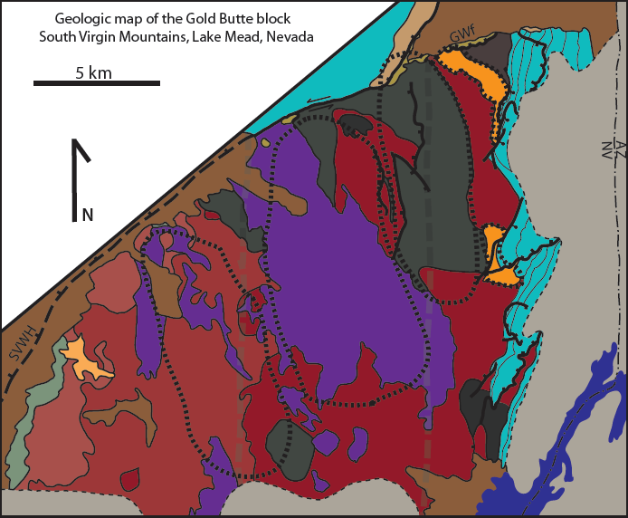
Megabreccias and Gold Butte lithologies
Breccia 1
Breccia 2
?
Breccia 3
Breccia 4
modified from Fryxell et al. (1992)
Notes:
Correlation of the breccia types to the outcrops on Gold Butte Block (GBB) (Sitton modified from Fryxell et al. 1992). As GBB was exhumed, the breccia clasts were sourced from GBB. The first Breccia correlates to the first exposure of GBB on the eastern portion of the map. The same sequence continues for all four breccias.
In collaboration with Sitton (MS Geology, NAU), the breccia deposits were classified based on clast type and were compared to the geologic map of Gold Butte block by Fryxell et al. (1992). The four megabreccia types record mass wasting events from three different portions of Gold Butte block. The exhumation of Gold Butte block along the South Virgin – White Hills detachment fault exposed the Paleoproterozoic crystalline rocks. From east to west along Gold Butte block, the sequence of breccia deposits can be inferred based on the breccia clast types. The comparison of source area on Gold Butte block geologic map correlates with the stratigraphic position in the Thumb Member at Frenchman Mountain. The top of breccia 2b is 4 m below the dated tuff of 15.30 Ma, which provides constraints on the timing of deposition.

Slide 17

Unroofing of Gold Butte block
source
Tbr1
Gold Butte
Notes:
An interpretation depicting the exhumation of Gold Butte Block using current images of GBB from Google Earth.
The yellow line shows the adjusted alluvial plane from the current view of the GBB to match the paleo-view during deposition.
The white dashed line depicts the location of the detachment (South Virgin-White Hills) fault exhuming GBB. The orange circle depicts the location of the source rock for Breccia 1, which is depicted by the location of the orange triangle. The next three slides continue the exhumation and deposition of the overlying breccias.

Slide 18
Unroofing of Gold Butte block
source
Tbr2
Tbr1
Notes:
The source and deposit location for Breccia 2.

Slide 19
Unroofing of Gold Butte block
source
Tbr3
Tbr2
Tbr2
Tbr1
Notes:
The source and deposit location for Breccia 3.

Slide 20
Unroofing of Gold Butte block
source
Tbr4
Tbr3
Tbr2
Tbr2
Tbr1
Notes:
The source and deposit location for Breccia 4.

Slide 21
CONCLUSIONS
Tuff samples dated with ⁴⁰Ar/³⁹Ar: 18.41 ± 0.04 Ma, 15.30 ± 0.06 Ma,
14.53 ± 0.10 Ma
Earliest evidence of faulting in the study area is ~15.6 Ma
Sedimentation rates are interpreted to increase at ~15.6 Ma to ~450 m/my
Disrupted substrate within breccia corridor suggests northward transport of landslides
Provenance and disrupted substrate of footwall geology of Gold Butte block suggest that landslides derived from Gold Butte moved to N to NNW into Thumb basin
Sequence of breccia lithologies suggests that landslides were derived from sequentially more western parts of the footwall as the Gold Butte block was exhumed
Notes:
For any questions about this project please contact the author or my advisor at the following email addresses.
Rachelle Wagner rrw38@nau.edu
Paul Umhoefer paul.umhoefer@nau.edu

