Slide 1
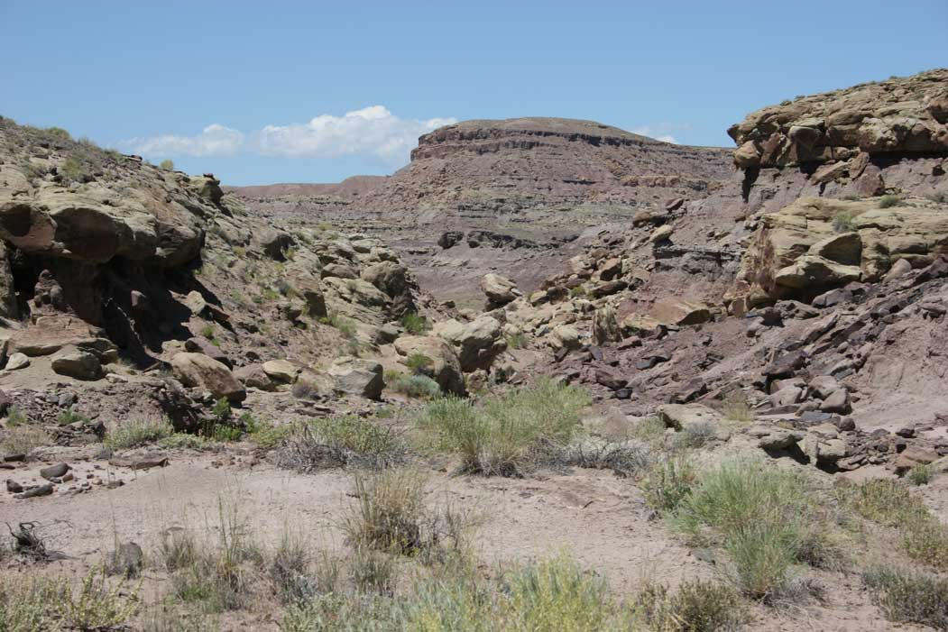
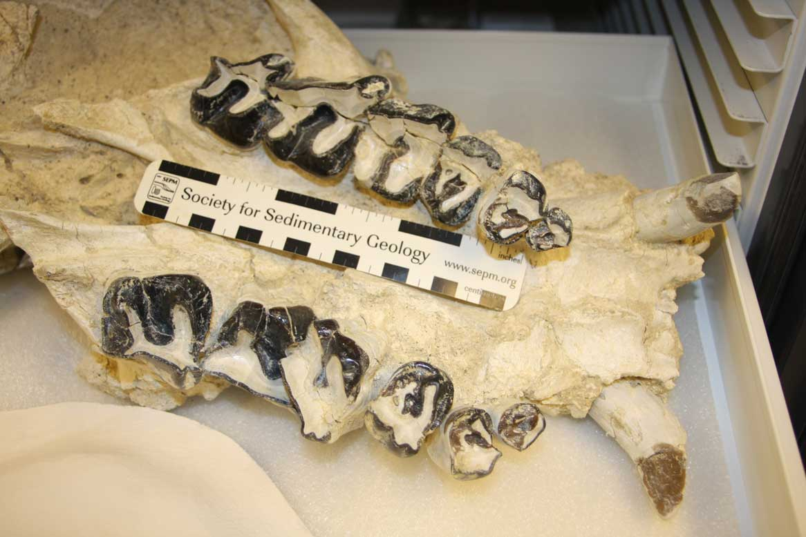
THE FAUNA AND CORRELATION OF THE UINTA “A,” UINTA FORMATION (MIDDLE EOCENE), NORTHEASTERN UTAH, USA
Paul C. Murphey
Department of Paleontology, San Diego Natural History Museum
Paleontology Principal Investigator, SWCA Environmental Consultants

Slide 2
INTRODUCTION
Purpose: to inform you about an important interval that has thus far produced few fossils!
Uinta Formation, Uinta A , and geographic distribution and stratigraphic relations
Paleontologic and biochronologic importance
Problems with stratigraphic nomenclature and locality records
Sequences and faunas of possible stratigraphic and temporal equivalence
Uinta A fauna
Biochronologic implications
Future work

Slide 3
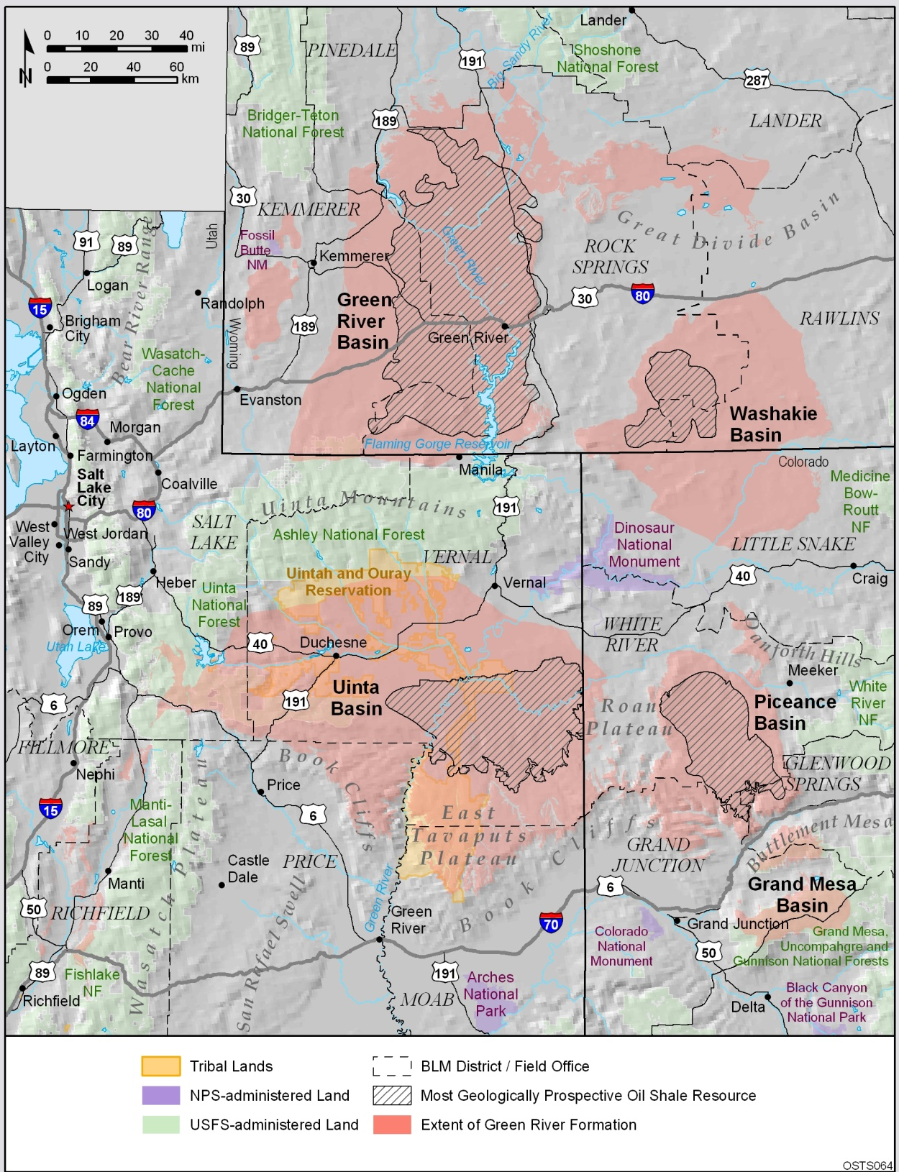

Slide 4
INTRODUCTION
Uinta Formation informal subdivisions A-C constitute the nominal stratotype of the Uintan North American Land Mammal “Age”
The lowermost subdivision, Uinta A, is sparsely fossiliferous, so it’s precise age is uncertain. Problems with stratigraphic nomenclature changes and museum locality records have compounded the lack of knowledge of the Uinta A fauna.
The importance of the Uinta A:
Few sequences that document the Bridgerian-Uintan faunal transition exist
Those that do exist contain few fossils and/or are difficult to access
Obtaining additional mammalian fossils of undoubted Uinta A provenance will permit a better understanding of this important faunal transition IN THE UINTAN TYPE AREA and permit more precise correlation with other transitional faunas

Slide 5
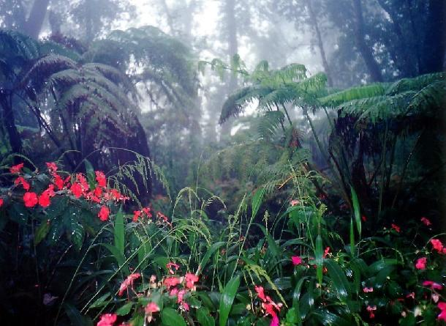
Uintan North American Land Mammal Age
Uinta Formation is stratotype of Uintan NALMA, but is both pre- and post-dated by Uintan-age faunas as presently defined
Uintan Paleontological Highlights:
Approximately 30% of modern mammalian families appear
Fauna reflects transition from climatically stable tropical conditions to more arid conditions
Origination and radiation of selenodont artiodactyls
Family level diversification of rodents
Diversification of rhinoceratoid perissodactyls
Disappearance or decline of some archaic groups including uintatheres, north American primates, hyopsodonid condylarths, and oxyaenid creodonts
The Uinta Formation in the Uinta Basin was designated the type locality of the Uintan NALMA by the Wood Committee (1941).

Slide 6
The Uinta Formation
Conformably overlies and interfingers with Parachute Creek Mbr., Green River Formation
Conformably overlain by Brennan Basin Mbr., Duchesne River Fm.
Uinta Formation (Tu) is dominantly fluvial but includes some lacustrine rocks
Maximum thickness of 625 m (Sprinkel, 2007), but thins to north and east
Both the Tu and 1,350 m thick Duchesne River Formation (Tdr) are fining upwards sequences that reflect pulses of uplift in the Uinta Mountains and highlands to the east, followed by erosion as stream gradients were reworked to base level

Slide 7
Early History of Paleontological Work
O.C. Marsh is often credited with naming the Uinta Basin and formation, but Wood (1934) credited Comstock (1875) with first using the name Uinta to describe rock units in the Uinta Basin
First fossils from Uinta Formation collected by O.C. Marsh in 1870 during his foray into the basin from Fort Bridger in the GRB, described by J. Leidy.
Cope (1884) described fish and crocodilian fossils from rocks now referred to as the Green River Formation in the Uinta Basin.
W.B. Scott, H.F. Osborn (1988-1878, 1886), and J.B. Hatcher (1895) from Princeton University collected from Uinta and Duchesne River formations.
H.F. Osborn, O.A. Peterson (1893-1894), and W.D. Matthew (1899) of the American Museum of Natural History collected from Uinta and Duchesne River formations.
Earl Douglass (1909) of Carnegie Museum discovered the Carnegie Quarry in the Morrison Formation while on an expedition to collect fossils from the Uinta Formation, and worked in the basin for the next 15 years.
Major workers of the early-to-mid twentieth century include O.A. Peterson (AMNH), C.W. Gilmore (Smithsonian), E.S. Riggs (Field Museum), J.L. Kay (Carnegie Museum), and J. Clark (then at Carnegie).
The Uinta Formation in the Uinta Basin was designated the type locality of the Uintan NALMA by the Wood Committee (1941).

Slide 8
Lapoint Tuff (39.74 ± 0.07 Ma)
Approximate level of Duchesnehippus intermedius,
and Halfway Hollow One (SDSNH Loc. 5939)
Approximate level of Randlett Point local fauna
reportedly containing Duchesneodus sp.

Slide 9
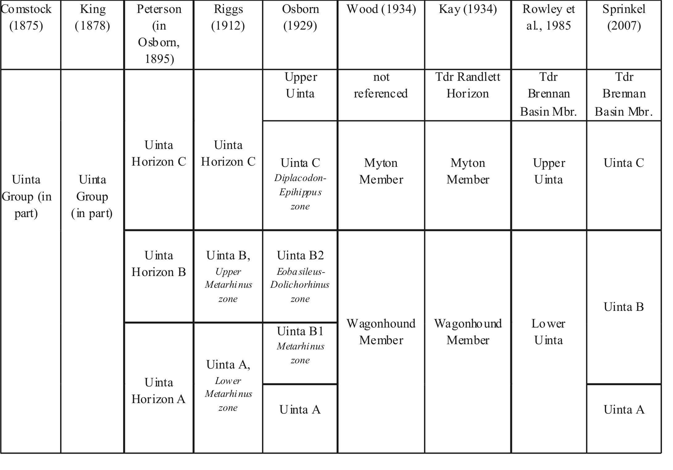
History of Uinta Formation Stratigraphic Nomenclature

Slide 10
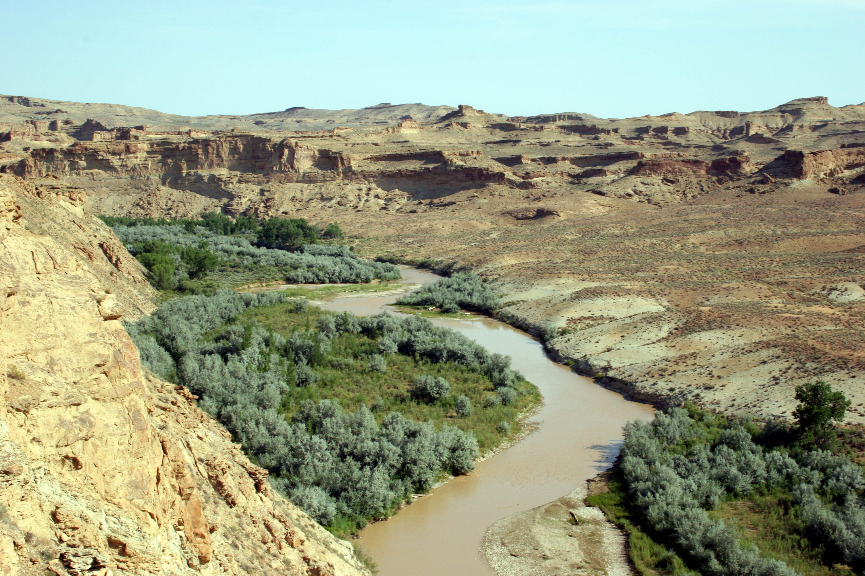
TuA-B1
Tgp-TuA
The Uinta A consists of approximately 150 m (500 ft) of cliff forming tan and brown sandstone
The lower part of Uinta A intertongues with shale and limestone of the underlying Parachute Creek Mbr, Green River Fm.
Uinta A inferred to represent deltaic deposits prograding westward and replacing lacustrine deposition, with sediment sources in the Uncompahgre uplift and Park Ranges in Colorado
Uinta A paleocurrent directions in this area are predominantly from east and southeast
Tgr Parachute Creek Mbr., TuA, TuB1 at Wagonhound Canyon, Uinta Basin

Slide 11
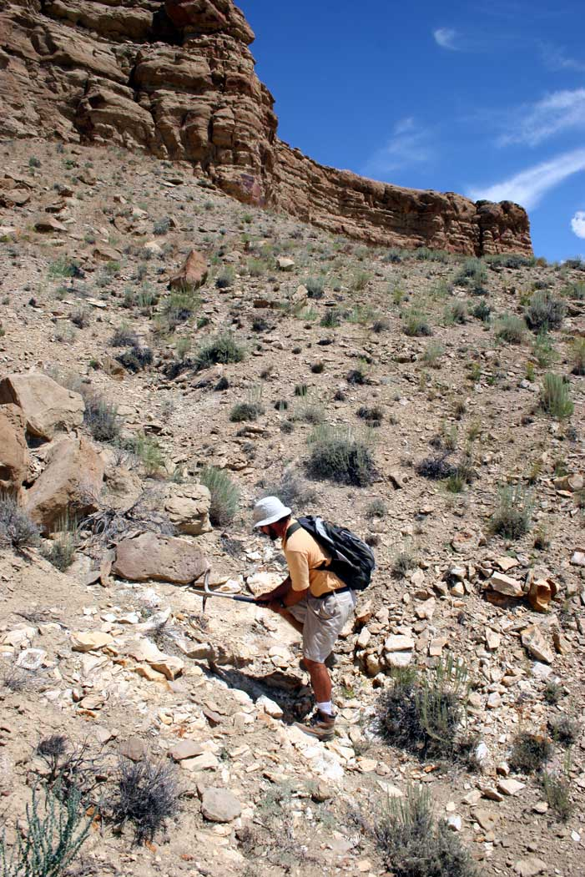
Uinta A-B contact in Wagonhound Canyon as mapped by Cashion (1974)
Cashion’s “a” tuff
(1986)

Slide 12
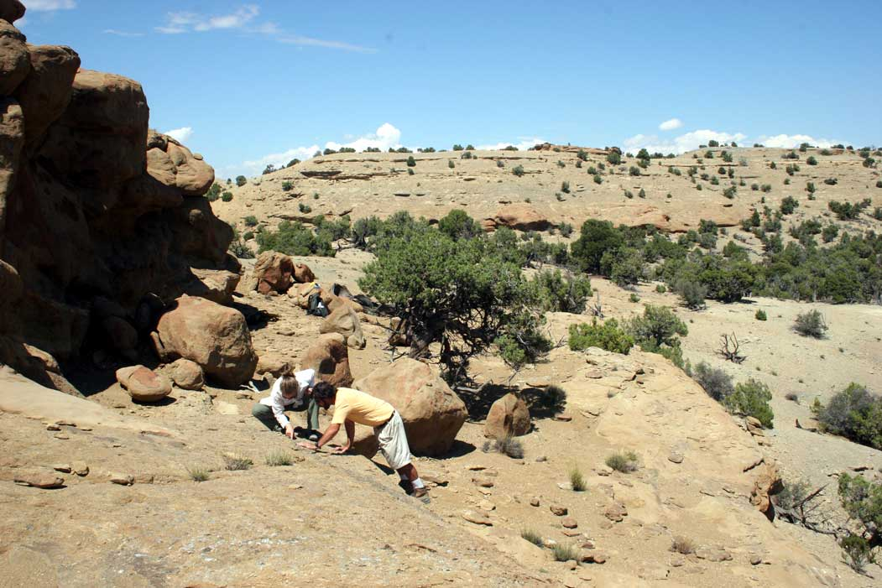
TuA-TuB1
Uinta A-B1 contact in the eastern Uinta Basin consists of change from massive cliff forming sandstone beds to ledge forming sandstone beds interbedded with greenish gray siltstone beds
Exposures of Uinta A and B1 west of Southam Canyon

Slide 13
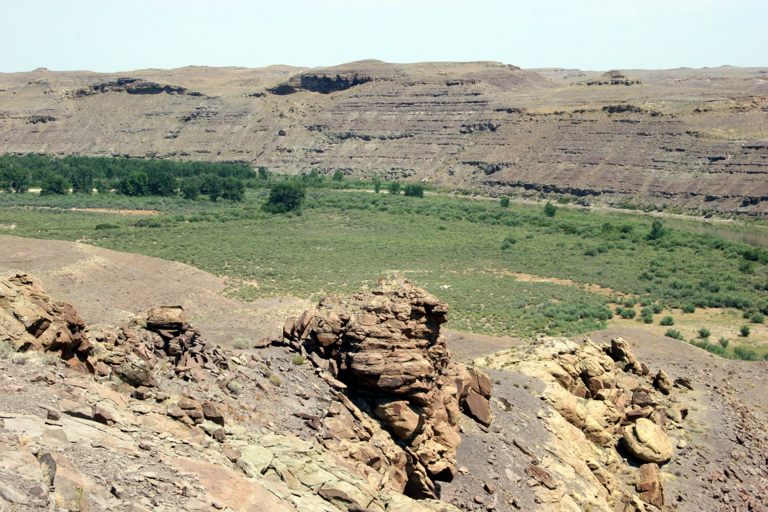
Uinta A thins to the west
It becomes finer-grained to the west
Lower fluvial sandstones in the east are laterally equivalent to lacustrine evaporites, limestones, and shales in the west
Uinta A exposures along the Green River near Eightmile Flat in the central Uinta Basin

Slide 14
Historical Work Has Resulted in Confusion
Osborn’s (1929) redefinition of the Uinta A-B boundary has caused confusion in the stratigraphic provenance of many specimens
Osborn removed the upper fossiliferous portion of Peterson’s (1895) Uinta A and renamed it Uinta B1
Thus, pre-1929 specimens labeled as having been collected in the Uinta A almost certainly came from Uinta B1 (while in fact the Uinta A has produced very little although it is a very important interval)
Support for this conclusion comes from Peterson’s (1924) “Dolichorhinus Quarry” which as listed as Uinta A in CM records but occurs 122 m above A-B contact as mapped by Cashion (1974)

Slide 15
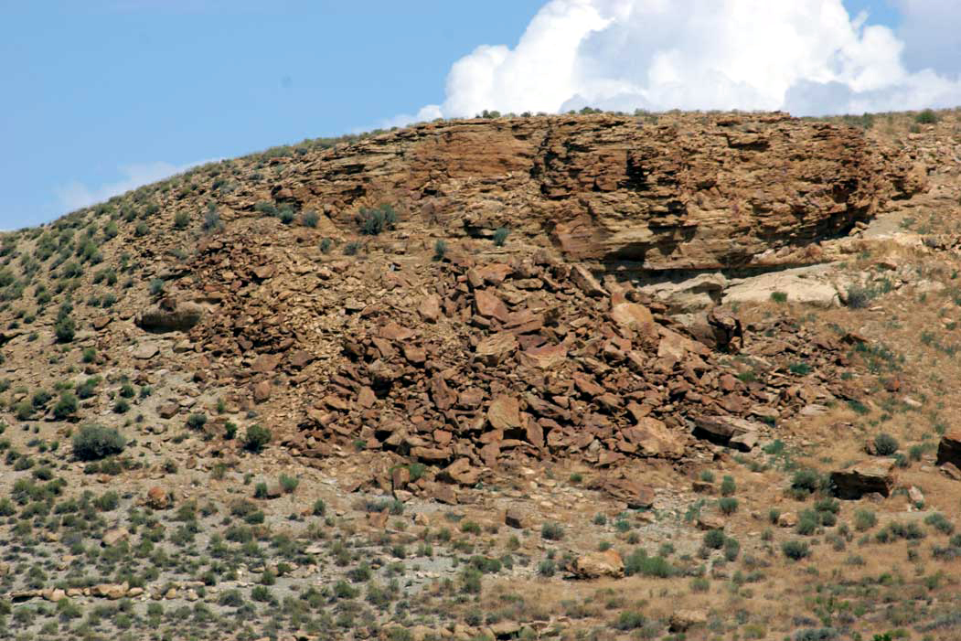
Carnegie “Dolichorhinus Quarry” (CM Loc. 366) within Uinta B1, re-discovered by Bilbey et al. (2002)

Slide 16
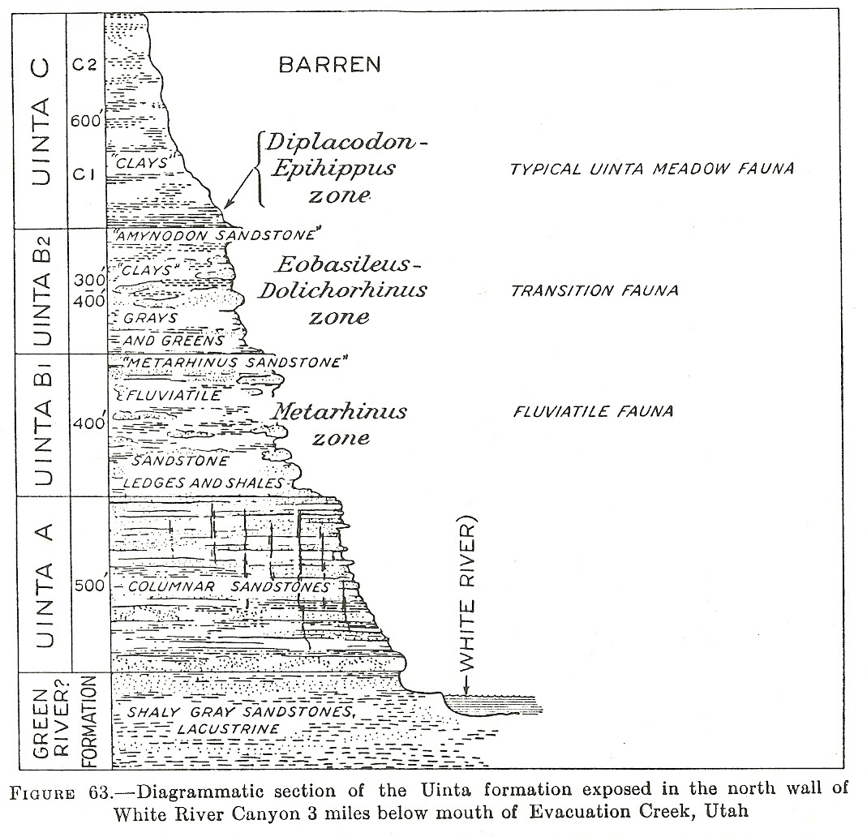
Peterson’s 1895 B-C Boundary
Osborn’s 1929 B-C Boundary
Peterson’s 1895 A-B Boundary
Osborn’s 1929 A-B Boundary
Osborn’s (1929) stratigraphic column

Slide 17
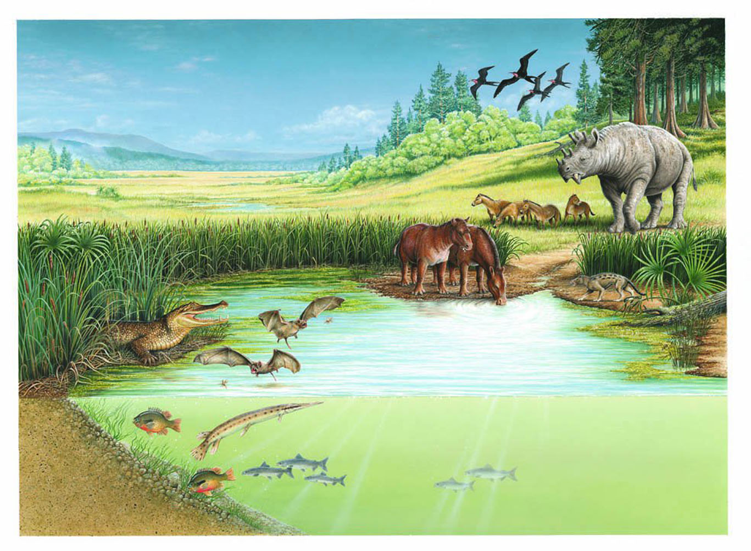
BIOCHRONOLOGY
For decades, paleontologists have utilized assemblages of fossil mammals to determine relative ages of rock sequences, and to correlate between rock sequences over large geographic distances

Slide 18
BIOCHRONOLOGY
For decades, paleontologists have utilized assemblages of fossil mammals to determine relative ages of rock sequences, and to correlate between rock sequences over large geographic distances
Early efforts led to the establishment of provincial “North American Land Mammal Ages” codified in 1941. These were named after rock units named earlier, and subdivided on basis of lithostratigraphy or biostratigraphy

Slide 19
BIOCHRONOLOGY
For decades, paleontologists have utilized assemblages of fossil mammals to determine relative ages of rock sequences, and to correlate between rock sequences over large geographic distances
Early efforts led to the establishment of provincial “North American Land Mammal Ages” codified in 1941. These were named after rock units named earlier, and subdivided on basis of lithostratigraphy or biostratigraphy
Over last thirty years, precision of “Land mammal Age” correlations has increased so that now mammalian fossil record as it relates to faunal turnover is understood and well documented. Now, most of the associated “Land Mammal Age” definitions are relatively stable, and a fairly rigorous mammalian biochronology has been established

Slide 20
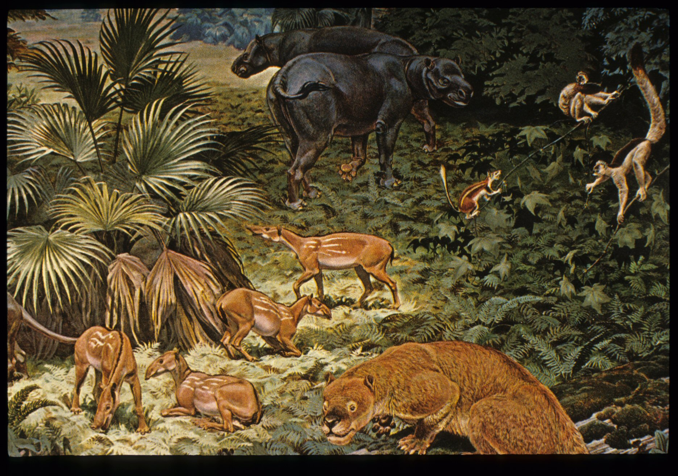
Eocene | NALMA | Biochron
Middle (49.0–37.0) | Duchesnean (40.5–37.0) | Randlett LF, Halfway LF
 | Uintan (46.0–40.5) | Ui1a, Ui1b, Ui2, Ui3
 | Bridgerian (50.3–46.0) | Br1a, Br1b, Br2, Br3

Slide 21
Earliest Uintan Biochron Ui1a (from Gunnell et al., 2009) Biostratigraphic Designation – Hemiacodon engardae Interval Zone
Stratotype Section – Type Section of Turtle Bluff Member of Bridger Formation (Murphey and Evanoff, 2007). Section measured on Sage Creek Mountain and Hickey Mountain, Uinta County, Wyoming. Measured thickness of Turtle Bluff Member type section is 131 m.
Reference Sections
Basal Tertiary conglomerate of the Devils Graveyard Formation, Trans Pecos, Texas
All or part of Uinta Formation informal unit A, Uinta Basin, Utah
All or part of the Parachute Creek Member of the Green River Formation in the Uinta and Piceance Creek basins, Utah and Colorado
All or part of Uinta Formation Unit B1 of Osborn (1929) as defined in the eastern part of Uinta Basin, Utah
All or part of the lower part of Uinta Formation informal unit B in the western part of the Uinta Basin, Utah

Slide 22
Earliest Uintan Biochron Ui1a Biostratigraphic Designation – Hemiacodon engardae Interval Zone
Index Species (2)
Hemiacodon engardae
Oromerycidae gen. and sp. nov.
Genus LRD (6)
Epihippus
Metanoiamys
Oromerycidae gen. & sp. nov.
Pareumys sp.
Sespedectinae indet.
Triplopus
Genus HRD (7)
Entomolestes
Hemiacodon
Oromerycidae gen. & sp.nov.
Mysops
Paramys
Taxymys
Uintasorex
Species LRD (3)
Epihippus gracilis
Metanoiamys sp.
Triplopus cubitalis
Species HRD (8)
Entomolestes grangeri
Paramys delicatior
Pauromys perditus
Pontifactor bestiola
Sciuravus nitidus
Taxymys lucaris
Thisbemys corrugatus
Uintasorex parvulus
Range-Through Taxa (36)

Slide 23
Summary of Revised Uintan Biochronology (from Gunnell et al., 2009)
Biochron | NALMA | Interval Zone Designation | Stratotype Section
Ui3 | Late Uintan | Pentacemylus progressus | Coyote Basin, Deadman Bench, upper part of Uinta Fm. unit C and lower portion of Duchesne River Fm., UT
Ui2 | Middle Uintan | Ourayia uintensis – Pareumys milleri | Coyote Basin, Deadman Bench, part of Uinta Formation unit B2 and lower portion of unit C, UT
Ui1b | Early Uintan | Achaenodon robustus-Hyrachyus eximius- Amynodon advenus | None designated at present due to lack of detailed lithostratigraphic data (potential candidates include Washakie Fm. in WY or CO)
Ui1a | Earliest Uintan | Hemiacodon engardae | Type Section of Turtle Bluff Member of Bridger Formation , WY

Slide 24
SIGNIFICANCE OF BRIDGERIAN-UINTAN TRANSITION
The Bridgerian-Uintan transition is associated with the disappearance or decline in diversity of certain archaic groups including uintatheres, north american primates, hyopsodontid condylarths, and oxyaenid creodonts
The Bridgerian-Uintan NALMA boundary is poorly understood because few fossiliferous sequences from this interval are known from North America
This Uintan NALMA was an important time period that saw the evolution and radiation of selenodont artiodactyls, a family-level diversification of rodents, and a diversification of rhinocerotoid perissodactyls
Where do transitional (earliest) UINTAN faunas occur?

Slide 25
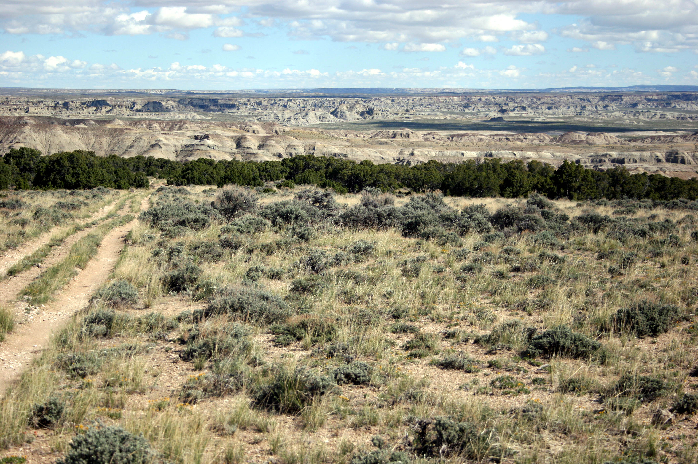
View north at Skull Creek Rim, Washakie Formation Adobe Town Member, WY

Slide 26
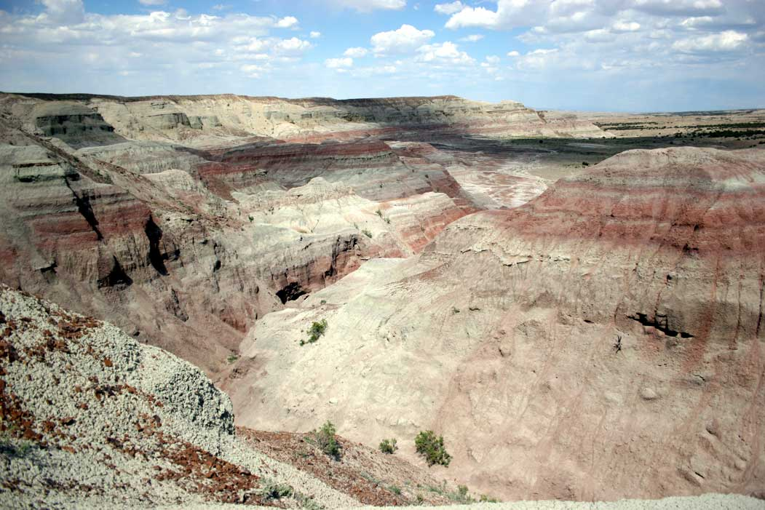
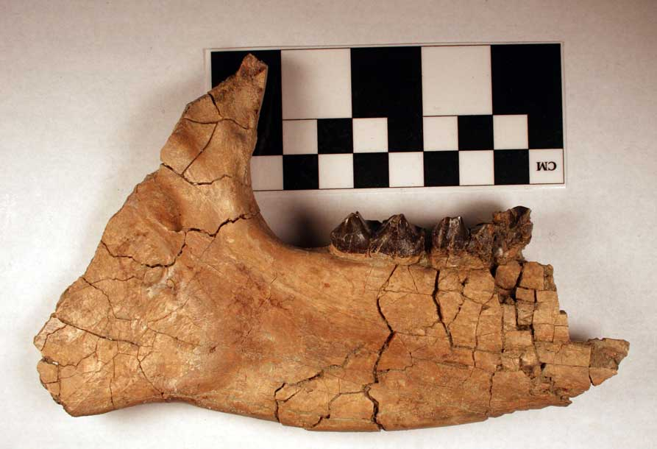
Exposures of the Washakie Formation, Adobe Town Member

Slide 27
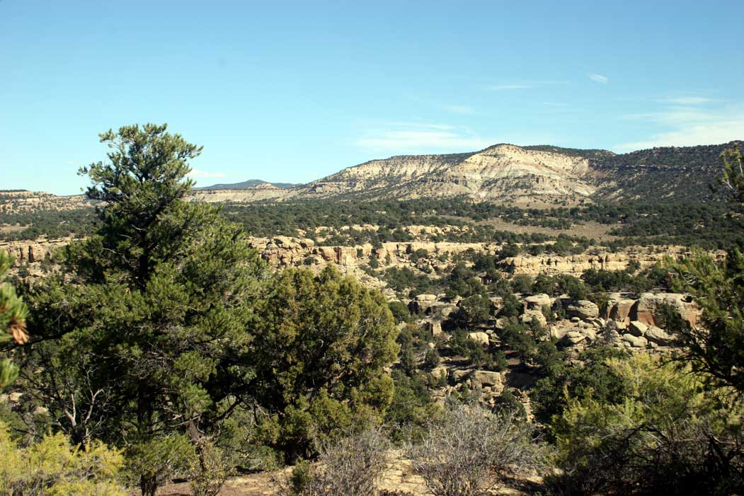
Intertonguing rocks of Uinta and Green River formations, Piceance Creek Basin, Colorado (possibly includes strata of earliest Uintan age)

Slide 28
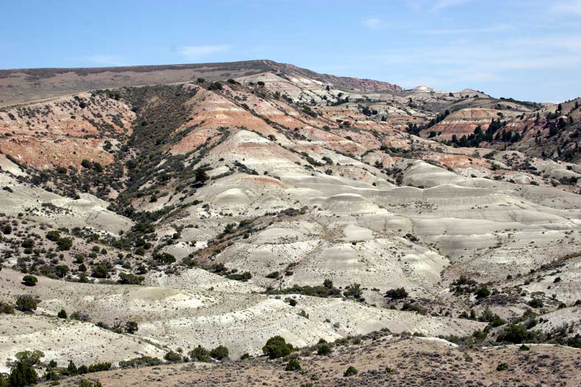
Earliest Uintan (Ui1a) strata of Bridger Formation Turtle Bluff Member (red beds) over late Bridgerian strata of uppermost Twin Buttes Member (gray beds), GRB, Wyoming

Slide 29
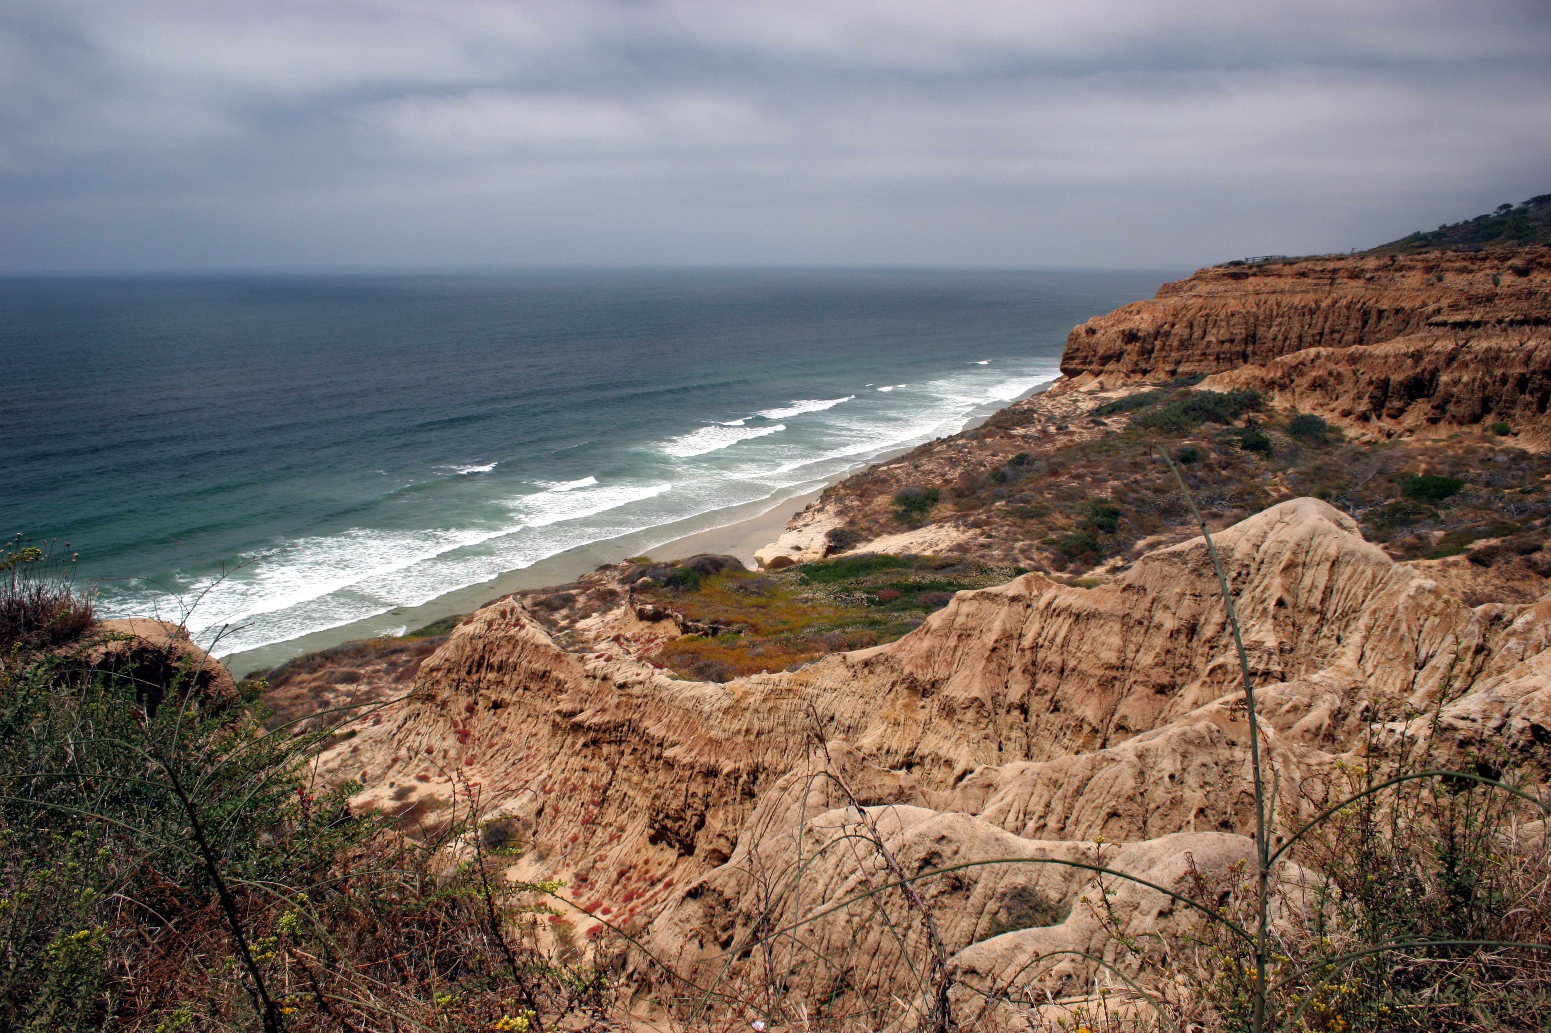
Late Bridgerian/early Uintan strata of Del Mar, Torrey, Scripps formations,
San Diego, California

Slide 30
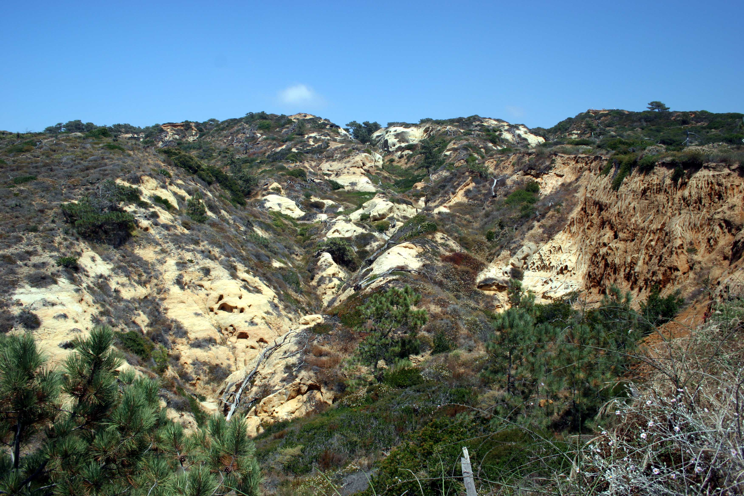
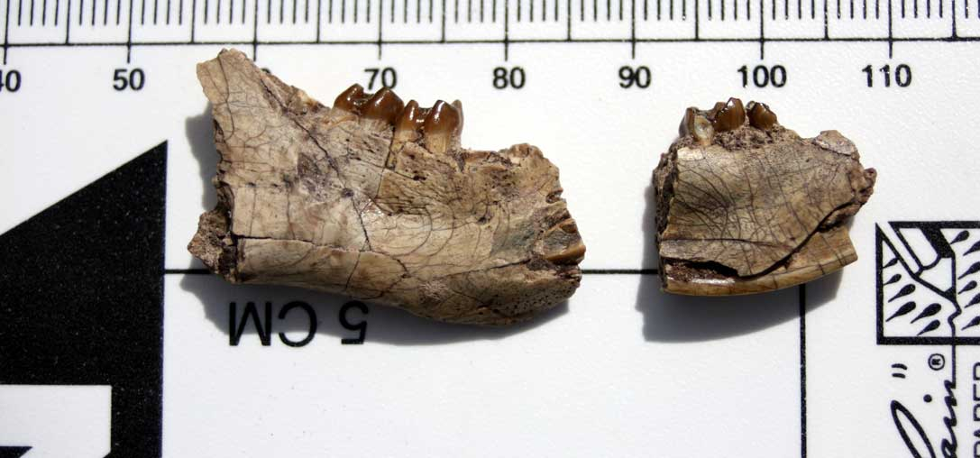
Late Bridgerian/early Uintan strata of Scripps Formation,
San Diego, California

Slide 31
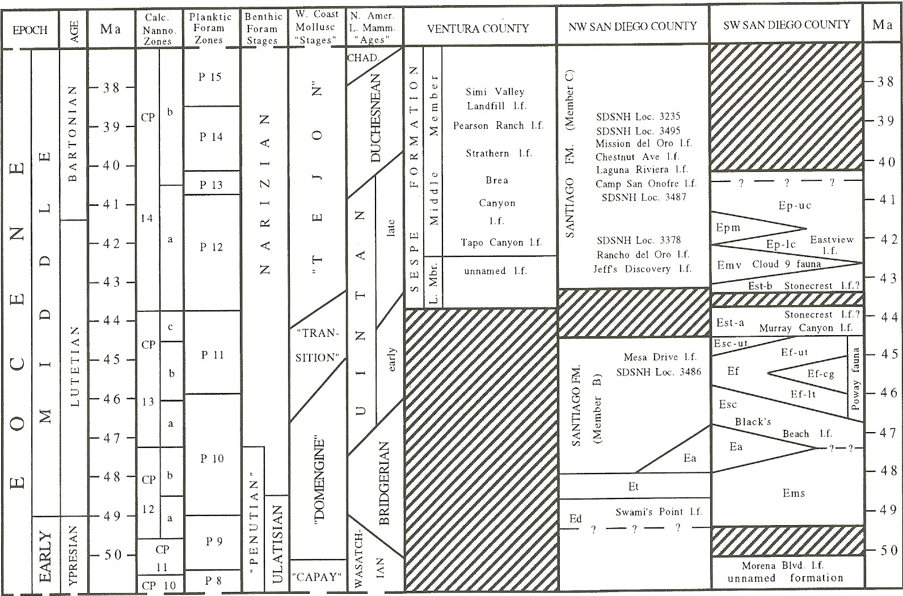
Eocene correlation chart for southern California (from Walsh, 1996)

Slide 32
Parachute Creek Member Tgr, Uinta A, Uinta B1 at Wagonhound Canyon

Slide 33
CMNH Uinta “A” Localities
LOCALITY# | LOCALITY NAME | Actual Provenance
83 | WAGONHOUND CANYON | Both A & B1
84 | WAGONHOUND BEND | Probably A
364 | HAPPY CANYON | Definitely B1
366 | DOLICHORHINUS QUARRY | Definitely B1
1582 | EAST OF WHITE RIVER POCKET | Definitely B1

Slide 34
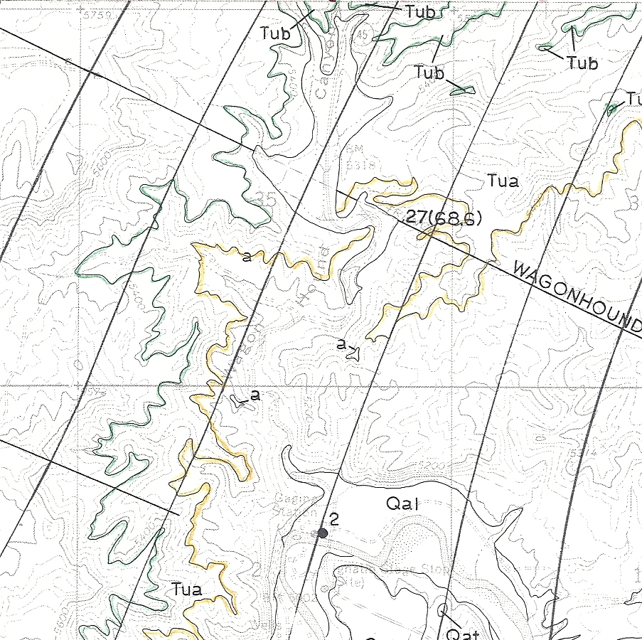
Geologic Map of Southam Canyon 7.5’ Quad (Cashion, 1974), to illustrate the problem with CMNH Loc. 83 (Wagonhound Canyon)

Slide 35
Fauna of the “lower” Uinta Fm. Based on CMNH, AMNH, UFH records, & *literature
Reptilia
Testudines ( MNI = 2)
Mammalia
Metarhinus sp. (MNI = 3)
Metarhinus earlei (MNI = 1)
Sthenodectes sp. (MNI =1)
Dolichorhinus sp. (MNI = 5)
Dolichorhinus longiceps (MNI = 6)
Uintaceras sp. (MNI = 1)
Amynodon sp. (MNI = ?)
Triplopus sp. (MNI = ?)
Forstercooperia sp. (MNI = ?)
Isectolophus sp. (MNI = 1)
All mammalian taxa med. - large
All are Perissodactyls
3 genera of brontotheres, 3 rhinos, 1 tapir
Most specimens represent skulls or partial skulls and partial skeletons
All CMNH specimens collected by Earl Douglass, 1911-1917
Only the tapir is unquestionably from the Uinta A (found in 1995), and this genus occurs in both the Bridgerian and Uintan
Other specimens are likely from Uinta B1, not A
All other taxa are known only from the Uintan, not Bridgerian
*Krishtalka et al., 1987
*Osborn, 1929
*Peterson (in Osborn, 1895)
*Prothero, 1996
*Riggs, 1912

Slide 36

Fauna of the Uinta “A” Based on CMNH, AMNH, UFH records, & *literature
Mammalia
Isectolophus sp. (1)
Approximately 500 feet of cliff forming sandstones at the base of Wagonhound Canyon were part of Peterson ‘s Uinta A. The upper fossiliferous part was removed and renamed Uinta B1 by Osborn (1929)
As was first pointed out by Prothero (1996), most of pre-1929 museum specimen labels that say “Uinta A” should actually read “Uinta B1”
As a result, very few specimens can be positively confirmed as originating in the Uinta A
As best I can tell, only 1 identifiable specimen can be positively confirmed, and many of the other records are either ambiguous or come from B1
*Krishtalka et al., 1987
*Osborn, 1929
*Peterson (in Osborn, 1895)
*Prothero, 1996
*Riggs, 1912

Slide 37
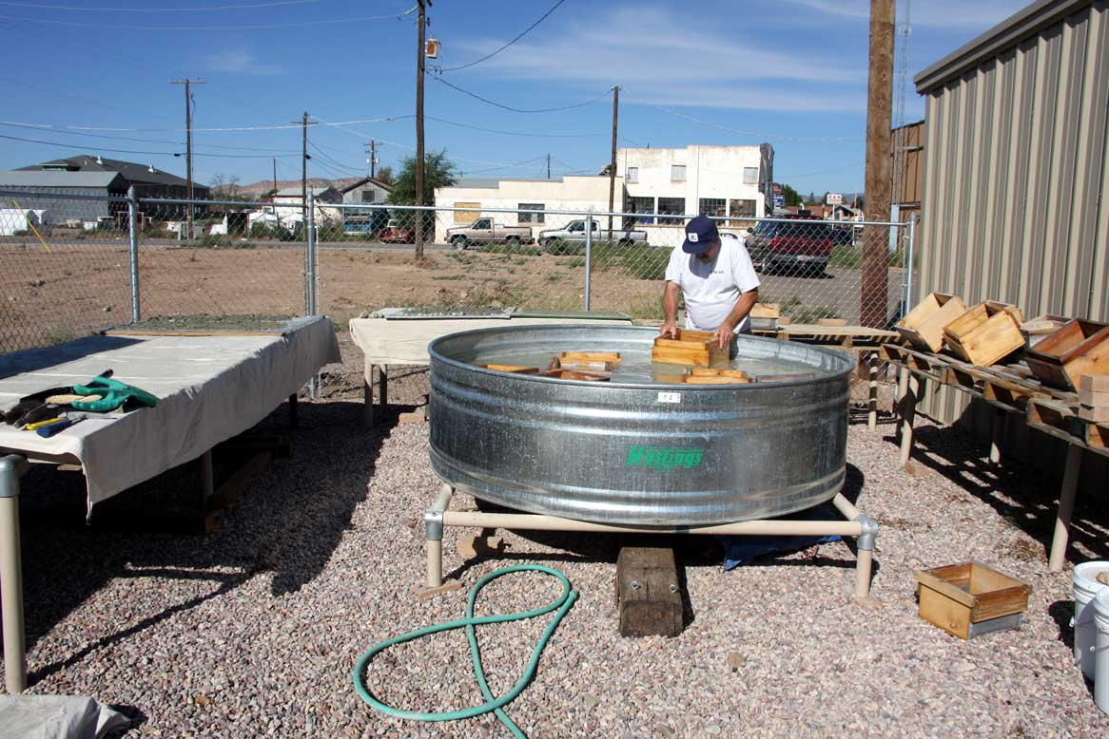
IMPLICATIONS AND CONCLUSIONS
The perissodactyl-dominated Uinta A and lower B1 fauna has little utility for precise faunal correlation, and early workers were correct in reporting that basal 500 feet of Uinta Formation (Uinta A in today’s parlance) are seemingly barren of fossils. However, modern fossil-finding techniques have yet to be applied.
If one were to ignore the obvious stratigraphic confusion and resulting locality problems, one could rule out a Bridgerian (Br3) age for Uinta A

Slide 38
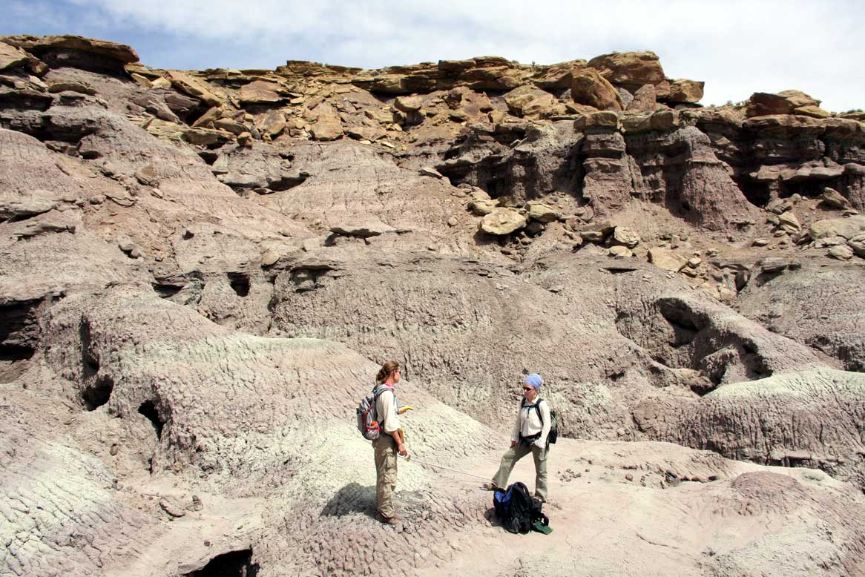
IMPLICATIONS AND CONCLUSIONS
Presence of 3 Uintan brontotheres and 3 Uintan rhinos suggests an early Uintan age (Ui1a, Ui1b or Ui2) for Uinta A - ignoring stratigraphic confusion
However, if the Uinta A fauna in fact consists only of Isectolophus which seems likely, then one cannot rule out a late Bridgerian (Br3) age
Considering the stratigraphic problems with most of the known Uinta A localities, there is no way to confidently assign the Uinta A to a late Bridgerian or early Uintan biochron at the present time
Considering the coarse lithologies of the Uinta A, reliable magnetostratigraphic control is seemingly unlikely (Prothero, 1996 correlated with Chron C21n), and preliminary analysis of Cashion’s “a” tuff does not offer much hope for radioisotopic dating

Slide 39
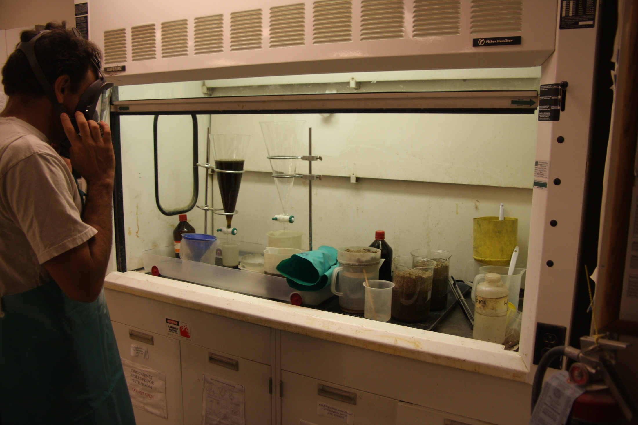
IMPLICATIONS AND CONCLUSIONS
It is anticipated based on preliminary testing that future stratigraphically controlled fossil collection efforts will yield more biostratigraphically useful smaller bodied mammalian taxa
Localized fine-grained lenses of sediment within the Uinta A offer hope for this paleontologically challenging and important sequence

Slide 40


