Slide 1
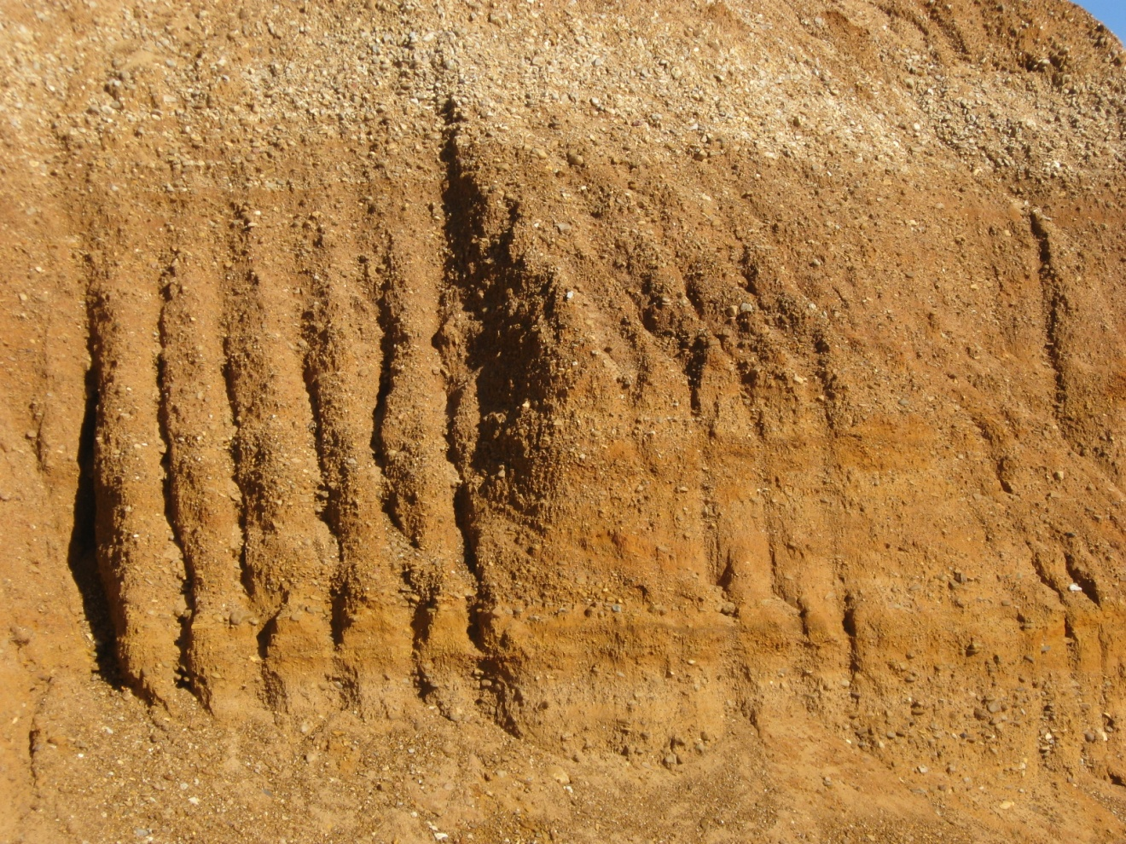
Provenance of the Upland Complex:
Where did all that Pliocene gravel and sand come from?
Dave Lumsden
Randy Cox
Roy VanArsdale
Department of Earth Sciences
The University of Memphis
dlumsden@memphis.edu

Slide 2
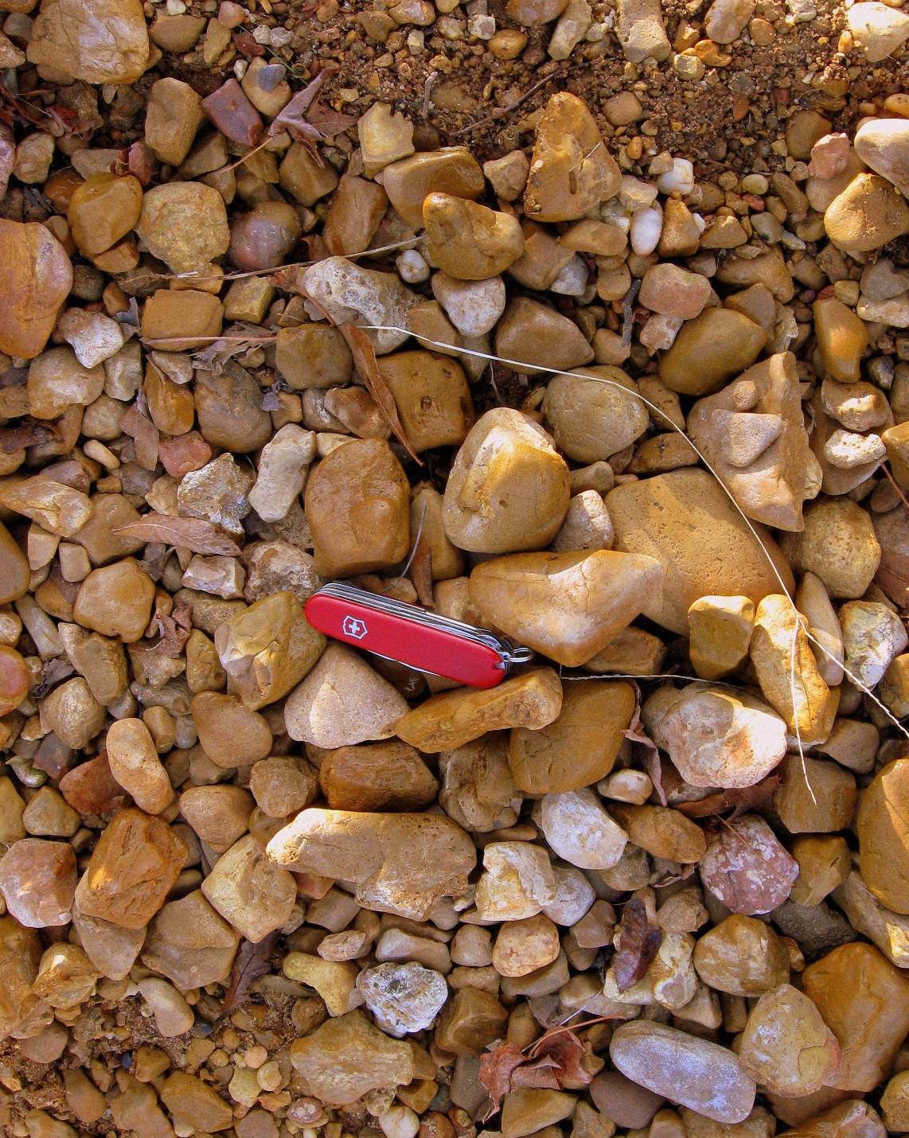
THE PROBLEM
Where did all the gravel and sand in the Upland Complex (UC) come from?
Hypothesis
Contrary to intuition much of the UC chert gravel came from now vanished formations in central Canada whereas
the sand fraction came from very different and much closer sources, most likely the St. François Mountains of Missouri.
To test this hypothesis we analyzed the petrology of the Upland Complex in the Mississippi Embayment.

Slide 3
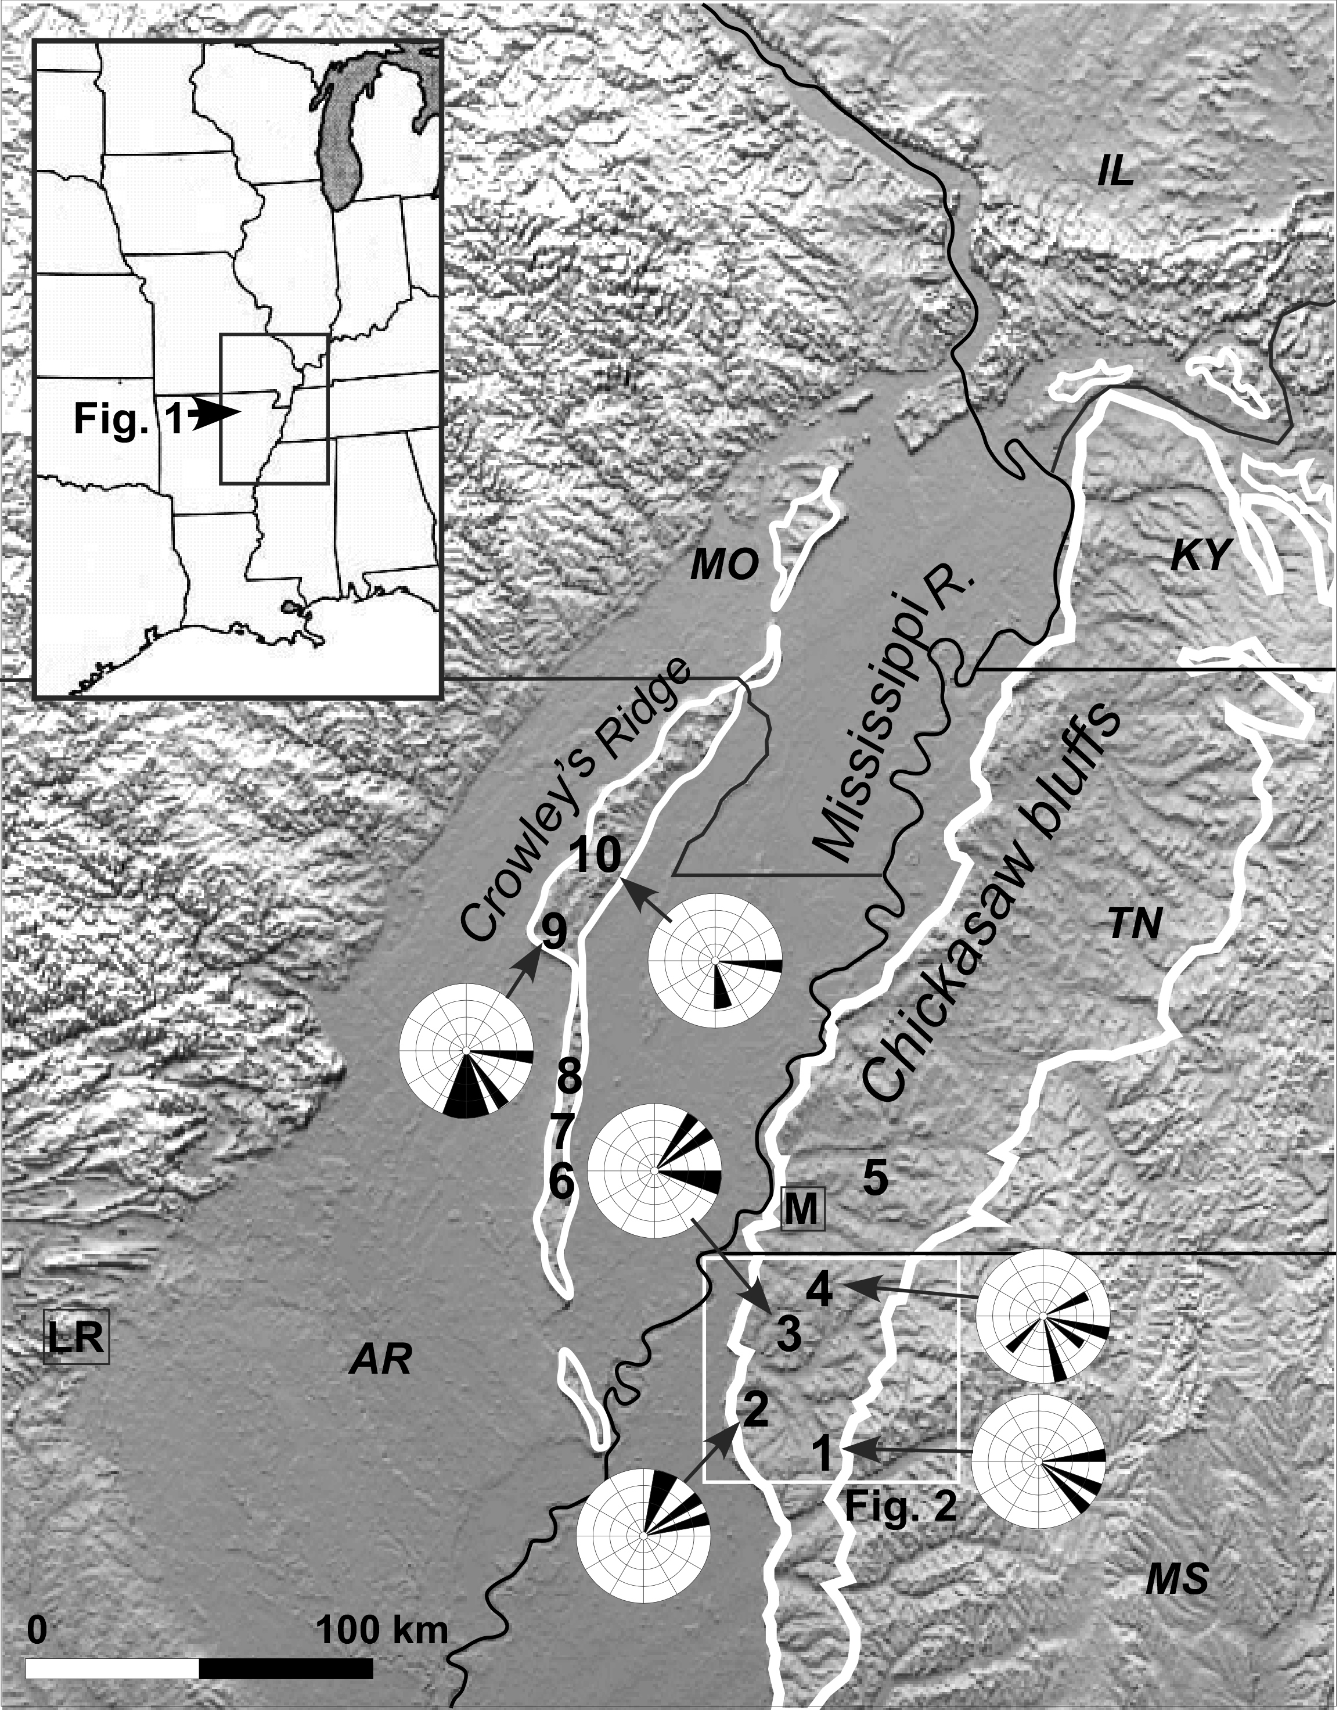
What is the Upland Complex?
The UC is a terrace gravel and sand deposited by a south flowing ancestor to the modern Mississippi system.
We call this ancestor Arc River.
Lumsden, D.N., Cox, R.T., VanArsdale, R.V., and Parks, A., 2010, Ancestral Mississippi River: Discharge evidence from the Upland Complex: Geological Society of America Abstracts with Programs, v. 42, n. 2, p. 69
In the Mississippi Embayment the UC is exposed under the Chickasaw Bluffs (KY, TN, MS) and Crowley’s Ridge (MO, AR).
The UC extent in the study area is enclosed by the white lines in this figure.

Slide 4
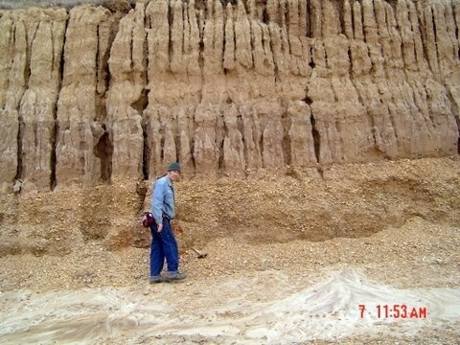
RELEVANT
STRATIGRAPHY
Peoria Loess
Holocene Epoch
Mississippi River alluvium
Pleistocene Epoch
Peoria Loess
Roxanna Loess
~~~~DISCONFORMITY~~~~~~
Pliocene Epoch (?)
Upland Complex
~~~~DISCONFORMITY~~~~~~
Eocene Epoch
  Claiborne Group
  Jackson Formation
  Cockfield Formation
  Cook Mountain Formation
  Memphis Sand Formation
Farmdale Soil
Roxanna Loess
Disconformity
Upland Complex
Base DISCONFORMITY not exposed
Upland Complex gravel and sand disconformably underlies Pleistocene loess and disconformably overlies Eocene formations on the Chickasaw Bluffs and Crowley’s Ridge.
Indirect evidence favors a Pliocene age (2.6 to 5.4 MYBP) for the UC
UC thickness varies from 0 to 30 m within its outcrop belt (VanArsdale et al., 2007).

Slide 5
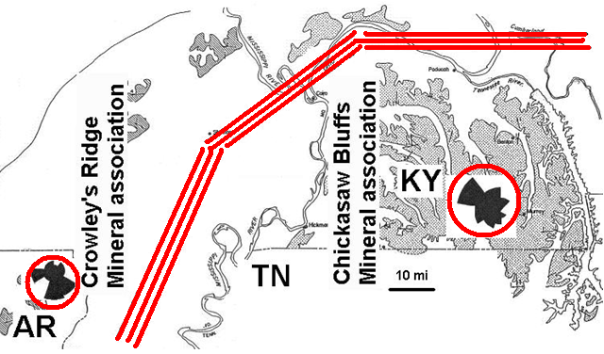
Previous Results
Our story begins with Potter’s (1955) observations in western KY and southeast MO.
1) There are no clasts associated with glacial outwash, i.e., the source was not glacial.
2) The mineral association of the Upland Complex on Crowley’s Ridge differs from that on the Chickasaw Bluffs.
3) The cross bed orientation also differs between the two region.
This suggests that the two areas differed in their sand source (but not necessarily their gravel source) despite their close proximity and overall similarity.

Slide 6
Previous Results
  Based on empirical formulas, Lumsden, Cox , VanArsdale and Parks (2010) * proposed that the UC was deposited by ARC RIVER, a Pliocene ancestor to the modern Mississippi River.
  ARC RIVER had
  a velocity of 18 km/hr (11 mph), 2 times that of the modern Mississippi.
  a discharge of 94,000 m³/s (3 to 4 million cfs) , 5 times the volume of the modern Mississippi.
  Such a giant river may be due to
  1. a much wetter pre-glacial climate or (our currently preferred alternative)
  2. a much larger drainage basin
  a drainage basin of 6,000,000 km² , twice that of the modern Mississippi.
  *Lumsden, D.N., Cox, R.T., VanArsdale, R.V., and Parks, A., 2010, Ancestral Mississippi River: Discharge evidence from the Upland Complex: Geological Society of America Abstracts with Programs, v. 42, n. 2, p. 69

Slide 7
METHODS
10 sample locations
5 on Chickasaw Bluffs
5 on Crowley’s Ridge
were searched to determine
  Stratigraphy
  Structures, sedimentary and tectonic
Samples were analyzed for
  Grain size - sieving of disaggregated samples
  Petrography – optical and infrared analysis of epoxy impregnated thin sections
  Mineralogy – fines were XRD scanned from 4 to 40 degrees two-theta.
Locations 6 to 10
Locations 1 to 5
Lumsden, D.N., Cox, R.T., VanArsdale, R.V., and Parks, A., 2010, Ancestral Mississippi River: Discharge evidence from the Upland Complex: Geological Society of America Abstracts with Programs, v. 42, n. 2, p. 69

Slide 8
Results – Stratigraphy Chickasaw Bluffs
Upper member
transitional contact
Lower member
Chickasaw Bluffs, Love Quarry, DeSoto Co., MS.
Upper member - massive bedded “dumped in” grain supported gravel (braided river)
contrasts with the
Lower members - cross bedded, poorly stratified sand and gravel (meandering river) .

Slide 9
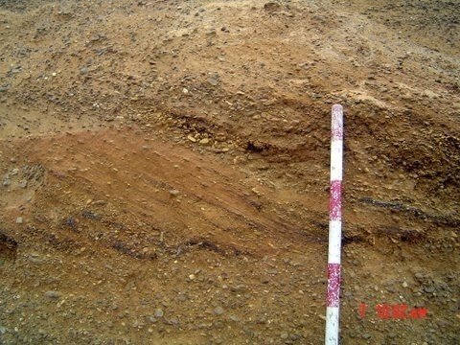
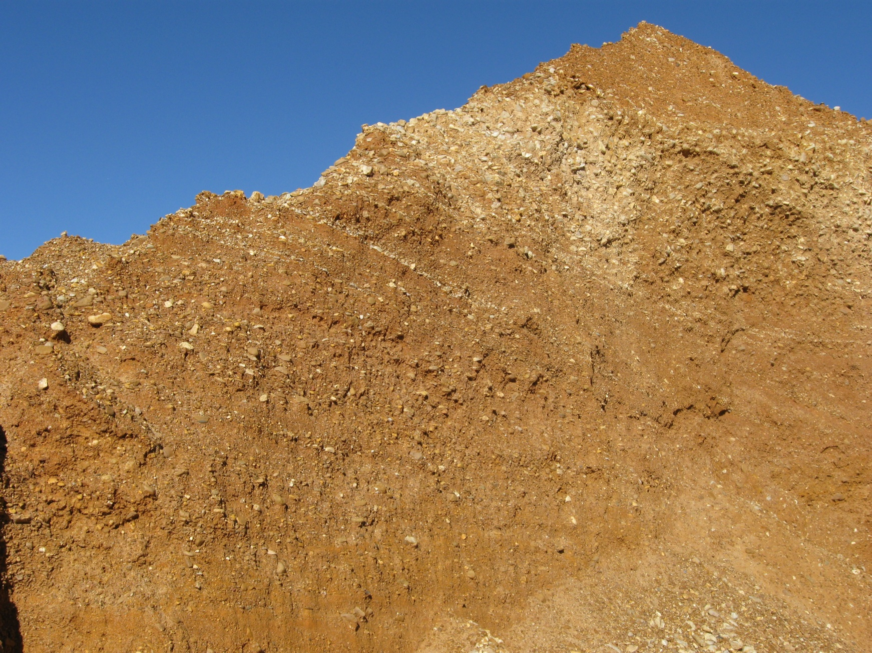
Results Sedimentary structures, Lower member, torrential cross bed suggest a powerful meandering river
Red band = 10 cm (4 in)
1.0 m

Slide 10
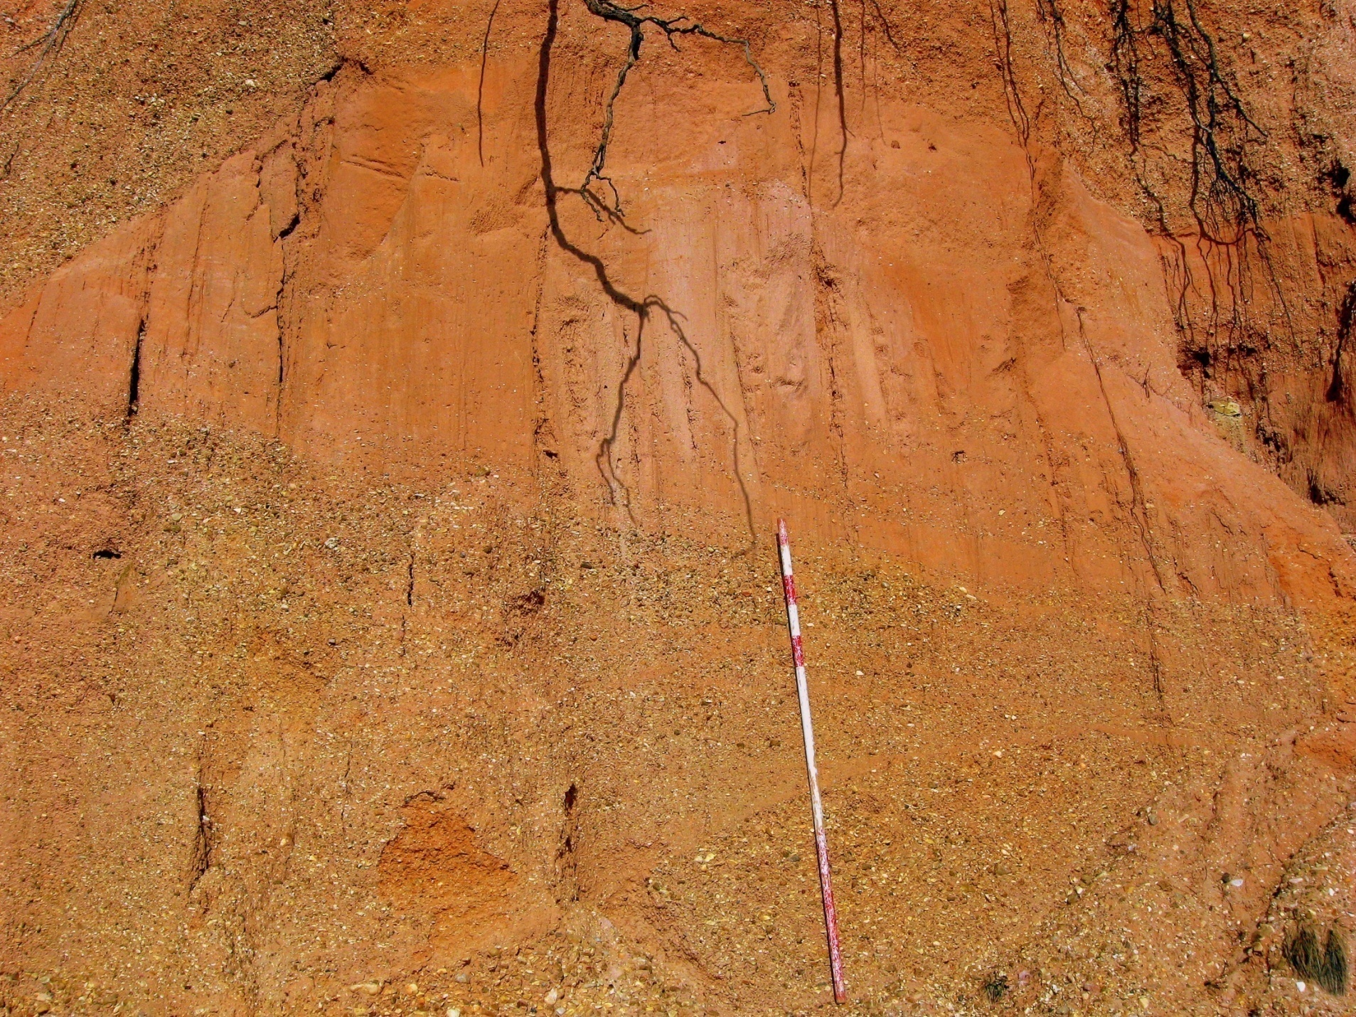
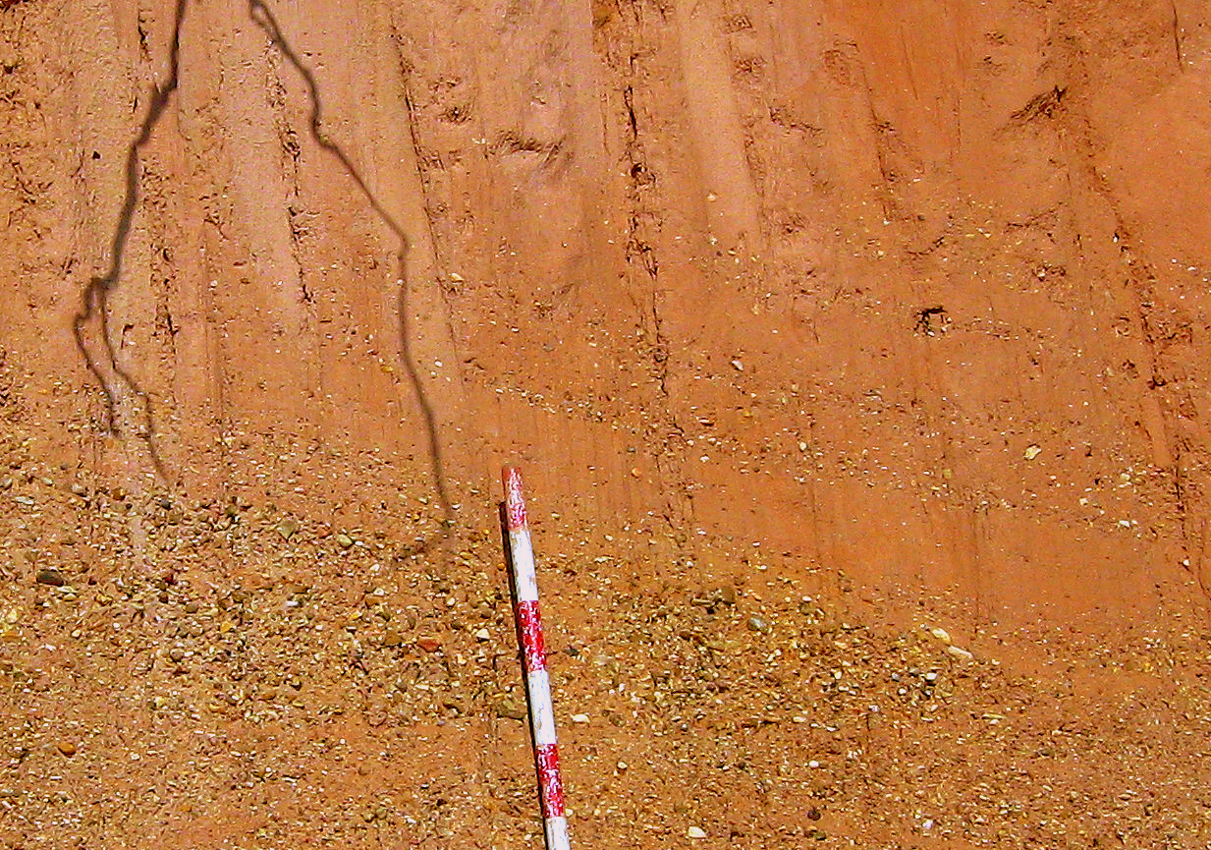
Results – Stratigraphy Crowley’s Ridge
Upland Complex, Paragould, AR
Complex relation of gravel and poorly sorted sand in the northern Crowley’s Ridge suggests braided river deposition.

Slide 11


X-bed orientation
6 x-bed locations
  2 - Crowley’s Ridge, AR
  4 - Chickasaw Bluffs, MS
From Potter, 1955
The distinct difference between S-oriented X-beds on Crowley’s Ridge and the NE orientation on Chickasaw Bluffs suggests different flow regimes and source areas
(in agreement with Potter, 1955).

Slide 12
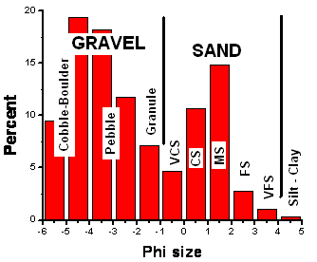
RESULTS - GRAIN SIZE
Distinct bimodal size for bulk samples suggests two sources.
Grain size distribution for composite samples is distinctly bimodal with strong modes in pebble gravel and medium sand. Silt/clay are ~ 1%. (Data from Potter, 1955)

Slide 13
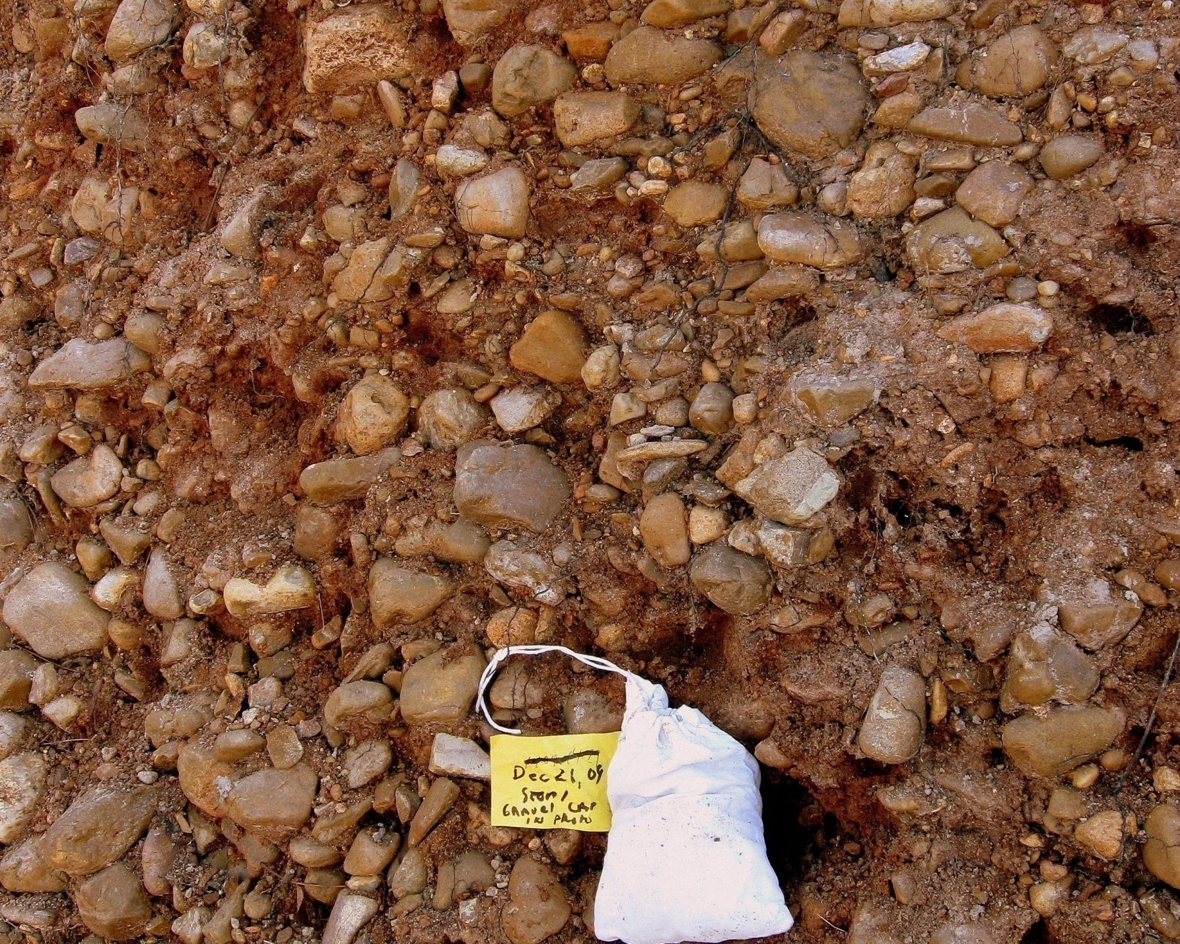
RESULTS - Grain Petrology - Gravel fraction
Gravel (2 to 10 cm) is 80% chert, the balance is polycrystalline quartz.
No igneous, or metamorphic lithology was observed.
Modern Mississippi River gravel as far south as Bolivar County, MS contain up to 10% igneous/metamorphic rock fragments derived from the Canadian Shield (Dockery et al., 2008).
The absence of such material in the UC indicates a non-glacial source (Potter, 1955).

Slide 14
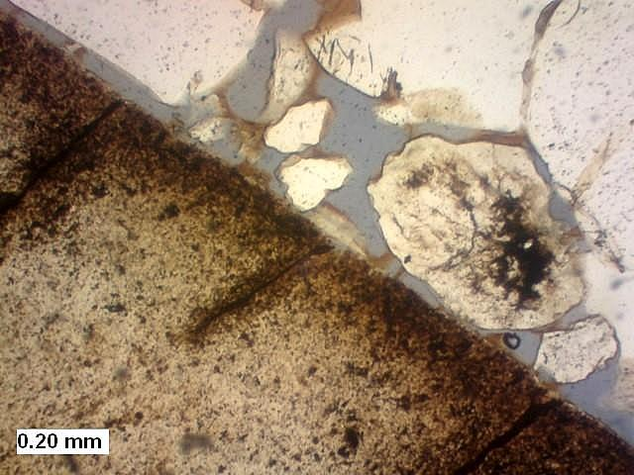
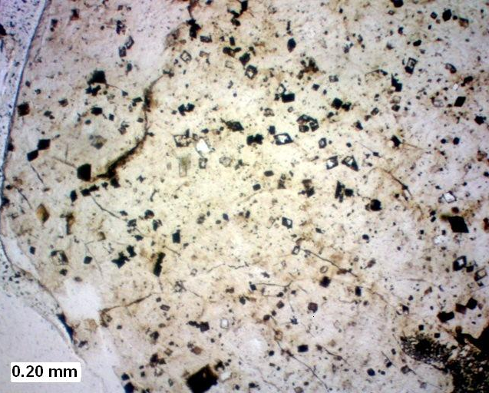
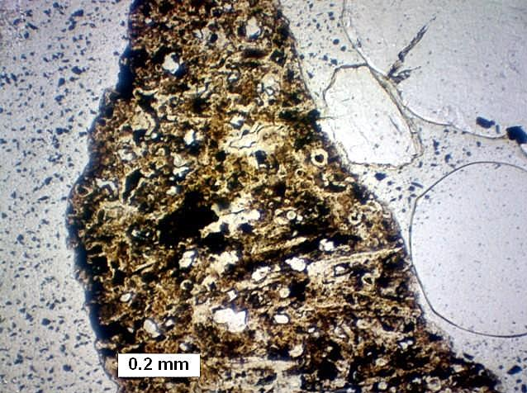
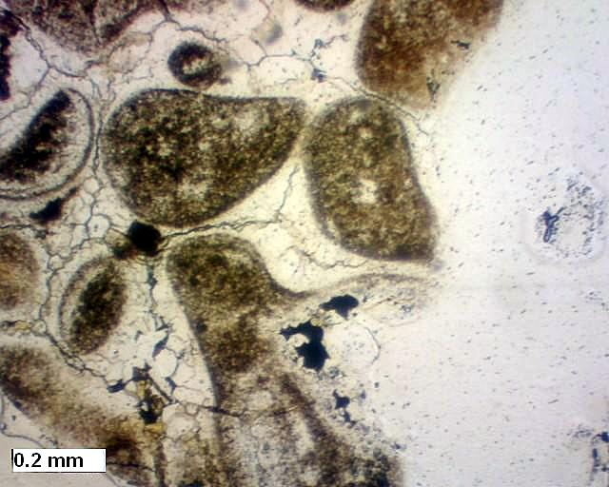
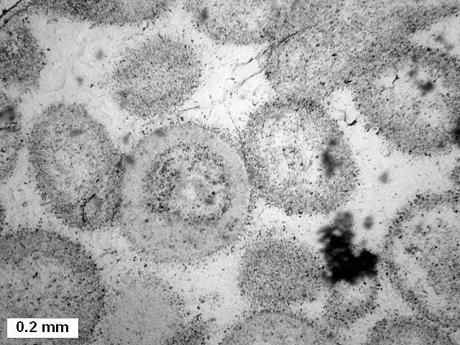
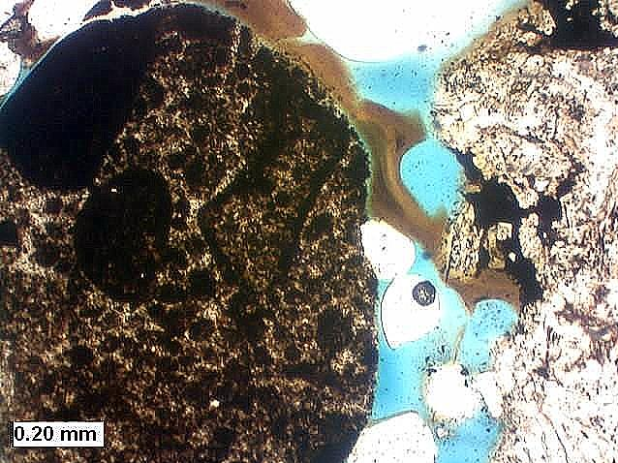
RESULTS - Chert gravel texture
Clasts derived from
bedded and
nodular chert are present in the UC
Bedded chert
Bedded chert
Bedded chert
uniform fine chert with dolomolds
uniform fine chert
Sponge spicules, goethite
Nodular chert
Nodular chert
Nodular chert

Slide 15
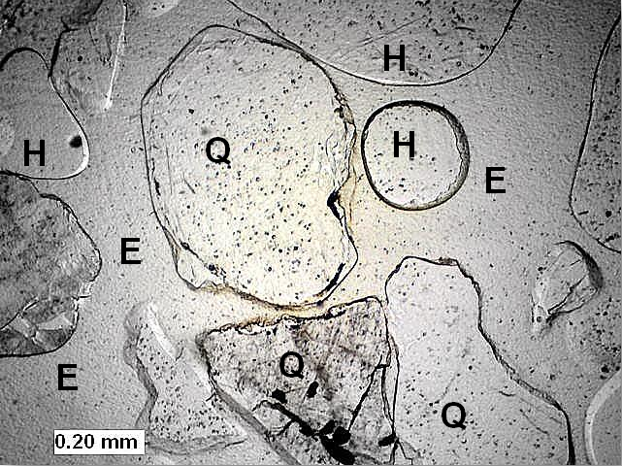
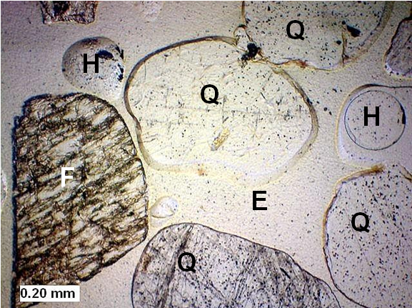
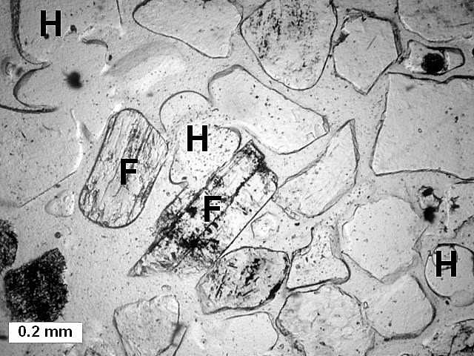
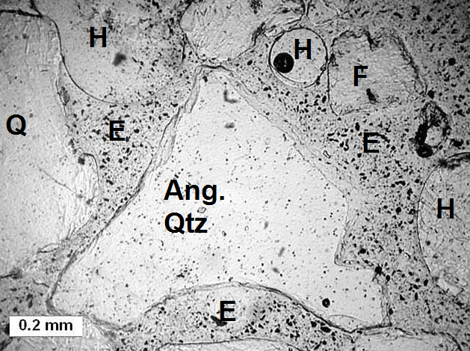
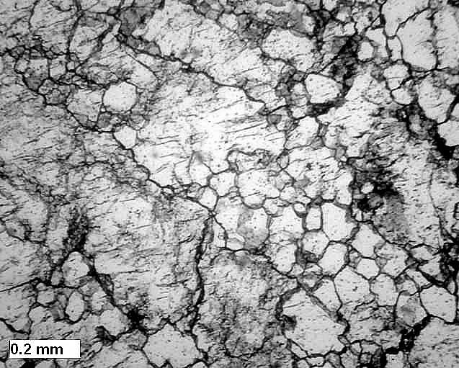
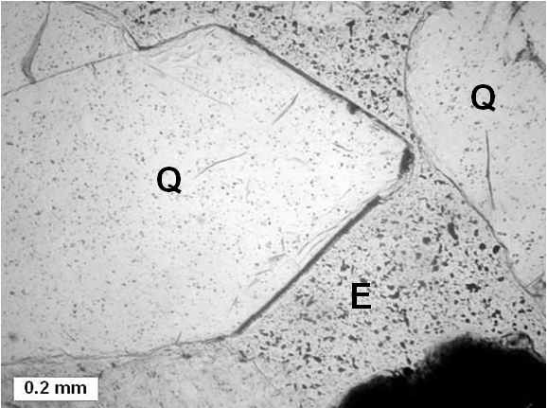
RESULTS - Sand petrology
Shape – subequal rounded and angular, common embayed
Texture – monocrystal > polycrystal, great variety of polycrystal textures, some cloudy qtz, some recycled sedimentary qtz, some sand lithoclasts, trace vein qtz
Mineralogy – 95+% qtz, feldspar (2 to 7%) present only on Crowley’s Ridge
Recycled sedimentary quartz
Well rounded quartz + feldspar
Angular quartz and feldspar
Angular and embayed quartz, volcanic?
Polycrystal quartz
Terminated vein quartz?
Q = quartz; F = feldspar; E= epoxy, H = hole in epoxy

Slide 16
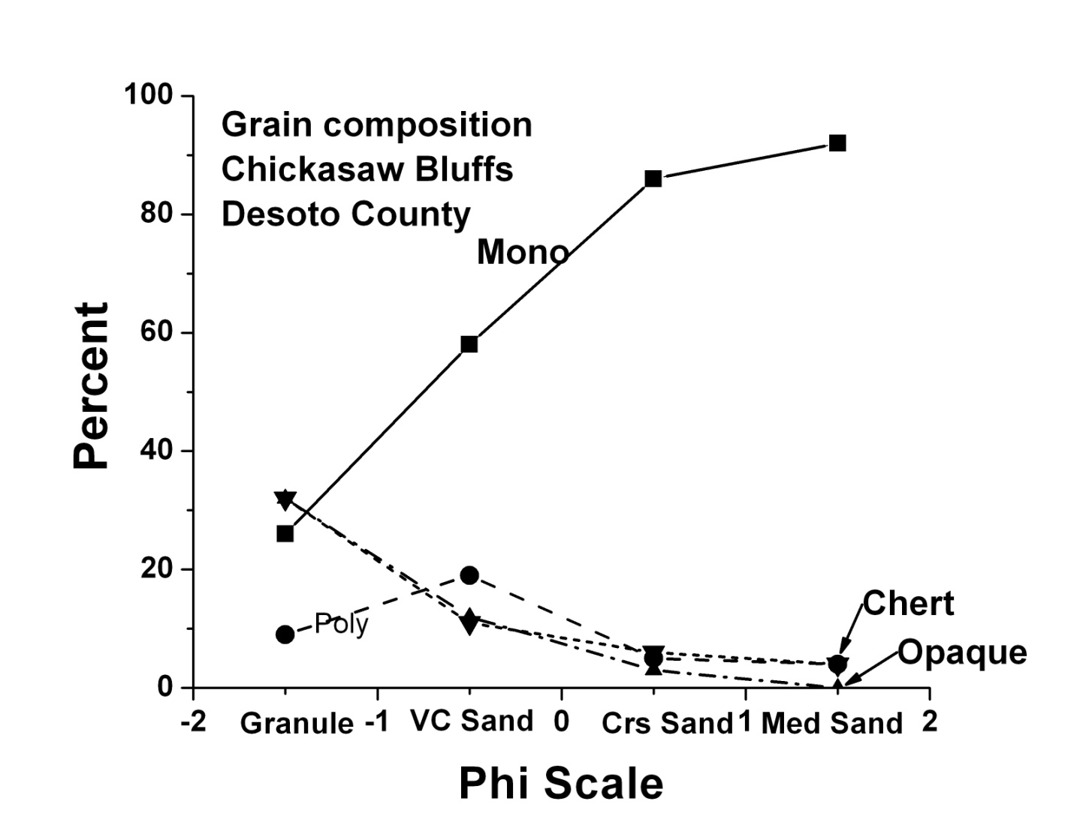
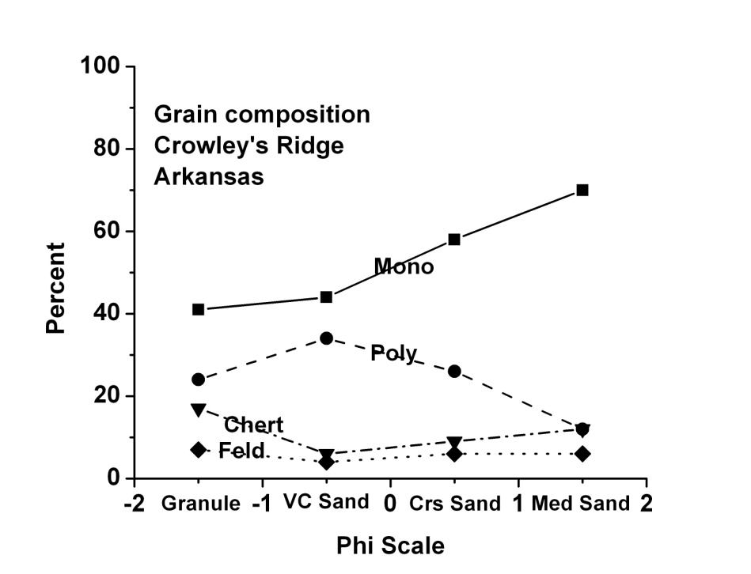
RESULTS
Contrasting sand grain composition
Chickasaw Bluff east of Mississippi – monocrystalline quartz >>polycrystalline quartz > = chert.
Crowley’s Ridge west of Mississippi has a greater proportion of polycrystalline grains than Chickasaw Bluffs and it contains 5 to 7% feldspar (both plagioclase and K-spar).
Other details combine to suggest that at least some Crowley’s Ridge sand came from the Ozarks, probably the St. Francois Mountains.
Decreasing grain size
Decreasing grain size

Slide 17
DISCUSSION
Chert grains and quartz grains are commonly grouped in clastic sedimentary rock classifications (e.g., Dott, 1964) however they differ profoundly in their origin.
Chert is a sedimentary rock and chert clasts tend to be gravel size.
Bedded chert texture is commonly a blur of microcrystalline quartz formed of altered biogenic opal, sponge spicules in the case of the UC.
Nodular chert forms by alteration of carbonate rocks and commonly contains ghosts of recognizable carbonate grains, fossil, oolite , peloid and intraclasts.
Quartz grains tend to be sand sized and come from:
  previously deposited sandstone formations,
  “granite” igneous rocks,
  volcanic igneous rocks
All textures occur in Upland Complex sand.

Slide 18
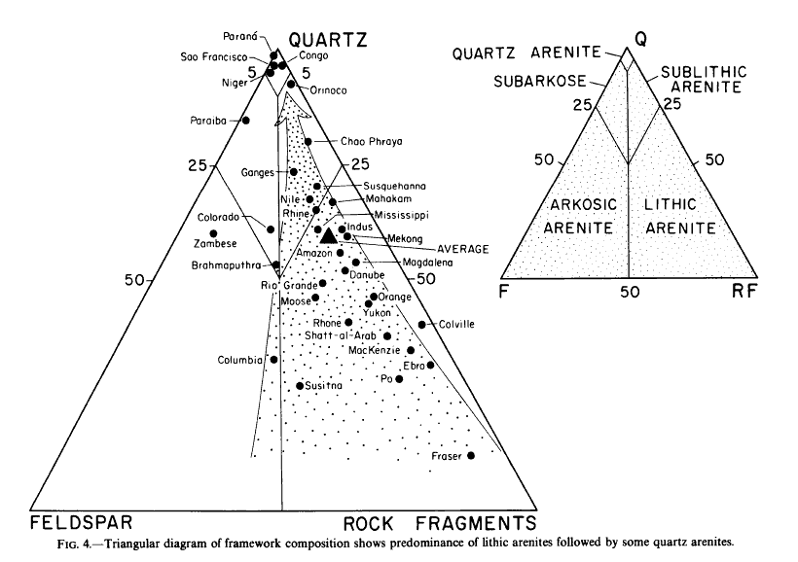
DISCUSSION
Chickasaw Bluffs
Miss. River
Crowley’s Ridge
From Potter, 1978
Most modern river sand is commonly a lithic to sublithic arenite,
quartz arenite rivers are relatively uncommon.
The UC is a quartz arenite suggesting a dominantly sedimentary source.

Slide 19
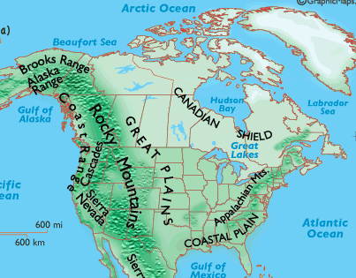
DISCUSSION –
Source of the chert gravel
Arc River
Modern Miss
If the drainage basin area of the Arc River was twice that of the modern Mississippi River (6 million km² versus 3 million km²) then the drainage basin may have extended to the Arctic circle (Lumsden et al., 2010, GSA abs). [Alternatively the large size of Arc River may be a consequence of a much warmer and wetter climate in the Pliocene relative to the Pleistocene (Ballantyne et al., 2010, Geology).]

Slide 20
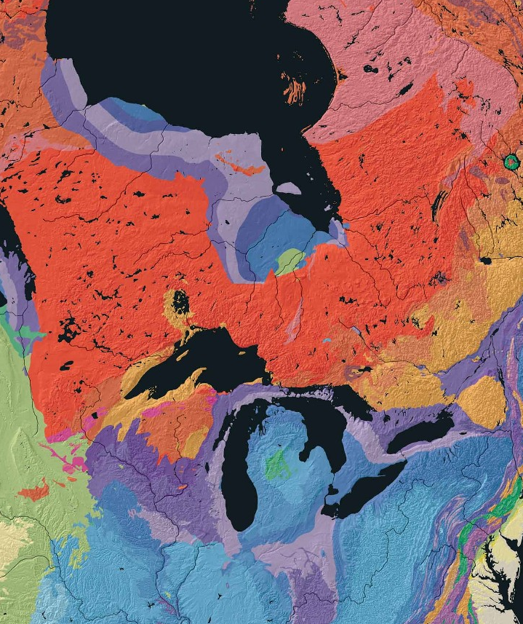
Discussion Source of the chert gravel
Cambrian, Ordovician,
Silurian, Devonian
Chert, both bedded and nodular, is common in Mid-Paleozoic rocks of the North American craton from Canada to the southern U.S.
We hypothesize that the Cambrian to Mississippian sedimentary rocks that once covered central Canada were an important source of the chert gravel in the Pliocene.
They were subsequently eroded by Pleistocene glaciation.
Inferred extent of Paleozoic sedimentary rocks prior to glaciations
Cambrian, Ordovician,
Silurian, Devonian,
Mississippian
Nationalatlas.gov

Slide 21
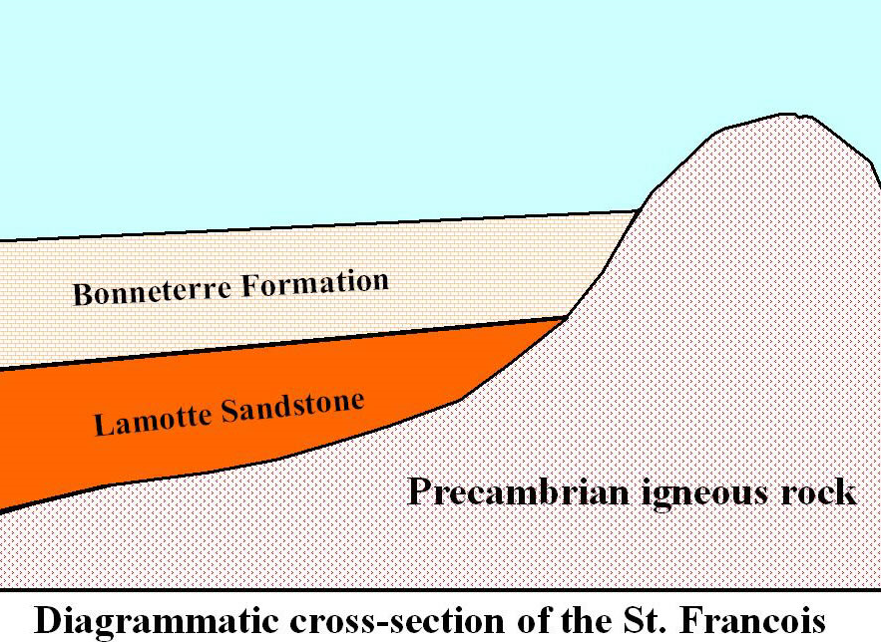
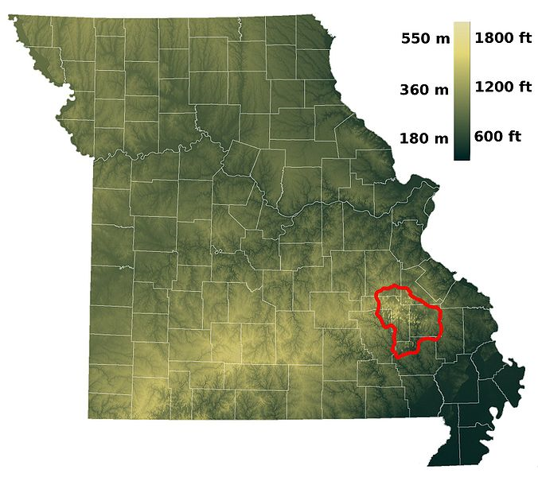
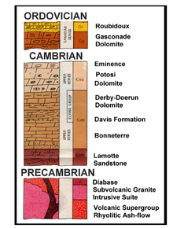
DISCUSSION – sand source
St. Francois Mountains
Ozark Plateau
The St. Francois Mountains that core the Ozark Uplift expose “granite” sources of feldspar, monocrystalline and polycrystalline quartz, volcanic sources of embayed and vacuole-rich quartz, and sandstone sources of recycled grains. It may be the source of alluvial fan and braided deposits in the northern Crowley’s Ridge (Guccione et al., 1986).

Slide 22
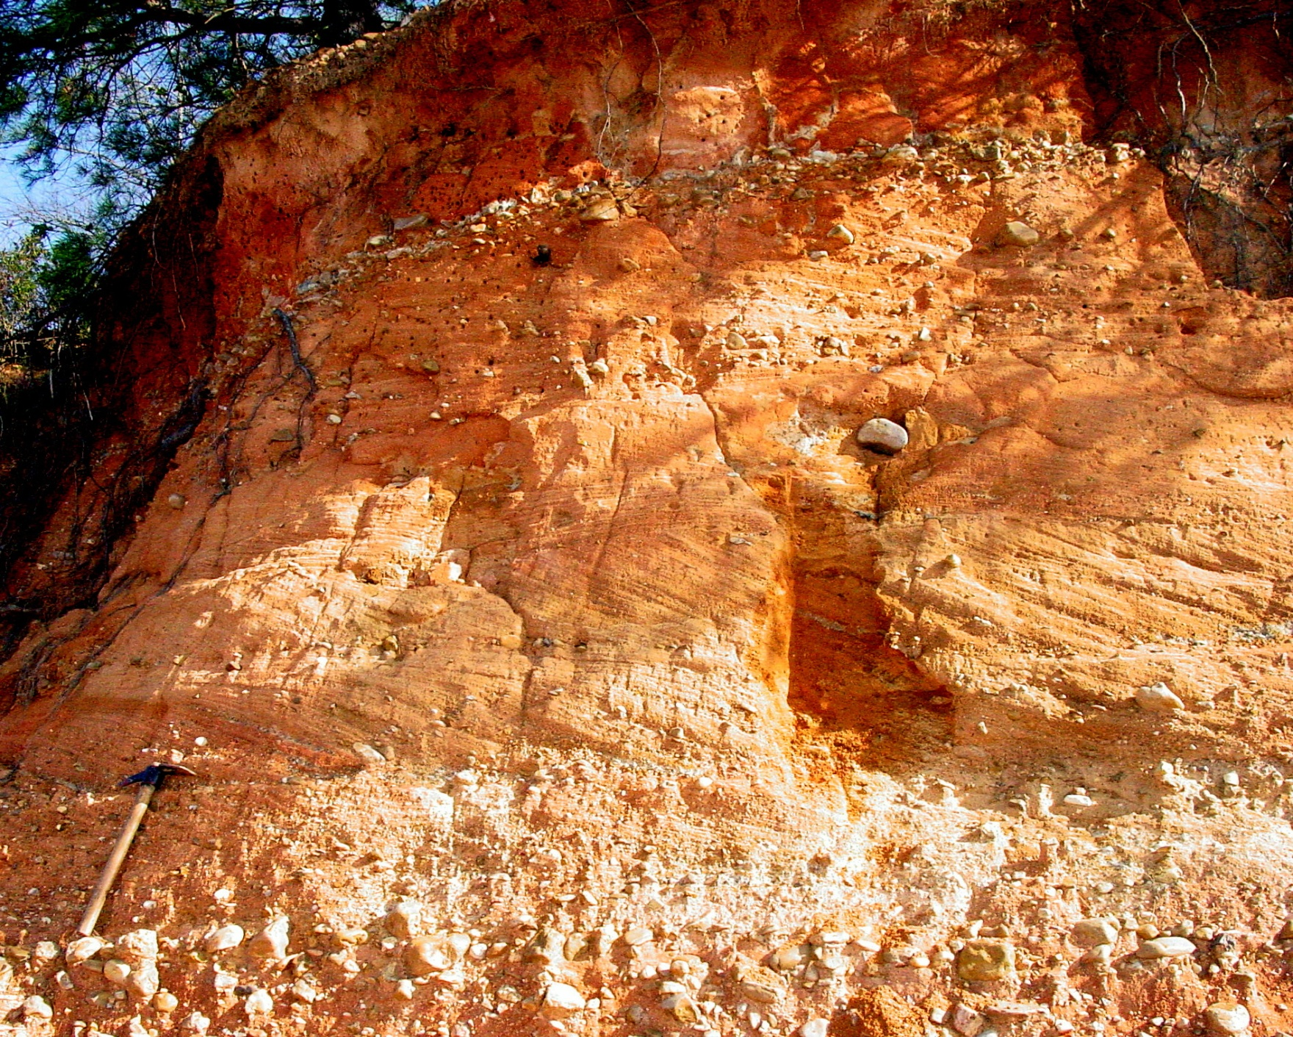
CONCLUSIONS
Gravel - Bedded chert and nodular chert formations in central Canada were the source of much of the UC gravel. These formations were subsequently removed by glacial erosion. Some of the chert probably came from southern, American, sources. The relative proportion of northern and southern sources is undetermined.
Sand - In contrast to the chert the monocrystalline quartz, polycrystalline quartz and the small amount of feldspar of the sand fraction came from more proximal sources, most likely the St. Francois Mountains in the Ozark Uplift of Missouri.

Slide 23
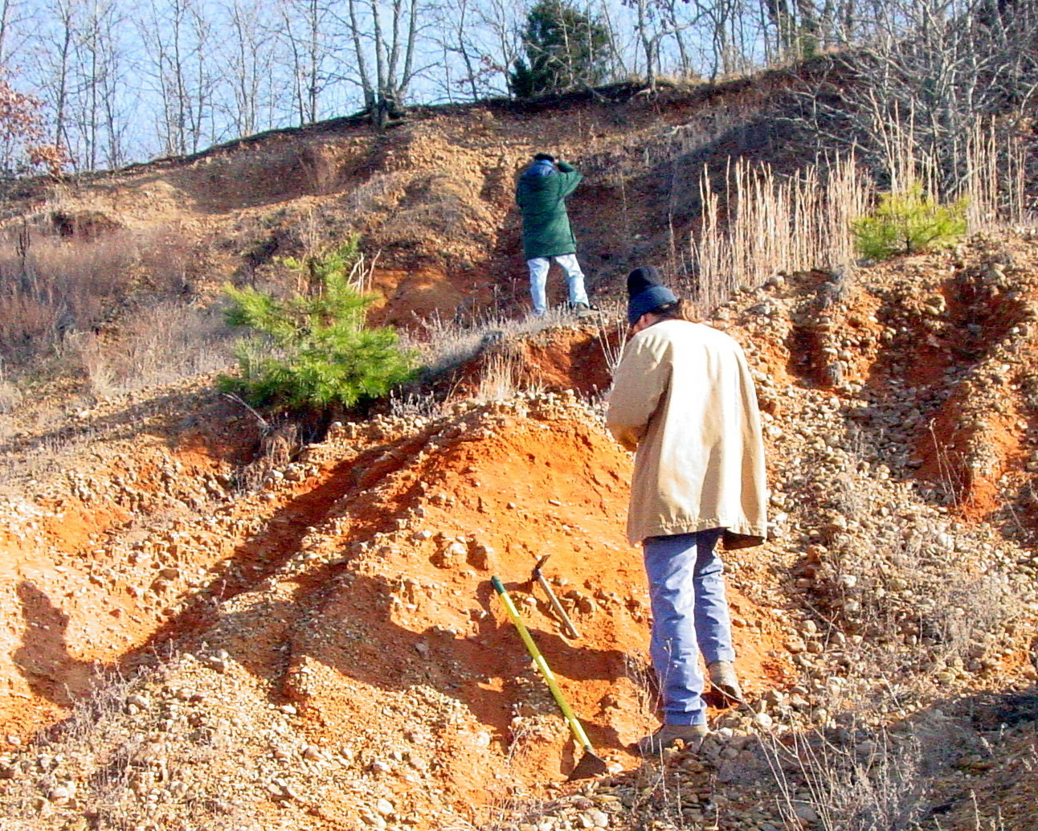
ANY QUESTIONS?

