Slide 1
THE TRANS-PECOS MAGMATIC PROVINCE, TEXAS: AN EXAMPLE OF MAGMATISM IN A TRANSITIONAL TECTONIC SETTING
John C. White
Eastern Kentucky University

Slide 2
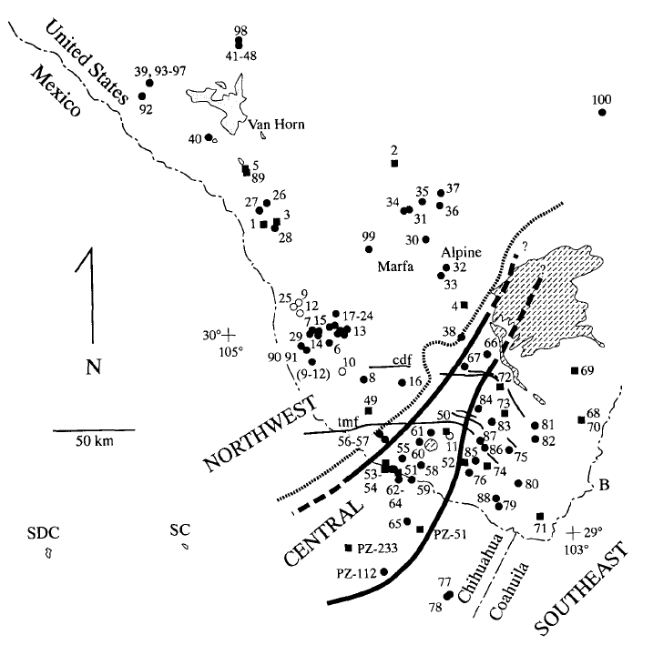
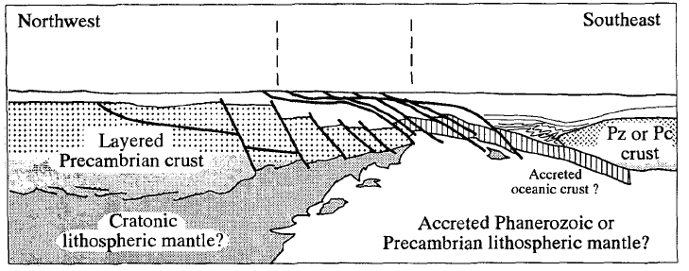
James and Henry (1993)
GSA Bull. 105, 116-126.

Slide 3
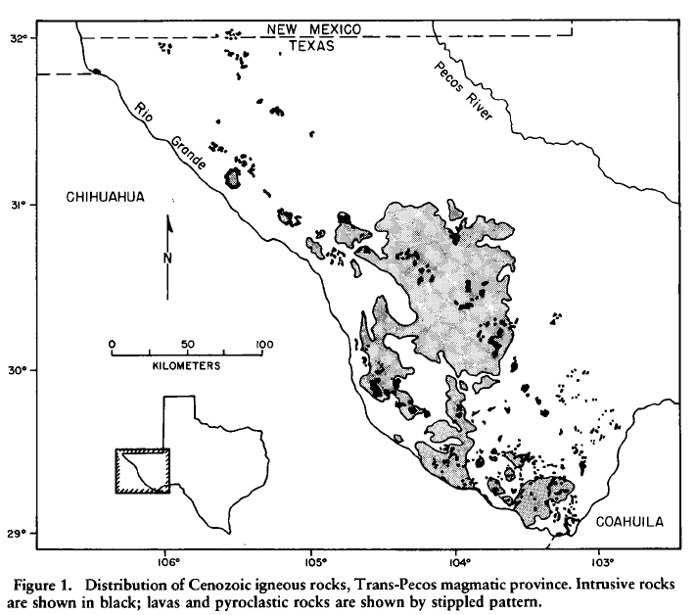
Trans Pecos Magmatic Province (TPMP)
Barker (1977) GSA Bull 88, 1421-1427

Slide 4
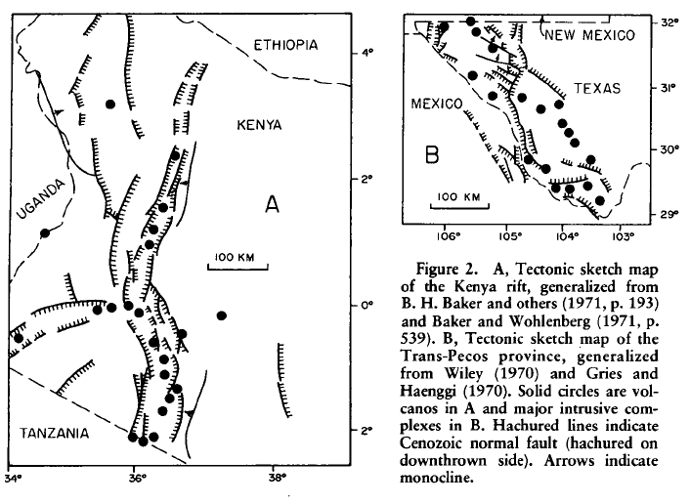
Barker, Op. cit.

Slide 5
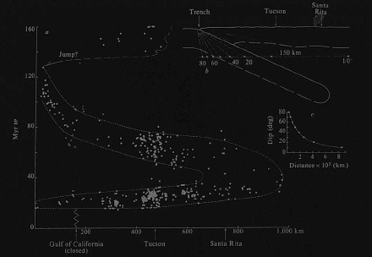
Coney and Reynolds (1977)
Nature 270, 403-406

Slide 6
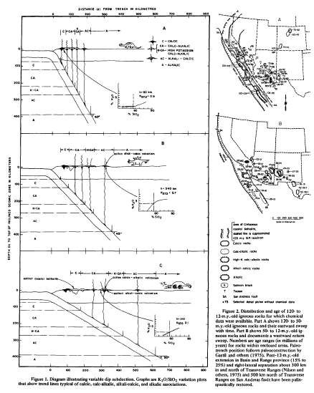
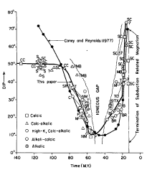
Keith (1978)
Geology 6, 516-521

Slide 7
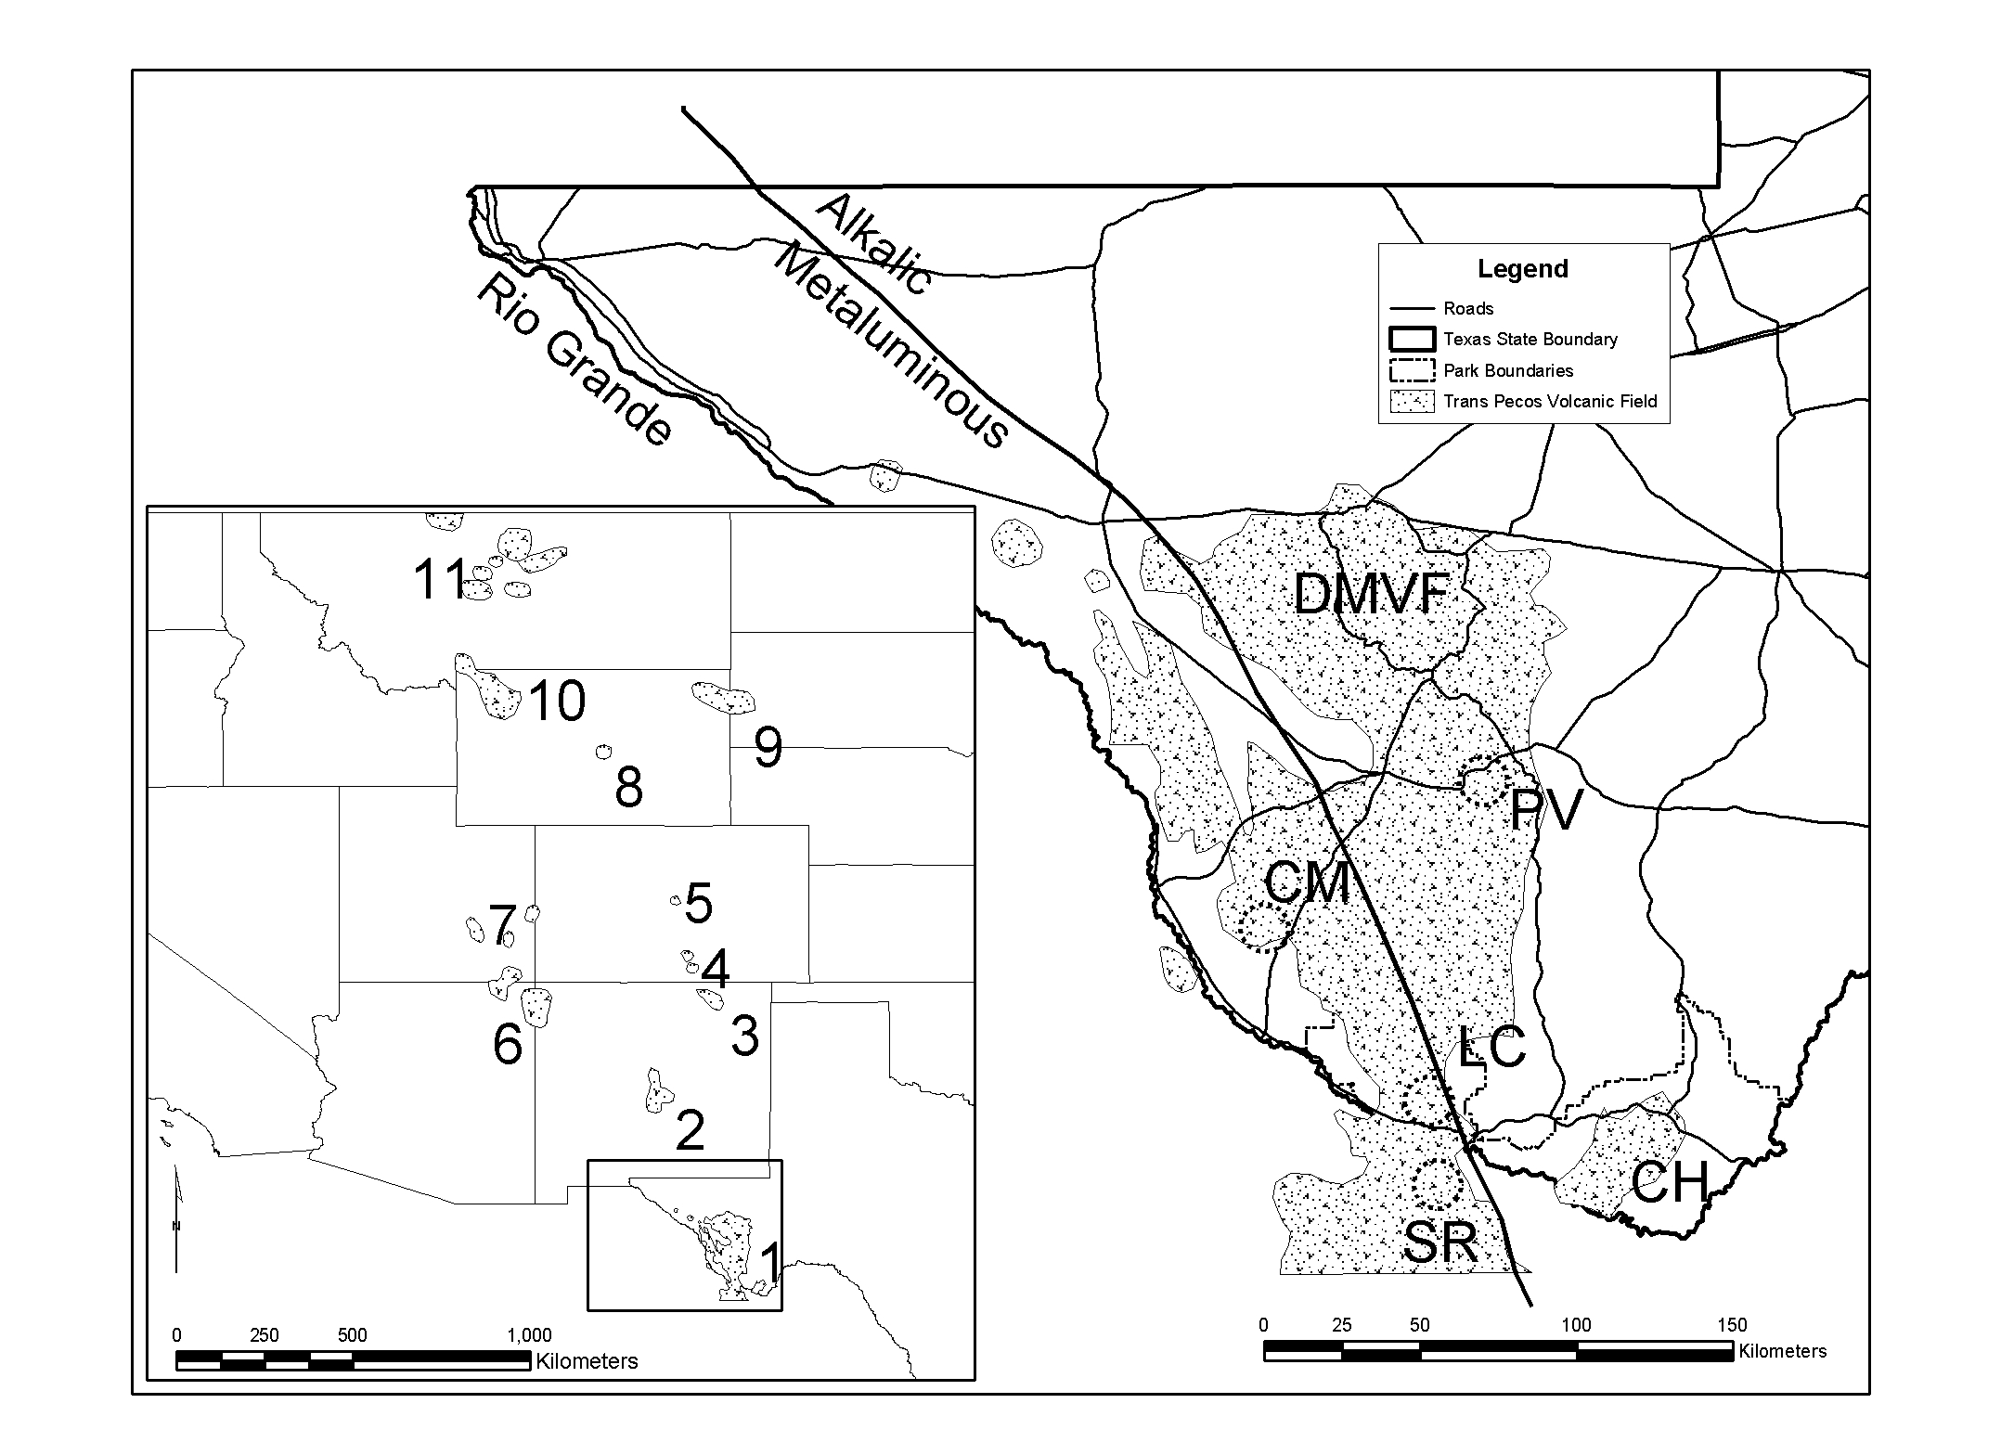
Part of a far-inland volcanic arc?
White and Urbanczyk (2001) JVGR 111, 155-182

Slide 8
Supporting Evidence for Arc Magmatism in the TPMP to 31 Ma
Space-time patterns of “arc” magmatism.
Age of normal faults (<28 Ma).
Paleostress analysis (Henry et al., 1991).
Trace-element geochemistry (James and Henry, 1991).

Slide 9
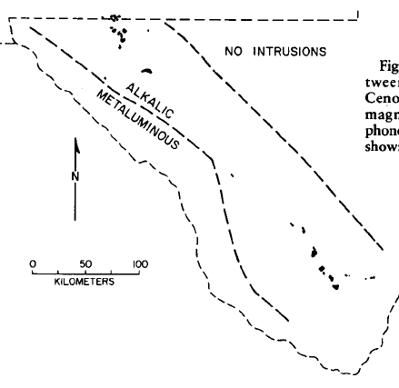
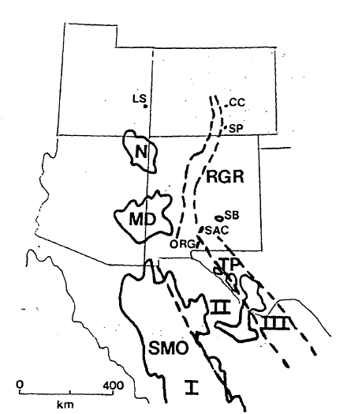
Barker, Op. cit.
Calc-Alkaline
Alkali-Calcic
Alkalic
McDowell and Clabaugh (1979)
GSA Special Paper 180, 113-124

Slide 10
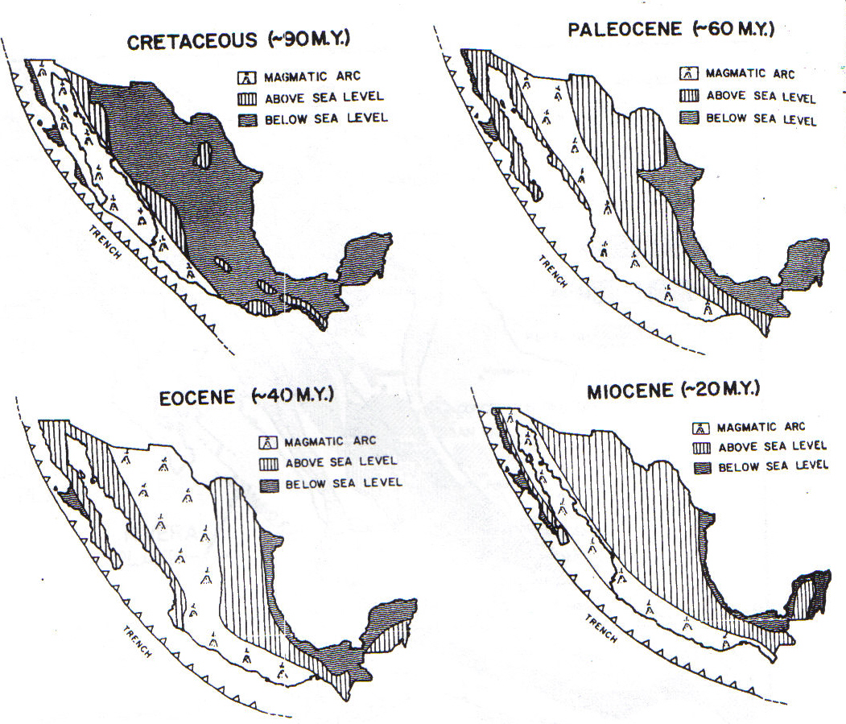
Damon et al. (1981) Arizona Geol. Soc. Digest 14, 137-154

Slide 11
Supporting Evidence for Extensional Magmatism in the TPMP prior to 31 Ma
Age of normal faults (<28 Ma).
  Volcanism preceded faulting by ~20 Ma in Ethiopia, and by ~8 Ma in northern Kenya (Ebinger et al., 2000, GSA Bull 112, 163-176).
  Geophysical studies of the lower Rio Grande rift have shown that extension in the lower crust is distributed over a region four times as wide as the crustal expression of extension. In the early stages of rifting, continental extension may have triggered magmatism in the upper mantle/lower crust long before that extension was manifested at the surface (Wilson et al., 2005, Nature 433, 851-855).

Slide 12
Supporting Evidence for Extensional Magmatism in the TPMP prior to 31 Ma
Paleostress analysis (Henry et al., 1991).
  Paleostress analysis of dikes does not provide a unique solution; Henry et al. note that σ₁ could range between east-northeast and vertical, which could be consistent with north-northwest extension.
  Henry et al. also note considerable scatter in their data, which indicates a small difference in magnitude between σ₁ and σ₃, typical of tectonically “neutral” or “near-neutral” regions (Cf. Chapin et al., 2004, NMBG Bull 160-13-40, for the northern RGR from 45-36 Ma.)

Slide 13
Supporting Evidence for Extensional Magmatism in the TPMP prior to 31 Ma
Trace-element geochemistry (James and Henry, 1991).
  Nb anomalies, other arc signatures in basalts, could be due to a previously metasomatized mantle (e.g., Taos Plateau Volcanic Field, northern RGR; Dungan et al., 1986, JGR 91, 5999-6028).
  Trace-element tectonic discrimination diagrams suggest these are anorogenic (A-type) magmas.

Slide 14
39-37 Ma
Buckhorn Caldera
Flood Trachytes/Rhyolites
(Parker and White, 2008,
Bull Volc 70, 403-415).
33-31 Ma
Pine Canyon Caldera
(White et al., 2006,
Lithos 91, 74-94).

Slide 15
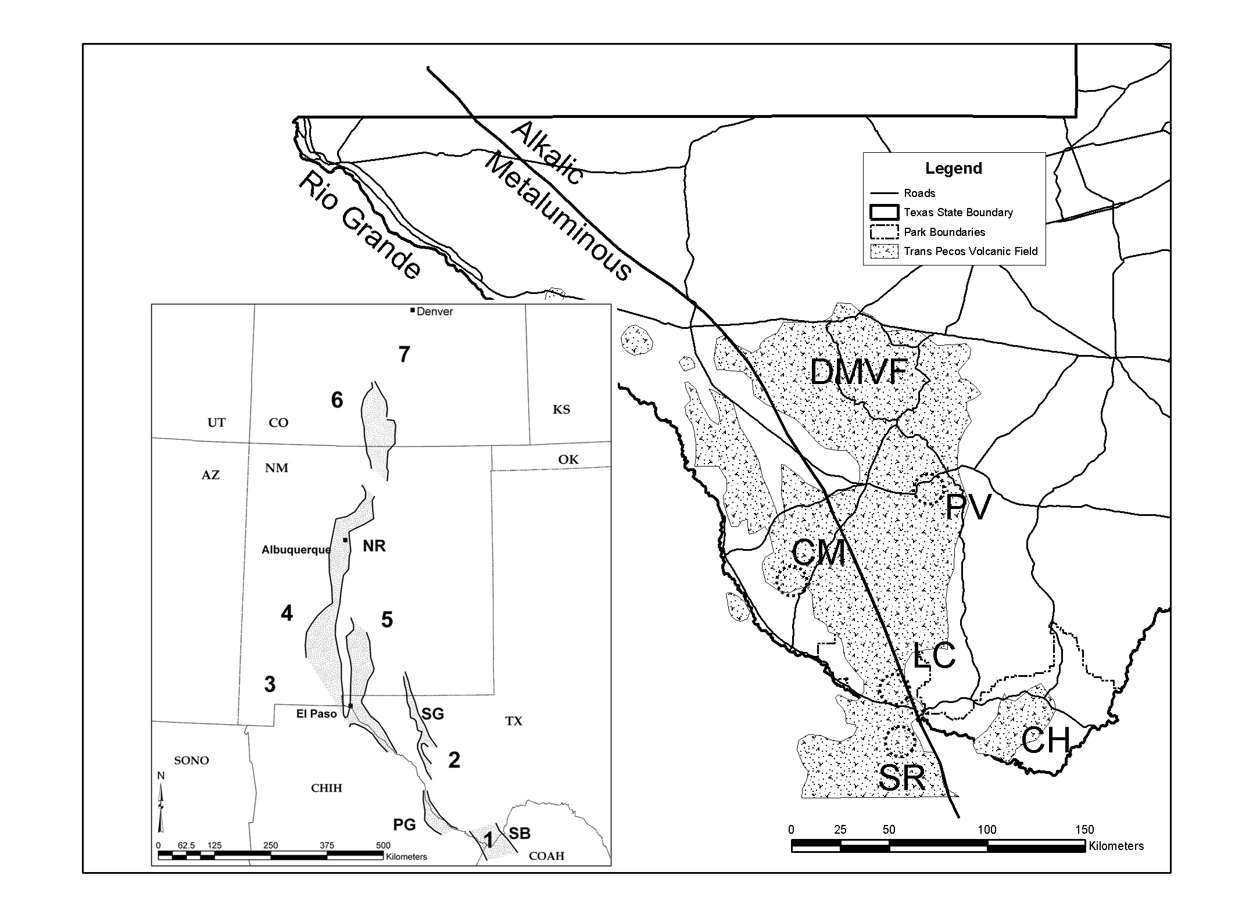
…or the Rio Grande Rift?
Central
Colorado
San Juan
Mtns
Mogollon-
Datil
Sierra
Blanca
Boot Heel
Davis Mtns
Big Bend
White et al., Op. Cit.

Slide 16
100-50 Ma
Laramide Orogeny

Slide 17
48-39 Ma
Post-collision, “Early Slab Retreat”
Christmas Mountains
  Peralkaline domes, caldera
Alamo Creek Basalt
1
2

Slide 18
39-37 Ma
1
4
2
2
2
2
2
3
Buckhorn Caldera
  Pantelleritic ignimbrite
Flood Trachytes/Rhyolites
  Comendite lavas
Infiernito Caldera
  Metaluminous
Van Horn Mountains Caldera
  Metaluminous

Slide 19
37-35 Ma
Post-orogenic, “Early Asthenospheric”
5
4
3
1
6
Paisano Volcano
  Peralkaline q-trachyte
  shield volcano with caldera.
Solitario (q-trachyte/rhyolite)
Paradise Mountain Caldera
Eagle Mountains Caldera
Quitman Mountains Caldera
Ne-trachyte/phonolite intrusions
2

Slide 20
35-33 Ma
4
2
Chisos Group
Basalt to Trachyandesite
lavas.
Pre-caldera lavas (Chinati)
Sierra Quemada Caldera
Ne-trachyte/Phonolite intrusions
3
1

Slide 21
33-31 Ma
2
Pine Canyon Caldera
and domes. Peralkaine
q-trachyte/rhyolite.
Chinati Mountains Caldera
Metaluminous to mildly peralkaline
  q-trachyte/rhyolite.
1

Slide 22
31-24 Ma
Relaxation
2
Burro Mesa dome field
Peralkaline rhyolite
Bofecillos Mountains
  Peralkaline trachyte shield
  Basalt to q- and ne-trachyte lavas
San Carlos and Santana
Calderas
3
1

Slide 23
24-17 Ma
Basin and Range
Orogeny
RGR
Salt
Basin
3
Presidio
Graben
2
1
Basalts
Closed Canyon Fm
Black Gap WMA
Van Horn Dikes (17 Ma)
Sunken
Block

Slide 24
